Slide 1
31st International Input-Output Association Conference
Both mechanisms make PV trade barriers counterproductive in protecting local employment
Presenting Author：Yiying Gao China university of petroleum(Beijing)
Co-Author：Xinzhu Zheng, Prof. China university of petroleum(Beijing)
July 2025

Slide 2
01
Background
CONTENTS
02
Methodology
03
Argument
04
Discussion and Recommendations

Slide 3
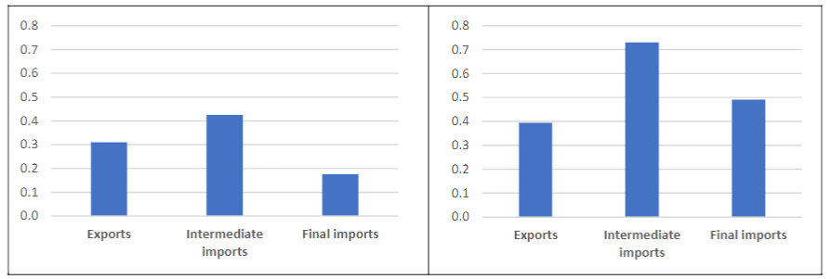
Background
International trade plays a fundamental role in driving economic growth, generating employment opportunities, and elevating wage levels.
trade liberalization^{[1]}
Winkler et al. (2023) found from regression results based on trade data and industry employment data from 48 countries between 1995 and 2018 that:
Export growth of 10%，a 3.1% increase in employment ，a 3.9% increase in labor income
Imports of intermediate goods increased by 10%, a 4.2% rise in employment , a 7.3% increase in labor income.
Path 1
reduce product prices
reduce raw material costs
Path 2
Path 3
increase demand for capital goods or services
reduce expenses
enhance competitivene
increase consumption
increase exports
stimulate production
expand production
expand production
economic growth, job growth, and income growth
Figure 1 Trade-employment (left) and trade-income elasticities (right), by type of trade^{[2]}
Reference：
[1] OECD (2011), “The Impact of Trade Liberalisation on Jobs and Growth: Technical Note”, OECD Trade Policy Papers, No. 107, OECD Publishing, Paris, https://doi.org/10.1787/5kgj4jfj1nq2-en.
[2] Winkler,Deborah Elisabeth; Kruse,Hagen; Aguilar Luna,Luis Alejandro; Maliszewska,Maryla.Linking Trade to Jobs, Incomes, and Activities : New Stylized Facts for Low- and Middle-Income Countries (English). Policy Research working paper ; no. WPS 10635 Washington, D.C. : World Bank Group. http://documents.worldbank.org/curated/en/099813412112341111
Notes:
、

Slide 4
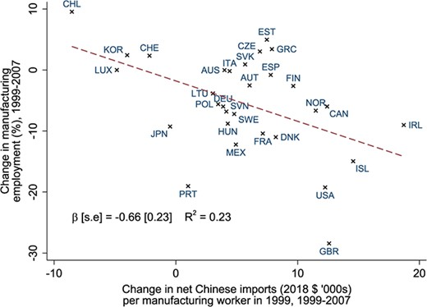
Background
Under the turbulence of the global labor market and the rise of protectionism, the positive impact of international trade is being questioned.
trade liberalization^{[1]}
OECD member countries show a negative correlation between per capita import growth and changes in manufacturing employment
Path 1
Path 2
intensified import competition
reduced demand for raw materials
shrinking of inefficient industries
contraction of related industries
decrease in employment
Figure 1 Growth of net Chinese import competition and percentage change in manufacturing jobs in OECD countries.^{[2]}
Reference：
[1] Acemoglu, Daron et al. “Import Competition and the Great US Employment Sag of the 2000s.” Journal of Labor Economics 34.S1 (2016): S141–S198. © 2015 by The University of Chicago
[2] David Dorn, Peter Levell, Trade and inequality in Europe and the US, Oxford Open Economics, Volume 3, Issue Supplement_1, 2024, Pages i1042–i1068, https://doi.org/10.1093/ooec/odad046

Slide 5
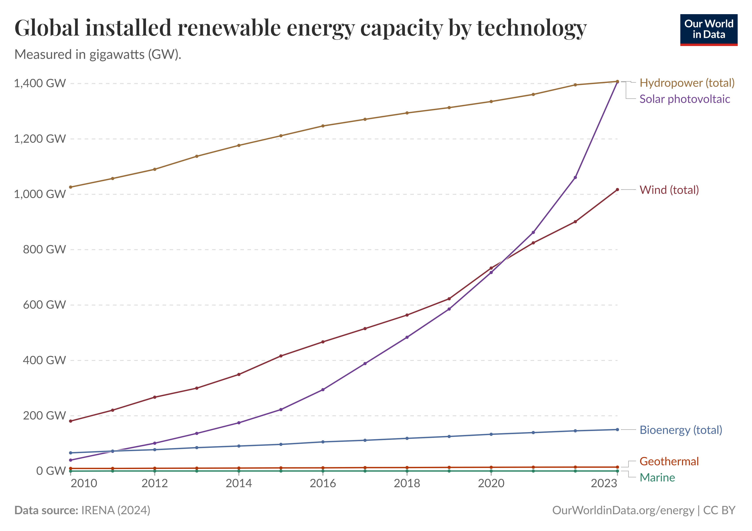
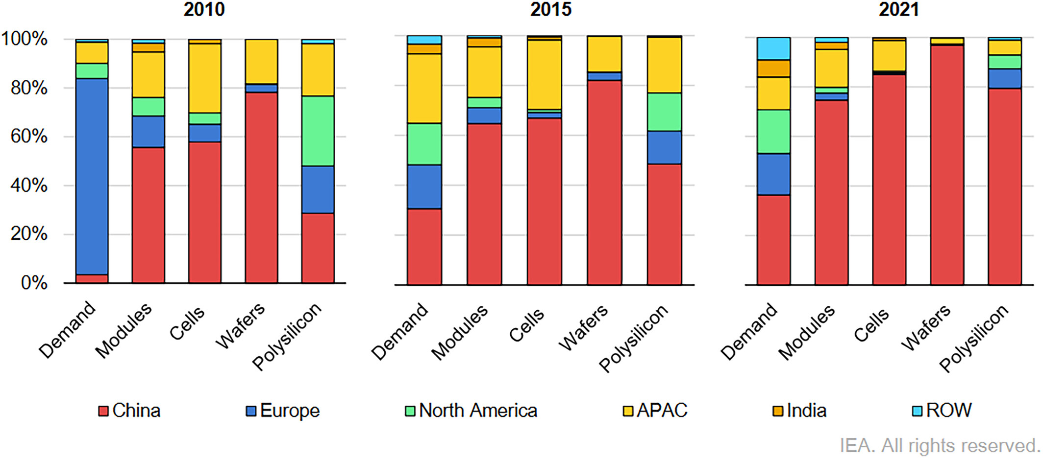
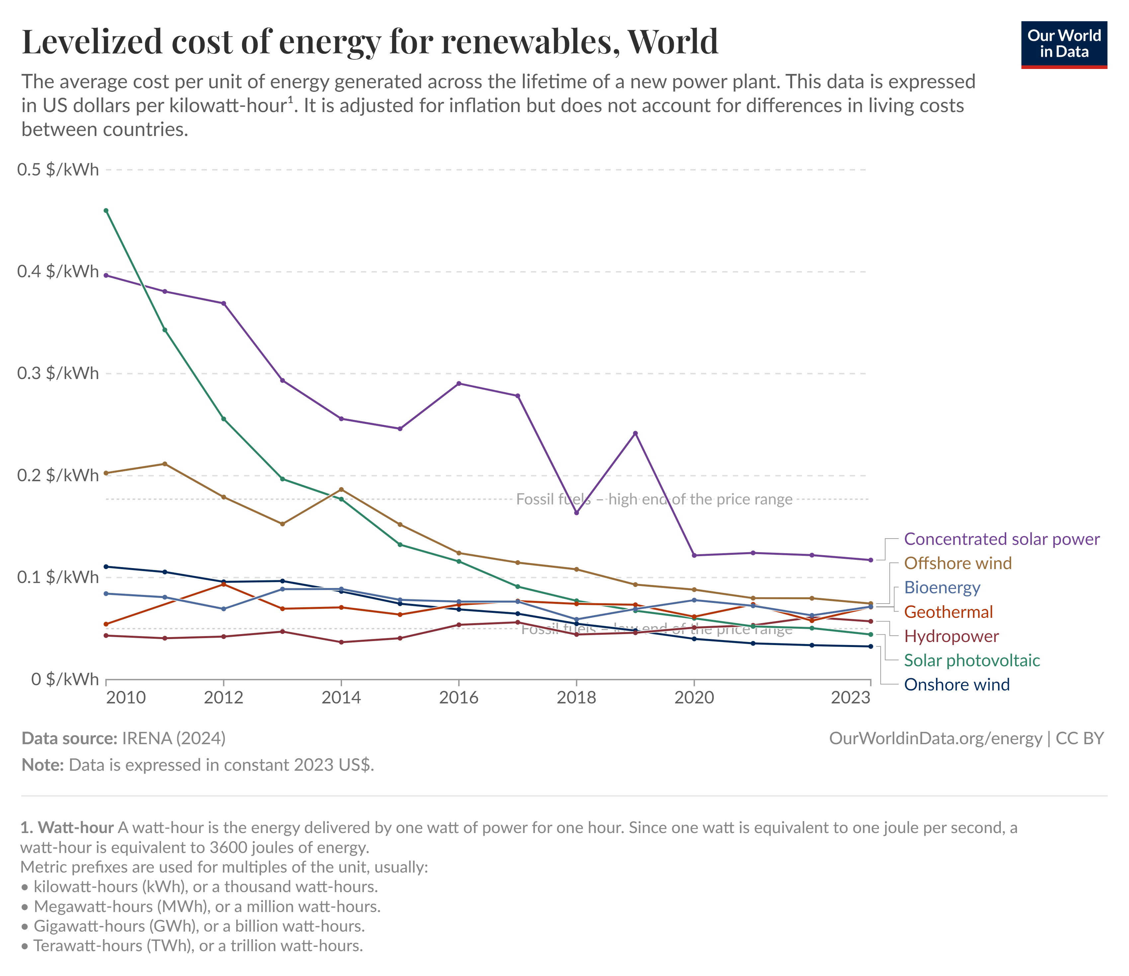
Background
The photovoltaic industry is at the forefront due to its strategic importance in energy transition and global competition imbalance.
Solar photovoltaic, with a compound annual growth rate (CAGR) of 37%, has become the fastest-growing energy technology and the most promising one.
In 2023, the Levelized Cost of Energy (LCOE) for solar photovoltaics has decreased by nearly 91% compared to 2010.
China dominates every stage of the solar photovoltaic supply chain, with the country accounting for over 80% of all manufacturing stages.
Figure 1 Global installed renewable energy capacity by technology
Figure 2 Levelized cost of energy for renewables, World
Figure 3 Solar PV manufacturing capacities by country and region
Notes:
https://www.sciencedirect.com/science/article/pii/S2772940023000139#sec0001

Slide 6
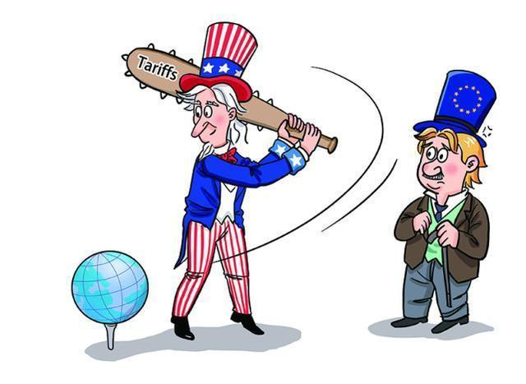
Background
Countervailing duties：14.78%-15.97%
Anti-dumping duties：18.32%—249.96%
EU starts to impose anti-dumping duties on Chinese solar cells by 47.6%
Lasted until 2018
the US: The first anti-dumping and anti-dumping investigation
The second double reversal of the US
Countervailing duties：27.64%—49.21%
Anti-dumping duties：26.71%—151.98%
2011
2012
2013
India: 14.9% import duty on China, Thailand and Vietnam
the US: Increase Section 301 tariffs from 10% to 25%; Tariffs on China in 2019 at 20%
India: 2-year safeguard tax on PV products from China and Malaysia, 25% in 2018
2014
Turkey: Anti-dumping duties on China for a period of 5 years at a rate of $20-25/㎡
2017
India: Tariffs on China, Thailand and Vietnam adjusted to 14.5%
2020年
2019
2018
1
The US Section 201 extension: Initial tariff of 14.5%, decreasing by 0.25% annually over 4 years.
India : imposes 40% tariff on imported solar modules and 25% on solar cells.
Brazil : impose 10.8% tariff on imported solar panels from 2024
The US: raise Section 301 tariffs from 25% to 50%
2021
The US: impose 30% tariff on imported solar panels under Section 201, declining 5% annually after four years
2022
2024

Slide 7
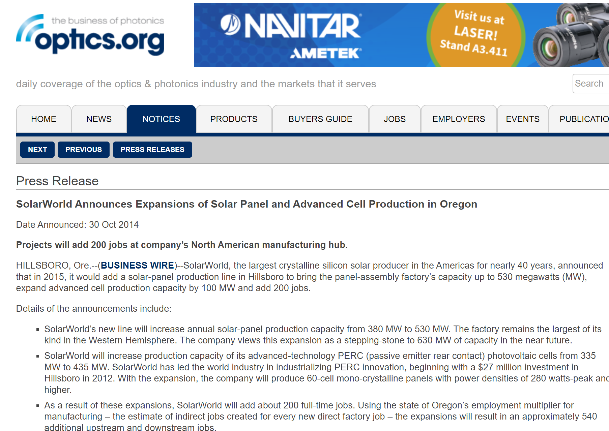

Background
Some viewpoints suggest that photovoltaic trade barriers have, to some extent, contributed to the growth of domestic employment and capacity expansion.
Souce: https://optics.org/press/2567
Souce: https://solarbuildermag.com/news/suniva-begins-construction-new-michigan-module-manufacturing-facility/#allow

Slide 8
Background
We finds that two mechanisms challenge the employment protection effect of photovoltaic trade barriers
PV trade barriers
Input-output relationship between countries
PV trade structure
Technical coefficient matrix
mechanism 1
mechanism 2
All industries
Consumption demand for other types of power generation
Other manufacturing/services industries
PV power generation consumption demand
PV installation
PV manufacturing
PV operation and maintenance
PV industry

Slide 9
01
Background
CONTENTS
02
Methodology
03
Argument
04
Discussion and Recommendations

Slide 10
Quantification approach
Scenario
The counterfactual scenario only removes the U.S. photovoltaic trade barriers, while other countries remain consistent with the actual situation
Changes in the trade matrix of PV products between countries
GSIM model
01
Constructing an input-output table including the PV industry
Quantifying the specific changes in different stages of the PV value chain
02
Coupling the GSIM model with PVIO
Simultaneously reflecting changes in trade structure and consumption demand between countries
03
Introducing the sector-specific unit output employment coefficient
04
Transforming economic changes into changes in employment

Slide 11
Constructing an input-output table including the PV industry
wafer
PV manufacturing industry
Silver, aluminum, and other metals
Cells
Electrical machinery and equipment manufacturing
PV
industry
Other consumables
manufacturing
electricity
Metal fabrication industry
labor
Non-metallic manufacturing industry
Maintenance of equipment and facilities
Equipment depreciation
electricity
Research, sales, etc
Value added
Glass, welding strips, etc
module
Installation
Backplanes, junction boxes, etc
Other business activities
O&M
electricity

Slide 12
Constructing an input-output table including the PV industry
Lifecycle splitting
wafer
PV manufacturing industry
Silver, aluminum, and other metals
Cells
Electrical machinery and equipment manufacturing
PV
industry
Other consumables
manufacturing
electricity
Metal fabrication industry
labor
Non-metallic manufacturing industry
Maintenance of equipment and facilities
Equipment depreciation
electricity
Research, sales, etc
Value added
Glass, welding strips, etc
module
Backplanes, junction boxes, etc
Other business activities
Installation
Proportional splitting
O&M
electricity

Slide 13
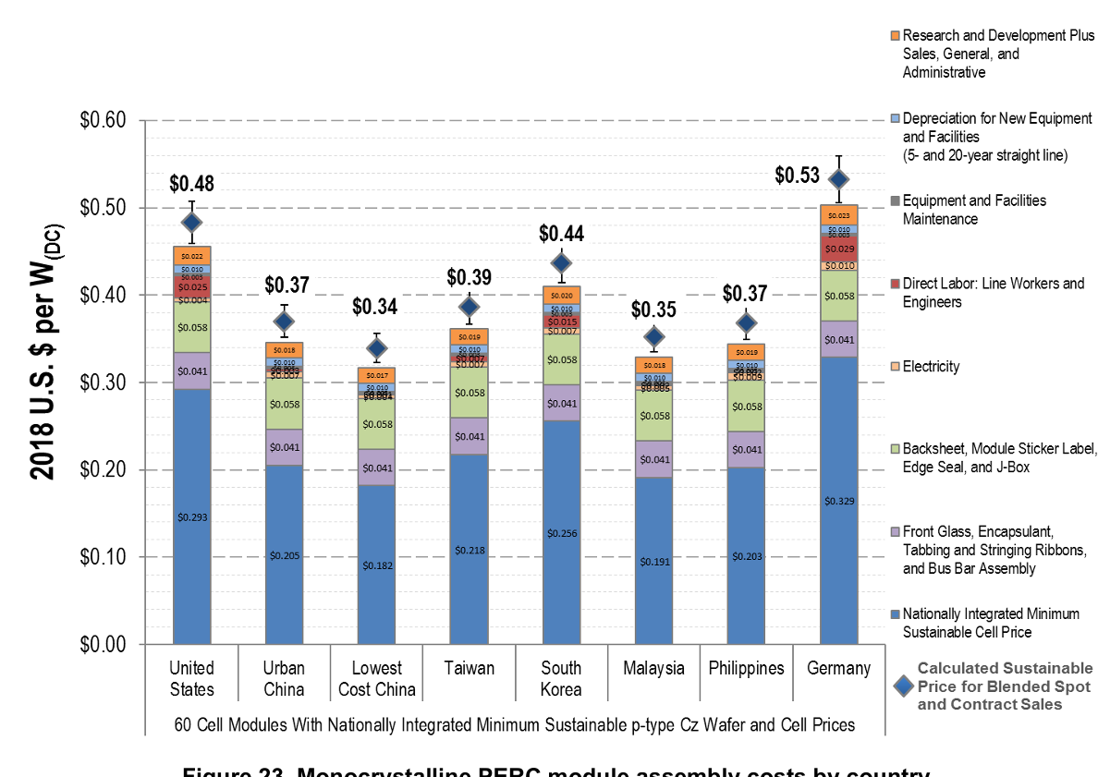
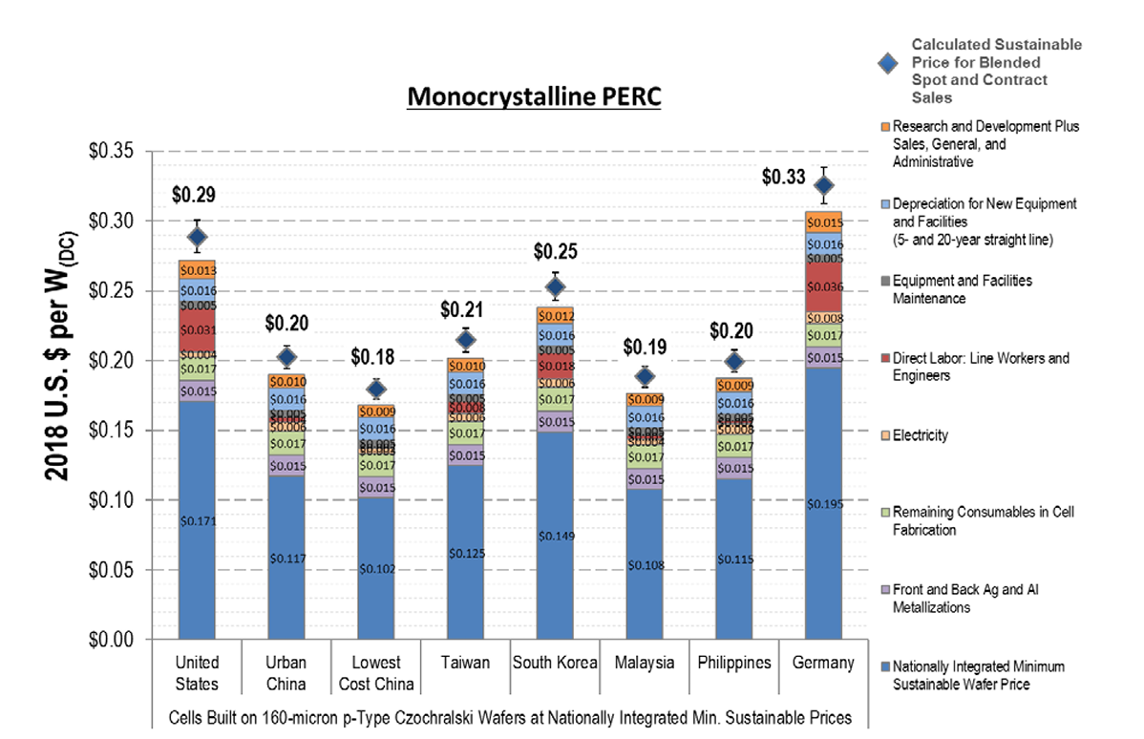
Constructing an input-output table including the PV industry
Lifecycle splitting
PV manufacturing industry
PV
industry
Electrical machinery and equipment manufacturing
manufacturing
Metal fabrication industry
Figure 1 Cost structure of the PV manufacturing process ^{[1]}
Non-metallic manufacturing industry
electricity
Unit cost × output = total output of the manufacturing process
Value added
Other business activities
Installation
O&M
[1]Woodhouse, Michael. Brittany Smith, Ashwin Ramdas, and Robert Margolis. 2019. Crystalline Silicon Photovoltaic Module Manufacturing Costs and Sustainable Pricing: 1H 2018 Benchmark and Cost Reduction Roadmap. Golden, CO: National Renewable Energy Laboratory. https://www.nrel.gov/docs/fy19osti/72134.pdf.
electricity

Slide 14
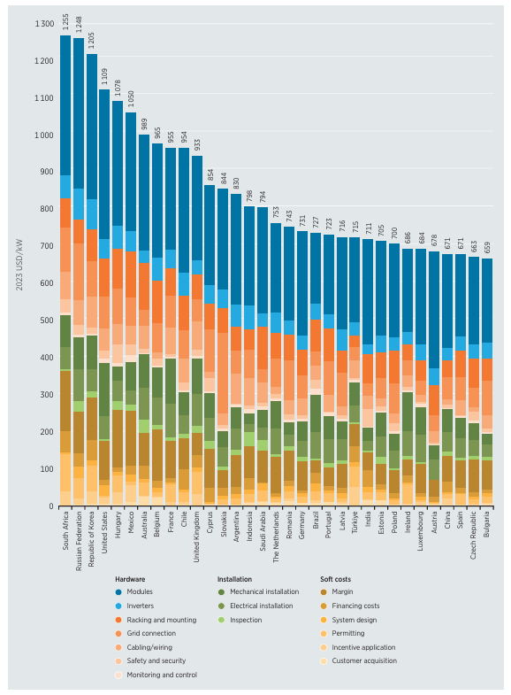
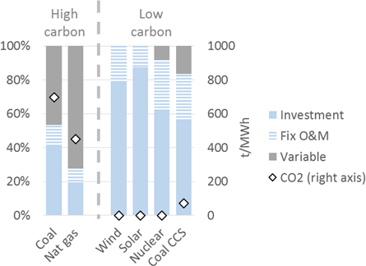
Constructing an input-output table including the PV industry
manufacturing
Intermediate input from manufacturing to installation = total output of installation * proportion of component input
Proportional splitting
PV
industry
Final demand in manufacturing = total output - intermediate input
Figure 1 Utility-scale solar PV total installed costs by country ^{[1]}
Installation
Total output of installation/operation and maintenance = total output of pv power generation * proportion of capital
Intermediate investment in installation/o&m = intermediate investment in pv power generation * proportion of capital
O&M
Final demand for installation/O&M = Corresponding total output - Corresponding intermediate input
electricity
Figure 2 Cost composition of different power generation technologies ^{[2]}
[1] IRENA (2024), Renewable power generation costs in 2023, International Renewable Energy Agency, Abu Dhabi.
[2] Lion Hirth and Jan Christoph Steckel 2016 Environ. Res. Lett. 11 114010

Slide 15
Model coupling
GSIM
PVIO
Initial Trade Matrix
The change in the intermediate flow matrix of PV manufacturing in each country
Initial tariff matrix
elements
Changes in the final demand matrix for different power generation types in different countries
Final Tariff Matrix
Elastic coefficient
Update the input-output table, intermediate flow and final demand matrix
Source: ITC; Websites of ministries of commerce; Niu et al.(2018)； Wang et al.(2021)
model
Source: EXIOBASE
∆X=(I－A’)⁻¹ • Y’－ X₀
The amount of change in trade between countries
Employment coefficient
Changes in employment

Slide 16
Model coupling
GSIM model results
PVIO
Changes in the national trade matrix
 | A | B
A | AA | AB
B | BA | BB
Only the manufacturing process is changed, and the others are consistent with the quantity of the initial intermediate matrix
Manufacturing | A | B
A | aa+AA | ab+AB
B | ba+BA | bb+BB
Intermediate Traffic Matrix Final Value
A country's total power generation demand remains unchanged, and pv and non-pv power generation complement each other
The final demand for power generation | A | B
pv | FA+AA+BA | FC+AB+BB
non-pv | FB-AA-BA | FD-AB-BB
Changes in PV demand
A | B
AA+BA | AB+BB
The final value of the final demand matrix
∆J=E•(I－A’)⁻¹ • （Y+∆Y）－ E•(I－A)⁻¹ • Y
=E•(I+A’+A’²+A’³+....)• （Y+∆Y）－ E•(I+A+A²+A³+....)•Y
=E•∆Y+E•A’•∆Y+E•A’²•∆Y+E•A’³•∆Y+...+E•(A’-A)•Y+E•(A’²-A²)•Y+E•(A’³-A³)•Y+...

Slide 17
01
Background
CONTENTS
02
Methodology
03
Argument
04
Discussion and Recommendations

Slide 18
Argument
 | Mechanism 1 | Mechanism 2
Argument1 | Trade barriers lead to negative net employment benefits for the PV industry as a whole
Argument2 | Trade barriers have hurt the global PV job market
Argument3 | The employment-driven effect of photovoltaic power generation is generally better than that of other power generation types
Argument4 |  | Global supply chains further amplify the negative employment impact of PV trade barriers
Argument5 |  | The "boomerang" effect weakens the employment protection effect of PV trade barriers

Slide 19
Argument 1：Trade barriers lead to negative net employment benefits for the PV industry as a whole
Compared with the no-trade barrier scenario, the PV trade barriers in the United States between 2012 and 2021 have increased the domestic production of PV products by about 2,947 MW, an increase of about 3.4%, and created about 35,000 additional manufacturing-related jobs.
U.S. PV trade barriers reduced domestic PV consumption (the sum of imports and domestic sales of local manufacturing) by 6,678 MW, or 3.5%, compared to the counterfactual scenario without tariffs. This change directly led to a reduction of about 14,000 jobs in the installation sector and about 47,000 jobs in the operation and maintenance sector.
Figure 1 The impact of U.S. trade protection policies on domestic PV employment from 2012 to 2021

Slide 20
Argument 2：Trade barriers have hurt the global PV job market
Compared with the no-trade barrier scenario, the PV trade barriers in the United States from 2012 to 2021 have reduced the global production and consumption of PV products by about 4,494 MW, a decrease of about 0.2%, resulting in a cumulative loss of about 100,000 jobs in the global PV industry, including about 57,000, 9,000 and 30,000 jobs related to manufacturing, installation, and operation and maintenance, respectively.
Global PV employment losses are mainly concentrated in China and the United States, accounting for about 60% and 28% of the total employment losses in the global PV industry, respectively.
Figure 1 The impact of U.S. trade protection policies on global PV employment from 2012 to 2021

Slide 21
Argument 3：The employment-driven effect of photovoltaic power generation is generally better than that of other power generation types
With the final demand for power generation remaining unchanged, for the vast majority of countries, the overall employment changes in the power generation industry are consistent with the changes in photovoltaic consumption.
The protectionist measures imposed by the United States between 2012 and 2021 have caused significant losses in employment in the domestic power generation sector. While other types of power generation have created about 10,000 new jobs in the process of replacing PV, this increase is far from enough to compensate for the 60,000 jobs lost due to the decline in demand for PV.
Figure 1 The impact of PV trade protection measures in the United States on employment in different types of power generation industries from 2012 to 2021

Slide 22
Argument 4：Global supply chains further amplify the negative employment impact of PV trade barriers
From 2012 to 2021, the changes in the PV trade pattern and power generation consumption demand caused by the trade barriers imposed by the United States will delay the industrial chain and impact the employment market of many related industries, resulting in the loss of nearly 700,000 global jobs, which is 7 times the total job loss in the global PV value chain.
Agriculture, forestry, fishery and livestovk, wholesale and retail trade, electrical machinery and equipment manufacturing, ore mining, non-metallic, metal and other industries lost the most significant jobs, with losses of 180,000, 80,000, 80,000, 50,000, 50,000 and 40,000, respectively.
Figure 1 Comparison of the employment impact of mechanism 1 and mechanism 2 under the scenario of PV trade barriers imposed by the United States from 2012 to 2021

Slide 23
Argument 5：Te "Bumeron" Efekt Wickenstern Proimon Protect, Ephect Benputra de Barrijes
Compared with the barrier-free policy scenario, the changes in domestic consumer demand caused by the imposition of PV trade barriers in the United States from 2012 to 2021 could increase domestic jobs by nearly 130,000.
Changes in consumer demand in other countries/regions driven by barrier policies will have a negative impact on U.S. product exports, thereby reducing the positive pull effect of trade barriers on domestic employment.
From 2012 to 2021, this mechanism of action reduced the employment-driven benefits driven by increased domestic PV production by 22%.
Figure 1 From 2012 to 2021, the impact of changes in demand in various countries triggered by the U.S. PV trade policy on the U.S. job market

Slide 24
01
Background
CONTENTS
02
Methodology
03
Argument
04
Discussion and Recommendations

Slide 25
Discussion1:Why are trade barriers still prevalent when they are not significant in protecting jobs?
Lack of sufficient motivation to speak out
Consumers are a large and dispersed group, and the benefits of lower tariffs are quite limited for each individual.
Social loss aversion further exacerbates excessive public concerns about the loss of available jobs.
Dominate trade policy choices
To maximize profits, producers tend to lobby together to raise tariffs.
Organized interest groups often increase their influence over policymakers through political contributions, political and technical information, and so on
Consumer
Politics
Producer

Slide 26

Discussion2:How does the effect of trade barriers on employment change in a more realistic scenario?
If further consideration is given to the counter-sanctions of the target side of the barrier, the loss of employment will be further magnified
The barrier imposer
Barrier target
Global value chains
Employment in industry B has been impaired
Reduce the import of product B
Tax is levied on target party A products
A tax is levied on the product of the imposing party
Counter-sanctions
Reduce the import of product A
Employment in industry A has been impaired

Slide 27
Conclusion and Recommendation
Trade barrier measures have long been considered one of the most effective measures to protect jobs in industries that are vulnerable to the impact of cheap foreign goods. But our findings confirm that both mechanisms can compromise this protective effect or even have the opposite effect.
We should prudently adopt a policy of trade barriers and actively promote multilateral consultations.
A highly interconnected and interdependent global system is unlikely to abandon large-scale international trade anytime soon. However, free trade often leads to a gap of interests between the "winners" and the "losers", which in turn leads to a political backlash. In order to alleviate this contradiction, the uneven distribution of the social benefits of free trade can be alleviated by strengthening social security and re-employment support for the unemployed, increasing public participation in trade policies, and providing subsidies to damaged firms.

Slide 28
Debriefing is over!
Criticism and correction are welcome

