Slide 1
CO₂ Reduction Potential of Global Supply Chain Networks: An MRIO Approach Incorporating Maritime Network Structures
Tomomi SHODA¹, Keitaro MAENO², Taiga SHIMOTSUURA¹, and Shigemi KAGAWA³
1 Graduate School of Economics, Kyushu University, Japan
2 National Institute of Advanced Industrial Science and Technology, Japan
3 Faculty of Economics, Kyushu University, Japan

Slide 2
1. Introduction
1/26
The Paris Agreement was adopted in 2015 to tackle climate change and its negative impacts, and more than 120 countries and regions have set a goal of “net zero carbon dioxide emissions” (United Nation, 2016).
The global supply chain (GSC) structure has significantly developed over the past few decades driven by the expansion of international trade.
23% of global CO₂ emissions are embodied in traded goods through GSCs, and 30% of consumption-based emissions of wealthy countries were imported, indicating the potential for international carbon leakage (Davis et al., 2011).
Environmentally Extended Multi-Regional Input-Output (EE-MRIO) models are one of the most powerful tools for tracing GSCs and allocate emissions from production to consumption across countries (Vershuur et al., 2022 & Fry et al., 2024).

Slide 3
1. Introduction
2/26
In Input-Output Analysis, Multi-Regional Input-Output (MRIO) tables describe inter- and intra-industry dependencies within and between countries by modeling GSCs as a multidimensional space defined by country, commodity, and industry (Vershuur et al., 2022 & Fry et al., 2024).
However, MRIO tables do not provide insights into the domestic and international transportation systems used for these trade flows, as paths through physical space are not explicitly defined (Fry et al., 2024).
On the other hand, the development of the GSCs has led to the geographic separation of production areas and consumption areas (Wiedmann & Lenzen, 2018).
Therefore, current GSC is highly dependent on international shipping (UNCTAD, 2021).

Slide 4
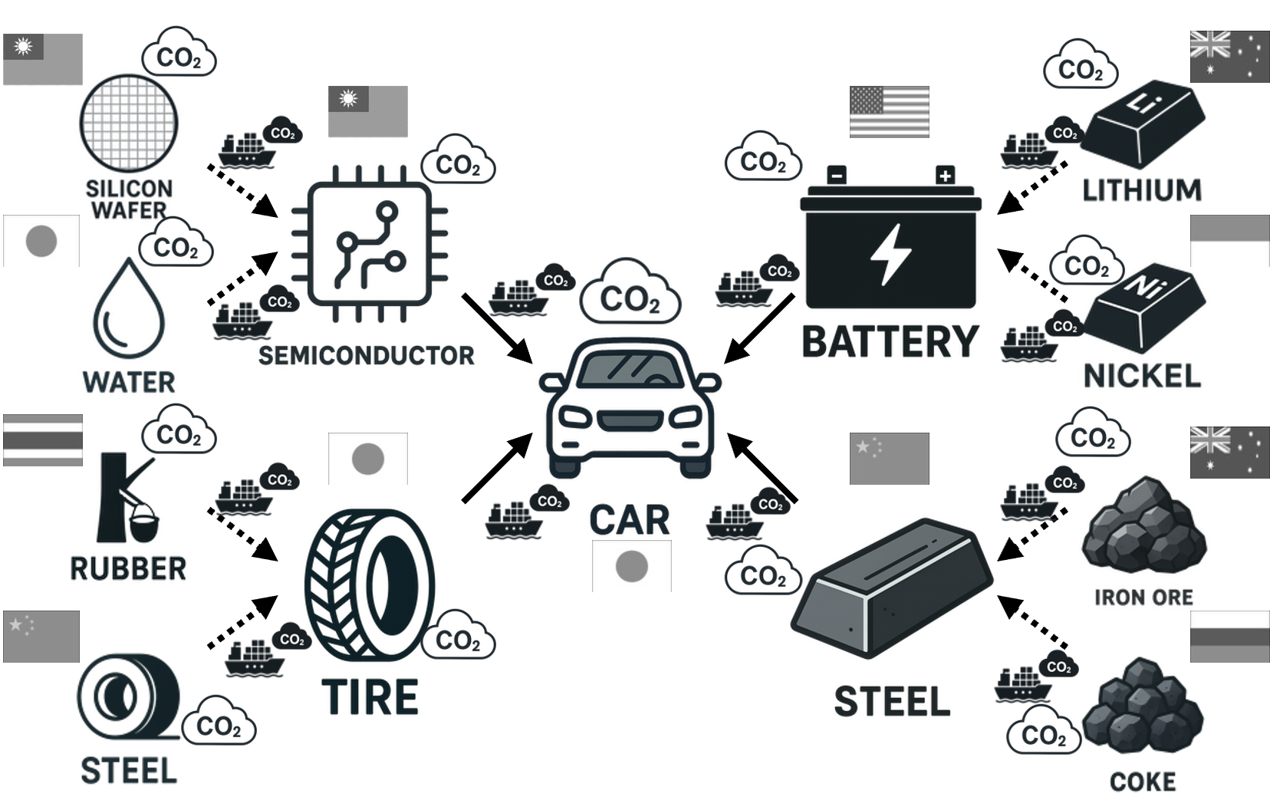
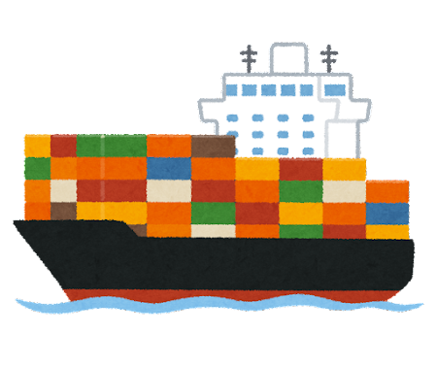
1. Introduction
3/26
To more accurately evaluate the environmental impact of GSCs, it is essential to develop analytical EE-MRIO methods that incorporate physical dimensions.
To develop a new framework to analyze trade flows transported by international container shipping based on MRIO.
To estimate CO₂ emissions from international container shipping induced by GSCs and allocate CO₂ emissions to countries.
Objective
🇩🇪 ?%
🇯🇵 ?%
🇺🇸 ?%
🇨🇳 ?%

Slide 5
2. Methodology
4/26
Estimation of CO₂ emissions from international container shipping using MRIO (Conceptual)
$$B=C∘R∘{\left(I−A\right)}^{−1}\hat{f}$$
$$=C∘R∘L\hat{f}$$
$B$ : Offshore CO₂ emissions matrix for
international container shipping
$C$ : CO₂ emission intensity matrix for
international container shipping
$R$ : Container transport ratio matrix
$I$ : Identity matrix
$A$ : Input coefficient matrix
$\hat{f}$ : Diagonal matrix of global final demand
$L$ : Leontief inverse matrix
$L\hat{f}$: direct and indirect input induced by global final demand
$R∘L\hat{f}$: direct and indirect input transported by container shipping induced by global final demand
$C∘R∘L\hat{f}$: CO₂ emissions from international shipping induced by global final demand through GSCs

Slide 6
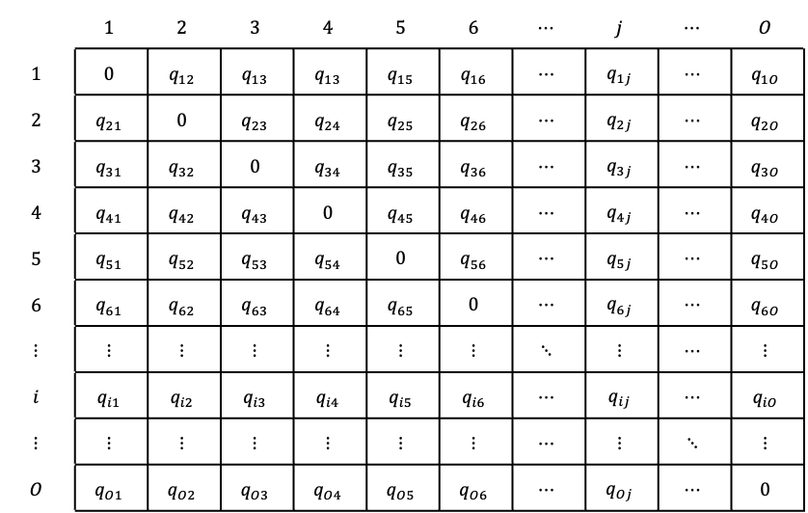
2. Methodology
5/26
Estimation of CO₂ emission intensity matrix for international container shipping $C$ – CO₂ emission (Conceptual)
Adjacency matrix weighted by CO₂ emissions (t-CO₂) from container ships between 893 ports
Row element the departure port
Column element the arrival port
$$q_{ij}$$ the total amount of CO₂ emissions from container ships departing from 𝑖-th port and arriving at 𝑗-th port

Slide 7
2. Methodology
6/26
Estimation of CO₂ emission intensity matrix for international container shipping $C$ – CO₂ emission (Conceptual)
Flaw of the adjacency matrix is that only direct transport is recorded. e.g. Hamburg (Gremany) – Tokyo (Japan): 0 t-CO₂
Estimation of CO₂ emissions of each voyage (t-CO₂)
Arrival time : ${\overline{T}}_{j_{0}}^{n_{0},k_{0}}$
Departure time : ${\tilde{T}}_{i_{0}}^{n_{0},k_{0}}$
Carbon intensity: $g^{k_{0}}$ (t-CO₂/h) Speed :$v^{k_{0}}$ (km/h)
Voyage time: $t_{i_{0}j_{0}}^{n_{0},k_{0}}$(h)
$$t_{i_{0}j_{0}}^{n_{0},k_{0}}={\overline{T}}_{j_{0}}^{n_{0},k_{0}}−{\tilde{T}}_{i_{0}}^{n_{0},k_{0}}$$
CO₂ emissions: $q_{i_{0}j_{0}}^{n_{0},k_{0}}$ (t-CO₂)
$$q_{i_{0}j_{0}}^{n_{0},k_{0}}=g^{k_{0}}t_{i_{0}j_{0}}^{n_{0},k_{0}}$$

Slide 8
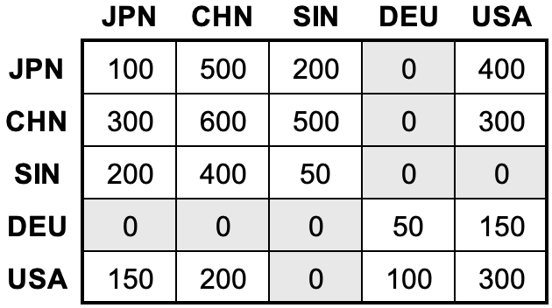
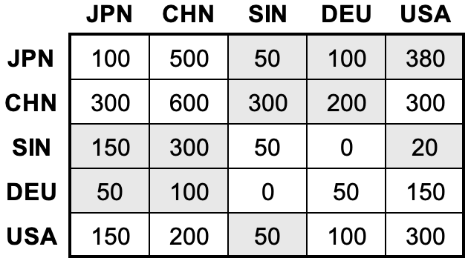
2. Methodology
7/26
Estimation of CO₂ emission intensity matrix for international container shipping $C$ – CO₂ emission (Conceptual)
Reallocating CO₂ emissions attributed to hub ports to origin ports
To overcome the flaw, shortest path is used for estimation of CO₂ emissions from indirect transport based on graph theory and economics of scale.
Before
After

Slide 9
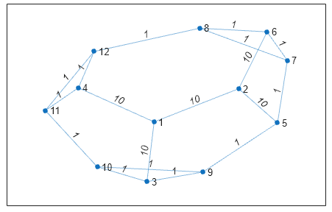
2. Methodology
8/26
Estimation of CO₂ emission intensity matrix for international container shipping $C$ – CO₂ emission (Conceptual)
Shortest path based on graph theory and economic of scale $${Cost}_{ij}=ln\left(\frac{1.01∗{Fre}_{max}}{{Fre}_{ij}}\right)$$
Based on economies of scale, the more a certain route is used, the lower the cost becomes, which in turn leads to even greater usage of that route.
Based on shortest path, the most cost-effective route between any two ports is calculated.
cost to pass through
port

Slide 10
2. Methodology
9/26
Estimation of CO₂ emission intensity matrix for international container shipping $C$ – CO₂ emission (Conceptual)
CO₂ emissions reallocation based on shortest path
e.g. Hamburg (Gremany) – Tokyo (Japan)
Hamburg – Rotterdam – Suez Canal – Singapore – Johor – Hong Kong – ZhouShan – Okpo – Yokohama – Tokyo
However, Suez Canal – Singapore does not only appear on Hamburg – Tokyo.
Suez Canal – Singapore appears also on Hamburg – Shanghai, Antwerp – Hong Kong, and so on …
CO₂ emissions from Suez Canal – Singapore need to be reallcated to all paths where it appears.

Slide 11
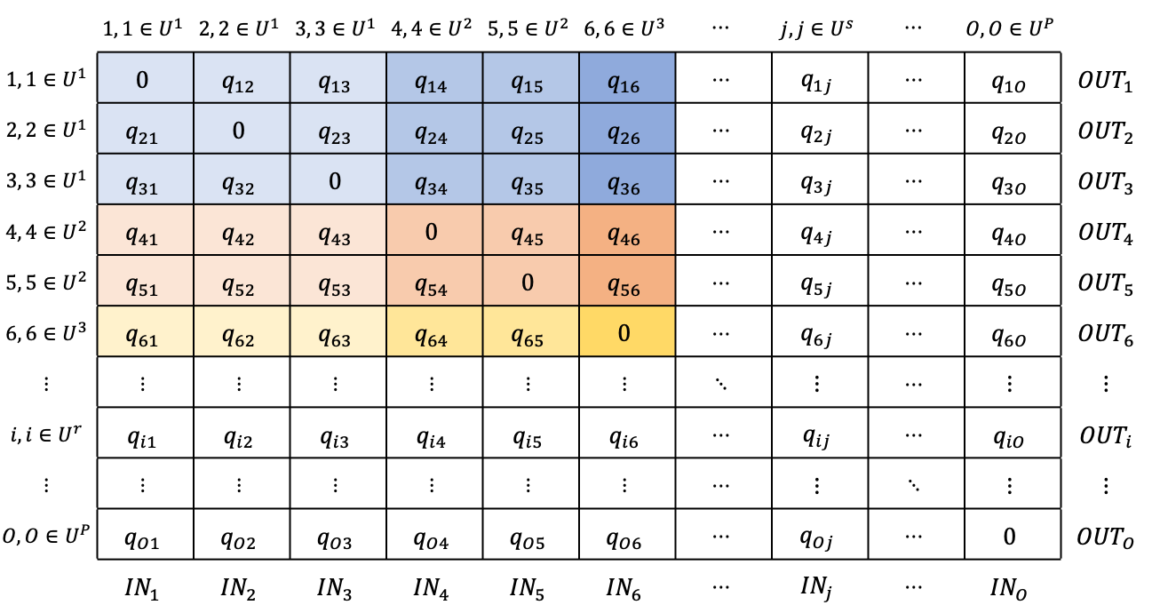
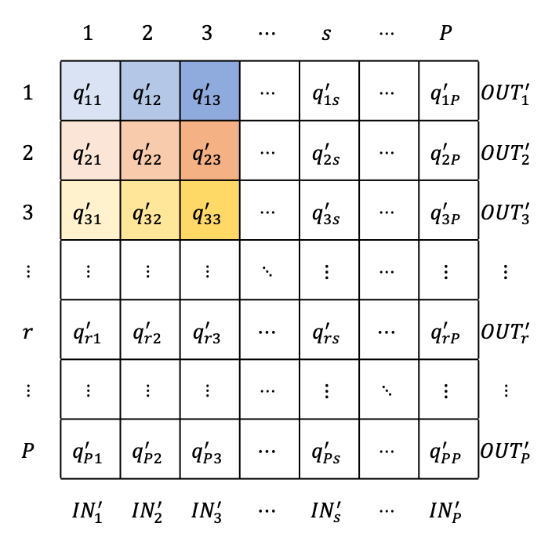
2. Methodology
10/26
Estimation of CO₂ emission intensity matrix for international container shipping $C$ – CO₂ emission (Conceptual)
CO₂ emissions reallocation based on shortest path
The rate of reallocation to all paths is based on trade value between countries where ports belong to.
893
ports
164
regions

Slide 12
3. Data
11/26
Multi-Regional Input-Output Database GLORIA 2019 (Lenzen et al., 2021)
International shipping database Sea-web Database (IHS Markit Ltd) voyage histories in 2019 of container ships owned by top 10 container shipping companies (84% of full containers in the world) Carbon intensity estimated in bottom-up method (IMO, 2021)
Trade statistics Trade Statistic Data for Japan – Sea Container Cargo Commodity by Country – Import (2019) (Ministry of Finance Japan, 2020)
Due to data limitation, this study takes Japan’s import as a case.

Slide 13
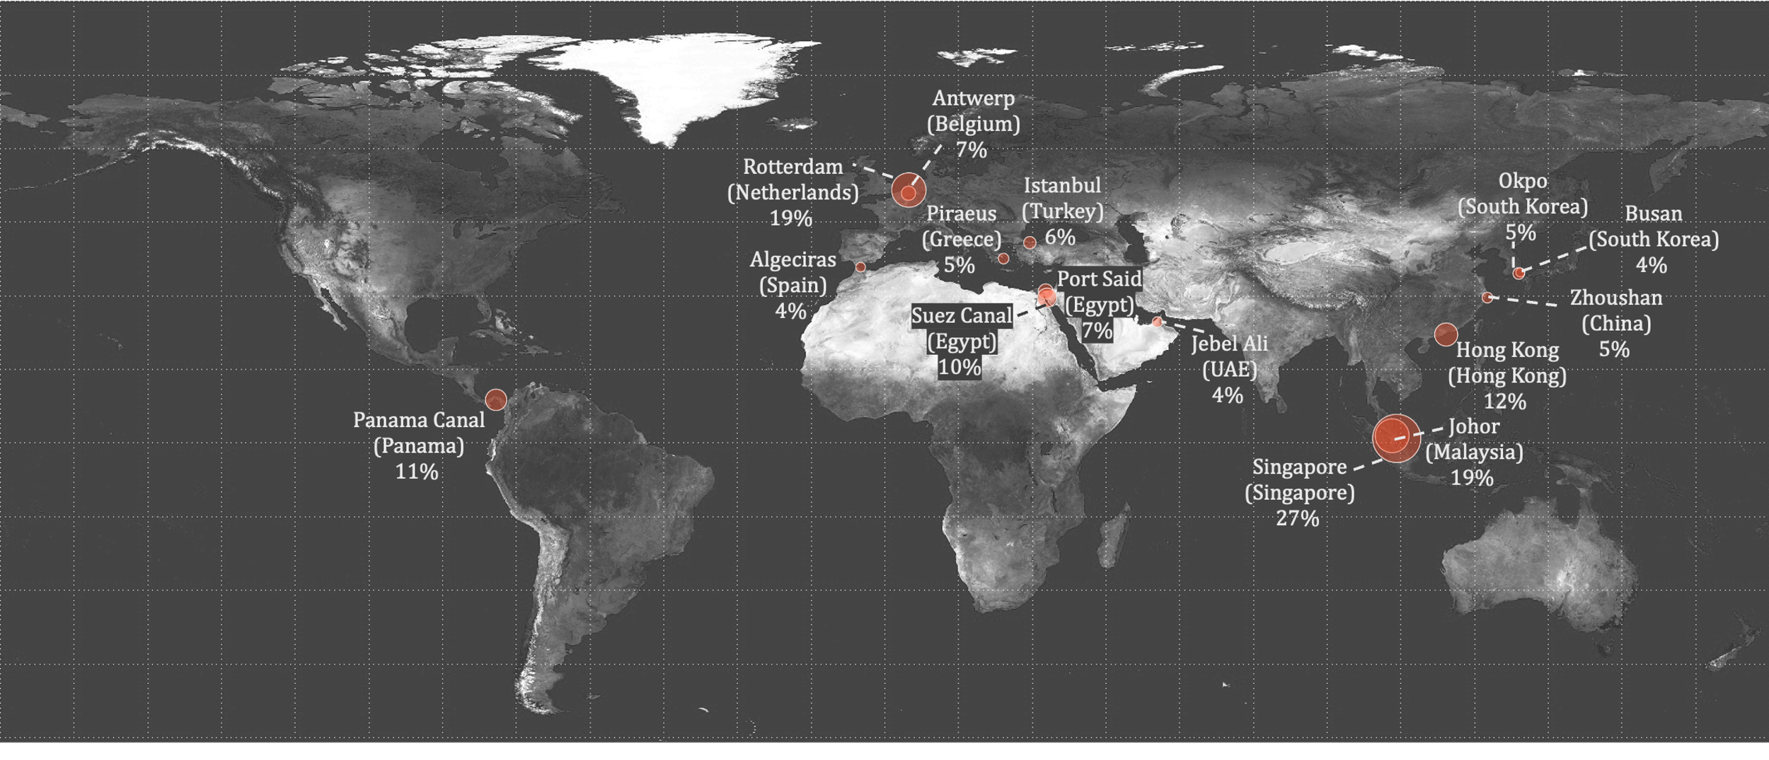
4. Results
12/26
Critical international shipping ports in terms of frequency of appearance in the 797,449 (893×893) shortest paths

Slide 14
4. Results
13/26
Singapore is the most critical port, highlighting its role as a global maritime hub port.

Slide 15
4. Results
14/26
Rotterdam is second most critical port, highlighting its role as a regional maritime hub port.

Slide 16
4. Results
15/26
Ports like Johor, Antwerp, Piraeus, and Busan reflect their importance as regional gateways that connect smaller ports to the global network.

Slide 17
4. Results
16/26
The presence of Panama Canal and Suez Canal highlights their geographic importance as vital corridors.

Slide 18
4. Results
17/26
The prominence of Asian ports emphasizes East Asia and Southeast Asia’s centrality in international container shipping and central role in GSCs.

Slide 19
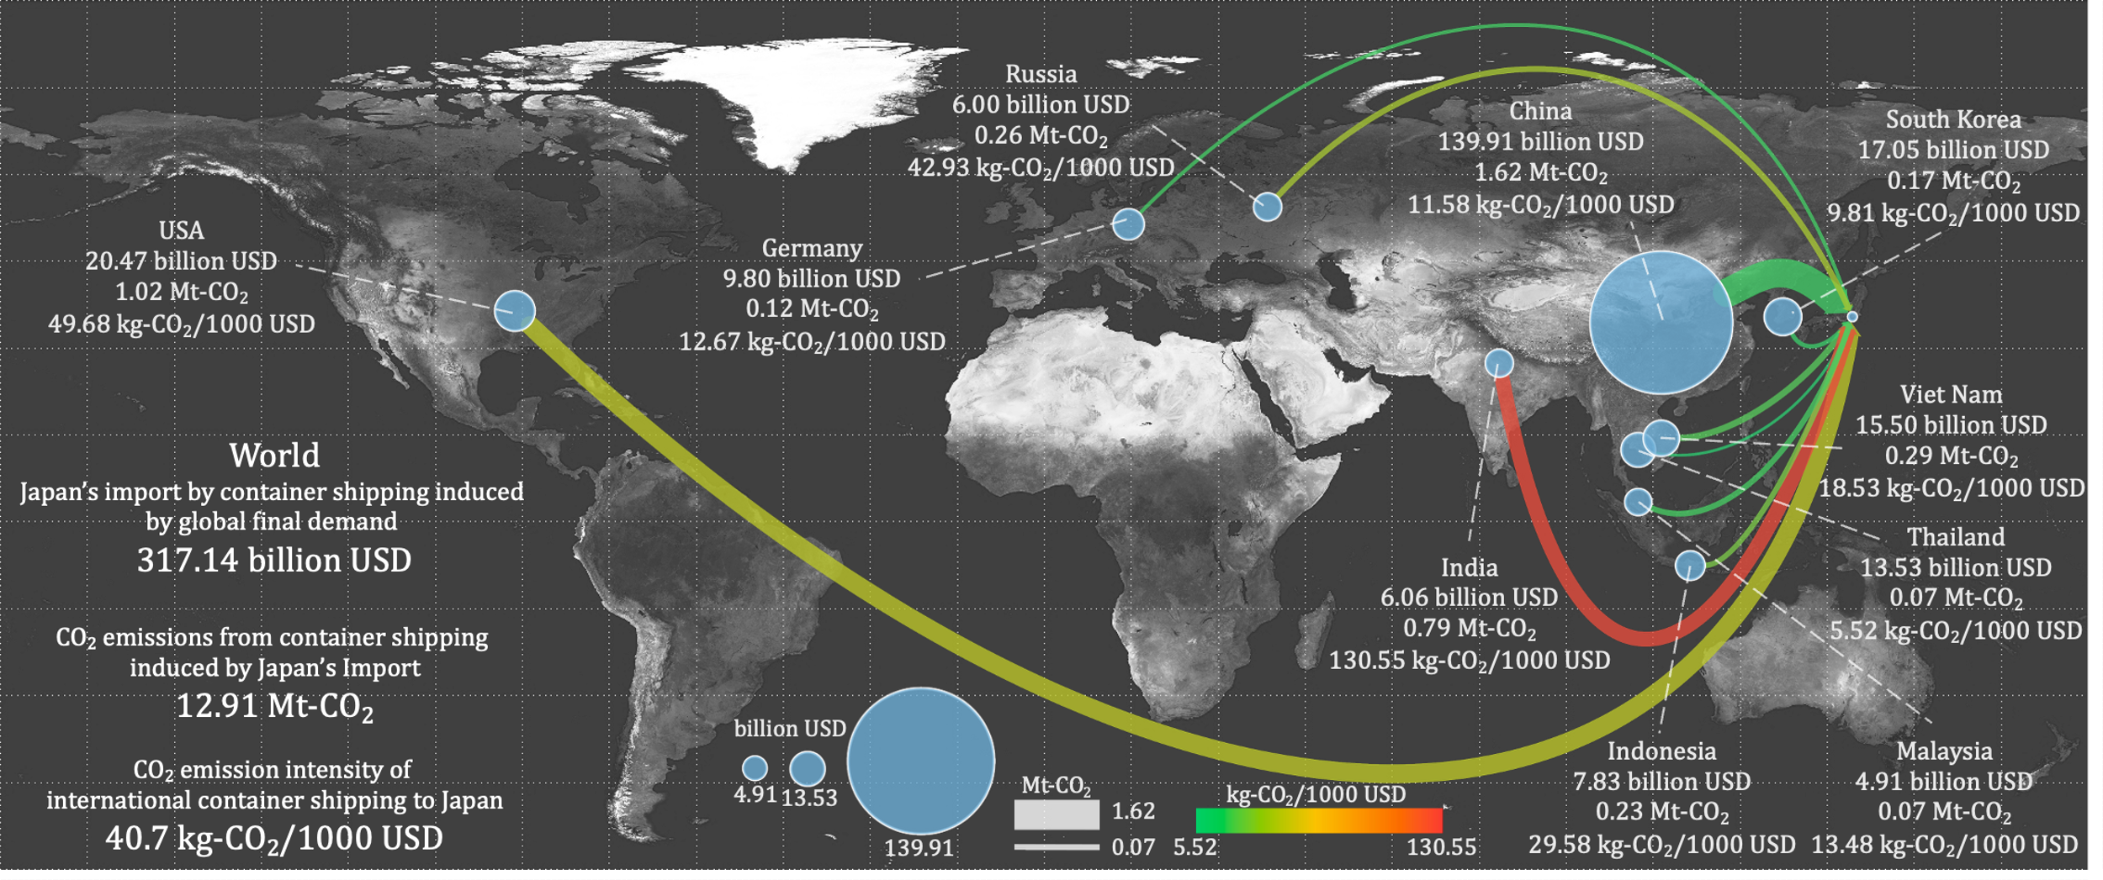
4. Results
18/26
Japan’s import by container shipping induced by global final demand was 317.14 billion USD.

Slide 20
4. Results
19/26
CO₂ emissions from international container shipping induced by Japan’s Import was 12.91 Mt-CO₂.

Slide 21
4. Results
20/26
CO₂ emission intensity of international container shipping toward Japan was 40.7 kg-CO₂/1000 USD.

Slide 22
4. Results
21/26
Asian countries (e.g., China, South Korea, Vietnam, Thailand) generally show lower CO₂ emission intensity of international container shipping.

Slide 23
4. Results
22/26
Distant countries (e.g., USA, Russia) show higher CO₂ emission intensity, reflecting longer transport distances.

Slide 24
4. Results
23/26
India has the highest CO₂ emission intensity, indicating inefficient or long-distance shipping routes.

Slide 25
4. Results
24/26
Despite the geographical distance, Germany shows relatively low CO₂ emission intensity, reflecting efficient logistics and high-value exports.

Slide 26
5. Discussion
25/26
For GSC restructuring
According to Maeno et al. (2022), the restructuring of the GSC has the potential to significantly reduce the carbon footprint of production.
For governments, it is crucial to establish trade policies to facilitate the transition of import destinations under the context of decarbonization.
When CO₂ emission intensity of production and CO₂ emissions from procuction is similar, CO₂ emission intensity of international container shipping estimated in this study is an index for deciding production countries.
More specific and inclusive policy implications for GSC restructuring are possible by combining model developed in this study with usual EE-MRIO model.

Slide 27
6. Conclusion
26/26
Singapore is the most critical port for GSCs, and East Asia and Southeast Asia are most critical areas for GSCs in terms of international container shipping.
Asian countries show lower CO₂ emission intensity of international container shipping to Japan, while Distant countries show higher CO₂ emission intensity, reflecting longer transport distances.
Geographical distance does not necessarily lead to higher CO₂ emission intensity of international container shipping.
When CO₂ emission intensity of production and CO₂ emissions from procuction is similar, CO₂ emission intensity of international container shipping estimated in this study is an index for deciding production countries.

Slide 28
Thanks for your attention! Tomomi SHODA Kyushu University Email: shoda.tomomi@gmail.com

