Slide 1
Analysis of CO₂
Emissions from Inbound Consumption in Japan
Sakura Murabe^{a*}, Kaoru Tsudaª, Shigemi Kagawa^{b}
a: Graduate School of Economics, Kyushu University, Fukuoka, Japan
b: Faculty of Economics, Kyushu University, Fukuoka, Japan
Notes:
Hello everyone.
I’m Sakura Murabe from Kyushu university.
Today ,/ I’d like to talk about/Analysis of CO₂ Emissions from Inbound Consumption in Japan.

Slide 2
1. Introduction
1
International tourism plays an important role in economy.
International tourism recorded 1.4 billion arrivals and generated 1.5 trillion USD in revenue in 2019 (UNWTO, 2020).
Japan recorded 32 million inbound tourists and 4.8 trillion yen in travel spending in 2019 (JNTO, 2020).
In Japan, tourism became an important growth sector, supported by pro-tourism policies and low-cost carriers.
(million
people)
Trends in the number of inbound tourists to Japan
2019
Notes:
・ In Japan, thirty two (32) million inbound tourists /arrived in twenty nineteen (2019), /with four point eight (4.8) trillion yen / in travel spending.
・ So, In Japan, tourism became an important growth sector, / supported by pro-tourism policies and low-cost carriers.

Slide 3






1. Introduction
2
Tourism has a large environmental impact due to GHG emissions.
Tourism-induced emissions accounted for 8.8% of global CO₂ emissions in 2019, totaling 5.2 Gt (Sun et al., 2024).
They increased by 3.5% annually between 2009 and 2019, and are projected to continue rising
These emissions can be broadly categorized into two main sources:
air transport and tourism consumption.
From Aviation
CO₂ From Tourism
From Consumption
These emissions can be broadly categorized into two main sources:
air transport and tourism consumption
Notes:
These emissions can be broadly divided into two main categories: /one is air transport, /and the other is tourism consumption.

Slide 4
1. Introduction
3
Air travel is the main driver of tourism CO₂ emissions.
Air travel is internationally recognized as
the most emission-intensive mode of
transportation.
In Japan, about 99% of inbound tourists travel by air, so it's important to estimate aviation emissions accurately (JNTO, 2025a).
99%
Airplane
Notes:
In Japan, /about ninety-nine(99)% of inbound tourists travel by air, / so it's important to estimate aviation emissions accurately.

Slide 5












1. Introduction
4
Air travel is the main driver of tourism CO₂ emissions.
Air travel is internationally recognized as
the most emission-intensive mode of
transportation.
In Japan, about 99% of inbound tourists travel by air, so it's important to estimate aviation emissions accurately. (JNTO, 2025a).
Differences in consumption patterns lead to differences in emission structures, so it is also necessary to consider supply chain emissions induced by tourism consumption.
Notes:
On the other hand, / differences in consumption patterns/ lead to differences in emission structures,/ so it is also necessary to consider supply chain emissions induced by tourism consumption.

Slide 6
1. Introduction
5
Previous studies mostly used monetary-based input-output models to estimate aviation emissions (Lenzen et al., 2018).
However, such approaches fail to account for differences in flight distance and aircraft type—whose fuel efficiency can differ by as much as twofold in some cases—making it difficult to accurately assess aviation-related emissions by nationality (Sharp et al., 2016; Oga and Kagawa, 2025).
Notes:
Then, previous studies mostly used monetary-based models / to estimate emissions.
However, such approaches fail to account for differences / in flight distance and aircraft type /—whose fuel efficiency can differ by as much as twofold in some cases— / making it difficult to accurately assess aviation-related emissions by nationality.

Slide 7
1. Introduction
6
Purpose of this study
This study quantifies CO₂ emissions induced by inbound tourism to Japan with high precision, separating them into two categories:
air transport and tourism consumption. Based on these estimations, it aims to propose effective decarbonization policies.
Novelty of this study
This study achieved a more accurate calculation of CO₂ emissions based on actual flight operation data by separately estimating emissions from air transport and tourism consumption.
This study analyzed changes in tourism-induced CO₂ emissions before and after the COVID-19 pandemic.
Notes:
・ So, This study quantifies CO₂ emissions / induced by inbound tourism to Japan /with high precision / and it separates them into two categories / air transport and tourism consumption.
・ Based on these estimations, /it aims to propose effective decarbonization policies.
・ And, There are two novelty of this study.
・ First, this study achieved a more accurate calculation of CO₂ emissions / based on actual flight operation data
/ by separately estimating emissions from air transport and tourism consumption.
・ Second, it also analyzed changes in tourism-induced CO₂ emissions / before and after the COVID-19 pandemic.

Slide 8









2. Methodology
7
(1) Estimation of CO₂
emissions from aviation
We use GLORIA, a global multi-regional input-output table, to analyze how tourists’ spending—on things like food, hotels, and transport—leads to CO₂ emissions.
(2) Estimation of CO₂ emissions
from tourism consumption
We estimate direct CO₂ emissions using flight schedules and operational data from JTB.
Direct CO₂ emission
Indirect CO₂ emission
Operational
data
Analyze on PC
Data
Company, Airport,
The number of fright, Aircraft type,
Notes:
・ This study adopts two main analytical approaches.
・ To begin with, I will provide an overview of both methods using this slide.
・ The first method is the aviation-based estimation.
・ We use GLORIA, a global multi-regional input-output table, / to analyze how tourists’ spending—on things / like food, hotels, and transport— / leads to CO₂ emissions.
・ Next, the second method is the aviation-based estimation.
・ We estimate direct CO₂ emissions / using flight schedules and operational data from JTB.

Slide 9








2. Methodology –Estimation of CO₂ emissions from aviation-
8
Aviation emissions
$$b^{c_{s}}=h×d^{c_{s}}×m^{c_{s}}×l^{c_{s}} （1）$$
$$b^{c_{s}}：\text{direct} \text{CO}\text{2} \text{emissions} \text{from}$$
$\text{operating}$ aircrafts
$h$ ：direct CO₂ emission factor of
jet fuel
$d^{c_{s}}$ ：average distance of the
specific flight route between the
country of residence and Japan
$m^{c_{s}}$：total number of flights
operated
$l^{c_{s}}$ ：average fuel efficiency of the
aircraft used on that route
$c_{s}$​ ：flight route between the country
of residence of foreign tourists
＝
$$×$$
$$×$$
$$×$$
We first estimate direct CO₂ emissions derived from international flights from foreign countries to Japan
Notes:
・ Then, I will go into each method in more detail with equations.
・ To begin with, I will explain the emissions from air transport / in more detail.
・ we estimated the CO₂ emissions from aircraft operations / on route s from country c to Japan / using Equation number one (1).
・ In this equation,/ h is the emission factor of jet fuel, /d is the flight distance, /m is the number of flights, /and l is the fuel efficiency of the aircraft.
・ By multiplying these factors,/ we estimate the direct CO₂ emissions per flight for a given route.
・ Rather than simply assuming that longer distances /lead to higher emissions, / this approach also takes into account aircraft type and flight frequency.

Slide 10

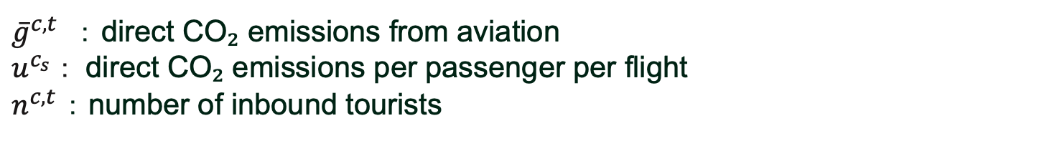
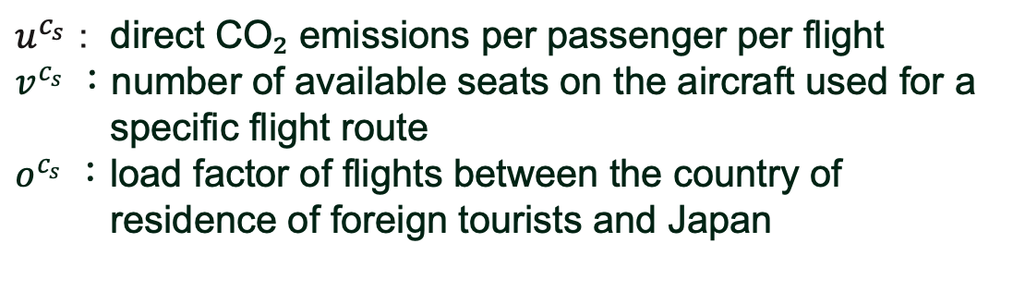

We estimated the direct CO₂ emissions per passenger per flight by dividing the previously estimated CO₂ emissions per flight by the number of passengers per flight.
2. Methodology –Estimation of CO₂ emissions from aviation-
9
Aviation emissions
$u^{c_{s}} ：$direct CO₂ emissions per passenger per flight
$v^{c_{s}}$：number of available seats on the aircraft used for a
specific flight route
$o^{c_{s}} ：$load factor of flights between the country of
residence of foreign tourists and Japan
$$u^{c_{s}}=\frac{b^{c_{s}}}{v^{c_{s}}×o^{c_{s}}} (2)$$
We estimated the direct CO₂ emissions per passenger per flight by dividing the previously estimated emissions per flight by the number of passengers per flight.
${\overline{g}}^{c,t}$ ： direct CO₂ emissions from aviation
$u^{c_{s}} ：$direct CO₂ emissions per passenger per flight
$n^{c,t}$ ： number of inbound tourists
$${\overline{g}}^{c,t}=u^{c_{s}}×n^{c,t} (3)$$
Then, we multiplied the CO₂ emissions per passenger by the number of inbound tourists to estimate the total emissions from their air travel.
Notes:
・ In the next step, / we convert the route-level emissions / into a per-passenger basis.
・ We estimated the amount of CO₂ emissions / generated by one tourist taking a single flight,/ denoted as u, /using Equation number two(2).
・ In this equation, / b represents the emissions per flight, / v is the number of seats, /and o is the load factor.
・ By dividing the emissions per flight by the number of seats and the load factor, we obtain the CO₂ emissions per passenger per flight.
・ Then, we estimated the total direct CO2 emissions from aviation by nationality and year, denoted as g, using Equation (3).
・ In this equation, n refers to the number of inbound tourists from each country.
・ By multiplying the per-passenger emissions u by the number of tourists n, we can calculate the total emissions by nationality and year.

Slide 11




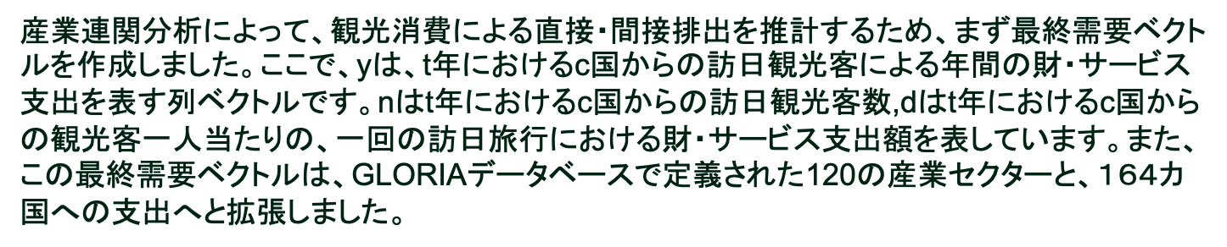
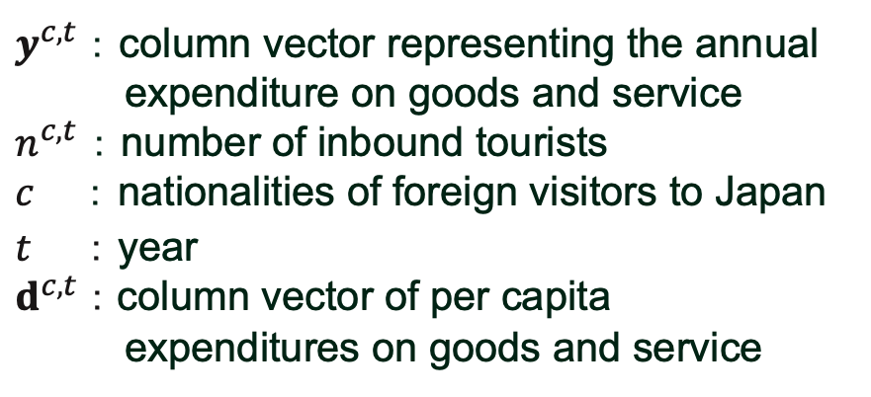

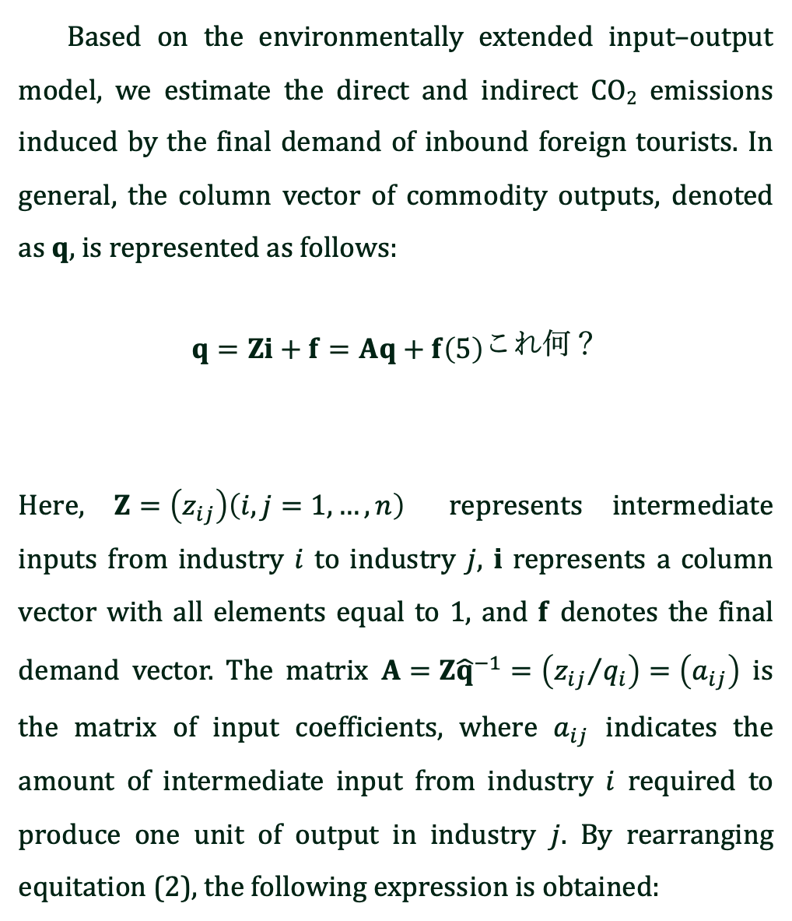

2. Methodology –Estimation of CO₂ emissions from tourism consumption–
10
Consumption-based emissions
$y^{c,t}$： column vector representing the annual
expenditure on goods and service
$n^{c,t}$ ： number of inbound tourists
$c$ ： nationalities of foreign visitors to Japan
$t ：$ year
$d^{c,t} ：$column vector of per capita
expenditures on goods and service
$$y^{c,t} =n^{c,t}d^{c,t} (4)$$
＝
$$×$$
We first constructed a final demand vector to estimate the direct and indirect emissions from tourism consumption using input-output analysis.
This final demand vector was then expanded to cover 120 industrial sectors and 164 countries, based on the GLORIA database.
Based on the environmentally extended input–output model, we estimate the direct and indirect CO₂ emissions induced by the final demand of inbound foreign tourists. In general, the column vector of commodity outputs, denoted as $q$, is represented as follows:
$$\begin{aligned}q=Zi+f=Aq+f\#\left(5\right)\end{aligned}これ何？$$
Here, $Z=\left(z_{ij}\right)\left(i,j=1,…,n\right)$ represents intermediate inputs from industry $i$ to industry $j$, $i$ represents a column vector with all elements equal to 1, and $f$ denotes the final demand vector. The matrix $A=Z{\hat{q}}^{−1}=\left({z_{ij}}/{q_{i}}\right)=\left(a_{ij}\right)$ is the matrix of input coefficients, where $a_{ij}$ indicates the amount of intermediate input from industry $i$ required to produce one unit of output in industry $j$. By rearranging equitation (2), the following expression is obtained:
Notes:
・ We first constructed a final demand vector to using Equation number (4) / estimate the direct and indirect emissions from tourism consumption / using input-output analysis.
・ Here, / D is the expenditure vector per inbound tourist, / and n is the number of inbound tourists.
・ By multiplying these two,/ we obtain the final demand vector, / which shows how much demand is generated in each industry.
・ This final demand vector was then expanded / to cover 120 industrial sectors and 164 countries,/ based on the GLORIA database.

Slide 12

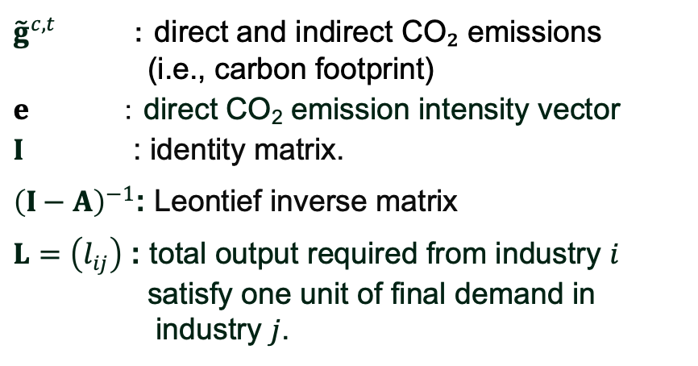
2. Methodology –Estimation of CO₂ emissions from tourism consumption–
11
From tourism consumption
${\tilde{g}}^{c,t}$ ：direct and indirect CO₂ emissions
(i.e., carbon footprint)
$e$ ：direct CO₂ emission intensity vector
$I$ : identity matrix.
${\left(I−A\right)}^{−1}$: Leontief inverse matrix
$L=\left(l_{ij}\right)$ : total output required from industry $i$
satisfy one unit of final demand in
industry $j$.
$${\tilde{g}}^{c,t}={\hat{e}\left(I−A\right)}^{−1}y^{c,t}=\hat{e}Ly^{c,t} (5)$$
Based on the environmentally extended input-output model, we estimated the direct and indirect CO₂ emissions induced by the final demand of inbound tourists to Japan.
By using the GLORIA database, we can capture the intra- and inter-country CO₂ emissions induced by the tourism-related consumption of inbound foreign visitors in Japan.
Notes:
・ This slide shows / the estimation formula for CO₂ emissions / from tourism consumption using input-output analysis.
・ Based on an environmentally extended input-output model, / we estimate the direct and indirect CO₂ emissions induced by tourism consumption / using Equation number five(5).
・ In this equation, / e is the vector of direct CO₂ emission coefficients, / L is the Leontief inverse matrix constructed using the GROLIA model, / and y is the final demand vector created on the previous slide.
・ By multiplying these components, / we can estimate the total direct and indirect CO₂ emissions / triggered by tourism consumption.
・ By using the GLORIA database, / we can capture the intra- and inter-country CO₂ emissions / induced by the tourism-related consumption of inbound foreign visitors in Japan.

Slide 13






2. Methodology
12
By combining the emissions from consumption and air transport estimated using two methods, we can formulate the CO₂ emissions from inbound tourism in Japan at the nationality level as follows.
$$g^{c,t}={\overline{g}}^{c,t}{+i′\tilde{g}}^{c,t}(6)$$
＝
$$×$$
Notes:
・ Finally, By combining the emissions from consumption and air transport / estimated using two methods, / we can formulate the CO₂ emissions / from inbound tourism in Japan / at the nationality level as follows

Slide 14
3. Data
13
The number of inbound tourists to Japan
the Japan National Tourism Organization’s Statistics on Foreign Visitors to Japan (2025)
Air transport
Tourism Consumption
Data on routes, flight frequency and aircraft used
JTB Timetable (2023)
Maximum flight distance and maximum fuel capacity of the aircraft
All Nippon Airways’ (ANA) seat maps (n.d.)
Flight distances
the ICAO Carbon Emissions Calculator(n.d.)
the CO₂ emission factor per unit of jet fuel
the Environmental Emission Intensity Database
(3EID)
Average consumption per trip and expenditure breakdowns
by category
the Consumption Trend Survey
for Foreign Visitors to Japan
(JTA, 2025).
Direct and Indirect CO₂ emissions associated with tourism consumption
the Global Resource Input-Output
Assessment (GROLIA, 2019 edition).
the ICAO Carbon Emissions Calculator(n.d.)
Notes:
・ The data used in this study are as follows:
• For the number of inbound tourists to Japan, / we used the Japan National Tourism Organization’s Statistics on Foreign Visitors to Japan, / which was applied in both estimation methods.
• For the aviation-based estimation, / we used JTB's flight timetables for route, frequency, and aircraft information; / ANA's seat maps for fuel efficiency data; / and ICAO’s tool for flight distance.
• For the consumption-based estimation, / we used the Consumption Trend Survey of Foreign Visitors to Japan / by the Japan Tourism Agency, / along with the twenty-nineteen(2019) edition of GROLIA.

Slide 15
4. Results –Trends in Tourism-Related CO₂ Emissions by Country–
14
The CO₂ emissions induced by inbound tourists to Japan were 43Mt-CO₂ in 2019, but increased to around 50Mt-CO₂ in 2023.
Due to the impact of COVID-19, emissions significantly declined from 2020 to 2021. However, they recovered rapidly from 2022 onward, resulting in a 16% increase in 2024 compared to 2019.
■ Other
■ Korea
■ Hong Kong
■ Taiwan
■ The U.S.
■ China
Figure 1. Trends in total CO₂ emissions from inbound tourists to Japan
Notes:
・ Let me begin / by explaining the overall trends in total CO₂ emissions associated with tourism.
・ Figure 1 shows that / the overall trend in total CO₂ emissions from inbound tourists to Japan.
・ The CO₂ emissions induced by inbound tourists to Japan / were approximately forty-three(43) million tons in twenty-nineteen(2019), / but increased to around fifty(50) million tons in twenty-twenty three(2023).
・ While emissions significantly declined from twenty-twenty(2020) to twenty-twenty one(2021) due to the impact of COVID-19, / they recovered rapidly from twenty-twenty two(2022) onward, / resulting in a sixteen(16)% increase in twenty-twenty four (2024) compared to twenty-nineteen(2019).
・ This increase was mainly driven by the sudden resurgence of travel demand / that had been temporarily suppressed during the pandemic.
・ Next, we turn to the changes in CO₂ emission patterns by top two country of emission.

Slide 16
4. Results –Trends in Tourism-Related CO₂ Emissions by Country–
15
In 2019, tourists from China induced the largest amount of CO₂ emissions, but by 2024, the United States had surpassed China.
American tourist numbers have been growing again after COVID-19, but Chinese tourist numbers remain low.
In particular, CO₂ emissions associated with American tourists increased by approximately 64% compared to 2019—an exceptionally large change.
■ The U.S.
■ China
Figure 1. Trends in total CO₂ emissions from inbound
tourists to Japan
Notes:
・ In twenty-nineteen(2019), tourists from China induced the largest amount of CO₂ emissions, / but by 2024, / the United States had surpassed China.
・ While the number of American tourists has been recovering and increasing after COVID-19, / similar to other countries, /the number of Chinese tourists has remained sluggish.
・ In particular, CO₂ emissions associated with American tourists / increased by approximately sixty-four(64)% compared to twenty-nineteen(2019)—an exceptionally large change.

Slide 17
4. Results –Trends in Tourism-Related CO₂ Emissions by Country–
16
In 2019, tourists from China induced the largest amount of CO₂ emissions, but by 2024, the United States had surpassed China.
American tourist numbers have been growing again after COVID-19, but Chinese tourist numbers remain low.
In particular, CO₂ emissions associated with American tourists increased by approximately 64% compared to 2019—an exceptionally large change.
■ The U.S.
■ China
Why have tourists from the United States contributed such a large increase in emissions?
⇨The main reason is the high
level of emissions from air
travel.
Figure 1. Trends in total CO₂ emissions from inbound
tourists to Japan
Notes:
・ So, why have tourists from the United States contributed such a large increase in emissions?
・ The main reason is the high level of emissions from air travel.

Slide 18
4. Results –Comparison of per capita emissions from air travel–
17
Figure 2. Per capita CO₂ emissions in 2019 and 2024 for the top five countries
The per capita CO₂ emissions of American tourists reach around 3 tons, with 80% of that amount coming from air travel.
This percentage is significantly higher than that of tourists from Asian countries, whose emissions range from 0.5 to 1.2 tons per person.
Due to such high per capita emissions, even a small increase in the number of American visitors can have a substantial impact on the total emissions.
Notes:
・ Figure two(2) shows per capita CO2 emissions in twenty-nineteen(2019) and twenty-twenty four(2024) for the top five countries.
・ The per capita CO₂ emissions of American tourists reach around three(3) tons, / with approximately eighty(80)% of that amount coming from air travel.
・ This figure is significantly higher than that of tourists from Asian countries, / whose emissions range from zero-point-five(0.5) to one-point-two(1.2) tons per person.
・ Due to such high per capita emissions, / even a small increase in the number of American visitors can have a substantial impact on the total emissions.

Slide 19
4. Results –Comparison of per capita emissions from air travel–
18
Figure 2. Per capita CO₂ emissions in 2019 and 2024 for the top five countries
When it comes to emissions from consumption, American tourists do not show particularly high levels, despite their relatively long stays.
This is likely because much of American tourists spending goes toward services such as food, lodging, and train transportation, rather than high-emission products like clothing or cosmetics.
Notes:
・ On the other hand, /when it comes to emissions from consumption, / American tourists do not show particularly high levels, / despite their relatively long stays.
・ This is likely because much of their spending goes toward services such as food, lodging, and train transportation, / rather than high-emission products like clothing or cosmetics.

Slide 20
4. Results –Comparison of per capita emissions from air travel–
19
Figure 2. Per capita CO₂ emissions in 2019 and 2024 for the top five countries
China shows relatively low per capita emissions.
⇨This is because of its geographical proximity to Japan, shorter flight distances, and the widespread use of efficient aircraft due to the high flight frequency.
Notes:
・ In contrast, China shows relatively low per capita aviation emissions.
・ This is because of its geographical proximity to Japan, / shorter flight distances, and the widespread use of efficient aircraft / due to the high flight frequency.

Slide 21
4. Results –Comparison of per capita emissions from air travel–
20
Figure 2. Per capita CO₂ emissions in 2019 and 2024 for the top five countries
In 2019, Chinese tourists spent heavily on high-emission products such as cosmetics, which resulted in relatively high consumption-based emissions.
By 2024, this trend had subsided, and their per capita emissions had decreased.
Notes:
・ However, in twenty-nineteen(2019), Chinese tourists spent heavily on high-emission products such as cosmetics, / which resulted in relatively high consumption-based emissions.
・ By twenty-twenty four(2024), this trend had subside)d, and their per capita emissions had decreased.

Slide 22
4. Results –Comparison of per capita emissions from air travel–
21
While Chinese tourists used to be the main contributors to emissions, now American tourists—particularly through air travel—are the dominant source.
Given the expected increase in visitors from the United States, aviation-related emissions are likely to become more significant environmental burden in the future.
Figure 2. Per capita CO₂ emissions in 2019 and 2024 for the top five countries
In 2019, Chinese tourists spent heavily on high-emission products such as cosmetics, which resulted in relatively high consumption-based emissions.
By 2024, this trend had subsided, and their per capita emissions had decreased.
Notes:
In these results,
While Chinese tourists used to be the main contributors to emissions, / now American tourists—particularly through air travel—are the dominant source.
Given the expected increase in visitors from the United States, / aviation-related emissions are likely to become more significant environmental burden in the future.

Slide 23


We estimated CO₂ emissions from inbound tourism by separating them into:
(1) Air transportation and (2) Domestic consumption
5. Discussion and Conclusions
22
This study estimated:
The analysis revealed:
the total emissions reached approximately 50 million tons in 2024, representing a 16% increase compared to 2019.
More than half of the emissions came from air transport, and for long-haul countries such as the United States, about 80% of emissions were aviation-related.
From a nationality-based perspective, the main source of emissions has shifted from Chinese tourists to American tourists.
Notes:
・ Finally, I will present the conclusion and policy recommendations.
・ This study estimated CO₂ emissions associated with inbound tourism to Japan by separating them into two components: air transport and tourism consumption.
・ Then, the analysis of this study mainly revealed three findings.
・ First, the total emissions reached approximately fifty(50) million tons in twenty- twenty four(2024), representing a sixteen(16)% increase compared to twenty-nineteen(2019).
・ Second, More than half of the emissions came from air transport, / and for long-haul countries such as the United States, / about 80% of emissions were aviation-related./
・ Third, From a nationality-based perspective, / the main source of emissions has shift ed from Chinese tourists to American tourists.

Slide 24

5. Discussion and Conclusions – policy recommendations –
23
The Japanese government should prioritize efforts to reduce aviation-related emissions associated with inbound tourism from the United States.
Two effective measures include:
• Prioritizing the introduction of fuel-efficient aircraft on U.S. routes
• Mandating carbon offset programs for long-haul tourists
Since U.S. tourists have per capita emissions several times higher than those from other countries, these measures could lead to highly efficient emission reductions.
Notes:
・ Based on these findings, / we suggest that the Japanese government should prioritize efforts to reduce aviation-related emissions / associated with inbound tourism from the United States.
・ Specifically, two effective measures include:
• First, the Japanese government should Prioritize the introduction of fuel-efficient aircraft on U.S. routes
• Second, the Japanese government should Mandate carbon offset programs for long-haul tourists
・ Since U.S. tourists have per capita emissions several times higher than those from other countries, / these measures could lead to highly efficient emission reductions.

Slide 25
Thank you for your kind attention!
Notes:
That concludes my presentation. Thank you very much for your attention.

Slide 26
Appendix
■ Other
■ The U.S.
■ Hong Kong
■ Taiwan
■ Korea
■ China
Figure 1. Trends in the number of inbound tourists to Japan
Notes:
Looking at the country breakdown, in 2019, China was the top country of origin with 10 million visitors, but in 2022, Korea became the top with 9 million.

Slide 27
Appendix
Figure 3. Direct CO₂ emissions per passenger per flight from air transport
Notes:
Figure 3.shows Direct CO₂ emissions per passenger per flight from air transport
Looking at per-passenger emissions, short-distance travel (e.g., China, Korea) resulted in 0.2–0.6 t-CO₂ per passenger, while long-distance travel (e.g., U.S.) resulted in 1.2 t-CO₂ per passenger. Long-haul visitors notably increase aviation emissions, suggesting that growing long-distance tourism may increase environmental pressure.

Slide 28
Appendix
Figure 4. Per-trip spending by inbound tourists to Japan
Notes:
Regarding sector trends, spending on accommodation and apparel increased across all countries. However, JR Pass and rental car expenses declined in many countries, suggesting that domestic travel among inbound tourists seems to be declining.

Slide 29
Appendix
Figure 5. Direct and indirect CO₂ emissions from consumption by inbound tourists to Japan
Notes:
Figure 5 shows the direct and indirect CO₂ emissions from consumption by inbound tourists to Japan. Total emissions increased from 14.9 million t-CO₂ in 2019 to 16.3 million t-CO₂ in 2024, a 10% increase.
Regarding sector trends, the top contributor was electricity (from hotels, transport, goods). For China, in 2019, heavy spending on cosmetics led to high chemical sector emissions. However, in 2024, spending remained unchanged, but a drop in cosmetics cut emissions from chemical sectors, resulting in an overall decline.

