Slide 1
Downstream impacts
from a Leontief perspective
Kajwan Rasul & Richard Wood
XIO Sustainability Analytics & NTNU Industrial Ecology Programme
31st IIOA Conference
10th of July 2025

Slide 2
Two perspectives on impacts
Notes:
Two main perspectives on impacts in input-output modelling

Slide 3
Two perspectives on impacts
Leontief
Notes:
Leontief demand model
Most used perspective
Consumption-based accounts
Upstream supply chain impacts

Slide 4
Two perspectives on impacts
Leontief
Ghosh
Notes:
Ghosh supply (cost-push) model
Less used than the Leontief model
Income-based accounts
Downstream impacts

Slide 5
Two perspectives on impacts
Leontief
Ghosh
Impacts are driven by…
Adapted from Lenzen & Murray (2010)
Notes:
Fundamental different perspective on what drives the impact

Slide 6
Two perspectives on impacts
Leontief
Ghosh
Impacts are driven by…
Final consumers of goods & services
Adapted from Lenzen & Murray (2010)
Notes:
Leontief model: Final consumers of goods & services

Slide 7
Two perspectives on impacts
Leontief
Ghosh
Impacts are driven by…
Final consumers of goods & services
Intermediate sellers of primary inputs
Adapted from Lenzen & Murray (2010)
Notes:
Ghosh model: Intermediate sellers of primary inputs

Slide 8
Two perspectives on impacts
Leontief
Ghosh
Impacts are driven by…
Final consumers of goods & services
Intermediate sellers of primary inputs
Intermediate sectors are responsible for their…
Adapted from Lenzen & Murray (2010)
Notes:
- The role of intermediate sectors are also different in the two models

Slide 9
Two perspectives on impacts
Leontief
Ghosh
Impacts are driven by…
Final consumers of goods & services
Intermediate sellers of primary inputs
Intermediate sectors are responsible for their…
Purchases
Adapted from Lenzen & Murray (2010)
Notes:
- Leontief model: Sectors are responsible for their purchases

Slide 10
Two perspectives on impacts
Leontief
Ghosh
Impacts are driven by…
Final consumers of goods & services
Intermediate sellers of primary inputs
Intermediate sectors are responsible for their…
Purchases
Sales
Adapted from Lenzen & Murray (2010)
Notes:
- Ghosh: companies are responsible for their sales

Slide 11
Two perspectives on impacts
Leontief
Ghosh
Impacts are driven by…
Final consumers of goods & services
≠
Intermediate sellers of primary inputs
Intermediate sectors are responsible for their…
Purchases
Sales
Adapted from Lenzen & Murray (2010)
Notes:
The two contrasting perspectives on who drives the impact implies different allocation principles,
The issue being that it is the same impacts, that are being allocated twice.

Slide 12
Two perspectives on impacts
Leontief
+
Ghosh
=
Double Counting
Impacts are driven by…
Final consumers of goods & services
≠
Intermediate sellers of primary inputs
Intermediate sectors are responsible for their…
Purchases
Sales
Adapted from Lenzen & Murray (2010)
Notes:
- Unable to add the results from the two models, without double counting.

Slide 13
Two perspectives on impacts
Leontief
+
Ghosh
=
Double Counting
Impacts are driven by…
Final consumers of goods & services
≠
Intermediate sellers of primary inputs
Intermediate sectors are responsible for their…
Purchases
Sales
Adapted from Lenzen & Murray (2010)
Notes:
We want to:
Adopt the Leontief perspective, that final consumers of goods and services are the main drivers of impacts.
And make intermediate sectors responsible for both their purchases and sales.

Slide 14
Intermediate sectors are
producers, buyers, & sellers
of goods and services
Notes:
To get the complete impacts accounts of intermediate sectors (or nations), we must treat them as producers, buyers, and sellers of goods and services, simultaneously,
Following the same underlying allocation principle (Leontief demand driven model)

Slide 15
Final consumer
Notes:
Figure to make it easier to follow the nomenclature.
Consider a global economy with a single final consumer.

Slide 16
Final consumer
1
2
Notes:
With two (group of) intermediate sectors (nations)

Slide 17
Final consumer
1
2
1
2
1
2
Notes:
- That purchases goods and services from one another.

Slide 18
Final consumer
1
2
1
2
1
2
1
2
1
2
1
2
1
2
1
2
1
2
1
2
1
2
1
2
1
2
1
2
1
2
Notes:
- And the supply chain continues to create a “final demand supply chain tree”

Slide 19
Impact
1
Direct
Final consumer
1
2
1
2
1
2
1
2
1
2
1
2
1
2
1
2
1
2
1
2
1
2
1
2
1
2
1
2
1
2
Notes:
Focusing on sector 1.
The direct impacts (or economic activities) are highlighted in green

Slide 20
Impact
1
2
Final consumer
Direct
Upstream
1
2
1
2
1
2
1
2
1
2
1
2
1
2
1
2
1
2
1
2
1
2
1
2
1
2
1
2
1
2
Notes:
- The upstream impacts of sector 1, that happen in sector 2, are marked purple.

Slide 21
Impact
1
2
Final consumer
Direct
Upstream
2
Downstream
1
2
1
2
1
2
1
2
1
2
1
2
1
2
1
2
1
2
1
2
1
2
1
2
1
2
1
2
1
2
Notes:
- And then we have the downstream impacts, that happen in sector 2 with inputs from sector 1 but does not channel back into sector 1.

Slide 22
Impact
1
2
Final consumer
Demand
Direct
Upstream
Direct
2
Downstream
1
2
1
2
1
2
1
2
1
2
1
2
1
2
1
2
1
2
1
2
1
2
1
2
1
2
1
2
1
2
Notes:
- The tree can be split into two, based on whether it is due to a direct demand on sector 1.

Slide 23
Impact
1
2
Final consumer
Demand
Direct
Upstream
Direct
2
Indirect
Downstream
1
2
1
2
1
2
1
2
1
2
1
2
1
2
1
2
1
2
1
2
1
2
1
2
1
2
1
2
1
2
Notes:
Or an indirect demand on sector 1, through sector 2
So that is the mental picture of the economy you should keep for the presentation.

Slide 24
Hypothetical Extraction Method
Notes:
- Our methodology is based on the hypothetical extraction method.

Slide 25
Hypothetical Extraction Method
Upstream impact of intermediate sector
Notes:
The method estimates the Upstream impact of an intermediate sector (or set of sectors)

Slide 26
Hypothetical Extraction Method
Upstream impact of intermediate sector
=
Impact of whole economy
Notes:
As the impact of the whole economy

Slide 27
Hypothetical Extraction Method
Upstream impact of intermediate sector
=
Impact of whole economy
—
Impact of hypothetical extracted economy
Notes:
Minus the impact of a hypothetical economy, where a sector (or set of sectors) are extracted.

Slide 28
Hypothetical Extraction Method
Upstream impact of intermediate sector
=
Impact of whole economy
—
Impact of hypothetical extracted economy
$$x^{o}=Ly−L^{∗}y^{∗}$$
Notes:
Mathematically, it looks like this.
With L the Leontief inverse, and y the final demand.
xo represents the total upstream activities of an intermediate sector.
In this presentation, it is always assumed that the final demand is aggregated into a global final demand vector.
We are only interested in regions and sectors in their role as intermediates, not final consumers.

Slide 29
Hypothetical Extraction Method
Upstream impact of intermediate sector
=
Impact of whole economy
—
Impact of hypothetical extracted economy
$$x^{o}=Ly−L^{∗}y^{∗}$$
$$D_{HEM}=SLy−S^{∗}L^{∗}y^{∗}$$
Notes:
Which can be converted to impacts by multiplying with corresponding environmental intensity vectors S.

Slide 30
Hypothetical Extraction Method
Upstream impact of intermediate sector
=
Impact of whole economy
—
Impact of hypothetical extracted economy
$$x^{o}=Ly−L^{∗}y^{∗}$$
$$D_{HEM}=SLy−S^{∗}L^{∗}y^{∗}$$
$$A^{∗}=\left(\begin{matrix}0 & 0 \\ 0 & A_{22}\end{matrix}\right)$$
$$y^{∗}=\left(\begin{matrix}y_{1} \\ y_{2}\end{matrix}\right)$$
$$L^{∗}={\left(\begin{matrix}I & 0 \\ 0 & 1−A_{22}\end{matrix}\right)}^{−1}$$
Notes:
- Multiple types of extraction are available, but for our purpose, we are interested in a specific one.
- It allows us to break down the tree diagram in a specific way that is useful for our needs.

Slide 31
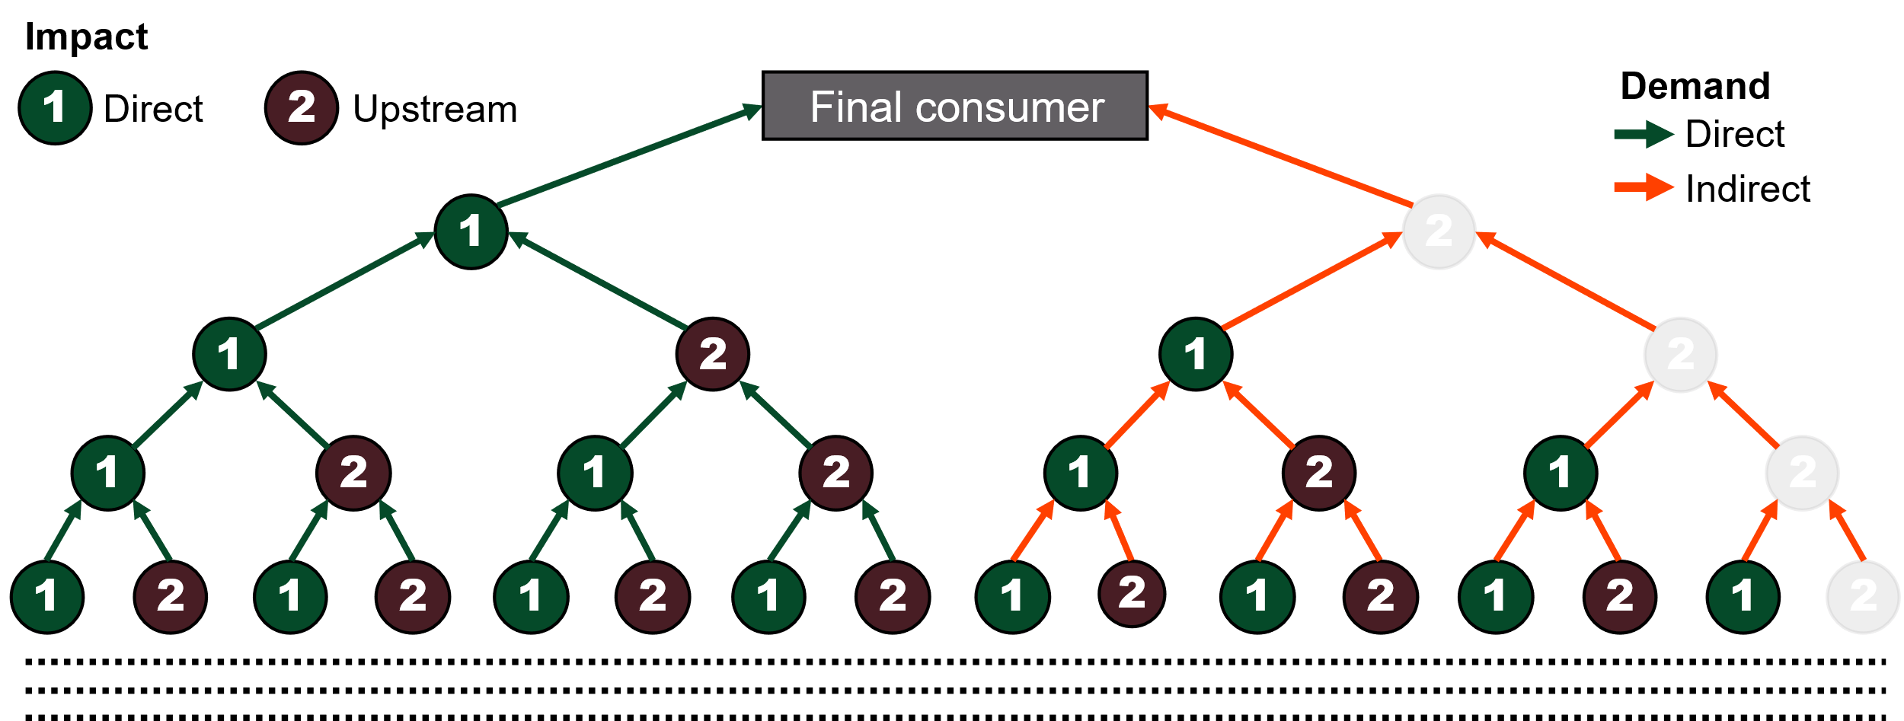
Hypothetical Extraction Method
Upstream impact of intermediate sector
=
Impact of whole economy
—
Impact of hypothetical extracted economy
$$x^{o}=Ly−L^{∗}y^{∗}$$
$$D_{HEM}=SLy−S^{∗}L^{∗}y^{∗}$$
$$A^{∗}=\left(\begin{matrix}0 & 0 \\ 0 & A_{22}\end{matrix}\right)$$
$$y^{∗}=\left(\begin{matrix}y_{1} \\ y_{2}\end{matrix}\right)$$
$$L^{∗}={\left(\begin{matrix}I & 0 \\ 0 & 1−A_{22}\end{matrix}\right)}^{−1}$$
Notes:
From the HEM we can estimate the direct and upstream impact of a sector.
The diagram shows the parts included in the impacts calculated.

Slide 32
Decomposing HEM
Notes:
The HEM expression can be decomposed to provide further details.

Slide 33
Decomposing HEM
$$D_{HEM}=SLy−S^{∗}L^{∗}y^{∗}$$
Notes:
Starting from the expression we had before.

Slide 34
Decomposing HEM
$$D_{HEM}=S\left(\begin{matrix}H \\ L_{22}A_{21}H\end{matrix}\right)⨂\left(\begin{matrix}y_{1} \\ A_{12}L_{22}y_{2}\end{matrix}\right)$$
$$D_{HEM}=SLy−S^{∗}L^{∗}y^{∗}$$
Notes:
One can decompose it into the following terms.
Where the $⨂$ symbol indicates outer product.

Slide 35
Decomposing HEM
$$H={\left(I−A_{11}−A_{12}L_{22}A_{21}\right)}^{−1}$$
$$L_{22}={\left(I−A_{22}\right)}^{−1}$$
$$D_{HEM}=S\left(\begin{matrix}H \\ L_{22}A_{21}H\end{matrix}\right)⨂\left(\begin{matrix}y_{1} \\ A_{12}L_{22}y_{2}\end{matrix}\right)$$
$$D_{HEM}=SLy−S^{∗}L^{∗}y^{∗}$$
Notes:
For completeness, the terms H and L22 are defined as follows. Although it is not really important.
The decomposed version shows the different parts of the tree

Slide 36
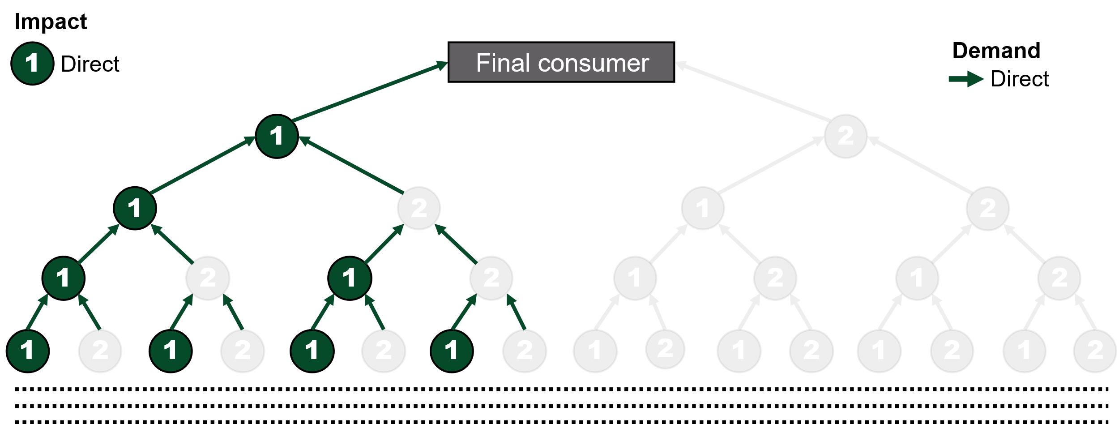
Decomposing HEM
$$H={\left(I−A_{11}−A_{12}L_{22}A_{21}\right)}^{−1}$$
$$L_{22}={\left(I−A_{22}\right)}^{−1}$$
$$D_{HEM}=S\left(\begin{matrix}H \\ L_{22}A_{21}H\end{matrix}\right)⨂\left(\begin{matrix}y_{1} \\ A_{12}L_{22}y_{2}\end{matrix}\right)$$
$$D_{HEM}=SLy−S^{∗}L^{∗}y^{∗}$$
$$D_{direct,direct}=Hy_{1}$$

Slide 37
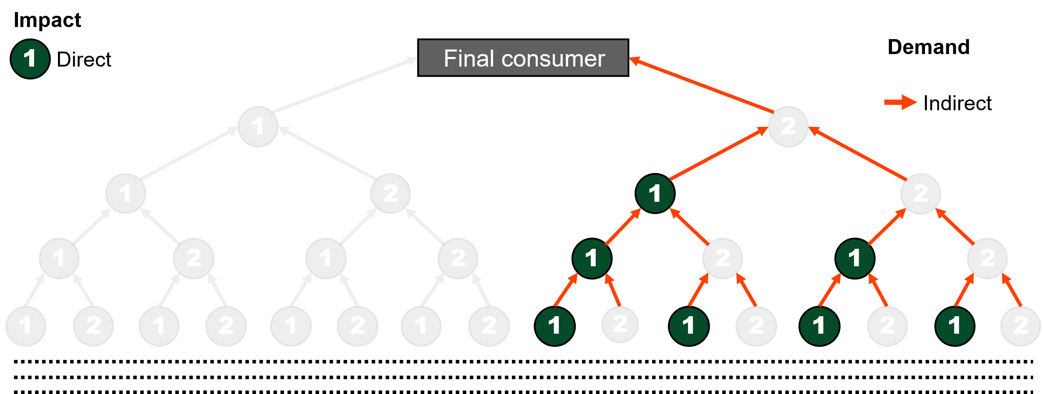
Decomposing HEM
$$H={\left(I−A_{11}−A_{12}L_{22}A_{21}\right)}^{−1}$$
$$L_{22}={\left(I−A_{22}\right)}^{−1}$$
$$D_{HEM}=S\left(\begin{matrix}H \\ L_{22}A_{21}H\end{matrix}\right)⨂\left(\begin{matrix}y_{1} \\ A_{12}L_{22}y_{2}\end{matrix}\right)$$
$$D_{HEM}=SLy−S^{∗}L^{∗}y^{∗}$$
$$D_{direct,direct}=Hy_{1}$$
$$D_{direct,indirect} =HA_{12}L_{22}y_{2}$$

Slide 38
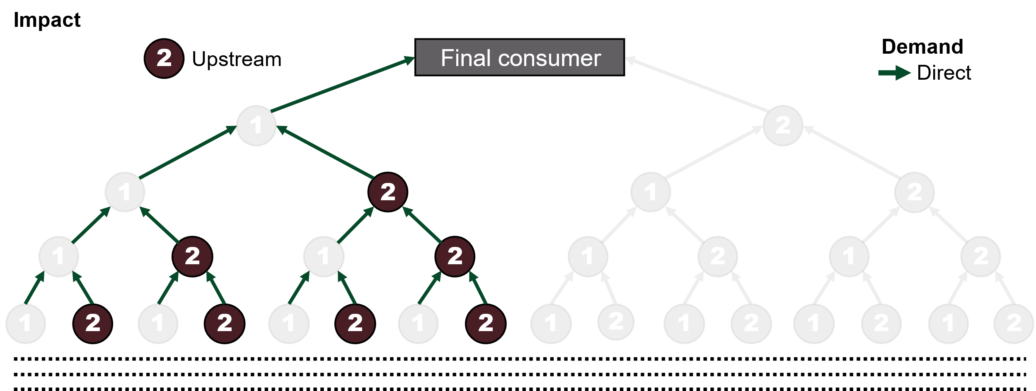
Decomposing HEM
$$H={\left(I−A_{11}−A_{12}L_{22}A_{21}\right)}^{−1}$$
$$L_{22}={\left(I−A_{22}\right)}^{−1}$$
$$D_{HEM}=S\left(\begin{matrix}H \\ L_{22}A_{21}H\end{matrix}\right)⨂\left(\begin{matrix}y_{1} \\ A_{12}L_{22}y_{2}\end{matrix}\right)$$
$$D_{HEM}=SLy−S^{∗}L^{∗}y^{∗}$$
$$D_{direct,direct}=Hy_{1}$$
$$D_{direct,indirect} =HA_{12}L_{22}y_{2}$$
$$D_{upstream,direct}=L_{22}A_{21}Hy_{1}$$

Slide 39
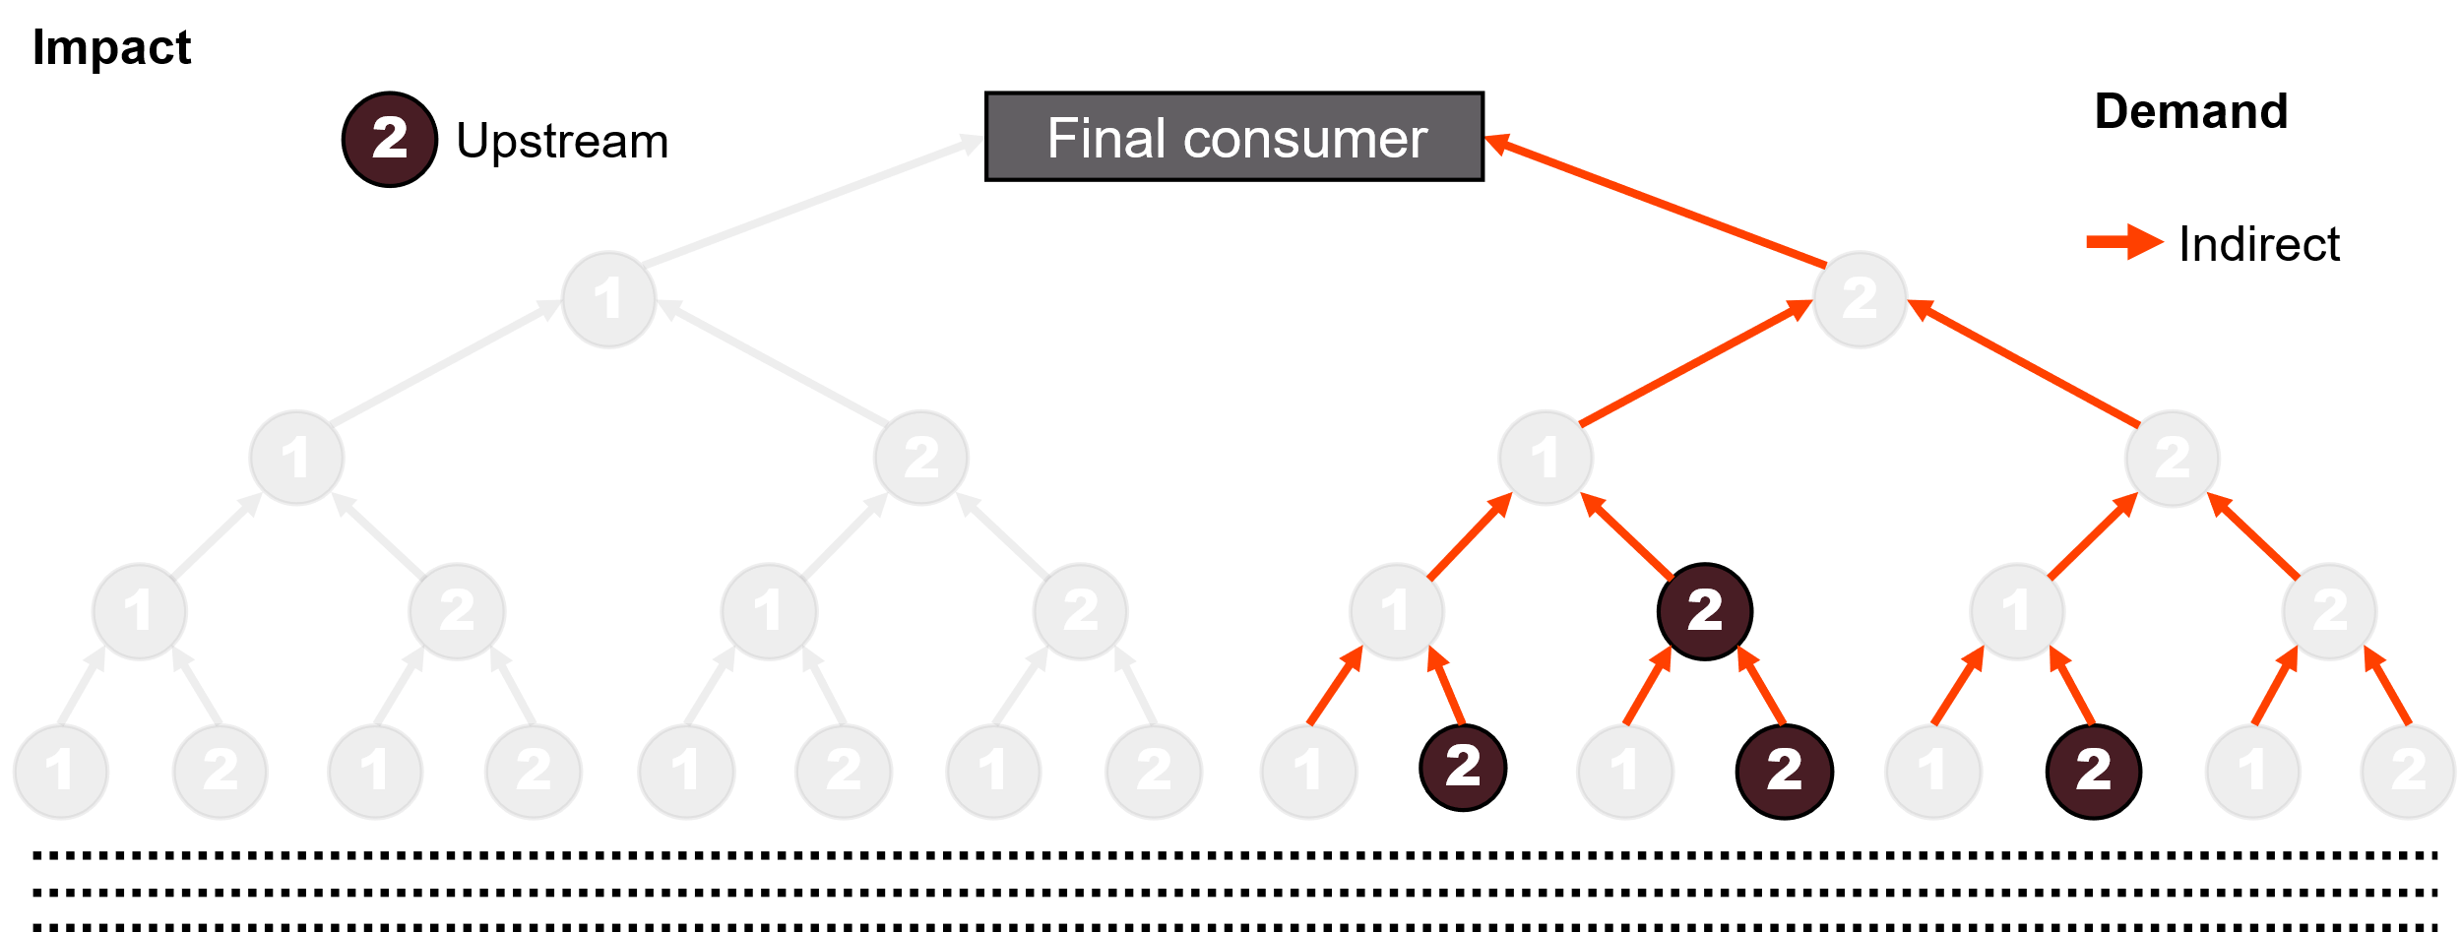
Decomposing HEM
$$H={\left(I−A_{11}−A_{12}L_{22}A_{21}\right)}^{−1}$$
$$L_{22}={\left(I−A_{22}\right)}^{−1}$$
$$D_{HEM}=S\left(\begin{matrix}H \\ L_{22}A_{21}H\end{matrix}\right)⨂\left(\begin{matrix}y_{1} \\ A_{12}L_{22}y_{2}\end{matrix}\right)$$
$$D_{HEM}=SLy−S^{∗}L^{∗}y^{∗}$$
$$D_{direct,direct}=Hy_{1}$$
$$D_{direct,indirect} =HA_{12}L_{22}y_{2}$$
$$D_{upstream,direct}=L_{22}A_{21}Hy_{1}$$
$$D_{upstream,indirect}=L_{22}A_{21}HA_{12}L_{22}y_{2}$$

Slide 40
Decomposing HEM
$$H={\left(I−A_{11}−A_{12}L_{22}A_{21}\right)}^{−1}$$
$$L_{22}={\left(I−A_{22}\right)}^{−1}$$
$$D_{HEM}=S\left(\begin{matrix}H \\ L_{22}A_{21}H\end{matrix}\right)⨂\left(\begin{matrix}y_{1} \\ A_{12}L_{22}y_{2}\end{matrix}\right)$$
$$D_{HEM}=SLy−S^{∗}L^{∗}y^{∗}$$
$$D_{direct,direct}=Hy_{1}$$
$$D_{direct,indirect} =HA_{12}L_{22}y_{2}$$
$$D_{upstream,direct}=L_{22}A_{21}Hy_{1}$$
$$D_{upstream,indirect}=L_{22}A_{21}HA_{12}L_{22}y_{2}$$

Slide 41
What are we missing?

Slide 42
What are we missing?
Impact
1
2
Final consumer
Demand
Direct
Upstream
Direct
2
Indirect
Downstream
1
2
1
2
1
2
1
2
1
2
1
2
1
2
1
2
1
2
1
2
1
2
1
2
1
2
1
2
1
2
Notes:
Here’s the full economy again.
It should be clear, that we are missing the downstream impacts.

Slide 43
What are we missing?
Impact
1
2
Final consumer
Demand
Direct
Upstream
Direct
2
Indirect
Downstream
1
2
1
2
1
2
1
2
1
2
1
2
1
2
1
2
1
2
1
2
1
2
1
2
1
2
1
2
1
2
Notes:
All other parts of the tree was covered with the previous HEM expression.
How do we get an expression for the impacts in that part of the tree?

Slide 44
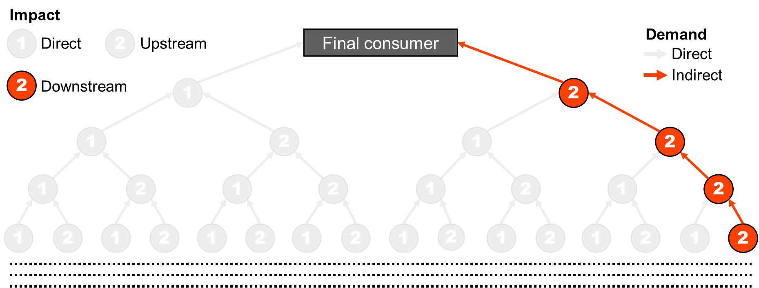
What are we missing?
$$D_{HEM}=S\left(\begin{matrix}H \\ L_{22}A_{21}H\end{matrix}\right)⨂\left(\begin{matrix}y_{1} \\ A_{12}L_{22}y_{2}\end{matrix}\right)$$
Notes:
- Going back and analysing the expression we had before.

Slide 45
What are we missing?
$$D_{HEM}=S\left(\begin{matrix}H \\ L_{22}A_{21}H\end{matrix}\right)⨂\left(\begin{matrix}y_{1} \\ A_{12}L_{22}y_{2}\end{matrix}\right)$$
$$All potential downstream activities=L_{22}y_{2}$$
$$L_{22}={\left(I−A_{22}\right)}^{−1}$$
Notes:
It is clear from the expression, that part of the tree we are missing is determined by the shown expression.
However, it would not make sense, to have sector 1 be responsible for all impacts occurring in sector 2.
Instead, it should only be responsible for a share of it.
Adopting the same allocation principle as with upstream impacts, the most natural choice would be the A matrix.

Slide 46
What are we missing?
$$D_{HEM}=S\left(\begin{matrix}H \\ L_{22}A_{21}H\end{matrix}\right)⨂\left(\begin{matrix}y_{1} \\ A_{12}L_{22}y_{2}\end{matrix}\right)$$
$$All potential downstream activities=L_{22}y_{2}$$
$$L_{22}={\left(I−A_{22}\right)}^{−1}$$
$$Downstream activties of sector 1=A_{12}L_{22}y_{2}$$
Notes:
In the paper, we will discuss other alternatives and their implications.
However, this gives us only the downstream activities of Sector 1.

Slide 47
What are we missing?
$$D_{HEM}=S\left(\begin{matrix}H \\ L_{22}A_{21}H\end{matrix}\right)⨂\left(\begin{matrix}y_{1} \\ A_{12}L_{22}y_{2}\end{matrix}\right)$$
$$All potential downstream activities=L_{22}y_{2}$$
$$L_{22}={\left(I−A_{22}\right)}^{−1}$$
$$Downstream activties of sector 1=A_{12}L_{22}y_{2}$$
$$Downstream impacts of sector 1=A_{12}\left(s_{2}⨀L_{22}y_{2}\right)$$
Notes:
To get the downstream impacts, we need to convert these into impacts using the impact intensity vectors.
The conversion must occur before we allocate the impact to the extracted sector(s).
Hence $⨀$ symbol is a element wise multiplication.

Slide 48
Downstream impacts
Notes:
- As with regular upstream impacts calculated with the Leontief multiplier, the term can be adjusted to show the results by different dimensions.

Slide 49
Downstream impacts
$$D_{downstream}^{final demand}=A_{12}\left(s_{2}⨀L_{22}y_{2}\right)$$

Slide 50
Downstream impacts
$$D_{downstream}^{final demand}=A_{12}\left(s_{2}⨀L_{22}y_{2}\right)$$
$$D_{downstream}^{final product}=A_{12}\left(s_{2}⨀L_{22}\hat{y_{2}}\right)$$

Slide 51
Downstream impacts
$$D_{downstream}^{final demand}=A_{12}\left(s_{2}⨀L_{22}y_{2}\right)$$
$$D_{downstream}^{final product}=A_{12}\left(s_{2}⨀L_{22}\hat{y_{2}}\right)$$
$$D_{downstream}^{first product}=A_{12}\left(s_{2}⨀\hat{{L_{22}y}_{2}}\right)$$

Slide 52
Downstream impacts
$$D_{downstream}^{final demand}=A_{12}\left(s_{2}⨀L_{22}y_{2}\right)$$
$$D_{downstream}^{final product}=A_{12}\left(s_{2}⨀L_{22}\hat{y_{2}}\right)$$
$$D_{downstream}^{first product}=A_{12}\left(s_{2}⨀\hat{{L_{22}y}_{2}}\right)$$
$$D_{downstream}^{multiple impacts}=A_{12}\left(S_{2}\hat{{L_{22}y}_{2}}\right)$$

Slide 53
What can we use it for?
Notes:
What can we actually use it for?

Slide 54
Complementary up- and downstream multipliers

Slide 55
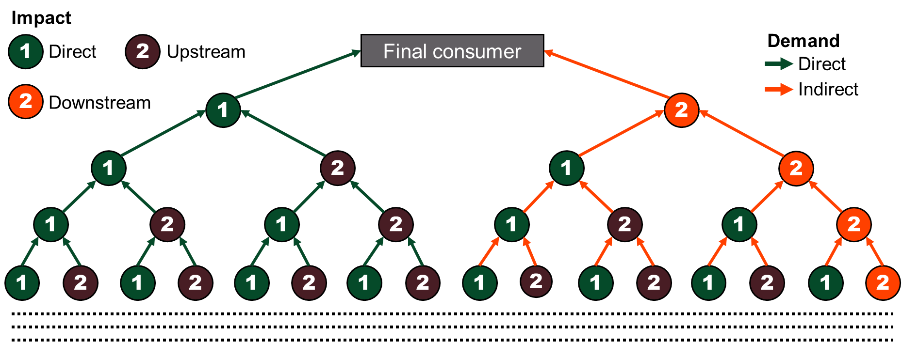
Complementary up- and downstream multipliers

Slide 56
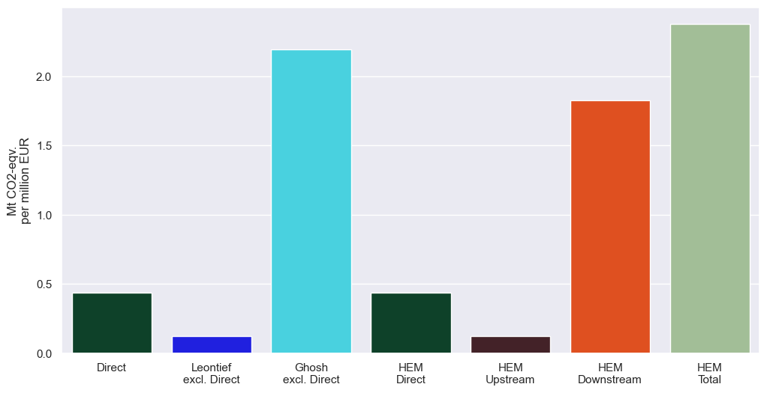
Complementary up- and downstream multipliers
Notes:
- Here we show the CO2 emission multipliers from a specific Norwegian oil and gas sector from EXIOBASE

Slide 57
Complementary up- and downstream multipliers
Notes:
- The direct multiplier is the emission intensity of the production.

Slide 58
Complementary up- and downstream multipliers
Notes:
The sector has very limited upstream CO2 emissions.
I.e., it does not rely on emission intensive goods and services to operate.

Slide 59
Complementary up- and downstream multipliers
Notes:
However, its Ghosh multiplier is significantly larger.
I.e., it share of value-added (income) is large compared to the sectors it sells to.

Slide 60
Complementary up- and downstream multipliers
Notes:
The HEM multiplier for a single sector will always be equal to its direct multiplier.
For a set of sectors, it would be the weighted average direct multiplier.

Slide 61
Complementary up- and downstream multipliers
Notes:
The HEM upstream multiplier for a single sector is always slightly smaller than the Leontief multiplier.
The reason for that is due to self-trade within the extracted sector.

Slide 62
Complementary up- and downstream multipliers
Notes:
The HEM downstream multiplier is significantly for this sector is significantly larger than its upstream sector.
It is expected for a primary sector, which deliver emission intensive goods (natural gas) to other sectors that combust it.

Slide 63
Complementary up- and downstream multipliers
Notes:
However, the most crucial thing is, that the HEM multipliers can be aggregated.
While the Ghosh and Leontief multiplier can not without double counting.
This allows us to make complementary direct, upstream, and downstream spend-based impact factors for all sectors in the input-output model.
This is particularly useful for corporate environmental impact reporting.

Slide 64
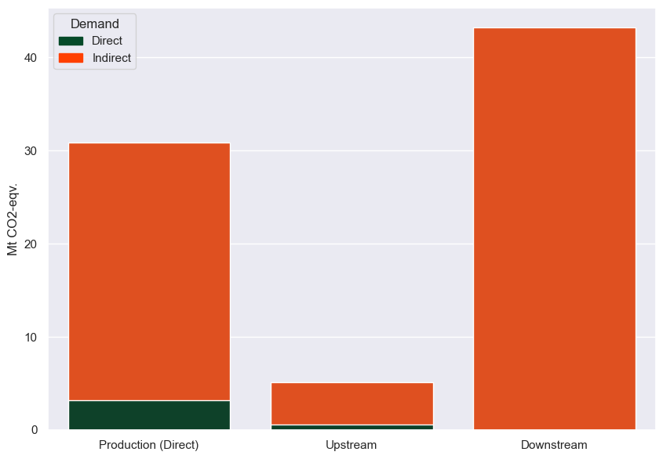
Norwegian Oil & Gas Sectors
Notes:
Instead of just extracting a single sector, we can extract a set of related sectors to analyse their role.
Here we have extracted all Norwegian oil and gas sectors.
Oil and gas sectors are of particular interest, as majority of their emissions occur after they have sold their products.
The Leontief demand model will not pick that up.
While the Ghosh model might pick it up, but only if their value-added share is relatively high.
Using the HEM approach, the downstream impacts are clearly dominating.
Neglecting these would severely underestimate their environmental impacts as part of the global economy.

Slide 65
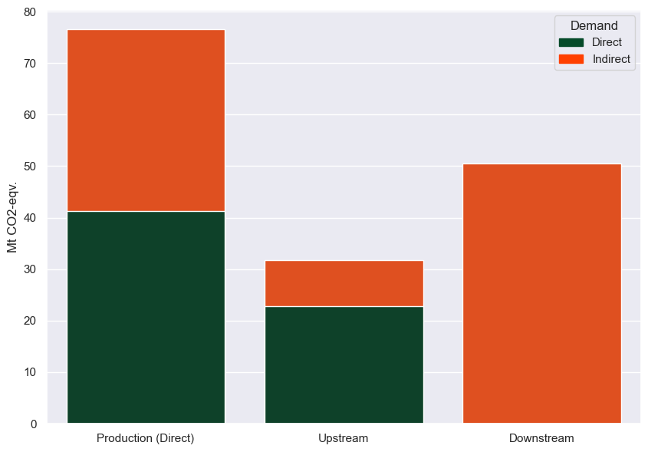
Norwegian Economy
Notes:
Here we have extracted the full Norwegian Economy and calculated their emissions accounts.
It provides us estimated for the imports and exports of the Norwegian economy.
And whether the production occurs to satisfy direct demand on Norwegian goods and services, or due to demand on goods and services enabled by the Norwegian economy.

Slide 66
Coupling with National Accounts
Notes:
The impact accounts calculated with the HEM, can be used to easily couple MRIOs to National Accounts.
A major critique of global MRIOs is that they are rarely in agreement with national statistics.
Especially not for small trade-exposed economies.

Slide 67
Coupling with National Accounts
Notes:
In the corner we have emissions accounts of the Norwegian economy as calculated by the HEM.

Slide 68
Coupling with National Accounts
National Accounts

Slide 69
Coupling with National Accounts
National Accounts
Import Statistics
Export
Statistics
National Impact Account

Slide 70
Coupling with National Accounts
National Accounts
Import Statistics
Complete Impact Accounts
Export
Statistics
National Impact Account

Slide 71
Coupling with National Accounts
National Accounts
Import Statistics
Complete Impact Accounts
Export
Statistics
HEM Upstream Impact Multiplier
National Impact Account
*HEM multipliers calculated for the whole national economy decomposed by extracted sector

Slide 72
Coupling with National Accounts
National Accounts
Import Statistics
Complete Impact Accounts
Export
Statistics
HEM Upstream Impact Multiplier
HEM Downstream Impact Multiplier
National Impact Account
*HEM multipliers calculated for the whole national economy decomposed by extracted sector

Slide 73
Questions?
Contact
Kajwan@xio-sa.com
Kajwan.Rasul@ntnu.no

Slide 74
Impact
1
2
Final consumer
Demand
Direct
Upstream
Direct
Indirect
1
2
1
2
1
2
1
2
1
2
1
2
1
2
1
2
1
2
1
2
1
2
1
2
1
2
1
2
1
2

Slide 75
Impact
1
Direct
Final consumer
Demand
Direct
1
2
1
2
1
2
1
2
1
2
1
2
1
2
1
2
1
2
1
2
1
2
1
2
1
2
1
2
1
2

Slide 76
Impact
1
Direct
Final consumer
Demand
Indirect
1
2
1
2
1
2
1
2
1
2
1
2
1
2
1
2
1
2
1
2
1
2
1
2
1
2
1
2
1
2

Slide 77
Impact
2
Upstream
Final consumer
Demand
Direct
1
2
1
2
1
2
1
2
1
2
1
2
1
2
1
2
1
2
1
2
1
2
1
2
1
2
1
2
1
2

Slide 78
Impact
2
Upstream
Final consumer
Demand
Indirect
1
2
1
2
1
2
1
2
1
2
1
2
1
2
1
2
1
2
1
2
1
2
1
2
1
2
1
2
1
2

