Slide 1



Shielding supply chains from weather-induced power failures
by Pengfei Yuan, Daoping Wang, Jiashuo Li
King’s College London | Shandong University
24/06
Notes:
Good morning everyone. My name is Pengfei Yuan, from King’s College London and Shandong University. Today I will present our work on shielding supply chains from weather-induced power failures.

Slide 2

Self-Introduction
Pengfei Yuan
Shandong University
Email: pengfei.yuan1@outlook.com
Education
2022-2026, Institute of Blue and Green Development, Shandong University, PHD
2022-2026, Department of Geography, King’s College London, visiting PHD
Research Experience
First-author papers were published in One Earth and Global Environmental Change, presentations at major international conferences such as IIOA and UKADR, selection among One Earth’s 2025 Top 10 Research Highlights, and the Best Poster Award at the inaugural USS Conference.
Research
Interests
Climate-Energy-Economic nexus modelling;
Energy transiton risk management
Notes:
Before moving to the study, I would like to briefly introduce my background. My research focuses on climate–energy–economic nexus modelling and energy-transition risk management. I work on how climate-related shocks affect energy infrastructure, economic systems and supply chains. This project builds on that background by linking power outage data, climate projections and supply-chain cascade modelling.

Slide 3
Part 1. Motivation

Slide 4
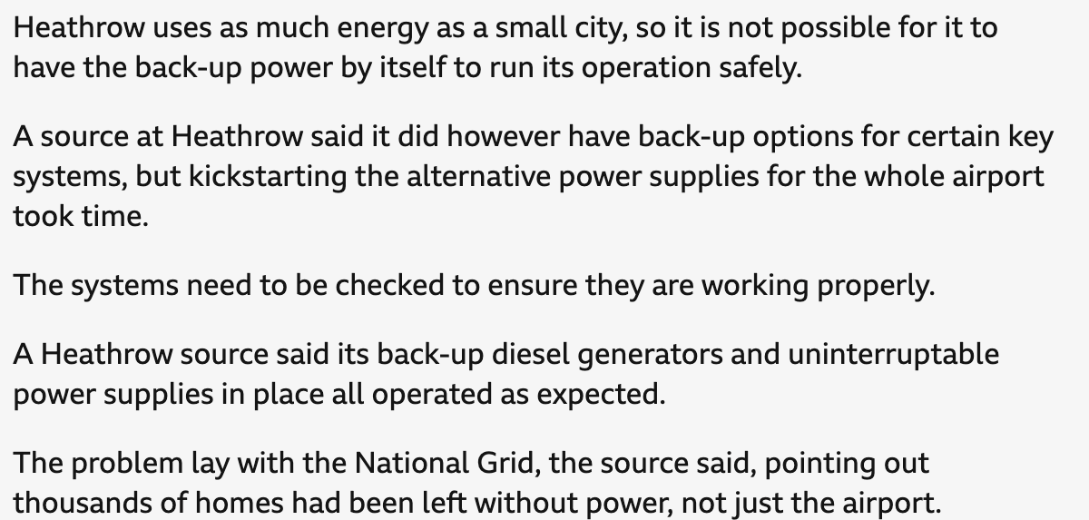
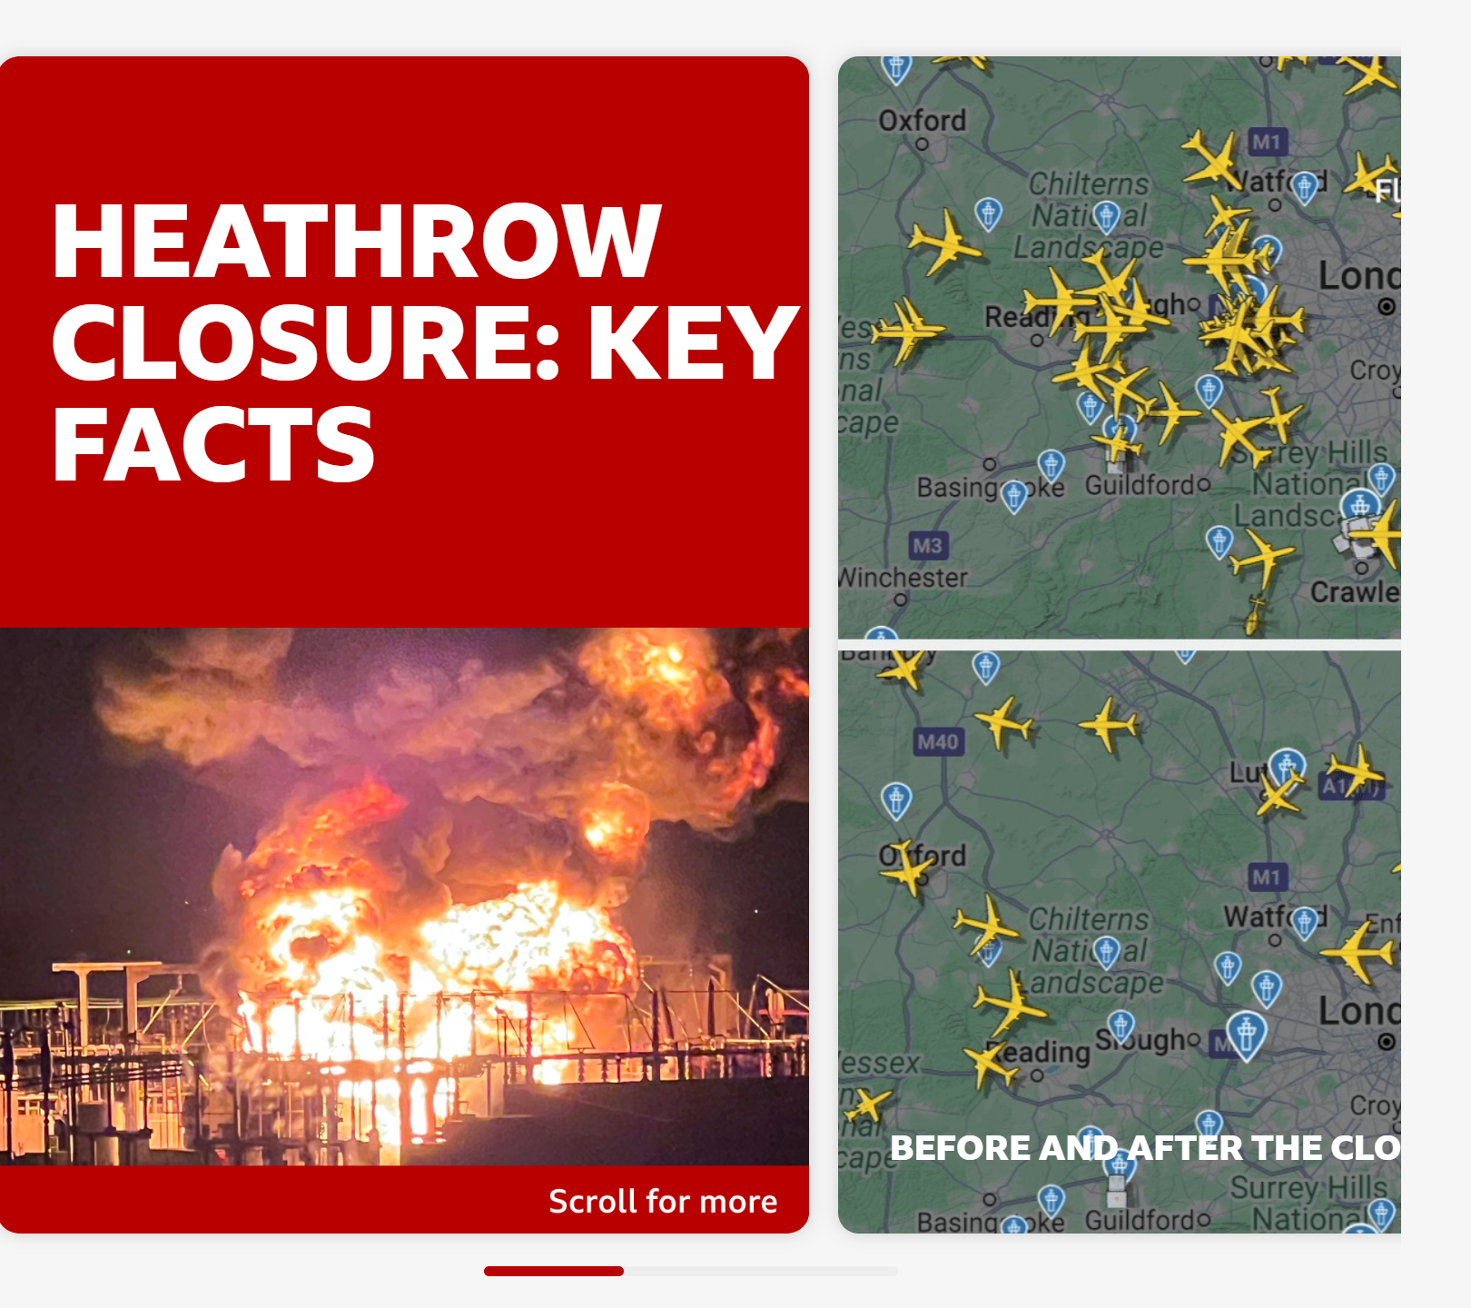

Opening case：Heathrow
How can a local power failure disrupt a national transport hub?
Heathrow Airport was closed for one day after a nearby substation fire caused an unprecedented power loss.
Around 200,000 passengers were affected
Notes:
I start with a recent and intuitive example. How can a single local power failure disrupt one of Europe’s busiest transport hubs? In this case, Heathrow Airport was closed for one day after a nearby substation fire caused an unprecedented loss of power. Around 200,000 passengers were affected. This motivates a broader question: how do local power failures become wider economic shocks?

Slide 5










CASCADE MECHANISM
From Local Power Failure to Global Supply-Chain Shock
Weather-induced outages can propagate far beyond the failed asset through critical services, modern logistics, and interregional production networks.
Substation Failure
Logistics Disruption
Delayed Deliveries
Production Loss
Systemic Spillover
Initial regional power grid blackout
Critical hub systems offline & cargo grounded
Raw materials & sub-assemblies arrive late
Downstream factory lines forced to halt or limit output
Financial and inventory losses diffuse globally
Strategic Takeaway: The key risk is not only who loses power locally, but who bears the wider economic disruption across the global network.
Notes:
This slide summarises the core cascade mechanism. A substation failure first causes a local outage. If that outage affects an airport, logistics hub or production facility, critical services may be interrupted. Deliveries can then be delayed, inputs may arrive late, and downstream factories may reduce or halt production. Eventually, losses spread through supply-chain networks. The key risk is therefore not only who loses power locally, but who bears the wider economic disruption.

Slide 6


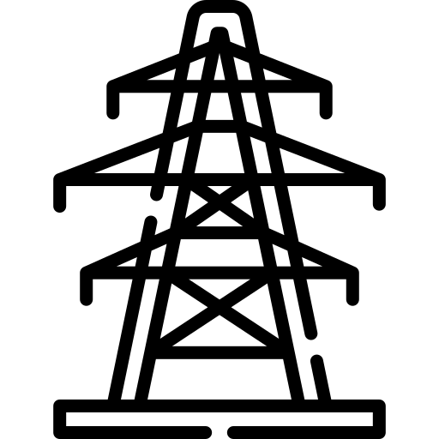


Climate change increases outage-relevant weather risks
Summer vs. Winter
For the same wind speed, outage probability is 3-4x higher in summer due to leaf cover.
Wind gale
Extreme heat
Wet vs. Dry
Outage probability is 2-3X higher in wet conditions due to vulnerable tree roots.
The compounding effects
When all conditions align, the risk of power outages can increase 4-5 fold.
Antecedent
Rainfall
Seasonality
As climate change alters storm seasonality and increases heavy rainfall, these compounding effects are becoming the norm, not the exception.
Source: Colin et al, 2025
Notes:
Weather-induced outages are shaped by compound environmental conditions. For the same wind speed, outage risk can differ substantially across seasons because of vegetation conditions. Wet antecedent conditions can also increase vulnerability by weakening tree roots and surrounding soils. When wind, rainfall and seasonality coincide, the risk of outages can rise sharply. This matters because climate change can alter storm seasonality, heavy rainfall and extreme-weather exposure.

Slide 7
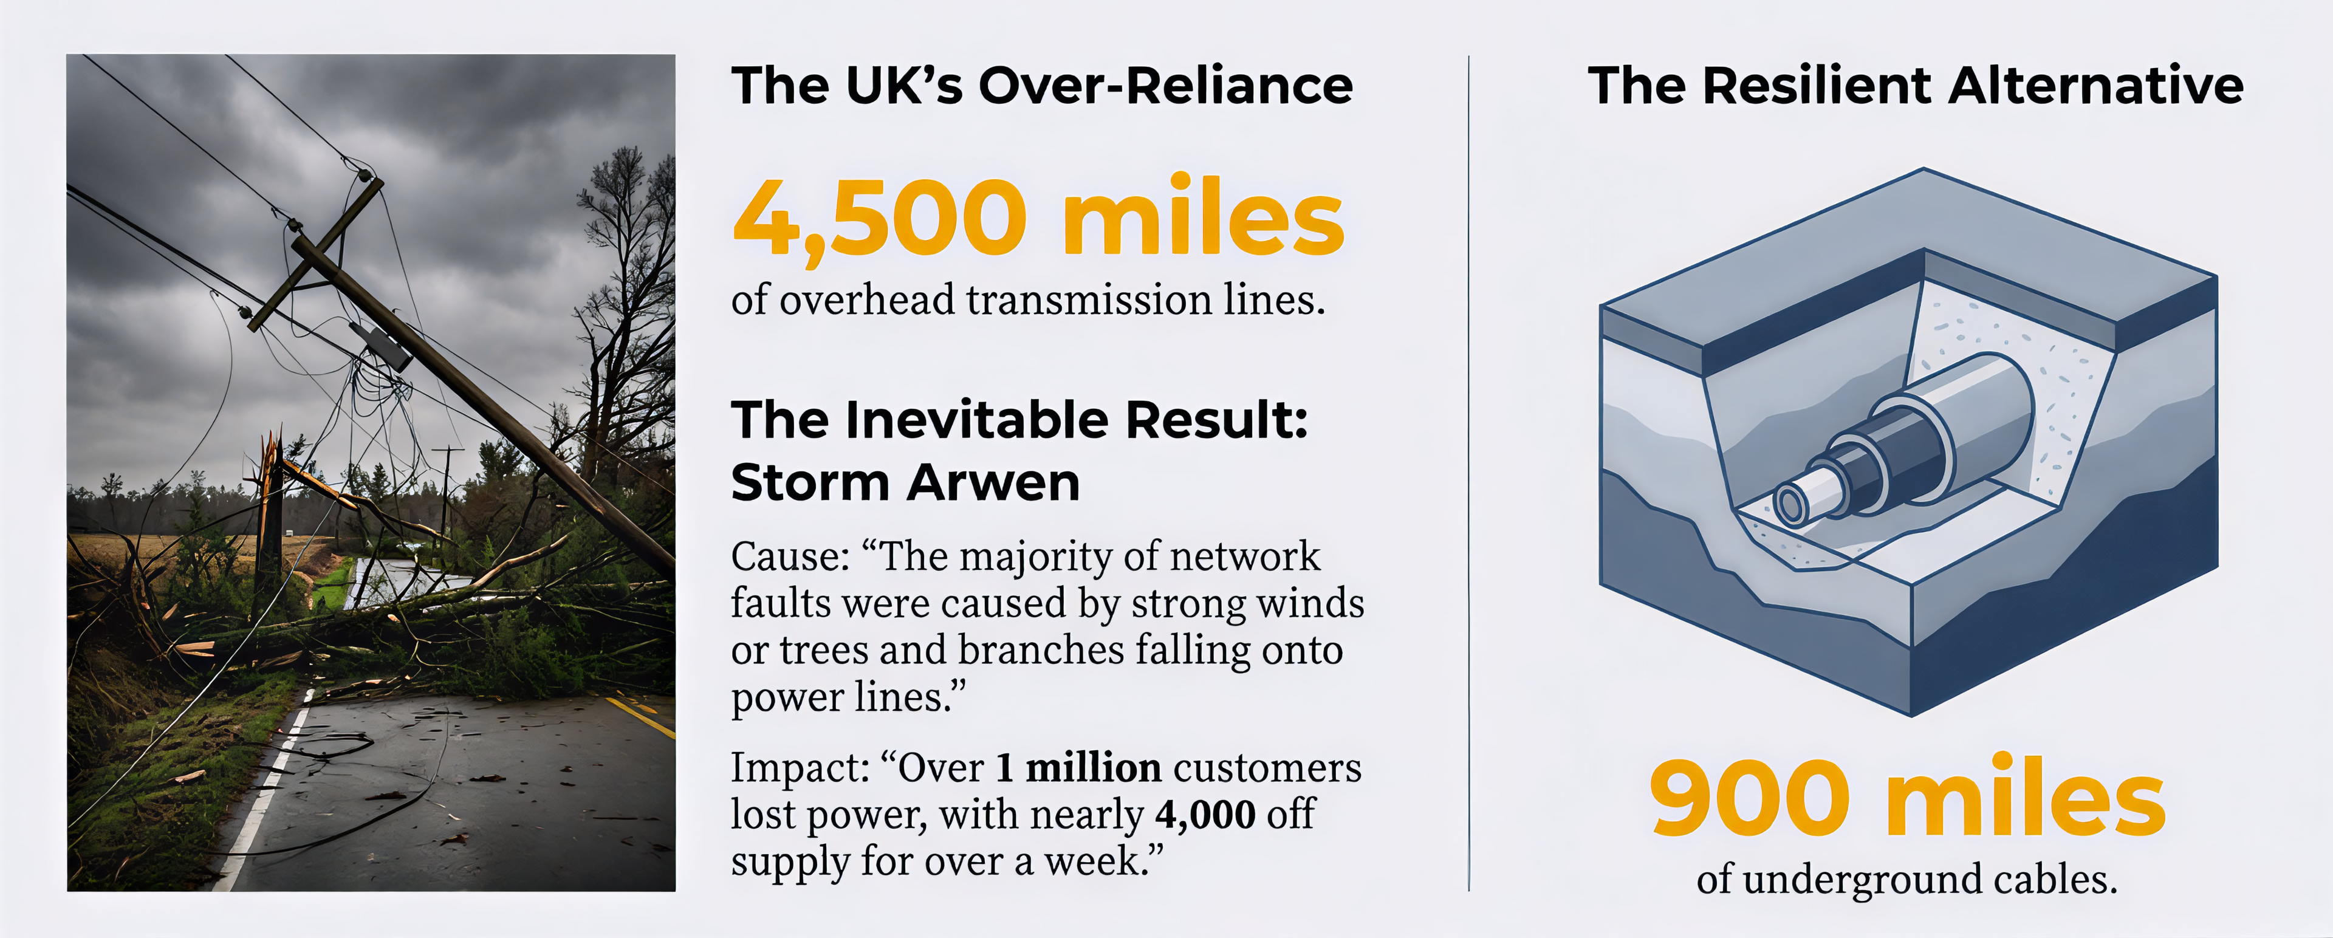
UK networks are exposed to weather-induced failures
Source: Nation Grid
Notes:
The UK is a useful case because its distribution networks remain exposed to weather-induced failures. Overhead lines, vegetation exposure and local network constraints make parts of the system vulnerable to storms and compound weather conditions. This does not mean that every region faces the same level of risk. Instead, it suggests that outage risk is spatially uneven and should be assessed at the infrastructure level.

Slide 8
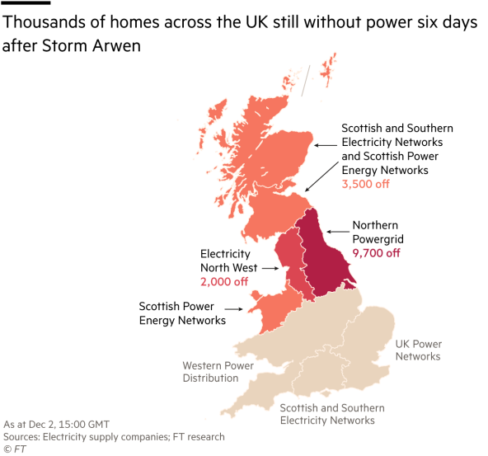
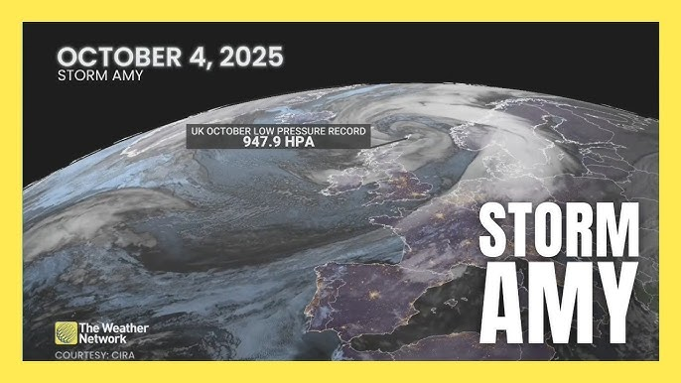
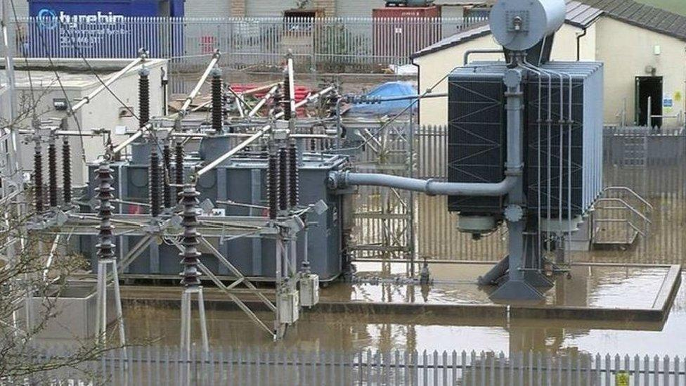
Recent storms reveal repeated disruption
30,000 customers are without power as a result of damage caused by Storm Amy
Reported by Energy Networks Association (ENA)
2021
2025
Notes:
Recent storms in the UK show that this is not only a future concern. Severe weather events have repeatedly caused customer interruptions and infrastructure damage. These events demonstrate that weather-induced outages remain a practical risk for energy networks, households and economic activities. They also highlight the need to understand not only where outages occur, but how their consequences spread.

Slide 9
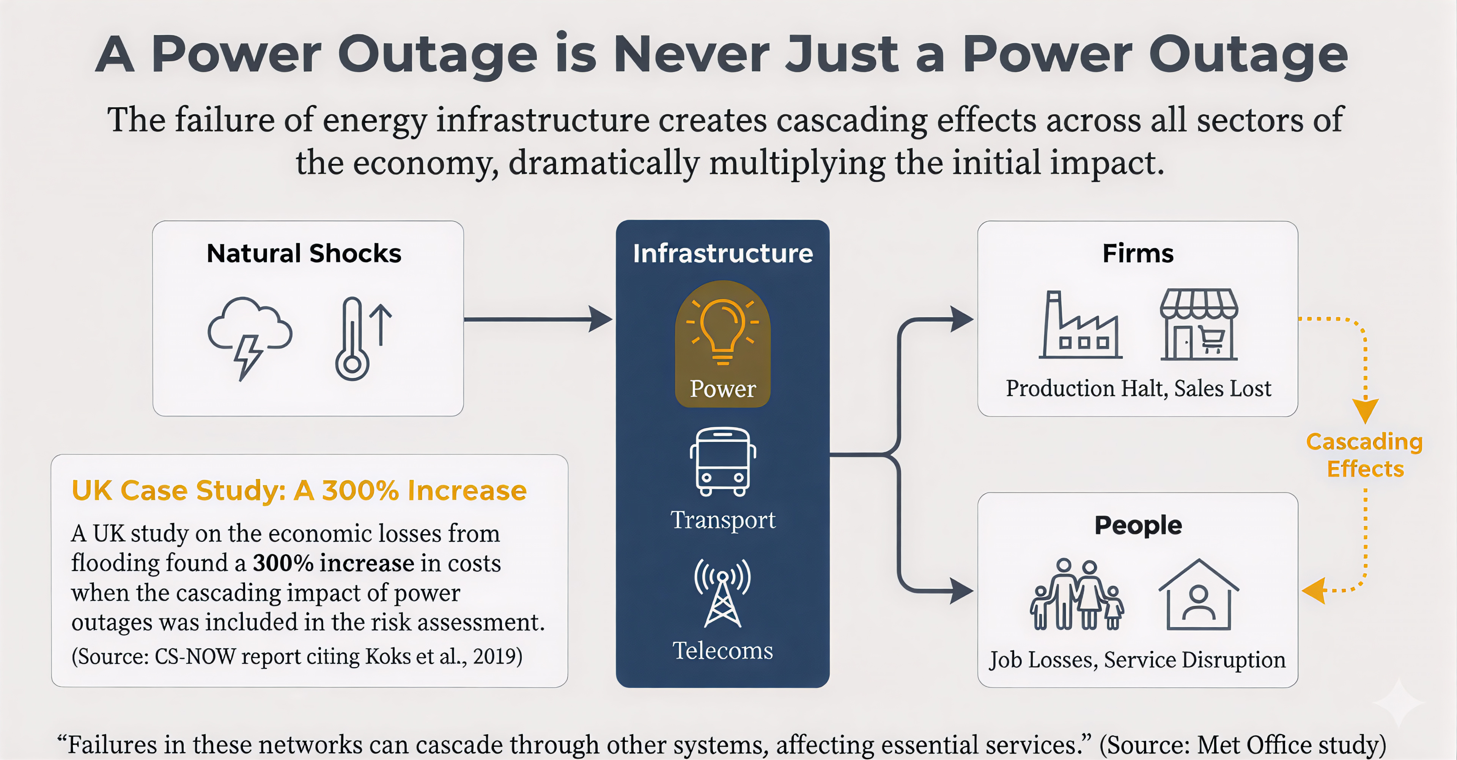
Notes:
This is where the topic becomes directly relevant to input–output and supply-chain analysis. A local electricity shortfall can constrain production in affected sectors. If those sectors supply inputs to other regions or industries, the initial shock can propagate through interregional production networks. Therefore, outage assessment requires more than estimating local electricity losses. It requires tracing how production constraints move through the economy.

Slide 10
Research questions
How will future climate extremes reshape weather-induced outage risk?
How do local outages propagate into cross-regional and cross-sectoral economic losses?
How can targeted resilience interventions reduce system-wide supply-chain disruption?
Notes:
This study addresses three questions. First, how will future climate extremes reshape weather-induced outage risk? Second, how do local outages propagate into cross-regional and cross-sectoral economic losses? Third, how can targeted resilience interventions reduce system-wide supply-chain disruption? These questions connect physical climate risk, electricity infrastructure and economic cascade modelling.

Slide 11
Part 2. Research gaps
Notes:
Three gaps motivate this work. The first is fragmented outage data. The second is limited modelling of cascading economic losses from electricity interruptions. The third is the lack of an integrated workflow that connects outage projection, economic impact assessment and resilience testing. Our framework is designed to address these three gaps together.

Slide 12
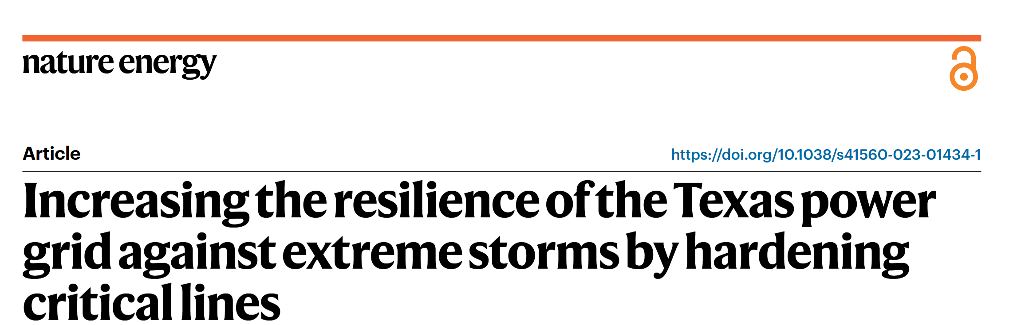
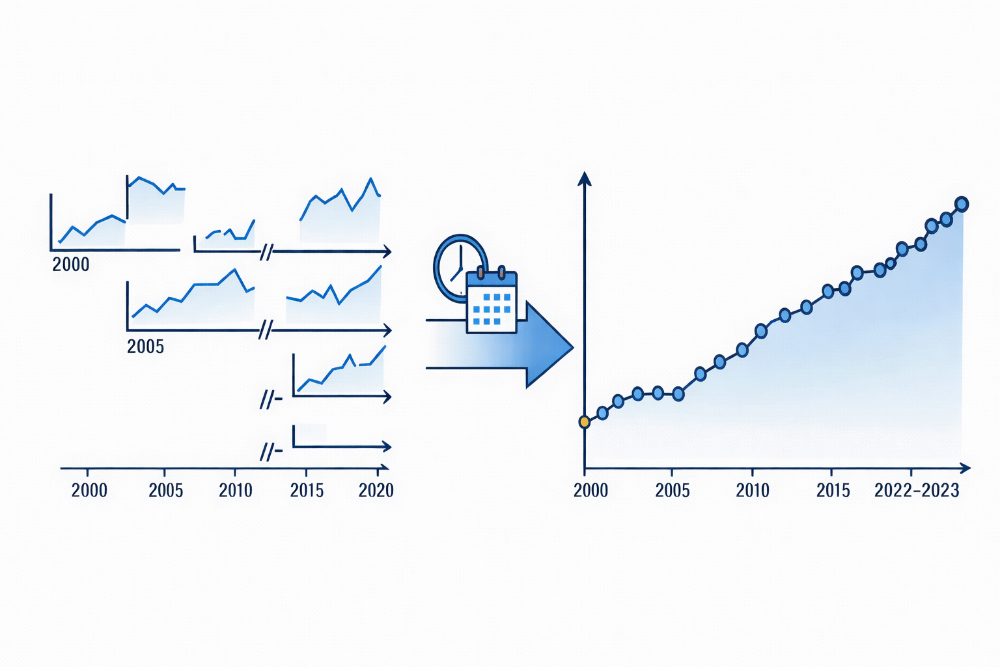
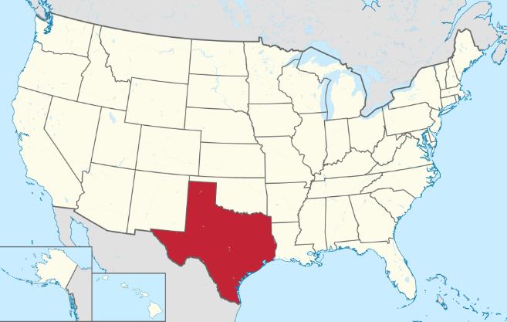
Research Gaps 1: fragmented outage data
Fragmented historical outage data
Time fragment
Only for selected regions
Lack key parameters
Frequency
Duration ?
Customer affected?
Outage Cause?
Missing future projections
Change
climate
Uncertainty of future weather-induced outage recognition
2000
2020
2050
Notes:
Historical outage records are often fragmented. They may cover only selected regions or time periods, and they often miss key parameters such as outage duration, affected customers and outage causes. More importantly, historical records alone cannot tell us how outage risk may change under future climate conditions. This creates uncertainty in future weather-induced outage recognition and projection.

Slide 13
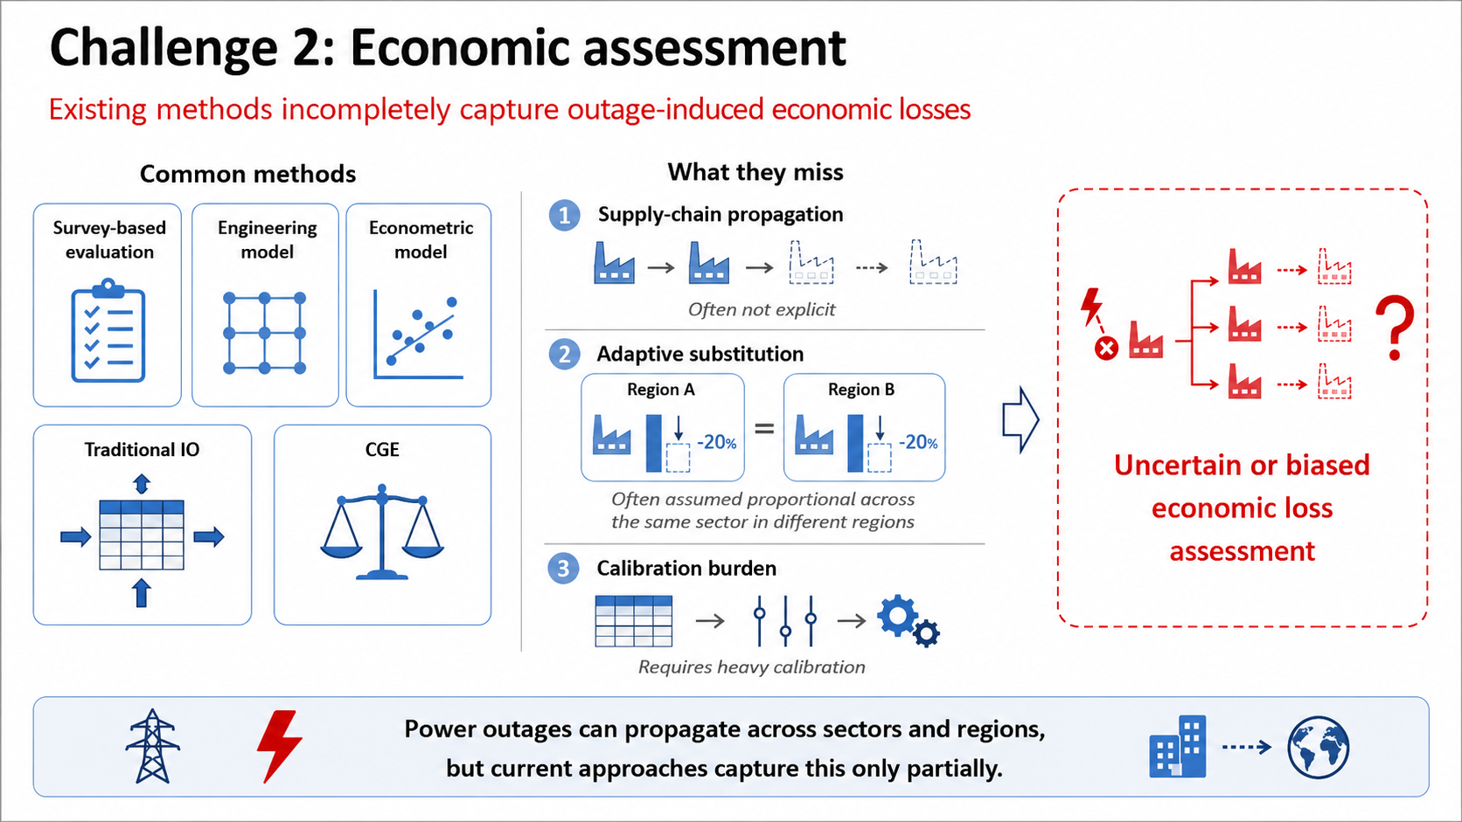
Gap2: economic impact assessment
Notes:
The second gap is economic assessment. Many approaches focus on direct local losses, such as the value of electricity not supplied or immediate production interruption. However, power outages can also create indirect losses through supply-chain linkages. These losses are difficult to capture because they depend on sectoral electricity dependence, inventory constraints, substitution possibilities and interregional trade relationships.

Slide 14
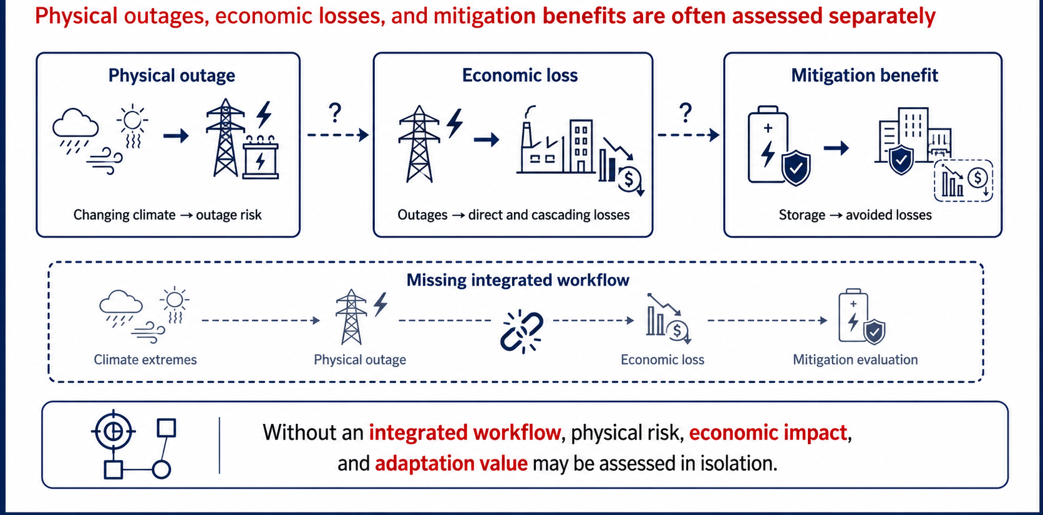
Gap 3: integrated workflow
Notes:
The third gap is workflow integration. Physical outage projection, economic-loss assessment and resilience evaluation are often analysed separately. This separation makes it difficult to ask where physical risk becomes economically important, or where an intervention would generate the greatest system-wide benefit. We therefore need an integrated framework that links physical outage risk to economic propagation and resilience testing.

Slide 15
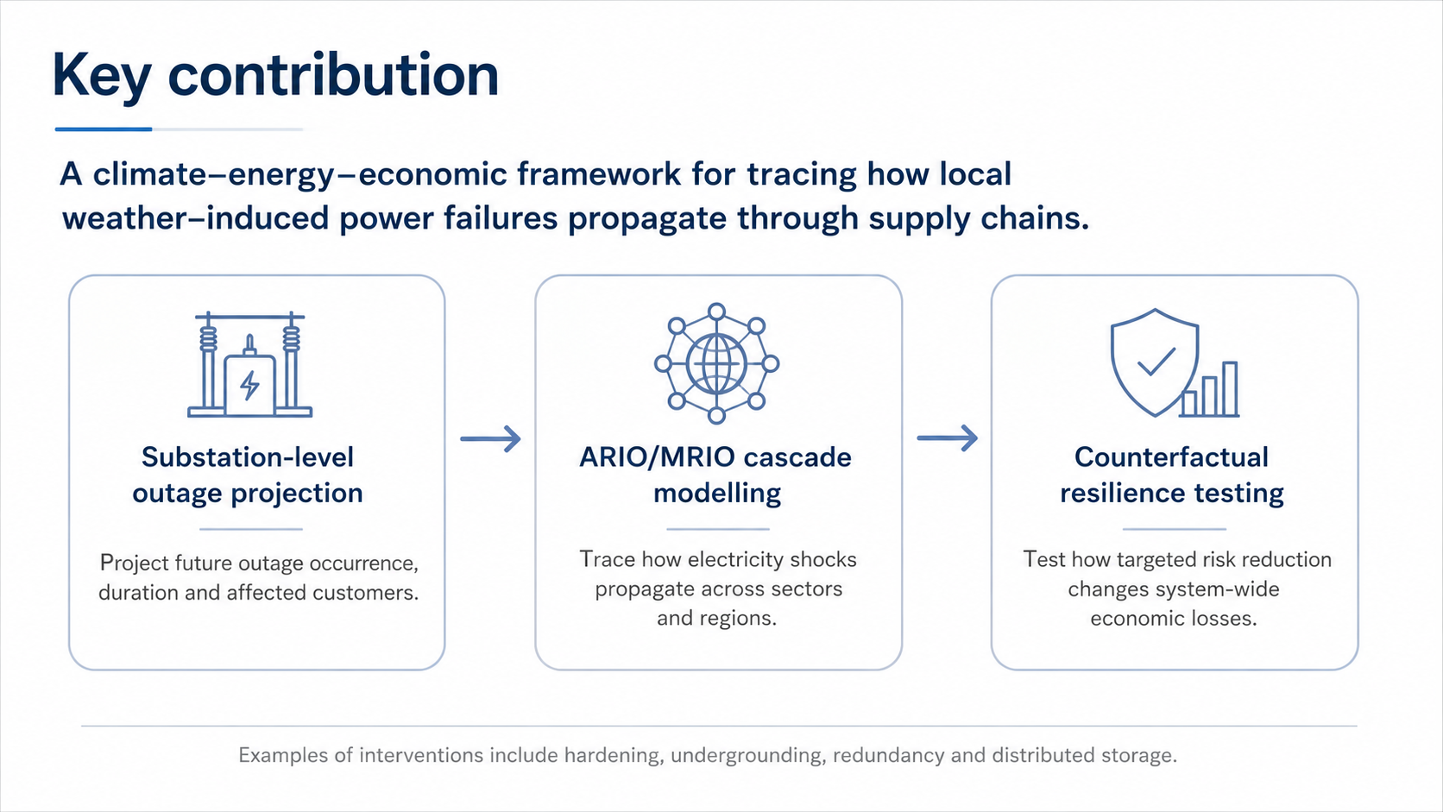

Slide 16
Part 3. Data and model

Slide 17
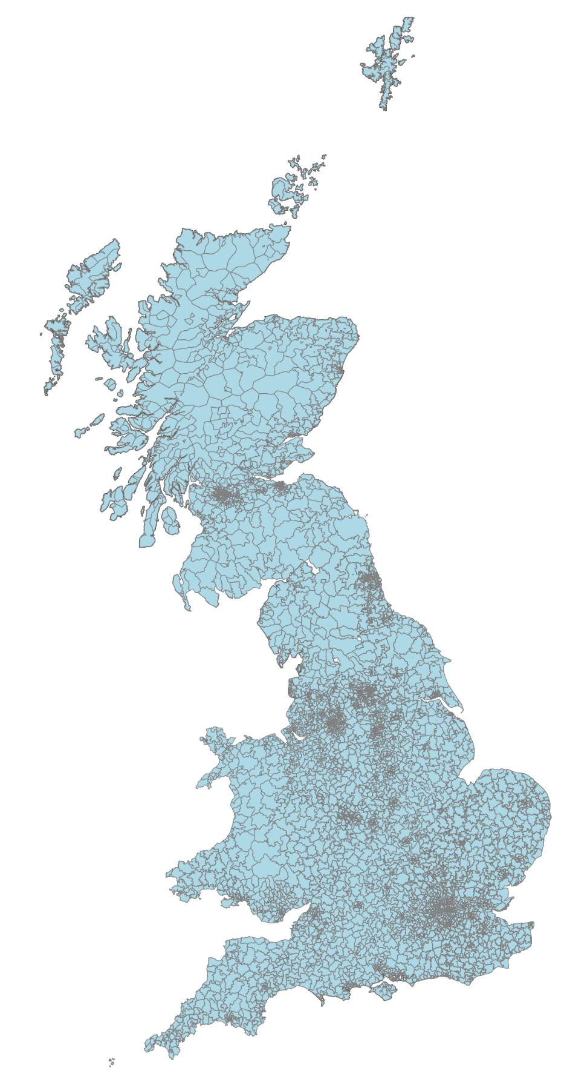
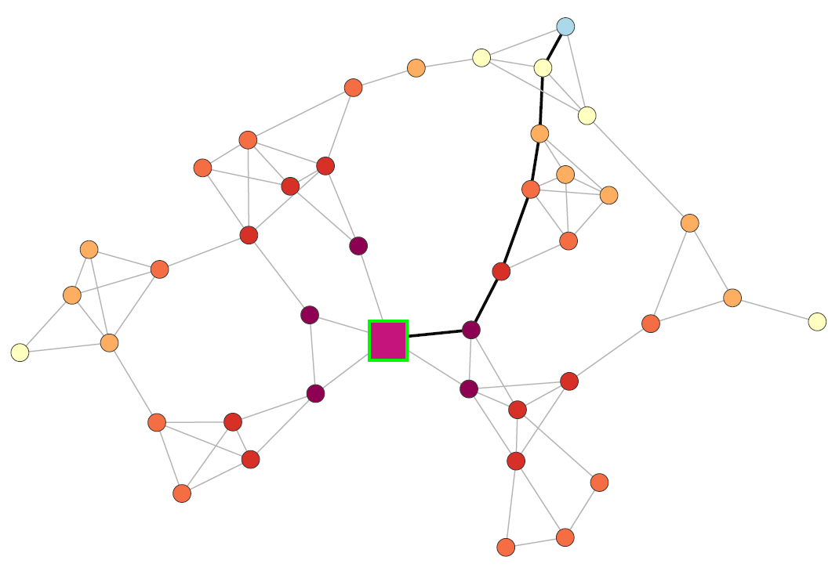
Work 1: Data foundation
Outage records
Climate data
From 2024 to 2050
From 2000 to 2023
Hourly-level
4,300+ primary substation
100,000 weather-induced outage records, duration, affected customers, outage causes
……
Multi climate members
Wind speed
Precipitation
Temperature
…..
Economic data
Infrastructure attributes
MRIO
substation characteristics
customer base
……
Economic network
Energy consumption
Customers
Population
…
Notes:
Our work starts from a substation-level data foundation. We combine outage records for more than 4,300 primary substations, including over 100,000 weather-induced outage records, with information on duration, affected customers and outage causes. We then link these records to climate data, infrastructure attributes and economic data, including MRIO information, regional energy consumption, customers and population. This allows us to connect physical outage events with regional and sectoral economic exposure.

Slide 18
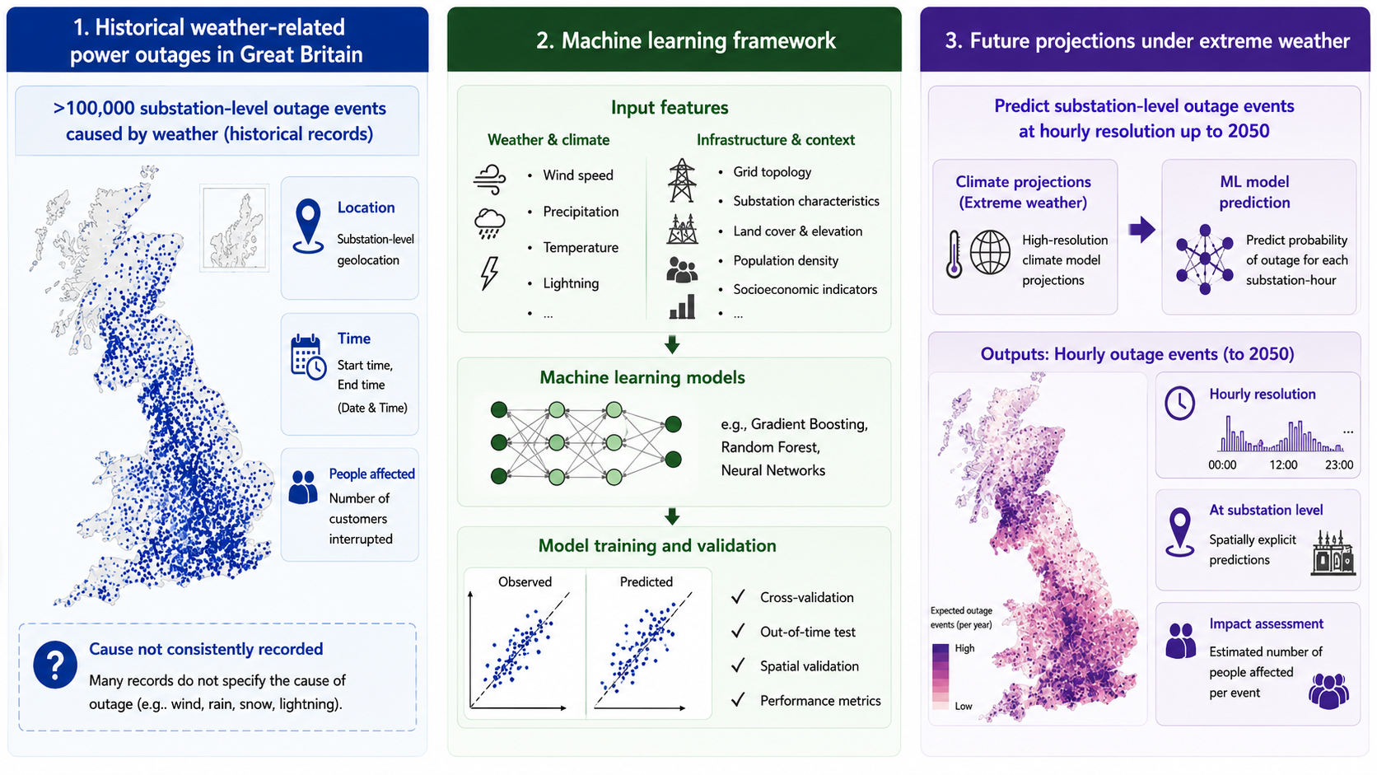
Physical outage projection
Notes:
The first modelling step is physical outage projection. We use historical weather and outage records to estimate how weather conditions translate into outage occurrence, duration and affected customers at the primary-substation level. We then apply this relationship to future climate projections. The aim is not only to predict whether outages increase nationally, but also to identify where future risk becomes concentrated.

Slide 19
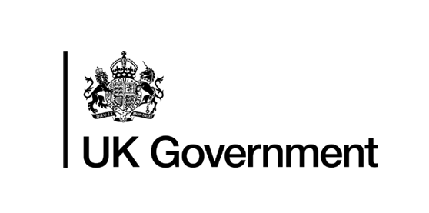
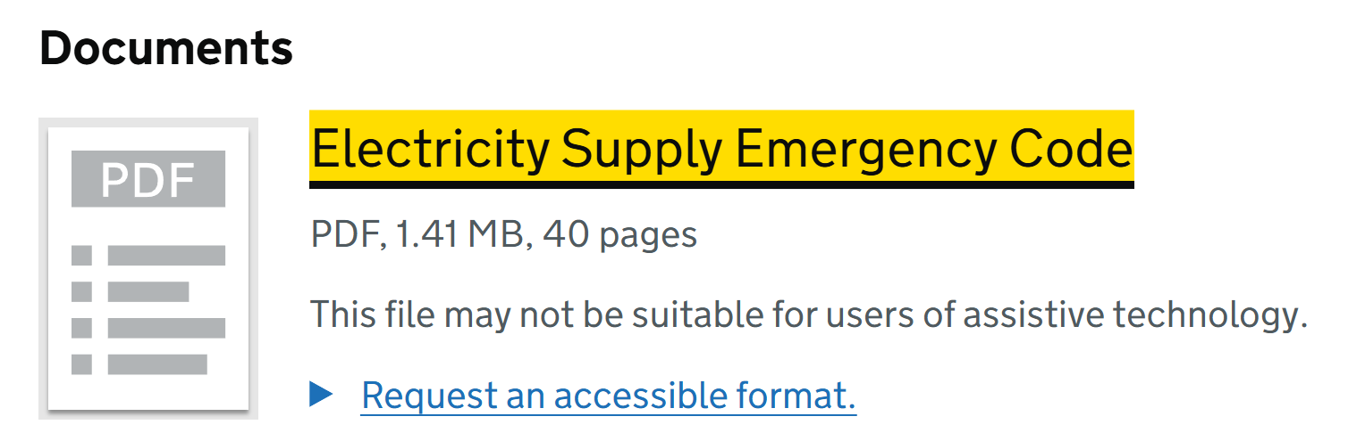
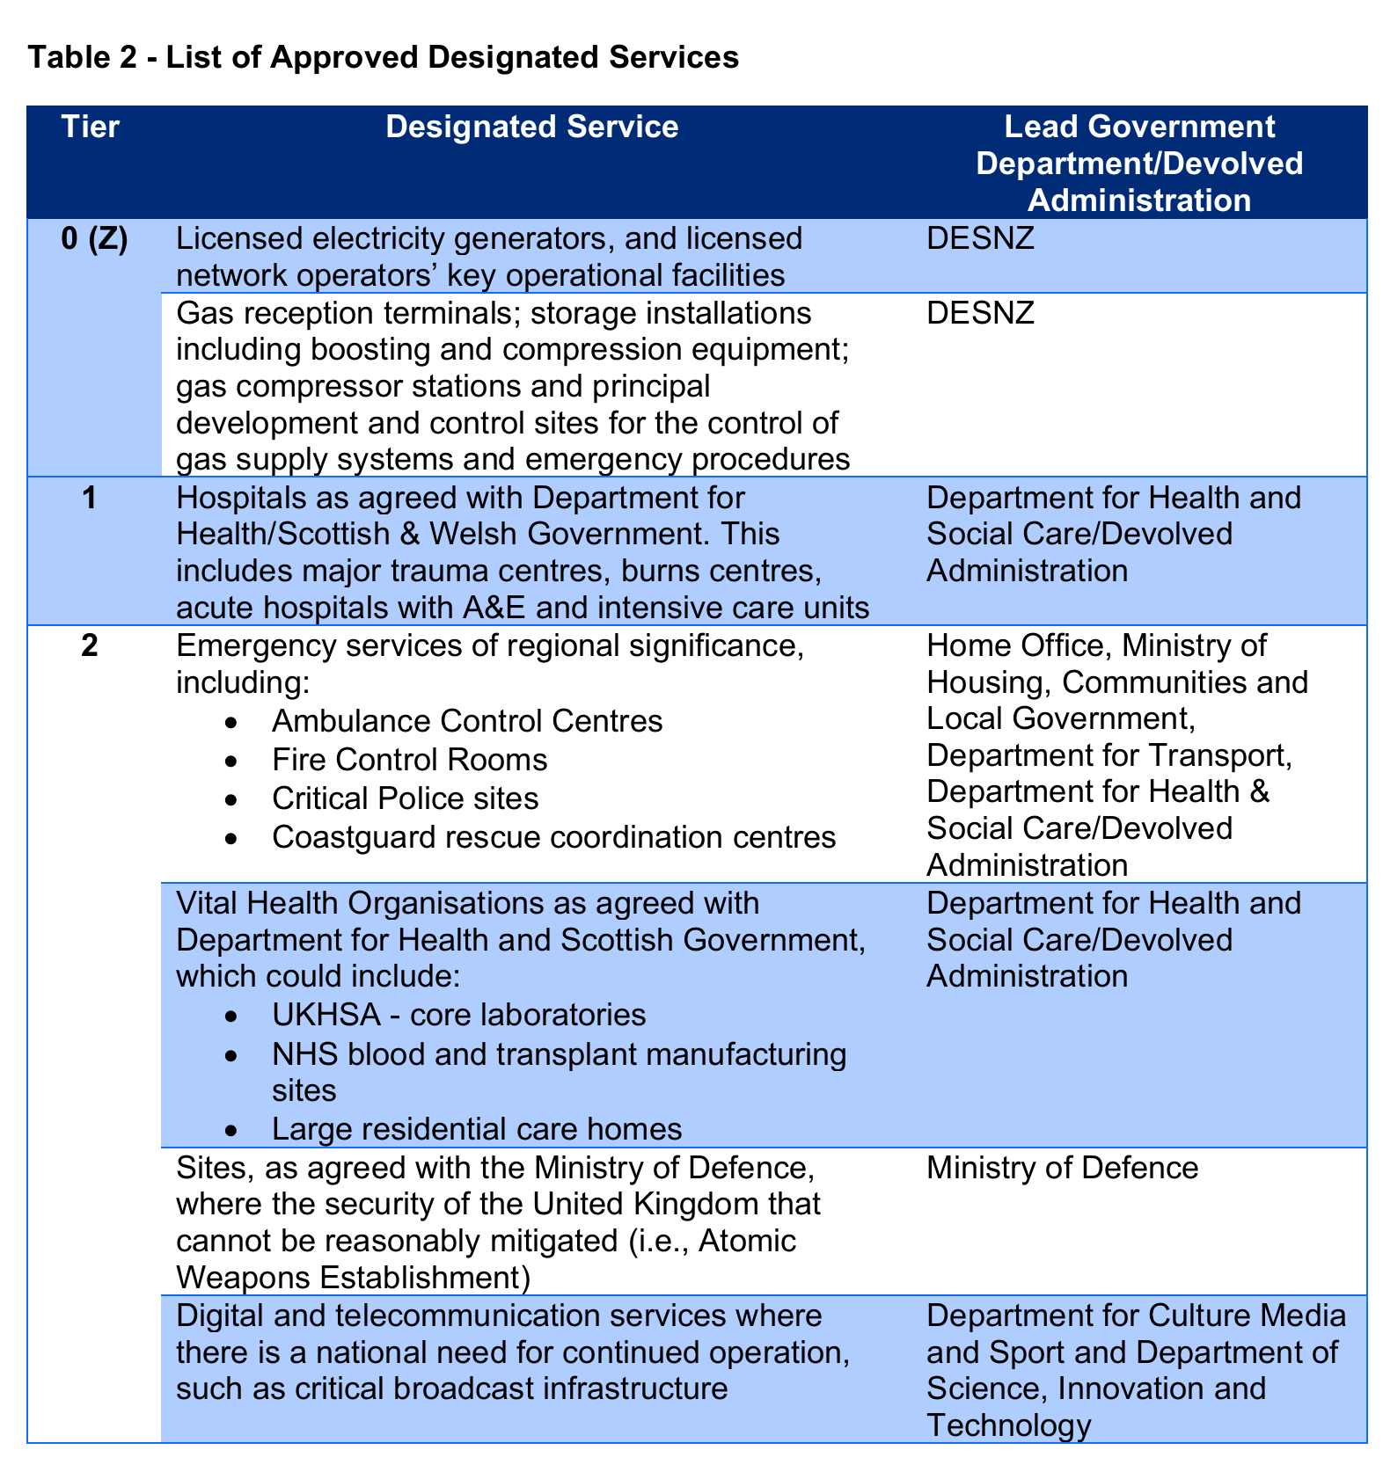
Work 2: translating outage shocks into production constraints
ARIO
External shocks
Power outage
Extreme weather
Production module
Labor disruption
Inventory availability
Import constraint
Supply
Demand
Interregional substitution
Allocation module
Supply in disequilibrium
Sectoral outage losses are not uniform. Hospitals, energy supply, etc. are protected first, while manufacturing sectors, etc., are more likely to be curtailed.
Household
Inventory restore
Demand module
If the pre equilibrium is restored
No
Yes
Economy recovered
Demand adjustment
provides a more realistic outage shock allocation rule for the MRIO.
Notes:
The second step translates outage shocks into production constraints. We extend ARIO/MRIO modelling by representing outage-driven electricity shortfalls as sectoral production shocks. Importantly, we do not assume that all sectors are affected uniformly. Critical sectors such as hospitals and energy supply are more likely to be protected, while manufacturing and other interruptible sectors may face stronger curtailment. This provides a more realistic sectoral shock allocation rule for MRIO modelling.

Slide 20
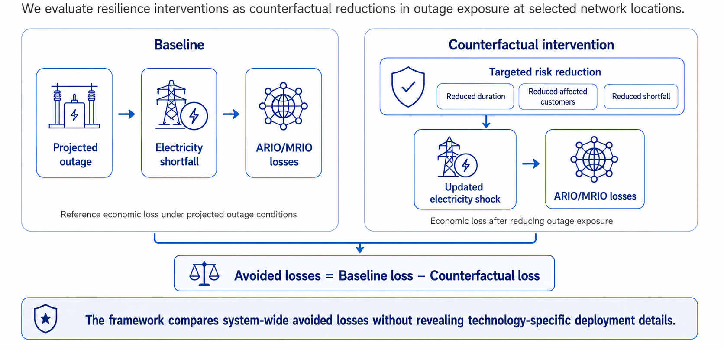
Work 3: Counterfactual resilience testing
Notes:
The third step is counterfactual resilience testing. We compare a baseline outage-loss scenario with counterfactual scenarios in which outage exposure is reduced at selected network locations. The reduction can be represented through shorter outage duration, fewer affected customers or smaller electricity shortfall. We then use the ARIO/MRIO model to estimate avoided losses. This allows us to compare system-wide benefits without revealing technology-specific deployment details.

Slide 21
Part 4. Preliminary findings
Notes:
I now present preliminary findings.

Slide 22
Finding 1: Future climate change amplifies outage risk
36% of all projected annual weather-induced outage happens in the top 5% of substations.
Spatially concentrated in coastal and upland regions
Customer impact does not always follow outage frequency.
Weather-induced outages are projected to intensify under future climate conditions.
The maximum annual national mean for outage frequency and number of customers affected reaches 2.7–3.9 events yr⁻¹ and 1,045–1,190 customers per outage, respectively
Top 5%
1.18
430
~1.8
~600
Climate model
Notes:
Our first finding is that future climate change amplifies outage risk. Weather-induced outages at primary substations are projected to intensify under future climate conditions, especially in high-risk years. The risk is also spatially concentrated: a small share of substations accounts for a large share of projected outage events. Importantly, customer impact does not always follow outage frequency, because affected customers also depend on substation service areas and local demand density.

Slide 23
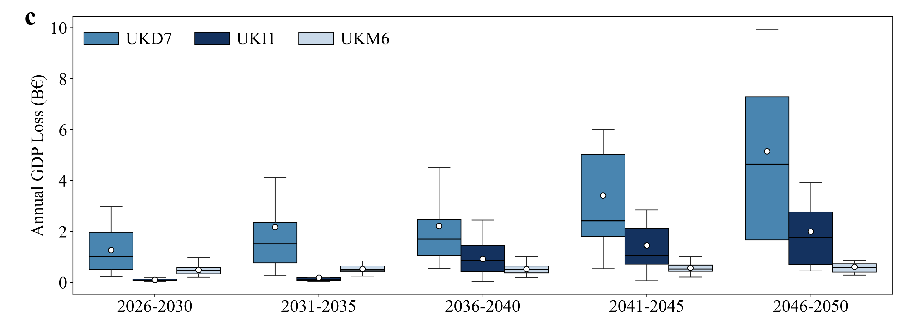
Finding 2: local outages generate economy-wide losses
Annual losses raise from €8.6 to €22.6 billion from 2026 to 2050 (uncertainty range also widens).
Annual losses raise from €8.6 to €22.6 billion from 2026 to 2050 (uncertainty range also widens).
The most obverse rise would happen in regions with significant indirect loss.
€ 22.6 B
€8.6 B
Economic centre
Supply chain hub
Notes:
The second finding is that local outages can generate economy-wide losses. Annual losses increase over time, and uncertainty also widens in later periods. The largest increases tend to occur in regions where indirect losses are substantial, especially regions connected to major economic centres or supply-chain hubs. This shows why local outage assessment is insufficient: the economic burden can be borne far beyond the outage location.

Slide 24
Finding 3: sectoral exposure is highly uneven
We examine food manufacturing in UKM6 (Highlands and Islands) as an example, tracing how outage-induced losses propagate to its upstream and downstream sectors and how storage mitigate these losses (Fig. 4).
Notes:
The third finding is that sectoral exposure is highly uneven. We use food manufacturing in UKM6 as an example to trace how outage-induced losses propagate to upstream and downstream sectors. This example shows how a local electricity disruption can affect sectoral production networks. It also illustrates why sector-specific exposure and supply-chain position are essential for understanding outage impacts.

Slide 25
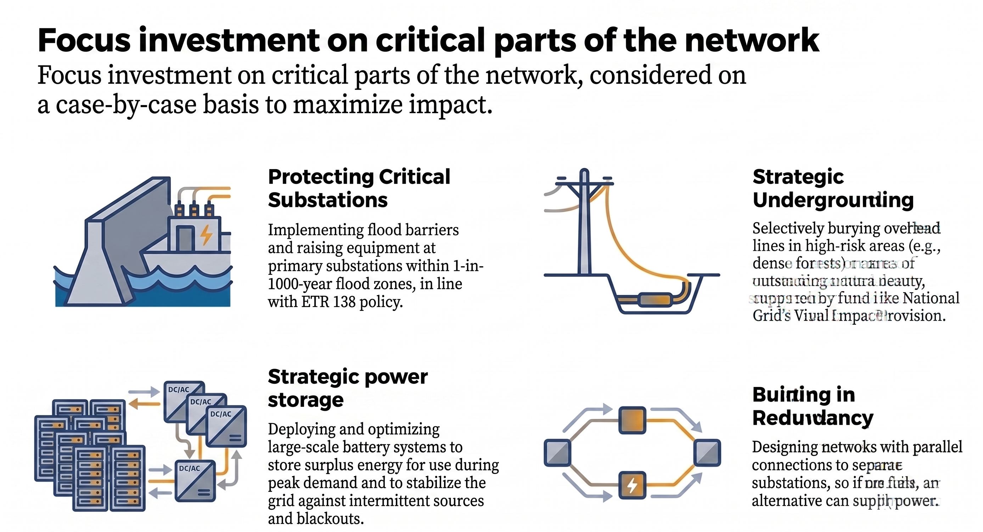

Ongoing work: resilience intervention assessment
Focus investment on critical parts of the network to minimize the impact of power outage and shock to economic activities.
Substation hardening
Strategic
Undergrounding
Implementing flood barriers and raising equipment at primary substations
Intelligently bury lines in high-risk areas (e.g., forests)
Distributed storage
Network redundancy
Deploying and optimizing large-scale distributed storage to store surplus energy
Designing networks with parallel connections to separate substations
Notes:
We are now extending the framework to evaluate targeted resilience interventions. These include substation hardening, strategic undergrounding, network redundancy and distributed storage. At this stage, we treat these options as counterfactual reductions in outage exposure rather than presenting one technology-specific solution. The goal is to assess how local risk reduction changes system-wide supply-chain losses under future climate conditions.

Slide 26
Part 5. Collaboration

Slide 27
Open Cascade Map: a collaborative data platform
Who was affected, when, where, what, how?
  Research data from various fields
  Publicly reported data [official report, media]
  Individual voluntary contribution
  High frequency survey/interview [specific events]
  Satellite imagery and remote sensing
  Surface Sensor data
Validation: Evidence, mutual verification between multiple data source
Develop data structure/attribution methods to integrate the information
Notes:
Finally, this work connects to a broader collaborative platform: Open Cascade Map. The aim is to integrate evidence from outage records, public reports, voluntary contributions, interviews, remote sensing and surface sensors. By linking hazard, entity and economic layers, we can ask: who was affected, when, where, by what shock and through which pathway? This type of platform can improve validation, attribution and real-world relevance.

Slide 28
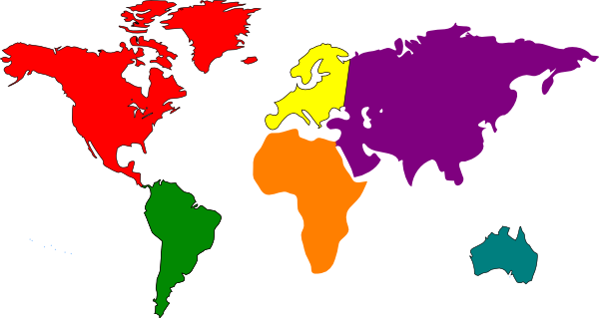
Hazard layer
Shock
Outcome
Entity layer
Economic layer
Shock
Notes:
There are several areas where collaboration can improve the framework. Outage event records can improve validation of timing, duration and affected customers. Remote-sensing evidence can help track outage extent and recovery. Sectoral interruption data can reveal how firms actually respond to electricity shortfalls. Critical infrastructure data can help connect power outages with transport, logistics, water, health and communication systems.

Slide 29
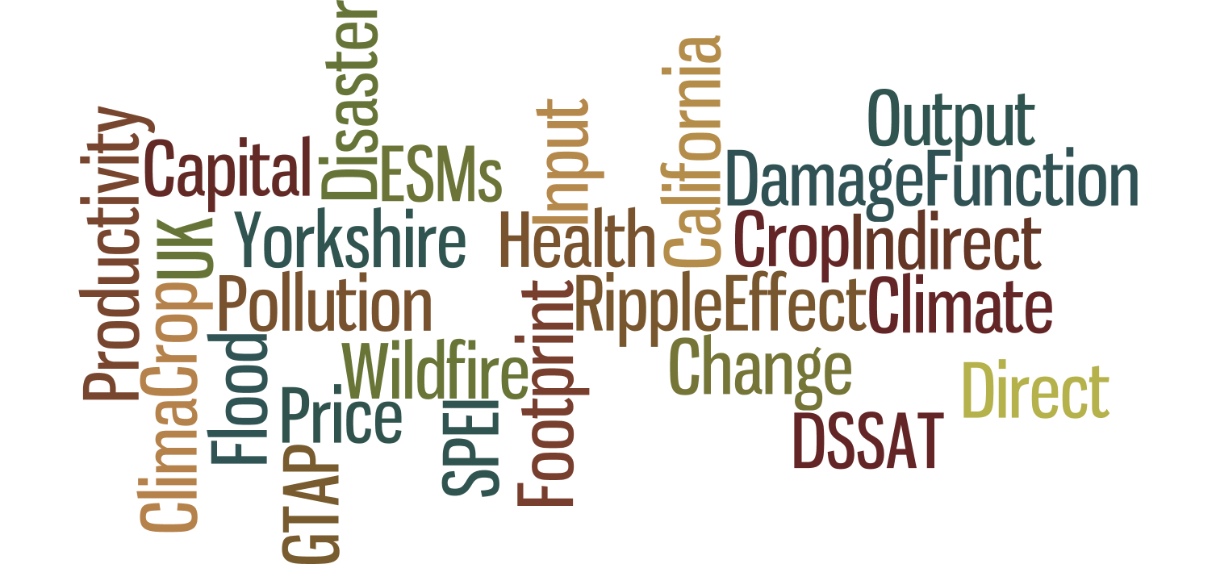
THANKS
Email: pengfei.yuan1@outlook.com
Notes:
Thank you very much for listening. I would be very happy to discuss potential collaboration on outage data, supply-chain disruption and infrastructure resilience

