Slide 1




Integrating solar PV supply chain into EXIOBASE to assess EU Net-Zero Industry Act impacts
Lorenzo Rinaldi*
Raffaele Merletti, Camilla Citterio, Nicolò Golinucci, Matteo V. Rocco
Department of Energy, Politecnico di Milano · eNextGen s.r.l., Milan
*Contact · lorenzo.rinaldi@polimi.it
32nd International Input–Output Association Conference
22–26 June 2026 | Seville, Spain

Slide 2

Outline
1
Solar PV: a concentrated, strategic supply chain
2
The Net Zero Industry Act & the research question
3
A hybrid LCA framework: process detail + MRIO
4
Scenario design & sensitivities
Scan for the dataset
This study builds on the hybrid-units database of Ghezzi et al. 2026
The presented work is currently under review
5
Model verification & the structure of the footprint
6
Reshoring results: emissions, value added, jobs
7
Conclusions & policy implications
POLITECNICO MILANO 1863 2

Slide 3


Context | A concentrated, strategic supply chain
Solar PV is the fastest-growing power source, set to become the largest renewable source by 2029
Manufacturing is highly concentrated: China dominates every upstream stage, and other Asian producers depend on Chinese intermediates.
The Net Zero Industry Act (NZIA) targets ≥40% of EU PV module demand from domestic manufacturing by 2030 as a part of a broader reshoring plan.
>80%
of global cell & module
>95%
of polysilicon, ingot & wafer
<1%
EU share of world module production today
40%
EU module demand to be made domestically by 2030
Research question
|
How does explicitly resolving the PV supply chain within a hybrid MRIO framework helps in the assessment of an NZIA-type reshoring policy?
References: IEA PVPS; IEA WEO; European Commission
POLITECNICO MILANO 1863 3

Slide 4


Materials & methods | Building the hybrid LCA model
22
model regions (EU27 as one)
+18 / +16
new PV activities / commodities
205 / 220
total activities / commodities
2024
Updated electricity supply mixes (EMBER)
Hybrid version, extended by Ghezzi et al 2026
Crystalline-silicon chain modelled stage-by-stage (IEA PVPS Task 12 inventories)
Poly-
silicon
Ingot &
Wafer
Cell
Module
PV
electricity
Supply matrix
Use, value added & final consumption matrices
Regions & Commodities
Regions & Activities
s
u
Y
Per-kWh functional unit
Tech coefficients inputs scaled to lifetime electricity production via regional capacity factors, 25-yr life and 19.5% module efficiency.
Implemented in MARIO
Regions & Activities
Regions & Commodities
v
References: Most data from IEA PVPS and NREL
POLITECNICO MILANO 1863 7

Slide 5
Materials & methods | Scenario design & sensitivities
Once the 2024 model was setup, we considered two 2030 configurations
Parameter | Baseline 2030 | NZIA 2030
EU domestic share | MG-/SoG-Si 50%, Ingot/Wafer 1% · Cells 2% · Modules 3% | All stages reach 40% (MG-/SoG-Si remain 50%)
Electricity mix & EU demand in 2030 | IEA STEPS projection (both in EU and China) EU electricity demand raises by +17%
Sensitivity analysis around a central case
Sensitivity parameter | Central case | Alternative value(s)
Capacity factor | EMBER · Energy Institute · IRENA | Renewables Ninja
Module efficiency | 19.5% | 22% · 24%
Annual degradation | 0 %/yr (constant output) | 0.5 %/yr
Electricity requirements in upstream stages | IEA PVPS Task 12 | NREL (×1.47 SoG-Si · ×1.20 ingot · ×0.49 wafer)
POLITECNICO MILANO 1863 8

Slide 6
Results | Verification — Solar electricity carbon footprint
Hybrid model footprints fall in a narrower 22–65 gCO₂eq/kWh band, in line with harmonised LCA and IPCC / IRENA / NREL ranges
Top-down model is more irregular and generally lower → Capital endogenization effect!
Carbon footprint of PV electricity by region — Hybrid (circles) vs Top-down (diamonds), against IPCC/NREL literature ranges (grey bands).
POLITECNICO MILANO 1863 9

Slide 7
Results | Where the footprint comes from
Electricity dominates: the carbon-intensive grids feeding electricity-hungry upstream stages.
Coal power, mostly Chinese ≈ 38% of the EU Solar electricity footprint.
About 58% of EU Solar electricity footprint originates in China
Breakdown of the PV-electricity carbon footprint by activity of origin (a) and by macro-region of origin (b).
POLITECNICO MILANO 1863 10

Slide 8
Results | Where the footprint comes from
Electricity dominates: the carbon-intensive grids feeding electricity-hungry upstream stages.
Coal power, mostly Chinese ≈ 38% of the EU Solar electricity footprint.
About 58% of EU Solar electricity footprint originates in China
The Hybrid model also allocates regional impacts much more realistically!
Breakdown of the PV-electricity carbon footprint by activity of origin (a) and by macro-region of origin (b).
POLITECNICO MILANO 1863 10

Slide 9
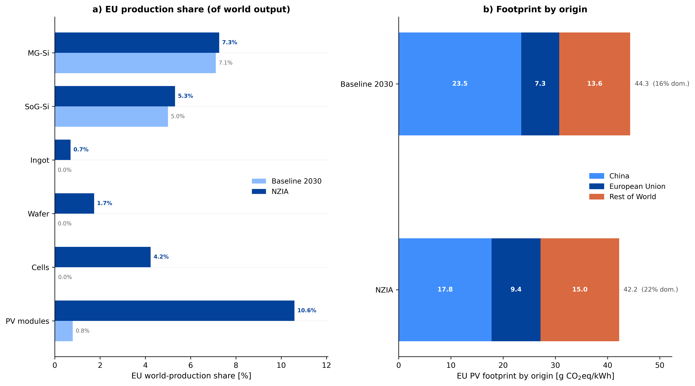
Results | NZIA – a downstream-anchored reshoring
EU module production rises from <1% to ~10% of world production…
…but cells, wafers & ingots stay at a few per cent because the reshoring targets only domestic demand.
Carbon footprint of electricity from PV does not change dramatically. Domestic share of impact increase only from 16 to 22%, so the EU PV footprint falls only ~5% (≈0.6 Mt CO₂eq)
16%
22%
EU share of world production by manufacturing stage (a) and carbon footprint of EU PV electricity by region of origin (b): Baseline vs NZIA 2030.
POLITECNICO MILANO 1863 12

Slide 10
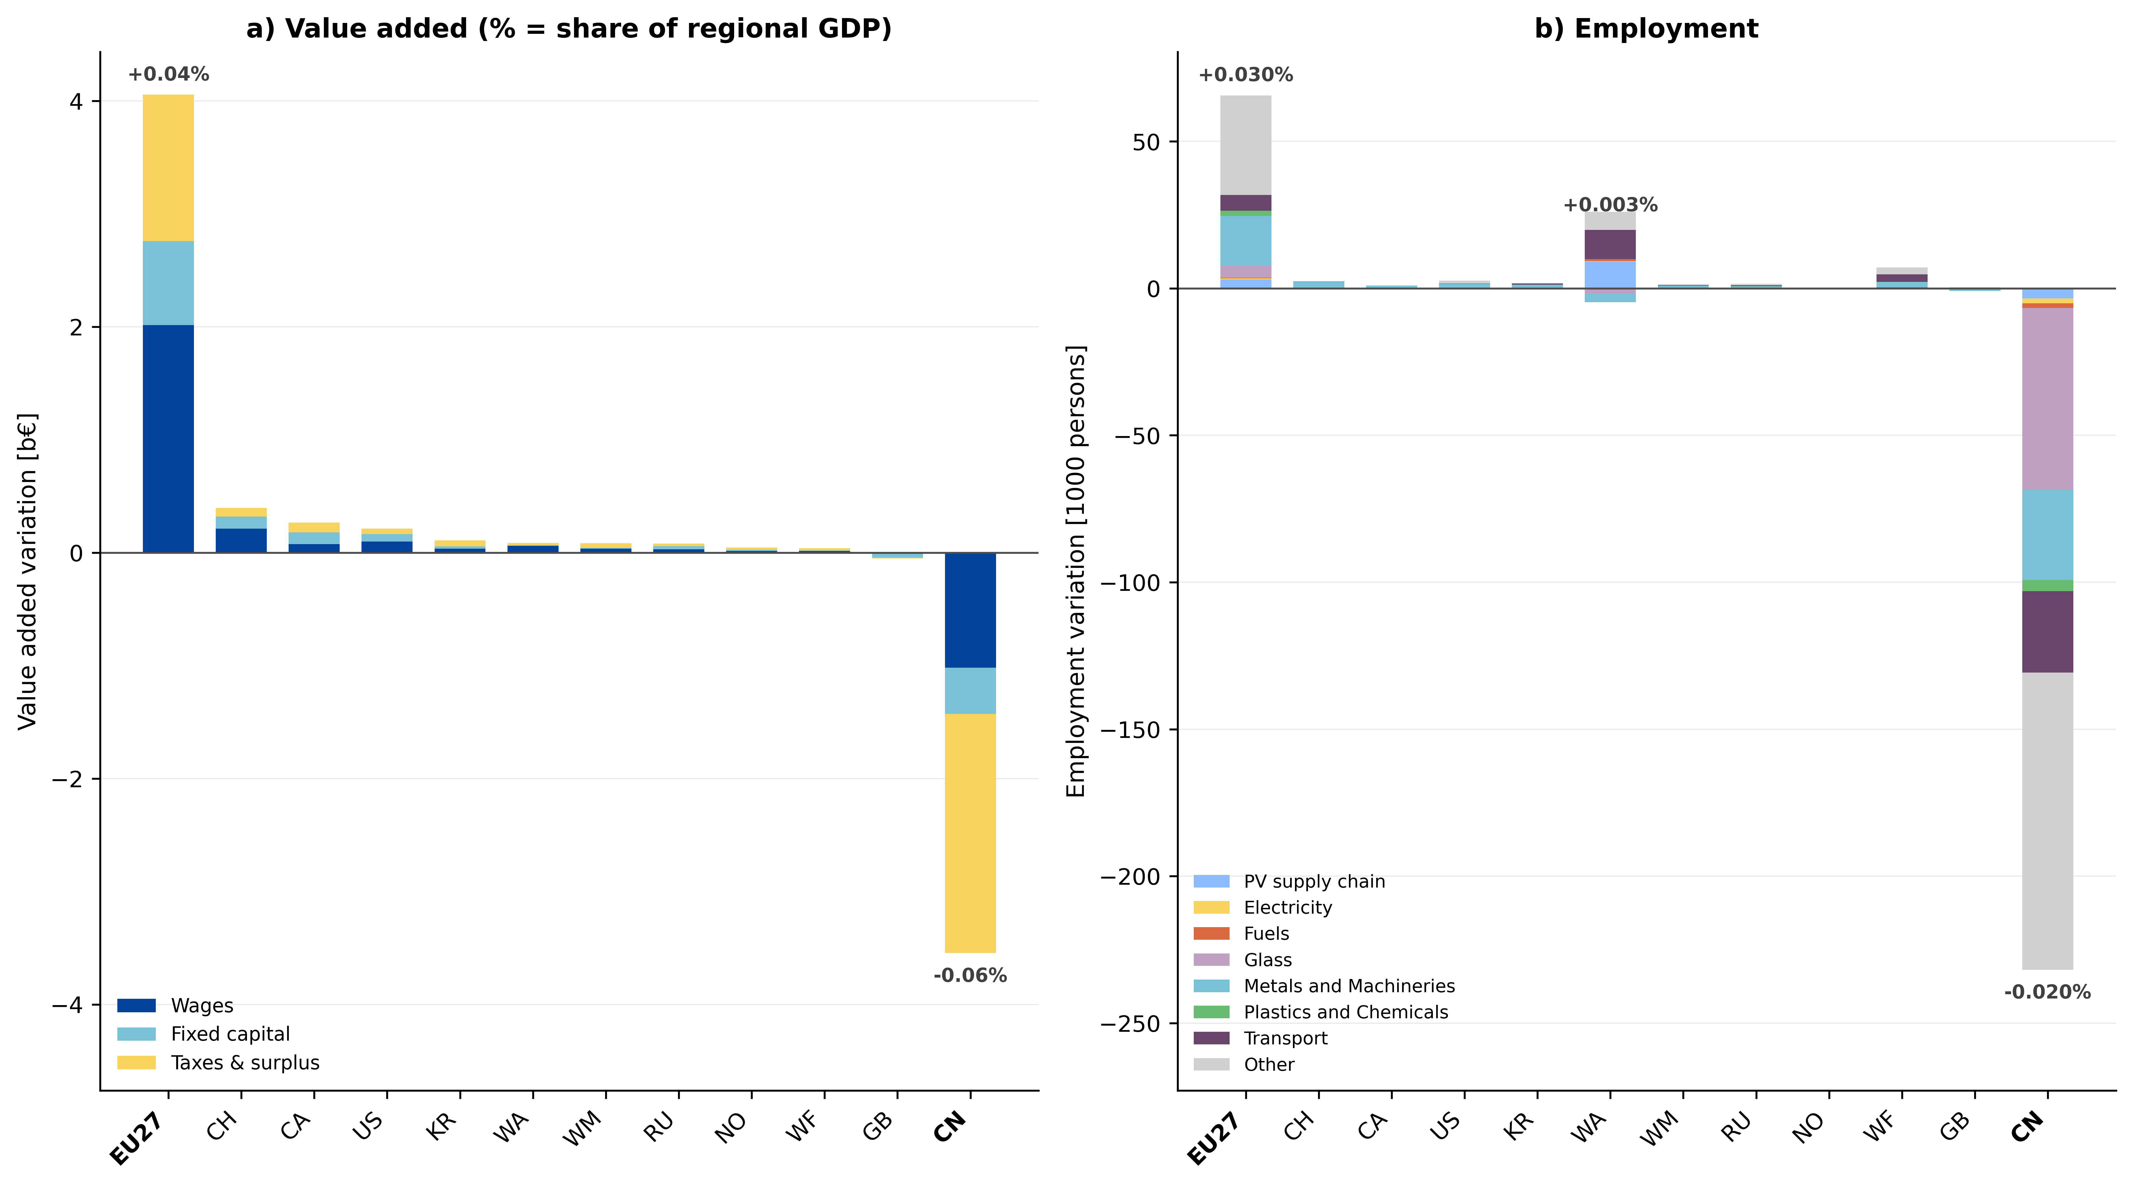
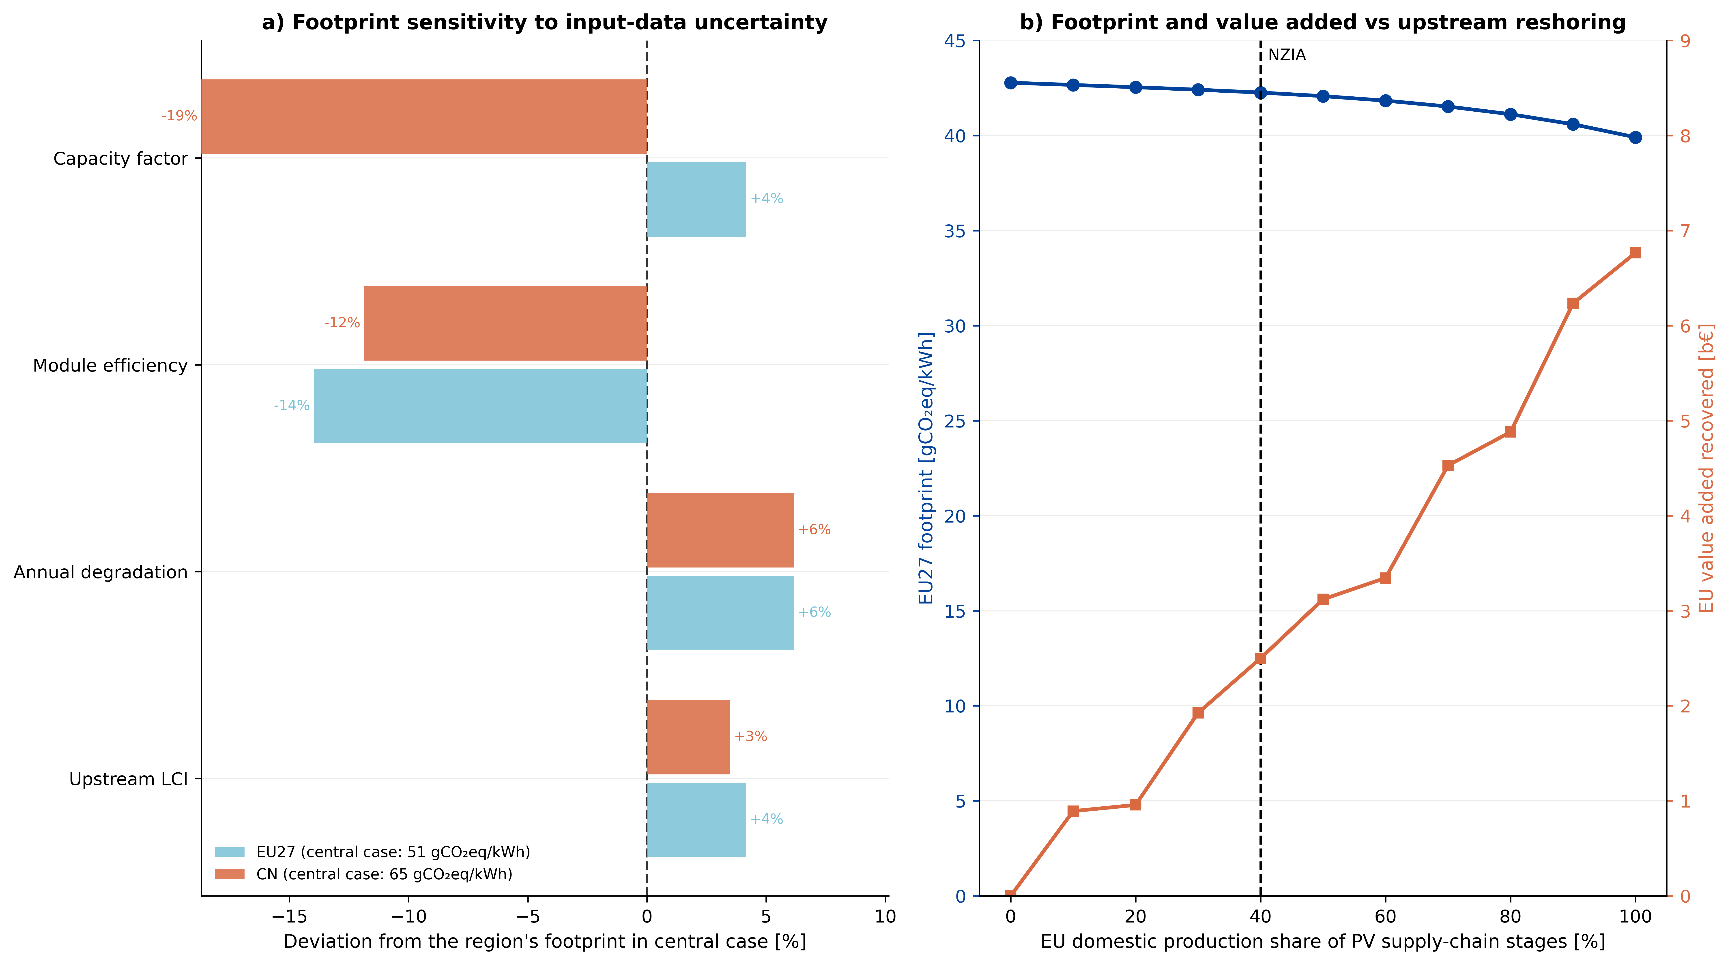
Results | Impact on value added
EU GDP rises +€4 bn (<0.04%), ~half as employee compensation; China loses −€3.5 bn.
Would it be better if EU reshored upstream stages for more than 40%?
Not so much!
Out of those +€4 bn, ~€2.5 bn are due to upstream stages.
With 100% reshoring, this figure raises to ~€7 bn
~€7 bn
~€2.5 bn
Value added by component and EU footprint & recovered value added as the upstream EU share sweeps 0→100% (b).
POLITECNICO MILANO 1863 18

Slide 11
Conclusions & policy implications
Reshoring is downstream-concentrated
EU module share jumps to ~10%, but cells, wafers & ingots stay a few per cent
→ upstream import dependence persists.
Modest value added, large leakage
+€4 bn EU value added, but much of it leaks to upstream suppliers abroad — closing that gap would need deeper upstream reshoring.
A resilience policy, not a climate one
Footprint falls only ~5% (≈0.6 Mt CO₂eq) and the edge shrinks as China decarbonises
→ pair the NZIA with ETS & CBAM.
Why supply-chain detail matters
Downstream concentration, upstream dependence & emissions redistribution are invisible to top-down MRIO. This is a structural gain.
POLITECNICO MILANO 1863 14

Slide 12

Thank you for your attention
Questions & discussion welcome
Scan: dataset
Ghezzi et al.
Lorenzo Rinaldi · lorenzo.rinaldi@polimi.it
Department of Energy, Politecnico di Milano

Slide 13
Back-up
Verification details & sensitivity analysis

Slide 14
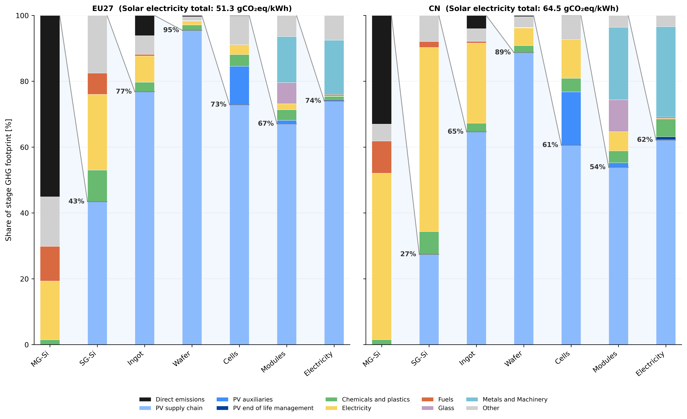
Bakc-up | A footprint that cascades upstream
Each stage inherits 60–95% of its footprint from the PV commodity just upstream.
Delivered electricity is dominated by upstream impacts: ≈74% of 51.3 g in the EU; ≈62% of 64.5 g in China.
Implication: relocating only downstream assembly changes little in environmental terms, as long as upstream stays external.
Each stage split into direct emissions and first-tier embodied inputs; the line shows the share inherited from the upstream PV commodity.
POLITECNICO MILANO 1863 11

Slide 15
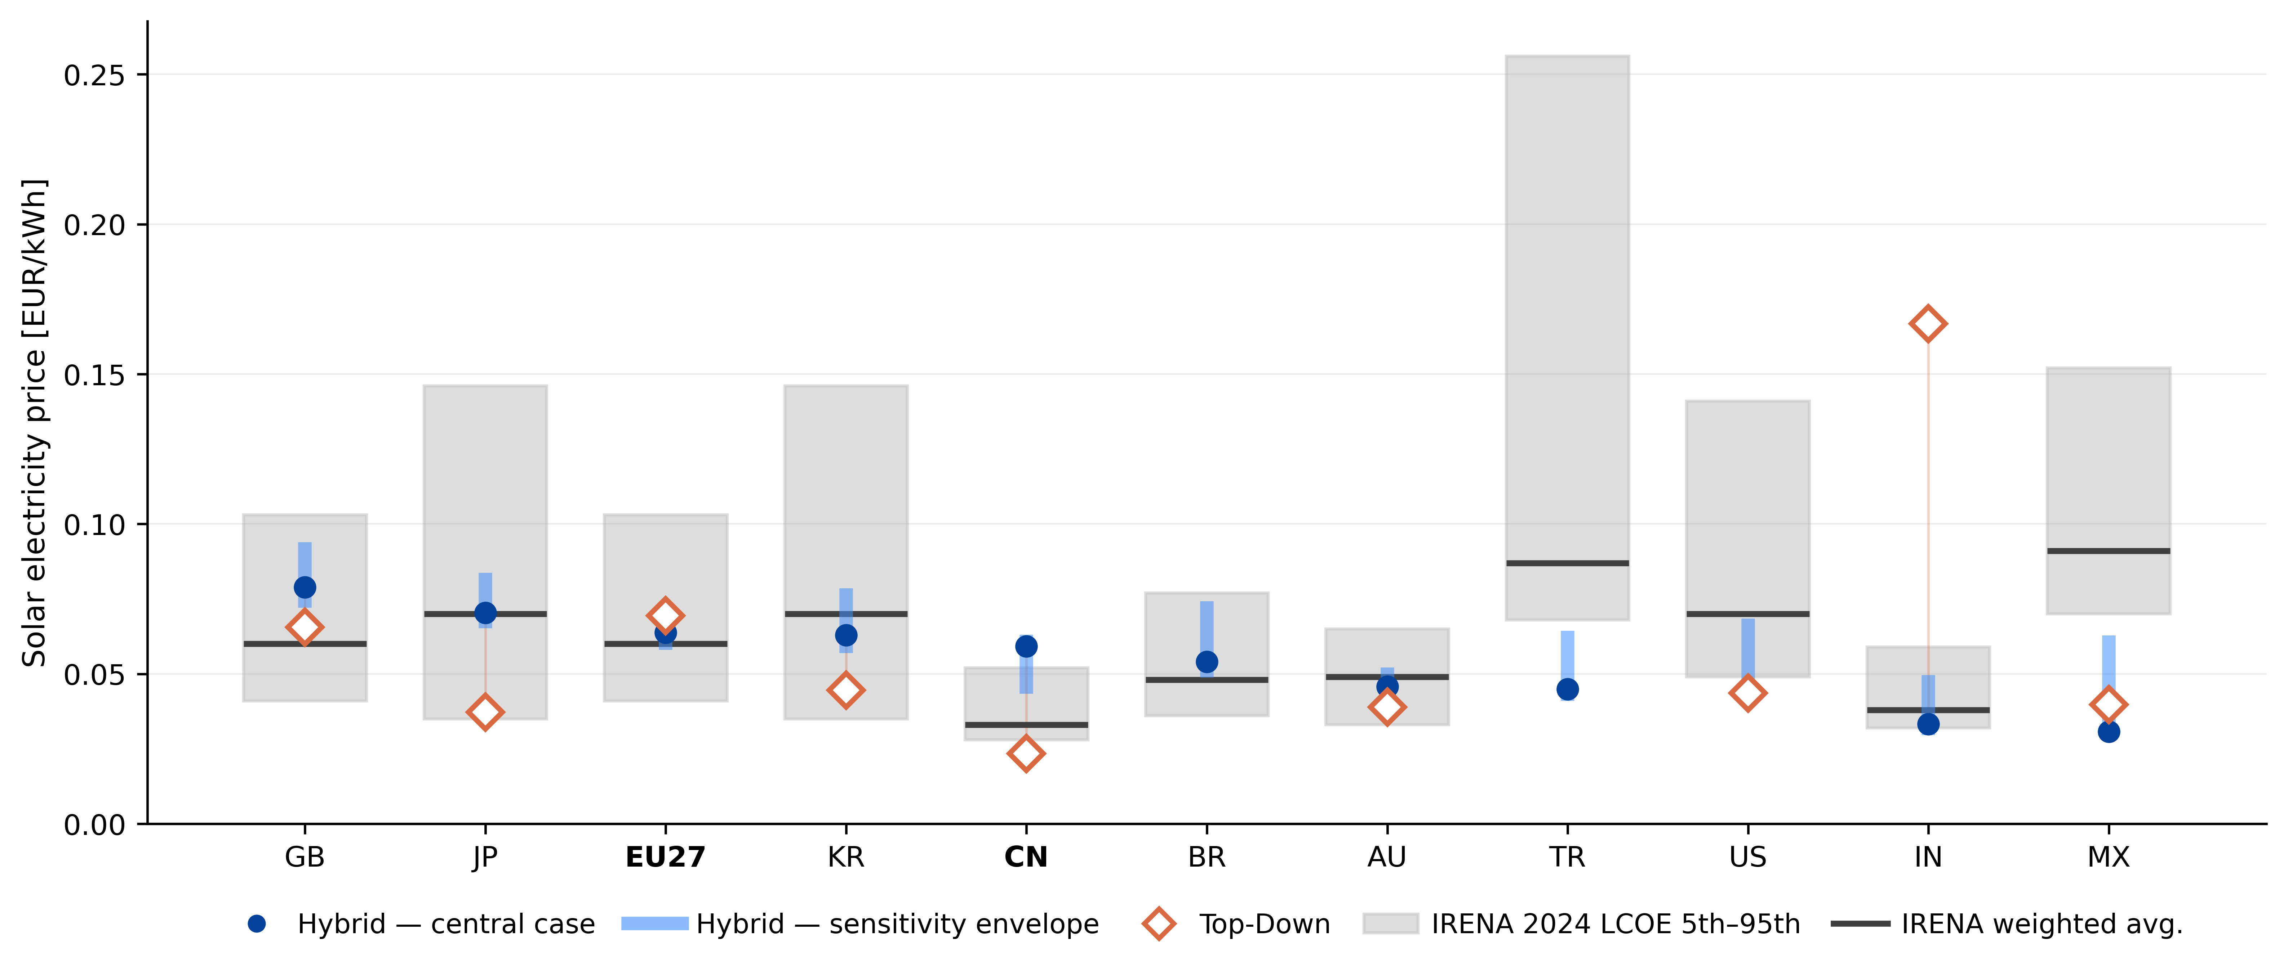
Back-up | Verification — producer prices
The Hybrid model reproduces the magnitude and regional ranking of IRENA levelized-cost estimates more consistently than the top-down model; residual gaps (e.g. China) trace to simplified cost & margin assumptions.
Producer price of PV electricity by region (EUR/kWh) — Hybrid vs Top-down, with IRENA 2024 levelized-cost ranges.
POLITECNICO MILANO 1863 17

Slide 16
Back-up | Value added, leakage & jobs
EU GDP rises +€4 bn (<0.04%), ~half as employee compensation; China loses −€3.5 bn.
Jobs: +65k in the EU vs −229k in China. The EU expands mostly in downstream sectors.
Reliance on imported cells, wafers & polysilicon leaks value added to Asia-Pacific suppliers (WA region).
Value added by component (a) and employment by sector (b): change versus Baseline 2030; labels report relative changes.
POLITECNICO MILANO 1863 13

Slide 17
Back-up | Robustness & the upstream question
Footprints are robust: dominant levers are module efficiency for the EU (−14% at 24%) and capacity factor for China (−19%).
Scanning upstream sourcing 0→100% shows no leakage threshold: the 40% case recovers only ~€2 bn of the ~€7 bn available under full upstream reshoring.
Climate effect is incremental
≈0.6 Mt CO₂eq — ~5% of EU PV emissions, ~0.02% of total. Full upstream reshoring lowers it only 42.8 → 39.9 g.
Footprint deviation per uncertainty lever (a) and EU footprint & recovered value added as the upstream EU share sweeps 0→100% (b).
POLITECNICO MILANO 1863 18

