Slide 1


32nd International Input-Output Association Conference
14th Edition of the International School of I-O Analysis
11th Jornadas de Análisis Input Output
Overall environmental impacts of industrial agglomeration:An energy consumption-based agglomeration accounting for Chinese cities
Xinyu Zeng; Xiaofang Wu; Shanshan Wu
24 June 2026

Slide 2
1
Introduction
2
Research Background
and main findings
CONTENTS
3
Methods and data
4
Results and discussions
5
Conclusions

Slide 3

Introduction
Industrial agglomeration (IA) and its environmental impact
Industrial agglomeration (IA) is a typical form of regional economic development, whose evolution in China has garnered significant attention. Nevertheless, relevant studies on the link between IA and the environment have yielded inconsistent and diverse findings, which has also raised public concern over environmental issues^{[1]}.
[1] Guo Y H, Tong L J and Mei L. 2020. The effect of industrial agglomeration on green development efficiency in Northeast China since the revitalization. Journal of Cleaner Production 258.

Slide 4


Research Background
Literature Review——Mainstream Research & Core Limitations
Monetary dimension only, missing physical energy perspective
Local energy only, ignore inter-city embodied energy transfer
Coarse spatial MRIO, lack nationwide city-scale Environmental extended Input and Output table (EE-MRIO)
To address these gaps, this study used a framework combining city-level EE-MRIO embodied energy accounting with energy-based agglomeration metrics.

Slide 5
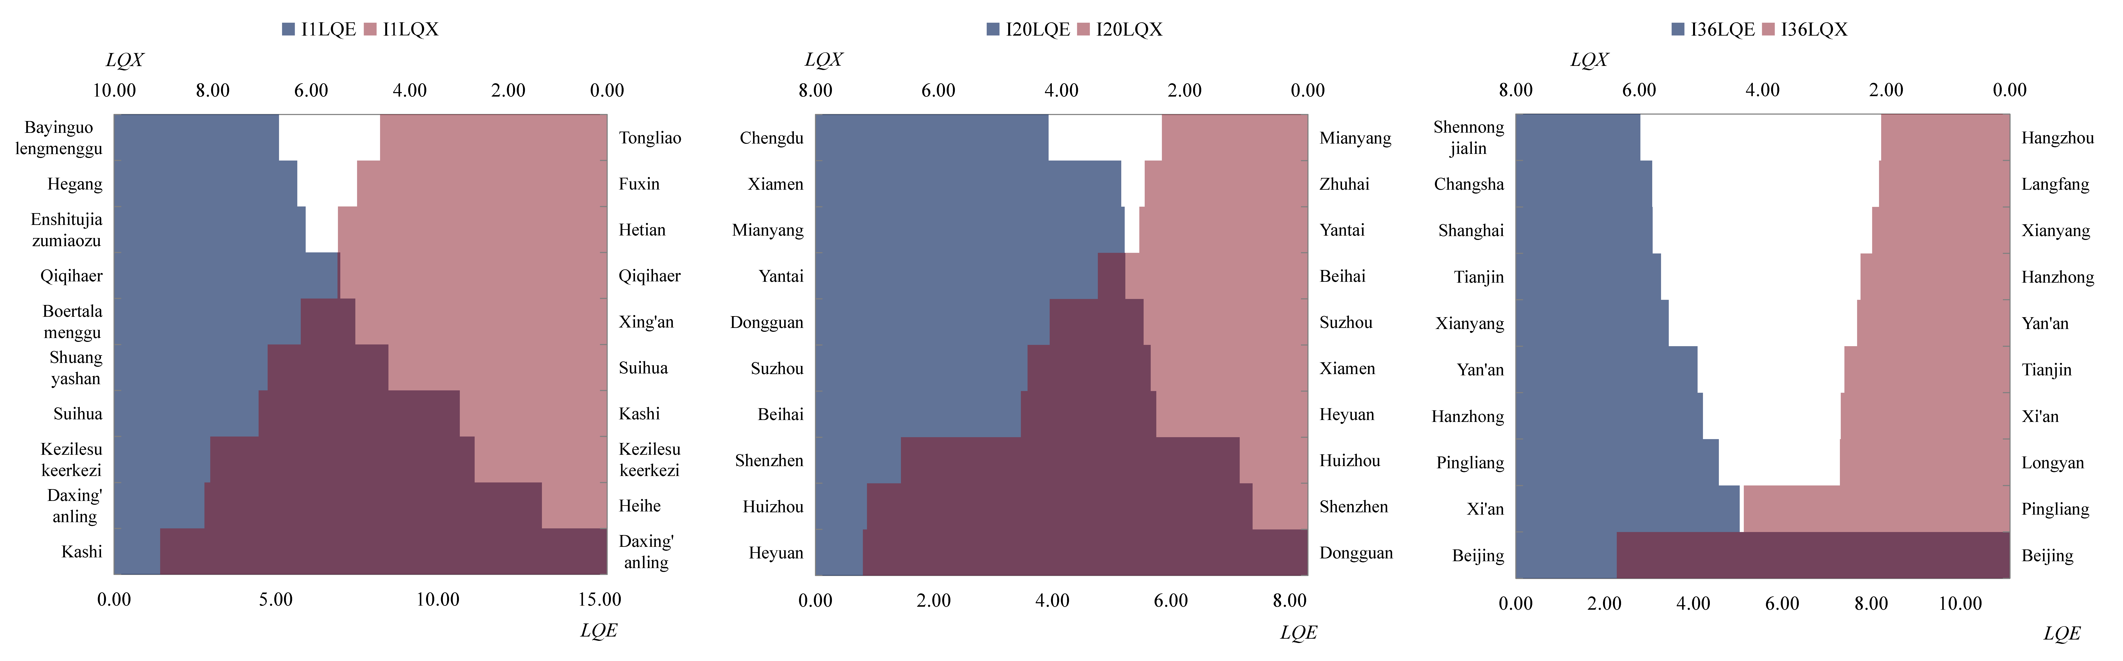
Main findings
Differences in agglomeration patterns
Energy-based agglomeration results are obviously different from traditional output-based results. (Cities that are not included in the analysis are assigned a value of 0)
Figure 1 Agglomeration of energy consumption for representative sectors at the city scale: (I1) Agriculture, forestry, animal husbandry and fisher; (I20) Manufacturing of communication equipment, computers and other electronic equipment; (I36) Scientific research and polytechnic services ( LQE and LQX respectively denote the location quotient values of energy consumption and total output.)

Slide 6
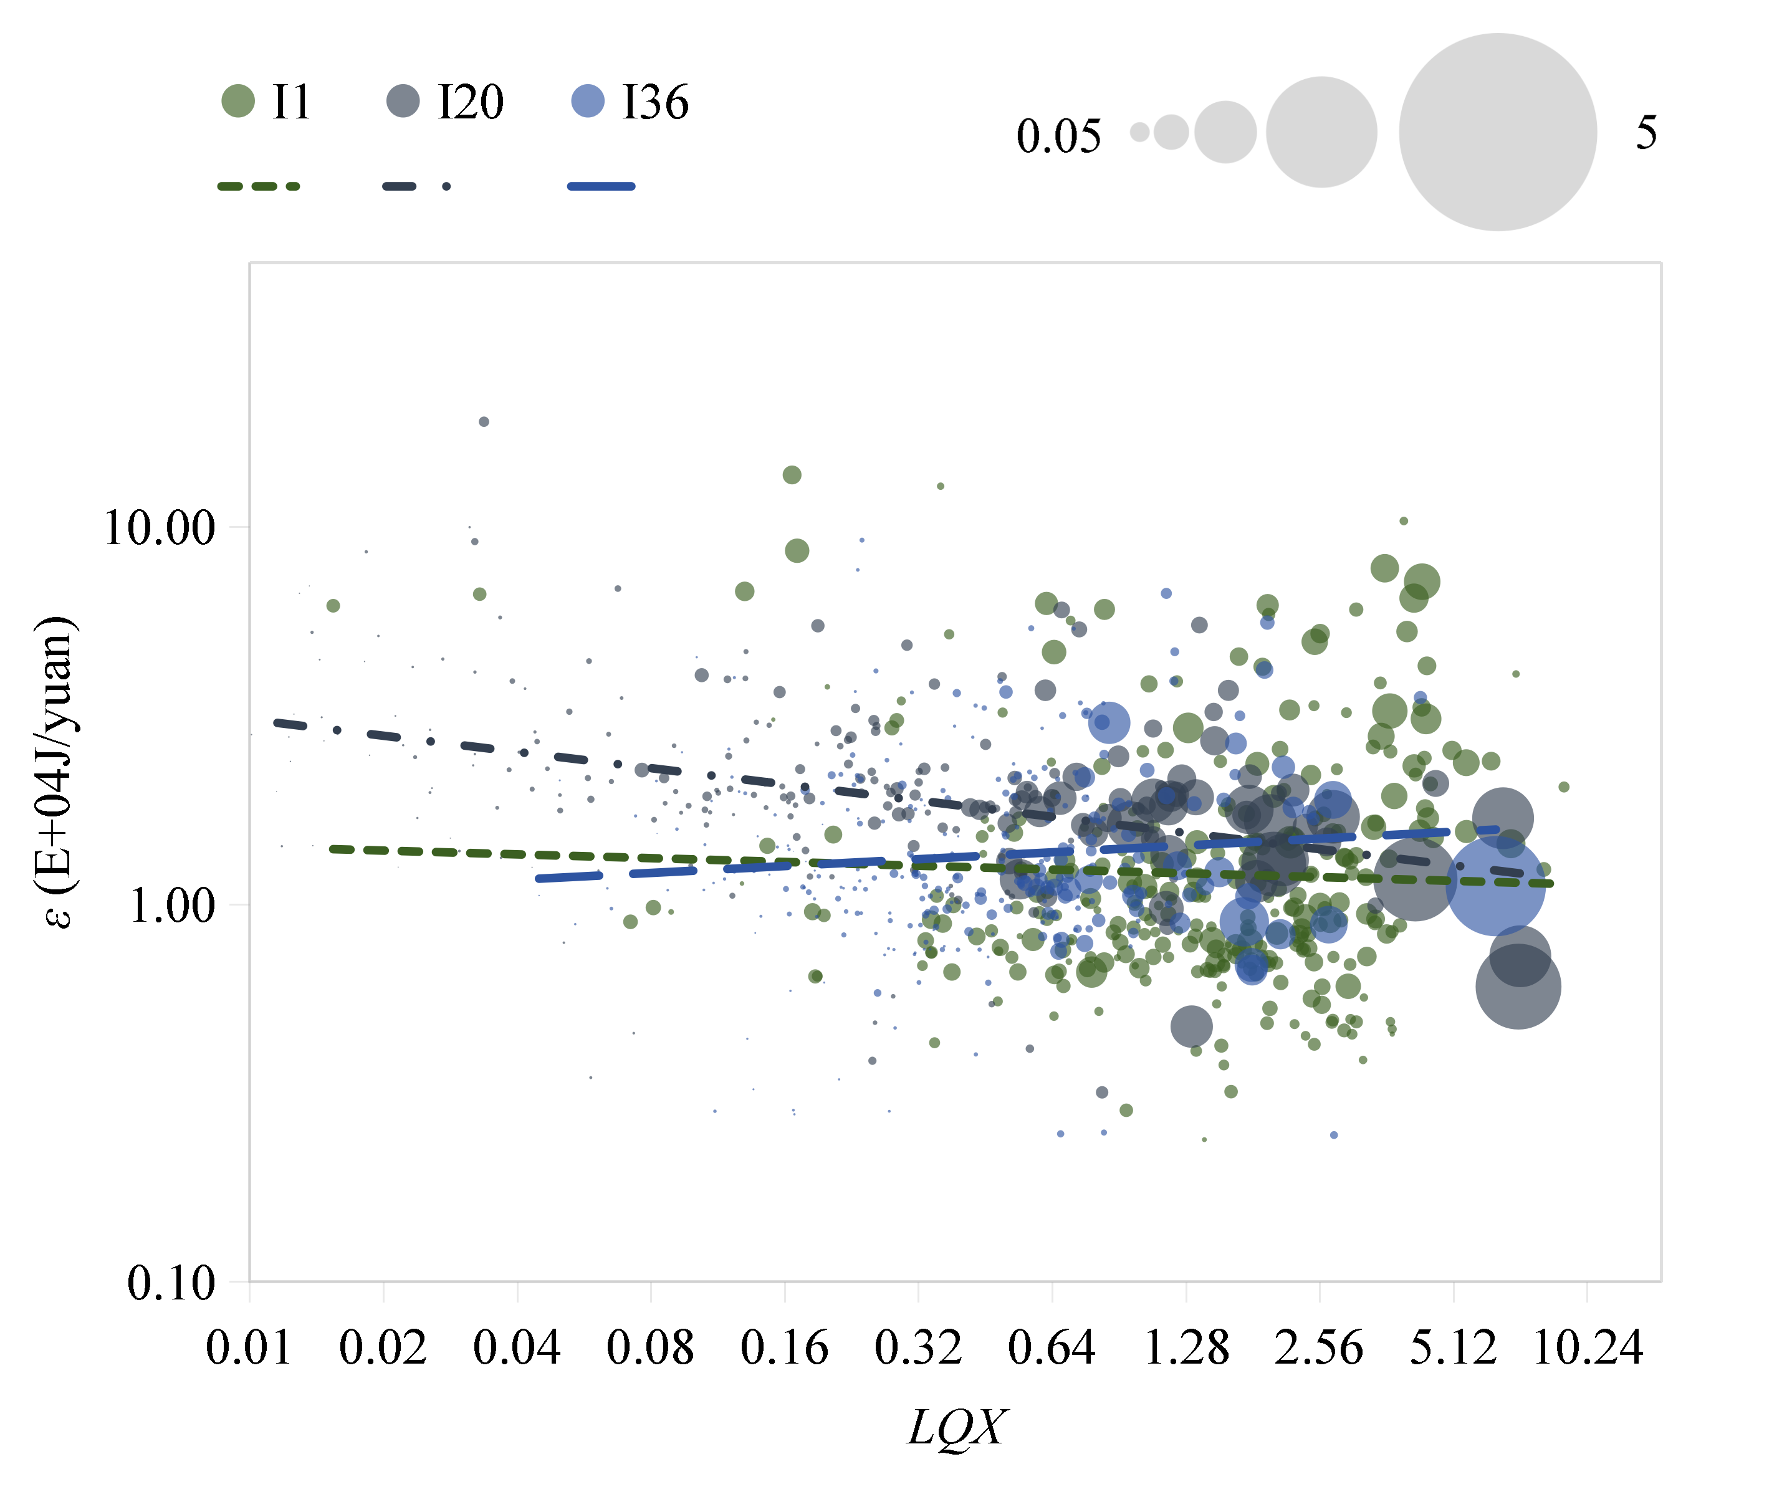
Main findings
Sectoral heterogeneity
- Manufacture of communication & electronic equipment (I20): Higher agglomeration reduces overall environmental pressure.
- Scientific research and polytechnic services (I36): Higher agglomeration increases overall environmental pressure.
Figure 2 Overall environmental impacts of IA for the three sectors (I1, I20, I36). (Bubbles are used to denote cities, and the radius of each bubble corresponds to the city’s EET value; LQX denotes the location quotient value of total output and measures the embodied energy intensity.)

Slide 7
Research Objectives
Re-assessing An energy consumption-based agglomeration
1. Establish an accounting framework for industrial agglomeration based on energy consumption.
2. Calculate embodied energy and agglomeration level of 313 Chinese cities and 42 industrial sectors.
3. Explore the correlation between industrial agglomeration and environmental impacts, as well as sector differences.

Slide 8
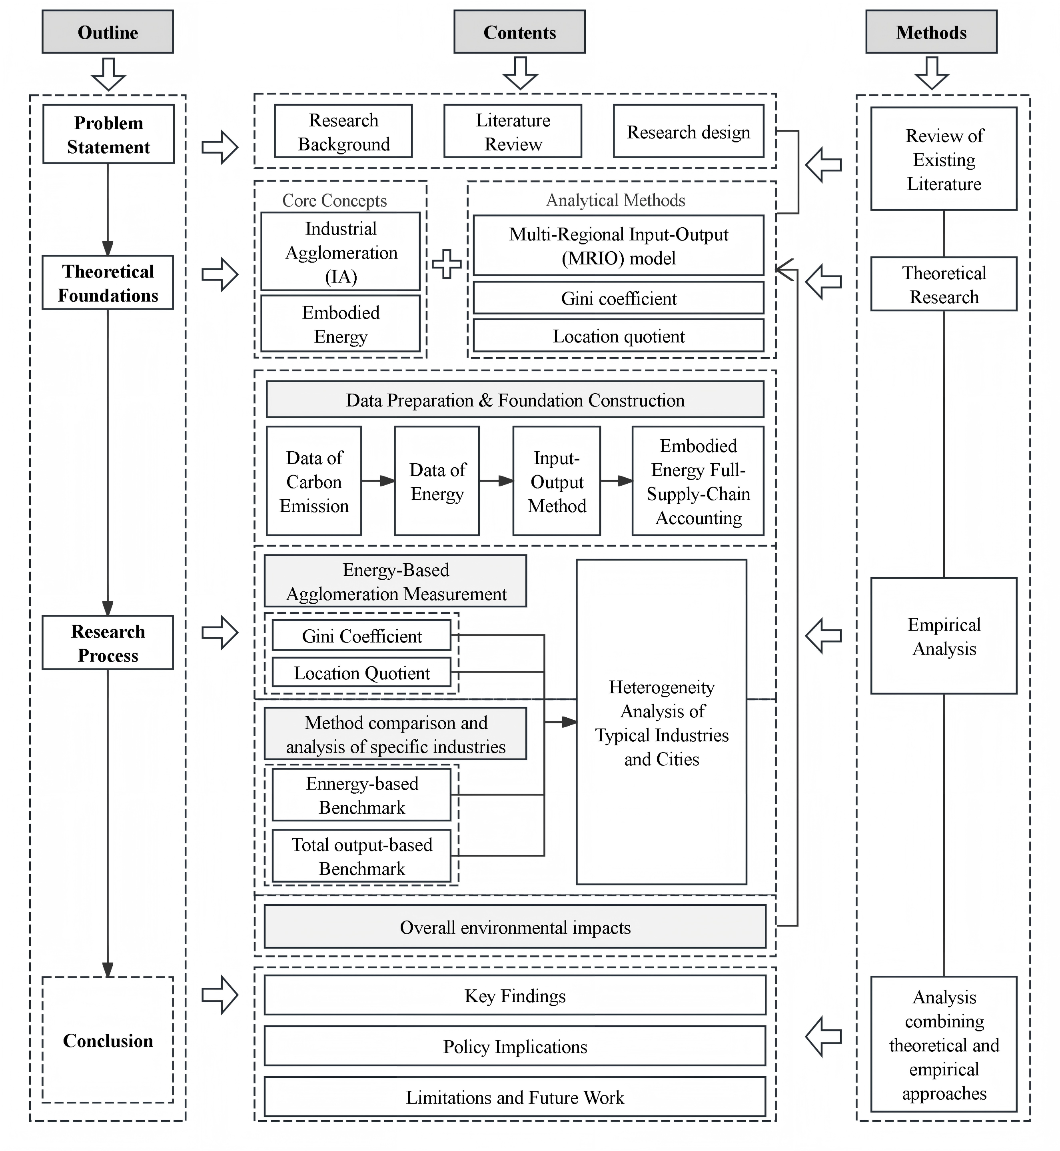
Research Objectives
Research Technical Route
→ Literature Review
→ Data Processing
→ Model & Indicator Calculation
→ Multi-dimensional Empirical Analysis
→ Result Discussion → Conclusions & Implications
Figure 3 Research technical route of the research.

Slide 9
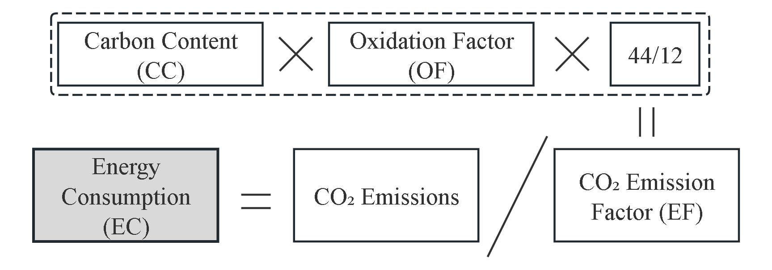
Methodology & Data
Calculate the Energy consumption
Figure 4 Flowchart for Calculation of Primary Energy Consumption in Cities.

Slide 10
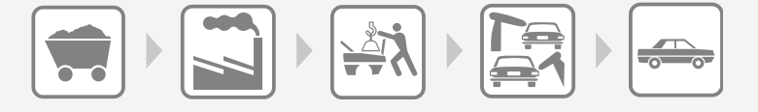
Methodology and Data
Using MRIO to calculate the embodied energy in the total output (EET)
Embodied energy consumption
The total (direct plus indirect) energy consumed to generate or acquire a good or service ^{[2]}.
It measures the transfer of carbon emissions due to the trade of goods and services.
Energy Consumption
Energy Consumption
Energy Consumption
Energy Consumption
EET
[2] Davis, S.J., Caldeira, K. Consumption-based accounting of CO2 emissions. Proceedings of the National Academy of Sciences of the United States of America 107.12 (2010).

Slide 11
Methodology and Data
Using MRIO to calculate the embodied energy in the total output (EET)
The multi-regional input-output model is employed to estimate the embodied carbon emissions in trade between cities in China.
Output Input | Intermediate use | Final demand
 |  | Rural household consumption | Urban household consumption | Government consumption | Fixed capital formation | Changes in inventories
Intermediate input | Z (Intermediate trade matrix) | FD (Final trade matrix)
Direct energy consumption | EC (Intermediate trade matrix)

Slide 12
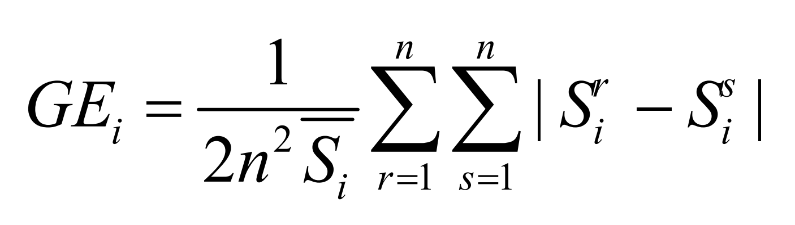
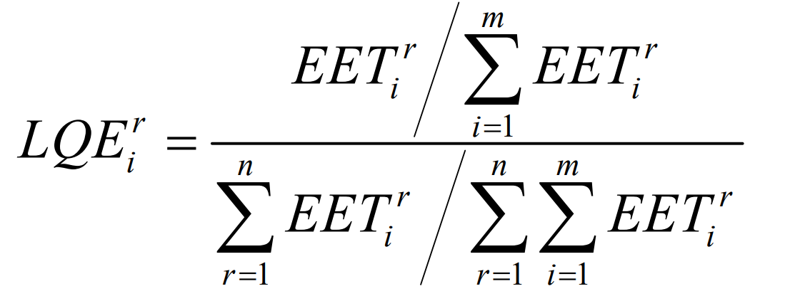
Methodology and Data
Measurement of industrial agglomeration
The Gini coefficient is commonly used to measure income inequalityand the geographical concentration of production. Here, the Gini coefficient is employedtoindicatethe concentration of energy consumption in industrial sectors.
The location quotient is a specialization index used to measure the spatial distributionofregional factors and indicate the level of industrial specialization

Slide 13
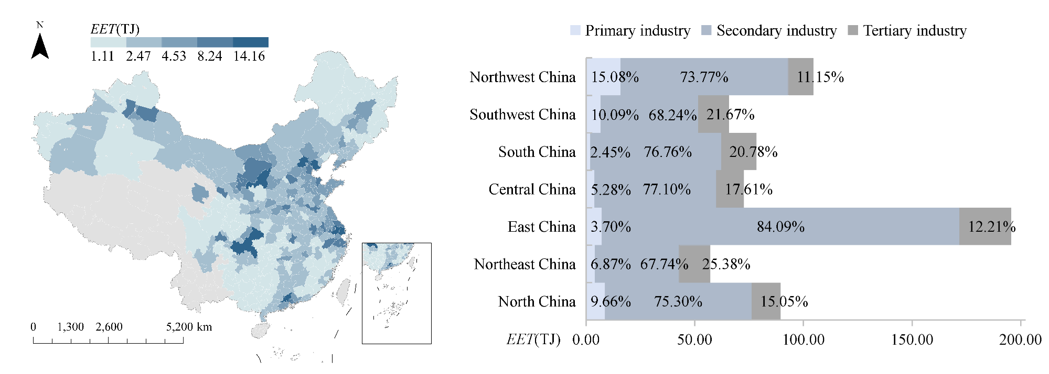
Empirical Results I:
Regional Distribution of Energy Consumption
1. Obvious regional differences; 2. Industrial structure; 3. Spatial driving factors.
Figure 5: Geographical distribution of embodied energy consumption for China (Cities that are not included in the analysis are assigned a value of 0; EET records the embodied energy consumption in the total output of the sector in the city or region.)

Slide 14
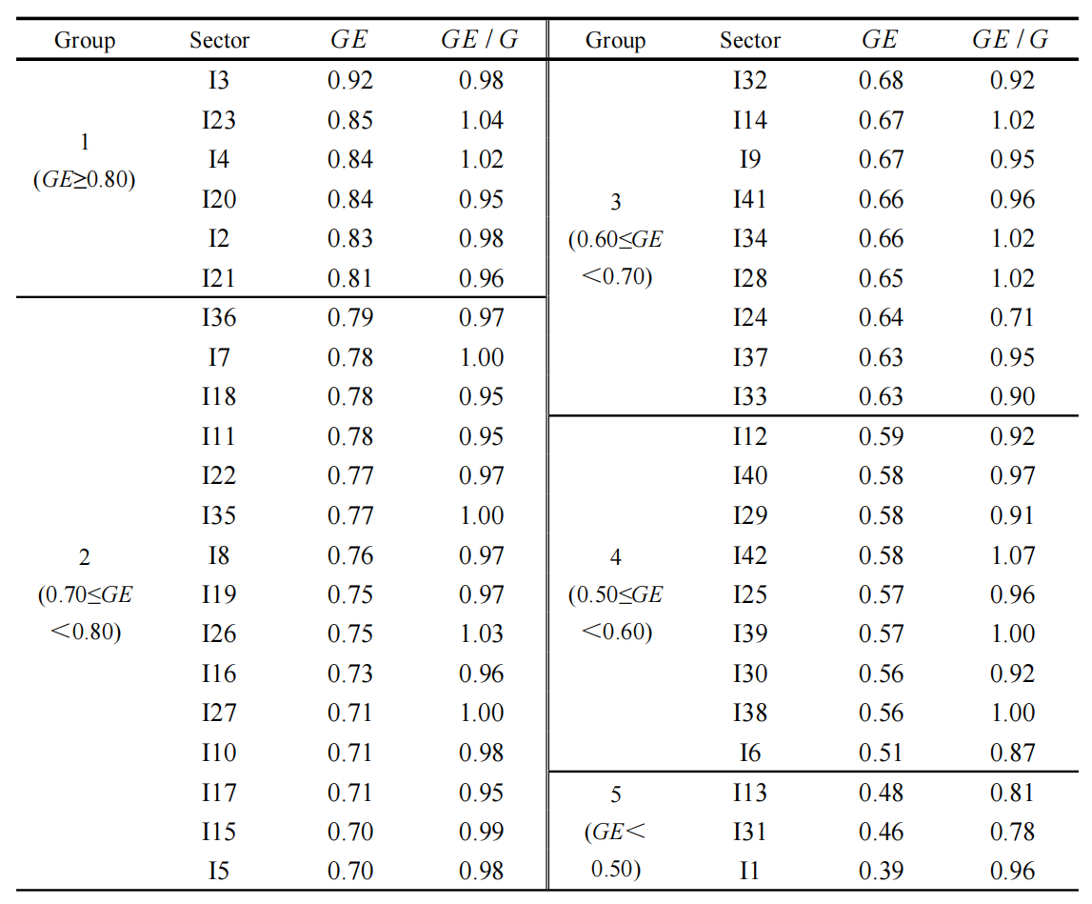
Empirical Results II:
Sectoral Energy Agglomeration
Table 1 Gini coefficient based on energy consumption for the sectors
1. Highly agglomerated sector: Extraction of petroleum and natural gas (GE=0.92), with highly concentrated energy consumption.
2. Lowly agglomerated sector: Agriculture, forestry, animal husbandry and fishery (GE=0.39), with evenly distributed energy consumption.
3. Most service industries and light industries show a moderate level of energy agglomeration.

Slide 15
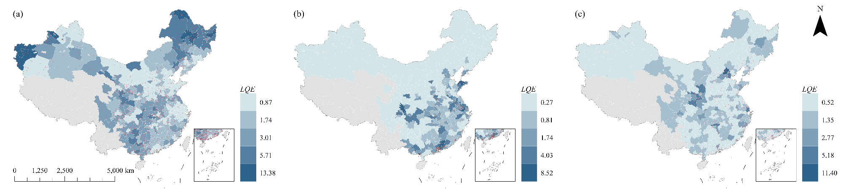
Empirical Results III:
Typical Sectors & Cities
1. Manufacture of electronic equipment (I20): Mainly agglomerated in Guangdong; higher agglomeration improves energy efficiency.
2. Scientific research services (I36): Highly concentrated in Beijing; more than 40% of its embodied energy comes from other regions.
3. Agriculture: Concentrated in major grain-producing areas with relatively low energy efficiency.
Figure 6: Agglomeration of energy consumption for representative sectors at the city scale. (Cities that are not included in the analysis are shown in gray on the map; LQE denote the location quotient values of energy consumption.)

Slide 16
Disscussion
The differences between the two measurement methods
Table 1 Gini coefficient based on energy consumption for the sectors
economic indicators cannot fully reflect environmental pressure.
While traditional methods only reflect economic performance, the new method comprehensively captures local and cross-regional resource & environmental impacts along supply chains.

Slide 17
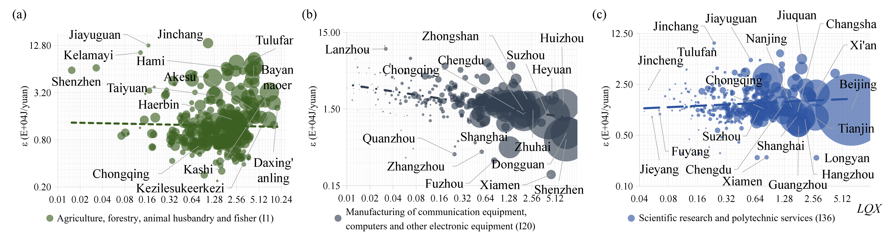
Disscussion
Overall environmental impact of IA
The environmental impact of industrial agglomeration is not uniform across sectors.
A general trend shows that higher agglomeration is associated with lower environmental pressure. However, there are also exceptions.
Figure 7 Environmental impacts of IA for the three representative sectors. (Bubbles are used to denote cities, and the radius of each bubble corresponds to the city’s EET value; LQX denotes the location quotient value of total output and measures the embodied energy intensity.)

Slide 18
Conclusion
Policy Implications & Future Work
Policy Implications
1. Establish cross-regional coordinated environmental governance to manage local and external energy impacts.
2. Implement differentiated regulation for different sectors and guide sound industrial agglomeration.
3. Incorporate embodied energy into urban and industrial environmental assessment.
Limitations & Future Work
1. Limitations: Only data of 2017 is used, without micro firm data.
2. Future Work: Adopt long-term panel data and micro data for further mechanism analysis.

Slide 19

Thank you for your attention!
Welcome your valuable comments & discussions!
Xinyu Zeng (zengxinyu@stu.zuel.edu.cn)
Xiaofang Wu (xfwu@zuel.edu.cn)
Shanshan Wu (swu@zuel.edu.cn)
24 June 2026

