Slide 1
A Hybrid LCA Framework for Drug-Level Carbon Footprint Assessment Under Data Constraints
Rosalie H. Hagenaars, IIOA conference 2026
Co-authors: Arjan de Koning, Reinout Heijungs, Arnold Tukker, Ranran Wang
r.h.hagenaars@cml.leidenuniv.nl

Slide 2
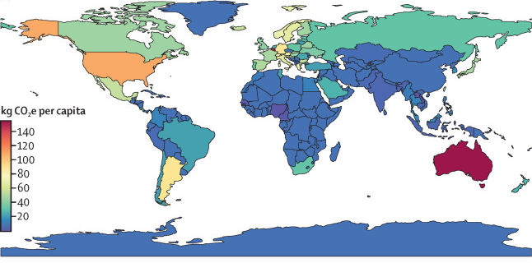

Targeted mitigation requires knowledge of drug-level emissions by country
Hagenaars R.; Heijungs R; de Koning, A; Tukker A.; Wang R. The GHG Emissions of Pharmaceutical Consumption and Production: An Input-Output Analysis Over Time and Across Global Supply Chains (2025), The Lancet Planetary Health，https://doi.org/10.1016/S2542-5196(25)00028-2
1.
Notes:
We developed this drug-level carbon footprint framework, because we found that pharmaceutical carbon footprints vary substantially across countries, and even within income groups. To better understand these differences and to develop targeted mitigation measure, a drug-specific view is essential.

Slide 3
HLCA to enable drug-level assessment
LCA: drug-level detail, yet difficult to recreate
Chemicals missing from LCI
Stoichiometric modelling
IO: can help in modeling these inputs
Upstream emissions
Global and country-specific scope
2.
Notes:
This requires knowledge of the emission of more specific drugs as opposed to the aggregated pharmaceuticals group used in IOA. LCA studies are useful for this, however, since we want to have this global footprint perspective and that is able to trace consumption-based emissions, we decided to start working on disaggregating pharmaceuticals in the IO tables, using a method that is called matrix augmentation. And we started with antbiotics, because this was the pharmaceutical with the most available data.

Slide 4
Case study penicillin carbon footprint
Disaggregation: matrix augmentation
  a) requires less detailed pharma LCI
  b) country-heterogeneity enables cross-country comparisons
ICIO-2023, 77 regions
LCI: penicillin V by Harding et al. (2018)
-> raw materials, energy, water
penicillin
3.
Notes:
We selected the MA hybridization method for two main reasons: (1) it reduces the need for detailed LCI data, which is often limited in the pharmaceuticals, and (2) the country heterogeneity captured in the EE-MRIO enables cross-country comparisons

Slide 5
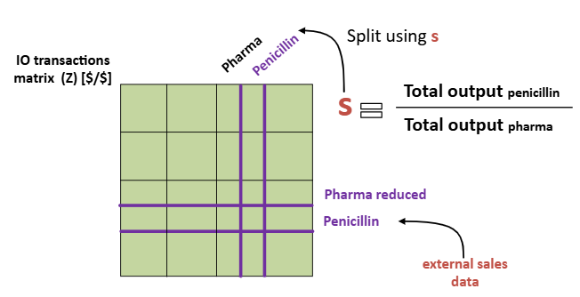
Matrix augmentation is challenging for pharmaceuticals
Pharma data limitations:
Production recipes
Sales data
Basic prices data
Total output data
4.
Notes:
We selected the MA hybridization method for two main reasons: (1) it reduces the need for detailed LCI data, which is often limited in the pharmaceuticals, and (2) the country heterogeneity captured in the EE-MRIO enables cross-country comparisons.

Slide 6
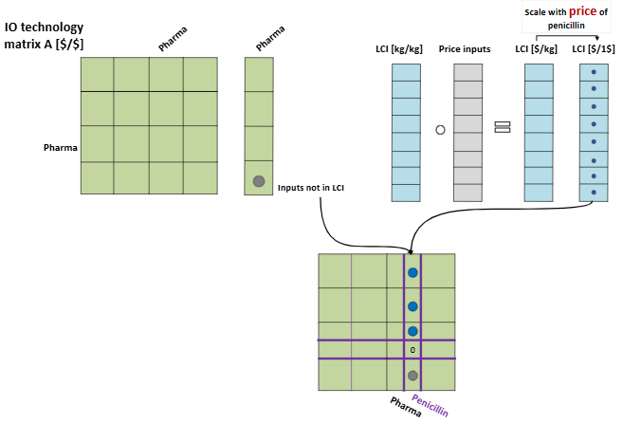
Splitting pharma without production data
1. Scaling of LCA data in A matrix
2. Estimating missing inputs
5.
Notes:
While all data limitations mentioned in the previous slide hinder MA, production data is the largest barrier, which is why I specifically mention how we solved it here. We utilize the LCI data of penicillin, which show how penicillin is produced in physical units. We convert this production recipe to monetary units using the price data of the inputs, and scale this so that the recipe produces 1MUSD. Similarly the emission extension vector can be obtained. We do however not adjust the pharma A column, because we do not know how the technology recipe would change, and subtracting penicillin from pharma in the transaction matrix is impossible, due to the lack of total output data. However, since we only are interested in the Carbon footprint of penicillin, this assumption is less of an issue. Furthermore, we also can estimate missing inputs from the LCI using the pharmaceutical sector as a proxy.

Slide 7
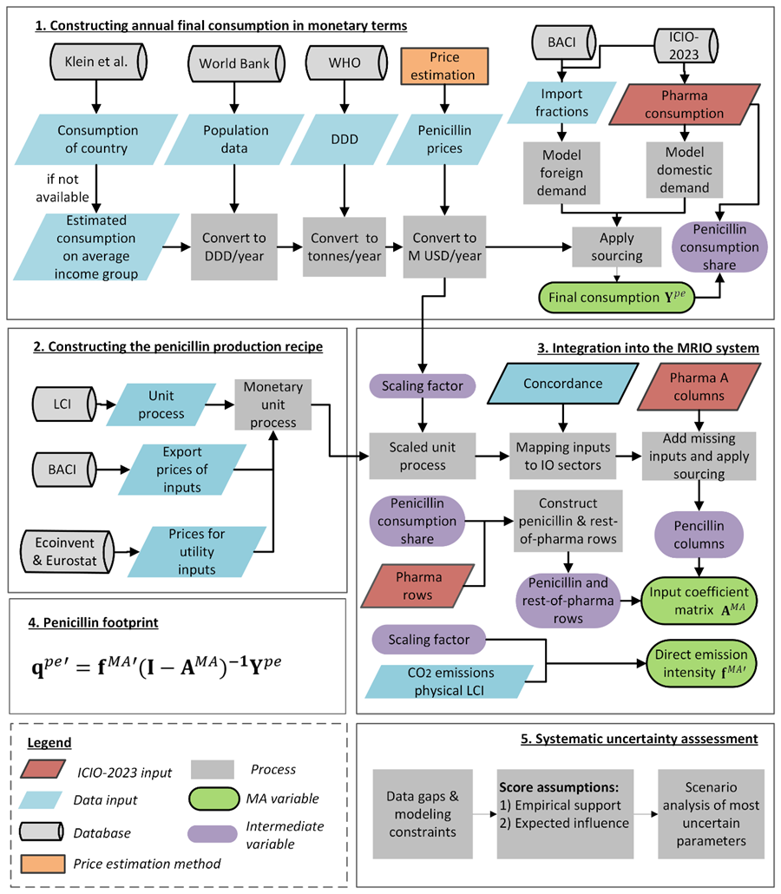
Data-limited MA
Framework
Construct annual final consumption in $
Construct the penicillin production recipe
Integrate both into the MRIO system
Calculate penicillin CF
Systematic uncertainty assessment
6.
Notes:
However, when you utilize life cycle inventory, you can directly use it to make a new sector in input-coefficient matrix, but you need price data to convert the physical inputs into monetary ones. Next we also need to scale the LCI to produce 1 MUSD of output. You can also used final demand to split the rows of pharmaceuticals and antbiotics. Basically the assumptions you need to make are based on data availability, and since we have no total output data we assume that total inputs equal total outputs. The main message is that In reality MA requires many assumptions and these will influence our newly calculated country-specific penicillin footprints.
The message is that you need to make assumptions and you can make them in a different way which leads to different results

Slide 8
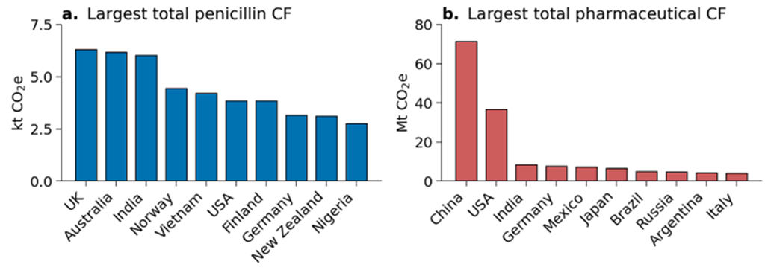
Distinct penicillin carbon footprint patterns and drivers
Alternative geographic hotspots
Per capita spending vs. economy size as major driver
7.
Notes:
Alternative geographic hotspots
Distribution of carbon footprint among more countries compared to the pharmaceutical CF
Penicillin CF’s are more substantially driven by high per-capita spending and population, compared to the pharmaceutical CF that is driven by large economies and populous countries

Slide 9
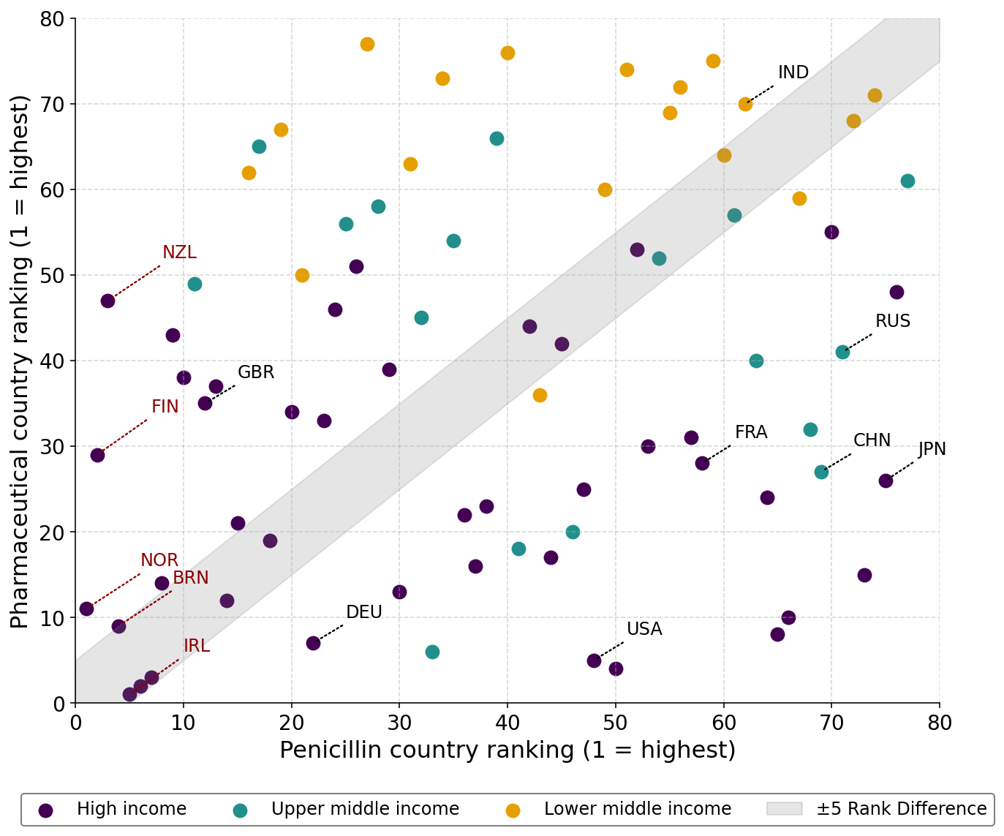
Disaggregation reveals substantial cross-country differences
Aggregated pharma: poor proxy for drug-level patterns
Disaggregation: essential for true emission hotspots and mitigation targets
8.
Notes:
On average, countries move 23 positions when comparing their carbon footprint of penicillin to that of pharmaceuticals, and only a small subset lies within a ±5-position band. The cross-country variation in per-capita carbon footprints is also substantially greater for penicillin (coefficient of variation, CV, 2.2) than for pharmaceuticals (CV=1). Together, these results show that carbon footprint assessments of aggregated pharmaceuticals are a poor proxy for drug-level patterns, masking substantial heterogeneity and limiting the ability to identify true emission hotspots or target mitigation efforts effectively.

Slide 10
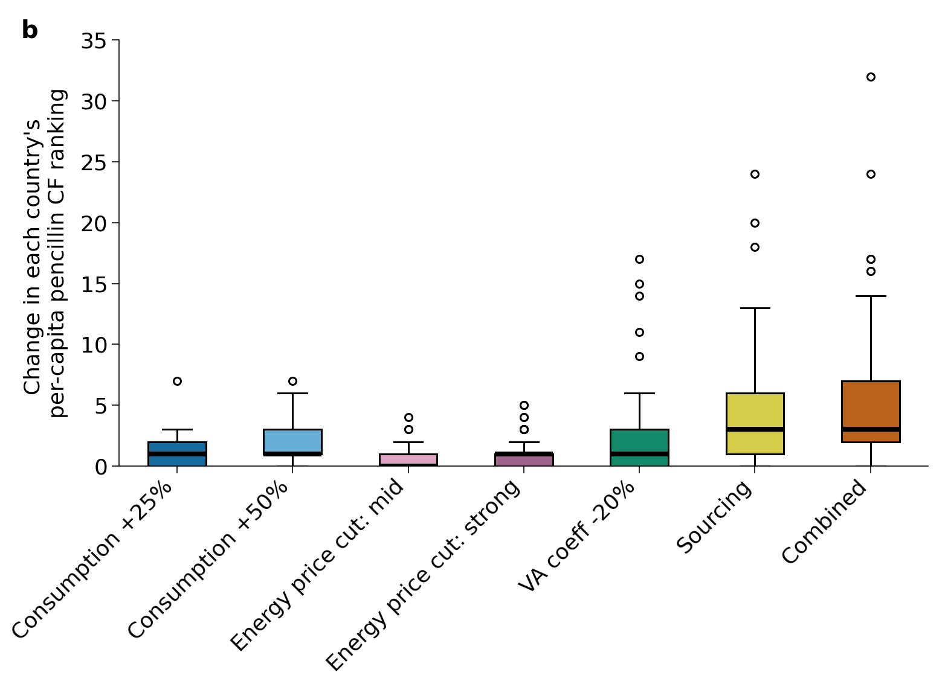
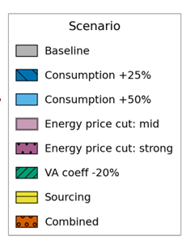
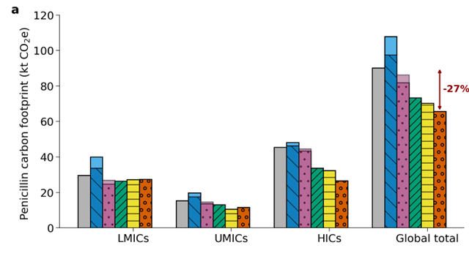
Footprint estimates remain robust under alternative assumptions
9.

Slide 11
Data and process modeling limitations
MA compared to other hybrid methods
a) Upstream aggregation errors
b) Large price dependency
Single LCI
Cross-country variation through price data
10.
Notes:
We selected the MA hybridization method for two main reasons: (1) it reduces the need for detailed LCI data, which is often limited in the pharmaceuticals, and (2) the country heterogeneity captured in the EE-MRIO enables cross-country comparisons.

Slide 12
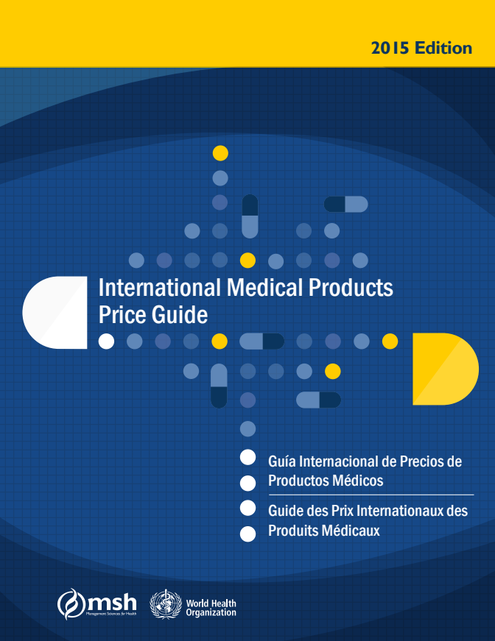
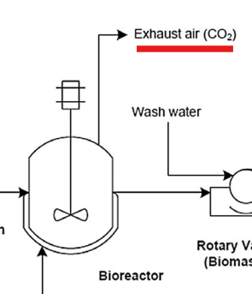
The Data Laundry List: data gaps & future research
On the statistics side:
Total output: data mining and modeling
Continued price tracking by international organizations
Consumption data for non-OECD countries & other pharma
On the LCA side:
Documentation of unit processes and direct emissions
Varied technological representation
Figure adapted from Harding et al. 2018
11.

Slide 13
Questions?
r.h.hagenaaars@cml.leidenuniv.nl

Slide 14
Picture references
Slide 2: Vector Juice. (n.d.). https://www.freepik.com/free-vector/import-goods-services-abstract-concept-illustration_12291353.htm#from_element=cross_selling__vector
Slide 10: MSH (Management Sciences for Health). 2016. International Medical Products Price Guide, 2015 Edition. (Updated annually.) Medford, Mass.: MSH. Cover design by Joe Meiring.
Slide 10: Harding, K. G., Dennis, J. S., & Harrison, S. T. L. (2018). Generic flowsheeting approach to generating first estimate material and energy balance data for Life Cycle Assessment (LCA) of Penicillin V production. Sustainable Production and Consumption, 15, 89-95.

Slide 15

Zooming out: mitigation and product-level footprint accounting
Mitigation focused on decreasing consumption
HICs ->minimize wastage and supply chain efficiency
LMICs: misuse and overuse of antibiotics, prevention of disease
Emerging regulatory and data-transparency initiatives

Slide 16
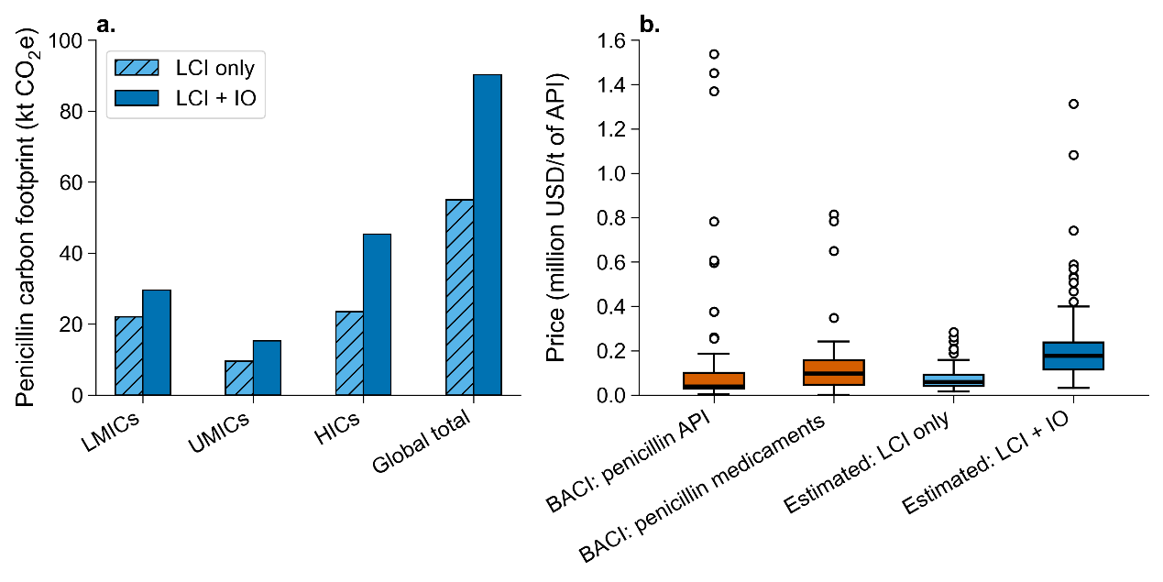
Additional robustness checks

