Slide 1




A systematic framework for extending MRIO databases: an application to energy-transition critical sectors in GTAP
Camilla Citterio
Lorenzo Rinaldi, PhD
Nicolò Golinucci, PhD
Maksym Chepeliev, PhD
Matteo Vincenzo Rocco, PhD
NextGen
Notes:
Center for Global Trade Analysis, Purdue University

Slide 2
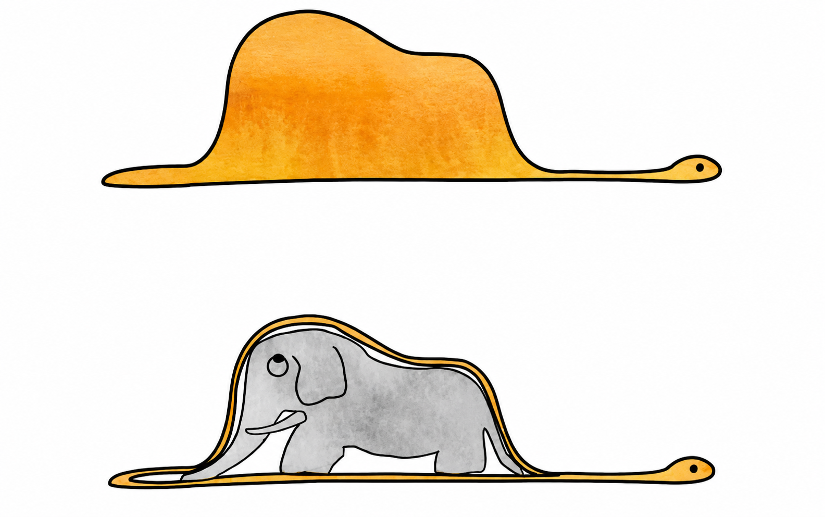

Slide 3
Saint-Exupéry, A. de. (2000). The little prince

Slide 4
The aggregation problem in MRIOT
Electrical Equipment (EEQ)
Rest of EEQ
LFP
NMC
NCA
Cost structures
Material use
Supply chain dependency
Environm. impact profiles

Slide 5
Decision tree
Disaggregation methodology
Sector/Comm. characteristics
Research question
Database characteristics
Data availability
Physical substi-
tution+Balancing
Simultaneus entropy
model for HMRIO
START
Azuero-Pedraza
2022
Tobben 2018
Yes
Yes
SUT?
Hybrid
units?
Only for
footprint?
Relevant weight
on parent?
Yes
Existing?
No
Matrix
augmentation
No
No
Yes
No
Detailed physical
& price data?
No
Miller & Blair
Yes
Tisserant 2016
Simultaneous
entropy model
Yes
Rectangular matrix
augmentation
Többen 2017
No
Refinement by
proxy level
Different quality
proxy?
Bakindi 2026
Yes
Wenz 2015
No
Unresolved
information
Conflicts?
Input and Output
shares
KRAS
Yes
Lenzen 2009
No
Wolsky 1984,
Lindner 2012
Yes
Stone-Byron
Known
row and
column totals?
Same technical
structure of
parent?
Yes
Byron 1978,
Van der Ploeg 1987
Yes
Coefficients+
Trade+
Cross entropy
No
Quantified
variance
No
Yes
Share preserving
Cross Entropy
No
Use coefficients
and trade data
MR-GRAS/
TRAS
No
Peters 2015, 2016
Glichrist 1999,
Temursho 2021

Slide 6


Disaggregating an IOT: where to start
Lessons learned from
1
2
3
4
Select database
Identify sector
Evaluate data availability
Select disaggregation method
Version
Temporal dimension
Geographical dimension
Parent sector
Map in
main classifications
(NACE, ISIC, HS6…)

Slide 7
Disaggregation in MARIO
Constrained optimization,
minimizing cross entropy including prior estimates

Slide 8
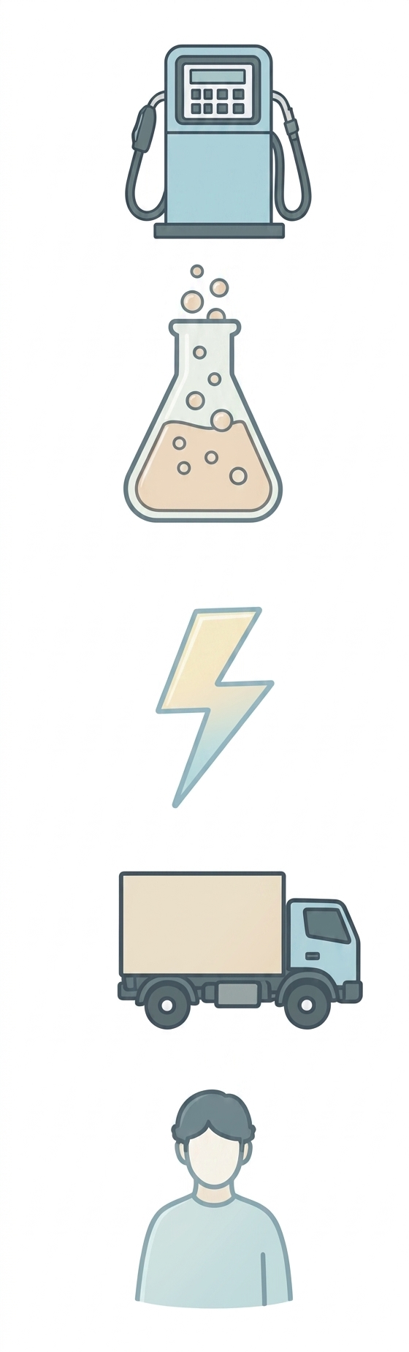
Disaggregation methodology: Deterministic step
Cost structure
EU27
 | Cost share
Fossil fuels | 5.2 %
Chemicals | 1.9 %
Electricity | 2.2 %
Transport | 0.7 %
… | …
Labor | 15.6 %
Capital | 15.8 %
Total | 100%
Austria
…
Intermediate transactions
Possibility to define
sector and region clusters
Sweden
AT
Value added
…
SE
Total = 1
New column coefficients

Slide 9
Disaggregation methodology: Deterministic step
Cost structure
Column coefficients
Column flows
Total outputs

Slide 10
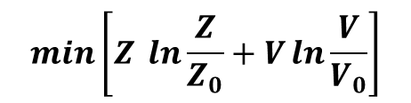
Disaggregation methodology: Optimization problem
$$\min\left[Z \ln{\frac{Z}{Z_{0}}}+V\ln{\frac{V}{V_{0}}}\right]$$
Trade data
OBJ
Cost structure
Column coefficients
Priors and constraints
    Original totals
    Row and column balance
    Trade per region
    Zeroes stay zeroes
Column flows
Cross entropy minimization
CONSTRAINTS
Total outputs

Slide 11




Disaggregation methodology: Computational implementation
Original IOT
Trade data
Cost structure
Column coefficients
Priors and constraints
Column flows
Cross entropy minimization
Total outputs
Enhanced IOT
MARIO
Multifunctional Assessment
of Regions through
Input-Output
Laboratory for database-centered convex optimization modeling.

Slide 12

Case study

Slide 13
Testing
GTAP fictitious split
OIL
OIL
OIL&GAS
GTAP 12 Power
GAS
GAS
Aggregation of 2 sectors
Disaggregation in MARIO
76
Sectors
75
Sectors
76
Sectors
80
Regions
68 countries + 12 clusters

Slide 14
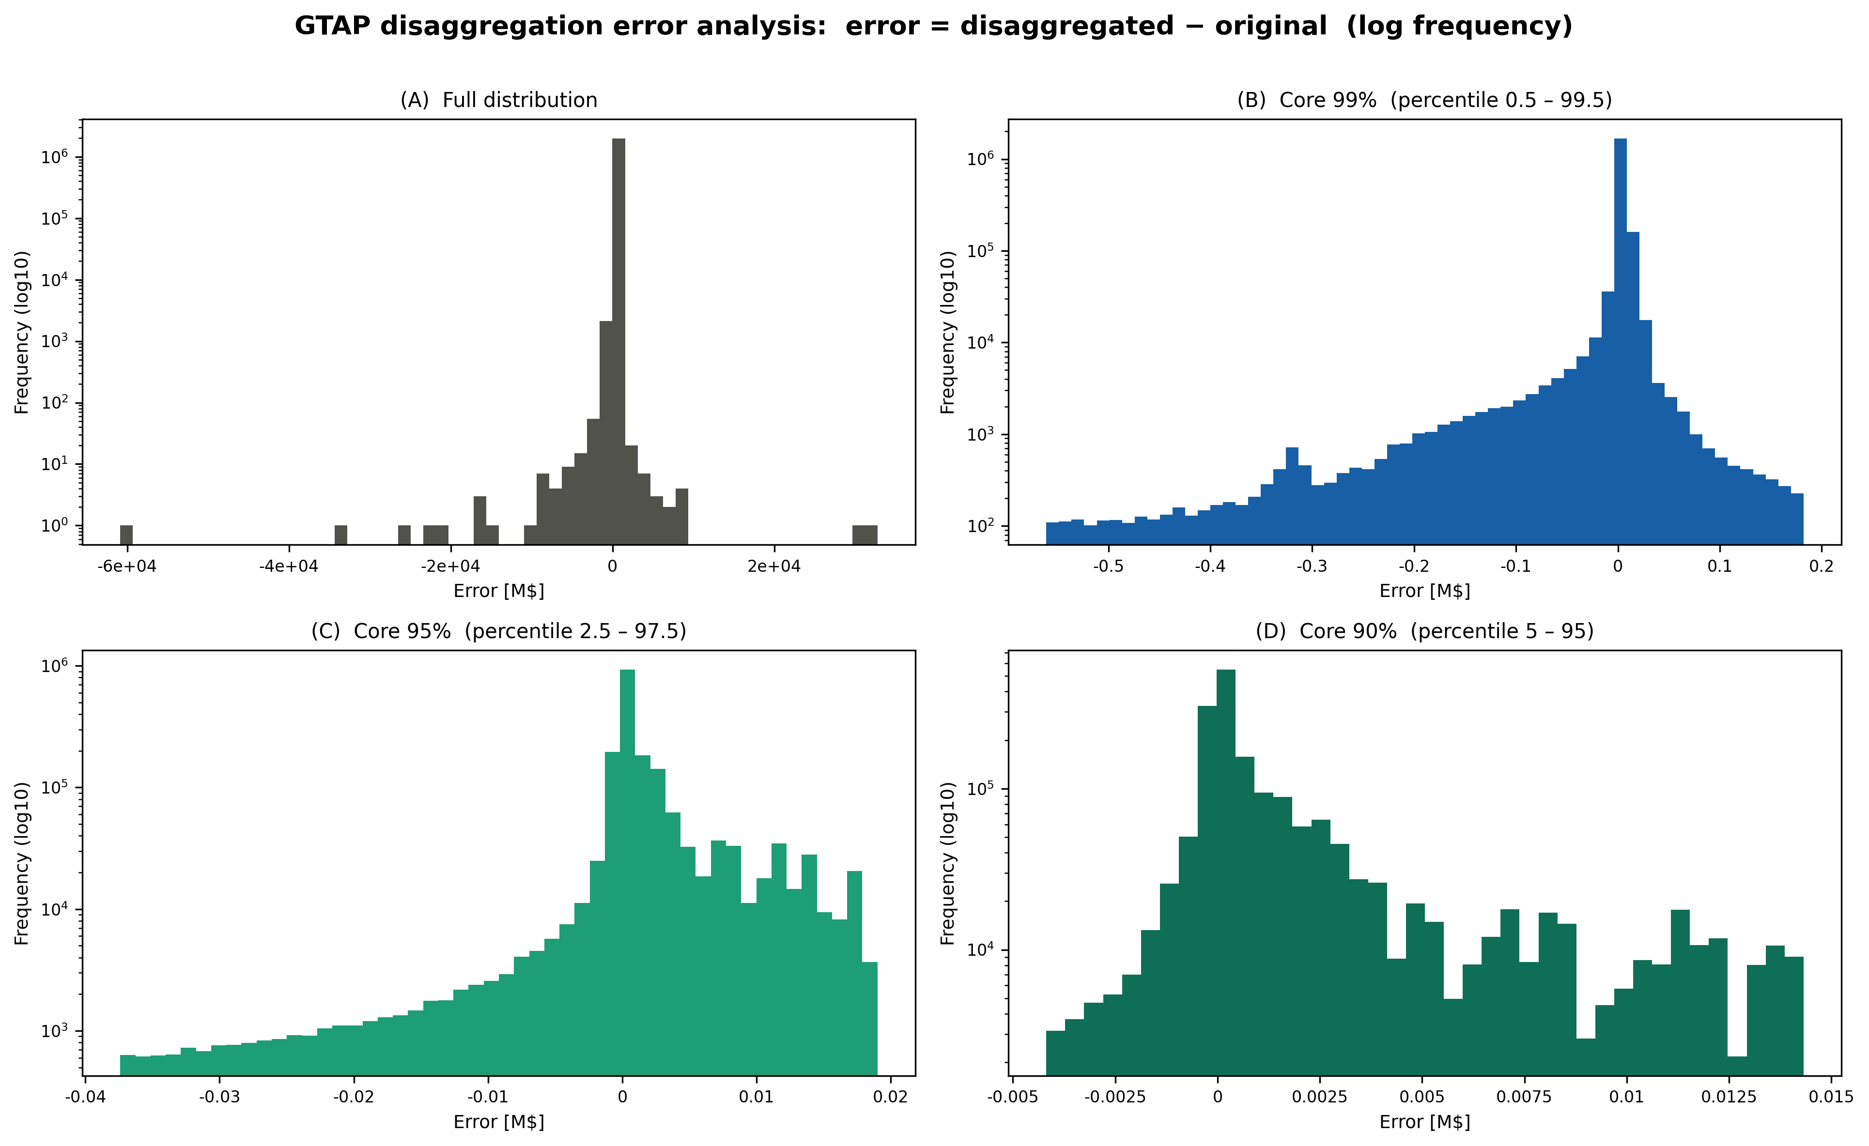
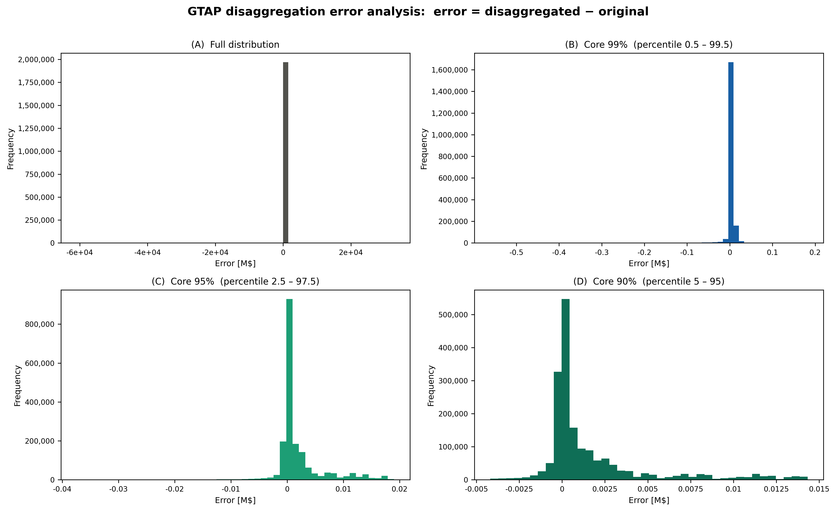
Key results
5% of table values are modified (almost 2 M data points)
Median absolute error : 700 USD
Weakest point: self-consumption cells
Error distribution
Gradual outliers exclusion

Slide 15

Impact of disaggregation on gas footprints
 | Median | Average
CH4 | 0.2% | 5.0%
BC | 0.1% | 4.7%
CO2 | 0.1% | 2.0%
CO | 0.1% | 8.5%
N2O | 0.1% | 14.1%
NOX | 0.1% | 3.3%
OC | 0.1% | 7.5%
PM10 | 0.1% | 5.9%
PM2.5 | 0.1% | 4.6%
SF6 | 0.1% | 6.7%
SO2 | 0.1% | 5.0%
New footprint computed considering the original gas emissions satellite accounts and the new Leontief matrix
$$\frac{\left|F_{new}−F_{original}\right|}{F_{original}}$$

Slide 16

Steps foreward
1
Complete
Extend number of regions; include environmental extensions
2
ENTICE project
Enhanced GTAP12 for 2023
3
Expand
Implement in MARIO additional enhancement routines

Slide 17
References
Azuero-Pedraza, C. G. et al. (2022). Incorporating New Technologies in EEIO Models.
Bakindi, A. et al. (2026). Streamlined column-based disaggregation method for carbon footprint quantification for multi-regional input–output (MRIO) models.
Byron, R. P. (1978). Estimation of Large Social Account Matrices.
Gilchrist, D. A., & St Louis, L. V. (1999). Completing Input–Output Tables using Partial Information, with an Application to Canadian Data.
Lenzen, M. et al. (2009). Matrix balancing under conflicting information.
Lindner, S. et al. (2012). Disaggregating input-output models with incomplete information.
Miller, R. E., & Blair, P. D. (2009). Input-Output Analysis: Foundations and Extensions.
Peters, J. C., & Hertel, T. W. (2015). Matrix balancing with unknown total costs: preserving economic relationships in the electric power sector.
Peters, J. C. (2016). The GTAP-Power Data Base: Disaggregating the Electricity Sector in the GTAP Data Base.
M. A. Tahavori et al. (2023) MARIO: A Versatile and User-Friendly Software for Building Input-Output Models
Temursho, U. et al. (2021). A multi-regional generalized RAS updating technique.
Tisserant, A., & Pauliuk, S. (2016). Matching global cobalt demand under different scenarios for co-production and mining attractiveness.
Többen, J. (2017). On the simultaneous estimation of physical and monetary commodity flows.
Többen, J. et al.(2018). A novel maximum entropy approach to hybrid monetary-physical supply-chain modelling and its application to biodiversity impacts of palm oil embodied in consumption.
van der Ploeg, F. (1987). Balancing Large Systems of National Accounts.
Wenz, L. et al. (2015). Regional and Sectoral Disaggregation of Multi-Regional Input-Output Tables – A Flexible Algorithm.
Wolsky, A. M. (1984). Disaggregating Input-Output Models.

Slide 18


Softwares’ docs and repo:
MARIO
Thank you
for your attention!
Camilla Citterio
camilla.citterio@polimi.it
SESAM research group
PhD candidate, year 2

