Slide 1
Economy-wide and international spillovers of the economic impacts of climate change
Maksym Chepeliev,¹ Dominique van der Mensbrugghe¹ and Toon Vandyck²
¹Center for Global Trade Analysis, Purdue University, USA
²KU Leuven, Belgium
32nd International Input-Output Association Conference
June 22-26, 2026
Seville, Spain

Slide 2
Outline
Motivation: widely diverging estimates of climate damages
Methods
  2.1. Modeling framework: recursive-dynamic CGE model ENVISAGE
  2.2. Parametrization of top-down and bottom-up impacts
Results
  3.1. Climate damages
  3.2. Decomposing economic impacts
  3.3. International spillovers
  4. Conclusions

Slide 3
Widely varying estimates of climate impacts
Climate damage estimates vary widely because of uncertainties in impact persistence, adaptation, extreme events, tipping points, welfare valuation, and discounting assumptions (Tol, 2018; Dietz et al., 2021; Casey et al., 2023; Howard & Sterner, 2025).
One of the sources of heterogeneity in the estimates lies in the methods used.
  Top-down econometric estimates directly relate climate variables to aggregate economic outcomes (Burke et al., 2015; Bilal & Känzig, 2026).
  Bottom-up structural approaches quantify damages through individual impact channels such as agriculture, labor productivity, health, and tourism (Auffhammer, 2018; Roson & Sartori, 2016; van der Wijst et al., 2023).
Top-down estimates typically imply larger climate damages than bottom-up assessments. While recent bottom-up work has narrowed this gap (van der Wijst et al., 2023), newer empirical evidence points to much larger losses, renewing questions about the underlying impact channels (Neal et al., 2025; Bilal & Känzig, 2026).
Large differences between climate damage estimates highlight the need to better understand the drivers of macroeconomic impacts and reconcile competing methodological approaches.

Slide 4
A need for a better understanding of climate damages
We address several methodological gaps through a systematic comparison of top-down and bottom-up climate damages in a structural model of global economy.
Gap 1: Limited understanding of the importance of different climate impact channels
  Existing studies often focus on selected impact channels or report combined climate damages without explicitly decomposing underlying mechanisms.
  We provide a comprehensive decomposition of climate damages across agriculture, labor, health, tourism, and sea-level rise channels, including their interactions and economy-wide spillovers.
Gap 2: Insufficient evidence on international spillovers of climate change
  Most studies focus on individual countries or aggregate damage estimates, providing limited insight into how climate impacts propagate through international trade and global value chains.
  We quantify cross-border spillovers of climate damages and assess the role of international trade in amplifying or buffering economic impacts.
Gap 3: Lack of understanding of how top-down climate damages translate into economy-wide impacts
  Top-down estimates are typically reported as GDP or productivity shocks, providing little guidance on how damages should be represented across production factors in structural economic models.
  We decompose top-down climate damages across labor, capital, land, and intermediate inputs, highlighting the implications of alternative implementation choices for estimated economic losses.

Slide 5
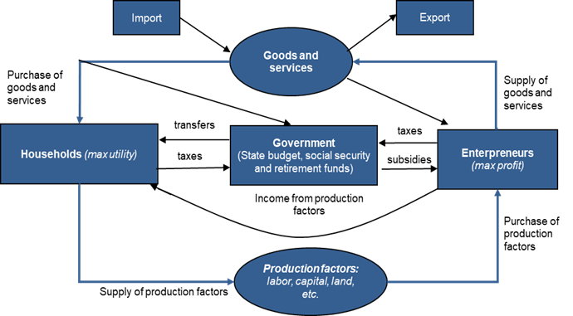
Methodological framework: ENVISAGE CGE model
Global computable general equilibrium (CGE) model
  Recursive-dynamic (2017-2050).
Nested energy demand
Alternative generation technologies, such as coal, gas, wind, solar, hydro and other renewables (GTAP-Power database v11).
Preference shifts/technological changes
  Decreasing cost of renewables; increasing preferences toward renewable energy; increasing electrification rates; energy efficiency improvements.
  Model aggregation: 27 regions (G20-focused) and 30 activities.
Circular flows in a CGE model
The model captures climate impacts through multiple sector- and factor-specific channels, including labor productivity, agriculture, land availability, tourism, energy demand, and infrastructure, as well as economy-wide productivity shocks.

Slide 6
Scenario framework combines SSP2 baseline and climate impacts under RCP4.5
Baseline scenario
  Is calibrated to the middle-of-the road SSP2 pathway (IIASA, 2024).
  Baseline scenario radiative forcing corresponds to the RCP4.5 projections.
Top-down shocks
  Are based on Casey et al. (2023) and implemented as changes in the total factor productivity (TFP) assumed uniform across sectors.
  TFP shocks range from negative 0.9-1% (Saudi Arabia and India) to positive 0.6-0.7% (Russia and Canada) relative to baseline in 2050.
  Sensitivity scenarios explore variation in the production factors coverage.
Bottom-up shocks
  We rely on the shocks developed in Roson and Sartori (2016) complemented with selected additional data sources and refinements.
  The bottom-up framework captures climate impacts through five impact channels applied as country-, sector- and factor-specific shocks (detailed on next slide).

Slide 7
Bottom-up shocks are implemented across five impact channels
Impact channel | Model implementation | Approximate magnitude by 2050
Sea-level rise | Reduction in agricultural land availability | Global loss of ~4,660 km² of agricultural land (<0.001% of total agricultural land)
Crop yields | Shock to agricultural land productivity (sector-specific yields) | −2–3% in South Asia and Sub-Saharan Africa; +2–3% in Canada and Russia
Labor heat stress | Reduction in labor productivity (sector-specific) | Largest damage channel; agricultural labor productivity losses exceed 10% in many regions
Health impacts | Economy-wide labor productivity shock from heat-related diseases | Generally <1% labor productivity loss across countries
Tourism | Changes in tourism expenditures and trade flows | Up to ~0.6% of GDP loss in Rest of East Asia; gains in several high-income countries

Slide 8
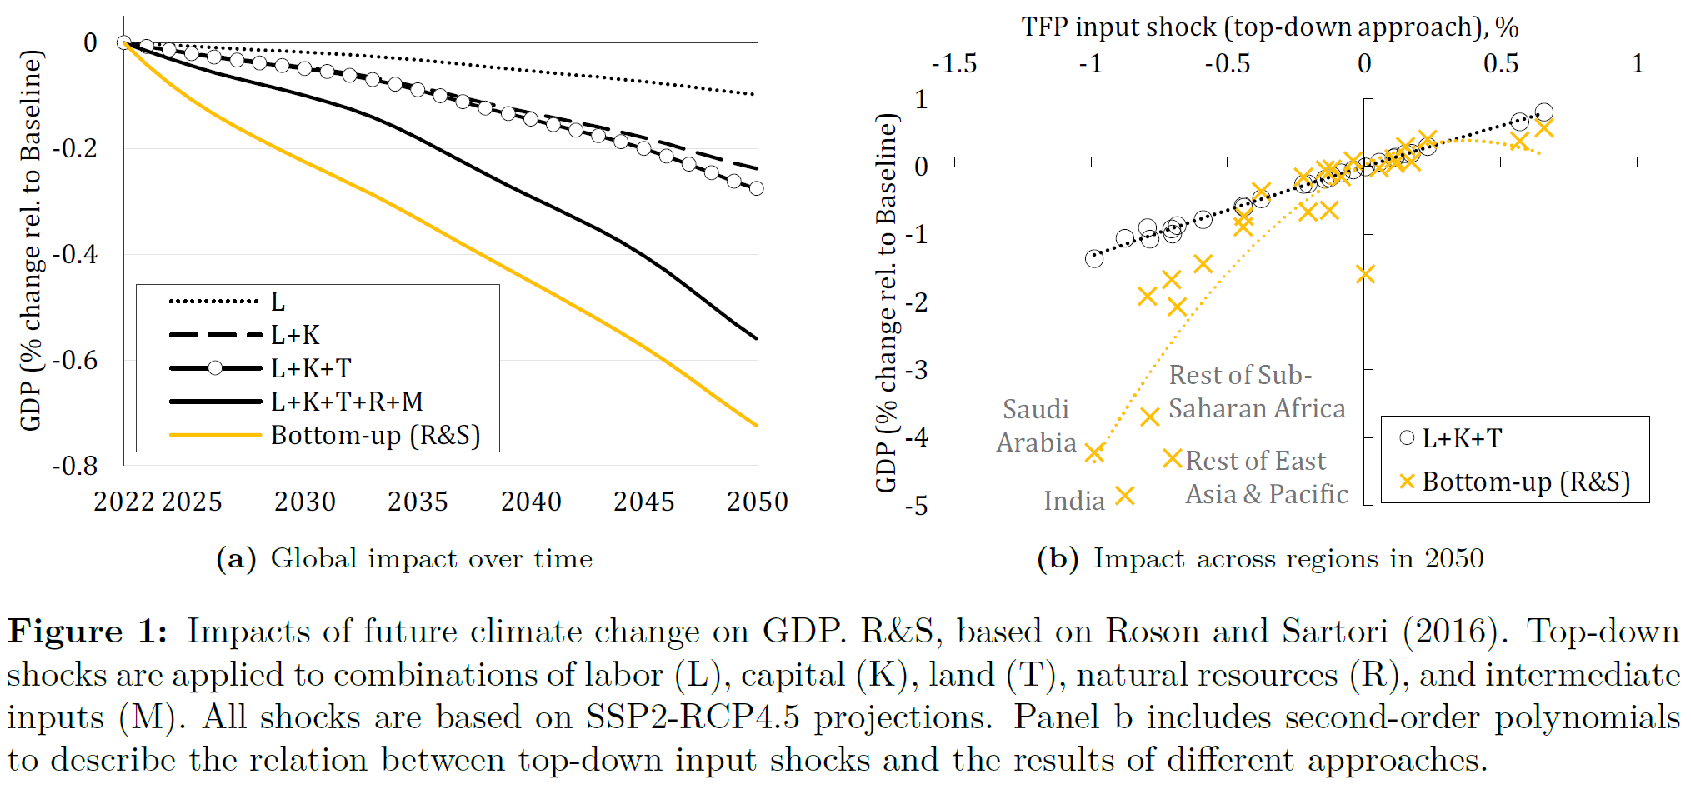
Broad alignment between bottom-up and top-down estimates
Top-down and bottom-up approaches produce broadly similar global climate damages by 2050 (≈0.3–0.7% GDP loss), despite relying on fundamentally different damage representations.
The coverage of production factors within top-down shocks matters a lot with intermediate inputs contributing the largest share of total losses (though the value-added only shock is more justifiable).
Similar global outcomes mask important regional differences: while both approaches identify broadly similar winners and losers, bottom-up estimates generate greater cross-country variability.

Slide 9
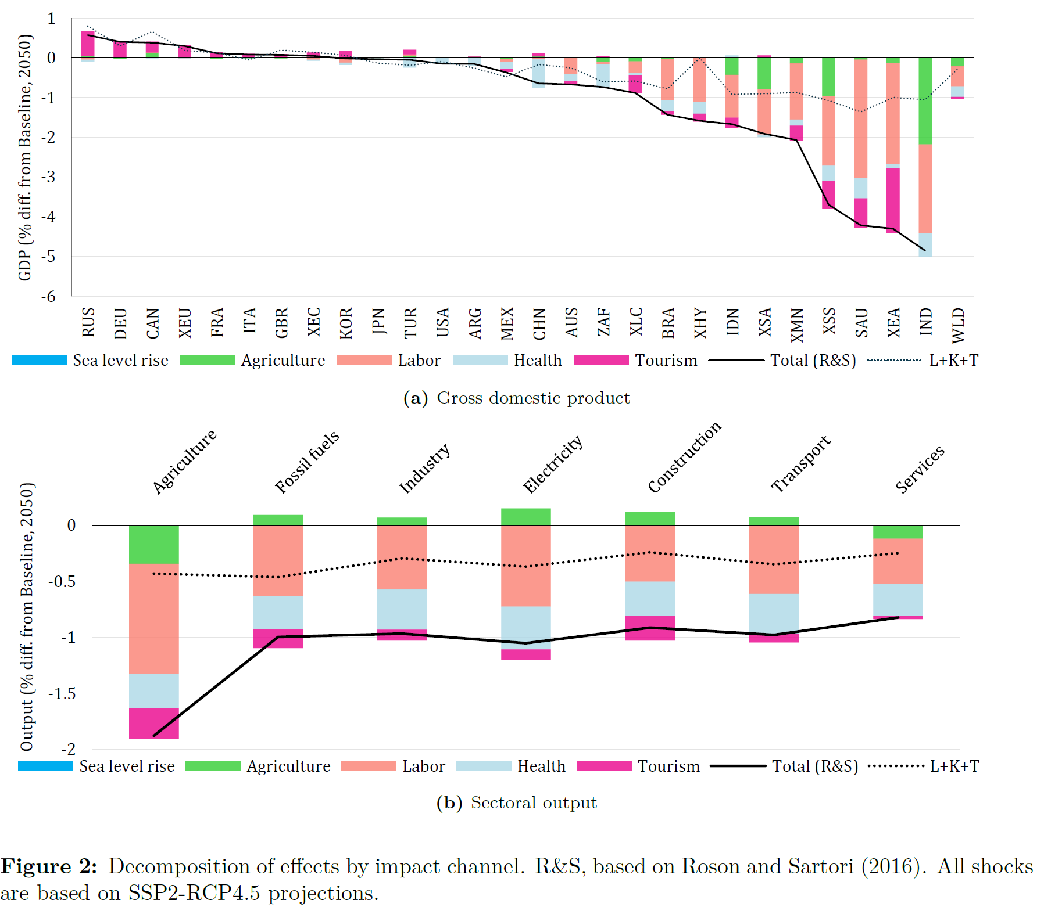
Higher variation of inter-country and inter-sectoral damages under bottom-up estimates
Countries and regions in the global South (India, Indonesia, SEA, SSA) are impacted the most adversely, with India losing up to 5% of GDP in 2050 under the bottom-up shocks.
High- and upper-middle-income countries in the global North experience moderate gains.
Differences in country-specific impacts across the two approaches imply larger negative impacts under bottom-up approach, largely attributed to labor heat stress.
In the majority of the adversely impacted countries, climate damages are caused via multiple channels, substantially complicating future climate adaptation challenges.
Top-down shocks imply a limited variation of impacts across sectors, while to bottom-up estimates

Slide 10
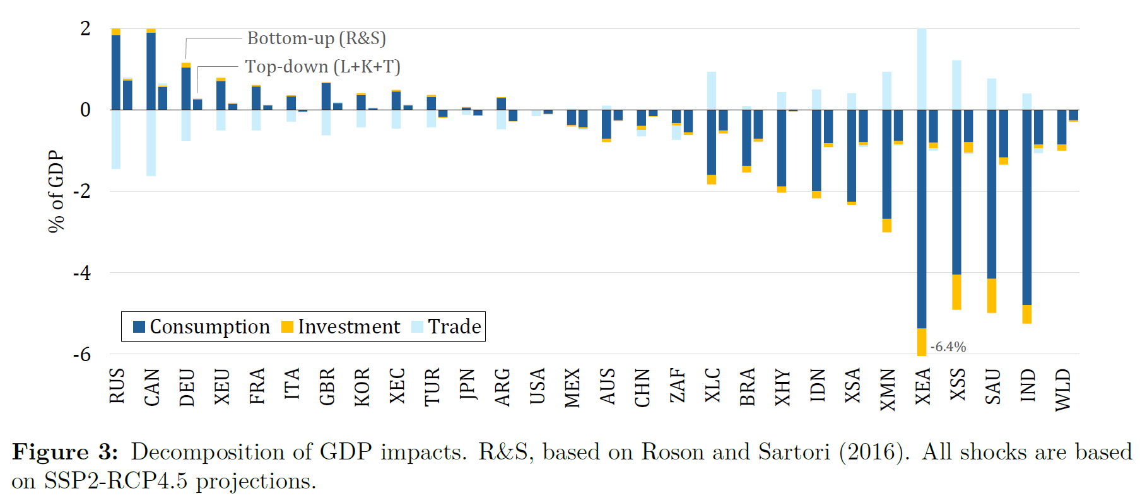
Broad alignment between bottom-up and top-down estimates
Decomposition of GDP impacts shows broadly similar consumption and investment effects across approaches, but substantial differences in trade impacts.
Top-down climate shocks generate relatively small trade effects because economy-wide productivity changes do not create strong sector-specific comparative advantages.
Bottom-up impacts induce larger trade adjustments through sector-specific damages (including tourism), and trade becomes the primary channel explaining differences in climate impacts across regions.

Slide 11
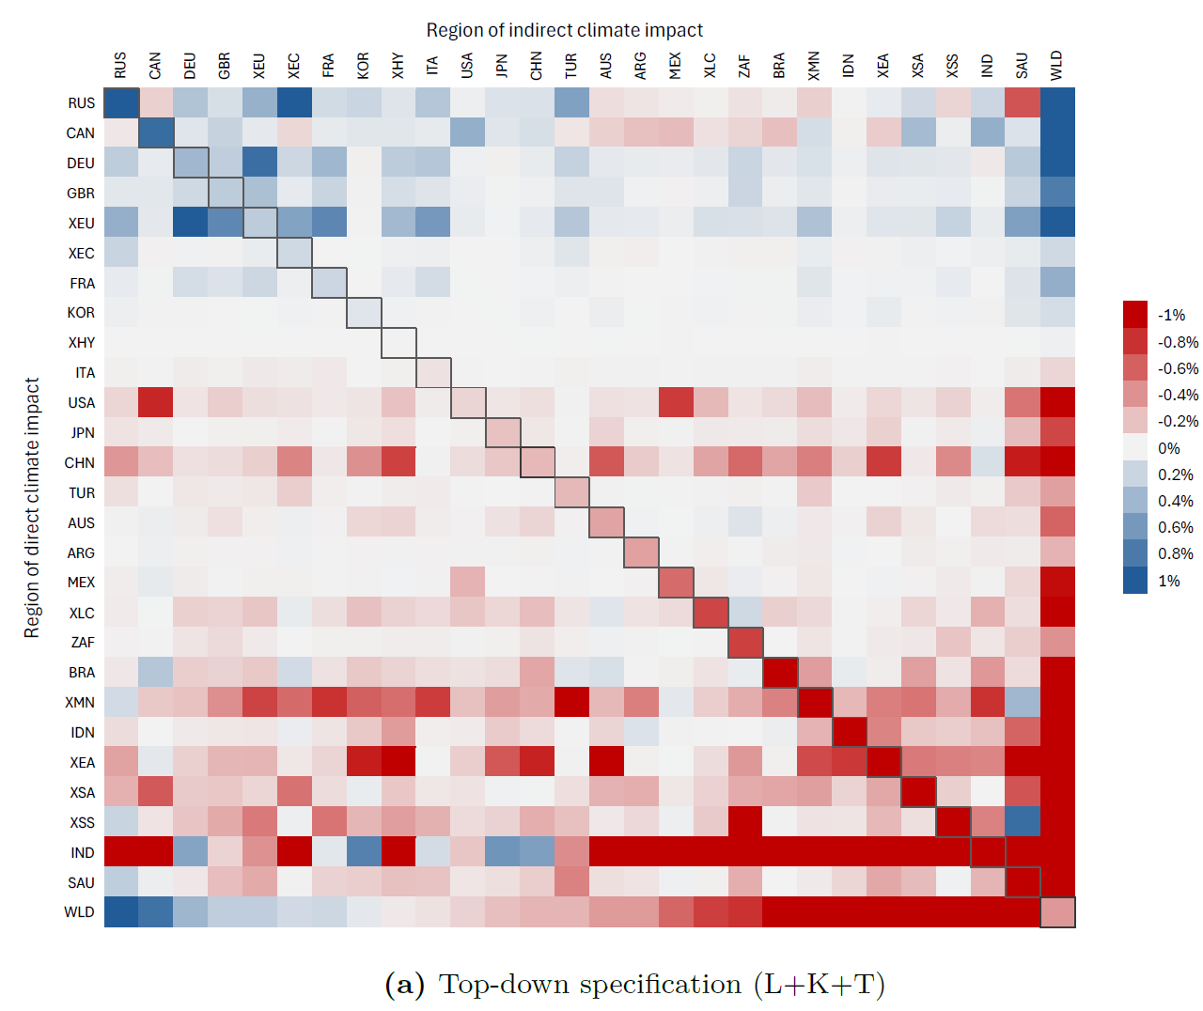
International spillovers: top-down shocks
Welfare impacts
To assess international spillovers in more detail, we implement key scenarios on a region-by-region basis, where climate impacts are introduced for one region at a time, further comparing the sum of the region-specific impacts with global shock.
International spillover effect raises global economic damages by 1–7% relative to the domestic-only impacts.
Under the top-down approach, international spillovers generally mirror domestic climate impacts: countries benefiting (losing) from climate change tend to generate positive (negative) welfare spillovers for their trading partners.
A few exceptions arise through shifts in comparative advantage and trade patterns—for example, climate damages in India benefit China (and vice versa), while positive impacts in Canada increase U.S. welfare but reduce Mexico’s as trade flows are redirected.

Slide 12
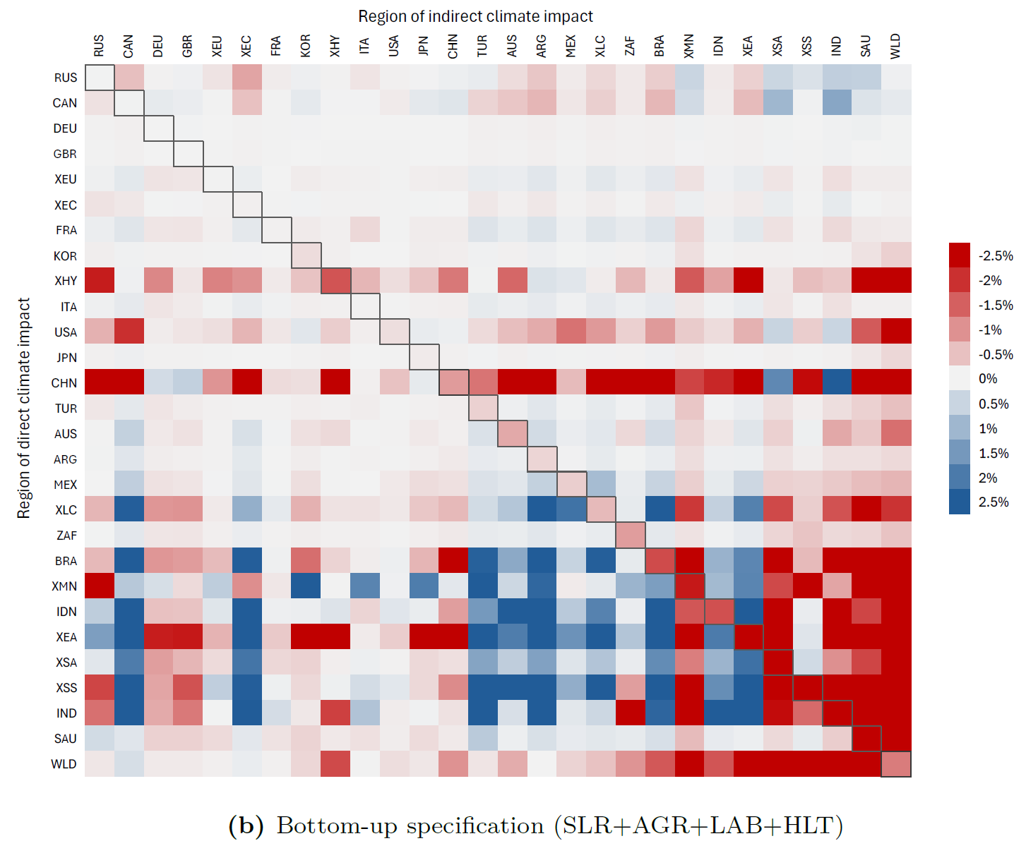
International spillovers: bottom-up shocks
Welfare impacts
Bottom-up impacts generate more heterogeneous and asymmetric bilateral spillovers than top-down productivity shocks, reflecting stronger sector-specific trade responses.
Moderately affected regions (e.g., Turkey and Argentina) gain competitiveness relative to more heavily impacted regions such as India and Sub-Saharan Africa.
Foreign climate impacts play a larger role under the bottom-up approach: domestic impacts account for 90–110% of total welfare changes in only 11 regions, compared with 24 regions under the top-down approach.

Slide 13
Conclusions
For top-down approach, estimated damages depend strongly on factor coverage: intermediate inputs (with limited empirical evidence of direct climate impacts) represent the largest contributor to total losses (over half), followed by capital and labor, with land contributes less than 10% of damages. -> future research to justify empirical basis for these modeling choices.
Strong sectoral spillover effects across climate impact channels, highlighting the importance of accounting for both direct and indirect climate damages across multiple channels, even when focusing the assessment on a specific sector (e.g. in agriculture yield shocks account for <20% of the total impact) -> widely used yield impact shocks might substantially underestimate impacts on agriculture.
Top-down estimates show more limited sectoral and inter-country variation of impacts compared to the bottom-up implementation. -> this is largely driven by the (sector-uniform) nature of the shock.
International trade is a key transmission mechanism, increasing global climate damages by approximately 1–7% relative to the sum of domestic impacts.
Bottom-up damage representations generate stronger trade responses and international spillovers: domestic impacts account for 90–110% of total welfare changes in only 11 regions, compared with 24 regions under the top-down approach.

Slide 14
Future research agenda
Better quantify the role of market-mediated adaptation, including production reallocation, factor substitution, and trade adjustments that buffer or amplify climate damages (endogenously included in the CGE model).
Expand the bottom-up representation of climate impacts beyond the five channels considered here to better capture economy-wide damages and transmission mechanisms (e.g. livestock heat stress, extreme weather events, energy supply and demand impacts, losses of ecosystem services, etc.).
Systematically compare alternative top-down and bottom-up damage functions to identify the drivers of divergent climate damage estimates and strengthen methodological robustness.

Slide 15
Thank you!
mchepeli@purdue.edu

