Slide 1

SUT and IOT indicators and visualisation on HCSO website
Eva Samekh-Varga
Hungarian Central Statistical Office
23-26.06.2026.

Slide 2
Introduction
1.
2.
About the input–output indicators
3.
Methodology
4.
Further directions

Slide 3





Introduction

Slide 4
The SUT is an integrated part of the National Accounts compilation in Hungary
As part of a Eurostat Grant project compilation of IOTs (both industry by industry and product by product) at 2-digit level on annual basis for 2020-2023
possible to use data from multiple years to produce short queries and analyses

Slide 5
The input–output table is one of the fundamental statistical tools of the national economy
It helps reveal the interdependencies between industries, as well as the direct and indirect effects that changes in the output of a given industry have on the economy as a whole.
In the analysis, which were used the industry by industry IOT and the so-called “Type I” multipliers derived from it.
These multipliers are based on the Leontief inverse.

Slide 6
About the input–output indicators

Slide 7
Distribution of the direct use of imports
This section shows how direct import use is distributed between intermediate (current production) and final uses, and which industries are the main users of imported products that are directly used for production purposes.
Total import content of final use items
The total import content of final use consists of two components: direct and indirect (cumulative) import content. This section presents the distribution of imports allocated to final purposes according to these two components.
Direct and Indirect GVA generated through production linkages in supplier industries
Based on direct and indirect gross value added (GVA) contributions, the individual components of final consumption are decomposed in this section.

Slide 8
Methodology

Slide 9
1. The Supply and Use Table data at purchasers’ prices are transformed into basic prices.
2. Using import data, the use matrix at basic prices is split into domestic and imported components.
3. These are usually using one of the following technology assumptions to transform IOT from SUT’s:
- Product technology assumption (A)
- Industry technology assumption (B)
HCSO used the B-type assumption of fixed product sales structure (each product is characterized by its own sales structure, regardless of the industry in which it is produced) — following the methodology described in the UN manual—the industry by industry IOT, the coefficient matrix, and the Leontief inverse are constructed.

Slide 10
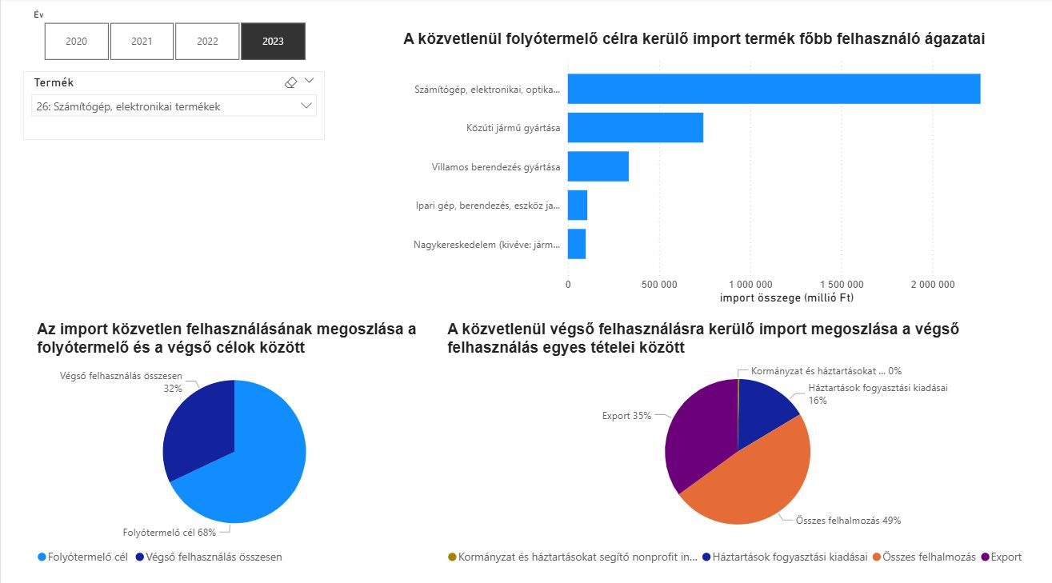
Indicator 1.: Distribution of the direct use of imports

Slide 11
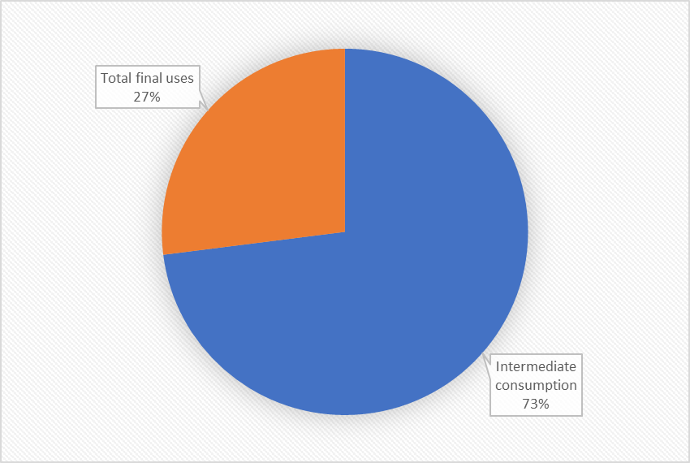
for example, CPA01: Crop and animal production, hunting and related products

Slide 12
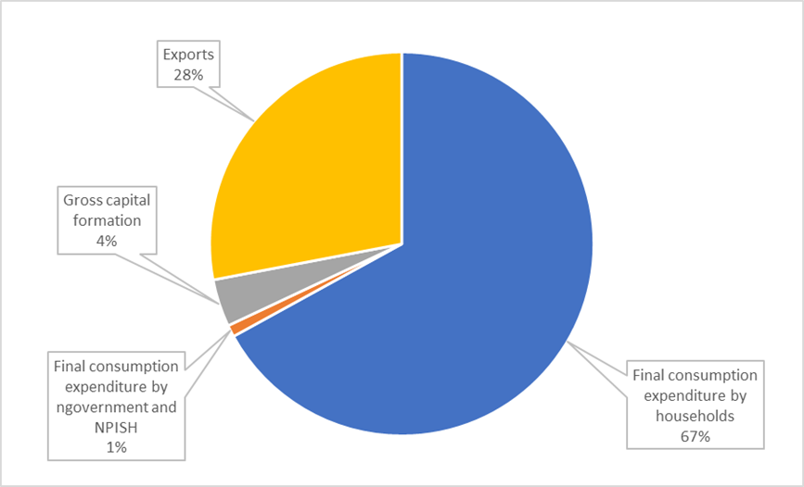

Slide 13
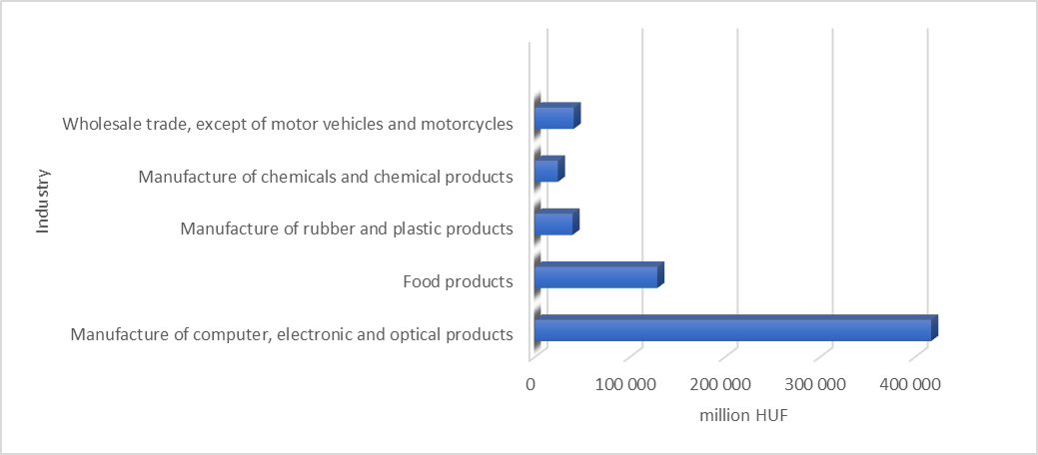

Slide 14
Indicator 2.: Total import content of final use item
The total import content of final uses consists of two components: direct and cumulative import.
Meaning of direct import: meaning of distribution of direct import used for final use across the different components of final uses.
In the case of cumulative import content, it is calculated the import content of final use categories (through production linkages).

Slide 15
To calculate Cumulative import data, it was necessary compiling the following matrices:
A matrix= direct input coefficient matrix
E matrix = identity matrix, which has ones on the diagonal and zeros elsewhere;
Q matrix= Leontief inverse (The Leontief inverse shows the total output required from each industry to satisfy a unit increase in final demand, accounting for both direct and indirect effects.)
H matrix = primary input coefficient matrix
Y matrix = matrix of final uses
H * Q matrix
H * Q * Y matrix = It measures the cumulative primary input content embodied in the output for each final use category.

Slide 16
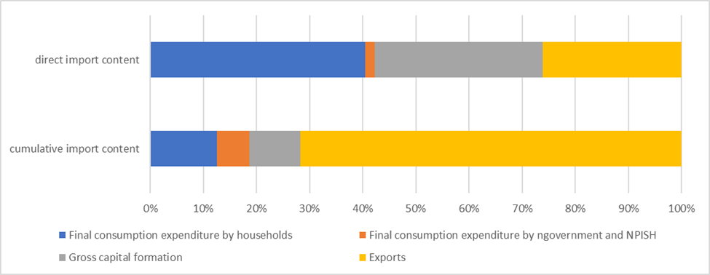

Slide 17
Indicator 3.: Indirect GVA generated through production linkages in supplier industries
Direct GVA refers to the value generated solely by the production of the activity itself; it does not include the GVA of suppliers, subcontractors, or other ripple (indirect) effects.
Indirect GVA, on the other hand, represents the gross value added created along the supply chain—that is, the economic value generated not directly by the activity itself, but by the related supplier industries.

Slide 18
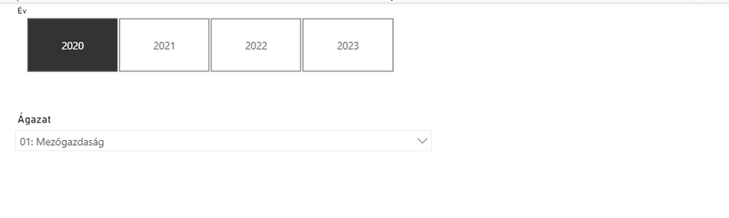
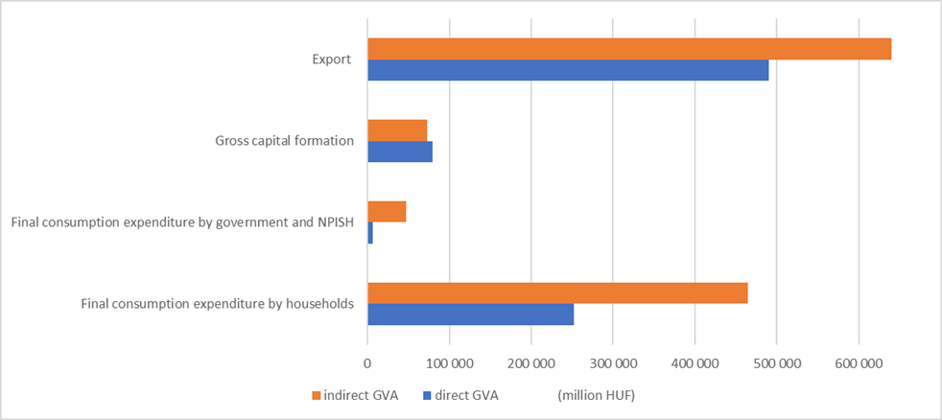
The Supply and Use Table data at purchasers’ prices are

Slide 19
To calculate GVA content the following matrices have to be calculated
A matrix= direct input coefficient matrix
E matrix = identity matrix, which has ones on the diagonal and zeros elsewhere;
Q matrix= Leontief inverse (The Leontief inverse shows the total output required from each industry to satisfy a unit increase in final demand, accounting for both direct and indirect effects.)
diagGVA matrix = a matrix where the diagonal consists of the GVA row of the ‘H’ matrix and zeros elsewhere
Y matrix = matrix of final uses
(diagGVA * Q) matrix = is a matrix multiplication, in which the above mentioned diagGVA is multiplied with Leontief inverse
(diagGVA * Q * Y) matrix
directGVA matrix = (diagGVA * Symmetric input-output table for domestic production (industry x industry) final uses columns)
indirectGVA matrix = (diagGVA * Q * Y) - directGVA

Slide 20


Slide 21
Future Directions

Slide 22
Looking ahead, the analytical framework offers several opportunities for further refinement and expansion. One immediate direction involves the integration of the most recent annual data into the existing input–output matrices, thereby enabling the continuous updating and improved temporal relevance of the indicators.
In addition, the current set of indicators can be significantly extended through the development of new metrics derived from more detailed analytical structures. This includes the utilization of industry-by-industry input–output tables, which allow for a deeper exploration of intersectoral relationships, as well as product-by-product matrices, which enable a more granular analysis of production and supply chain dynamics.
Overall, these prospective developments will contribute to enhancing both the analytical depth and practical applicability of the framework, supporting more comprehensive economic analysis and evidence-based decision-making.

Slide 23





Thank you for your attention!
If you have any questions: eva.varga2@ksh.hu
www.ksh.hu
Facebook.com/KozpontiStatisztikaiHivatal
Instagram.com/kozpontistatisztikaihivatal
x.com/StatsHungary
linkedin.com/company/hungarian-central-statistical-office/

