Slide 1

Smart systemic modelling: how we are able to combine INFORGE with LLM
Marc Ingo Wolter
June 2026, 32nd International Input-Output Association Conference

Slide 2
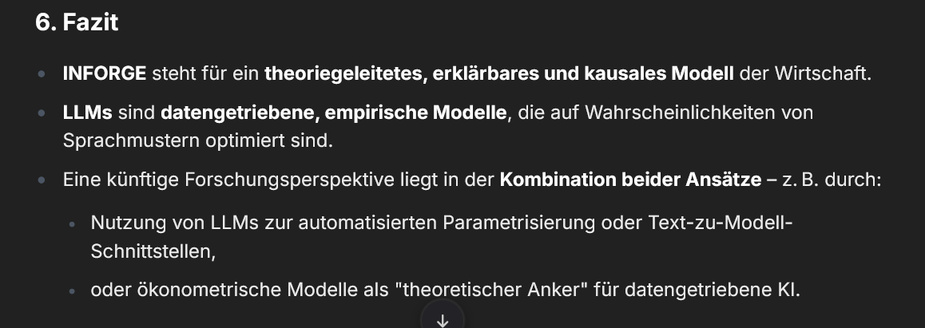
To start with
Question: What are the differences and similarities between large-scale econometric models such as the INFORUM-Model INFORGE and LLMs?
Answer: Translated:
  INFORGE represents a theory-driven, interpretable and causal model of the economy.
  LLMs are data-driven, empirical models optimised for the probabilities of language patterns.
  A future research avenue lies in combining both approaches – for example, through:
    the use of LLMs for automated parameterisation or text-to-model interfaces,
    or econometric models as a ‘theoretical anchor’ for data-driven AI.

Slide 3
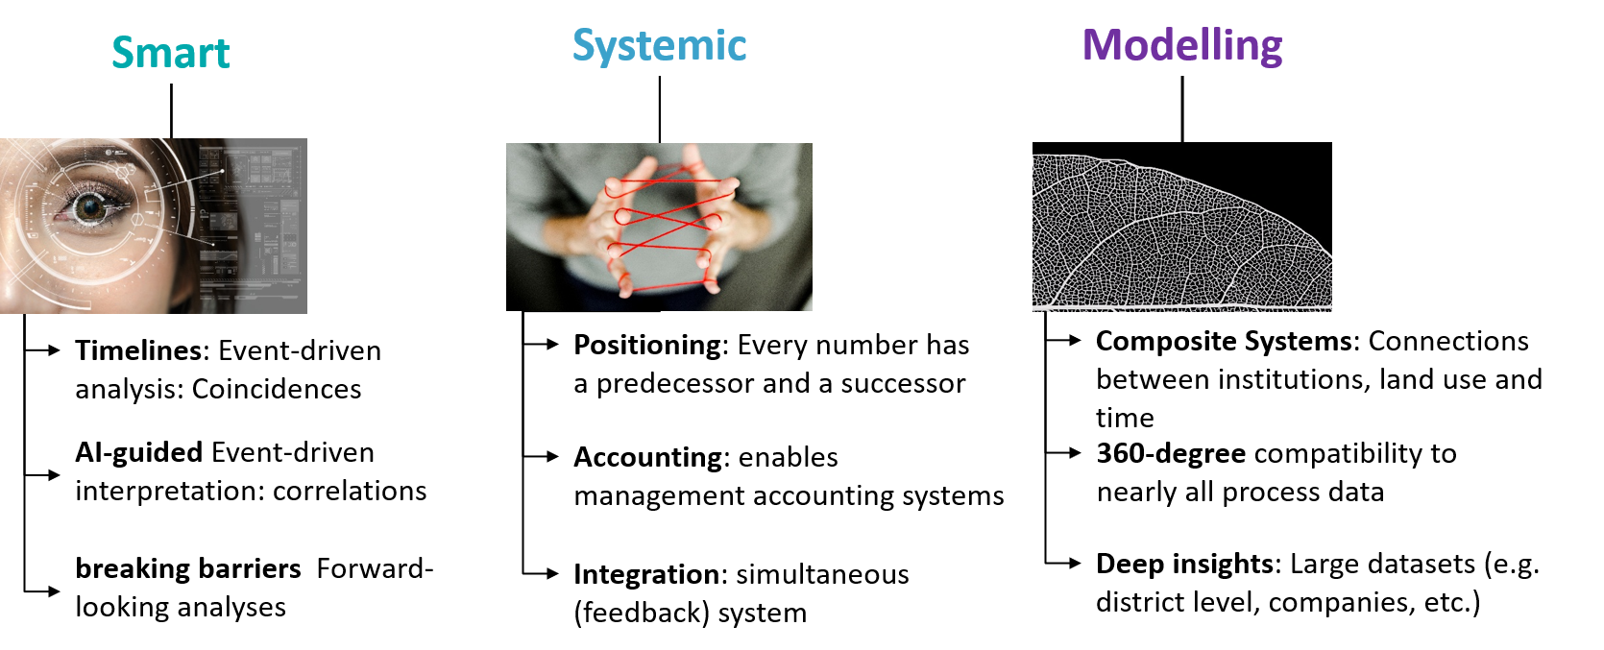
smart systemic modelling – SSM
What does it mean?
We gain a better understanding by looking at the figures and broaden the basis for our recommendations
We know more about inter- and intra-temporal feedback effects: ‘White Box’
We know more about complex relationships and the integration of components

Slide 4
smart systemic modelling – SSM
Emerging questions
Timelines: Are sectors linked through “their” events?
AI-guided: How do industries typically react to certain events?
breaking barriers: What challenges and objectives can industries achieve in the future? What policy measures will help to achieve this?
Positioning, Accounting, Integration → business as usual →
Composite Systems: The IO table’s classification system is too simplistic; socio-economic clusters require: groups, areas, state systems and networks
360-degree: How is economic development linked to environmental use, resource scarcity and time use?
Deep insights: Which sectors are most severely affected by shortages of critical raw materials (EU-Definition)? MORE (Monitoring Regional) now has access to thousands of figures per district; combinig clusters (e.g. defence, cultural landscapes) with ‘mega-impact”

Slide 5
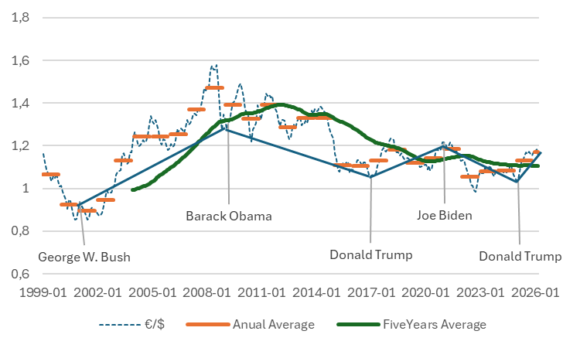
smart systemic modelling – SSM
What are „Timelines“:
A few simple examples → Correlation or causality?
  Presidencies and exchange rates $/€
  Weather events and damage
Models require the inclusion of chronological time

Slide 6
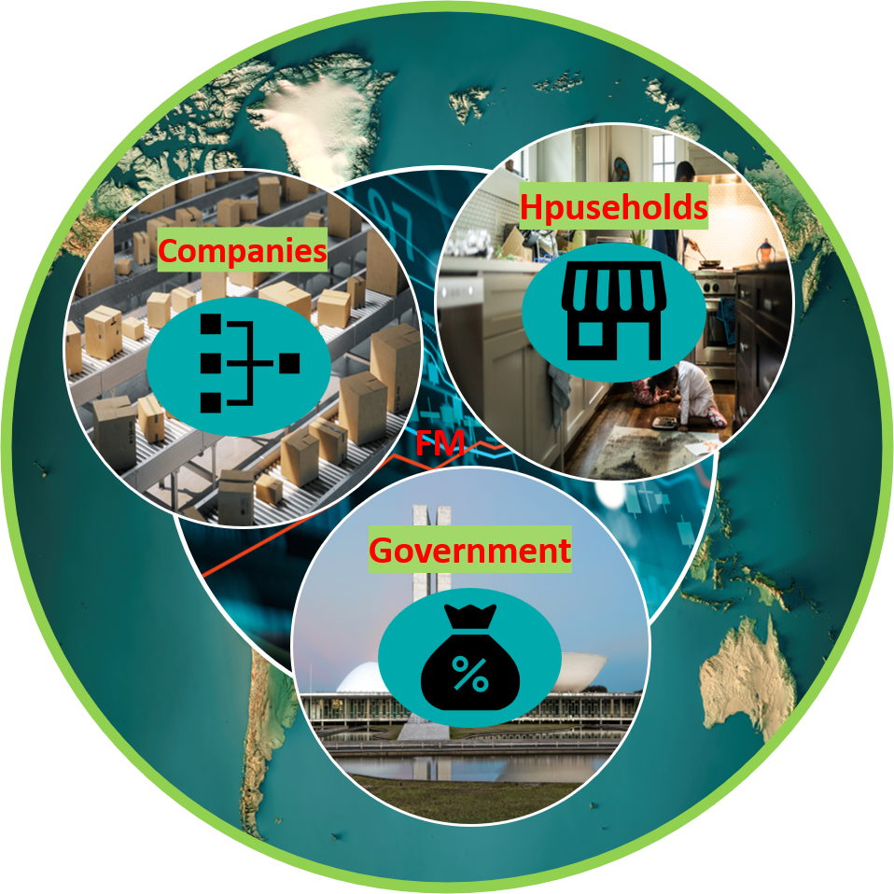
smart systemic modelling – SSM
The key transformation
processes in GINFORS
(global) & INFORGE
Private households: labour supply, qualifications, deciles: wage distribution & spending patterns
→ increasingly more imports and digital goods
Companies:
Inter-sectoral network for intermediate goods and investment: high level of detail and expert knowledge
→ Germany as a country with few natural resources and a high dependence on exports
Financial Market:
Still in its early stages: but interest and investment income are endogenised; debt and assets are being monitored
→ €/$, investment flows
Government:
Detailed breakdown of expenditure: consumption and investment (COFOG), defence, taxation set to improve; social security contributions, …
→ EU, NATO, Group of the Willing

Slide 7
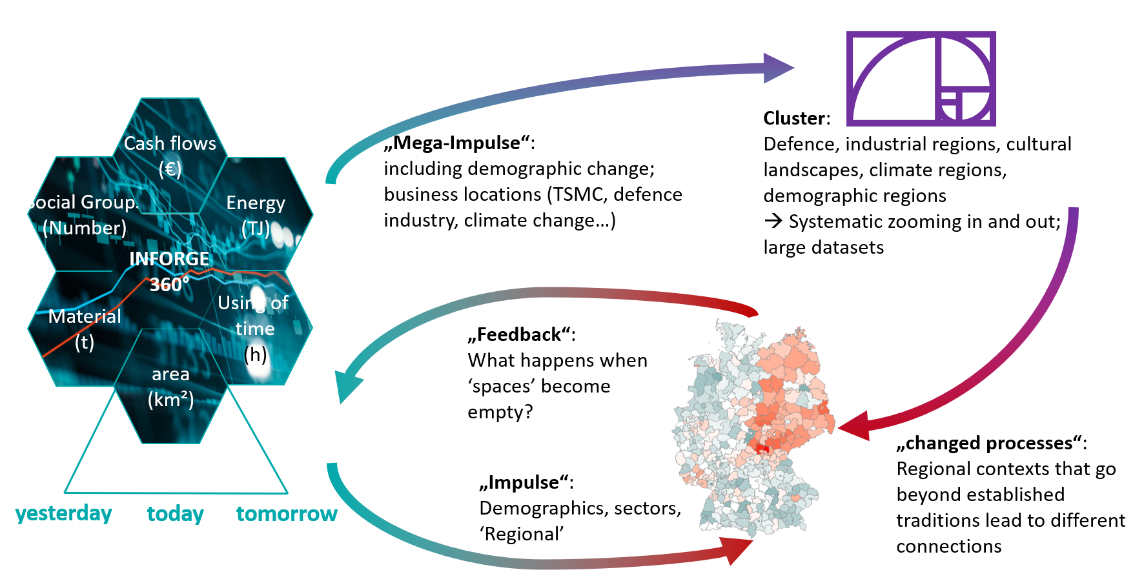
smart systemic modelling – SSM
Interdependent Systems in MORE (Regional Model)
from national to local and back

Slide 8
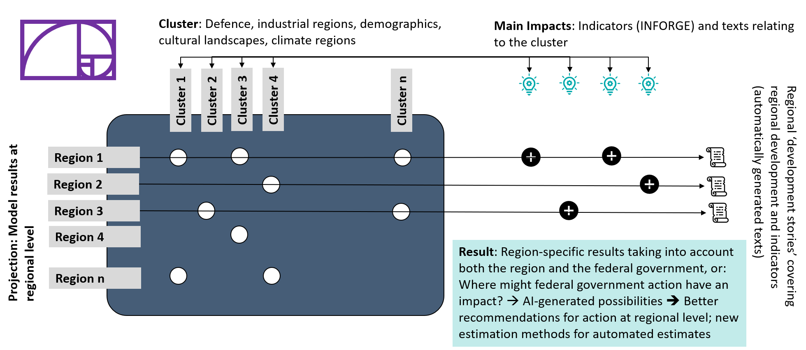
smart systemic modelling – SSM
What kind of information do we need? How does the ‘punched card system’ work?

Slide 9

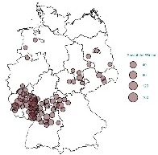
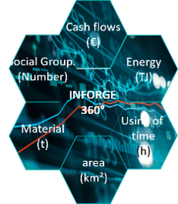




smart systemic modelling – SSM
Linking the models with relevant information to create a pre-structured dataset for use by AI
Using INFORGE – (INFORUM) Model as theoretical anchor for the information
expert-led selection of information, incorporating scientifically based causality
Sectoral
Regional
Mutual
linkages
future development
Relevant „Datalake“

Slide 10
Working in SSM context
Companies:
  In collaboration with BIBB (Federal Institute for Vocational Education and Training): companies and their size categories
  At the INFORGE level, there will now be 22 investment options per economic sector
Private households:
  New data on gross wage distribution has been implemented (720 groups)
  Consumption expenditure by 43 household types
Government:
  Detailed government investment figures; at the same time, the focus is on the tax and levy system (currently defence and infrastructure)
Regional clusters are being “driven forward”
Implementation of an “editorial process”: a first visible step – the Friday update

Slide 11
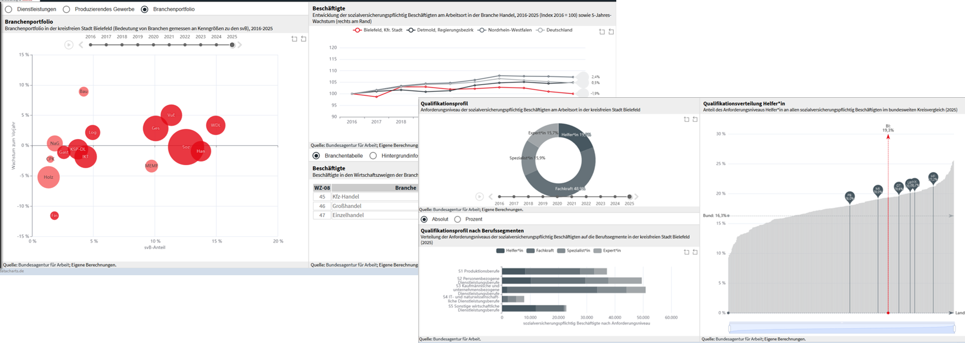
Working in SSM context: Dashboards
User guided dashboards on our webpage
https://gws-os.com/de/die-gws/news/freitagsupdate
Dash board: special use, individual content

Slide 12
A lot of work for the next years
We started in 2026
  established the editorial process, include an edogenous household-procedure and a new investment-procedure, start to prepare the timelines and clusters
  Retrieval Augmented Generation (RAG) in collaboration with Bielefeld University of Applied Sciences; used for GWS publications
  We collect qualitative data and assign this data to the model variables
  compile your own content that you can control
Conclusion:
  We cannot yet say whether everything is working as intended
  nor do we yet know which direction developments will take
  but we have already broadened our knowledge as a result
  SSM provides guidance on the direction of future work
  and we can say that the INFORUM models provide a solid foundation for future work

Slide 13

What's all this about?
A new "ruthless" competitor is on the horizon
Agent-based generative AI is now capable of producing
"new reports", for example on the relationship between
industries and economic changes
It won’t be long before agents will also be able to calculate
‘rucksacks’ based on their own data collections
… or even a more complex data analysis
The answer to this can only be to …
… have exclusive content,
… carry out creative and therefore novel analyses,
… demonstrate causal relationships (transparency),
… work together in partnerships (→ INFORUM) and
… establish a "person-to-person" form of communication
based on trust, knowledge and creativity

Slide 14
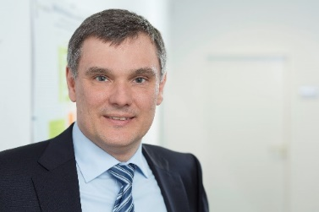

Thank you very much for your attention!
The Friday Update: Weekly update on macroeconomic indicators – “In the making”
https://gws-os.com/de/die-gws/news/freitagsupdate
What is GWS working on? Follow us on LinkedIn
Dr. Marc Ingo Wolter
T +49 541 40933-150
E wolter@gws-os.com
Bereichsleitung Wirtschaft und Soziales

