Slide 1
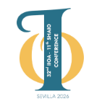


32nd International Input-Output Association Conference
22nd - 26th June 2026, Seville, Spain
Assessing the effects of education expansion policies in Brazil: Evidence from a CGE model with endogenous human capital
Libania Araújo Silva, PhD in Economics, Federal University of Juiz de Fora, Brazil
Admir Antonio Betarelli Junior, Department of Economics, Federal University of Juiz de Fora, Brazil
Kênia Barreiro de Souza, Department of Economics, Federal University of Paraná, Brazil

Slide 2
CONTEXT AND MOTIVATION
Despite the expansion of schooling over the past five decades, exclusion persists at different stages of the education system, especially in low- and middle-income countries.
Public investment in education is a key policy instrument for promoting the inclusion of lower-income households in the education system.
Governments must determine the appropriate level of educational investment given public spending constraints, while such investment contributes to the accumulation of human capital.
In Brazil, the National Education Plan (PNE) defined a target of investing 10% of GDP in education over the past decade, which was not achieved (education investment remaining around 5% of GDP), and this goal has now been repeated in the new plan for the next decade.

Slide 3
OBJECTIVE
Examine how increased public investment in education, allocated to both the public and private educational sectors, affects Brazil’s economic structure, human capital accumulation, and knowledge production, in light of the targets defined by the National Education Plan.
Employ a national CGE model, which specifies the channels through which public education spending influences the formation of skilled labor.
To contribute to filling a gap in the Brazilian empirical economic literature on the structural effects of education investment on human capital accumulation through CGE modeling.

Slide 4
LITERATURE REVIEW
The term “human capital” gained prominence in economic debates in the late 1950s with the development of human capital theory.
Mincer (1958), Schultz (1959), and Becker (1962) laid the foundations of human capital theory, conceptualizing it as a form of capital based on individuals’ skills and abilities.
Over time, the concept has expanded to include additional dimensions, such as innate, biological, and social factors.
Beyond the microeconomic focus on individual returns to education, macroeconomic approaches — especially endogenous growth models such as Romer (1986, 1990) and Lucas (1988) — highlight the role of human capital on economic growth.

Slide 5
LITERATURE REVIEW
Region | Impact analysis | Reference
Vietnam | Impacts of a reduction in public subsidies for higher education on poverty | Cloutier, Cockburn and Decluwé (2008)
Australia | Impacts of the increased participation of individuals with higher education in the workforce | Rao (2011)
Burkina Faso | Effects of increased public spending on primary education on levels of well-being and poverty | Balma et al. (2012)
Morocco | Effects of public subsidies for higher education on the economy and poverty | Karim and El Moussaoui (2020)
Slovenia | The impact of investments in education and R&D on economic growth | Verbič, Majcen, Ivanova and Čok (2011)
Chile | Macroeconomic and distributive effects of increases in income tax aimed at financing public spending on education | Mardones (2015)
India | Impact of an increase in public spending on education on economic growth and income distribution | Ojha (2017)
Colombia | Impacts of shocks in international commodity prices on income, families' educational demand, and the labor market | Giraldo, Arguello and Herrera (2019)
South Korea | Effects of investments in innovation and human capital accumulation on economic growth | Yeo and Lee (2020)
Sudan | Economic implications of public subsidy policies for education and vocational training | Elnour, Siddig and Grethe (2025)
Zambia and Tanzania | Macroeconomic and distributive effects of a increase in government spending on education | Jung and Thorbecke (2003)
South Korea | Economic effects of investments in education in a scenario of population aging | Kim, Hewings and Lee (2016)

Slide 6
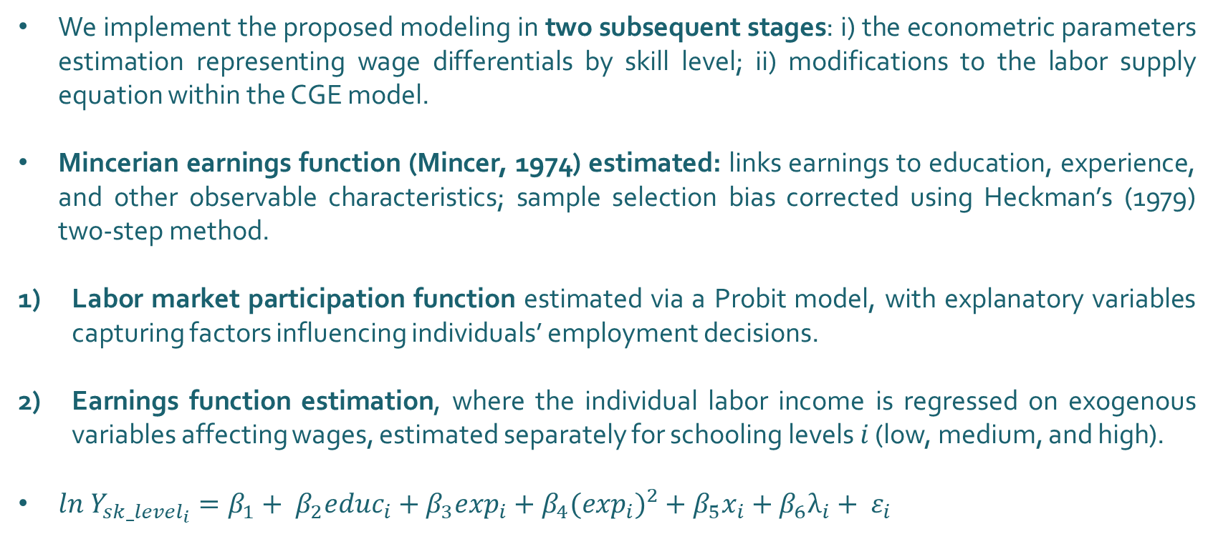
METHODOLOGY
We implement the proposed modeling in two subsequent stages: i) the econometric parameters estimation representing wage differentials by skill level; ii) modifications to the labor supply equation within the CGE model.
Mincerian earnings function (Mincer, 1974) estimated: links earnings to education, experience, and other observable characteristics; sample selection bias corrected using Heckman’s (1979) two-step method.
Labor market participation function estimated via a Probit model, with explanatory variables capturing factors influencing individuals’ employment decisions.
Earnings function estimation, where the individual labor income is regressed on exogenous variables affecting wages, estimated separately for schooling levels $i$ (low, medium, and high).
$ln{ Y}_{{sk_level}_{i}}=β_{1}+ β_{2}{educ}_{i}+β_{3}\exp_{i}+β_{4}{{(exp}_{i})}^{2}+β_{5}x_{i}+β_{6}λ_{i}+ ε_{i}$

Slide 7
METHODOLOGY
The BIM-RDHC (R&D-based and Human Capital Brazilian Intersectorial Model) is a recursive-dynamic model, based on the Johansen-Australian tradition, implemented on Gempack.
It is based on the BIM-RD, which incorporates changes in the specification of capital accumulation and the relationship between the rate of return on capital and investments, with the accumulation of intellectual capital based on endogenous variations in R&D investments.
Our specification expands the BIM-RD framework by incorporating the endogenous accumulation of human capital driven by changes in public educational investment.
The first modification adopted was the disaggregation of the labor factor in SAM into three groups according to the workers' education level (low, medium, and high qualification).
Then, we modified the labor equation allowing the supply of human capital (workers with medium or high qualification) vary according to both relative wages and public educational investments.

Slide 8
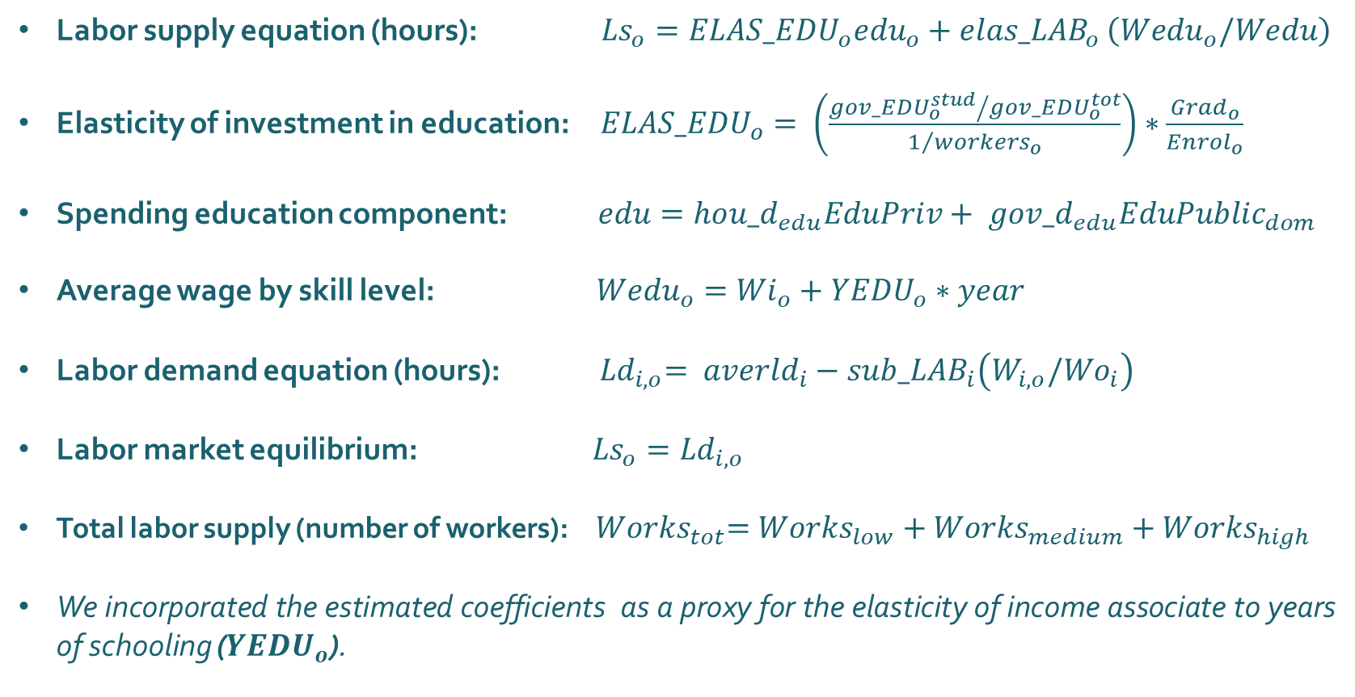
METHODOLOGY
Labor supply equation (hours): ${Ls}_{o}={ELAS_EDU}_{o}{edu}_{o}+{elas_LAB}_{o }\left({Wedu}_{o}/Wedu\right)$
Elasticity of investment in education: ${ELAS_EDU}_{o}= \left(\frac{{{gov_EDU}_{o}^{stud}}/{{gov_EDU}_{o}^{tot}}}{1/{{workers}_{o}}}\right)∗\frac{{Grad}_{o}}{{Enrol}_{o}}$
Spending education component: $edu=ho{u_d}_{edu}EduPriv+ gov{_d}_{edu}{EduPublic}_{dom}$
Average wage by skill level: ${Wedu}_{o}={Wi}_{o}+{YEDU}_{o}∗year$
Labor demand equation (hours): ${ Ld}_{i,o}= {averld}_{i}−{sub_LAB}_{i}\left(W_{i,o}/{Wo}_{i}\right)$
Labor market equilibrium: ${Ls}_{o}={Ld}_{i,o}$
Total labor supply (number of workers): ${ Works}_{tot}={Works}_{low}+{Works}_{medium}+{Works}_{high}$
We incorporated the estimated coefficients as a proxy for the elasticity of income associate to years of schooling (${YEDU}_{o}$).

Slide 9
DATABASE
The CGE model is calibrated using a Social Accounting Matrix (SAM) developed from the 2015 national Input–Output Tables provided by the Brazilian System of National Accounts (IBGE, 2024), composed of 28 productive activities responsible for the production of 126 products.
Behavioral parameters and elasticities estimated in the literature, such as Armington elasticities, export demand elasticities, and the Frisch parameter, are also incorporated.
Econometric parameters estimated in this study using a Mincerian earnings equation based on data from the Brazilian Continuous National Household Sample Survey (PNADC).
The PNADC were also used to disaggregate the labor factor in the SAM by skill level.

Slide 10
SIMULATION ESTRATEGY
Based on our CGE framework with endogenous human capital, and considering the National Education Plan (PNE) educational investment target, we simulated following scenarios:
Policy scenario | Description | Instrument | Time horizon
Scenario 1 | Increase in public spending on public education, reaching 7% in 2029 and 10% of GDP in 2034, according to the National Education Plan (PNE). | Variation in government demand for public education | 2024-2034
Scenario 2 | Increase in public spending on private education until 2034, according to the projected spending in Scenario 1. | Subsidies for private education | 2024-2034
Scenario 3 | Increase in public spending on public education, aiming to reach 10% of GDP by 2044. | Variation in government demand for public education | 2024-2044
Scenario 4 | Increase in public spending on private education until 2044, according to the projected spending in Scenario 3. | Subsidies for private education | 2024-2044

Slide 11
RESULTS
About the main macroeconomics effects:
Scenarios 1 and 3 stand out in terms of GDP variation compared to the baseline scenario, driven primarily by private investment and government consumption.
It is related to the stimulus in knowledge capital investment caused by the public education sector, which excels in national R&D production.
Scenarios 2 e 4, marked by government subsidies to private education through tax breaks for this activity, lead to negative percentage changes in the long term.

Slide 12
RESULTS
About the labor market effects (aggregate):
Scenarios 1 and 3 project a cumulative increase of approximately 4.5% in national aggregate employment, with sustained positive effects over time.
Subsidies for private education (scenarios 2 and 4) promote lower aggregate employment growth.

Slide 13
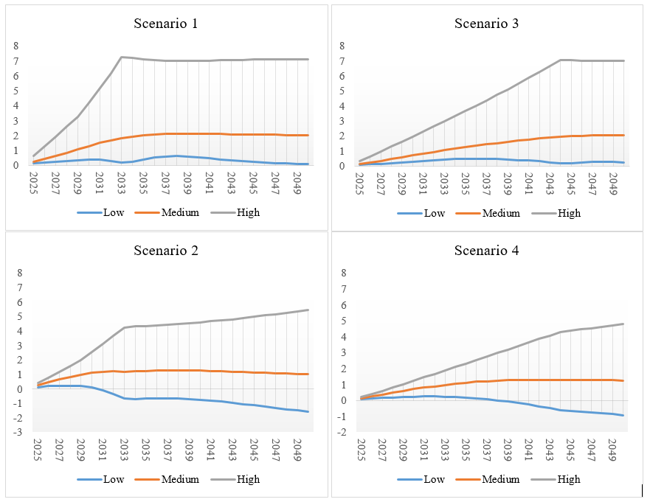
RESULTS
About the labor market effects:
In the first scenario, the increase in highly skilled work surpasses that of medium-skilled work, growing until 2034 and stabilizing linearly until the end of the period. With the expansion of spending distributed over 20 years, as in the 3rd scenario, the growth of skilled work occurs more uniformly over time.
In Scenario 2, subsidies for private education over a decade gradually reduce low-skilled labor, increase medium-skilled labor, and highlight highly skilled labor, with continuous growth during shocks and cumulative progress until 2050. When distributed over 20 years, the changes follow a more continuous trajectory.

Slide 14
RESULTS
About the R&D investiment effects:
The four simulations of policies expanding government spending and subsidies on education also affect investments in R&D and the production of knowledge capital in Brazil.
The shocks that showed the best results on this economic element were those aimed at increasing public spending on public education.
In the first scenario, the stock of knowledge capital grows gradually until 2034 and then remains constant; in the third scenario, the increase is smaller, but continuous.
Scenarios 2 and 4, with subsidies for private education, show less variation, although the second scenario accumulates more knowledge capital than the fourth.

Slide 15
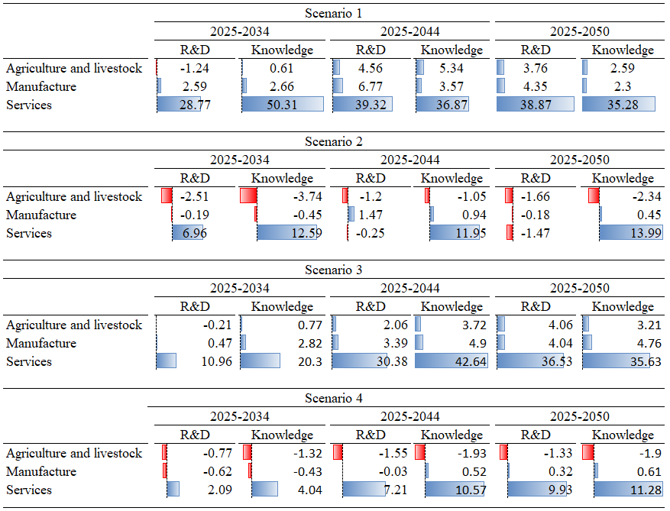
RESULTS
About sectorial effects:
For the four simulated scenarios, both investments in R&D and the stock of knowledge capital stand out predominantly in the service sector.
This is associated with the fact that there is an expansion directly concentrated in the education sector and other activities intensive in the production and demand for knowledge capital, such as those related to information and computing.

Slide 16
Concluding Remarks
Simulations indicate that increased public spending on public education tends to promote greater economic growth over the projected time horizon, while subsidies to private education have smaller macroeconomic effects.
All simulated scenarios significantly affected total employment and increased the use of highly skilled labor, with milder effects when distributed over a longer time horizon.
Subsidies to private education more intensely increase human capital, while public investments in education are more effective for R&D and knowledge accumulation, highlighting their importance on the country's technological axis.
Limitations: the simulations were performed under the assumption of a free budget, allowing the government to absorb fiscal deficits or surpluses generated by the simulated policies, with tax revenue adjusting endogenously, without changes in other government spending.

Slide 17
ACKNOWLEDGMENT
I would like to thank the Minas Gerais State Research Foundation (FAPEMIG) and the Brazilian Federal Agency for Support and Evaluation of Graduate Education (CAPES) for the financial support under the PhD Scholarship grant and, mainly, the IIOA, for the travel grant that allowed me to be at this conference.

Slide 18
CONTACT INFORMATION
Thank you!
libaniaaraujo147@gmail.com

