Slide 1
Fragmentation, Corridor Dependence, and Origin–Destination Coupling in Global Value Chain Layers
Mass ≠ Shape
Participation shares do not reveal corridor structure
Shuning Chen, Màrius Vila, and Mateu Sbert
Hiroshima University · University of Girona
1
Notes:
Timing: ~1 min. Open with the central distinction: standard GVC measures are useful for how much value added crosses borders, but this paper asks how the intermediate-export system is organized.

Slide 2
Problem
Motivation: equal trade mass can imply very different exposure
• scalar GVC shares answer “how much?”
• they do not answer “how organized?”
• risk and substitutability depend on structure
Diversified routing
Backbone concentration
Many active links reduce dependence on a small set of corridors.
The same total mass can be carried by a narrow hub-and-spoke structure.
2
Notes:
Timing: ~1.5 min. Explain that a volume or share can hide whether the system is diversified or corridor-dependent. This is the core empirical motivation.

Slide 3
Framing
Research question and contribution
Research question
How are intermediate-export value-added and CO₂ flows organized across origin–destination corridors and GVC path layers?
Contribution
• Treat each GVC layer matrix as a normalized joint distribution over origin–destination links.
• Decompose “fragmentation” into origin concentration, destination portfolio diversification, and origin–destination coupling.
• Compare value added and embodied CO₂ across path-defined GVC layers and across country vs country–sector scales.
H(X)
H(Y|X)
I(X;Y)
Δ scale
origin concentration / dispersion
destination portfolio diversification
origin–destination coupling
information loss under aggregation
3
Notes:
Timing: ~1.5 min. State the paper’s contribution as a measurement framework, not as a replacement for standard participation indicators. It complements them by adding structural diagnostics.

Slide 4
Data object
Three path-defined GVC layers
Origin
Destination
Consumption
Direct intermediate trade
A
B
B
one-border intermediate flows absorbed without further re-export
Relay intermediate trade
A
B
C
relay / re-export flows: destination transmits origin value added onward
Complex multi-hop
A
?
B
residual complex multi-hop component after netting out direct absorption
VA and CO₂ matrices are built in parallel for each layer and year.
4
Notes:
Timing: ~2 min. Define the three layers operationally. Emphasize that the analysis is not only across countries and sectors, but also across path complexity.

Slide 5
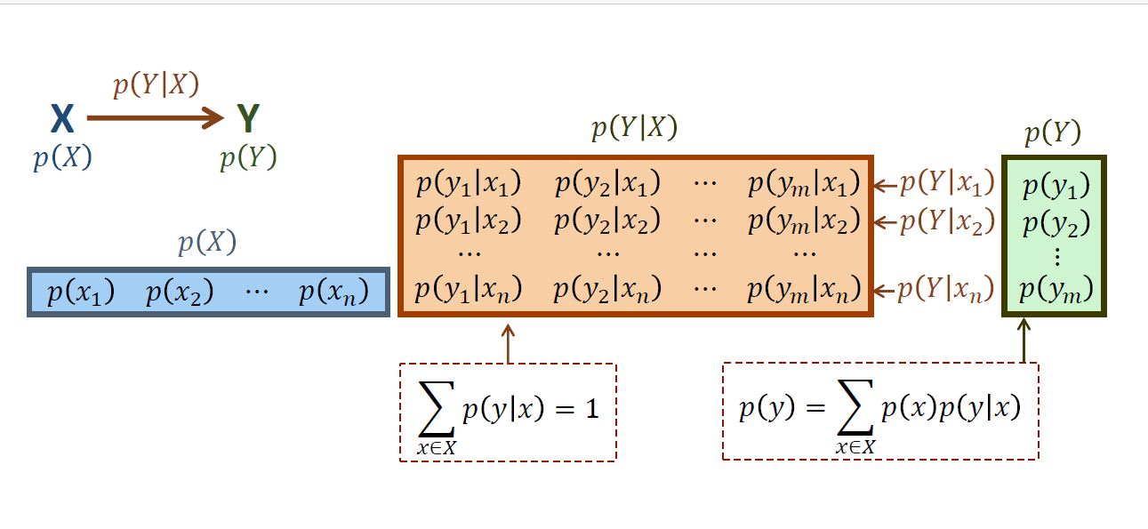
Method bridge for IO audience
Information-channel representation
• X: origin economy or origin country–sector
• Y: destination economy or destination country–sector
• p(Y|X): routing profile conditional on origin
• p(X) and p(Y): origin and destination shares
Normalization
p(i,r) = F(i,r) / ΣᵢΣᵣ F(i,r)
Interpretation: the total system mass is normalized away, so the measures capture the shape of the flow matrix.
5
Notes:
Timing: ~2 min. Explain that the paper uses normalized matrices. This is why the measures separate “mass” from “shape.” No stationarity assumption is needed; a joint distribution over OD links is sufficient.

Slide 6
Method bridge for IO audience
From an IO flow table to an information channel
IO / GVC flow table
Joint probability over links
The information channel view
D1
D2
D3
D4
p(i,j) = Z(i,j) / Σ Z
• X = origin node; Y = destination node.
• The table is read as a distributional shape, not only as volume.
• The channel asks how much knowing X reduces uncertainty about Y.
O1
normalize
O2
Zᵢⱼ
O3
p(i)
origin
share
p(j)
destination share
O4
total mass
ΣᵢΣⱼ Zᵢⱼ
p(j|i)
routing profile
Same IO matrix object;
probabilistic interpretation.
6

Slide 7
Method bridge for IO audience
Separate marginal size from origin–destination interaction
log p(i,j) = αᵢ + βⱼ + γᵢⱼ
αᵢ
origin marginal size
βⱼ
destination marginal size
γᵢⱼ
interaction / association
• drives origin diversity H(X)
• low H(X): dominant origin backbone
• drives destination diversity H(Y)
• not enough to identify corridor structure
• this is the coupling structure
• MI is the average deviation from independence
I(X;Y) = ΣᵢΣⱼ p(i,j) log₂ [ p(i,j) / (p(i)p(j)) ]
Independence: γᵢⱼ = 0 ⇒ I(X;Y) = 0. No origin–destination coupling remains.
7

Slide 8
Method bridge for IO audience
RAS is the natural counterfactual counterpart
Mutual information
RAS / biproportional scaling
Bridge interpretation
READS the observed table
How strongly are origins and destinations coupled?
RESHAPES the table
Hit new row/column totals with minimum information loss.
Counterfactual table
new scale, old association pattern as far as feasible.
log p*(i,j) = [αᵢ + log rᵢ] + [βⱼ + log sⱼ] + γᵢⱼ
Changed by RAS:
row/column marginals
Preserved by RAS:
interaction / odds ratios
Therefore:
MI moves only as targets force
Ireland & Kullback (1968): RAS as minimum cross-entropy / KL updating under fixed marginals.
8

Slide 9
Method bridge for IO audience
What the measures mean substantively
H(X)
H(Y|X)
I(X;Y)
I/H
Does knowing the origin strongly predict the destination?
How large is coupling relative to origin diversity or total bilateral complexity?
Are flows dispersed across many origins, or dominated by few origins?
Does each origin route broadly, or depend on a narrow destination portfolio?
Decomposition logic
Fragmentation is not one property. It can mean dispersed origins, diversified routing, or tight bilateral pairing. These are empirically separable.
Scale test
• Country level: 77 economies.
• Country–sector level: 77 economies × 12 sectors = 924 nodes.
• Information loss under aggregation identifies where meaningful structure is embedded.
6
Notes:
Timing: ~1.5 min. Make the three dimensions intuitive. This slide helps the audience read all result charts later.

Slide 10
Hypotheses
Three working hypotheses — and how the data respond
H1
More complex layers should show tighter origin–destination coupling.
Overturned: GVC2net is near-random mixing.
H2
VA and CO₂ should evolve similarly because emissions are embedded in production.
Partially overturned: strongest divergence in relay chains.
H3
Country-level analysis should capture the main structural patterns.
Partially overturned: sectoral detail matters for GVC1 and GVC3.
The empirical contribution is not simply measurement; it changes what “complex GVC participation” appears to mean.
7
Notes:
Timing: ~1.5 min. Present hypotheses as expectations from standard intuition, then preview that the results are not aligned with that intuition.

Slide 11
Data and computation
Empirical design
1995–2020
77
3 × 2
2 scales
annual OECD ICIO system
economies, with China and Mexico processing trade preserved
GVC layers × VA/CO₂ factors
country and country–sector
Pipeline
• Construct layer-specific nonnegative OD matrices Fᵏ(i,r) for VA and CO₂e.
• Normalize each matrix into pᵏ(i,r) for each year and factor.
• Compute entropy and mutual-information diagnostics over time.
• Repeat at country–sector resolution and compare information loss.
8
Notes:
Timing: ~1.5 min. Keep this concise; the methodological novelty is the normalization and the layer-specific channel interpretation.

Slide 12
Results: H(X)
Finding 1: origin entropy is ordered by layer
• VA: Direct intermediate trade (GVC (D)) has the broadest origin base; Relay international trade GVC(R) becomes comparatively more concentrated after 2014.
• CO₂: complex and relay layers show stronger origin concentration than VA, especially around the 2000s–early 2010s.
• Interpretation: economic participation can broaden while embodied-emission origins concentrate.
9
Notes:
Timing: ~2 min. Explain the consistent GVC1 > GVC2net > GVC3 ordering for VA. Then emphasize that CO₂ concentration is more striking in complex and relay layers.

Slide 13
Results: H(Y|X)
Finding 2: destination diversification reverses the origin ordering
• Direct intermediate trade: many origins, but each tends to use narrower destination portfolios.
• Complex layers: fewer dominant origins, but those origins route to broader destination sets.
• Thus, origin concentration and routing diversification move differently across layers.
10
Notes:
Timing: ~2 min. This is the fragmentation decomposition: the system can have concentrated origins and diversified destination portfolios at the same time.

Slide 14
Results: mutual information I(X;Y)
Finding 3: Complex intermediate trade is a near-random mixing layer
The residual complex multi-hop layer (GVC(C)) carries almost no origin–destination pairing information. Complexity here means diffuse routing, not tight bilateral coupling.
≈0.07–0.10 bits
Complex intermediate trade country-level mutual information
11
Notes:
Timing: ~2.5 min. This is the central result. Explain mutual information as how much knowing the origin reduces uncertainty about the destination. GVC2net stays near zero in both VA and CO₂.

Slide 15
Results: normalized mutual information
Finding 4: coupling efficiency remains negligible in GVC2net
~0.02
GVC2net coupling share
~0.10–0.13
GVC1/GVC3 coupling share
Low MI is not an artifact of low origin diversity; after normalization, Complex GVCs remains weakly coupled.
12
Notes:
Timing: ~1.5 min. Use this slide as a robustness check on the MI interpretation. The result persists even after scaling by origin diversity.

Slide 16
Results: GVC3
VA–CO₂ decoupling is clearest in relay chains
• Relay CO₂ origin entropy falls much more than relay VA entropy, indicating stronger emission-source concentration.
• At the same time, CO₂ relay mutual information declines, weakening bilateral traceability.
• Carbon responsibility can become more concentrated even while corridor pairing becomes less informative.
13
Notes:
Timing: ~2 min. This slide bridges the GVC contribution and the carbon accounting implication. Be precise: concentration in responsibility does not necessarily imply tight bilateral corridor dependence.

Slide 17
Results: aggregation
Sectoral robustness: information loss is layer-specific
Approximate information gain from country to country–sector mutual information
• Direct GVC and relay GVC recover substantial coupling when country–sector nodes are retained.
• Complex GVC remains weakly coupled even at 924 × 924 resolution.
• Therefore, direct and relay layers carry sector-specific pairing structure; complex multi-hop routing does not.
≈0.27 bits
≈0.27 bits
≈0.04 bits
GVC(D)
GVC(R)
GVC(R)
14
Notes:
Timing: ~2 min. Explain the data-processing implication: aggregation cannot increase mutual information. The interesting point is that the information loss differs sharply by layer.

Slide 18
Discussion
Interpretation: fragmentation, diversification, and coupling are separable
Main conceptual result
“Complex GVC participation” should not be read automatically as tightly structured bilateral interdependence.
backbone concentration
routing diversification
coupling intensity
who dominates the origin side
how broad each origin’s destination set is
how much origin and destination identify each other
These dimensions can move in different directions across GVC layers and between VA and CO₂.
15
Notes:
Timing: ~1.5 min. Synthesize findings at the conceptual level. This helps avoid presenting the results as a list of indicators.

Slide 19
Discussion
Implications for IO/GVC and carbon-accounting research
1. GVC measurement
Participation shares remain useful, but they should be complemented by structural shape measures.
2. Vulnerability analysis
Corridor dependence is not equivalent to complexity; it must be measured from OD structure.
3. Carbon accounting
Relay CO₂ chains can become more source-concentrated while less bilaterally traceable.
4. Aggregation choice
Country-level analysis may understate direct and relay coupling, but is adequate for the GVC2net mixing property.
16
Notes:
Timing: ~2 min. Translate results to audiences familiar with IO, GVC, and environmental accounting. Avoid overclaiming causal mechanisms; these are structural diagnostics.

Slide 20
Research agenda
Limitations and next steps
• Sectoral decomposition: identify which industries drive Direct/Relay pairing and relay CO₂ concentration.
• Environmental extension: apply the same channel framework to material extraction, water, land, and other satellite accounts.
• Causal integration: connect information-channel diagnostics with trade policy, firm behavior, infrastructure, and gravity-style models.
Caution
The current framework characterizes system-level organization. It does not by itself identify the causal mechanisms that produced the observed structural changes.
17
Notes:
Timing: ~1.5 min. State limitations directly. This strengthens credibility and prevents the audience from reading too much causality into the descriptive structural measures.

Slide 21
Takeaways
Conclusion: the central message
1
2
3
Fragmentation is multidimensional, not a scalar share.
GVC2net behaves as a mixing layer, not a tightly coupled bilateral structure.
Relay CO₂ chains show source concentration and declining bilateral traceability.
By distinguishing mass from shape, information-channel metrics reveal corridor dependence and structural organization that standard GVC participation indicators cannot recover.
Thank you
18
Notes:
Timing: ~1 min. Close with three takeaways. Invite questions on methods, layer construction, and carbon-accounting implications.

