Slide 1



Integrated model
A channel-based framework for endogenizing climate-inequality dynamics in macroeconomic input-output models

Slide 2

Motivation
Problem: climate–inequality dynamics are usually not closed
Existing IO/MRIO work is strong on propagation and footprints — but weaker on distributional feedbacks.
What models often do
What is missing
Our proposal
• Aggregate damage functions
• Representative or average household
• Policy incidence as post-processing
• Distribution as an output, not a variable
• Household-group exposure
• Asset-loss incidence
• Wellbeing-to-labour mechanisms
• Inequality → emissions / feasibility
Account-consistent incidence modules attached to an MRIO core:
1. Agriculture & food prices
2. Vulnerability & asset losses
3. Wellbeing & health
Loop closure criterion: climate → household-group income/wealth/wellbeing → demand, footprints and feasibility → future emissions and hazards
Notes:
This slide should be handled briskly. The key message is not that existing models ignore everything, but that they typically do not make both directions operational. Use the distinction between “distribution as output” and “distribution as a state variable that affects subsequent emissions and policy feasibility.”

Slide 3
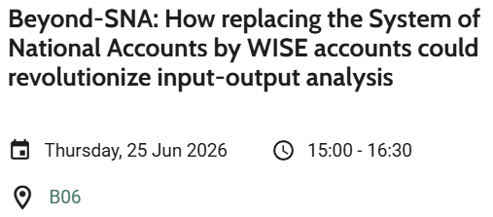
Model architecture
The MRIO macro core: one accounting space for flows, prices and footprints
Logic/philosophy
Data layers
SUT/IOT / FIGARO: products × industries × countries
• Model climate-inequality
• Follow WISE accounts
• Identify data gaps, opportunities and limitations of a macro top-down approach
Chancel, L., Mohren, C., Bothe, P., & Semieniuk, G. (2025). Climate change and the global distribution of wealth. Nature Climate Change, 15(4), 364-374.
Distribution: income, savings, wealth by group
Satellite accounts: emissions, resources, employment
Hazards & wellbeing: climate, health, exposure
Discrete-time closure: solve output/prices within year; update wealth, vulnerability and wellbeing between years.
Notes:
Spend about one minute. Emphasize that the equations are conventional IO equations, but the novelty is where distributional and physical state variables enter. A_t is allowed to change over time. The same product/industry structure hosts households, emissions, prices and climate incidence.

Slide 4
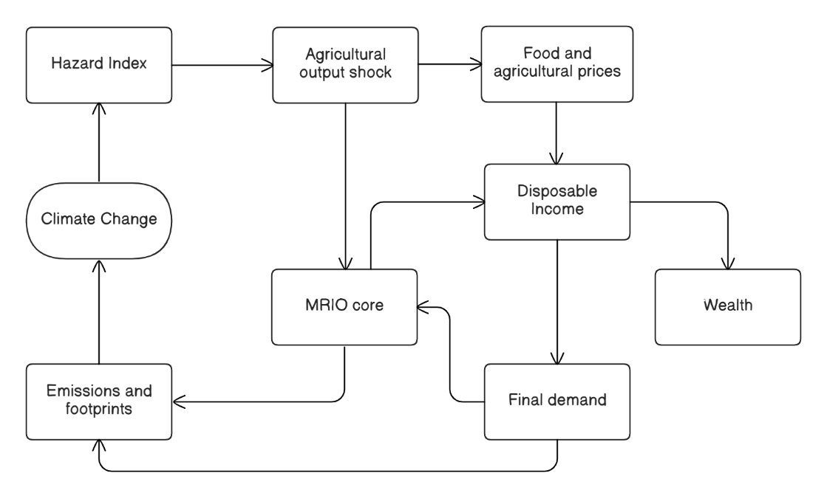
Loop mechanisms
Channel 1: Agriculture and food prices
Data needed
• Hazard index (drought / heat / floods)
• Agricultural output or yield response
• Food price pass-through
• HBS/COICOP food shares by group
• Agriculture and food products
Quantity effects
Traditional IO output/employment effects
Price effects
Food costs and group-specific baskets
Notes:
Use agriculture as the most intuitive example. Highlight that the mechanism has two effects: quantity effects through sectoral output and employment/income multipliers, and price effects through food costs and group-specific baskets. Emphasise that the IO contribution is to keep the price and final demand vector in the same product classification.

Slide 5
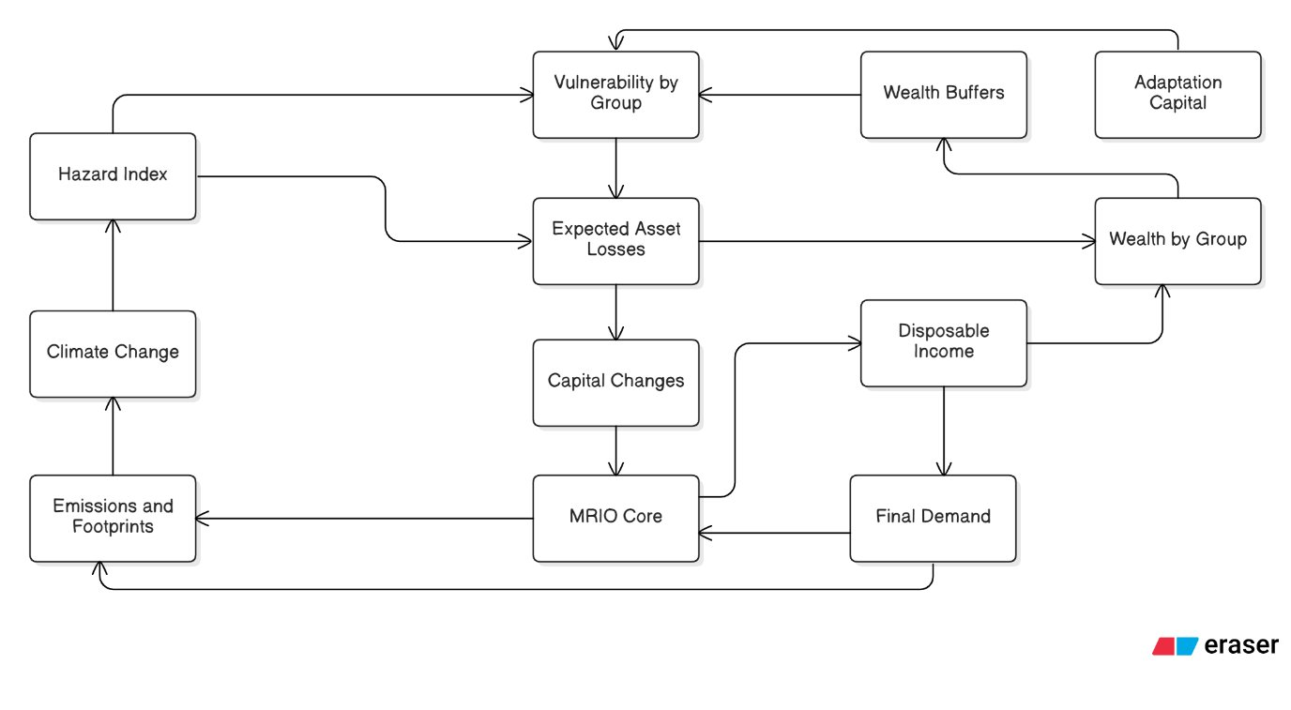
Loop mechanisms
Channel 2: Adaptation, vulnerability, and asset losses
Data bottleneck
Asset-type capital stocks and ownership matrices by household group are the critical missing bridge objects.
Link climate effects to wealth dynamics
key IO role: assets must map to GFCF / product space
Notes:
This is the most data-intensive channel. Stress that the paper does not claim the data are fully available. Its contribution is to identify the bridge objects: asset-type capital stocks, exposure by asset and region, and ownership by household group. This creates a channel from climate shocks to wealth dynamics, not just output loss.

Slide 6
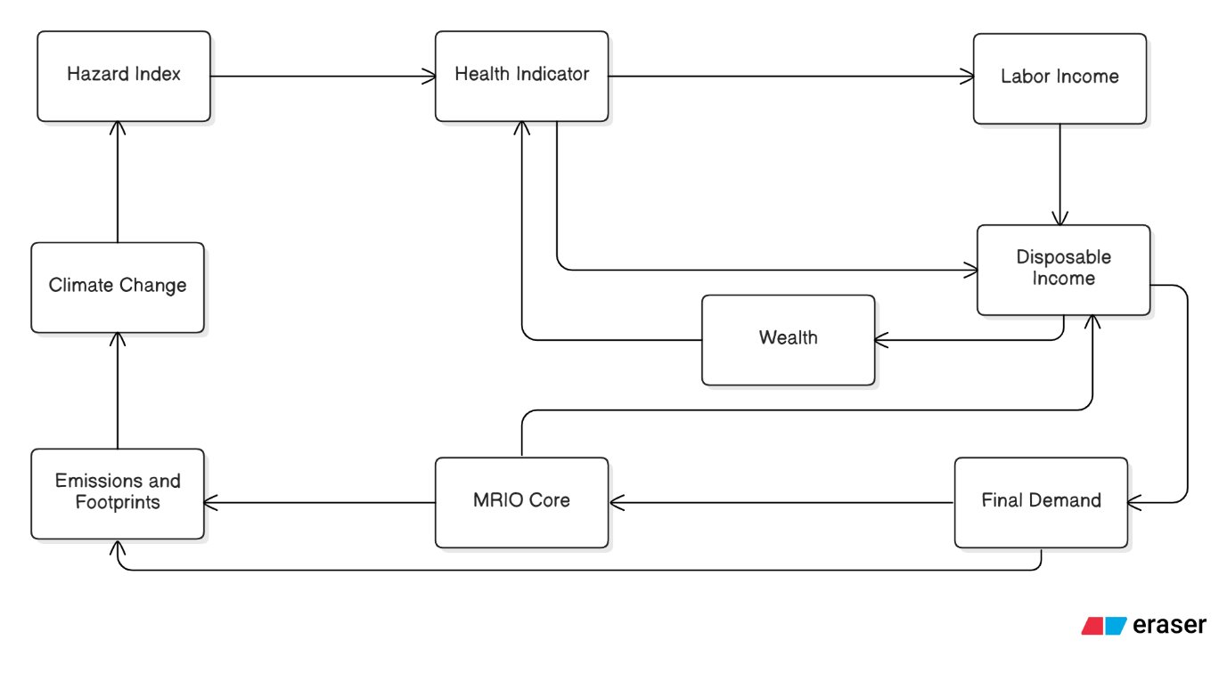
Loop mechanisms
Channel 3: Wellbeing, health and work capacity
Data focus
Objective health variables, labour statistics, out-of-pocket spending, public health spending, and household-group mapping.
Notes:
Keep the claims bounded. The wellbeing channel uses health as an operational example because it has better data and maps into labour income and out-of-pocket expenditures. Mention that mental health, education and social cohesion are treated as priority extensions, not fully operationalised in the baseline.

Slide 7
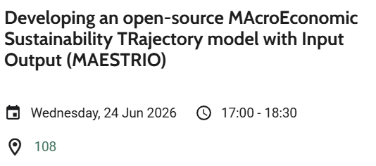
Data strategy
Bridge matrices and implementation
COICOP / HBS
CPA / product
MRIO/e.g FIGARO
Group footprints
MAESTRIO – See
Tier 2
Full incidence mapping
Asset ownership
Exposure/loss accounts
Wellbeing by group
Tier 1
EU data implementation
FIGARO / NAM
WID + ILO
EU-SILC + HBS
Air emissions + EDGAR
R prototype
2 regions × 4 sectors
3 groups × 2 assets
Tier 0
Toy / stylised
Notes:
Data and development should be the strongest practical slide. Tell the audience that the toy model already tests accounting consistency and closure, but not calibration. The next development step is an EU implementation: FIGARO/NAM plus HBS, EU-SILC and emissions accounts. The full tier requires new bridge matrices for asset ownership and exposure.

Slide 8
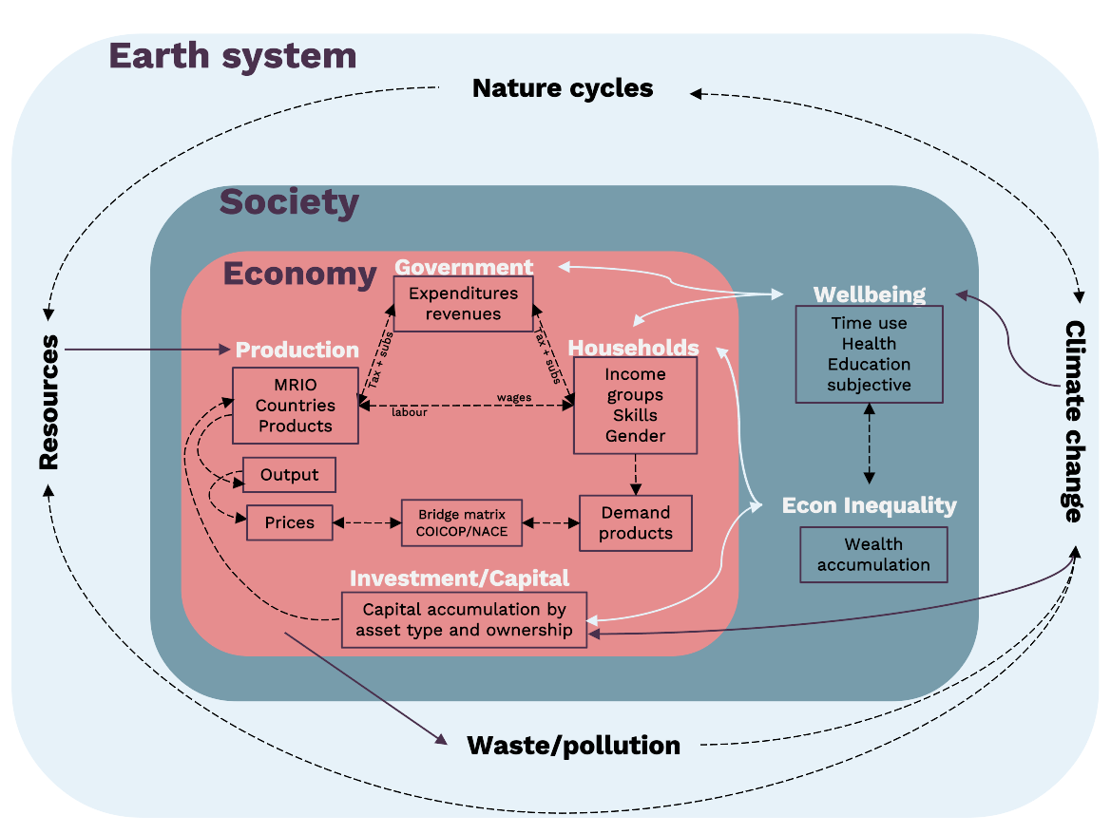

Slide 9
Takeaways for the IO community
Endogenise climate impacts (not just mitigation policy shocks) in a distributionally explicit way
Strengthen WISE analysis.
Improve model transparency via explicit loop closure by introducing additional, clearly defined propagation mechanisms.
Provide a clearer accounting interpretation of disaster losses and adaptation. Move beyond reduced-form productivity shocks and support a richer decomposition of losses, investment, and debt/fiscal responses.
Notes:
Final minute. State the three messages. End by inviting the IO community to engage on bridge matrices and data infrastructure. If there is time, mention the R toy model as a way to test closure before full empirical calibration.

Slide 10
Thank you
For your attention

Slide 11

Colour codes
Background slides:
#E7F2F9
#FFFFFF
Main Colours:
#E68D8E
#779CAB
#4A314D

