Slide 1
Incorporating critical minerals and renewable energy technologies into the MRIO framework: a case of GTAP
Maksym Chepeliev,¹ Krzysztof Wojtowicz,² Eddy Bekkers,² Nihal Yilmaz²
¹Center for Global Trade Analysis, Purdue University
²World Trade Organization, Geneva, Switzerland
32nd International Input-Output Association Conference
June 22-26, 2026
Seville, Spain

Slide 2
Growing role of critical minerals in the global economy
Decarbonization and digitalization will change the structure of the global economy
    Critical minerals, such as nickel, platinum group metals, zinc, rare earths, are essential inputs for the development of renewable energy systems (Tokimatsu et al., 2018).
    Under limiting global warming <1.5C, the demand for critical minerals could increase between 2 and 267 times by 2050 depending on the mineral (Wang et al., 2022).
  Growing demand for semiconductors, data centres and other equipment due to digitalization and the growth of artificial intelligence (AI), also fosters demand for critical minerals.
It is important to have the analytical capacity for the assessment of future energy transition scenarios with an explicit representation of the critical minerals value chains in an economy-wide framework.

Slide 3
Existing modeling frameworks lack essential details
Global economy-wide models, such as IAMs and CGEs, are well-suited for assessing impacts of decarbonization, digitalization and the growth of AI on critical mineral supply chains:
  A quantification of the impacts of the energy transition and digitalization on critical minerals' trade, value chains, and the concentration of production and trade.
  The role of trade and domestic policies related to critical minerals and energy equipment, such as subsidies, export restrictions and local content requirements.
  Implications of the energy transition and digitalization for investment needs in critical minerals.
Most global economic models still lack essential details to facilitate the granular analysis of these policy issues.

Slide 4
Core MRIO: GTAP Data Base
GTAP is a multi-region input-output (MRIO) database widely used for the parametrization of computable
general equilibrium (CGE) models and applied policy analysis.
Latest releases of the GTAP Data Base:
GTAP 12 Data Base has been publicly released in February 2026
  https://www.gtap.agecon.purdue.edu/databases/v12/
Bilateral tariffs and trade data/shipping margins, global land use, GHG emissions, air pollutants, nutritional accounts
 | Version 11 | Version 12
Global Coverage | 141 countries 19 composite regions | 145 countries 18 composite regions
Sectoral Detail | 65 sectors (20 ag/food, 25 manufactures, 20 services) + 11 generation sectors in GTAP-Power | 65 sectors (20 ag/food, 25 manufactures, 20 services)
Reference Years | 2004, 2007, 2011, 2014, 2017 | 2004, 2007, 2011, 2014, 2017, 2019, 2023

Slide 5
GTAP-CE: Starting point for the GTAP-CM developments
No. | GTAP | New sector | Description
1 | oxt | nmn | Non-metallic minerals mining
2 |  | mio | Mining of iron ores
3 |  | mao | Mining of aluminum ores
4 |  | mco | Mining of copper ores
5 |  | moo | Mining of other ores
6 | rpp | rbr | Rubber products
7 |  | plp | Plastic products – primary
8 |  | pls | Plastic products – secondary
9 |  | plr | Recycling - plastics
10 | nmm | cem | Cement
11 |  | nmx | Other mineral products
12 | i_s | isp | Iron and steel – primary
13 |  | iss | Iron and steel – secondary
14 |  | ris | Recycling - iron and steel
15 |  | isc | Iron and steel casting
16 | nfm | app | Aluminum – primary
17 |  | aps | Aluminum – secondary
18 |  | ral | Recycling - aluminum
19 |  | cpp | Copper – primary
20 |  | cps | Copper – secondary
21 |  | rcp | Recycling - copper
22 |  | mpp | Other metals – primary
23 |  | mps | Other metals – secondary
24 |  | rom | Recycling - other metals
25 |  | nfc | Non-ferrous metals casting
26 | chm | nfr | Nitrogen fertilizer
27 |  | pfr | Phosphorus fertilizer
28 |  | kfr | Potassium fertilizer
29 |  | xch | Other chemicals
First publication release of the GTAP-CE Data Base (January 2025): 76 GTAP-Power 11 Data Base sectors are disaggregated into 99 sectors.
These sectoral splits provide complete coverage of the CBAM commodities (except hydrogen).
GTAP-CM sectoral splits are implemented on top of the GTAP-CE sectoral details, further disaggregating selected upstream and downstream activities.
Source: Chepeliev, M. 2026. Global Trade Analysis Project Circular Economy (GTAP-CE) Data Base. GTAP Research Memorandum No. 40. https://www.gtap.agecon.purdue.edu/resources/res_display.asp?RecordID=7674

Slide 6
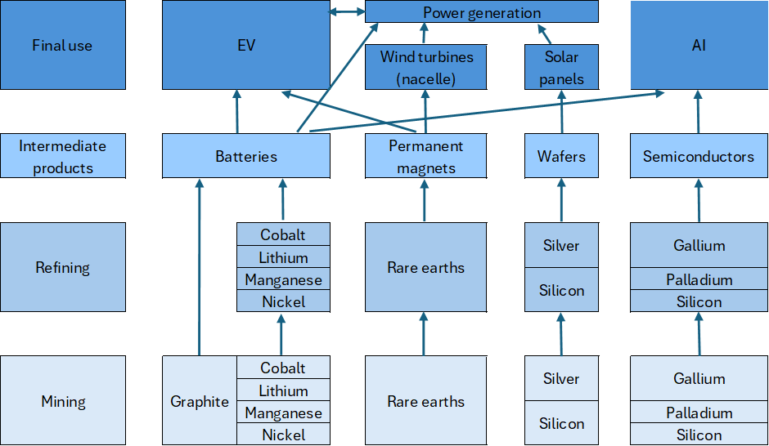
Identification of the key elements of the renewable energy and AI supply chains
Source: Chepeliev, M., Bekkers, E., Iyer, G., Qiu, Y., Wojtowicz, K., Yarlagadda, B., and Yilmaz, A.N. 2026. Critical Minerals and the Global Supply Chain. Annual Review of Resource Economics (forthcoming).

Slide 7
Overview of GTAP-CM sectoral splits
Disaggregated mining and refining activities
Disaggregated downstream uses
No. | GTAP-CE sector | GTAP-CM sector
 |  | Code | Description
1 | Mining of other ores ("moo") | man | Manganese
2 |  | nik | Nickel
3 |  | cob | Cobalt
4 |  | zin | Zink
5 |  | chr | Chromium
6 |  | tit | Titanium
7 |  | nio | Niobium
8 |  | sil | Silver
9 |  | gal | Gallium
10 |  | pgm | Platinum group metals
11 |  | mooR | Rest of other ores mining
12 | Non-metallic minerals mining ("nmn") | lit | Lithium
13 |  | gra | Graphite
14 |  | rre | Rare earth elements
15 |  | pho | Phosphorus
16 |  | mgm | Magnesium
17 |  | nmnR | Rest of non-metallic minerals mining
18 | Other chemicals ("xch") | cor | Refined cobalt
19 |  | mnr | Refined manganese
20 |  | lir | Refined lithium
21 |  | rer | Refined rare earths
22 |  | nir | Refined nickel
23 |  | agp | Artificial graphite
24 |  | xchR | Rest of other chemicals
25 | Other metals ("mpp") | siR | Refined silver
26 |  | mppR | Rest of other metals
No. | GTAP-CE sector | GTAP-CM sector
 |  | Code | Description
27 | Electrical equipment ("eeq") | mag | Permanent magnets
28 |  | LCO | Lithium Cobalt Oxide batteries
29 |  | LFP | Lithium Iron Phosphate batteries
30 |  | NCM | Nickel Manganese Cobalt Oxide batteries
31 |  | NCA | Lithium Nickel Cobalt Aluminum Oxide batteries
32 |  | LMO | Lithium Manganese Oxide batteries
33 |  | egs | Nacelle
34 |  | egs | Nacelle
 |  | eeqR | Rest of electrical equipment
35 | Electronics ("ele") | sop | Solar panels
36 |  | eleR | Other electronics
37 | Motor vehicles and parts ("mvh") | evl | Private electric vehicles EV
38 |  | pvl | Private hybrid vehicles PHEV
39 |  | cbl | Private combustion engine vehicles
40 |  | evb | Electric buses
41 |  | vpr | Motor vehicle parts
42 |  | otv | Other transport vehicles
In addition to mining activities, refining and selected downstream uses are disaggregated in the GTAP-CM Data Base.
As a result, 7 original GTAP-CE sectors are further disaggregated into 42 activities.

Slide 8
Refining of minerals is mapped to chemical and metallurgical routes
Out of the broad list of selected critical minerals, seven are analyzed in detail.
Artificial graphite production is introduced as an additional activity.
 | Chemical refining (“xch”) |  |  |  |  |  | Metallurgical refining (“mpp”) |  | Other
 | lir | cor | mnr | nir | rer | xchR | sir | mppR
Lithium (lit) | x |  |  |  |  |  |  |  | x
Cobalt (cob) |  | x |  |  |  |  |  | x | x
Manganese (man) |  |  | x |  |  |  |  | x | x
Nickel (nic) |  |  |  | x |  |  |  | x | x
Silver (sil) |  |  |  |  |  |  | x |  | x
Rare earths (rre) |  |  |  |  | x |  |  |  | x
Natural graphite (gra) |  |  |  |  |  |  |  |  | x
Artificial graphite (agp) |  |  |  |  |  |  |  |  | x

Slide 9
Material intensity is specified across key mid-stream technologies
Refined minerals are used in two mid-stream technologies: lithium batteries and permanent magnets.
 |  |  | Lithium-ion batteries (kWh) |  |  |  |  | Permanent magnets (kg)
 |  |  | LCO | LMO | LFP | NMC | NCA | mag
kg | Lithium | lir | 0.11 | 0.11 | 0.10 | 0.14 | 0.14
 | Cobalt | cor | 0.96 |  |  | 0.20 | 0.13
 | Manganese | mnr |  | 1.40 |  | 0.28
 | Nickel | nir |  |  |  | 0.51 | 0.68
 | Graphite | gra + agp | 0.94 | 0.92 | 1.09 | 0.99 | 0.97
 | Rare earths | rer |  |  |  |  |  | 0.3
Source: Sun et al. 2022. Surging lithium price will not impede the electric vehicle boom. Joule 6.8: 1738-1742.

Slide 10
Mid-stream inputs are linked to downstream technologies
 |  | Electric cars | Plug-in hybrids | Electric buses | Solar panels | Nacelles (wind turbine) | Other
 |  | evl | pvl | evb | sop | egs
Batteries | LCO |  |  |  |  |  | x
 | LMO |  |  |  |  |  | x
 | LFP | x | x | x |  |  | x
 | NMC | x | x |  |  |  | x
 | NCA | x | x |  |  |  | x
Magnets (rare earths) | mag | x | x | x |  | x | x
(refined) silver | sir |  |  |  | x |  | x

Slide 11
Data on production, bilateral trade and total supply of each product has been collected
 | Production | Trade | Total supply
Mining | USGS (r,q), OS* | CEPII (r,v,q)**
Refining |  | CEPII (r,v,q)
Midstream | JRC, BNEF, OS | CEPII (r,v,q) | IEA (q)
Downstream | BNEF | CEPII (r,v,q) | IEA, IRENA (r,q)
(r,v,q) – data availability: r - country level, v – values, q – quantities.
*OS – other sources: scientific reports, articles, web.
**- for some minerals HS code was not available.

Slide 12
Adjustment factors are used to convert trade data volumes to production-consistent units
Commodity | Code | Conversion factor
Graphite | gra | 1
Phosphorus | pho | 1
Magnesium | mgm | 0.285 ª
Manganese | man | 1
Nickel | nik | 0.015ª
Cobalt | cob | 0.07 ª
Zinc | zin | 0.65 ª
Chromium | chr | 0.68 ª
Titanium | tit | Own estimates
Niobium | nio | 1
Silver | sil | 0.017 ª
Lithium refining | lir | 0.2^{b}
Cobalt refining | cor | 0.72 e
Rare earths refining | rer | 1
Manganese chemical refining | mnr | 0.77 ^{b}
Nickel chemical refining | nir | 0.78 ^{b}
Private vehicles EV | evl | 2 tonnes/unit^{d}
Private vehicles PHEV | pvl | 2 tonnes/unit^{d}
Private combustion vehicles | cbl | 1.5 tonnes/unit^{d}
Electric buses | evb | 10 tonnes/unit^{d}
Solar panels | sop | 10 W/kg^{c}
a – Based on Alvarez et al. (2026).
b – Estimated as the share of mineral content in chemical mass of the refined products of nickel oxide and manganese oxide (assumed to be NiO and MnO).
c – Based on IRENA (2018).
d – Based on US EPA (2024). For three countries (USA, Canada and Germany) we assume that the weight of private combustion vehicles is 1.8 tonnes instead of 1.5 tonnes. This is to reflect that North American cars are larger and for Germany we scaled down the number of exported cars to obtain a better match with the combustion car production data from OICA.
e – Based on Gulley (2024).

Slide 13
Mining of the battery grade minerals
cob | Cobalt
lit | Lithium
gra | Graphite
man | Manganese
nik | Nickel

Slide 14
Refining of the battery grade minerals
cor | Refined cobalt
mnr | Refined manganese
lir | Refined lithium
nir | Refined nickel
agp | Artificial graphite

Slide 15
Production of batteries
LFP | Lithium Iron Phosphate batteries
NCM | Nickel Manganese Cobalt Oxide batteries
NCA | Lithium Nickel Cobalt Aluminum Oxide batteries

Slide 16
Production of electric vehicles
evl | Private electric vehicles EV
pvl | Private hybrid vehicles PHEV
cbl | Private combustion engine vehicles

Slide 17
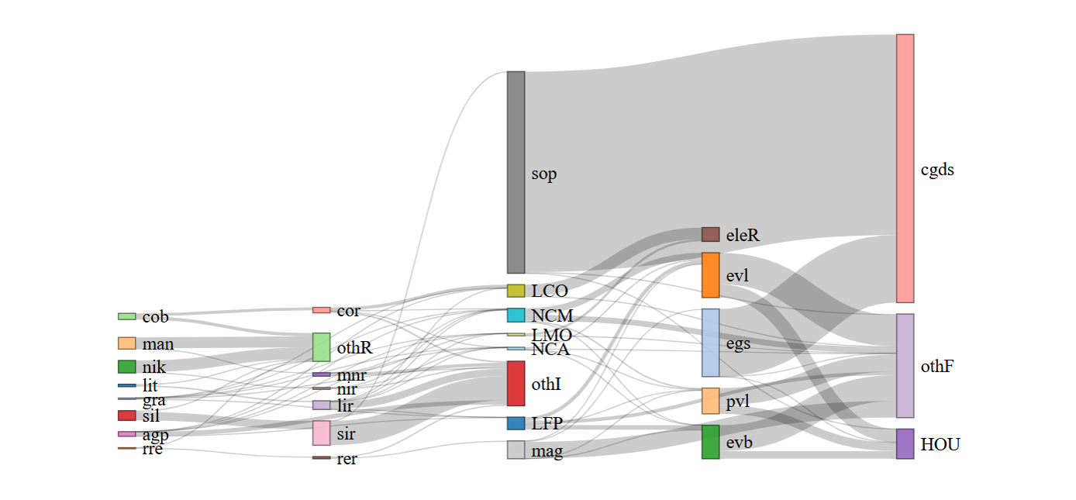
Major value-added expansion along the supply chain
Global supply chain based on the GTAP-CM database
Hight of the bars on the figure is proportional to the underlying value flows

Slide 18
Ongoing work: Rapid development of the critical mineral supply chains between 2017 and 2023
Critical minerals mining, million USD
Critical minerals refining, million USD

Slide 19
Future research
Extension with semiconductors
  To study the upstream effects of digitalization and AI, semiconductors should be explicitly included in the database representation, together with the critical minerals employed in the production of semiconductors.
Investment matrix
  Most of the renewable energy equipment used by renewable energy sectors (solar and wind) is capital (80%). At the same time, most MRIO frameworks, including GTAP, work with a capital accumulation equation at the national level, implying national average investment mix.
  By developing an investment matrix, distinguished the sourcing of investments by sector, this omission can be addressed.

Slide 20
Selected References
Aguiar, A., Baldos, U., Chepeliev, M., Corong, E., & Simonato, T. 2025. The Global Trade Analysis Project (GTAP) Data Base: Version 12. Journal of Global Economic Analysis, 10(2), 1–45. https://doi.org/10.21642/JGEA.100201AF
Chepeliev, M. 2026. Global Trade Analysis Project Circular Economy (GTAP-CE) Data Base. GTAP Research Memorandum No. 40. https://www.gtap.agecon.purdue.edu/resources/res_display.asp?RecordID=7674
Chepeliev, M., Bekkers, E., Iyer, G., Qiu, Y., Wojtowicz, K., Yarlagadda, B., and Yilmaz, A.N. 2026. Critical Minerals and the Global Supply Chain. 2026. Annual Review of Resource Economics (forthcoming).
Wojtowicz, K., Bekkers, E., Chepeliev, M., and Yilmaz, A.N. 2026. The Development of GTAP-CM version 11: Incorporating Critical Minerals and Renewable Energy Technologies in Multi-Region Input-Output Tables. GTAP Research Memorandum No. 41. https://www.gtap.agecon.purdue.edu/resources/res_display.asp?RecordID=7918

Slide 21
Thank you!
mchepeli@purdue.edu

