Slide 1

“GRASing a Matrix with Low-Precision Arithmetic: refining the iterative algorithm to improve accuracy”
Juan Manuel Valderas Jaramillo
(valderas@us.es)
Universidad de Sevilla
32nd IIOA Conference, Sevilla 23/06/2026

Slide 2

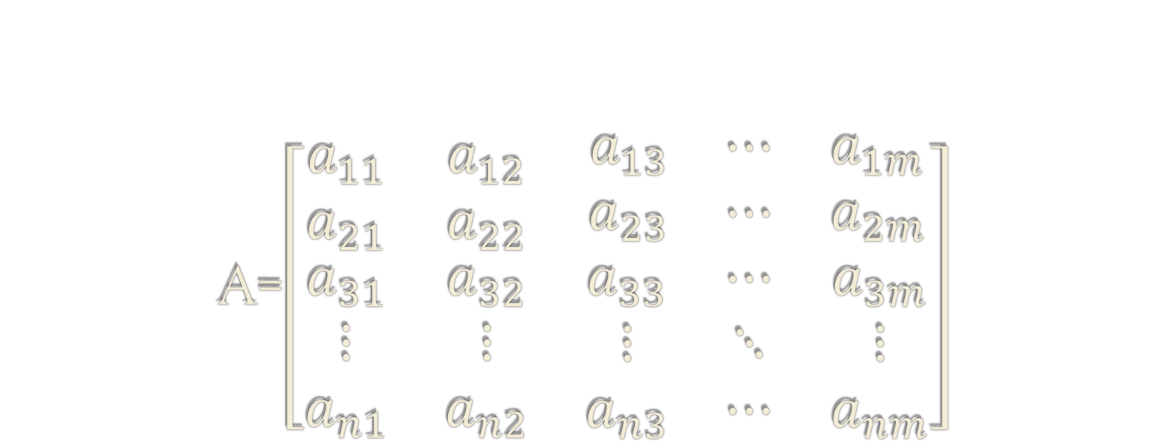






A=$\left[\begin{matrix}a_{11} & a_{12} & \begin{matrix}a_{13} & ⋯ & a_{1m}\end{matrix} \\ a_{21} & a_{22} & \begin{matrix}a_{23} & ⋯ & a_{2m}\end{matrix} \\ \begin{matrix}a_{31} \\ \begin{matrix}⋮ \\ a_{n1}\end{matrix}\end{matrix} & \begin{matrix}a_{32} \\ \begin{matrix}⋮ \\ a_{n2}\end{matrix}\end{matrix} & \begin{matrix}a_{33} & ⋯ & a_{3m} \\ ⋮ & ⋱ & ⋮ \\ a_{n3} & ⋯ & a_{nm}\end{matrix}\end{matrix}\right]$
Indirect methods and the GRAS
$$u=\left[\begin{matrix}u_{1} \\ u_{2} \\ \begin{matrix}u_{3} \\ ⋮ \\ u_{m}\end{matrix}\end{matrix}\right]$$
$$PRIOR$$
$$v=\left[\begin{matrix}v_{1} & v_{2} & \begin{matrix}v_{3} & ⋯ & v_{n}\end{matrix}\end{matrix}\right]$$
$$TARGETS$$
$∃a_{ij}>0$ and $∃a_{ij}<0$
$$ι^{′}A≠v$$
$$Aι≠u$$

Slide 3
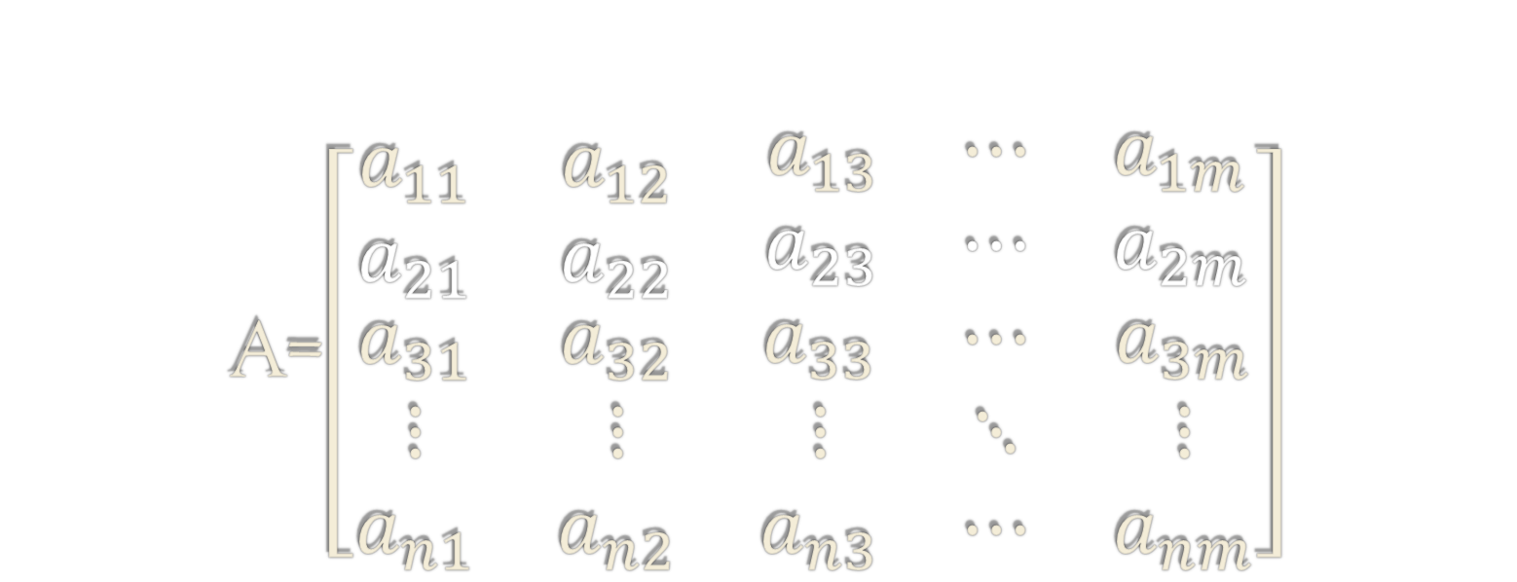


A=$\left[\begin{matrix}a_{11} & a_{12} & \begin{matrix}a_{13} & ⋯ & a_{1m}\end{matrix} \\ a_{21} & a_{22} & \begin{matrix}a_{23} & ⋯ & a_{2m}\end{matrix} \\ \begin{matrix}a_{31} \\ \begin{matrix}⋮ \\ a_{n1}\end{matrix}\end{matrix} & \begin{matrix}a_{32} \\ \begin{matrix}⋮ \\ a_{n2}\end{matrix}\end{matrix} & \begin{matrix}a_{33} & ⋯ & a_{3m} \\ ⋮ & ⋱ & ⋮ \\ a_{n3} & ⋯ & a_{nm}\end{matrix}\end{matrix}\right]$
$$u=\left[\begin{matrix}u_{1} \\ u_{2} \\ \begin{matrix}u_{3} \\ ⋮ \\ u_{m}\end{matrix}\end{matrix}\right]$$
$$v=\left[\begin{matrix}v_{1} & v_{2} & \begin{matrix}v_{3} & ⋯ & v_{n}\end{matrix}\end{matrix}\right]$$

Slide 4
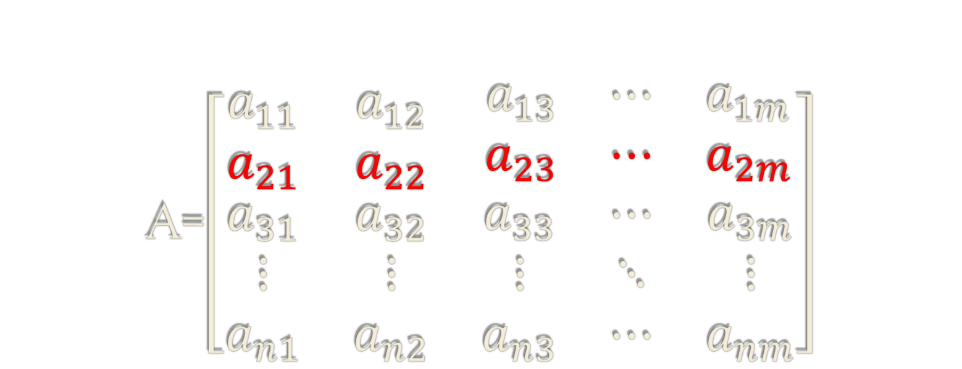

A=$\left[\begin{matrix}a_{11} & a_{12} & \begin{matrix}a_{13} & ⋯ & a_{1m}\end{matrix} \\ a_{21} & a_{22} & \begin{matrix}a_{23} & ⋯ & a_{2m}\end{matrix} \\ \begin{matrix}a_{31} \\ \begin{matrix}⋮ \\ a_{n1}\end{matrix}\end{matrix} & \begin{matrix}a_{32} \\ \begin{matrix}⋮ \\ a_{n2}\end{matrix}\end{matrix} & \begin{matrix}a_{33} & ⋯ & a_{3m} \\ ⋮ & ⋱ & ⋮ \\ a_{n3} & ⋯ & a_{nm}\end{matrix}\end{matrix}\right]$
$$u=\left[\begin{matrix}u_{1} \\ u_{2} \\ \begin{matrix}u_{3} \\ ⋮ \\ u_{m}\end{matrix}\end{matrix}\right]$$
$$v=\left[\begin{matrix}v_{1} & v_{2} & \begin{matrix}v_{3} & ⋯ & v_{n}\end{matrix}\end{matrix}\right]$$

Slide 5

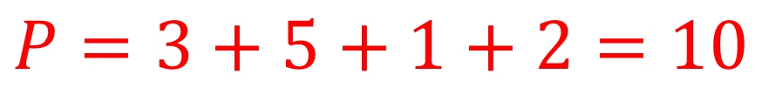

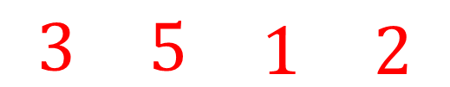
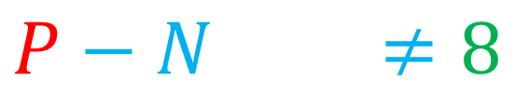
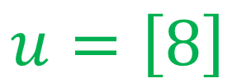
$$\left[\begin{matrix}3 & −2 & \begin{matrix}5 & \begin{matrix}1 & −4 & 2\end{matrix} & −1\end{matrix}\end{matrix}\right]$$
$$u=\left[8\right]$$
$$\left[\begin{matrix}3 & −2 & \begin{matrix}5 & \begin{matrix}1 & −4 & 2\end{matrix} & −1\end{matrix}\end{matrix}\right]$$
$$\left[\begin{matrix}3 & 5 & \begin{matrix}1 & 2\end{matrix}\end{matrix}\right]$$
$$\left[\begin{matrix}−2 & −4 & −1\end{matrix}\right]$$
$$P=3+5+1+2=10$$
$$N=2+4+1=7$$
$$P−N=3≠8$$

Slide 6





Günlük-Senesen and Bates (1988), Junius and Oosterhaven (2003), Huang et al. (2008)…
$$kP−\frac{1}{k}N=u$$
$$k=\frac{u+\sqrt{u^{2}+4PN}}{2}$$
$$P$$
$$P=0?$$
Temursho, Miller and Bouwmeester (2013)
$$k =\left\{\begin{matrix}\frac{u+\sqrt{u^{2}+4PN}}{2P} if P>0 \\ −\frac{N}{u} if P=0\end{matrix}\right.$$

Slide 7
What’s the goal of this work?
Further improvement of this factor
Addressing an additional empirical situation characterized by low-precision computations (Kahan, 2004; Blinn, 2008)
The standard quadratic formula becomes numerically unreliable when implemented in finite-precision arithmetic.

Slide 8
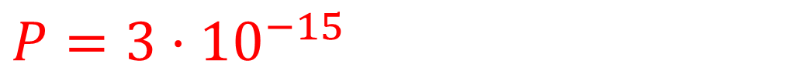
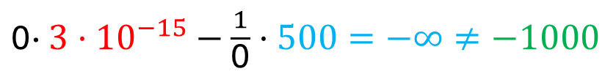

Low-precision arithmetic
$$kP−\frac{1}{k}N=u$$
$P=3·{10}^{−15}$
$$u=−1000$$
$$N=500$$
$$k=\frac{u+\sqrt{u^{2}+4PN}}{2P}=\text{0}$$
$\text{0}\text{·}$ $3·{10}^{−15}−$ $\frac{1}{\text{0}}·500=−∞≠−1000$

Slide 9
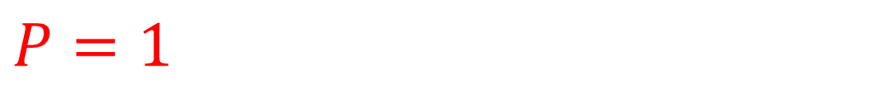

Another example
$P=1$
$$kP−\frac{1}{k}N=u$$
$$u=−{10}^{8}$$
$$N=1$$
$$k=\frac{u+\sqrt{u^{2}+4PN}}{2P}=\text{7,45·}{10}^{−9}$$
$\text{7,45·}{10}^{−9}\text{·}$ $1−$ $\frac{1}{\text{7,45·}{10}^{−9}}·1=−1,34·{10}^{8}≠−{10}^{8}$

Slide 10

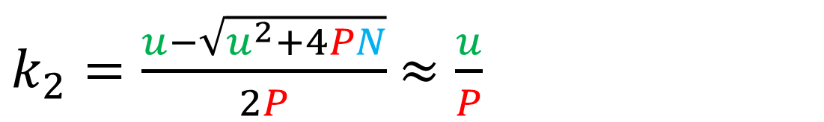

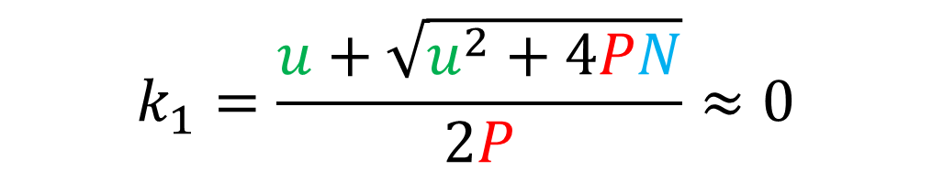


Where does this problem stem from?
“Catastrophic cancellation”
$$\sqrt{u^{2}+4PN}$$
$PN≈0 or \frac{PN}{u^{2}}$ $≈0$
$u^{2}+4PN≈$ $u^{2}$
$\sqrt{u^{2}+4PN}$ $≈u$
$$k_{1}=\frac{u+\sqrt{u^{2}+4PN}}{2P}≈0$$
$k_{2}=\frac{u−\sqrt{u^{2}+4PN}}{2P}$ $≈\frac{u}{P}$

Slide 11







A simple solution using basic algebra
$$k_{2}=\frac{\left(u−\sqrt{u^{2}+4PN}\right)}{2P}$$
$$\frac{\left(u+\sqrt{u^{2}+4PN}\right)}{u+\sqrt{u^{2}+4PN}}$$
$$=\frac{−4PN}{2P\left(u+\sqrt{u^{2}+4PN}\right)}$$
$$=\frac{−2N}{u+\sqrt{u^{2}+4PN}}$$
$$k =\left\{\begin{matrix}\begin{matrix} \\ \end{matrix} \\ \\ \end{matrix}\right.$$
$$\frac{u+\sqrt{u^{2}+4PN}}{2P} if P>0$$
$$−\frac{N}{u} if P=0$$
$$\frac{−2N}{u+\sqrt{u^{2}+4PN}} if PN/u^{2}≈0$$

Slide 12
Some numerical examples
 | c1 | c2 | c3 | u
r1 | 10 | 0 | 300 | 5000
r2 | 0 | 3 | -500 | -200
r3 | -2 | 45 | 0 | 100
v | 50 | 60 | 4790 | 4900
Crashes after 64 iterations using Temursho et al. (2013) solution…
Before crashing it was not converging…on the 63rd iteration we have:
 | c1 | c2 | c3 | u
r1 | 50,72 | 0 | 4949,28 | 5000
r2 | #¡DIV/0! | 0 | #¡DIV/0! | -200
r3 | -1,48E-15 | 100 | 0 | 100
v | 50 | 60 | 4790 | 4900
 | c1 | c2 | c3 | u
r1 | 50 | 0 | 4878,95 | 5000
r2 | 0 | 8,5E-15 | -88,95 | -200
r3 | -2,467E-15 | 60 | 0 | 100
v | 50 | 60 | 4790 | 4900

Slide 13
Using the modified factor
The algorithm is stabilised and does not crash!!!
 | c1 | c2 | c3 | u
r1 | 10 | 0 | 300 | 5000
r2 | 0 | 3 | -500 | -200
r3 | -2 | 45 | 0 | 100
v | 50 | 60 | 4790 | 4900
We have an oscillating loop since our problem is not convergent.
 | c1 | c2 | c3 | u
r1 | 50 | 0 | 4988,47 | 5000
r2 | 0 | 2,64E-18 | -198,47 | -200
r3 | -1,74E-18 | 60 | 0 | 100
v | 50 | 60 | 4790 | 4900
 | c1 | c2 | c3 | u
r1 | 49,62 | 0 | 4950,38 | 5000
r2 | 0 | 2,62E-18 | -200 | -200
r3 | -1,05E-18 | 100 | 0 | 100
v | 50 | 60 | 4790 | 4900

Slide 14
Another practical example
 | c1 | c2 | c3 | c4 | c5 | v
r1 | 700 | 300 | 555 | 5000 | 0 | 7200
r2 | 200 | 300 | 300 | 0 | 0 | 11000
r3 | 0 | 100 | -2 | -100 | 2 | -15000
r4 | 1 | 0 | 0 | 256 | 0 | 4000
r5 | 0 | 100 | 0 | -13 | -3 | 1100
u | 1620 | 5000 | 0 | 5300 | -3620 | 8300

Slide 15
Using the standard algorithm
After multiple iterations, the algorithm fails to find a convergent solution:

Slide 16
Using the modified algorithm
We achieve practical convergence after 200-ish iterations:

Slide 17
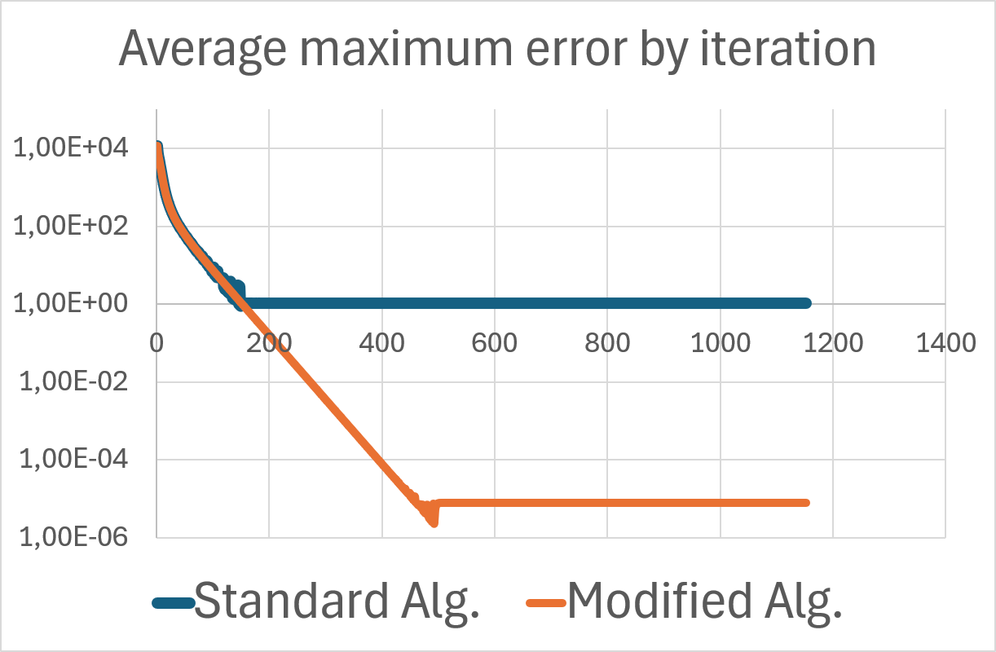
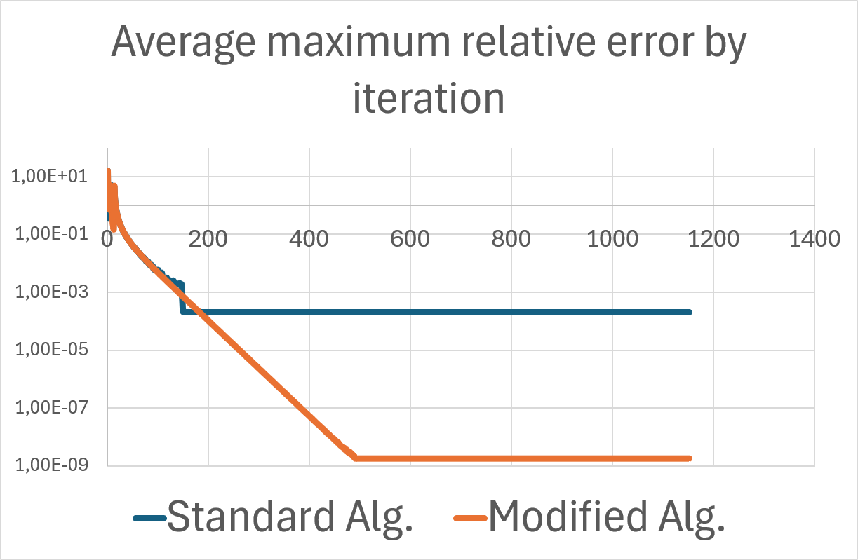
In a graphical way
The standard algorithm gets stacked at some point and doesn’t go beyond!.
This barrier is easily overcome by the modified algorihtm.
Potential crash issue also posible because of low accuracy.

Slide 18
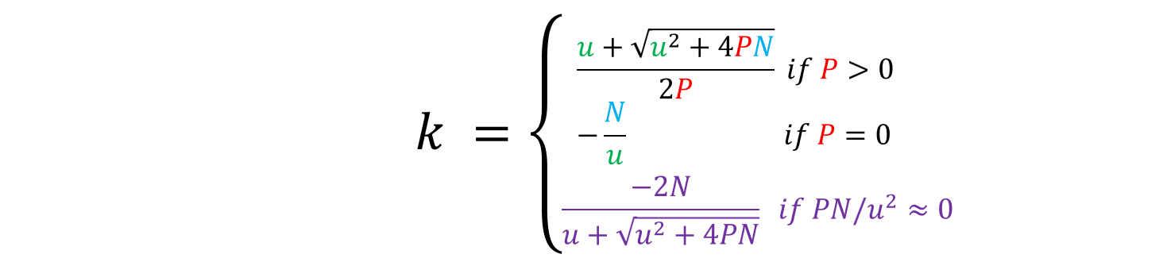
Conclusions
A refined version of the GRAS factor that induces:
A more stable algorithm
That prevents crashes and artificial divergences
Reduces the number of iterations, time saving and reduction of ad-hoc interventions
The GRAS technique is largely used in indirect methods
Let’s think of a multidimensional version (typical of MRIO tables, i.e. FIGARO)
49 countries plus RoW, 64 products and industries, plus 5 final demand categories…
More than 220.000 quadratic equations to be solved in every iteration, thousands of potential problems preventing convergence…NAM-FIGARO even more…
WORK IN PROGRESS: other examples of low accuracy not related to catastrophic cancellation implying loss of significance and coefficient sensitivity

Slide 19
“GRASing a Matrix with Low-Precision Arithmetic: refining the iterative algorithm to improve accuracy”
Thanks for your attention!!!!!
Contact: valderas@us.es

