Slide 1
An integrated energy-system and multisectoral economic model for long-term transition analysis
Matteo V. Rocco, Debora Ghezzi, Lorenzo Rinaldi (Politecnico di Milano)
Rossella Bardazzi, Maria Grazia Pazienza (Università degli Studi di Firenze)
Leonardo Ghezzi, Renato Paniccià (IRPET)
Joint SHAIO-IIOA conference 2026, Seville

Slide 2
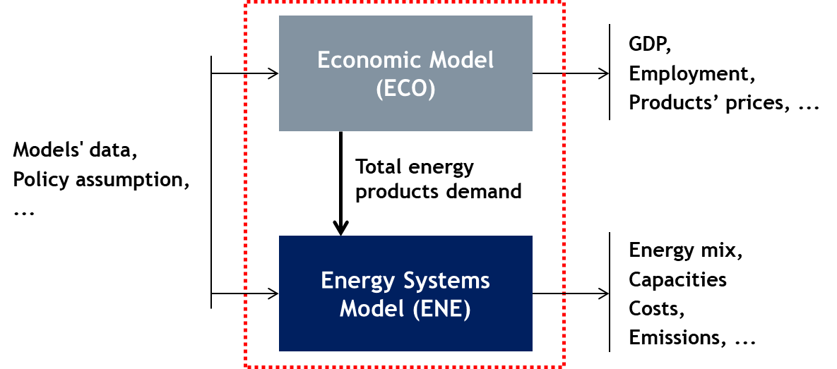
The standard modelling paradigm
  Economic models generate demand of energy products (assuming fixed technology)
  Energy systems models take this demand push and determines future structural technology changes
  Simple method, one-way integration
  Several drawbacks:
  Inconsistency in definitions and classification across models
  Feedback loops are missing:
    Economic growth trajectories not affected by structural energy technology changes
    Structural energy technology changes not affected by socio-economic constraints
Joint SHAIO-IIOA conference, 2026 - Seville

Slide 3
Background: Features of the energy transition
It affects all sectors of the economy directly or indirectly.
The adoption of new energy technologies in different industries may imply deep structural changes.
It is supported by a variety of policies, such as regulation, market-based measures and command-and-control.
It occurs over several decades (long term).
It may imply a change in the behaviour of economic agents.
It must be designed to be technically, socially, economically and environmentally sustainable.

Slide 4
Why integrating economic and energy (physical) models?
  Structural changes in energy-related industries:
    may have severe economic implications and feedbacks in all industries: system-wide interdependencies must be captured
    require high investments over time
  Structural changes in non-energy-related industries:
      imply changes in type and quantity of future energy demand
  Behaviour of economic agents (households, firms):
      affects energy demand and is influenced by energy policies (taxes, incentives, regulation)
Joint SHAIO-IIOA conference, 2026 - Seville

Slide 5
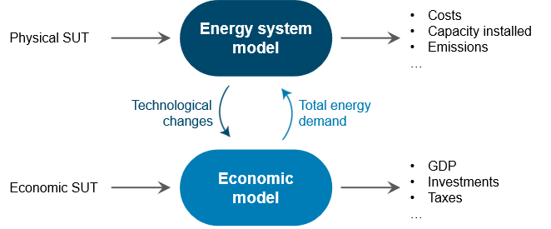


Multi-sectoral Integrated Modelling platform
  Main objective
  “[…] developing a novel set of integrated modeling tools, able to quantify the impact of energy transition pathways and to support policy decisions to ensure short and long-term sustainability of such pathways.”
Joint SHAIO-IIOA conference, 2026 - Seville

Slide 6
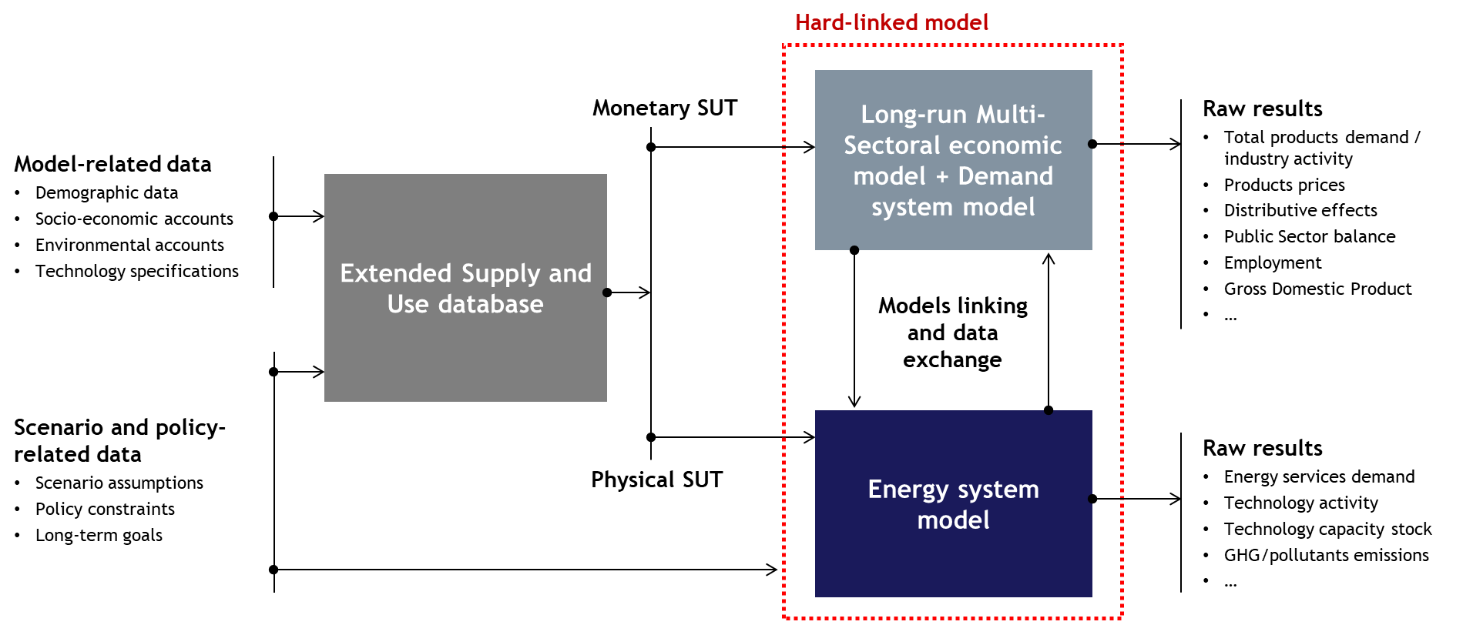
Integrated model development
Joint SHAIO-IIOA conference, 2026 - Seville

Slide 7
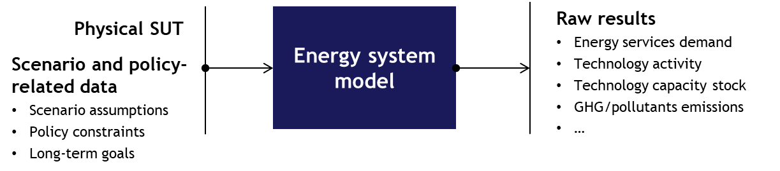
Energy system model
  Engineering complexities covered by the model:
Competition among technologies for the production of a same commodity
Time dynamics at an annual level, as the installation and disposal of productive capacity are tracked over the modelling period
Time dynamics at an hourly resolution, allowing for a more accurate representation of renewable electricity production and energy storage dynamics
Generated and captured emissions, covering both combustion-based and technology-based emission sources
Costs of new installation, operation and emissions.
Joint SHAIO-IIOA conference, 2026 - Seville

Slide 8
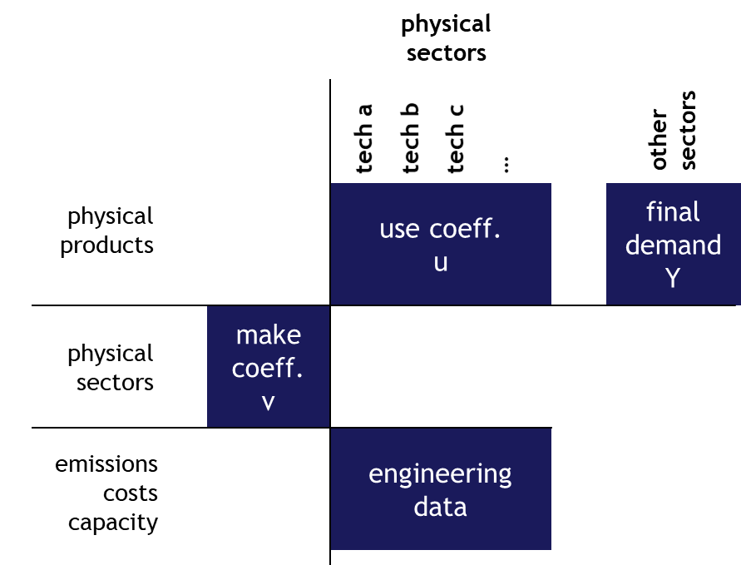
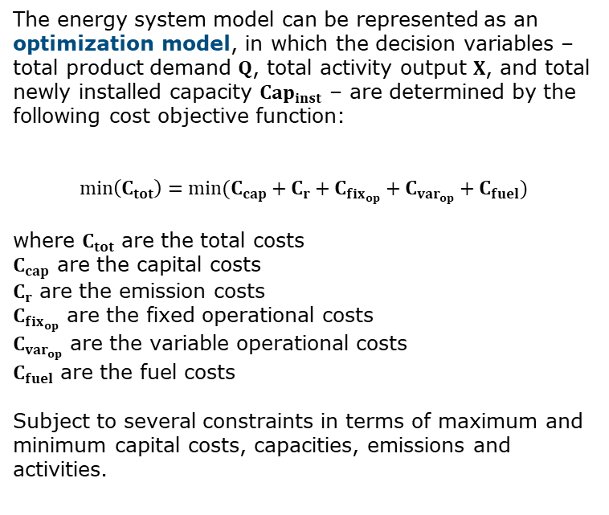
Energy system model
The energy system model can be represented as an optimization model, in which the decision variables – total product demand $Q$, total activity output $X$, and total newly installed capacity $Cap_{inst}$ – are determined by the following cost objective function:
$$min\left(C_{tot}\right)=min(C_{cap}+C_{r}+C_{fix_{op}}+C_{var_{op}}+C_{fuel})$$
where $C_{tot}$ are the total costs
$C_{cap}$ are the capital costs
$C_{r}$ are the emission costs
$C_{fix_{op}}$ are the fixed operational costs
$C_{var_{op}}$ are the variable operational costs
$C_{fuel}$ are the fuel costs
Subject to several constraints in terms of maximum and minimum capital costs, capacities, emissions and activities.
Joint SHAIO-IIOA conference, 2026 - Seville

Slide 9
Long-run Multi-Sectoral economic model
Relationship between the economy and the energy system raises three challenges:
Capturing system-wide interdependencies (i.e. tracing how changes in electricity generation propagate to raw-material demand, manufacturing activities,...)
Representing structural non-linearities (i.e. shifts in technical coefficients over the long-run and changes in the behaviour of households and firms)
Incorporating sustainability constraints (i.e. environmental, economic and social sustainability should be simultaneously considered)
Joint SHAIO-IIOA conference, 2026 - Seville

Slide 10
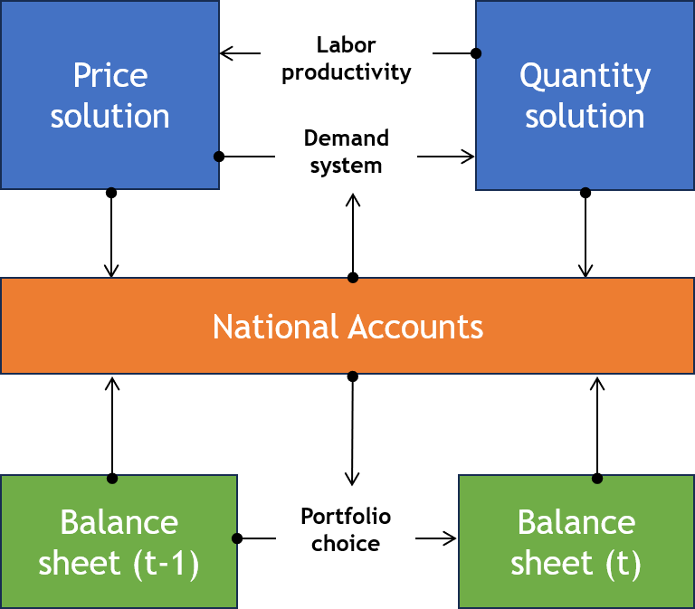
Long-run Multi-Sectoral economic model
  Dynamic, multi-sectoral stock-flow consistent model
  Financial / nonfinancial stocks-flows relations determine behaviour of institutional sectors
  It does not embed ex-ante long run equilibrium
  Income distribution determines the growth path
  Traditional Input-Output solution (Leontief)
    Quantity and Price models
  Extended INFORUM approach (Almon)
    Real and nominal sides are fully integrated (demand system and labour productivity)
    Model reproduces National Accounts by institutional sector
  Stock-Flow-Consistent IO approach (Godley)
    Financial stocks influence economic growth path
    Stocks influence flows and vice-versa
Joint SHAIO-IIOA conference, 2026 - Seville

Slide 11
The role of time in the long-run economic model
Time is a crucial component of the energy transition analysis that allows to identify the transition path from the current state to a hypothetical final state. It is important to trace the development of the economy over time where business cycles are possible.
Time is essential also for alternative technologies to become established, and equipment lifetimes are highly important in determining the adoption of these new technologies.
The multisectoral economic model is built around a concept of chronological time not a logical time as in the neo-classical model (short-term= you are not in the equilibrium; long term= you are in the equilibrium).
Each year is the result of previous years conditions + new exog. shocks→ path-dependency
Dynamics is intrinsically built within the model because of the continuous interaction and conditioning of flows on stocks and viceversa.
Joint SHAIO-IIOA conference, 2026 - Seville

Slide 12
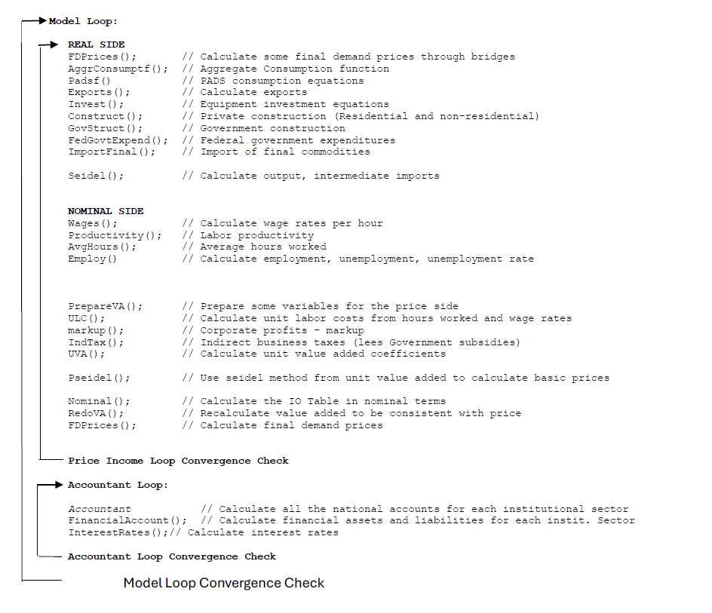
Long-run Multi-Sectoral economic model: solution algorithm
Real side block: final demand components estimated in real terms
Solution of real gross output by Seidel method
Nominal side block: labour productivity, employment and wages; value-added components
Solution of sectoral prices by Pseidel method
Distribution of value added to institutional sectors
Calculate financial flows and stocks for institutional sectors
Joint SHAIO-IIOA conference, 2026 - Seville

Slide 13
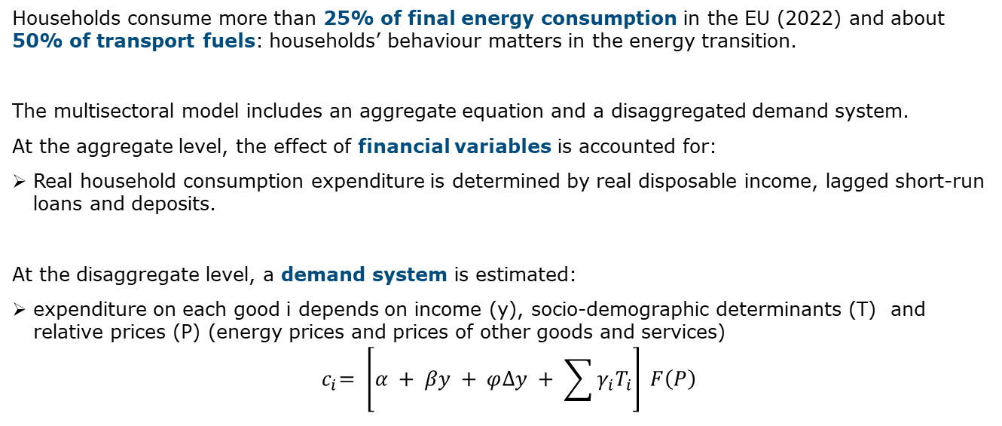
An example of behavioural equations:
Household consumption
Households consume more than 25% of final energy consumption in the EU (2022) and about 50% of transport fuels: households’ behaviour matters in the energy transition.
The multisectoral model includes an aggregate equation and a disaggregated demand system.
At the aggregate level, the effect of financial variables is accounted for:
Real household consumption expenditure is determined by real disposable income, lagged short-run loans and deposits.
At the disaggregate level, a demand system is estimated:
expenditure on each good i depends on income (y), socio-demographic determinants (T) and relative prices (P) (energy prices and prices of other goods and services)
${ c}_{i}= \left[α + βy + φ∆y + \sum{γ_{i}T_{i}}\right] F\left(P\right)$
Joint SHAIO-IIOA conference, 2026 - Seville

Slide 14
Household consumption in the integrated model
The demand system is linked to several variables estimated in the economic model and in the energy system model.
Inputs:
Disposable income is estimated in the accountant side of the model (institutional accounts)
Population by age groups is forecasted in a population projection module
Prices are computed in the energy system model and passed to the demand system (bridge matrix)
Adoption of new energy technologies determined by the interaction of the demand and the energy system model
Output:
Personal consumption by expenditure categories is included in the final demand and in the real solution of the multisectoral model (bridge matrix)
Joint SHAIO-IIOA conference, 2026 - Seville

Slide 15
Integrated model development: an intense preliminary data work
Joint SHAIO-IIOA conference, 2026 - Seville

Slide 16
Data work for the multisectoral economic model: main sources
IO tables for Italy (OECD-ICIO)
ISTAT National Accounts for Italy
Household consumption by expenditure functions (COICOP) (ISTAT)
Financial accounts (Bank of Italy)
Construction of a unified database that is internally coherent, despite inevitable inconsistencies across sources, vintages, and accounting perspectives.
Another important task:
the build-up of bridge matrices
  linking household consumption by function (COICOP) to consumption by industries
  to link the investment, in different type of categories (residential buildings, non-residential buildings, equipment, other categories as intellectual property), by owner sector and investment by producing sectors/industries.
Joint SHAIO-IIOA conference, 2026 - Seville

Slide 17
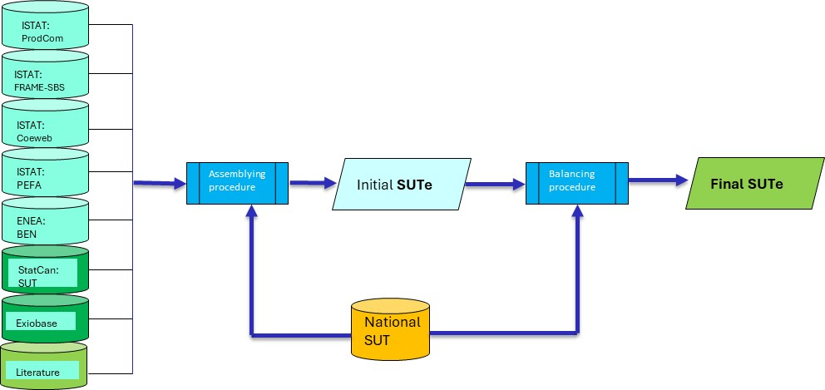
Consistency via SUT Framework
The hard-linked architecture is grounded in the supply-use framework, establishing a structural consistency between physical energy transactions and monetary flows.
Building the Extended Supply-Use Table (SUTe) for Italy required to use several sources.
The Extended Supply-Use Table (SUTe) untangles and disaggregates technological cost structures already embedded within ISTAT’s macro-sectors.
Joint SHAIO-IIOA conference, 2026 - Seville

Slide 18
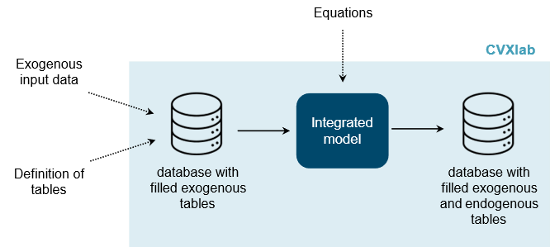


Implementation of the models with CVXlab package (Rocco 2025)
  Package features
  Open-source, Python-based
  General purpose model generator
  Symbolic problems defined by user
  Very low coding skills required
  Excel/CSV-based data collection for end-users
  Easy data inspection based on PowerBI reports
GitHub repository
Documentation
Joint SHAIO-IIOA conference, 2026 - Seville

Slide 19
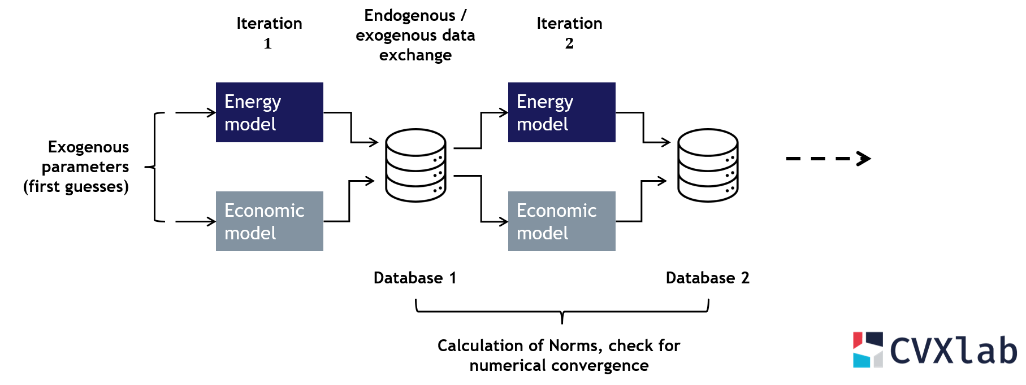
Operational hard-linking process: a first step
The energy system model transfers to the economic model the market-share coefficients with which technologies supply each product and the installed capacity of energy-related technologies.
The (simplified) economic model computes a new demand for energy products which is fed back to the energy model.
Iterative solution with block Gauss-Seidel scheme (updated endogenous variables are exchanged until convergence)
Convergence criterion: endogenous variables Norms stable and below given thresholds
Joint SHAIO-IIOA conference, 2026 - Seville

Slide 20
What has been achieved so far
An extended and consistent supply and use database for physical and economic models.
Two fully developed advanced energy system and economic models for Italy.
A package to implement the integration of the two models (CVXlab).
A prototype of an integrated model with achieved convergence.
What remains to be done
A further development of the integrated model with the SFC economic model
A long-run baseline scenario and policy simulation scenarios
Joint SHAIO-IIOA conference, 2026 - Seville

Slide 21
Thank you for your attention! rossella.bardazzi@unifi.it

Slide 22
Other slides

Slide 23
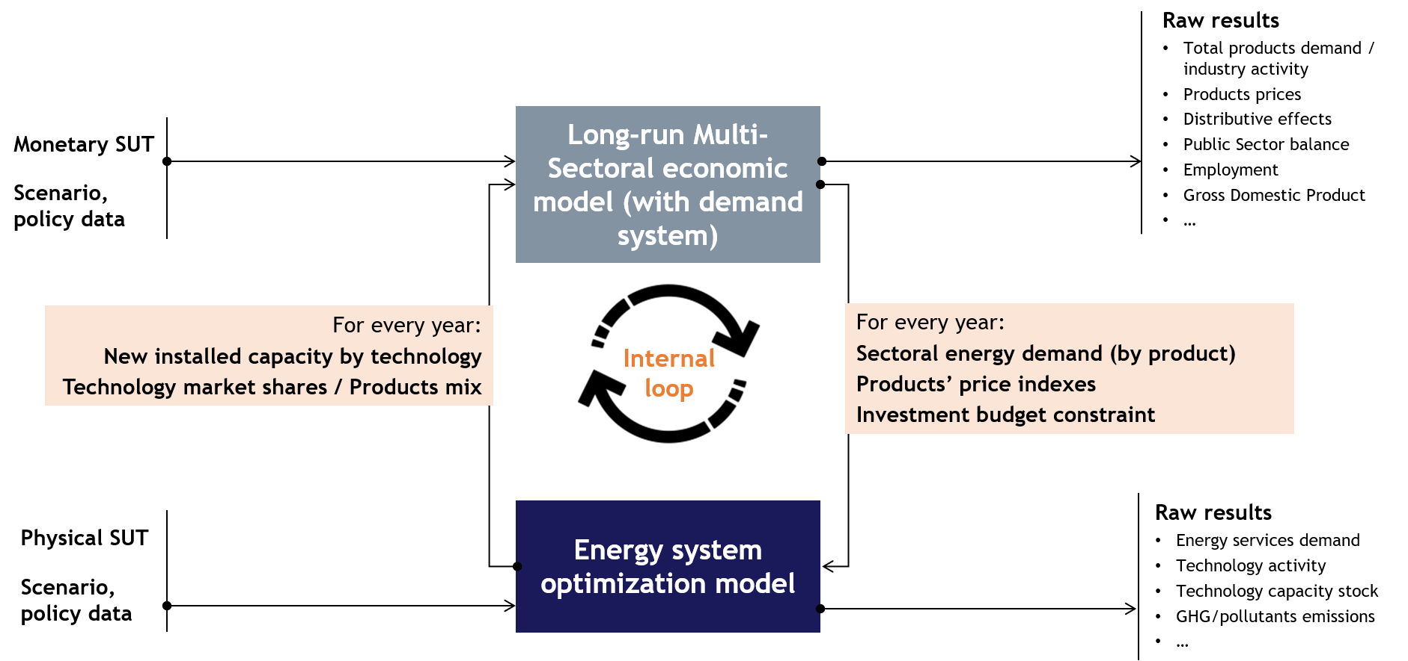
Conceptual hard-linking process
Joint SHAIO-IIOA conference, 2026 - Seville

Slide 24
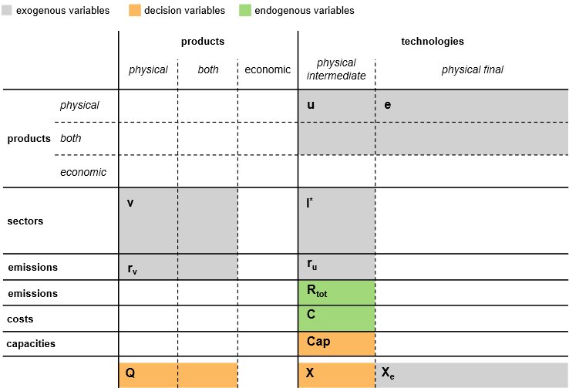
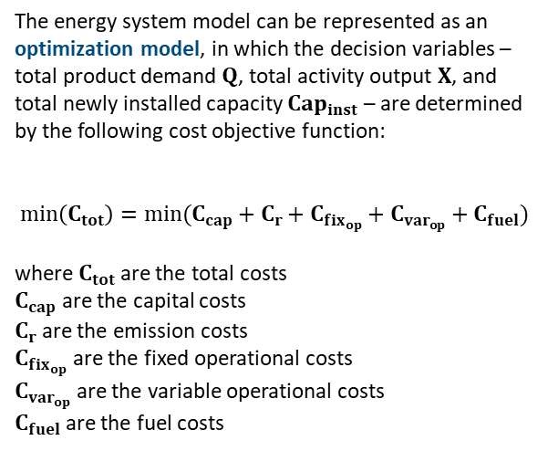
Energy system model
The energy system model can be represented as an optimization model, in which the decision variables – total product demand $Q$, total activity output $X$, and total newly installed capacity $Cap_{inst}$ – are determined by the following cost objective function:
$$min\left(C_{tot}\right)=min(C_{cap}+C_{r}+C_{fix_{op}}+C_{var_{op}}+C_{fuel})$$
where $C_{tot}$ are the total costs
$C_{cap}$ are the capital costs
$C_{r}$ are the emission costs
$C_{fix_{op}}$ are the fixed operational costs
$C_{var_{op}}$ are the variable operational costs
$C_{fuel}$ are the fuel costs
Joint SHAIO-IIOA conference, 2026 - Seville
Notes:
Costs are organized into three categories: (i) capital costs, (ii) emission costs, and (iii) operational costs. Capital costs $C_{cap}$ depend on the newly installed capacity $Cap_{inst}$, while emission costs $C_{r}$ depend on total system emissions $R_{tot}$. Operational costs are further disaggregated into fixed operational costs $C_{fix_{op}}$, depending on operative capacity $Cap_{op}$, variable operational costs $C_{var_{op}}$, depending on total activity output $X$, and fuel costs $C_{fuel}$, depending on fuel consumption by each technology and by final demand categories as described by the use coefficients matrix and the final demand matrix, respectively.

Slide 25
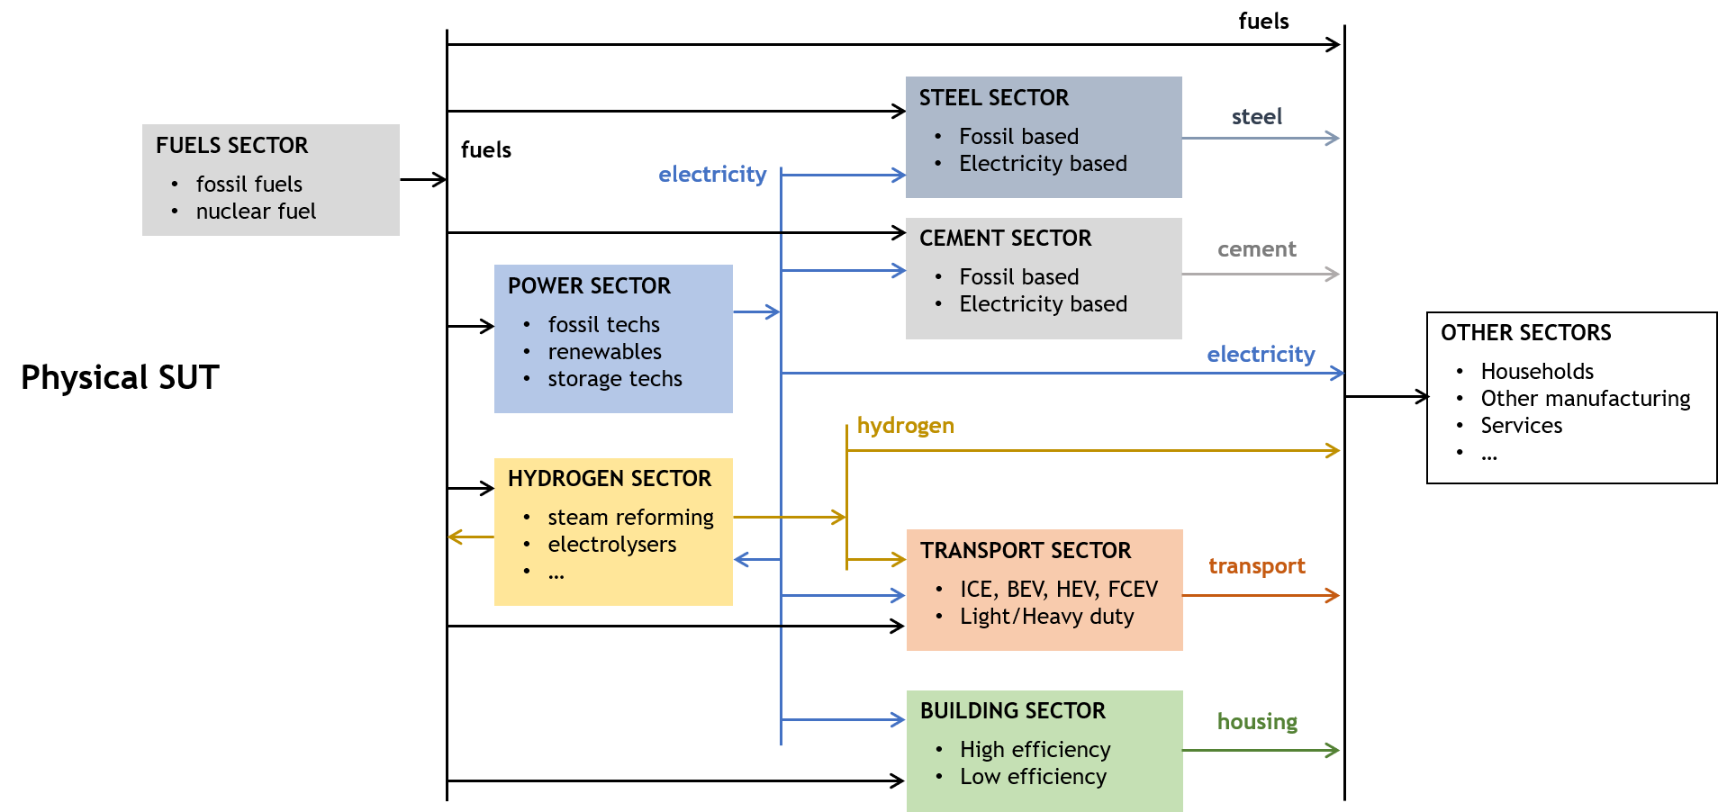
Energy system model

Slide 26
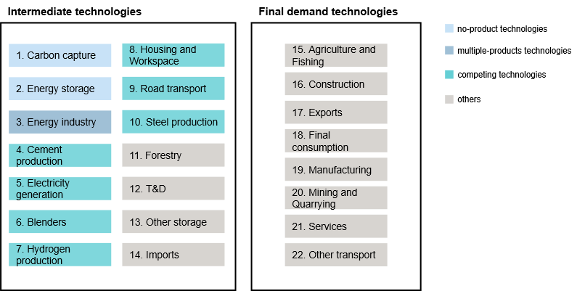
Technologies and products in the energy system model
Notes:
The energy system model comprises 115 technologies, distinguished between intermediate (62) and final demand (52) technologies, with the former being energy-related technologies. The total number of products included in the model is 25, which differs from the number of intermediate technologies. This discrepancy arises because the one-to-one correspondence between technologies and products does not hold for all technologies: there are (i) technologies that do not generate any product, (ii) technologies that yield multiple products, and (iii) technologies that compete with others to produce the same output. Figure 3 illustrates the full set of intermediate and final demand technologies included in the model, aggregated into 20 groups.

Slide 27
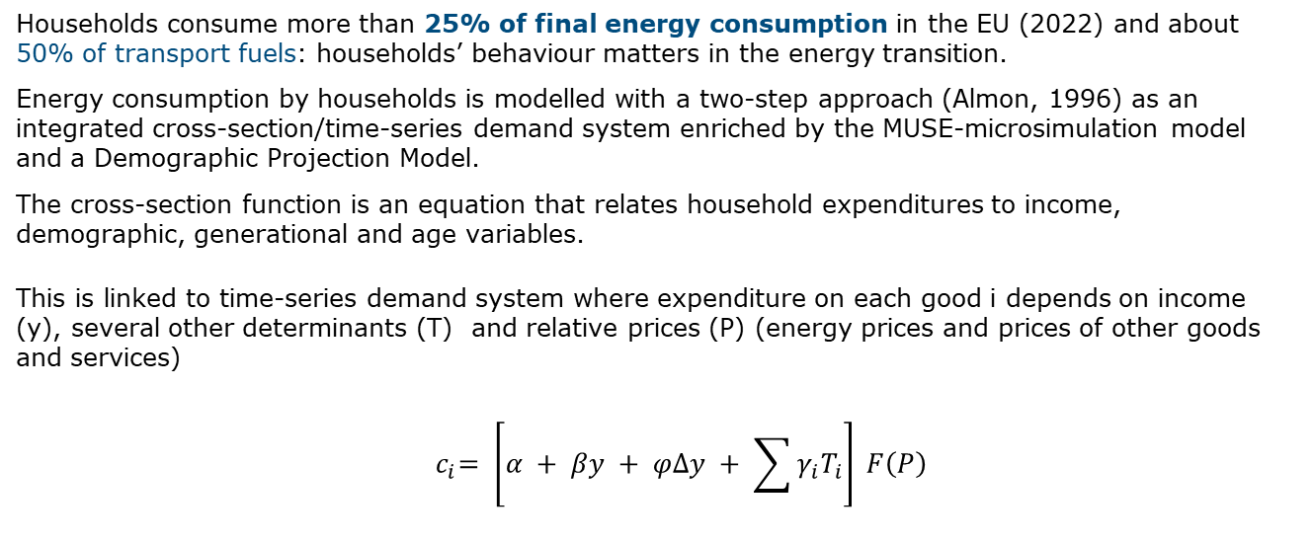
An example of behavioural equations:
Personal consumption demand system
Households consume more than 25% of final energy consumption in the EU (2022) and about 50% of transport fuels: households’ behaviour matters in the energy transition.
Energy consumption by households is modelled with a two-step approach (Almon, 1996) as an integrated cross-section/time-series demand system enriched by the MUSE-microsimulation model and a Demographic Projection Model.
The cross-section function is an equation that relates household expenditures to income, demographic, generational and age variables.
This is linked to time-series demand system where expenditure on each good i depends on income (y), several other determinants (T) and relative prices (P) (energy prices and prices of other goods and services)
$${ c}_{i}= \left[α + βy + φ∆y + \sum{γ_{i}T_{i}}\right] F\left(P\right)$$
Joint SHAIO-IIOA conference, 2026 - Seville

Slide 28
Consistency via SUT Framework
The hard-linked architecture is grounded in the supply-use framework, establishing a structural consistency between physical energy transactions and monetary flows.
Building the Extended Supply-Use Table (SUTe) for Italy required to use several sources.
The Extended Supply-Use Table (SUTe) untangles and disaggregates technological cost structures already embedded within ISTAT’s macro-sectors.
Data Source | Role in SUTe Construction
ISTAT ProdCom | Quantifies national output at the 8-digit CPA level to isolate specialized products (e.g., green hydrogen, BEV vs. HEV vehicles).
ISTAT FRAME-SBS | Provides the fundamental structural business statistics to reconstruct elementary cost pathways and intermediate inputs.
ISTAT Coeweb | Feeds highly detailed NP8 foreign trade matrices into the SUTe, tracking the exact import/export of green transition technologies.
ISTAT PEFA / Balances | Supports physical-to-monetary reallocation of energy products across domestic industries and consumer categories.
EXIOBASE & Literature | Parameterizes emerging clean tech (e.g., electrolyzers, FCEV, active solar) missing from standard national accounts.
Joint SHAIO-IIOA conference, 2026 - Seville
Notes:
The economic model comprises 113 technologies (commonly referred to as economic sectors), 104 of which are classified as intermediate and 9 as final demand, as illustrated in Figure 5. The set of technologies is largely identical to that of the energy system model, with the exception that the economic model encompasses two fewer technologies. These are storage technologies employed in the energy system model to simulate the charging and discharging processes of Battery Electric Vehicles.

