Slide 1

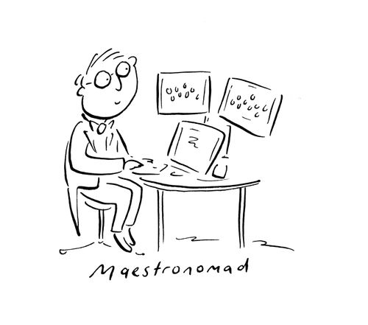
MAESTRIO
Developing an open-source MAcroEconomic Sustainability TRajectory model with Input-Output
https://images.cartoonstock.com/previews/CS640582_preview.jpg
i
Kirsten Wiebe, Fabian Aponte, Meron Arega – SINTEF
Nicolas Lhuillier, Alvaro Durante - RTE

Slide 2


https://www.theguardian.com/commentisfree/2026/jun/10/economists-maths-growth-doomed-strategy-un-agencies-political-leaders
https://www.neep-poverty.org/roadmap-for-eradicating-poverty-beyond-growth/

Slide 3
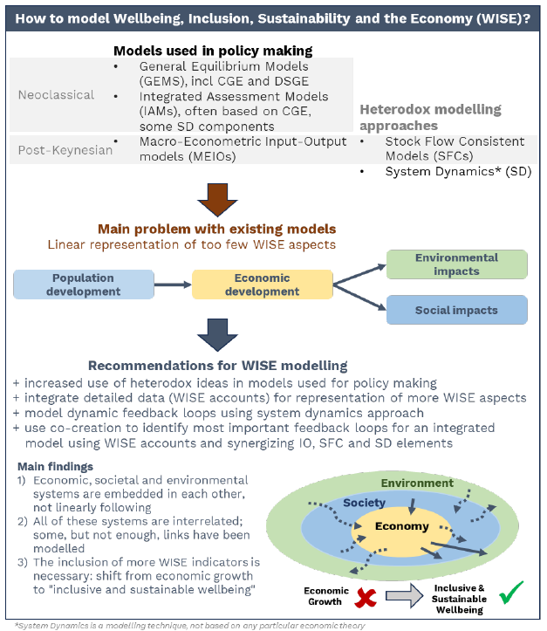
Why do we need MAESTRIO?
“Democratising the Macroeconomic Modelling Toolbox” (D’Alessandro et al. 2026)
What models need
  Industry and product resolution (exploration of structural change)
  Physical (e.g. energy) consistency
  Flexibility that allows for feedback loops between nature – society – economy
  Distributional aspects
  Integration with National Accounting Matrices
  Wellbeing and post-growth scenarios
→Open-source global inter-industry model with a post-Keynesian approach to foster pluralism in modelling
D’Alessandro, S. Bordenave, M., & Rouge, K. (2026). Policy Profile: Democratising the Macroeconomic Modelling Toolbox. https://www.neep-poverty.org/wp-content/uploads/2026/04/6.4_Democratising-the-macroeconomic-modelling-toolbox_WEBSITE.pdf
Wiebe, K. S., Aponte, F. R., Kaufmann, R., & Lampropoulos, D. (2023). Review of macroeconomic approaches to modelling Wellbeing, Inclusion, and Sustainability. Final Version of WISE Horizons Deliverable 1.2. https://doi.org/10.5281/ZENODO.8370002
Edwards, A., Brockway, P. E., Bickerstaff, K., & Nijsse, F. J. M. M. (2025). Towards modelling post-growth climate futures: a review of current modelling practices and next steps. Environmental Research Letters, 20(5), 053005. https://doi.org/10.1088/1748-9326/ADC9C6

Slide 4

MAESTRIO in short
Core economic model
  Joint effort with RTE
  Open-source (most probably MPL2.0)
  Demand-driven SUT-based model (FIGARO 2025 Edition)
  Iterative solution: going forward one year at a time
Wellbeing-climate feedbacks and post-growth scenarios
  Fabian’s presentation (yesterday)
  WISE Horizons project
https://images.cartoonstock.com/lowres/music-conductor-conducting-symphony-planets-space-CS593128_low.jpg

Slide 5
Theoretical background
Demand-driven input-output trajectory model
Post-Keynesian (Eichner and Kregel, 1975)
  Dynamics and path-dependence:
  one year forward at a time, myopic foresight
  Money and the financial system:
  No constraints on investment
  Importance of distributional and aggregate outcomes:
  household quintiles
  Micro-basis to complement macro-level outcomes
Main differences to CGE modelling
Fundamental uncertainty vs perfect knowledge
Econometrically estimated behaviour vs optimization
Endogenous vs fixed money supply
Demand-driven (not at full capacity) vs supply driven

Slide 6

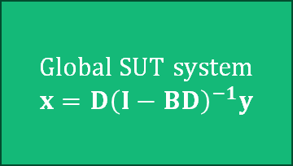
Empirical model
Gravity trade model (t-1)
modelled
Market share matrices
Market share matrices
planned
Market share matrices
Market share matrices
Intermediate import shares
Final import shares
Global SUT system
$$x=D{\left(I−BD\right)}^{−1}y$$
Exogenous change options
Market share matrices
Market share matrices
Market share matrices
Population
Market share matrices
Market share matrices
Market share matrices
Market share matrices
Use coefficientmatrices
Final demand matrices
Value added
FIGARO-NAM
${GFCF}_{rt}=$ ${GFCF}_{rt−1}\frac{{VA}_{rt−1}}{{VA}_{rt−2}}$
$${GOV}_{rt}\sim f\left({POPU}_{rt},{GOV}_{r,t−lag},…\right)$$
Prices / Wages

Slide 7


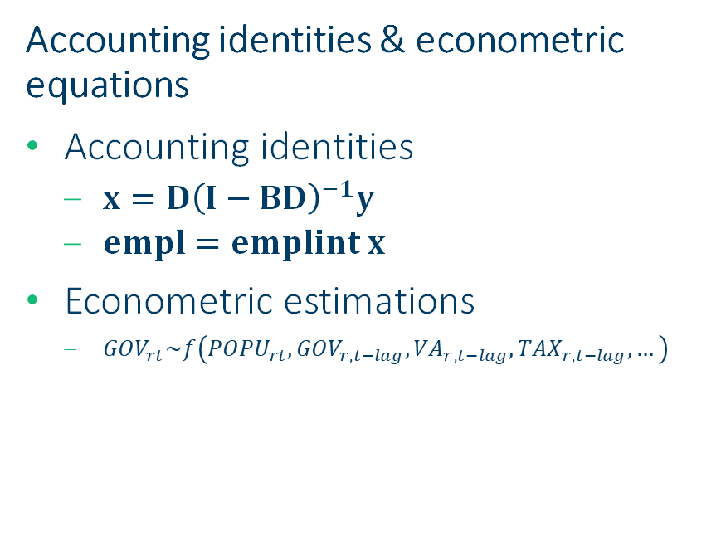
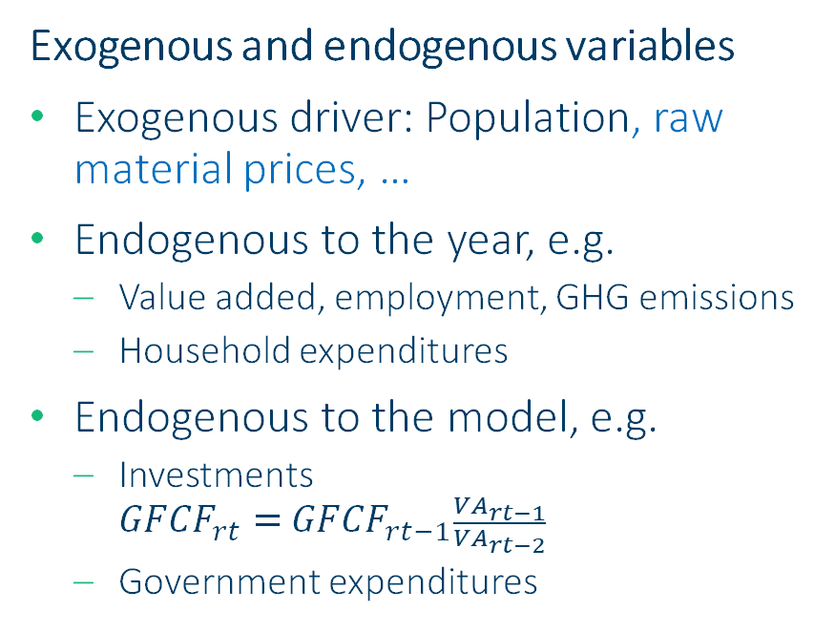
Empirical model
Exogenous and endogenous variables
Exogenous driver: Population, raw material prices, …
Endogenous to the year, e.g.
  Value added, employment, GHG emissions
  Household expenditures
Endogenous to the model, e.g.
  Investments
  ${GFCF}_{rt}=$ ${GFCF}_{rt−1}\frac{{VA}_{rt−1}}{{VA}_{rt−2}}$
  Government expenditures
Accounting identities & econometric equations
Accounting identities
  $x=D{\left(I−BD\right)}^{−1}y$
  $empl=emplint x$
Econometric estimations
  ${GOV}_{rt}\sim f\left({POPU}_{rt},{GOV}_{r,t−lag},{VA}_{r,t−lag},{TAX}_{r,t−lag},…\right)$

Slide 8
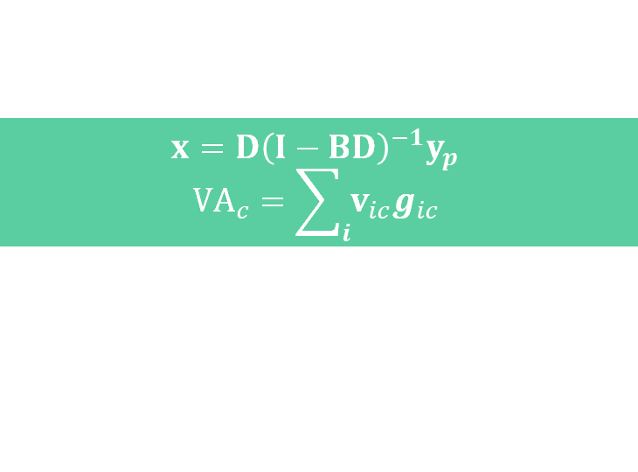
Model flow
Year t-1
Year t
Structural changes
Technology
Trade
Market shares
Final demand
Households
Government
Investments
exog
exog
Prices (wage, ind & prod)
Update prices
Price conversion of all
Aggregate price
$$x=D{\left(I−BD\right)}^{−1}y_{p}$$
$${VA}_{c}=\sum_{i}{v_{ic}g_{ic}}$$
0.5
Physical extensions
GHG
EMPL
FIGARO-NAM

Slide 9
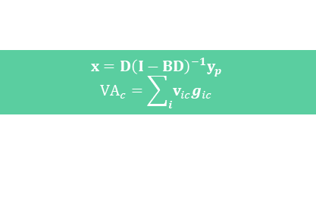

Model flow
Year t
exog
Structural changes
Technology
Trade
Market shares
Final demand
Households
Government
Investments
exog
Prices (wage, ind & prod)
Update prices
Price conversion of all
Aggregate price
$$x=D{\left(I−BD\right)}^{−1}y_{p}$$
$${VA}_{c}=\sum_{i}{v_{ic}g_{ic}}$$
0.5
Physical extensions
GHG
EMPL
FIGARO-NAM
Year t+1
exog
Structural changes
Technology
Trade
Market shares
Final demand
Households
Government
Investments
exog
Prices (wage, ind & prod)
Update prices
Price conversion of all
Aggregate price
$$x=D{\left(I−BD\right)}^{−1}y_{p}$$
$${VA}_{c}=\sum_{i}{v_{ic}g_{ic}}$$
0.5
Physical extensions
GHG
EMPL
FIGARO-NAM

Slide 10
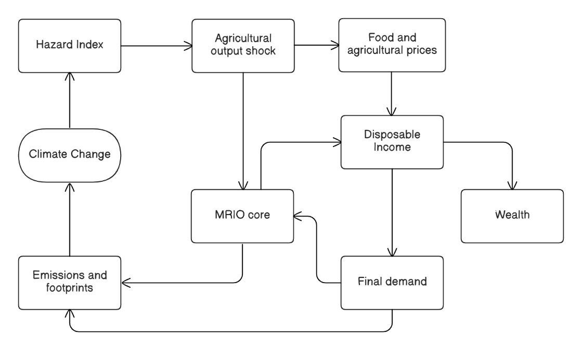
Loop mechanisms
Channel 1: Agriculture and food prices
Data needed
• Hazard index (drought / heat / floods)
• Agricultural output or yield response
• Food price pass-through
• HBS/COICOP food shares by group
• Agriculture and food products
Quantity effects
Traditional IO output/employment effects
Price effects
Food costs and group-specific baskets
From: Fabian Aponte “A channel-based framework for endogenizing climate-inequality dynamics in macroeconomic models” Tuesday, Parallel Session 2, 15:00-16:30, B03
Notes:
Use agriculture as the most intuitive example. Highlight that the mechanism has two effects: quantity effects through sectoral output and employment/income multipliers, and price effects through food costs and group-specific baskets. Emphasise that the IO contribution is to keep the price and final demand vector in the same product classification.

Slide 11
Empirical model
MAcroEconomic Sustainability TRajectory model with Input-Output (MAESTRIO)
Household expenditures
(to be implemented)
  Consumption changes based on elasticities from FIDELIO
  Almost ideal demand system also based on FIDELIO
  Perhaps adequate demand system …
Price modelling
(to be implemented)
  Technological change B
  Prices for individual commodities (energy, materials) pq
  Wages w
  Taxes on products tls
  Taxes on production tax

Slide 12

Code and code structure
Three main open-source R packages:
  maestrio-core (study management, general computation, basic plots)
  maestrio-dataprocessing (easing preprocessing of SUT data)
  maestrio-scenariosetup (allowing excel-based scenario configuration)
100% flexible model (endogenous vs exogenous trajectory evolution, data granularity, results)
Study structure supported by HDF5 file allowing efficient (and portable) access to any trajectory data and result

Slide 13
Code and code structure
100% flexible model
  endogenous or exogenous trajectory evolution
  data granularity
  results
Study structure
  HDF5 file
  efficient (and portable) access to any trajectory data and result
-packages
MAESTRIOdummy
MAESTRIOfigaro
study management
general computations
basic plots
MAESTRIOdummy_setup
- Data
- ParameterEstimation
MAESTRIOfigaro _setup
- Data
- ParameterEstimation
MAESTRIO_core
Reading and processing SUT data
Aggregation routines
Reading and processing of other relevant data
MAESTRIOdummy_study1
IndustrySplit
StudyParameterEstimation
ScenarioInputs
ScenarioResults
MAESTRIOfigaro _study1
IndustrySplit
StudyParameterEstimation
ScenarioInputs
ScenarioResults
MAESTRIO_dataprocessing
Allowing Excel-based scenario configuration
Country and industry grouping for scenarios
MAESTRIO_scenariosetup
MAESTRIOdummy_study2
IndustrySplit
StudyParameterEstimation
ScenarioInputs
ScenarioResults
MAESTRIOfigaro _study2
IndustrySplit
StudyParameterEstimation
ScenarioInputs
ScenarioResults
Plotting scenario data
Comparing scenarios
MAESTRIO_resultsGUI
Notes:
Three main open-source R packages:
maestrio-core (study management, general computation, basic plots)
maestrio-dataprocessing (easing preprocessing of SUT data)
maestrio-scenariosetup (allowing excel-based scenario configuration)

Slide 14
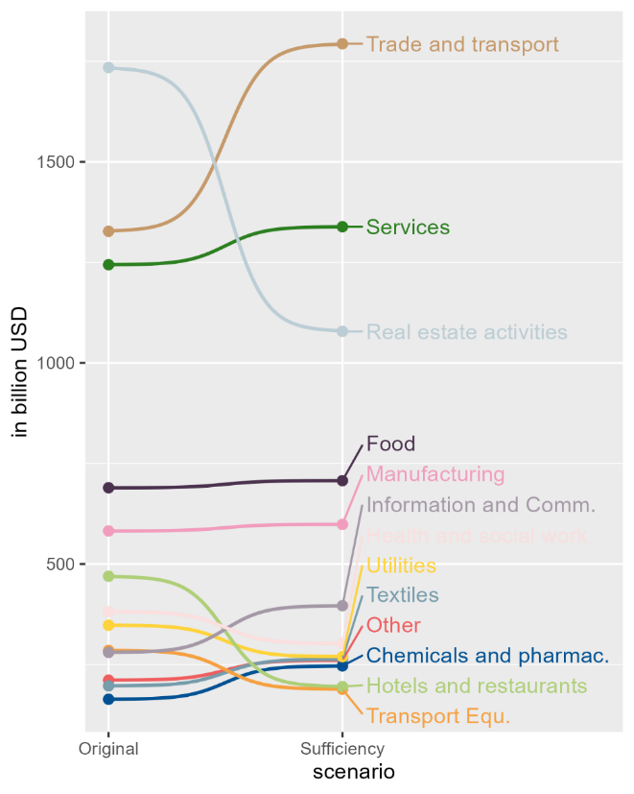
WISE Horizons scenario examples
Changing final demand
Sufficiency scenario
  Change in spending patterns of Western European HH
  HH spending about 4% lower
  Rest of the world HH endogenous
Slow growth scenario
  HH spending: sufficiency
  350% increase in government spending on education and health

Slide 15
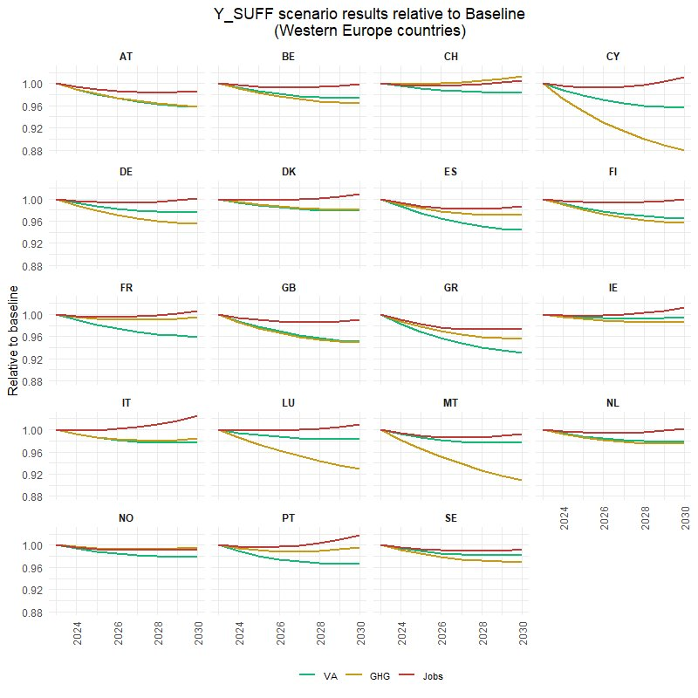
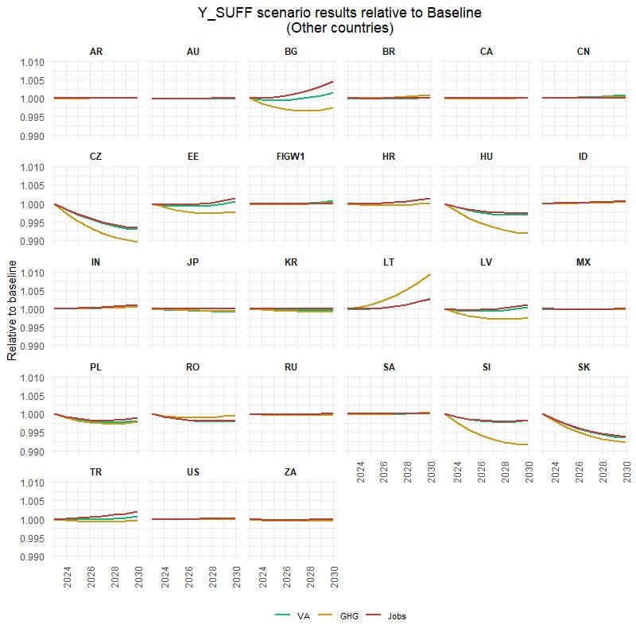

WISE Horizons “sufficiency” scenario

Slide 16
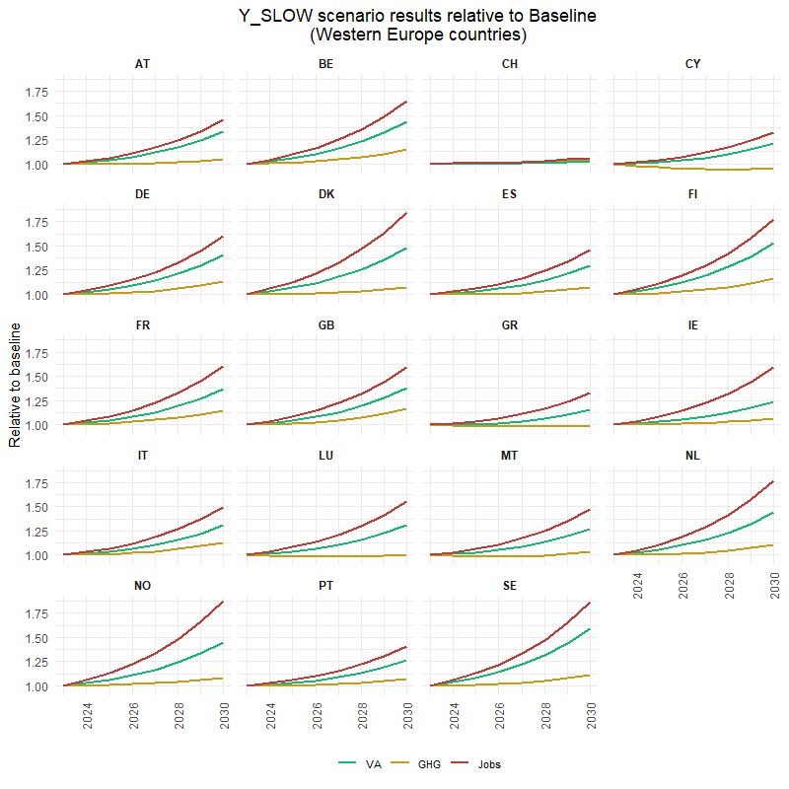
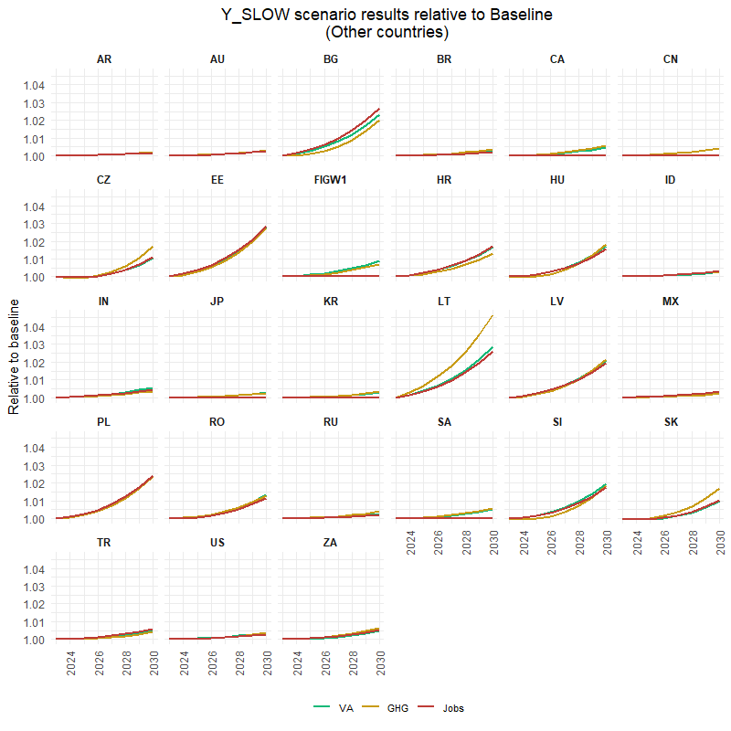
WISE Horizons “slow growth” scenario

Slide 17
RTE EV scenario example
European transition towards Electric Vehicles:
Impact on Energy Consumption across world regions
Country aggregation of FIGARO into 4 regions: Europe (EU); North America (NAM); Asia (AS); Rest of the world (ROW)
Disaggregation of original automobile industry and product (C29) into Electric (EV) and Internal Combustion (ICEV) Vehicles, with specific considerations by regions and for key sectors (batteries)
Final energy extensions based on IEA and EUROSTAT data
Scenario
Final demand changes: European FD shift from ICEV to EV (total FD of automobile sector remains constant)
Technological change: Evolution of technical coefficients to represent EV shift on intermediate consumption of EU industries

Slide 18
EV scenario implementation in MAESTRIO
Scenario change | Variables | From | To | 2024 | 2025 | ... | 2050
Shift in final demand | EU_P3_S14 EU_P51G | CPA_C29_ICEV | CPA_C29_EV | -5% | -6% | … | -27%
Shift in use coefficients | B matrix | CPA_C29_ICEV | CPA_C29_EV | -5% | -6% | … | -27%
Exogenous final demand increase | EU_P3_S14 EU_P51G | EU_CPA_D35 | N/A
Exogenous final demand decrease | EU_P3_S14 EU_P51G | EU_CPA_C19 | N/A
FIGARO classification
P3_S14 : HH
P51G : GFCF
CPA_D35 : Electricity, gas and steam
CPA_C19 : Petroleum products

Slide 19
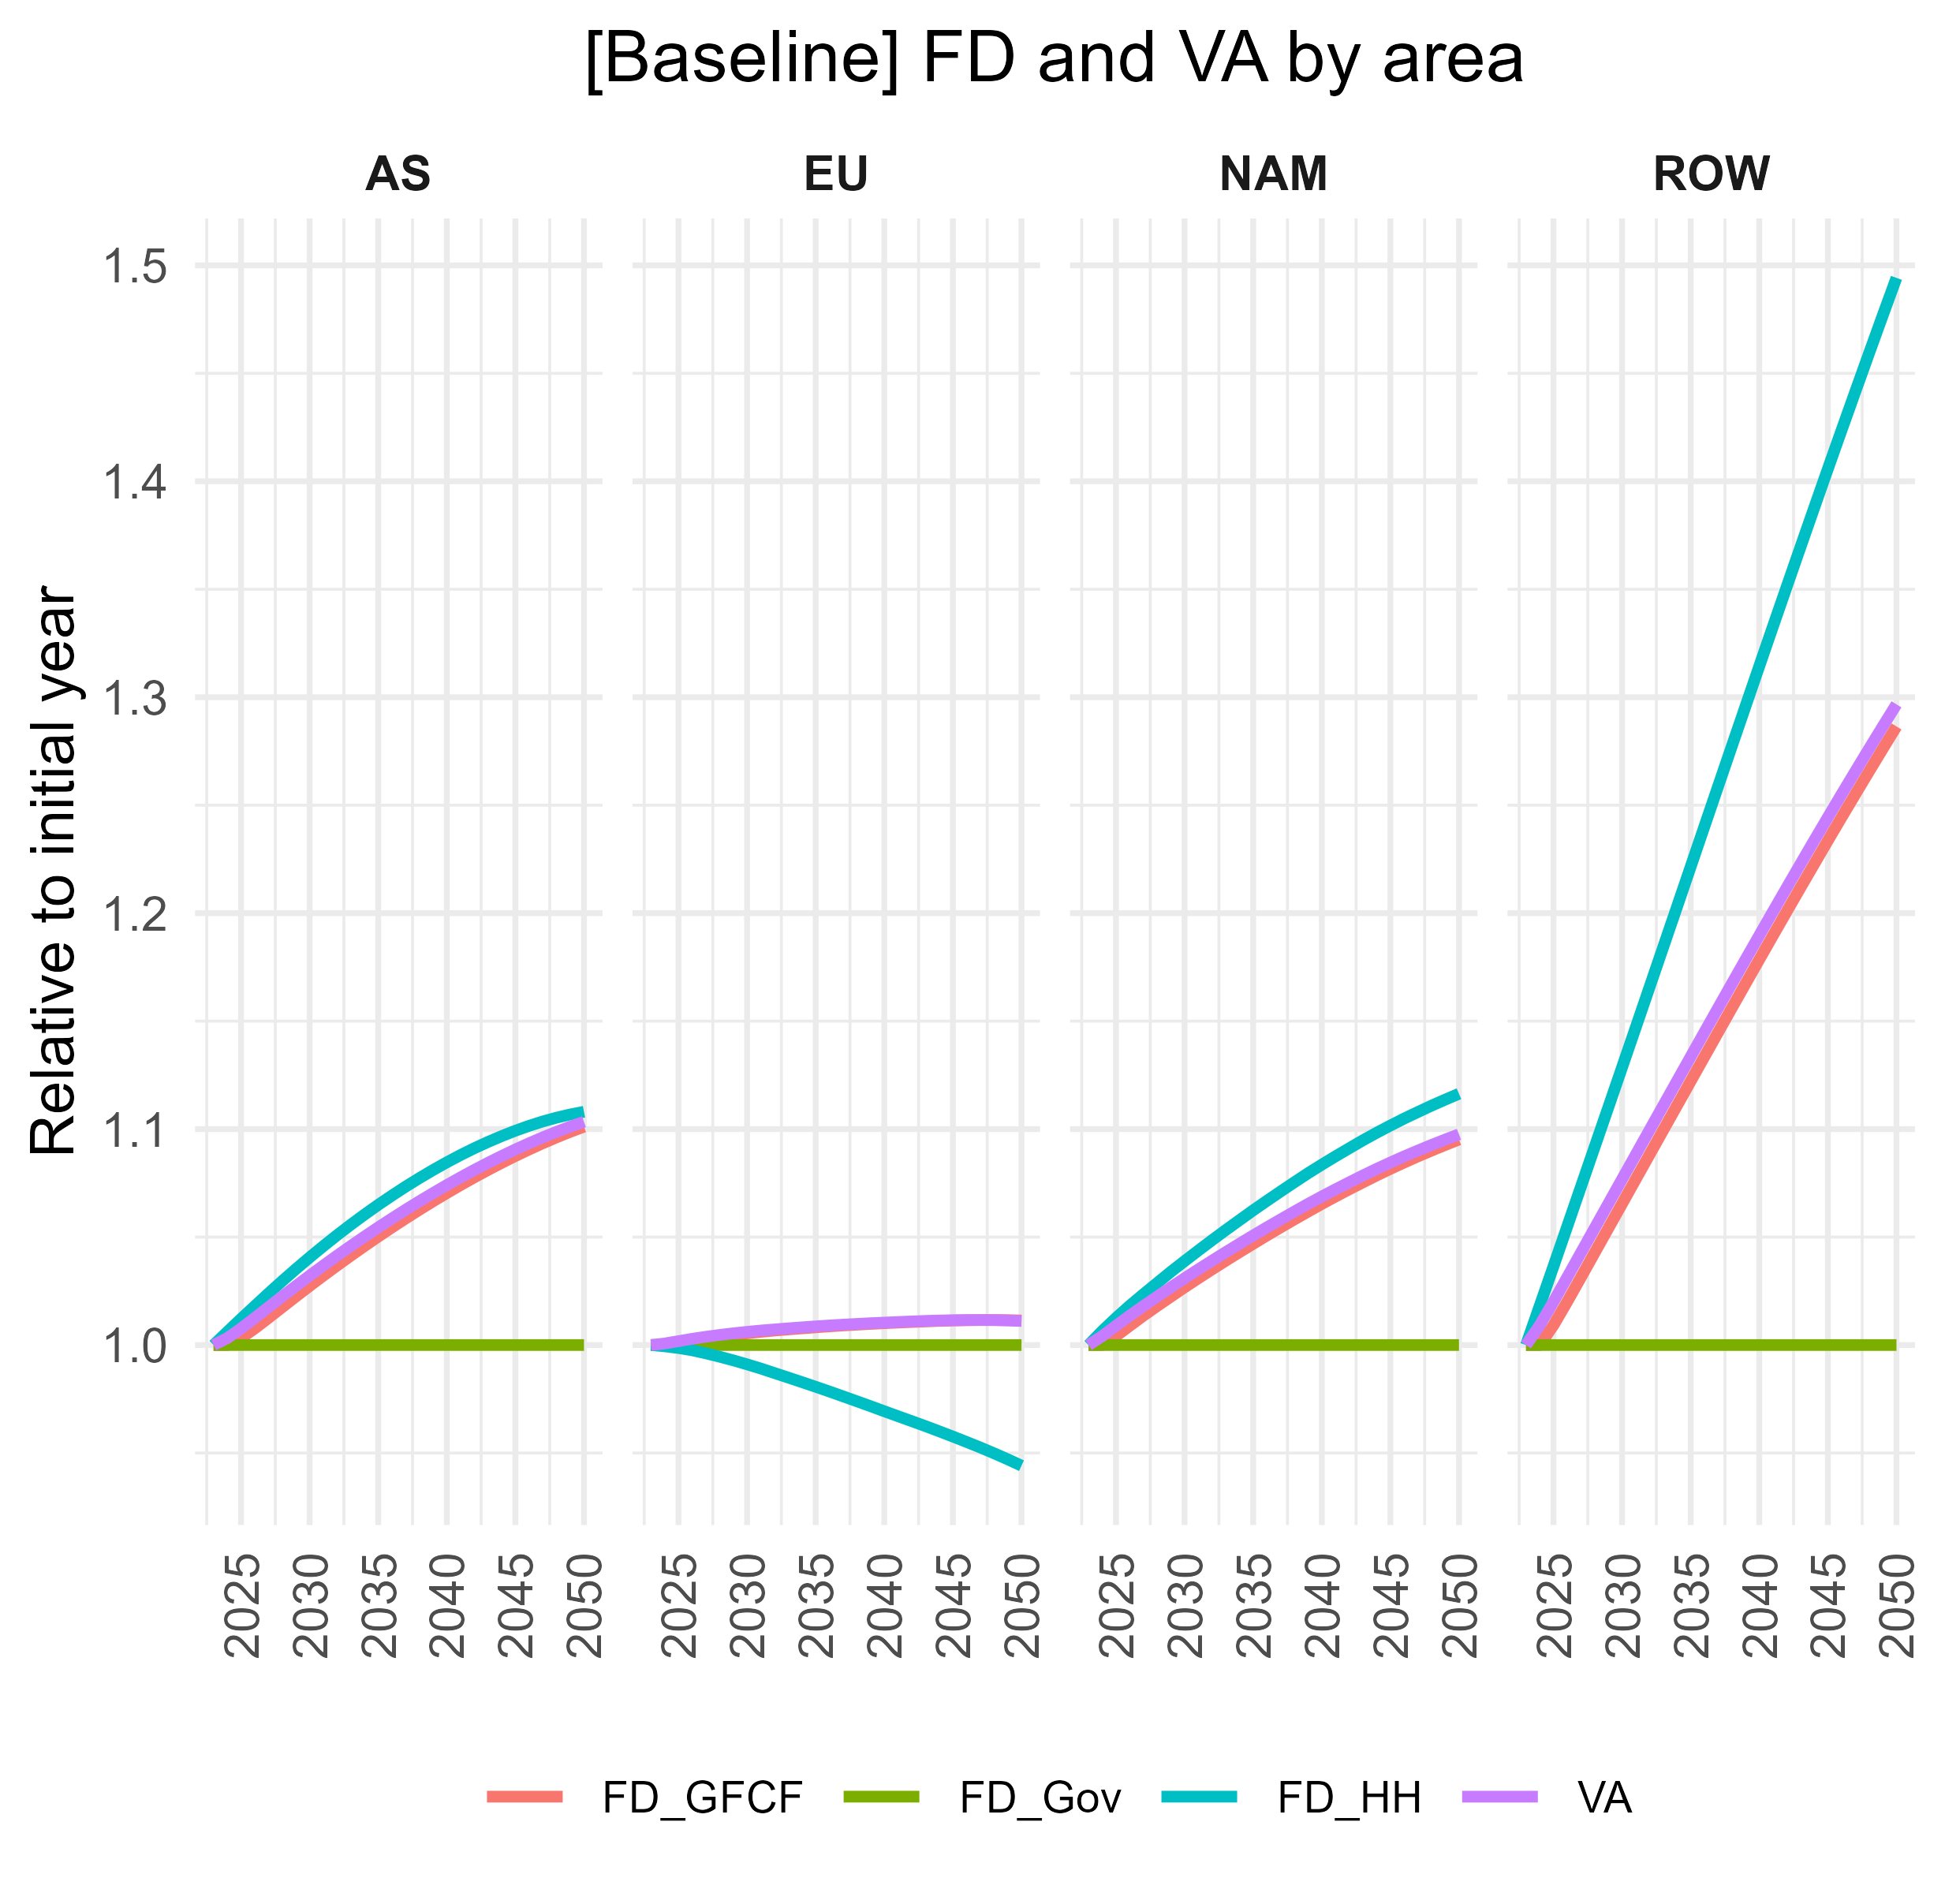
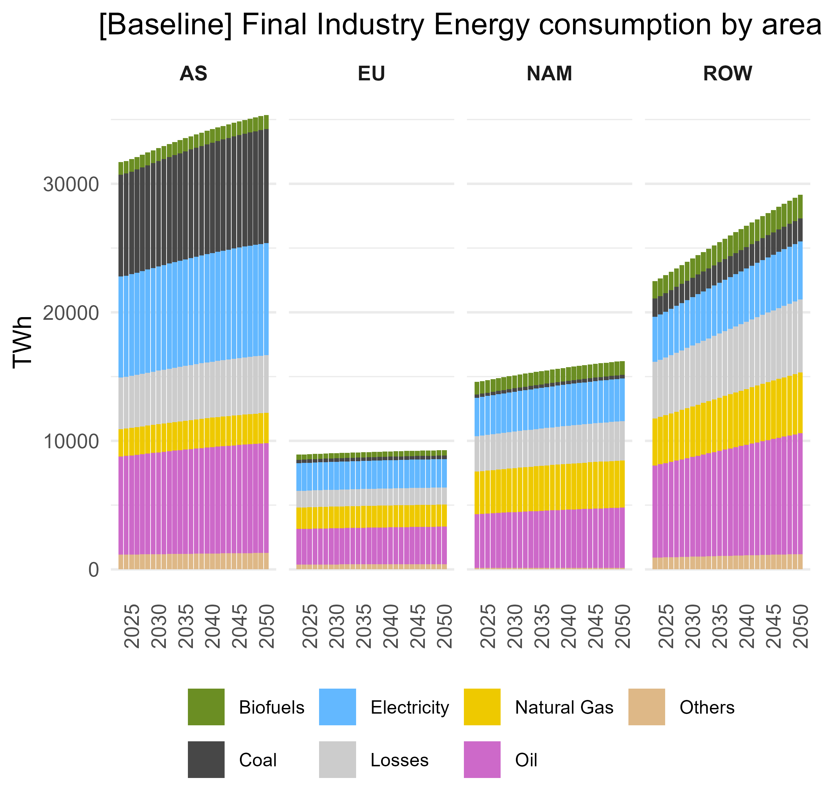
EV example: Baseline – Pop growth

Slide 20
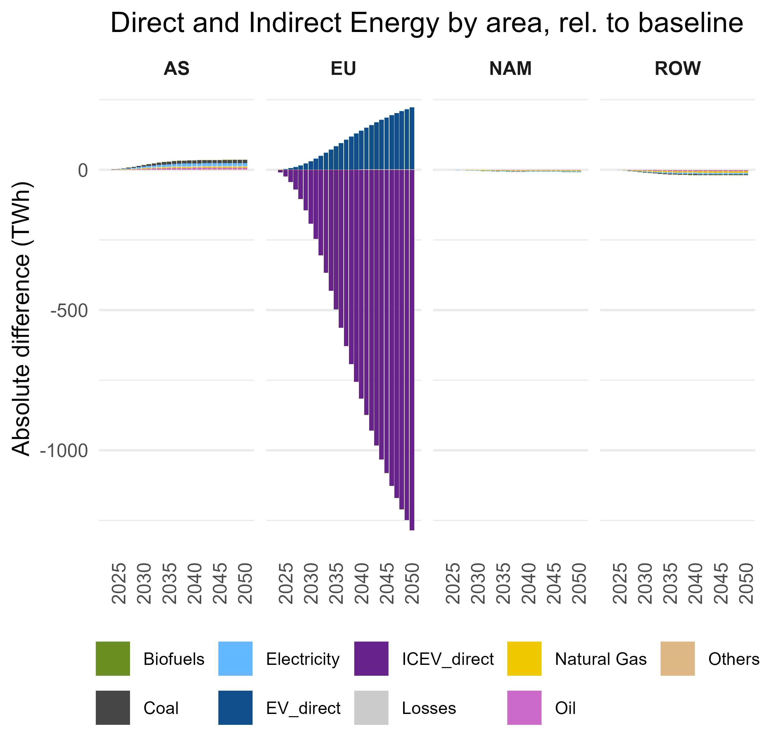
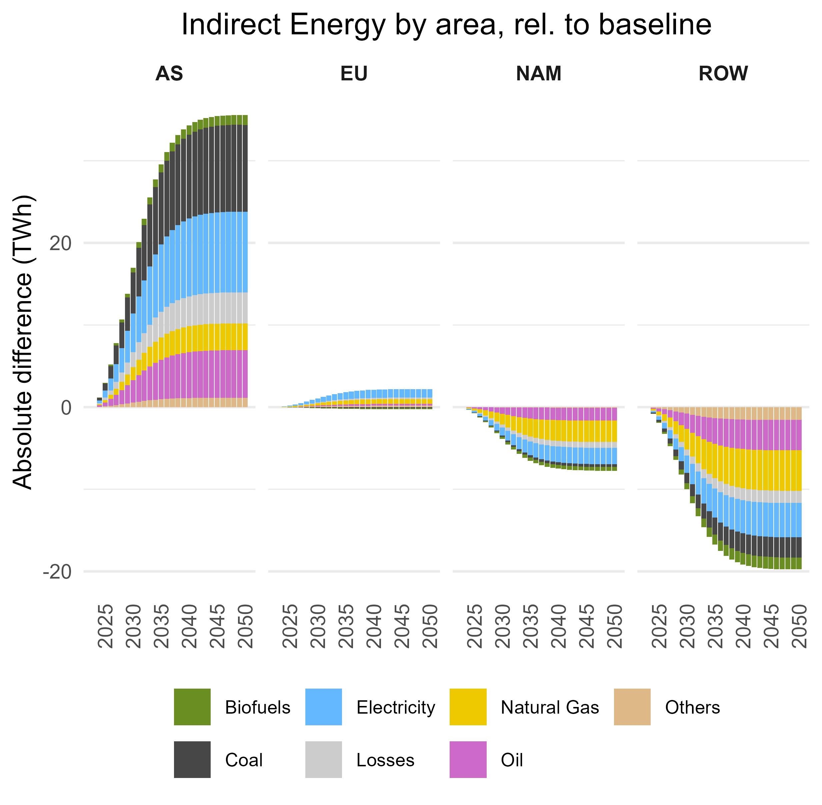
EV scenario results
(direct & indirect energy consumption)
* EU Final Energy consumption for road transport in 2023: 3 050 TWh

Slide 21
Refining energy (final and intermediate) consumption modelling
A more physical approach to environmental extensions use
  Linking direct energy consumption and related GHG emissions by households with the evolution of the final demand
  Linking direct energy consumption and related GHG emissions by industries with the evolution of the use coefficients
Industry / product split
  C19 – split gasoline, diesel and kerosene
  D35 – split electricity, gas and heat as three products and split electricity (wind, pv, nuclear, gas...) and gas (natural gas, biogas) industries
  G47 – here we can assume that you either pay the services for fuelling your car or services for charging your car (though a lot of charging will be done at home) – small difference

Slide 22
Way forward
https://images.cartoonstock.com/previews/CS640582_preview.jpg
Model development
  Direct energy consumption and emissions by households
  Disaggregation of some key sectors in FIGARO data (eg. D35)
  Energy and emission footprints
  Household module
  FIGARO NAM loop
  Price modelling
  Production capacity checks to refine investment modelling
  Climate – wellbeing loops
Model applications
  Job assessment for different electricity mixes from RTE's scenarios
  WISE Horizons scenarios
  Energy and GHG emissions footprints for RTE prospective scenarios
Model comparison with JRC FIDELIO
i

Slide 24
Theoretical background
Ecological Economics
  Not environmental economics (getting prices right to optimize welfare)
  Placing the economy in the wider society and the wider natural environment
  No explicit modelling of natural constraints, but showing surpassing of natural constraints and modelling of feedback loops
Limitations of the approach
  Data driven: uncertainty/quality of data
  Country / industry / HH resolution → lack of micro foundation
  Lukas critique, but any other method would also get a critique
  Less complex than, e.g. E3ME regarding technology and short/long-term terms, number of econometric equations

