Slide 1

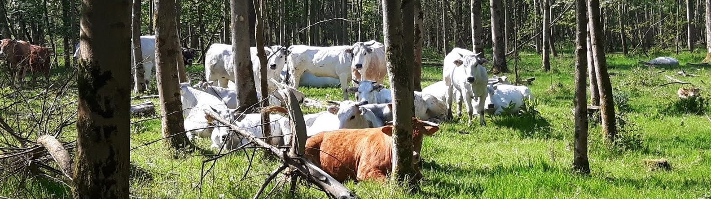
Unravelling biodiversity impacts of consumption
A production layer decomposition for the Netherlands
IIOA Seville| June 2026
Daan in 't Veld | PBL Netherlands Environmental Assessment Agency,
joint work with Harry Wilting, Alexandra Marques & Mark van Oorschot

Slide 2


Biodiversity crisis
Biodiversity loss is caused by multiple environmental pressures, including greenhouse gas (GHG) emissions, land use and pollution.
Unsustainable consumption patterns are important drivers of biodiversity loss. Especially consumption in high income countries, such as the Netherlands.
Notes:
Nickel mine in the Philippines + Container ship

Slide 3
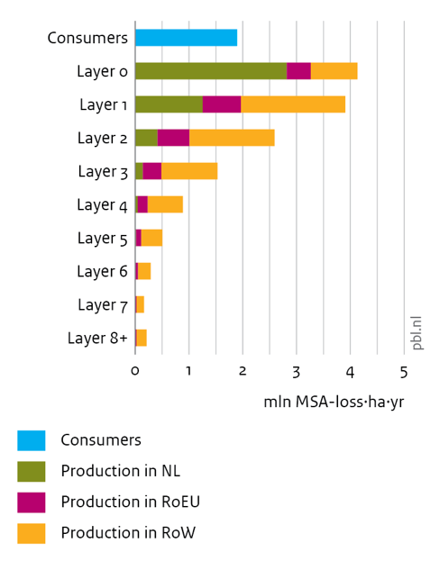
Preview: Biodiversity footprint of Dutch consumption originates for around 60% from upstream supplies abroad
Layer decomposition of consumption footprint, “breaking down the supply chain”
Contributions of regions
  Netherlands (12 + 29 = 41%)
  Rest of European Union (15%),
  Rest of the World (44%).

Slide 4
Outline
Definition of PBL biodiversity footprints (=composite indicator)
  Level and unit of footprint (“16 million MSA-loss·ha·yr”)
  Data approach of PBL together with CBS Statistics Netherlands
Breakdowns by consumption groups, regions and sectors
Production layer decomposition analysis of supply chains
Relevance for policy makers

Slide 5
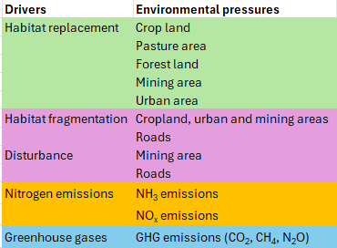
PBL biodiversity footprints use MSA metric
Biodiversity impact factors (BIFs) from GLOBIO 4 (Schipper et al, 2025)
Pressures and impacts are assigned to sectors and regions
  Forest land: based on wood production per country and regrowth of trees
  Urban area: assigned to final demand
  Roads: allocated to sectors and final demand by using data on energy use by transport
MSA-loss in hectares for 100 years: time horizon of GHG (alternatively: 20, 500 years)

Slide 6
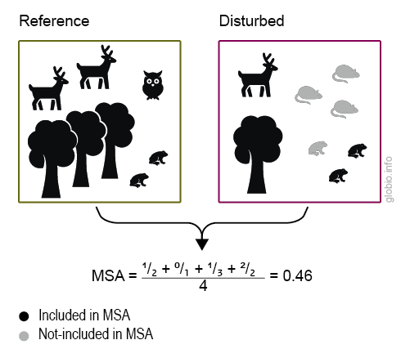
MSA (mean species abundance)
MSA ranges from 0 to 1, where 1 means that the species assemblage is fully intact, and 0 means that all original species are extirpated (locally extinct)
In the picture three species decrease in abundance (tree, deer and owl).
Increases do not count in MSA
Footprints based on biodiversity loss (0.54 = 1 - 0.46 in example)

Slide 7
Biodiversity footprint of consumption in region j
MRIO-FP model
B^{j} = i (M ∘ D) (I – A)⁻¹ y^{j} + m^{j} d^{j}
Consumption
BIFs
Production and trade
Direct
pressures
by final
consumers
Pressure
intensities
BIFs
Wilting et al. (2017)

Slide 8
Consumption footprint vs export
Imports by Dutch consumers
Imports by Dutch producers for consumption in the Netherlands
Dutch producers for consumption in the Netherlands
Dutch consumers
Consumption footprint
Imports by Dutch producers for exports
Dutch producers for exports
NL producers
and consumers
NL imports
Production footprint
Wilting & in 't Veld (2025)

Slide 9
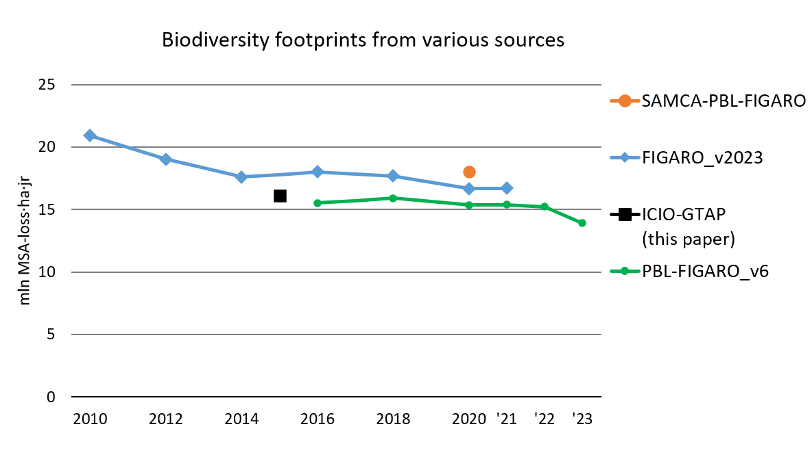
Level of biodiversity impact
Dutch consumption in 2015 resulted in ~16 million MSA-loss·ha·yr all over the world.
Data series shows a (slow) downward trend.

Slide 10
Data approach of PBL (with CBS)
Start from MRIO and environmental data from ‘official’ institutions
  FIGARO, ICIO, … (Wilting et al., 2022)
This paper
  ICIO (OECD)
  GTAP 10 for more detail on sectors, in particular the agricultural sector
  Eurostat and other sources for GHG and nitrogen emissions, land use, roads.
CBS / PBL in Dutch policy context: SAMCA-PBL-FIGARO footprints
  FIGARO (Eurostat)
  Further detail based on other data sources (GLORIA) (Lenzen et al., 2017, 2021)
  For the domestic part of the footprint, other CBS statistical data of NL are used

Slide 11
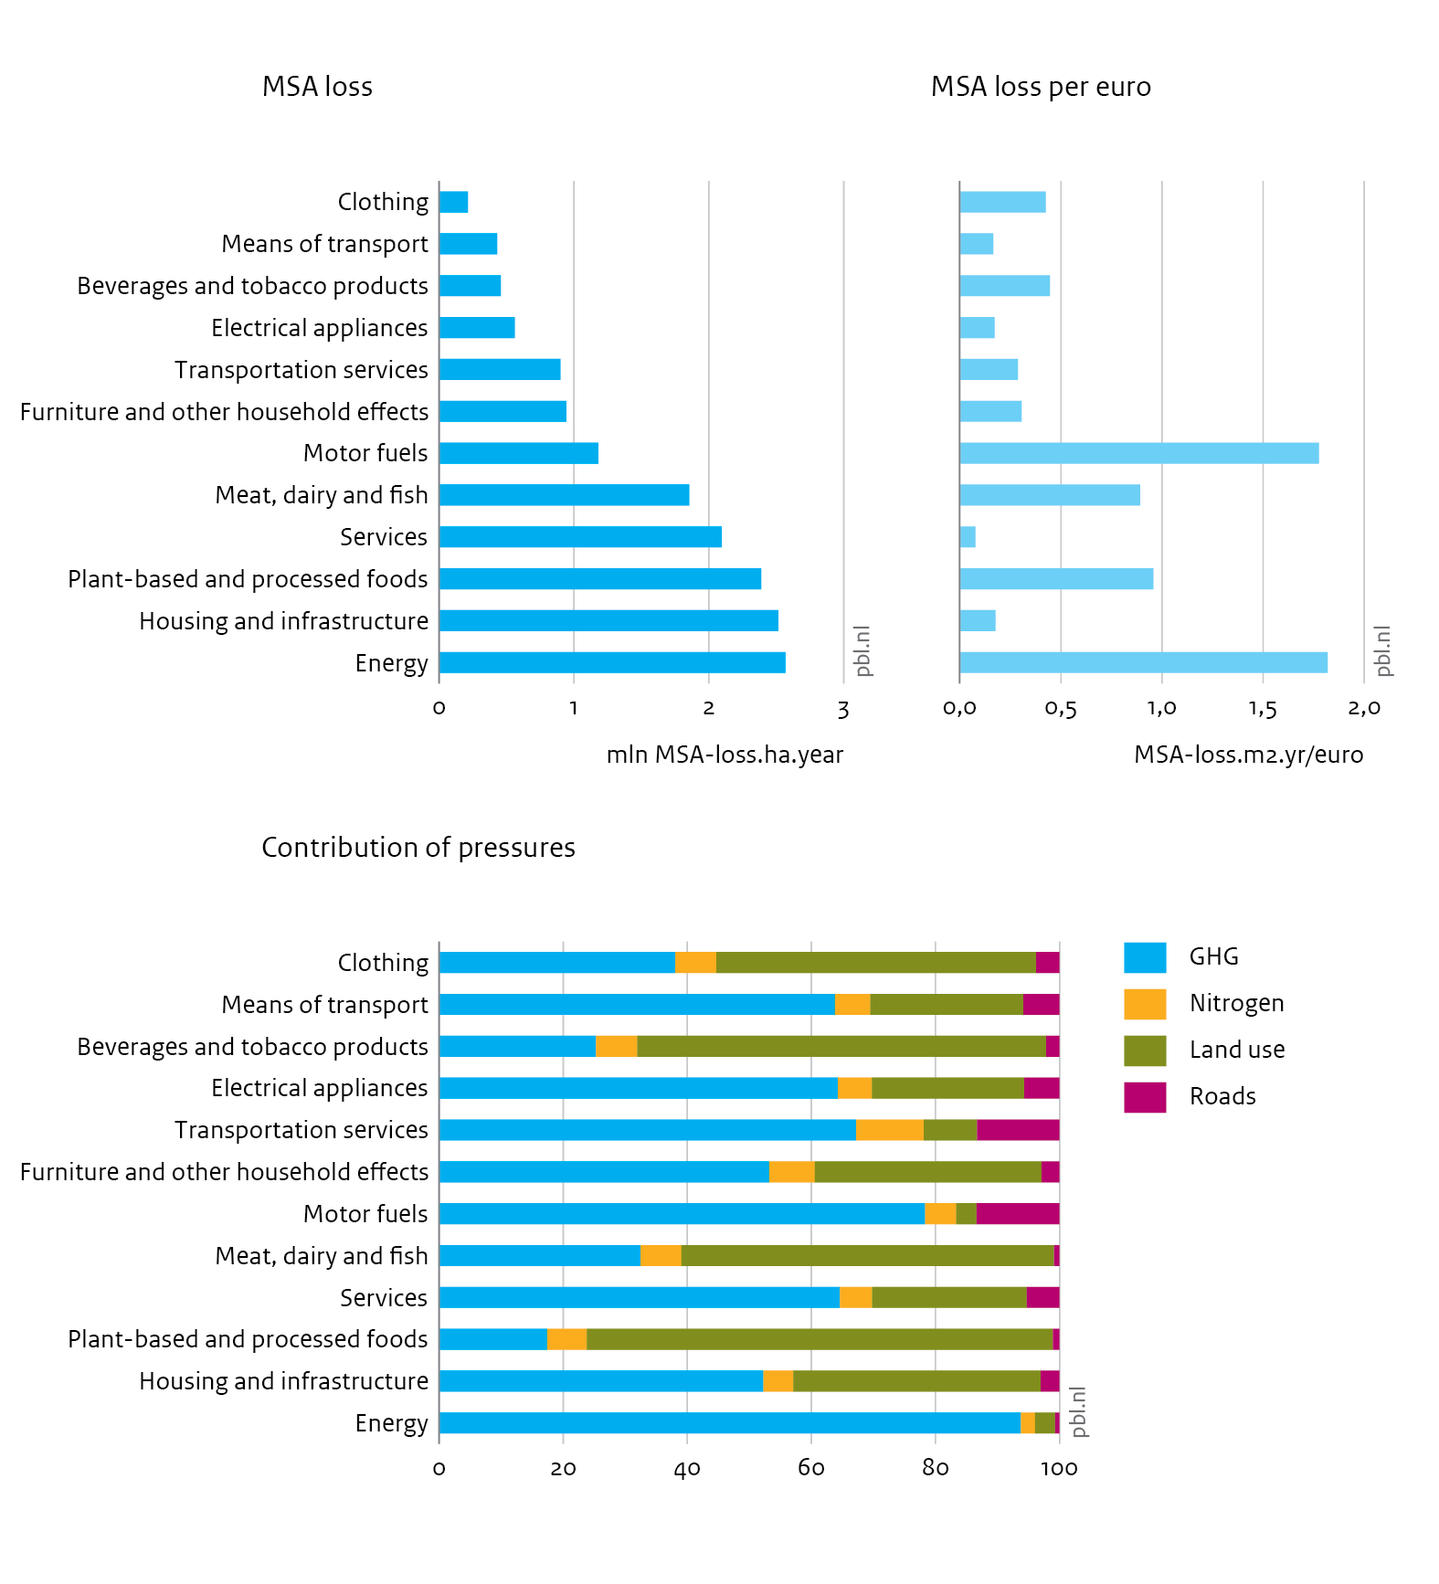
Results: Biodiversity footprint, NL 2015
Breakdown by consumption categories
Wilting et al. (2026)

Slide 12
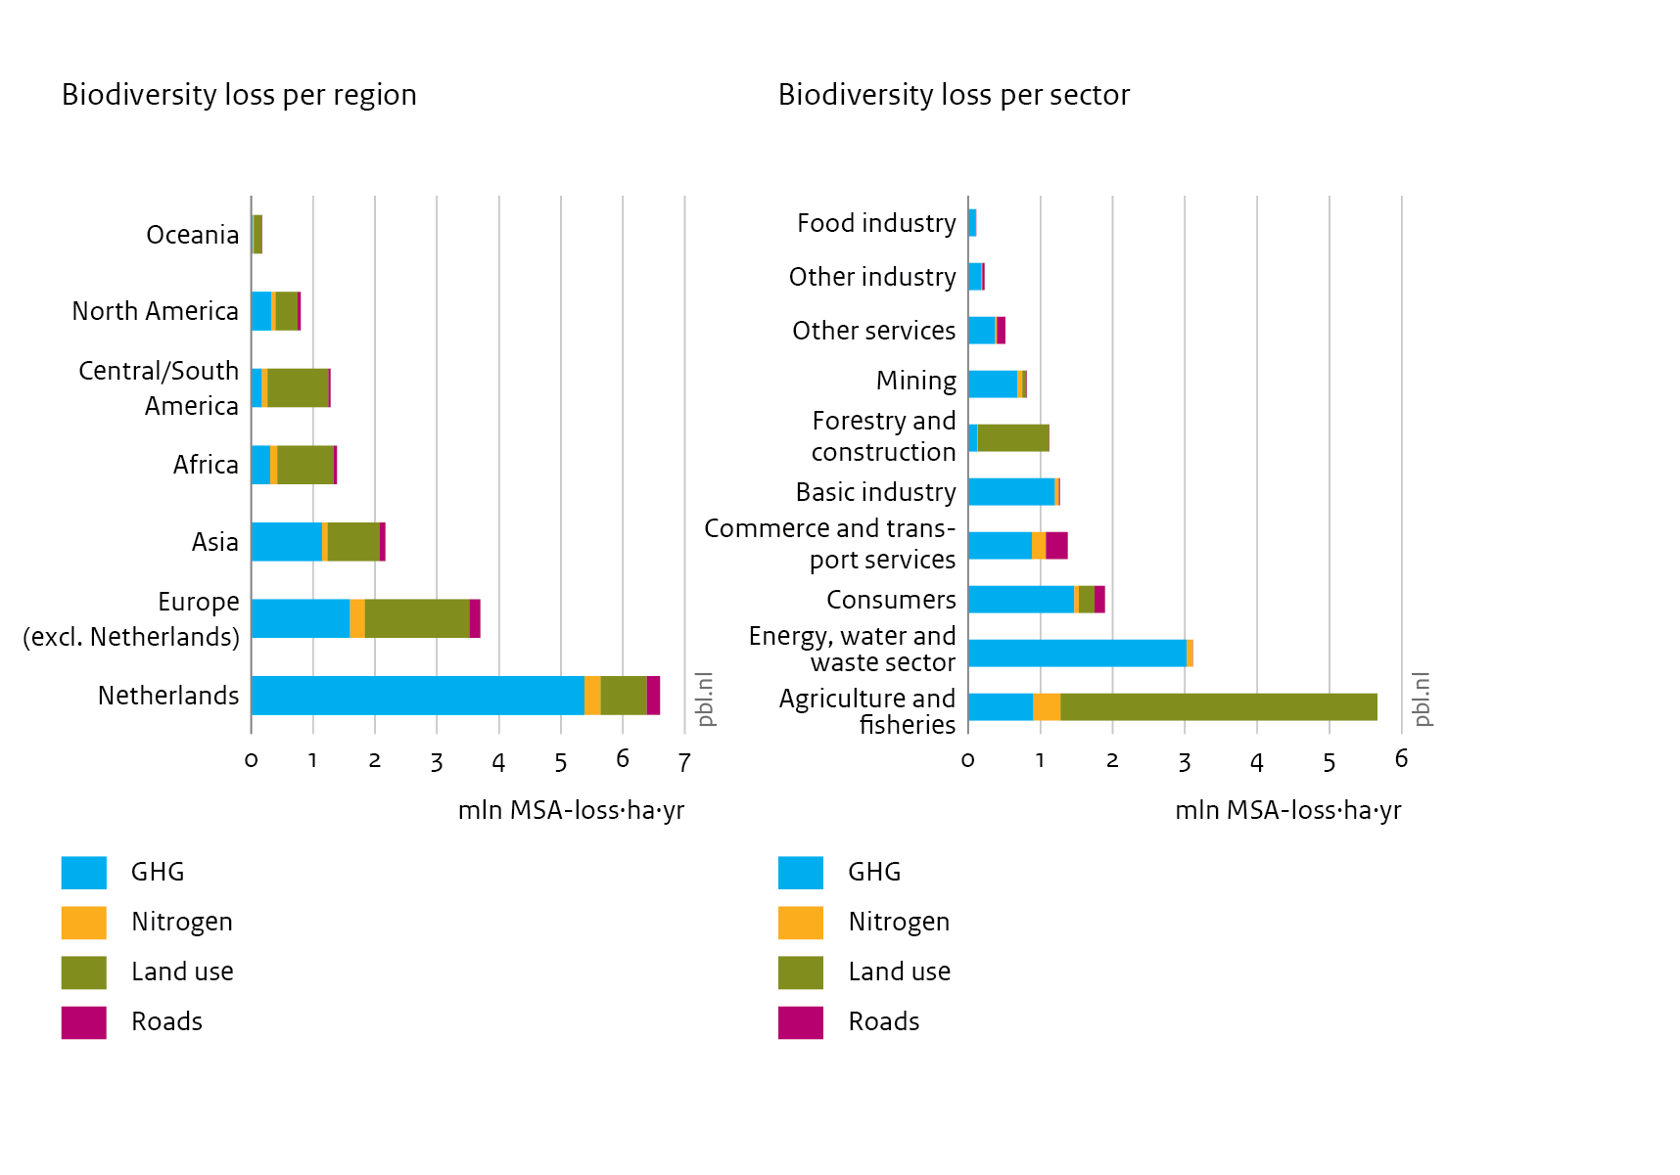
Biodiversity footprint, NL 2015
Breakdown by regions where losses are caused
Wilting et al. (2026)

Slide 13
Analysing supply chain layers
Production layer decomposition
Unravelling of supply chains
  Contribution of supplier layers
  Provides insights in:
    Responsibilities and dependencies
    Relevant paths for identifying reduction options
(I-A)⁻¹ = I + A + A² + A³ + A⁴ + …
B^{j} = i (M ∘ D) (I + A + A² + A³ + A⁴ + …) y^{j} + m^{j} d^{j}

Slide 14
Production layer decomposition
Layer decomposition of biodiversity footprint of Dutch consumption
Contributions of regions (NL, RoEU, RoW)
Wilting et al. (2026)

Slide 15
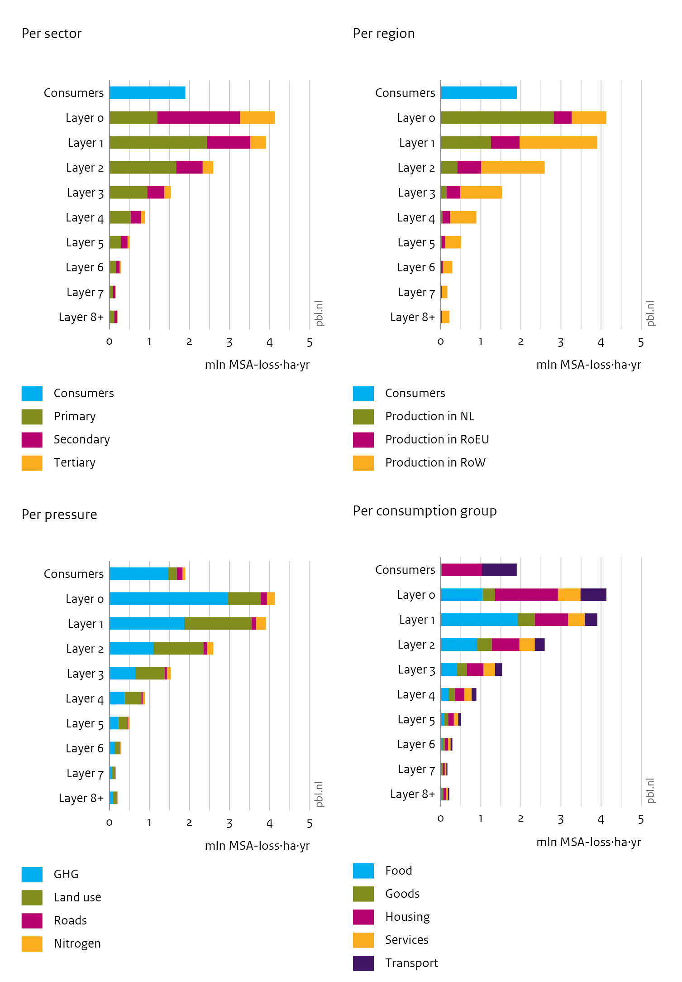
Production layer decomposition
Layer decomposition of biodiversity footprint of Dutch consumption
Contributions of sectors
Wilting et al. (2026)

Slide 16
Production layer decomposition
Layer decomposition of biodiversity footprint of Dutch consumption
Contributions of consumption groups
Wilting et al. (2026)

Slide 17
Production layer decomposition
Layer decomposition of biodiversity footprint of Dutch consumption
Contributions of pressures
Wilting et al. (2026)

Slide 18
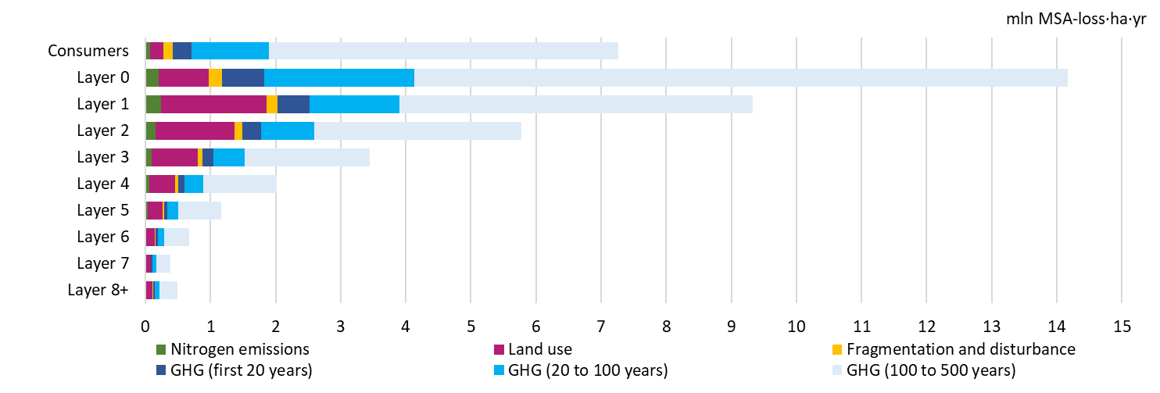
Effect of time horizon of GHG
Wilting et al. (2026)

Slide 19
Results of production layer decomposition
Housing generates the largest loss in sectors directly producing for Dutch consumption
For goods and food losses occur further upstream in their supply chains.
The impact of GHG emissions is most significant at the layers close to consumption; losses from land use occur further upstream in the supply chain
Overall: housing and food contributed most to the Dutch consumption footprint, primarily through GHG emissions and land use.

Slide 20

Relevance for policy makers
To reduce biodiversity impacts of consumption, actors in different parts of the supply chain have to be targeted depending on the consumption category
Related policies:
  EU CSRD (reporting on supply chains)
  EU CS-DDD (due diligence for supply chain issues)
  NL and EU climate & energy policies
  national policies reducing global territorial impacts
  national nitrogen emission targets
  .. and many more..

Slide 21

Thank you! https://www.pbl.nl/
Daan.intVeld@pbl.nl

Slide 22
References (sorted by date)
Manfred Lenzen et al. (2017), The Global MRIO Lab – charting the world economy, Economic Systems Research 29 (2): 158-186.
Manfred Lenzen et al. (2021), Implementing the Material Footprint to measure progress towards SDGs 8 and 12, Nature Sustainability.
Harry Wilting, Edwin Horlings, Anne Gerdien Prins, Niels Schoenaker, Mark van Oorschot & Adam Walker (2022), Duurzaam economisch beleid heeft meetbare voetafdrukken nodig, ESB 107 (4814), 458-461.
Harry Wilting & Daan in 't Veld (2025). An overview of accounting approaches for national greenhouse gas emissions; comparing consumption and production footprints in the European Union. Economic Systems Research. https://doi.org/10.1080/09535314.2025.2463954
Aafke Schipper, van der Marel, M., Bakkenes, M., Giesen, P., van Oorschot, M.M.P., Wilting, H.C., Huijbregts, M.A.J., Marques, A. (2025), Intactness-based impact factors for quantifying regionalized terrestrial biodiversity footprints (IBIF). Scientific Data 12, 1660. https://doi.org/10.1038/s41597-025-05946-1
Harry Wilting, Daan in 't Veld, Alexandra Marques & Mark van Oorschot (2026), Unravelling biodiversity impacts of consumption: a production layer decomposition analysis for the Netherlands, manuscript submitted for publication.

