Slide 1


Employment vulnerability in an era of geopolitical risk: exposure of European workers and households to US trade
María Moyano-Reina, Eva Alonso-Epelde, Ignacio Cazcarro, Iñaki Arto
Basque Centre for Climate Change
International Input-Output Association Conference
22nd - 26th June 2026, Seville, Spain

Slide 2
01
Introduction and objectives
02
Data and methodology
02a
Input – Output model
02b
Labour demand model
03
Results
03a
Macroeconomic results
03b
Results at individual level
03c
Results at household level
04
Conclusions

Slide 3

01
Introduction and objectives

Slide 4






01. Introduction
TRADE
INTERCONNECTION
The European Union is one of the most trade-dependent economies in the world.
This dependence goes beyond firms that export directly to the US.
EU jobs are supported by exports outside the EU, and the United States is the EU's largest export market.
Given that European economies are interconnected through global value chains, a fall in US demand can affect numerous suppliers and sectors across the economy.
14%
UNCERTAINTY
CHALLENGE
In recent years, growing trade tensions and geopolitical uncertainty have increased concerns about how much European employment depends on foreign demand.
The problem is that traditional trade statistics reflect trade flows, but do not indicate how many jobs depend on external demand, or who the workers occupying those jobs are.
Notes:
The European Union is one of the most trade-dependent economies in the world. Around 14% of EU jobs are supported by exports outside the EU, and the United States is the EU's largest export market.
In recent years, growing trade tensions and geopolitical uncertainty have increased concerns about how much European employment depends on foreign demand.
This dependence goes beyond firms that export directly to the US. Because European economies are connected through global value chains, a reduction in US demand can affect many suppliers and industries across the economy.
The problem is that traditional trade statistics show trade flows, but they do not show how many jobs depend on foreign demand or who the workers behind those jobs are.

Slide 5






01. Objective
In this context, the main objective of this paper is to identify which workers and households are most dependent on US final demand.
To do this, we develop a macro-micro framework that combines two types of information.
1
2
Use a multiregional IO model to estimate the jobs directly and indirectly supported by exports to US
We use EU-SILC microdata to identify the characteristics of individuals behind this jobs
How vulnerable employment is associated with household labour-income vulnerability
Vulnerable workers
This allows us to move from exposed sectors to exposed people, analysing differences by gender, age, education and household income.
The micro analysis focuses on Spain and Belgium, two countries with different patterns of trade integration.
It is important to note that we do not simulate a specific trade shock. Our goal is to identify the workers and households that are structurally dependent on US demand under current economic conditions.
Notes:
In this context, the main objective of this paper is to identify which workers and households are most dependent on US final demand.
To do this, we develop a macro-micro framework that combines two types of information.
First, we use a multiregional input-output model to estimate the jobs directly and indirectly supported by exports to the United States.
Second, we use EU-SILC microdata to identify the characteristics of individuals behind this jobs and how this vulnerable employment is associated with household labour-income vulnerability.
This allows us to move from exposed sectors to exposed people, analysing differences by gender, age, education and household income.
The micro analysis focuses on Spain and Belgium, two countries with different patterns of trade integration.
Finally, it is important to note that we do not simulate a specific trade shock. Our goal is to identify the workers and households that are structurally dependent on US demand under current economic conditions.

Slide 6
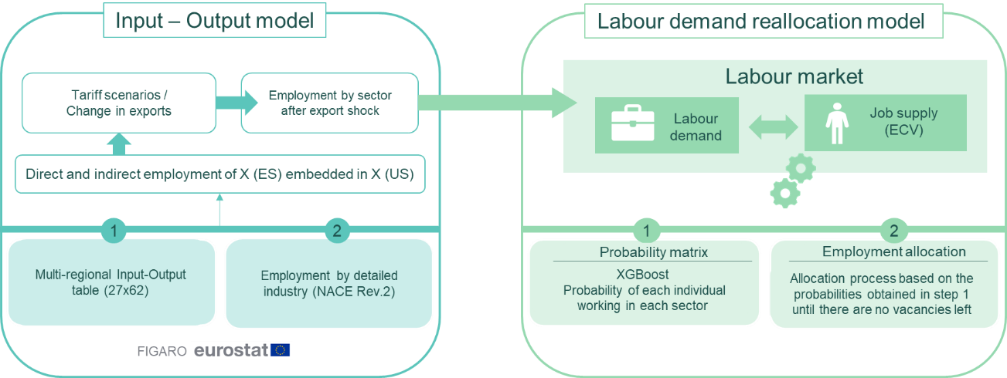
02
Data and methodology
(EU-SILC)
Notes:
In terms of methodology, the study adopts an innovative methodological approach that combines multi-regional input-output modelling techniques using macroeconomic data with a microeconometric model based on individual survey data

Slide 7

02a. Input – Output model
1st
PHASE OF
THE ANALYSIS
DATA
We use data from Eurostat:
Multiregional Input-Output Table:
Based on FIGARO data for the year 2022.
(27x62)
Employment data:
Employment by detailed industry
(NACE Rev.2) - national accounts.
Notes:
In the first phase, we use an Input-Output model based on Eurostat data.
On the one hand, we use a Multiregional Input-Output Table based on FIGARO 2022.
On the other hand, we use employment data by industry from Eurostat national accounts.

Slide 8

02a. Input – Output model
1st
PHASE OF
THE ANALYSIS
DATA
MODEL
We use data from Eurostat:
Multiregional Input-Output Table:
Based on FIGARO data for the year 2022.
(27x62)
Employment data:
Employment by detailed industry
(NACE Rev.2) - national accounts.
We use a MRIO model:
This model integrates:
EU countries are grouped together as an interconnected bloc
Exports outside the EU are integrated as exogenous final demand
With this approach, we can estimate the production and employment required to meet external demand, particularly that related to exports to the United States
Notes:
Using these data, we build a Multiregional Input-Output model.
EU countries are treated as an interconnected economic block, while exports outside the EU are included as external final demand.
With this approach, we can estimate the production and employment needed to satisfy external demand, especially exports to the United States.

Slide 9



02a. Input – Output model
1st
PHASE OF
THE ANALYSIS
MODEL
Standard Input-Output model
to obtain total employment supported by exports to the US in each sector and EU country
Production generated by EU exports to US
$$X^{UE,US}= L^{UE}e^{UE,US}$$
Employment supported by EU exports to US
$$W^{UE,US}= {(V^{UE})}^{′}L^{UE}e^{UE,US}$$
Where:
  $V^{UE}$: employment coefficients per unit of production.
  $L^{UE}$: Leontief inverse.
  $e^{UE,US}$: EU-US exports vector.
Notes:
So, in this first phase, we follow the standard Input-Output approach to estimate the total employment linked to exports to the United States in each EU country and sector.
First, we calculate the production needed to satisfy US exports by multiplying the Leontief inverse by the EU-US export vector.
Then, we estimate how many jobs are needed to produce these goods and services by multiplying this production by the employment coefficients.

Slide 10
02a. Input – Output model
1st
PHASE OF
THE ANALYSIS
MODEL
Standard Input-Output model
to obtain total employment supported by exports to the US in each sector and EU country
The model captures both direct and indirect employment associated with exports to the United States.
Production generated by EU exports to US
$$X^{UE,US}= L^{UE}e^{UE,US}$$
Employment supported by EU exports to US
$$W^{UE,US}= {(V^{UE})}^{′}L^{UE}e^{UE,US}$$
The model allows us to:
Measure the total employment supported by US demand, including supply-chain effects
Compare exposure across EU countries and economic sectors
Where:
  $V^{UE}$: employment coefficients per unit of production.
  $L^{UE}$: Leontief inverse.
  $e^{UE,US}$: EU-US exports vector.
Notes:
This model captures both direct and indirect effects.
It allows us to measure the total employment supported by US demand, including supply-chain effects and compare exposure across EU countries and economic sectors

Slide 11
02b. Labour demand model
2nd
PHASE OF
THE ANALYSIS
A labour demand reallocation model is used to identify the workers and households associated with export-supported employment
Notes:
In the second phase of the analysis, a labour demand reallocation model is used to identify the workers and households associated with export-supported employment.

Slide 12
02b. Labour demand model
2nd
PHASE OF
THE ANALYSIS
A labour demand reallocation model is used to identify the workers and households associated with export-supported employment
We have developed a model that connect sectoral employment associated with US demand to individual workers and households
Notes:
The objective is to connect sectoral employment associated with US demand to individual workers and households

Slide 13


02b. Labour demand model
2nd
PHASE OF
THE ANALYSIS
A labour demand reallocation model is used to identify the workers and households associated with export-supported employment
We have developed a model that connect sectoral employment associated with US demand to individual workers and households
ALLOCATION APPROACH
Labour
supply
Labour
demand
Notes:
To do this, we combine two sources of information.

Slide 14
02b. Labour demand model
2nd
PHASE OF
THE ANALYSIS
A labour demand reallocation model is used to identify the workers and households associated with export-supported employment
We have developed a model that connect sectoral employment associated with US demand to individual workers and households
EU-SILC panel (2012-2022)
ALLOCATION APPROACH
Employment history and sector of activity
Socioeconomic characteristics
Labour
supply
Labour
demand
Notes:
On the one hand, we use the EU-SILC panel dataset, which provides information on labour supply

Slide 15
02b. Labour demand model
2nd
PHASE OF
THE ANALYSIS
A labour demand reallocation model is used to identify the workers and households associated with export-supported employment
We have developed a model that connect sectoral employment associated with US demand to individual workers and households
EU-SILC panel (2012-2022)
ALLOCATION APPROACH
EXPORT-SUPPORTED EMPLOYMENT BY SECTOR FROM THE MRIO MODEL
(2022)
Employment history and sector of activity
Socioeconomic characteristics
Labour
supply
Labour
demand
Notes:
On the other hand, we use the employment estimates obtained from the MRIO model in the first phase of the analysis
.

Slide 16
02b. Labour demand model
We have developed a model that connect sectoral employment associated with US demand to individual workers and households
EU-SILC panel (2012-2022)
ALLOCATION APPROACH
EXPORT-SUPPORTED EMPLOYMENT BY SECTOR FROM THE MRIO MODEL
(2022)
Employment history and sector of activity
Socioeconomic characteristics
Labour
supply
Labour
demand
Notes:
This allocation process consists of two parts:

Slide 17
02b. Labour demand model
We have developed a model that connect sectoral employment associated with US demand to individual workers and households
EU-SILC panel (2012-2022)
ALLOCATION APPROACH
EXPORT-SUPPORTED EMPLOYMENT BY SECTOR FROM THE MRIO MODEL
(2022)
Employment history and sector of activity
Socioeconomic characteristics
Labour
supply
Labour
demand
1
2
Statistical model that estimates the probability of each individual being employed in each sector
Notes:
First, we estimate the probability of each individual being employed in each sector.

Slide 18
02b. Labour demand model
We have developed a model that connect sectoral employment associated with US demand to individual workers and households
EU-SILC panel (2012-2022)
ALLOCATION APPROACH
EXPORT-SUPPORTED EMPLOYMENT BY SECTOR FROM THE MRIO MODEL
(2022)
Employment history and sector of activity
Socioeconomic characteristics
Labour
supply
Labour
demand
1
2
Statistical model that estimates the probability of each individual being employed in each sector
XGBoost Model based on:
Previous labour-market trajectory
Previous sector of activity
Gender, age and education
Household characteristics
Notes:
For this, we use an XGBoost model based on previous labour-market trajectory, previous sector of activity, gender, age, education and household characteristics.

Slide 19
02b. Labour demand model
We have developed a model that connect sectoral employment associated with US demand to individual workers and households
EU-SILC panel (2012-2022)
ALLOCATION APPROACH
EXPORT-SUPPORTED EMPLOYMENT BY SECTOR FROM THE MRIO MODEL
(2022)
Employment history and sector of activity
Socioeconomic characteristics
Labour
supply
Labour
demand
1
2
Statistical model that estimates the probability of each individual being employed in each sector
XGBoost Model based on:
Previous labour-market trajectory
Previous sector of activity
Gender, age and education
Household characteristics
The probabilities estimated are adjusted to ensure consistency with the sectoral employment structure
Notes:
These probabilities are then adjusted to ensure consistency with the sectoral employment structure.
In the baseline, this calibration reproduces the observed sectoral employment distribution.
We then incorporate the employment changes associated with exports to the United States estimated by the MRIO model.
This allows the probabilities to reflect both individual employability patterns and the sectoral employment changes associated with US demand.

Slide 20


02b. Labour demand model
We have developed a model that connect sectoral employment associated with US demand to individual workers and households
EU-SILC panel (2012-2022)
ALLOCATION APPROACH
EXPORT-SUPPORTED EMPLOYMENT BY SECTOR FROM THE MRIO MODEL
(2022)
Employment history and sector of activity
Socioeconomic characteristics
Labour
supply
Labour
demand
1
2
Statistical model that estimates the probability of each individual being employed in each sector
Develop an allocation approach on the basis of the probabilities previously obtained until there are no vacancies
Develop an allocation approach on the basis of the probabilities previously obtained until there are no vacancies
XGBoost Model based on:
Previous labour-market trajectory
Previous sector of activity
Gender, age and education
Household characteristics
Labour force
Labour demand
The probabilities estimated are adjusted to ensure consistency with the sectoral employment structure
Labour force
Labour demand
Pr
Pr
Notes:
Second, we have developed an allocation approach on the basis of the probabilities previously obteined until there ar no vacancies

Slide 21
03
Results
We identify the employment currently associated with exports to the United States and, by linking this employment to workers and households, we can identify which groups are more dependent on this source of demand
Results at the macroeconomic level
Results at the individual level
Results at the household level
Phase 1
How employment associated with US demand is distributed across EU countries and sectors
Phase 2
Which groups of workers are more dependent on this employment
Phase 2
How this dependence is distributed across different income groups
Notes:
The results are presented at three different levels.
First, at the macro level, we analyse how employment associated with US demand is distributed across EU countries and sectors.
Second, at the individual level, we identify which groups of workers are more dependent on this employment.
Finally, at the household level, we examine how this dependence is distributed across different income groups.
With this interpretation in mind, let me move to the main results.

Slide 22

1st
03a. Macroeconomic results
PHASE OF
THE ANALYSIS
BY COUNTRY
Employment associated with US demand across the EU
5.2 million jobs in the EU are associated with US demand
Equivalent to 2.4% of total EU employment
Exposure differs substantially across Member States
Spain and Belgium are selected for the micro-level analysis
Notes:
Let me start with the macroeconomic results.
The MRIO model estimates that around 5.2 million jobs in the European Union are associated, directly or indirectly, with exports to the United States. This represents approximately 2.4% of total EU employment.
However, this dependence is not distributed evenly across Member States.
The left map shows exposure in relative terms, as a percentage of national employment, while the right map shows the absolute number of jobs associated with US demand.
This distinction is important because countries with high relative exposure are not necessarily those with the largest number of exposed jobs.

Slide 23
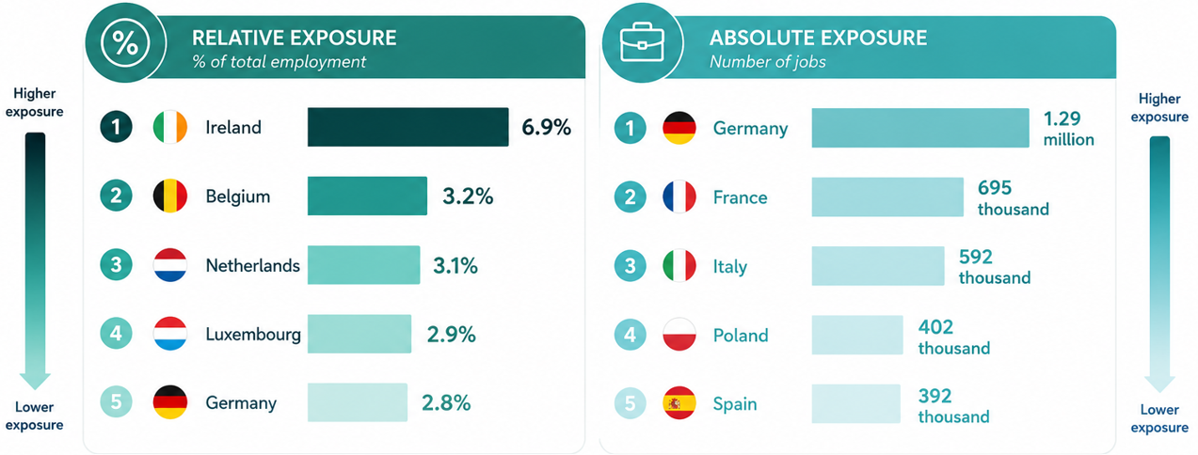
1st
03a. Macroeconomic results
PHASE OF
THE ANALYSIS
BY SECTOR
Exposure is highest in small and highly open economies
Larger economies concentrate the largest number of jobs associated with US demand
Notes:
The results reveal two different dimensions of exposure.
In relative terms, exposure is highest in small and highly open economies.
Ireland is clearly the most exposed country, followed by Belgium, the Netherlands and Luxembourg.

Slide 24
1st
03a. Macroeconomic results
PHASE OF
THE ANALYSIS
BY SECTOR
Exposure is highest in small and highly open economies
Larger economies concentrate the largest number of jobs associated with US demand
Notes:
In absolute terms, the ranking changes completely.
Larger economies concentrate the largest number of jobs associated with US demand.
Germany alone accounts for almost 1.3 million jobs, followed by France, Italy, Poland and Spain.

Slide 25


1st
03a. Macroeconomic results
PHASE OF
THE ANALYSIS
BY SECTOR
Is a larger and more diversified economy, with a lower relative exposure and a greater importance of domestically oriented activities.
Is a small and highly open economy with a strong integration into international value chains and a relatively high dependence on US demand
Notes:
Then, we focus on Spain and Belgium, as they represent two very different economic structures and are two of the countries most exposed to trade with the US
Belgium is a small and highly open economy with a strong integration into international value chains and a relatively high dependence on US demand.
Spain, in contrast, is a larger and more diversified economy, with a lower relative exposure and a greater importance of domestically oriented activities.
This comparison allows us to explore whether different patterns of trade dependence translate into different profiles of vulnerable workers and households.

Slide 26
03b. Results at the individual level
2nd
PHASE OF
THE ANALYSIS
The macro results tell us how much employment is associated with US demand
To identify who is behind this employment
By linking the macro results with microdata, we can analyse the characteristics of workers associated with export-supported employment
Vulnerable workers
Spain vs Belgium
Notes:
The macro results tell us how much employment is associated with US demand.
The next step is to identify who is behind this employment.

Slide 27
03b. Results at the individual level
Gender
 |  | Vulnerable workers | Share of Vulnerable workers (%) | Vulnerability rate (%) | Share in baseline employment (%) | Share in scenario unemployment (%)
ES | Female | 168,734 | 46.1 | 1.9 | 45.6 | 55.2
 | Male | 197,150 | 53.9 | 1.9 | 54.4 | 44.8
BE | Female | 78,064 | 51.7 | 3.5 | 47.5 | 47.8
 | Male | 72,951 | 48.3 | 2.9 | 52.5 | 52.2
Notes:
I begin with the gender dimension.
First, we can see in the table, the number of vulnerable workers identified by the model.

Slide 28
03b. Results at the individual level
Gender
 |  | Vulnerable workers | Share of Vulnerable workers (%) | Vulnerability rate (%) | Share in baseline employment (%) | Share in scenario unemployment (%)
ES | Female | 168,734 | 46.1 | 1.9 | 45.6 | 55.2
 | Male | 197,150 | 53.9 | 1.9 | 54.4 | 44.8
BE | Female | 78,064 | 51.7 | 3.5 | 47.5 | 47.8
 | Male | 72,951 | 48.3 | 2.9 | 52.5 | 52.2
Notes:
The second column shows their share among all vulnerable workers.

Slide 29
03b. Results at the individual level
Gender
 |  | Vulnerable workers | Share of Vulnerable workers (%) | Vulnerability rate (%) | Share in baseline employment (%) | Share in scenario unemployment (%)
ES | Female | 168,734 | 46.1 | 1.9 | 45.6 | 55.2
 | Male | 197,150 | 53.9 | 1.9 | 54.4 | 44.8
BE | Female | 78,064 | 51.7 | 3.5 | 47.5 | 47.8
 | Male | 72,951 | 48.3 | 2.9 | 52.5 | 52.2
Notes:
The vulnerability rate measures the proportion of workers within each gender group that are associated with US-demand-supported employment.

Slide 30
03b. Results at the individual level
Gender
 |  | Vulnerable workers | Share of Vulnerable workers (%) | Vulnerability rate (%) | Share in baseline employment (%) | Share in scenario unemployment (%)
ES | Female | 168,734 | 46.1 | 1.9 | 45.6 | 55.2
 | Male | 197,150 | 53.9 | 1.9 | 54.4 | 44.8
BE | Female | 78,064 | 51.7 | 3.5 | 47.5 | 47.8
 | Male | 72,951 | 48.3 | 2.9 | 52.5 | 52.2
Notes:
The last two columns compare the gender structure of vulnerable employment with the gender structure of total employment in the baseline.

Slide 31
03b. Results at the individual level
Gender
 |  | Vulnerable workers | Share of Vulnerable workers (%) | Vulnerability rate (%) | Share in baseline employment (%) | Share in scenario unemployment (%)
ES | Female | 168,734 | 46.1 | 1.9 | 45.6 | 55.2
 | Male | 197,150 | 53.9 | 1.9 | 54.4 | 44.8
BE | Female | 78,064 | 51.7 | 3.5 | 47.5 | 47.8
 | Male | 72,951 | 48.3 | 2.9 | 52.5 | 52.2
Aggregate neutrality:
Pre-existing inequality
Vulnerability rates are almost identical for both groups, at around 1.9%.
At the share in scenario unemployment, women jump to 55.2%
Men and women have the same probability of being exposed to US trade demand
10 pp. higher than their share in baseline employment which is due to pre-existing inequality
The share of vulnerable workers is almost identical to the baseline employment structure, being a little straight for men in both cases
Notes:
Looking first at Spain, the first important finding is aggregate neutrality:
Vulnerability rate are almost identical for both groups, at around 1.9%, So, men and women have the same probability of being exposed to US trade demand
This is because the share of vulnerable workers is almost identical to the baseline employment structure, being a little straight for men in both cases
However, when we look at the share in scenario unemployment, women jump to 55.2%, nearly 10 pp. higher than their share in baseline employment which is due to pre-existing inequality in the labour market

Slide 32
03b. Results at the individual level
Gender
 |  | Vulnerable workers | Share of Vulnerable workers (%) | Vulnerability rate (%) | Share in baseline employment (%) | Share in scenario unemployment (%)
ES | Female | 168,734 | 46.1 | 1.9 | 45.6 | 55.2
 | Male | 197,150 | 53.9 | 1.9 | 54.4 | 44.8
BE | Female | 78,064 | 51.7 | 3.5 | 47.5 | 47.8
 | Male | 72,951 | 48.3 | 2.9 | 52.5 | 52.2
Female Bias in Exposure:
Pre-existing masculinized unemployment
The vulnerability rate for women is 3.5%, which is higher than the 2.9% for men
Although women account for a higher proportion of vulnerable workers, unemployment in this vulnerability scenario does not rise disproportionately for them
Women account for the absolute majority of vulnerable workers, at 51.7%, despite representing a minority in the total baseline employment
Notes:
In Belgium, the pattern is a little different.
The vulnerability rate for women is 3.5%, which is higher than the 2.9% for men.
This is because women account for the absolute majority of vulnerable workers, at 51.7%, despite representing a minority in the total baseline employment
In Belgium, although women account for a higher proportion of vulnerable workers, unemployment in this vulnerability scenario does not rise disproportionately for them

Slide 33
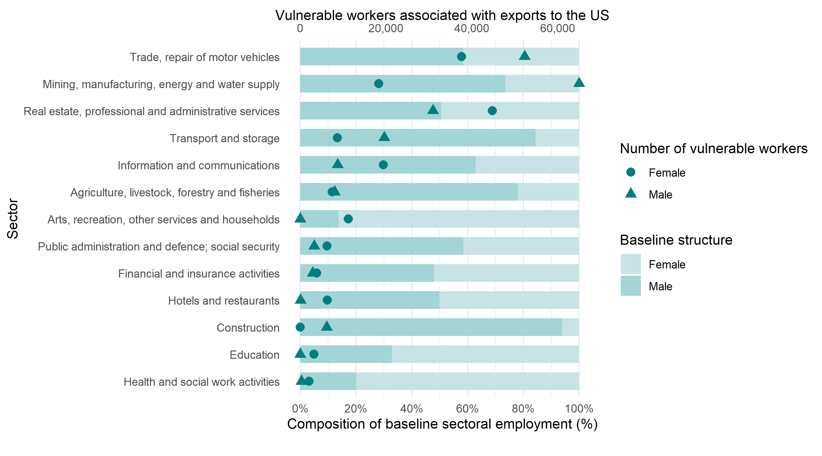
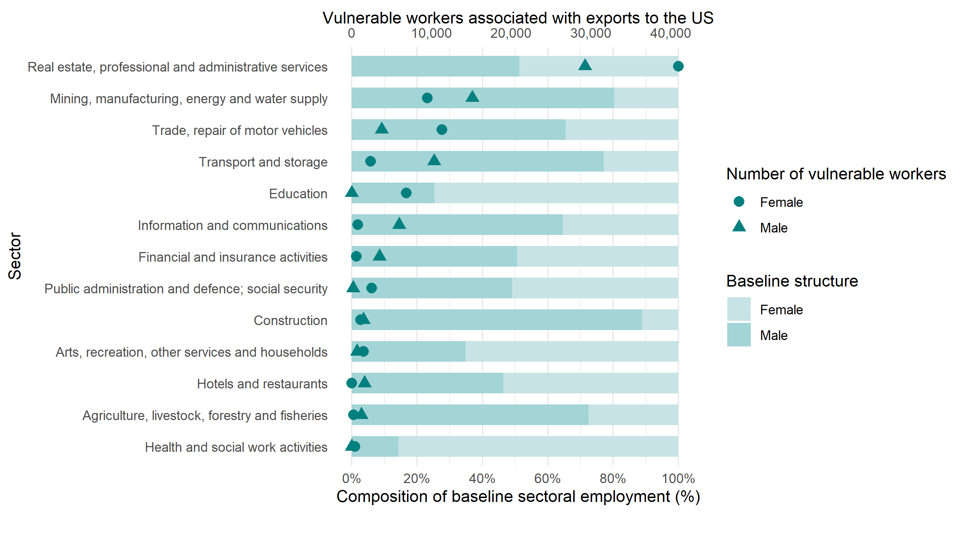
03b. Results at the individual level
Gender
SPAIN
BELGIUM
Notes:
These aggregate patterns are largely explained by the sectoral composition of export-supported employment.
The bars show the gender structure of employment associated with US demand in each sector, while the symbols indicate the number of vulnerable workers identified for each gender.

Slide 34
03b. Results at the individual level
Gender
SPAIN
Why vulnerability is almost gender-neutral in Spain
Male vulnerability is concentrated in manufacturing and transport, while female vulnerability is concentrated in professional and administrative services
These sectors represent large shares of export-supported employment, so male and female exposure tends to balance out.
By contrast, highly feminised sectors such as health and education show very low vulnerability because they are much less connected to US demand
Notes:
Starting with Spain, the sectoral results help explain the aggregate pattern.
Male vulnerability is concentrated in manufacturing and transport, while female vulnerability is concentrated in professional and administrative services.
These sectors represent large shares of export-supported employment, so male and female exposure tends to balance out.
By contrast, highly feminised sectors such as health and education show very low vulnerability because they are much less connected to US demand.

Slide 35
03b. Results at the individual level
Gender
BELGIUM
Professional services drive female vulnerability in Belgium
Vulnerability is strongly concentrated in professional and administrative services, the largest export-supported sector.
Women account for a larger share of vulnerable workers in this sector, and additional vulnerability comes from trade and education
As a result, women are slightly overrepresented among vulnerable workers and show higher vulnerability rates than men.
This helps explain the female bias observed in the aggregate results.
Notes:
Belgium shows a different picture.
Vulnerability is strongly concentrated in professional and administrative services, the largest export-supported sector.
Women account for a larger share of vulnerable workers in this sector, and additional vulnerability comes from trade and education.
As a result, women are slightly overrepresented among vulnerable workers and show higher vulnerability rates than men.
This helps explain the female bias observed in the aggregate results.

Slide 36
03b. Results at the individual level
Educational level
 |  | Vulnerable workers | Share of Vulnerable workers (%) | Vulnerability rate (%) | Share in baseline employment (%) | Share in scenario unemployment (%)
ES | Low | 27,750 | 7.6 | 2.3 | 6.3 | 15.6
 | Intermediate | 129,855 | 35.5 | 1.9 | 35.1 | 47.9
 | High | 207,827 | 56.9 | 1.8 | 58.6 | 36.6
BE | Low | 3,074 | 2 | 2.9 | 2.2 | 7
 | Intermediate | 36,975 | 24.5 | 4.6 | 17 | 34.7
 | High | 110,966 | 73.5 | 2.9 | 80.8 | 58.3
As education level rises, the vulnerability rate decreases
Workers with low education have the highest relative risk at 2.3%, followed by medium education at 1.9%, and high education at 1.8%
Highly educated represent the absolute majority of vulnerable positions, at 56.9% because they dominate the baseline employment structure at 58.6%
Followed by workers with intermediate and low education
Notes:
Let’s move to the educational level
In Spain, we can see that as education level rises, the vulnerability rate decreases.
Workers with low education have the highest relative risk at 2.3%, followed by medium education at 1.9%, and high education at 1.8%
However, highly educated workers represent the absolute majority of vulnerable positions, at 56.9% because they dominate the baseline employment structure at 58.6%, followed by workers with intermediate an low education

Slide 37
03b. Results at the individual level
Educational level
 |  | Vulnerable workers | Share of Vulnerable workers (%) | Vulnerability rate (%) | Share in baseline employment (%) | Share in scenario unemployment (%)
ES | Low | 27,750 | 7.6 | 2.3 | 6.3 | 15.6
 | Intermediate | 129,855 | 35.5 | 1.9 | 35.1 | 47.9
 | High | 207,827 | 56.9 | 1.8 | 58.6 | 36.6
BE | Low | 3,074 | 2 | 2.9 | 2.2 | 7
 | Intermediate | 36,975 | 24.5 | 4.6 | 17 | 34.7
 | High | 110,966 | 73.5 | 2.9 | 80.8 | 58.3
The middle group has the highest risk
Workers with intermediate education have the highest vulnerability rate at 4.6%. High education and low education have the same lower risk, at 2.9%
In absolute terms, people with a high level of education account for 73.5% of all vulnerable workers, a proportion similar to the baseline employment
Followed by workers with intermediate (24.5%) and low education (2%)
Notes:
In Belgium, workers with intermediate education have the highest vulnerability rate at 4.6%. High education and low education have the same lower risk, at 2.9%
Then, in absolute terms, people with a high level of education account for 73.5% of all vulnerable workers, a proportion similar to the baseline employment, Followed by workers with intermediate (24.5%) and low education (2%)

Slide 38
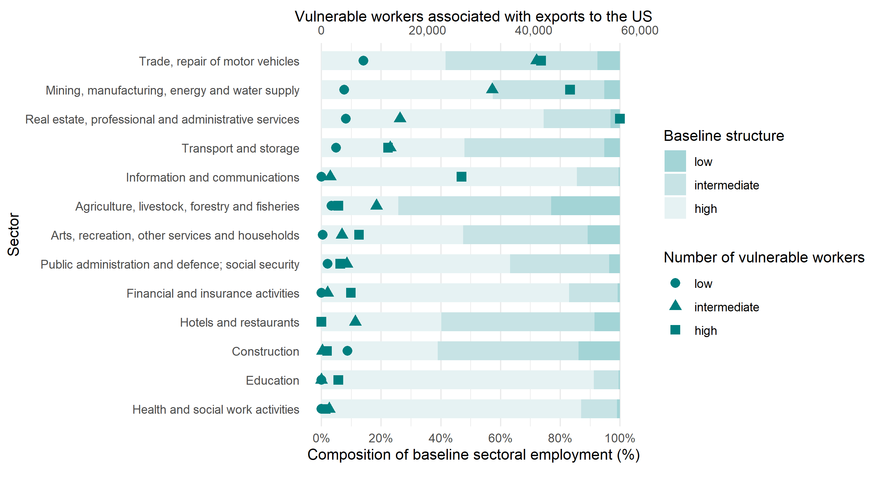
03b. Results at the individual level
Educational level
SPAIN
Professional services and ICT concentrate many highly educated vulnerable workers
Trade and manufacturing concentrate many workers with intermediate education and also contribute strongly to vulnerability
By contrast, education and health have many highly educated workers but very low vulnerability.
This is because they are much less dependent on exports to the US
Notes:
Considering the sectoral composition for Spain, The graph shows two main patterns.
Professional services and ICT concentrate many highly educated vulnerable workers.
Trade and manufacturing concentrate many workers with intermediate education and also contribute strongly to vulnerability.
By contrast, education and health have many highly educated workers but very low vulnerability.
This is because they are much less dependent on exports to the US.

Slide 39
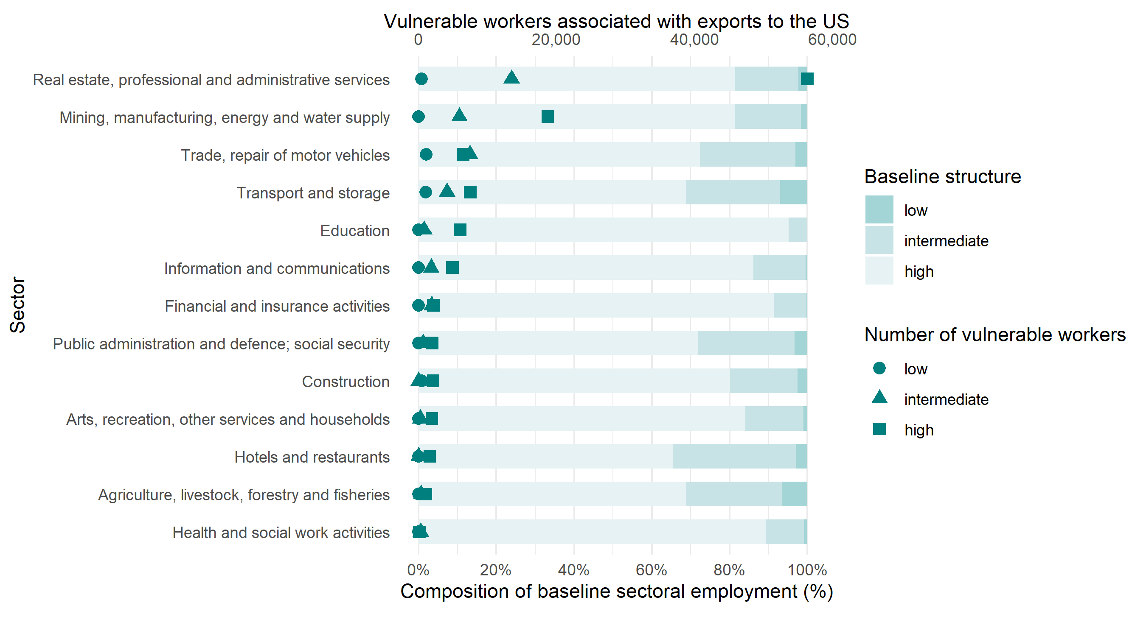
03b. Results at the individual level
Educational level
BELGIUM
Most export-supported sectors are highly educated, so highly educated workers account for most vulnerable jobs
At the same time, workers with intermediate education show the highest vulnerability rate.
This is largely explained by sectors such as trade and transport, where intermediate education is more common.
So, in Belgium, highly educated workers dominate the number of vulnerable workers, but intermediate-educated workers face the highest relative risk.
Notes:
The Belgian results are quite different from Spain.
Most export-supported sectors are highly educated, so highly educated workers account for most vulnerable jobs.
At the same time, workers with intermediate education show the highest vulnerability rate.
This is largely explained by sectors such as trade and transport, where intermediate education is more common.
So, in Belgium, highly educated workers dominate the number of vulnerable workers, but intermediate-educated workers face the highest relative risk.

Slide 40
03b. Results at the individual level
Age
 |  | Vulnerable workers | Share of Vulnerable workers (%) | Vulnerability rate (%) | Share in baseline employment (%) | Share in scenario unemployment (%)
ES | 16-34 | 98,501 | 26.9 | 2.1 | 24.5 | 30.1
 | 35-54 | 202,909 | 55.5 | 1.8 | 58.4 | 46.6
 | 55+ | 64,474 | 17.6 | 1.9 | 17.1 | 23.2
BE | 16-34 | 51,609 | 34.2 | 3.5 | 31.2 | 28.9
 | 35-54 | 73,466 | 48.6 | 3 | 51.7 | 45.5
 | 55+ | 25,941 | 17.2 | 3.2 | 17 | 25.6
Absolute volume concentrates in the middle, but the highest risk is at the extremes
Workers aged 35 to 54 account for the largest share of vulnerable workers, around 56% of the total.
However, they show the lowest vulnerability rate, at 1.8%, because they also represent the largest share of baseline employment.
Workers aged 16 to 34 account for a smaller share of vulnerable workers, around 27%, but display the highest vulnerability rate, at 2.1%
Workers aged 55 and over represent around 18% of vulnerable workers, with a vulnerability rate of 1.9%.
Notes:
And now, we analise results by age
Considering Spain,
workers aged 35 to 54 account for the largest share of vulnerable workers, around 56% of the total.
However, they show the lowest vulnerability rate, at 1.8%, because they also represent the largest share of baseline employment.
Workers aged 16 to 34 account for a smaller share of vulnerable workers, around 27%, but display the highest vulnerability rate, at 2.1%
Finally, workers aged 55 and over represent around 18% of vulnerable workers, with a vulnerability rate of 1.9%.

Slide 41
03b. Results at the individual level
Age
 |  | Vulnerable workers | Share of Vulnerable workers (%) | Vulnerability rate (%) | Share in baseline employment (%) | Share in scenario unemployment (%)
ES | 16-34 | 98,501 | 26.9 | 2.1 | 24.5 | 30.1
 | 35-54 | 202,909 | 55.5 | 1.8 | 58.4 | 46.6
 | 55+ | 64,474 | 17.6 | 1.9 | 17.1 | 23.2
BE | 16-34 | 51,609 | 34.2 | 3.5 | 31.2 | 28.9
 | 35-54 | 73,466 | 48.6 | 3 | 51.7 | 45.5
 | 55+ | 25,941 | 17.2 | 3.2 | 17 | 25.6
Absolute volume concentrates in the middle, but the highest risk is at the extremes
Workers aged 35 to 54 account for the largest share of vulnerable workers, almost 49% of the total.
However, they display the lowest vulnerability rate, at 3%, because they also represent the largest share baseline employment.
Workers aged 16 to 34 account for around 34% of vulnerable workers but show the highest vulnerability rate, at 3.5%.
Finally, workers aged 55 and over represent around 17% of vulnerable workers, with a vulnerability rate of 3.2%
Notes:
Belgium shows a very similar pattern.
Workers aged 35 to 54 account for the largest share of vulnerable workers, almost 49% of the total.
However, they display the lowest vulnerability rate, at 3%, because they also represent the largest share of baseline employment.
Younger workers, aged 16 to 34, account for around 34% of vulnerable workers but show the highest vulnerability rate, at 3.5%.
Finally, workers aged 55 and over represent around 17% of vulnerable workers, with a vulnerability rate of 3.2%.

Slide 42
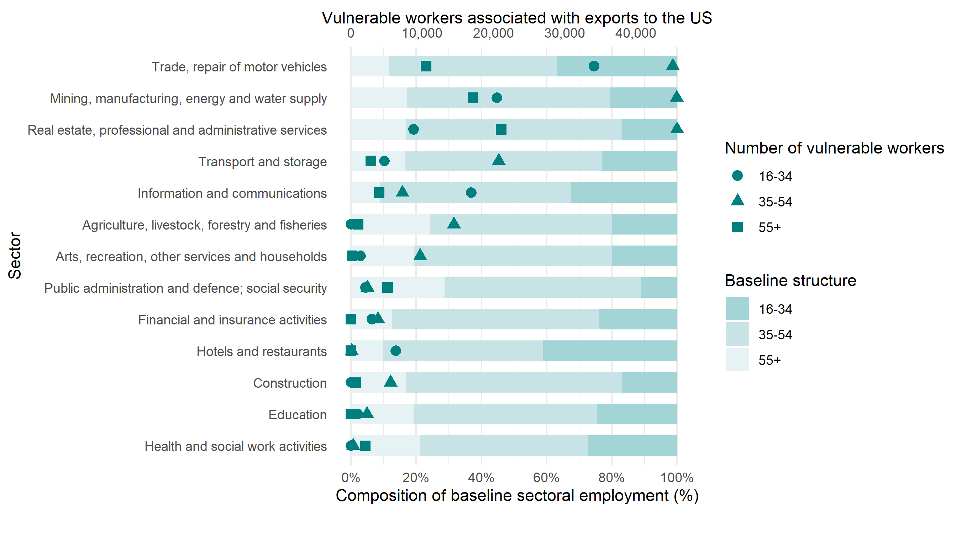
03b. Results at the individual level
Age
SPAIN
Workers aged 16-34 are more concentrated in sectors such as trade and accommodation services, which account for a significant share of vulnerable employment
Workers aged 35 to 54 dominate large sectors such as manufacturing and professional services, explaining why they account for most vulnerable workers in absolute terms
Workers aged 55 and over are more concentrated in public administration, education and health.
Since these sectors are much less dependent on exports to the US, vulnerability among this workers remains comparatively lower
Notes:
Workers aged 16-34 are more concentrated in sectors such as trade and accommodation services, which account for a significant share of vulnerable employment
By contrast, workers aged 35 to 54 dominate large sectors such as manufacturing and professional services, explaining why they account for most vulnerable workers in absolute terms
Finally, Workers aged 55 and over are more concentrated in public administration, education and health. Since these sectors are much less dependent on exports to the US, vulnerability among this workers remains comparatively lower

Slide 43
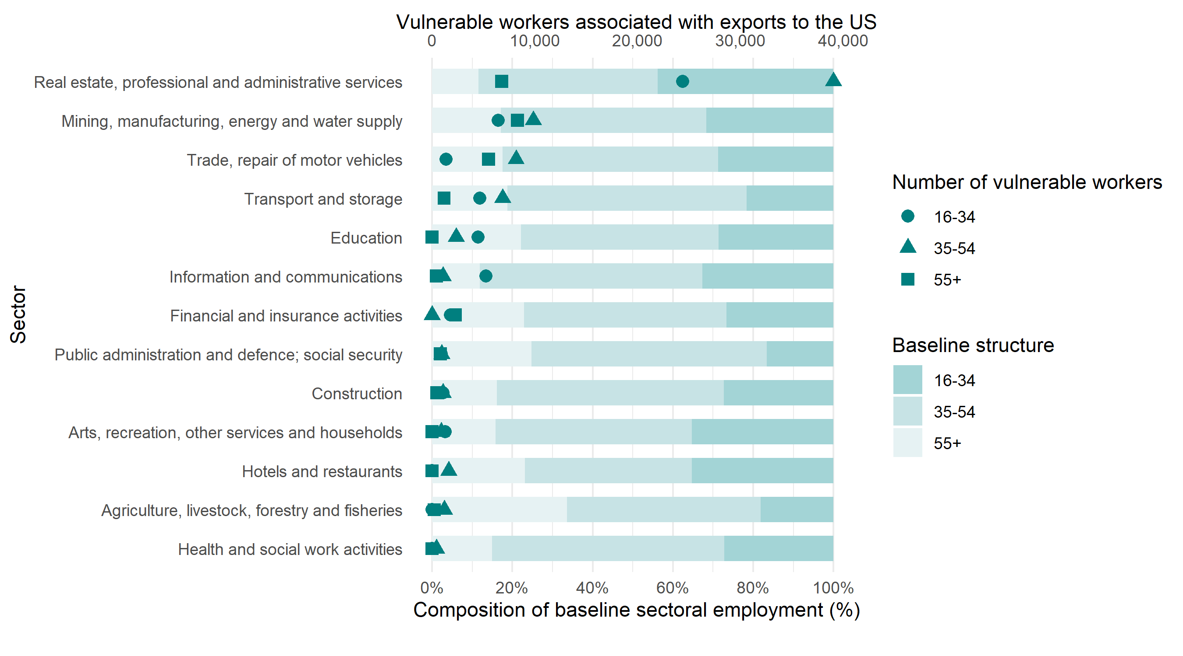
03b. Results at the individual level
Age
BELGIUM
Workers aged 16-34 are more concentrated in trade and business services, which contributes to their higher vulnerability rates.
Workers aged 35 to 54 dominate the largest export-supported sectors and therefore account for the largest share of vulnerable workers.
Workers aged 55 and over also have an important presence in manufacturing and transport, which explains their contribution to vulnerable employment.
Overall, vulnerability is distributed across all age groups, but it is slightly more pronounced among younger workers.
Notes:
Workers aged 16-34 are more concentrated in trade and business services, which contributes to their higher vulnerability rates.
At the same time, workers aged 35 to 54 dominate the largest export-supported sectors and therefore account for the largest share of vulnerable workers.
Workers aged 55 and over also have an important presence in manufacturing and transport, which explains their contribution to vulnerable employment.
Overall, vulnerability is distributed across all age groups, but it is slightly more pronounced among younger workers.

Slide 44
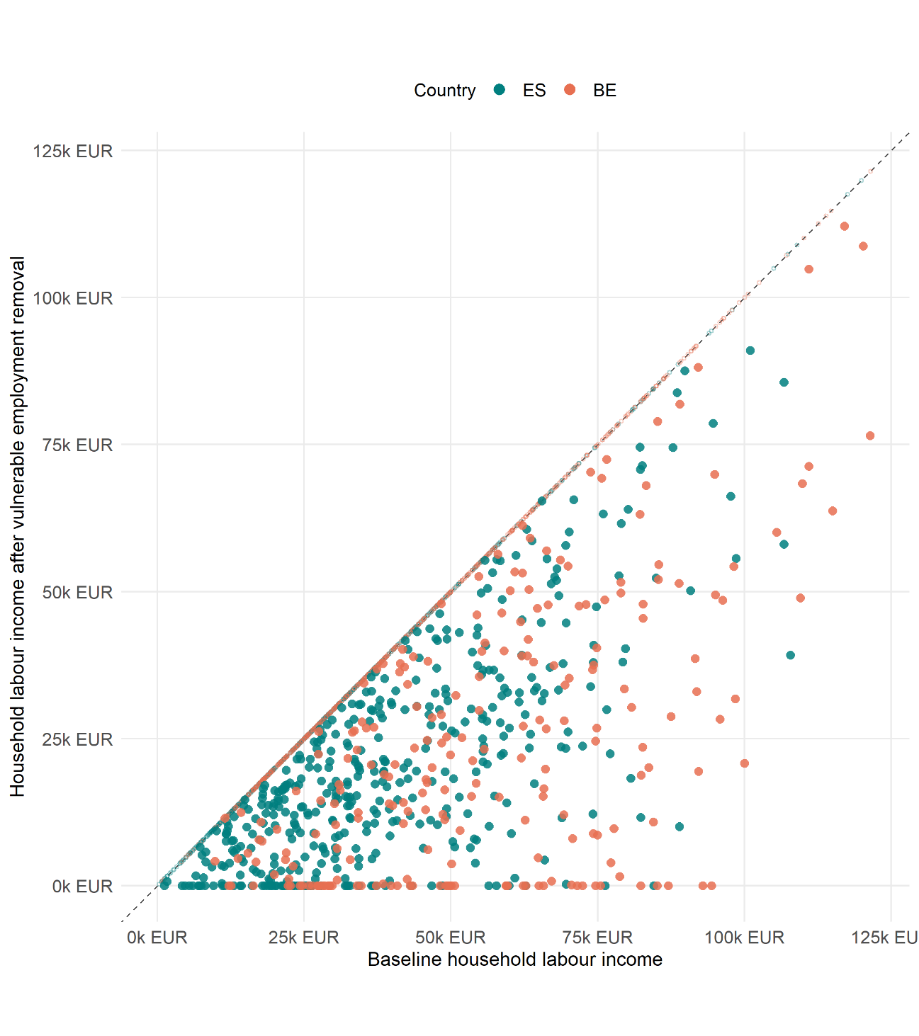
03c. Results at the household level
HOUSEHOLD INCOME
Most households remain relatively close to the diagonal, but some experience much larger income losses, showing a stronger dependence on export-supported employment
In Spain, vulnerable households are concentrated mainly among low- and middle-income groups
In Belgium, the distribution is much more dispersed across income levels
This suggests that dependence on export-supported employment extends across a broader range of household profiles in Belgium
Notes:
Finally, let's look at household income.
The graph compares baseline household labour income with household labour income after vulnerable employment is removed.
The diagonal line represents no change.
Households below the line experience a reduction in labour income because they depend on vulnerable employment.
Most households remain relatively close to the diagonal, but some experience much larger income losses, showing a stronger dependence on export-supported employment.
In Spain, vulnerable households are concentrated mainly among low- and middle-income groups.
In Belgium, the distribution is much more dispersed across income levels.
This suggests that dependence on export-supported employment extends across a broader range of household profiles in Belgium.

Slide 45
03c. Results at the household level
HOUSEHOLD VULNERABILITY
INEQUALITY INDICATORS
 |  | Gini index | Palma ratio | S80/S20 ratio
ES | No export reduction | 0.3234 | 1.206 | 5.817
 | Export cessation | 0.3277 | 1.232 | 6.028
BE | No export reduction | 0.2439 | 0.828 | 3.455
 | Export cessation | 0.2528 | 0.86 | 3.675
All measures increase in both countries
The increase is slightly larger in Belgium, although Belgium remains more equal than Spain in absolute terms
The fact that all inequality indicators increase means that household labour-income vulnerability are not distributed evenly across households
0
<
As a result, vulnerability associated with exports to the US contributes to higher household labour-income inequality in both countries
Lower inequality
Higher Inequality
Notes:
Looking at the inequality indicators, all measures increase in both countries.
The increase is slightly larger in Belgium, although Belgium remains more equal than Spain in absolute terms.
The fact that all inequality indicators increase means that household labour-income vulnerability are not distributed evenly across households.
As a result, vulnerability associated with exports to the US contributes to higher household labour-income inequality in both countries.

Slide 46
04
Conclusions
Notes:
To conclude, let’s review the main findings of the study

Slide 47


04. Conclusions
Employment associated with exports to the United States is not distributed evenly across the European labour market
The degree of dependence on US demand varies substantially across countries, sectors, workers and households
Two different patterns of exposure
Spain concentrates a large absolute number of vulnerable workers, particularly in market service activities
Belgium, by contrast, shows a higher relative dependence on US demand, reflecting its stronger integration into international production networks
29
Notes:
First, employment associated with exports to the United States is not distributed evenly across the European labour market.
The degree of dependence on US demand varies substantially across countries, sectors, workers and households.
Second, we observe two different patterns of exposure.
Spain concentrates a large absolute number of vulnerable workers, particularly in market service activities.
Belgium, by contrast, shows a higher relative dependence on US demand, reflecting its stronger integration into international production networks.

Slide 48
04. Conclusions
Employment associated with exports to the United States is not distributed evenly across the European labour market
The degree of dependence on US demand varies substantially across countries, sectors, workers and households
Vulnerability is associated with existing labour-market and household inequalities
Gender differences are relatively limited in Spain, but women are slightly overrepresented among vulnerable workers in Belgium, mainly because vulnerability is concentrated in export-oriented service activities
In terms of education, highly educated workers account for most vulnerable employment in both countries because they dominate export-supported sectors. However, vulnerability rates tend to be higher among workers with intermediate or lower educational attainment.
Younger workers display higher vulnerability rates than older workers, while household vulnerability is concentrated disproportionately among certain income groups and contributes to higher labour-income inequality
At the household level, vulnerability is not distributed evenly across the income distribution
30
Notes:
Third, vulnerability is associated with existing labour-market and household inequalities.
Gender differences are relatively limited in Spain, but women are slightly overrepresented among vulnerable workers in Belgium, mainly because vulnerability is concentrated in export-oriented service activities.
In terms of education, highly educated workers account for most vulnerable employment in both countries because they dominate export-supported sectors. However, vulnerability rates tend to be higher among workers with intermediate or lower educational attainment.
Finally, younger workers display higher vulnerability rates than older workers, while household vulnerability is concentrated disproportionately among certain income groups and contributes to higher labour-income inequality.
At the household level, vulnerability is not distributed evenly across the income distribution and is associated with higher levels of labour-income inequality.

Slide 49
04. Conclusions
These results highlight the importance of moving beyond sectoral measures of exposure
Understanding who the vulnerable workers and households are is essential for assessing how dependence on external demand is distributed across society and for designing policies that support economic resilience in an increasingly uncertain international environment
31
Notes:
Finally, these results highlight the importance of moving beyond sectoral measures of exposure.
Understanding who the vulnerable workers and households are is essential for assessing how dependence on external demand is distributed across society and for designing policies that support economic resilience in an increasingly uncertain international environment.

Slide 50

Further research
Integrate everything into a dynamic or general equilibrium model
Extension of the labour market model to other EU27 countries.
Analysis of induced effects
32

Slide 51



Thank you for your attention
Eskerrik asko
Gracias
Any questions or comments?
maria.moyano@bc3research.org
eva.alonso@bc3research.org
vicenprice@gmail.com
iñaki.arto@bc3research.org

Slide 52
03b. Results at the individual level
Gender
BELGIUM
The result is not driven by gender directly.
It comes from the internal structure of the L-N sector. Although the sector is gender-balanced overall, women are more concentrated in administrative and support jobs, with lower wages, fewer hours and more part-time work.
These characteristics are associated with lower predicted sectoral persistence in the model. Since the algorithm selects workers with the lowest predicted persistence, women become overrepresented among vulnerable workers.
Notes:
The result is not driven by gender directly.
It comes from the internal structure of the L-N sector. Although the sector is gender-balanced overall, women are more concentrated in administrative and support jobs, with lower wages, fewer hours and more part-time work.
These characteristics are associated with lower predicted sectoral persistence in the model. Since the algorithm selects workers with the lowest predicted persistence, women become overrepresented among vulnerable workers.

