Slide 1
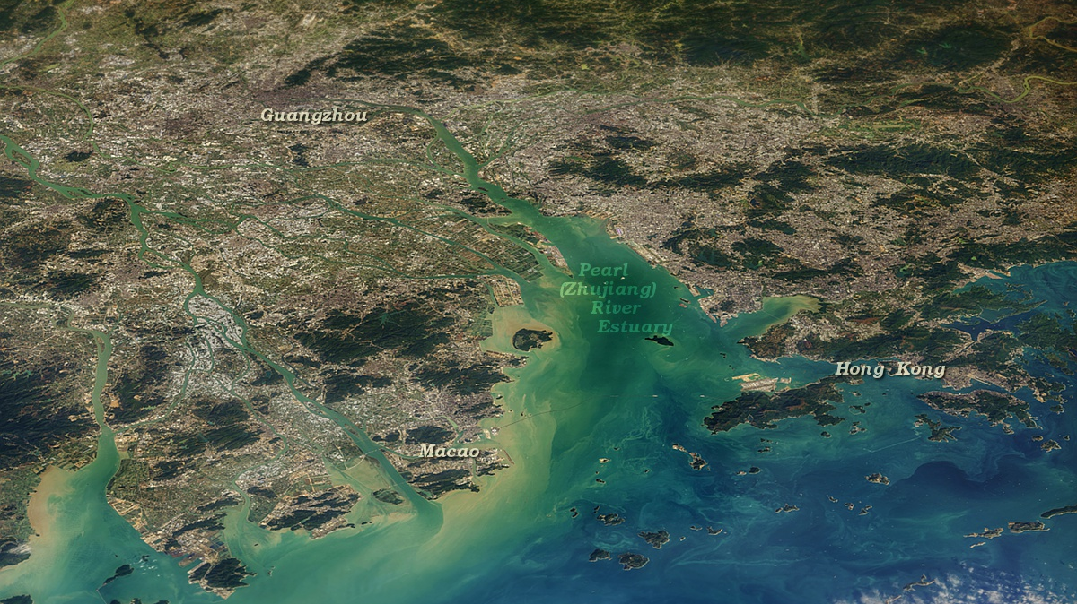

Coupling Hydrological and Economic Leakages to Share Nitrogen Pollution Responsibility
among Cities in Pearl River Basin
Aixi Han, Ying Zhang, Heran Zheng, Dabo Guan and Jianping Gan
Presented by Aixi Han
The Hong Kong University of Science and Technology
32nd IIOA & 11th SHAIO Conference
23 June 2026 | Sevilla, Spain
Notes:
Hi everyone. Today I will present our work on coupling hydrological and economic leakages to share nitrogen pollution responsibility among cities in the Pearl River Basin.

Slide 2
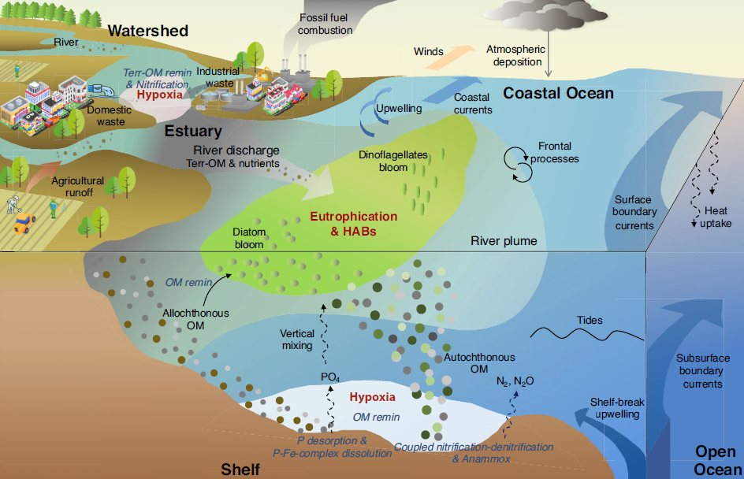
BACKGROUND
Nitrogen pollution is a critical worldwide challenge
Anthropogenic nitrogen enrichment
Excess nitrogen
Agriculture (fertilizer/manure)
Synthetic fertilizers and soil nitrogen
stimulate
Algal growth / eutrophication
Livestock (manure)
Manure and urine nitrogen
Dometic sewage
Septic systems and sewer overflows
Organic matter decomposes
Urban/Rural wastewater
Municipal wastewater treatment effluent
Consumes DO
Industry
Industrial processes and wastewater
(Dai et al. 2023)
Hypoxia
10× expansion of oxygen-depleted costal areas since the mid-20th century
>500 reported hypoxia sites worldwide
Ecological and Economic Losses
fisheries decline | ecosystem degradation | increasing mitigation costs
Notes:
Anthropogenic nitrogen enrichment has become one of the major pressures on coastal ecosystems. Excess nitrogen stimulates algal growth and primary production. When this organic matter decomposes, it consumes dissolved oxygen and can eventually lead to coastal hypoxia.
This is not a marginal problem. Since the mid-20th century, oxygen-depleted coastal areas have expanded about tenfold, and more than 500 hypoxic sites have been reported globally. These impacts also generate ecological and economic losses, including fisheries decline, ecosystem degradation, and increasing mitigation costs.
Therefore, nitrogen management is not only about reducing emissions at individual discharge points. It also requires a basin-scale governance framework that can decide how responsibility should be shared across connected regions.

Slide 3
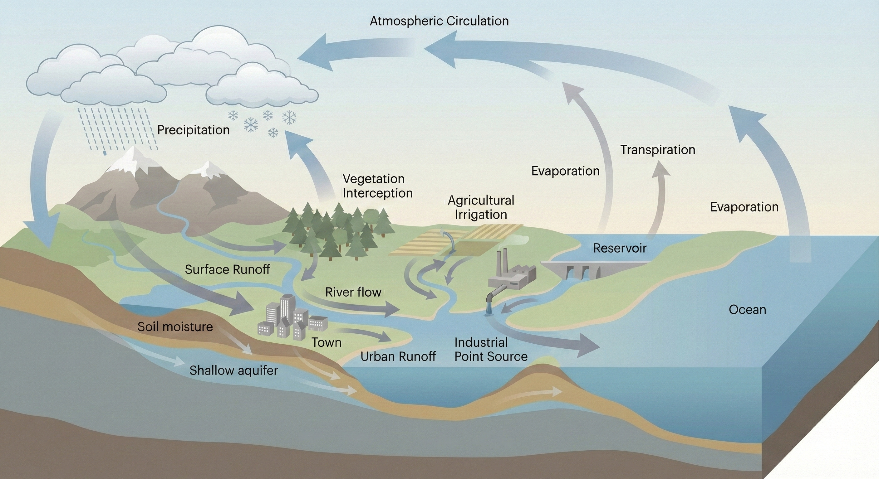
BACKGROUND
1.
Nitrogen pollution is a hydro-economic externality
Nature of Riverine Nitrogen Pollution
Riverine nitrogen is not just a local discharge problem; it is a coupled process of production, consumption, transport, and response.
1.
2.
5.
3.
4.
6.
3.
Surface eutrophication
Benthic hypoxia
5.
5.
5.
3.
Notes:
The motivation of this research comes from the spatial nature of riverine nitrogen pollution.
In a river basin, water enters through atmospheric circulation and precipitation, then moves through surface runoff, soil moisture and shallow aquifers before connecting to river flow. Along these pathways, nitrogen can be discharged from different human sources. Agricultural activities carry fertilizer-related nitrogen into rivers, towns generate urban runoff, and factories release nitrogen through industrial point sources.
Once nitrogen enters river flow, it is no longer confined to the discharge location. It can be retained, transported downstream and eventually delivered to the ocean, where it may contribute to eutrophication and hypoxia.
The key message is that riverine nitrogen is not only a local discharge problem. The discharge location, the economic driver and the burden receiver can be spatially separated. Nitrogen may be released in one place, induced by demand in another, and transported by the river network to a third.

Slide 4
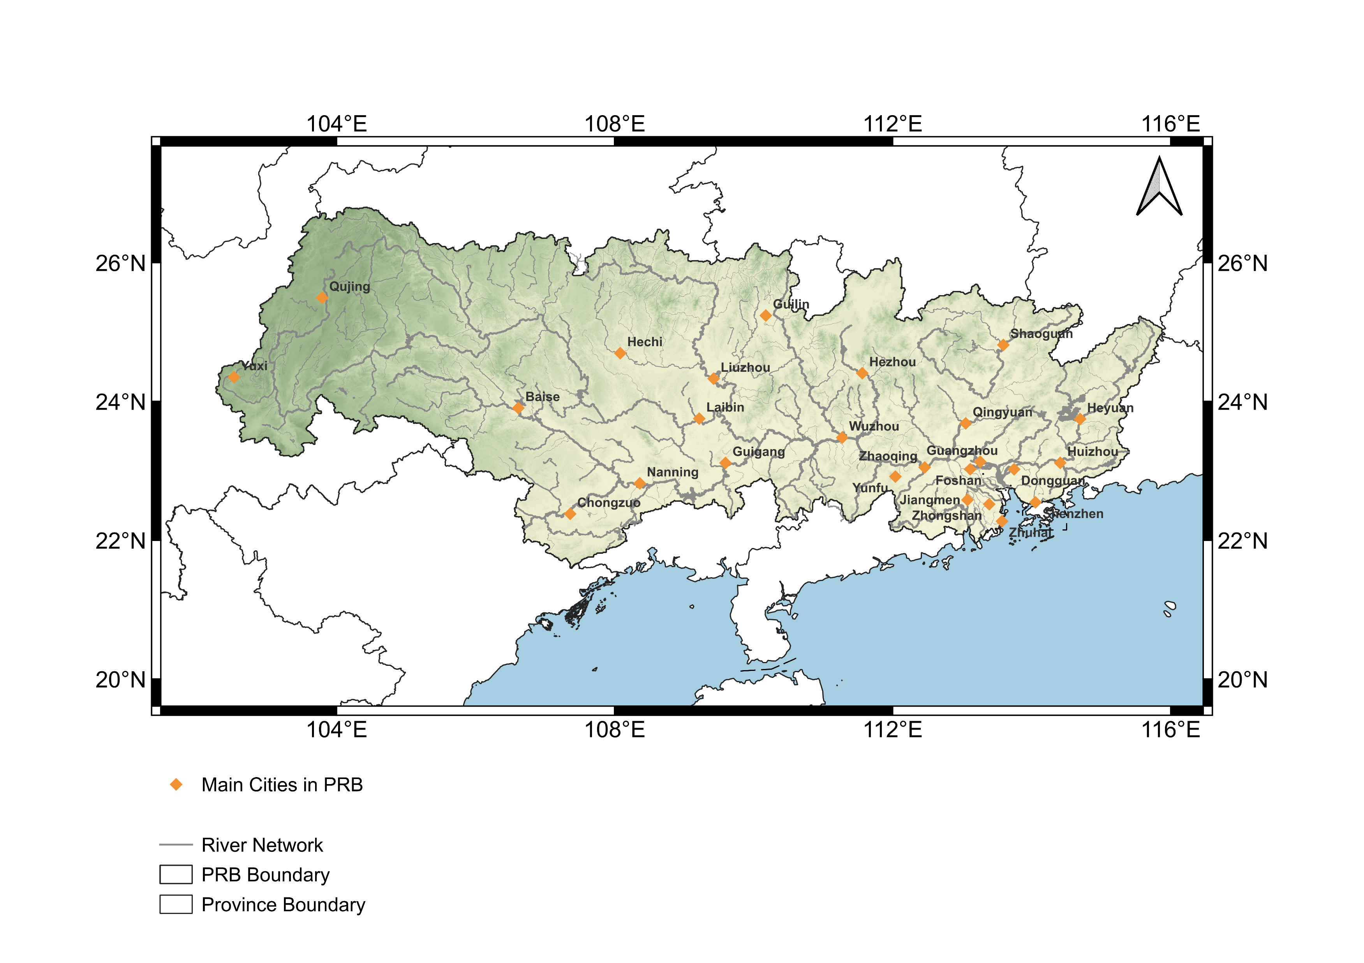
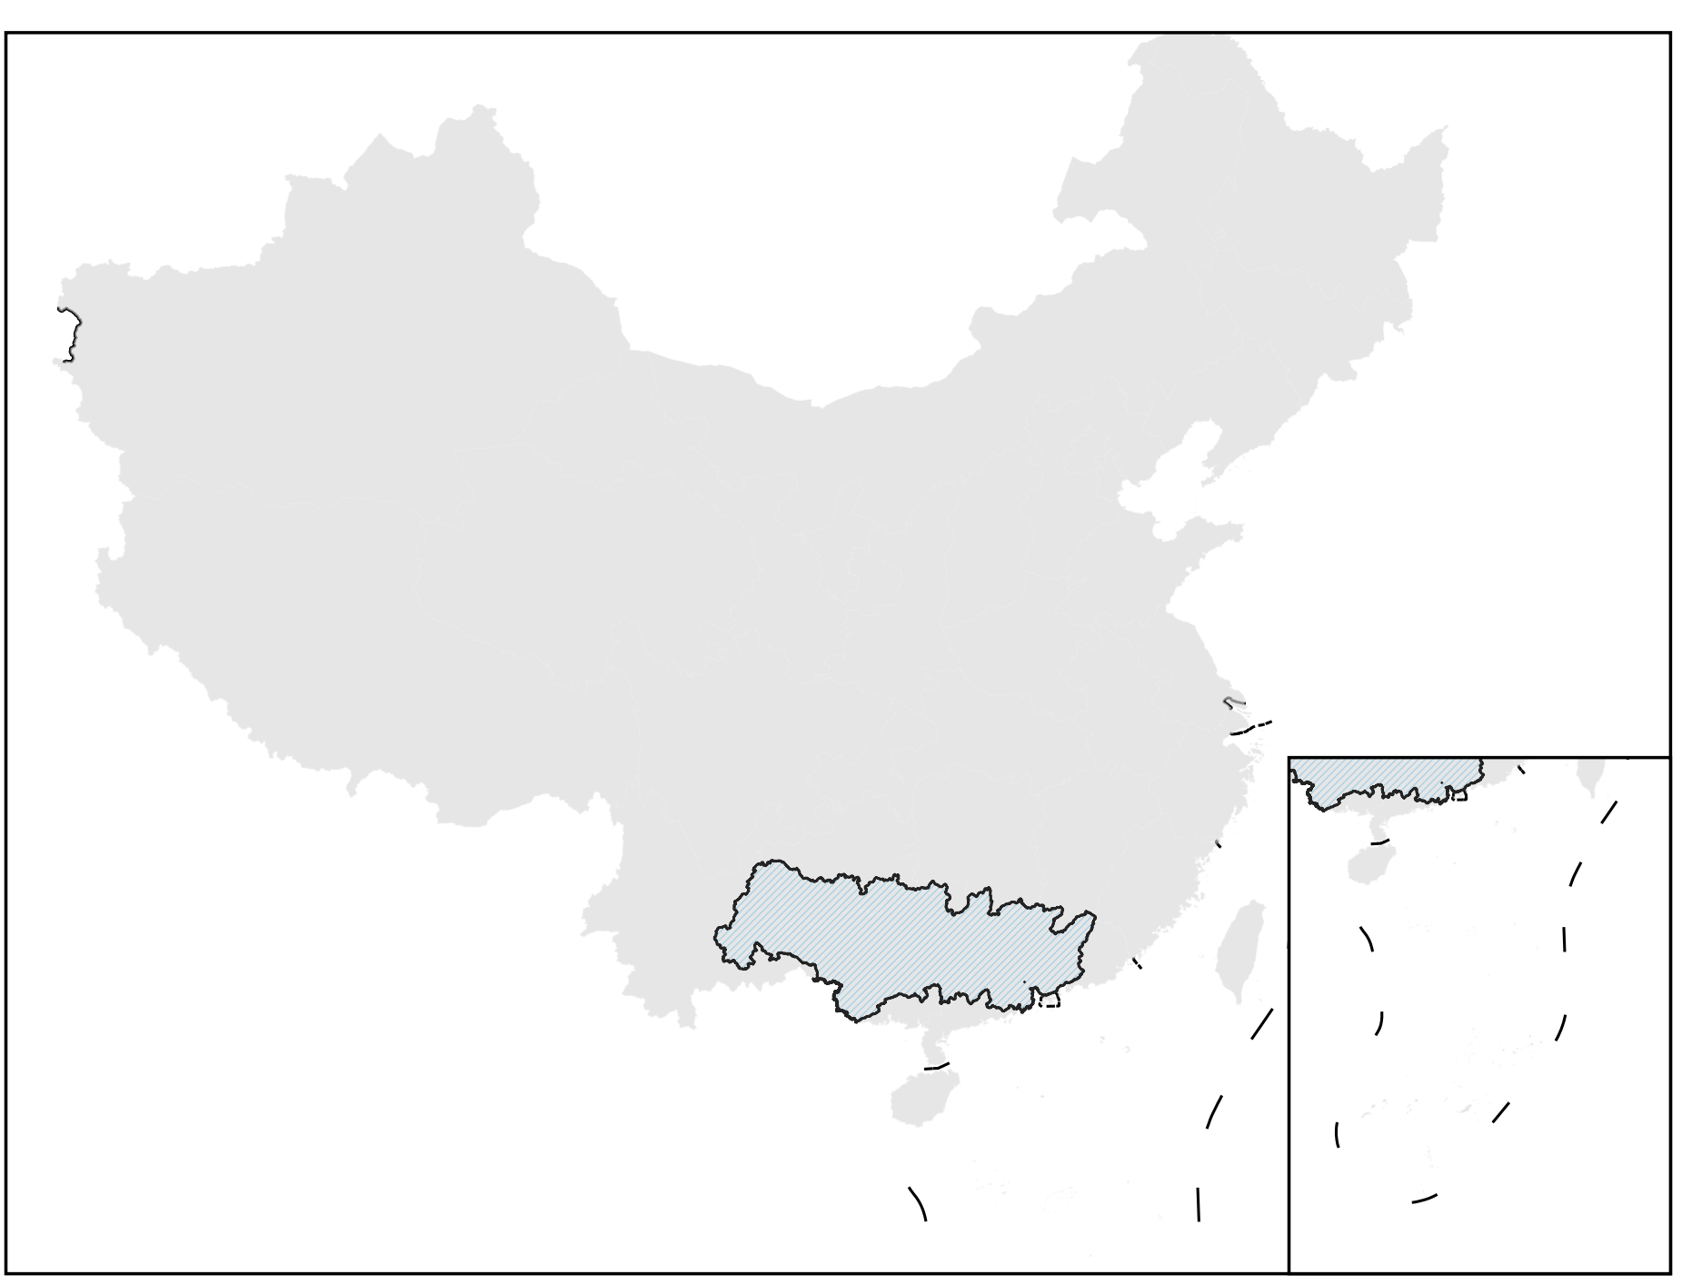
BACKGROUND
The Pearl River Basin makes the mismatch visible
Yungui Plateau
North river
West river
East River
PRB
The Greater Bay Area
Why this basin?
Why responsibility is contested
- The Pearl River is one of the world's major rivers by nitrogen discharge and is important for Asian coastal nutrient fluxes.
- The receiving coastal zone has moved from episodic oxygen depletion toward persistent eutrophication and hypoxia risks.
- Agricultural intensification and urban growth have increased pressure on nitrogen management.
- Inland regions host agricultural and industrial production that directly releases nitrogen.
- The Greater Bay Area concentrates population, wealth, and service-oriented consumption.
- Administrative boundaries divide these regions, but the river network connects them hydrologically.
Notes:
The Pearl River Basin is a useful case because it has both strong hydrological connectivity and strong economic connectivity.
It is located in southern China. The upper basin extends across the Yungui Plateau, and the river system is mainly formed by three branches: the West River, the North River, and the East River. These rivers flow toward the Pearl River Delta where we can see one of the most developed bay area, the Greater Bay Area.
The basin faces strong nitrogen pressure. The Pearl River is one of the world’s major rivers by nitrogen discharge and is important for Asian coastal nutrient fluxes. Its receiving coastal waters have also moved from episodic oxygen depletion toward more persistent eutrophication and hypoxia risks. Because agricultural intensification and urban growth have increased pressure on nitrogen management.
More importantly, the basin has a clear spatial mismatch. Inland regions directly release nitrogen through agricultural and industrial production, while the Greater Bay Area concentrates population, wealth, final demand, and services. Administrative boundaries divide these regions, but the river network connects them hydrologically.
This makes responsibility sharing difficult and scientifically important.

Slide 5
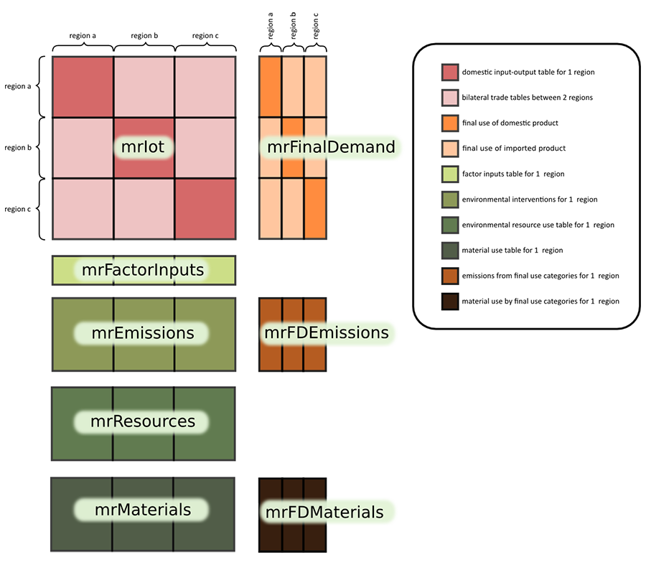
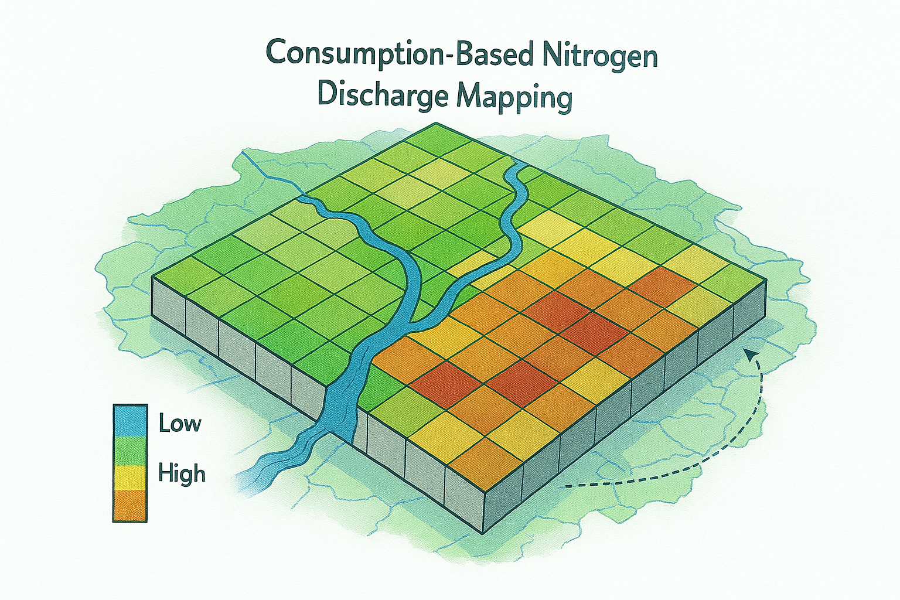
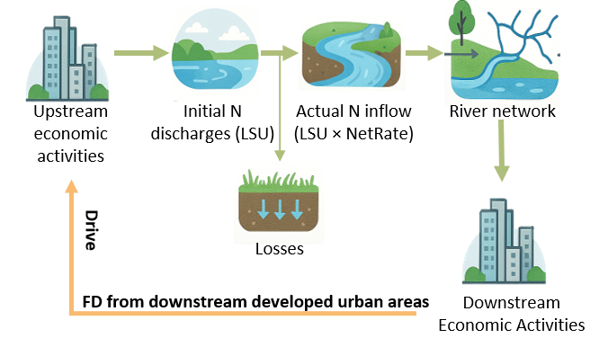
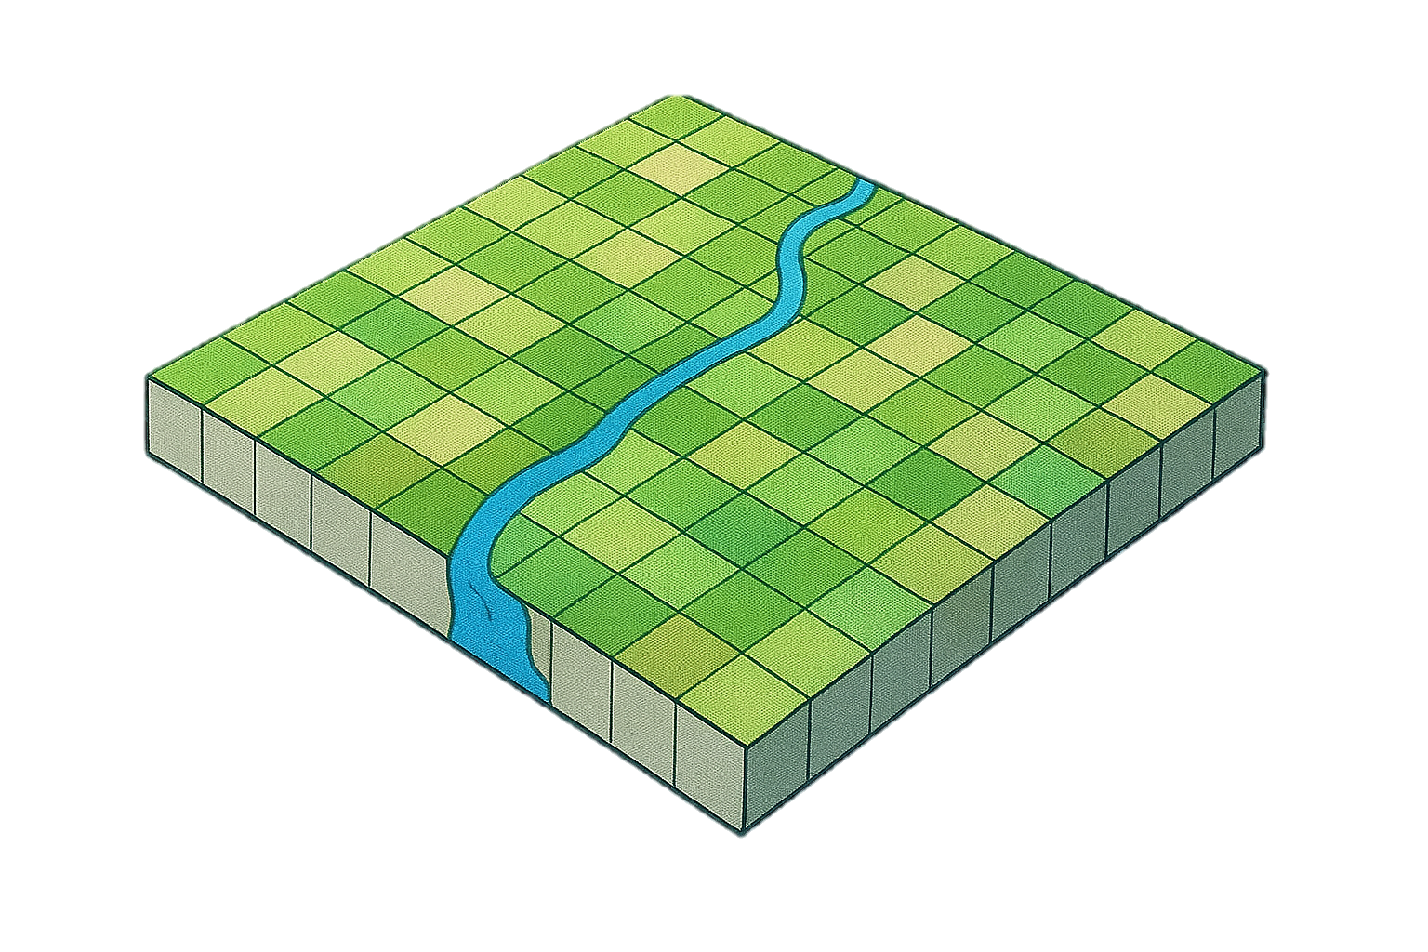
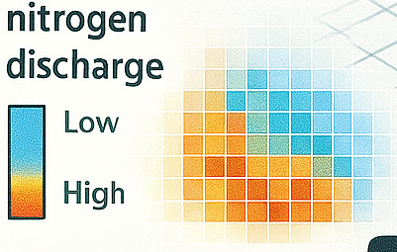
FRAMEWORK
Integrated framework: from final demand to riverine load
M1 SWAT Modeling
M2 MRIO Analysis
M3 Source-to-Sea: Riverine Source Attribution
A. Hotspot Identification
Channel in
Channel out
Low
High
Discharge hotspots
B. Riverine Source Attribution
SWAT: Soil and Water Assessment Tool
Hydrology process and Pollutant transport
Pollutant Discharge
FD Pollutant Discharge
final-demand-driven pollutant discharge
low
high
full-sector, city-level inventory
Nitrogen chain
Supply chain
Notes:
Here, we develop an integrated hydro-economic framework to trace nitrogen pollution from final demand to riverine load. The framework builds on SWAT-based hydrology and pollutant transport and contains three connected modules.
M1 is SWAT-based hydrology, pollutant transport and inventory construction. Point-source and non-point-source nitrogen inputs are introduced into SWAT to represent runoff generation, streamflow routing, land-to-channel transfer, in-stream retention, attenuation and downstream accumulation. Based on the SWAT-derived hydrological and pollutant-transport outputs, we construct a full-sector, city-level nitrogen discharge inventory by linking source-specific nitrogen inputs with city boundaries and sectoral allocation information.
M2 is MRIO-based economic attribution. This module links the full-sector, city-level nitrogen inventory with the multi-regional input-output table and final demand. It estimates how consumption in one city induces nitrogen discharge in another city through intercity production and trade, producing supply chain-based nitrogen responsibility and trade-embodied nitrogen flows.
M3 is source-to-sea riverine source attribution. This module connects MRIO-based economic attribution with SWAT-based hydrological transport. At the channel scale, nitrogen is traced from source areas to downstream sinks under two perspectives. The nitrogen chain-based perspective follows where nitrogen is discharged, transported and delivered through the river network. The supply chain-based perspective reallocates the same riverine load to the final demand that induces nitrogen-generating production.
Overall, this framework connects final demand, sectoral nitrogen discharge, trade-embodied nitrogen flows and riverine nitrogen load. It identifies both where nitrogen enters and moves through the river network, and which consumption activities drive its generation.

Slide 6
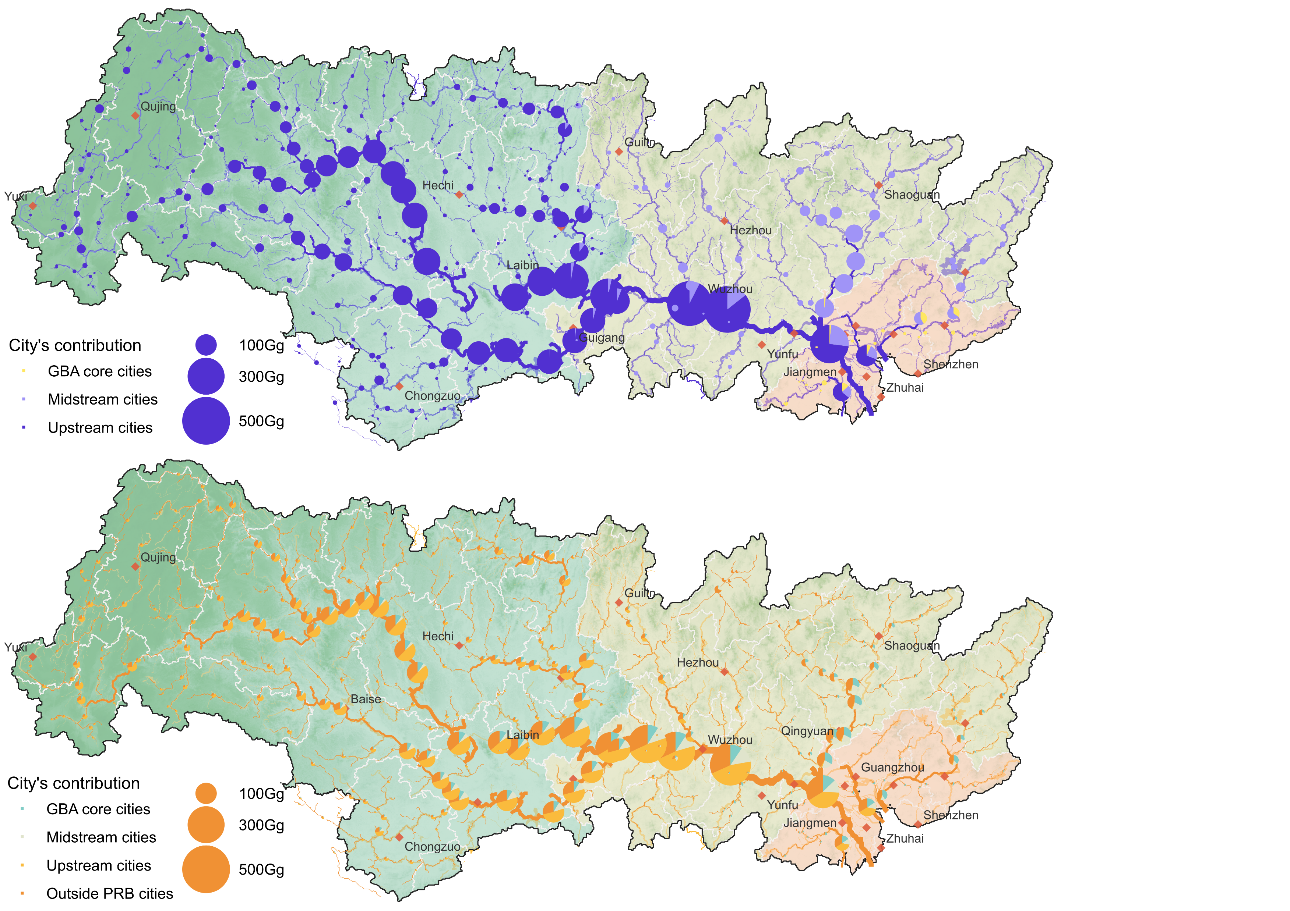
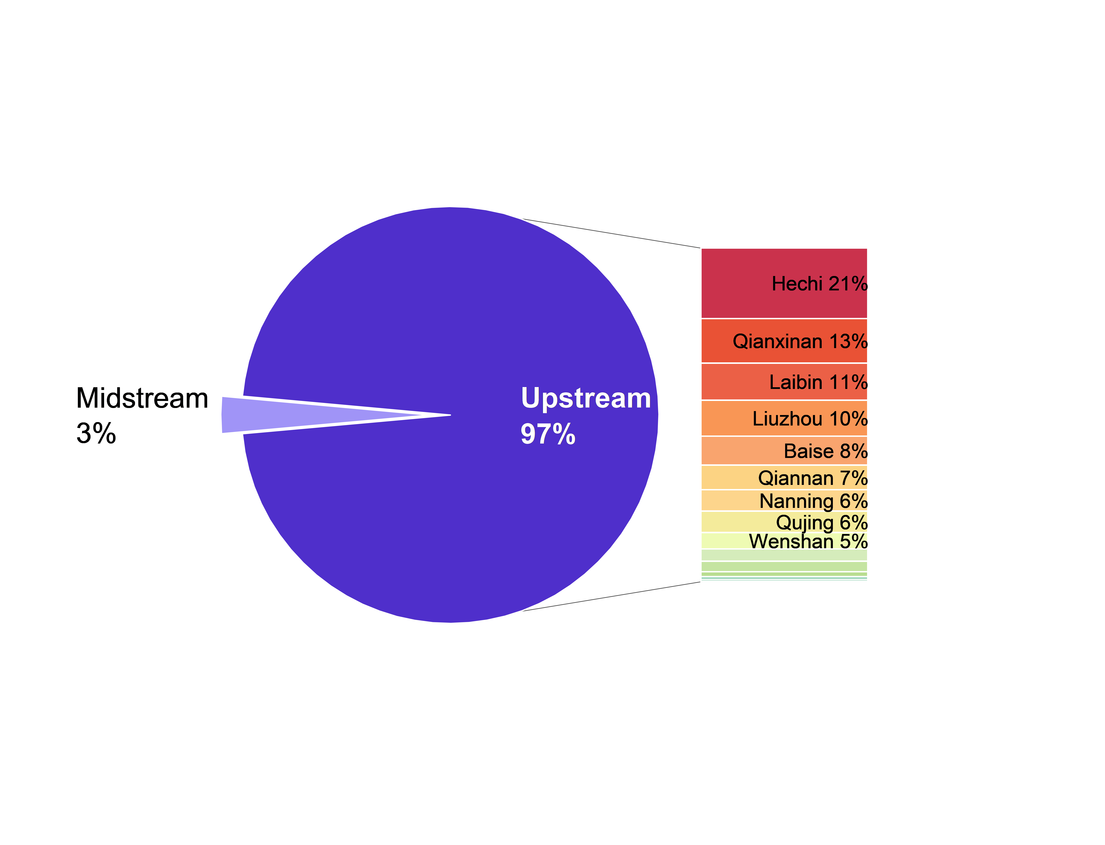
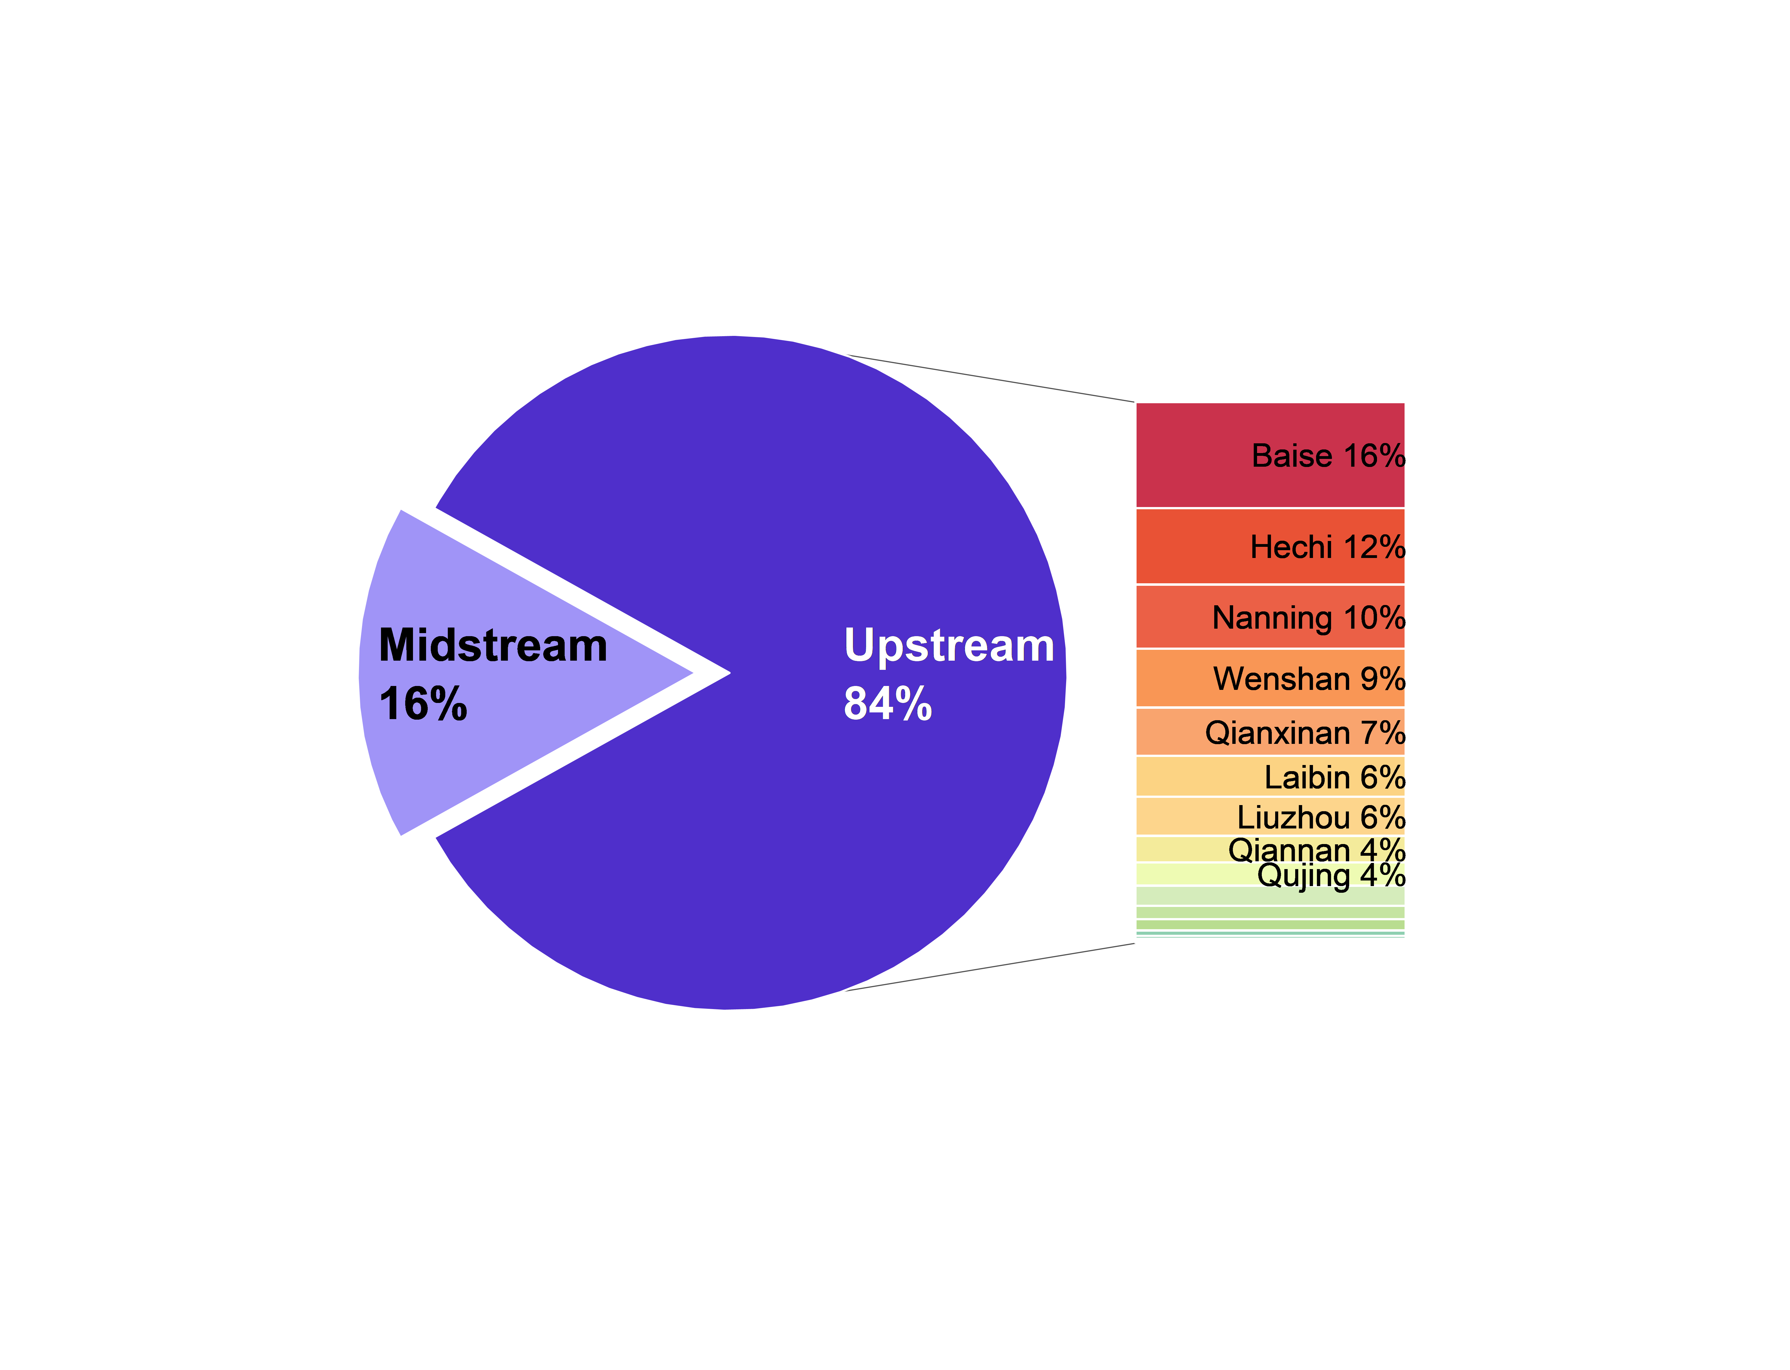
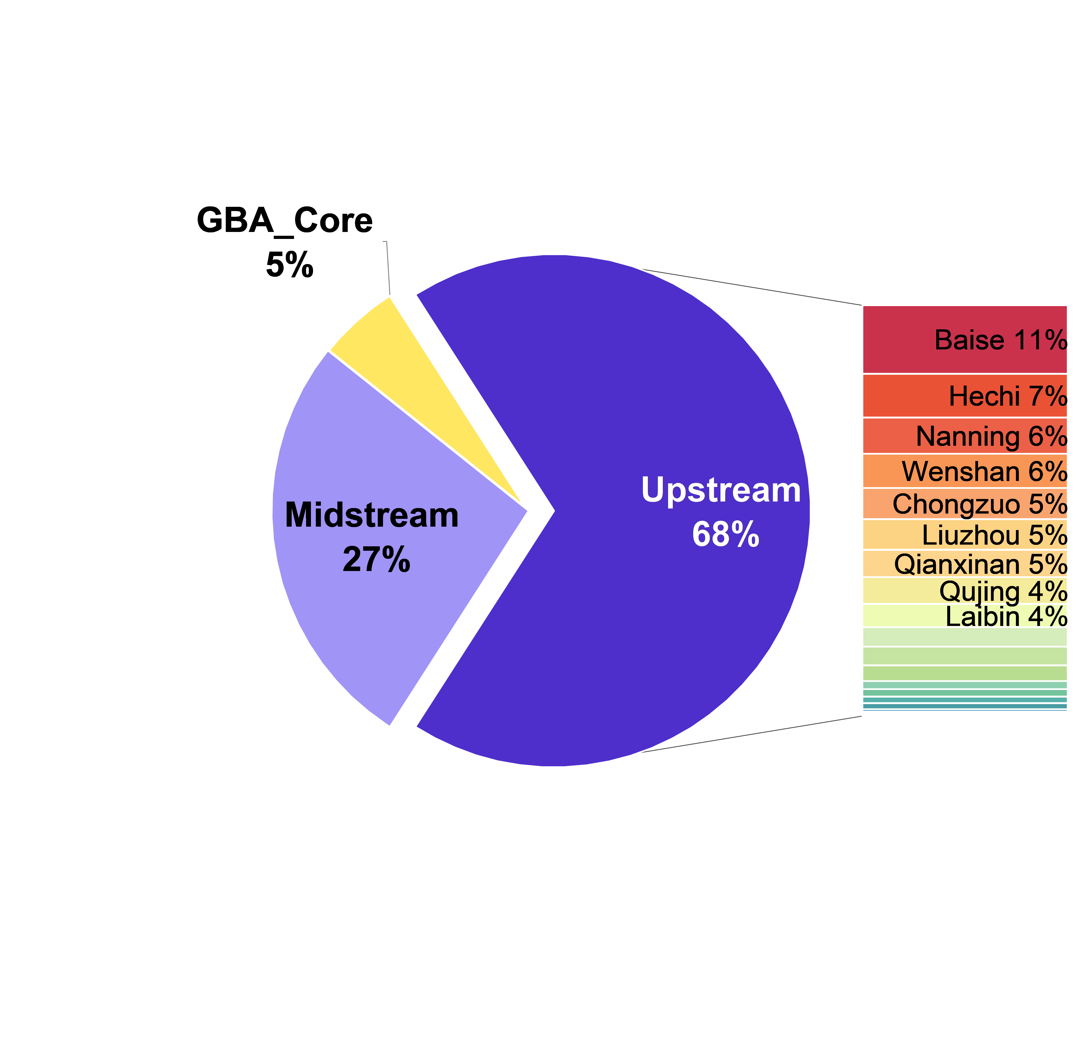
RESULTS
Result 1: nitrogen chain-based attribution makes upstream cities look dominant
a. Nitrogen chain-based attribution
Take-home message:
Under nitrogen chain-based attribution, most nitrogen at downstream channels is transported from inland regions, while the GBA Core cities appears relatively detached.
Interpretation
- Agriculture dominates the load: about 67% upstream and 68% at the delta outlet.
- Secondary source sectors include heavy manufacturing, light manufacturing, power, and utilities.
- The GBA Core contains around 15% of the basin population but accounts for only about 5% of the hydrologically attributed riverine load.
- A familiar narrative: inland cities are the main polluters because they are the main discharge locations.
Upstream Channel
276.77Gg
Midstream Channel
486.02Gg
Deltaic Outlet
793.95Gg
Figure 1 a, Nitrogen chain-based attribution showing nitrogen loads traced from direct discharge locations and accumulated along the river network through hydrological transport.
Notes:
The first result shows what we see from a strict hydrological perspective. This is source-based attribution. It traces nitrogen loads from direct discharge locations and accumulates them along the river network through hydrological transport.
At the upstream channel, the annual nitrogen load reaches 276.77 gigagrams per year, and 97 percent is attributed to upstream cities. At the midstream channel, the cumulative load increases to 479.51 gigagrams per year. The upstream share declines in percentage terms, but the absolute upstream contribution increases to about 402.79 gigagrams, because more tributaries are added into the main channel. 【少加一点数值 更多用百分比】
At the deltaic outlet, the total load reaches 787.44 gigagrams per year, and upstream regions still contribute about 68 percent. Agriculture remains the dominant sector throughout the basin.
Under this source-based view, the Greater Bay Area Core looks like a minor contributor, despite its large population and economic demand. So the hydrological story is clear but incomplete: the pollution appears to come mainly from inland regions.

Slide 7
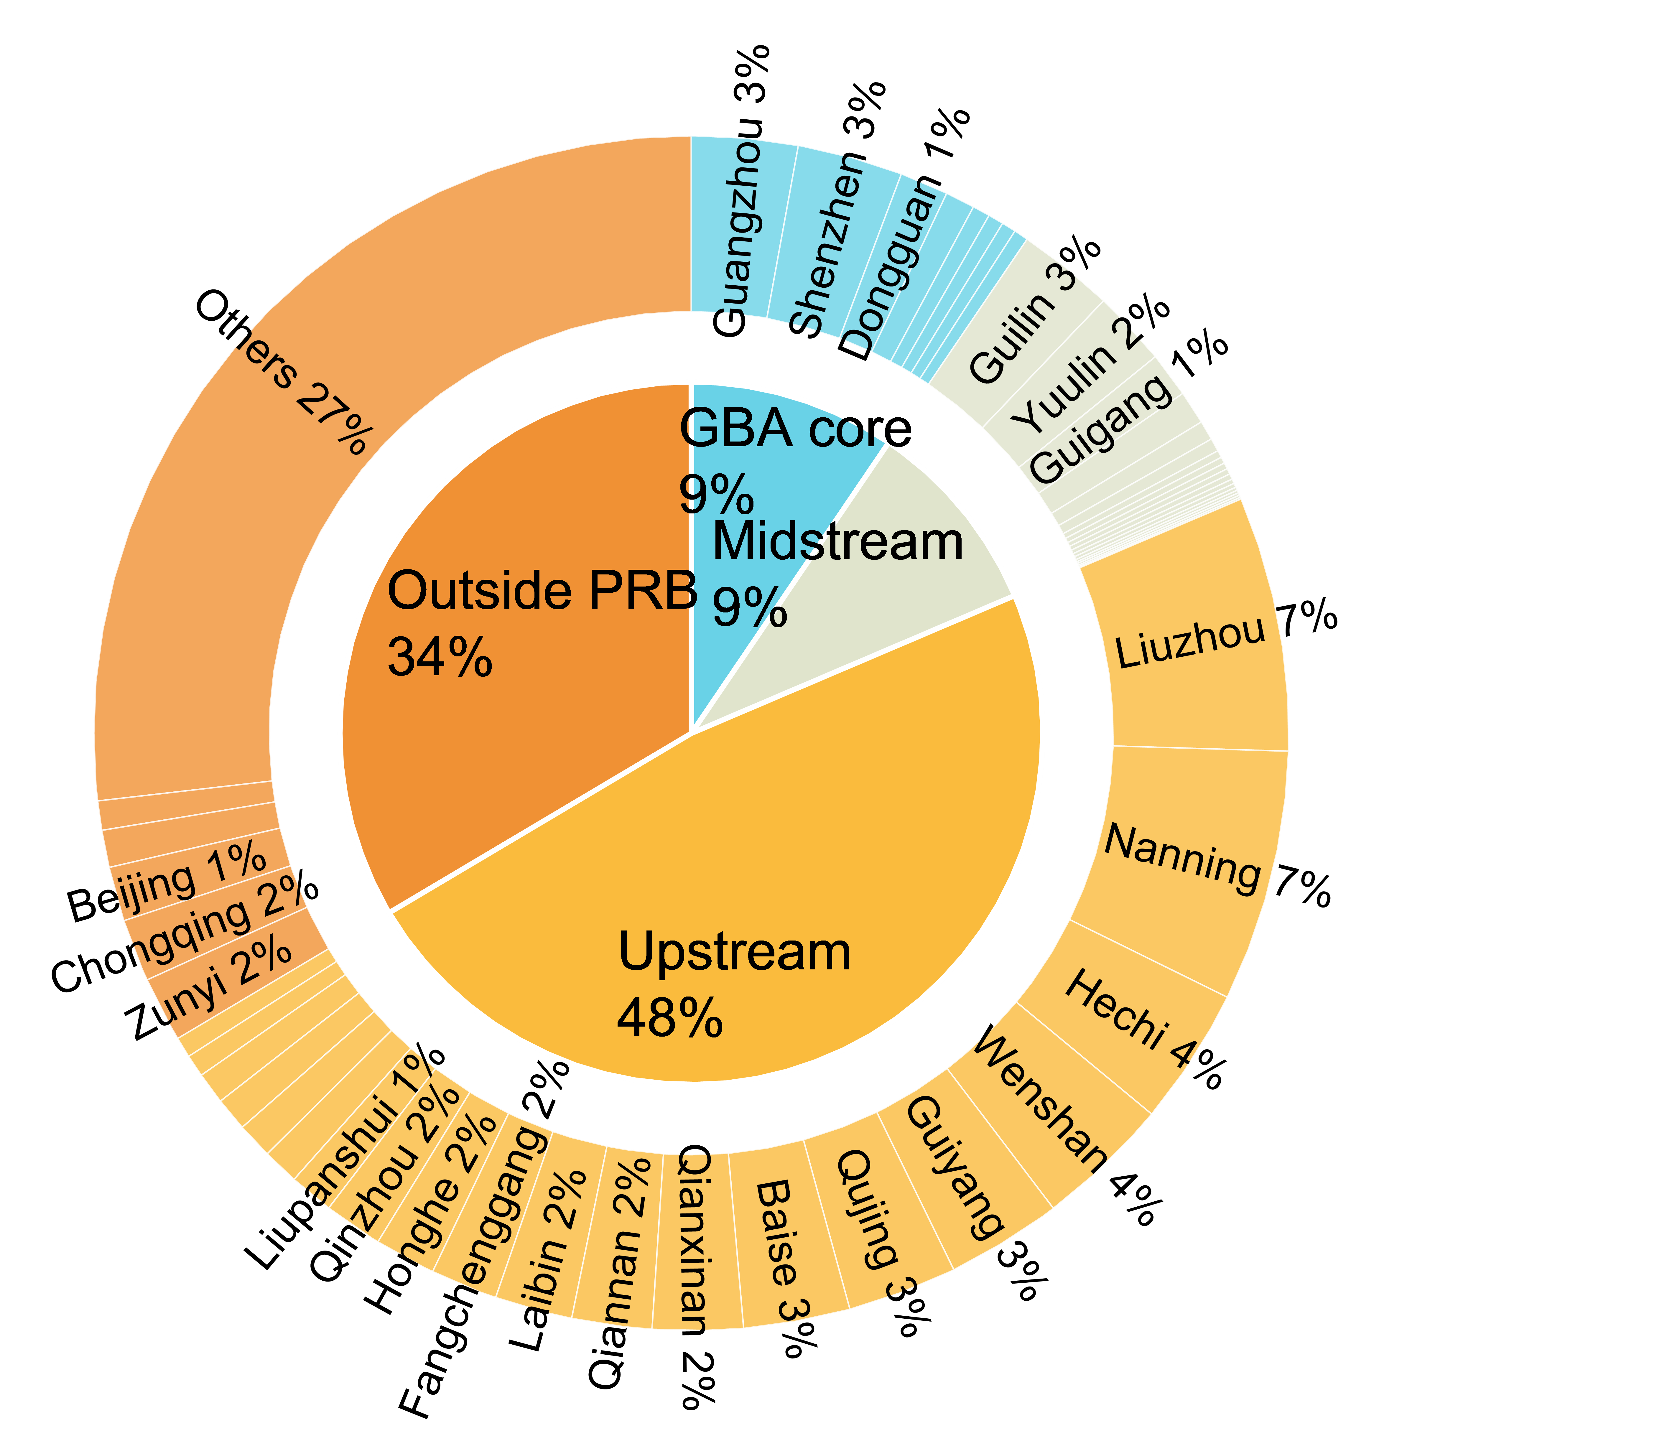
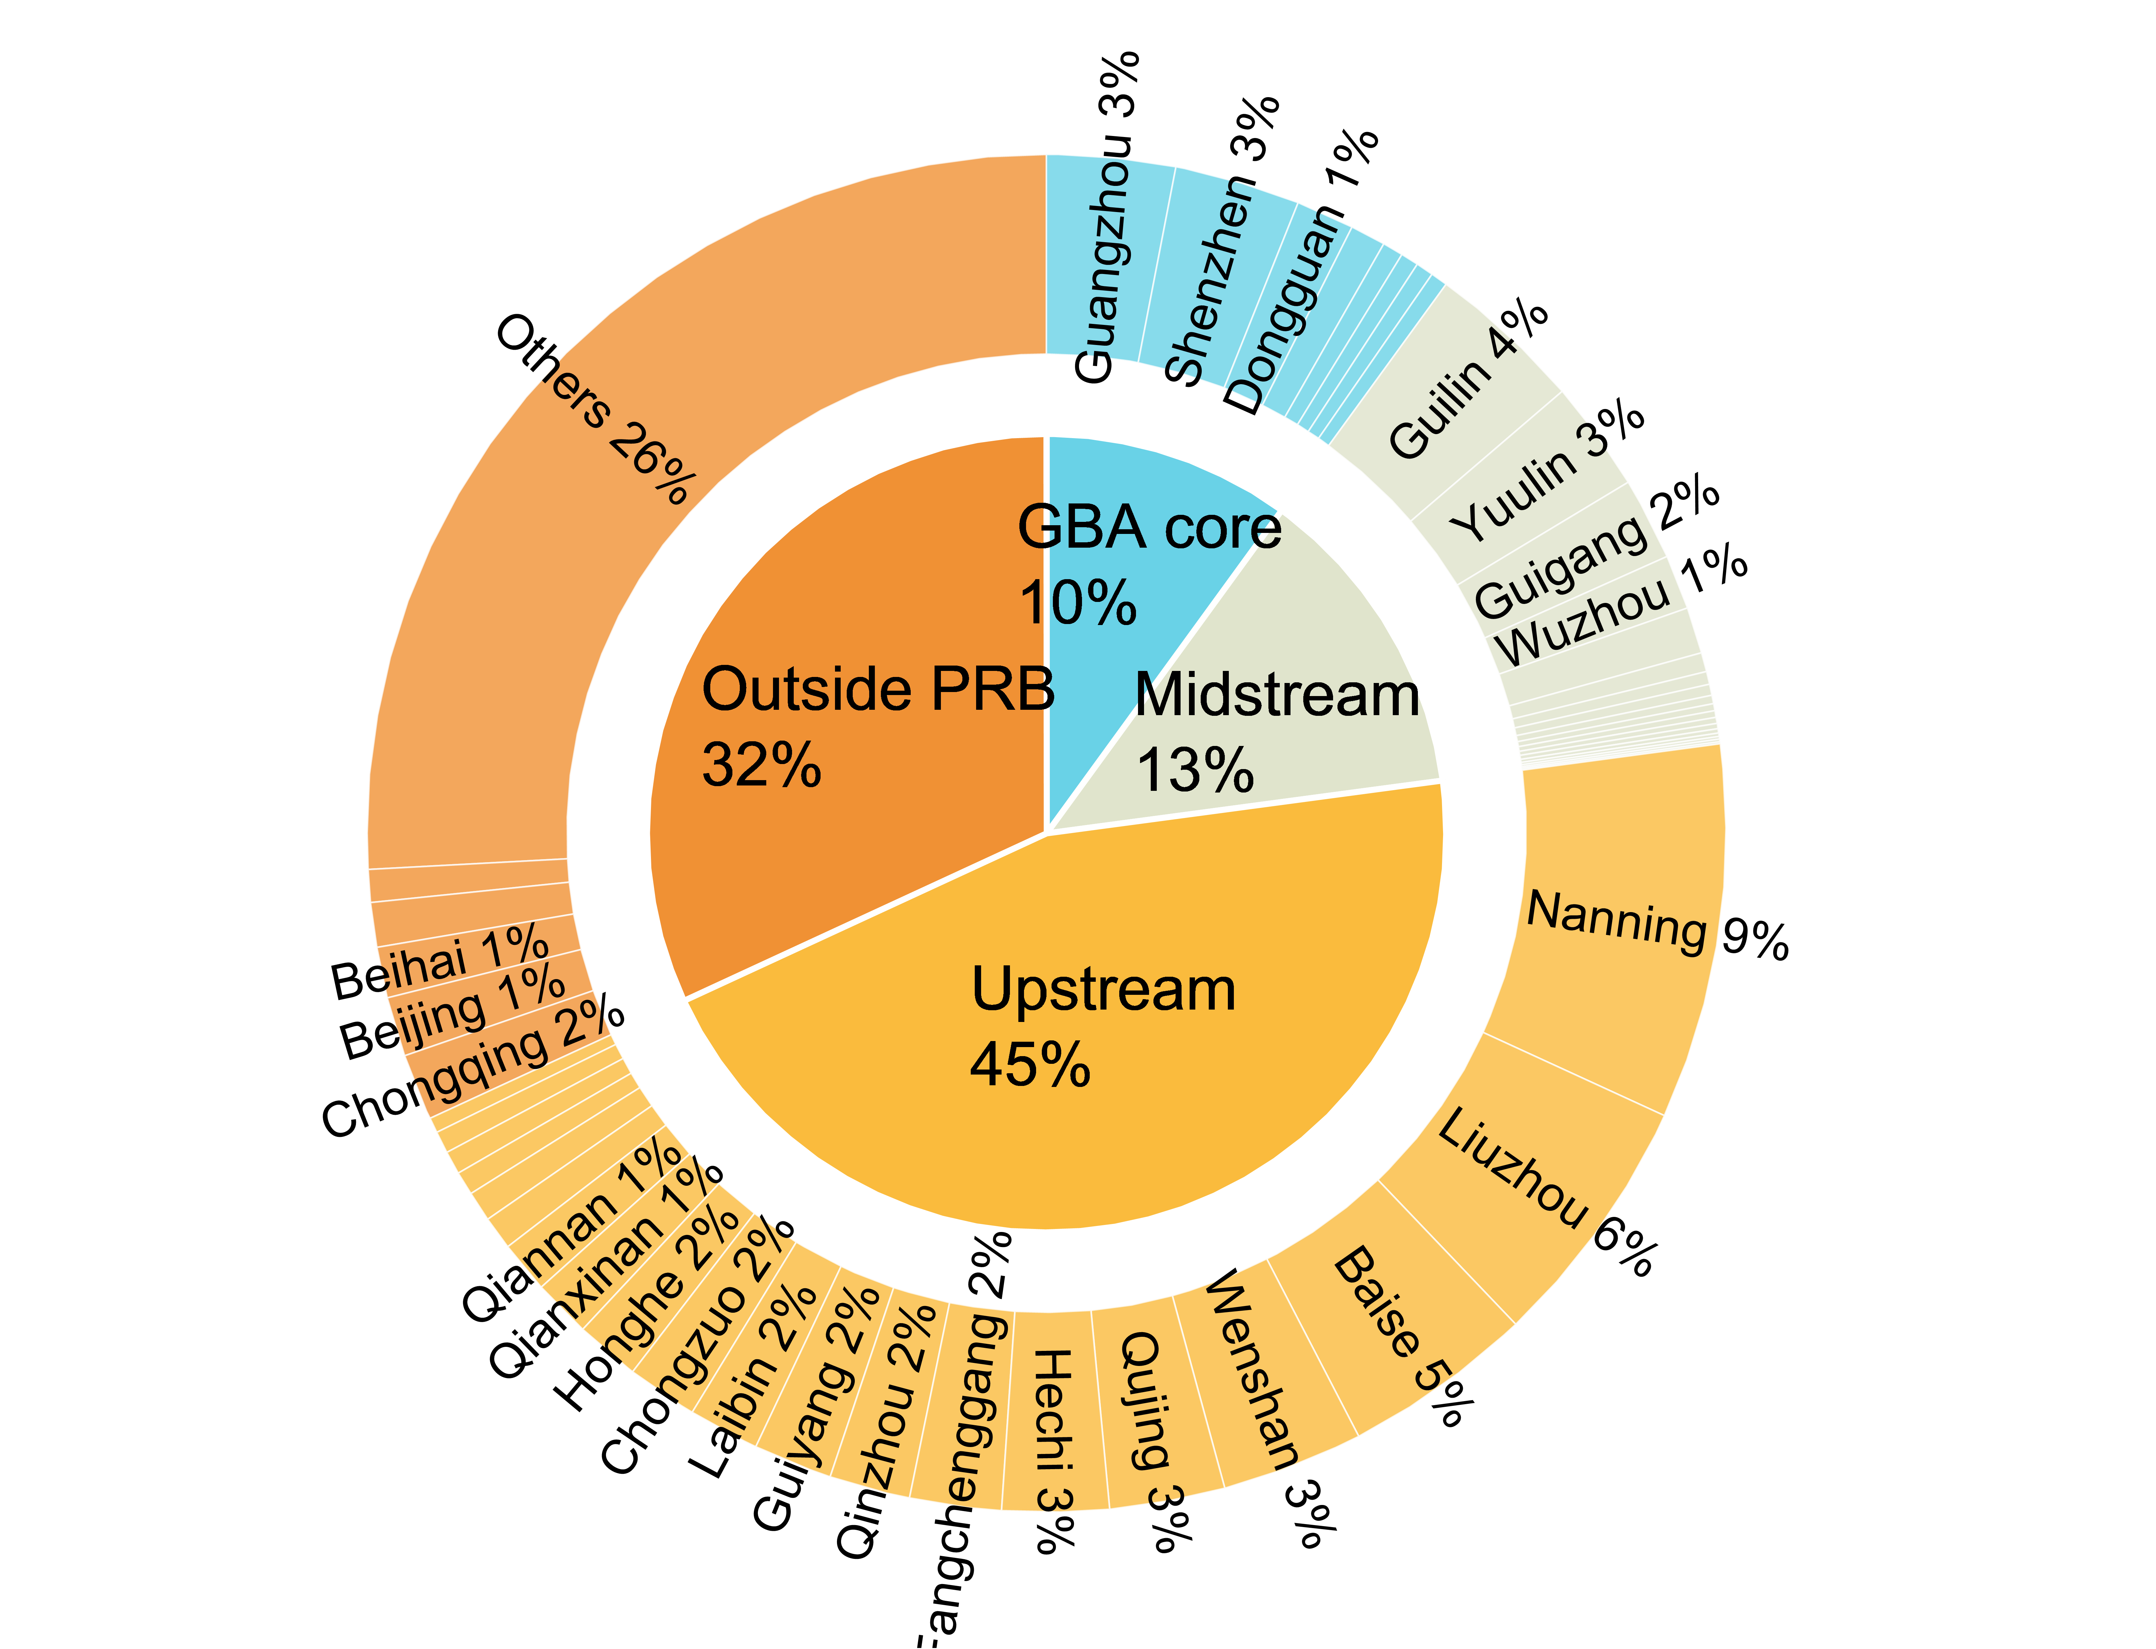
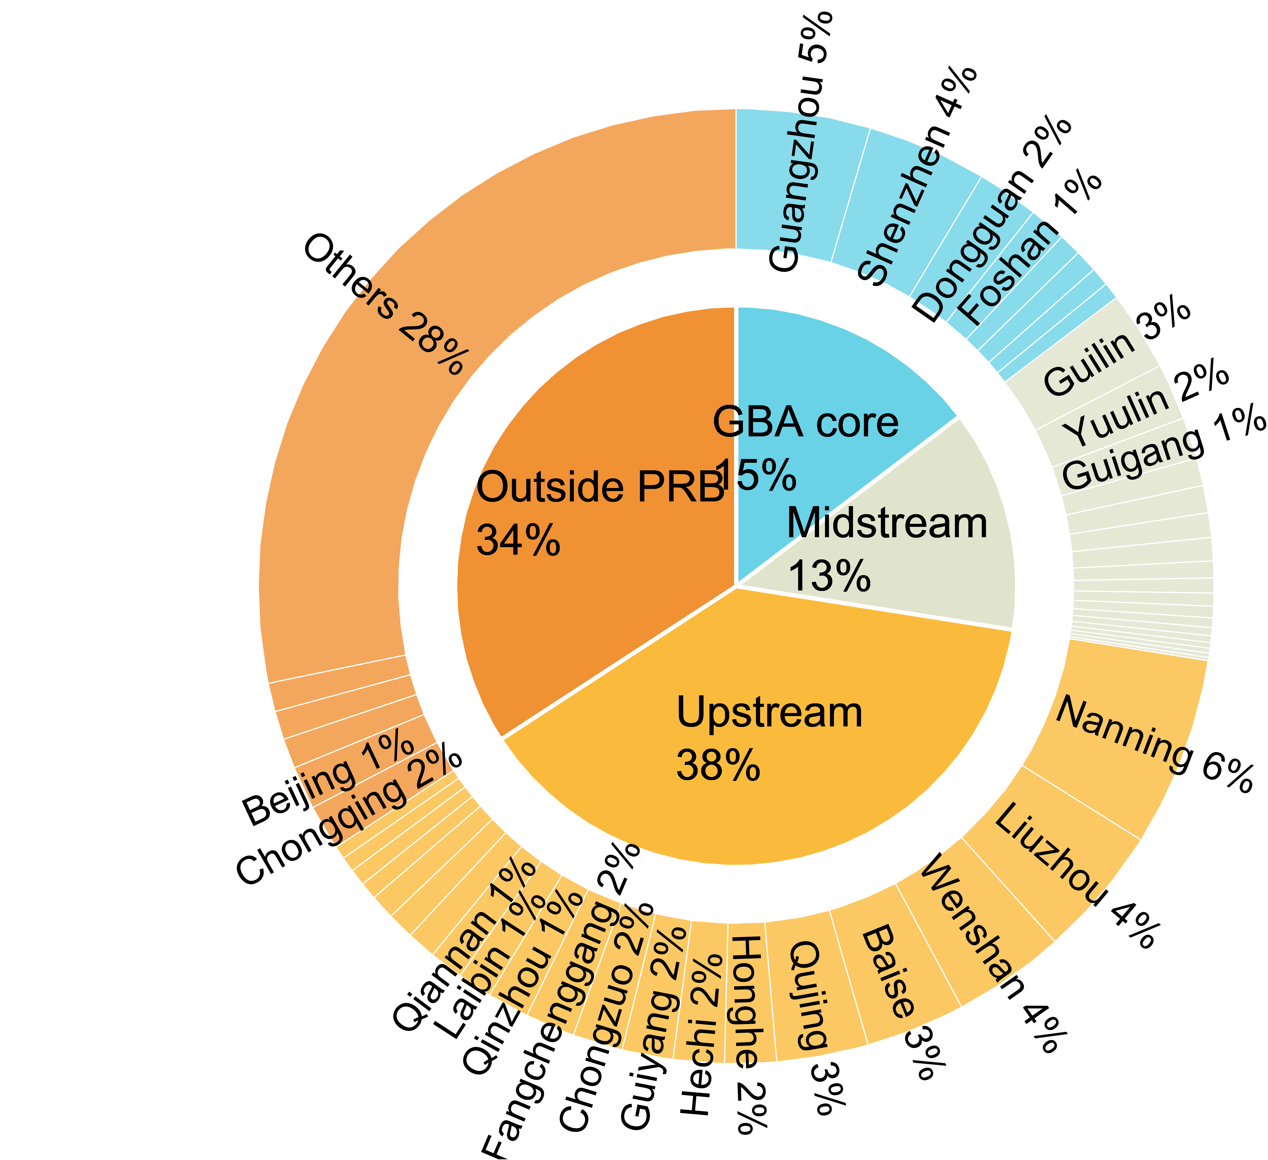
RESULTS
Result 2: supply chain-based attribution reverses the responsibility profile
b. Supply chain-based attribution
Take-home message:
When loads are attributed to final demand (supply chain-based attribution), downstream and extra-basin beneficiaries become much more visible.
Interpretation
- At the midstream channel, upstream responsibility falls from 84% (nitrogen chain) to 45% (supply chain) .
- At the deltaic outlet, upstream and midstream responsibility shrink to 38% and 13% (supply chain), compared with 68% and 27% (nitrogen chain).
- GBA Core responsibility triples to 15% at the outlet; Guangzhou and Shenzhen reach 5% and 4%, respectively.
- Agriculture, light manufacturing, construction, and services are the main consumption channels that transmit nitrogen responsibility through supply chains.
Upstream Channel
206.28Gg
Midstream Channel
373.15Gg
Deltaic Outlet
572.63Gg
Figure 1 b, Supply chain-based attribution showing the same hydrologically transported nitrogen loads reallocated to the final economic demand that induces their generation.
Notes:
The second result shows the same hydrologically transported nitrogen loads, but reallocates them to the final economic demand that induces their generation. This is consumption-based attribution.
Once nitrogen load is attributed to final demand, the responsibility profile changes sharply. At the upstream channel, about one third of the nitrogen load is driven by external demand. GBA Core cities already account for around 9 percent, even though their direct discharge is small.
At the midstream channel, source-based accounting assigns 84 percent of the load to upstream regions. But consumption-based accounting reduces upstream responsibility to 45 percent. Outside-PRB demand also becomes important, driving 32 percent of the midstream burden.
The reversal is strongest at the deltaic outlet. Upstream responsibility falls from 68 percent under source-based attribution to 38 percent under consumption-based attribution. Meanwhile, GBA Core responsibility triples to 15 percent, and outside-PRB final demand accounts for 34 percent.
This result shows that apparent upstream pollution is partly a downstream and extra-regional consumption externality.

Slide 8
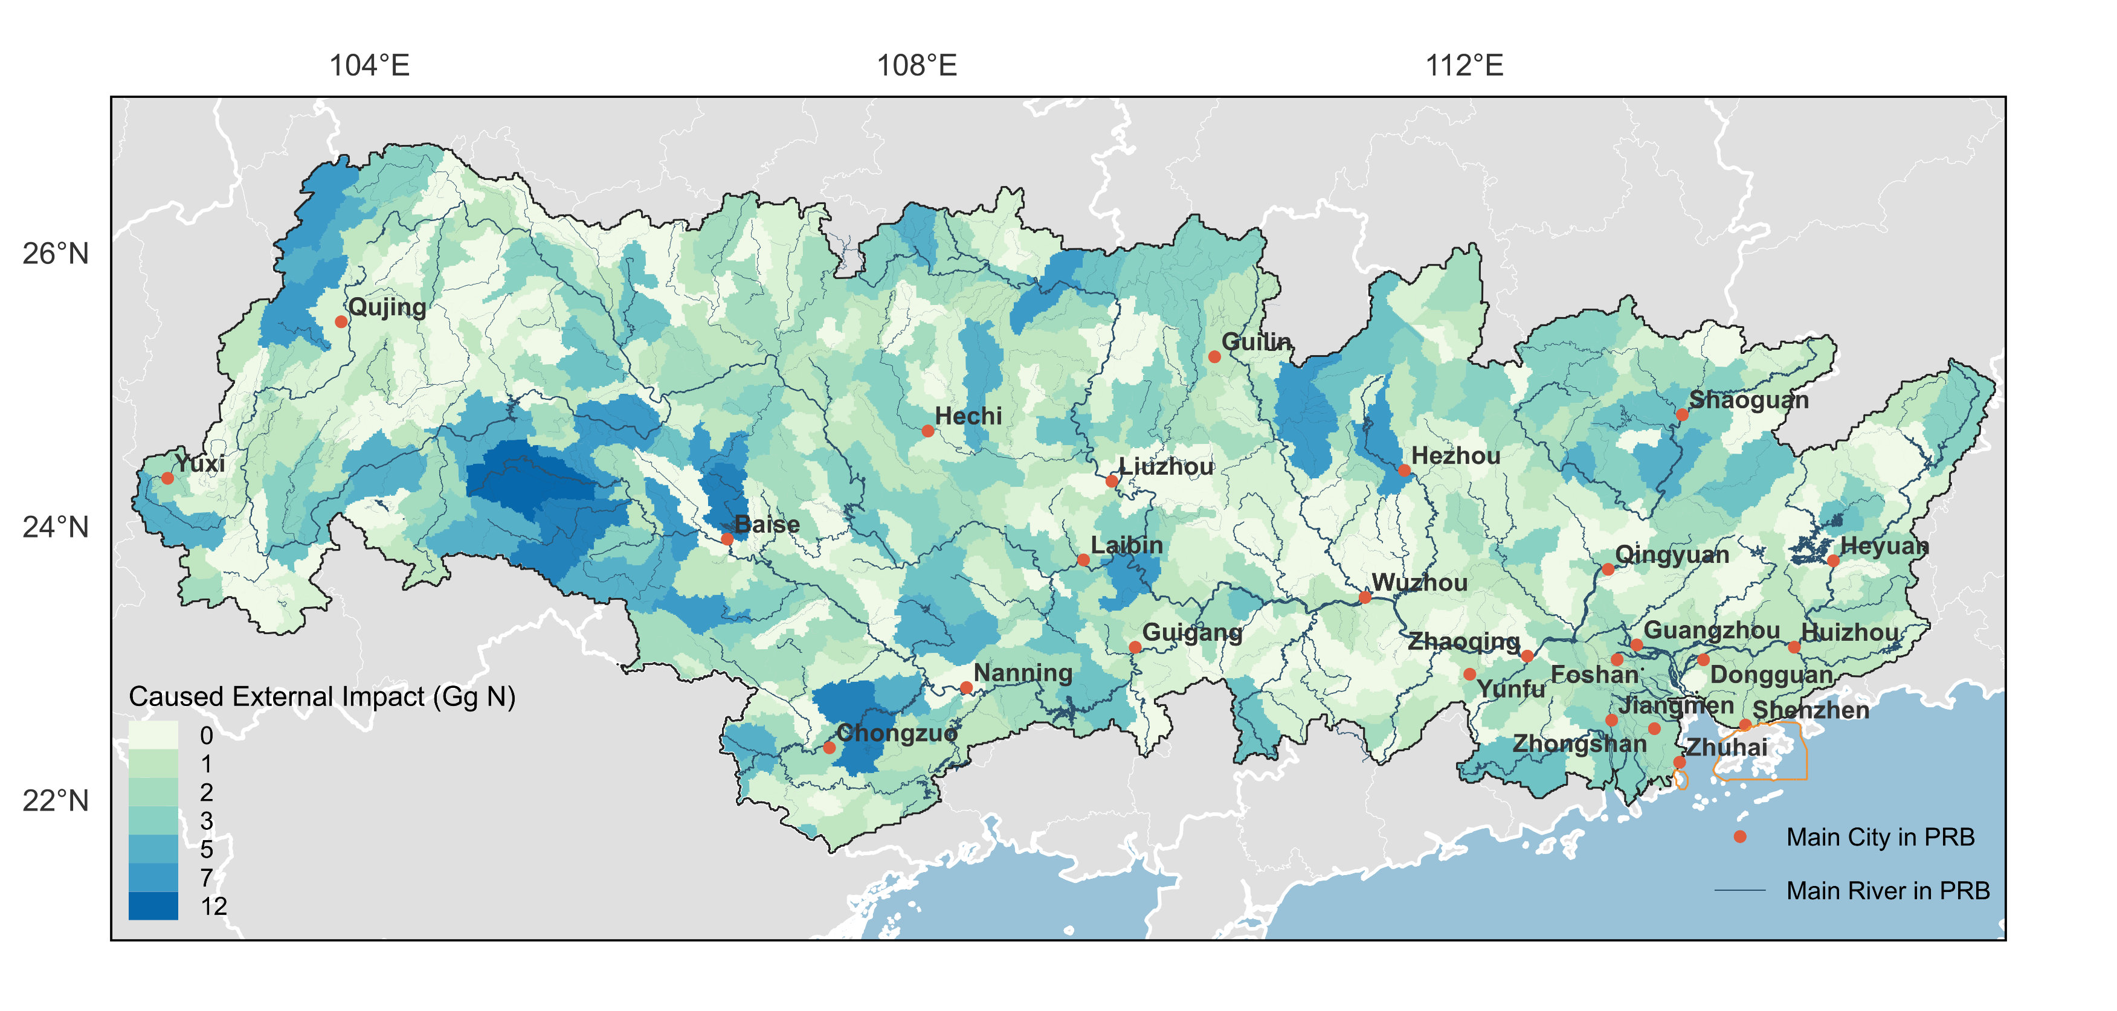
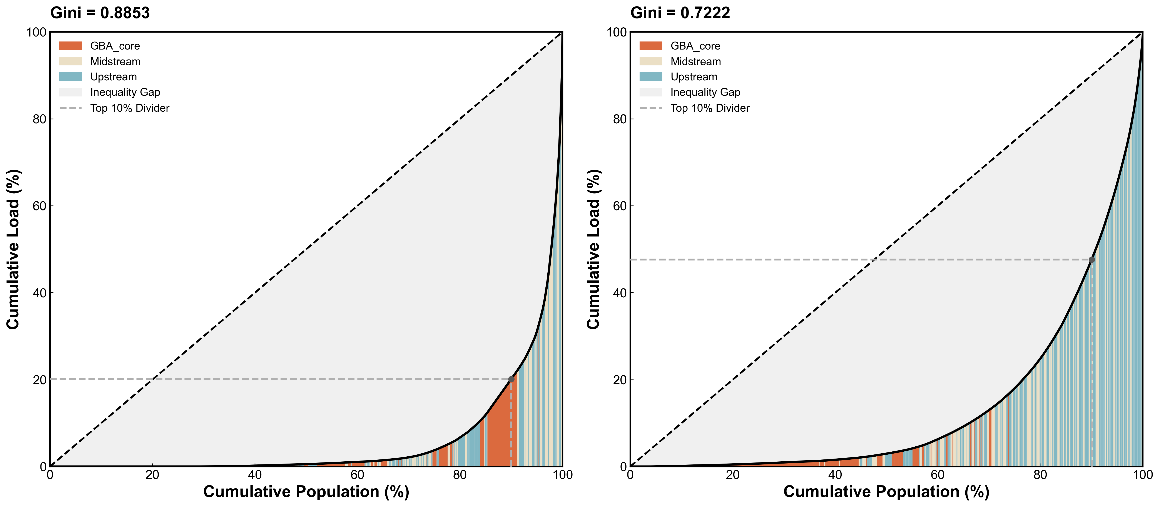
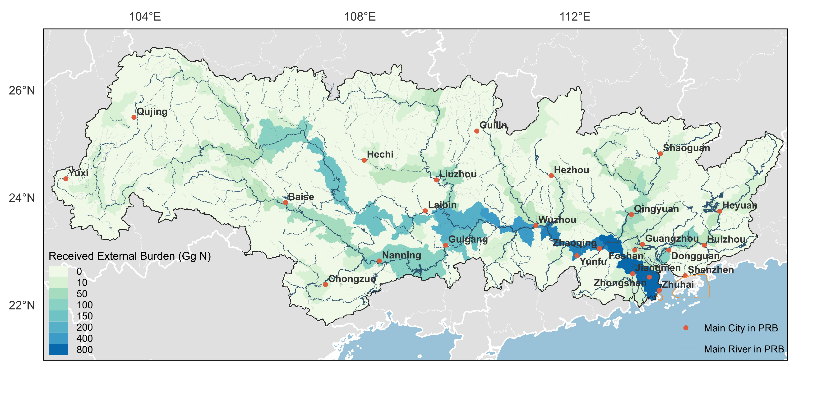
RESULTS
Result 3: river transport amplifies environmental inequality
a.
b.
Take-home message:
Production-based inequality is already high, but hydrological routing concentrates exposure even more strongly in downstream corridors.
Top 10% Pop contributes 52.4% of Total Load
c.
d.
Externally driven discharge
- Externally driven discharge is concentrated in upstream agricultural and industrial hubs such as Baise, Wenshan, and Nanning.
- The top ten subbasins account for over 11% of externally driven discharge while hosting only about 1% of the basin population.
- The Lorenz curve gives a Gini coefficient of 0.72; 10% of the population accounts for 52.37% of externally driven discharge.
Top 10% Pop contributes 79.9% of Total Load
Figure 2. Spatial mismatch between externally discharge responsibility and environmental burden.
a. nitrogen discharges generated within each subbasin specifically to satisfy final demand from non-local cities; b. quantifies the spatial inequality of this responsibility, where subbasins are ranked by per capita discharge intensity (plotting cumulative population % against cumulative load %)
Notes:
The next result focuses on spatial inequality. We first examine externally driven discharge responsibility.
Here, externally driven discharge means nitrogen discharge generated within a subbasin to satisfy final demand from non-local cities. In other words, it captures where production occurs for external demand.
The map shows that externally driven discharge is highly concentrated in upstream agricultural and industrial hubs, such as Baise, Wenshan, and Nanning. The top ten subbasins account for more than 11 percent of externally driven discharge, while hosting only about 1 percent of the basin population.
The Lorenz curve confirms this inequality. The Gini coefficient is 0.72. Around 10 percent of the population accounts for 52.37 percent of externally driven discharge.
So production-based inequality is already strong. A small share of the basin population hosts a large share of nitrogen-intensive production for non-local demand.

Slide 9
RESULTS
Result 3: river transport amplifies environmental inequality
a.
b.
Take-home message:
Production-based inequality is already high, but hydrological routing concentrates exposure even more strongly in downstream corridors.
Top 10% Pop contributes 52.4% of Total Load
c.
d.
Involuntary burden
- After river routing, high burdens form a continuous belt along the West River corridor from Guigang and Wuzhou toward Zhuhai and Foshan.
- The Gini coefficient rises to 0.89 for involuntary burden, higher than the discharge responsibility Gini of 0.72.
- Around 10% of the basin population bears nearly 79.9% of externally driven nitrogen load.
Top 10% Pop contributes 79.9% of Total Load
Figure 2. Spatial mismatch between externally discharge responsibility and environmental burden.
Map (c) tracks the accumulation of nitrogen loads retained within subbasins as a consequence of non-local final demand, representing the involuntary burden imposed on local channels. The Lorenz curve (d) quantifies the spatial inequality of these hydrological consequences
Notes:
However, discharge responsibility is only one side of the story. We also need to ask where the externally driven nitrogen load is finally accumulated. This is the involuntary burden. Map (c) tracks the accumulation of nitrogen loads retained within subbasins as a consequence of non-local final demand, representing the involuntary burden imposed on local channels. The Lorenz curve (d) quantifies the spatial inequality of these hydrological consequences
After river routing, the high-burden areas shift away from some original discharge locations. Instead, they form a continuous belt along the West River corridor, from Guigang and Wuzhou toward Zhuhai and Foshan.
This means that riverine transport does not simply passively move pollution. It reshapes the spatial distribution of environmental burden. The Gini coefficient rises from 0.72 for externally driven discharge to 0.89 for involuntary burden. Around 10 percent of the basin population bears nearly 79.9 percent of externally driven nitrogen load.
The take-home message is that production-based inequality is already high, but hydrological routing concentrates exposure even more strongly in downstream corridors.

Slide 10
RESULTS
Result 4: four city roles reveal who imposes and who receives burden
a.
Take-home message:
The same basin contains polluting engines, involuntary sinks, insulated cities, and consumption beneficiaries.
Type I
Self-inflicted Stressors
Type II
Sacrificial Receivers
High imposed burden + high received burden. Often upstream hubs such as Nanning and Liuzhou; they generate large discharge and retain substantial local load.
Low imposed burden + high received burden. Cities such as Zhaoqing, Wuzhou, and Zhuhai act as involuntary hydrological sinks.
Type III
Insulated Bystanders
Type IV
Exploitative Free Riders
Low imposed burden + low received burden. These cities are marginal in cross-boundary pollution flows.
High imposed burden + low received burden. Includes consumption centers such as Guangzhou and Shenzhen, and some upstream capitals with high consumption but low exposure.
Figure 3a. Classification of city roles and inter-sectoral nitrogen flows.
Notes:
To interpret this inequality at the policy scale, we classify cities into four functional roles.
The classification is based on two indicators. The x-axis shows the net pollution burden a city imposes on external cities. The y-axis shows the net pollution burden a city receives from external sources.
This gives four types of cities.
Self-inflicted Stressors have both high imposed burden and high received burden. They are often upstream production hubs, such as Nanning and Liuzhou. They generate large nitrogen discharge and also retain substantial local load.
Sacrificial Receivers have low imposed burden but high received burden. Cities such as Zhaoqing, Wuzhou, and Zhuhai act as involuntary hydrological sinks.
Insulated Bystanders have low imposed burden and low received burden. These cities are relatively marginal in cross-boundary nitrogen flows.
Exploitative Free Riders have high imposed burden but low received burden. They include consumption centers such as Guangzhou and Shenzhen, and some upstream capitals with high consumption but relatively low exposure.
This typology shows that the same basin contains production engines, involuntary sinks, insulated cities, and consumption beneficiaries.

Slide 11
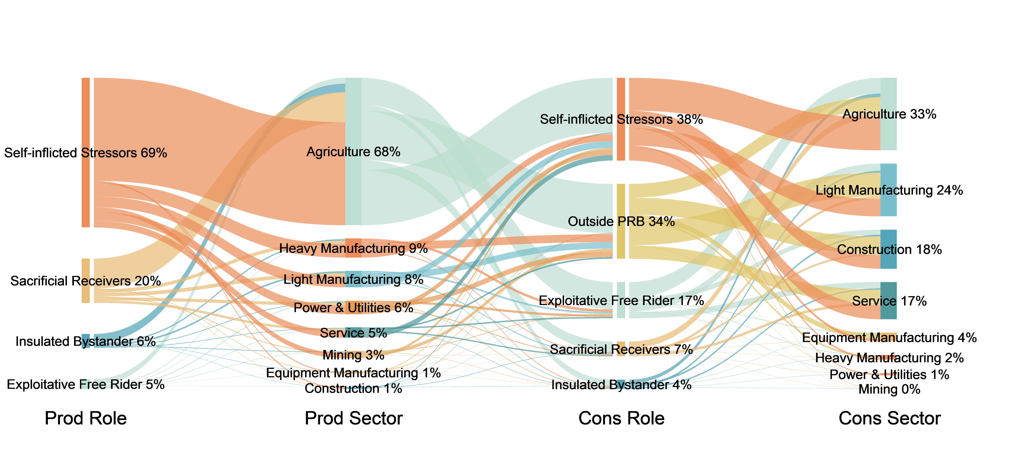
RESULTS
Result 5: inter-sectoral flows explain why the imbalance persists
b.
Take-home message:
The pattern is not only a pollution-haven story; it is sustained by agriculture, local subsistence demand, national supply chains, and river geography.
Figure 3b. Nitrogen flows from production sectors to consumption sectors across the four identified city roles.
Sectors transmitting responsibility
Why upstream hubs remain trapped
- Agriculture remains the largest driver: it dominates physical loads and explains major shares of consumption-driven responsibility.
- Light manufacturing, construction, and services transmit additional responsibility through inter-city and extra-basin supply chains.
- Demand from outside the Pearl River Basin drives nearly 34% of total nitrogen discharge, with construction a major external driver.
- Self-inflicted Stressors generate 69% of total nitrogen discharge destined for PRB and external markets; agriculture alone accounts for 47%.
- These cities also receive 38% of basin-wide nitrogen discharge to satisfy their own final demand, indicating a local agricultural loop.
- High fertilizer intensity, exceeding 10 tonnes per million CNY of GDP in cities such as Laibin, Nanning, and Liuzhou, signals structural inefficiency.
Notes:
The city‘s type tells us who plays different roles. The sectoral flow analysis tells us how responsibility is transmitted across the basin.
Agriculture remains the largest driver. It dominates physical nitrogen loads and explains major shares of consumption-driven responsibility. But responsibility is not transmitted only through agriculture.
Light manufacturing, construction, and services also transmit nitrogen responsibility through inter-city and extra-basin supply chains. Demand from outside the Pearl River Basin drives nearly 34 percent of the total nitrogen discharge, with construction as a major external driver.
This means that nitrogen responsibility is embedded not only in local production, but also in the wider economic system. Final demand for food, manufactured goods, construction, and services can all induce nitrogen discharge somewhere else in the basin.
The sectoral results also explain why some upstream cities remain trapped in a high-pollution position.
Self-inflicted Stressors generate 69 percent of total nitrogen discharge destined for both PRB and external markets. Agriculture alone accounts for 47 percent. These cities are therefore not just passive pollution havens for external demand. They also function as the internal production engine of the basin.
At the same time, these cities receive 38 percent of basin-wide nitrogen discharge to satisfy their own final demand. This suggests a local agricultural loop, where production, consumption, and pollution remain strongly concentrated within the same regional system.
In cities such as Laibin, Nanning, and Liuzhou, nitrogen fertilizer intensity exceeds 10 tonnes per million CNY of GDP. This indicates structural inefficiency: high nitrogen input supports relatively low economic output.
The take-home message is that the pattern is not only a pollution-haven story. It is sustained by agriculture, local demand, national supply chains, and river geography together.

Slide 12
GOVERNANCE
Governance should move from territorial blame to beneficiary responsibility
A fair compensation system must reflect who benefits, who generates, and who involuntarily receives the load.
Why polluter-pays is insufficient
Differentiated instruments
- Source-based regulation targets local discharge points, but it misses the final demand that induces production.
- Upstream regions may lack incentives and resources to internalize costs created by downstream and national consumption.
- Ecological compensation should be mandatory, long-term, and tied to quantified outsourced nitrogen externalities.
- Exploitative Free Riders: pay through monetary compensation, technology transfer, industrial restructuring, and tradable nitrogen credits.
- Self-inflicted Stressors: receive support for agricultural upgrading, nitrogen intensity decoupling, and resource efficiency.
- Sacrificial Receivers: prioritize ecosystem restoration, exposure reduction, and public health risk mitigation.
Notes:
These results imply that governance should move from territorial blame to beneficiary responsibility.
Source-based regulation targets local discharge points. This is necessary, but it misses the final demand that induces production. If upstream regions are asked to reduce nitrogen alone, they may lack both the incentive and the resources to internalize costs created by downstream and national consumption.
A fair compensation system must therefore reflect three questions: who benefits, who generates, and who involuntarily receives the load.
For Exploitative Free Riders, responsibility should include monetary compensation, technology transfer, industrial restructuring, and potentially tradable nitrogen credits.
For Self-inflicted Stressors, support should focus on agricultural upgrading, nitrogen intensity decoupling, and resource efficiency improvement.
For Sacrificial Receivers, compensation should prioritize ecosystem restoration, exposure reduction, and public health risk mitigation.
Overall, ecological compensation should be mandatory, long-term, and tied to quantified outsourced nitrogen externalities.

Slide 13
CONCLUSION
Five takeaways
Fair nitrogen governance requires accounting for both the supply chain and the river network.
Two chains, two questions: Nitrogen-chain attribution shows how nitrogen is transported and redistributed through the river network, while supply-chain attribution shows which final demand induces its generation.
Coupling reshapes responsibility: At the deltaic outlets, the upstream responsibility share decreases from 68% under nitrogen chain-based attribution to 38% under supply chain-based attribution.
Downstream demand emerges: The GBA Core Cities’ responsibility rises to about 15%, and final demand outside the PRB accounts for 34% of the outlet nitrogen load under supply chain-based attribution.
River transport amplifies inequality: the Gini rises from 0.72 for externally driven discharge responsibility to 0.89 for involuntary burden.
City roles matter: Free Riders, Stressors, Receivers, and Bystanders require different compensation and mitigation instruments.
Notes:
Let me close with five takeaways.
First, nitrogen chain-based attribution and supply chain-based attribution answer different but complementary questions. Nitrogen chain-based attribution shows how nitrogen is transported and redistributed through the river network, while supply chain-based attribution shows which final demand induces its generation.
Second, coupling the two perspectives substantially changes the responsibility profile. At the deltaic outlets, the upstream responsibility share decreases from 68% under nitrogen chain-based attribution to 38% under supply chain-based attribution.
Third, downstream and extra-basin demand becomes visible under supply chain-based attribution. The GBA Core’s responsibility rises to about 15%, and final demand outside the PRB accounts for 34% of the outlet nitrogen load.
Fourth, hydrological routing amplifies spatial inequality in responsibility. The Gini coefficient increases from 0.72 for discharge responsibility to 0.89 for involuntary riverine burden.
Finally, cities play different functional roles along the nitrogen pathway, so governance should be differentiated rather than uniform. The broader message is that fair nitrogen governance requires accounting for both supply chain-based drivers and nitrogen chain-based transport.

Slide 14

Thank You
TO SEE, TO PRESERVE
Follow our WeChat Official Account
Blue Economy insights, stories and research updates
We warmly welcome your follow and exchange.
Notes:
Thank you very much for your attention.
We also have a WeChat official account focusing on Blue Economy, where we share ocean-related research updates, stories and insights on sustainable coastal and marine development.
If you are interested, please feel free to scan the QR code and follow us.
Thank you again, and I look forward to your questions and suggestions.

