Slide 1
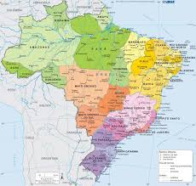
The Persistence of Regional Inequality in Brazil: An Interregional Input–Output Approach
Autores: Lúcio Barbosa, André Carrascal-Incera, Geoffrey Hewings, Carla Souza

Slide 2
Populism, secessionism and territorial tensions...
In the last few decades, populism, secessionism and territorial tensions seems to be increasing around the world, partially rooted in persistent spatial income balances.
The causes are rooted in:
Globalization, new technologies and modernal production process (McCann, 2016; Blanchard and Rodrik, 2021); stronger centripetal effects that favor the urban and richer regions (Rodriguez-Pose, 2018); development traps (Diemer et al.,2022).
Spatial asymmetries in the spillovers of household earnings and expenditures across different regions (Carrascal-Incera and Hewings, 2022, 2026).

Slide 3
Brazil: a Large and Unequal country
Brazil is one of the largest countries in the world
Its states are comparable in size to some European countries (Minas Gerais, for example is similar in size to Spain).
Brazil is also an extremely unequal middle-income country
Ranked as 8th most unequal country in 2024 (top 10% richer has near 60% of the national income).
Higher level of spatial inequality in Latin America (Lessman and Seidel, 2017; Ramos et al, 2018).

Slide 4
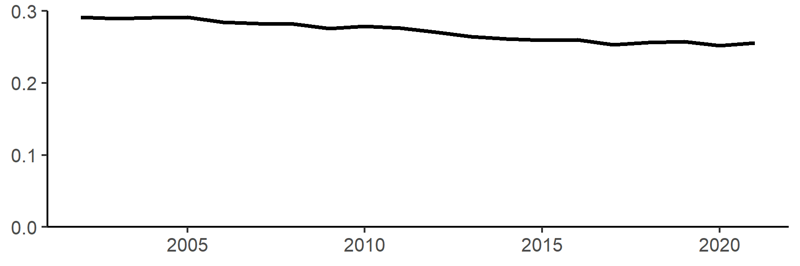
Inequality is persistent over time
Figure 2 – Interstate inequality in Brazil: states and the Federal District – Gini index
Source: Own elaboration based on IBGE.

Slide 5
Research question
Are asymmetric interregional spillovers a mechanism behind the persistence of regional inequality in Brazil?

Slide 6
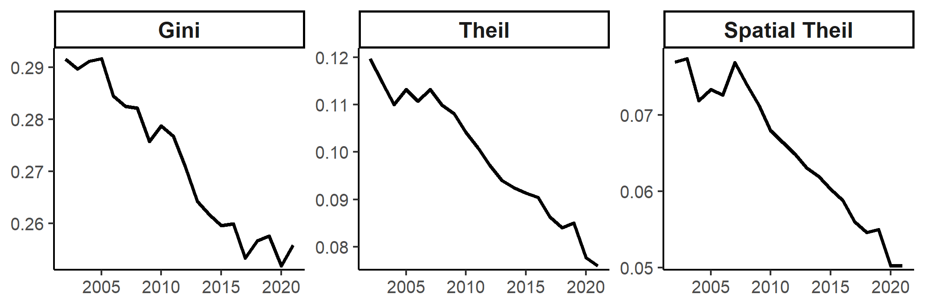
Interregional inequality in Brazil
Figure 2 – Interstate inequality across Brazilian states and the Federal District (2002–2021)
Source: Own elaboration based on IBGE data and OECD (PPP for GDP).

Slide 7
Literature – Declining inequality (evidences)
Consistency with Williamson’s (1965) Proposition: Inequality rose during the 1920–1970 economic boom, followed by a significant decline (Magalhães and Alves, 2021).
Periods of high (low) economic growth are associated with a slower (faster) speed of convergence (Azzoni and Castro, 2025).
Inequality decreased from 1995 to 2005 due to: labor productivity convergence, decrease of inflation, real growth of minimum wage and income transferences(Silveira Neto and Azzoni, 2011) .
Domestic trade reinforced structural disparities by redirecting growth benefits away from less developed regions (Araújo and Haddad, 2025).
Club Convergence: Evidence of a dual-club convergence pattern: Center-South versus North-Northeast (Manzini et al, 2023).

Slide 8
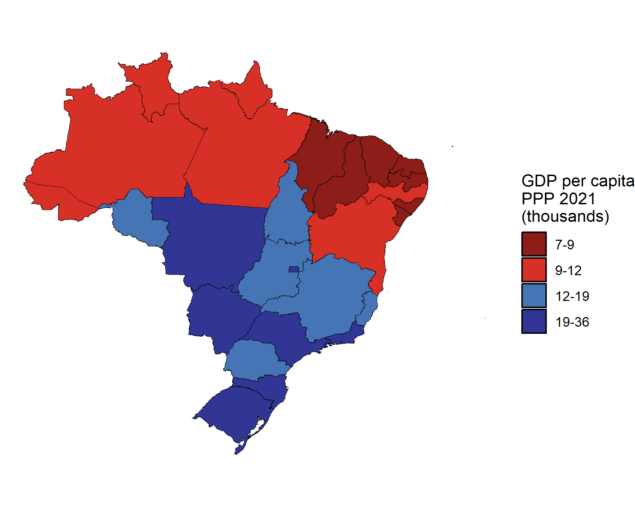
Regional inequality in Brazil
Figure 1 – GDP per capita in Brazil: states and the Federal District – PPP 2021 (thousands)
Source: Own elaboration based on IBGE data and OECD (PPP for GDP).

Slide 9
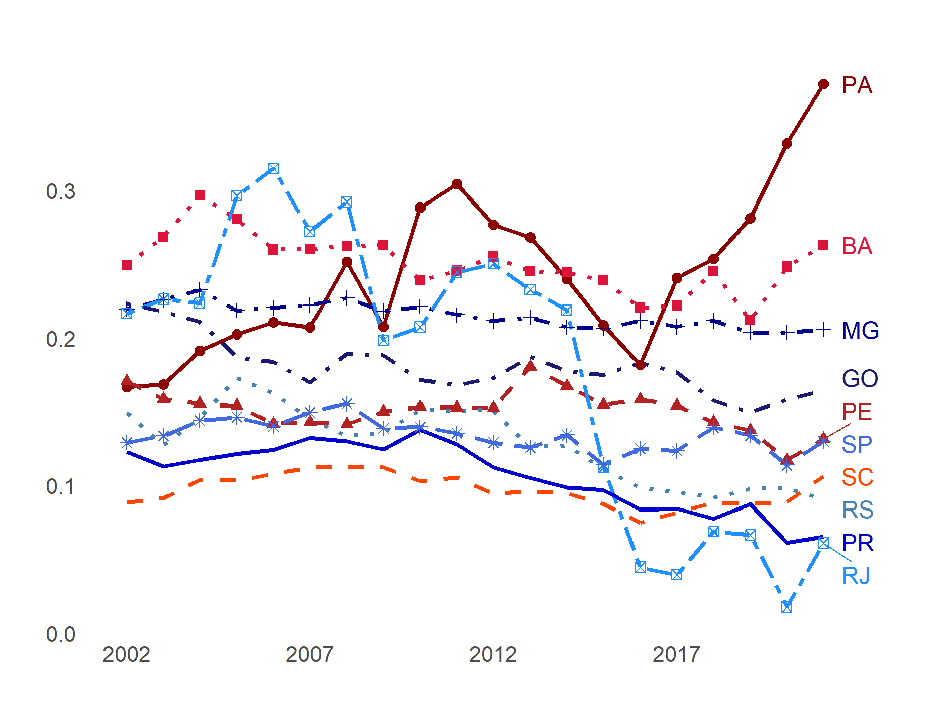
Interregional inequality within Brazilian states
Figure 3 – Evolution of the Gini index across Intermediate Geographic Regions within the 10 largest Brazilian states, 2002–2021
Source: Own elaboration based on IBGE data and OECD (PPP for GDP).

Slide 10
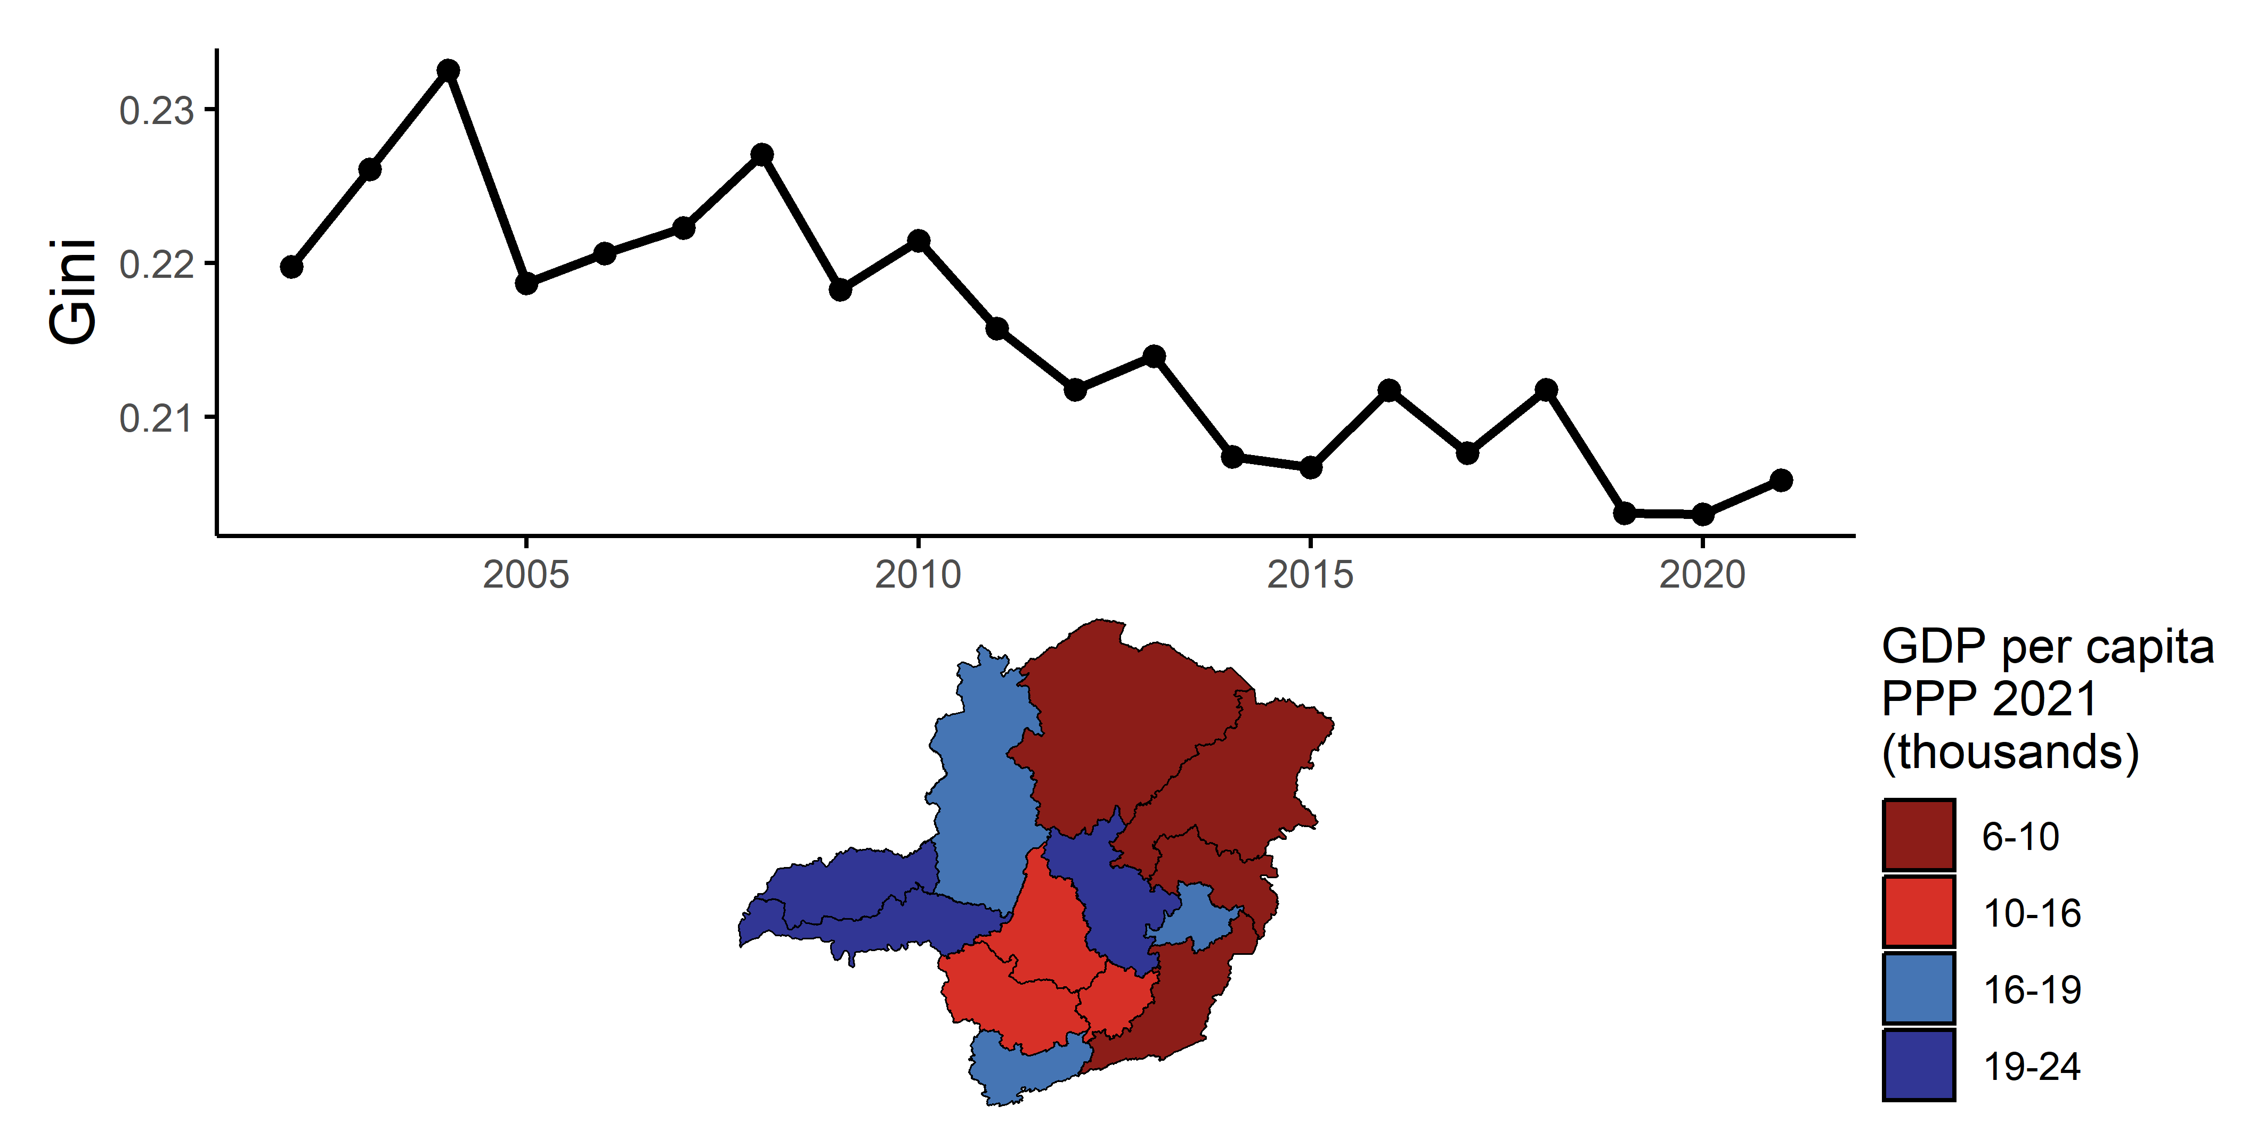
Interregional inequality in Minas Gerais
Figure 4 – Interregional inequality in Minas Gerais – 2002-2021
Source: Own elaboration based on IBGE data and OECD (PPP for GDP).

Slide 11

Methodology
Extended input-output models (type II multiplier models).
Expanded IO system in matrix form:
x: gross output vector
y: total income vector per household group
f*: final demand vector excluding endogenized household categories
g: vector of exogenous income for income groups (if any)
A: matrix of technical coefficients (productive sectors × productive sectors)
V: factor income coefficient matrix (households × productive sectors)
C: consumption shares matrix (productive sectors × households)
$$\left[\begin{matrix}x \\ y\end{matrix}\right]= \left[\begin{matrix}A & C \\ V & 0\end{matrix}\right]\left[\begin{matrix}x \\ y\end{matrix}\right]+\left[\begin{matrix}f^{∗} \\ g\end{matrix}\right]$$

Slide 12
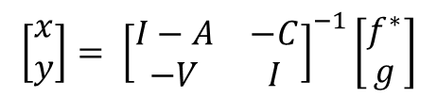
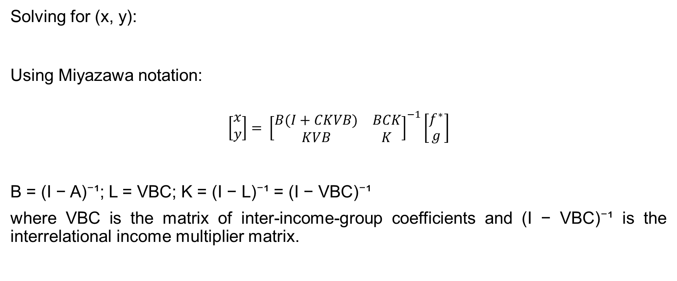
Methodology
Solving for (x, y):
Using Miyazawa notation:
$$\left[\begin{matrix}x \\ y\end{matrix}\right]= {\left[\begin{matrix}B(I+CKVB) & BCK \\ KVB & K\end{matrix}\right]}^{−1}\left[\begin{matrix}f^{∗} \\ g\end{matrix}\right]$$
B = (I − A)⁻¹; L = VBC; K = (I − L)⁻¹ = (I − VBC)⁻¹
where VBC is the matrix of inter-income-group coefficients and (I − VBC)⁻¹ is the interrelational income multiplier matrix.
$$\left[\begin{matrix}x \\ y\end{matrix}\right]= {\left[\begin{matrix}I−A & −C \\ −V & I\end{matrix}\right]}^{−1}\left[\begin{matrix}f^{∗} \\ g\end{matrix}\right]$$

Slide 13

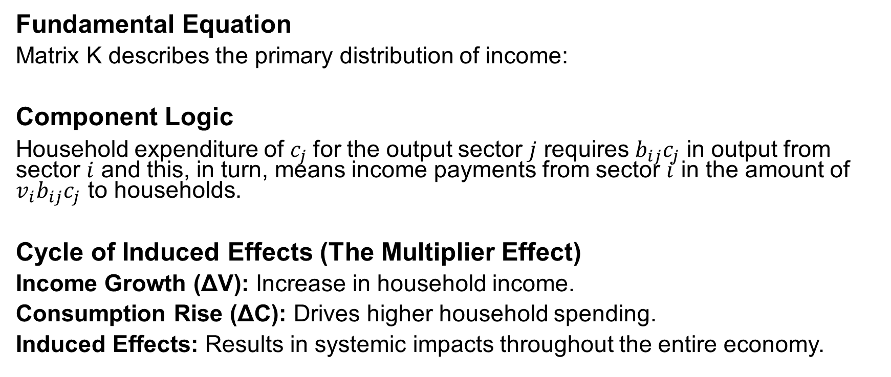
Methodology
Fundamental Equation
Matrix K describes the primary distribution of income:
Component Logic
Household expenditure of $c_{j}$for the output sector $j$ requires $b_{ij}c_{j}$ in output from sector $i$ and this, in turn, means income payments from sector $i$ in the amount of ${v_{i}b}_{ij}c_{j}$ to households.
Cycle of Induced Effects (The Multiplier Effect)
Income Growth (ΔV): Increase in household income.
Consumption Rise (ΔC): Drives higher household spending.
Induced Effects: Results in systemic impacts throughout the entire economy.
$$K={\left(I−L\right)}^{−1}=(I−VBC)^{−1}$$

Slide 14
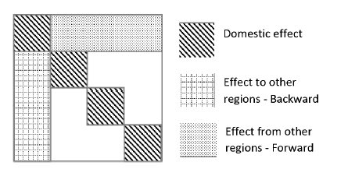
Methodology
Figure 5: Composition of the K matrix and the different effects analyzed
Source: Carrascal-Incera and Hewings (2026)

Slide 15
Methodology (assumptions)
The model considers only employent revenues.
The model considers only the primary distribution of income (no redistribution is considered).
The analysis is applied to one period, thus no savings are considered.
Household consume and receive their wages in the same region.

Slide 16
Database
Interregional Input-Output Table for Brasil, 2011
Haddad, E. A., Gonçalves Jr, C.A., Nascimento, T. B. (2017). Matriz Interestadual de Insumo-Produto para o Brasil: Uma Aplicação do Método IIOAS. Revista Brasileira de Estudos Regionais e Urbanos (RBERU), v. 11, n. 4, pp. 424-446.
Interregional Input-Output Table for Brasil, 2019
Haddad, E. A.; Araújo, I. A.; Rocha, A. A.; Vale, V. A. (2025). Matriz Interestadual de Insumo-Produto para o Brasil, 2019. Revista Brasileira de Estudos Regionais e Urbanos, v 19, n. 4, p. 607-638, 2025. DOI: 10.54766/rberu.v19i4.1225.
Interregional Input-Output Table for Minas Gerais, 2019
Fundação João Pinheiro. Estatística e Informações: Matriz Insumo-Produto Inter-regional de Minas Gerais – 2019 – n° 65, 2025

Slide 17
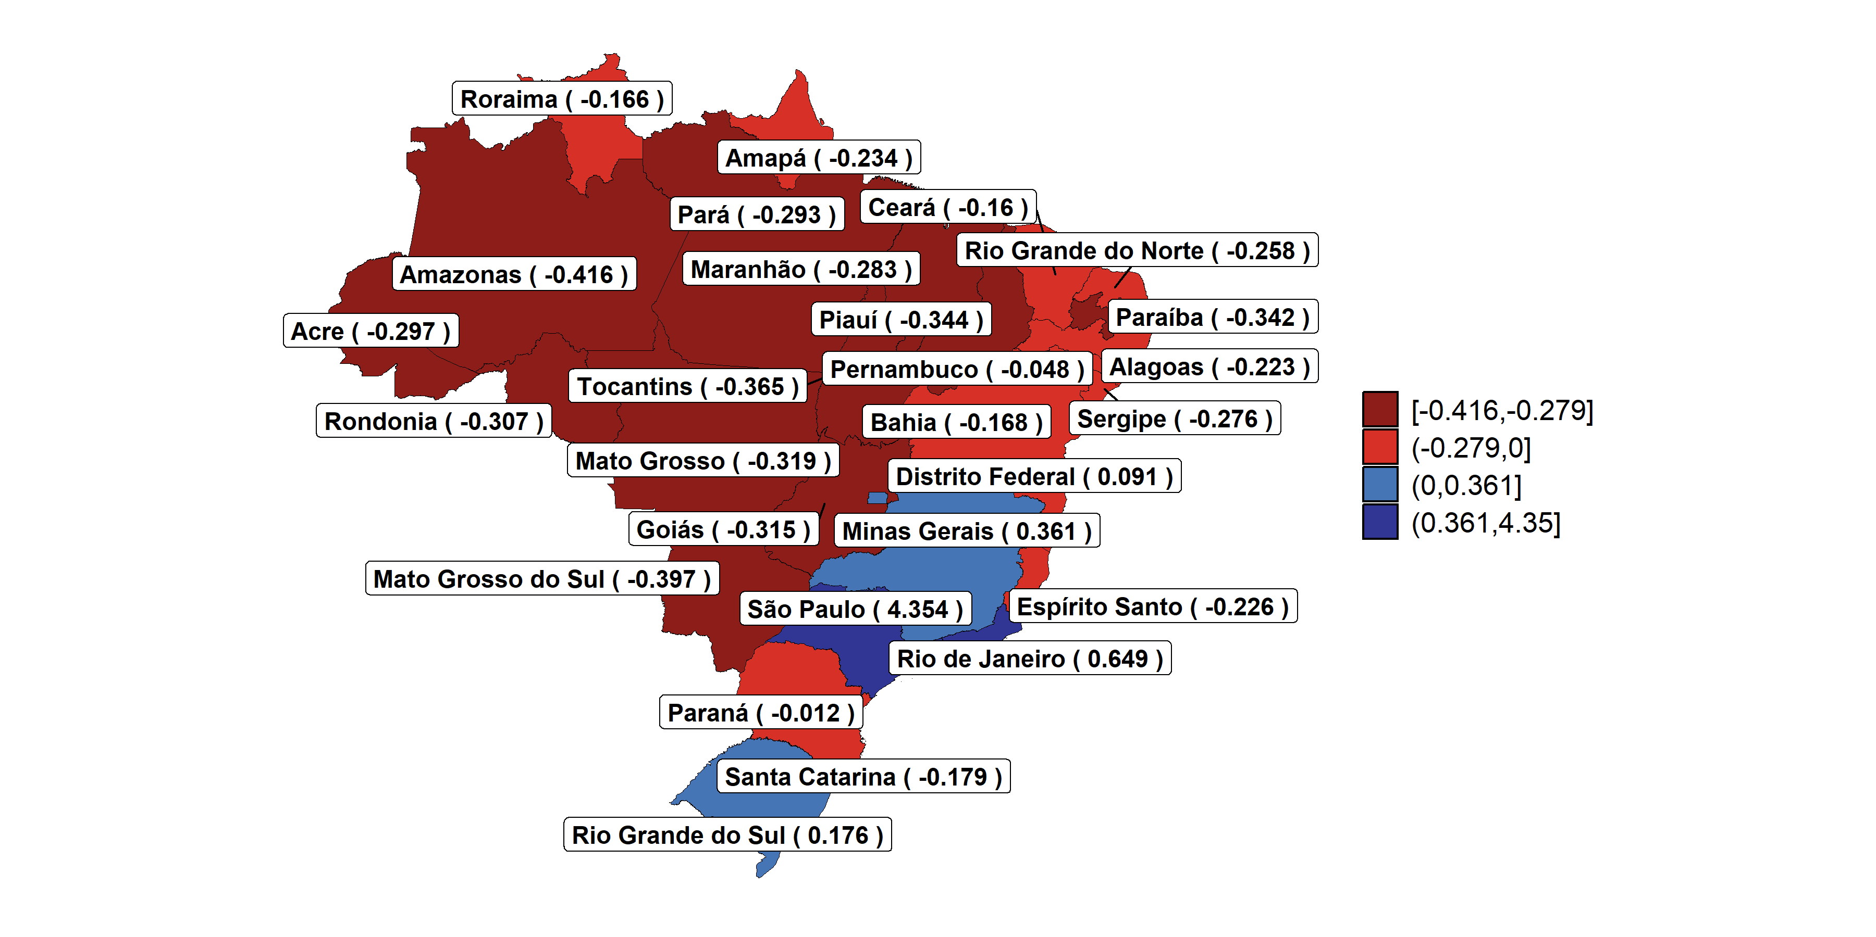
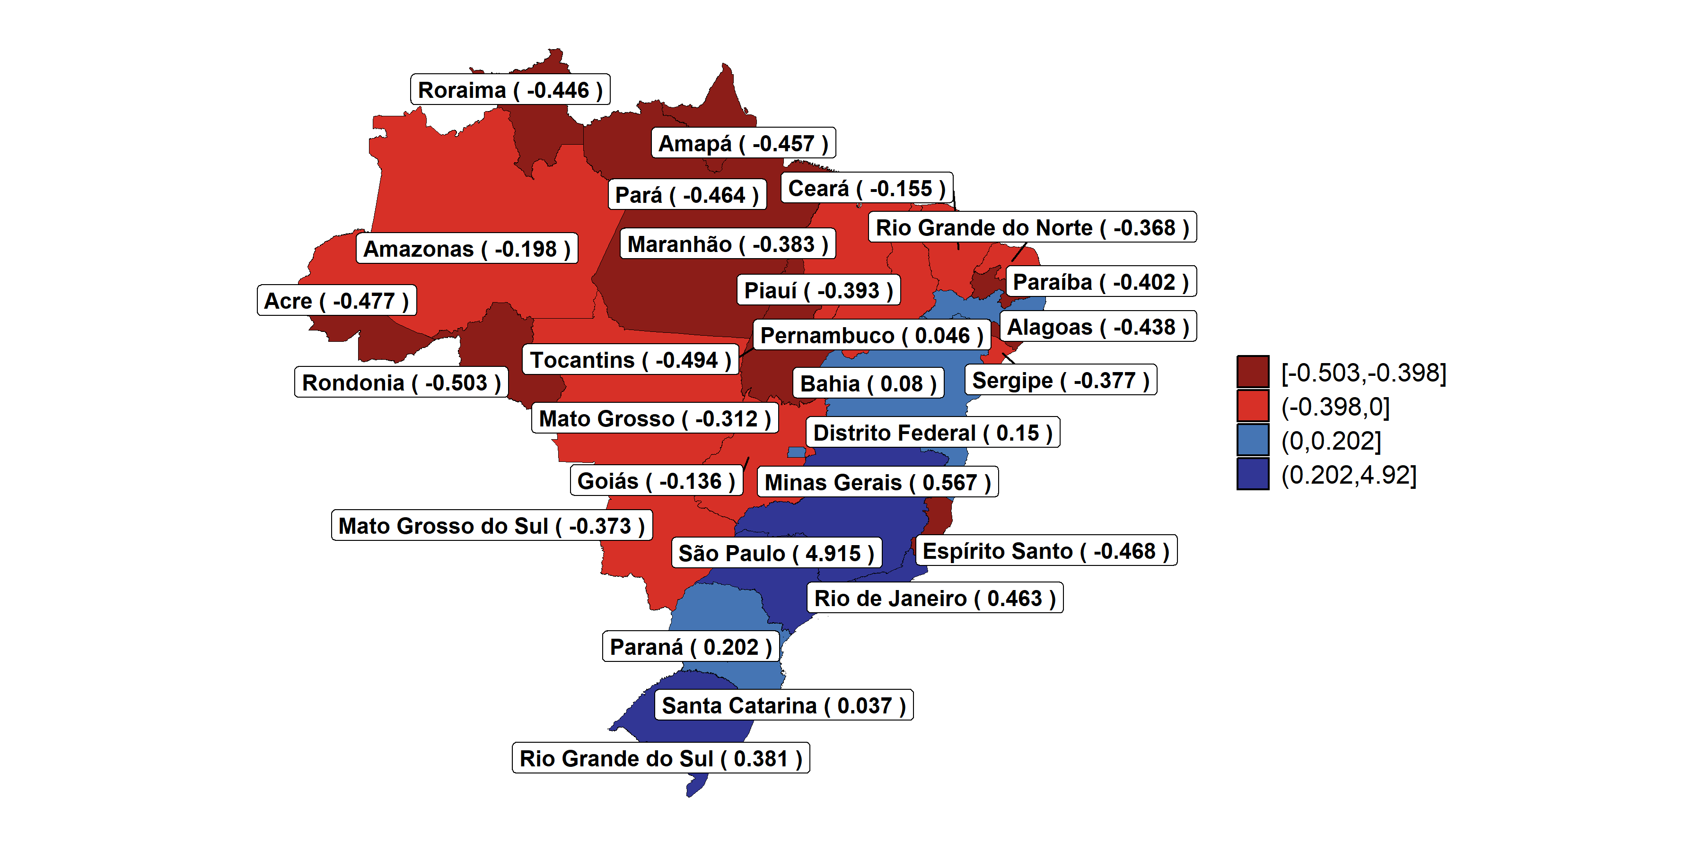
Net income effects across regions (Brazil)
Figure 6: Net effect (balance) in the structure of income formation and distribution in Brazil.
2011
2019
Source: Own elaboration.

Slide 18
Table 1a - Main Results of the Interrelational Income Multipliers (K matrix) – Brazil - 2011
State | Forward effects | Forward effects (excluded within) | Backward effects | Backward effects (excluded within) | Balance | GDP per capita (PPP thousands) | Pop. Dens (people per Km2)
SP | 6.105 | 4.623 | 1.751 | 0.269 | 4.354 | 23.449 | 167.112
RJ | 2.206 | 0.943 | 1.557 | 0.294 | 0.649 | 21.602 | 367.333
MG | 2.101 | 0.794 | 1.740 | 0.433 | 0.361 | 13.767 | 33.532
RS | 2.037 | 0.651 | 1.861 | 0.475 | 0.176 | 16.763 | 38.055
DF | 1.345 | 0.246 | 1.254 | 0.155 | 0.091 | 40.199 | 451.418
PR | 1.899 | 0.568 | 1.912 | 0.580 | -0.012 | 16.602 | 52.633
PE | 1.577 | 0.297 | 1.625 | 0.346 | -0.048 | 8.435 | 90.015
CE | 1.554 | 0.242 | 1.714 | 0.402 | -0.160 | 7.138 | 57.039
RR | 1.105 | 0.009 | 1.272 | 0.176 | -0.166 | 10.774 | 2.048
BA | 1.659 | 0.330 | 1.828 | 0.498 | -0.168 | 8.022 | 24.866
SC | 1.699 | 0.397 | 1.878 | 0.576 | -0.179 | 18.704 | 65.875
AL | 1.271 | 0.077 | 1.494 | 0.301 | -0.223 | 6.836 | 112.419
ES | 1.328 | 0.138 | 1.554 | 0.364 | -0.226 | 20.280 | 76.752
AP | 1.140 | 0.010 | 1.374 | 0.244 | -0.234 | 9.333 | 4.782
RN | 1.325 | 0.090 | 1.584 | 0.348 | -0.258 | 8.699 | 60.300
SE | 1.276 | 0.063 | 1.551 | 0.339 | -0.276 | 9.455 | 94.922
MA | 1.272 | 0.090 | 1.556 | 0.373 | -0.283 | 5.326 | 20.073
PA | 1.300 | 0.105 | 1.593 | 0.399 | -0.293 | 8.715 | 6.144
AC | 1.177 | 0.016 | 1.474 | 0.314 | -0.297 | 8.139 | 4.530
RO | 1.235 | 0.061 | 1.542 | 0.368 | -0.307 | 11.873 | 6.604
GO | 1.583 | 0.277 | 1.898 | 0.592 | -0.315 | 13.540 | 17.812
MT | 1.394 | 0.164 | 1.713 | 0.483 | -0.319 | 15.261 | 3.393
PB | 1.298 | 0.091 | 1.640 | 0.433 | -0.342 | 6.644 | 66.853
PI | 1.244 | 0.043 | 1.588 | 0.387 | -0.344 | 5.607 | 12.421
TO | 1.207 | 0.033 | 1.572 | 0.398 | -0.365 | 8.889 | 5.029
MS | 1.341 | 0.112 | 1.738 | 0.509 | -0.397 | 15.105 | 6.917
AM | 1.339 | 0.175 | 1.755 | 0.591 | -0.416 | 13.569 | 2.259
Source: Own elaboration.

Slide 19
Table 1a - Main Results of the Interrelational Income Multipliers (K matrix) – Brazil - 2011
Income categories (2011) | Balance (mean) | Pop. density categories (2011) | Balance (mean)
Richer states | 1.217 | High-density states | 1.218
Intermediate | -0.157 | Intermediate | -0.118
Poorer states | -0.253 | Low-density states | -0.314
Source: Own elaboration.
Note: Richer states: GDP per capita > 20 thousands US$ PPP; intermediate: GDP per capita between 10 thousands US$ PPP and 20 thousands US$ PPP; Poorer states: GDP per capita < 10 thousands US$ PPP.
High-density states: Population density > 100 people per km2; intermediate: population density between 20 people per km2 and 100 people per km2; low-density states: population density < 20 people per km2.

Slide 20
Table 1b - Main Results of the Interrelational Income Multipliers (K matrix) – Brazil - 2019
State |  | Forward effects | Forward effects (excluded within) | Backward effects | Backward effects (excluded within) |  | Balance | GDP per capita (PPP thousands) |  | Pop. Dens (people per Km2)
SP | 6,711 |  | 5,176 | 1,796 | 0,261 | 4,915 |  |  | 22,438 | 184,519
MG | 2,405 |  | 1,020 | 1,837 | 0,453 | 0,567 |  |  | 13,511 | 35,979
RJ | 2,242 |  | 0,880 | 1,779 | 0,418 | 0,463 |  |  | 19,820 | 393,602
RS | 2,190 |  | 0,796 | 1,810 | 0,416 | 0,381 |  |  | 18,606 | 40,340
PR | 2,053 |  | 0,717 | 1,851 | 0,515 | 0,202 |  |  | 17,896 | 57,247
DF | 1,539 |  | 0,384 | 1,389 | 0,234 | 0,150 |  |  | 39,813 | 521,513
BA | 1,844 |  | 0,495 | 1,764 | 0,415 | 0,080 |  |  | 8,650 | 26,234
PE | 1,796 |  | 0,487 | 1,750 | 0,441 | 0,046 |  |  | 9,083 | 97,043
SC | 1,823 |  | 0,507 | 1,786 | 0,470 | 0,037 |  |  | 19,796 | 74,715
GO | 1,741 |  | 0,403 | 1,876 | 0,539 | -0,136 |  |  | 13,045 | 20,559
CE | 1,700 |  | 0,325 | 1,855 | 0,480 | -0,155 |  |  | 7,859 | 61,063
AM | 1,376 |  | 0,185 | 1,574 | 0,383 | -0,198 |  |  | 11,452 | 2,647
MT | 1,444 |  | 0,219 | 1,756 | 0,530 | -0,312 |  |  | 17,895 | 3,843
RN | 1,400 |  | 0,091 | 1,768 | 0,458 | -0,368 |  |  | 8,925 | 66,110
MS | 1,398 |  | 0,162 | 1,771 | 0,535 | -0,373 |  |  | 16,884 | 7,759
SE | 1,380 |  | 0,089 | 1,758 | 0,466 | -0,377 |  |  | 8,530 | 104,409
MA | 1,325 |  | 0,103 | 1,708 | 0,486 | -0,383 |  |  | 6,036 | 21,370
PI | 1,280 |  | 0,052 | 1,672 | 0,445 | -0,393 |  |  | 7,075 | 12,946
PB | 1,369 |  | 0,115 | 1,771 | 0,517 | -0,402 |  |  | 7,424 | 70,853
AL | 1,391 |  | 0,099 | 1,829 | 0,536 | -0,438 |  |  | 7,752 | 119,357
RR | 1,170 |  | 0,009 | 1,615 | 0,455 | -0,446 |  |  | 10,352 | 2,697
AP | 1,193 |  | 0,005 | 1,650 | 0,462 | -0,457 |  |  | 9,077 | 5,910
PA | 1,365 |  | 0,114 | 1,830 | 0,578 | -0,464 |  |  | 9,097 | 6,875
ES | 1,462 |  | 0,145 | 1,930 | 0,613 | -0,468 |  |  | 14,995 | 86,957
AC | 1,251 |  | 0,016 | 1,727 | 0,493 | -0,477 |  |  | 7,776 | 5,353
TO | 1,236 |  | 0,039 | 1,730 | 0,533 | -0,494 |  |  | 10,978 | 5,646
RO | 1,332 |  | 0,096 | 1,835 | 0,599 | -0,503 |  |  | 11,626 | 7,445
Source: Own elaboration.

Slide 21
Table 1b - Main Results of the Interrelational Income Multipliers (K matrix) – Brazil – 2019
Income categories (2019) | Balance (mean) | Pop. density categories (2019) | Balance (mean)
Richer states | 2,532 | High-density states | 0,943
Intermediate states | -0,098 | Intermediate states | -0,050
Poorer states | -0,316 | Low-density states | -0,411
Source: Own elaboration.
Note: Richer states: GDP per capita > 20 thousands US$ PPP; intermediate: GDP per capita between 10 thousands US$ PPP and 20 thousands US$ PPP; Poorer states: GDP per capita < 10 thousands US$ PPP.
High-density states: Population density > 100 people per km2; intermediate: population density between 20 people per km2 and 100 people per km2; low-density states: population density < 20 people per km2.

Slide 22
Main patterns – Brazil
Spill-overs: the backward effects vary between 1.254 (0.155) and 1.930 (0.592).
Spill-ins: the forward effects range from 1.105 (0.005) when excluding within effects to 6.711 (4.623).
The income generating effect capacity of one Real spent by any household in Brazil is more similar than the spatial distribution of that impact.
São Paulo (SP) exhibits the largest positive balance in both years, reaching 4.354 in 2011 and 4.915 in 2019.
The lowest balances were recorded in states in the North and Midwest of Brazil.

Slide 23
Main patterns – Brazil
Richer and more densely populated states tend to benefit more from interregional linkages.
However, the Midwest of Brazil recorded negative balances in both years, despite its relative wealth.
The labor share of the value added is lower.
In 2019, Bahia and Pernambuco, both located in the Northeast of Brazil, reached positive balances.
In the 2014-2016 economic crisis, on average, more industrialized states entered before and stayed more in a state of recession (Colombo and Lazzari, 2021; Azzoni e Castro, 2025).
Income transfers acts as a buffer against economic cycles in the Northeast.
Bahia and Pernambuco are more economically dynamic than other states in the region.
The region is specialized in agriculture and farming.

Slide 24
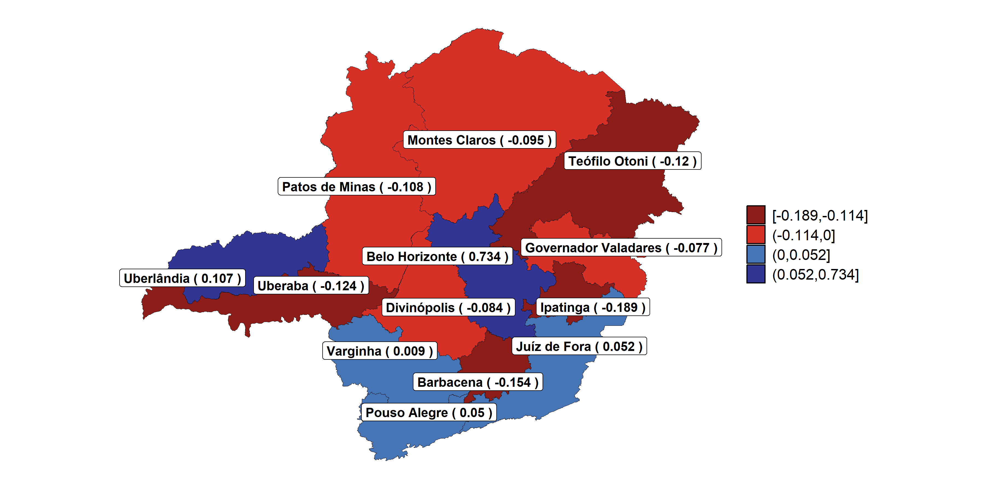
Net income effects across regions (Minas Gerais)
Figure 7: Net effect (balance) in the structure of income formation and distribution in Minas Gerais.
Source: Own elaboration.

Slide 25
Table 2 - Main Results of the Interrelational Income Multipliers (K matrix) – Minas Gerais - 2019
RGInt | Forward effects | Forward effects (excluded within) | Backward effects | Backward effects (excluded within) | Balance | GDP per capita (PPP thousands) | Pop. Dens (people per Km2)
Belo Horizonte | 2,176 | 0,833 | 1,443 | 0,100 | 0,734 | 16,738 | 153,532
Uberlândia | 1,550 | 0,240 | 1,443 | 0,133 | 0,107 | 20,634 | 32,927
Juíz de Fora | 1,446 | 0,165 | 1,394 | 0,113 | 0,052 | 9,854 | 60,092
Pouso Alegre | 1,436 | 0,180 | 1,386 | 0,130 | 0,050 | 16,700 | 62,448
Varginha | 1,417 | 0,130 | 1,408 | 0,121 | 0,009 | 11,301 | 44,446
Governador Valadares | 1,313 | 0,039 | 1,390 | 0,116 | -0,077 | 7,441 | 29,604
Divinópolis | 1,342 | 0,100 | 1,426 | 0,184 | -0,084 | 12,670 | 36,323
Montes Claros | 1,289 | 0,047 | 1,384 | 0,142 | -0,095 | 7,083 | 13,513
Patos de Minas | 1,382 | 0,079 | 1,490 | 0,187 | -0,108 | 14,317 | 9,745
Teófilo Otoni | 1,251 | 0,028 | 1,370 | 0,148 | -0,120 | 5,627 | 15,645
Uberaba | 1,354 | 0,118 | 1,478 | 0,242 | -0,124 | 20,644 | 21,835
Barbacena | 1,273 | 0,041 | 1,427 | 0,195 | -0,154 | 11,913 | 50,751
Ipatinga | 1,271 | 0,059 | 1,460 | 0,248 | -0,189 | 13,991 | 77,479
Income categories (2011) |  |  | Balance (mean) | Pop. density categories (2011) |  |  | Balance (mean)
Richer regions |  |  | 0,191 | High-density regions |  |  | 0,099
Intermediate regions |  |  | -0,105 | Intermediate regions |  |  | -0,034
Poorer regions |  |  | -0,060 | Low-density regions |  |  | -0,108
Source: Own elaboration.
Note: Richer regions: GDP per capita > 15 thousands US$ PPP; intermediate: GDP per capita between 10 thousands US$ PPP and 15 thousands US$ PPP; Poorer states: GDP per capita < 10 thousands US$ PPP.
High-density states: Population density > 50 people per km2; intermediate: population density between 20 people per km2 and 50 people per km2; low-density states: population density < 20 people per km2.

Slide 26
Subnational evidence: Minas Gerais
Belo Horizonte exhibits the highest forward effects both with and without within effects (2.176 and 0.833, respectively).
Teófilo Otoni recorded the lowest values (1.251 and 0.028).
Belo Horizonte registers the highest balance effect (0.743), while Ipatinga shows the lowest (–0.189).
The net effects are much smaller than the results for the Brazilian states (within-state inequality is smaller).

Slide 27
Subnational evidence: Minas Gerais
More densely populated regions tend to benefit more from interregional linkages.
The labor share of the value added is lower.
Ipatinga, for instance, recorded the worst performance despite having a GDP per capita above the state average.
However, poorer regions had better results than intermediate ones.
Uberaba, which has a higher GDP per capita, also had a negative balance.
The region is a steel manufacturing hub, deeply integrated with the metal-mechanic productive chain located in the Belo Horizonte RGInt (Aguilar et al.. 2026).
  The labor share of the value added is lower.
  The region is highly dependent on the Uberlândia RGInt, particularly for inputs related to food manufacturing and biofuels (Aguilar et al.. 2026).

Slide 28
Conclusions and Discussion
Spatial Distribution: Income is generated and distributed unequally across the economic system.
Persistence: This spatial imbalance demonstrates a strong tendency to persist over time.
Economic Dynamics: Demand-side centripetal forces continue to favor wealthier, densely populated centers regions (similar to the results of Carrascal-Incera and Hewings, 2026).
Value Chain Positioning: A region's role in the production chain may influences income outcomes.
How do we counteract interregional inequalities?

Slide 29
Thank you (lucio.barbosa@fjp.mg.gov.br)

