Slide 1
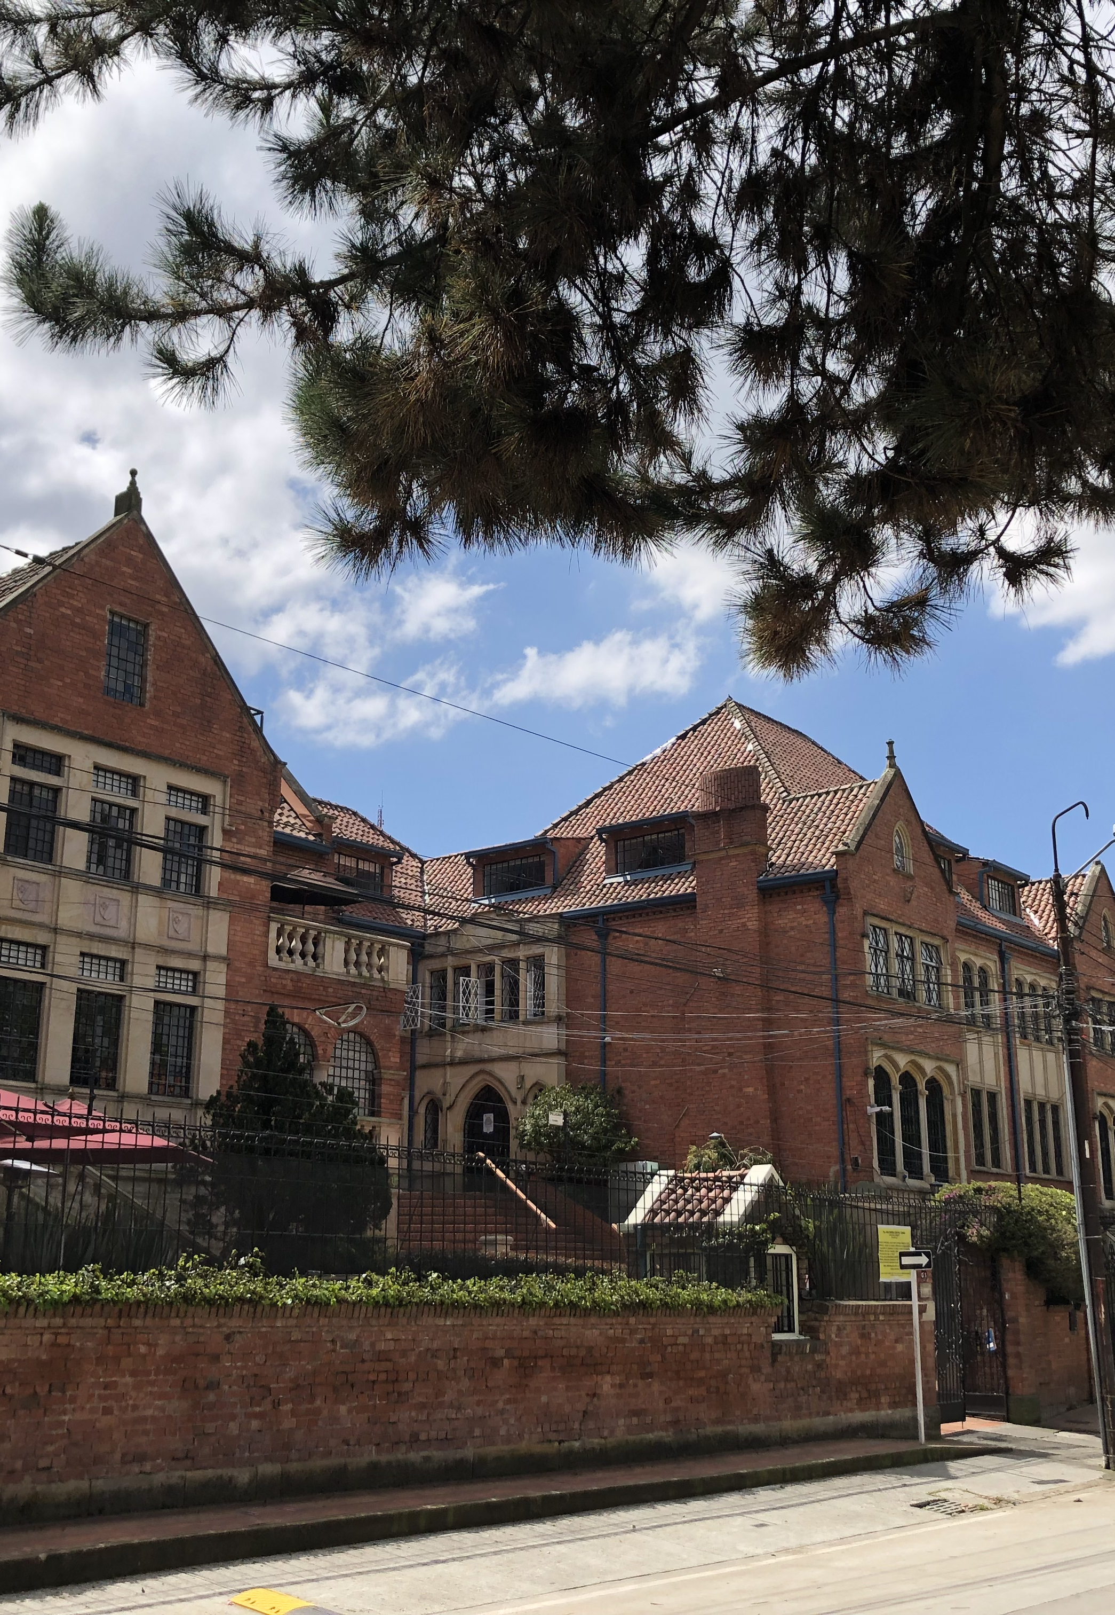
Population Ageing and Regional Economic Dynamics in Colombia: An Interregional Input-Output Analysis
Enrique Gilles (CESA Business School, Colombia)
32nd Conference of the IIOA |Sevilla, Spain
June 23-26, 2026
This research is supported by a grant from Fundación MAPFRE.

Slide 2
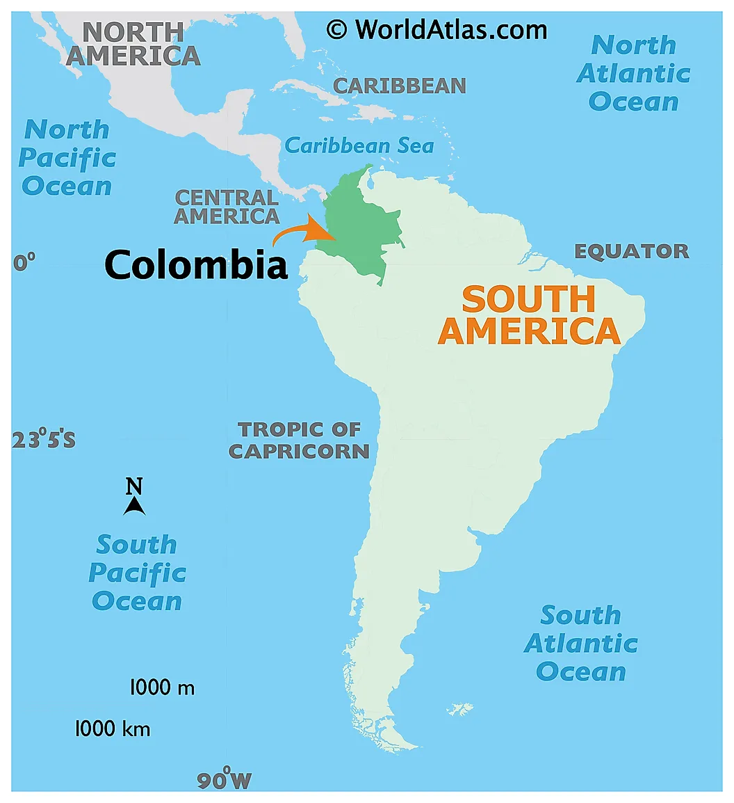
Motivation
The Demographic Context: Colombia is undergoing a rapid demographic transition, but unlike developed nations, this process takes place in an economy characterized by high informality and severe regional disparities
The "Silver Economy" Phenomenon: Defined as the economic activity generated by the consumption and needs of the population aged 55 and over.

Slide 3
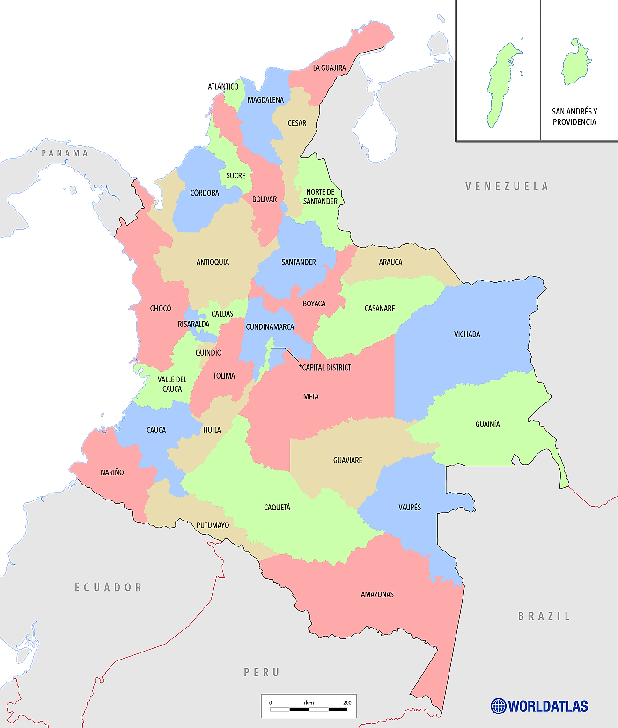
Motivation
Colombia is a country with 32 departments plus the capital district of Bogotá
Regional inequalities are large
Core – periphery scheme

Slide 4
Research question and objectives
The Core Economic Question: How do shifting consumption baskets among older adults influence sectoral production and value-added across highly uneven territories?
Characterize the specialized consumption patterns of the "Silver" segment (aged 55+) using microdata from the National Household Budget Survey (ENPH).
Quantify the direct, indirect, and induced impacts of this demographic demand vector on sectoral production and Value Added (VA) across 33 regions.
Identify a unique typology of regions by contrasting local economic autonomy (retention) against structural dependence on interregional spillovers (leakages).

Slide 5
Literature and research gap
Emergent Narrative: Current literature on the Silver Economy is largely market-oriented and commercial, lacking a cohesive, structural economic modeling framework.
The Subnational Blind Spot: Macro and national-level analyses mask territorial inequalities. A shift toward services in one urban hub triggers supply chain reactions (spillovers) across borders, while causing value-added leakages from peripheral regions.
Our Contribution: First study to integrate high-resolution, household-level microeconomic consumption data with a macro-structural IRIO model at a subnational scale in Colombia.

Slide 6
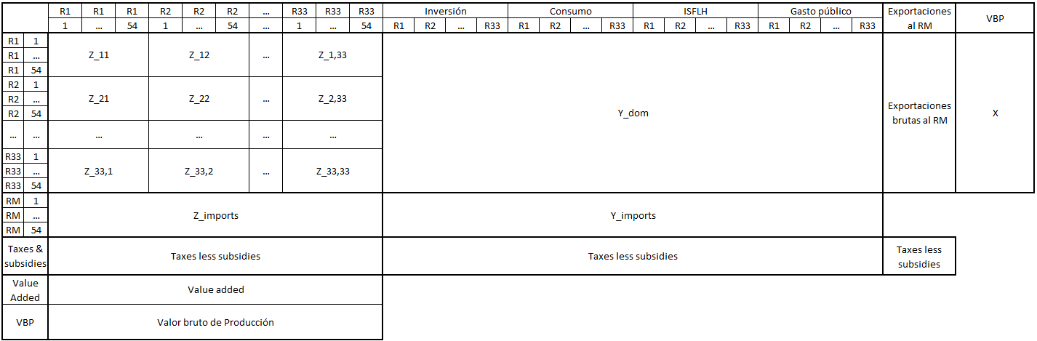
Intermediate transactions table (Z)
Subnational, IRIOT structure
Gross output vector (X)
Final demand table (Y)
To operationalize this, we build upon the 2015 Interregional Input-Output Table for Colombia developed by Haddad et al. (2023), which covers 54 industries for 32 departments + Bogotá. We combine it with microdata from the Household Budget Survey (ENPH 2015, 87202 observations, 12 COICOP divisions, 38 cities)

Slide 7
Methods:
Household Identification & Scales
The Identification Challenge: How to isolate an individual's senior expenditure inside multi-generational households without artificially inflating the "Silver Economy"?
The Solution (OECD-Modified Equivalence Scale):
  Household Head: Weight 1.0
  Additional Adults (14+): Weight 0.5
  Children: Weight 0.3
Hierarchy Alignment: If the elderly individual is the designated household head, they anchor the fixed consumption costs (1.0). If they reside in a multi-generational home headed by a non-elderly member, they are weighted as an additional adult (0.5). This respects actual household economies of scale.

Slide 8
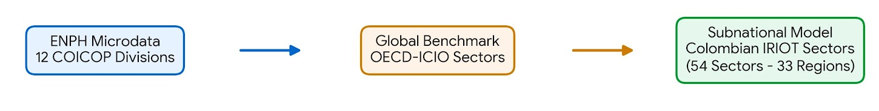
Methods:
From COICOP to IRIOT industries
The problem: How to connect the 12 COICOP divisions (micro) to the 54 economic sectors of the IRIO model (macro) → bridge matrix
A Two-Step Process:
  Use, as initial guess, a previous bridge table connecting COICOP to ICIO (OECD) table (Gilles et al., 2026). Filtered statistical noise by establishing a 0.5% allocation threshold.
  Resolved the classification mismatch between the international ICIO and the local Colombian table by performing a granular re-allocation using the national-level household expenditure distribution.

Slide 9
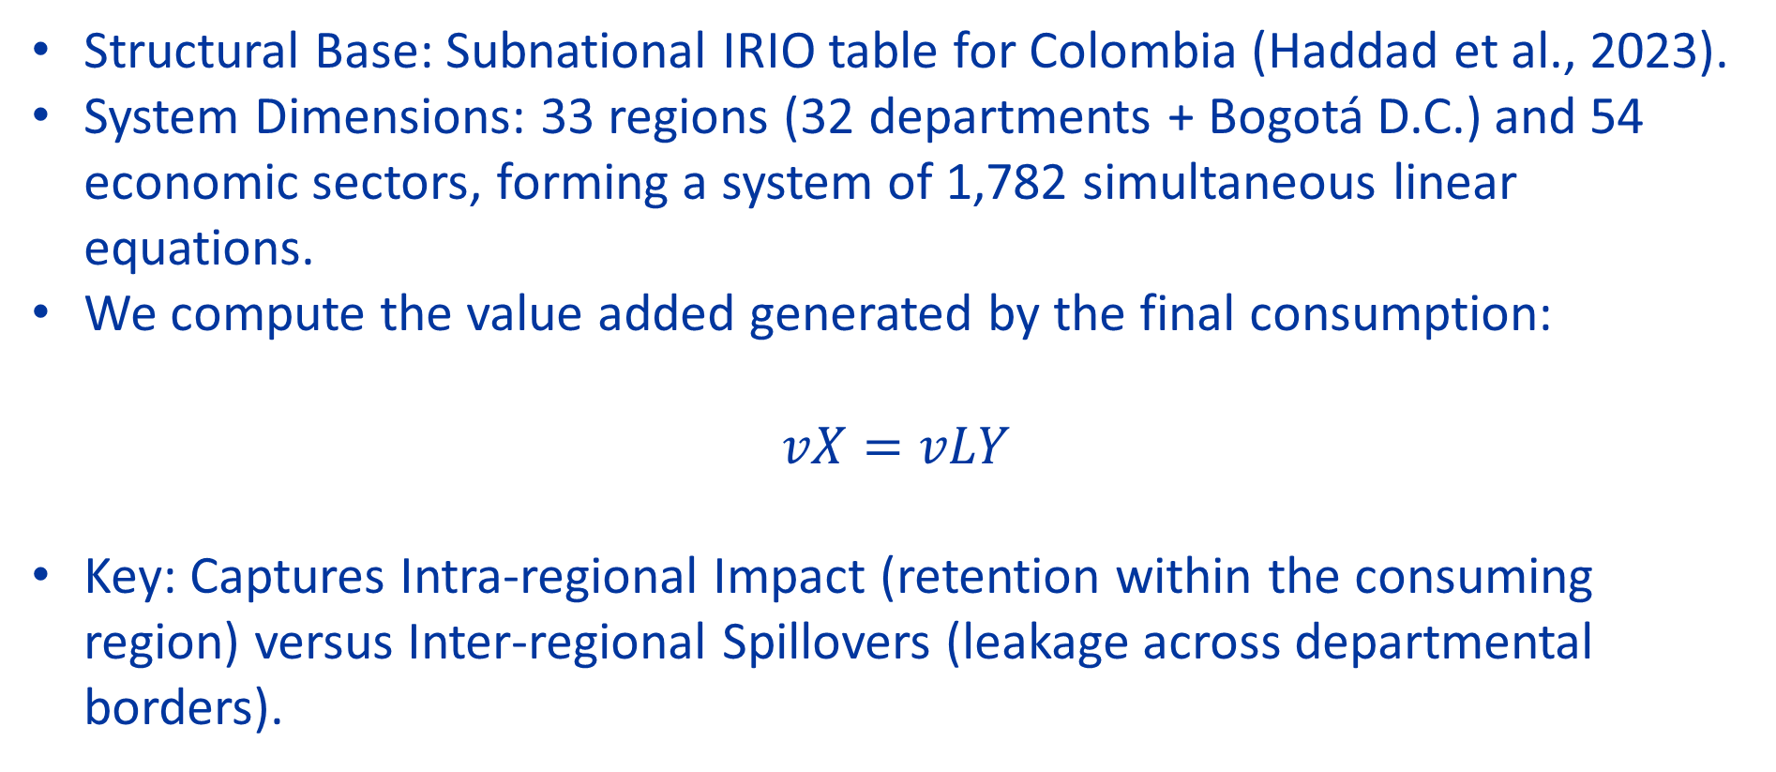
Methods
Structural Base: Subnational IRIO table for Colombia (Haddad et al., 2023).
System Dimensions: 33 regions (32 departments + Bogotá D.C.) and 54 economic sectors, forming a system of 1,782 simultaneous linear equations.
We compute the value added generated by the final consumption:
$$vX=vLY$$
Key: Captures Intra-regional Impact (retention within the consuming region) versus Inter-regional Spillovers (leakage across departmental borders).

Slide 10
Results

Slide 11
Results
Results I: Characterize consumption vectors Senior/Not-senior, regional differences
Results II: Value-added generated by Senior vs not-senior population. Impact in regional GDP
Results III: Regional disparities

Slide 12
Results I:
Descriptive Statistics & Consumption Mix
24.3%
75.7%
Spending by main COICOP categories. Colombia, Silver and not-Silver. In COP billions | Spending composition by main COICOP categories. Colombia, Silver and not-Silver.
The data reveals that the 'Silver' segment is a major macroeconomic force, accounting for 24.3% of Colombia's total urban household consumption. Structurally, the senior expenditure profile shows a higher relative concentration in essential spending (such as housing and food) compared to the non-silver population.
Essential spending = Food, Housing, Transportation, Clothes, Furnishing. HK and wellbeing = Communication, Education, Recreation & Culture, Health. Rest = Alcohol & Tobacco, Restaurant and hotels, miscellaneous goods and services

Slide 13
Results I:
Descriptive Statistics & Consumption Mix
National expenditure averages mask a deep structural divergence, as demographics vary fundamentally according to regional income levels.

Slide 14
Results I:
A tale of two cities
While peripheral urban contexts like Quibdó lock senior demand into essential spending for survival, high-income hubs like Medellín reveal a structural shift toward human capital and wellbeing sectors.

Slide 15
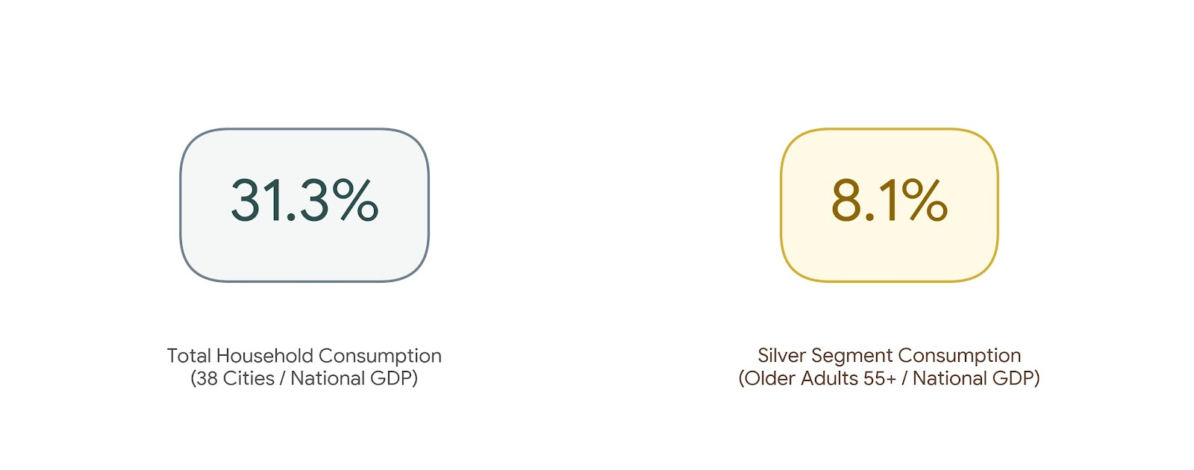
Results II:
Economic Impact — Value Added Generation
The Macro Magnitude: On average, total household consumption across the 38 analyzed cities generates value added that represents 31.3% of national GDP. The Silver segment alone represents 8.1% of total GDP—accounting for a quarter of total household consumption.

Slide 16
Results II:
Economic Impact — Value Added Generation
Aggregated Concentration: The country's main metropolitan areas (Bogotá, Medellín, Cali, Bucaramanga, and Barranquilla) produce 77.2% of the total Value Added generated by the Silver Economy.
The Top Silver Economies (Share of Local GDP):
Bogotá (13.0%) | Armenia (10.7%) | Manizales (9.6%) | Pereira (9.0%) | Cúcuta (9.0%).
Sectoral Multipliers: High demand concentration in labor-intensive sectors like Services and Retail, showing that senior consumption is a vital supporter of local employment.

Slide 17
Results III:
Regional Typologies & Structural Spillovers
Geographical Transfer: Because local economies lack the productive complexity to supply specialized goods and services (like complex healthcare), this income acts as an inadvertent pipeline of wealth transfer, subsidizing the growth of advanced industrial cores.
Demographic Divergence: Ageing deepens the economic divide between the center and the periphery instead of acting as a uniform economic dividend.

Slide 18
Results III:
Regional Typologies & Structural Spillovers
Impact of the Silver economy by cities, in % of the region’s GRP.
On top of highlighting the most industrialized regions (Bogota, Medellin, Cali), this graph identifies other, middle-sized cities with large Silver impacts (Armenia, Manizales, Pereira)

Slide 19
Results III:
Regional Typologies & Structural Spillovers
Geographical transfers:
Percentage of impacts leaked to other regions, by city.
Part of impacts occur in the same region, but some of them are leaked to others
Cities in less developed regions produce higher leakages in other regions

Slide 20
Final thoughts
The Silver Economy is not a spatially uniform engine of growth. Its developmental dividend depends strictly on pre-existing local industrial and service complexity.
Integrated Policy Design: Social security and pension expansion must be aligned with regional industrial policy. If peripheral regions cannot produce what their older populations need, the financial stimulus will always leak.
Targeted Territorial Strategies: Fostering local supply chains in healthcare, basic manufacturing, and food processing within peripheral territories is a requirement to turn the demographic transition into a tool for territorial cohesion.

Slide 21
Thank you
enrique.gilles@cesa.edu.co

