Slide 1




The trillion-dollar question: how large is the economic value of biodiversity loss embedded in global consumption and supply chains?
David Font Vivanco (IRTA, CREDA), Roberto Manzanaro (EIG), Cristina Sendra (EIG), José M. Gil (UPC, CREDA)
23/06/2026
32nd IIOA & 11th SHAIO Conference, Sevilla
Contact: david.font@irta.cat
Notes:
La foto la podeis cambiar por cualquiera que querais de repositorio de imágenes (ex: https://unsplash.com/es // https://www.pexels.com/es-es/)

Slide 2
Monetized biodiversity impacts equal $\frac{3!+\log_{2}\left(64\right)+\sqrt{36}}{3}\%$ of global GDP

Slide 3

Introduction
Biodiversity loss is increasingly driven by complex global supply chains, making footprint approaches essential for tracing responsibility.
Challenge #1: Biodiversity footprints rarely translate biophysical impacts into decision-relevant metrics that capture the societal consequences of biodiversity loss.
Challenge #2: Spatial detail is not consistently integrated across activity data, biodiversity impact characterization, and monetization.
Solution: A spatially explicit global EEMRIO framework for monetized biodiversity footprints.

Slide 4


Biodiversity footprint framework
Standard demand-pull Leontief model
EXIOBASE 3 v3.10.1 2022 pxp with consolidated extensions from 2021 and 2011
Impact World+ 2.2.1 using regionalized characterization factors when available (2.5- and 0.5-degree global grid, biomes, and water basins)
12 impact categories spanning climate change and fisheries; freshwater and marine systems, including acidification, ecotoxicity and eutrophication; terrestrial ecosystems and land use; atmospheric pollution; and water-related effects such as thermal pollution and water availability

Slide 5
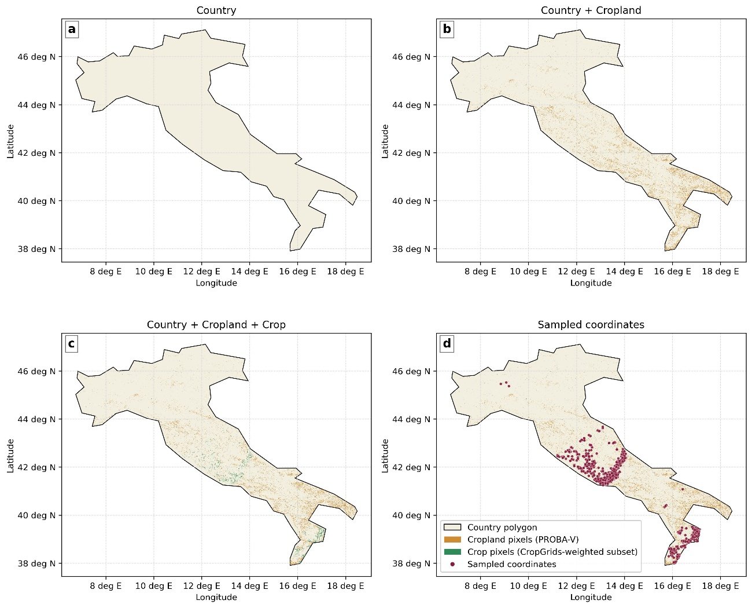
Geolocation of activities
Geolocation of activity-country combinations via plausible coordinates through a spatial sampling procedure informed by multiple geospatial datasets
Dataset | Information used | Spatial resolution / unit
PROBA-V Land Cover (LC100) (Copernicus Land Monitoring Service and Copernicus Land Monitoring Service Helpdesk, 2015) | Land-cover classes | 100 m
CropGrids v1.08 (Tang et al., 2024) | Crop-specific harvested area | 5 arc-min
Natural Earth country boundaries (naturalearthdata.com) | National polygons | Polygon boundaries
WRI Global Power Plant Database (Byers et al., 2021) | Power plant locations, fuel type, generation, capacity | Facility points
Global mining polygons (Maus et al., 2022) | Mining site footprints and area | Polygon footprints
SFI Global Cement Database (McCarten et al., 2021) | Cement plant locations and capacity | Facility points
Global Energy Monitor Global Iron and Steel Tracker (Global Energy Monitor, 2026) | Steel plant locations, production route, status, production, capacity | Facility points

Slide 6
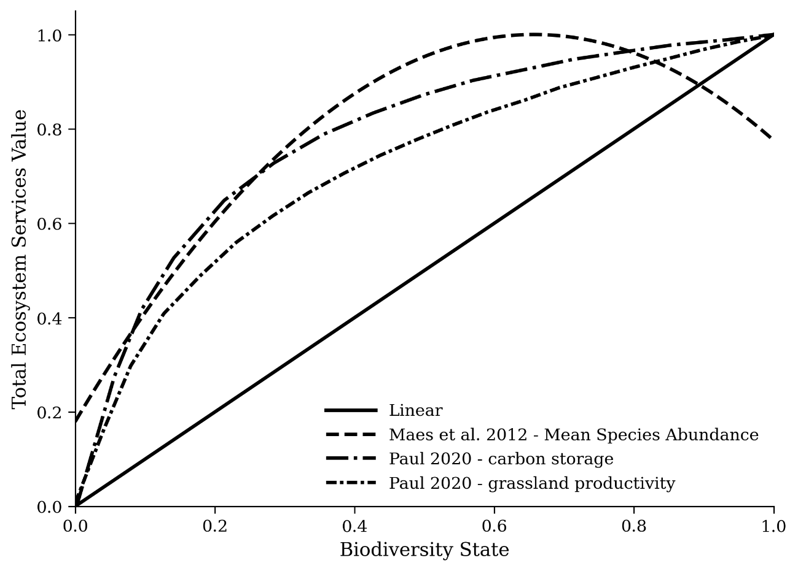
Biodiversity impact monetisation
Logic: Biodiversity impact → biodiversity state change → TESV response function → monetary loss
We assume stylized relationships between biodiversity state and Total Ecosystem Services Value (TESV)
A coordinate-level TESV calculator is developed using regression-based value transfer trained on valuations from an enriched version of the Ecosystem Services Valuation Database (ESVD) (+ biodiversity intactness, climate, population density, income, urbanization, etc.)
Predicted + fallback values (biome or global medians)

Slide 7
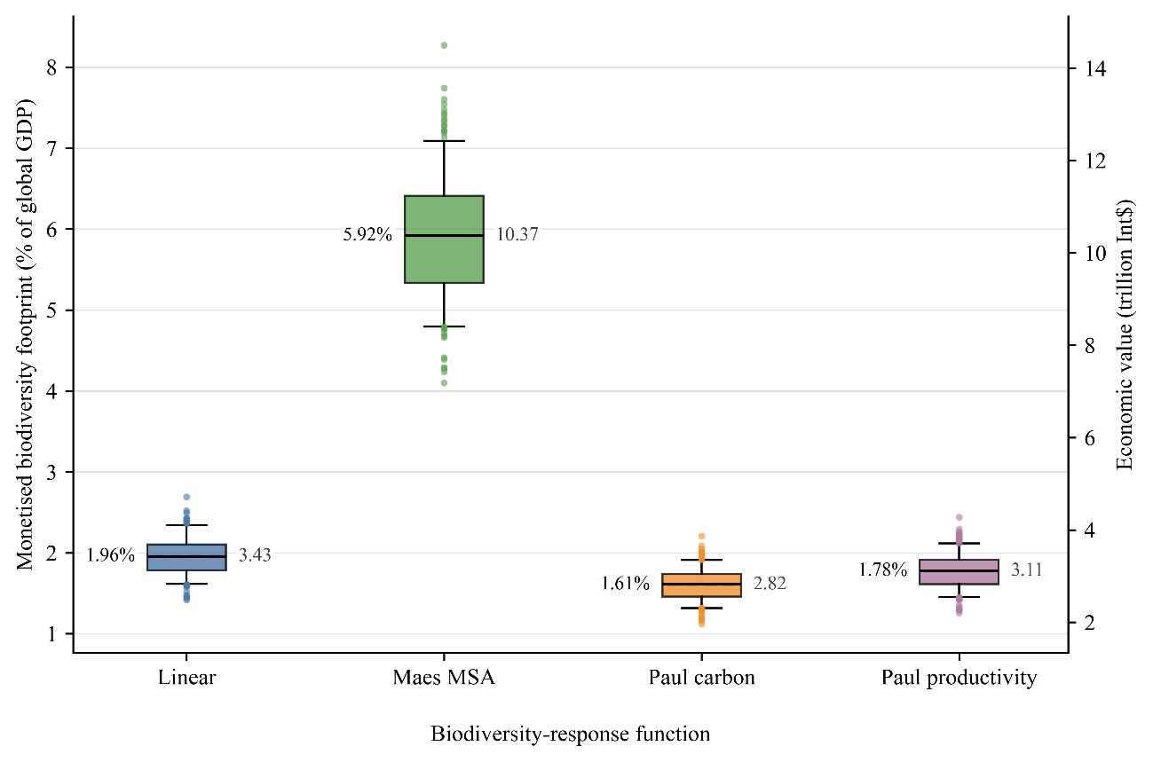
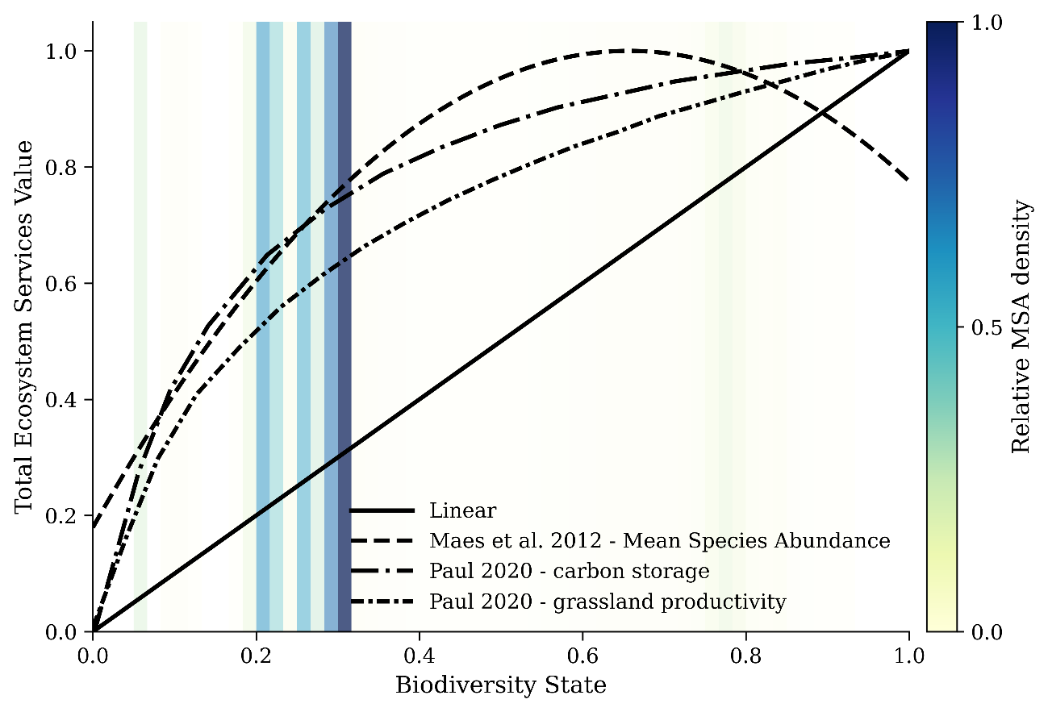
Results
Annual monetized biodiversity impacts are estimated at 1.6–5.9% of global GDP, depending on the biodiversity-response function.
The “Maes MSA” function yields the highest estimates because many observations fall within its steepest range.
Uncertainty in the “Maes MSA” estimate is driven by characterization factors (53%), CF–TESV interactions (26%), and TESV (21%).

Slide 8
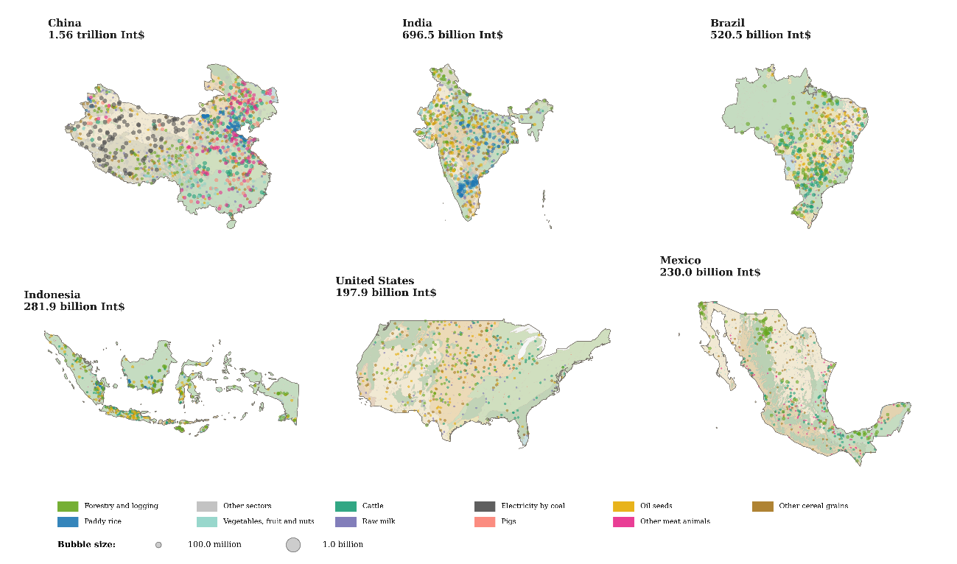
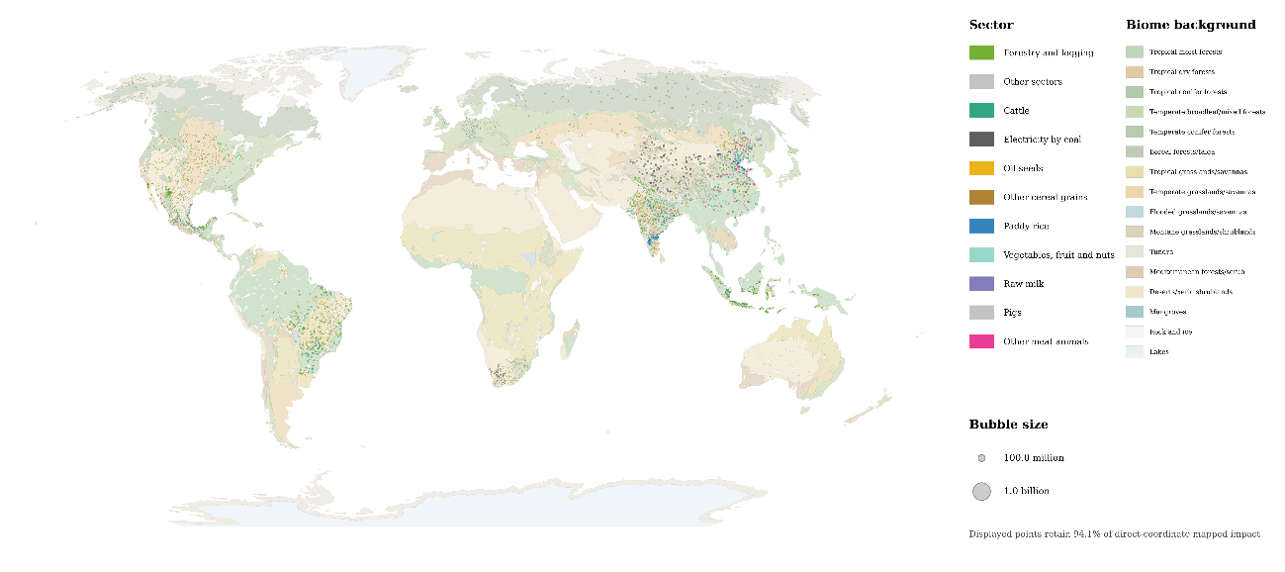
Results
Monetized biodiversity impacts are highly uneven across space, with major clusters across the Americas and Asia, particularly in North, Central and South America, South Asia, Southeast Asia, and East Asia.
Monetized biodiversity impacts are concentrated in a small number of countries, with China alone accounting for 1.56 trillion Int$, followed by India (696.5 billion Int$) and Brazil (520.5 billion Int$).
Agriculture-related sectors dominate the mapped impacts, particularly forestry and logging, cattle, cereals, oil seeds, and fruit and vegetable production.

Slide 9
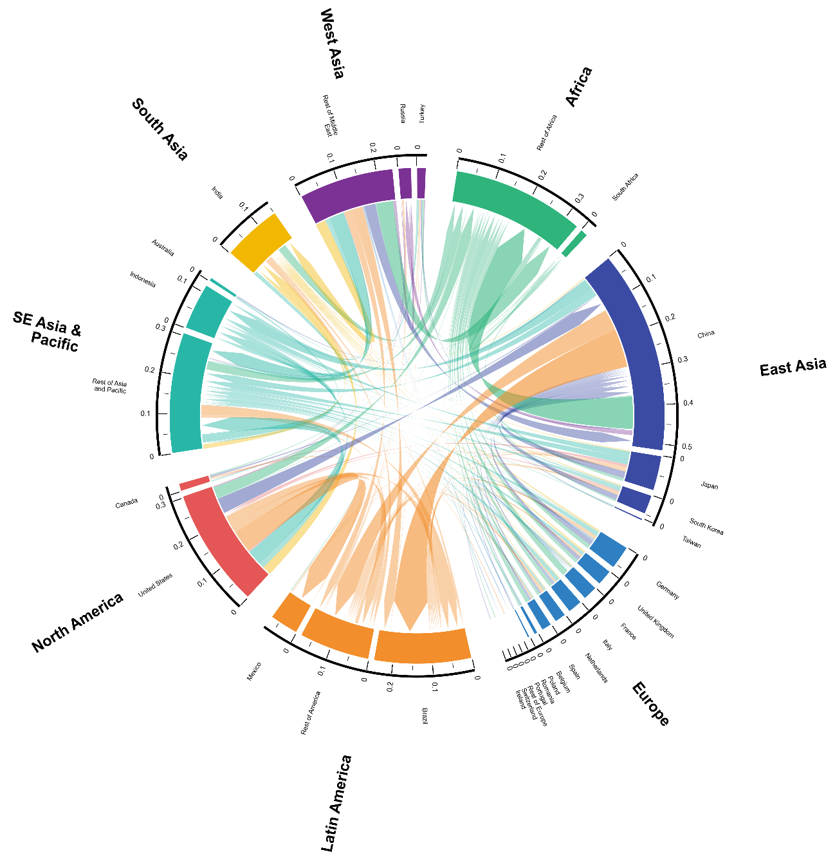
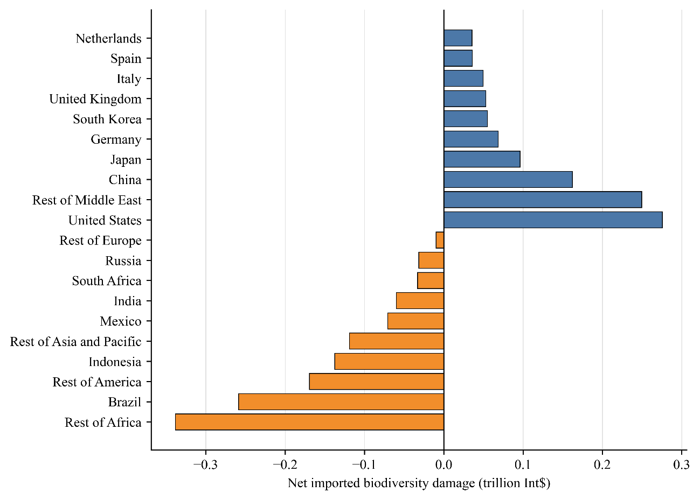
Results
Top net importers: USA (0.28 trillion int$), Middle East (0.25), China (0.16)
Top net exporters: Africa (-0.34), Brazil (-0.26), Central/South America (-0.17)

Slide 10
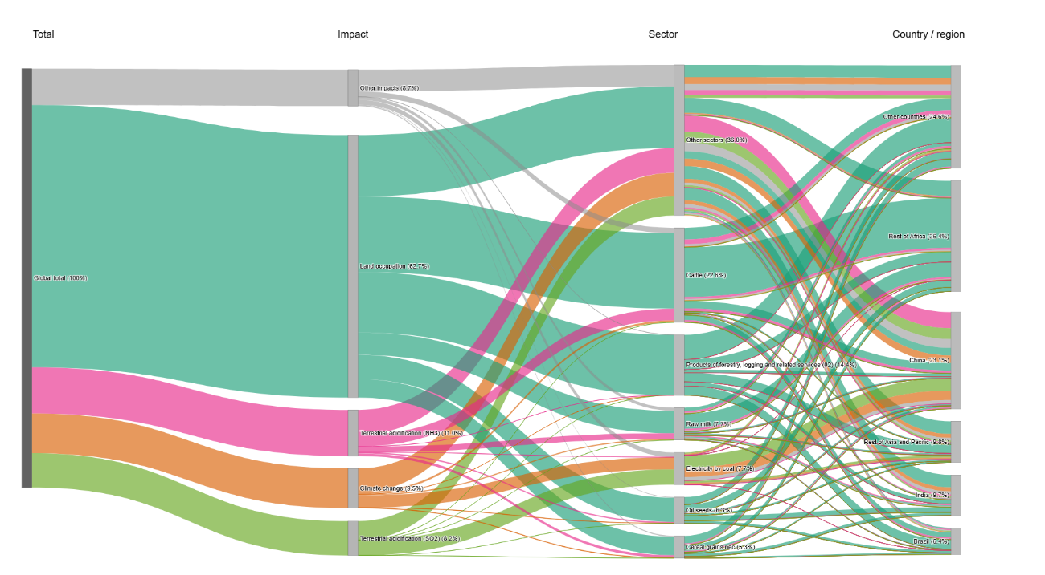
Results
Impact drivers: land occupation (64%), terrestrial acidification from NH3 (11%), climate change (10%)
Activity drivers: cattle (23%), forestry (14%), raw milk (8%), electricity by coal (8%)

Slide 11
Conclusions
Biodiversity loss has a large economic value, comparable in scale to major global shocks (e.g., COVID-19 pandemic, the Great Depression) and lower-bound estimates of climate change damages (5%, Stern Review).
The framework provides unprecedented spatial detail on the drivers of monetized biodiversity impacts and on where natural capital is depreciated, thereby supporting more targeted multi-level decision-making.
Uncertainty remains high, especially around whether TESV is an adequate proxy and whether a single TESV-biodiversity relationship can represent diverse ecosystem-service responses.

Slide 12
The trillion-dollar question: how large is the economic value of biodiversity loss embedded in global consumption and supply chains?
Thank you!
Parc Mediterrani de la Tecnología, Edifici EEABB
Esteve Terrades 8, 08860 Castelldefels
Tel + 34 935 521 124 | Fax + 34 935 521 121 | E-mail: creda@creda.es

