Slide 1
The Economic and Environmental Impacts of Railroad Construction in Africa
Timothy Na, Arjan de Koning, Jeroen Guinée, Ranran Wang
32nd IIOA conference | 24 June 2026, Seville

Slide 2
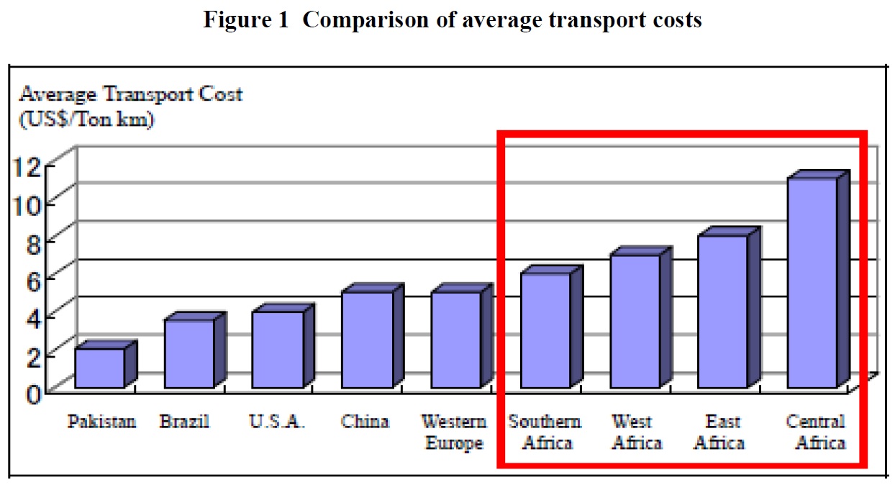
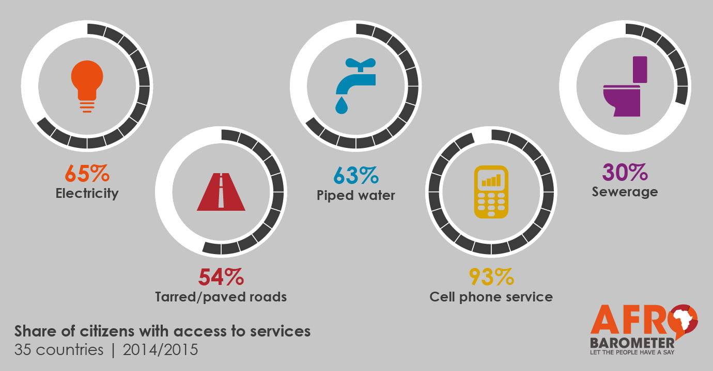
Africa lacks the infrastructure its development requires
Three key gaps: quantity, quality and access
Without infrastructure, there is no sustainable development
Afrobarometer (2016)
Kessides (2012)
Notes:
Africa, particularly SSA is the least-well endowed region in the world for infrastructure
Africa is lacking in quantity, quality and access to infrastructure which is constricting sustainable development
Transport in particular is a problematic sector. Transport costs in Africa are very high compared to other regions and this is hampering trade and economic development. Additionally, it requires large amounts of investments to build a proper network transportation network.

Slide 3
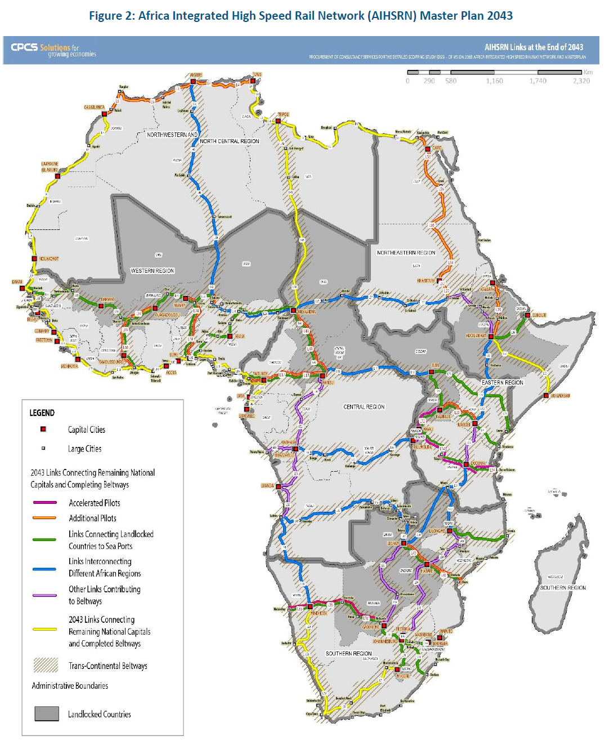
The AU plans to double Africa’s railway network by 2063
65,000 km of new railway links
Connect all capitals and regions, and connect landlocked countries with ports
CPCS (2020)
Notes:
To address these issues, the African Union plans to build a transcontinental railway network. The extent of the network is roughly the size of China’s HSR network.
The proposed network has three political goals: connecting all capitals, connecting all regions and connecting landlocked countries with ports.
To model the macro-economic impact of this 65,000 km network, we run into a major IO problem: standard MRIO tables treat this massive rail expansion as generic construction.

Slide 4
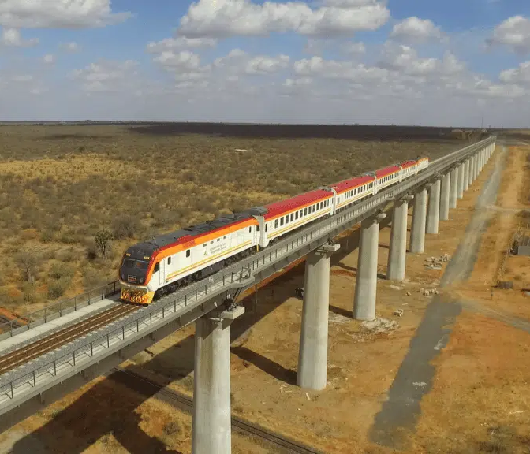
Knowledge gap
Rail can cut operational emissions, but the construction phase is a blind spot
Data, LCA,, and IOA literature on rail is weak for Africa
Construction in MRIO is a single sector
Tradeoffs in global south development are underexplored
China Communications Construction (2024)
Notes:
Railway is a green form of land transport, when looking at its operational emissions (compared to road, also compared to air)
Large amount of high carbon materials are used in railway construction: steel, concrete
Construction activity: earthworks and land clearing has large impact on the environment (such as biodiversity, water)

Slide 5
Research aim
Develop African railway production recipe from African engineering data
Disaggregate the construction sector into railway and non-rail construction for African countries in MRIO
Assess production recipes and embodied emissions across African countries
Notes:
Need to understand regional heterogeneity

Slide 6
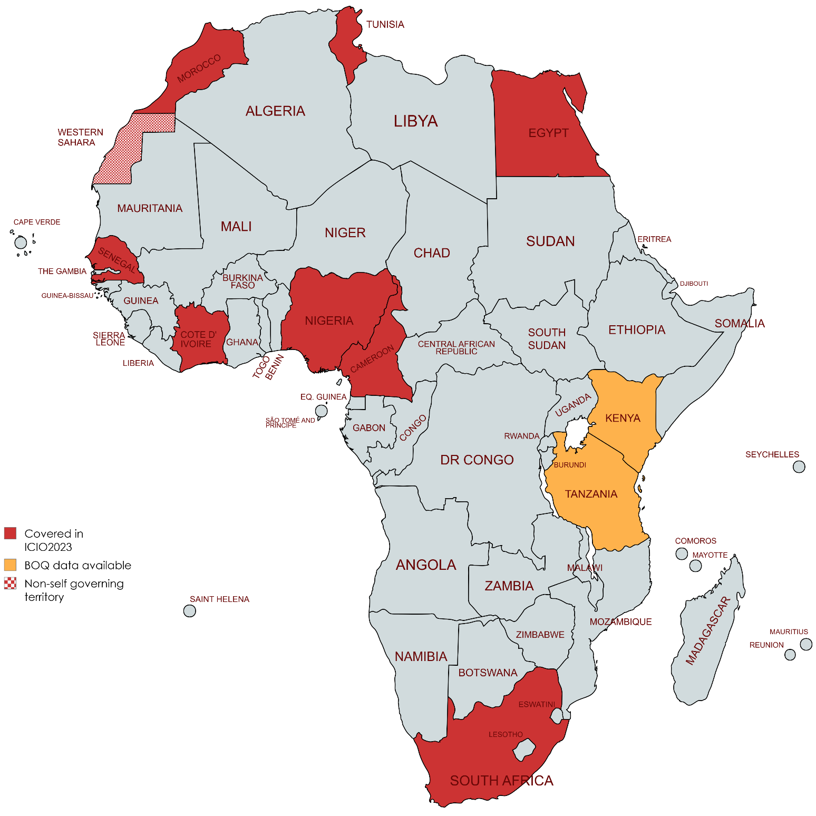
Data
ICIO2023: 77 regions, 45 sectors
African countries: CMR, CIV, EGY, MAR, NGA, SEN, ZAF, TUN
Environmental extensions: CO2
BOQ data:
  Tanzania (Uvinza-Kigadye), 2023, 282 km, $1.45 B investment
  Kenya (Mombasa-Nairobi), 2012, 479 km, $2.9 B investment

Slide 7
Methodology
Convert BOQ data into ICIO-compatible production recipe
Disaggregate column (inputs), row (outputs), VA, TLS, F
Balance the augmented MRIO using GRAS
Validate and consistency-check

Slide 8
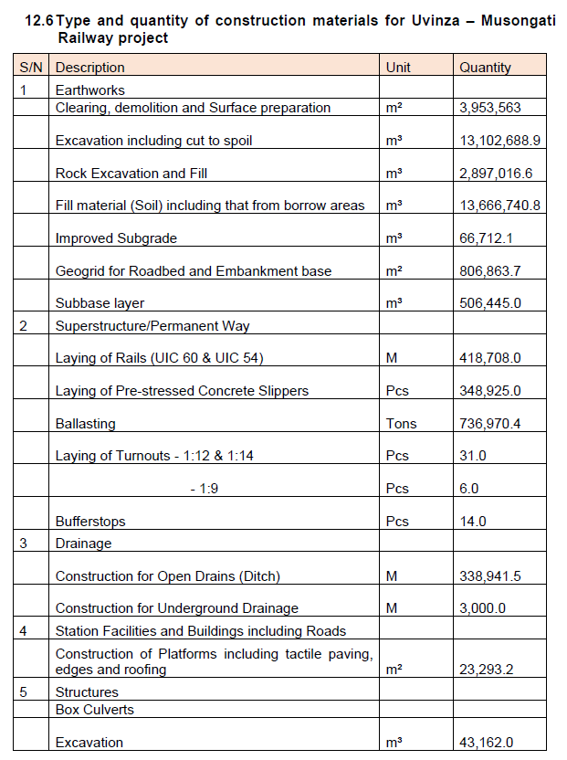
BOQ conversion
BOQ item | Unit | BOQ quantity | ICIO code | ICIO description | Price (USD/m) | Monetary value (USD)
Laying of rails (UIC 60 & UIC 54) | m | 418.708 | C25 | Manufacture of fabricated metal products | 40 | 16.748.320
Notes:
Show an example of the conversion of item → allocation to ICIO sector → conversion to monetary value using price → summing items per ICIO sector
Requirement of total project value

Slide 9
BOQ recipe
Code | Description | Total value ($) | Value per m ($) | Input value per unit output ($) | Share
F | Construction | 370.675.579 | 1.314,4524 | 0,26 | 0,45
B08 | Other mining and quarrying | 307.854.436 | 1.091,6824 | 0,21 | 0,38
C19 | Manufacture of coke and refined petroleum products | 3.360 | 0,0119 | 2,32E-06 | 4,12E-06
C22 | Rubber and plastic products | 1.613.727 | 5,7224 | 1,11E-03 | 1,98E-03
C23 | Manufacture of other non-metallic mineral products | 78.687.320 | 279,0330 | 0,054 | 0,096
C25 | Manufacture of fabricated metal products | 53.701.220 | 190,4299 | 0,037 | 0,066
C26 | Manufacture of computer, electronic and optical products | 49.000 | 0,1738 | 3,38E-05 | 6,01E-05
C27 | Manufacture of electrical equipment | 2.977.000 | 10,5567 | 2,05E-03 | 3,65E-03
J61 | Telecommunications | 8.000 | 0,0284 | 5,52E-06 | 9,81E-06
J62_63 | Computer programming and information service activities | 8.000 | 0,0284 | 5,52E-06 | 9,81E-06
Note: Tanzanian BOQ applied to all 8 countries
Notes:
BOQ covers 10 input sectors. There are also inputs from other sectors which are assumed to be 5% of the input going into the original construction sector.

Slide 10
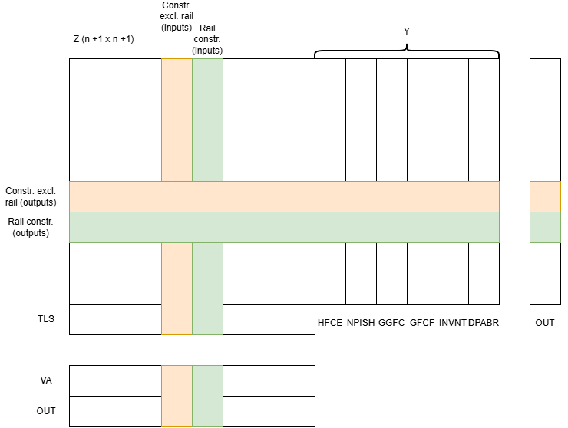
Disaggregation

Slide 11
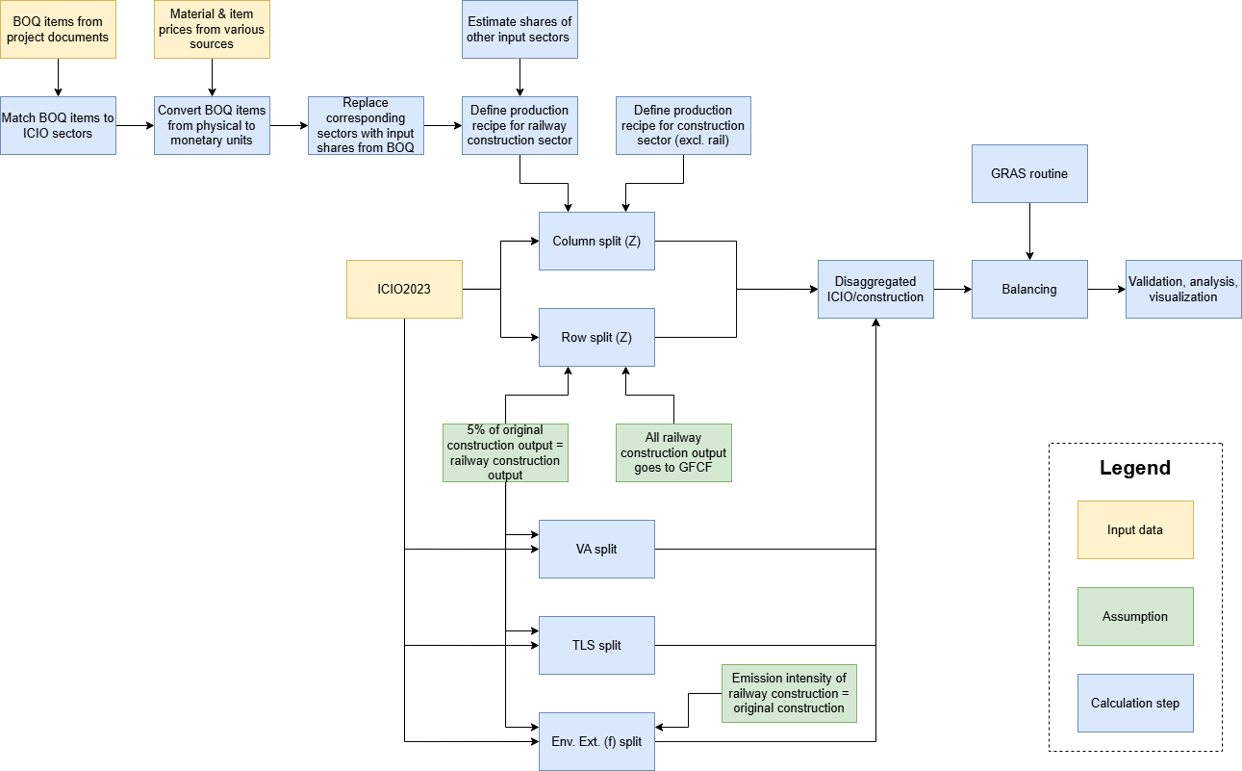
Research flow diagram
Notes:
This RFD shows an overview of all the calculation steps, input data and assumptions. We have covered the definition of the railway construction sector and the construction sector excluding rail.
The row split is done assuming that the amount of railway construction is equivalent to 5% of general construction output. Another assumption that we make is that all railway construction output goes to GFCF. This is a reasonable assumption since railway construction mostly produces capital goods and does not directly service other sectors.
Balancing is done using GRAS, where we make sure that constraints such as total inputs = total outputs and that original construction = railway construction + construction excluding railway

Slide 12
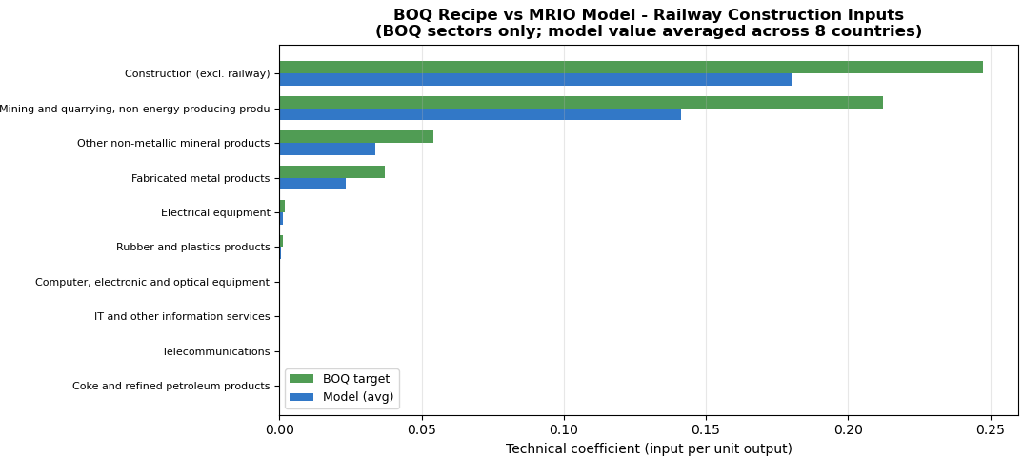
A distinct production recipe
Preliminary results, do not cite

Slide 13
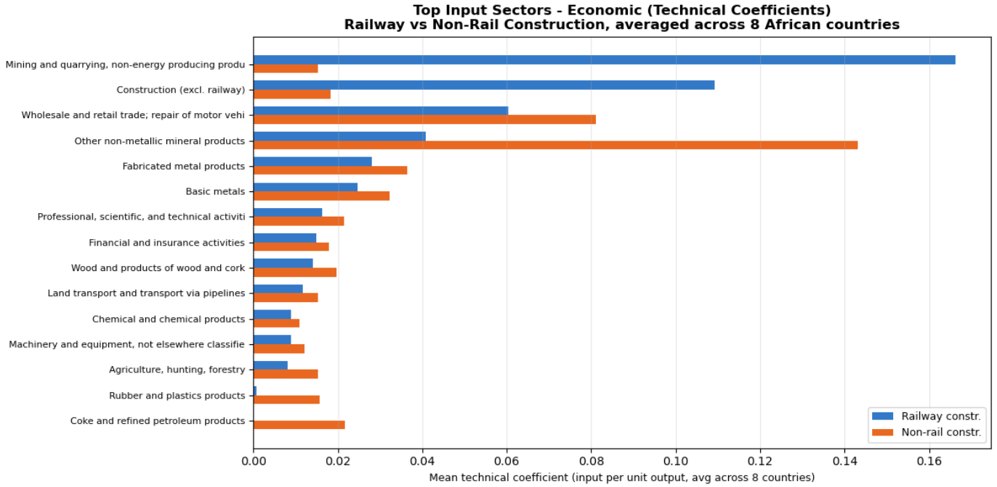
Different supply chains: railway vs general construction
Preliminary results, do not cite
Notes:
Using a generic construction sector significantly underestimates or distorts the true upstream economic pulls (like fabricated metals and mining)

Slide 14
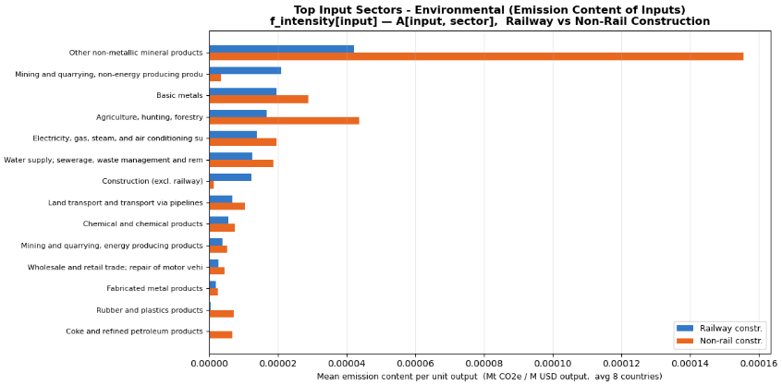
Embodied emissions concentrated in mineral supply chains
Preliminary results, do not cite

Slide 15
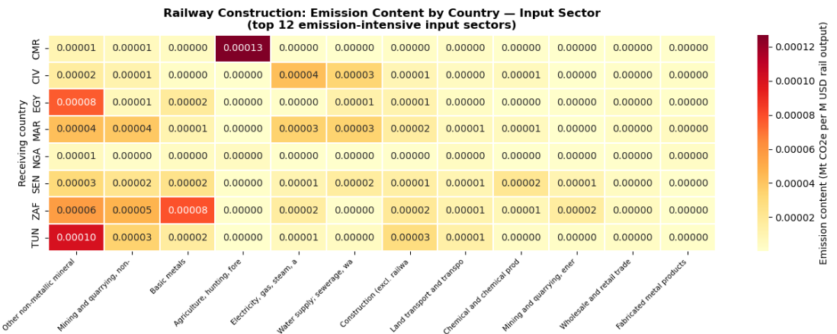
Cross-country variation: no single decarbonisation story
Preliminary results, do not cite

Slide 16
Next steps
More BOQ data to cover more countries, terrain types and technologies
Railway-specific environmental profile
Additional environmental extensions (e.g., materials)
Price data
Sensitivity analysis

Slide 17
In summary
Key findings
  Railway construction has a distinct supply chain from general construction
  Embodied emissions are concentrated in upstream non-metallic mineral supply chains
  It is important to evaluate African countries separately
Future work
  Scenario analysis of Agenda 2063 and other development pathways
Main takeaway
  Engineering-informed MRIO disaggregation is a viable, high-reward strategy for evaluating large-scale infrastructure pathways in data-poor regions

Slide 18
Thank you!
t.c.na@cml.leidenuniv.nl

Slide 19
Sources
Afrobarometer. (2016). AD69: Building on progress: Infrastructure development still a major challenge in Africa. URL: https://www.afrobarometer.org/publication/ad69-building-progress-infrastructure-development-still-major-challenge-africa/
China Communications Construction Company Ltd. (2024). CCCC trains construction and management talents for Kenya. URL: https://en.ccccltd.cn/xwzx/ywfb/202402/t20240205_212972.html
CPCS. (2020). Detailed Scoping Study (DSS) – of Vision 2063 Africa Integrated High Speed Railway Network and Master Plan.
Kessides. (2012). Regionalizing Infrastructure for Deepening Market Integration: The Case of East Africa.

Slide 20
GRAS balancing
Balancing framework: one-sided GRAS optimization to adjust the disaggregated rail proxy matrix
Accounting identities: strict non-negativity enforced; system-wide grand total reconciled via intermediate column demand
Model invertibility: targets intermediate demand (x – VA – TLS) rather than gross output to ensure a valid Leontief inverse
Notes:
To balance the system, we implement a robust GRAS routine. We enforce strict non-negativity across the active support using a tiny positive prior to handle structural zeros and avoid clipping errors. > Crucially, to ensure our Leontief inverse remains non-singular, we set our column targets to intermediate input demand rather than gross output, which avoids forcing the column sums of our technical coefficients to one. Any residual system-wide discrepancy from the initial data fusion is absorbed cleanly into the column targets to maintain perfect accounting identities.

Slide 21
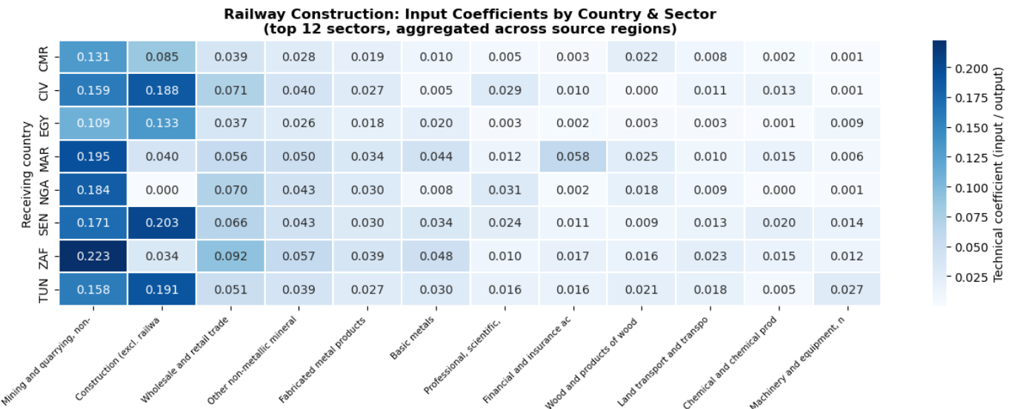
Technical coeff. By sector

Slide 22
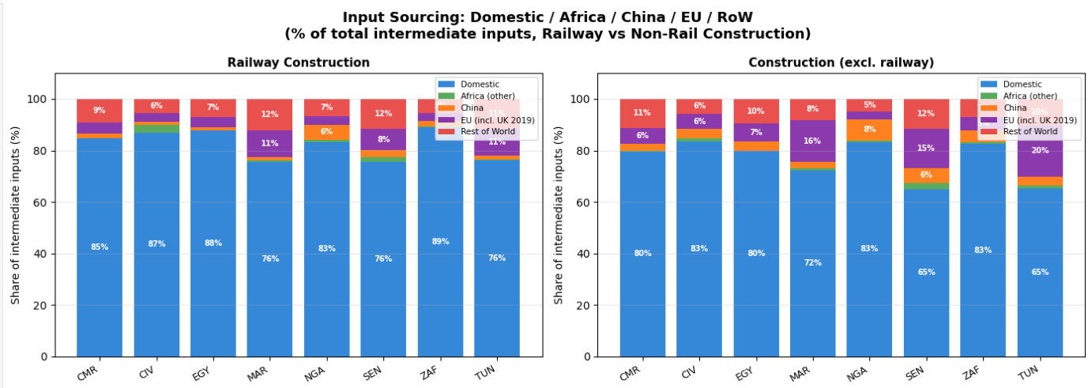
Sourcing

Slide 23
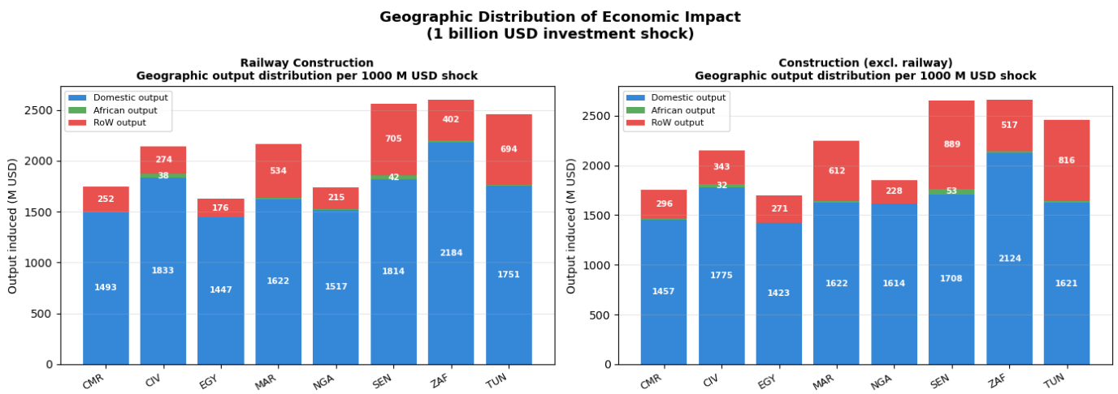
Invesment shock

Slide 24
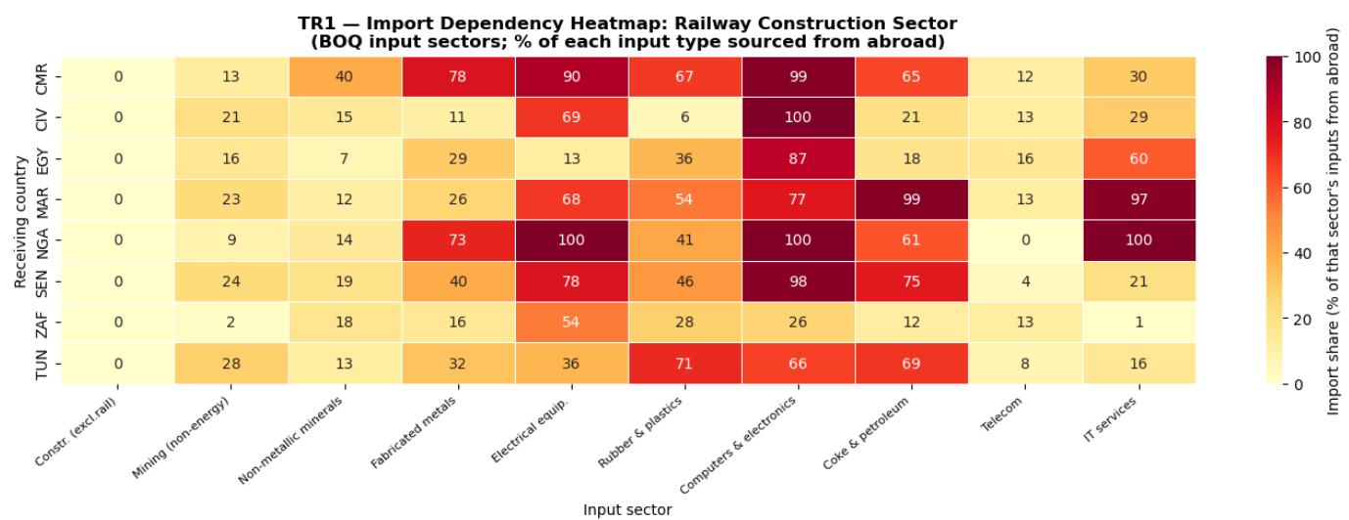
Import dependency by sector

Slide 25
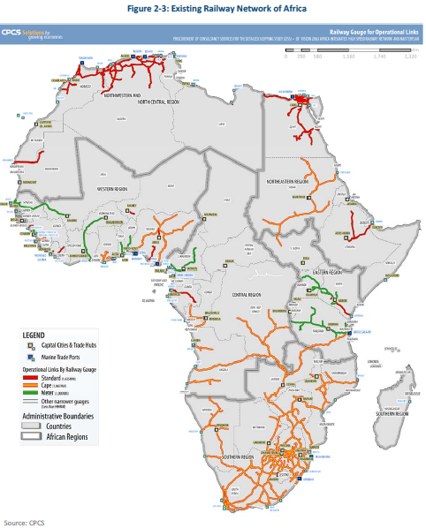
Existing railways

Slide 26
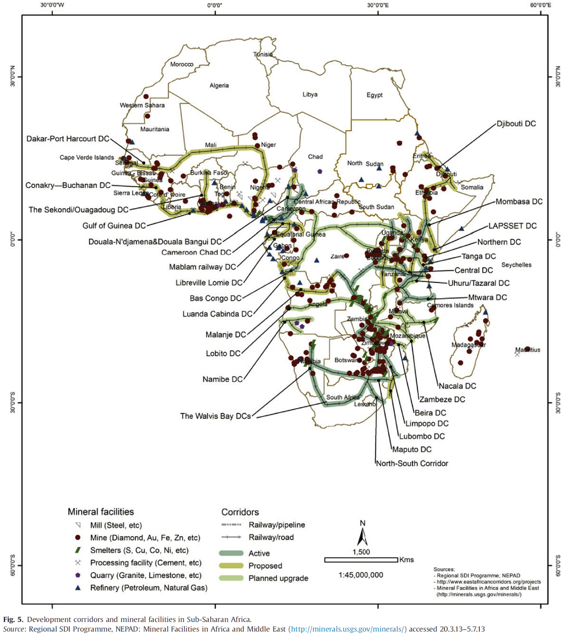
Mining resources

Slide 27
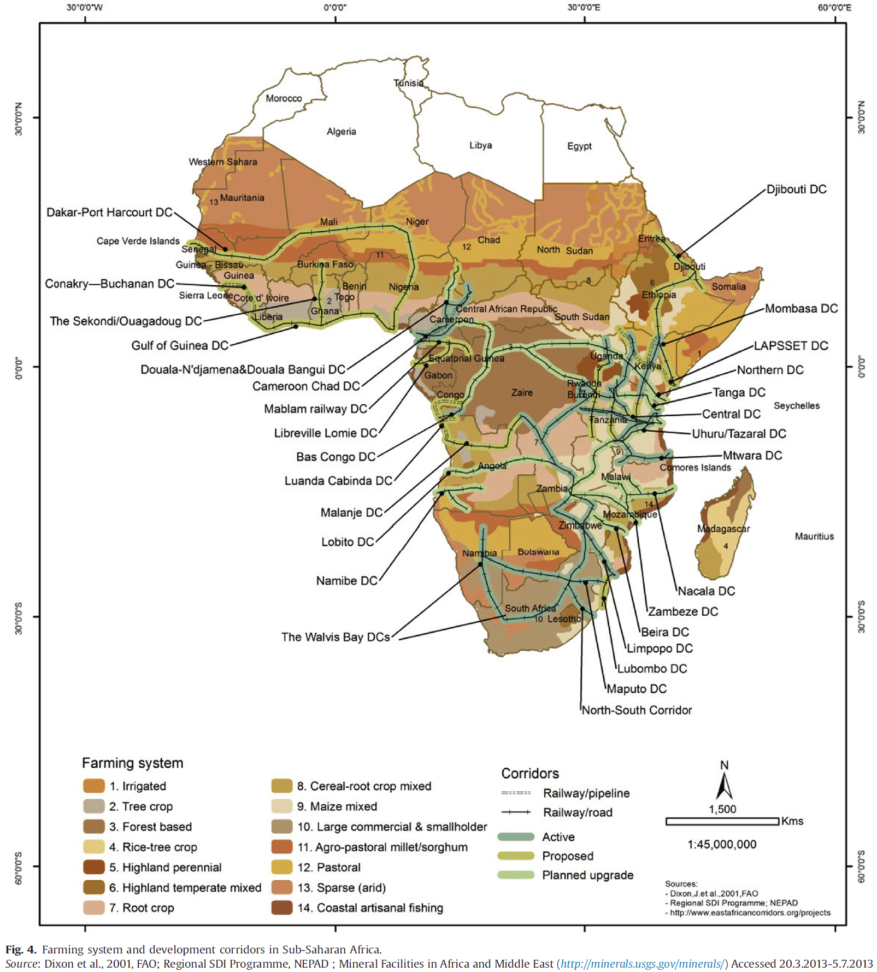
Agricultural production

Slide 28
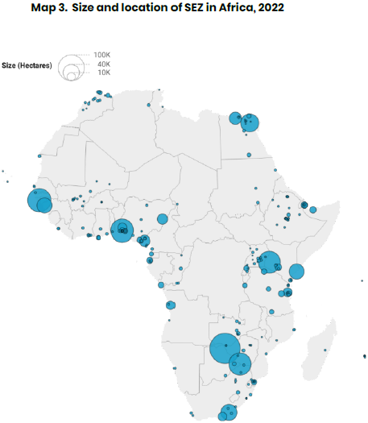
Special economic zones (SEZ)

