Slide 1
The Effects of US Tariffs on Southern Europe: The case of Spain
María T. Álvarez-Martínez ª, Alfredo J. Mainar Causapé ª, Clemente Polo Andrés ^{b}, Raimundo Viejo Rubio ^{c}.
University Pablo Olavide
University Abad Oliva (CEU)
University of Santiago de Compostela.

Slide 2
Trump Administration
Liberation Day (April 2025)
Supreme Court (February 2026)
Trade policies
2

Slide 3
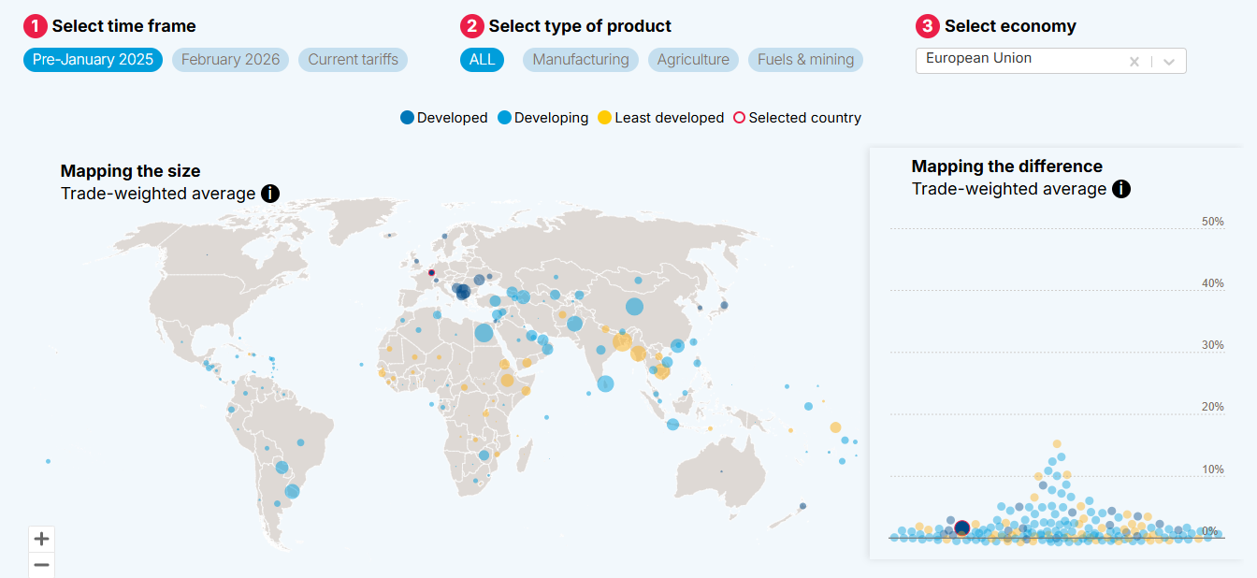


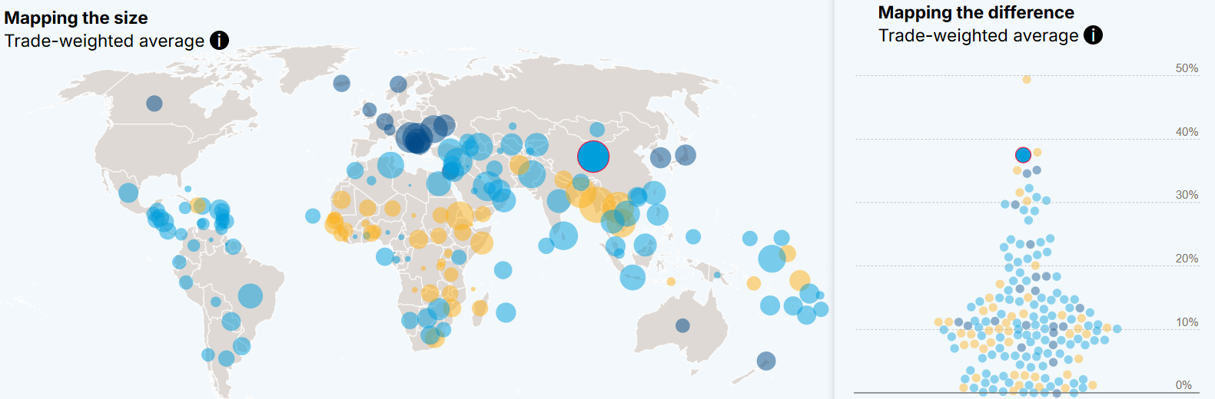
January 2025
China 12.3%
EU 1.1%
February 2026
China
37,5%
EU
10.6%
Source: UN Trade and Development (UNCTAD)

Slide 4
Previous tariffs
Sectors | US Tariffs (%)
Agriculture, forestry and Fishing | 4.3
Mining and quarrying | 0.2
Food, beverage and tobacco products | 6.0
Textiles, wearing apparel and leather | 9.6
Wood and products of wood | 1.3
Paper and printing services | 0.0
Coke and refined petroleum products | 0.5
Chemicals and plastic products | 1.5
Manufacture of rubber and plastic products | 3.0
Other non-metallic mineral products | 0.2
Basic metals and fabricated metal products | 1.5
Computer and electrical equipment | 1.2
Machinery and equipment | 1.3
Motor vehicles and other transport equipment | 3.5
Other manufactures | 2.3
Source: Observatory of Economic Complexity (2026)

Slide 5
Sectors | Exports | Imports | Exports | Imports
 | € billion ª |  | % of total output
Agriculture, forestry and Fishing | 0.44 | 1.33 | 0.39 | 1.16
Mining and quarrying | 0.27 | 7.63 | 0.30 | 8.27
Food, beverage and tobacco products | 3.59 | 0.71 | 1.35 | 0.26
Textiles, wearing apparel and leather. | 1.06 | 0.13 | 1.48 | 0.18
Wood and products of wood | 0.19 | 0.10 | 1.16 | 0.59
Paper and printing services | 0.33 | 0.51 | 0.81 | 1.25
Coke and refined petroleum products | 2.19 | 1.41 | 2.03 | 1.31
Chemicals and plastic products | 6.16 | 7.05 | 3.12 | 3.57
Manufacture of rubber and plastic pr. | 0.62 | 0.17 | 1.24 | 0.34
Other non-metallic mineral products | 1.23 | 0.16 | 2.73 | 0.35
Basic metals and metal products | 2.19 | 0.55 | 1.33 | 0.33
Computer and electrical equipment | 1.66 | 0.66 | 1.89 | 0.75
Machinery and equipment | 1.44 | 0.57 | 2.10 | 0.83
Motor vehicles and other transport eq. | 2.60 | 1.45 | 1.56 | 0.87
Other manufactures | 0.62 | 0.72 | 1.40 | 1.64
Total Products | 24.61 | 23.14 | 1.60 | 1.51
Total Services | 11.57 | 4.88 | 0.60 | 0.25
TOTAL | 36.18 | 28.02 | 1.05 | 0.81
a: € billion = 10⁹ €

Slide 6
 | Policy Measure | GDP (%change) | Region
Ortiz & Da Rocha (2025) | 10% Tariff | -0.74 | Spain
 | 15% UE & 25% Canada, China and Mexico | -1.34 | Spain
The Kiel Institute (2025) | 50% Tariff | -0.70 | EU
 |  | -0.0044 | Spain
Bottazzi et al (2025) | 10% Tariff war | -0.8-1.2 | EU
Demertzis and Panitsas (2025) | 20% Tariff | -0.20 | EU

Slide 7
Present Research
Effect of three levels of US tariffs on Spanish economy using a single country CGE model.
SAM for the year 2023.
  30 sectors
  2 primary factors.
  5 types of households
  Public sector.
  Corporate sector
  Foreign sector

Slide 8
Production Technology
Y_{j}
Y_{Dj}
Y_{ROWj}
Y_{USj}
X_{ij}
V_{j}
K
L
CES
Leontief
Cobb-Douglas

Slide 9
Foreign sector
Foreign Savings
Revenues
Imports
Transferences
Labor
Payments
Exports
Transferences
Taxes
Labor

Slide 10
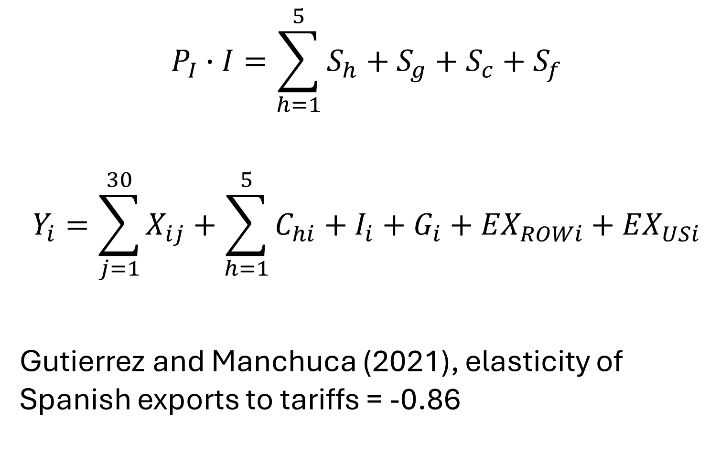
Equilibrium
$$P_{I}∙I=\sum_{h=1}^{5}{S_{h}+S_{g}+S_{c}+S_{f}}$$
$$Y_{i}=\sum_{j=1}^{30}{X_{ij}+\sum_{h=1}^{5}{C_{hi}}+I_{i}+G_{i}+{EX}_{ROWi}+{EX}_{USi}}$$
Gutierrez and Manchuca (2021), elasticity of Spanish exports to tariffs = -0.86

Slide 11
Scenario 1: Neoclassical
 | Base year | 15% | 25% | 50%
 | € billion ª | % change
Real GDP | 1,498.29 | 0.00 | 0.00 | -0.01
Foreign Savings | -39.77 | -3.84 | -6.45 | -11.59
Public Savings | -16.91 | 0.17 | 0.28 | 0.51
Public receipts | 606.62 | 0.005 | 0.008 | 0.015
Public payments | 623.54 | 0.009 | 0.015 | 0.028
Corporate savings | 257.04 | -0.01 | -0.01 | -0.02
Investment | 314.77 | 0.50 | 0.80 | 1.50
a: € billion = 10⁹ €

Slide 12
Scenario 2: Unemployment rate
 | Base year | 15% | 25% | 50%
 | € billion | % change
Real GDP | 1,498.29 | 0.00 | 0.00 | 0.00
Foreign Savings | -39.77 | -3.89 | -6.54 | -11.76
Public Savings | -16.91 | 0.06 | 0.10 | 0.19
Public receipts | 606.62 | -0.001 | -0.002 | -0.003
Public payments | 623.54 | 0.001 | 0.001 | 0.002
Corporate savings | 257.04 | 0.00 | 0.00 | -0.01
Investment | 314.77 | 0.49 | 0.82 | 1.47
Unemployment rate (%) | 12.18 | 12.17 | 12.17 | 12.16
Household disposable income
HH1 (Poor) | 76.59 | 0.00 | 0.01 | 0.01
HH2 | 119.25 | 0.00 | 0.01 | 0.01
HH3 | 154.2 | 0.00 | 0.01 | 0.01
HH4 | 210.09 | 0.00 | 0.01 | 0.01
HH5 (Rich) | 384.06 | 0.00 | 0.01 | 0.01

Slide 13
DOMESTIC PRODUCTION
Sectors | Base year | 15% | 25% %change | 50%
 | € billion
Agriculture, forestry and Fishing | 95.16 | -0.05 | -0.11 | -0.21
Mining and quarrying | 13.56 | -0.15 | -0.24 | -0.40
Food, beverage and tobacco products | 212.63 | -0.09 | -0.17 | -0.34
Textiles, wearing apparel and leather | 34.1 | -0.04 | -0.13 | -0.30
Wood and products of wood | 13.74 | -0.13 | -0.21 | -0.37
Paper and printing services | 32.37 | -0.10 | -0.16 | -0.28
Coke and refined petroleum products | 74.18 | -0.24 | -0.37 | -0.63
Chemicals and plastic products | 128.28 | -0.33 | -0.53 | -0.93
Manufacture of rubber and plastic products | 36.66 | -0.15 | -0.26 | -0.47
Other non-metallic mineral products | 38.71 | -0.23 | -0.35 | -0.59
Basic metals and fabricated metal products | 126.79 | -0.12 | -0.19 | -0.34
Computer and electrical equipment | 49.04 | -0.10 | -0.16 | -0.26
Machinery and equipment | 48.94 | -0.06 | -0.08 | -0.12
Motor vehicles and other transport eq. | 112.08 | -0.05 | -0.10 | -0.18
Other manufactures | 28.27 | -0.07 | -0.11 | -0.19
Construction | 195.04 | 0.35 | 0.59 | 1.05
Wholesale and retail Trade | 64.62 | -0.10 | -0.17 | -0.30

Slide 14
Scenario 3: Keynesian and Unemployment
 | Base year | 15% | 25% | 50%
 | € billion | % change
Real GDP | 1,498.29 | -0.12 | -0.20 | -0.35
Foreign Savings | -39.77 | -2.24 | -3.77 | -6.77
Public Savings | -16.91 | 2.73 | 4.59 | 8.25
Public receipts | 606.62 | -0.09 | -0.16 | -0.28
Public payments | 623.54 | -0.02 | -0.03 | -0.05
Corporate savings | 257.04 | -0.10 | -0.17 | -0.31
Unemployment rate (%) | 12.18 | 12.37 | 12.49 | 12.74
Household disposable income
HH1 (Poor) | 76.59 | -0.08 | -0.14 | -0.26
HH2 | 119.25 | -0.08 | -0.13 | -0.24
HH3 | 154.2 | -0.08 | -0.13 | -0.24
HH4 | 210.09 | -0.08 | -0.13 | -0.24
HH5 (Rich) | 384.06 | -0.08 | -0.14 | -0.25

Slide 15
DOMESTIC PRODUCTION
Sectors | Base year | 15% | 25% %change | 50%
 | € billion
Agriculture, forestry and Fishing | 95.16 | -0.11 | -0.21 | -0.39
Mining and quarrying | 13.56 | -0.05 | -0.07 | -0.10
Food, beverage and tobacco products | 212.63 | -0.17 | -0.31 | -0.58
Textiles, wearing apparel and leather | 34.1 | -0.12 | -0.26 | -0.54
Wood and products of wood | 13.74 | -0.28 | -0.45 | -0.80
Paper and printing services | 32.37 | -0.22 | -0.35 | -0.62
Coke and refined petroleum products | 74.18 | -0.31 | -0.50 | -0.86
Chemicals and plastic products | 128.28 | -0.41 | -0.66 | -1.16
Manufacture of rubber and plastic products | 36.66 | -0.27 | -0.46 | -0.83
Other non-metallic mineral products | 38.71 | -0.40 | -0.63 | -1.09
Basic metals and fabricated metal products | 126.79 | -0.29 | -0.47 | -0.83
Computer and electrical equipment | 49.04 | -0.31 | -0.50 | -0.89
Machinery and equipment | 48.94 | -0.32 | -0.51 | -0.90
Motor vehicles and other transport eq. | 112.08 | -0.21 | -0.37 | -0.67
Other manufactures | 28.27 | -0.22 | -0.37 | -0.65
Wholesale and retail trade | 64.62 | -0.22 | -0.37 | -0.67
Accommodation and food services | 139.04 | -0.07 | -0.12 | -0.21

Slide 16
Scenario 4: Keynesian and Spanish Tariffs
 | Base year | 15% | 25% | 50%
 | € billion | % change
Spanish Tariffs |  | 3.42 | 4.72 | 7.60
Real GDP | 1,498.29 | -0.06 | -0.09 | -0.15
Foreign Savings | -39.77 | -0.67 | -1.03 | -1.72
Corporate savings | 257.04 | -0.06 | -0.10 | -0.17
Unemployment rate (%) | 12.18 | 12.26 | 12.30 | 12.37
Household disposable income
HH1 (Poor) | 76.59 | -0.04 | -0.07 | -0.13
HH2 | 119.25 | -0.04 | -0.07 | -0.12
HH3 | 154.2 | -0.04 | -0.06 | -0.11
HH4 | 210.09 | -0.04 | -0.07 | -0.12
HH5 (Rich) | 384.06 | -0.04 | -0.07 | -0.13

Slide 17
DOMESTIC PRODUCTION
Sectors | Base year | 15% | 25% %change | 50%
 | € billion
Agriculture, forestry and Fishing | 95.16 | -0.29 | -0.31 | -0.34
Mining and quarrying | 13.56 | 1.57 | 2.10 | 3.16
Food, beverage and tobacco products | 212.63 | -0.14 | -0.23 | -0.42
Textiles, wearing apparel and leather | 34.1 | -0.10 | -0.18 | -0.34
Wood and products of wood | 13.74 | -0.17 | -0.27 | -0.44
Paper and printing services | 32.37 | -0.02 | -0.06 | -0.12
Coke and refined petroleum products | 74.18 | -0.28 | -0.43 | -0.71
Chemicals and plastic products | 128.28 | -0.07 | -0.16 | -0.30
Manufacture of rubber and plastic products | 36.66 | -0.25 | -0.36 | -0.58
Other non-metallic mineral products | 38.71 | -0.33 | -0.52 | -0.88
Basic metals and fabricated metal products | 126.79 | -0.25 | -0.37 | -0.60
Computer and electrical equipment | 49.04 | -0.20 | -0.30 | -0.47
Machinery and equipment | 48.94 | -0.20 | -0.31 | -0.51
Motor vehicles and other transport eq. | 112.08 | -0.24 | -0.32 | -0.46
Other manufactures | 28.27 | -0.09 | -0.11 | -0.14
Wholesale and retail trade | 64.62 | -0.12 | -0.18 | -0.29
Accommodation and food services | 139.04 | -0.01 | -0.03 | -0.05

Slide 18
Scenario 5: Keynesian and Other Taxes on Products
 | Base year | 15% | 25% | 50%
 | € billion | % change
Other Taxes on Products |  | 0.03 | 0.06 | 0.10
Real GDP | 1,498.29 | -0.11 | -0.18 | -0.32
Foreign Savings | -39.77 | -1.45 | -2.43 | -4.38
Corporate savings | 257.04 | -0.15 | -0.24 | -0.44
Unemployment rate (%) | 12.18 | 12.35 | 12.46 | 12.69
Household disposable income
HH1 (Poor) | 76.59 | -0.10 | -0.17 | -0.31
HH2 | 119.25 | -0.09 | -0.15 | -0.28
HH3 | 154.2 | -0.09 | -0.15 | -0.26
HH4 | 210.09 | -0.09 | -0.15 | -0.27
HH5 (Rich) | 384.06 | -0.10 | -0.17 | -0.30

Slide 19
DOMESTIC PRODUCTION
Sectors | Base year | 15% | 25% %change | 50%
 | € billion
Agriculture, forestry and Fishing | 95.16 | -0.11 | -0.20 | -0.37
Mining and quarrying | 13.56 | 0.17 | 0.31 | 0.58
Food, beverage and tobacco products | 212.63 | -0.17 | -0.32 | -0.61
Textiles, wearing apparel and leather | 34.1 | -0.07 | -0.18 | -0.38
Wood and products of wood | 13.74 | -0.26 | -0.42 | -0.75
Paper and printing services | 32.37 | -0.21 | -0.34 | -0.60
Coke and refined petroleum products | 74.18 | -0.33 | -0.52 | -0.90
Chemicals and plastic products | 128.28 | -0.39 | -0.63 | -1.11
Manufacture of rubber and plastic products | 36.66 | -0.25 | -0.43 | -0.77
Other non-metallic mineral products | 38.71 | -0.39 | -0.62 | -1.06
Basic metals and fabricated metal products | 126.79 | -0.27 | -0.44 | -0.78
Computer and electrical equipment | 49.04 | -0.26 | -0.43 | -0.75
Machinery and equipment | 48.94 | -0.28 | -0.46 | -0.80
Motor vehicles and other transport equipment | 112.08 | -0.21 | -0.36 | -0.65
Other manufactures | 28.27 | -0.19 | -0.31 | -0.56
Wholesale and retail trade | 64.62 | -0.20 | -0.34 | -0.60
Accommodation and food services | 139.04 | -0.07 | -0.12 | -0.22

Slide 20
SUMMARY
 | 15% | 50% | 15% | 50% | 15% | 50%
 | Keynesian |  | Spanish Tariffs |  | Other taxes on products
Real GDP (% change) (% change) | -0.12 | -0.35 | -0.06 | -0.15 | -0.11 | -0.32
Foreign Savings (% change) | -2.24 | -6.77 | -0.67 | -1.72 | -1.45 | -4.38
Corporate savings(% change) | -0.10 | -0.31 | -0.06 | -0.17 | -0.15 | -0.44
Unemployment rate (%) | 12.37 | 12.74 | 12.26 | 12.37 | 12.35 | 12.69
Household disposable income (% change)
HH1 (Poor) | -0.08 | -0.26 | -0.04 | -0.13 | -0.10 | -0.31
HH2 | -0.08 | -0.24 | -0.04 | -0.12 | -0.09 | -0.28
HH3 | -0.08 | -0.24 | -0.04 | -0.11 | -0.09 | -0.26
HH4 | -0.08 | -0.24 | -0.04 | -0.12 | -0.09 | -0.27
HH5 (Rich) | -0.08 | -0.25 | -0.04 | -0.13 | -0.10 | -0.30

Slide 21
Conclusions
Current US tariffs have limited negative effects on the Spanish economy.
Strengthen support for key manufacturing industries
Substitution effect
Rises in poverty and inequality

Slide 22
APPENDIX

Slide 23
Sectors | US Tariffs (%) | SP Tariffs (%)
Agriculture, forestry and Fishing | 4.3 | 9.3
Mining and quarrying | 0.2 | 0.0
Food, beverage and tobacco products | 6.0 | 4.6
Textiles, wearing apparel and leather | 9.6 | 7.4
Wood and products of wood | 1.3 | 1.9
Paper and printing services | 0.0 | 0.0
Coke and refined petroleum products | 0.5 | 0.8
Chemicals and plastic products | 1.5 | 0.7
Manufacture of rubber and plastic products | 3.0 | 5.5
Other non-metallic mineral products | 0.2 | 0.0
Basic metals and fabricated metal products | 1.5 | 2.4
Computer and electrical equipment | 1.2 | 1.9
Machinery and equipment | 1.3 | 1.8
Motor vehicles and other transport equipment | 3.5 | 5.2
Other manufactures | 2.3 | 2.3

Slide 24
 | Sectors | MA | W | SSC | GOS | OTP | OTPR | H | CORP | DTX | GOV | S-I | ROW
Sectors
MA
W
SSC
GOS
OTP
OTPR
H
CORP
DTX
GOV
S-I
ROW

Slide 25

Prices
$p_{i}={\left(\frac{p_{di}\left(1+τ_{i}^{otpr}\right)}{{AD}_{i}^{\left(1−σ_{i}\right)}}+\frac{p_{ROW i}\left(1+τ_{i}^{otpr}\right)}{{AR}_{i}^{\left(1−σ_{i}\right)}}+\frac{p_{US i}\left(1+τ_{i}^{otpr}+τ_{i}^{Imp}\right)}{A_{USi}^{\left(1−σ_{i}\right)}}\right)}^{\frac{1}{\left(1−σ_{i}\right)}}$
$Y_{USi}=A_{US i}^{\left(σ_{i}−1\right)}{\left(\frac{p_{i}}{p_{US}\left(1+τ_{i}^{otpr}+τ_{i}^{Imp}\right)}\right)}^{σ_{i}}Y_{i}$

Slide 26
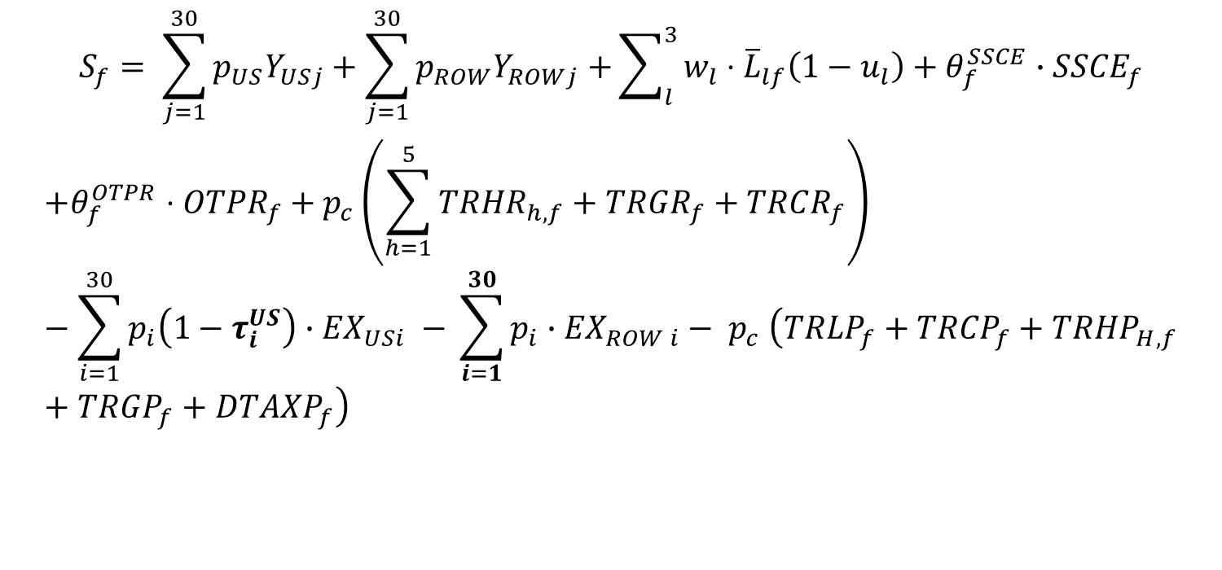
Foreign Savings
$$S_{f}= \sum_{j=1}^{30}{p_{US}Y_{USj}+\sum_{j=1}^{30}{p_{ROW}Y_{ROWj}+}\sum_{l}^{3}{w_{l}⋅{\overline{L}}_{lf}\left(1−u_{l}\right)}+θ_{f}^{SSCE}}∙{SSCE}_{f}$$
$$+θ_{f}^{OTPR}⋅{OTPR}_{f}+p_{c}\left(\sum_{h=1}^{5}{TRHR_{h,f}}+TRGR_{f}+TRCR_{f}\right)−\sum_{i=1}^{30}{{p_{i}\left(1−τ_{i}^{US}\right)∙EX}_{USi} }{− \sum_{i=1}^{30}{{p_{i}∙EX}_{ROW i}}− p}_{c}\left(TR{LP}_{f}+{TRCP}_{f}+TRHP_{H,f}+TRGP_{f}+DTAXP_{f}\right)$$

Slide 27

$$\frac{\hat{w}}{p}={\left(\frac{1−\hat{u}}{1−\overline{u}}\right)}^{\frac{1}{γ}}$$
$γ$= 0 flexible wage U = U0
$γ$ = $∞$ rigid wage

