Slide 1
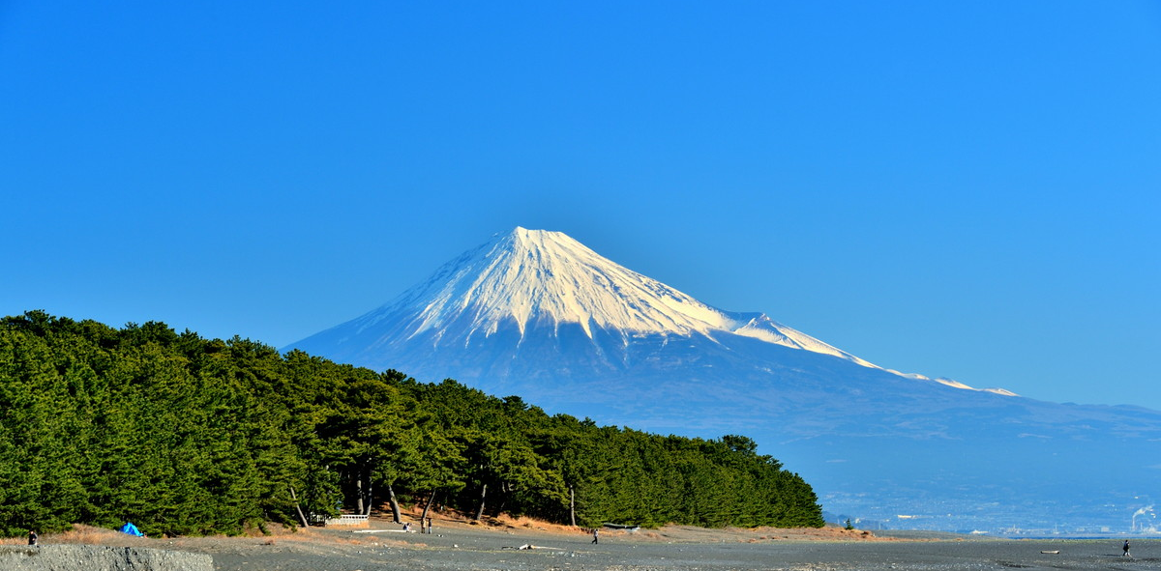
Environmental and Economic Consequences of Population Migration
from the Tokyo Metropolitan Area
Kairi Inoue¹, Sho Uehara¹, Mami Matsuse¹, Shigemi Kagawa²
1) Graduate School of Economics, Kyushu University, Fukuoka, Japan
2) Faculty of Economics, Kyushu University, Fukuoka, Japan
Email: inoue.kairi.992@s.kyushu-u.ac.jp
Notes:
Hello I’m Kairi Inoue. I’m from Kyushu university, Japan. My study is Environmental and Economic Consequences of Population Migration from the Tokyo Metropolitan Area.

Slide 2
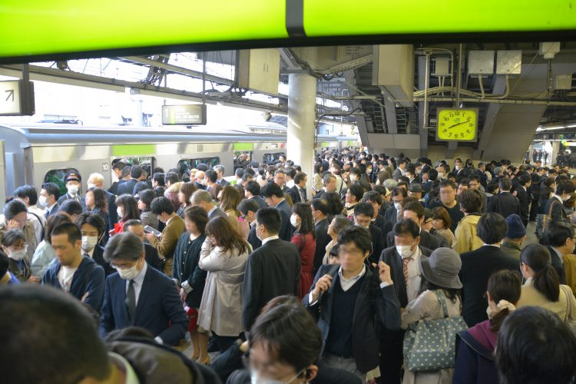
Notes:
This is a train station in Tokyo - in the morning.
Some trains are very crowded(クラウディッド) with more than / twice their capacity.

Slide 3
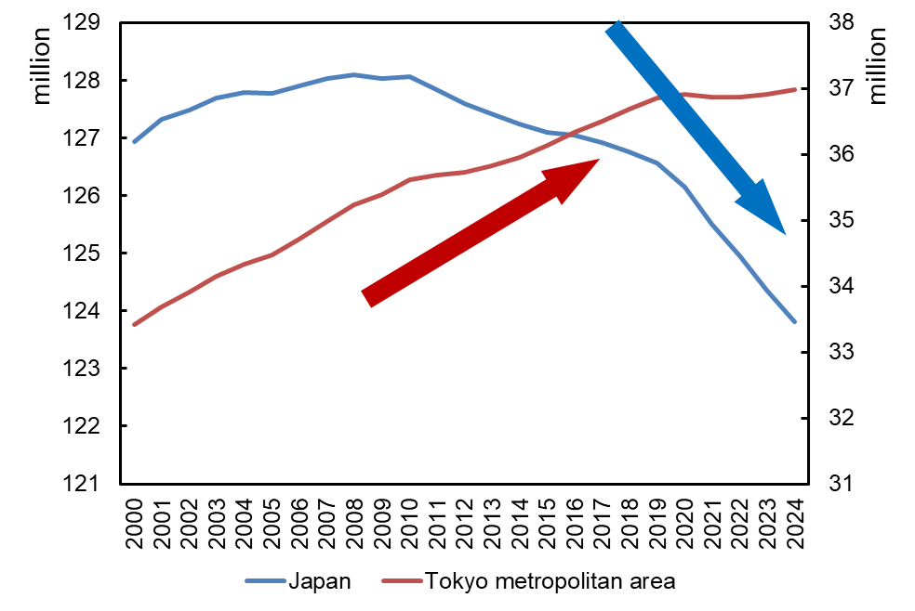
1. Introduction - overconcentration in Tokyo -
1
The population in Japan has been declining.
Population of Tokyo metropolitan area
Population of Japan
The population in the Tokyo metropolitan area has been growing.
Figure 1 : Population trends in the
Tokyo metropolitan area and Japan
Notes:
First, I’d like to talk about introduction, how serious the overconcentration in the Tokyo area.
This graph shows the population trends in Japan and the Tokyo metropolitan area.
The blue line represents the population in Japan, which has been declining in recent years.
In contrast, the red line represents the population in the Tokyo metropolitan area, which has been growing over time.
As you can see, the concentration of population in Tokyo metropolitan area and depopulation of rural areas has become a major challenge in Japan.

Slide 4
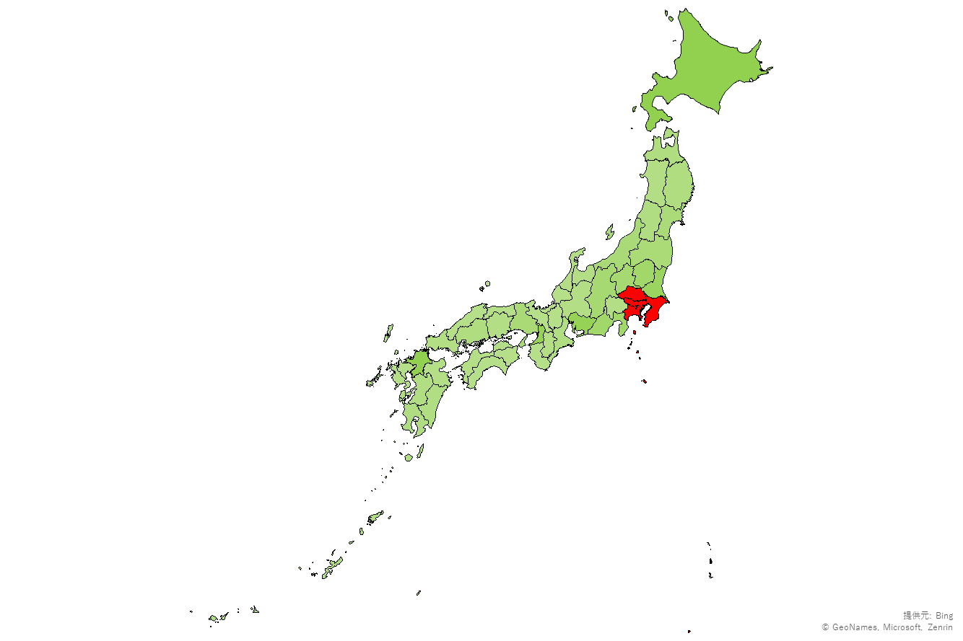
1. Introduction - What is the Tokyo metropolitan area -
2
Tokyo is the largest city in Japan.
- population
- economic sale
Saitama
Tokyo
Chiba
Prefectures other than Tokyo have continued to grow as bedroom communities and satellite cities.
Kanagawa
Figure 2 : A map of the Tokyo metropolitan area
Notes:
This graph shows that a map of the Tokyo metropolitan area.
Tokyo is the capital of Japan and the largest city / in terms of both population and economic scale in Japan.
The area includes(インクルーズ) not only Tokyo but also Saitama, Chiba, and Kanagawa Prefectures.
Prefectures other than Tokyo have continued to bedroom communities and satellite cities.

Slide 5
1. Introduction - the problem of overconcentration in Tokyo -
3
The risk of a huge earthquake hitting Tokyo (The Cabinet Office, 2015)
Heat island phenomenon (Matsumoto et al., 2017)
Driven-up prices and rent (Ministry of Internal Affairs and Communications, 2025)
Notes:
Next, I will introduce some problems caused(コーズド) by serious overconcentration in the area.
For example, there is the risk of a huge earthquake hitting Tokyo, so if that happens, Japan as a whole will suffer a serious impact. In addition, there are heat island phenomenon and an increase in prices and rents.

Slide 6
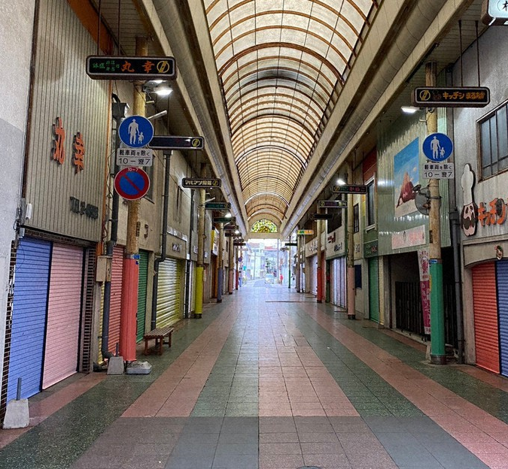
1. Introduction - the problem of depopulation in rural area -
4
The shrinking of regional economics (Ministry of Land, Infrastructure, Transport and Tourism, 2020)
The decline in the diversity of jobs and services. (Ministry of Land, Infrastructure, Transport and Tourism, 2016)
Notes:
In contrast, rural(ルーロー) areas face serious problems / due to the decrease in population.
That leads to some problems, for example, / shrinking its economy and declining the diversity of jobs and services.
This photo shows a street lined with closed shops.
This scene has become common across Japan.

Slide 7
1. Introduction - national and local government initiatives -
5
National Government
The Digital Garden City Nation Initiative, it aims to resolve overconcentration in the Tokyo metropolitan area. (The Cabinet Office, 2021)
This initiative has target index that a net outflow of 10,000 people from the Tokyo metropolitan area.
Local Governments
Providing migration subsidies to attract migrants and business.
Notes:
Against this background, / the national government and local government take some actions. For example, national government set the Digital Garden City Nation Initiative, / it aims to resolve(リソーブ) overconcentration in Tokyo metropolitan area. The initiative has target index that a net outflow of 10,000 people from Tokyo metropolitan area. Also, local governments provide migration subsidies to attract migrants and businesses.

Slide 8
1. Introduction - national and local government initiatives -
5
National Government
The Digital Garden City Nation Initiative, it aims to resolve overconcentration in the Tokyo metropolitan area. (The Cabinet Office, 2021)
Resarch question:
Could population migration also have
negative effects?
This initiative has target index that a net outflow of 10,000 people from the Tokyo metropolitan area.
Local Governments
Providing migration subsidies.
Notes:
But we have a question here,
Could population migration also have negative effects?
This time, we focus on the environmental impacts through population migration, because there are several previous researches / which point out the problem.

Slide 9


2. Literature review
6
Bu et al. (2022) estimated how population migration in China changes CO₂ emissions using Environmentally extended input-output (EEIO) analysis.
The results show that both direct and indirect CO₂ emissions increase. In particular, the increase in indirect emissions driven by consumption is the main factor.
Komatsu et al.(2013) estimated how population migration changes CO₂ emissions from the household sector in Hanoi, Vietnam.
The results show that population migration reduces CO₂ emissions.
Notes:
Bu at al. estimated how population migration in China changes(チェンジズ) CO₂ emissions / using Environmentally extended input-output (EEIO) analysis. The results show that / both direct(ドゥレクゥトゥ) and indirect(インドゥレクゥトゥ) CO₂ emissions increase.
In particular, they found that the increase in indirect(インドゥレクゥトゥ) emissions driven by consumption is the main factor behind the overall rise - in CO₂ emissions.
And Komatsu et, al. estimated how population migration changes CO₂ emissions from the household sector in Hanoi, Vietnam.
The results show that population migration reduces CO₂ emissions.

Slide 10
2. Literature review
6
The impact of population movement on the environment differs depending on a country’s stage of development and industrial structure.
Bu et al. (2022) estimated how population migration in China changes CO₂ emissions using EEIO (environmental extended input-output analysis).
Previous study of the environmental impacts of internal migration in Japan is limited, and how government migration policies affect the environment is still unknown.
The results show that both direct and indirect CO₂ emissions increase. In particular, the increase in indirect emissions driven by consumption is the main factor.
By evaluating not only economic impacts but also environmental impacts, this study aims to provide policy implication for sustainable policy.
Komatsu et, al. estimated how population migration changes CO₂ emissions from the household sector in Hanoi, Vietnam.
The results show that population migration reduces CO₂ emissions.
Notes:
As these previous studies show, the impact of population movement on the environment / differs depending on / a country’s stage of development and industrial structure.
In addition, previous study of the environmental impacts of internal migration in Japan is limited, and how / government migration policies affect the environment is still unknown.
By evaluating not only economic impacts but also environmental impacts, this study aims - to provide – policy - implications for sustainable policy.

Slide 11


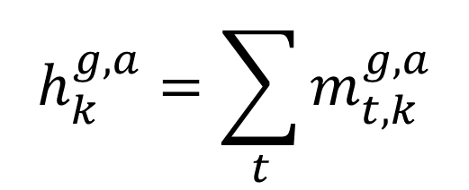
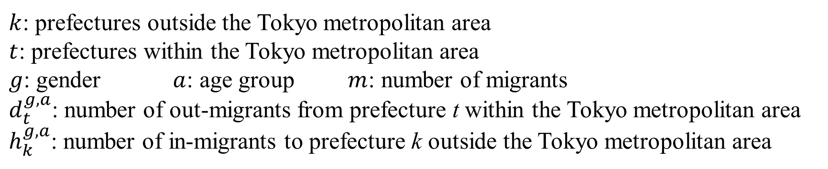
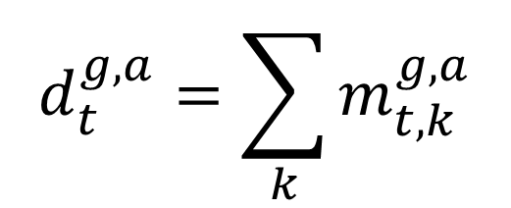
3. Methodology - Estimation of in/out-migrants by attributes-
7
A net outflow of 10,000 people from the Tokyo metropolitan area.
(the Digital Garden City National Initiative and migration, 2021)
Allocated 10,000 people of out-migrants based on 2015 data on the number of people out-migrants from the Tokyo metropolitan area to each prefecture.
$$d_{t}^{g,a}=\sum_{k}{m_{t,k}^{g,a}}$$
$$h_{k}^{g,a}=\sum_{t}{m_{t,k}^{g,a}}$$
$$t$$
$$k$$
$k$: prefectures outside the Tokyo metropolitan area
$t$: prefectures within the Tokyo metropolitan area
$g$: gender $a$: age group $m$: number of migrants
$d_{t}^{g,a}$: number of out-migrants from prefecture t within the Tokyo metropolitan area
$h_{k}^{g,a}$: number of in-migrants to prefecture k outside the Tokyo metropolitan area
Notes:
Next, I’d like to introduce our methodology.
Firstly, we estimated the number of in and out-migrants by attributes.
In this study, the number of migrants is based on the Digital Garden City Nation Initiative. That Initiative’s - target index is / a net outflow of 10,000 people from the Tokyo metropolitan area.
So, we allocated the 10,000 people of out-migrants based on 2015 data on the number of people out-migrants from the Tokyo metropolitan area to each prefecture.
We used this equation / to calculate the number of migrants in each prefecture.
k represents prefectures outside the Tokyo metropolitan area / which are green area in this picture.
𝑡 represents prefectures within the Tokyo metropolitan area which are red area in this picture.
g is gender, a is age group, and m is number of migrants.
So, d, 𝑡, 𝑔, 𝑎 represents the number of out-migrants from prefecture t within the Tokyo metropolitan area.
m, 𝑘, 𝑔, 𝑎 represents the number of in-migrants to prefecture k outside the Tokyo metropolitan area.

Slide 12

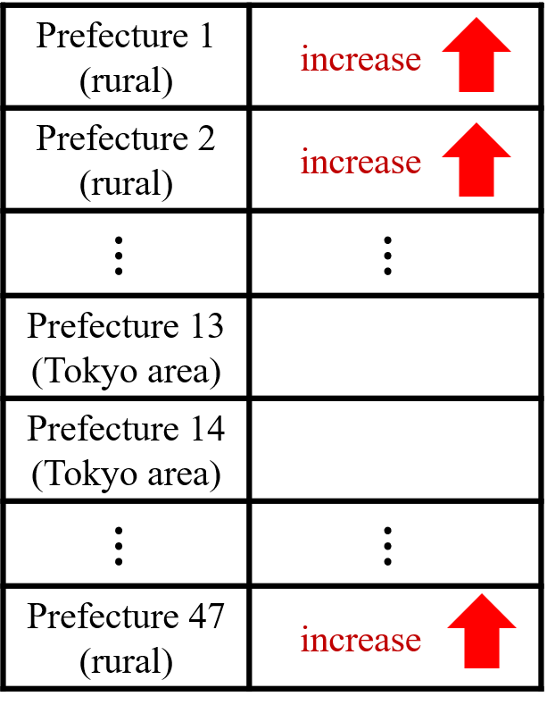
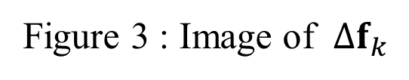

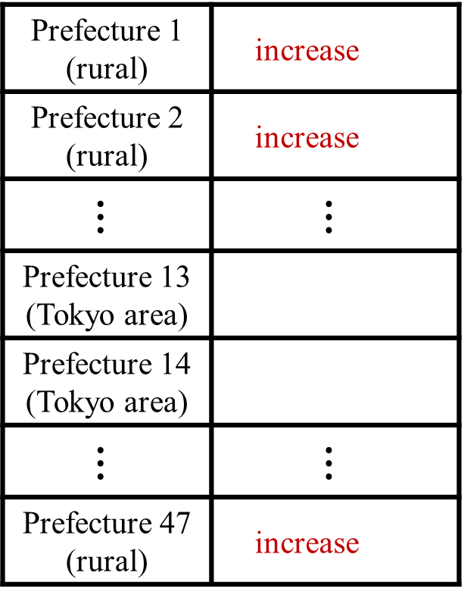

3. Methodology - Estimation of changes in household consumption -
8
Increase in final consumption expenditure in each prefecture without the Tokyo metropolitan area due to out-migrants
Prefecture 1 (rural) | increase
Prefecture 2 (rural) | increase
$$⋮$$ | $$⋮$$
Prefecture 13 (Tokyo area)
Prefecture 14 (Tokyo area)
$$⋮$$ | $$⋮$$
Prefecture 47 (rural) | increase
$k:$ prefectures without the Tokyo metropolitan area
$g$: gender $a$: age group
$∆f_{k}$: change vector of the final consumption expenditure in prefecture $k$
$h_{k}^{g,a}$: number of in-migrants from prefecture k within the Tokyo metropolitan area
$c_{k}^{g,a}$: vector of average per capita consumption expenditure on goods and services in prefecture $k$, estimated based on average income
Figure 3 : Image of $∆f_{k}$
$$\begin{aligned}∆f_{k}=\sum_{g}{\sum_{a}{h_{k}^{g,a}c_{k}^{g,a}}}\#\#\#\#\#(1)\end{aligned}$$
Notes:
Next, we estimated the changes in household consumption.
This equation represents the increase in final consumption expenditure in each prefecture except the Tokyo metropolitan area / due to in-migrants.
$∆f_{k}$is the change vector of the final consumption expenditure in prefecture $k$
h, k, g, a is the number of in-migrants to prefecture $k$ outside the Tokyo metropolitan area
c, k, g, a is the vector of average per capita consumption expenditure / on goods and services in prefecture $k$, estimated based on average income.
$∆f_{k}$ is always positive(パジティブ) because prefecture k receives only in-migrants, as shown in Figure 3.

Slide 13
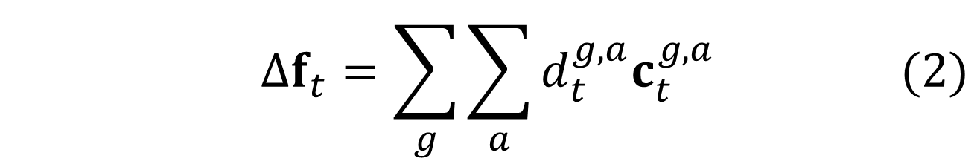
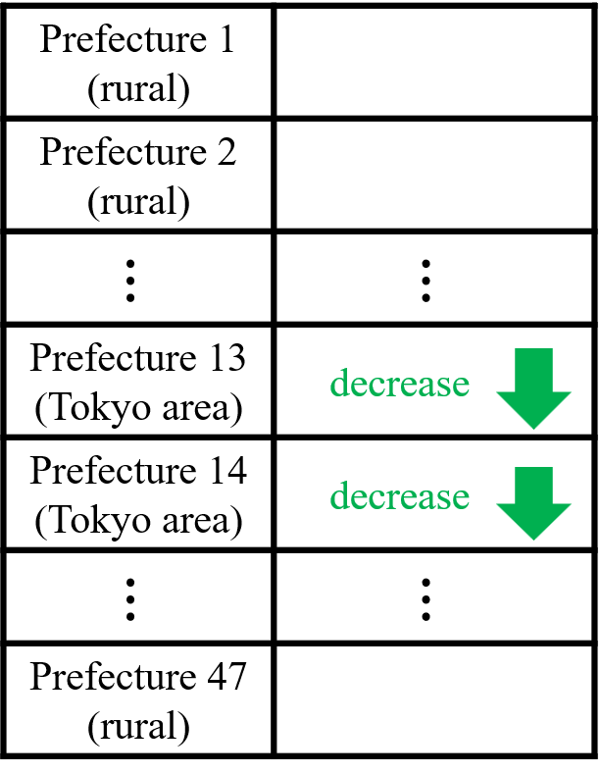

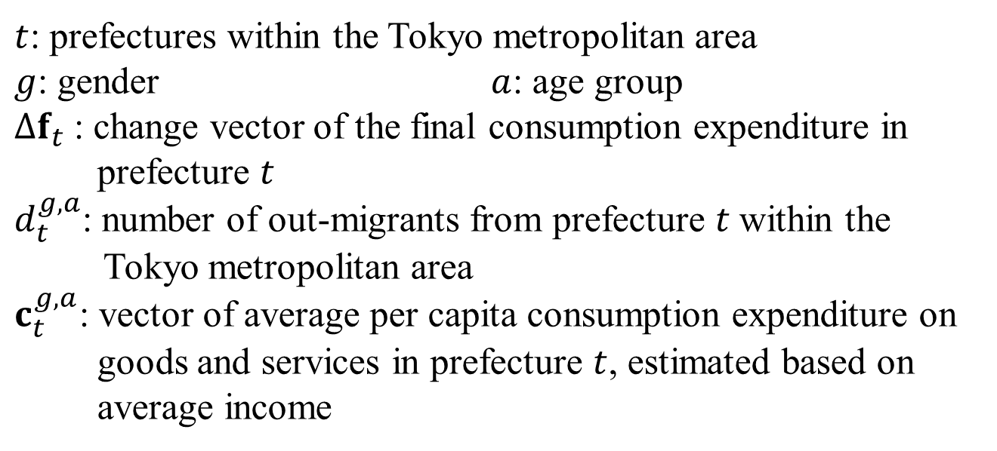
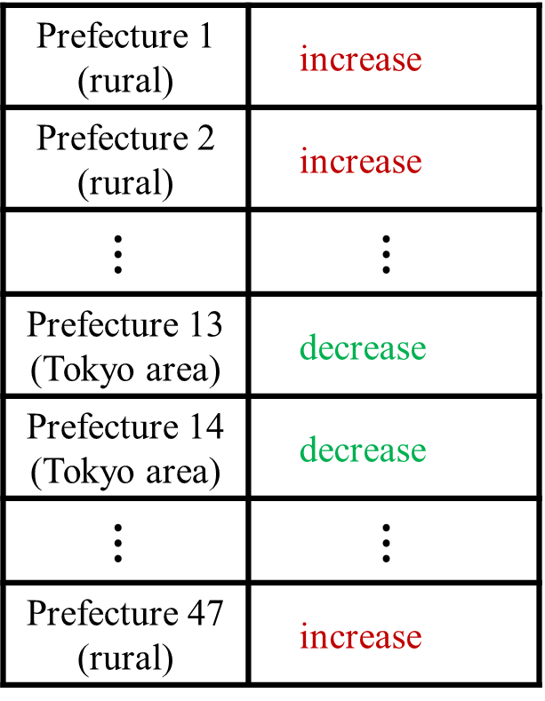
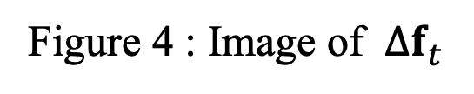
3. Methodology - Estimation of changes in household consumption -
9
Decrease in final consumption expenditure in each prefecture within the Tokyo metropolitan area due to out-migrants
Prefecture 1 (rural) | increase
Prefecture 2 (rural) | increase
$$⋮$$ | $$⋮$$
Prefecture 13 (Tokyo area) | decrease
Prefecture 14 (Tokyo area) | decrease
$$⋮$$ | $$⋮$$
Prefecture 47 (rural) | increase
$t$: prefectures within the Tokyo metropolitan area
$g$: gender $a$: age group
$∆f_{t}$: change vector of the final consumption expenditure in prefecture $t$
$d_{t}^{g,a}$: number of out-migrants from prefecture $t$within the Tokyo metropolitan area
$c_{t}^{g,a}$: vector of average per capita consumption expenditure on goods and services in prefecture $t$, estimated based on average income
Figure 4 : Image of $∆f_{t}$
$$\begin{aligned}∆f_{t}=\sum_{g}{\sum_{a}{d_{t}^{g,a}c_{t}^{g,a}}}\#\#\#\#(2)\end{aligned}$$
Notes:
In similarly, using $d_{t}^{g,a}$, in prefecture $t$ within the Tokyo metropolitan area, the change of final consumption expenditure, $∆f_{t}$, can be estimated using the following equation.
Here, $c_{t}^{g,a}$ is vector representing the average consumption expenditure of / goods and services per capital, based on the average income by gender and age in prefecture $t.$
And Figure 4 shows image of $∆f_{t}$

Slide 14
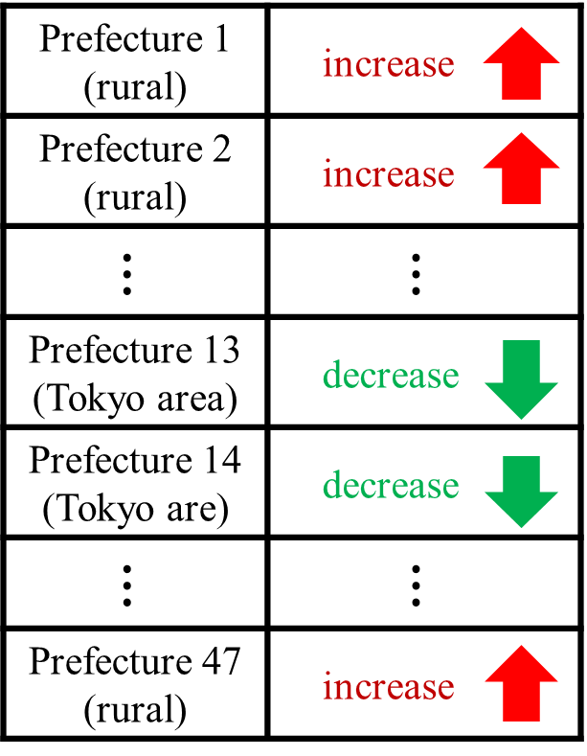

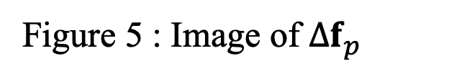

3. Methodology - Estimation of changes in household consumption -
10
Change in final consumption expenditure due to migration
$$\begin{aligned}{∆f}_{p}= Δf_{k} − Δf_{t} \#\left(3\right)\end{aligned}$$
Prefecture 1 (rural) | increase
Prefecture 2 (rural) | increase
$$⋮$$ | $$⋮$$
Prefecture 13 (Tokyo area) | decrease
Prefecture 14 (Tokyo are) | decrease
$$⋮$$ | $$⋮$$
Prefecture 47 (rural) | increase
Increase in rural area
Decrease in the Tokyo metropolitan area
$k$ : prefectures outside the Tokyo metropolitan area
$t$ : prefectures within the Tokyo metropolitan area
$p$ : prefectures in Japan.
$Δf_{k}$ : increase vector of final consumption expenditure due to in-migrants
$Δf_{t}$ : decrease vector of final consumption expenditure due to out-migrants
${∆f}_{p}$: change vector of final consumption expenditure in prefecture $p$ due to migration
Figure 5 : Image of ${∆f}_{p}$
Notes:
Then, the change in household consumption in prefecture $p$, Japan as a whole, $∆f_{p}$, can be estimated using the following equations.
Here, $p$ represents all prefectures, including both $t$ and $k$.

Slide 15
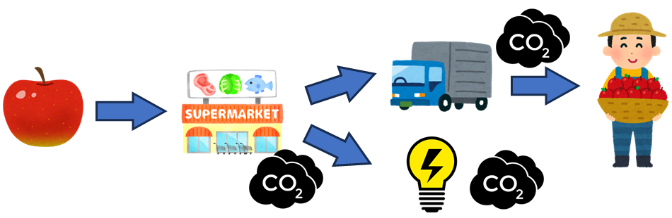
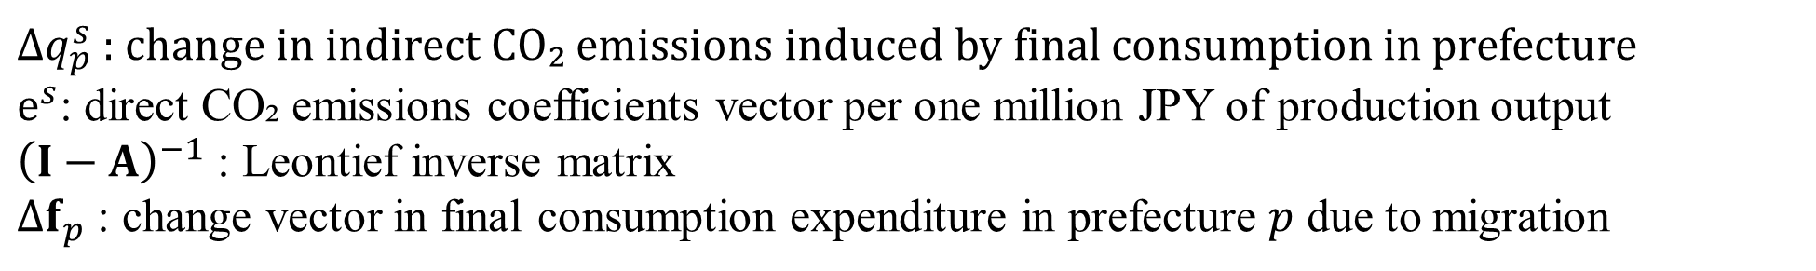
3. Methodology - Estimation of indirect CO₂ emissions -
11
Change in indirect CO₂ emissions induced by household consumptions
${∆q}_{p}^{s}$ : change in indirect CO₂ emissions induced by final consumption in prefecture
$e^{s}$: direct CO₂ emissions coefficients vector per one million JPY of production output
${\left(I−A\right)}^{−1}$ : Leontief inverse matrix
${∆f}_{p}$ : change vector in final consumption expenditure in prefecture $p$ due to migration
$$\begin{aligned}\begin{aligned}∆q_{p}^{s}=e^{s}{(I−A)}^{−1}{∆f}_{p}\#\#\end{aligned}\#\#(4)\end{aligned}$$
Notes:
Next, we estimated the change in indirect(インドゥレクゥトゥ) CO₂ emissions / induced by household consumptions in prefecture p, which is ${∆q}_{p}^{s}$.
e, s is direct CO₂ emissions coefficients vector per one million JPY of production output.
${\left(I−A\right)}^{−1}$ is Leontief inverse matrix.
${∆f}_{p}$ is change vector in final consumption expenditure in prefecture $p$ / due to migration.
In other words, this equation shows supply chain / induced by change in consumption due to migration.

Slide 16


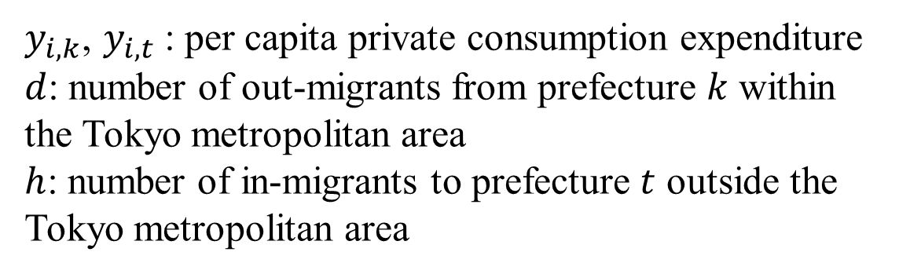
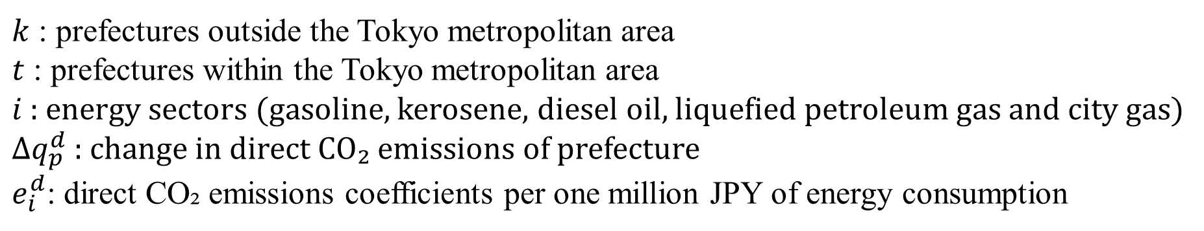
3. Methodology - Estimation of direct CO₂ emissions -
12
Change in direct CO₂ emissions from household consumptions
$k$ : prefectures outside the Tokyo metropolitan area
$t$ : prefectures within the Tokyo metropolitan area
$i$ : energy sectors (gasoline, kerosene, diesel oil, liquefied petroleum gas and city gas)
${∆q}_{p}^{d}$ : change in direct CO₂ emissions of prefecture
$e_{i}^{d}$: direct CO₂ emissions coefficients per one million JPY of energy consumption
$y_{i,k}$, $y_{i,t}$: per capita private consumption expenditure
$d$: number of out-migrants from prefecture $k$ within the Tokyo metropolitan area
$h$: number of in-migrants to prefecture $t$ outside the Tokyo metropolitan area
$$\begin{aligned}∆q_{p}^{d}=\sum_{i}{e_{i}^{d}y_{i,k}h_{k}}−\sum_{i}{e_{i}^{d}y_{i,t}d_{t}}\#\#\#(5)\end{aligned}$$
Notes:
Next, we estimated the change in direct(ドゥレクゥトゥ) CO₂ emissions from household consumptions in prefecture p, which is $∆q_{p}^{d}$.
$e_{i}^{d}$is a direct CO₂ emissions coefficients per one million JPY of production output in sector $i$.
The sector$i$represents gasoline, kerosene(ケロシーン), diesel oil, liquefied (リキュファイド) petroleum gas and city gas. $y_{i,k} and y_{i,t}$ represent per capita private consumption expenditure for energy sector $i$ in each prefecture. And, d and h represent the number of out-migrants and in-migrants from Tokyo metropolitan area to rural area respectively(リスペク タ ブゥリィー).

Slide 17
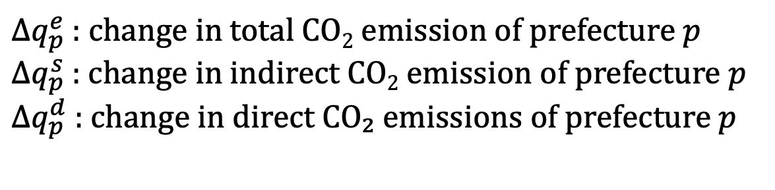
3. Methodology - Estimation of CO₂ emissions -
13
Chage in total CO₂ emissions
$$\begin{aligned}Δq_{p}^{e}= Δq_{p}^{s} + Δq_{p}^{d} \#\left(6\right)\end{aligned}$$
Indirect emissions
Direct emissions
$Δq_{p}^{e}$ : change in total CO₂ emission of prefecture $p$
$Δq_{p}^{s}$ : change in indirect CO₂ emission of prefecture $p$
${∆q}_{p}^{d}$ : change in direct CO₂ emissions of prefecture $p$
Notes:
Finally, we estimated the change in the total CO₂ emissions, in prefecture $p$, which is $∆q_{p}^{e}$. In other words, $∆q_{p}^{e}$ is include not only emission from industries but also energy consumption.
.

Slide 18






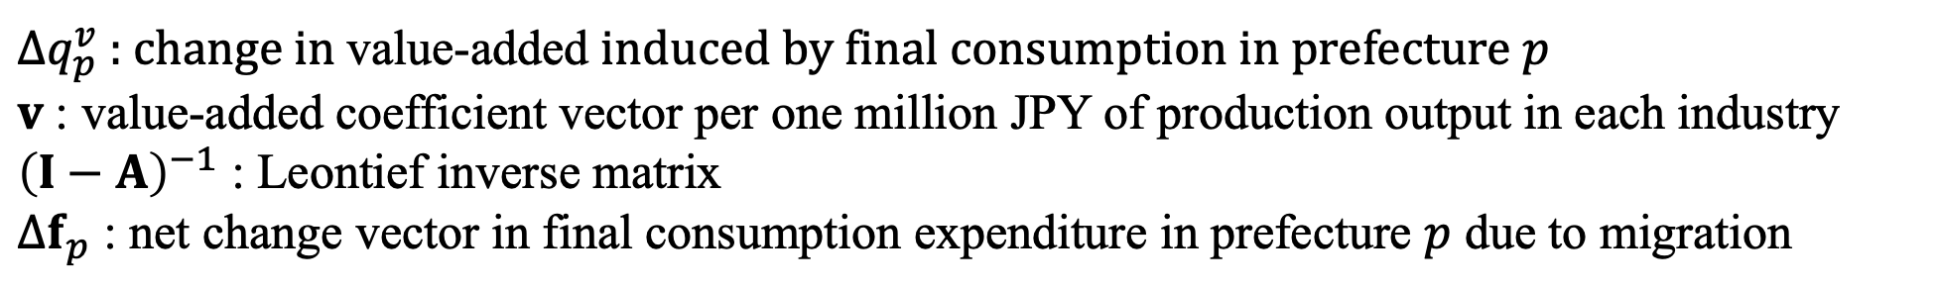
3. Methodology - Estimation of value added -
14
Chage in value added
${∆q}_{p}^{v}$ : change in value-added induced by final consumption in prefecture $p$
$v$: value-added coefficient vector per one million JPY of production output in each industry
${\left(I−A\right)}^{−1}$ : Leontief inverse matrix
${∆f}_{p}$ : net change vector in final consumption expenditure in prefecture $p$ due to migration
$$\begin{aligned}∆q_{p}^{v}={v\left(I−A\right)}^{−1}∆f_{p}\#\#\#\#(7)\end{aligned}$$
Notes:
Next, we estimated the change in value added, which is $∆q_{p}^{v}$, induced by final consumption change in prefecture p by migration, which is ${∆f}_{p}$. Here, $v$ is value-added coefficient vector per one million JPY of production output in each industry.

Slide 19
4. Data
15
Report on Internal Migration in Japan Derived from the Basic Resident Registration (Ministry of Internal Affairs and Communications)
Long-Term Time-Series Data from the population Estimates (Ministry of Internal Affairs and Communications)
Statistical Survey of Actual Status for Salary in the Private Sector (2015) (National Tax Agency)
Basic Survey on Wage Structure (2015) (Ministry of Health, Labor and Welfare)
Annual Report on the Family Income and Expenditure Survey, Income and Expenditure Section (2015) (Ministry of Internal Affairs and Communications)
Inter-Prefectural Multi-Regional Input-Output Table (MRIO) (2015) (Matsuse et al., 2025)
Embodied Energy and Emission Intensity Data for Japan Using Input-Output Table (3EID) (National Institute for Environmental Studies)
Notes:
These are main data.

Slide 20
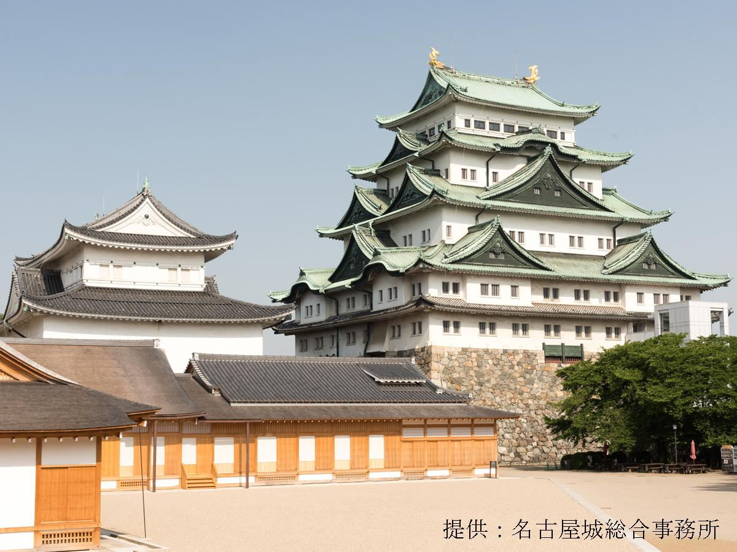
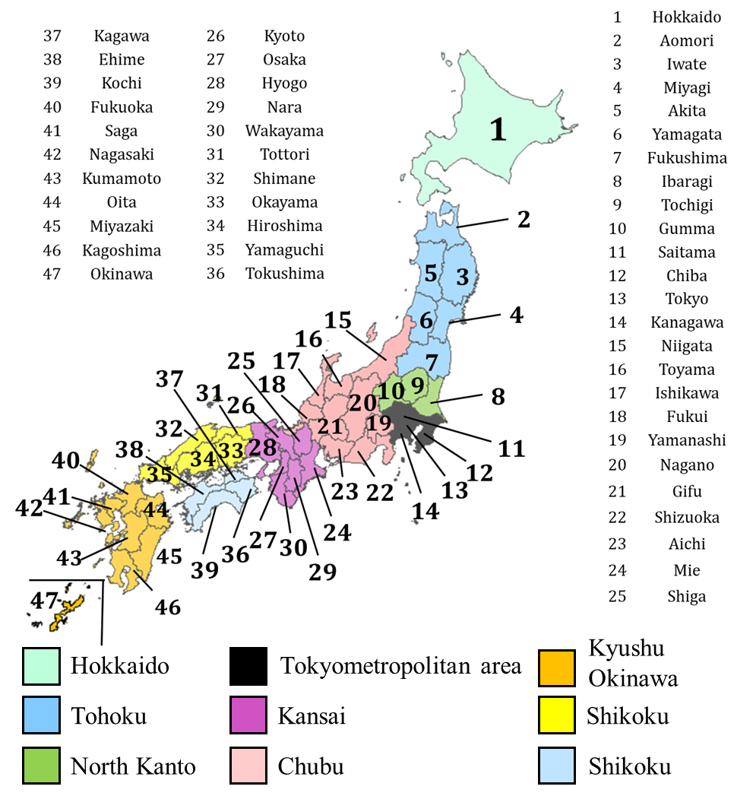



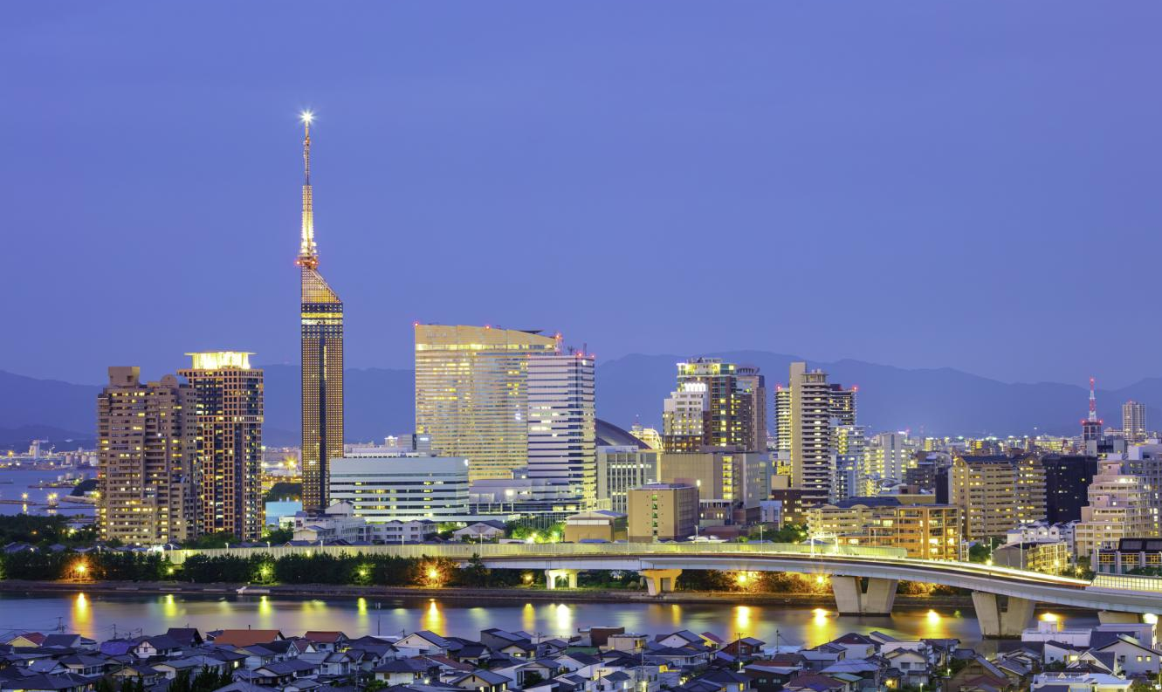

4. Data
16
Nagoya
Kyoto
Fukuoka
Figure 6 : A map of Japan
Notes:
To understand this study, for basic data, I introduce Japan. Japan has 47 prefectures and can be divided into 9 regions.
Starting from the region / containing the prefecture with the lowest number, Hokkaido, Tohoku, North Kanto, Tokyo metropolitan area, Chubu, Kansai, Tyugoku, Shikoku, Kyushu-Okinawa.
For example, Chubu has headquarters of TOYOTA, Kansai has Kyoto, Kyushu-Okinawa has Fukuoka.

Slide 21
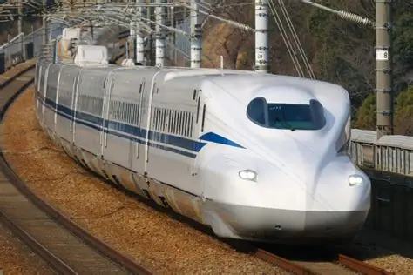

5. Results - Basic information -
17
< Largest migrant population >
Chubu area
- Good accessibility
- Large industrial scale
10,000 people
in total
< Second largest migrant population >
Kansai area
- 3 major cities
(Osaka, Kyoto and Kobe)
Figure 7 : The number of migrants from the Tokyo metropolitan area to each region and their composition ratios.
Notes:
First, I would like to show you the basic information results on the number of out-migration from the Tokyo metropolitan area to each region.
Figure 7 shows the number of migrants from the Tokyo metropolitan area to each region and their composition ratios(レイシオズ).
The Chubu area, shown in red, has the largest number of migrants.
We believe that there are two reasons why the area is most popular.
Firstly, its good accessibility from anywhere because the Shinkansen passes through the region.
Secondly, its large industrial scale because major Japanese transportation manufacturers, such as Toyota, Suzuki, and Yamaha, are located there.
And, The Kansai area, shown in pink, has the second largest number of migrants.
One reason why this area attracts many people is that it includes major cities such as Osaka, Kyoto, and Kobe.

Slide 22
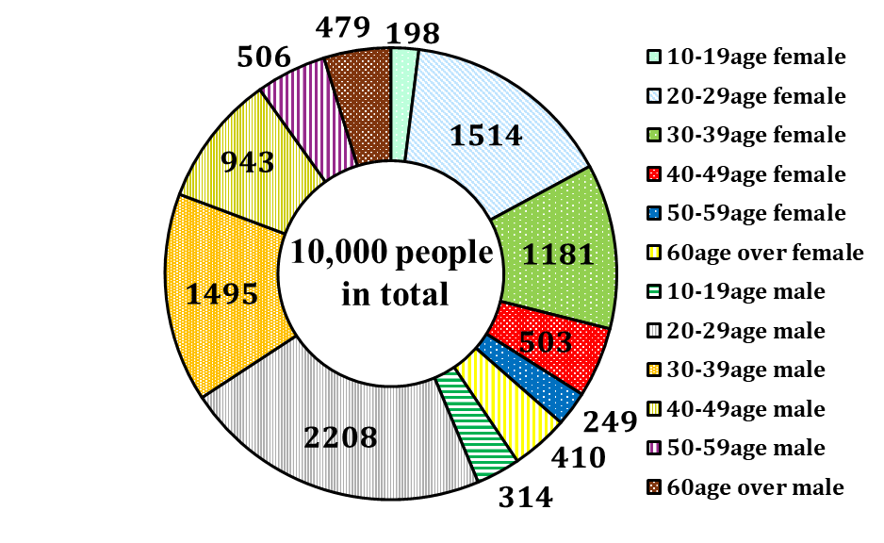
5. Results - Basic information -
18
< Age groups >
Aged 20–29 and 30–39 account for large shares.
This is considered to life-stage events, such as U-turn employment and job transfers.
< Gender >
Men account for a larger share.
This may also be due to work-related reasons, such as job transfers.
Figure 8 : The number of migrants from the Tokyo metropolitan area by age group and gender, together with their composition ratios.
Notes:
Figure 8 shows the number of migrants from the Tokyo metropolitan area by age group and gender, together with their composition ratios.
From the perspective of age group, those aged 20–29 and 30–39 account for large shares. This is considered life-stage events, such as U-turn employment and job transfers.
From perspective of gender, men account for a larger share. This may also be due to work-related reasons, such as job transfers.

Slide 23
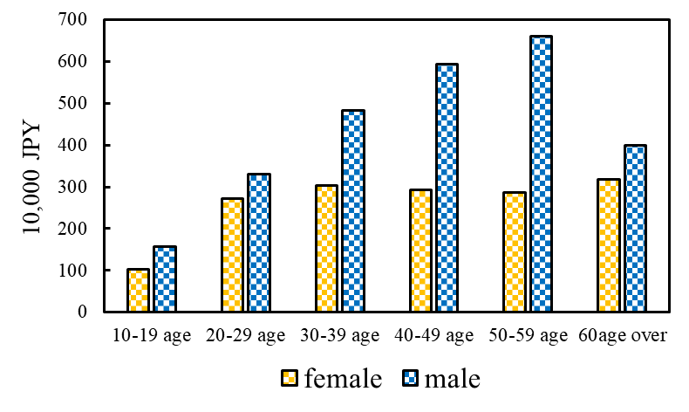
5. Results - Basic information -
17
< Male >
Male’s income gradually increases up to the 50-59 age group due to the Japanese seniority-based employment system.
< Female >
Female’s income remains at similar levels across age groups.
Figure 7 : Average income by age and gender group.
Notes:
Next, I would like to talk about the average income by age and gender group in Figure 9. bule bar is the average income of male in each age group. yellow bar is the average income of female in each age group. In terms of male, its income increases up to the 50–59 age group, strongly reflecting Japan’s seniority(シニアリティ)-based employment system. In contrast, Femal’s income remains at similar levels across age groups. The results also indicate gender income gap.

Slide 24
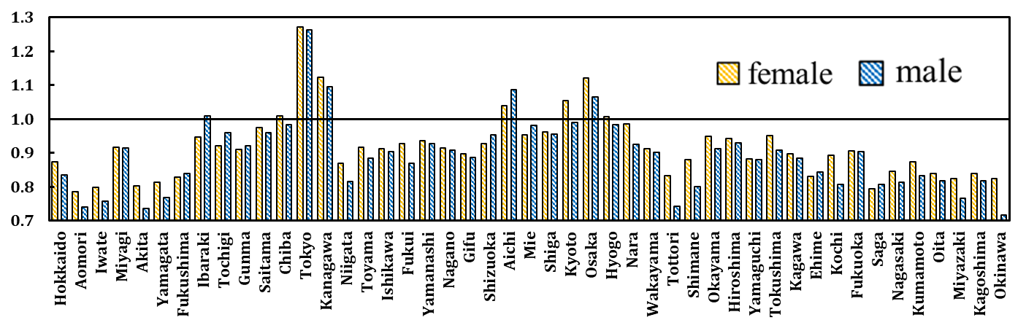
5. Results - Basic information -
18
There is large difference between each prefecture.
Tokyo is the highest wage level in all prefectures.
Figure 7 : Gap of wage across prefectures, arranged by gender and prefecture.
Notes:
Next, we’d like to look at the gap problem of wage(ウエィジ) - across prefectures, arranged by gender and prefecture in Figure 7.
The vertical axis represents the wage(ウエィジ) index. A value of 1.0 indicates the average wage in Japan. The yellow bars show the wage index for female in each prefecture, while(ワイエオ) The blue bars show the wage index for male in each prefecture.
There are large differences among(アマング) prefectures. Tokyo has the highest wage level in all prefectures.
In other words, if people living in Tokyo move to rural areas, their average wage may decrease.

Slide 25
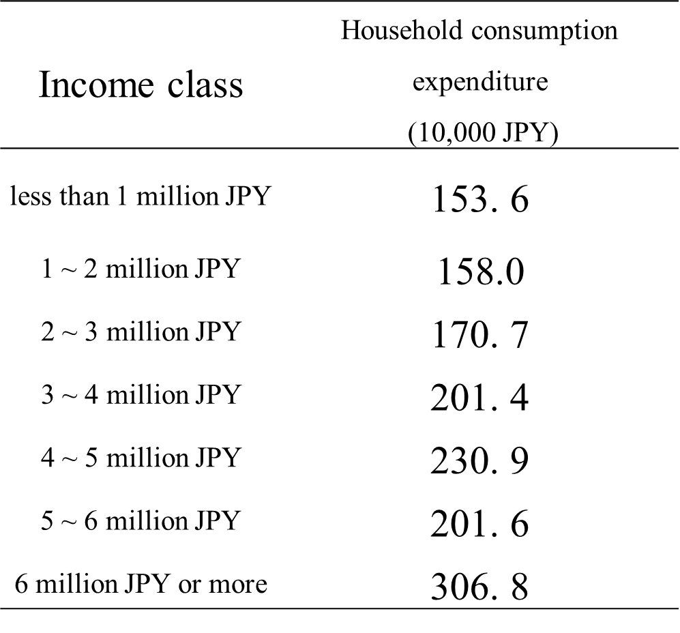
5. Results - Basic information -
19
Table 1 : Household consumption expenditure by income class.
In general, consumption expenditure increases as income class rises.
Income class | Household consumption expenditure (10,000 JPY)
less than 1 million JPY | 153. 6
1 ~ 2 million JPY | 158.0
2 ~ 3 million JPY | 170. 7
3 ~ 4 million JPY | 201. 4
4 ~ 5 million JPY | 230. 9
5 ~ 6 million JPY | 201. 6
6 million JPY or more | 306. 8
Notes:
Next is about household consumption expenditure by income class in Table 1.
In general(ジェネロー), consumption expenditure increases / as income class rises.

Slide 26
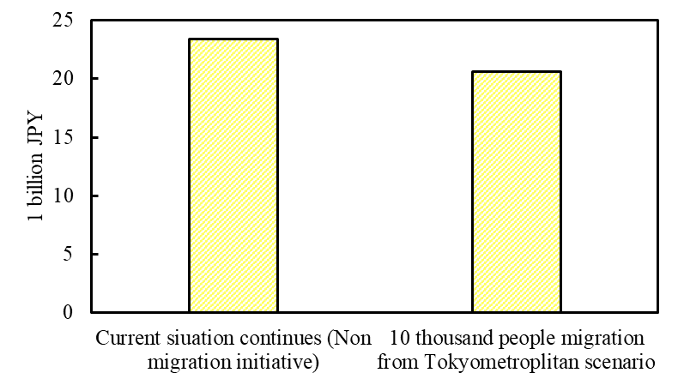
5. Results
20
Household consumption expenditure decreases by about 2.9 billion JPY, or 12%, under the 10,000 migrants initiative.
This is due to a decrease in income.
Figure 8 : Total household consumption expenditure
with and without migration initiatives.
Notes:
Let’s move to our main results.
Firstly, I’d like to explain about the change in total household consumption expenditure / with and without migration initiatives in Figure 8. Household consumption expenditure decreases by about 2.9 billion JPY, or 12%, under the 10,000-migrant initiative.
This is due to a decrease in income.

Slide 27
5. Results - CO₂ emissions -
21
Although total CO₂ emissions do not change significantly,
Indirect CO₂ emissions ↓
Direct CO₂ emissions ↑
< Indirect emissions decrease>
This is due to a decline in household consumption expenditure.
< Direct emission increase >
This is due to an increase in energy consumption.
- Gasoline for automobile use
- Kerosene for heating
Figure 9 : CO₂ emissions with and without the migration of 10,000 people initiatives.
Notes:
Next is about the difference of CO₂ emissions / with and without the migration of 10,000 people initiatives in Figure 9.
The part of red represents direct(ドゥレクゥトゥ) emission and / the part of blue represents indirect(インドゥレクゥトゥ) emission.
Although total CO₂ emissions do not change significantly(シグニフィカントリー), indirect CO₂ emissions decrease, / whereas(ウェアラス) direct emissions increase.
The decrease in indirect (インドゥレクゥトゥ) CO₂ emissions is due to a decline in household consumption expenditure.
In contrast, the increase in direct CO₂ emissions is due to an increase in energy consumption.
For example, gasoline consumption - associated with automobile use and / increased kerosene consumption for heating.

Slide 28
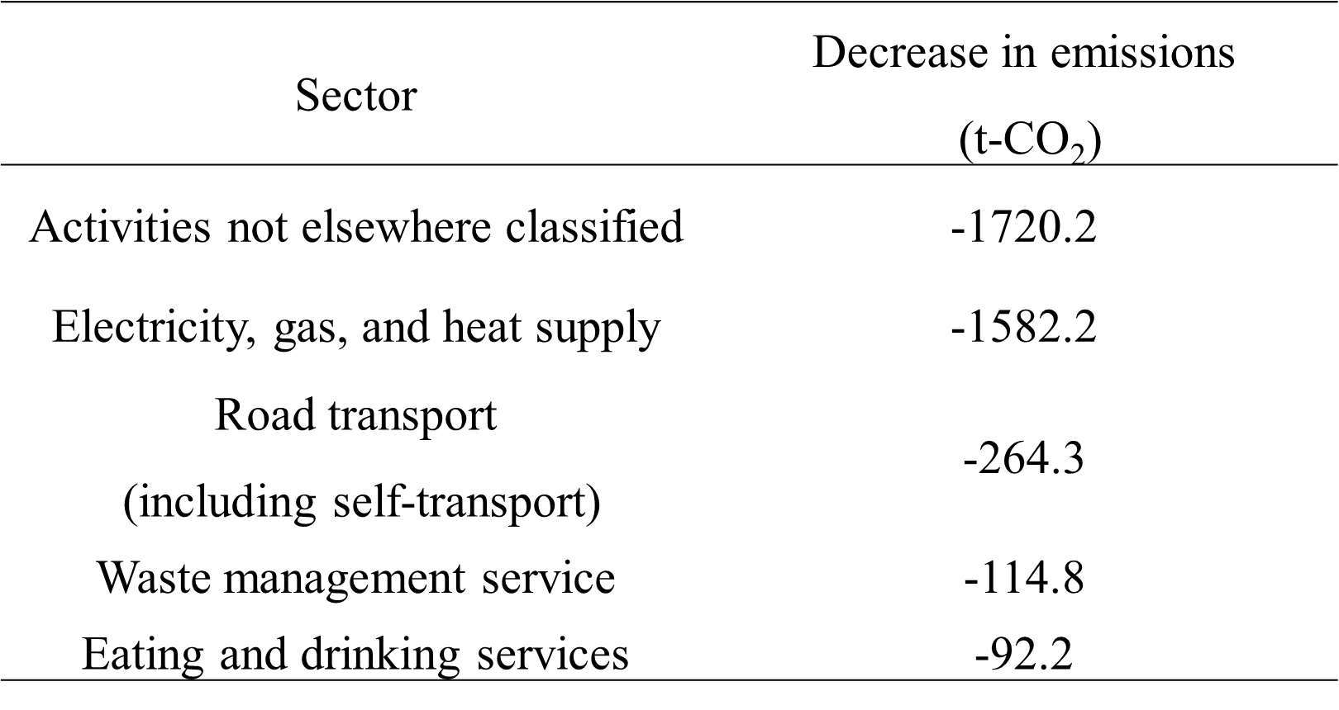



5. Results - CO₂ emissions -
22
Table 1 : The five sectors with the largest expected decreases in CO₂ emissions due to migration.
The reduction in CO₂ emissions is mainly driven by electricity, gas, and heat supply.
It also indicates that urban areas have an electricity-intensive industrial structure.
Sector | Decrease in emissions (t-CO₂)
Activities not elsewhere classified | -1720.2
Electricity, gas, and heat supply | -1582.2
Road transport (including self-transport) | -264.3
Waste management service | -114.8
Eating and drinking services | -92.2
Notes:
So, let’s see the top(タップ) sectors which contributes the CO₂ emissions reduction.
Table 2 shows the five sectors with the largest expected decreases in CO₂ emissions due to migration.
The largest decrease is in activities not elsewhere classified.
The second largest decrease is in electricity, gas, and heat supply, with a reduction of about 1,600 tons of CO₂.
Road transport, waste management services, and eating and drinking services also / show decreases.
Overall, the reduction in CO₂ emissions is mainly driven(ドゥライブン) by activities not elsewhere classified and electricity, gas, and heat supply.
This suggests that many of these sectors are related to urban consumption patterns. It also indicates that / urban areas have an electricity-intensive industrial structure.

Slide 29
5. Results - Value added -
23
This decreases by about 2.5 billion JPY, or 12%, under the 10,000 migrants initiative.
This is due to a decline in household consumption expenditure.
Figure 10 : Value added with and without the migration of 10,000 people initiatives
Notes:
Next, I’d like to represent the results of the value added / with and without the migration of 10,000 people initiatives in Figure 10.
Value added decreases by about 2.5 billion JPY, or 12%, under the 10,000-migrant scenario.
This is due to a decline in household consumption expenditure.

Slide 30
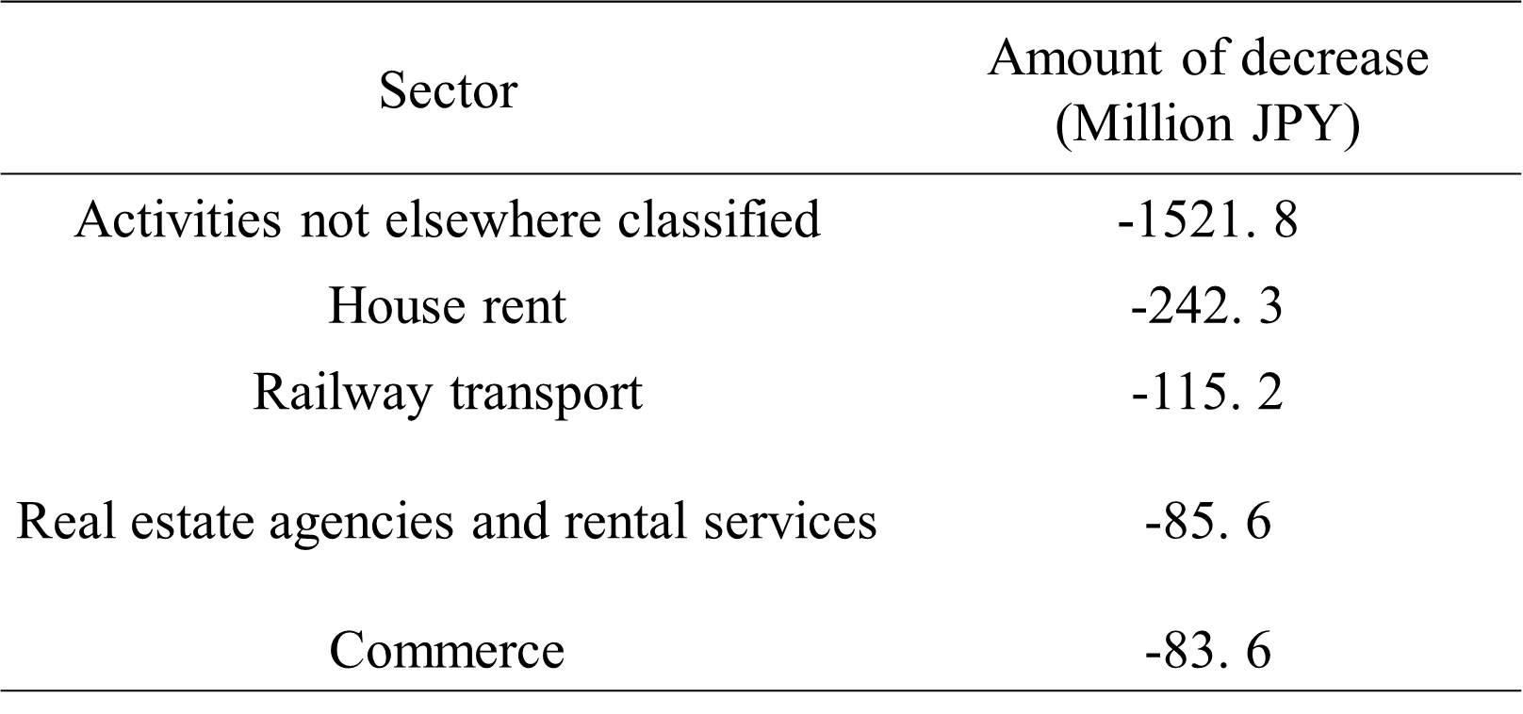
5. Results - Value added -
24
Table 3 : The five sectors with the largest expected decreases in value added due to migration
The largest decrease is in activities not elsewhere classified.
This include head office functions. This is main factor of a decline in value added
Sector | Amount of decrease (Million JPY)
Activities not elsewhere classified | -1521. 8
House rent | -242. 3
Railway transport | -115. 2
Real estate agencies and rental services | -85. 6
Commerce | -83. 6
Notes:
So, let’s see the top(タップ) sectors which contributes the value added reduction.
Table 3 shows the five sectors with the largest expected decreases in value added / due to migration.
The largest decrease is in activities not elsewhere classified, with a reduction of about 1,500 million JPY.
The second largest decrease is in house rent.
Railway transport, Real estate agencies(エイジェンシーズ) and rental services, and Commerce(コマース) also show decreases.
Overall, the reduction in value added is mainly driven by activities not elsewhere classified.
One possible reason for this / is that this sector includes head office functions, which may make a large contribution to value added.
In fact, about 62% of the headquarters of large Japanese companies are located in the Tokyo metropolitan area. This suggests that the Tokyo metropolitan area plays an important role / as a source of value added.

Slide 31
6. Conclusion and Policy implication
25
Conclusion
Although migration initiative provides no environmental benefits, lead to decreasing in GDP in current migration structure.
CO₂ emission
The composition of CO₂ emission changes. Although indirect CO₂ emission is decreasing, direct CO₂ emission is increasing.
Value-added
Activities not elsewhere classified (including the head office function) is main factor of a decline in value added.
Notes:
In conclusion, I will introduce four main findings.
Overall, although for migration initiative provides no environmental benefits, / lead to decreasing in GDP in current migration structure.
In terms of CO₂ emission , even there is not so much big change, the composition of CO₂ emissions changes. While(ワイエオ) indirect(インドゥレクゥトゥ) CO₂ emissions decrease, direct CO₂ emissions increase.
In terms of value added, activities not elsewhere classified including the head office function / is main factor of a decline in value added.

Slide 32


6. Conclusion and Policy implication -
26
Policy implication
Based on these results, promoting migration policies may not be desirable under the current circumstances.
How to improve migration policies
1) Relocate head office functions from the Tokyo metropolitan area to regional areas
2) Developing cities with established public transportation systems, rather than relying on car use.
Notes:
Based on these results, promoting migration policies may not be desirable(デザイラブル) / under the current circumstances.
However, migration policies could be improved by following policies.
First one is relocating head office functions from the Tokyo metropolitan area to rural areas.
Second policy is developing cities with established(イスタブリッシュド) public transportation systems, / rather than relying on car - use.
Once these conditions are in place, migration policies can generate both environmental and economic benefits.

Slide 33

Thank you for your kind attention

Slide 34
Appendix

Slide 35
Appendix
1
< Largest migrant population >
Chubu area
- Good accessibility
- Large industrial scale
10,000 people
in total
< Second largest migrant population >
Kansai area
- 3 major cities
(Osaka, Kyoto and Kobe)
Figure a : The number of migrants from the Tokyo metropolitan area to each region and their composition ratios.
Notes:
First, I would like to show you the basic information results on the number of out-migration from the Tokyo metropolitan area to each region.
Figure 7 shows the number of migrants from the Tokyo metropolitan area to each region and their composition ratios(レイシオズ).
The Chubu area, shown in red, has the largest number of migrants.
We believe that there are two reasons why the area is most popular.
Firstly, its good accessibility from anywhere because the Shinkansen passes through the region.
Secondly, its large industrial scale because major Japanese transportation manufacturers, such as Toyota, Suzuki, and Yamaha, are located there.
And, The Kansai area, shown in pink, has the second largest number of migrants.
One reason why this area attracts many people is that it includes major cities such as Osaka, Kyoto, and Kobe.

Slide 36
Appendix
2
< Age groups >
Aged 20–29 and 30–39 account for large shares.
This is considered to life-stage events, such as U-turn employment and job transfers.
< Gender >
Men account for a larger share.
This may also be due to work-related reasons, such as job transfers.
Figure b : The number of migrants from the Tokyo metropolitan area by age group and gender, together with their composition ratios.
Notes:
Figure 8 shows the number of migrants from the Tokyo metropolitan area by age group and gender, together with their composition ratios.
From the perspective of age group, those aged 20–29 and 30–39 account for large shares. This is considered life-stage events, such as U-turn employment and job transfers.
From perspective of gender, men account for a larger share. This may also be due to work-related reasons, such as job transfers.

Slide 37
Appendix
3
< Male >
Male’s income gradually increases up to the 50-59 age group due to the Japanese seniority-based employment system.
< Female >
Female’s income remains at similar levels across age groups.
Figure c : Average income by age and gender group.
Notes:
Next, I would like to talk about the average income by age and gender group in Figure 9. bule bar is the average income of male in each age group. yellow bar is the average income of female in each age group. In terms of male, its income increases up to the 50–59 age group, strongly reflecting Japan’s seniority(シニアリティ)-based employment system. In contrast, Femal’s income remains at similar levels across age groups. The results also indicate gender income gap.

Slide 38
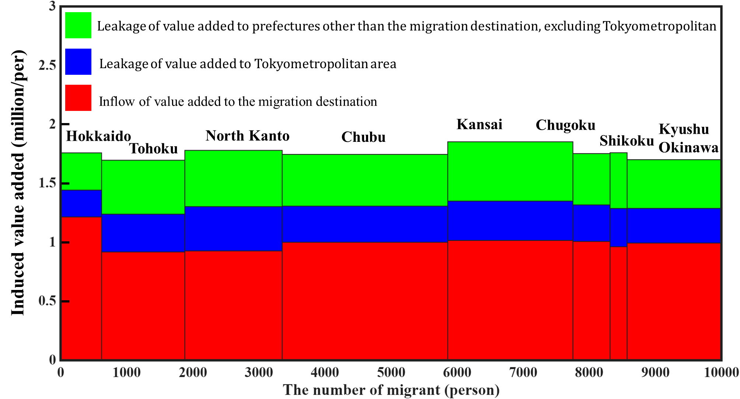
Appendix
3
Notes:
Next, I would like to talk about the average income by age and gender group in Figure 9. bule bar is the average income of male in each age group. yellow bar is the average income of female in each age group. In terms of male, its income increases up to the 50–59 age group, strongly reflecting Japan’s seniority(シニアリティ)-based employment system. In contrast, Femal’s income remains at similar levels across age groups. The results also indicate gender income gap.

Slide 39
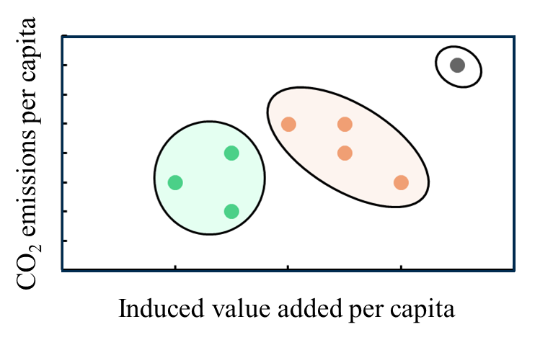
Appendix
4
In addition
Using cluster analysis, this study identifies prefectures where migration is desirable from both environmental and economic perspectives.
※Figure is image
4 dimensions
Kyoto
Induced CO₂ emissions per capita within destination prefecture
Cluster 3
Induced CO₂ emissions per capita outside destination prefecture
Induced value added per capita flowing into destination prefecture
Cluster 2
Cluster 1
Induced value added per capita flowing into destination prefecture
Notes:
Next, I would like to talk about the average income by age and gender group in Figure 9. bule bar is the average income of male in each age group. yellow bar is the average income of female in each age group. In terms of male, its income increases up to the 50–59 age group, strongly reflecting Japan’s seniority(シニアリティ)-based employment system. In contrast, Femal’s income remains at similar levels across age groups. The results also indicate gender income gap.

Slide 40
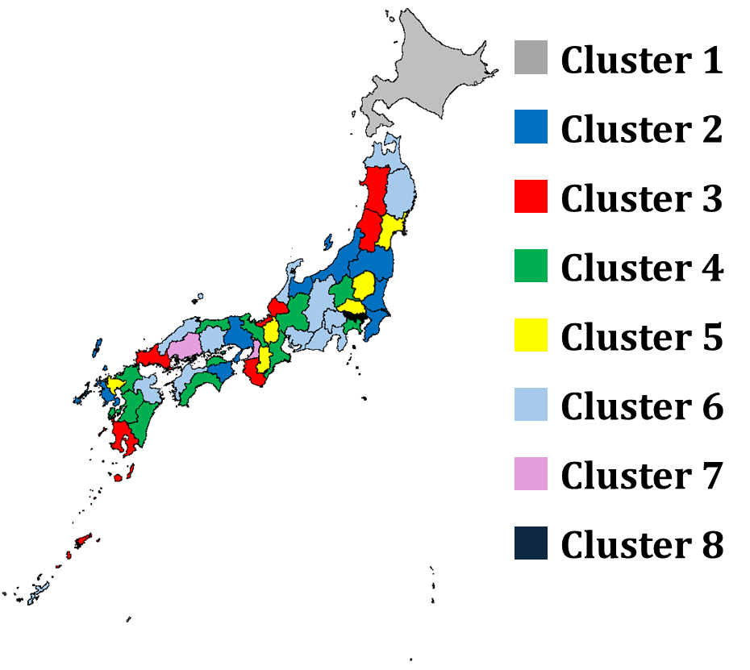
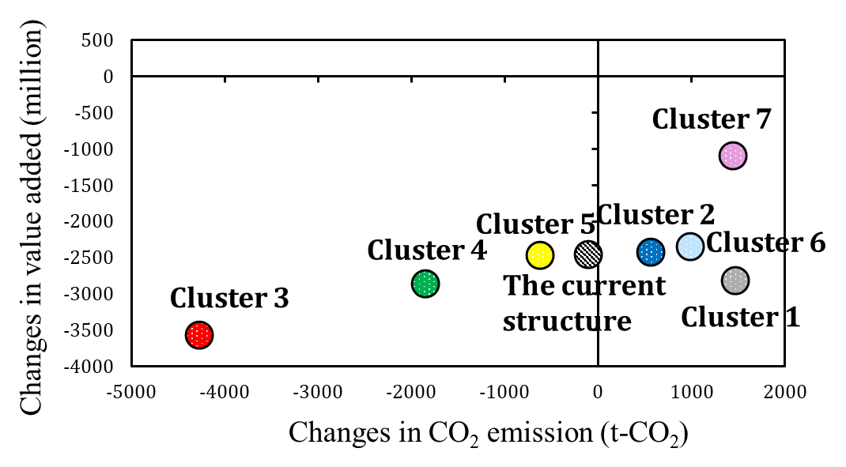
Appendix
5
Figure d is a map of the clustering result.
Figure e is a scatter plot of changes in CO₂ emissions and induced value added under the scenario of 10,000 migrants for each cluster

Slide 41
Appendix
6
Figure d is a map of the clustering result.
Figure e is a scatter plot of changes in CO₂ emissions and induced value added under the scenario of 10,000 migrants for each cluster

Slide 42
Appendix
7
negative decoupling
Environmental burdens are increasing despite the absence of economic growth.
Figure d is a map of the clustering result.
Figure e is a scatter plot of changes in CO₂ emissions and induced value added under the scenario of 10,000 migrants for each cluster

Slide 43
Appendix
8
The results suggest that migration policy should be implemented in Clusters 3, 4, and 5.
Figure d is a map of the clustering result.
Figure 8 is a scatter plot of changes in CO₂ emissions and induced value added under the scenario of 10,000 migrants for each cluster

Slide 44
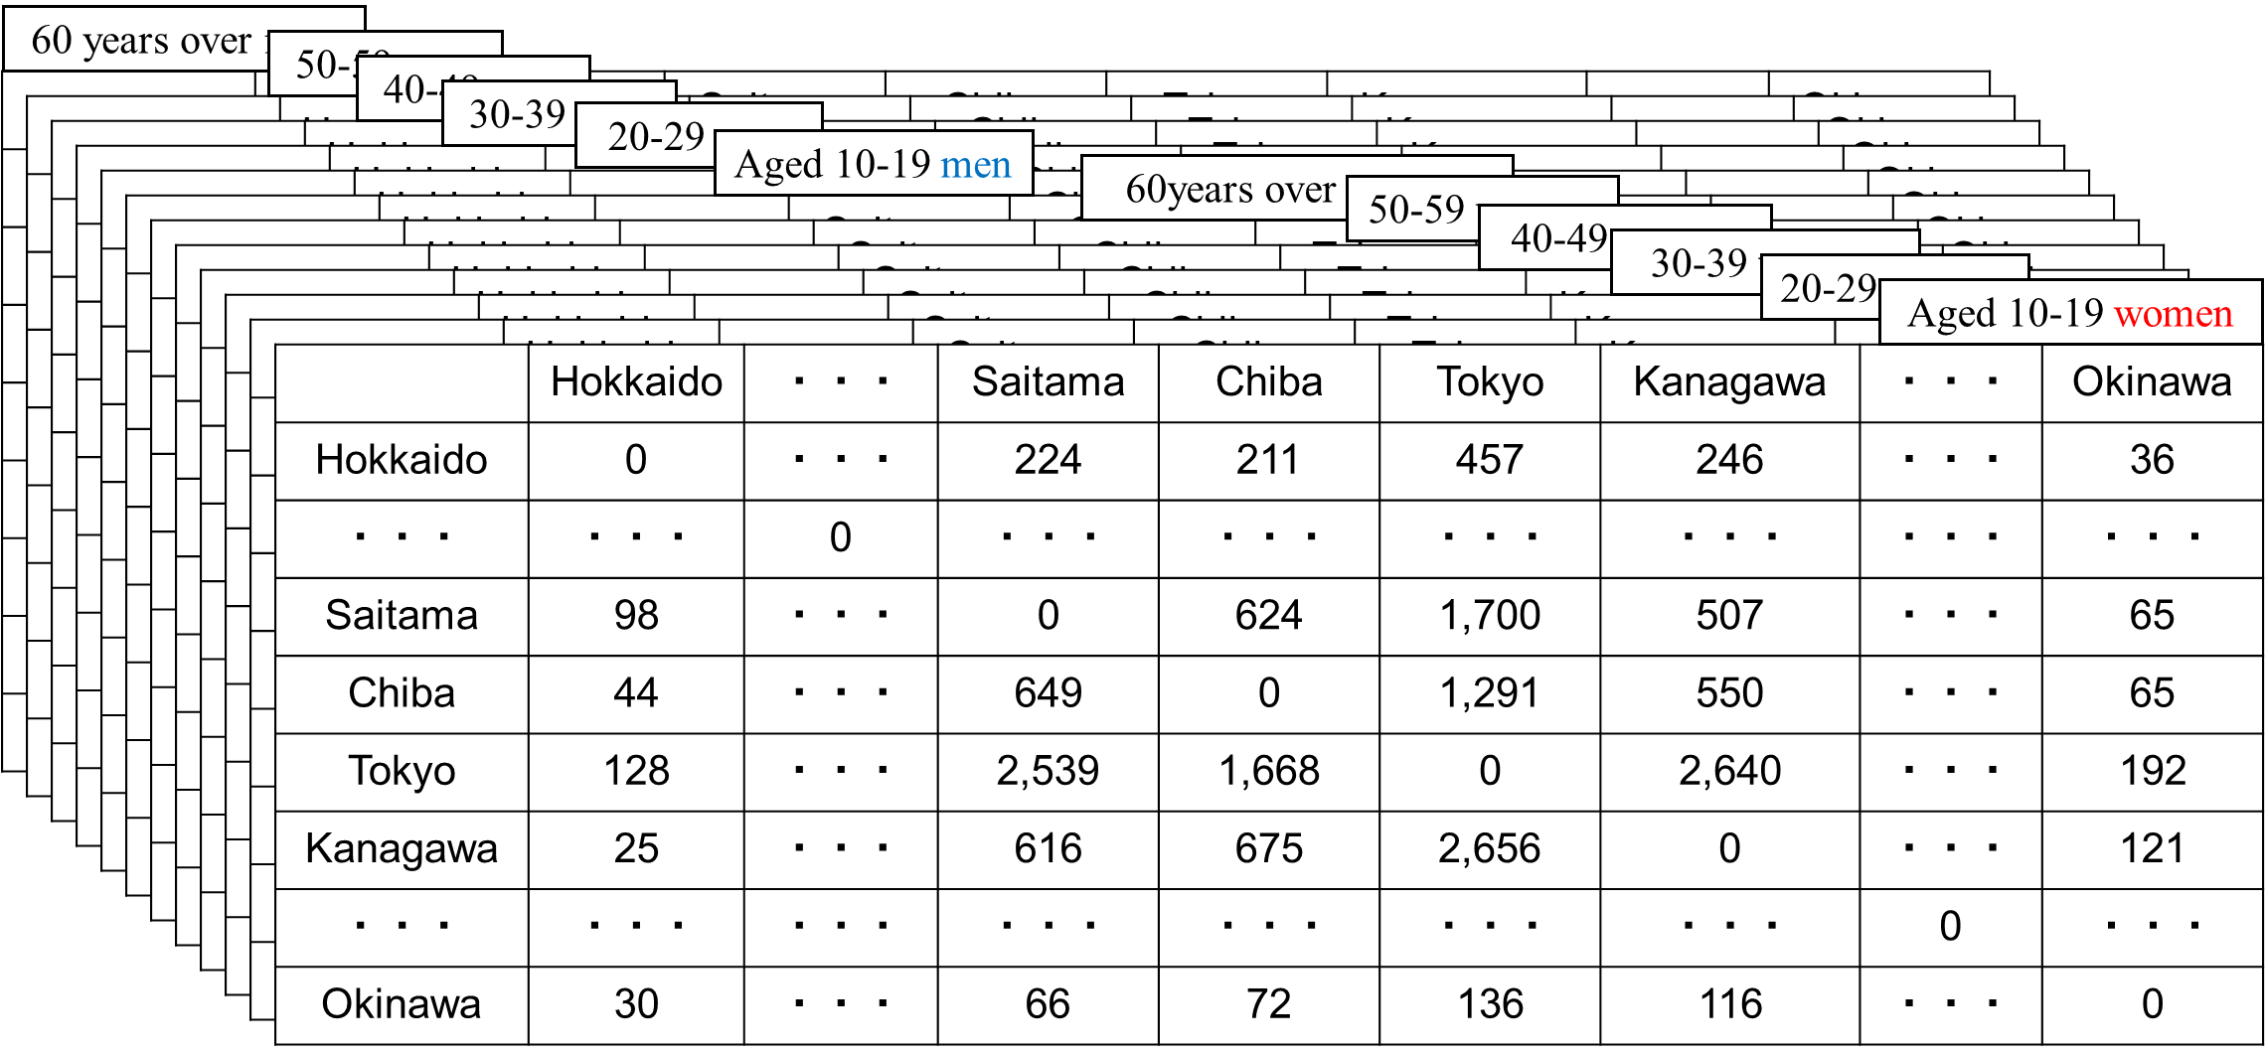
Appendix
Inflow population
Outflow population

Slide 45
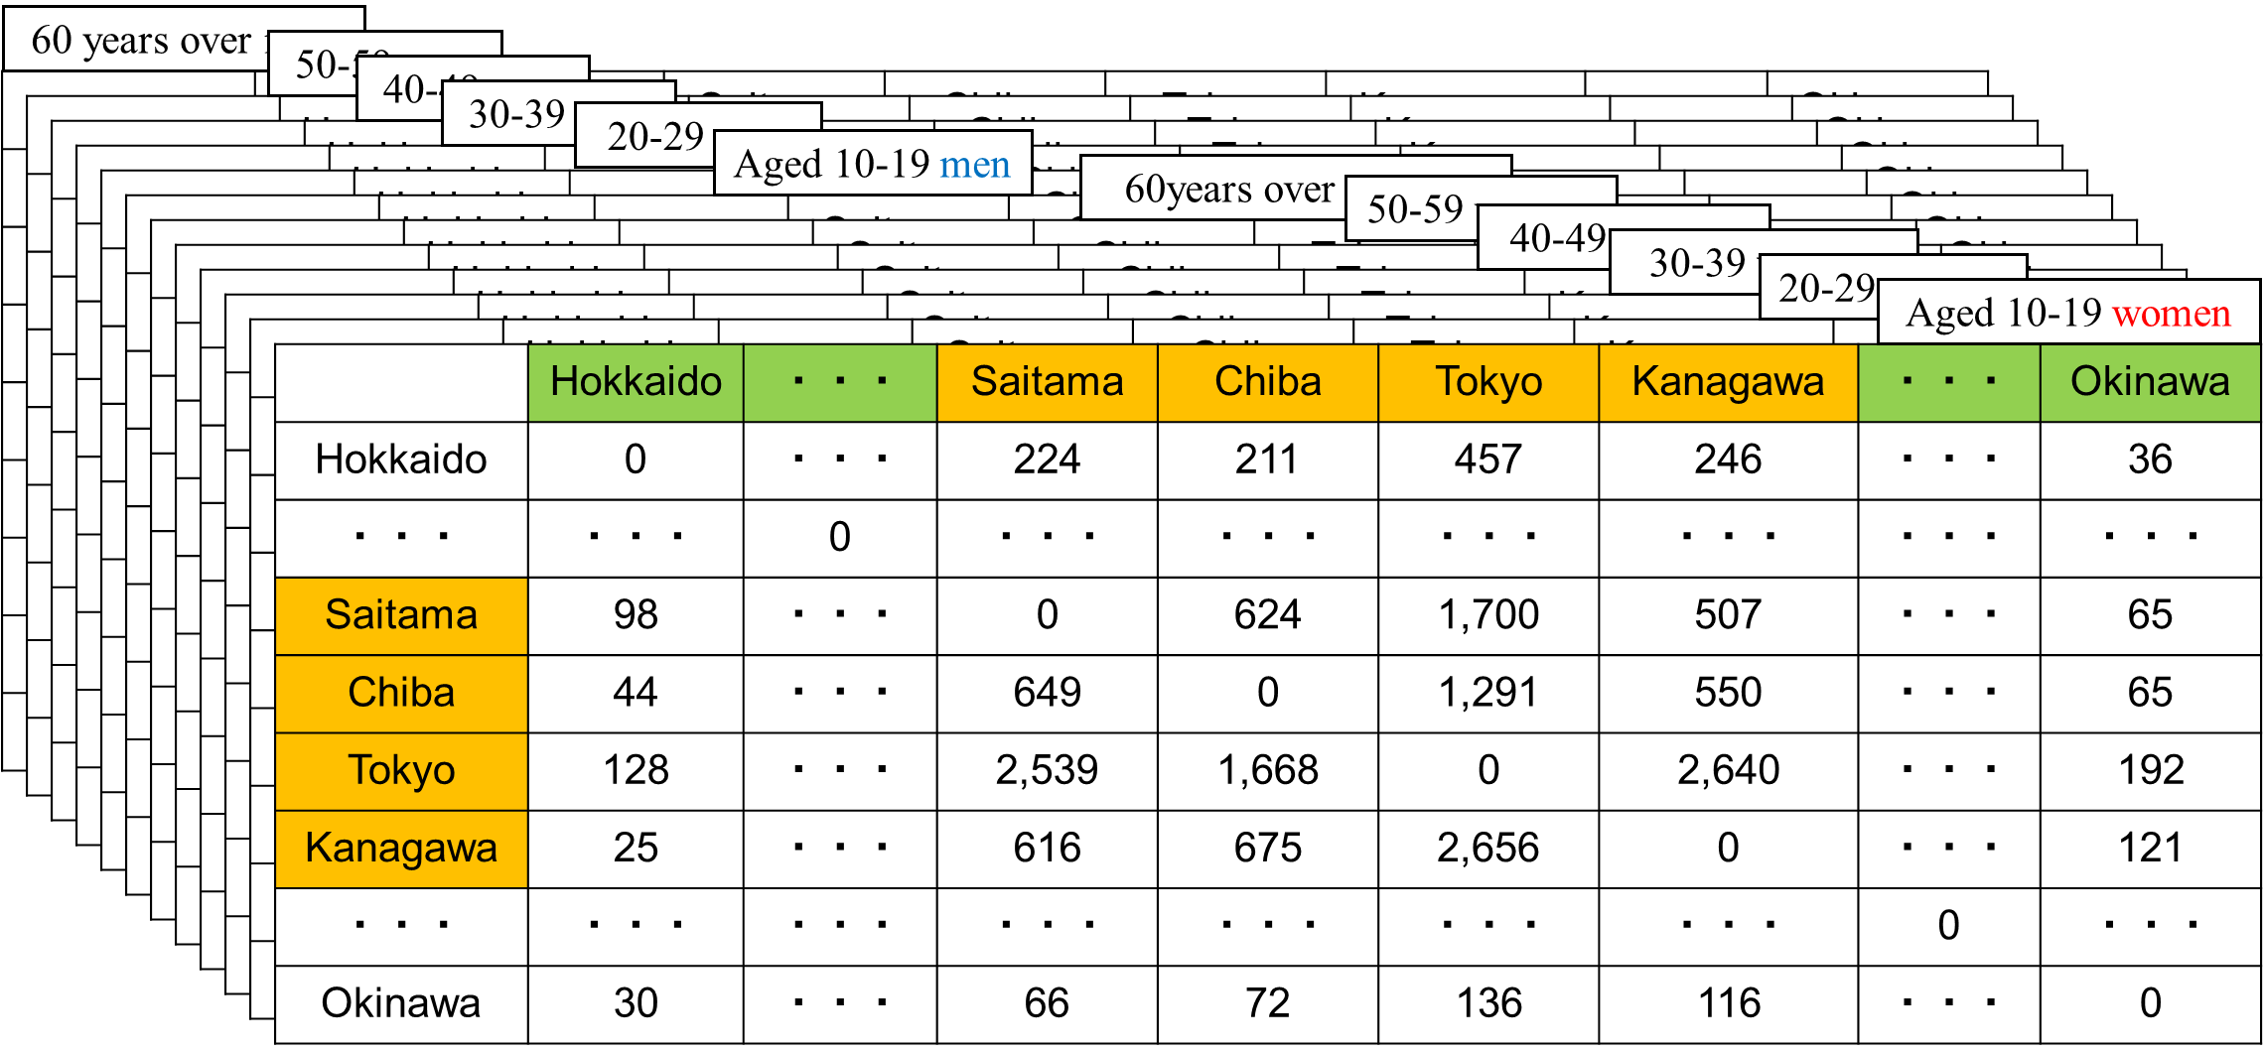
Appendix
Rural area
Tokyo metropolitan area

Slide 46
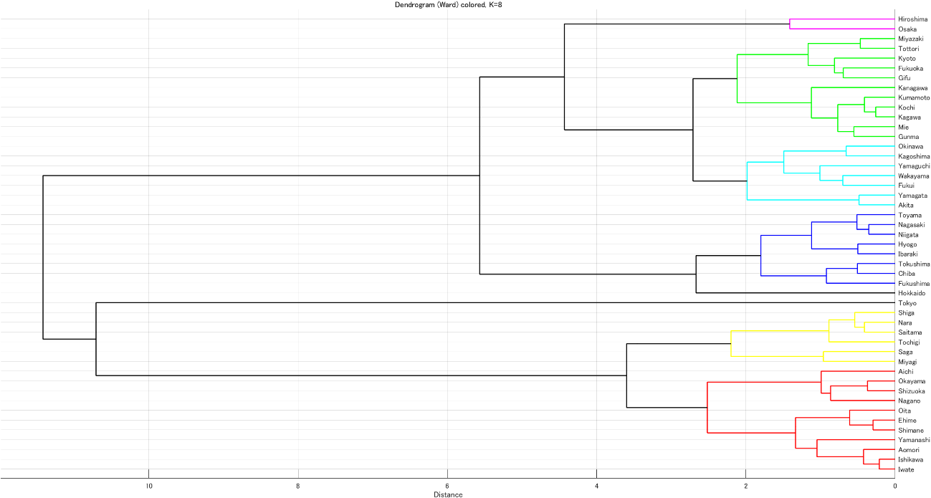
Appendix

