Slide 1

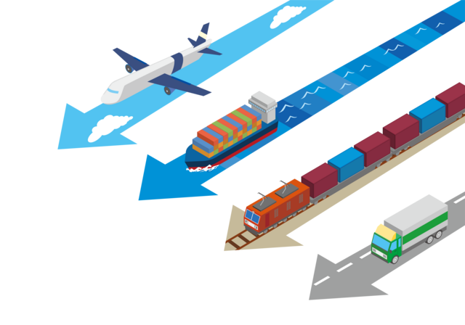
Global Supply Chain Vulnerability to Crime-Related Risk: An Economic Impact Analysis of Cargo Theft
*Haruka Mitoma¹, Norihiko Yamano² Shohei Tokito³
(1. Hiroshima Shudo University, 2. OECD, 3. Yamagata University)
Notes:
I’m Haruka Mitoma from Hiroshima Shudo University. Today, I will present our study, entitled “Global Supply Chain Vulnerability to Crime-Related Risk: An Economic Impact Analysis of Cargo Theft.”

Slide 2
Introduction: Current landscape of cargo theft
Cargo theft is one of the most recurrent crime-related risks in supply chains
156,000 incidents in the EMEA region ($585 million loss), 2,852 incidents in the US and Canada ($331 million loss) were reported in 2023 (TAPA, 2023).
Forms of cargo theft have become more sophisticated and organized
A rise in “strategic theft”, particularly in the EU and the US.
Most thefts occurred during truck transportation (71%) or at facilities (23%).
(BSI and TT club, 2023)
The economic impacts of cargo theft have not been quantitatively assessed
It involves indirect costs related to preventive and responsive measures, which are far beyond the value of stolen goods (Burges, 2012)
Cargo theft increases the costs of distribution and transportation,
which can ultimately raise final product prices
Notes:
Let me start with the current landscape of cargo theft.
Among various risks, cargo theft is one of the most recurrent crime-related risks in supply chains.
In 2023, 156,000 incidents were reported in the EMEA region. In the United States and Canada, 2,852 incidents were reported.
Recent reports also suggest that cargo theft has become more sophisticated and organized. In particular, these forms of theft have increased in the advanced economies. Most thefts occur during truck transportation or at facilities, rather than through piracy.
Despite its frequency, the economic impacts of cargo theft remain underexamined.
The economic impact of cargo theft is not limited to the value of stolen goods. It also involves indirect costs, related to preventive and responsive measures, which are far beyond the value of stolen goods.
These costs can ultimately raise final product prices. However, the extent to which these cost pressures spread through global supply chains has not been quantitatively assessed.

Slide 3


Introduction: Research questions
To what extent does cargo theft increase product prices?
How does cargo theft spread its impact through supply chains?
Has the expanded fragmentation increased vulnerability to cargo-theft-related cost pressures?
Novelty of this study
Quantitatively assessing the impact of cargo theft on
product prices in the complexity of global supply chain
A new MRIO framework that applies insights from trade cost literature to security risk analysis
©pikisuperstar
Notes:
Against this background, this study addresses three research questions.
First, to what extent does cargo theft increase product prices?
Second, how does cargo theft spread its impact through supply chains?
Third, has the expanded fragmentation of global supply chains increased vulnerability to cargo-theft-related cost pressures?
The novelty of this study is that we quantitatively assess the impact of cargo theft on product prices in the complex structure of global supply chains.
To do this, we propose a new MRIO-based framework that applies insights from trade cost literature to security risk analysis.

Slide 4






Methodology: How does cargo theft risk affect prices?
Motor vehicle factory (France)
Final
consumer (Japan)
Payments to trade and transport services
Trading, wholesale and retail services
Transport, cargo insurance
Warehousing, port services
$$\left(1+m_{car}^{FRA}\right)Basic_p_{car}^{FRA}$$
$$Basic_p_{car}^{FRA}$$
Basic price
Trade and transport margins
Purchaser's price
The cost required for a good to “ safely arrive” at the consumer varies across
countries and industries.
As cargo theft risk increases, higher insurance premiums, rerouting of transport, increased security expenditures, and precautionary inventory buffers are required.
Higher cargo theft risk pushes up margins, leading to higher purchaser prices.
Notes:
Let me now move to the methodology.
First, I explain how cargo theft risk affects prices in this study.
There is a difference between the basic price of a good at the production stage and the purchaser’s price paid by the final consumer.
This difference includes payments to trade and transport services such as…. These are called trade and transport margins.
In other words, trade and transport margins can be interpreted as the cost required for a good to safely arrive at the final destination.
This cost varies across countries and industries.
When cargo theft risk increases, additional costs are required, such as higher insurance premiums, rerouting of transport, increased security expenditures, and precautionary inventory buffers.
Therefore, higher cargo theft risk pushes up trade and transport margins, leading to higher purchaser prices.
These cost pressures can then propagate through domestic transactions and international trade.

Slide 5



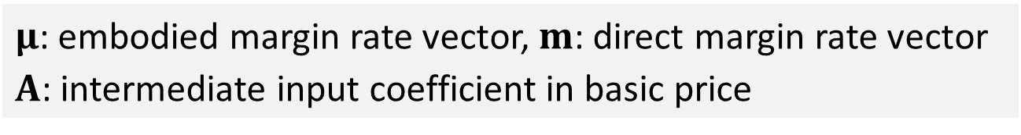
Methodology: Calculating embodied margin rate
We define the embodied margin rate as the cumulative margin burden associated with intermediate input transactions before the stage of producing final products.
The embodied margin rate of final goods consists of two components:
$$\begin{aligned}μ=mA+μA\end{aligned}$$
$$\left(1\right)$$
$μ$: embodied margin rate vector, $m$: direct margin rate vector
$A$: intermediate input coefficient in basic price
The direct margin burden incurred
on its immediate intermediate inputs
(ii) The indirect margin burden already
embodied in upstream inputs
Pre-cargo theft scenario
$$\begin{aligned}μ=mA{\left(I−A\right)}^{−1}=mAL\end{aligned}$$
$$\left(2\right)$$
Post-cargo theft scenario
$$\tilde{μ}=\tilde{m}AL$$
$$\left(3\right)$$
$\tilde{μ}$: embodied margin rate vector, $\tilde{m}$: direct margin rate vector considering cargo theft risk
Notes:
To capture these propagated cost pressures, we define the embodied margin rate.
The embodied margin rate is the cumulative margin burden associated with intermediate input transactions before the stage of producing final products, expressed as a ratio to the basic price.
The embodied margin rate of a final good consists of two components.
The first component is the direct margin burden incurred on its immediate intermediate inputs.
The second component is the indirect margin burden already embodied in upstream inputs.
By rearranging Equation 1, we obtain Equation 2. This equation represents the embodied margin rate in the pre-cargo theft scenario.
Next, we calculate the embodied margin rate under the post-cargo theft scenario, using a modified direct margin rate vector that reflects margin increases due to cargo theft risk.
By comparing the embodied margin rates in the pre- and post-cargo theft scenarios, we estimate the impact of cargo theft risk on product prices.

Slide 6



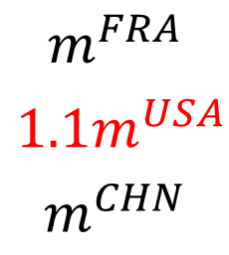
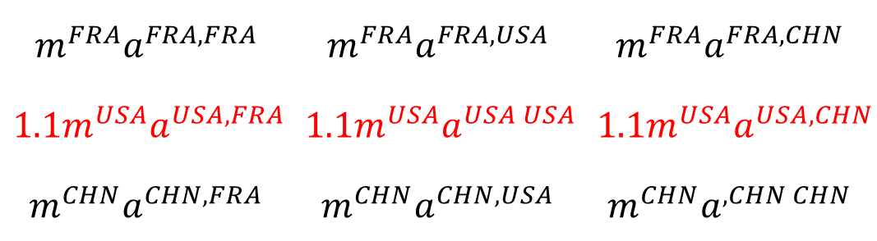


Methodology: Setting a post-cargo theft scenario
Estimation of the post-cargo theft margin rate vector $\tilde{m}$through Monte Carlo simulation
(1000 trials)
(ex) When cargo theft occurred in the USA
$$\tilde{μ}=\tilde{m}AL$$
$$\tilde{m}$$
$$diag\tilde{m}A$$
Cargo theft
probability (%)
Margin rate (%)
$$m^{FRA}a^{FRA, FRA}$$ | $$m^{FRA}a^{FRA, USA}$$ | $$m^{FRA}a^{FRA, CHN}$$
$${1.1m}^{USA}a^{USA,FRA}$$ | $$1.1m^{USA}a^{USA USA}$$ | $$1.1m^{USA}a^{USA, CHN}$$
$$m^{CHN}a^{CHN,FRA}$$ | $$m^{CHN}a^{CHN,USA}$$ | $$m^{CHN}a^{,CHN CHN}$$
$$\begin{matrix}p^{FRA} \\ \begin{aligned}p^{USA} \\ p^{CHN}\end{aligned}\end{matrix}$$
$$m^{FRA}$$
$${1.1m}^{USA}$$
$$m^{CHN}$$
1. Does cargo theft occur in the USA? →YES
2. Apply a 10% increase to the US margin rate
3. The increased margin rate is applied to transactions originating in the USA
Based on the estimated increase in shipping costs after piracy shocks (Besley et al., 2015)
Notes:
Next, I explain how we set the post-cargo theft scenario.
The post-cargo theft margin rate vector m tilder is estimated through a Monte Carlo simulation with 1,000 trials.
In each trial, for each country, whether cargo theft occurs is determined based on the estimated cargo theft probability.
If cargo theft is assumed to occur in a country, a uniform 10% increase is applied to the margin rates of that country.
we adopted this value with Based on the estimated increase in shipping costs after piracy shocks.
For example, if cargo theft occurs in the United States, the margin rates of the United States increase by 10%.
Then, this increased margin rate is applied to transactions originating in the United States.

Slide 7

Methodology: Setting a post-cargo theft scenario
We construct a country-level cargo theft risk index ($CR_{i}$=0 to 100) as a proxy
for cargo theft exposure using the following sigmoid function.
$$CR_{i}=\frac{1}{1+exp\left(−\left(−α×LPI_{i}+β×log\left(Homicide Rate_{i}+1\right)+γ×Criminal Networks_{i}+δ\right)\right)}$$
$$(α=1,β=0.5,γ=0.5, δ=0)$$
Logistics performance index (LPI) (World Bank, 2023): Quality of logistics
(customs performance, infrastructure quality, international shipments, logistics competence, tracking and tracing, and timeliness)
Intentional homicide rate (UNODC, 2025) : General public safety, especially in relation to traditional violent cargo theft
Criminal Networks score (GOCI, 2023) : General public safety, especially related to “strategic cargo theft”
These variables are selected based on previous studies on the determinants of cargo theft risk (e.g., Liang et al., 2022)
Notes:
Next, I will explain how we estimate cargo theft probability.
we construct a country-level cargo theft risk index as a proxy for cargo theft exposure. The index ranges from 0 to 100.
The index is constructed using three variables.
The first is the Logistics Performance Index, or LPI, which captures the quality of logistics.
The second is the intentional homicide rate, which reflects general public safety conditions, especially in relation to traditional violent cargo theft.
The third is the criminal networks score from the Organized Crime Index, which captures exposure to more organized and sophisticated forms of cargo theft.

Slide 8
Methodology: Data used in this study
Inter-Country Input-Output (ICIO) Tables (OECD, 2023) 2005 and 2019
Coverage: 76 countries and 45 sectors
Harmonized supply tables (OECD, 2023): margin rate by country and sector
12 sectors subject to cargo theft: Agriculture, Food products, Mining (energy), Mining (non-energy), Textiles, Refined petroleum products, Pharmaceuticals, Basic metals, Computers and electronics, Electrical equipment, Motor vehicles, and Manufacturing n.e.c.
Cargo theft risk index
Logistics performance score (World Bank, 2023)
Intentional homicide rate (UNODC, 2025)
Criminal network indicator (GOCI, 2023)
Notes:
Here are the data used in this study.
We use the OECD Inter-Country Input-Output tables for 2005 and 2019. The data cover 76 countries and 45 sectors.
We also use OECD harmonized supply tables to calculate margin rates by country and sector.
And these are data used to estimate the cargo theft risk index.
We focus on 12 sectors that are commonly subject to cargo theft.

Slide 9
Results: Cargo theft risk index
Countries with relatively high risk are concentrated primarily
in Africa and South America for both years.
Top 10 countries in 2019: Colombia (97), Mexico (96), Nigeria (96), Cameroon (92), Myanmar (92), Peru (91), South Africa (89), Russia (88), Brazil (87), and Pakistan (86)
Significant improvements are observed mainly in Eastern Europe and Asia.
Top 10 improvements: Estonia (-28), Lithuania (-27), Kazakhstan (-25), Poland (-21),
Latvia (-21), Croatia (-18), Côte d'Ivoire (-16), China (-15), Belarus (-15), and Philippines (-14)
Baltic states and Eastern Europe: the resolution of instability following the post-Soviet transition and institutional reforms and economic growth associated with EU accession
Asian countries: investment in logistics infrastructure driven by the promotion of
export-oriented industrialization policies
Notes:
Let me move to the result of the cargo theft risk index.
Countries with relatively high risk are concentrated mainly in Africa and South America for both years .
The top 10 countries in 2019 include following countries.
On the other hand, significant improvements are observed mainly in Eastern Europe and Asia.
The top 10 countries improved their cargo theft risk index by around 20 points
In the Baltic states and Eastern European countries, the marked decline in cargo theft risk can be associated with the stabilization of society and institutions after the post-Soviet transition, as well as institutional reforms and economic growth related to EU accession.
In Asia, countries such as China and the Philippines also show improvements in the cargo theft risk index.
One possible explanation is increased investment in logistics infrastructure, driven by export-oriented industrialization policies.

Slide 10
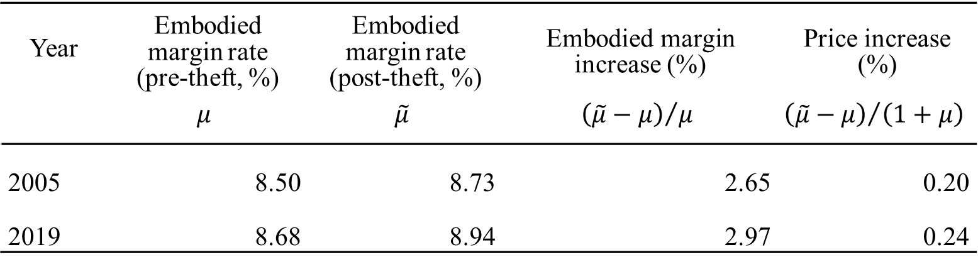
Results: Overall impact of cargo theft on the world economy
Year | Embodied margin rate (pre-theft, %) | Embodied margin rate (post-theft, %) | Embodied margin increase (%) | Price increase (%)
 | $$μ$$ | $$\tilde{μ}$$ | $${\left(\tilde{μ}−μ\right)}/μ$$ | $${\left(\tilde{μ}−μ\right)}/{\left(1+μ\right)}$$
2005 | 8.50 | 8.73 | 2.65 | 0.20
2019 | 8.68 | 8.94 | 2.97 | 0.24
Cargo theft increased embodied margin rates by approximately
2.65% (2005) and 2.97% (2019), corresponding to final product price increases of 0.20% (2005) and 0.24% (2019), respectively
The impacts of cargo theft on margins and prices have increased over time, suggesting that global supply chains have become more exposed
to cost pressures associated with cargo theft risk.
Notes:
Let me now move to the results of the economic impact analysis.
We first present the world-sector average impact of cargo theft on embodied margin rates and final product prices.
Country-sector-specific embodied margin rates and prices are aggregated to the global level using output shares as weights.
We found that cargo theft increased embodied margin rates by approximately 2.65% in 2005 and 2.97% in 2019.
These increases correspond to final product price increases of 0.20% in 2005 and 0.24% in 2019.
The price impact increased over time. This suggests that global supply chains have become more exposed to cost pressures associated with cargo theft risk.

Slide 11
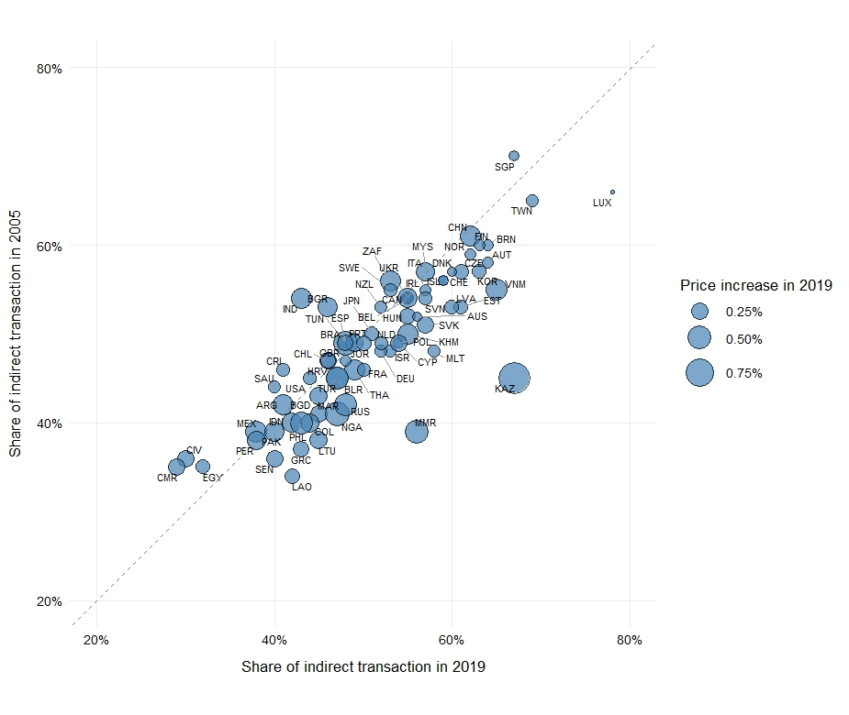
Results: Direct transactions vs Indirect transactions
X-axis: Share of the embodied margin increase arising from indirect transactions in 2019
Y-axis: Share of the embodied margin increase arising from indirect transactions in 2005
Indirect transactions account for 40–60% of the embodied margin increase in most countries.
Many countries show a higher indirect-transaction contribution in 2019.
Countries below the 45-degree line have a higher indirect-transactions contribution in 2019.
Notes:
Next, we decompose the embodied margin increase due to cargo theft into components arising from direct and indirect transactions.
This blue bubble chart figure shows the share of the embodied margin increase arising from indirect transactions in 2005 and 2019 for each country.
The x-axis reports the share in 2019, and the y-axis reports the share in 2005.
The bubble size represents the price increase in 2019.
Countries below the 45-degree line have a higher indirect-transaction contribution in 2019 than in 2005.
Most countries are clustered within a range of roughly 40 to 60% in both years. This suggests that indirect transactions account for a substantial share of cargo-theft-related cost propagation.
Many countries are located below the 45-degree line, indicating a higher indirect-transaction contribution in 2019.

Slide 12
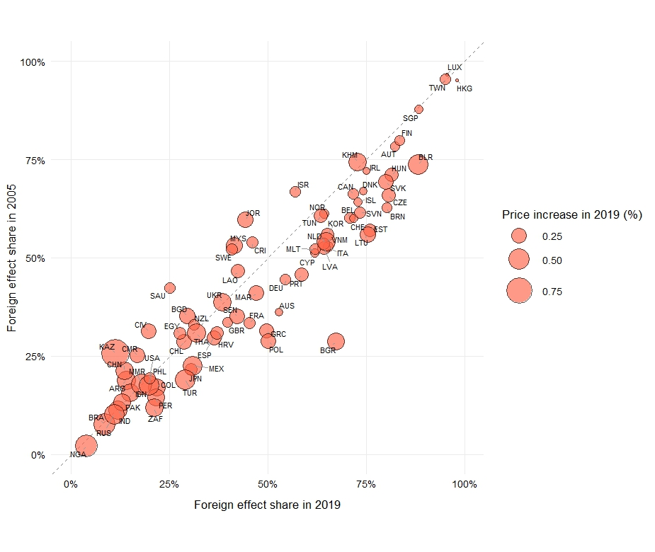
Results: Domestic risk vs Foreign risk
X-axis: Share of the embodied margin increase arising from foreign cargo theft risk in 2019
Y-axis: Share of the embodied margin increase arising from foreign cargo theft risk in 2005
Contributions of foreign cargo theft risk
vary among countries.
Foreign cargo theft risk share in 2005
Many countries show a higher contribution of foreign cargo theft risk in 2019.
Countries below the 45-degree line have a higher foreign-risk contribution in 2019.
Foreign cargo theft risk share in 2019
Notes:
Next, we decompose the embodied margin increase into components arising from domestic cargo theft risk and foreign cargo theft risk.
This red bubble chart plots the share of the embodied margin increase arising from foreign cargo theft risk in 2005 and 2019.
Again, the x-axis reports the share in 2019, and the y-axis reports the share in 2005.
The bubble size represents the price increase in 2019.
Countries below the 45-degree line have a higher foreign-risk contribution in 2019 than in 2005.
The contribution of foreign cargo theft risk varies substantially across countries.
As in the previous slide, many countries are located below the 45-degree line, indicating a higher foreign-risk contribution in 2019.

Slide 13
Summary of results so far
Results presented so far suggest that between 2005 and 2019,
As reflected in the growing price impacts, the global economy became more exposed to cargo theft–induced cost pressures transmitted through global supply chains, despite the decline in cargo theft risk in many countries.
These cost pressures increasingly originated from upstream transactions and from foreign cargo theft risks, making them more difficult for final producers to trace and mitigate.
Notes:
Let me summarize the results so far.
In the next part, we focus on the interdependency of cost propagation among countries.

Slide 14
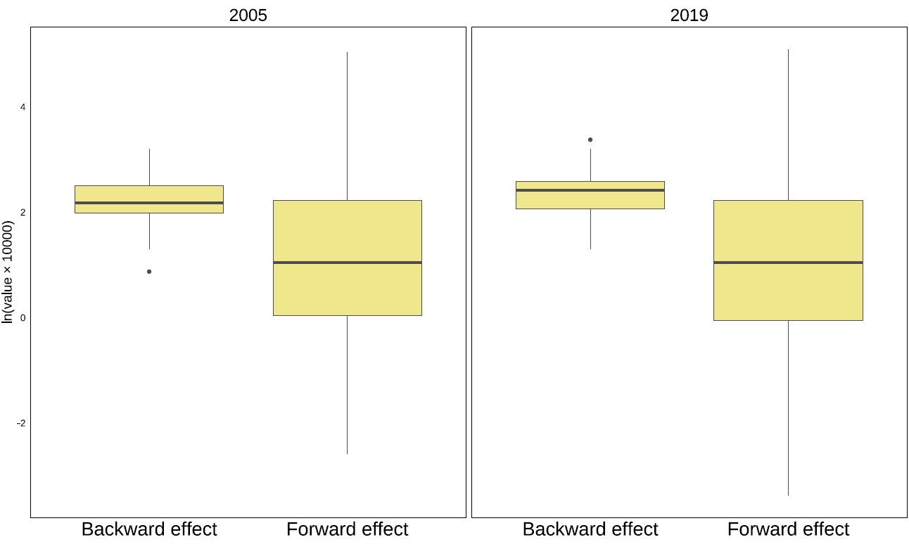
Results: Backward effect vs Forward effect
Backward effect (left)
Total cost pressure that the country receives from all other countries
Forward effect (right)
Total cost pressure that the country imposes on all other countries
The distribution of the backward effect is relatively narrow, indicating that
cost pressure is more uniformly borne across countries.
The forward effect shows a much wider distribution, revealing
the presence of countries that impose a disproportionately large burden on other countries.
Notes:
To examine international interdependency, we calculate two types of effects.
The first is the backward effect. This is the total cost pressure that a country receives from all other countries.
The second is the forward effect. This is the total cost pressure that a country imposes on all other countries.
The box plot shows the distributions of the backward and forward effects.
The distribution of the backward effect is relatively narrow. This indicates that cost pressures are more uniformly borne across countries.
In contrast, the distribution of the forward effect is much wider. This reveals the presence of countries that impose a disproportionately large burden on other countries.

Slide 15
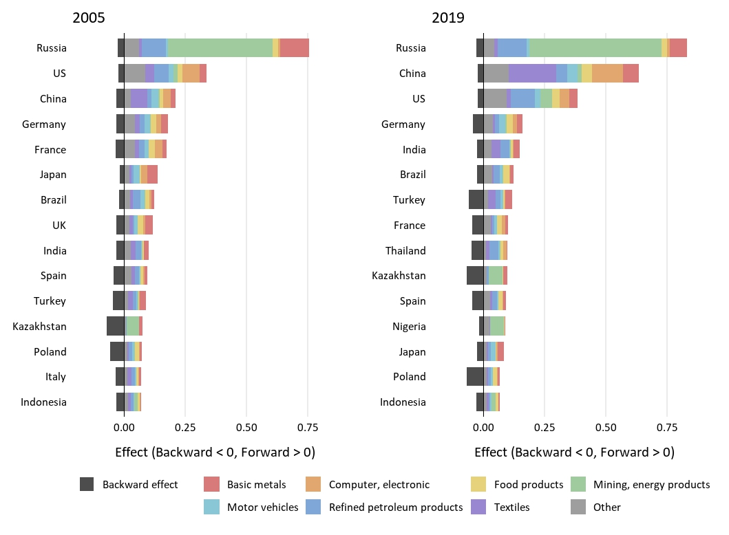
Results: Which countries are the key drivers of cost pressure?
Cargo theft risk in Russia, the US, and China has large forward effects on global supply chains.
Key factors of the forward effect
Cargo theft risk index
Trade volume and centrality in supply chain
Russia’s large forward effect is associated with its centrality in the supply of energy and mineral resources.
Notes:
This figure presents the top 15 countries with the largest forward effect in 2005 and 2019.
The positive bars show the forward effect, and the negative bars show the backward effect.
Countries ranked in the top 15 generally impose cost pressures on other countries that are several times larger than the cost pressures they receive from abroad.
Cargo theft risk in Russia, the United States, and China has large forward effects on global supply chains.
China’s forward effect increased substantially between 2005 and 2019.
The magnitude of the forward effect is determined by two factors: the level of cargo theft risk, and the country’s trade volume and structural centrality in supply chains.
Russia’s large forward effect is associated with both its relatively high cargo theft risk and its centrality in the supply of energy and mineral resources.

Slide 16
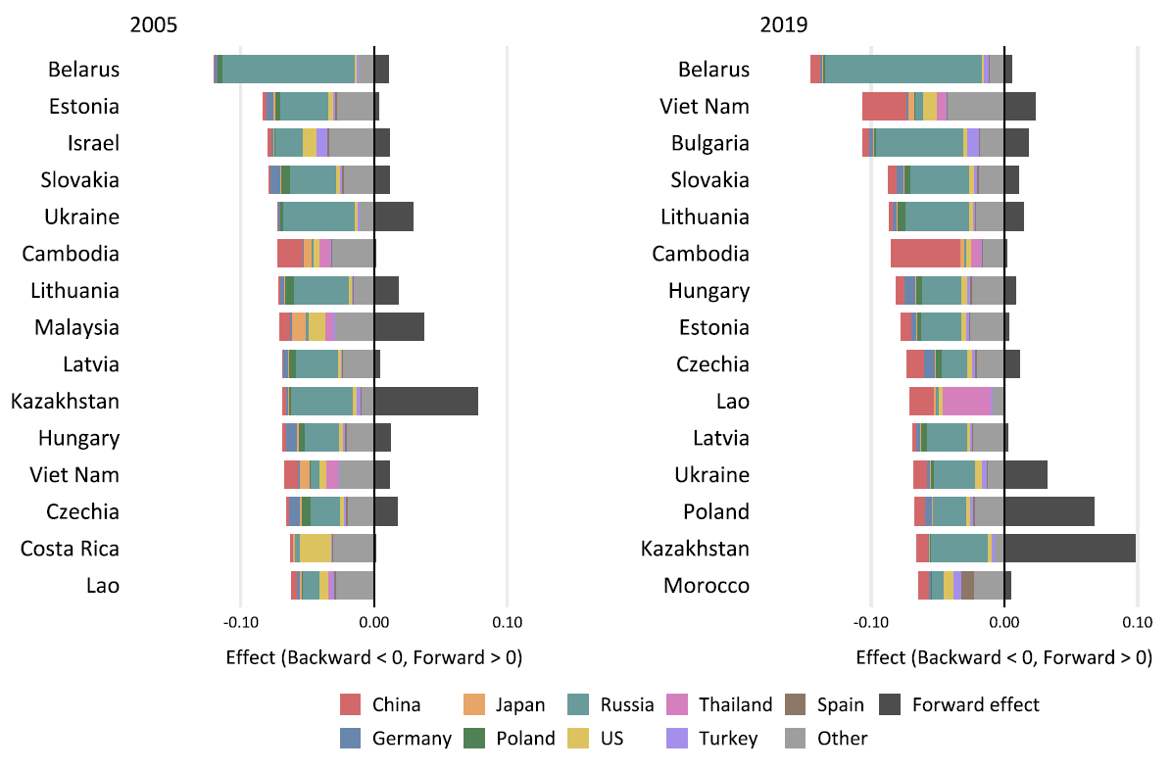
Results: Which countries are vulnerable to cost pressure from other countries?
Eastern European countries and some East and Southeast Asian countries have large backward effects.
These countries tend to be strongly involved in manufacturing production networks and processing trade.
Production relies on imported intermediate inputs, making them more exposed to cost pressures originating abroad
Notes:
This figure presents the top 15 countries with the largest backward effect.
These are countries that receive large cost pressures from other countries.
Eastern European countries and some East and Southeast Asian countries have large backward effects.
These countries tend to be strongly involved in manufacturing production networks and processing trade.
Because their production relies heavily on imported intermediate inputs, they are more likely to be exposed to cost pressures arising from their trading partners.

Slide 17
Discussion and Summary
Unlike natural disasters or geopolitical shocks, cargo theft risk is more manageable through improvements in security and logistics management.
One key question:
Where would improved security measures most effectively reduce global cost pressures?
Based on the 2019 structure, global cost pressures are driven primarily by
advanced economies with dense and highly interconnected supply chain networks rather than by regions with the highest cargo theft risk indices.
Cargo theft risk indices in many emerging and developing economies have shown only limited improvement, while global production fragmentation has intensified exposure to foreign cargo theft risk.
If the expansion of global value chain participation in these economies outpaces improvements in cargo security, the global economy may become increasingly exposed to the economic impacts of cargo theft risk.
Notes:
Finally, let me discuss the policy implications.
One key question is: where would improved security measures most effectively reduce global cost pressures?
Our results provide some insights into this question.
This suggests that improving cargo security in advanced economies could yield substantial benefits for the global economy.
One concern is that if the expansion of global value chain participation in these economies outpaces improvements in cargo security, the global economy may become increasingly exposed to the economic impacts of cargo theft risk.
Therefore, in the long term, sustained efforts to reduce cargo theft risk in emerging and developing economies will also be essential to mitigate systemic vulnerabilities.

Slide 18
Thank you for your attention.

Slide 19
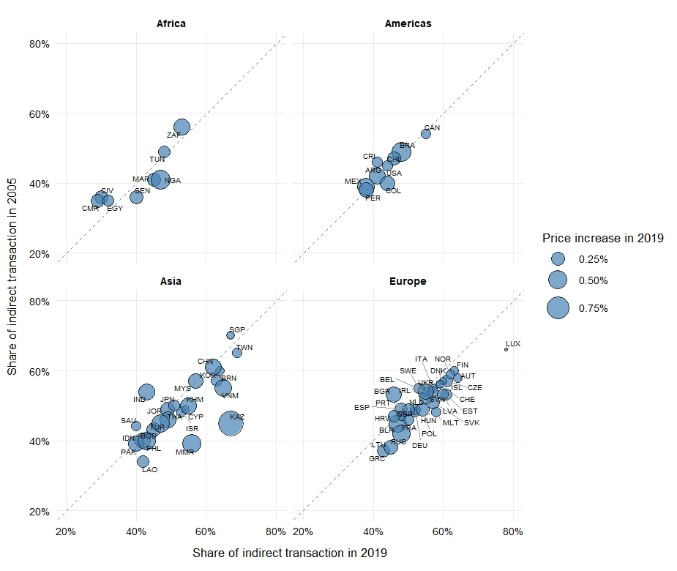
Results: Direct transactions vs Indirect transactions (Regional pattern)
X-axis: Share of the embodied margin increase arising from indirect transactions in 2019
Y-axis: Share of the embodied margin increase arising from indirect transactions in 2005
The contribution of indirect transactions generally increases in Asia and Europe.
Africa and the Americas show a more mixed pattern.
Notes:
In terms of change between 2005 and 2019, Africa shows a mixed pattern, with some countries moving upward and others downward relative to the 45-degree line, while several countries in the Americas exhibit only modest changes. By contrast, the upward shift in the indirect-transaction share is more noticeable in Asia and Europe, where many countries are located below the 45-degree line. This may reflect differences in industrial structure and supply chain integration. Countries in Asia and Europe tend to have larger manufacturing sectors and higher participation in global value chains, which involve more fragmented production processes and complex production networks with multiple intermediate stages.

Slide 20
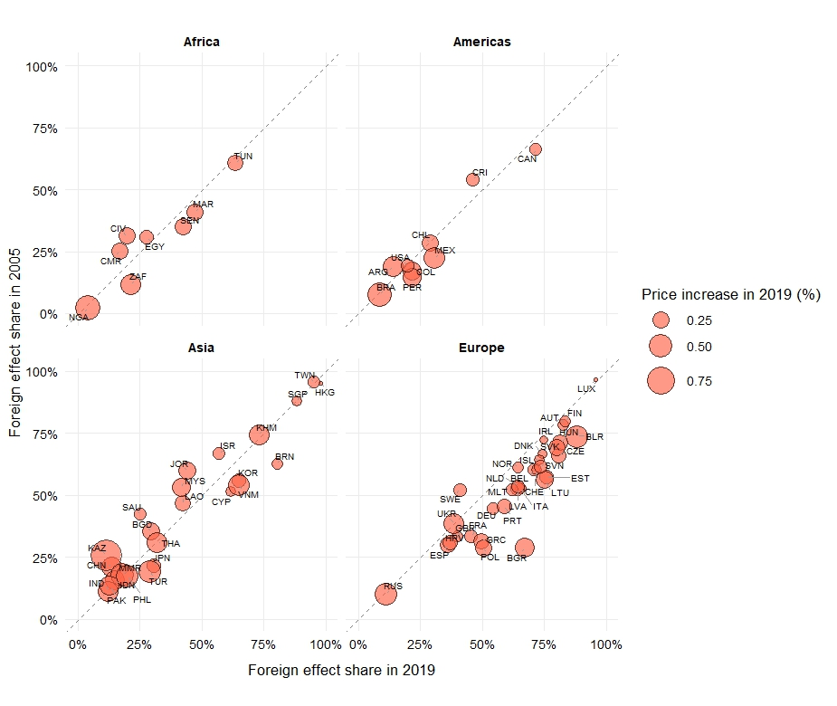
Results: Domestic risk vs Foreign risk (Regional pattern)
X-axis: Share of the embodied margin increase arising from foreign cargo theft risk in 2019
Y-axis: Share of the embodied margin increase arising from foreign cargo theft risk in 2005
The contribution of foreign cargo theft risk generally increases in Africa,
the Americas, and Europe.
The increase is especially clear in Europe.
Asia shows a more mixed pattern.
Notes:
Regional patterns (Figure 5) show that Africa and the Americas generally exhibit relatively low foreign effect shares, whereas Asia and Europe include more countries with higher foreign effect shares. Regarding change over time, the foreign effect share shows an upward tendency in Africa, the Americas, and Europe. This increase is most pronounced in Europe, where many countries are located below the 45-degree line. By contrast, Asia shows a more mixed pattern.

Slide 21

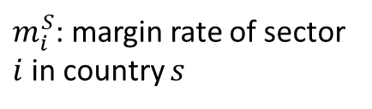
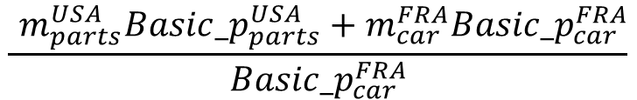



Methodology: Concept of embodied margin rate
We applied the accounting framework of embodied tariff in product prices proposed by Duan et al. (2021)
Auto parts factory (USA)
Motor vehicle factory (France)
Final
consumer (Japan)
Price including margins
$$\left(1+m_{parts}^{USA}\right){Basic_p}_{parts}^{USA}$$
$$\left(1+m_{car}^{FRA}\right)Basic_p_{car}^{FRA}$$
$m_{i}^{S}$: margin rate of sector $i$ in country $s$
Embodied margin rate in product prices
$$\frac{ m_{parts}^{USA}{Basic_p}_{parts}^{USA}+m_{car}^{FRA}{Basic_p}_{car}^{FRA}}{{Basic_p}_{car}^{FRA}}$$
$$\frac{m_{parts}^{USA}{Basic_p}_{parts}^{USA}}{{Basic_p}_{parts}^{USA}}$$
Notes:
Before, cargo theft framework to estimate the impact of cargo theft on the product prices, let me explain the concept of embodied margin, which is constructed based on the accounting framework of embodied tariff in product prices proposed by Duan et al. (2021).
When we アメリカのauto partsがフランスのmotor vehicleに投入され、完成した自動車が日本に輸出されるというフローを考えるとき、auto parts,vehicleそれぞれにcorresponding Trade and transportation margin がimposedされる。このとき、最終製品である自動車の最終価格には自動車のtradeやtransportにかかるマージンだけでなく、投入された中間財にimposedされたマージンを含んでいる。
製品価格に対するサプライチェーン全体でembodiedされたマージンの比率がembodied margin rateと定義する
margins are imposed on the
Embodied marginの考え方 Origin country のmargin率を適用することを伝えたい
Paid by Fance motor vehicle sector

Slide 22
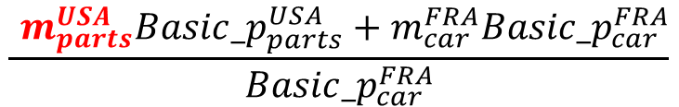


Methodology: Key assumptions
The costs associated with cargo theft lead to an increase in trade and transport margins of goods, which are passed on to product prices
Auto parts factory (USA)
Motor vehicle factory (France)
Final
consumer (Japan)
Cargo theft occurred
in the USA
Price including margins
$$\left(1+m_{parts}^{USA}\right){Basic_p}_{parts}^{USA}$$
$$\left(1+m_{car}^{FRA}\right)Basic_p_{car}^{FRA}$$
Rise in prices of intermediate goods produced in the US
Rise in final product prices
Embodied margin rate in product prices
$$\frac{ m_{parts}^{USA}{Basic_p}_{parts}^{USA}+m_{car}^{FRA}{Basic_p}_{car}^{FRA}}{{Basic_p}_{car}^{FRA}}$$
$$\frac{m_{parts}^{USA}{Basic_p}_{parts}^{USA}}{{Basic_p}_{parts}^{USA}}$$
Increase in the USA margin rates
Notes:
この研究のkey assumptionとして、私たちはassume that The costs associated with cargo theft lead to an increase in trade and transport margins of goods and which are passed on to product prices
For example, もしアメリカでcargo theftの発生確率が高まったら, USAにおけるmargin rateが増加する（より多くのtrade, transport marginを払わなければならなくなる）→このコストが転嫁された結果、Rise in prices of intermediate goods produced in the USAが起こる→最終的に製品価格にembodied margin rateが増加し、 Rise in final product pricesが起こると仮定します。
なぜマージン？
直接的な原材料の投入（価格）を増加させるわけではない oil price increase→fertilizer スムーズにconsumerまで届けるための手間や費用が増加、リスクをヘッジするための費用が増加→マージン

Slide 23
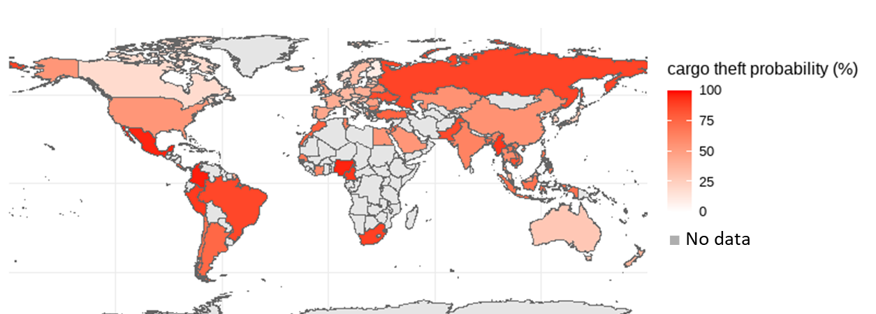
Results: Cargo theft risk index
Countries with relatively high risk are concentrated primarily in Africa and South America
Notes:
Cargo theft riskが高い国、変化が大きい国

Slide 24



Introduction: Forms of cargo theft in global supply chains
Cargo theft type
Theft from facility
Theft from/of vehicle
Theft from facility
Theft from/of container
Top commodities stolen
1. Food and beverage (21%), 2. Agriculture (10%), 3. Electronics (10%),
4. Fuel (8%), 5. Metal (7%), 6. Automotive (7%), Others (38%)
Source: (BSI and TT club, 2023)
Notes:
Origin country のmargin率を適用する

Slide 25

Introduction: Diversifying disruption risks in global supply chains
In the era of global value chains, products cross multiple borders before reaching the final consumers. The expanded fragmentation has diversified disruption risks along supply chains.
Extensive research has examined economic impacts of catastrophic events
(earthquake, floods, hurricanes, terrorist attacks etc. )
→ lower frequency but substantial economic loss risk
(e.g., Yagi et al., 2020)
In contrast, there are fewer studies on the risks of
higher frequency but milder economic loss despite their
potential to generate significant cumulative economic losses.
Cargo theft is a global and daily issue and one of the
fastest-growing risks to supply chain security.
©vectorjuice
Notes:
While the expanded fragmentation has brought about gains in efficiency and specialization, it has also introduced a variety of vulnerabilities along the supply chain.
Among supply chain risks, Extensive research has examined economic impact of catastrophic events (earthquake, floods, hurricanes, terrorist attacks etc. )
These events often result in the fundamental disruption of the supply chain, resulting in substantial and long-term losses in both production and consumption. In contrast, there are fewer studies on the risks characterized by higher frequency but milder impacts, despite their potential to generate significant cumulative economic losses.
We focus on cargo theft, which is a global and daily issue and one of the fastest-growing risks to supply chain security
yet their potential to generate significant cumulative losses has been largely overlooked.

