Slide 1
32ST INTERNATIONAL INPUT-OUTPUT ASSOCIATION CONFERENCE
Reanalysis of Comparative Advantage of China’s Manufacturing Exports Based on Factor Income
Presented by Xuefan Guo, Tsinghua University
Co-authors: Kunfu Zhu, Jiarong Wang
June 20, 2026

Slide 2
1 Introduction

Slide 3
Motivation
Since China's accession to the WTO, the scale of trade and foreign direct investment have been continuously increasing. However, the explosive growth in export scale cannot truly reflect the improvement in China's own technological capabilities and comparative advantage.
The international flow of production factors has transformed the world's industrial landscape. The previous territorial measurement of comparative advantage is no longer an intuitive reflection of the country's factor endowment structure.
It is necessary to explore the competitiveness of China's manufacturing export products from the perspective of global value chain, based on the economic essence of the international flow of production factors.
Revealed comparative advantage (RCA index) is one of the core indicators for measuring the international competitiveness of export products.
3

Slide 4
Questions
To what extent does the RCA index of factor income "correct" the competitive advantages of China's manufacturing industry?
What are the characteristics of the comparative advantages demonstrated by China's manufacturing industry, which is based on different types of factor income?
What is the main driving factor of the growth of RCA of China’s manufacturing sectors?
4

Slide 5
What did we do?
1) Construct a measurement method of RCA index based on factor income, providing theoretical support for accurately judging national competitive advantage and factor endowment;
2) Attempts to deconstruct the RCA index based on factor income into the RCA index of labor income, RCA index of capital income of domestic enterprises and RCA index of capital income of domestic-funded enterprises in host country, which is helpful to identify the hidden comparative advantage potential of different factor incomes;
3) Discuss the influence of different production factors on the changes in RCA of China's manufacturing sectors, and identify the key factors that affect the growth of RCA.
5

Slide 6
2 Methodology and data
Notes:
Now let‘s move on to the theoretical part.

Slide 7
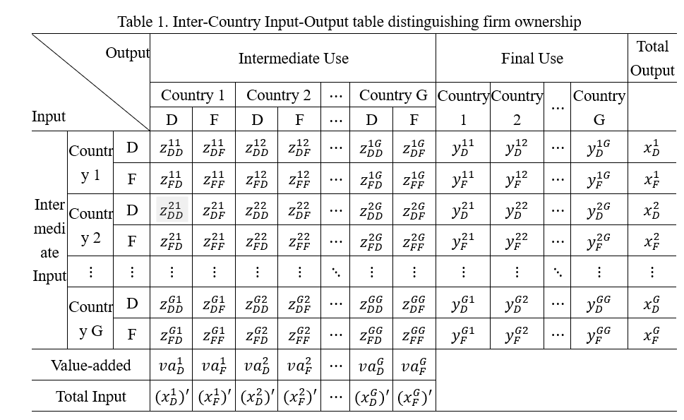
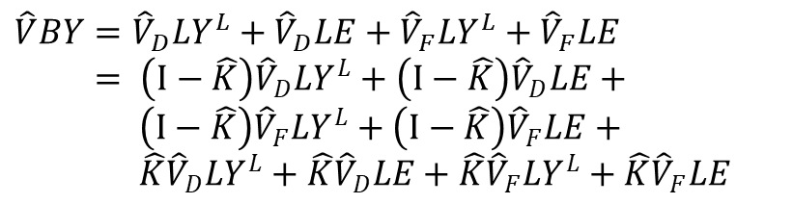


The input-output accounting framework reflecting the activities of MNEs
Gross export
$$E=Z^{E}+Y^{E}$$
Value-added Export (Wang et al., 2017)
$$VAT=\hat{V}LE=\hat{V}LY^{E}+\hat{V}LA^{E}BY$$
Factor Income Trade
$$\hat{V}BY={\hat{V}}_{D}LY^{L}+{\hat{V}}_{D}LE+{\hat{V}}_{F}LY^{L}+{\hat{V}}_{F}LE$$
$= \left(I−\hat{K}\right){\hat{V}}_{D}LY^{L}+\left(I−\hat{K}\right){\hat{V}}_{D}LE+$
$\left(I−\hat{K}\right){\hat{V}}_{F}LY^{L}+\left(I−\hat{K}\right){\hat{V}}_{F}LE+$
$\hat{K}{\hat{V}}_{D}LY^{L}+\hat{K}{\hat{V}}_{D}LE+\hat{K}{\hat{V}}_{F}LY^{L}+\hat{K}{\hat{V}}_{F}LE$
$$FIT=\underset{Labor Income}{\underbrace{\left(I−\hat{K}\right)\left({\hat{V}}_{D}LE+{\hat{V}}_{F}LE\right)}}+\underset{\begin{aligned}Capital income of \\ domestic enterprises\end{aligned}}{\underbrace{\hat{K}{\hat{V}}_{D}LE}}+\underset{\begin{aligned}Capital income of domestic−funded \\ enterprises located overseas\end{aligned}}{\underbrace{W_{M}\hat{K}{\hat{V}}_{F}LY^{L}+W_{M}\hat{K}{\hat{V}}_{F}LE}}$$
7

Slide 8



Construction of the Global Value Chain Comparative Advantage Index
$${RCA_G}_{i}^{s}=\frac{{e_{i}^{s}}/{\sum_{i}^{N}{e_{i}^{s}}}}{{\sum_{r}^{G}{e_{i}^{s}}}/{\sum_{r}^{G}{\sum_{i}^{N}{e_{i}^{s}}}}}$$
$${RCA_VA}_{i}^{s}=\frac{{{vat}_{i}^{s}}/{\sum_{i}^{N}{{vat}_{i}^{s}}}}{{\sum_{r}^{G}{{vat}_{i}^{s}}}/{\sum_{r}^{G}{\sum_{i}^{N}{{vat}_{i}^{s}}}}}$$
$${RCA_FI}_{i}^{s}=\frac{{{fit}_{i}^{s}}/{\sum_{i}^{N}{{fit}_{i}^{s}}}}{{\sum_{r}^{G}{{fit}_{i}^{s}}}/{\sum_{r}^{G}{\sum_{i}^{N}{{fit}_{i}^{s}}}}}$$
RCA_FI index can be decomposed into: RCA_FIL (the labor income export RCA index), RCA_FIKD (the capital income export RCA index of domestic enterprises) and RCA_FIKDO (the capital income RCA index of the overseas Chinese-funded enterprises)
8

Slide 9
Data sources
ICIO table covers 76 countries across 45 industries from 2000 to 2020 from OECD-AMNE Database;
Bilateral output flow matrix of multinational companies from OECD-AMNE Database;
The proportion of labor remuneration in value added from Tiva.
9

Slide 10
3 Typical Results and Analysis
Notes:
Next, I will show some typical facts and analysis.

Slide 11
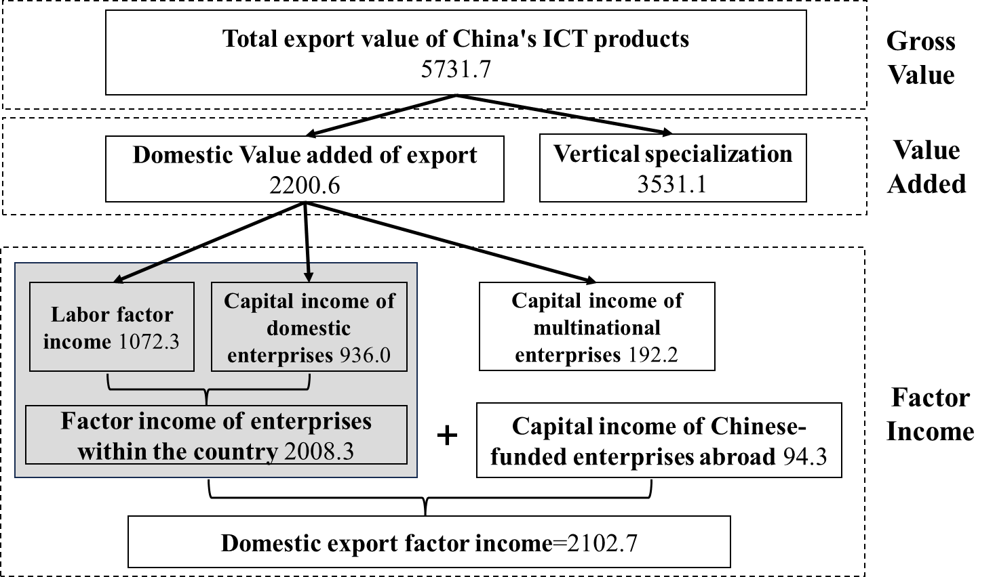
The conceptual distinction between export value-added and export factor income
There is a difference between the export volume from the perspective of factor income and value-added due to the investment activities of MNEs, and the degree of such difference depends on the scale of net outflow of capital returns.
Note: The numerical units in the figure are in billions of US dollars.
Figure 1 Decomposition of China's ICT manufacturing sector exports
11

Slide 12
The trade statistics method from the perspective of value-added will magnify the export earnings of the Chinese ICT sector, which may lead to a misjudgment of its competitive advantages.
Figure 2 Changes in scale of export and their differences in the ICT manufacturing sector in China under two accounting framework from 2000 to 2020
12

Slide 13
The RCA index of China's manufacturing sectors based on the factor income
The RCA index based on factor income >1 China's manufacturing industry has an advantage in international factor trade;
An "up-down-up" N-shaped pattern: traditional advantages shrinking, servitization and digitalization provide impetus;
The RCA index of factor income < the RCA index of value added. The gap has narrowed somewhat.
Figure 3 Changes in the RCA index of China's manufacturing sectors based on factor income and value added
13

Slide 14
There is a marked divergence between two RCA indices for high‑technology manufacturing.
China’s manufacturing sectors are shifting from relying on cost advantages derived from primary production factors such as labor to leveraging technological advantages driven by advanced factors including digital technologies.
low‑tech manufacturing sectors (b) medium‑tech manufacturing sectors (c) high‑tech manufacturing sectors
Figure 4 Changes in RCA index of different manufacturing sectors with different R&D intensities in China
14
Notes:
Further, this paper analyzes the changes in comparative advantage levels of manufacturing industries with different R&D intensities from the factor‑income perspective, and finds significant differences in the revealed comparative advantage (RCA) indices under the two measurement approaches across China’s manufacturing sectors by R&D intensity. As shown in Figure 4, for low‑technology manufacturing and medium‑technology manufacturing, the value‑added‑based RCA index and the factor‑income‑based RCA index are relatively close. For high‑technology manufacturing, however, there is a marked divergence between the two RCA indices. it is evident that substantial room remains for improvement if China aims to establish absolute international competitive advantages and occupy high‑end or even dominant positions in global value chains.
from 2000 to 2020, the comparative advantage indices of China’s low‑technology manufacturing continuously declined. Both medium‑ and high‑tech manufacturing sectors witnessed fluctuating rises in their RCA indices, whereas high‑technology manufacturing underwent a transition from comparative disadvantage to advantage. It reflects that China’s advantageous manufacturing sectors are shifting from labor‑intensive to technology‑intensive types.

Slide 15
Table 2. Different RCA index of China's manufacturing sectors
Sector | 2000 |  | 2020
 | RCA_VA | RCA_FI | RCA_VA | RCA_FI
Manufacturing Sectors | 1.3804 | 1.3582 | 1.6187 | 1.5536
Low‑tech | 2.3998 | 2.3609 | 1.9326 | 1.8963
-Textiles | 5.4771 | 6.1257 | 3.5639 | 3.9460
-Wood and wood products | 0.9557 | 1.0692 | 1.4510 | 1.5495
-Paper products and printing | 0.7763 | 0.8213 | 1.3819 | 1.4236
-Coke and refined petroleum products | 1.4214 | 1.3452 | 1.2584 | 1.2478
-Food products, beverages and tobacco | 1.5307 | 1.2677 | 1.0283 | 0.9473
Medium‑tech | 1.2596 | 1.3114 | 1.6804 | 1.7306
-Basic metals | 1.3143 | 1.4591 | 1.9301 | 2.0968
-Other non-metallic mineral products | 1.4190 | 1.2265 | 2.2927 | 1.9656
-Rubber and plastic products | 1.5038 | 1.5334 | 1.7498 | 1.8017
-Fabricated metal products | 0.7491 | 0.8152 | 1.3921 | 1.4876
-Other manufacturing | 1.4955 | 1.5201 | 1.2672 | 1.2657
High‑tech | 1.0403 | 0.9873 | 1.4705 | 1.3524
-Electrical equipment | 1.5581 | 1.5565 | 2.3114 | 2.2936
-Computer, electronic and optical products | 1.2777 | 1.2762 | 2.2692 | 2.2002
-Chemicals and chemical products | 1.5345 | 1.4571 | 1.5143 | 1.4508
-Machinery and equipment | 0.7599 | 0.7879 | 1.3435 | 1.3163
-Other transport equipment | 0.6471 | 0.6812 | 0.6743 | 0.6894
-Motor vehicles | 0.5100 | 0.4283 | 0.5560 | 0.4784
-Pharmaceuticals | 0.4178 | 0.2881 | 0.2820 | 0.2724
From the factor‑income perspective, China exhibits prominent competitiveness in labor‑intensive sectors represented by textiles, upstream resource‑based sectors such as basic metals and non‑metallic minerals , and certain technology‑
intensive sectors including electrical equipment and ICT;
Some high‑tech sectors such as transport equipment and pharmaceuticals remain weak points.
15

Slide 16
The Disintegration of RCA index of China's Manufacturing Sectors
Figure 5 The contribution of different factors to income and RCA index in China's manufacturing sectors
Labor income made the largest contribution, though its share has declined; contribution rates of capital income from domestic firms and overseas Chinese‑funded capital have generally trended upward;
The RCA index of capital income from domestic‑funded enterprises has consistently ranked first. Upgrading of capital factors among China’s local firms is the key driver of improved manufacturing competitiveness.
16
Notes:
To unpack the drivers behind such disparities and explore the actual factor‑endowment advantages in China’s manufacturing production, this paper further decomposes the factor‑income‑based RCA indices of China’s manufacturing sectors into the labor‑income‑based RCA index, the domestic‑firm capital‑income‑based RCA index, and the overseas Chinese‑funded firm capital‑income‑based RCA index.

Slide 17
Low‑tech: labor income; medium‑ and high‑tech: capital income of domestic‑funded enterprises；
the RCA indices of capital income from overseas Chinese‑funded enterprises in textiles, electrical equipment and motor vehicle >>1, while in machinery, other transport equipment and pharmaceuticals < 1
Sector | RCA_FI | RCA_FIL | RCA_FIKD | RCA_FIKDO
Low‑tech | 1.8963 | 2.0218 | 1.8572 | 1.3073
-Textiles | 3.9460 | 3.7436 | 3.0767 | 3.0211
-Wood and wood products | 1.5495 | 1.1948 | 1.6037 | 0.7744
-Paper products and printing | 1.4236 | 1.1105 | 1.6469 | 1.0671
-Coke and refined petroleum products | 1.2478 | 0.8685 | 1.3054 | 1.4715
-Food products, beverages and tobacco | 0.9473 | 0.7841 | 1.2549 | 1.1455
Medium‑tech | 1.7306 | 1.2902 | 1.9798 | 1.3732
-Basic metals | 2.0968 | 1.3911 | 2.1019 | 1.9848
-Other non-metallic mineral products | 1.9656 | 1.7191 | 2.7103 | 1.5714
-Rubber and plastic products | 1.8017 | 1.3869 | 2.2175 | 1.5289
-Fabricated metal products | 1.4876 | 1.0497 | 1.7604 | 0.9270
-Other manufacturing | 1.2657 | 1.2246 | 1.2924 | 0.6719
High‑tech | 1.3524 | 1.3692 | 1.7047 | 1.0574
-Electrical equipment | 2.2936 | 1.8089 | 2.7553 | 2.3232
-Computer, electronic and optical products | 2.2002 | 2.7485 | 2.0019 | 1.1625
-Chemicals and chemical products | 1.4508 | 1.0965 | 1.8959 | 1.2948
-Machinery and equipment | 1.3163 | 1.0184 | 1.7818 | 0.8518
-Other transport equipment | 0.6894 | 0.5759 | 0.7467 | 0.9638
-Motor vehicles | 0.4784 | 0.2866 | 0.7598 | 1.0543
-Pharmaceuticals | 0.2724 | 0.3484 | 0.4180 | 0.4857
17
Notes:
Table 3 presents the factor‑specific RCA indices for disaggregated manufacturing sectors in 2020. As shown in the table, low‑technology manufacturing sectors derive their main competitive advantages from labor‑factor income, while medium‑ and high‑technology manufacturing sectors exhibit prominent competitive advantages in capital‑factor income of domestic‑funded enterprises.
This suggests that China’s global‑expanding high‑tech industries still face intense competition. On the one hand, institutional and resource constraints hinder operational implementation in developing host economies. On the other hand, technological weaknesses restrict market penetration in developed economies, resulting in a lack of core competitiveness.

Slide 18
4 The Influence of Different Production Factors on the Changes in RCA of China’s Manufacturing Sectors

Slide 19
Sector | Total change of RCA_FI | Change of RCA_FIL | Change of RCA_FIKD | Change of RCA_FIKDO
Manufacturing Sectors | 0.1954 | 0.2644(18.48) | 0.1861(26.88) | 0.1158(54.64)
Low‑tech | -0.4646 | -0.3937(51.73) | -0.5172(46.39) | -0.0390(1.89)
-Textiles | -2.1797 | -1.6404(45.45) | -2.1620(42.70) | 0.6308(11.85)
-Wood and wood products | 0.4803 | 0.4226(31.53) | 0.4631(34.54) | -0.3678(33.93)
-Paper products and printing | 0.6023 | 0.4800(33.92) | 0.7016(35.94) | 0.2393(30.15)
-Coke and refined petroleum products | -0.0974 | -1.6605(75.83) | 0.1664(60.53) | -0.0757(-36.36)
-Food products, beverages and tobacco | -0.3204 | -0.2716(48.62) | -0.7121(44.56) | -0.0038(6.82)
Medium‑tech | 0.4193 | 0.1902(29.04) | 0.5172(33.08) | 0.1741(37.88)
-Basic metals | 0.6378 | 0.0461(31.36) | 0.8252(34.44) | -0.0561(34.20)
-Other non-metallic mineral products | 0.7391 | 0.2465(33.10) | 1.2254(35.46) | 0.2299(31.44)
-Rubber and plastic products | 0.2683 | 0.3086(21.90) | 0.0827(28.88) | 0.3948(49.22)
-Fabricated metal products | 0.6724 | 0.4712(34.33) | 0.7372(36.18) | 0.1102(29.48)
-Other manufacturing | -0.2544 | -0.1266(54.2) | -0.4057(47.84) | 0.1226(-2.03)
High‑tech | 0.3651 | 0.5184(30.21) | 0.3819(33.76) | 0.1403(36.02)
-Electrical equipment | 0.737 | 0.5728(31.85) | 0.8167(34.72) | 1.1944(33.43)
-Computer, electronic and optical products | 0.9239 | 1.6256(33.87) | 0.6223(35.91) | -0.1142(30.22)
-Chemicals and chemical products | -0.0064 | -0.3037(667.98) | 0.0485(407.99) | 0.2727(-975.97)
-Machinery and equipment | 0.5284 | 0.4203(33.56) | 0.7299(35.73) | 0.0385(30.71)
-Other transport equipment | 0.0082 | -0.021(-192.95) | 0.0164(-97.18) | 0.2213(390.13)
-Motor vehicles | 0.0501 | -0.0627(14.08) | 0.0069(24.30) | 0.3818(61.62)
-Pharmaceuticals | -0.0157 | -0.0547(88.35) | -0.309(67.88) | -0.2633(-56.23)
Table 4 Changes in RCA index of various factors in China's manufacturing sectors from 2000 to 2020 and their impact on the overall variations
The overall rise in the manufacturing RCA index stems from the combined effects of the three production factors. Capital from overseas Chinese‑funded enterprises played an indispensable positive role, contributing 54.64%;
The declining RCA of labor income in low‑tech manufacturing sectors, together with the rising RCA of labor income in medium‑ and high‑tech manufacturing sectors, jointly reflect the improvement in the quality of China’s labor force;
Domestic factors constitute key constraints on the improvement of comparative advantages in low‑ and medium‑tech manufacturing sectors as well as certain high‑tech manufacturing sectors, whereas the competitiveness of capital factors from overseas Chinese‑funded enterprises is the main factor hindering RCA growth in sectors such as chemicals and pharmaceuticals.
Note: The figures in () indicate the contribution (%) of changes in RCA indices driven by each production factor to the total change.
19
Notes:
medium‑ and high‑technology manufacturing sectors, where capital, as a key production factor, actively boosts competitive advantages. By contrast, the comparative advantage of low‑technology manufacturing is mainly shaped by the labor‑factor RCA index. The declining labor‑factor advantage in low‑technology manufacturing, together with the rising labor‑factor advantage in medium‑ and high‑technology manufacturing, jointly reflect the improvement in the quality of China’s labor force.

Slide 20
5 Conclusions and Discussion

Slide 21
Conclusions
Under the traditional value-added measurement framework, the RCA index of China's manufacturing sector, especially that of high-tech manufacturing, is significantly overestimated.
In the terms of factor income, China's labor-intensive sectors such as the textile, upstream resource-based sectors such as basic metals, and some technology-intensive sectors such as electrical equipment possess obvious global competitive advantages. However, core technology and high-tech manufacturing sectors such as transportation equipment and pharmaceutical products still have shortcomings.
The RCA index of labor income has always occupied the first place, and China's outward investment income is gradually becoming an important part of the comparative advantage of manufacturing industry.
Domestic factors are the key constraints on the improvement of comparative advantages in low‑ and medium‑tech manufacturing sectors as well as certain high‑tech manufacturing sectors, whereas the competitiveness of capital factors from overseas Chinese‑funded enterprises is the main factor hindering RCA growth in sectors such as chemicals and pharmaceuticals.
21
Notes:
This paper advances the GVC production accounting framework from the perspective of value added to factor income, and proposes the RCA index of factor income and further deconstructed it into RCA index of different production factors. It shows that:

Slide 22
Discussion
We needs to
Against the backdrop of large‑scale GVC restructuring, to upgrade toward high‑end GVC segments and escape low‑end lock‑in, China needs to adopt appropriate restructuring pathways;
It should gradually shift from cost advantages built on primary production factors such as low‑cost labor to technological advantages driven by advanced factors including digital technologies, so as to foster core industrial competitiveness and gain leading positions in manufacturing value chains;
Emerging risks including outward relocation of foreign capital and diminishing labor advantages have limited the improvement of domestic production‑factor strengths. Global expansion of indigenous Chinese enterprises may become a crucial direction for enhancing manufacturing comparative advantages in the future.
22

Slide 23
THANK YOU
Presenter: Xuefan Guo
Institution: Tsinghua University, China
E-mail: somnus1214@126.com

