Slide 1





Driving Impact? How Imperfect Substitution Shapes Heterogeneous Rebound in Carsharing
Tamar Meshulam (Ben-Gurion University), Jozef Cossey (ESCP Business School), David Font Vivanco (IRTA, CREDA), Tamar Makov (Ben-Gurion University)
23/06/2026
32nd IIOA & 11th SHAIO Conference, Sevilla
Contact: david.font@irta.cat
Notes:
La foto la podeis cambiar por cualquiera que querais de repositorio de imágenes (ex: https://unsplash.com/es // https://www.pexels.com/es-es/)

Slide 2

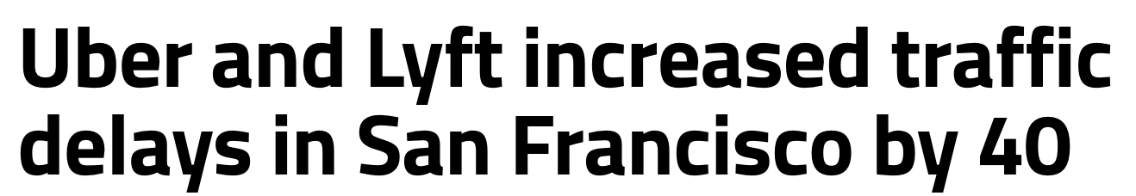
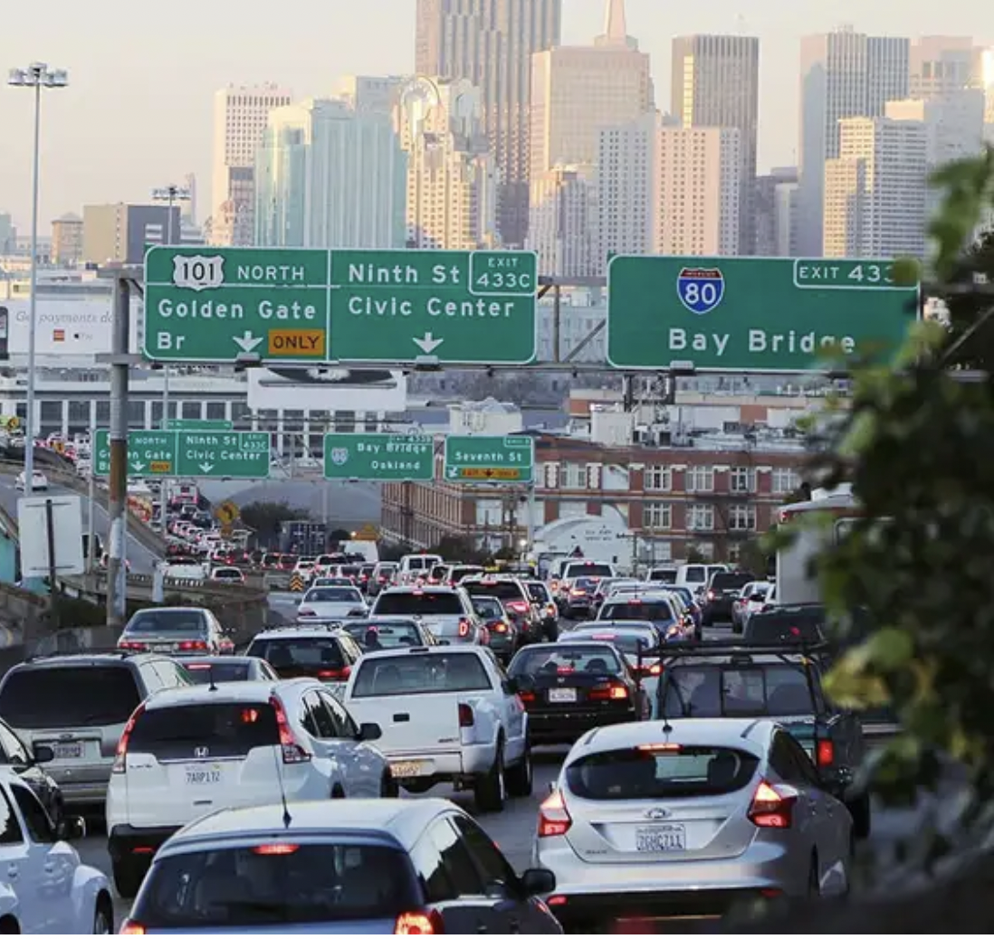
Introduction
Carsharing is intended to reduce private car ownership and lower environmental impacts, but rebound effects can erode these benefits through changes in user behaviour.
Challenge #1: The magnitude of rebound effects from carsharing remains uncertain, especially when both direct and indirect (re-spending) effects are considered.
Challenge #2: Rebound studies often assume perfect substitution between carsharing and private car use.
Challenge #3: Average rebound estimates hide heterogeneous user responses and modal shifts.
Solution: A microdata-informed EEMRIO rebound framework that translates carsharing-induced changes in mobility and expenditure into direct and supply-chain GHG impacts.
%

Slide 3
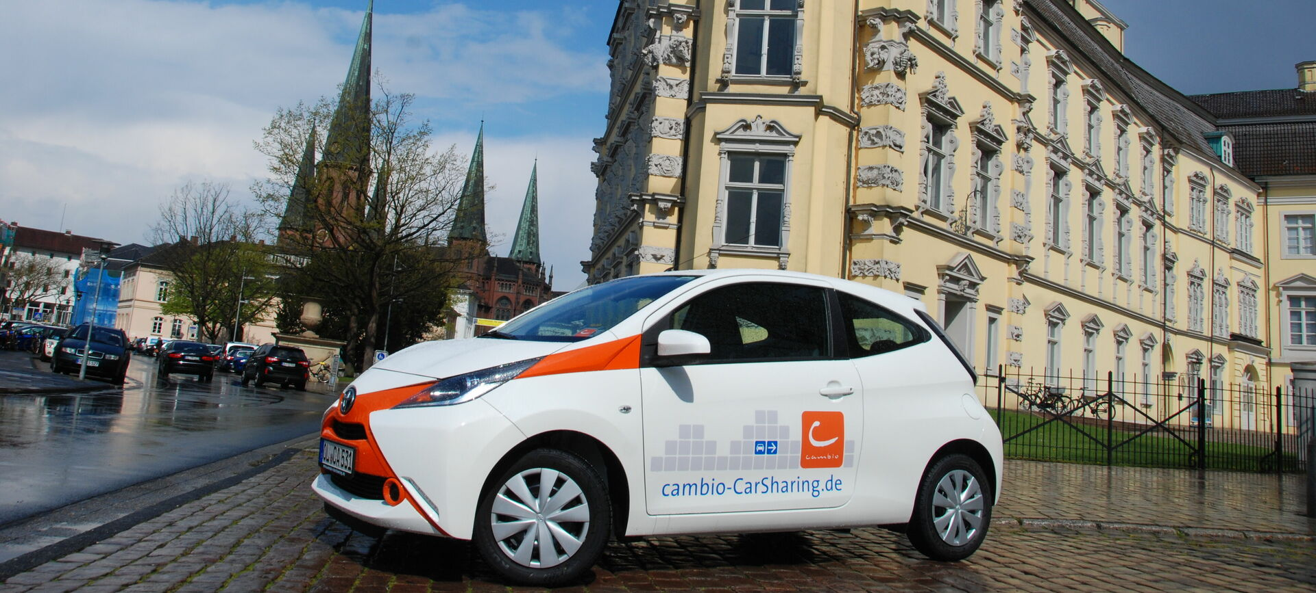

Methods
Logic: Survey responses → final-demand change vectors → EEMRIO → GHG impacts → rebound effect
Survey data: 4,468 users of Cambio carsharing in Flanders, Belgium, covering current transport-mode use and self-reported changes after adopting carsharing.
EEMRIO model: EXIOBASE3 is used to translate avoided and additional expenditure into economy-wide GHG impacts through supply-chain emission intensities.
Rebound effect: Direct rebound comes from modal shifts; indirect rebound comes from re-spending across the wider economy.
Re-spending model: An Almost Ideal Demand System estimates how cost savings are reallocated across COICOP consumption categories.
Cluster analysis: DBSCAN clustering is used to identify user groups with different substitution patterns and segment-specific rebound effects.

Slide 4
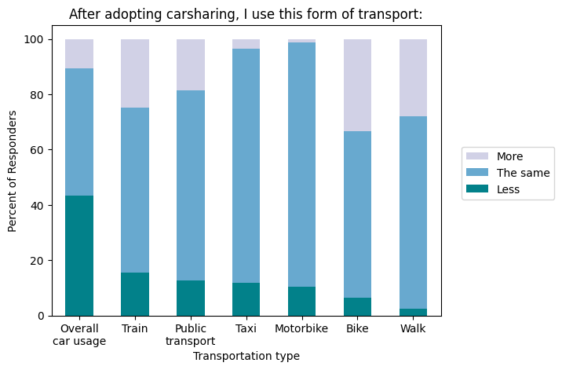
Results
Carsharing does not simply replace private car use: while many users report stable use of individual transport modes, around 43% report lower overall car use after adopting carsharing.
The direction of modal change varies across users and modes: walking, cycling, train, and public transport increase for some users, while car use decreases for many, supporting the need to model imperfect substitution rather than one-to-one displacement.

Slide 5
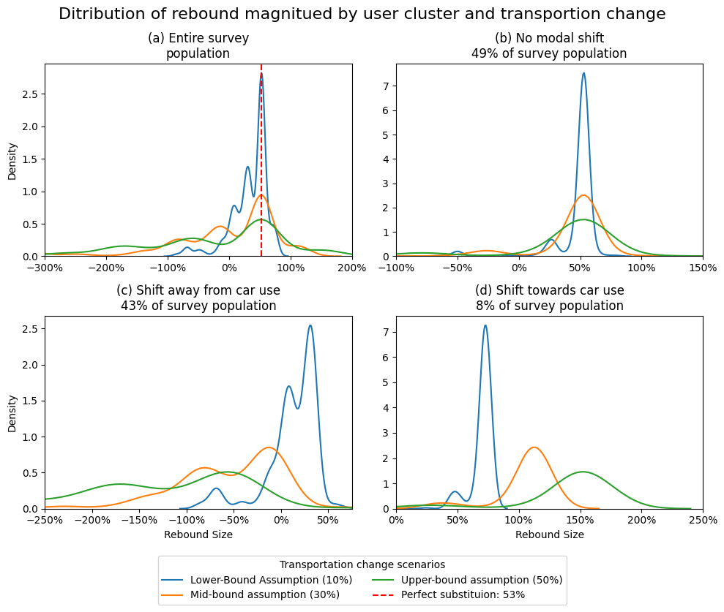
Results
Average rebound of 53% hides strong heterogeneity: the full sample includes both negative rebound values and backfire, depending on users’ transport changes.
Imperfect substitution affects 51% of users: 43% shift away from car use, generating much lower or negative rebound, while 8% shift toward greater car use, driving high rebound and potential backfire.
High rebound is concentrated in a small group: 8% of users shift toward greater car use, with mean rebound rising from 102% to 300% across scenarios.

Slide 6

Conclusions
Carsharing should not be treated as an inherently low-carbon solution; its environmental value depends on the mobility practices it displaces and how it reshapes final demand across consumption categories.
Rebound analysis needs to move beyond average estimates, because aggregate results can hide both highly beneficial users and users who generate backfire.
Substitution assumptions are policy-relevant modelling choices: one-to-one displacement hides whether carsharing replaces private car use, complements public and active transport, or expands car-dependent mobility.
Policy should target the conditions under which carsharing substitutes private car use, rather than simply promoting carsharing adoption in general.
For IO and rebound research, imperfect substitution and user heterogeneity are not secondary refinements; they can fundamentally change the interpretation of sustainability outcomes.

Slide 7
Driving Impact? How Imperfect Substitution Shapes Heterogeneous Rebound in Carsharing
Thank you!
Parc Mediterrani de la Tecnología, Edifici EEABB
Esteve Terrades 8, 08860 Castelldefels
Tel + 34 935 521 124 | Fax + 34 935 521 121 | E-mail: creda@creda.es

