Slide 1
Impact of US tariffs on the Spanish economy:
An analysis based on the “exposure” indicator and FIGARO data
Juan Cervigón
june 2026

Slide 2
Agenda
Main results
What is the Exposure indicator
Implementing Tariffs in IOT
Calculating the impact of Tariffs

Slide 3
Main results
Exposure of the Spanish economy to the US economy
Impact of a 15% increase in US tariffs. Year 2013

Slide 4
Impact by industry sorted by impact in million euros
The 10 most impacted industries
The 10 least impacted industries
figures in million euros

Slide 5
The exposure indicator

Slide 6
Exposure Indicator and FIGARO data base
Exposure indicator is one of the Macroeconomic Global Indicator (MGI) published by Eurostat based on FIGARO database
Trading partner exposure measures domestic gross value added generated by the exports of an economy to a trade partner directly and indirectly through third countries.
https://doi.org/10.2908/NAIO_10_FGTEX

Slide 7
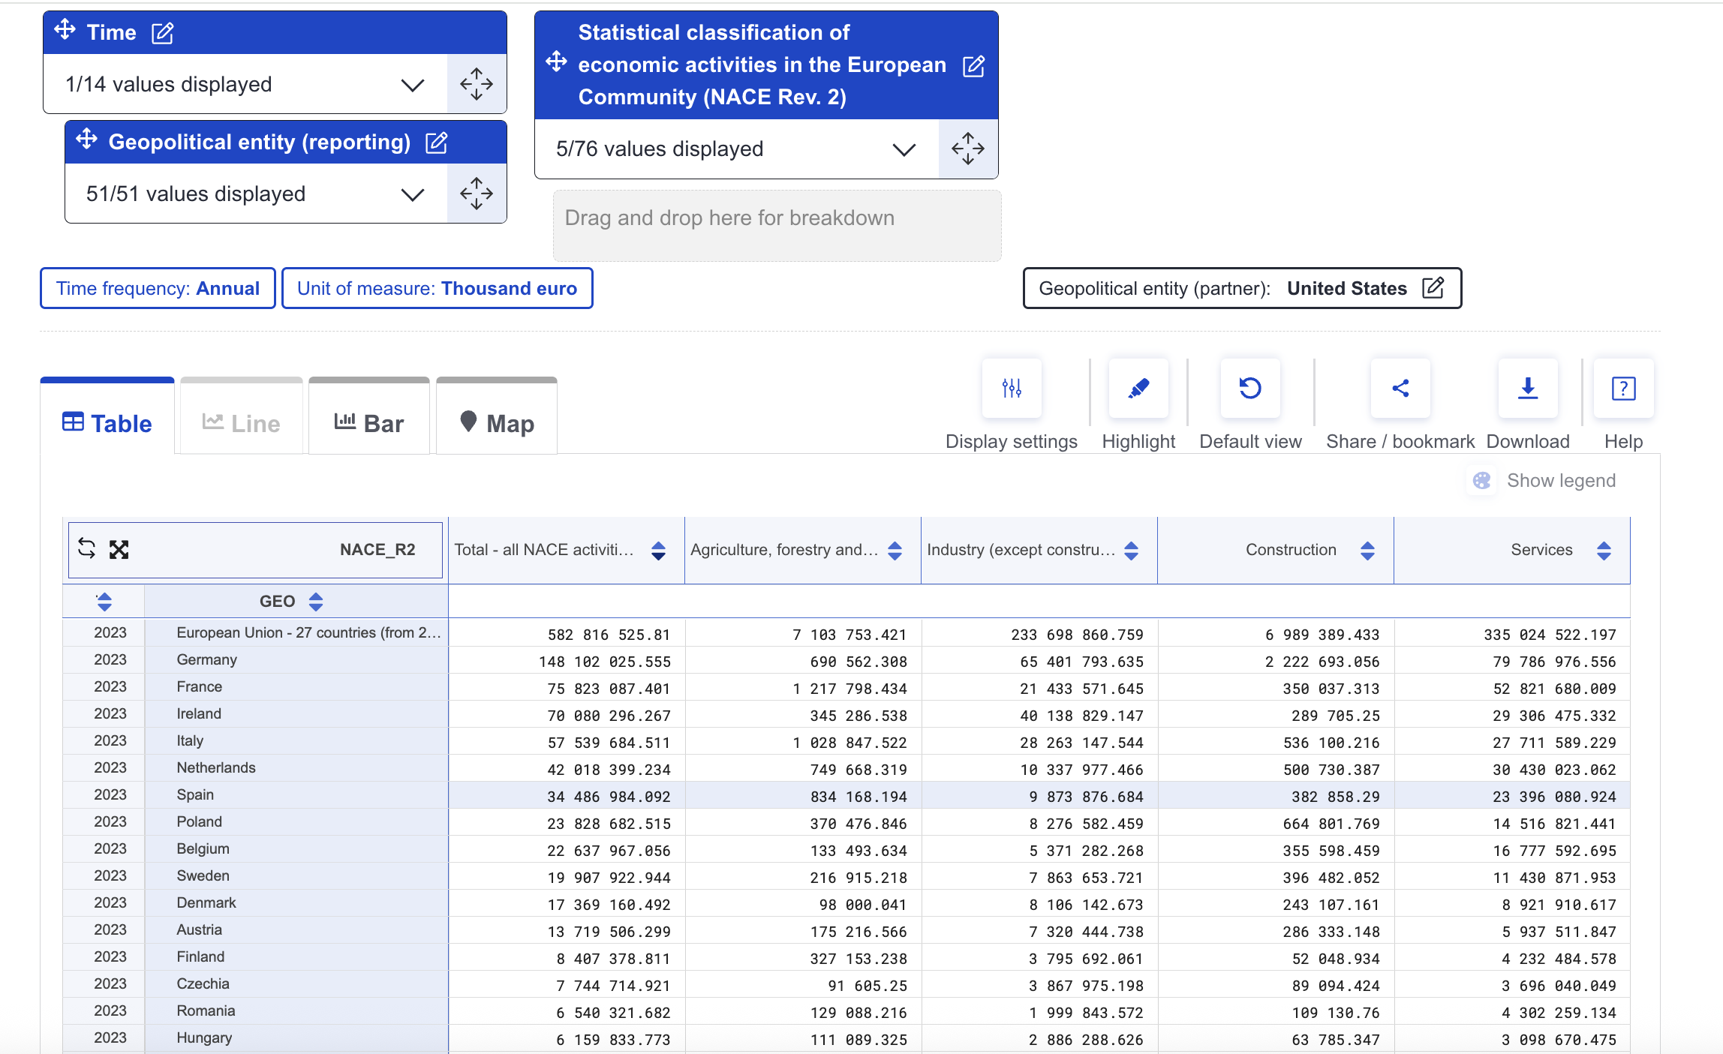
The indicator can be found in Eurostat Database
https://ec.europa.eu/eurostat/databrowser/view/naio_10_fgtex/default/table?lang=en&category=na10.naio_10.naio_10_f.naio_10_fg

Slide 8
Calculation of the exposure indicator
Calculate the economic flows from the exposed economy to the partner economy
Calculate de production needed to meet that flows using the local inverse Leontief of the exposed country
Calculate the value added and employment involved in production

Slide 9
Flows from Spain to US
US final use
US intermediate use
RW Intermediate use for US final use
Designed by pikisuperstar / Freepik

Slide 10
The flows in the MRIO tables

Slide 11
Formula scheme: given a flow, calculate the production

Slide 12


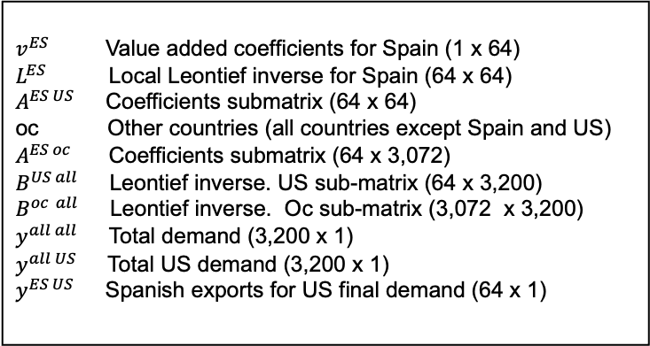


Formulas
Value added
Production
Flow
$$v^{ES} L^{ES} y^{ES US}$$
$$v^{ES} L^{ES} Z^{ES US}u_{ones}$$
or
$$v^{ES} L^{ES} A^{ES US}B^{US all}y^{all all}$$
$$v^{ES} L^{ES}{ A}^{ES oc}B^{oc all}y^{all US}$$
$v^{ES}$ Value added coefficients for Spain (1 x 64)
$L^{ES}$ Local Leontief inverse for Spain (64 x 64)
$A^{ES US}$ Coefficients submatrix (64 x 64)
oc Other countries (all countries except Spain and US)
$A^{ES oc}$ Coefficients submatrix (64 x 3,072)
$B^{US all}$ Leontief inverse. US sub-matrix (64 x 3,200)
$B^{oc all}$ Leontief inverse. Oc sub-matrix (3,072 x 3,200)
$y^{all all}$ Total demand (3,200 x 1)
$y^{all US}$ Total US demand (3,200 x 1)
$y^{ES US}$ Spanish exports for US final demand (64 x 1)

Slide 13
Breakdown of exposure by flows

Slide 14
Exposure of the Spanish economy to the US economy over time

Slide 15
Exposure of EU economies to US economy
Economies with GDP over 1 Tr

Slide 16
Implementation of Tariffs in IOT
Tariffs increase nominal prices, producing new prices
Demand reacts to the new prices and reduces quantity according to Price Elasticity
The economic flows from the exposed country to the partner country are reduced in terms on quantity
The reduction of the flows is used to calculate the impact of the tariffs

Slide 17
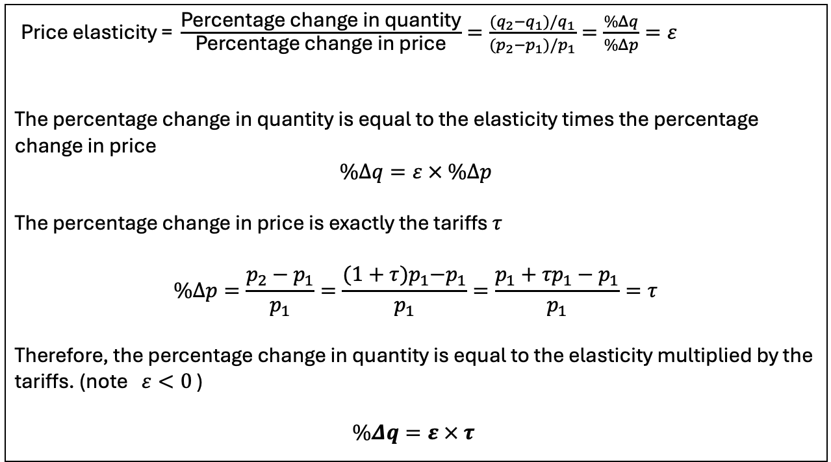
A quick refresher on price elasticity
$\text{Price} \text{elasticity} \text{= }\frac{\text{Percentage} \text{change} \text{in} \text{quantity}}{\text{Percentage} \text{change} \text{in} \text{price}}=\frac{(q_{2}−q_{1})/q_{1}}{(p_{2}−p_{1})/p_{1}}=\frac{\%Δq}{\%Δp}=ε$
The percentage change in quantity is equal to the elasticity times the percentage change in price
$$\%Δq=ε × \%Δp$$
The percentage change in price is exactly the tariffs $τ$
$$\%Δp=\frac{p_{2}−p_{1}}{p_{1}}=\frac{{(1+τ)p}_{1}−p_{1}}{p_{1}}=\frac{{p_{1}+τp}_{1}−p_{1}}{p_{1}}=τ$$
Therefore, the percentage change in quantity is equal to the elasticity multiplied by the tariffs. (note $ε<0$ )
$$\%Δq=ε × τ$$

Slide 18
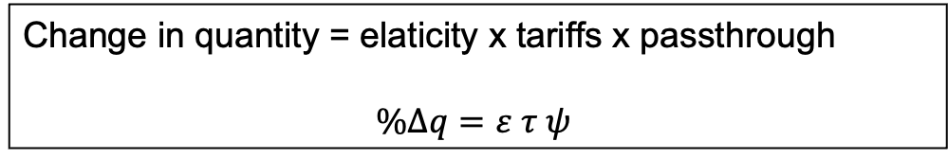
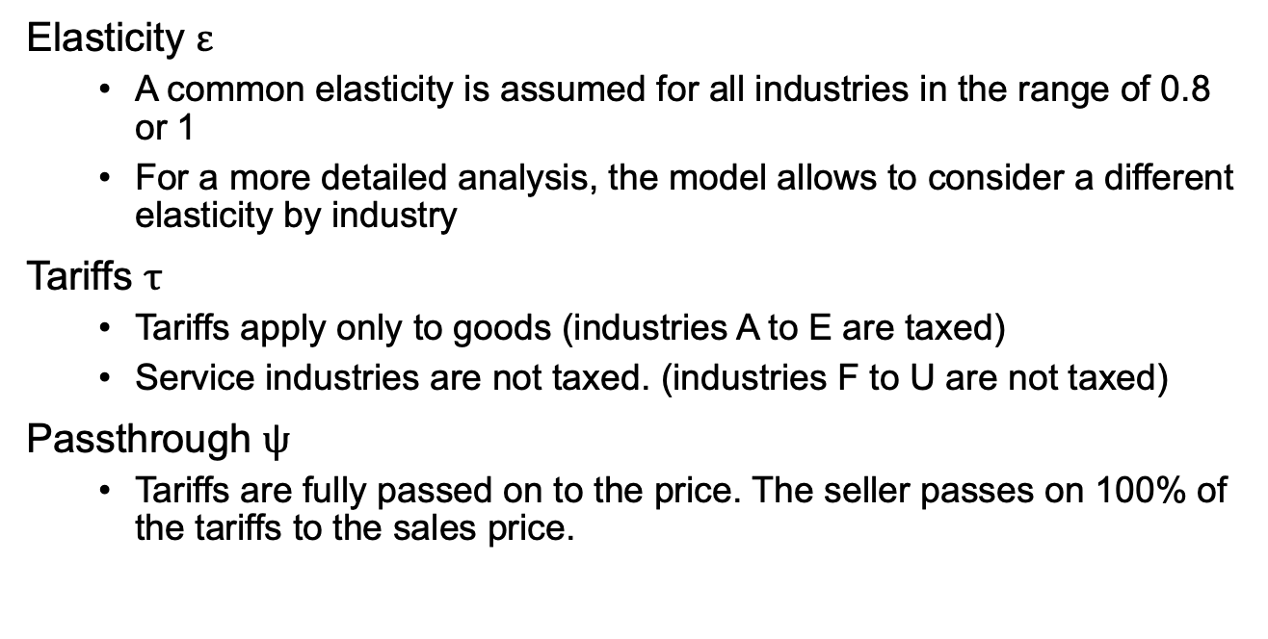
Assumptions for the implementation of tariffs in the IOT
Elasticity $ε$
  A common elasticity is assumed for all industries in the range of 0.8 or 1
  For a more detailed analysis, the model allows to consider a different elasticity by industry
Tariffs $τ$
  Tariffs apply only to goods (industries A to E are taxed)
  Service industries are not taxed. (industries F to U are not taxed)
Passthrough $ψ$
  Tariffs are fully passed on to the price. The seller passes on 100% of the tariffs to the sales price.
Change in quantity = elaticity x tariffs x passthrough
$$\%Δq=ε τ ψ$$

Slide 19
The Budget Lab is publicly releasing the Tariff Rate Tracker, a fully open-source tool that computes daily effective tariff rates from official USITC Harmonized Tariff Schedule (HTS) data
During 2025 U.S. tariff rates have been revised more than thirty times.
The ETR (Efective Tariff Rate) started the year 2025 at under 3 percent and reached over 22 percent after Liberation Day on April 2025..

Slide 21

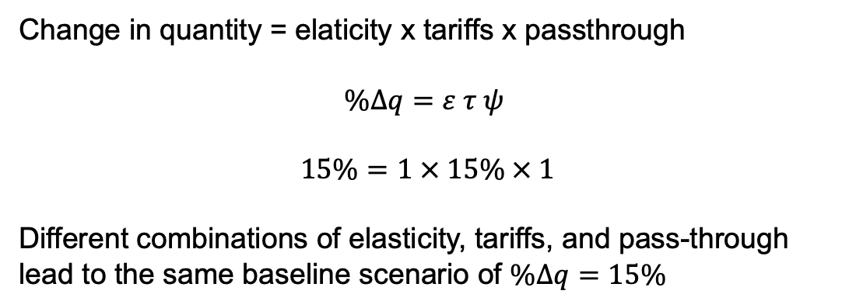

Base Scenario: $\%Δq=15\%$
Change in quantity = elaticity x tariffs x passthrough
$$\%Δq=ε τ ψ$$
$$15\%=1 × 15\% × 1$$
Different combinations of elasticity, tariffs, and pass-through lead to the same baseline scenario of $\%Δq=15\%$
$$\%Δq=constant$$

Slide 22
Impact of tariffs $ετψ=0.15$

Slide 23
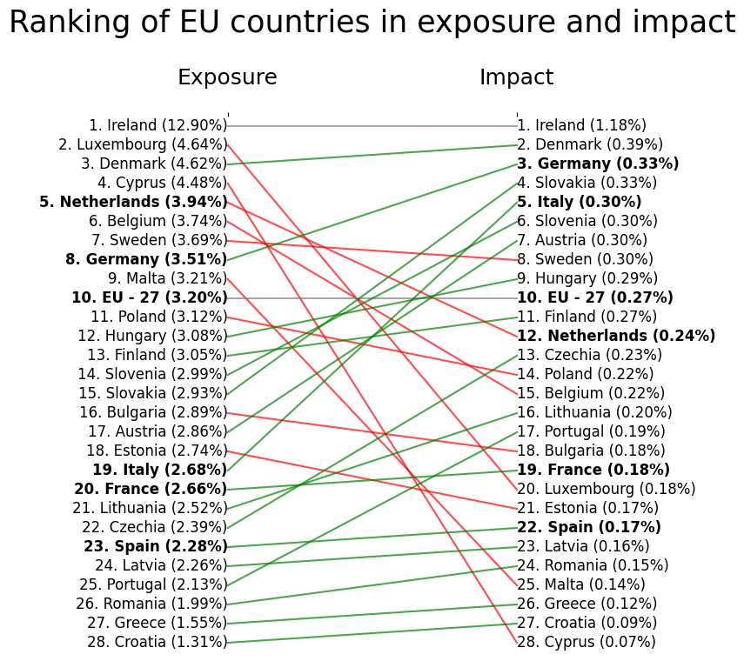
Countries with a GDP over 1 trillion are in bold

Slide 24
Thank you very much

