Slide 1


Modeling structural change in the green transition
New industries, balancing procedure, and price and quantity effects
Clara Caiafaª , Kurt Kratena^{b,c} and Iñaki Arto^{b}
ªEindhoven University of Technology, Eindhoven, the Netherlands
^{b}Basque Center for Climate Change (BC3), Bilbao, Spain
^{c}Centre of Economic Scenario Analysis and Research (CESAR), Vienna, Austria

Slide 2
Structural change in the green transition
Green transition expected to lead to a process of widespread structural change
    Renewable energy carriers (e.g., green hydrogen and electricity) have higher transport costs than fossil fuels
    Impacting locational advantages of regions
    “Renewables-pull” argument: energy-intensive industries may relocate to places with higher availability of renewables
    Impacts on global value chains, costs, competitiveness, etc
(Gielen et al, 2020; Samadi et al, 2023; Verpoort et al, 2024; Egerer et al 2024; Day et al 2024)

Slide 3
Research gap
Changes in physical quantities, production costs, as well as in trade patterns
MRIO models could potentially be used to analyze impacts, however:
    Input-output tables published by national statistical offices are too aggregated and do not reflect these new technologies, as they are not yet deployed at scale
    More disaggregated IOTs from databases such as EXIOBASE have been through a process of rebalancing, which introduces an element of endogeneity to the coefficients

Slide 4
Research gap
Two balancing problems:
Finding the new levels of output and value added in a way that technological coefficients remain exogenous
Ensuring the columns of coefficients sum one (that its, that output equals outlays)

Slide 5
Research gap
Two balancing problems:
Finding the new levels of output and value added in a way that technological coefficients remain exogenous
Ensuring the columns of coefficients sum one (that its, that output equals outlays)
→ Analytical balancing methods can find a new level of output while preserving the exogeneity of the coefficients determined based on techno-economic data

Slide 6
Research gap
Two balancing problems:
Finding the new levels of output and value added in a way that technological coefficients remain exogenous
Ensuring the columns of coefficients sum one (that its, that output equals outlays)
→ Two approaches found in the literature for ensuring coefficients sum unity
  Rescaling before inserting the new column
    Distortions in physical quantities if unit prices are considered constant

Slide 7
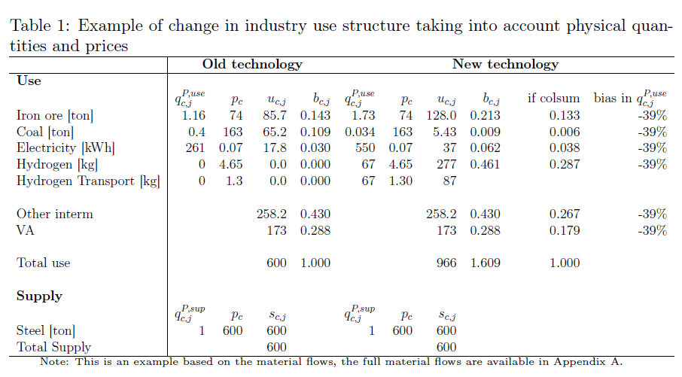
Distortions from rescaling to new outlays

Slide 8
Distortions from rescaling to new outlays

Slide 9
Distortions from rescaling to new outlays
Decrease
Given prices are constant, bias in the physical quantities
Increase
Increase
New prices need to be found, as well as new use values for consumers

Slide 10
Research gap
Two balancing problems:
Finding the new levels of output and value added in a way that technological coefficients remain exogenous
Ensuring the columns of coefficients sum one (that its, that output equals outlays)
→ Two approaches found in the literature for ensuring coefficients sum unity
  Rescaling before inserting the new column
  To assume perfect substitution
    Inconsistent with the underlying physical technologies
    Unable to assess cost differences between old and new technologies, and between different potential locations for the new technology

Slide 11
Conditions for balancing
Two conditions for coherence between the technological coefficients in the augmented IO system and the underlying technological structures derived from engineering data:
The balancing procedure to restore equality between inputs and outputs needs to preserve the exogenous technological structures
Ensuring that technological coefficients coherently reflect the underlying “physical-world” technologies requires avoiding rescaling distortions and relaxing the assumption of perfect substitution, incorporating potential cost effects arising from technological change.

Slide 12
Our contribution
Our approach overcomes existing limitations by satisfying both conditions:
It removes the requirement that coefficients sum unity at the augmentation stage, ensuring consistency between monetary values and underlying physical structures and allowing different cost structures to be reflected on different sales prices.
It then restores balance between inputs and outlays through an analytical procedure that combines a price and a quantity model, preserving the exogeneity of the technological-change shock and accounting for the potential price effects arising from different production costs.

Slide 13
Methodology
Augment tables
  CASE 1: A new industry producing an existing commodity
  CASE 2: A new industry producing a new commodity
Balancing procedure by a combination of the price and quantity model

Slide 14
Methodology
Augment tables
  CASE 1: A new industry producing an existing commodity
  CASE 2: A new industry producing a new commodity
Balancing procedure by a combination of the price and quantity model

Slide 15
CASE 1: A new industry producing an existing commodity
Based on techno-economic data, combined with data on prices and company reports in the sector of interest:
    Disaggregate the old industry technology and the existing commodity
    Add a new column for the new industry technology, where use values should be proportional to the changes in physical inputs
    Coefficients are determined by dividing new use values by old commodity output (both physical quantity consumed and price unchanged at this point)
    In a SUT framework, the technological change shock is applied by changing the market shares between the old and the new technologies
    In a multiregional framework, changes in the trade shares can enable assessing price effects arising from costs in different locations

Slide 16
Methodology
Augment tables
  CASE 1: A new industry producing an existing commodity
  CASE 2: A new industry producing a new commodity
Balancing procedure by a combination of the price and quantity model

Slide 17
CASE 2: A new industry producing a new commodity
If the new industry uses a commodity that is not yet consumed and that will be consumed only by industries that do not yet exist, we call this a new commodity
    Think of green steel using green hydrogen: steel currently does not use hydrogen, and green hydrogen would be produced via a different route than current hydrogen production. Then we can assume that green hydrogen in our table would only be consumed by green steel.
    Add a new column for the new industry technology and also a new column for this new commodity with use values based on technoeconomic data
    A price can be determined based on the technoeconomic data (via e.g., a levelized cost)
    Balance is ensured “backwards”: from the physical use of this commodity by the new industry (e.g. steel) and the price, determine the commodity output and the corresponding industry output for that production level.

Slide 18
Methodology
Augment tables
  CASE 1: A new industry producing an existing commodity
  CASE 2: A new industry producing a new commodity
Balancing procedure by a combination of the price and quantity model

Slide 19
Balancing procedure in short:
    With the augmented tables and baseline final demand, run the quantity model
    With the obtained industry output levels, construct an unbalanced use matrix (at this stage, changes come from different multipliers)
    With the augmented tables, run the price model
    Obtain balanced use matrix by multiplying the unbalanced use matrix and final demand by the commodity prices
    Obtain output by summing over columns (x) and rows (q)
    Multiply the augmented market shares matrix by the industry prices
    Obtain balanced make matrix by multiplying the balanced market shares matrix by the balanced commodity outputs

Slide 20
Discussion
Physical consistency in this approach
Sensitivity to unit price assumptions
Interpretation of price effects
Dealing with cost increases

Slide 21
Conclusion
Our approach overcomes existing limitations by satisfying two conditions:
It removes the requirement that coefficients sum unity at the augmentation stage, ensuring consistency between monetary values and underlying physical structures and allowing different cost structures to be reflected on different sales prices.
It then restores balance between inputs and outlays through an analytical procedure that combines a price and a quantity model, preserving the exogeneity of the technological-change shock and accounting for the potential price effects arising from different production costs.

Slide 22
Thank you
Dr. Clara R. Caiafa
Postdoctoral Researcher
School of Innovation Sciences
Eindhoven University of Technology
Eindhoven, Netherlands
c.rabelo.caiafa.pereira@tue.nl

