Slide 1

32nd International Input-Output Association Conference
14th Edition of the International School of I-O Analysis
11th Jornadas de Análisis Input Output
Bridging the Temporal Gap
A Comparative Analysis of Matrix Updating Techniques for the Portuguese Economy (2010-2023)
José Miguel Rebolho¹ | Luís Cruz¹ | João Pedro Ferreira²
¹ Univ Coimbra, CeBER, Faculty of Economics, Portugal | ² Weldon Cooper Center for Public Service, University of Virginia, VA, USA
22nd - 26th June 2026, Seville, Spain

Slide 2
Introduction – Input-Output Framework
Input-Output Models, first proposed by Leontief (1936), provide an economic framework for analyzing intersectoral interdependencies by quantifying flows of inputs and outputs.
By examining relationships between sectors, I-O Models enable a comprehensive understanding of how changes in one sector reverberate throughout the economy.
Utilizing a matrix representation, the framework allows the estimation of cumulative effects of demand fluctuations via multiplier analysis, making the assessment of economic impacts possible.

Slide 3
Introduction – Updating
Input-output models are generally released at intervals of two to three years, a pattern also observed in the data provided by Statistics Portugal (INE).
However, INE does produce annual sectoral data in the National Accounts, which allow us to know the values of Production and Uses for each sector as an aggregate.
Therefore, given the necessity of updating the models, our proposal is to understand which methodology best suits the process of updating input-output matrices, using the Portuguese case and the structure of National Accounts as our empirical basis.

Slide 4
Literature – Previous Contributions
1941
Wassily Leontief
Applied biproportional balancing techniques in I-O context.
1961–1962
Richard Stone
Presented the RAS technique, developing it and adding extensions to the methodology.
1970
Bacharach
Formalized the RAS algorithm that is still used today.
2003
Junius & Oosterhaven
Generalized RAS (GRAS)
2004
Lahr & de Mesnard
Extensive overview on RAS
2004
Jackson & Murray
Exhaustive testing on biproportional methods.

Slide 5
Literature – Recent Contributions
2008
Huang et al.
Sign-preservation extensive review.
2009
Lenzen et al.
“Konfliktfreies” RAS (KRAS)
2024
de la Torre Cuevas et al.
Modified KRAS (MKRAS)
2009
Lemelin
2011
Temurshoev et al.
Projection methods extended review.
2015
Wang et al.
Updating tables with benchmark table series.
2023
Révész
Improved Normalized Squared Differences extension.
GRAS variant solving for minimum information loss.

Slide 6
Our Proposal
Aim
Test multiple matrix updating techniques to determine which produces the lowest estimation error under the Portuguese economic structure.
Generalized RAS (GRAS)
Sign Preserving Absolute Differences (SPAD)
Sign Preserving Squared Differences (SPSD)
Normalized Squared Differences (NSD)
Improved Normalized Squared Differences (INSD)
Improved Weighted Squared Differences (IWSD)
Improved Sign Preserving Squared Differences (ISPSD)
Weighted Squared Differences (WSD)
RAS

Slide 7
Our Proposal
/
Comparative Analysis
Year-by-year estimation.
Based on different time gaps: 2-, 3-, 4- and 5-year gaps.
Based on the average values of the previous 2-5 years.
Error Measures’ Assessment
Mean Absolute Deviation (MAD)
Weighted Absolute Deviation (WAD)
Mean Absolute Percentage Error (MAPE)
Root Mean Square Error (RMSE)
Correlation Coefficient (CORR)
Approach on Aggregated (88×80) and High-Resolution (431×125) Supply and Use Tables (2010 – 2023)
Estimation based on the base year.

Slide 8
Data
/
The data are derived from the National Accounts provided by the Statistics Portugal (INE).
01
We used Supply and Use Tables for the period from 2010 to 2023, classified under A82/P82 (at current prices), and from 2017 to 2023, classified under A125/P431.
02

Slide 9
Results: Three Empirical Findings
/
Method Ranking
01
Resolution Paradox
02
INSD and GRAS dominate aggregated SUT updating.
Mean-based baselines work best for dense matrices, but Gap 1 works best for high-resolution sparse matrices.
Volatile Margin Contamination
03
Exogenous information on volatile final-demand components helps preserve the estimated inter-industry core.

Slide 10
Error Types
Not All Metrics Tell the Same Story
Metric | What it captures | Why it matters here
MAD | Average absolute cell error | General entry-wise accuracy
WAD | Error weighted by economic volume | Whether large flows are correctly estimated
MAPE | Relative percentage error | Sensitivity to small sectors and near-zero cells
RMSE | Penalization of large deviations | Detection of outlier cells and shock-induced failures
CORR | Structural similarity | Whether the pattern of flows is preserved

Slide 11
Aggregated SUTs Benchmark: Ranking
Method | MAD | WAD | MAPE | RMSE | CORR | Overall
INSD | 1 | 1 | 2 | 1 | 1 | Top performer
GRAS | 2 | 2 | 1 | 2 | 2 | Top performer
RAS | 3 | 3 | 3 | 4 | 4 | Robust fallback
ISPSD | 4 | 4 | 4 | 3 | 3 | Intermediate
SPSD | 5 | 6 | 6 | 5 | 5 | Weak
SPAD | 6 | 5 | 7 | 6 | 6 | Weak
IWSD | 7 | 7 | 8 | 7 | 7 | Weak
WSD | 8 | 8 | 9 | 8 | 8 | Unstable
NSD | 9 | 9 | 5 | 9 | 9 | Unstable

Slide 12
Aggregated SUTs
MAD by Baseline Strategy

Slide 13
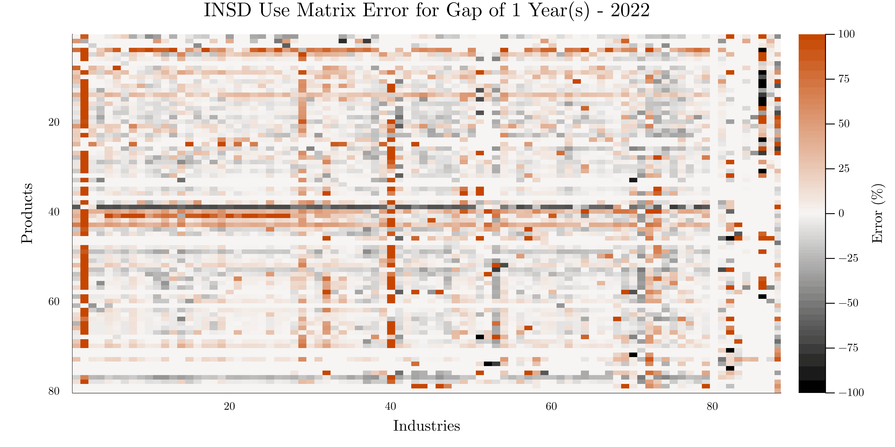
Error “Heat-Geography”
Where the Aggregated SUT Resists Updating
Notes:
Hot rows / products:
04 – Produtos das indústrias extrativas
19 – Coque, produtos petrolíferos refinados e aglomerados de combustíveis
50 – Serviços de transporte por água
52 – Serviços de armazenagem e auxiliares dos transportes
53 – Serviços postais e de Courrier
55 – Serviços de alojamento
65 – Serviços de seguros, resseguros e fundos de pensões, exceto serviços da segurança social obrigatória
93 – Serviços desportivos, de diversão e recreativos
Hot columns:
02
51
Changes in inventories

Slide 14
Resolution Paradox
/
Feature | Aggregated matrix: 88 × 80 | High-resolution matrix: 431 × 125
Structure | Dense | Sparse
Zeros | Few structural zeros | Many meaningful zeros
Preferred Baseline | Mostly 2-Year Mean | Mostly Gap 1
Why | Smooths volatility | Preserves recent structure
Risk | Overreacting to shocks | Artificial densification
Best method | INSD / GRAS | GRAS
Takeaway | Structural memory helps | Short-term adaptation wins
Resolution Paradox: smoothing helps dense matrices but can damage sparse matrices.

Slide 15
High-Resolution Stress Test
Structural Fit

Slide 16
Constraint Design Matters
Full information
Without exports
Without investment
Without exports and investment
Aggregated investment

Slide 17
Partial-Information Results
Selective Treatment of Volatile Margins Improves GRAS Accuracy

Slide 18
Volatile Margin Contamination
Known volatile margins are valuable information
Volatile Margin Contamination
An empirical diagnostic.
The problem arises when volatile final-demand components are imposed as detailed hard constraints inside the updating routine.
These components may be better treated externally, aggregated, or imposed selectively to preserve the inter-industry core.
When unstable final-demand constraints pollute the estimated production core.

Slide 19
Recommended Updating Protocol
Based on | For the Portuguese Tables
High-resolution sparse SUT.
Use immediate-past baseline: Gap 1.
Apply GRAS.
Treat volatile investment/export margins externally, aggregate them, or impose them selectively.
Updated matrix for impact analysis.

Slide 20
Concluding Remarks
Optimization does not automatically dominate biproportional updating.
1
GRAS matches INSD closely while remaining operationally simpler.
The optimal baseline depends on resolution.
2
In the Portuguese Tables
Constraint design matters.
3
Known volatile margins should not automatically enter the updating routine as detailed hard constraints.
They may be better treated exogenously or imposed at a more aggregated level.
High-resolution updating is a structural-preservation problem.
4
The aim is not only to minimize error, but to preserve coherent inter-industry relationships.
Mean works for dense aggregated matrices.
Gap 1 works for sparse high-resolution matrices.

Slide 21
Acknowledgments
This work has been supported by national funds through FCT – Fundação para a Ciência e a Tecnologia, I.P., Projects UID/05037/2025 (DOI https://doi.org/10.54499/UID/05037/2025), 2023.02227.BDANA (DOI https://doi.org/10.54499/2023.02227.BDANA), and Integrated Project RN21 – Innovation in the Natural Resin Sector to Strengthen the National Bioeconomy, co-financed by the Environmental Fund through Component 12 – Promotion of the Sustainable Bioeconomy – Investment TC-C12-i01 – Sustainable Bioeconomy – Notice No. 01/C12-i01/2021 and No. 02/C12-i01/2021, of the European funds allocated to Portugal by the Recovery and Resilience Mechanism (RRP), under the European Union’s (EU) Recovery and Resilience Facility (RRF), as part of Next Generation EU, for the period 2021 – 2026.

Slide 22
Thank You!
José Miguel Rebolho
jose.d.rebolho@fe.uc.pt
Luís Cruz
João Pedro Ferreira

