Slide 1


Testing Closure in
Input–Output Models
João Pedro Ferreira, Ana Sargento & Diogo Nápoles Sousa
June 23-26, 2026, Seville, Spain
Input-Output Association Conference
Joao.ferreira@virginia.edu

Slide 2
Presentation Outline
Why close an input–output model?
Back to the basics. What changes when we close the model?
Research question
Alternative model specifications
Results
Interpretation and next steps

Slide 3
Why close an input–output model?
Because it makes sense: induced effects represent a possible economic mechanism through which production generates income, income is distributed, and part of that income returns as demand at national, state, or local level.
But in practice: closing the model is usually treated has a pure technicality that has no impact in the results, with limited discussion of the assumptions needed to make the feedback plausible.
Output
Income
Consumption
Output
Output
Taxes
Gov. Expenditure
Output
Output
Profits
Investment
Output

Slide 4
Back to the basics – Literature review
Myernik (1965): A study developed for Boulder, Colorado offers a theoretical discussion on Type I and Type II multipliers.
Miyazawa (1976): Formalizes income-distribution feedbacks inside IO systems and shows how household-income loops alter multiplier propagation
Pyatt & Round (1985): Embed closure in a SAM framework, broadening induced effects to institutional accounts and fixed-price multipliers.
Miller & Blair (3ed., 2022): Provide the standard reference on open/closed models and remind us that IO models are comparative-static, not forecasting models.
Emonts-Holley, Ross & Swales (2021): Show that different closure methods produce materially different Type II multipliers; method choice matters.
Most studies compare multiplier size.
Here, we statistically assess which method best reproduces observed changes in output.

Slide 5
Back to the basics
A national firm starts using local resins instead of glue in paint production.
Firms in country B buy products produced in country A.
Households in country A consume more agricultural products.
Country A shifts investment from software to road construction.
Government in country A decides to spend more on software.
 |  | Country A
 |  | Industries |  |  | Final Demand |  |  |  |  | Total
 |  | 01 | 02 | 03 | HH | Inv. | Gov. | Exp. | Other FD
Country A | 01
 | 02
 | 03
 | Wages
 | Profits
 | Taxes
 | Total

Slide 6
Back to the basics – Open (I)
Admissible exogenous shocks
A national firm starts using local resins instead of glue in paint production.
Firms in country B buy products produced in country A.
Households in country A consume more agricultural products.
Country A shifts investment from software to road construction.
Government in country A decides to spend more on software.
 |  | Country A
 |  | Industries |  |  | Final Demand |  |  |  |  | Total
 |  | 01 | 02 | 03 | HH | Inv. | Gov. | Exp. | Other FD
Country A | 01 | Endogenous |  |  | Exogenous
 | 02
 | 03
 | Wages
 | Profits
 | Taxes
 | Total

Slide 7
Back to the basics – Open (II)
Admissible exogenous shocks
A national firm starts using local resins instead of glue in paint production.
Firms in country B buy products produced in country A.
Households in country A consume more agricultural products.
Country A shifts investment from software to road construction.
Government in country A decides to spend more on software.
 |  | Country A |  |  | Country B |  |  | A | B | Total
 |  | Industries |  |  | Industries |  |  | FD | FD
 |  | 01 | 02 | 03 | 01 | 02 | 03
A | 01 | Endogenous |  |  |  |  |  | Exogenous
 | 02
 | 03
B | 01
 | 02
 | 03
 | VA
 | Total

Slide 8
Back to the basics – Close model (I)
Admissible exogenous shocks
A national firm starts using local resins instead of glue in paint production.
Firms in country B buy products produced in country A.
Households in country A consume more agricultural products.
Country A shifts investment from software to road construction.
Government in country A decides to spend more on software.
 |  | Country A
 |  | Industries |  |  | Final Demand |  |  |  |  | Total
 |  | 01 | 02 | 03 | HH | Inv. | Gov. | Exp. | Other FD
Country A | 01 | Endogenous |  |  |  | Exogenous
 | 02
 | 03
 | Wages
 | Profits
 | Taxes
 | Total

Slide 9
Back to the basics – Close model (II)
Admissible exogenous shocks
A national firm starts using local resins instead of glue in paint production.
Firms in country B buy products produced in country A.
Households in country A consume more agricultural products.
Country A shifts investment from software to road construction.
Government in country A decides to spend more on software.
 |  | Country A
 |  | Industries |  |  | Final Demand |  |  |  |  | Total
 |  | 01 | 02 | 03 | HH | Inv. | Gov. | Exp. | Other FD
Country A | 01 | Endogenous |  |  |  |  | Exogenous
 | 02
 | 03
 | Wages
 | Profits
 | Taxes
 | Total

Slide 10
Back to the basics – Close model (III)
Admissible exogenous shocks
A national firm starts using local resins instead of glue in paint production.
Firms in country B buy products produced in country A.
Households in country A consume more agricultural products.
Country A shifts investment from software to road construction.
Government in country A decides to spend more on software.
 |  | Country A
 |  | Industries |  |  | Final Demand |  |  |  |  | Total
 |  | 01 | 02 | 03 | HH | Inv. | Gov. | Exp. | Other FD
Country A | 01 | Endogenous |  |  |  |  |  | Exogenous
 | 02
 | 03
 | Wages
 | Profits
 | Taxes
 | Total

Slide 11
Back to the basics – Multi-country
Admissible exogenous shocks
A national firm starts using local resins instead of glue in paint production.
Households in country A consume more agricultural products.
Country A shifts investment from software to road construction.
Government in country A decides to spend more on software.
Firms in country B buy products produced in country A.
 |  | Country A |  |  |  | Country B |  |  |  | A | B | Total
 |  | Industries |  |  | End. FD | Industries |  |  | End. FD | Ex. FD | Ex. FD
 |  | 01 | 02 | 03 |  | 01 | 02 | 03
A | 01 | Endogenous |  |  |  |  |  |  |  | Exogenous
 | 02
 | 03
 | End. VA
B | 01
 | 02
 | 03
 | End. VA
 | Total

Slide 12

Methodological concerns
IMPORTANT NOTE
In all the models tested, it has to be true that
$$x_{t}=L_{t} ×f_{t}$$
Value of multipliers
Single
Regional
MR
Closed HH
MR
Closed Inv.
MR
Closed Gov.
≤
Multi-regional
≤
≤
≤
Single
Regional
MR
Closed HH
MR
Closed Inv.
MR
Closed Gov.
Exog. FD
≥
Multi-regional
≥
≥
≥
IMPORTANT DISCLOSURE
In this presentation, we are making simplified assumptions about the closing procedure. Despite the mathematical confirmation, the connection between profits and investment is more complex as well as the connection between taxes (and how they are represented in a IO table= and Government expenditures.

Slide 13
Research questions
If implemented according to theoretical rules, does closing the model improve accuracy?
If yes, what type of closure performs best?
Is there a problem of over- or underestimating the impacts generated?

Slide 14
Data
Figaro database: Eurostat’s inter-country input–output database. It links industries and final demand across countries in a consistent accounting framework.
Why? It is one of the most widely used IO databases and contains the information needed to compare open and closed structures consistently over the years.
In this presentation, we start with 2015–2016 because 2015 is the base year for most countries represented in FIGARO.
Small concern: We might be simply doing reverse engineering.

Slide 15
Scenarios
Open 1
Open 2
Open 1 plus…
Exports and imports endogenized
Closed 1
Open 2 plus…
Closed to HH consumption
Only national industries in the endogenous part
Single national model
Multi-country model
Increase in wages generates an impact in consumption
Close 2
Close 1 plus…
The model is closed to investment.
An increase in profits generates a new wave of investment.
Close 3
Close 1 plus…
The model is closed to government expenditure
Increase in taxes generates a additional government expenditures

Slide 16
Methodology and Error Assessment
Prediction
Validation
x̂2016 = L2015 · f2016
x̂2016 vs. x2016
Base year: 2015 ➔ validation year: 2016
For each scenario, compute the relevant inverse using the 2015 structure
Use observed 2016 final-demand information consistent with the chosen closure
Compare predicted output with observed output at the sector and country level
MAPE
WAPE
Average sectoral error
Error weighted by size

Slide 17
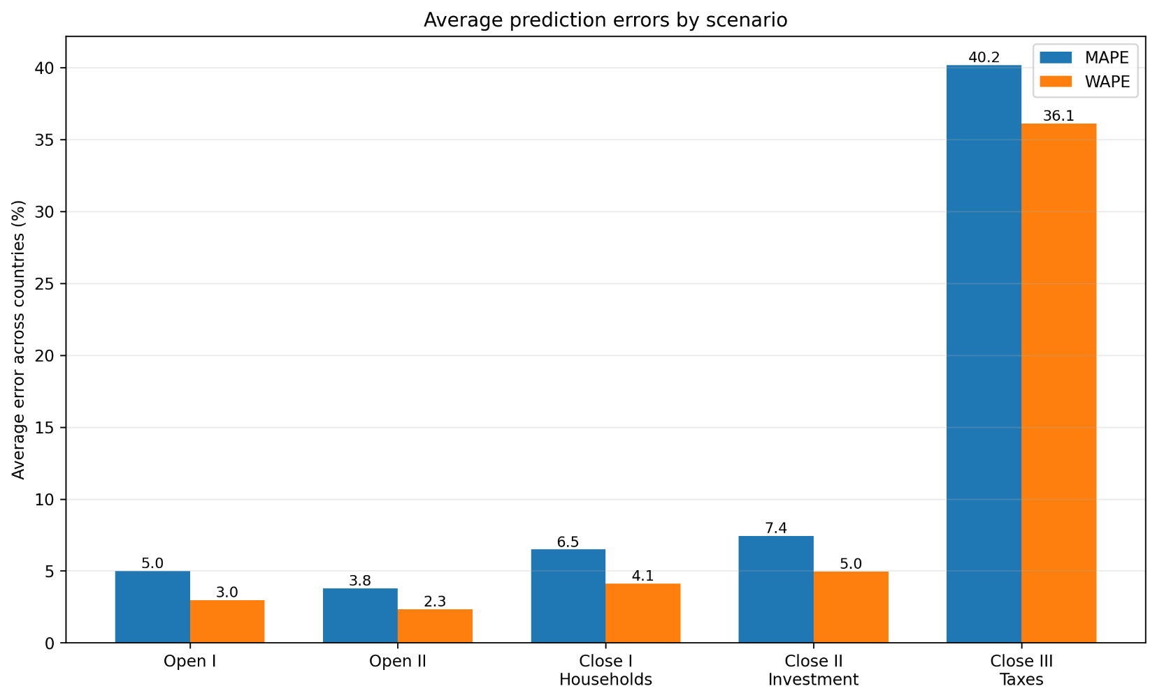
Results
Errors are larger:
in the single-regional model than the multi-regional model.
in the closed model than in the open model.
In the close 3 when compared to close 1 and 2.
As MAPE is bigger than WAPE, this means that the errors are concentrated in smaller sectors than in large ones.

Slide 18
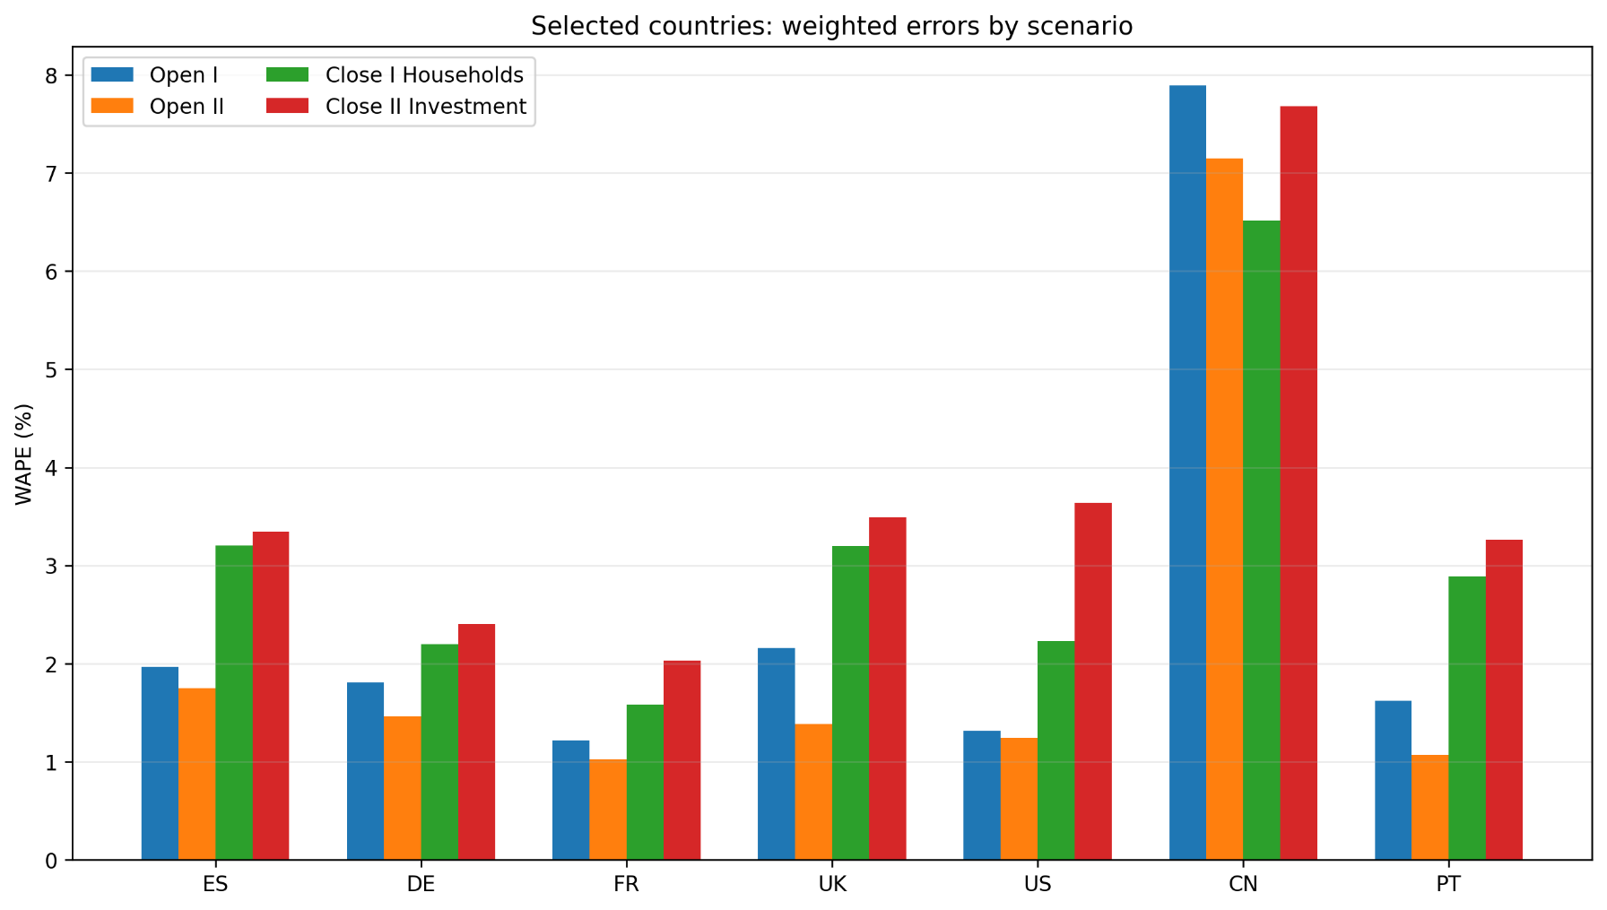
Results
Errors are larger:
in the single-regional model than the multi-regional model.
in the closed model than in the open model.
In the close 2 when compared to close 1 (besides China and other small EU economies).

Slide 19
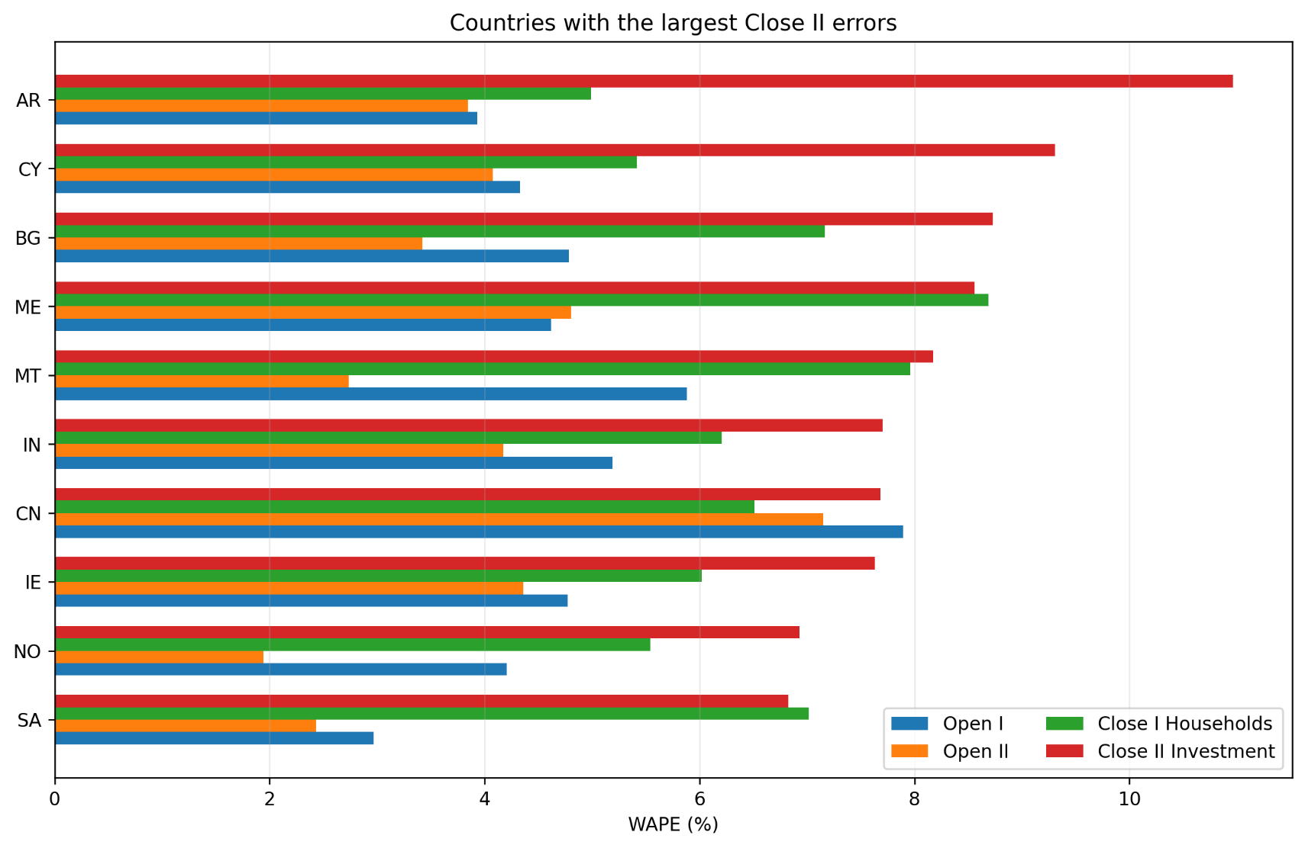
Results
Errors are larger:
in the single-regional model than the multi-regional model.
in the closed model than in the open model.
In the close 2 when compared to close 1 (besides China and other small EU economies).

Slide 20
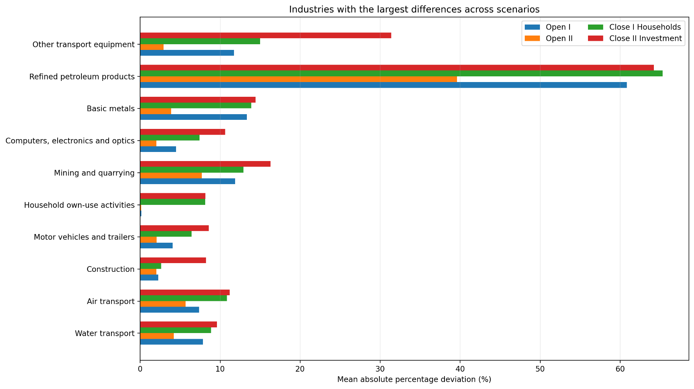
Results
Errors are larger:
In the refined petroleum products, when closed.
in other transport equipment when closed to investment.
In most of resource related sectores if single-region.

Slide 21
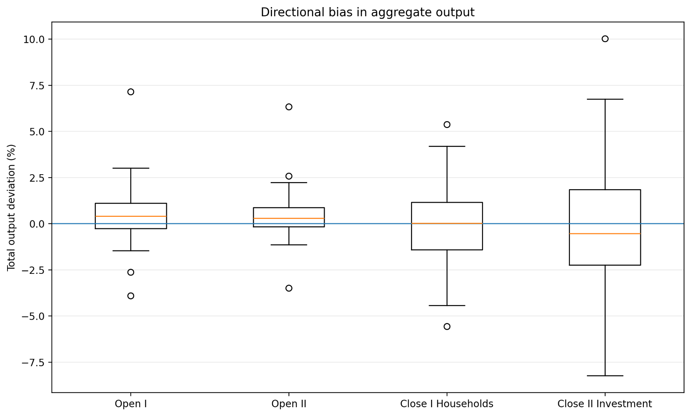
Results
It is not an over- or underestimation problem:
If applied accordingly, open models overestimate slightly more than closed models.
However, the size of the error increases.
Reason
Higher multiplier
Higher relative variance of ex fd ∆2016 compared ex fd ∆2015

Slide 22
Discussion/Conclusions
Framing the problem: The “closing approach” needs to be reframed. It is not a matter of how you can close, but why you are closing it, in that way, given a certain shock?
Is using closing for several FD components and having larger multipliers a problem? Not mathematically, but in practice, yes, for two main reasons:
- Researchers/practitioners end up simulating shocks as exogenous that should be applied as coefficient changes in the endogenous side, therefore overestimating the impacts.
- Higher relative variances in final demand produce larger errors.

Slide 23
Future work
Nuances are important: When closing to final demand components, the values in the row also matter → Problem with taxes.
There are flows between final demand components that also have to be accounted in the closing process.
- Taxes on consumption
- Migration remittances.
As Emonts-Holley, Ross & Swales (2021) showed , there are several ways to “close” a single column, and the multipliers are sensitive to it. We will test different ways in future work

Slide 24
Thank you

