Slide 1

Disaggregation of the Steel Sector in MRIO: Global Supply Chain Differences between BF–BOF and EAF Routes
Seiya Imadaª*, Shigemi Kagawa^{b}
a: Platform of Inter/Transdisciplinary Energy Research, Kyushu University, Fukuoka, Japan
b: Faculty of Economics, Kyushu University, Fukuoka, Japan
Notes:
Good afternoon.
I’m Seiya Imada from Kyushu University.
Today, I am here to talk about 〜

Slide 2
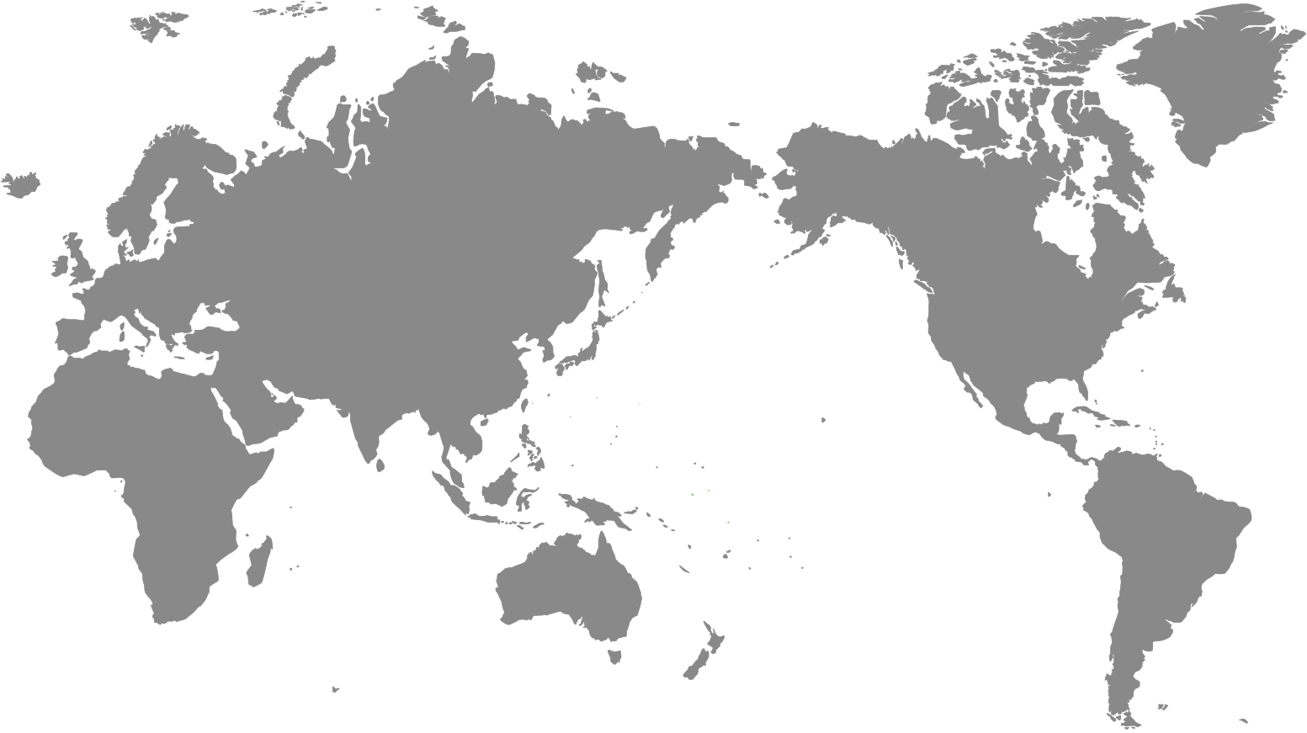


1. Introduction
1
Buildings and infrastructure
Steel Use
1.8 billion tons
52%
12%
10%
280 million tons of steel products were traded internationally in 2023
Automotive
Metal products
Notes:
So, let me begin my presentation with the introduction.
World Steel Association reported that global steel use reached about 1.8 billion tons in 2023.
Of the total steel use, 52% was used in buildings and infrastructure (インフラストラクチャー), 12% was used in Automotive sector.
These numbers highlight the important role of the steel sector in both our society and our economies.
Also, around 280 million tons of the steel products were traded internationally in 2023, which was about 15% of the total steel use that year.
These facts indicate that steel is deeply embodied in global supply chain.

Slide 3

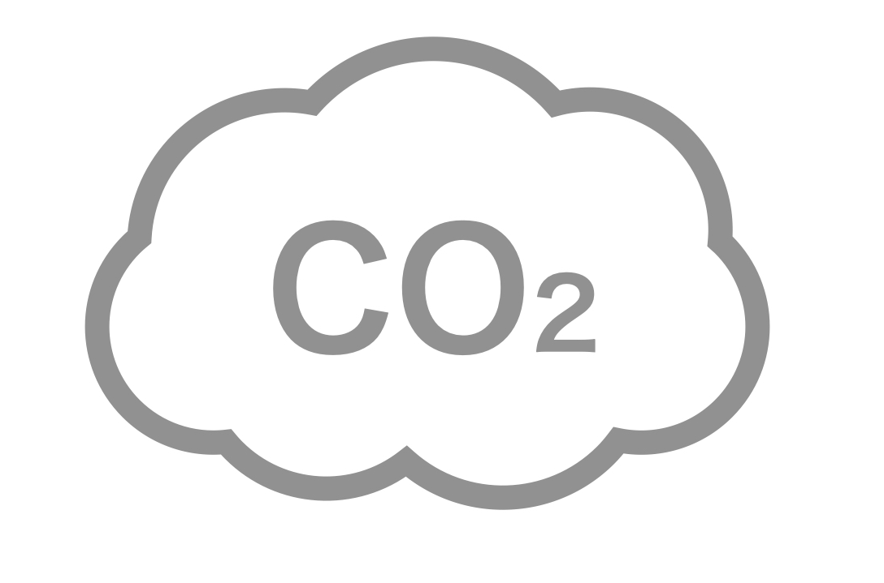

1. Introduction
2
These emissions are driven different domestic and international final demands (Chen et al, 2017; Peng et al, 2018)
Direct CO₂ emissions
2.6 billion tons (IEA, 2020)
Considering the scale of emissions and the interconnections, identifying CO₂ emission hotspots in steel sector’s global supply chain (GSC) is essential for designing effective decarbonization strategies.
Notes:
According to the IEA, direct CO₂ emissions from the iron and steel sector reached about 2.6 billion tonnes in 2020, accounting for around 7% of global CO₂ emissions.
However, these emissions are driven (ドリヴン) by different domestic and international final and intermediate demands, particularly from the construction and automotive sectors.
Considering the scale of emissions and the interconnections (インターコネクションズ), identifying CO₂ emission hotspots in steel sector’s global supply chain (GSC) is essential for designing effective decarbonization strategies.

Slide 4

1. Introduction
3
Many previous studies focusing on emission hotspots in GSC have used multi-regional input-output (MRIO) table.
Indirect emissions through domestic and international final demands (Chen et al, 2017; Peng et al, 2018)
Direct CO₂ emissions
2.6 billion tons
In the process of constructing an MRIO model, information is simplified and aggregated due to the averaging of data from multiple firms with different production technologies and differences in data resolution.
To reduce indirect emissions, effective policies targeting CO₂ reductions throughout global supply chains are crucial.
To establish an effective policy, it need to identify CO₂ emission hotpots in the iron and steel sector.
Notes:
Many previous studies focusing on emission hotspots in GSC have used multi-regional input-output (MRIO) table.
These studies have demonstrated that MRIO analyses are effective for evaluating the steel sector; however, this approach also has structural limitations.
In the process of constructing an MRIO model, information is simplified and aggregated due to the averaging of data from multiple firms with different production technologies and differences in data resolution.

Slide 5
1. Introduction
4
Aggregation bias
In addition to causing the loss of information on disaggregated sectors, this can lead to significant errors when there is considerable heterogeneity between sectors.
This significantly affects the estimation for supply chain CO₂ emissions, which is a key objective of environmentally extended input-output analysis (EEIOA) (Weber, 2008; Piñero et al., 2015; Lu and Chen, 2025)
Zhou et al. (2013) randomly aggregated an MRIO table consisting of 76 sectors in the Asia-Pacific region and conducted EEIOA.
They showed that aggregating certain sectors, such as China’s steel sector and fertilizer and pesticide sector, can lead to significant errors.
Notes:
In addition to causing（コージング） the loss of information on disaggregated sectors, this can lead to significant errors when there is considerable heterogeneity（ヘテロジェナイティ） between sectors.
These issues are known as aggregation bias.
It has been pointed out that this significantly affects the estimation for supply chain CO₂ emissions, which is a key objective of environmentally extended input-output analysis （EEIOA） (Weber, 2008; Piñero et al., 2015; Lu and Chen, 2025)
For example, Zhou et al. (2013) randomly aggregated an MRIO table consisting of 76 sectors in the Asia-Pacific region and conducted EEIOA.
They showed that aggregating certain（サーテン） sectors, such as China’s steel sector and fertilizer （ファーティライザー） and pesticide （ペスティサイド） sector, can lead to significant errors.

Slide 6
1. Introduction
5
In existing MRIO tables, crude steel production and steel products are often aggregated into a single sector, meaning that differences in steelmaking processes are not sufficiently reflected.
Steelmaking routes | Main raw materials | Typical applications
Blast furnace (BF) | Iron ore, coke | Vehicle body
Electric arc furnace (EAF) | Steel scrap・Electricity | Construction materials
Many previous studies have identified CO₂ emission hotspots associated with the steel sector without considering differences in intermediate input structures and environmental burdens across steelmaking routes.
Notes:
In existing MRIO tables, crude steel production and steel products are often aggregated into a single sector, meaning that differences in steelmaking processes are not sufficiently (サフィシェントゥリィ) reflected.
For example, the blast furnace and electric arc furnace routes are the two main steelmaking routes.
These routes differ in several aspects. In terms of raw materials, BF mainly uses iron ore and coke, whereas EAF mainly uses steel scrap and electricity.
They also differ in their typical (ティピカル) applications: steel produced via the BF route is mainly used for vehicle (ヴィークル) bodies, while steel produced via the EAF route is mainly used for construction materials.
In other words, many previous studies have identified CO₂ emission hotspots associated with the steel sector without considering differences in intermediate input structures and environmental burdens across steelmaking routes.

Slide 7
1. Introduction
6
In existing MRIO tables, crude steel production and steel products are often aggregated into a single sector, meaning that differences in steelmaking processes are not sufficiently reflected.
The contributions of this study
This study disaggregates the “basic iron” sector in the GLORIA MRIO database, which covers 164 countries and 120 sectors, into four subsectors—pig iron, converter, EAF, and steel products—for six countries: China, India, Japan, South Korea, Russia, and the United States.
This study estimates steel-sector supply chains by steelmaking route and identifies CO₂ emission hotspots in the steel supply chains of the target countries in greater detail.
Steelmaking routes | Main raw materials | Typical applications
Blast furnace (BF) | Iron ore, coke | Vehicle body
Electric arc furnace (EAF) | Steel scrap・Electricity | Construction materials
Many previous studies have identified CO₂ emission hotspots associated with the steel sector without considering differences in intermediate input structures and environmental burdens across steelmaking routes.
Notes:
The contributions of this study are as follows.
First, this study disaggregates the “basic iron” sector in the GLORIA MRIO database, which covers 164 countries and 120 sectors, into four subsectors—pig iron, converter, electric arc furnace steel, and steel products—for six countries: China, India, Japan, South Korea, Russia, and the United States.
Second, this study estimates steel-sector supply chains by steelmaking route and identifies CO₂ emission hotspots in the steel supply chains of the target countries in greater detail.
Given the limited presentation time, I will focus on the first contribution of this study.

Slide 8
2. Methodology
7
Basic iron
Crude steel
BF-BOF
Pig iron
Converter
Steel products
EAF
(i) Basic iron into crude steel and steel products
(ii) Crude steel into BF-BOF and EAF
(iii) BF-BOF into pig iron and converter
Notes:
First, I will briefly explain the overall steelmaking process.
The area enclosed by the line represents the overall steelmaking process.
In the BF route, iron ore is first converted into pig iron, which is then processed into steel products through the converter process.
In contrast, in the EAF route, steel scrap and other raw materials are processed into steel products through EAF process.
The combined pig iron and converter processes can be referred （リファード） to as BF-BOF, while BF-BOF and EAF together can be referred to as crude steel.
In GLORIA, the basic iron sector includes the production processes from crude steel to steel products.
We disaggregate in three stages: (i) “basic iron” into “crude steel and steel products,” (ii) “crude steel” into “BF–BOF and EAF,” and (iii) “BF–BOF” into “pig iron and converter.”

Slide 9
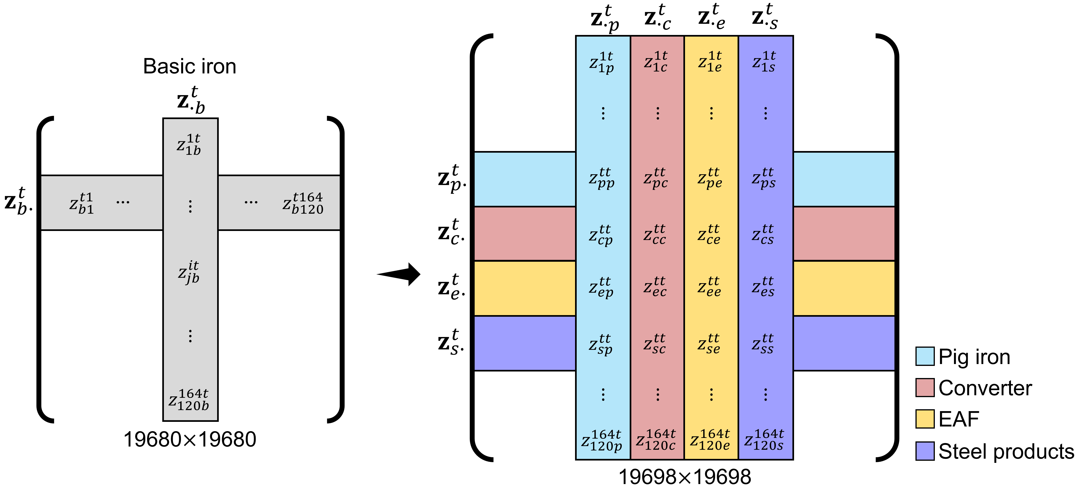
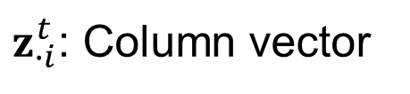
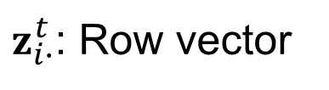
2. Methodology
8
MRIO tables before and after disaggregation
Before disaggregation
After disaggregation
Basic iron
Pig iron
Converter
EAF
Steel products
$z_{i∙}^{t}$: Row vector
$z_{∙i}^{t}$: Column vector
Notes:
The figure below illustrates the MRIO table before and after the disaggregation
The gray block represents the original Basic iron sector, while the blue, red, yellow, and purple blocks represent the disaggregated sectors: Pig iron, Converter, EAF, and Steel products, respectively.
In addition, Z I dot（ドット） superscript t denotes a row vector and its corresponding elements, whereas、z dot I superscript denotes a column vector and its corresponding elements.
As a result of disaggregating the Basic iron sector in six countries into four subsectors, the original $19,680（ナインティーン サウザンド シックス ハンドレッド エイティ）× （バイ）19,680$matrix was expanded to a $19,698 （ナインティーン サウザンド シックス ナインティエイト）×19,698$ matrix.

Slide 10
2. Methodology
9
Overview of disaggregation
After disaggregation
Japanese input-output table
Country-level BF/EAF production ratios published by the World Steel Association
Country-level intermediate input cost data for BF-BOF and EAF routes provided by TransitionZero.
When detailed country-level data were not available, we used the first dataset, which provides highly detailed sectoral classifications, as technical data.
For the intermediate input structures of the BF-BOF and EAF routes, we adjusted for country-specific differences by incorporating the second and third datasets.
Notes:
To disaggregate the steel sector, we used three data sources.
Japanese input-output table
Country-level BF/EAF production ratios published by the World Steel Association
Country-level intermediate input cost data for BF and EAF routes provided by TransitionZero.
When detailed country-level data were not available, we used the first dataset, which provides highly detailed sectoral classifications, as technical data.
However, for the intermediate input structures of the BF-BOF and EAF routes, we adjusted for country-specific differences by incorporating the second and third datasets.

Slide 11
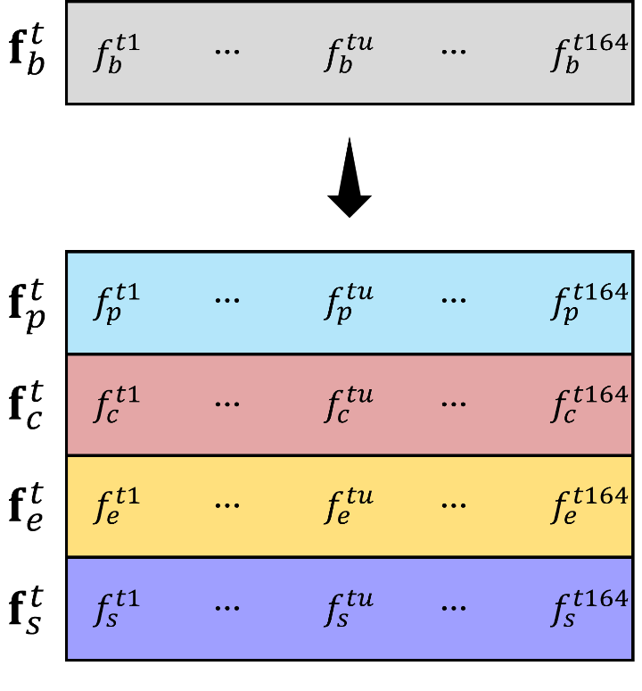
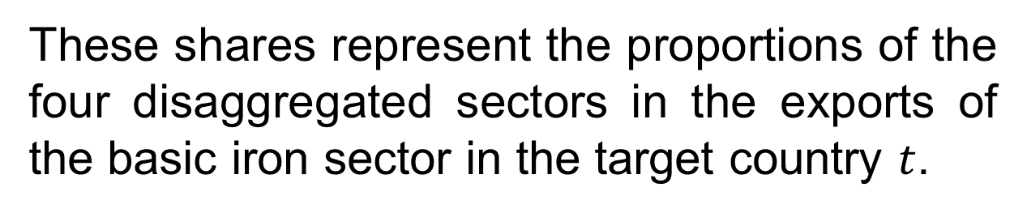
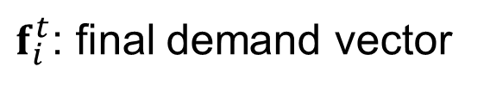
2. Methodology
10
Overview of disaggregation
To disaggregate the final demand vector, we multiply the final demand row vector of the basic iron sector by the sectoral shares.
These shares represent the proportions of the four disaggregated sectors in the exports of the basic iron sector in the target country $t$.
We used export value data from Trend Economy to estimate these share.
$f_{i}^{t}$: final demand vector
Notes:
Next, I will explain the overview of final demand disaggregation.
To disaggregate the final demand vector, we multiply the final demand row vector of the basic iron sector by the sectoral shares.
These shares represent the proportions of the four disaggregated sectors in the exports of the basic iron sector in the target country (t). We used export value data from Trend Economy to estimate these share.

Slide 12
3. Data
11
GLORIA MRIO in 2021 (Lenzen et al., 2017; Lenzen et al., 2021)
Japanese input-output table in 2015 (Ministry of Internal Affairs and Communications, 2019)
GSCT provided by TransitionZero (TransitionZero, 2022)
World Steel in Figures 2024 (World Steel Association, 2024)
Export values of crude steel and steel products in 2021 for China, India, Japan, South Korea, Russia, and the United States (Trend Economy, 2024)
2006 IPCC Guidelines for National Greenhouse Gas Inventories (IPCC, 2006)
U.S. Energy Information Administration (2024)
Notes:
Next, we used these data in this study.

Slide 13
4. Results
12
Comparison of the top three intermediate inputs in China’s steel sector
Before disaggregation
After disaggregation
27 %
Basic iron
(China)
4 %
Pig iron
(China)
Converter
(China)
57 %
49 %
18 %
24 %
10 %
6 %
6 %
Basic iron
Iron ore
Coke oven products
Hard coal
Pig iron
Finance and insurance
Others
Iron ore is the primary raw material used in pig iron production, whereas the converter process uses pig iron as its main input because it is designed to remove impurities from pig iron and produce steel.
Notes:
Next, I talk about results.
These graphs show the top three intermediate input sectors in China’s steel sector.
The left graph presents the result for the Basic iron sector before disaggregation, while the right graph presents the results for the disaggregated Pig iron and Converter sectors.
The results show that, in the Basic iron sector, inputs from the Basic iron sector itself account for the largest share.
In contrast, inputs from the iron ore sector account for the largest share in the pig iron sector, while inputs from the pig iron sector account for the largest share in the converter sector.
This reflects the fact that iron ore is the primary raw material used in pig iron production, whereas the converter process uses pig iron as its main input because it is designed to remove impurities (インピュラリティーズ) from pig iron and produce steel.

Slide 14
4. Results
13
Comparison of the top three intermediate input structures in China’s steel sector
Before disaggregation
After disaggregation
27 %
Basic iron
(China)
4 %
Pig iron
(China)
Converter
(China)
57 %
49 %
18 %
It is unclear which steelmaking process the Basic iron sector actually represents, or by which process it is mainly influenced.
24 %
10 %
6 %
6 %
Basic iron
Iron ore
Coke oven products
Hard coal
Pig iron
Finance and insurance
Others
Iron ore is the primary raw material used in pig iron production, whereas the converter process uses pig iron as its main input because it is designed to remove impurities from pig iron and produce steel.
Notes:
Comparing the Basic iron sector with the disaggregated Pig iron and Converter sectors shows that it is unclear which steelmaking process the Basic iron sector actually represents, or by which process it is mainly influenced.

Slide 15
4. Results
14
Comparison of the top three intermediate input structures in pig iron sector by country
4 %
Pig iron
(China)
Pig iron
(India)
Pig iron
(Japan)
57 %
60 %
40 %
6 %
18 %
13 %
8 %
19 %
Iron ore
Coke oven products
Hard coal
Wholesale and retail trade
Japan has a large input share from the Wholesale and retail trade sector.
Japan depends on imported iron ore and coke oven products for pig iron production, resulting in greater demand for trade-related services.
Notes:
Next, these graphs below show the top three intermediate input sectors for the pig iron sector in China, India, and Japan.
The results show that Iron ore and Coke oven products together account for the majority of intermediate inputs in all three countries.
Japan, however, has a relatively large input share from the Wholesale（ホールセール） and retail trade sector.
This is likely because Japan depends on imported iron ore and coke oven products for pig iron production, resulting in greater demand for trade-related services.

Slide 16
4. Results
15
Comparison of the top three intermediate input structures in EAF sector by country
17 %
27 %
35 %
EAF
(China)
EAF
(India)
14 %
EAF
(Japan)
9 %
14 %
10 %
12 %
8 %
Hard coal
Pig iron
Electricity
EAF
Quarrying of stone and clay
Wholesale and retail trade
In China, the top three inputs are coal, electricity, and pig iron.
In India, quarrying of stone and clay and wholesale and retail trade are among the top three input sectors.
In Japan, the top three inputs are wholesale and retail trade, EAF, and electricity.
Notes:
These graphs below show the top three intermediate input sectors for the EAF sector in China, India, and Japan.
One key finding is that the input structures differ significantly across countries.
In China, the top three inputs are Coal, Electricity, and Pig iron.
In India, Crushed stone and Wholesale and retail trade are among the top three input sectors.
In Japan, the top three inputs are Wholesale and retail trade, EAF, and Electricity.

Slide 17
4. Results
16
Comparison of the top three intermediate input structures in EAF sector by country
17 %
27 %
35 %
EAF
(China)
EAF
(India)
14 %
EAF
(Japan)
9 %
14 %
10 %
12 %
8 %
Hard coal
Pig iron
Electricity
EAF
Quarrying of stone and clay
Wholesale and retail trade
AC electric arc furnaces are the dominant type of EAF in India.
Compared with DC EAFs, AC EAFs tend to have higher electrode consumption and are more prone to hot inside the furnace.
The use of limestone and dolomite as fluxes or slag-conditioning materials, as well as refractory-related materials such as bricks.
Notes:
In India’s EAF, the largest share of intermediate inputs comes from the “Quarrying of stone and clay” sector.
This is likely related to the fact that AC electric arc furnaces are the dominant type of EAF in India.
Compared with DC EAFs, AC EAFs tend to have higher electrode (エレクトロード) consumption and are more prone to hot spots inside the furnace.
Therefore, the large input from the “Quarrying of stone and clay” sector may reflect the use of limestone and dolomite as fluxes （フラックス） or slag-conditioning materials, as well as refractory-related materials such as bricks.

Slide 18
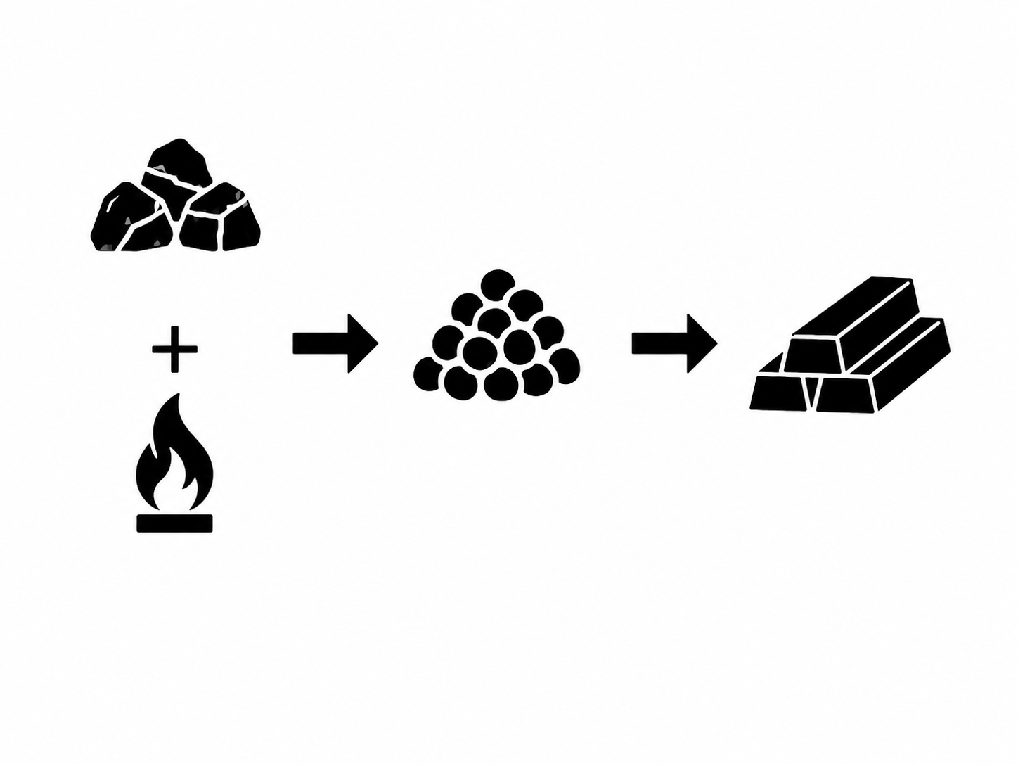




4. Results
17
Coal-based direct reduced iron (DRI)
EAF production
Steel product
EAF production
Steel scrap
Steel product
The disaggregated intermediate input structure developed in this study captures these country-specific differences in steelmaking processes.
Notes:
These differences mainly reflect the raw materials used in EAF steelmaking.
Both China and India use coal-based Direct Reduced Iron (DRI) as a major input to EAF production.
In contrast, Japan primarily uses steel scrap.
Therefore, the disaggregated intermediate input structure developed in this study captures these country-specific differences in steelmaking processes.

Slide 19
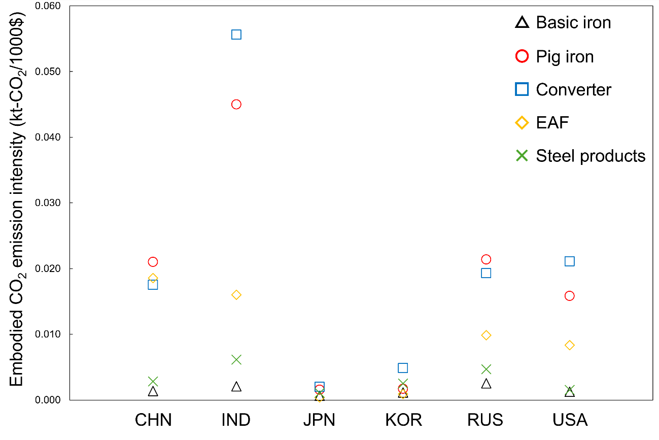
4. Results
18
A scatter plot of the embodied CO₂ emission intensities by country
Notes:
This is the final result.
The figure below shows scatter plots of embodied CO₂ emission intensities for the basic iron, pig iron, converter, EAF, and steel products sectors by country.
The vertical axis represents the embodied CO₂ emission intensity. Gray indicates the basic iron sector, red indicates the pig iron sector, blue indicates the converter sector, yellow indicates the EAF sector, and green indicates the steel products sector.

Slide 20
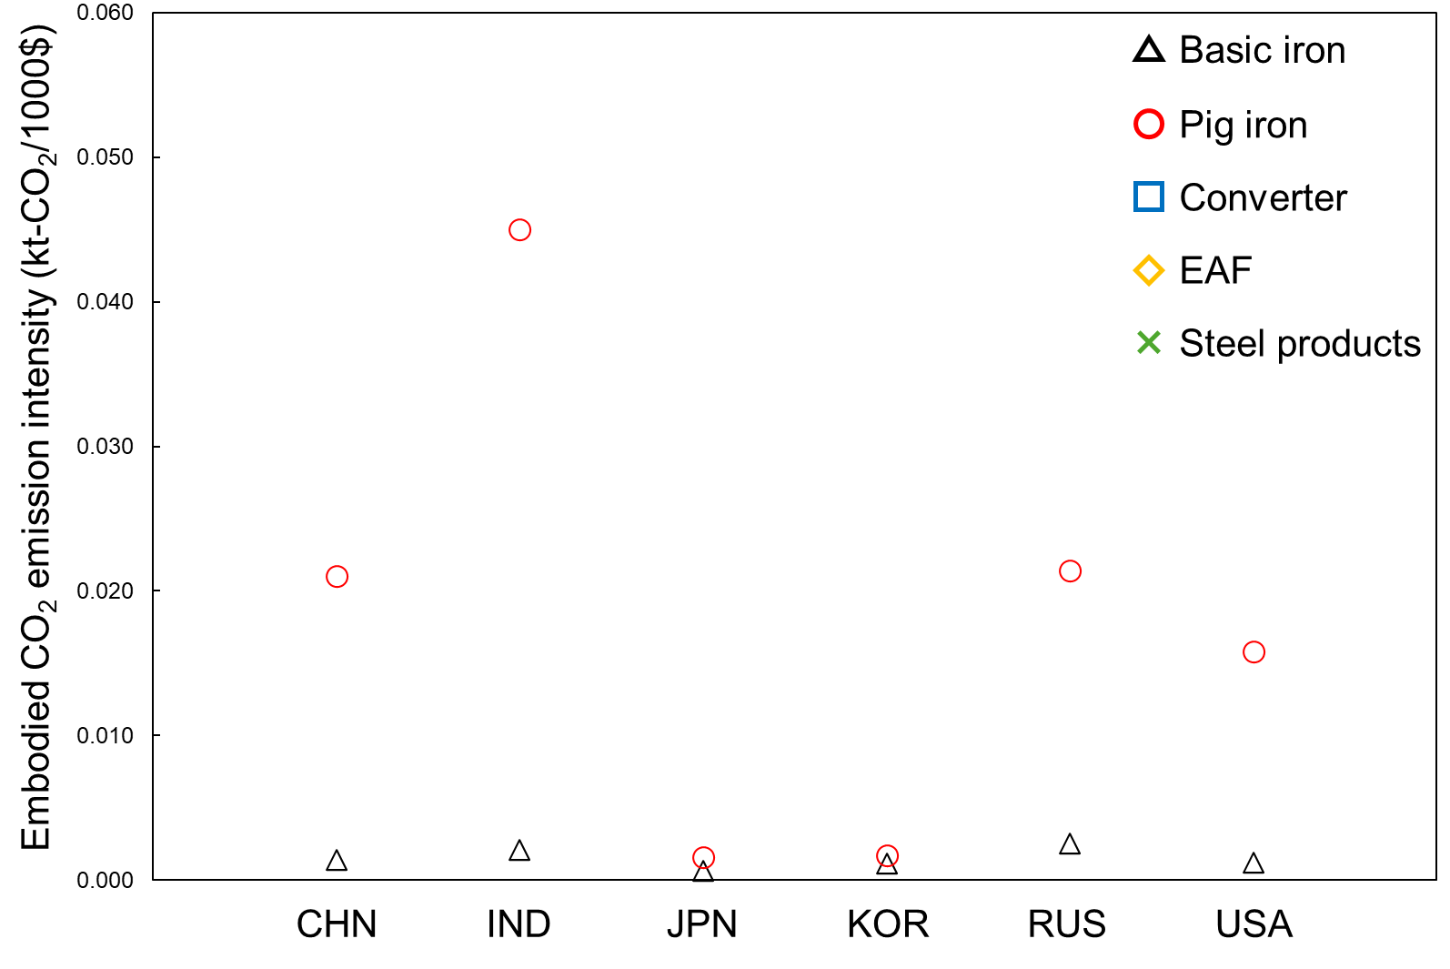
4. Results
19
A scatter plot of the embodied CO₂ emission intensities by country
The embodied emission intensities of the pig iron sectors in China and India are about 15 and 21 times higher, respectively, than those of the corresponding basic iron sectors.
Notes:
In particular, the embodied emission intensities of the pig iron sectors in China and India are approximately 15 and 21 times higher, respectively, than those of the corresponding basic iron sectors.

Slide 21
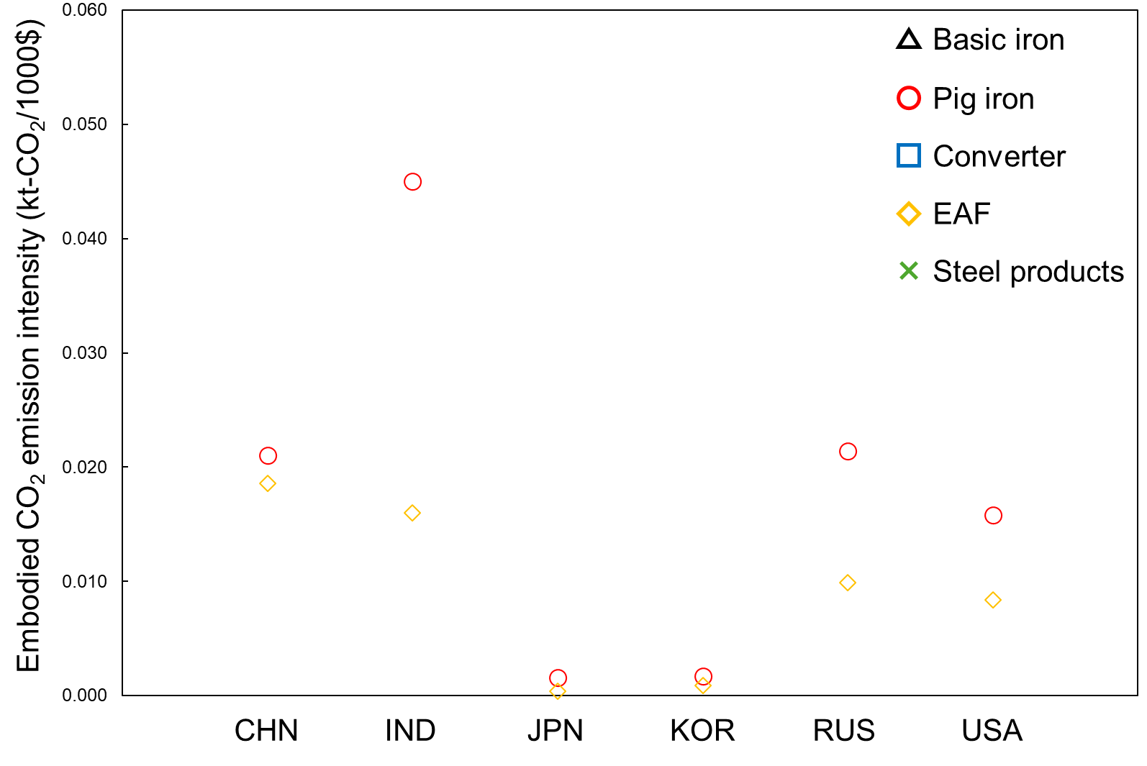
4. Results
20
A scatter plot of the embodied CO₂ emission intensities by country
EAF sector shows lower embodied CO₂ emission intensity than the pig iron sector, although large differences still remain across countries.
The emission intensities of the EAF sectors in Japan, South Korea, and the United States are much lower than those in India and China, ranging from about one-half to as little as one-fiftieth.
Notes:
On the other hand, in many countries, the EAF sector shows lower embodied CO₂ emission intensity than the pig iron sector, although large differences still remain across countries.
In particular, the emission intensities of the EAF sectors in Japan, South Korea, and the United States are much lower than those in India and China, ranging from about one-half to as little as one-fiftieth （フィフティエス）.
One major reason for this difference is the variation in raw materials used in the EAF route, as I explained earlier.

Slide 22
4. Results
20
A scatter plot of the embodied CO₂ emission intensities by country
Aggregating steelmaking process into a single basic iron sector may lead to aggregation bias in embodied emission intensities by country and sector.
Notes:
These results suggest that aggregating steelmaking process into a single basic iron sector may lead to aggregation bias in embodied emission intensities by country and sector.

Slide 23
5. Conclusion
21
We disaggregated the basic iron sector in the GLORIA MRIO table into four subsectors.
This allowed us to reveal process-specific intermediate input structures that could not be captured before disaggregation, as well as country-level differences in input structures within the same steelmaking process.
Aggregating different steelmaking processes into a single sector can cause aggregation bias in the estimation of embodied CO₂ emission intensities.
These findings highlight the importance of using a process-disaggregated MRIO to accurately capture direct and indirect CO₂ emissions from the steel sector and its supply chain structure.
Notes:
Finally, I will summarize the conclusions.
In this study, we disaggregated the basic iron sector in the GLORIA MRIO model into four subsectors.
This allowed us to reveal process-specific intermediate input structures that could not be captured before disaggregation, as well as country-level differences in input structures within the same steelmaking process.
The results show that aggregating different steelmaking processes into a single sector can cause aggregation bias in the estimation of embodied CO₂ emission intensities.
Overall, these findings highlight the importance of using a process-disaggregated MRIO, such as the one developed in this study, to accurately capture direct and indirect CO₂ emissions from the steel sector and its supply chain structure.

Slide 24
Thank you for your attention !

Slide 25


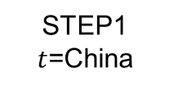
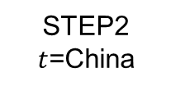







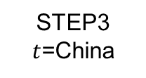
Appendix
STEP1
$t$=China
 | Basic iron | Motor vehicles |  | Construction
Crude steel | 70% | 0% |  | 0%
Steel products | 30% | 100% |  | 100%
$$⋯$$
Japanese input-output table in 2015
$$⋯$$
$$⋯$$
STEP2
$t$=China
 | Basic iron | Motor vehicles |  | Construction
BF-BOF | 90% | 0% |  | 0%
EAF | 10% | 0% |  | 0%
World Steel in Figures 2024
$$⋯$$
$$⋯$$
$$⋯$$
STEP3
$t$=China
 | Basic iron | Motor vehicles |  | Construction
Pig iron | 45% | 0% |  | 0%
Converter | 55% | 0% |  | 0%
$$⋯$$
Japanese input-output table in 2015
$$⋯$$
$$⋯$$
Notes:
To disaggregate the row vector of the Basic iron sector in country $t$, it is necessary to determine the proportions in which the outputs of the Pig iron, Converter, EAF, and Steel products sectors are supplied to other sectors.
Therefore, at each step of the disaggregation process, we estimate the relevant allocation shares using external data. We then multiply each element of the intermediate input matrix by the corresponding share to obtain the disaggregated row vectors.
t国のBasic ironの行ベクトルを細分化するうえで重要なのは、最終的にt国のPig iron, Converter, EAF, Steel productsが他部門にどの割合で供給されているかである。
なので、各ステップごとに外部データから割合を推計して、その割合を中間投入行列の要素にそれぞれかけることで細分化

Slide 26
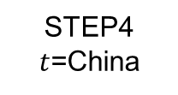
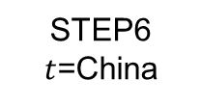
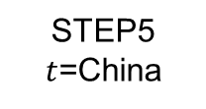
Appendix
STEP4
$t$=China
 | Crude steel | Steel products
Iron ore | 100% | 0%
Electricity | 35% | 65%
Japanese input-output table in 2015
STEP5
$t$=China
GSCT
 | BF-BOF | EAF
Iron ore | 100% | 0%
Electricity | 85% | 15%
STEP6
$t$=China
 | Pig iron | Converter
Iron ore | 100% | 0%
Electricity | 82% | 18%
Japanese input-output table in 2015
Notes:
When disaggregating the column vector, what matters is the final input structure of the Pig iron, Converter, EAF, and Steel products sectors in country $t$; in other words, the proportions in which these sectors use inputs from other sectors.
Therefore, at each step of the disaggregation process, we estimate the relevant input shares using external data and apply them to the corresponding elements of the intermediate input matrix.
In particular, because these shares are estimated using country-specific intermediate input cost data for the BF-BOF and EAF routes reported in GSCT, the disaggregated vectors can capture the main characteristics of BF-BOF and EAF production in each country.
中間財の種類：Coke DRI Iron ore Scrap Electricity Fuel like Coke etc.

Slide 27
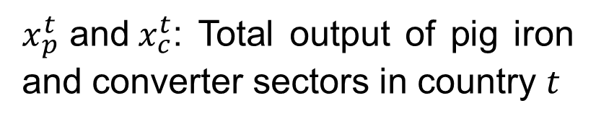
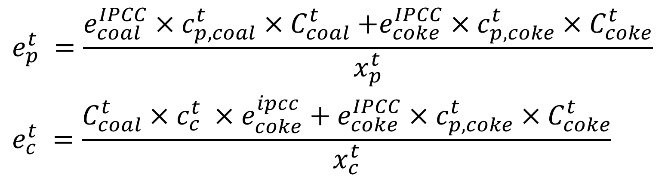
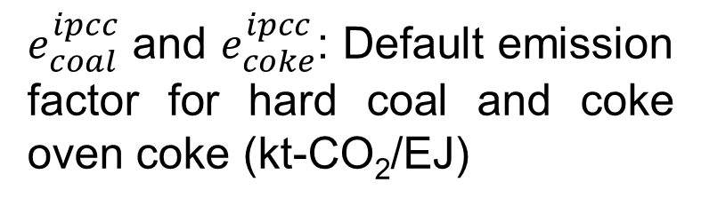
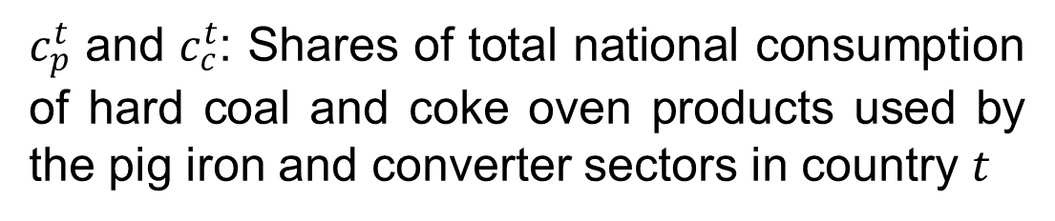
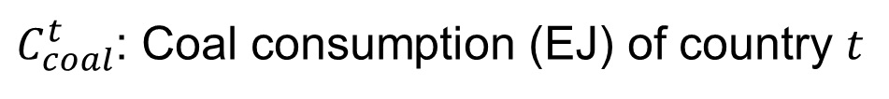
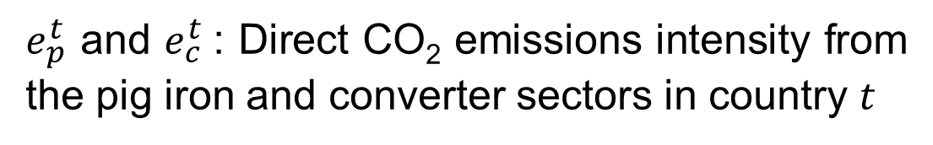
Appendix: Disaggregate direct CO₂ emission intensity
$$\begin{aligned}&e_{p}^{t} =\frac{e_{coal}^{IPCC}{×c_{p, coal}^{t}×C}_{coal}^{t}+e_{coke}^{IPCC}×c_{p,coke}^{t}{×C}_{coke}^{t}}{x_{p}^{t}} \\ &e_{c}^{t} =\frac{C_{coal}^{t}×c_{c}^{t} ×e_{coke}^{ipcc}+e_{coke}^{IPCC}×c_{p,coke}^{t}{×C}_{coke}^{t}}{x_{c}^{t}}\end{aligned}$$
$e_{p}^{t}$ and $e_{c}^{t}$: Direct CO₂ emissions intensity from the pig iron and converter sectors in country $t$
$e_{coal}^{ipcc}$ and $e_{coke}^{ipcc}$: Default emission factor for hard coal and coke oven coke (kt-CO₂/EJ)
$C_{coal}^{t}$: Coal consumption (EJ) of country $t$
$c_{p}^{t}\text{​ }\text{and} c_{c}^{t}$: Shares of total national consumption of hard coal and coke oven products used by the pig iron and converter sectors in country $t$
$x_{p}^{t}\text{​ }\text{and} x_{c}^{t}$: Total output of pig iron and converter sectors in country $t$
Notes:
This study calculated the direct CO₂ intensity vector of the pig ​iron, converter, EAF, and steel products sectors by equation 1, 2, 3, 4, respectively (リスペクティブリ)
We use these variables.
各変数を読む

Slide 28
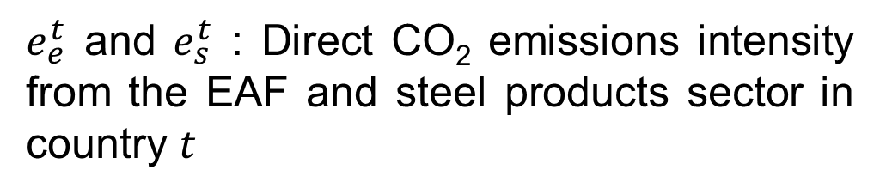
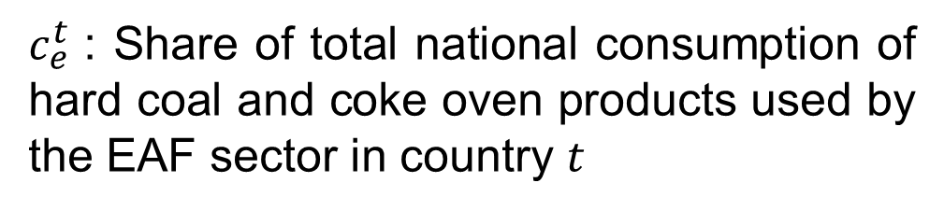
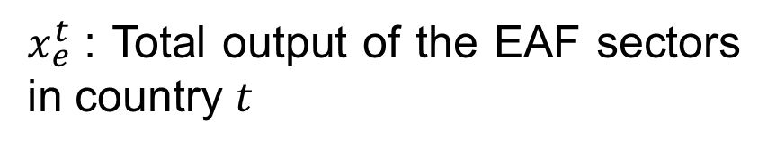
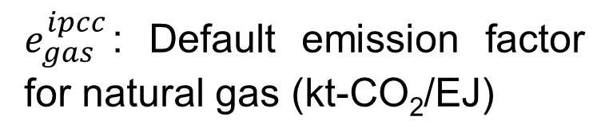
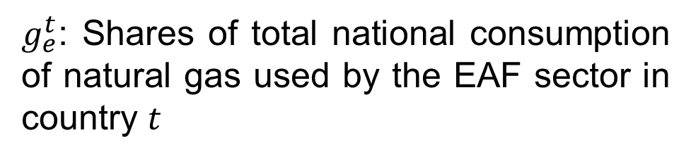
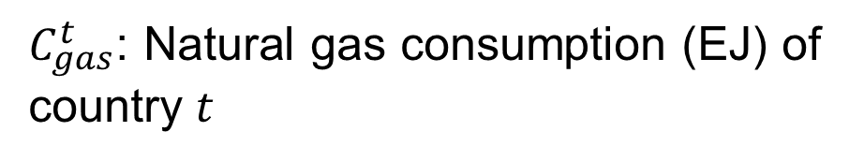
Appendix: Disaggregate direct CO₂ emission intensity
$$e_{e}^{t} =\frac{e_{coal}^{IPCC}×c_{e, coal}^{t}{×C}_{coal}^{t} +e_{coke}^{IPCC}×c_{e,coke}^{t}×C_{coke}^{t} +e_{gas}^{IPCC}×g_{e,gas}^{t}×C_{gas}^{t}}{x_{s}^{t}}$$
$$e_{s}^{t} =\frac{e_{coal}^{IPCC}×c_{s, coal}^{t}{×C}_{coal}^{t} +e_{coke}^{IPCC}×c_{s,coke}^{t}×C_{coke}^{t} }{x_{s}^{t}}$$
$e_{e}^{t}$ and $e_{s}^{t}$ : Direct CO₂ emissions intensity from the EAF and steel products sector in country $t$
$g_{e}^{t}$: Shares of total national consumption of natural gas used by the EAF sector in country $t$
$e_{gas}^{ipcc}$: Default emission factor for natural gas (kt-CO₂/EJ)
$C_{gas}^{t}$: Natural gas consumption (EJ) of country $t$
$c_{e}^{t}\text{​ }$: Share of total national consumption of hard coal and coke oven products used by the EAF sector in country $t$
$x_{e}^{t}\text{​ }$: Total output of the EAF sectors in country $t$

Slide 29
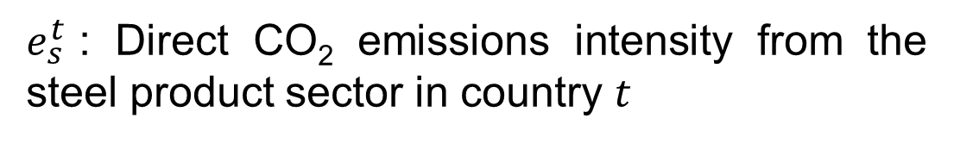
Appendix: Disaggregate direct CO₂ emission intensity
$$e_{s}^{t} =\frac{e_{coal}^{IPCC}×c_{s, coal}^{t}{×C}_{coal}^{t} +e_{coke}^{IPCC}×c_{s,coke}^{t}×C_{coke}^{t} }{x_{s}^{t}}$$
$e_{s}^{t}$: Direct CO₂ emissions intensity from the steel product sector in country $t$

