Slide 1
OECD Inter-country input-output database 2025 edition
OECD Directorate for Science, Technology and Innovation
Norihiko Yamano, Eleanor Keeble and Colin Webb
32nd IIOA and 11th SHAIO Conference in Seville, Spain
22-26 June 2026

Slide 2
Evolution of Input-Output and ICIO work at OECD
Work on international harmonised I-O started in the early 1990s.
  Climate change indicators (GHG footprints)
  Trade in Value Added (TiVA)
  Jobs (by characteristics) sustained by foreign demand
  Multinational Enterprises and GVCs
Recent shift in narratives:
  from: opportunities of integration in GVCs, identifying economic dependencies
  to: resilience in the face of global and regional shocks, identifying potential vulnerabilities in production networks; security of access to essential goods; non-GHG environmental analyses
  → new indicators to reveal global supply chain dependencies (Foreign Input and Foreign Market Reliance; Pass-Through Frequency; Regional Value Chains; Final destinations)
Always room for improvement: more countries; better timeliness; expanding industry coverage; better accounting for firm heterogeneity; subnational tables; price adjustments; uncertainty indexes, etc.

Slide 3
Examples of TiVA indicators
Foreign value-added content of gross exports i.e. backward linkages in global value chains (GVCs) to upstream countries, and their industries
Domestic value-added content of foreign exports i.e. forward linkages in GVCs to downstream countries
Distribution of services value added embodied in gross exports of manufactured goods
Decomposition of gross exports (value added of exporting industry, indirect impacts from other domestic industries, foreign value added)
Country and industry origin of value added in final demand of goods and services e.g.
  Domestic value added embodied in foreign final demand: how much of your production is driven by final demand abroad, directly and indirectly?
  Foreign value-added content of domestic final demand (HH consumption, GFCF): how much of your demand depends on production abroad, directly and indirectly?

Slide 4
Foreign dependencies – highlighting extended industry coverage
Foreign value-added content of total domestic demand, 2022
by source industry and region (OECD v non-OECD)
as a % of total industry VA in total domestic final demand, OECD averages
Most integrated into GVCs
Most common dependencies:
Oil and gas extraction
Non-ferrous metals
Mining of metal ores
Mining of coal and lignite
Textiles and apparel
Mining services
Chemicals
ICT and electronics
Motor vehicles
Iron and steel

Slide 5
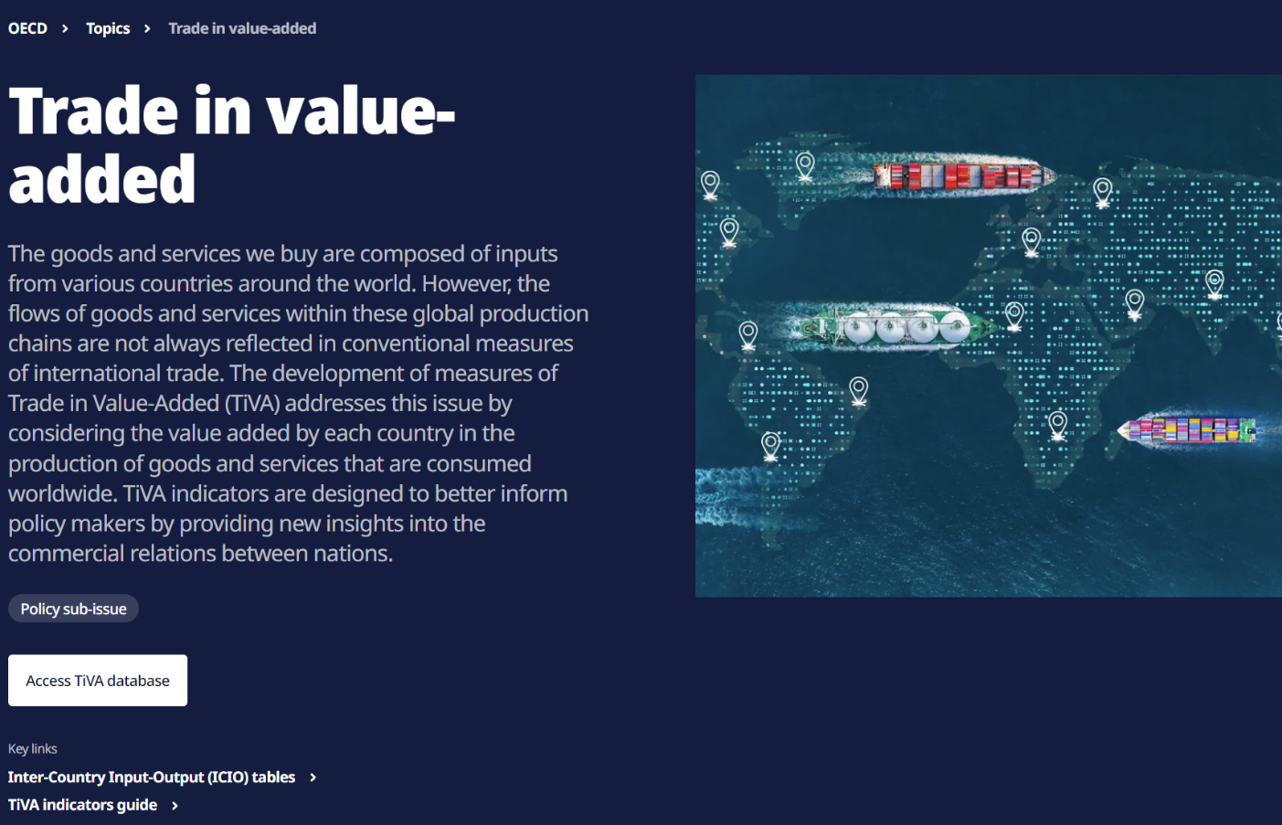
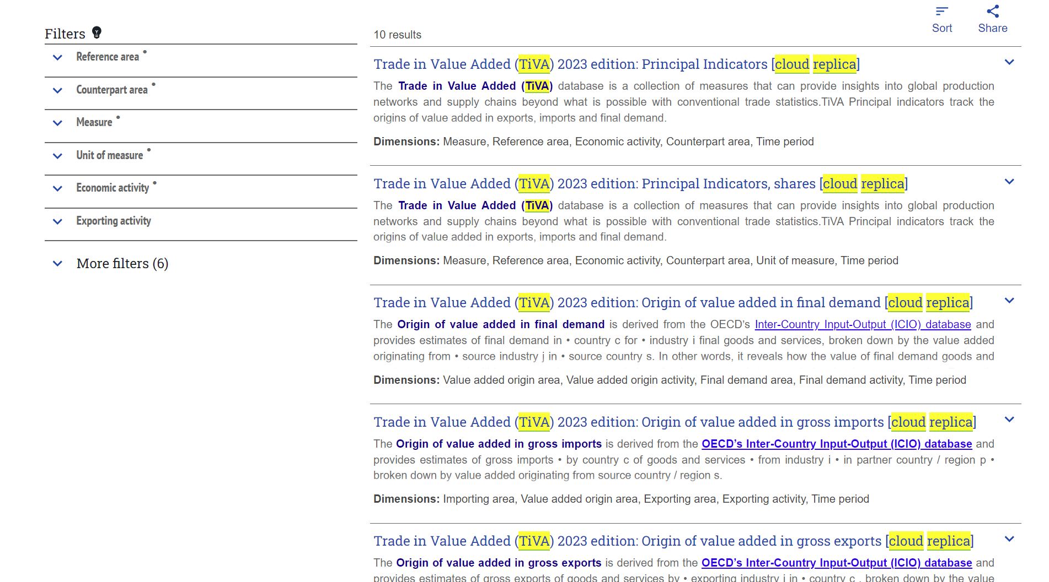
Where to find OECD TiVA indicators
www.oecd.org/en/topics/sub-issues/trade-in-value-added.html
Besides SNA statistics, TiVA has been one of the most downloaded OECD data sets (2013-2025)
OECD Data Explorer
Notes:
No2 number access in dotstat in whole oecd database

Slide 6
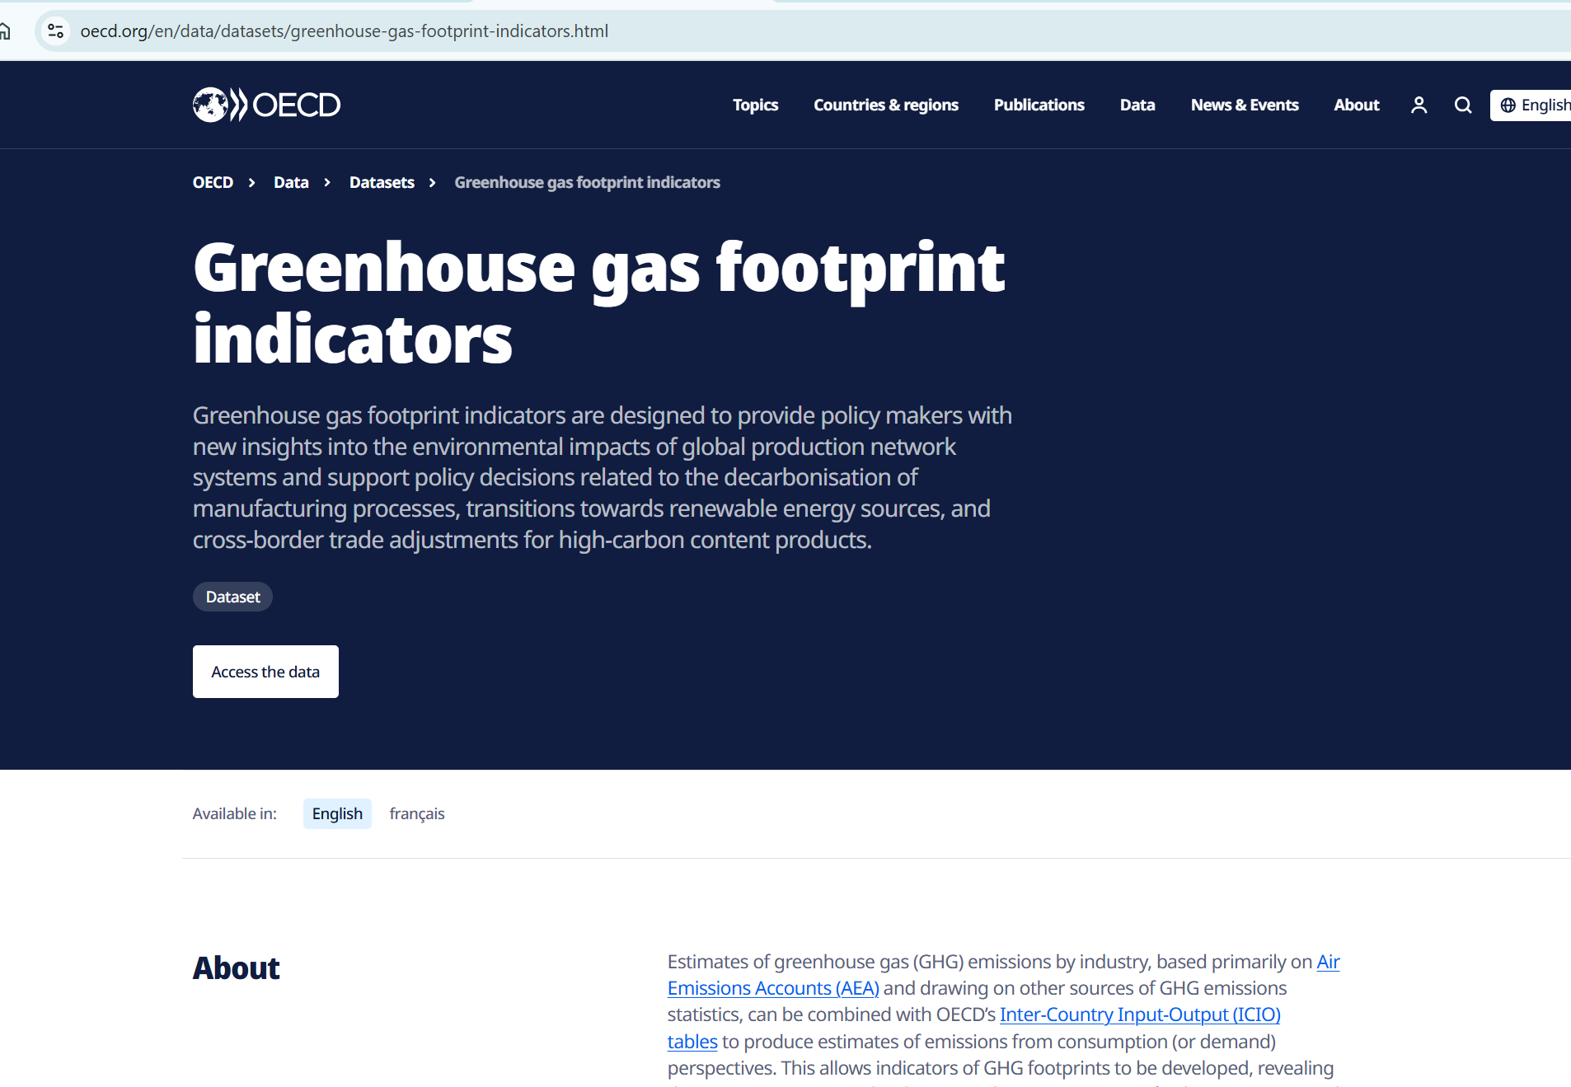
OECD GHG footprint indicators
Five sets of indicators
Principal indicators
Emissions embodied in international trade
Emissions embodied in production by scope
Origins of emissions embodied in final demand
Emissions embodied in final demand by expenditure categories
80 economies + Rest of the World
All years from 1995 to 2022
50 economic activities (based on ISIC Rev.4)
www.oecd.org/en/data/datasets/greenhouse-gas-footprint-indicators.html (http://oe.cd/io-ghg)

Slide 7
What’s new since 2023 edition?
ICIO Tables: https://www.oecd.org/en/data/datasets/inter-country-input-output-tables.html
TiVA indicators: https://www.oecd.org/en/tiva.html
Time series extended to cover 1995 to 2022
Number of economic activities increased from 45 to 50
    Split Agriculture, Hunting and Forestry (A01_02) into 2-digit ISIC Divisions: Agriculture and Hunting (A01) and Forestry (A02)
    Split Mining and quarrying (B) into 2-digit ISIC Divisions: Coal (B05); Oil and Gas (B06); Metal mining (B07); Other mining and quarrying (B08); and Mining support services (B09).
    Split Basic metals (C24) into Iron and steel (C24A) and Non-ferrous metals (C24B)
    Other transport equipment (C30) disaggregated to show Building of ships and boats (C301)
  for better measurement of energy use, embodied GHG emissions, supply chain resiliency …
Increase in geographical coverage from 76 to 80 economies (firm heterogeneity)
ICIO documentation (2018, 2021, 2023, 2025 annex)
Africa : Angola, DR Congo, Saõ Tomé and Príncipe
Asia : United Arab Emirates
7

Slide 8
ICIO compilation overview
Data collection and filling gaps
  National Accounts/Balance of Payments/Input-Output (SUT) / Bilateral trade in goods and services
Sectoral constraints
  Value added and Output
  Product-Industry supply ratios; Input coefficients
  Expenditure items (includes trade)
Balance World trade at industry (SNA) and product (SUT) levels
Balance SUTs
Balance bilateral trade in Goods, Services and Direct Purchases
Inter-Country Use Tables
Inter-Country Input-Output (ICIO) tables

Slide 9
SNA benchmarked ICIO (goal)
Notes:
Jun 2026

Slide 10
Minimum requirements
National Accounts
Time series data from the mid 1990s
GDP and its components (expenditure, income, output)
Supply, Use and Input-Output tables
Official national SUTs or IOTs for at least two years and the latest table must be for a relatively recent year
Bilateral trade statistics (Goods)
HS 6-digit merchandise trade statistics
Bilateral trade statistics (Services)
Main EBOPS category
Missing data will be
filled by OECD
estimation
system
10
Notes:
MAR 2026
There are ideal statistics/data input but none of the target countries are able to satisfy the input and the missing data are filled by OECD system.

Slide 11
ICIO Challenges – affects timeliness and frequency of updates
2008 SNA v. 1993 SNA The latter is still used by some non-OECD countries and is the format of vintage National Accounts and earlier SUTs and IOTs for many others
SUTs are not revised Very few countries produce long time-series of SUTs based on the latest standards (2008 SNA). Earlier SUTs compiled according to 1993 SNA. Also, format of a country’s SUTs may change over time
Conversion from Fiscal Years to Gregorian Calendar years e.g. AUS, EGY, IND, NZL, PAK
Benchmark revisions SNA and IOTs (every 5 years or so)
Differences in reporting in terms of valuations basic prices v. purchasers’ prices
National classifications mapping to ICIO standard industry list.
Industry / product coverage in SUTs and IOTs varies across countries.
Widespread asymmetries in reported bilateral trade statistics both goods and services
Dealing with confidential data
FILLING THE DATA GAPS

Slide 12
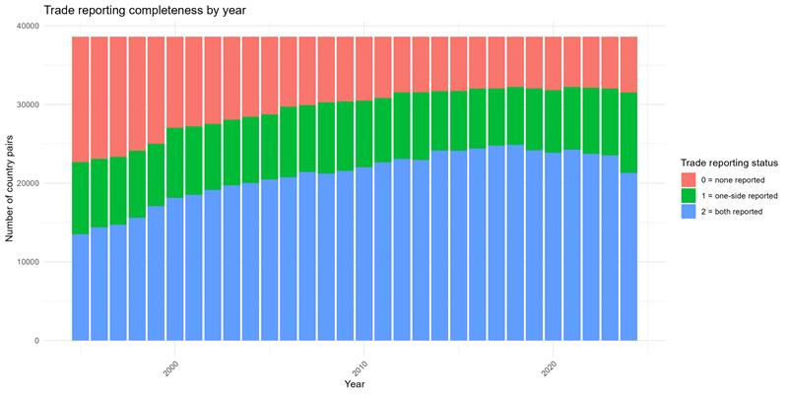
Data availability for SUTs and Trade statistics
Supply Table availability in OECD SUT database
Bilateral merchandise trade reporting, 1995-2024
Maximum combinations: 38,612 (= 197 x 196)
Source: www.oecd.org/en/data/datasets/supply-and-use-tables.html
Note: March 2026
Source: UN Comtrade

Slide 13
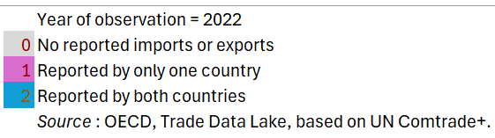
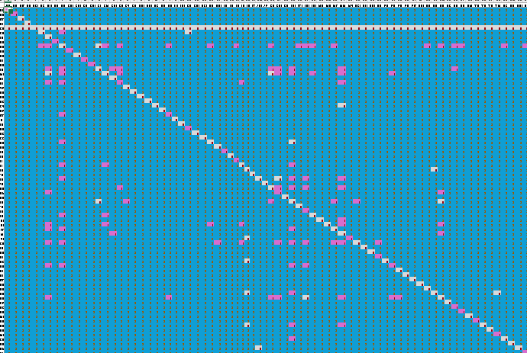
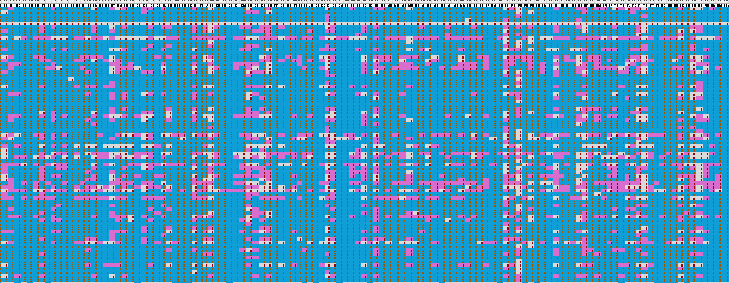






ICIO Challenges using bilateral trade flows
Intra TiVA 80 x 80 target countries
From TiVA 80 target countries to non-TIVA
From non-TiVA to
TiVA 80 target countries
Intra non-TiVA (“Rest of the World”)

Slide 14
Industry and trade databases and linkages at OECD
Key:
SNA: System of National Accounts
BoP: Balance of Payments
SBS: Structural Business Statistics
BaTiS: Balanced Trade in Services
BIMTS: Balanced International Merchandise Trade Statistics
BTiGE: Bilateral Trade in Goods by End-use (ex-BTDIxE)
STAN:
UN
Comtrade
Eurostat OECD
SBS/SSIS
UNIDO
INDSTAT
Eurostat, OECD, UNSD
2008 SNA
SUTs & IOTs
IMF, OECD, UN BoP, BaTiS
Statistics
SUTs
IOTs
OECD
Databases
BIMTS
BTiGE
STAN
BaTiS
ICIO
Derived Analytical Products
Trade in Value Added (TiVA)
GHG
Footprint indicators
Trade in Employment(TiM)
FMR/FIR PTF indicators
Indicators
Harmonised national IOTs
Analytical AMNE
TIVA
Nowcast
PYP ICIO
Notes:
Jun 2026

Slide 15
Multiple uses of IO-based analysis at OECD
_____________________________________________________________________
And many other organisations:
ADB, EC, IMF, UN (ECA, ECLAC, ECE), WB, WTO, UNIDO, etc
Government departments
Research institutions
Academia
Private think-tanks / consultancy firms
Analyses of GVCs (Committee on Industry, Innovation and Entrepreneurship: CIIE)
Trade policy papers (Trade Committee: TC)
Employment and GVCs (CIIE/TC)
Green growth Indicators (Environment Policy Committee)
Role of MNEs (CIIE/TC)
Agriculture and GVCs (Committee for Agriculture)
Steel and GVCs (Steel Committee)
Shipbuilding (Shipbuilding Committee)
Tourism (Tourism Committee)
Digital economy (Digital Policy Committee)
Responsible Business Conduct (Investment Committee)
OECD Country Studies (Economic Policy Committee)
OECD Skills outlook (Education Policy Committee)
Role of SMEs in GVCs (Committee on Statistics and Statistical Policy)
Notes:
OCT 2025

Slide 16
Environment extension

Slide 17
Main data sources for ICIO tables and GHG emissions
National Accounts
Main aggregates and detailed tables * § ♣
Supply and Use tables *♦ ♣ ‡
Input-Output tables * † ♦
Employment * ♥
Other industry statistics * ♣ ♥
Tourism Satellite Accounts
International trade
Balance of Payments *♣♠
Merchandise trade * §
Trade in Services by Partner ♣ § ^
Bilateral trade database by industry and end-use (BTDIXE)
OECD-WTO Balanced Trade in Services dataset (BaTIS)
Greenhouse gas emissions
Territorial:
GHG inventory* %$#
IEA CO2 from fuel combustion
Production:
Air Emissions Accounts *♣♦
National (CAN, CHE, IDN, JPN etc)
*National, †ADB ♦EUROSTAT $EU JRC ♠IMF ♣OECD §UNSD ‡UNECLAC ♥ UNIDO % UNFCCC
#WB/Climate Watch ^WTO

Slide 18
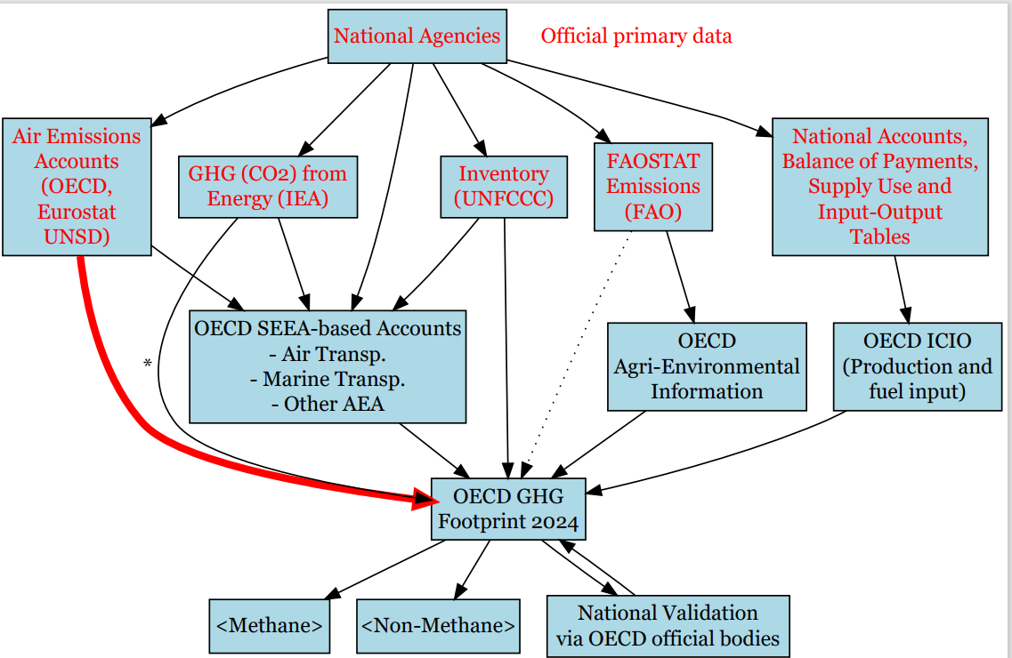
Data sources to GHG footprint indicators

Slide 19
Data challenges
Availability issues resolution
  Temporal inconsistencies across sources
  Heterogeneous sector classifications and disaggregation level
  Limited high-quality data for non-OECD countries → Usage of estimator for industries with weak data
  Difficulties measuring downstream (transportation, distribution and recycling and waste treatment)
  Comparison with other sources (AEA, UNFCCC, Climate Watch) and with GHGFP (version 2024)

Slide 20
ENvironmental Impact Valuation And its application in DEcision making (ENIVADE)
+MRIO footprint framework
+Environmental monetised valuations
+Enterprise level
+Future projections
7 to 11 EE-MRIO initiatives
have been reviewed
GHGs emissions
Air
pollution
Water use and
pollution
Land use
Biodiversity and
ecosystem services
Material &
Energy
Module 1 workshop (March 2026): EE-MRIOs, Environmental domains, Use cases at enterprises

Slide 21
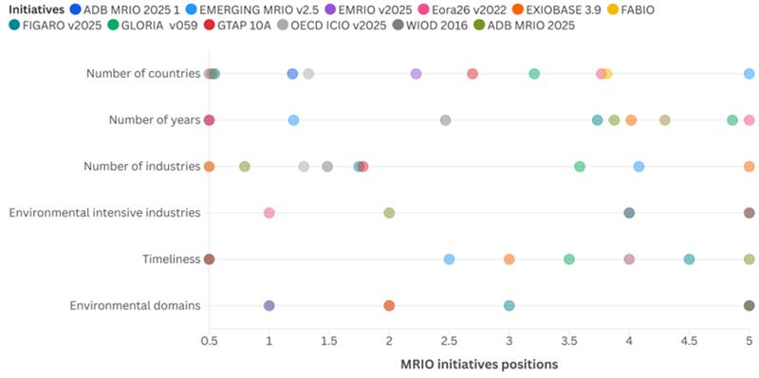
MRIO coverage
(GHG)
Higher/more/detail… etc. →
Authors’ elaboration
21

Slide 22
Frequently asked questions (database coverage)
More detailed industry breakdown?
  We have to compromise in ICIO construction – industry availability and quality across many countries.
  (2025 ed) Mining, Basic metals,
More timely estimates?
  National Accounts constraints (not many countries are able to publish them in 2008 SNA format and western calendar year)
  National Accounts (t+15 months)
  (2025 ed) additional two years
More countries?
  Working on this e.g. more African/Asian/European countries. Minimum data requirements for inclusion in ICIO tables. Stats capacity building exercises often required.
  (2025 ed) +4 economies

Slide 23

Thank you
Email : icio-tiva.contact@oecd.org
HOW TO ACCESS THE DATABASES
https://www.oecd.org/en/tiva.html
https://www.oecd.org/en/data/datasets/inter-country-input-output-tables.html
http://oe.cd/io-ghg
http://oe.cd/io-emp
http://oe.cd/gvc-mne

Slide 24
Foreign value-added content of manufactured gross exports
as a % of total manufacturing gross exports
Varies across countries according to:
geography (proximity to neighbouring suppliers) size of economy (ability to source intermediates from domestic suppliers) | Abundant natural resources (e.g. minerals) technology and skills base Physical and digital infrastructure

Slide 25
Services shares of total exports – a new perspective
Another FAQ!
OECD Services exports as a percent of total exports, 2022
On average, OECD BoP services share of total exports = 29%
in VA terms = 58%
BoP (and SNA) exports measured at purchasers’ prices and includes re-exported goods
Gross exports in underlying ICIO tables are at basic prices (i.e. trade and transport margins allocated to services) and re-exports of goods removed
In VA terms, upstream services embodied in exports of goods are captured.
Sources: IMF Balance of Payments database; OECD TiVA database
Note: For TiVA estimates, services esports refer to exports by ISIC Rev.4 Divisions 41 to 98

Slide 26
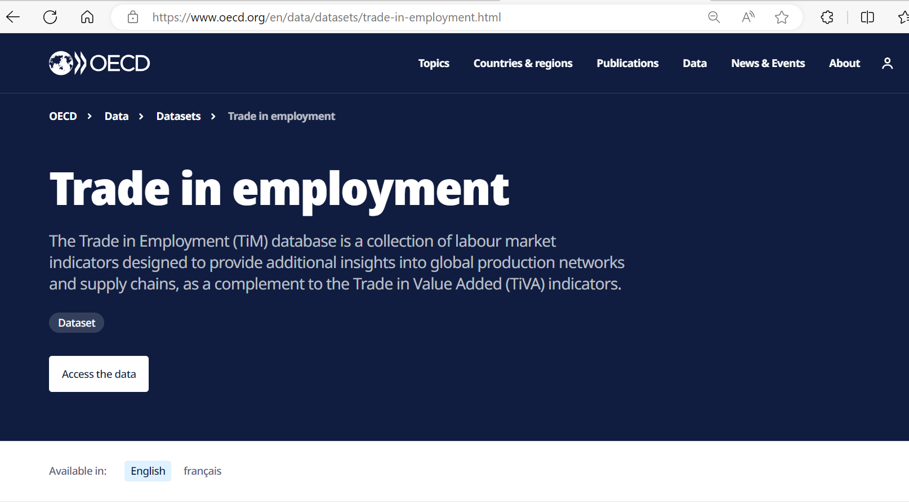
26

Slide 27
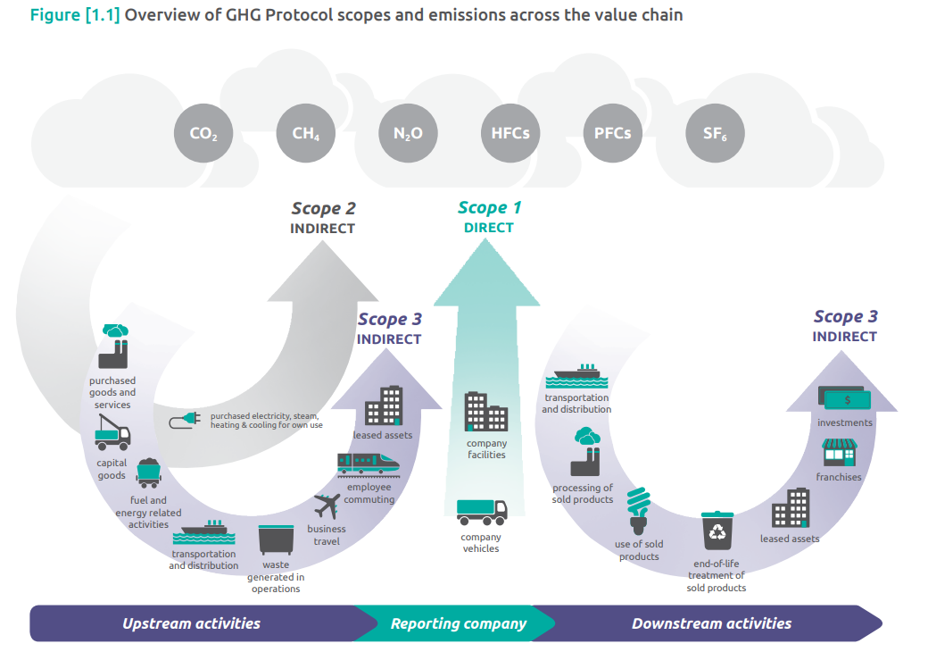
Coverage of OECD GHG indicators by Scope of emissions
covered
partially
covered
Source: Corporate-Value-Chain-Accounting-Reporing-Standard_041613_2.pdf (ghgprotocol.org)

Slide 28
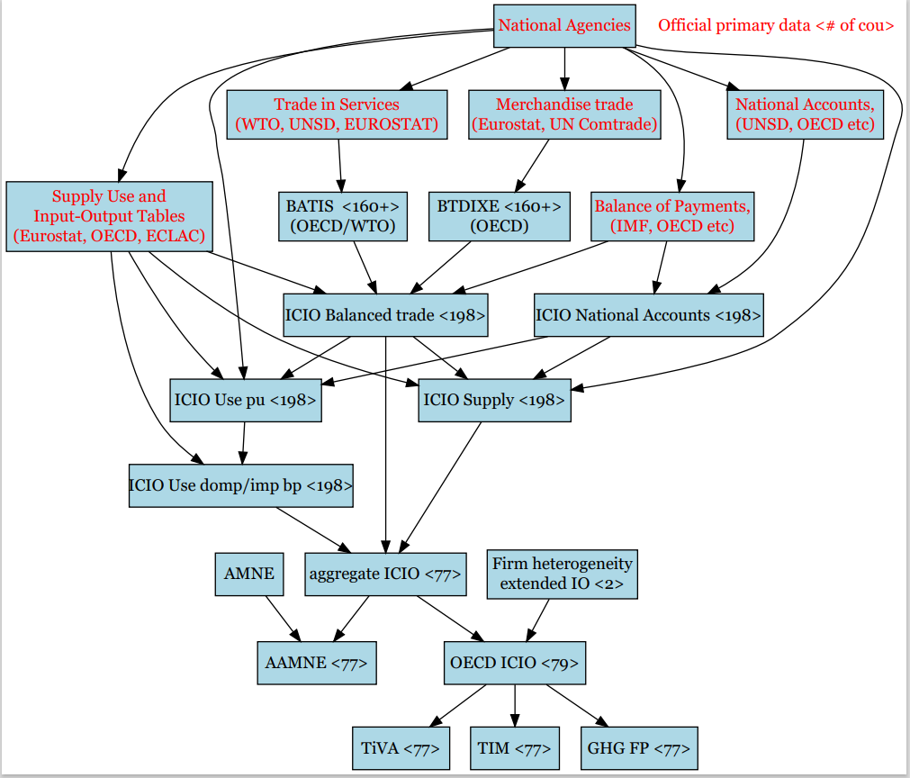
Data sources​ to ICIO database

Slide 29
National data availability determines estimation procedure(s)
This program is working on a scenario that only SNA and BTD data are available

Slide 30
Interpolating for missing SUTs to produce time series of supply, use domestic and use imports
Data availability
Compilation methodology
Available data sources | National accounts (2008 SNA) & Balance of Payments (BPM6) | National accounts (1993 SNA or 1968 SNA) | Merchandise trade | SUT | USE import or IO import tables
Case 1 | ✔ |  | ✔ | ✔ | ✔
Case 2 | ✔ |  | ✔ | ✔
Case 3 | ✔ |  | ✔
Case 4 | ✔
Case 5 |  | ✔ | ✔ | ✔ | ✔
Case 6 |  | ✔ | ✔ | ✔
Case 7 |  | ✔ | ✔
Case 8 |  | ✔
 | Rescale & harmonise (aggregate or split) industry classification
Case 1 | Rescale (SUT, Import)
Case 2 | Rescale (SUT), Estimate (import)
Case 3 | Estimate (SUT, import table)
Case 4 | Estimate (SUT, Trade by product from partners’ trade flows, import table)
Case 5 | Convert to 2008 SNA, then case 1 steps
Case 6 | Convert to 2008 SNA, then case 2 steps
Case 7 | Convert to 2008 SNA, then case 3 steps
Case 8 | Convert to 2008 SNA, then Case 4 steps

Slide 31
Development flows of TiVA
INDICATORS
National Accounts constraints
Value added and Output by industry
Cross border exports and Imports of goods and services; Direct purchases by non-res
Final expenditure
SUPPLY tables
ICIO
Indicators
USE tables @pu
Inter-Country Use Tables (ICUTs)
Dissemination
(data, publications)
USE tables:
Domestic production imports, trade and transport margins

Slide 32
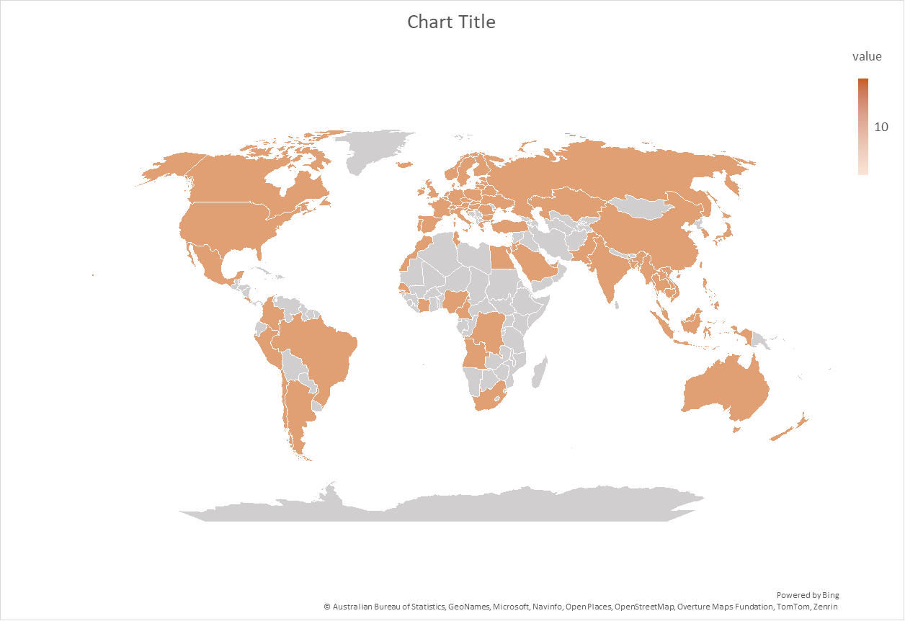
OECD ICIO&TiVA 2025 coverage
80 economies + Rest of the World
Time series covering all years from 1995 to 2022
50 economic activities
(based on ISIC Rev.4)
Africa | Northern (4), Middle (3), Western (3), Southern (1)
Americas | North America (2), Latin America and the Caribbean(7)
Asia | Eastern (5), Southern (3), Kazakhstan, South-eastern (10), Western Asia (5)
Europe | Eastern (9), Northern (10), Southern (7), Western (7)
Oceania | Australia, New Zealand
Region groups | OECD38, EU27, G20, ASEAN, Eastern Asia, Africa11, non-OECD, APEC, EU15, Euro Area19 etc.
() Number of economies
Notes:
Oct 2025

Slide 33
OECD ICIO and TiVA 2025 economic activities
 | ISIC Rev. 4 | Activity description |  | ISIC Rev. 4 | Activity description |  | ISIC Rev. 4 | Activity description
1 | 01 | Agriculture | 18 | 241,2431 | Basic iron and steel | 37 | 55,56 | Accommodation and food services
2 | 02 | Forestry | 19 | 242,2432 | Non-ferrous metals | 38 | 58,59,60 | Publishing and broadcasting
3 | 03 | Fishing | 20 | 25 | Fabricated metals | 39 | 61 | Telecommunications
4 | 05 | Mining of coal and lignite | 21 | 26 | ICT and electronics | 40 | 62,63 | Programming and information services
5 | 06 | Crude petroleum and gas | 22 | 27 | Electrical equipment | 41 | 64,65,66 | Finance and insurance
6 | 07 | Mining of metal ores | 23 | 28 | Machinery and equip. n.e.c | 42 | 68 | Real estate
7 | 08 | Other mining and quarrying | 24 | 29 | Motor vehicles | 43 | 69 to 75 | Professional and scientific
8 | 09 | Mining support | 25 | 301 | Ships and boats | 44 | 77 to 82 | Administrative and support
9 | 10,11,12 | Food and beverages | 26 | 302 to 309 | Other transport equipment | 45 | 84 | Public administration and defence
10 | 13,14,15 | Textiles and apparel | 27 | 31,32,33 | Other manufacturing | 46 | 85 | Education
11 | 16 | Wood and cork | 28 | 35 | Electricity and gas | 47 | 86 to 88 | Human health and social work
12 | 17,18 | Paper and printing | 29 | 36 to 39 | Water and waste services | 48 | 90 to 93 | Arts and recreation
13 | 19 | Petroleum products | 30 | 41,42,43 | Construction | 49 | 94 to 96 | Other services
14 | 20 | Chemicals | 31 | 45,46,47 | Wholesale and retail trade | 50 | 97,98 | Activities of households as employers
15 | 21 | Pharmaceuticals | 32 | 49 | Land transport
16 | 22 | Rubber and plastics | 33 | 50 | Water transport
17 | 23 | Other non-metallic minerals | 34 | 51 | Air transport
 |  |  | 35 | 52 | Warehousing and support
 |  |  | 36 | 53 | Postal
Notes:
OCT 2025

Slide 34
Characteristics of the OECD Inter Country IO model
Institutional, long-term project (the early 2010s - )
Maximum use of official statistics: National Accounts, Supply and Use tables and Input-Output tables
Benchmarked to latest National Accounts time series (final expenditures, value added, income)
Rest of the World (closed model)
Non-resident direct purchases (tourism and education)
Firm heterogeneity within manufacturing industries (China and Mexico)
International distribution margins allocated to country providing the trade and transport services
Trade flows are separately balanced for goods, services and direct purchases
Re-imports / Re-exports adjustment
Notes:
Oct 2023

Slide 35
Timeline

