Slide 1
CovREPowerEU and its possible impact on biomethane and organic fertilizers production in the EU
Bartlomiej Rokicki JRC Seville and University of Warsaw
Robert M’barek JRC Seville
Beyhan de Jong JRC Seville
Heleen Bartelings Wageningen Economic Research
Zuzana Smeets Křístková Wageningen Economic Research
George Philippidis Aragonese Agency for Research and Development

Slide 2
Background
The biogas sector has been gaining importance in Europe in the recent years.
First, because following the Russian invasion on Ukraine, the supply of natural gas seemed to be a major issue threatening stability of many countries.
Second, because biogases are considered as one of the tools to achieve EU’s carbon neutrality by 2050.
Last but not the least, because the digestate, a by-product of anaerobic digestion, can be considered as an organic alternative to synthetic fertilisers. In the case of the latter, the EU is heavily relying on imports that cover around 50% of total demand.

Slide 3
Goals of the study
We analyse what would be the impact of projected REPowerEU investments (EUR 37 billion) on the biomethane production level, as well as the remaining key industries that compete for the same feedstocks (e.g., livestock sector).
We also show what amount of investment would be required to achieve the production targets set in the REPowerEU.
Finally, we assess the evolution of organic fertilizer (digestate) production and its potential impact on synthetic fertilizer use in Europe.

Slide 4
Methodological approach
We apply the MAGNET model (The Modular Applied GeNeral Equilibrium Tool) with additional study-tailored extensions.
MAGNET is a recursive dynamic, multiregional, multi-commodity CGE model, covering the entire global economy (Woltjer and Kuiper, 2012).
It is built upon the GTAP (Global Trade Analysis Project) model (Hertel, 1997) and has been widely used for policy analysis.
The MAGNET model is modular in nature and extends the GTAP model through the addition of a number of policy-relevant modules.

Slide 5
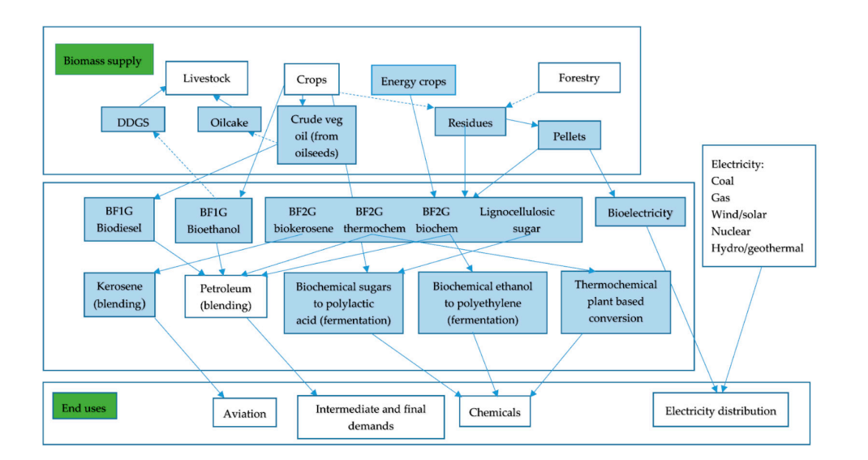
Overview of bio-based sectors and linkages in MAGNET
Source: Philippidis et al. (2018)

Slide 6
Extensions of the model
The version of the model applied in the study includes several extensions:
  Conversion to a recursively-dynamic model with sector-specific investment allocation by introduction of sector-specific capital markets.
  Separate biogas sector.
  Introduction of exogenous sector-specific investments -> steering of investment directly to the biogas sector.
  Implementation of technology learning effects in the bioeconomy sectors, including the biogas sector.

Slide 7
Database
The MAGNET used in this paper applies version 11c of the GTAP database. The original GTAP database, was further disaggregated to include additional agricultural and bioeconomy sectors. As a result, a complete MAGNET database used in this study contains the total of 123 sectors and 155 commodities.
The database includes detailed information on production, gross bilateral trade flows, transport costs and trade protection data for a 2017 benchmark year.
For the current paper the data was aggregated to 107 commodities produced in 84 sectors with particular focus on the bioeconomy, and 30 regions focusing mainly on the European Union.

Slide 8
Modelling biogas sector
For the present study biogas sector is split from the GTAP gas distribution (gdt) sector. The split was done by applying the EBA and EUROSTAT data on biogas production for the EU member states and IRENE database for the rest of the world.
Additionally, the data on feedstock was used to determine the biogas production structure in particular regions. Given the lack of one consistent dataset on feedstock, this study takes the landfill gas feedstock shares from Scarlat et al. (2018) and the monocrop feed cost shares from EBA (2022).
The feedstock used to produce biogas and thus biomethane, differs significantly between particular countries. Hence, an increase in biomethane production may negatively influence other bioeconomy sectors as they compete for similar feedstock.

Slide 9
Feedstock shares of biogas production
Source: constructed from Scarlat, Dallemand, Fahl (2018) & EBA (2022)

Slide 10
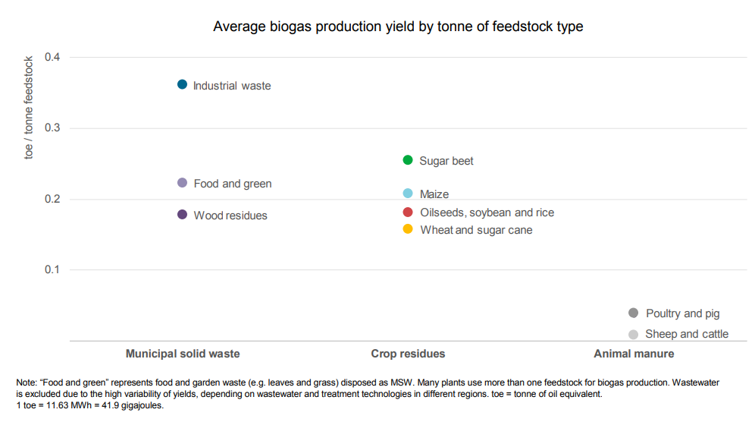
Feedstock energy content
Source: IEA (2020)

Slide 11
Biomethane production costs
Biomethane production costs can be divided into:
  Biogas plant related costs
  Feedstock costs
  Biogas upgrading unit costs
Feedstock costs differ significantly across countries – range from 0.3 €cent kWh_{hu}⁻¹ to 5.5 €cent kWh_{hu}⁻¹ with an average estimate of 3.5 €cent kWh_{hu}⁻¹
In general, biogas production costs account for around 2/3 of biomethane production costs. Significant effects of scale are observed in the industry.

Slide 12
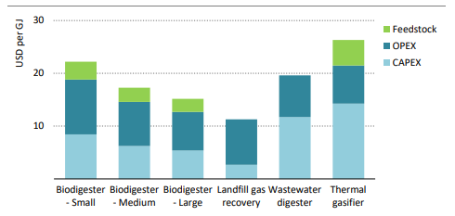
Scale effects in biomethane industry
Source: IEA (2025)

Slide 13
Total production costs vs natural gas
Recent studies provide estimates of total biomethane production costs in the EU through anaerobic digestion above EUR 70/MWh (e.g., Sulewski et al., 2023; IEA, 2025)
Expected decrease to around EUR 60/MWh in the next 30 years
In the case of gasification current costs around 90 EUR 70-90/MWh with an expected decrease to EUR 50/MWh
Additional costs related to grid connection and liquefaction over EUR 15/MWh
Natural gas prices May 2026 EUR 47/MWh

Slide 14
Baseline design
For the baseline projections, the MAGNET model uses assumptions from the EU exploratory bioeconomy baseline (Philippidis et al., 2025).
In the case of the biogas sector, global projections from the IEA are used, with global growth projected to equal approximately 23% between 2025 and 2030 (IEA, 2025b). Additionally, for the 2017-2025 period, we control for the biogas production trends in the EU member states, the UK and Ukraine, using production data form EBA.
The baseline and scenarios are produced for a simulation horizon from 2017 to 2040 in 5-year loops from 2025 onwards. The period 2017-2025 is split into two sub-periods, 2017-2019 and 2019-2025, to avoid the disturbances related COVID19 pandemic.

Slide 15
Biomethane production and potential
EU27 biogas sector production in bcm
EU biomethane potential in 2050 in bcm
Source: constructed from EBA data
Source: constructed from Gas for Climate (2022) report

Slide 16
Simulation design
Although the RePower EU plan assumed that the 37 billion investment would be implemented until 2030, current EBA data shows that this is unrealistic. Our policy scenarios assume an increase in the biogas sector investment by euro 37 billion (on top of baseline investment) over the 2025-2040 period.
Three policy scenarios are implemented with some ad-hoc assumptions concerning biogas sector production costs:
    Scenario 1 – additional investment is redistributed between 2025 and 2040. No other shocks are included.
    Scenario 2 – additional investment redistributed between 2025 and 2040. Additionally, production costs are increased by 5% in each period, beginning 2025 to mimic the increasing share of biomethane.
    Scenario 3 – additional investment redistributed between 2025 and 2040. Additionally, production costs are increased by 10% in each period, beginning 2025.

Slide 17
Baseline results
EU27 biogas sector production between 2025 and 2040 in bcm

Slide 18
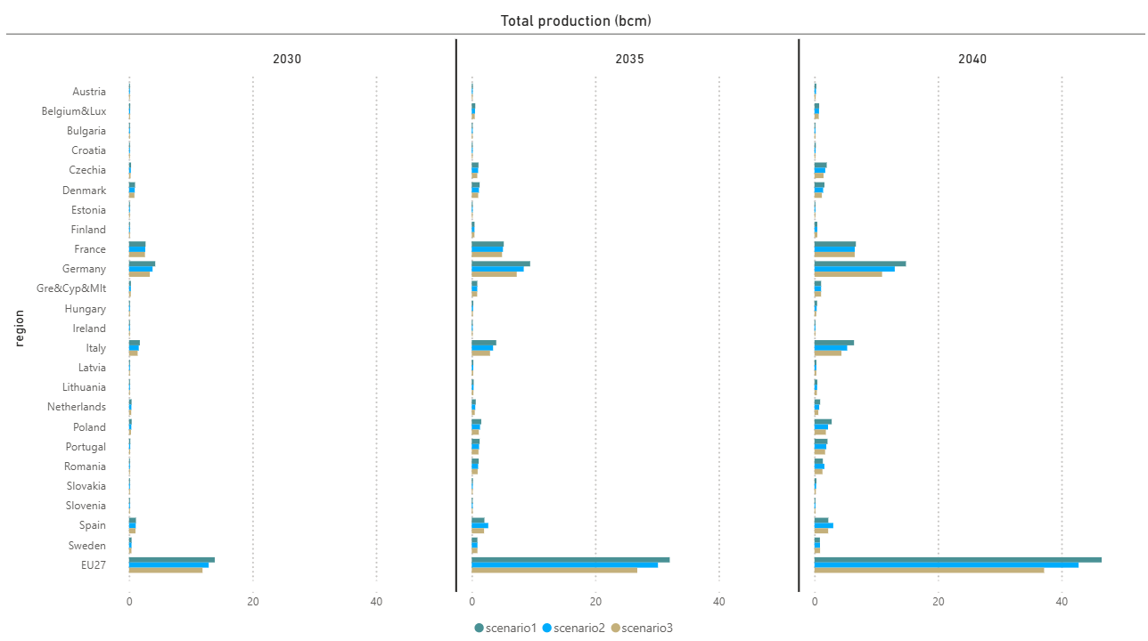
Simulation results
Biomethane production under different policy scenarios (in bcm)

Slide 19
Simulation results
Digestate production under different policy scenarios (in 1000 tons)
 | Scenario 1 |  |  | Scenario 2 |  |  | Scenario 3
 | 2030 | 2035 | 2040 | 2030 | 2035 | 2040 | 2030 | 2035 | 2040
Austria | 208 | 308 | 418 | 199 | 282 | 368 | 190 | 257 | 321
Belgium&Lux | 738 | 1,301 | 1,583 | 715 | 1,237 | 1,546 | 692 | 1,171 | 1,479
Bulgaria | 274 | 324 | 332 | 265 | 312 | 319 | 257 | 329 | 341
Croatia | 258 | 415 | 576 | 246 | 379 | 515 | 234 | 344 | 449
Czechia | 2,114 | 3,745 | 5,654 | 2,031 | 3,618 | 5,149 | 1,947 | 3,328 | 4,556
Denmark | 1,675 | 2,132 | 2,640 | 1,601 | 1,959 | 2,319 | 1,526 | 1,779 | 2,012
Estonia | 73 | 120 | 172 | 69 | 110 | 151 | 66 | 100 | 131
Finland | 390 | 966 | 992 | 381 | 960 | 996 | 372 | 947 | 1,001
France | 6,448 | 11,117 | 13,945 | 6,360 | 10,868 | 13,617 | 6,266 | 10,593 | 13,596
Germany | 12,152 | 17,051 | 22,088 | 11,744 | 16,071 | 20,383 | 11,327 | 15,006 | 18,452
Gre&Cyp&Mlt | 879 | 1,990 | 2,319 | 863 | 1,977 | 2,320 | 846 | 1,959 | 2,312
Hungary | 404 | 702 | 1,033 | 385 | 638 | 898 | 366 | 581 | 778
Ireland | 168 | 239 | 308 | 160 | 218 | 273 | 153 | 199 | 238
Italy | 3,768 | 5,791 | 8,024 | 3,605 | 5,324 | 7,008 | 3,441 | 4,869 | 6,162
Latvia | 224 | 577 | 678 | 217 | 557 | 671 | 211 | 536 | 655
Lithuania | 205 | 647 | 938 | 197 | 617 | 872 | 190 | 576 | 794
Netherlands | 1,066 | 1,470 | 1,931 | 1,015 | 1,331 | 1,668 | 963 | 1,199 | 1,428
Poland | 686 | 1,316 | 2,023 | 654 | 1,202 | 1,686 | 623 | 1,092 | 1,488
Portugal | 592 | 2,604 | 4,166 | 569 | 2,427 | 3,801 | 545 | 2,254 | 3,435
Romania | 247 | 2,155 | 2,586 | 236 | 1,980 | 3,056 | 225 | 1,837 | 2,467
Slovakia | 334 | 571 | 820 | 320 | 525 | 726 | 306 | 481 | 639
Slovenia | 104 | 197 | 182 | 101 | 197 | 184 | 97 | 194 | 185
Spain | 2,871 | 4,611 | 4,972 | 2,802 | 5,777 | 6,468 | 2,730 | 4,509 | 4,929
Sweden | 690 | 1,399 | 1,350 | 674 | 1,414 | 1,372 | 658 | 1,412 | 1,390
EU27 | 34,787 | 54,623 | 71,426 | 33,554 | 52,562 | 66,916 | 32,301 | 48,070 | 59,530

Slide 20
Simulation results
Main results EU27 - deviation from baseline (in % change)
 | Scenario 1 |  |  | Scenario 2 |  |  | Scenario 3
 | 2030 | 2035 | 2040 | 2030 | 2035 | 2040 | 2030 | 2035 | 2040
Biogas production | 18.7 | 51.5 | 61.0 | 14.5 | 45.8 | 50.9 | 10.2 | 33.3 | 34.2
Real GDP | 0.00 | 0.00 | -0.01 | 0.00 | -0.01 | -0.01 | 0.00 | 0.00 | -0.01
Agrifood production | 0.01 | 0.01 | 0.00 | 0.01 | 0.01 | 0.01 | 0.01 | 0.01 | 0.00
Coarse grains production (incl. maize) | 0.79 | 2.07 | 2.33 | 0.60 | 1.73 | 1.79 | 0.40 | 1.17 | 1.04
The small negative GDP impact in 2040 may be explained by lower overall investment (up to -0.01%) that is caused by the crowding-out effect.

Slide 21
Potential environmental impacts
Compared to baseline, there is a very small increase in emissions linked to combustion at the EU27 level. Depending on scenario, this increase varies between 0.16% and 0.26% in 2040, and it is equivalent to a growth in emissions between 5-8 Mt.
Higher manure demand could reduce GHG emissions in the agricultural sector by 3-4.5 Mt and further 1.2-1.8 by displacing fossil fuels. These numbers would be substantially increased if we accounted for methane emissions from landfill and sludge.
Further reduction could come from replacing synthetic fertilizers by digestate, estimated at 10 Mt in 2040.
Gross MAGNET emissions | Manure feedstock | Fossil fuel displacement | Digestate impact | Total impact
(+) 5–8 Mt | (-) 3–4.5 Mt | (-) 1.2–1.8 Mt | (-) up to 10 Mt | (-) 8.3–9.2 Mt

Slide 22
Conclusions
The 2030 biomethane production target will not be accomplished, although it appears to be achievable until 2040, providing that the necessary investment can be secured. Hence, there is a need to further reinforce policy incentives that would allow speeding up the biogas sector investment process. Simulation results suggest that around EUR 50 billion should be invested in the biogas sector until 2040 to produce at least 35 bcm of biomethane.
To maximize the profits from biogas production (both financial and environmental) more focus on digestate is required. Commercialization of digestate by-product may improve the profitability of biogas production and offer farmers an attractive alternative to mineral fertilizers.
Furthermore, the potential substitution of synthetic fertilizers by digestate may significantly improve biogas production net GHG emissions balance. Our results show that potential gains from such substitution constitute an important share of potential negative GHG emissions related to biogas production.

Slide 23
Thank you
Slide xx: element concerned, source: e.g. stock.adobe.com; Slide xx: element concerned, source: e.g. iStock.com
Icons by https://phosphoricons.com
Notes:
Update/add/delete parts of the copy right notice where appropriate.
More information in the Reuse guidelines: eceuropaeu.sharepoint.com/sites/intellectual-property/SiteAssets/Forms/AllItems.aspx?id=%2Fsites%2Fintellectual-property%2FSiteAssets%2FSitePages%2FGuides-and-Manuals%2F2019_Reuse-guidelines%28CC-BY%29_Jan2022%2Epdf&parent=%2Fsites%2Fintellectual-property%2FSiteAssets%2FSitePages%2FGuides-and-Manuals

