Slide 1
Decoupling Transition Patterns in the Global Economy:
A Multi-Regional Structural Decomposition Analysis
Waka Nishifuji^{1*}, Shigemi Kagawa²
1. Graduate School of Economics, Kyushu University, Fukuoka, Japan
2. Faculty of Economics, Kyushu University, Fukuoka, Japan
Notes:
Hello, everyone.
Thank you for attending my presentation today.
I’m Waka Nishifuji from Kyushu University, Japan.
The title of my presentation is "Decoupling Transition Patterns in the Global Economy: A Multi-Regional Structural Decomposition Analysis."

Slide 2
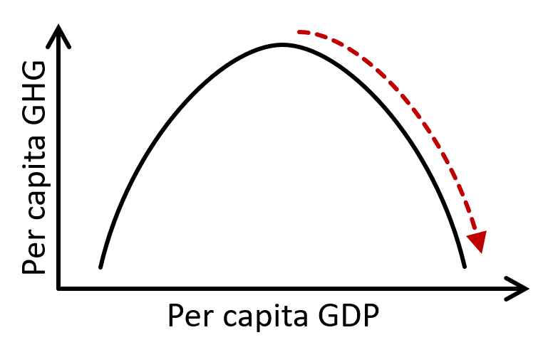
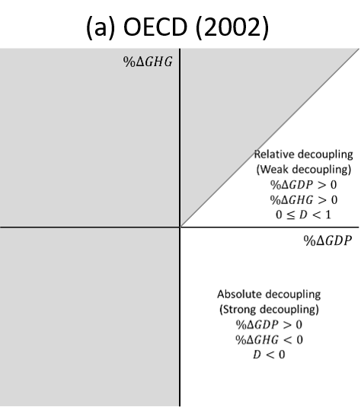
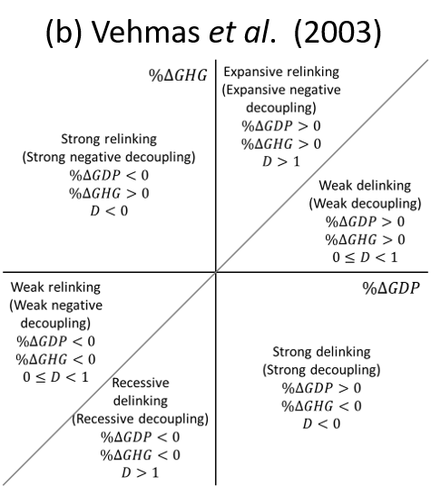
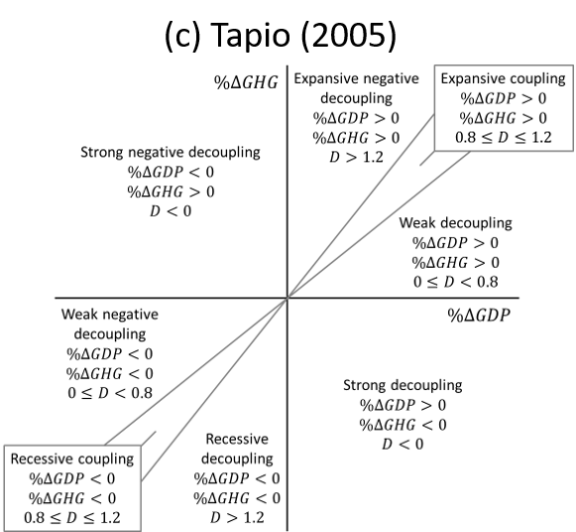
1. Introduction: Economic growth and environmental impact
  The Environmental Kuznets Curve (EKC) hypothesis suggests that environmental impacts increase during the early stages of economic growth, but decline after a certain level of development (Grossman, 1991; Arrow et al., 1995).
  Decoupling global economic growth from greenhouse gas (GHG) emissions is essential for achieving a low-carbon economy (Yang et al., 2021).
  To analyze decoupling, conventional state-based indicators have been developed to classify decoupling states (OECD, 2002; Vehmas et al., 2003; Tapio, 2005).
Figure 1. EKC curve
Figure 2. State-based classifications
Notes:
First, I would like to introduce the relationship between economic growth and environmental impacts.
The Environmental Kuznets Curve hypothesis suggests that environmental impacts increase during the early stages of economic growth but decline after a certain level of development due to structural transformation and the adoption of low-carbon technologies.
Therefore, decoupling global economic growth from greenhouse gas emissions is essential for achieving a low-carbon economy.
To analyze decoupling, conventional state-based indicators have been developed to classify different decoupling states, such as absolute and relative decoupling.

Slide 3
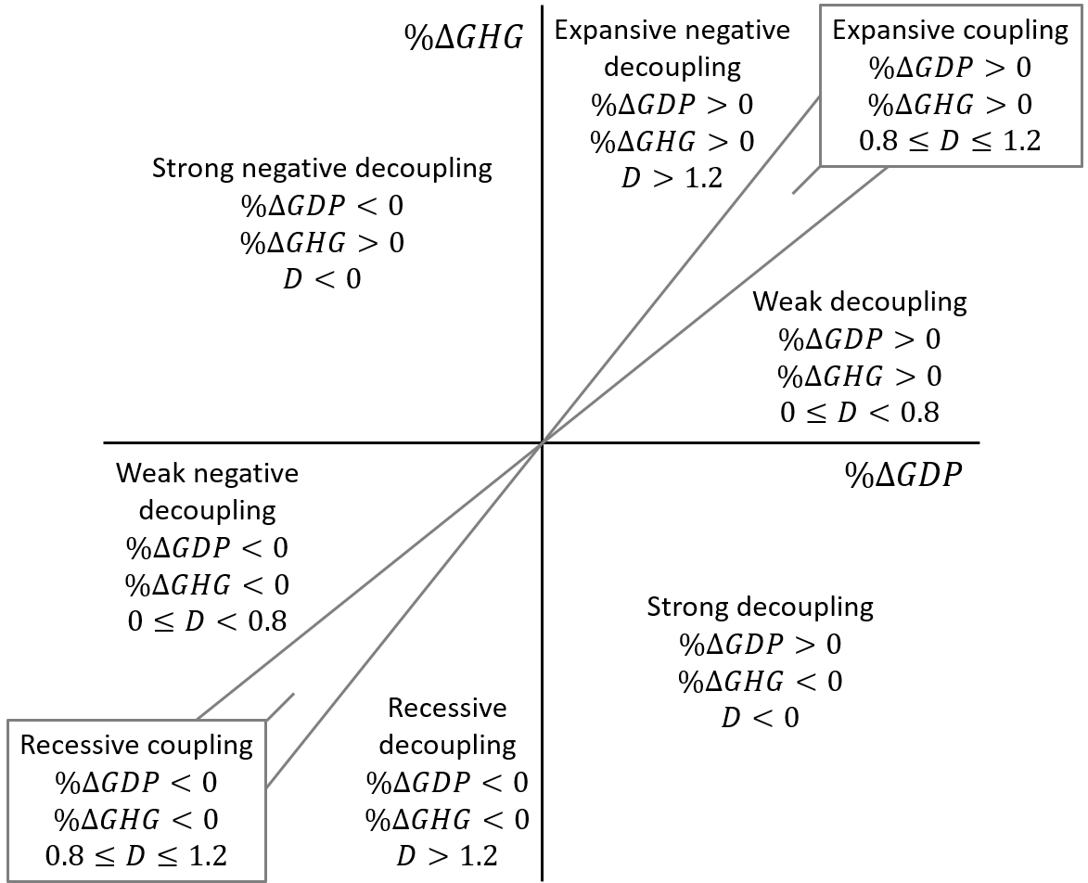
1. Introduction: State-based classification and its limitations
Contribution
  Provides a simple and intuitive framework to evaluate the relationship between economic growth and environmental impacts.
limitations
No consideration of economic growth stages: countries with substantially different GDP and GHG changes may be classified into the same state.
Exogenous thresholds: fixed thresholds may separate countries with similar GDP and GHG changes.
No transition information: This classification cannot capture decoupling trajectories.
Figure 3. Classifications of decoupling states proposed in Tapio (2005)
Notes:
Next, I will explain the advantages and limitations of conventional state-based classifications. The left figure shows an example of Tapio’s decoupling classification.
State-based classifications provide a simple and intuitive framework to evaluate the relationship between economic growth and environmental impacts.
However, they have three main limitations. First, they do not consider economic growth stages, meaning that countries with substantially different GDP and GHG changes may be classified into the same state.
Second, they rely on exogenous thresholds, where fixed threshold values may separate countries with similar GDP and GHG changes.
Finally, this classification cannot capture decoupling trajectories over time.

Slide 4
1. Introduction: Need for MRIO-based SDA in decoupling analysis
Decomposition studies for identifying the drivers of decoupling
Previous studies have identified the drivers of decoupling using decomposition approaches, such as LMDI (e.g., Wang et al., 2018, 2019; Wang and Su, 2020).
However, these studies mainly focus on production-based emissions and domestic factors.
Need for a global supply chain perspective
  Economic growth has been accompanied by the expansion of global supply chains, increasing the importance of carbon leakage through international trade.
  Production-based approaches cannot fully capture emissions transferred across countries and may misrepresent decoupling outcomes.
  Therefore, consumption-based Multi-Regional Structural Decomposition Analysis (SDA) is required to identify the structural drivers of decoupling from a global supply chain perspective.
Notes:
Next, I will discuss the need for a consumption-based MRIO-SDA to identify the structural drivers of decoupling.
Previous studies have identified the drivers of decoupling using decomposition approaches, such as LMDI. However, these studies mainly focus on production-based emissions and domestic mitigation factors.
As economic growth has been accompanied by the expansion of global supply chains, carbon leakage through international trade has become increasingly important. In this context, production-based approaches cannot fully capture emissions transferred across countries and may misrepresent decoupling outcomes.
Therefore, this study adopts a consumption-based multi-regional structural decomposition analysis, or MRIO-SDA, to identify the structural drivers of decoupling from a global supply chain perspective.

Slide 5
1. Introduction: Objective
Methodological contribution
  Develop a transition-based decoupling classification framework with endogenously determined thresholds.
  Identify distinct decoupling transition patterns using continuous per capita gross domestic expenditure (GDE)–carbon footprint (CF) trajectories.
Empirical objective
  Integrate consumption-based MRIO-SDA to identify the structural drivers of different decoupling transition patterns, including global supply chain effects and carbon leakage.
  Compare decoupling mechanisms across countries at similar economic growth stages and discuss differentiated policy directions.
Notes:
Finally, I will explain the objectives of this study.
The first methodological contribution is to develop a transition-based decoupling classification framework with endogenously determined thresholds. Using continuous per capita per capita gross domestic expenditure–carbon footprint trajectories, this framework identifies distinct decoupling transition patterns among countries.
The empirical objective is to integrate consumption-based MRIO-SDA to identify the structural drivers of different decoupling transition patterns, including the effects of global supply chains and carbon leakage.
Furthermore, by comparing decoupling mechanisms among countries at similar economic growth stages, this study discusses differentiated policy directions for achieving more favorable decoupling outcomes.

Slide 6

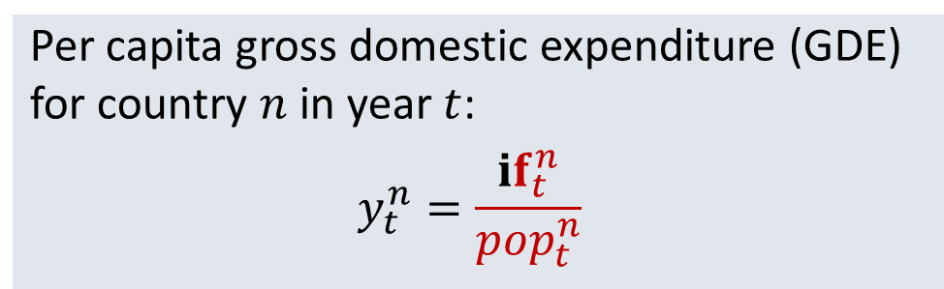
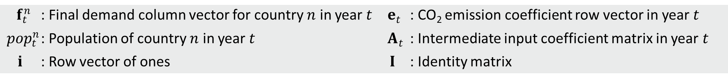




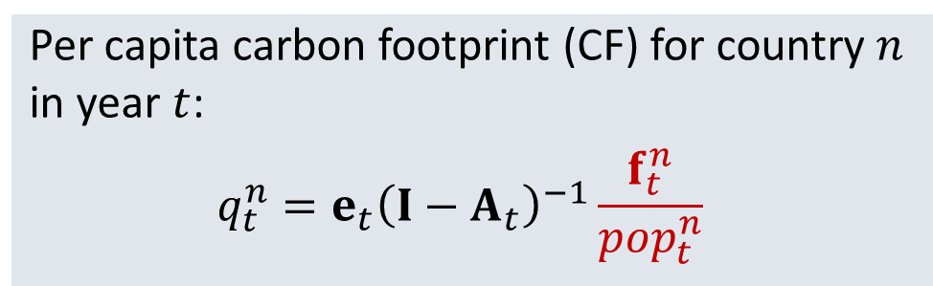

2. Methodology: Definition of decoupling indicators
  Economic and CO₂ emissions measures
  Per capita gross domestic expenditure (GDE) for country $n$ in year $t$:
  $$y_{t}^{n}=\frac{if_{t}^{n}}{{pop}_{t}^{n}}$$
  Per capita carbon footprint (CF) for country $n$ in year $t$:
  $$q_{t}^{n}=e_{t}{\left(I−A_{t}\right)}^{−1}\frac{f_{t}^{n}}{{pop}_{t}^{n}}$$
$$=(1)$$
$$=(2)$$
    $f_{t}^{n}$ : Final demand column vector for country $n$ in year $t$ $e_{t}$ : CO₂ emission coefficient row vector in year $t$
    ${pop}_{t}^{n}$ : Population of country $n$ in year $t$ $A_{t}$ : Intermediate input coefficient matrix in year $t$
    $i$ : Row vector of ones $I$ : Identity matrix
Decoupling indicators
  Percentage change in per capita GDE:
  $$\%∆y_{t}^{n}={(y_{t}^{n}−y_{0}^{n})}/{y_{0}^{n}}$$
  Percentage change in per capita CF:
  $$\%∆q_{t}^{n}={(q_{t}^{n}−q_{0}^{n})}/{q_{0}^{n}}$$
$$=(3)$$
$$=(4)$$
These indicators are used to measure how changes in per capita total final demand lead to changes in the CO₂ emissions induced by that demand.
Notes:
First, I'll introduce the economic and CO₂ emissions measures used in this study.
We begin by estimating per capita GDE and per capita carbon footprint for country n in year t.
Per capita GDE represents the total final demand generated by an average individual in a country.
Per capita carbon footprint represents the CO₂ emissions directly and indirectly induced by that final demand.
For year $t$, $f_{t}^{n}$ represents the final demand column vector for country $n$,
$e_{t}$ is the CO₂ emission coefficient row vector,
${pop}_{t}^{n}$ is the population of country $n$,
$A_{t}$ is the intermediate input coefficient matrix,
$i$ is the row vector of ones, and
$I$ is the identity matrix.
Next, I'll move on to the decoupling indicators.
The percentage changes in per capita GDE and per capita carbon footprint relative to the base year are calculated for each year t.
These indicators are used to measure how changes in per capita total final demand lead to changes in the CO₂ emissions induced by that demand.
This relationship is evaluated through the decoupling analysis in the following section.

Slide 7

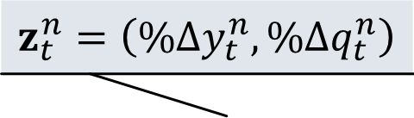
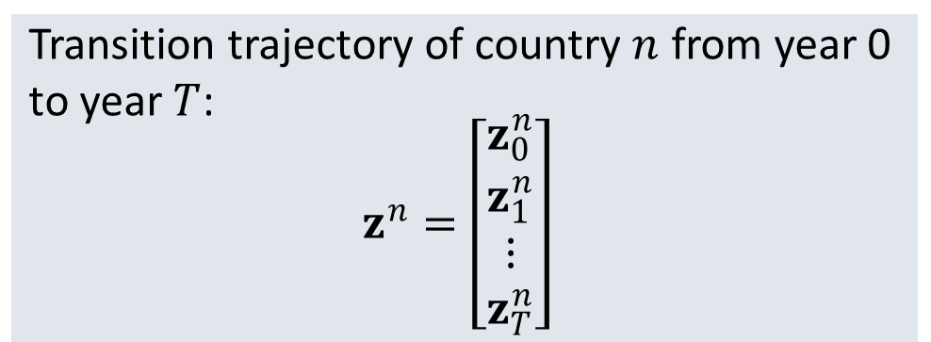






2. Methodology: Classification of decoupling transition patterns
$$z_{t}^{n}=\left(\%Δy_{t}^{n},\%Δq_{t}^{n}\right)$$
  Trajectory representation
Per capita CF change (%)
  Two-dimensional change vector at year $t$:
  $$z_{t}^{n}=\left(\begin{matrix}\%Δy_{t}^{n} \\ \%Δq_{t}^{n}\end{matrix}\right)$$
$$=(5)$$
  Transition trajectory of country $n$ from year 0 to year $T$:
  $$z^{n}=\left[\begin{matrix}z_{0}^{n} \\ z_{1}^{n} \\ ⋮ \\ z_{T}^{n}\end{matrix}\right]$$
$$z_{2}^{n}$$
$$z_{T}^{n}$$
$$=(6)$$
$$z_{1}^{n}$$
Per capita GDE change (%)
Clustering analysis
$$z_{0}^{n}$$
Hierarchical clustering using Ward’s method is applied to identify groups of countries with similar transition trajectories.
Notes:
Next, I will explain the classification of decoupling transition patterns.
Unlike the conventional state-based approach, this study focuses on the entire transition process over the study period.
First, we define a two-dimensional change vector for each year, consisting of the percentage changes in per capita GDE and per capita carbon footprint.
By combining these change vectors from year 0 to year T, we construct a transition trajectory for each country.
Then, hierarchical clustering using Ward’s method is applied to identify groups of countries with similar transition trajectories.

Slide 8
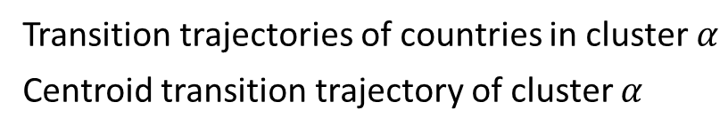
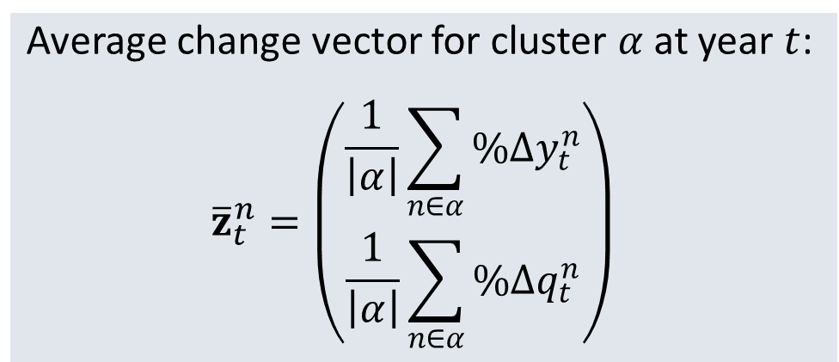

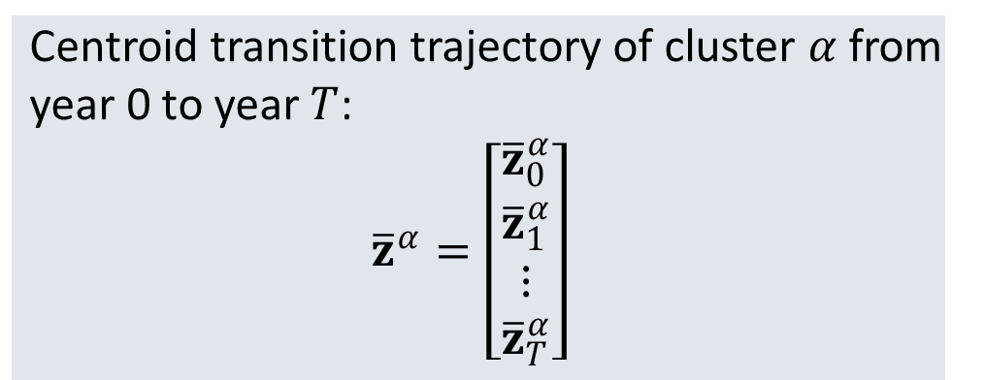

2. Methodology: Characterization of decoupling transition patterns
  Centroid transition trajectory
Per capita CF change (%)
  Average change vector for cluster $α$ at year $t$:
  $${\overline{z}}_{t}^{n}=\left(\begin{matrix}\frac{1}{\left|α\right|}\sum_{n∈α}{\%Δy_{t}^{n}} \\ \frac{1}{\left|α\right|}\sum_{n∈α}{\%Δq_{t}^{n}}\end{matrix}\right)$$
$$=(7)$$
  Centroid transition trajectory of cluster $α$ from year 0 to year $T$:
  $${\overline{z}}^{α}=\left[\begin{matrix}{\overline{z}}_{0}^{α} \\ {\overline{z}}_{1}^{α} \\ ⋮ \\ {\overline{z}}_{T}^{α}\end{matrix}\right]$$
Per capita GDE change (%)
$$=(8)$$
    Transition trajectories of countries in cluster $α$
    Centroid transition trajectory of cluster $α$
    $\left|α\right|$ : Number of countries in cluster $α$
Notes:
Next, I explain the characterization of cluster-level decoupling transition patterns.
Through hierarchical clustering, we identify groups of countries with similar transition trajectories.
For each cluster, we define a centroid transition trajectory that represents the average transition pattern of the cluster.
We calculate the average change vector for the cluster at year $t$.
And, by combining these average change vectors from year 0 to year T, we obtain the centroid transition trajectory of the cluster.
Here, the vertical bars indicate the number of countries in cluster $α$.

Slide 9

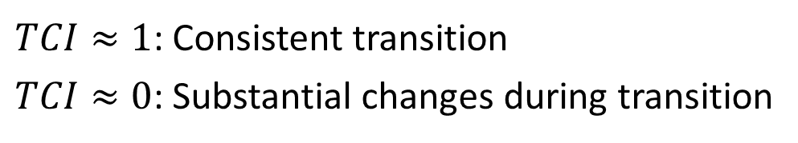


2. Methodology: Characterization of decoupling transition patterns
  Trajectory consistency
Per capita CF change (%)
  Trajectory consistency indicator of cluster $α$:
  $${TCI}^{α}=\frac{\left\|{\overline{z}}_{T}^{α}−{\overline{z}}_{0}^{α}\right\|}{\sum_{t=1}^{T}{\left\|{\overline{z}}_{t}^{α}−{\overline{z}}_{t−1}^{α}\right\|}}$$
Total transition distance
(Denominator)
$$=(9)$$
  $TCI≈1$: Consistent transition
  $TCI≈0$: Substantial changes during transition
  Economic growth stage
Direct distance
(Numerator)
Based on the average annual growth rate of per capita GDE:
Low growth: 0–2%
Moderate growth: 2–4%
High growth: >4%
Per capita GDE change (%)
    Transition trajectories of countries in cluster $α$
    Centroid transition trajectory of cluster $α$
Notes:
Next, we characterize the centroid transition trajectories from two perspectives: trajectory consistency and economic growth stages.
First, we evaluate the trajectory consistency using the trajectory consistency indicator, or TCI.
TCI compares the direct distance between the initial and final states with the total distance traveled along the transition path.
A TCI value close to 1 indicates a consistent transition, while a value close to 0 indicates substantial changes during the transition.
We also classify each cluster according to the average annual growth rate of per capita GDE into low-, moderate-, and high-growth stages.

Slide 10
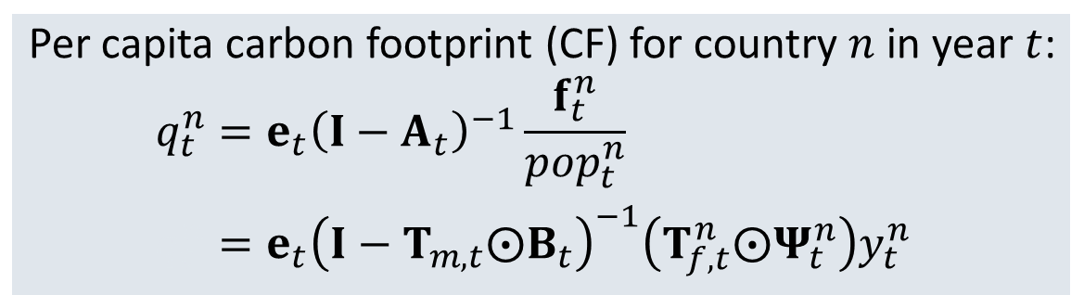
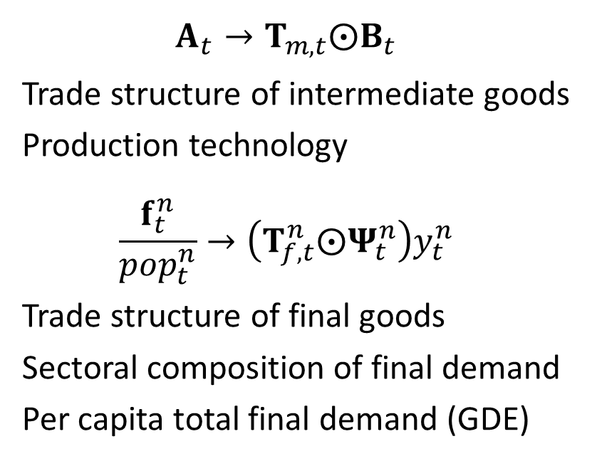
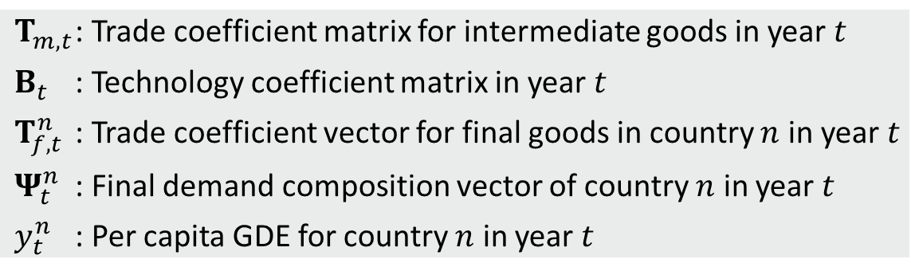

2. Methodology: Identification of decoupling drivers
  Selection of comparison clusters
Clusters with similar GDE growth stages but different carbon footprint transition patterns
▶▶ Apply SDA to identify the underlying drivers of the differences
  Reformulation of the carbon footprint equation
  Per capita carbon footprint (CF) for country $n$ in year $t$:
  $$q_{t}^{n}=e_{t}{\left(I−A_{t}\right)}^{−1}\frac{f_{t}^{n}}{{pop}_{t}^{n}}$$
  $$q_{t}^{n}=e_{t}{\left(I−T_{m,t}⨀B_{t}\right)}^{−1}\left(T_{f,t}^{n}⨀Ψ_{t}^{n}\right)y_{t}^{n}$$
$$A_{t}→T_{m,t}⨀B_{t}$$
Trade structure of intermediate goods
Production technology
$$\frac{f_{t}^{n}}{{pop}_{t}^{n}}→\left(T_{f,t}^{n}⨀Ψ_{t}^{n}\right)y_{t}^{n}$$
Trade structure of final goods
Sectoral composition of final demand
Per capita total final demand (GDE)
$$=(10)$$
    $T_{m,t}$ : Trade coefficient matrix for intermediate goods in year $t$
    $B_{t}$ : Technology coefficient matrix in year $t$
    $T_{f,t}^{n}$ : Trade coefficient vector for final goods in country $n$ in year $t$
    $Ψ_{t}^{n}$ : Final demand composition vector of country $n$ in year $t$
    $y_{t}^{n}$ : Per capita GDE for country $n$ in year $t$
Notes:
Next, I explain how we identify the drivers underlying different decoupling transition patterns.
First, we select comparison clusters with similar GDE growth stages but different carbon footprint transition patterns.
We then apply SDA to identify the underlying drivers of the differences.
To conduct SDA, we first reformulate the carbon footprint equation to separate the effects of different structural factors.
The intermediate input coefficient matrix is reformulated into two components: the trade structure of intermediate goods and production technology.
Per-capita final demand is decomposed into the trade structure of final goods, sectoral composition of final demand, and per capita total final demand, or per capita GDE.

Slide 11
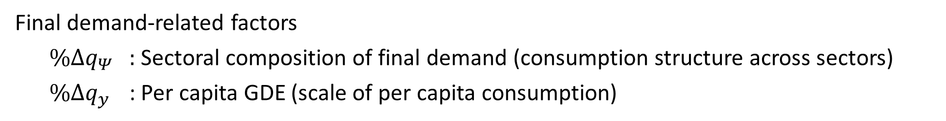
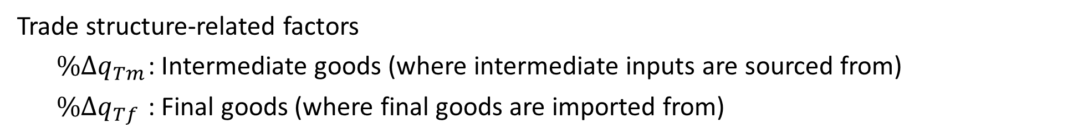
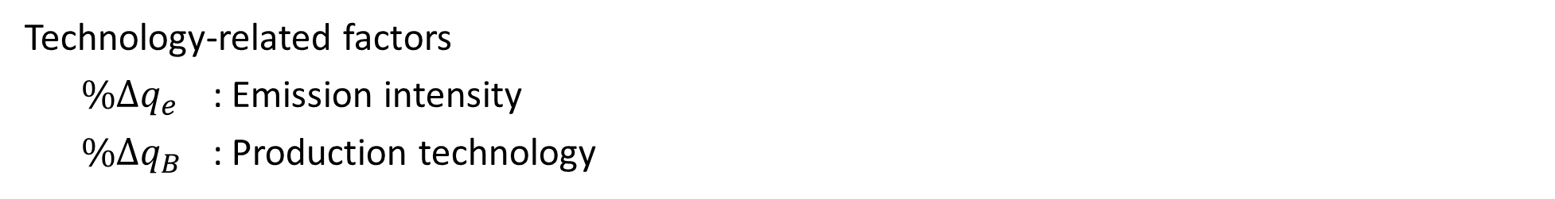

2. Methodology: Identification of decoupling drivers
  Structural decomposition analysis (SDA)
Percentage change in per capita CF for country $n$ is decomposed into six driving factors:
$$\%Δq_{t}^{n}=\%Δq_{e}+\%Δq_{Tm}+\%Δq_{B}+\%Δq_{Tf}+\%Δq_{Ψ}+\%Δq_{y}$$
$$=(10)$$
Technology-related factors
$\%Δq_{e}$ : Emission intensity
$\%Δq_{B}$ : Production technology
The average contribution of each driving factor is calculated for each cluster.
Each driving factor can be further decomposed at the sector, final demand category, and path levels.
Trade structure-related factors
$\%Δq_{Tm}$ : Intermediate goods (where intermediate inputs are sourced from)
$\%Δq_{Tf}$ : Final goods (where final goods are imported from)
Final demand-related factors
$\%Δq_{Ψ}$ : Sectoral composition of final demand (consumption structure across sectors)
$\%Δq_{y}$ : Per capita GDE (scale of per capita consumption)
Notes:
These six factors are organized into three groups:
Finaly, I explain how we decompose changes in the per capita carbon footprint.
The percentage change in per capita carbon footprint for country n is decomposed into six driving factors:
These six factors are grouped into three categories.
Technology-related factors capture the contribution of changes in emission intensity and production technology to changes in the carbon footprint.
Trade structure-related factors capture the contribution of changes in the sourcing structure of intermediate and final goods.
Final demand-related factors capture the contribution of changes in both the sectoral composition and scale of final demand.
We then estimate the average contribution of each driving factor within each cluster.
In addition, each driving factor can be further decomposed at the sector level, final demand category level, and path level, allowing for a more detailed analysis of the underlying mechanisms.

Slide 12
3. Data
ADB Multi-Regional Input-Output Tables at constant prices
  63 countries/regions and 35 sectors at constant 2010 prices for 2000 and 2007 to 2021.
Direct CO₂ emissions (International Energy Agency, 2023)
  Data from the IEA, aligned with MRIO sector classification (Nagashima et al., 2025).
Population
  Data from the World Development Indicators (World Bank, 2026);
  Taiwan data from the National Statistics database of Taiwan (not included in the WDI).
Country coverage
  Continuous direct CO₂ emissions data are required throughout the study period to calculate per centage changes over time; the final sample consists of 56 countries.
Notes:
Next, I describe the data used in this study.
The analysis is based on the ADB Multi-Regional Input-Output Tables at constant prices, covering 63 countries and 35 sectors at constant 2010 prices for the years 2000 and 2007 to 2021.
Direct CO₂ emissions data are obtained from the International Energy Agency and are aligned with the MRIO sector classification.
Population data are obtained from the World Development Indicators database.
Since Taiwan is not included in the WDI, its population data are obtained from the National Statistics database of Taiwan.
Continuous direct CO₂ emissions data are required throughout the study period to calculate percentage changes over time.
Therefore, the final sample consists of 56 countries.

Slide 13
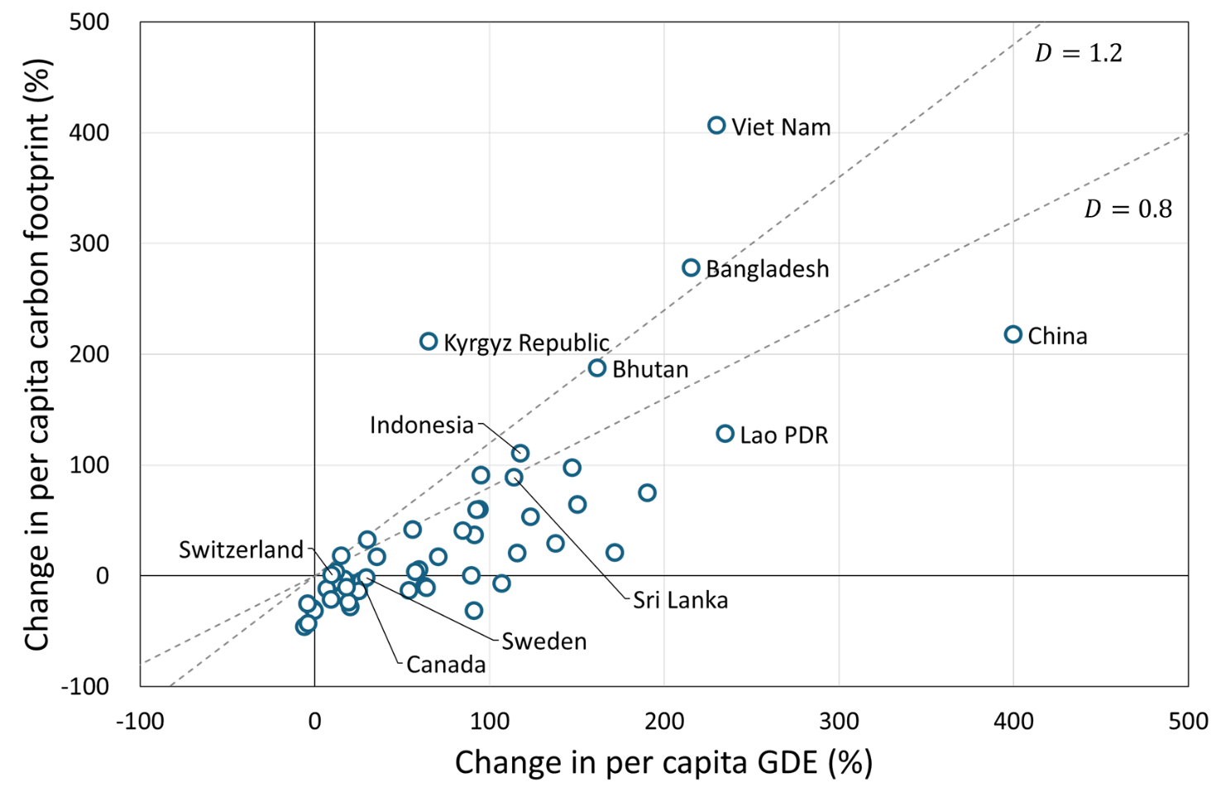

4. Results and discussion: State-based decoupling classification
  The state-based classification provides a clear and intuitive categorization of the relationship between changes in per capita GDE and CF, but it has three limitations.
  1. No consideration of economic growth stages
  China:
  GDE +399.8%, CF 217.6%, D=0.54
  Switzerland:
  GDE +9.9%, CF 0.7%, D=0.07
  are both classified as weak decoupling despite large differences in GDE and CF growth.
Weak decoupling
CF increases more slowly than GDE
$$\left(\begin{aligned}\%∆GDE>0,\%∆CF>0 \\ 0≤D<0.8\end{aligned}\right)$$
Figure 4. Changes in per capita GDE and per capita CF by country (2000–2021)
The dotted lines indicate Tapio’s conventional decoupling thresholds
Notes:
First, I present the results of the state-based decoupling classification based on the Tapio indicator.
Figure 4 shows the percentage changes in per capita GDE and per capita carbon footprint for 56 countries between 2000 and 2021.
The dotted lines indicate Tapio’s conventional decoupling thresholds.
The state-based classification provides a clear and intuitive (イン・トゥー・イ・ティヴ) categorization of the relationship between changes in per capita GDE and carbon footprints, but it has three limitations.
First, it does not consider differences in economic growth stages.
For example, China and Switzerland are both classified as weak decoupling because their D values fall within the same range, 0 to 0.8, despite large differences in GDE and CF growth.

Slide 14
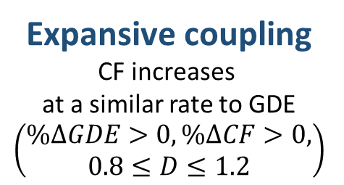
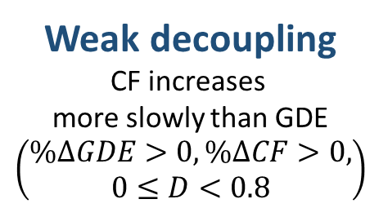
4. Results and discussion: State-based decoupling classification
Expansive coupling
CF increases
at a similar rate to GDE
$$\left(\begin{aligned}\%∆GDE>0,\%∆CF>0, \\ 0.8≤D≤1.2\end{aligned}\right)$$
  2. Exogenous thresholds
  Indonesia:
  GDE +117.6%, CF 110.2%, D=0.94
  Sri Lanka:
  GDE +114.3%, CF 88.7%, D=0.78
  are classified as expansive coupling and weak decoupling, respectively, despite similar changes in GDE and CF.
  3. No transition information
  The initial and final years cannot capture the evolution of decoupling over time.
Weak decoupling
CF increases
more slowly than GDE
$$\left(\begin{aligned}\%∆GDE>0,\%∆CF>0, \\ 0≤D<0.8\end{aligned}\right)$$
Figure 4. Changes in per capita GDE and per capita CF by country (2000–2021)
The dotted lines indicate Tapio’s conventional decoupling thresholds
Notes:
Second, the threshold values are determined subjectively.
For example, Indonesia and Sri Lanka show similar changes in GDE and carbon footprints.
However, because their D values are located on opposite sides of the threshold at D = 0.8, they are classified into different states: expansive coupling and weak decoupling.
This suggests that small differences around the threshold can lead to different classifications.
Third, this classification relies only on the initial and final years of the study period and therefore cannot capture the evolution of decoupling over time.
Countries with similar two-point changes may have followed different decoupling trajectories during the period.
To overcome these limitations, this study adopts a transition-based classification based on long-term decoupling trajectories.

Slide 15
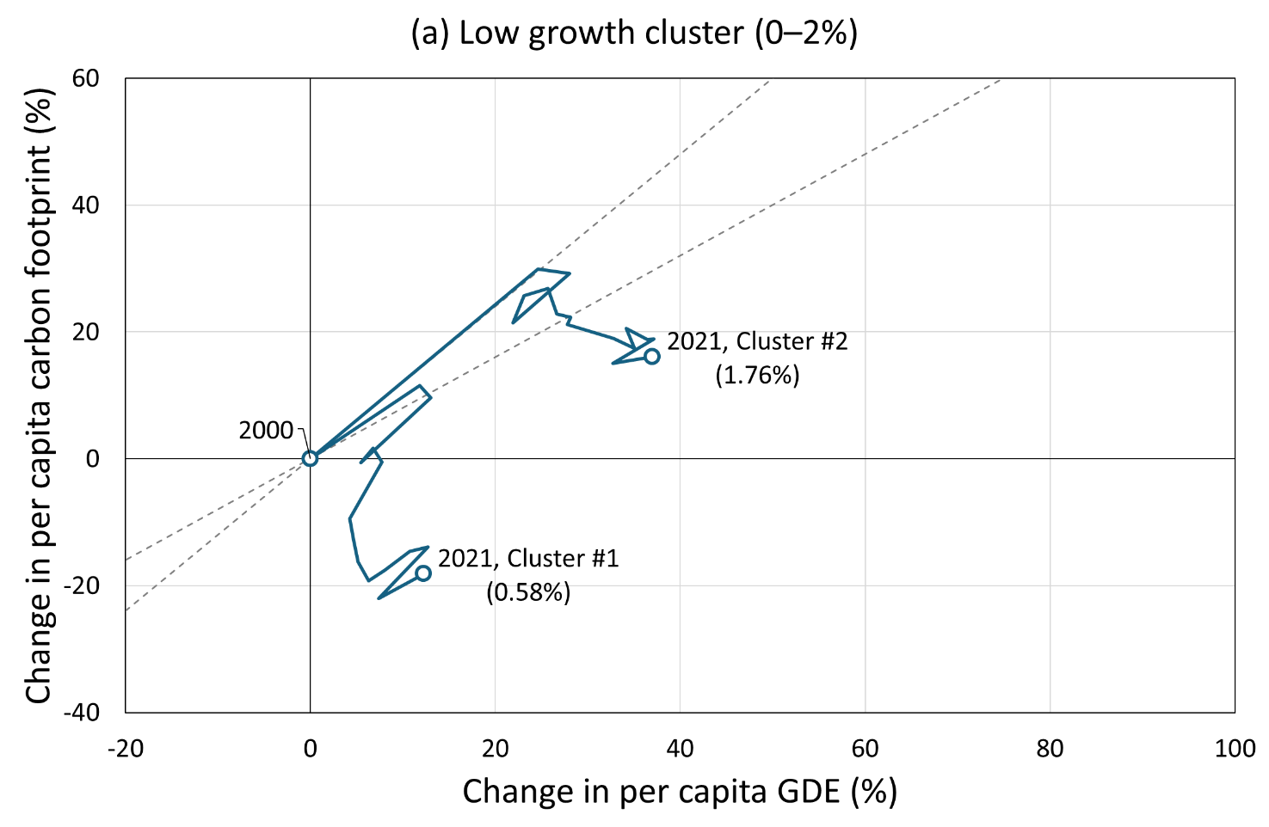
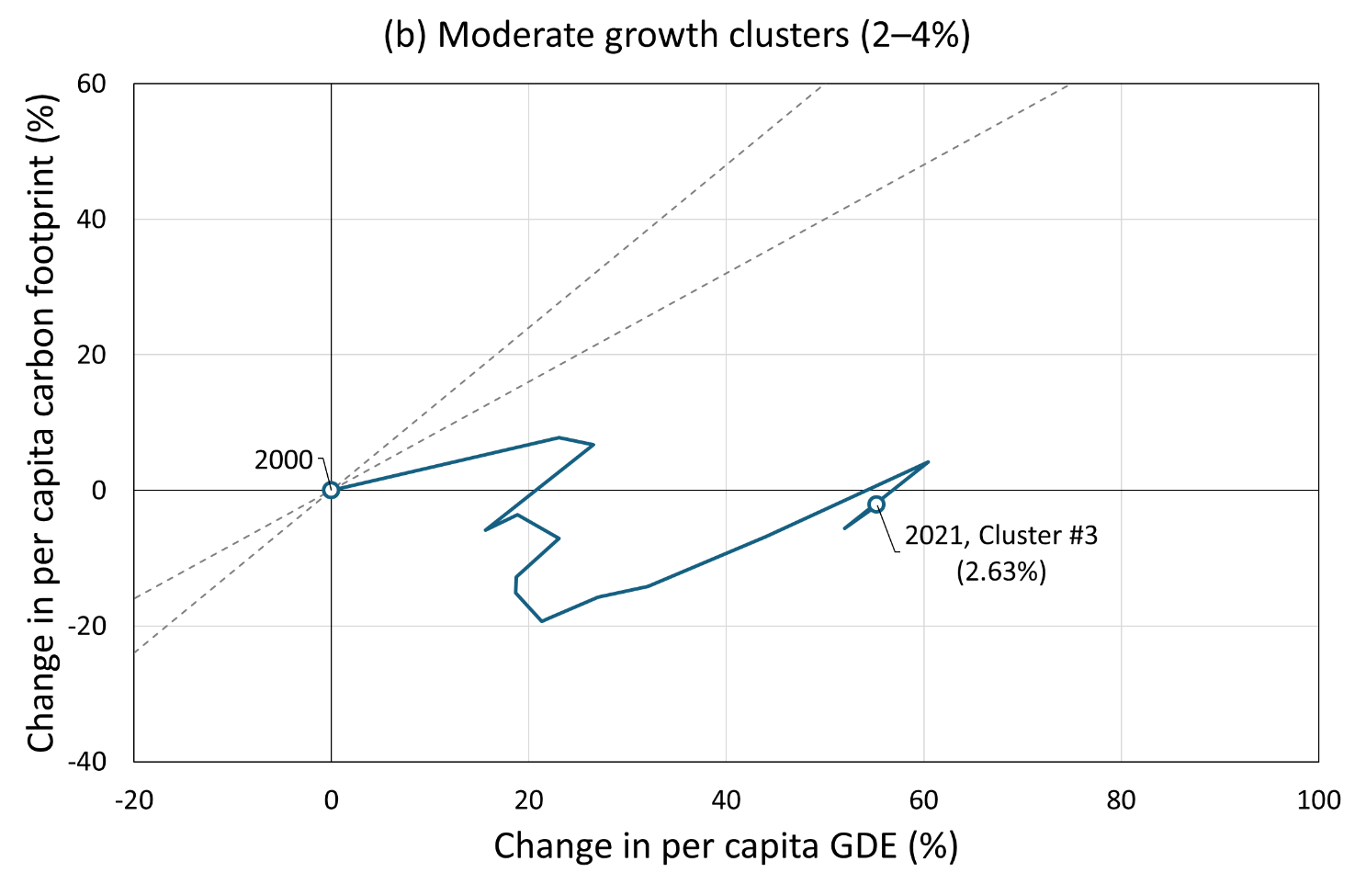
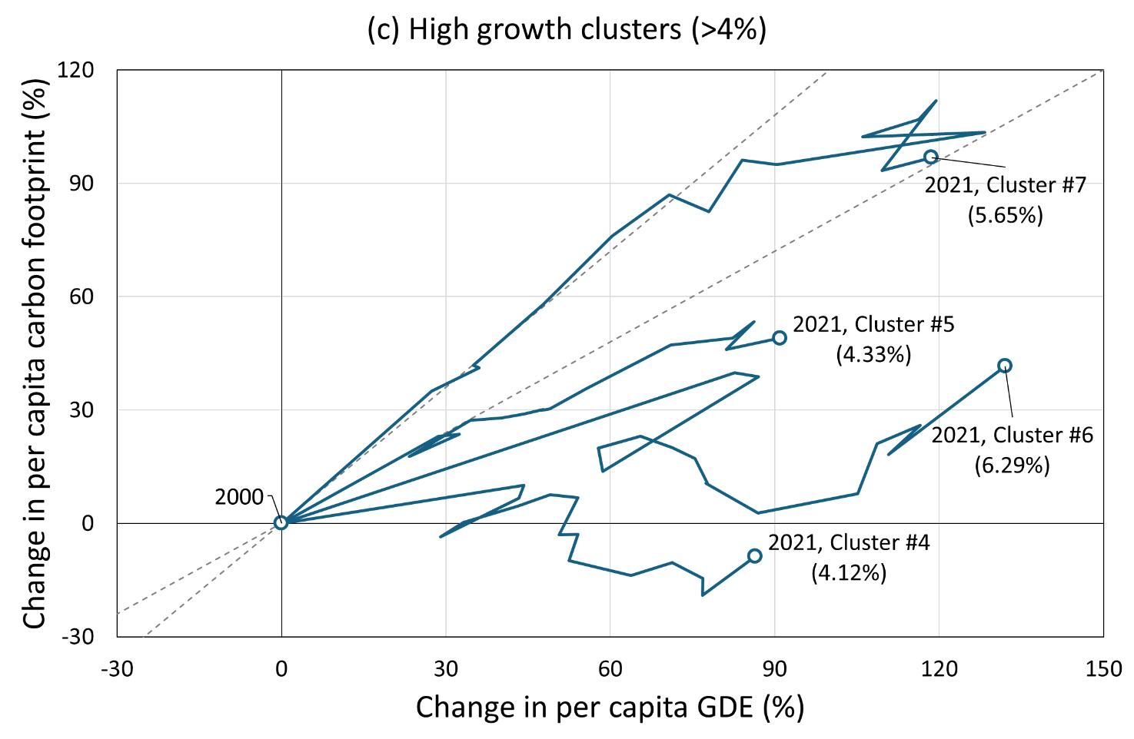
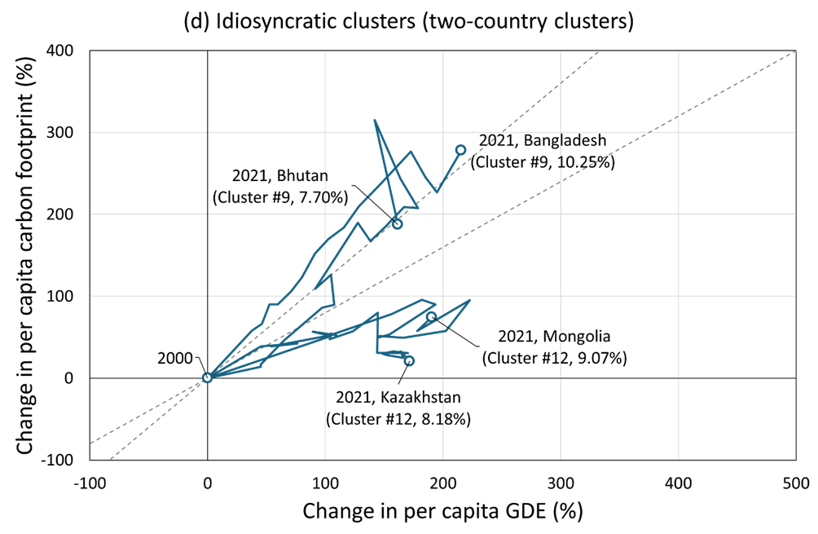
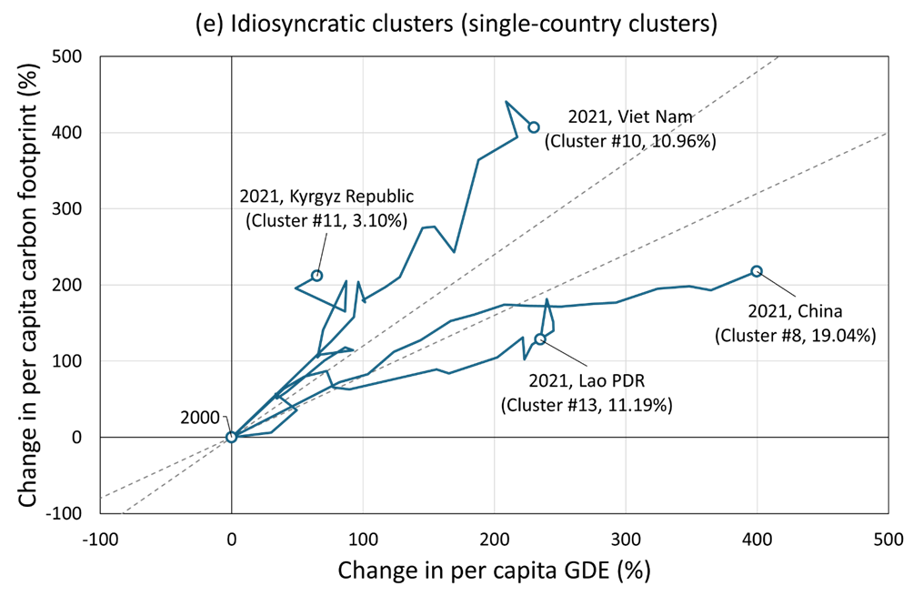
4. Results and discussion: Transition-based decoupling classification
  Transition trajectories capture the evolution of decoupling states over time.
  Hierarchical clustering identified countries with similar transition trajectories and determines cluster boundaries endogenously.
Figure 4. Decoupling transition patterns by growth category:
cluster centroid trajectories and idiosyncratic country paths (2000–2021)
Notes:
To address the limitations of the state-based classification, we apply a transition-based classification using clustering.
This approach considers transition trajectories that capture the evolution of decoupling states over time.
Hierarchical clustering identified countries with similar transition trajectories and determines cluster boundaries endogenously (エン・ドージェナスリー).
The clustering analysis identifies 13 distinct transition patterns.
Due to the limited presentation time, I focus on Cluster #4 and Cluster #5.

Slide 16
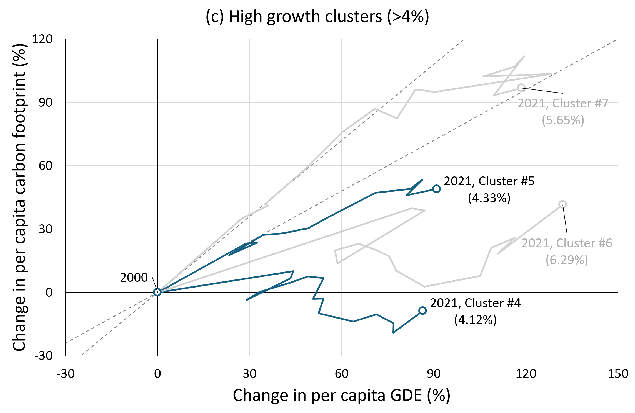
4. Results and discussion: Transition-based decoupling classification
  Similar per capita GDE growth but different carbon footprint trends
  Cluster #4:
  GDE +86.4%, CF -8.7%
  Despite GDE growth, CF remained nearly unchanged
  (Poland, Estonia, Bulgaria, …)
  Cluster #5:
  GDE +91.0%, CF 49.0%
  CF increased persistently alongside GDE growth (high TCI)
  (Republic of Korea, Thailand, …)
Figure 4. Decoupling transition patterns by growth category:
cluster centroid trajectories and idiosyncratic country paths (2000–2021)
Notes:
Due to the limited presentation time, I focus on two representative clusters that show similar per capita GDE growth but different carbon footprint trends: Cluster #4 and Cluster #5.
In Cluster #4, despite GDE growth, per capita carbon footprints remained nearly unchanged.
This cluster includes Poland, Estonia, and Bulgaria.
In contrast, Cluster #5 shows that per capita carbon footprints increased persistently alongside GDE growth, with high Trajectory consistency indicator, or TCI.
This cluster includes the Republic of Korea and Thailand.

Slide 17
4. Results and discussion: Transition-based decoupling classification
  Transition-based vs state-based
  Cluster #4 includes:
  slight increase in CF
  slight decrease in CF
In a state-based classification, these cases are separated into increase and decrease states.
Transition-based classification treats these small changes as “nearly unchanged” dynamics, without imposing a binary separation around zero.
State-based approach may overemphasize small differences.
Figure 4. Decoupling transition patterns by growth category:
cluster centroid trajectories and idiosyncratic country paths (2000–2021)
Notes:
Here, I compare transition-based and state-based classifications.
Cluster #4 includes both slight increases and slight decreases in per capita carbon footprints.
In a state-based classification, these cases are separated into increase and decrease states.
In contrast, the transition-based classification treats these small changes as “nearly unchanged” dynamics, without imposing a binary separation around zero.
As a result, the state-based approach may overemphasize small differences around zero.
Therefore, transition-based classification helps address the three limitations of the state-based approach: no consideration of economic growth stages, exogenous thresholds, and no transition information.

Slide 18
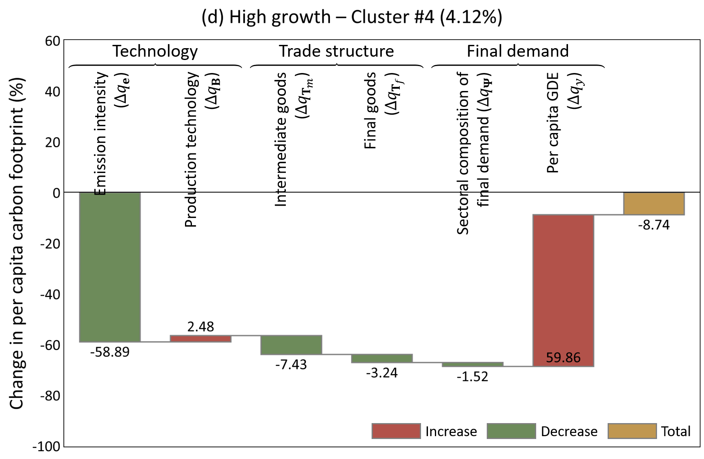
4. Results and discussion: Decomposition of per capita CF changes
  Cluster #4:
  Per capita CF did not increase despite per capita GDE growth.
Increase effects
per capita GDE (main driver)
production technology
Reduction effects
emission intensity (main driver)
trade structure of intermediate and final goods
Emission intensity improvements offset demand-driven increases.
Leading to an overall reduction in CF despite economic growth.
Figure 6. Structural decomposition of cluster-average changes in per capita carbon footprints (2000–2021)
Notes:
To identify the factors behind differences in carbon footprint change rates despite similar GDE growth rates, we applied structural decomposition analysis to changes in per capita carbon footprints and decomposed them into six factors.
In Figure 6, green indicates emission-reducing effects, red indicates emission-increasing effects, and yellow indicates total carbon footprint changes.
For Cluster #4, per capita carbon footprints did not increase despite per capita GDE growth.
Emission increases are mainly driven by change in per capita GDE and production technology.
In contrast, emission intensity is the main factor reducing emissions.
Trade structure changes in intermediate and final goods also contribute to emission reductions.
Overall, emission intensity improvements offset demand-driven increases, leading to an overall reduction in carbon footprints despite economic growth.

Slide 19
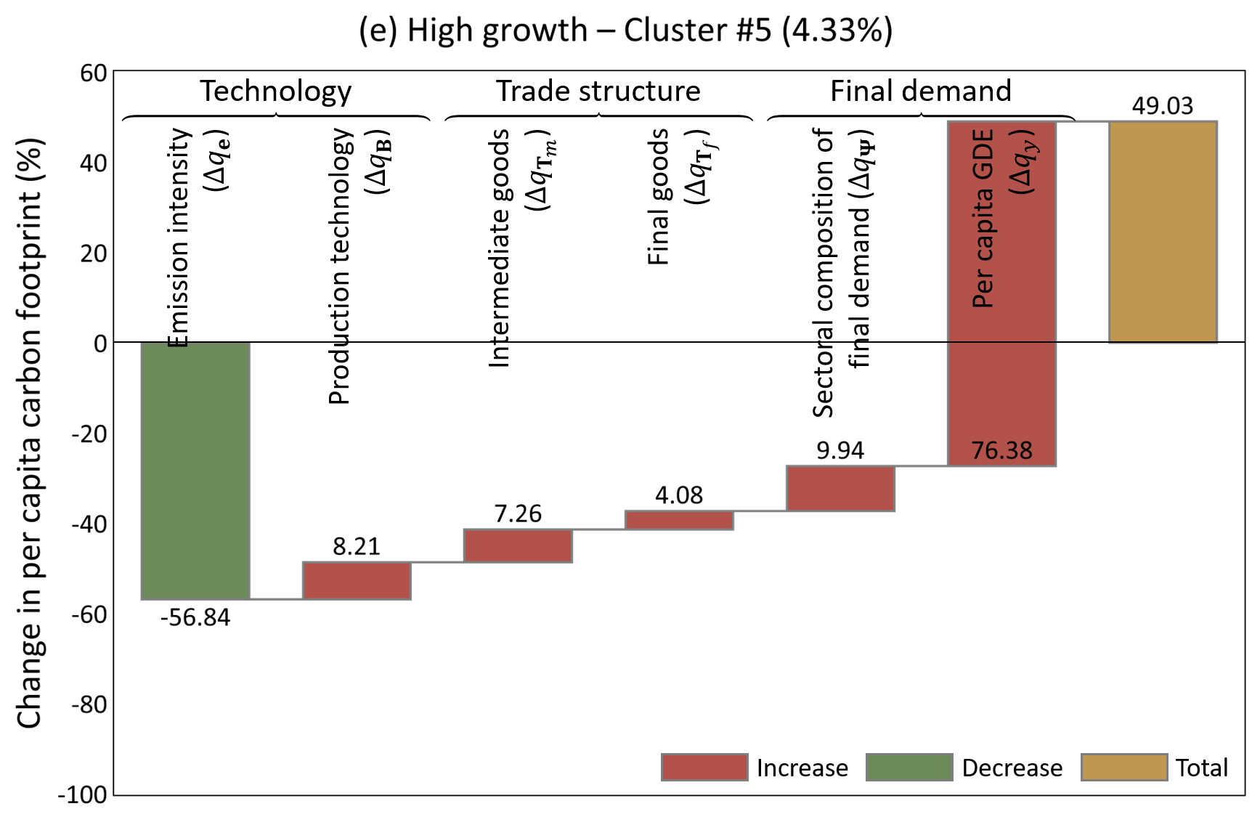
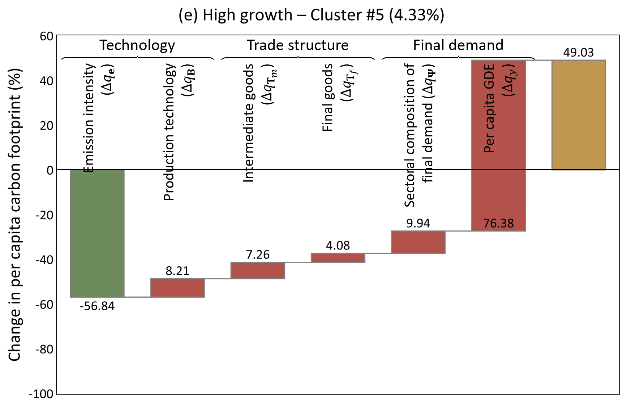
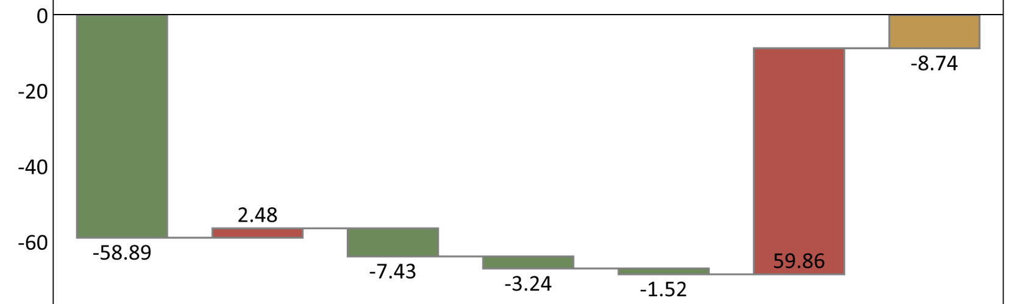
4. Results and discussion: Decomposition of per capita CF changes
  Cluster #5:
  Per capita CF increased persistently alongside GDE growth.
Increase effects
per capita GDE (main driver)
production technology
trade structure of intermediate and final goods
Sectoral composition of final demand
Reduction effects
emission intensity (main driver)
At this stage of economic growth, achieving more favorable decoupling outcomes requires shifting trade structures and the sectoral composition of final demand toward emission-reducing directions.
Cluster #4
Figure 6. Structural decomposition of cluster-average changes in per capita carbon footprints (2000–2021)
Notes:
In Cluster #5, per capita carbon footprint increased persistently alongside GDE growth.
As in Cluster #4, increases in per capita GDE are the main driver of emissions growth,
and emission intensity still plays a major role in reducing emissions.
In contrast to Cluster #4, trade structure of both intermediate and final goods, and the sectoral composition of final demand contribute to increasing emissions.
Therefore, at this stage of economic growth, compared with Cluster #4, achieving more favorable decoupling outcomes requires shifting trade structures and the sectoral composition of final demand toward emission-reducing directions.

Slide 20
4. Results and discussion: Trade structure and carbon leakage
  To further understand the mechanisms behind these differences, sector-level and path-level decompositions were conducted for the intermediate trade structure factor.
Sector-level decomposition
  Construction sector was the largest contributor to emission increases through changes in the trade structure of intermediate goods in Cluster #5.
Path-level decomposition
  Reduced domestic sourcing of metals in the construction sector contributed to CF increases (+0.4–1.8%) through greater reliance on foreign suppliers, particularly China and Vietnam.
  A shift in the sourcing of nonmetallic minerals for the construction sector from Japan and Western economies toward China further increased CF (+0.7%).
Changes in intermediate input sourcing can increase CF by relocating emission-intensive production across borders, leading to carbon leakage.
Notes:
To further understand the mechanisms behind these differences, sector-level and path-level decompositions were conducted for the intermediate trade structure factor.
At the sector level, the construction sector was the largest contributor to emission increases through changes in the trade structure of intermediate goods in Cluster number five.
At the path level, reduced domestic sourcing of metals in the construction sector contributed to carbon footprint increases through greater reliance on foreign suppliers, particularly China and Vietnam.
In addition, a shift in the sourcing of nonmetallic minerals for the construction sector from Japan and Western economies toward China further increased carbon footprints.
Therefore, changes in intermediate input sourcing can increase carbon footprints by shifting emission-intensive production across borders, leading to carbon leakage.

Slide 21
5. Conclusion and Policy implications
Table 6. Policy–cluster correspondence matrix based on SDA results across growth stages
Growth stage | Improved cluster | Reference cluster | Energy system improvement | Technology improvement | Global supply chain restructuring | Final demand policy
Low growth (0–2%) | Cluster #2 | Cluster #1 | ● | - | ○ | -
High growth (>4%) | Cluster #5 | Cluster #4 | - | ○ | ● | ●
 | Cluster #7 | Cluster #6 | ● | - | ○ | ○
The black circles (●) indicate primary policy priorities, whereas the white circles (○) indicate secondary priorities.
These results suggest that there is no single policy pathway for achieving decoupling.
Instead, effective mitigation strategies should be differentiated according to both economic growth stages and decoupling transition patterns.
Notes:
Next, we derive policy implications based on the identified drivers of carbon footprint changes.
First, each SDA factor was associated with a corresponding policy category. Specifically, improvements in emission intensity correspond to energy system improvement, production technology changes correspond to technology improvement, changes in trade structures correspond to global supply chain restructuring, and changes in final demand composition correspond to final demand policies.
Then, we compared clusters with similar economic growth stages but different decoupling transition patterns to identify the policy interventions required to achieve more favorable decoupling outcomes.
Table 6 summarizes the resulting policy priorities. The black circles indicate the primary policy priorities, while the white circles represent secondary priorities.
Overall, the results suggest that there is no single policy pathway for achieving decoupling. Instead, effective mitigation strategies should be differentiated according to both economic growth stages and decoupling transition patterns.

Slide 22
5. Conclusion and Policy implications
1. Transition-based decoupling classification
Proposed a transition-based framework considering decoupling pathways.
Overcame the limitations of conventional state-based classification: the lack of consideration of economic growth stages, the use of exogenous thresholds, and the absence of transition information.
2. Determinants of different decoupling transitions
Emission intensity improvements were a common driver of CF reduction.
More favorable decoupling depended on changes in trade structure and final demand composition.
3. Policy implications
No universal decoupling strategy exists.
Effective policies should be selected according to economic growth stages and decoupling transition patterns.
Notes:
Finally, I summarize the main conclusions of this study.
First, this study proposed a transition-based decoupling classification framework that considers dynamic decoupling pathways.
This framework addresses the limitations of conventional state-based approaches, including the lack of consideration of economic growth stages, the use of exogenous thresholds, and the absence of transition information.
Second, the SDA results revealed the determinants of different decoupling transition patterns.
Although improvements in emission intensity were a common driver of carbon footprint reductions, more favorable decoupling outcomes among countries with similar economic growth stages depended on changes in trade structures and final demand composition.
Finally, the policy implications suggest that there is no single pathway for achieving decoupling.
Therefore, effective mitigation strategies should be designed according to both economic growth stages and decoupling transition patterns.

Slide 23
Thank you for your kind attention.
Notes:
That concludes my presentation. Thank you for your attention.

Slide 24
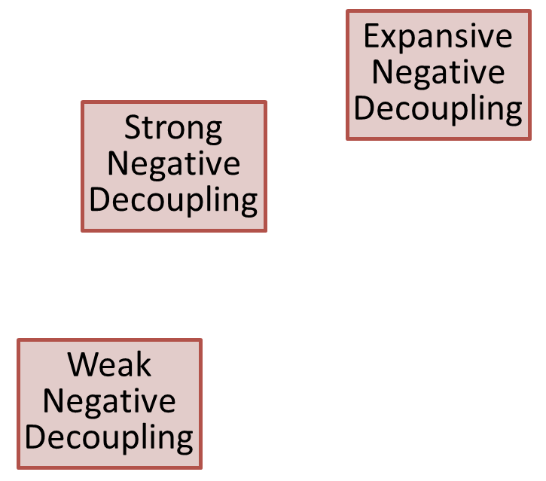


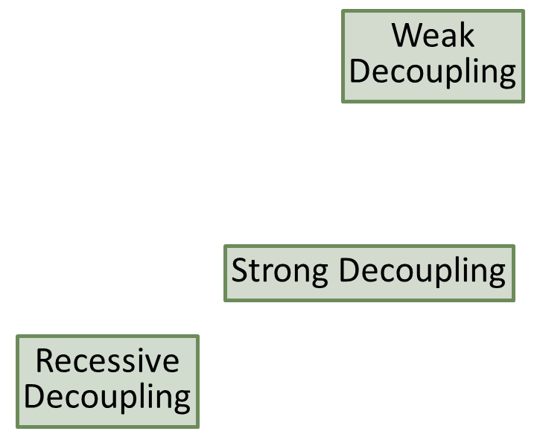

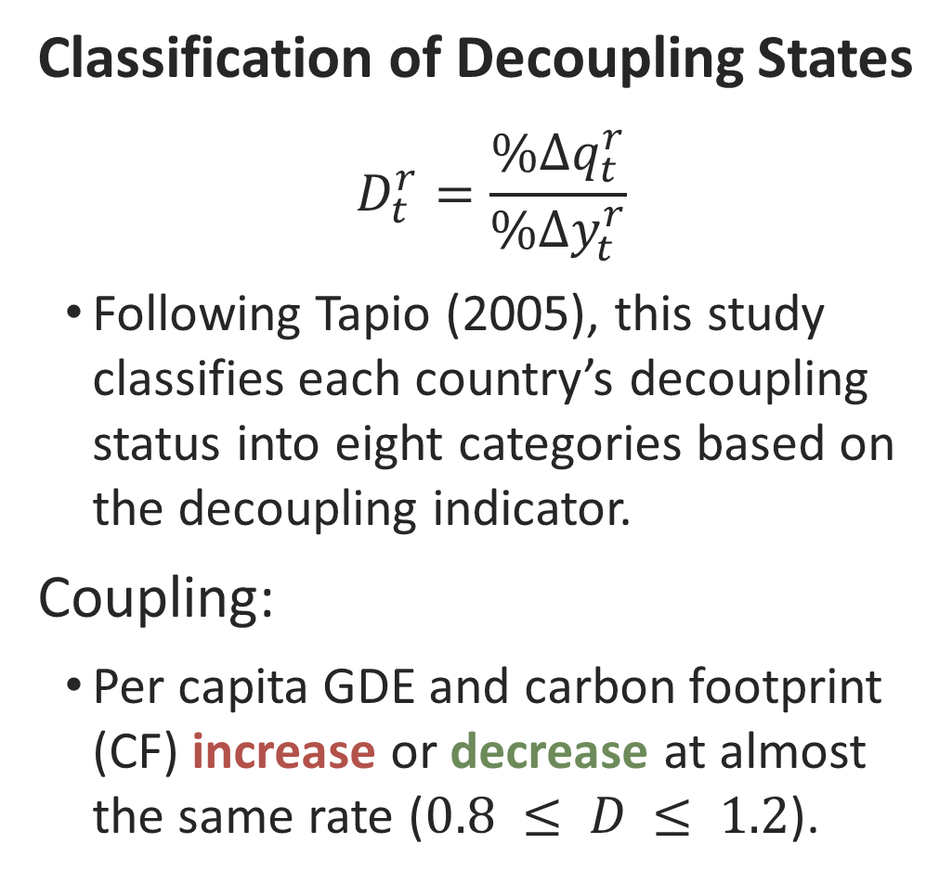




2. Methodology: Definition of decoupling indicator
$$D=1.2$$
Classification of Decoupling States
$$D_{t}^{r}=\frac{\%∆q_{t}^{r}}{\%∆y_{t}^{r}}$$
Following Tapio (2005), this study classifies each country’s decoupling status into eight categories based on the decoupling indicator.
Coupling:
Per capita GDE and carbon footprint (CF) increase or decrease at almost the same rate ($0.8 ≤ D ≤ 1.2$).
$$\%∆q$$
Expansive
Negative
Decoupling
$$D=0.8$$
Strong
Negative
Decoupling
$$(1)$$
Expansive Coupling
Weak
Decoupling
Weak
Negative
Decoupling
$$\%∆y$$
Strong Decoupling
Recessive Coupling
Recessive
Decoupling
Notes:
We’ll look at how we classify decoupling states.
Using the decoupling indicator defined on previous slide, we categorize each country's decoupling states into eight types.
First, "Coupling" refers to the state where per capita final demand, or GDE, and per capita carbon footprint increase or decrease at nearly the same rate. This corresponds to a decoupling indicator value between 0.8 and 1.2.

Slide 25

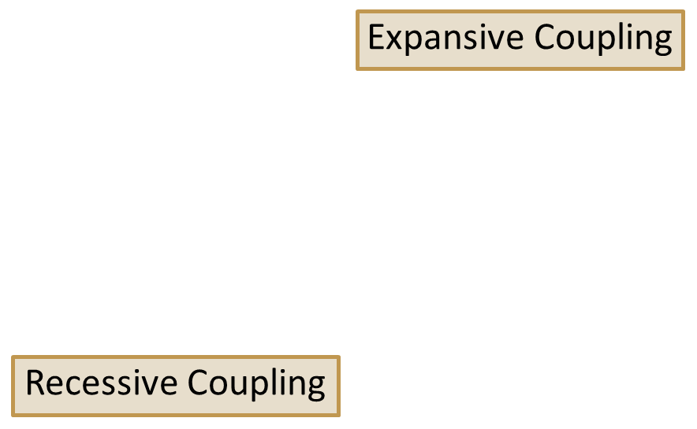

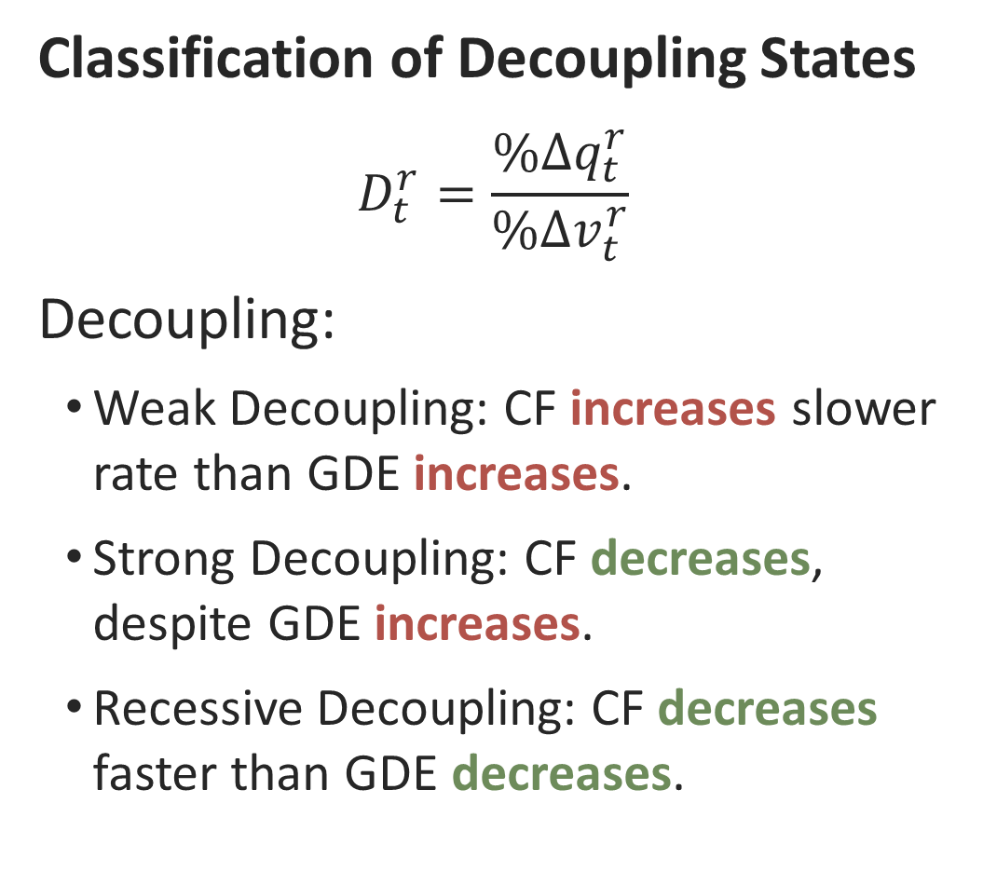

2. Methodology: Definition of decoupling indicator
$$D=1.2$$
Classification of Decoupling States
$$D_{t}^{r}=\frac{\%∆q_{t}^{r}}{\%∆v_{t}^{r}}$$
Decoupling:
Weak Decoupling: CF increases slower rate than GDE increases.
Strong Decoupling: CF decreases, despite GDE increases.
Recessive Decoupling: CF decreases faster than GDE decreases.
$$\%∆q$$
Expansive
Negative
Decoupling
$$D=0.8$$
Strong
Negative
Decoupling
$$(1)$$
Weak
Decoupling
Weak
Negative
Decoupling
$$\%∆y$$
Strong Decoupling
Recessive
Decoupling
Notes:
Decoupling has three types.
Weak Decoupling means CF increases, but slower than GDE.
Strong Decoupling means CF decreases, despite GDE increases.
Recessive Decoupling means CF decreases faster than GDE decreases.

Slide 26
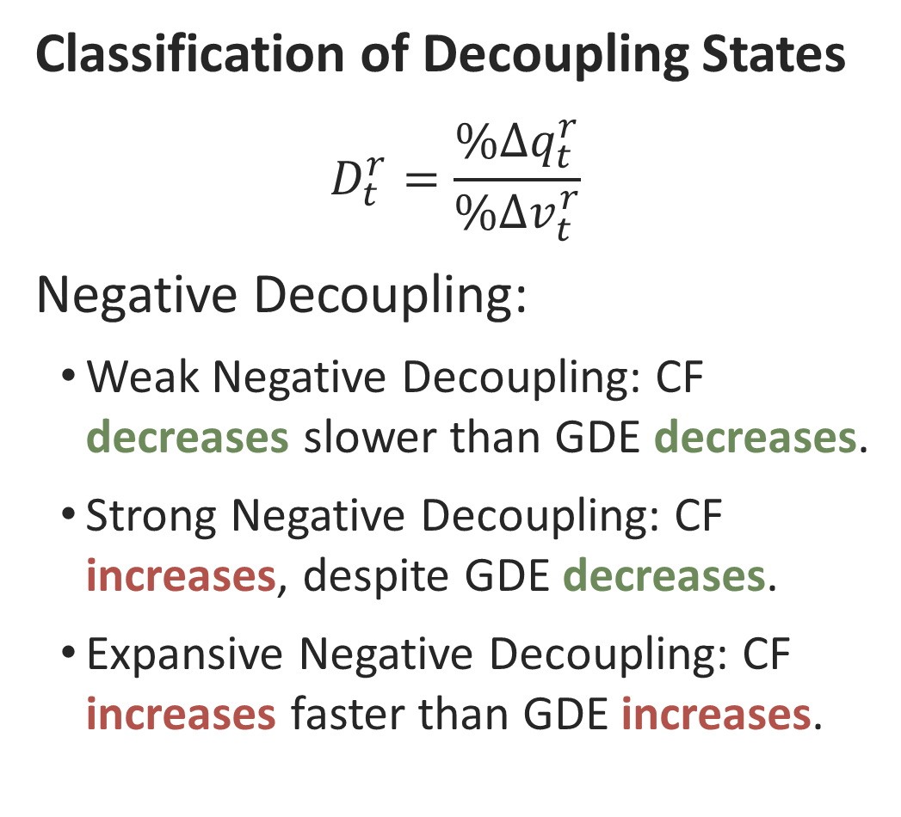
2. Methodology: Definition of decoupling indicator
$$D=1.2$$
Classification of Decoupling States
$$D_{t}^{r}=\frac{\%∆q_{t}^{r}}{\%∆v_{t}^{r}}$$
Negative Decoupling:
Weak Negative Decoupling: CF decreases slower than GDE decreases.
Strong Negative Decoupling: CF increases, despite GDE decreases.
Expansive Negative Decoupling: CF increases faster than GDE increases.
$$\%∆q$$
Expansive
Negative
Decoupling
$$D=0.8$$
Strong
Negative
Decoupling
$$(1)$$
Weak
Decoupling
Weak
Negative
Decoupling
$$\%∆y$$
Strong Decoupling
Recessive
Decoupling
Notes:
I will cover negative decoupling.
Weak negative decoupling is when the CF decreases, but more slowly than GDE.
Strong negative decoupling happens when the CF increases, despite a decrease in GDE.
Finally, expansive negative decoupling means CF increases faster than GDE.

Slide 27



Appendix:
  The per capita carbon footprint of country r :
$$q^{r}=e{\left(I−T_{m}⨀B\right)}^{−1}\left(T_{f}^{r}⨀Ψ^{r}\right)y^{r}q^{r}=e{\left(I−A\right)}^{−1}\frac{f^{r}}{{pop}^{r}}$$
  $q^{r}$ : Per capita carbon footprint of country $r$
  $e$ : Direct CO₂ emission coefficient row vector
  $I$ : Identity matrix
  $A$ : Input coefficient matrix
  $f^{r}$ : Final demand vector of country $r$
  ${pop}^{r}$ : Population of country $r$
  $T_{m}$ : Trade coefficient matrix for intermediate goods
  $B$ : Technology coefficient matrix
  $T_{f}^{r}$ : Trade coefficient vector for final goods of country $r$
  $Ψ^{r}$ : Final demand (sectoral) composition or preference coefficient matrix in country $r$
  $y^{r}$ : Per capita total final demand （i.e., GDE） in country $r$
  $⨀$ : Hadamard product (element-wise multiplication)
$$\left(2\right)$$
Notes:
The input coefficient matrix and the per capita final demand vector for country r, used in estimating the per capita carbon footprint, are each decomposed as follows.

Slide 28

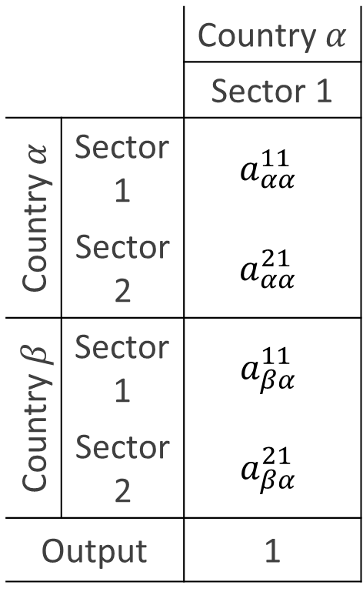
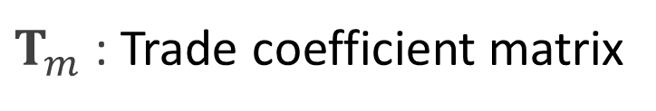

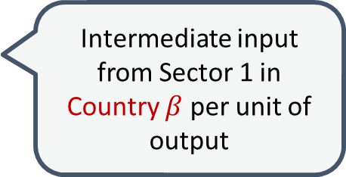
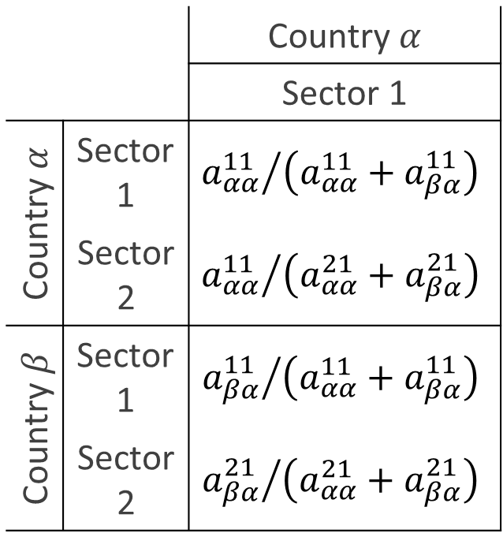

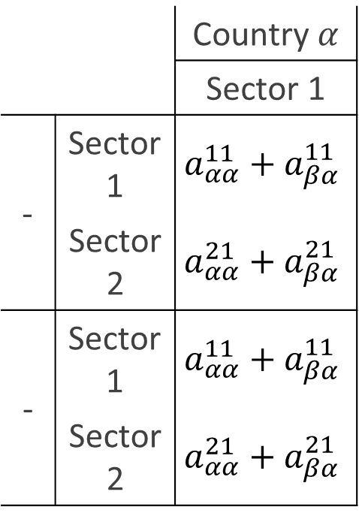

Appendix: Decomposition of the Input Coefficient Matrix
Decomposition of $A$into $T_{m}⨀B$
  $A$ : Input coefficient matrix
$B$ : Technology coefficient matrix
$T_{m}$ : Trade coefficient matrix
 |  | Country $α$
 |  | Sector 1
Country $α$ | Sector 1 | $$a_{αα}^{11}$$
 | Sector 2 | $$a_{αα}^{21}$$
Country $β$ | Sector 1 | $$a_{βα}^{11}$$
 | Sector 2 | $$a_{βα}^{21}$$
Output |  | 1
 |  | Country $α$
 |  | Sector 1
Country $α$ | Sector 1 | $${a_{αα}^{11}}/{\left(a_{αα}^{11}+a_{βα}^{11}\right)}$$
 | Sector 2 | $${a_{αα}^{11}}/{\left(a_{αα}^{21}+a_{βα}^{21}\right)}$$
Country $β$ | Sector 1 | $${a_{βα}^{11}}/{\left(a_{αα}^{11}+a_{βα}^{11}\right)}$$
 | Sector 2 | $${a_{βα}^{21}}/{\left(a_{αα}^{21}+a_{βα}^{21}\right)}$$
 |  | Country $α$
 |  | Sector 1
- | Sector 1 | $$a_{αα}^{11}+a_{βα}^{11}$$
 | Sector 2 | $$a_{αα}^{21}+a_{βα}^{21}$$
- | Sector 1 | $$a_{αα}^{11}+a_{βα}^{11}$$
 | Sector 2 | $$a_{αα}^{21}+a_{βα}^{21}$$
Intermediate input from Domestic Sector 1 per unit of output
Share of domestic inputs from Sector 1
$$=$$
$$⨀$$
Intermediate input from Sector 1 in Country $β$ per unit of output
Intermediate input from Sector 1 including both domestic and imported per unit of output
→ Pure production technology of Country 𝛼
Share of intermediate inputs from Sector 1 supplied by Country b

Slide 29
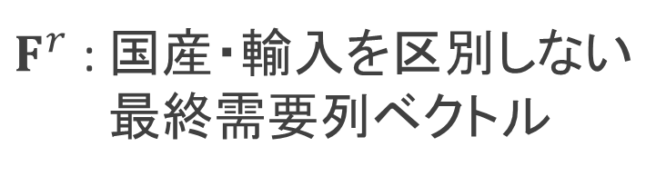
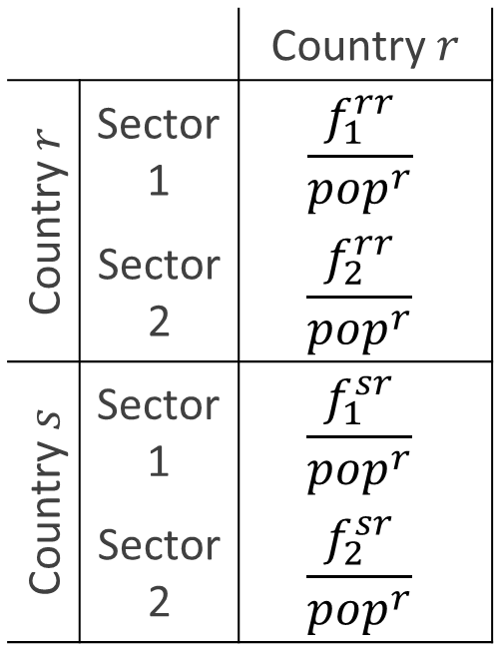
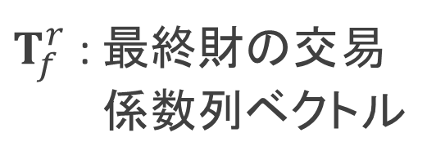







Appendix: Decomposition of the Final Demand Vector
  Decomposition of ${f^{r}}/{{pop}^{r}}$ into$\left(T_{f}^{r}⨀Ψ^{r}\right)y^{r}$
  ${f^{r}}/{{pop}^{r}}$: Per capita final demand vector of country $r$
$T_{f}^{r}$ : 最終財の交易
係数列ベクトル
$$⨀$$
$F^{r}$ : 国産・輸入を区別しない
最終需要列ベクトル
 |  | Country $r$
Country $r$ | Sector 1 | $$\frac{f_{1}^{rr}}{{pop}^{r}}$$
 | Sector 2 | $$\frac{f_{2}^{rr}}{{pop}^{r}}$$
Country $s$ | Sector 1 | $$\frac{f_{1}^{sr}}{{pop}^{r}}$$
 | Sector 2 | $$\frac{f_{2}^{sr}}{{pop}^{r}}$$
家計部門の
「国産・輸入を問わない」 「産業1」への最終需要額
 |  | Country $r$
Country $r$ | Sector 1 | $${f_{1}^{rr}}/{\left(f_{1}^{rr}+f_{1}^{sr}\right)}$$
 | Sector 2 | $${f_{1}^{rr}}/{\left(f_{1}^{rr}+f_{1}^{sr}\right)}$$
Country $s$ | Sector 1 | $${f_{1}^{rr}}/{\left(f_{1}^{rr}+f_{1}^{sr}\right)}$$
 | Sector 2 | $${f_{1}^{rr}}/{\left(f_{1}^{rr}+f_{1}^{sr}\right)}$$
 |  | Country $r$
Country $r$ | Sector 1 | $${f_{1}^{rr}}/{{pop}^{r}}$$
 | Sector 2 | $${f_{2}^{rr}}/{{pop}^{r}}$$
Country $s$ | Sector 1 | $${f_{1}^{sr}}/{{pop}^{r}}$$
 | Sector 2 | $${f_{2}^{sr}}/{{pop}^{r}}$$
Per capita final demand in country $r$
for domestic sector 1
 |  | 国r
- | 産業1 | 400
 | 産業2
産業1への最終需要のうち「国内」の割合
$$=$$
Per capita final demand in country $r$ for sector 1 from Country $s$
産業1への最終需要のうち「国s」の割合
300
最終財に占める各国の割合
＝国rの最終財の交易構造
家計部門の最終需要の産業構成

Slide 30




2. Methodology: Structural decomposition analysis
  Structural decomposition analysis of per capita carbon footprint
  We decompose the two matrices used to estimate the carbon footprint.
$A=\left(a_{ij}^{kl}\right)=\left(\frac{a_{ij}^{kl}}{\sum_{k}{a_{ij}^{kl}}}×\sum_{k}{a_{ij}^{kl}}\right)$
$$A=\left({t_{m}}_{ij}^{kl}×b_{ij}^{kl}\right)=T_{m}⨀B$$
$${f^{r}}/{{pop}^{r}}=\left({f_{i}^{kr}}/{{pop}^{r}}\right)$$
${f^{r}}/{{pop}^{r}}=\left(\frac{f_{i}^{kr}}{\sum_{k}{f_{i}^{kr}}}×\frac{\sum_{k}{f_{i}^{kr}}}{\sum_{i}{\sum_{k}{f_{i}^{kr}}}}×\frac{\sum_{i}{\sum_{k}{f_{i}^{kr}}}}{{pop}^{r}}\right)$
$${f^{r}}/{{pop}^{r}}=\left({t_{f}}_{i}^{kr}×ψ_{i}^{kr}×y^{r}\right)=\left(T_{f}^{r}⨀Ψ^{r}\right)y^{r}$$
$$(6)$$
$$(5)$$
Share of supplying
countries for
intermediate
goods
Production
technology
Share of supplying countries for final goods
Sectoral
composition
Per capita
GDE
Notes:
I will introduce the structural decomposition analysis for per capita carbon footprint.
We start by decomposing the two matrices used in the estimation.
First, the input coefficient matrix is divided into two parts: the share of supplying countries for intermediate goods, and pure production technology.
Production technology matrix represents the total intermediate inputs from worldwide industry i, per unit of production of industry j in country l;
Tm matrix indicating the shares of countries actually supplying the total intermediate inputs from industry i.
Second, the per capita final demand vector is divided into three parts: the share of supplying countries for final goods, the sectoral composition, and per capita GDE.
The per capita final demand vector reflects the size of per capita total final demand, the share of each sector in total final demand, and the country shares actually supplying the final goods.
This decomposition helps us identify the contributions of various factors to carbon footprint changes.
---
Using the decomposition framework developed by Oosterhaven and Hoen (1998) helps identify production technology, trade structures of intermediate and final goods, and final demand.

Slide 31


2. Methodology: Structural decomposition analysis
  Structural decomposition analysis of per capita carbon footprint
  We decompose the change in country $r$’s carbon footprint from the base year to year $t$ into 6 contributing factors.
  $$∆q_{t}^{r}=q_{t}^{r}−q_{0}^{r}=∆q_{e}+∆q_{B}+∆q_{Tm}+∆q_{Tf}+∆q_{Ψ}+∆q_{y}$$
$$(7)$$
Technology
Trade structure
Final demand
Emission
factor
Production
technology
Share of supplying countries:
Sectoral
composition
Per capita
GDE
Intermediate
goods
Final
goods
CO₂
Notes:
Here, we break down the structural decomposition analysis of per capita carbon footprint.
We decompose the change in carbon footprint of country r, from the base year to year t, into six factors.
These factors are grouped into three categories: technological factors, which include the emission factor and production technology; trade factors, which cover the trade structure of intermediate and final goods; and consumption factors, including sectoral composition of final demand and per capita GDE.
This approach helps us understand the detailed causes of carbon footprint changes.

Slide 32

    Figure 1. Classifications of decoupling states proposed in the four previous studies (OECD, 2002; De Bruyn, 2000; Vehmas et al., 2003; Tapio, 2005)

Slide 33
    Figure 1. Classifications of decoupling states proposed in the four previous studies (OECD, 2002; De Bruyn, 2000; Vehmas et al., 2003; Tapio, 2005)

Slide 34
    Table 1. Income-level classification of 56 countries in 2021, per capita production-based and consumption-based CO₂ emissions for 2000–2021 and their respective average annual growth rates

Slide 35
    Table 1. Income-level classification of 56 countries in 2021, per capita production-based and consumption-based CO₂ emissions for 2000–2021 and their respective average annual growth rates

Slide 36
    Table 1. Income-level classification of 56 countries in 2021, per capita production-based and consumption-based CO₂ emissions for 2000–2021 and their respective average annual growth rates

Slide 37
    Table 1. Income-level classification of 56 countries in 2021, per capita production-based and consumption-based CO₂ emissions for 2000–2021 and their respective average annual growth rates

Slide 38
    Table 1. Income-level classification of 56 countries in 2021, per capita production-based and consumption-based CO₂ emissions for 2000–2021 and their respective average annual growth rates

Slide 39
    Table 2. Per capita CO₂ emissions by income class in 2021 and their average annual change rates using two estimation methods (PBA and CBA)

Slide 40
    Table 2. Per capita CO₂ emissions by income class in 2021 and their average annual change rates using two estimation methods (PBA and CBA)

Slide 41
    Table 2. Per capita CO₂ emissions by income class in 2021 and their average annual change rates using two estimation methods (PBA and CBA)

Slide 42

Evaluation of the optimal number of clusters
  1. Calinski-Harabasz criterion (Caliński and Harabasz, 1974)
  $${CH}_{k}=\frac{{SS}_{b}}{{SS}_{w}}×\frac{\left(N−k\right)}{\left(k−1\right)}$$
  2. Davies-Bouldin criterion (Davies and Bouldin, 1979)
  $${DB}_{k}=\frac{1}{k}\sum_{α=1}^{k}{\max_{α≠β}\left(\frac{{\overline{d}}_{α}−{\overline{d}}_{β}}{\left\|{\overline{z}}^{α}−{\overline{z}}^{β}\right\|}\right)}$$
  3. Silhouette value (Rousseeuw, 1987)
  $$s_{n}=\frac{{MD}_{n}−{AD}_{n}}{max\left({AD}_{n},{MD}_{n}\right)}$$
Notes:
This procedure constructs a dendrogram representing a nested sequence of partitions from $N$ clusters to a single cluster. The optimal number of clusters is determined primarily using the Calinski–Harabasz index (Caliński and Harabasz, 1974). In addition, the Davies–Bouldin index (Davies and Bouldin, 1979) and the silhouette coefficient (Rousseeuw, 1987) are employed as complementary measures to assess the robustness of the selected clustering solution.

Slide 43

Additional agglomerative hierarchical clustering methods
  1. Complete linkage
  $$d^{complete}\left(β,γ\right)=\max\left(\left\|z^{βr}−z^{γs}\right\|\right)$$
  $$r∈\left(1,…,\left|β\right|\right)$$
  $$s∈\left(1,…,\left|γ\right|\right)$$
  2. Average linkage
  $$d^{average}\left(β,γ\right)=\frac{1}{\left|β\right|\left|γ\right|}\sum_{r∈β}{\sum_{s∈γ}{\left\|z^{βr}−z^{γs}\right\|}}$$
Notes:
To assess the robustness of the clustering results, we employ two additional agglomerative hierarchical clustering methods—complete and average linkage—based on distance (dissimilarity) measures (Everitt et al, 2011). Using three linkage methods (Ward’s, complete, and average), we apply an agglomerative hierarchical clustering algorithm and determine the optimal number of clusters for each method. We then evaluate robustness by examining the extent to which the classification of countries varies with the choice of linkage method.
The distance (dissimilarity) measures for the complete and average linkage methods are defined as follows: $d^{complete}\left(β,γ\right)=\max\left(\left\|z^{βr}−z^{γs}\right\|\right),r∈\left(1,…,\left|β\right|\right),s∈\left(1,…,\left|γ\right|\right)$, $d^{average}\left(β,γ\right)=\frac{1}{\left|β\right|\left|γ\right|}\sum_{r∈β}{\sum_{s∈γ}{\left\|z^{βr}−z^{γs}\right\|}}$.

Slide 44

    Figure S1. Robustness of clustering results: comparison across ward’s, complete, and average linkage methods
    Numbers in parentheses indicate the number of countries in each cluster.

Slide 45

    Figure 5. Decoupling transition patterns by growth category: cluster centroid trajectories and idiosyncratic country paths (2000–2021)

Slide 46

    Figure 5. Decoupling transition patterns by growth category: cluster centroid trajectories and idiosyncratic country paths (2000–2021)

Slide 47

    Figure 5. Decoupling transition patterns by growth category: cluster centroid trajectories and idiosyncratic country paths (2000–2021)

Slide 48

    Figure 5. Decoupling transition patterns by growth category: cluster centroid trajectories and idiosyncratic country paths (2000–2021)

Slide 49
    Table 4. Trajectory Consistency Index (TCI) by cluster and overall mean (2000–2021)
    Note: The Trajectory Consistency Index (TCI) ranges from 0 to 1 and measures the extent to which the trajectory follows a direct path from the initial to the final state. The mean value across clusters is 0.58. Clusters with values above this threshold are classified as relatively consistent trajectories, while those below are classified as structurally changing trajectories.

Slide 50

    Figure 6. Structural decomposition of cluster-average changes in per capita carbon footprints for Clusters #1 to #7 (2000–2021)

Slide 51

    Figure 6. Structural decomposition of cluster-average changes in per capita carbon footprints for Clusters #1 to #7 (2000–2021)

Slide 52

    Figure 6. Structural decomposition of cluster-average changes in per capita carbon footprints for Clusters #1 to #7 (2000–2021)

Slide 53

    Figure 6. Structural decomposition of cluster-average changes in per capita carbon footprints for Clusters #1 to #7 (2000–2021)

Slide 54

    Figure 6. Structural decomposition of cluster-average changes in per capita carbon footprints for Clusters #1 to #7 (2000–2021)

Slide 55

Cluster-average contribution of each driving factor to changes in CF
  When $N_{α}$ countries belong to a cluster $α$ with a similar decoupling transition pattern, the mean change rate in the per capita carbon footprint for the cluster is defined as
  $$\%Δ{\overline{q}}_{t}^{α}=\frac{\sum_{n∈α}{\%Δq_{t}^{n}}}{N_{α}}$$
  $$=\frac{\sum_{n∈α}{\%Δq_{e}}+\sum_{n∈α}{\%Δq_{Tm}}+\sum_{n∈α}{\%Δq_{B}}+\sum_{n∈α}{\%Δq_{Tf}}+\sum_{n∈α}{\%Δq_{Ψ}}+\sum_{n∈α}{\%Δq_{y}}}{N_{α}}$$
  $$=\%∆{\overline{q}}_{e}^{α}+\%∆{\overline{q}}_{Tm}^{α}+\%∆{\overline{q}}_{B}^{α}+\%∆{\overline{q}}_{Tf}^{α}+\%∆{\overline{q}}_{Ψ}^{α}+\%∆{\overline{q}}_{y}^{α}$$

Slide 56

Final demand category–level decomposition of SDA components
  The contributions of final demand–related components, namely $∆q_{Tf}$, $∆q_{Ψ}$, and $∆q_{y}$, are further decomposed by final demand category:
  $$∆q_{Tf}=\left[\begin{matrix}∆q_{Tf}^{\left(1\right)} & ⋯ & ∆q_{Tf}^{\left(q\right)} & ⋯ & ∆q_{Tf}^{\left(Q\right)}\end{matrix}\right]i=\sum_{q=1}^{Q}{∆q_{Tf}^{\left(q\right)}},$$
  $$∆q_{Ψ}=\sum_{q=1}^{Q}{∆q_{Ψ}^{\left(q\right)}}, and ∆q_{y}=\sum_{q=1}^{Q}{∆q_{y}^{\left(q\right)}}$$
  Accordingly, the total contribution of final demand–related components can be expressed as:
  $$∆q_{Tf}+∆q_{Ψ}+∆q_{y}=\sum_{q=1}^{Q}{\left(∆q_{Tf}^{\left(q\right)}+∆q_{Ψ}^{\left(q\right)}+∆q_{y}^{\left(q\right)}\right)}$$
  This formulation enables attribution of carbon footprint changes to individual final demand categories.

Slide 57

Sector- and country-level decomposition of SDA components
  The components $∆q_{e}$, $∆q_{Tm}$, and $∆q_{B}$ are further decomposed into sector–country–specific contributions. We define the sector–country–specific changes as follows:
  $$∆e^{\left(j,s\right)}=\left[\begin{matrix}0 & ⋯ & ∆e_{j}^{s} & … & 0\end{matrix}\right]$$
  $$∆T_{m}^{\left(j,s\right)}=\left[\begin{matrix}0 & ⋯ & 0 & ∆τ_{m,1j}^{1s} & 0 & ⋯ & 0 \\ ⋮ & ⋱ & ⋮ & ⋮ & ⋮ & ⋱ & ⋮ \\ 0 & ⋯ & 0 & ∆τ_{m,Mj}^{1s} & 0 & ⋯ & 0 \\ ⋮ & ⋱ & ⋮ & ⋮ & ⋮ & ⋱ & ⋮ \\ 0 & ⋯ & 0 & ∆τ_{m,1j}^{Ns} & 0 & ⋯ & 0 \\ ⋮ & ⋱ & ⋮ & ⋮ & ⋮ & ⋱ & ⋮ \\ 0 & ⋯ & 0 & ∆τ_{m,Mj}^{Ns} & 0 & ⋯ & 0\end{matrix}\right],∆B^{\left(j,s\right)}=\left[\begin{matrix}0 & ⋯ & 0 & ∆b_{1j}^{1s} & 0 & ⋯ & 0 \\ ⋮ & ⋱ & ⋮ & ⋮ & ⋮ & ⋱ & ⋮ \\ 0 & ⋯ & 0 & ∆b_{Mj}^{1s} & 0 & ⋯ & 0 \\ ⋮ & ⋱ & ⋮ & ⋮ & ⋮ & ⋱ & ⋮ \\ 0 & ⋯ & 0 & ∆b_{1j}^{Ns} & 0 & ⋯ & 0 \\ ⋮ & ⋱ & ⋮ & ⋮ & ⋮ & ⋱ & ⋮ \\ 0 & ⋯ & 0 & ∆b_{Mj}^{Ns} & 0 & ⋯ & 0\end{matrix}\right]$$
Notes:
where $∆e^{\left(j,s\right)}$, $∆{T_{m}}^{\left(j,s\right)}$, and $∆B^{\left(j,s\right)}$ denote changes in the emission factor, intermediate input trade coefficients, and production technology coefficients, respectively, for sector $j$ in country $s$.

Slide 58

Sector- and country-level decomposition of SDA components
  $$∆q_{t}^{n}=\sum_{j=1}^{M}{\underset{\begin{aligned}Effects of changes in sector j \\ in the home contry\end{aligned}}{\underbrace{\sum_{s=n}{\left(∆q_{e}^{\left(j,s\right)}+∆q_{Tm}^{\left(j,s\right)}+∆q_{B}^{\left(j,s\right)}\right)}}}}$$
  $$+\sum_{j=1}^{M}{\underset{\begin{aligned}Effects of changes in sector j \\ in foreign countries\end{aligned}}{\underbrace{\sum_{s≠n}{\left(∆q_{e}^{\left(j,s\right)}+∆q_{Tm}^{\left(j,s\right)}+∆q_{B}^{\left(j,s\right)}\right)}}}}$$
  $$+\sum_{q=1}^{Q}{\underset{\begin{aligned}Effects of changes in \\ final demand category q\end{aligned}}{\left(\underbrace{∆q_{Tf}^{\left(q\right)}+∆q_{Ψ}^{\left(q\right)}+∆q_{y}^{\left(q\right)}}\right)}}$$

Slide 59

Path-level decomposition of SDA components
  It is also straightforward to decompose the SDA components at the supply-chain path level. We define the path-specific change in the intermediate input trade coefficient matrix as follows:
  $$∆T_{m}^{\left(i,r\right),\left(j,s\right)}=\left[\begin{matrix}0 & ⋯ & 0 & 0 & 0 & ⋯ & 0 \\ ⋮ & ⋱ & ⋮ & ⋮ & ⋮ & ⋱ & ⋮ \\ 0 & ⋯ & 0 & 0 & 0 & ⋯ & 0 \\ 0 & ⋯ & 0 & ∆τ_{m,ij}^{rs} & 0 & ⋯ & 0 \\ 0 & ⋯ & 0 & 0 & 0 & ⋯ & 0 \\ ⋮ & ⋱ & ⋮ & ⋮ & ⋮ & ⋱ & ⋮ \\ 0 & ⋯ & 0 & 0 & 0 & ⋯ & 0\end{matrix}\right]$$
  The contribution of changes in intermediate input sourcing along a specific supply-chain path to variations in the per capita carbon footprint:
  $$∆q_{Tm}^{\left(i,r\right),\left(j,s\right)}=\frac{1}{6}\left(2e_{t}∆L_{1}^{\left(i,r\right),\left(j,s\right)}\frac{F_{t}^{r}}{{pop}_{t}^{r}}+e_{t}∆L_{1}^{\left(i,r\right),\left(j,s\right)}\frac{F_{0}^{r}}{{pop}_{0}^{r}}+e_{0}∆L_{1}^{\left(i,r\right),\left(j,s\right)}\frac{F_{t}^{r}}{{pop}_{t}^{r}}+{2e}_{0}∆L_{1}^{\left(i,r\right),\left(j,s\right)}\frac{F_{0}^{r}}{{pop}_{0}^{r}}\right)i$$
Notes:
where $∆T_{m}^{\left(i,r\right),\left(j,s\right)}$ denotes the change in the intermediate input trade coefficients associated with a specific supply-chain path from industry $i$ in country $r$ to industry $j$ in country $s$. When changes in the intra-regional trade coefficients, represented by $∆τ_{m,ij}^{rs}\left(r=s\right)$ this indicates an increase in domestic sourcing of intermediate inputs over the study period, and vice versa. In contrast, positive changes in the inter-regional trade coefficients $∆τ_{m,ij}^{rs}\left(r≠s\right)$ imply an increase in intermediate imports for the corresponding supply-chain path, and vice versa.

Slide 60

    Figure 7. Sector- and final demand category-level structural decomposition of cluster-average changes in per capita carbon footprints (2000–2021)
Notes:
This figure presents the structural decomposition of cluster-average changes in per capita carbon footprints across 13 clusters into six main components:
(i) changes in sectoral emission intensity,
(ii) changes in sectoral trade structure,
(iii) changes in sectoral technology,
(iv) changes in the trade structure of final demand categories,
(v) changes in commodity composition across final demand categories, and
(vi) changes in per capita final demand by category.
Components (i) to (iii) are further disaggregated into home-country effects and foreign-country effects.
The home-country effects represent the impacts of changes in sectoral emission intensity, trade structure, and production technology within the country itself.
The foreign-country effects represent the sum of the impacts of changes in sectoral emission intensity, trade structure, and production technology in all countries other than the home country.
All effects are expressed as contributions to changes in per capita carbon footprints and are averaged within each cluster to facilitate comparison of decoupling mechanisms across country groups.

Slide 61

    Figure 7. Sector- and final demand category-level structural decomposition of cluster-average changes in per capita carbon footprints (2000–2021)
Notes:
This figure presents the structural decomposition of cluster-average changes in per capita carbon footprints across 13 clusters into six main components:
(i) changes in sectoral emission intensity,
(ii) changes in sectoral trade structure,
(iii) changes in sectoral technology,
(iv) changes in the trade structure of final demand categories,
(v) changes in commodity composition across final demand categories, and
(vi) changes in per capita final demand by category.
Components (i) to (iii) are further disaggregated into home-country effects and foreign-country effects.
The home-country effects represent the impacts of changes in sectoral emission intensity, trade structure, and production technology within the country itself.
The foreign-country effects represent the sum of the impacts of changes in sectoral emission intensity, trade structure, and production technology in all countries other than the home country.
All effects are expressed as contributions to changes in per capita carbon footprints and are averaged within each cluster to facilitate comparison of decoupling mechanisms across country groups.

Slide 62

    Figure 7. Sector- and final demand category-level structural decomposition of cluster-average changes in per capita carbon footprints (2000–2021)
Notes:
This figure presents the structural decomposition of cluster-average changes in per capita carbon footprints across 13 clusters into six main components:
(i) changes in sectoral emission intensity,
(ii) changes in sectoral trade structure,
(iii) changes in sectoral technology,
(iv) changes in the trade structure of final demand categories,
(v) changes in commodity composition across final demand categories, and
(vi) changes in per capita final demand by category.
Components (i) to (iii) are further disaggregated into home-country effects and foreign-country effects.
The home-country effects represent the impacts of changes in sectoral emission intensity, trade structure, and production technology within the country itself.
The foreign-country effects represent the sum of the impacts of changes in sectoral emission intensity, trade structure, and production technology in all countries other than the home country.
All effects are expressed as contributions to changes in per capita carbon footprints and are averaged within each cluster to facilitate comparison of decoupling mechanisms across country groups.

Slide 63

    Figure 7. Sector- and final demand category-level structural decomposition of cluster-average changes in per capita carbon footprints (2000–2021)
Notes:
This figure presents the structural decomposition of cluster-average changes in per capita carbon footprints across 13 clusters into six main components:
(i) changes in sectoral emission intensity,
(ii) changes in sectoral trade structure,
(iii) changes in sectoral technology,
(iv) changes in the trade structure of final demand categories,
(v) changes in commodity composition across final demand categories, and
(vi) changes in per capita final demand by category.
Components (i) to (iii) are further disaggregated into home-country effects and foreign-country effects.
The home-country effects represent the impacts of changes in sectoral emission intensity, trade structure, and production technology within the country itself.
The foreign-country effects represent the sum of the impacts of changes in sectoral emission intensity, trade structure, and production technology in all countries other than the home country.
All effects are expressed as contributions to changes in per capita carbon footprints and are averaged within each cluster to facilitate comparison of decoupling mechanisms across country groups.

Slide 64

    Figure 7. Sector- and final demand category-level structural decomposition of cluster-average changes in per capita carbon footprints (2000–2021)
Notes:
This figure presents the structural decomposition of cluster-average changes in per capita carbon footprints across 13 clusters into six main components:
(i) changes in sectoral emission intensity,
(ii) changes in sectoral trade structure,
(iii) changes in sectoral technology,
(iv) changes in the trade structure of final demand categories,
(v) changes in commodity composition across final demand categories, and
(vi) changes in per capita final demand by category.
Components (i) to (iii) are further disaggregated into home-country effects and foreign-country effects.
The home-country effects represent the impacts of changes in sectoral emission intensity, trade structure, and production technology within the country itself.
The foreign-country effects represent the sum of the impacts of changes in sectoral emission intensity, trade structure, and production technology in all countries other than the home country.
All effects are expressed as contributions to changes in per capita carbon footprints and are averaged within each cluster to facilitate comparison of decoupling mechanisms across country groups.

Slide 65

    Figure 7. Sector- and final demand category-level structural decomposition of cluster-average changes in per capita carbon footprints (2000–2021)
Notes:
This figure presents the structural decomposition of cluster-average changes in per capita carbon footprints across 13 clusters into six main components:
(i) changes in sectoral emission intensity,
(ii) changes in sectoral trade structure,
(iii) changes in sectoral technology,
(iv) changes in the trade structure of final demand categories,
(v) changes in commodity composition across final demand categories, and
(vi) changes in per capita final demand by category.
Components (i) to (iii) are further disaggregated into home-country effects and foreign-country effects.
The home-country effects represent the impacts of changes in sectoral emission intensity, trade structure, and production technology within the country itself.
The foreign-country effects represent the sum of the impacts of changes in sectoral emission intensity, trade structure, and production technology in all countries other than the home country.
All effects are expressed as contributions to changes in per capita carbon footprints and are averaged within each cluster to facilitate comparison of decoupling mechanisms across country groups.

Slide 66

    Figure 7. Sector- and final demand category-level structural decomposition of cluster-average changes in per capita carbon footprints (2000–2021)
Notes:
This figure presents the structural decomposition of cluster-average changes in per capita carbon footprints across 13 clusters into six main components:
(i) changes in sectoral emission intensity,
(ii) changes in sectoral trade structure,
(iii) changes in sectoral technology,
(iv) changes in the trade structure of final demand categories,
(v) changes in commodity composition across final demand categories, and
(vi) changes in per capita final demand by category.
Components (i) to (iii) are further disaggregated into home-country effects and foreign-country effects.
The home-country effects represent the impacts of changes in sectoral emission intensity, trade structure, and production technology within the country itself.
The foreign-country effects represent the sum of the impacts of changes in sectoral emission intensity, trade structure, and production technology in all countries other than the home country.
All effects are expressed as contributions to changes in per capita carbon footprints and are averaged within each cluster to facilitate comparison of decoupling mechanisms across country groups.

Slide 67

    Figure 7. Sector- and final demand category-level structural decomposition of cluster-average changes in per capita carbon footprints (2000–2021)
Notes:
This figure presents the structural decomposition of cluster-average changes in per capita carbon footprints across 13 clusters into six main components:
(i) changes in sectoral emission intensity,
(ii) changes in sectoral trade structure,
(iii) changes in sectoral technology,
(iv) changes in the trade structure of final demand categories,
(v) changes in commodity composition across final demand categories, and
(vi) changes in per capita final demand by category.
Components (i) to (iii) are further disaggregated into home-country effects and foreign-country effects.
The home-country effects represent the impacts of changes in sectoral emission intensity, trade structure, and production technology within the country itself.
The foreign-country effects represent the sum of the impacts of changes in sectoral emission intensity, trade structure, and production technology in all countries other than the home country.
All effects are expressed as contributions to changes in per capita carbon footprints and are averaged within each cluster to facilitate comparison of decoupling mechanisms across country groups.

Slide 68

    Figure 7. Sector- and final demand category-level structural decomposition of cluster-average changes in per capita carbon footprints (2000–2021)
Notes:
This figure presents the structural decomposition of cluster-average changes in per capita carbon footprints across 13 clusters into six main components:
(i) changes in sectoral emission intensity,
(ii) changes in sectoral trade structure,
(iii) changes in sectoral technology,
(iv) changes in the trade structure of final demand categories,
(v) changes in commodity composition across final demand categories, and
(vi) changes in per capita final demand by category.
Components (i) to (iii) are further disaggregated into home-country effects and foreign-country effects.
The home-country effects represent the impacts of changes in sectoral emission intensity, trade structure, and production technology within the country itself.
The foreign-country effects represent the sum of the impacts of changes in sectoral emission intensity, trade structure, and production technology in all countries other than the home country.
All effects are expressed as contributions to changes in per capita carbon footprints and are averaged within each cluster to facilitate comparison of decoupling mechanisms across country groups.

Slide 69

    Figure 7. Sector- and final demand category-level structural decomposition of cluster-average changes in per capita carbon footprints (2000–2021)
Notes:
This figure presents the structural decomposition of cluster-average changes in per capita carbon footprints across 13 clusters into six main components:
(i) changes in sectoral emission intensity,
(ii) changes in sectoral trade structure,
(iii) changes in sectoral technology,
(iv) changes in the trade structure of final demand categories,
(v) changes in commodity composition across final demand categories, and
(vi) changes in per capita final demand by category.
Components (i) to (iii) are further disaggregated into home-country effects and foreign-country effects.
The home-country effects represent the impacts of changes in sectoral emission intensity, trade structure, and production technology within the country itself.
The foreign-country effects represent the sum of the impacts of changes in sectoral emission intensity, trade structure, and production technology in all countries other than the home country.
All effects are expressed as contributions to changes in per capita carbon footprints and are averaged within each cluster to facilitate comparison of decoupling mechanisms across country groups.

Slide 70

    Figure 7. Sector- and final demand category-level structural decomposition of cluster-average changes in per capita carbon footprints (2000–2021)
Notes:
This figure presents the structural decomposition of cluster-average changes in per capita carbon footprints across 13 clusters into six main components:
(i) changes in sectoral emission intensity,
(ii) changes in sectoral trade structure,
(iii) changes in sectoral technology,
(iv) changes in the trade structure of final demand categories,
(v) changes in commodity composition across final demand categories, and
(vi) changes in per capita final demand by category.
Components (i) to (iii) are further disaggregated into home-country effects and foreign-country effects.
The home-country effects represent the impacts of changes in sectoral emission intensity, trade structure, and production technology within the country itself.
The foreign-country effects represent the sum of the impacts of changes in sectoral emission intensity, trade structure, and production technology in all countries other than the home country.
All effects are expressed as contributions to changes in per capita carbon footprints and are averaged within each cluster to facilitate comparison of decoupling mechanisms across country groups.

Slide 71

    Figure 7. Sector- and final demand category-level structural decomposition of cluster-average changes in per capita carbon footprints (2000–2021)
Notes:
This figure presents the structural decomposition of cluster-average changes in per capita carbon footprints across 13 clusters into six main components:
(i) changes in sectoral emission intensity,
(ii) changes in sectoral trade structure,
(iii) changes in sectoral technology,
(iv) changes in the trade structure of final demand categories,
(v) changes in commodity composition across final demand categories, and
(vi) changes in per capita final demand by category.
Components (i) to (iii) are further disaggregated into home-country effects and foreign-country effects.
The home-country effects represent the impacts of changes in sectoral emission intensity, trade structure, and production technology within the country itself.
The foreign-country effects represent the sum of the impacts of changes in sectoral emission intensity, trade structure, and production technology in all countries other than the home country.
All effects are expressed as contributions to changes in per capita carbon footprints and are averaged within each cluster to facilitate comparison of decoupling mechanisms across country groups.

Slide 72
    Table S2. Country-level changes in per capita GDE and carbon footprint, and decomposition of carbon footprint drivers, 2000–2021 (%)

Slide 73
    Table S2. Country-level changes in per capita GDE and carbon footprint, and decomposition of carbon footprint drivers, 2000–2021 (%)

Slide 74
    Table S2. Country-level changes in per capita GDE and carbon footprint, and decomposition of carbon footprint drivers, 2000–2021 (%)

Slide 75
    Table S2. Country-level changes in per capita GDE and carbon footprint, and decomposition of carbon footprint drivers, 2000–2021 (%)

Slide 76
    Table S2. Country-level changes in per capita GDE and carbon footprint, and decomposition of carbon footprint drivers, 2000–2021 (%)

Slide 77
    Table 5. Changes in per capita carbon footprint and decomposition of its drivers for idiosyncratic clusters (Clusters #8–#13), 2000–2021 (%)

