Slide 1
Assessing drought exposure in European food commodities
A consumption-based analysis
Francis I. Barre, Jaime Gaona, Edgar Hertwich, Anders Strømman, Daniel D. Moran

Slide 2

Introduction
Drought risk and European Agriculture
  4 key climate change risks identified by the IPCC for Europe
Heat risk to human and ecosystem health
Heat and drought stress on crops
Water scarcity
Flooding and sea level rise
  “Substantial agricultural production losses are projected […] which will not be offset by gains in Northern Europe”
Sources: https://www.ipcc.ch/report/ar6/wg2/downloads/outreach/IPCC_AR6_WGII_FactSheet_Europe.pdf

Slide 3
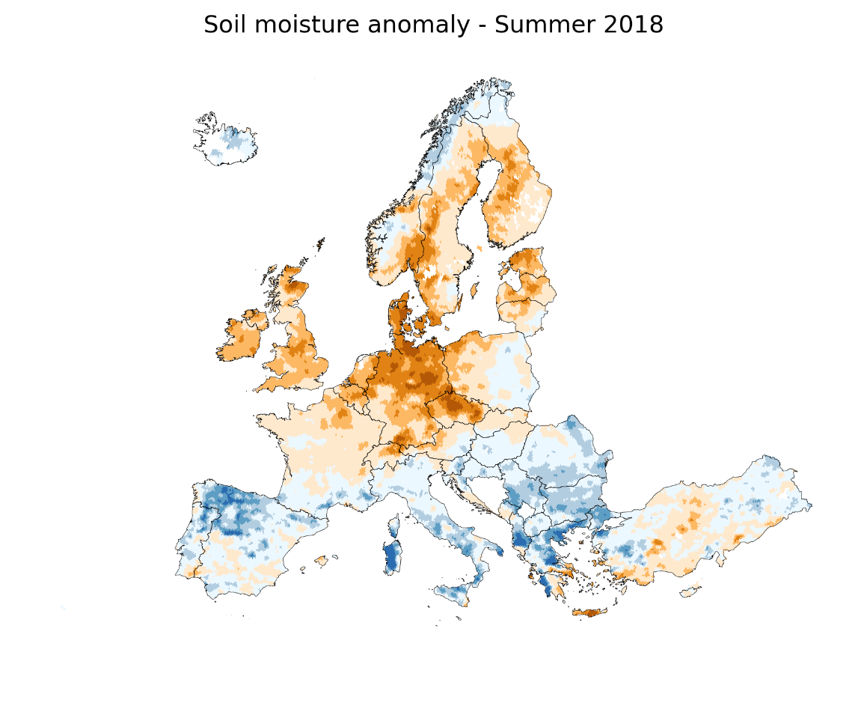
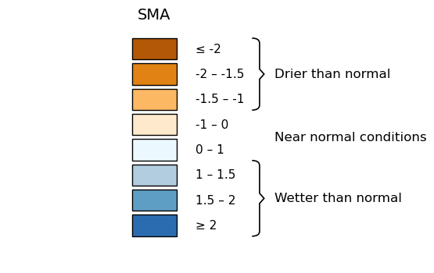
Introduction
The 2018 drought
  Mainly affected Northern and Central Europe
  Cereal yields decreased by 15-30% in the most affected countries (DE/DK/FI/SE/CZ/EE/LT)
  Beets, potato, rapeseed also affected
  Pasture productivity at record low levels
  Affected countries with low irrigation and less adaptation
Sources: JRC MARS Bulletin Vol. 26 No 8 - Crop monitoring in Europe, August 2018
EUROSTAT: Crop production in EU standard humidity

Slide 4
Subnational food trade
From MRIO to MR-IR-IO
Input data:
FABIO: Food input output model
National resolution
  ESP → FRA
115 ktons wheat

Slide 5
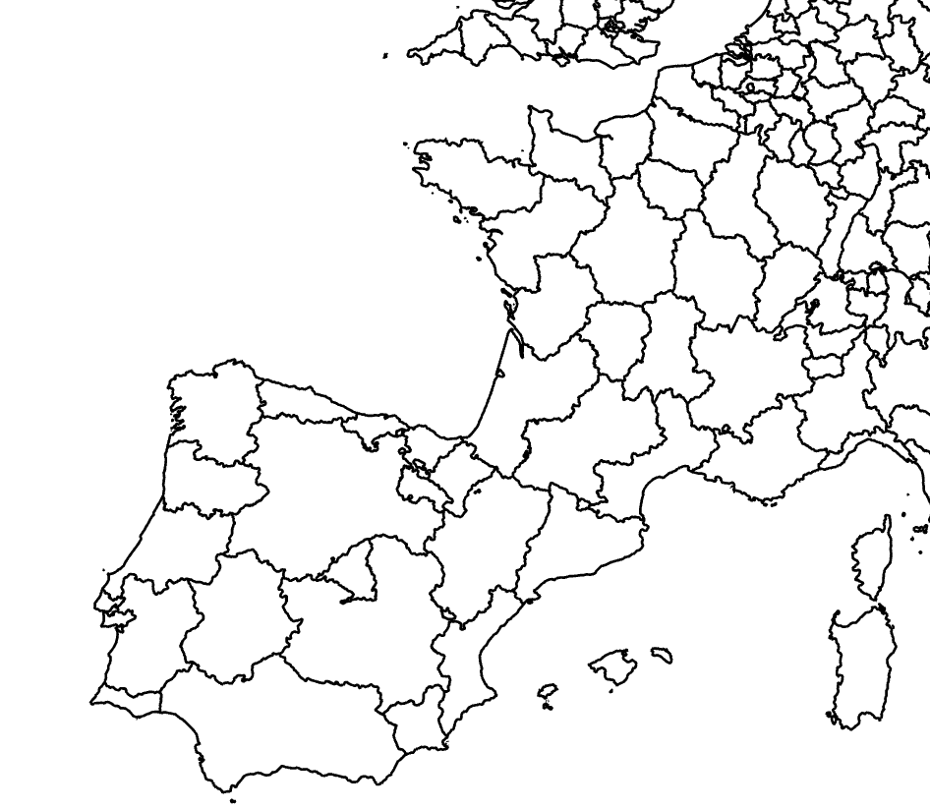
Subnational food trade
From MRIO to MR-IR-IO
Input data:
FABIO: Food input output model
Goal:
Subnational resolution (NUTS2)
  Andalusia ES61 → Poitou Charentes FRI3
??? ktons
wheat

Slide 6
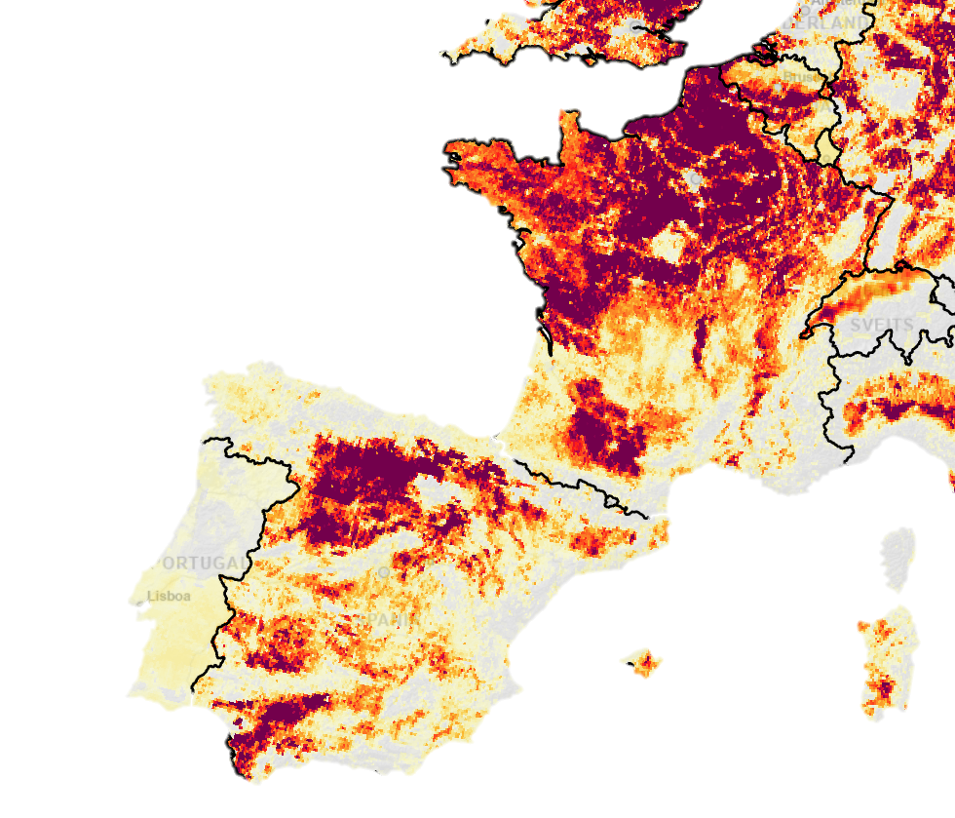
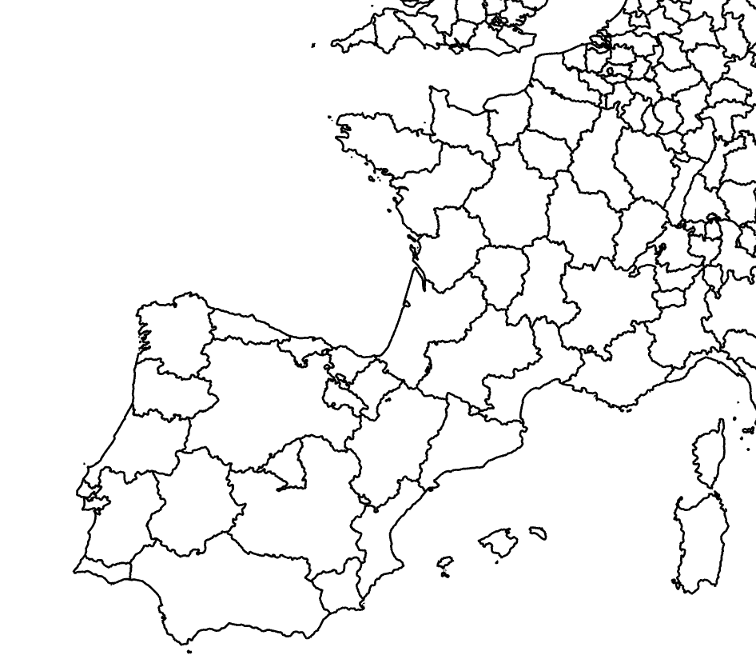
Subnational food trade
From MRIO to MR-IR-IO
Input data:
FABIO: Food input output model
MAPSPAM + CROPGRID: Production/Harvested area raster
Livestock: Eurostat live animals
ES41: 1168 ktons wheat
(18% Spanish production)

Slide 7
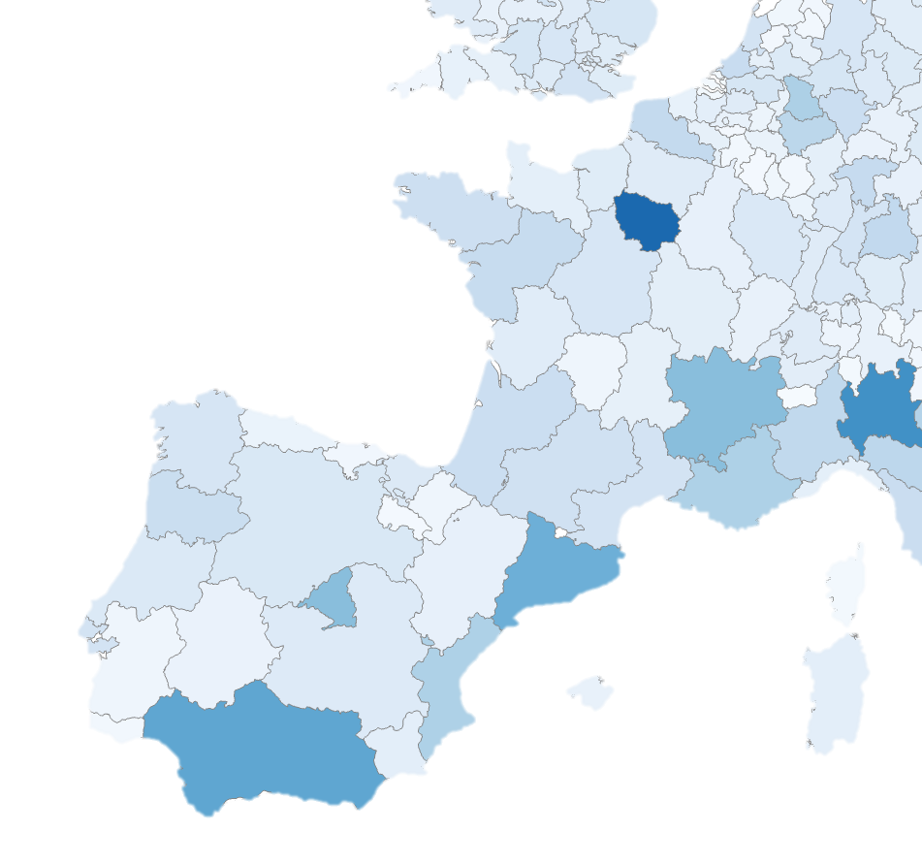
Subnational food trade
From MRIO to MR-IR-IO
Input data:
FABIO: Food input output model
MAPSPAM + CROPGRID: Production/Harvested area raster
Livestock: Eurostat live animals
Population (Eurostat)
FRI3: 8% final demand (FRA)

Slide 8
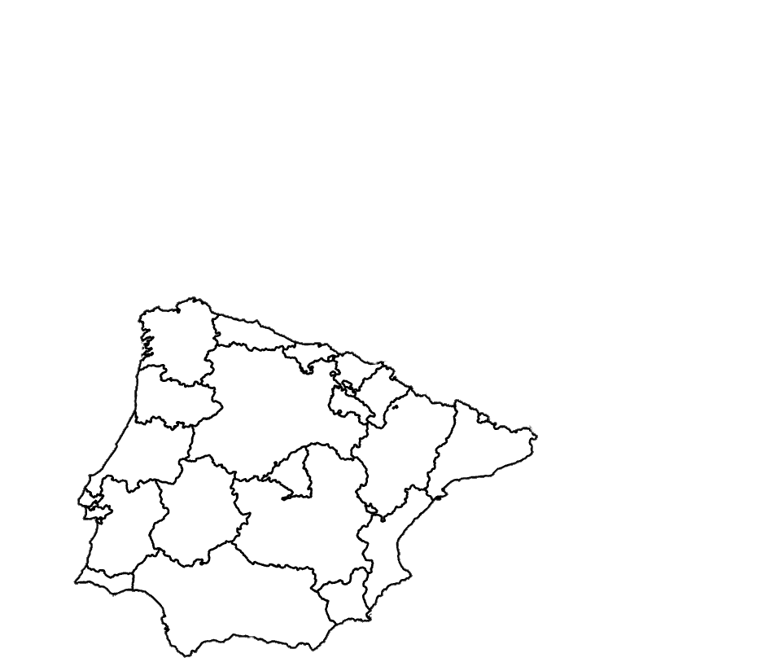
Subnational food trade
From MRIO to MR-IR-IO
Input data:
FABIO: Food input output model
MAPSPAM + CROPGRID: Production/Harvested area raster
Livestock: Eurostat live animals
Population (Eurostat)
Regional trade data (BONUS)
14.7 ktons wheat

Slide 9
Subnational food trade
From MRIO to MR-IR-IO
Input data:
FABIO: Food input output model
MAPSPAM + CROPGRID: Production/Harvested area raster
Livestock: Eurostat live animals
Population (Eurostat)
Regional trade data (BONUS)
Optimization procedure to estimate NUTS2 flows
0.6 ktons
wheat

Slide 10
Subnational food trade
 |  | FR |  | NO
 |  | A | B | A | B
FR | A | 10 | 4 | 4 | 2
 | B | … | … | … | 3
NO | A
 | B
Optimization
Multinational model
 |  |  | FR |  |  |  | NO
 |  |  | PAR |  | LYO |  | TRD |  | OSL
 |  |  | A | B | A | B | A | B | A | B
FR | PAR | A
 |  | B
 | LYO | A
 |  | B
NO | TRD | A
 |  | B
 | OSL | A
 |  | B
Interregional model

Slide 11
Subnational food trade
Optimization
Two stage optimizations
International flows: Least square deviation to prior
    Prior built from FABIO, regional trade data and regional output / demand
    Defaults as proportional to regional output / demand when missing
Ouyang, Q., Meng, J., Wang, Y., & Zheng, H. (2025). Multi-regional Input-output Dataset for the UK from 2017 to 2022. Scientific Data, 13(1), 52. https://doi.org/10.1038/s41597-025-06377-8

Slide 12
Subnational food trade
 |  | FR |  | NO
 |  | A | B | A | B
FR | A | 10 | 4 | 4 | 2
 | B | … | … | … | 3
NO | A
 | B
Optimization constraints: International
20
Constraints on exports/imports
Exports should not exceed regional output
x 0.3
x 0.7
 |  |  | FR |  |  |  | NO
 |  |  | PAR |  | LYO |  | TRD |  | OSL
 |  |  | A | B | A | B | A | B | A | B
FR | PAR | A
 |  | B
 | LYO | A
 |  | B
NO | TRD | A
 |  | B
 | OSL | A
 |  | B

Slide 13
Subnational food trade
 |  | FR |  | NO
 |  | A | B | A | B
FR | A | 10 | 4 | 4 | 2
 | B | … | … | … | 3
NO | A
 | B
Optimization constraints: International
Constraints on exports/imports
Exports should not exceed regional output
Imports should not exceed regional demand
Additional bounds to avoid all production to be exported when there is local demand / all demand to be imported when there is local production
 |  |  | FR |  |  |  | NO
 |  |  | PAR |  | LYO |  | TRD |  | OSL
 |  |  | A | B | A | B | A | B | A | B
FR | PAR | A
 |  | B
 | LYO | A
 |  | B
NO | TRD | A
 |  | B
 | OSL | A
 |  | B
x 0.4

Slide 14
Subnational food trade
 |  | FR |  | NO
 |  | A | B | A | B
FR | A | 10 | 4 | 4 | 2
 | B | … | … | … | 3
NO | A
 | B
Optimization constraints: International
Constraints on exports/imports
Exports should not exceed regional output
Imports should not exceed regional demand
Additional bounds to avoid all production to be exported when there is local demand / all demand to be imported when there is local production
Constraints on country sums to match original FABIO data (both Z and Y)
 |  |  | FR |  |  |  | NO
 |  |  | PAR |  | LYO |  | TRD |  | OSL
 |  |  | A | B | A | B | A | B | A | B
FR | PAR | A
 |  | B
 | LYO | A
 |  | B
NO | TRD | A
 |  | B
 | OSL | A
 |  | B

Slide 15
Subnational food trade
Optimization
Two stage optimizations with constraints
International flows: Least square deviation to prior
    Prior built from regional trade data
    Defaults as proportional to regional output / demand when missing
Domestic flows: CHARM + constrained gravity model
    CHARM determines the local supply and domestic supply (from other regions in the same country)
    The gravity model assigns the domestic supply to the domestic regions
    Gravity weights from FIGARO-NUTS2 for agriculture
Többen, J., & Kronenberg, T. H. (2015). CONSTRUCTION OF MULTI-REGIONAL INPUT–OUTPUT TABLES USING THE CHARM METHOD. Economic Systems Research. (world). https://doi.org/10.1080/09535314.2015.1091765

Slide 16
Subnational food trade
 |  |  | NO
 |  |  | BER |  | TRD |  | OSL
 |  |  | A | B | A | B | A | B
NO | BER | A
 |  | B
 | TRD | A
 |  | B
 | OSL | A
 |  | B
Optimization constraints
Domestic flow optimization is country by country
If we look at product A, and Bergen (BER)
CHARM assumes regional cross hauling (CH) = national CH
Provides local supply (=local demand), outputs from Bergen to rest of country, inputs from rest of country to Bergen
The gravity model is used to determine whether Oslo or Trondheim make up the outputs (and inputs) from Bergen to NOR (from NOR to Bergen).
Higher transport time BER→OSL compared to BER→TRD means flows from Oslo will be prioritized

Slide 17
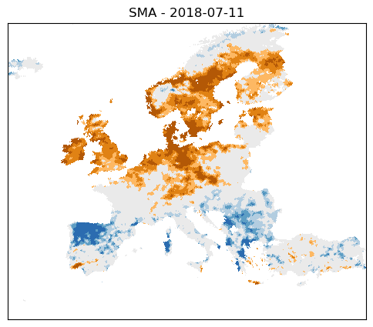
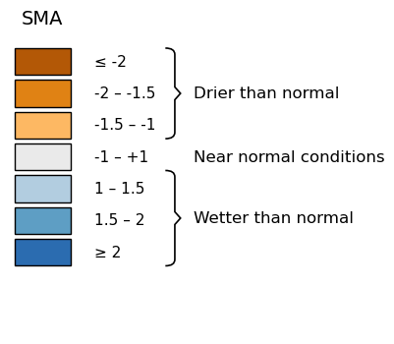
Characterizing drought
How to determine drought exposure
Sources: Drought Soil Moisture Anomalies (SMA) at 0.1deg spatial resolution derived from EUMETSAT

Slide 18

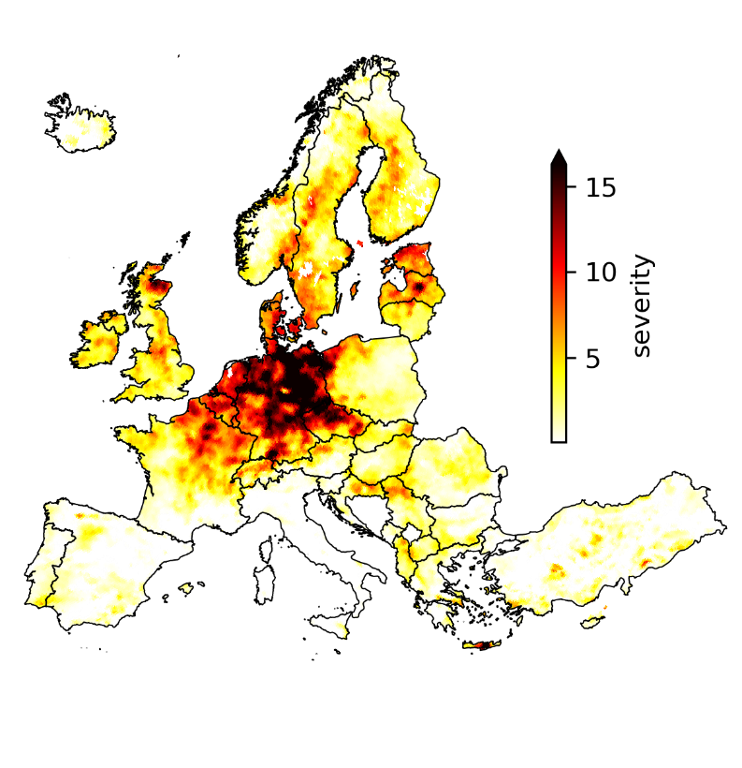

Characterizing drought
Intensity of the 2018 drought
from MetOp satellites
How to determine drought exposure
1
  Severity is defined as the total SMA accumulation during drought periods.
SMA
Observed soil moisture
Std deviation from mean
t1
duration
t2
0
Soil moisture anomaly
time
Accumulation
during drought
Drought severity in 2018
Drought severity
-1
MetOp satellite, Credit: ESA/Eumetsat
severity
Max intensity

Slide 19
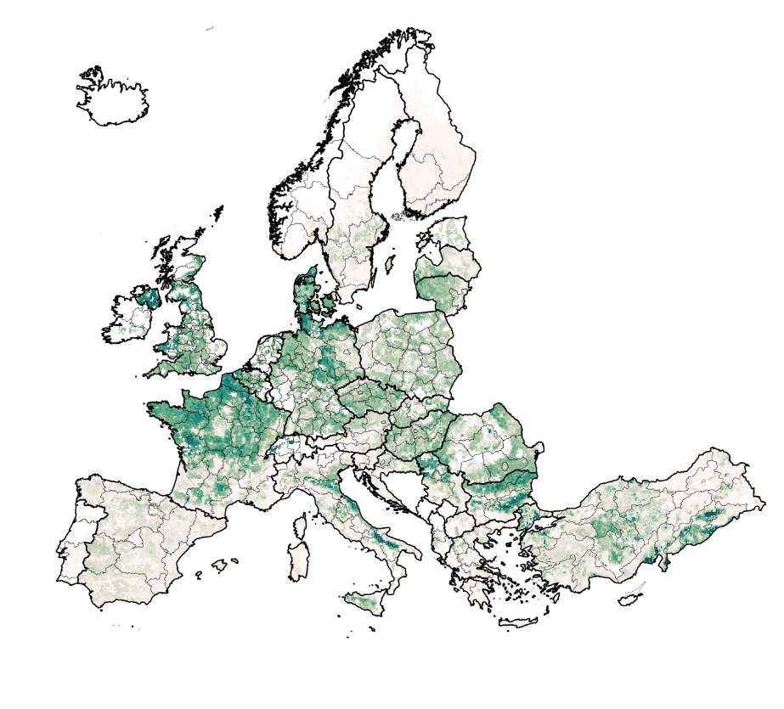


Crop exposure
Crop exposure to
drought at grid cell level
2
Defining exposure to the drought
Severity is calculated:
Cereals
Fruits & vegetables
For each rainfed crop
Fodder & grazing
Other crops
(sugar, oil, fiber)
62 crops, 4 groups
Wheat production in Europe

Slide 20
Crop exposure
Crop exposure to
drought at grid cell level
2
Defining exposure to the drought
Severity is calculated:
Cereals
Fruits & vegetables
For each rainfed crop
Fodder & grazing
Other crops
(sugar, oil, fiber)
In each pixel
62 crops, 4 groups
Wheat production in Europe

Slide 21
Crop exposure
Crop exposure to
drought at grid cell level
2
Defining exposure to the drought
Severity is calculated:
Cereals
Fruits & vegetables
For each rainfed crop
Fodder & grazing
Other crops
(sugar, oil, fiber)
In each pixel
62 crops, 4 groups
On crop growth period (GGCMI calendars)
Wheat production in Europe
Then relative exposure for a crop is defined as normalized severity

Slide 22
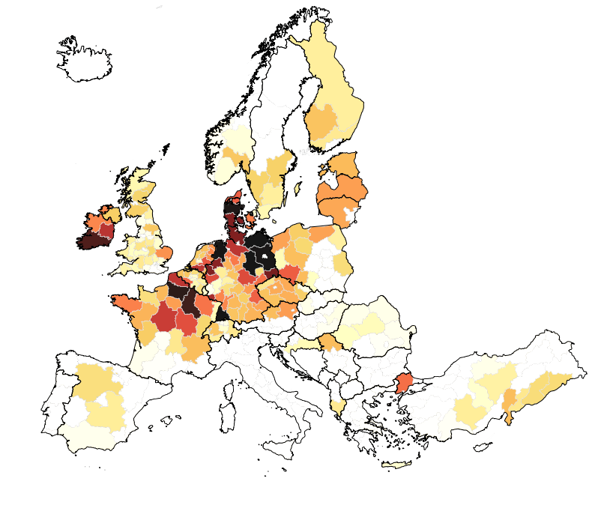


Commodity exposure
Modelling biomass trade
and supply chains
Production to consumption exposure
3
From production to consumption exposure
Using FABIO-NUTS2
Leontief inverse $L = {\left(I−A\right)}^{−1}$
“Embodied exposed crop in commodity”
Exposure is redistributed to the consumer, through trade and supply chains
fodder → cow → cheese
Crop exposure is allocated to food consumption

Slide 23
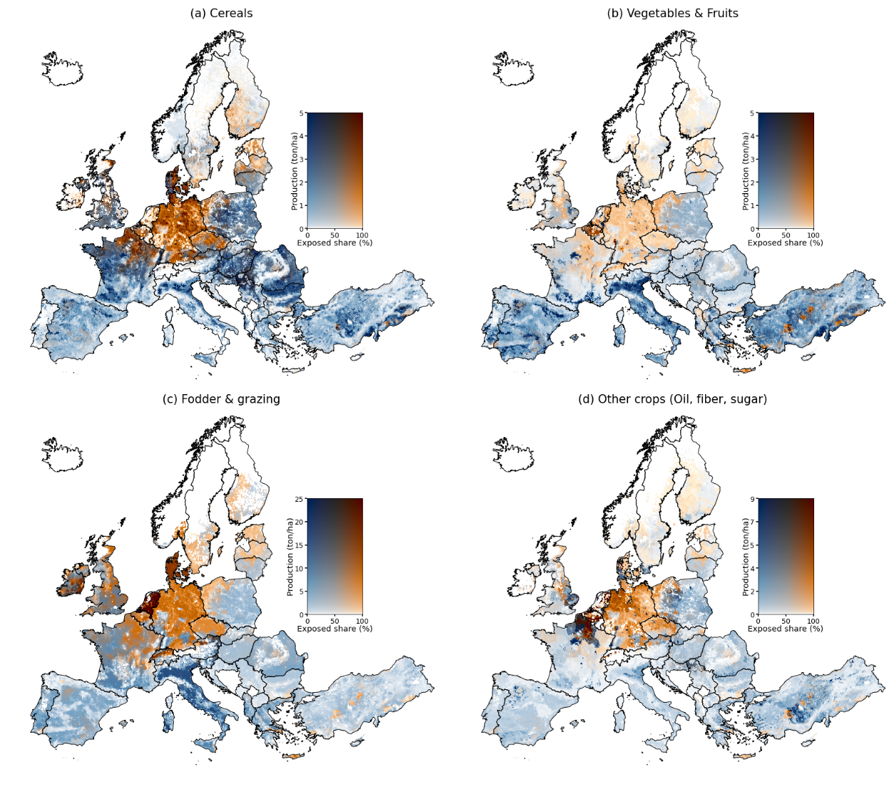
European agricultural drought exposure
Crop exposure

Slide 24
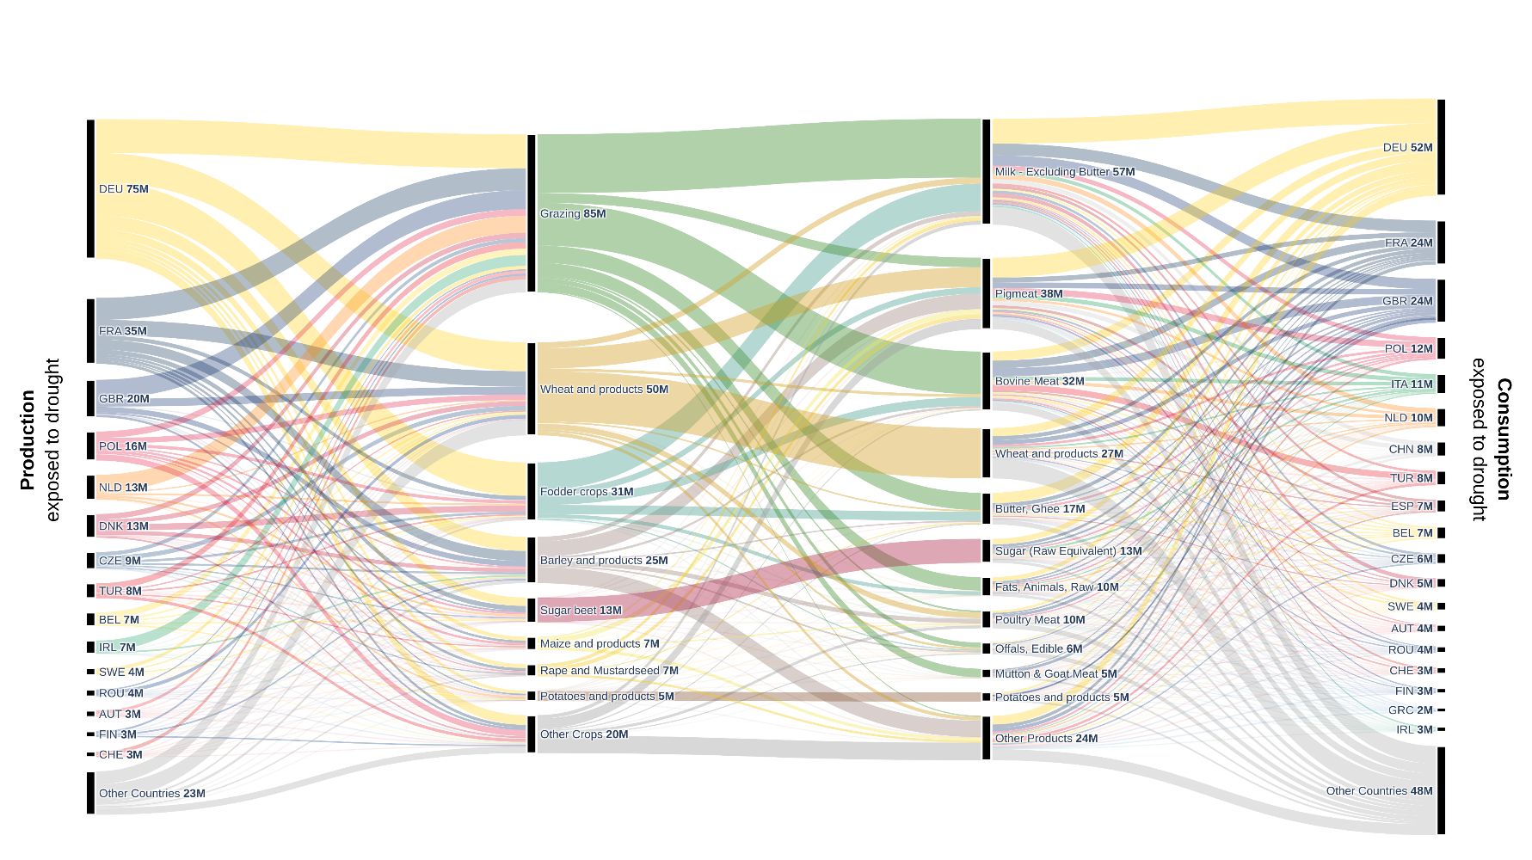
European agricultural drought exposure
From crop to commodity exposure

Slide 25
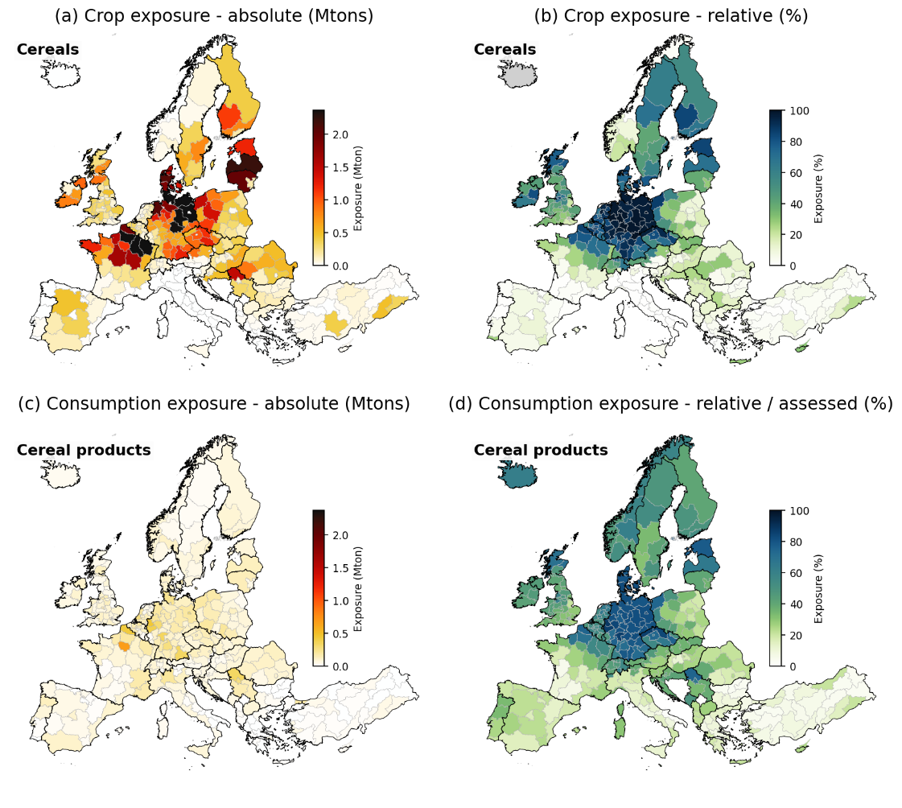
European agricultural drought exposure
Cereals and cereal products
High exposure to the 2018 drought
35% of European cereal production exposed – mostly wheat
North-East France and Northern Germany
Rye: 63%, Maize: 13%
Drought exposure propagates through supply chains to non-exposed countries (ES/IT/PT/IS)
Notes:
e.g. wheat in Italy → nearly 0% exposed
Wheat products – 10-40% exposed

Slide 26
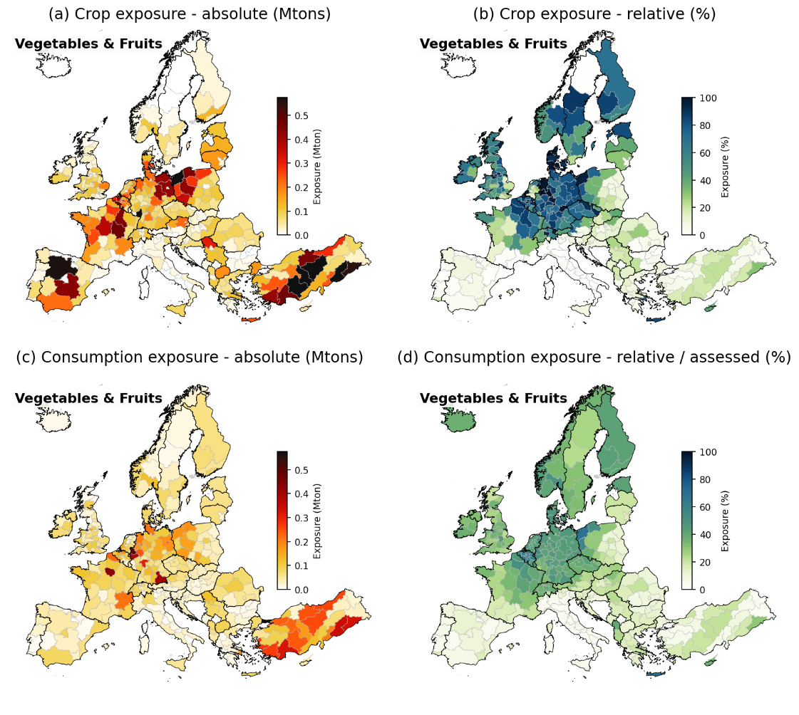
European agricultural drought exposure
Fruits and vegetables
Lower exposure than for cereals
17% of European cereal production exposed
East Germany + Poland + Turkey
Apples and Grapes largest
Less redistribution of drought exposure
Notes:
More local consumption + shorter supply chains
BUT less storage / inventory effect -> higher price effect?

Slide 27
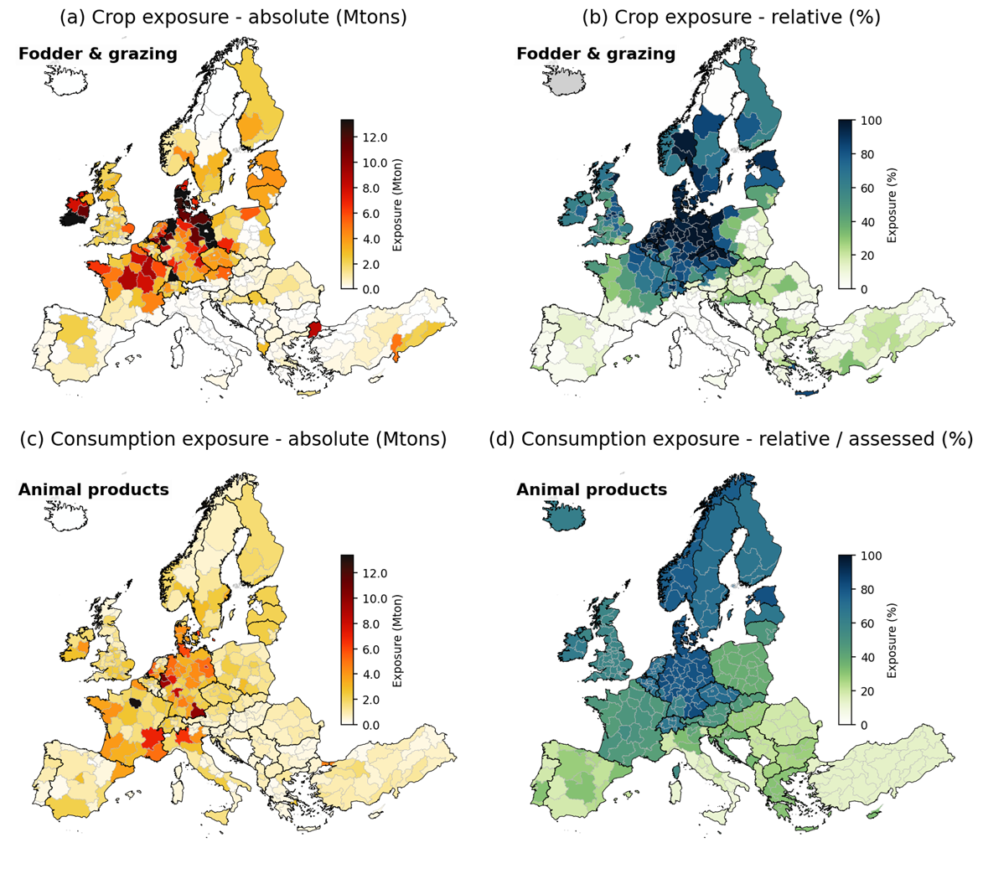
European agricultural drought exposure
Fodder crops, grazing and animal products
Very high exposure to the 2018 drought
48% of pasture and 44% of fodder crops
Denmark, Ireland and Northern Germany
Translates into high exposure for dairy products and bovine meat
Animals can also be directly impacted! (heat stress + water availability)

Slide 28
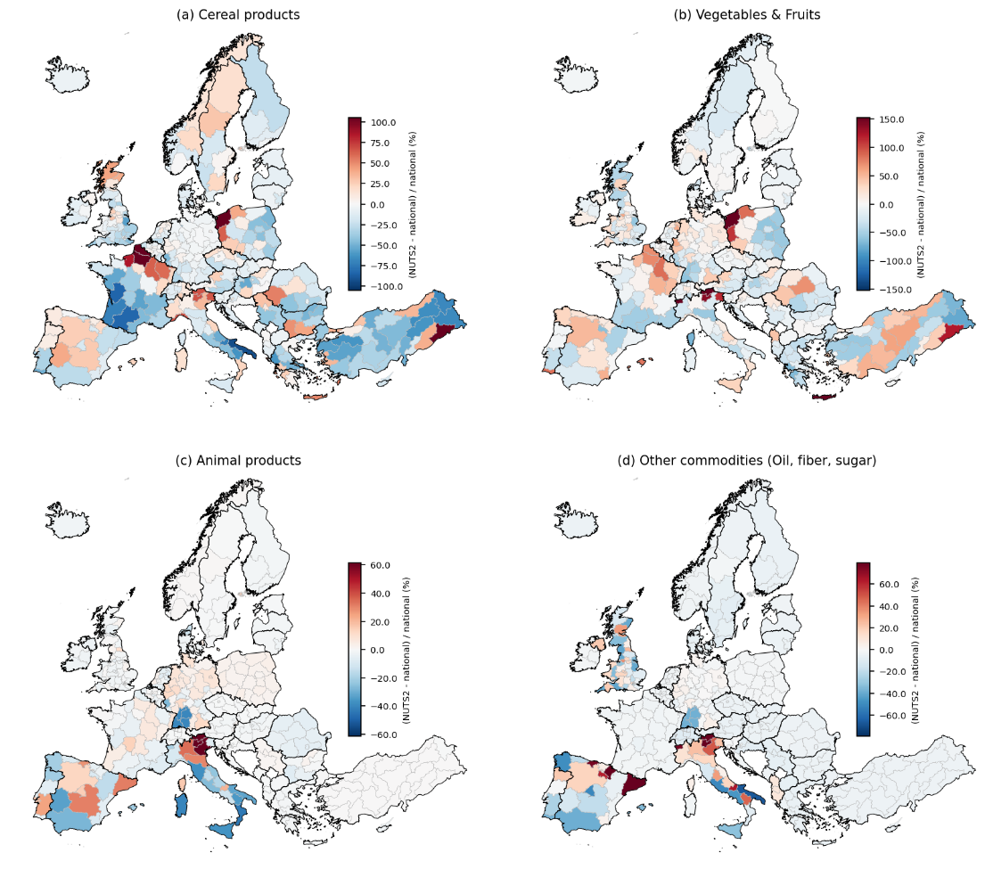
European agricultural drought exposure
National versus NUTS2
Marked difference in consumption exposure between models
Strongest in large countries only partly affected by the drought (FR/PL)
Strongest for cereals and veg & fruits
National model → homogenize risk
NUTS2 model → Fake sense of precision?

Slide 29
Subnational food trade
Limitations
Drought: Definition of the drought and drought exposure

Slide 30
Subnational food trade
Limitations
Drought: Definition of the drought and drought exposure
IO:
Model assumptions
Uncertainty → optimization procedure + FABIO (& FAO) uncertainty
Lack of subnational trade data

Slide 31
Subnational food trade
Limitations
Drought: Definition of the drought and drought exposure
IO:
Model assumptions
Uncertainty → optimization procedure + FABIO (& FAO) uncertainty
Lack of subnational trade data
Food:
Exposure versus impact
  How do droughts impact yield
  What happens in case of decreased production (prices, …)
  How does that impact consumption (inventories, substitution…)

Slide 32
Questions, reflections?

Slide 33
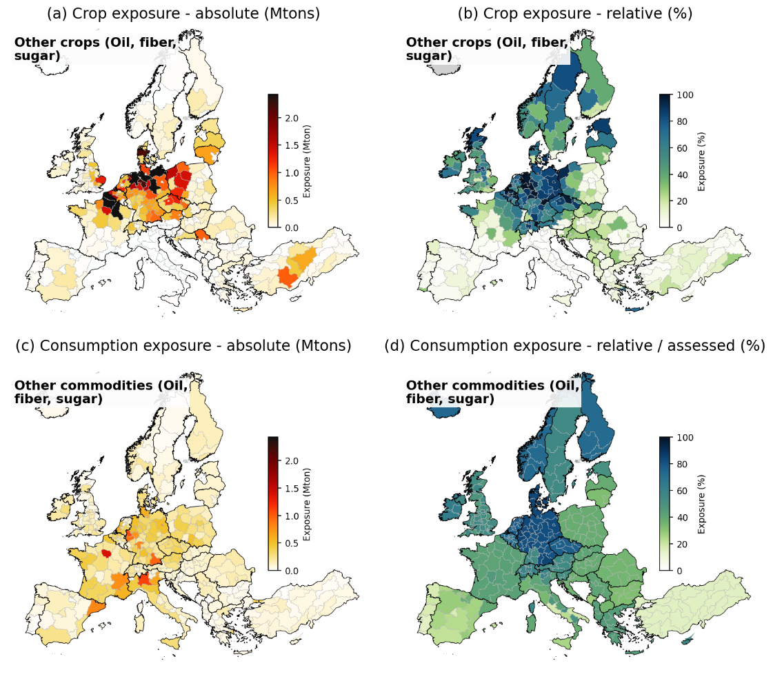

European agricultural drought exposure
Oil, sugar and fiber crops
High exposure to the 2018 drought – spatially concentrated
Sugar beet (68 Mtons, 49% exposed), potato (29 Mtons , 46%) and rapeseed (11 Mtons, 57%)
North-East France and Northern Germany
Strong propagation – global supply chains with concentrated production

Slide 34
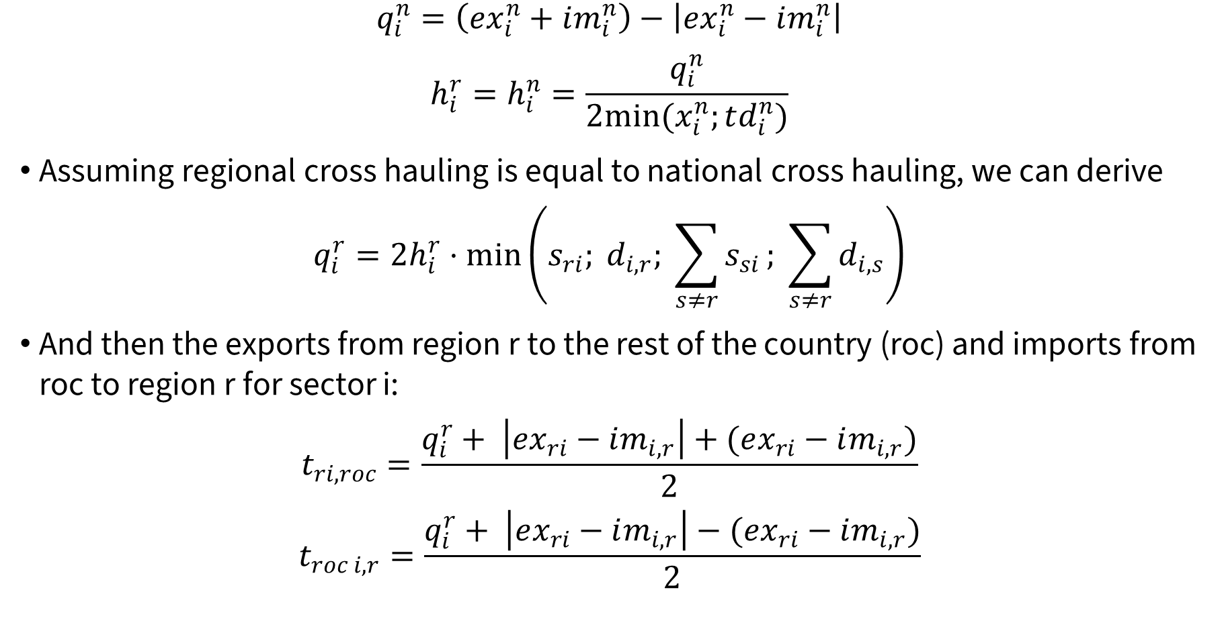
CHARM
$$\begin{aligned}q_{i}^{n}=\left(ex_{i}^{n}+im_{i}^{n}\right)−\left|ex_{i}^{n}−im_{i}^{n}\right|\end{aligned}$$
$$\begin{aligned}h_{i}^{r}=h_{i}^{n}=\frac{q_{i}^{n}}{2min⁡(x_{i}^{n};td_{i}^{n})}\end{aligned}$$
Assuming regional cross hauling is equal to national cross hauling, we can derive
$$\begin{aligned}q_{i}^{r}=2h_{i}^{r}⋅\min\left(s_{ri}; d_{i,r}; \sum_{s≠r}{s_{si}}; \sum_{s≠r}{d_{i, s}}\right)\end{aligned}$$
And then the exports from region r to the rest of the country (roc) and imports from roc to region r for sector i:
$$\begin{aligned}t_{ri, roc}=\frac{q_{i}^{r}+ \left|ex_{ri}−im_{i,r}\right|+(ex_{ri}−im_{i,r})}{2}\end{aligned}$$
$$\begin{aligned}t_{roc i, r}=\frac{q_{i}^{r}+ \left|ex_{ri}−im_{i,r}\right|−(ex_{ri}−im_{i,r})}{2}\end{aligned}$$

