Slide 1


Artificial Intelligence (AI)
Measuring Potential Impacts on the Labour Market. The case of Germany
Presentation at the 32nd International Input-Output Association Conference (IIOA)
Sevilla, June 25, 2026
Presenter: Anke Mönnig
Joint work of the qube-projekt:

Slide 2
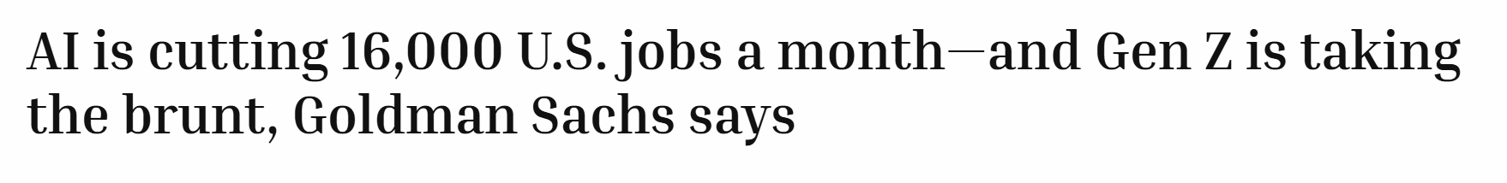
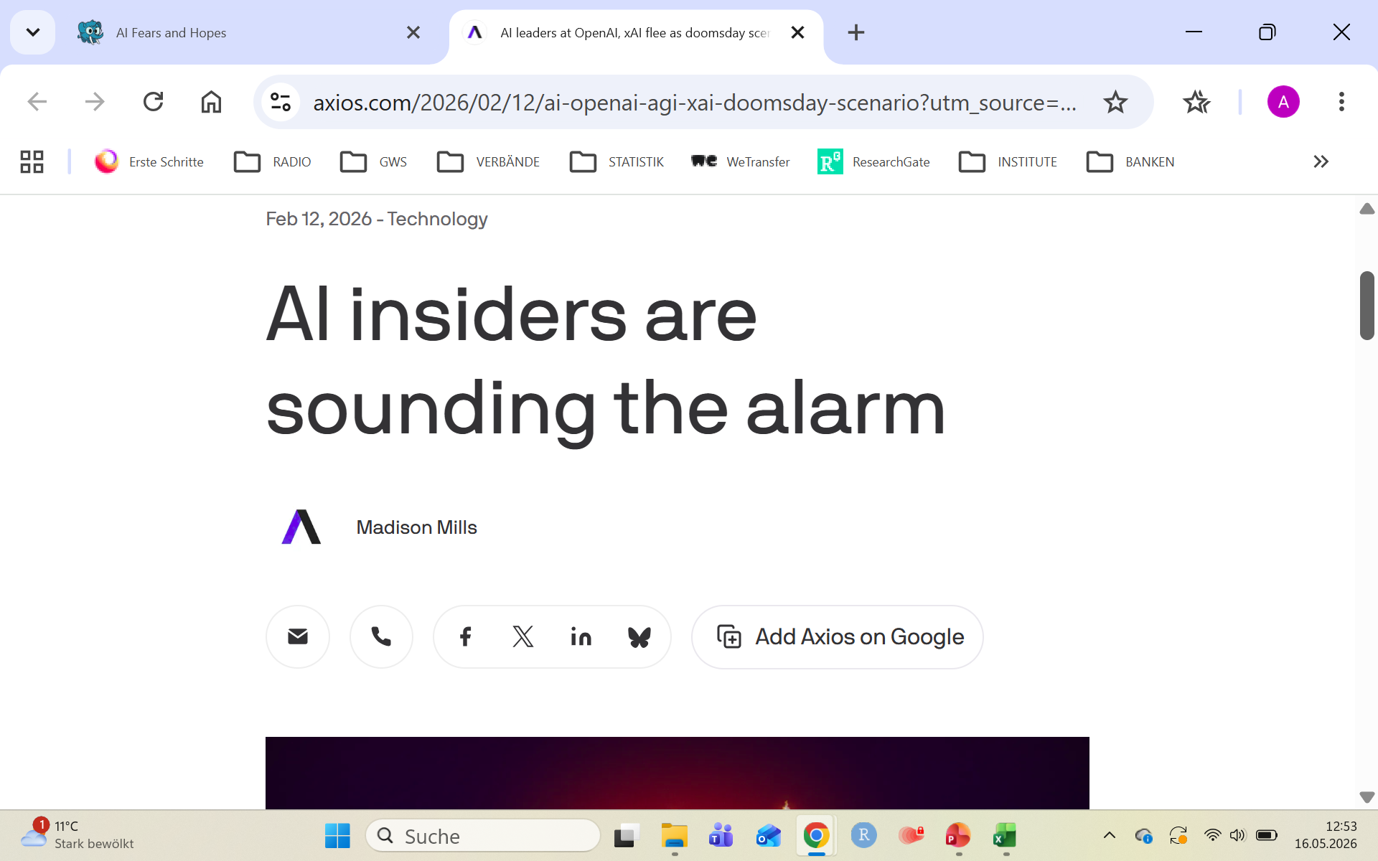
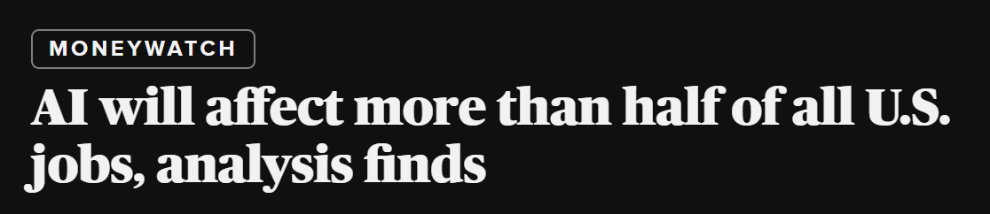
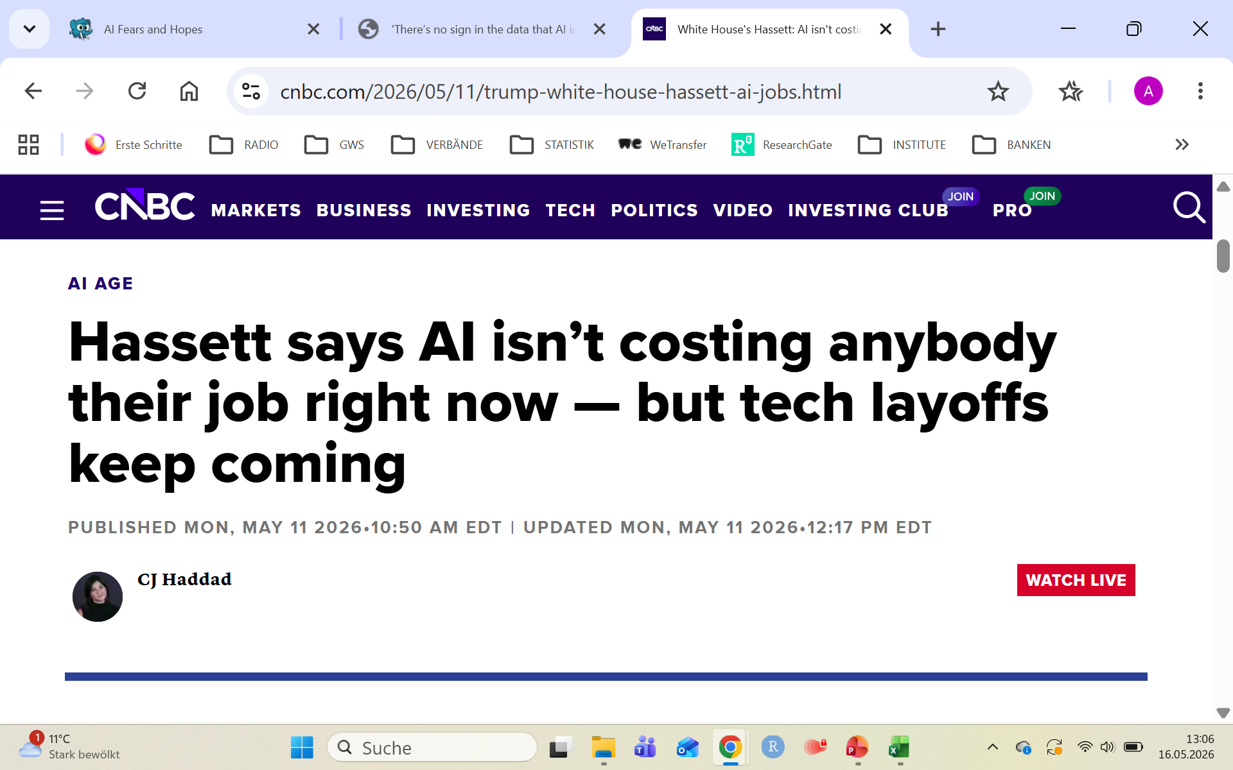
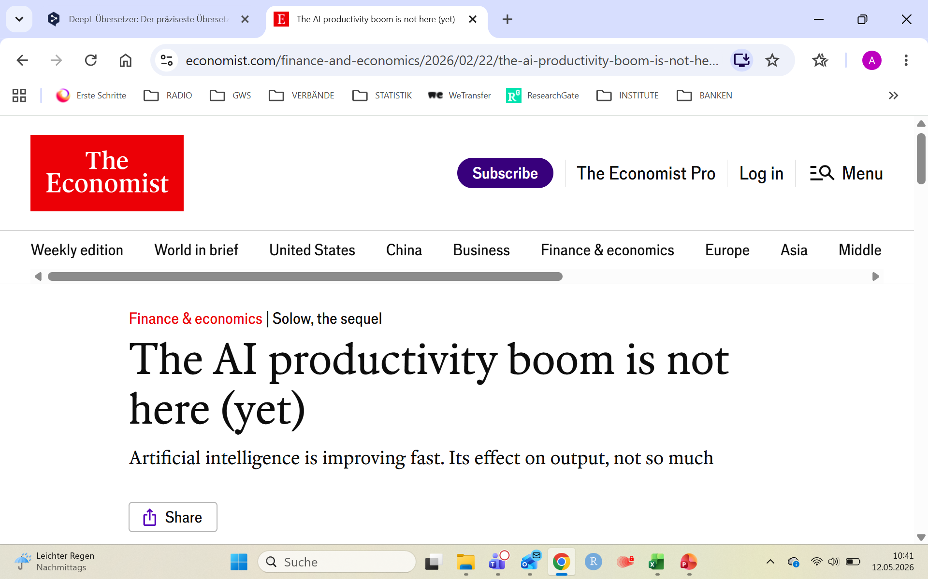
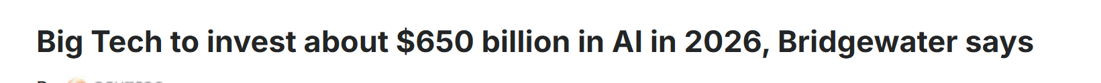
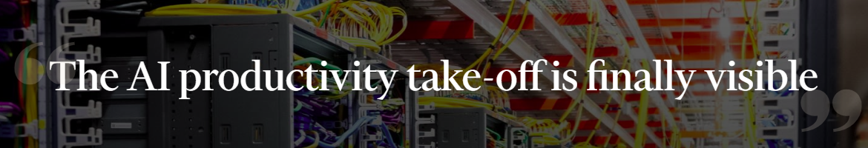
1 | Background
fortune.com, 6.4.2026
CBS NEWS, 7.4.2026
Axios.com, 12.2.2026
The Economist, 22.2.2026
CNBC, 11.5.2026
Investing.com, 23.2.2026
Financial Times, 14.2.2026

Slide 3
1 | Background
Artificial Intelligence is part of the digitalisation process
It is one of many technologies, that drive digitalisation:
  Digital platforms
  Internet of things
  Robotic
  Cloud Computing
  Blockchain
  Artificial Intelligence
These technologies
are designed to
modernize and
optimize the data
infrastructure in
companies.
Requires high
computing power,
availability of
large amounts of
data, new
algorithms
Efficient storage,
processing, and
analysis of large
amounts of data

Slide 4
1 | Background
Since 2019, AI has been a priority in European industrial policy
EU AI Act – becomes active in 2026. First of its kind in the world to provide a comprehensive regulation of AI.
Upcoming: Cloud and AI Development Act – strengthening of European Cloud- and AI-souverenity

Slide 5
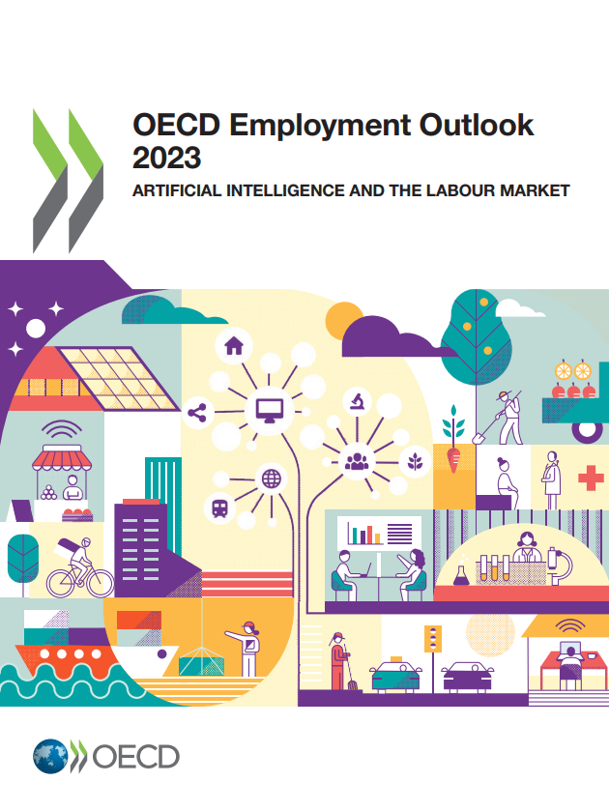
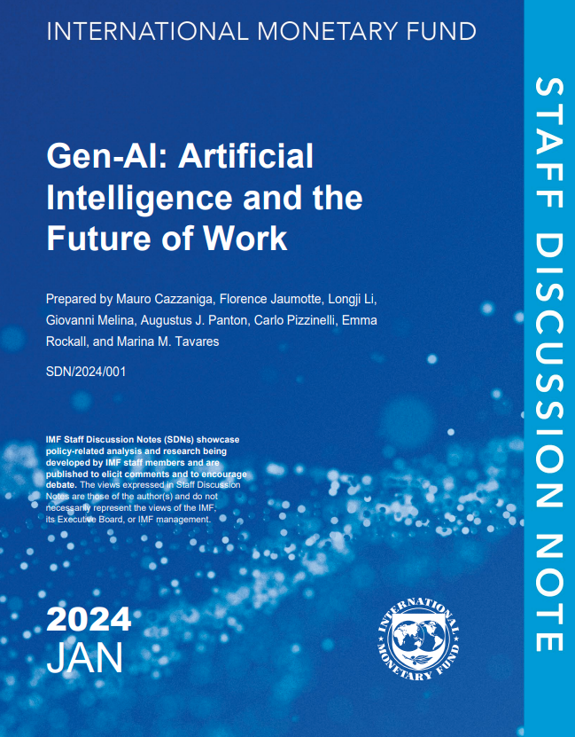
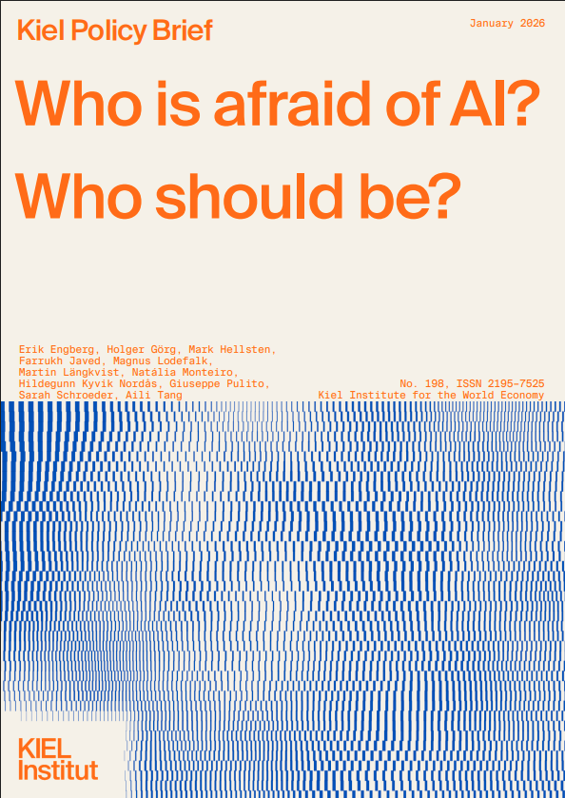
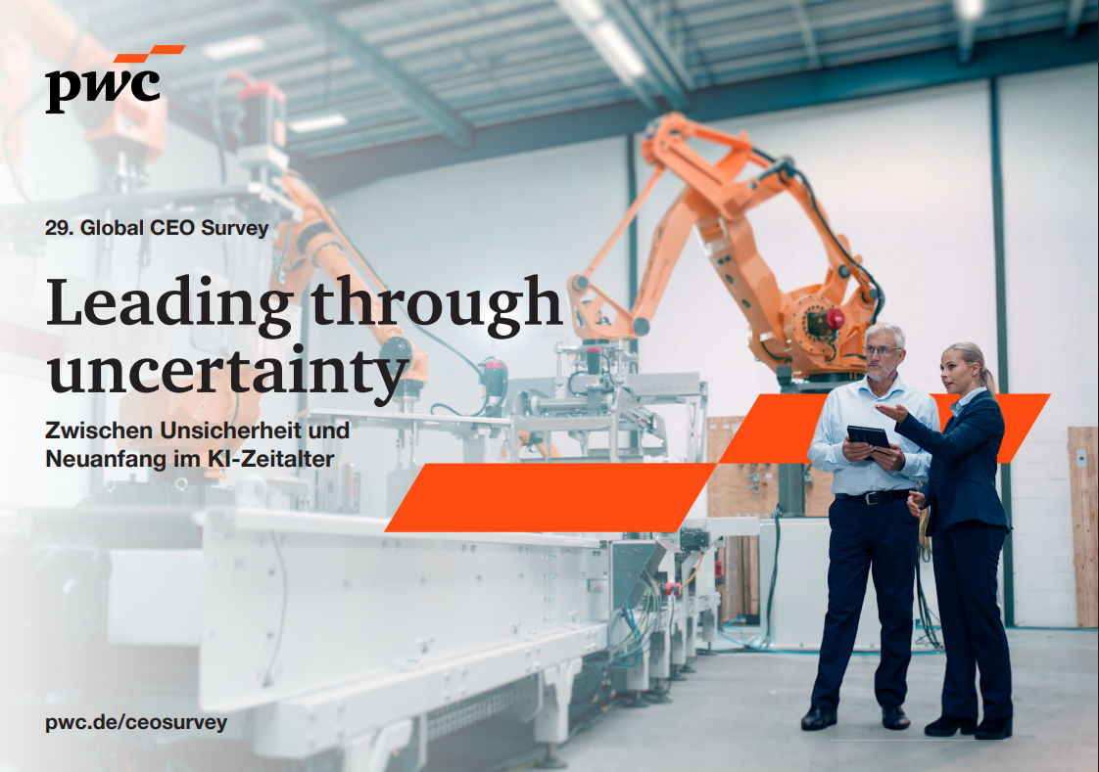
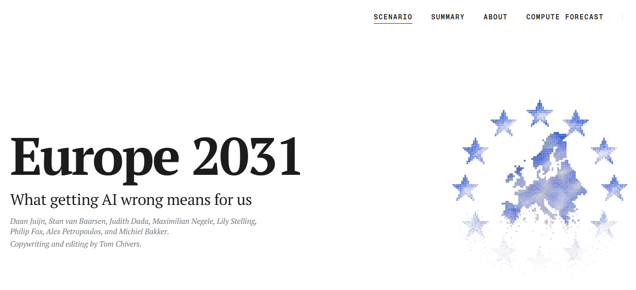
1 | Background
OECD (2023): There is a high degree of uncertainty regarding the future impact on the labor market. AI significantly expands the scope of tasks that can be automated beyond routine, non-cognitive tasks. AI is a general-purpose technology that affects nearly every sector and occupation.
IMF (2024): 60% of jobs will change. 50% could benefit from AI, while the rest would be eliminated by automation.
IWK (2026): White-collar jobs, in particular, are heavily affected by AI. No impact on overall employment.
PWC (2026): Globally, most companies (56%) do not see any benefits from AI. 12% have so far successfully reduced costs and increased revenue. A genuine business case has been rare so far. CEOs expect AI to lead to a decline in the workforce, particularly in entry-level positions.
Europe 2031 (2026): What if Europe misses the AI revolution? Unemployment, declining industry,
geopolitical irrelevance
Uncertainty makes economic research
and AI monitoring particularly relevant
Notes:
OECD (2023) Employment Outlook 2023. Artificial Intelligence and the labour market.
IMF (2024) Gen-AI: Artificial Intelligence and the Future of Work. Staff Discussion Note
IWK (2026) Who is afraid of AI? Who should be? Kiel Policy Brief
PWC (2026) Zwischen KI-Hoffnung und Cyberangst- wie deutsche CEOs Erfolg neu erfinden. 29. Global CEO Survey
CitriniResearch (2026) The Consequences of Abundant Intelligence. https://www.citriniresearch.com/p/2028gic

Slide 6
2 | AI in Germany
Total data center capacity in Germany amounts to 3000 MW
AI data centers account for 15 percent of the total capacity installed in Germany
Source: BITKOM

Slide 7
2 | AI in Germany
How many of you are using Artificial Intelligence in your company?

Slide 8
2| AI in Germany
26% of German enterprises are currently working with AI
Germany lags behind in AI diffusion
8th place in the EU
Source: DESTATIS

Slide 9
2| AI in Germany
It is mainly large companies with more than 250 employees that are heavy users of AI
SME are more cautious in AI.
But SME are backbone of German economy
Average
Source: DESTATIS

Slide 10
2| AI in Germany
It is the knowledge-based industry in the service sectors that currently apply AI technology
Traditional industrial sectors show limited AI application
Average
Source: DESTATIS

Slide 11
2| AI in Germany
It is mainly generative AI technology that is used.
Production based AI technology is not yet widely applied
Source: DESTATIS

Slide 12
2| AI in Germany
The majority of enterprises do not yet use AI
  due to lack of relevant knowledge,
  unclear legal consequences and
  due to privacy concerns
Source: DESTATIS

Slide 13
2| AI in Germany
AI research in Germany is world-class
  Germany leads all other European country in the number of AI patents.
Germany ranks third (by country) behind the U.S. and China, according to the Critical and Emerging Technologies Index 2025
 | Algorithm | Computing Power | Data | Economic Resources | Global Player | Human Capital | Regulatory | Accuracy of top models | TOTAL
United States | 15 | 15 | 8.7 | 20 | 2.5 | 17.1 | 2.5 | 10 | 90.8
China | 3.7 | 9.8 | 15 | 7.5 | 0.7 | 20 | 0.3 | 1.1 | 58
Germany | 1.2 | 3.4 | 8 | 0.8 | 1.3 | 3.6 | 0.3 | 0.3 | 18.9
United Kingdom | 1 | 1.4 | 7.4 | 1.1 | 2.1 | 5 | 0.9 | 0 | 18.9
France | 2 | 2.1 | 8.6 | 0.7 | 1.1 | 2 | 0.8 | 1.1 | 18.5
Source: Belfer Center (2025) Critical and Emerging Technologies Index 2025: Germany Report

Slide 14
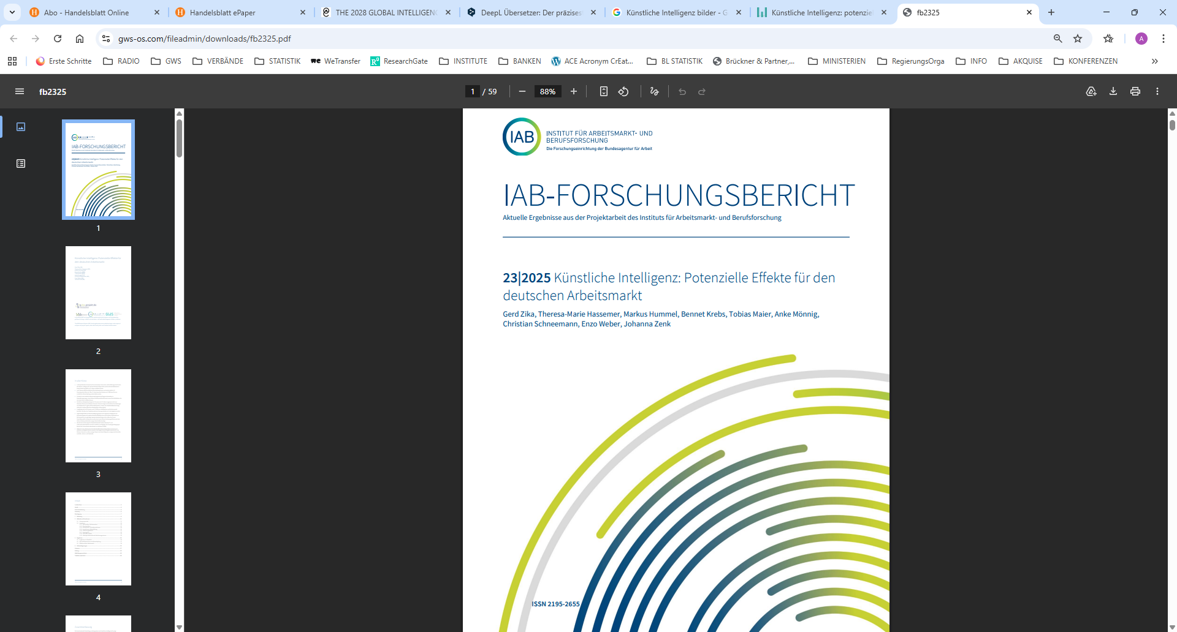


3 | Methodology
What if …
Germany manages to close the
transfer gap and participate
in the global AI boom?
What are the effects on the
German economy and
labour market?
And how can the
transfer gap be closed?
Scientific excellency
and data availability
Slow in AI market
penetration

Slide 15
3 | Methodology
Mixed Method Approach
Econometric model
(INFORUM-type)
called QINFORGE
quantitative approach
What-if-scenario
based on econometric
model
quantitative approach
Policy recommendation
based on scenario
outcome
qualitative approach

Slide 16

3| Methodology
Econometric estimations
-type of econometric model QINFORGE
Assumption
Econometrics
Features
Bounded rationality
Imperfect markets
Endogenous prices
Path dependency
Bottom-up
Total integration
Dynamic and structural model
Chronological time
Forecasts, projections, what-if-analysis
Purpose
offical data from German Statistical Office; low aggregation level
Data

Slide 17
3 | Methodology
What-if-analysis: Comparison of two scenarios
Difference
to baseline
past
today
next 15 years

Slide 18
3| Methodology
Policy recommendation
  The question of HOW – the Action Area Matrix
  Connecting scenario assumptions with recommendation for action
    First step: relationship between assumptions, measures
    Second step: relationship between measures and acceptance assessment.
Do measures
cost money?
Who has to
become active?
Is there a time
sequence ?
Scenario
assumptions
Measures that
adress assumptions
Acceptance assessment

Slide 19
4 | Setting the Scene
4 phases of the AI cycle
Data centers
Computing
power
Big models
Application
  Speed
  (how fast)
  Intensity
  (how deep)
  Each:
  Slow
  Moderate
  Fast
  Very fast
  Data centers
  Construction
  Operation
  (Electricity,
  water)
  Preperation
  Data, software,
  hardware
  Qualification
  of employees
  Efficiency
  Productivity
  New business
  models
  Skill level
  Import prices
Industry level
Infrastructure
Investment
Impact

Slide 20
4 | Setting the Scene
By 63 industries – AI classification
NACE | 14 Industries - MODERATE
84 | Public administration
85 | Education
86 | Health care
 | …
NACE | 11 Industries – VERY FAST
61 | Telecommunication
62-63 | IT services
64 | Finance services
65 | Insurances
 | …
NACE | 6 Industries - SLOW
41-43 | Construction
55-56 | Hospitality
 | …
NACE | 12 Industries - FAST
28 | Machine industry
47 | Retail
69-70 | Consultancy industry
71 | Engineering services
 | …
NACE | 20 Industries - NO
2 | Forestry
22 | Repair and installation of machinery and equipment
 | …
This sectoral differentiation forms the basis for our simulation, as it determines
when and to what extent individual economic sectors are affected by AI adoption

Slide 21
5 | Results on the German labour market
Cumulative total after 15 years: +4.5 trillion euros
Over the next 15 years, 33,000 jobs will be lost
Source: Zika et al. 2025

Slide 22
5 | Results on the German labour market
Source: Zika et al. 2025

Slide 23
5 | Results on the German labour market
+0,8 %-points p.a.
Source: Zika et al. 2025

Slide 24
5 | Results on the German labour market
Over the next 15 years, 33,000 jobs will be lost
Source: Zika et al. 2025

Slide 25
5 | Results on the German labour market
Over the next 15 years, 33,000 jobs will be lost
Source: Zika et al. 2025

Slide 26
5 | Results on the German labour market
Over the next 15 years, 33,000 jobs will be lost
Source: Zika et al. 2025

Slide 27
5 | Results on the German labour market
Over the next 15 years, 33,000 jobs will be lost
+1000
-1000
Source: Zika et al. 2025

Slide 28
5 | Results on the German labour market
Source: Zika et al. 2025

Slide 29
5 | Results on the German labour market
Source: Zika et al. 2025

Slide 30
5| Summary of results
1.
Significant gains in value creation
2.
Cost reduction, increased productivity, and higher revenue are possible
3.
Germany as a target market for productivity-focused AI solutions
4.
Minor impact on overall employment
6.
Jobs are being eliminated, but new ones are being created
7.
Cognitive tasks, in particular, are becoming replaceable
8.
If applied correctly, AI is not destructive
9.
Success depends on the potential to generate new business models
5.
Structural changes in the labor market will accelerate

Slide 31
5| Summary of results
1.
Significant gains in value creation
2.
Cost reduction, increased productivity, and higher revenue are possible
3.
Germany as a target market for productivity-focused AI solutions
4.
Minor impact on overall employment
6.
Jobs are being eliminated, but new ones are being created
7.
Cognitive tasks, in particular, are becoming replaceable
8.
If applied correctly, AI is not destructive
9.
Success depends on the potential to generate new business models
5.
Structural changes in the labor market will accelerate

Slide 32
5| Summary of results
1.
Significant gains in value creation
2.
Cost reduction, increased productivity, and higher revenue are possible
3.
Germany as a target market for productivity-focused AI solutions
4.
Minor impact on overall employment
6.
Jobs are being eliminated, but new ones are being created
7.
Cognitive tasks, in particular, are becoming replaceable
8.
If applied correctly, AI is not destructive
9.
Success depends on the potential to generate new business models
5.
Structural changes in the labor market will accelerate

Slide 33
6 | Recommendation for Action
Certain conditions muste be met that AI becomes such a success story

Slide 34
6 | Recommendation for Action
Certain conditions muste be met that AI becomes such a success story
1. Strengthening Digital Infrastructure
Grant Programs , Removal of regulatory barriers
2. Promoting Innovation and Entrepreneurship
Innovation Fund, access to venture capital through tax regulation
Politics, business
Politics, business, science
3. Empowering businesses to adopt AI
Business, politics
SME; internal AI roadmaps, investments in AI tools

Slide 35
6 | Recommendation for Action
Certain conditions muste be met that AI becomes such a success story
1. Strengthening Digital Infrastructure
Grant Programs , Removal of regulatory barriers
2. Promoting Innovation and Entrepreneurship
Innovation Fund, access to venture capital through tax regulation
Politics, business
Politics, business, science
3. Empowering businesses to adopt AI
Business, politics
SME; internal AI roadmaps, investments in AI tools
4. Realizing productivity and efficiency gains
Use of AI technology, AI pilot projects
Business, politics
5. Measuring Impact and Scalability
Analysis and Evaluation
Business, politics
6. Governance, Data Rooms, and Building Trust
Certification and Standardization
Politics

Slide 36
7 | Conclusion
Closing the transfer gap is crucial to benefit from AI
  Companies must adopt AI and implement it quickly → more courage
  Policymakers can establish the framework → serious support
  Digital sovereignty → European focus
If new business models cannot be harvest → distructive impacts possible
Our task is to monitor and observe → new opportunities, new risks?

Slide 37



Thank you for your attention!
Anke Mönnig
T +49 541 40933-210
E moennig@gws-os.com
Deputy head of division
Economic and Social Affaires
H www.gws-os.com

Slide 38
Back-up: Setting the Scene
Six basic assumptions for the AI role-out
According to industry specific speed and intensity of AI role-out
1| Data centers
    Construction
    Operation
2| Investments
    Data collection,
    software, hardware
    Qualification
3| Import prices
    Germany is not
    AI-First-Mover
    Import prices react
    as export prices
4| Efficiency
    Optimizing the Use
    of Intermediate Inputs
    Products & Services
5| New business
models
    Increase of demand
    Export, consumption,
    intermediates
6| Productivity
    Increase in sectoral
    productivity
    Impact on skill level
Notes:
Unsere Simulation beruht auf sechs zentralen Annahmen, die den Verlauf des KI‑Rollouts entlang der Zeitachse bestimmen.
Erstens gehen wir von einem fortgesetzten Ausbau der Rechenzentrumskapazitäten aus, die Deutschland in die Lage versetzen, nationale KI‑Modelle zu trainieren und zu hosten.
Zweitens werden erhebliche Investitionen in Datenerhebung, Software, Hardware sowie in die Qualifizierung der Beschäftigten unterstellt. Ohne diese flankierenden Maßnahmen bleibt der produktive Nutzen begrenzt.
Drittens wird angenommen, dass sich Importpreise an internationale Entwicklungen anpassen. Deutschland ist kein First‑Mover, daher werden neue KI‑Produkte zunächst überwiegend importiert, ehe heimische Anbieter Marktanteile gewinnen.
Viertens entstehen Effizienzgewinne durch die optimierte Nutzung von Zwischenprodukten und Dienstleistungen. KI trägt dazu bei, Prozesse datenbasiert zu steuern und Ressourceneinsatz zu reduzieren.
Fünftens wird mit einem Anstieg neuer Geschäftsmodelle und zusätzlicher Nachfrage gerechnet – sowohl im Export, in der Konsumgüternachfrage als auch bei unternehmensinternen Services.
Schließlich, sechstens, führen diese Mechanismen zu einem sektoralen Produktivitätswachstum, das sich differenziert nach Qualifikationsniveaus auswirkt: hochqualifizierte Arbeitskräfte profitieren stärker, während Routinetätigkeiten stärker automatisiert werden.
Diese Annahmen bilden den theoretischen Rahmen, innerhalb dessen wir im nächsten Teil die konkreten quantitativen Ergebnisse aufzeigen.
Data centers
2040: 15000 MW of AI capacity
€200 billion in cumulative investments
Investments
By 2040, additional investments will amount to no more than 10%
Efficiency
By 2040, a maximum of 15% of intermediate inputs will be saved
Source ranges between 30% and 9%.
New business models
By 2040, additional demand will reach a maximum of 25%
No source. Financing of investments and new turnovers with and because of AI technology
Productivity
By 2040, additional demand will reach a maximum of 25%
Source: Kerkhof u. a., 2024; Rampelt u. a., 2025
From a macroeconomic perspective, this assumption is expected to result in a 10 percent increase in productivity across all sectors within 15 years

