Slide 1
Input-Output Analysis for Structural Change and Economic Dynamics
Zhifu Mi, MAE, FAcSS
Professor, University College London
Lead Editor-in-Chief, Structural Change and Economic Dynamics
26th June 2026, IIOA Annual Conference
Notes:
Cover title slide using a full UCL Dark Purple colour as the background. The slide layout includes a main heading in the top left corner. The presenters’ names and the date are shown in the bottom left corner. The UCL logo is positioned in the bottom right corner of the slide.

Slide 2
Structural Change and Economic Dynamics (SCED)
Structural Change and Economic Dynamics is a research field concerned with how economies transform over time.
A distinctive feature of this field is its attention to interdependence. Economic sectors, firms, regions and countries are not isolated units. A change in one part of the economy can generate wider effects through supply chains, demand linkages, technological complementarities and institutional relationships.
Therefore, understanding structural change and economic dynamics requires tools that can capture the interconnected nature of economic systems.
Notes:
Structural Change and Economic Dynamics is a research field concerned with how economies evolve over time. Rather than treating the economy as a static system moving smoothly towards equilibrium, this field examines the transformation of economic structures, the emergence and decline of sectors, technological change, changes in demand, productivity growth, institutional development, and the redistribution of economic activities across regions and countries.
At its core, structural change refers to long-term shifts in the composition of an economy. These shifts may occur across sectors, such as the transition from agriculture to manufacturing and then to services; across technologies, such as the diffusion of digital technologies, automation, renewable energy and artificial intelligence; across regions, such as industrial relocation and global value chain restructuring; or across social and institutional systems, such as changes in labour markets, trade regimes, industrial policy and innovation systems.
Economic dynamics focuses on the processes through which these changes unfold. It asks not only what changes, but also why, how fast, through which mechanisms, and with what consequences. This makes the field especially relevant for understanding economic development, deindustrialisation, technological transitions, productivity divergence, globalisation, inequality, sustainability transitions and climate-related transformation.
A distinctive feature of this field is its attention to interdependence. Economic sectors, firms, regions and countries are not isolated units. A change in one part of the economy can generate wider effects through supply chains, demand linkages, technological complementarities and institutional relationships. Therefore, understanding structural change requires tools that can capture the interconnected nature of economic systems.

Slide 3
Structural Change and Economic Dynamics (SCED)
At its core, structural change refers to long-term shifts in the composition of an economy. These shifts may occur
  across sectors;
  across technologies;
  across regions;
  across consumption patterns;
  across social and institutional systems.
Sectoral
shifts
Agriculture
Countries
Demands
Lifestyles
Responsibility
Institutional change
Policy
Technological change
Spatial
relocation
Innovation
Consumption change
Services
Manufacturing
Diffusion
AI
Cities
GVC
Markets
Finance
Notes:
At its core, structural change refers to long-term shifts in the composition of an economy. These shifts may occur across sectors, such as the transition from agriculture to manufacturing and then to services; across technologies, such as the diffusion of digital technologies, automation, renewable energy and artificial intelligence; across regions, such as industrial relocation and global value chain restructuring; or across social and institutional systems, such as changes in labour markets, trade regimes, industrial policy and innovation systems.

Slide 4
Structural Change and Economic Dynamics (SCED)
Economic dynamics focuses on the processes through which these changes unfold. It asks not only what changes, but also why, how fast, through which mechanisms, and with what consequences.
Static view
“What is the structure?”
Dynamic view
“How does it change?”
Evolutionary view
“Why does the path differ?”
Composition of output and employment
Production linkages and supply chains
Demand, trade and investment patterns
Growth, decline, and future scenarios
Technology and productivity change
Diffusion, substitution and upgrading
Path dependence and lock-in
Uneven development and divergence
Resilience, vulnerability and transition
Notes:
Economic dynamics focuses on the processes through which these changes unfold. It asks not only what changes, but also why, how fast, through which mechanisms, and with what consequences.
This makes the field especially relevant for understanding economic development, deindustrialisation, technological transitions, productivity divergence, globalisation, inequality, sustainability transitions and climate-related transformation.

Slide 5
The role of IOA for SCED
In the context of SCED, IOA plays several important roles via:
Mapping structure
  Which sectors are central?
Tracing linkages
  Where do impacts propagate?
Decomposing changes
  What drives transformation?
Comparing places
  How do regions and countries differ?
Assessing impacts
  What are the direct and indirect effects?
Simulating scenarios
  What happens under alternative futures?
Overall, IOA contributes to the SCED field by providing a system-wide, inter-sectoral and multi-regional perspective. It allows researchers to move beyond sector-by-sector analysis and examine how economic transformation occurs through networks of production, consumption and trade.
Notes:
2. The Role of Input-Output Analysis in Structural Change and Economic Dynamics
Input-Output Analysis provides a powerful framework for studying structural change because it represents the economy as a system of interdependent sectors. It shows how the output of one sector becomes the input of another, and how final demand generates direct and indirect production requirements across the whole economy.
In the context of Structural Change and Economic Dynamics, Input-Output Analysis plays several important roles.
First, it helps reveal the structure of the economy. By mapping inter-sectoral linkages, Input-Output Analysis identifies which sectors are central to production networks, which sectors have strong upstream or downstream connections, and how different parts of the economy depend on each other. This is essential for understanding industrial structure and the changing position of sectors over time.
Second, it provides a method for analysing the drivers of economic change. Structural decomposition analysis, based on input-output tables, can separate changes in output, energy use, emissions, employment or value added into different contributing factors, such as changes in technology, production structure, consumption patterns, trade patterns and final demand. This makes it possible to identify whether economic transformation is mainly driven by technological improvement, changing demand, industrial upgrading, outsourcing or globalisation.
Third, Input-Output Analysis is highly relevant for studying global value chains. Multi-regional input-output models can trace production, consumption, value added, employment and environmental impacts across countries and regions. This is particularly important in a globalised economy, where production processes are fragmented internationally and where structural change in one country may be connected to demand, investment or policy changes elsewhere.
Fourth, Input-Output Analysis supports the study of environmental and sustainability transitions. By linking economic activities with energy use, carbon emissions, material use, land use or pollution, environmentally extended input-output analysis can assess how structural change affects environmental pressures. It is especially useful for studying consumption-based emissions, embodied carbon in trade, carbon leakage, supply-chain risks, and the distributional impacts of climate policies.
Fifth, Input-Output Analysis helps assess the systemic impacts of shocks and policies. Economic crises, climate disasters, trade restrictions, technological disruption and decarbonisation policies can all propagate through production networks. Input-output models can estimate not only the direct effects on affected sectors, but also the indirect effects transmitted through supply chains. This makes the method valuable for analysing resilience, vulnerability and transition risks.
Overall, Input-Output Analysis contributes to Structural Change and Economic Dynamics by providing a system-wide, inter-sectoral and often multi-regional perspective. It allows researchers to move beyond sector-by-sector analysis and examine how economic transformation occurs through networks of production, consumption and trade.

Slide 6
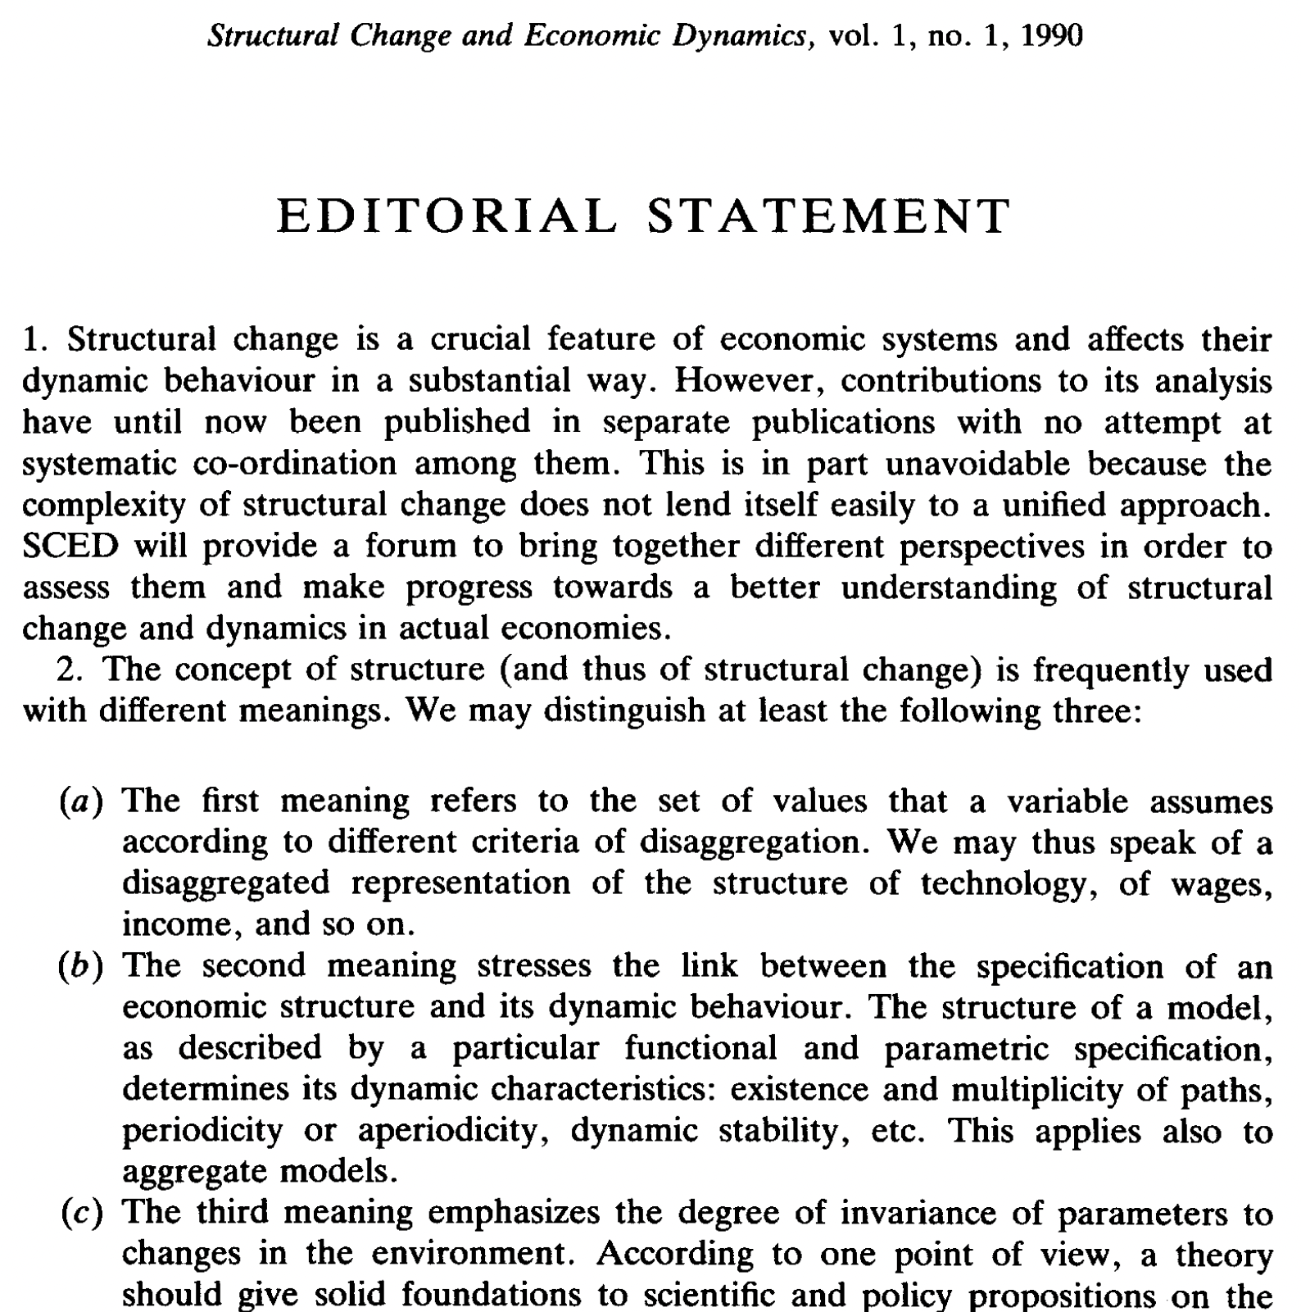
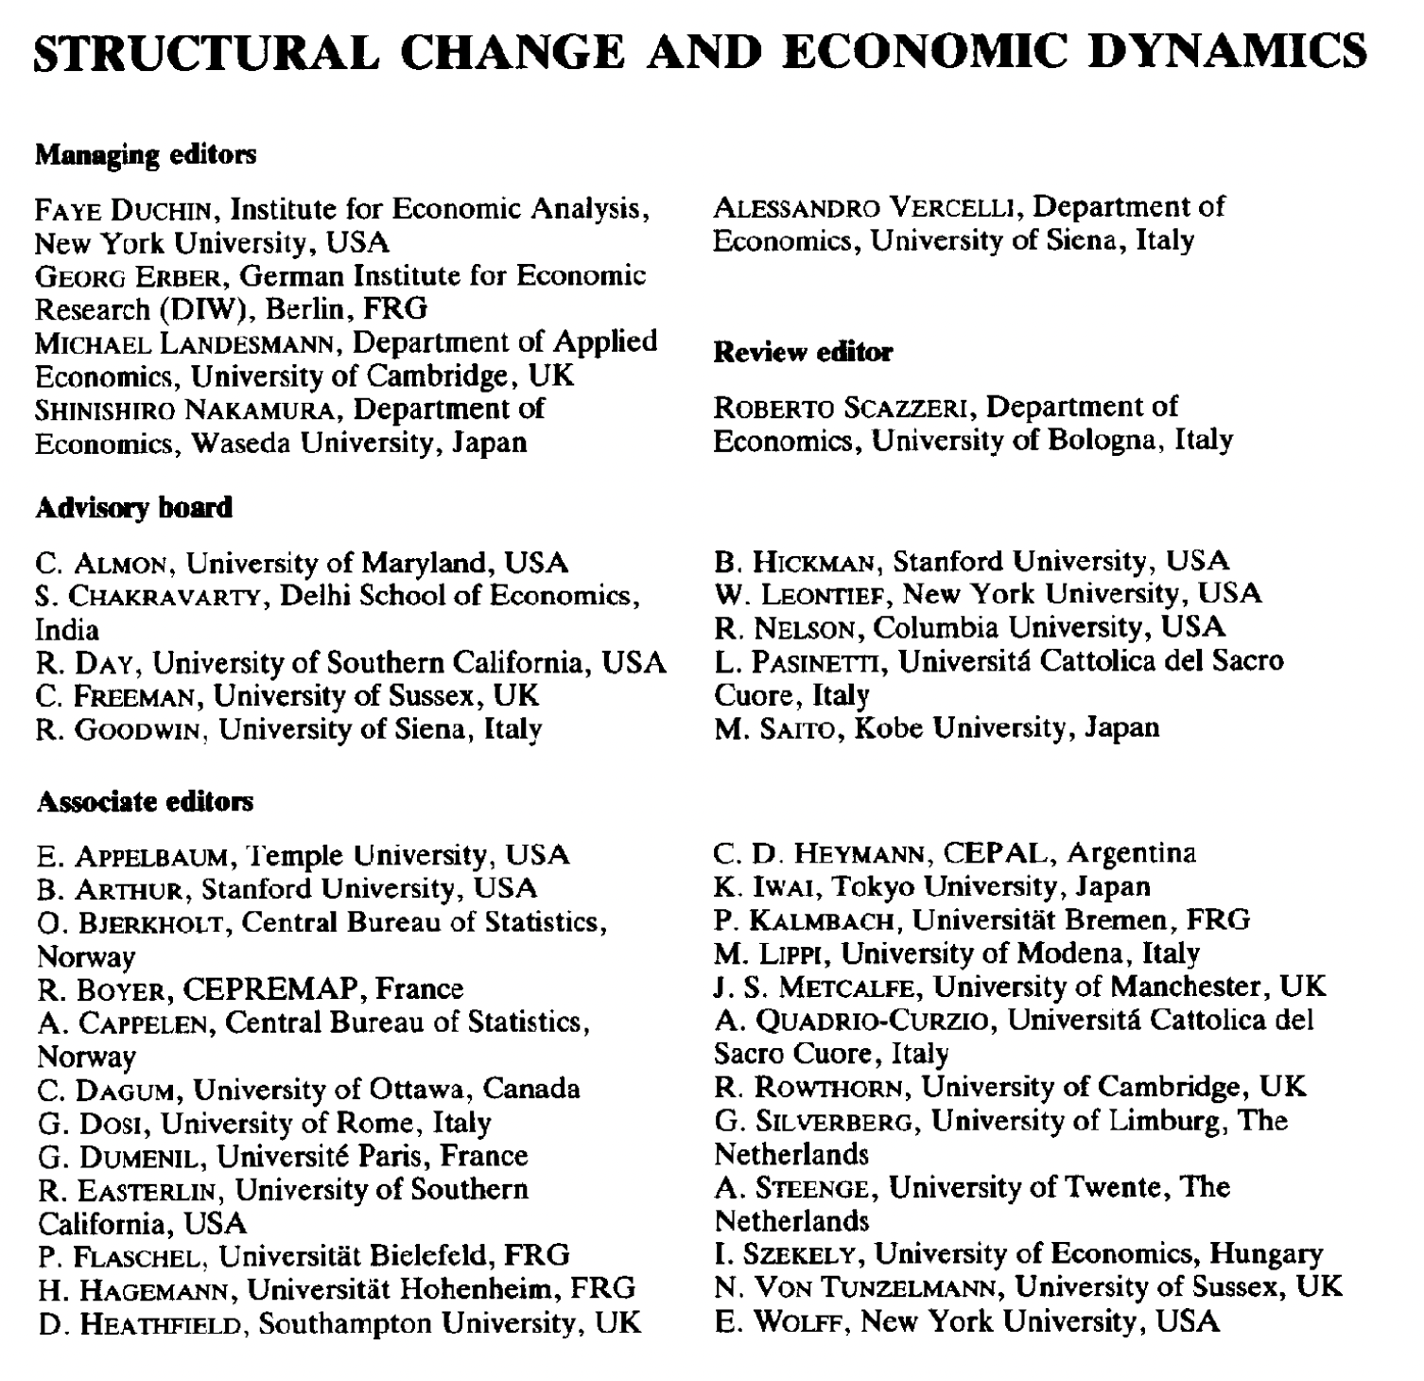
SCED journal launch in 1990
The first issue was published in June 1990 by Oxford University Press.
The publisher has been Elsevier since 1995.
Faye Duchin, Previous President and Fellow of the IIOA

Slide 7
SCED Editors-in-Chief
Zhifu Mi, University College London, UK
  Lead Editor-in-Chief of SCED (2026 –)
  Council member of IIOA (2024 – )
Ivano Cardinale, Goldsmiths, University of London, UK
Yuning Gao, Tsinghua University, China
Mario Pianta, Scuola Normale Superiore, Italy
  The rise and impact of the military economy in Europe, LEM Working Paper Series, May 2026. DOI: 10.57838/sssa/qrbx-v965

Slide 8
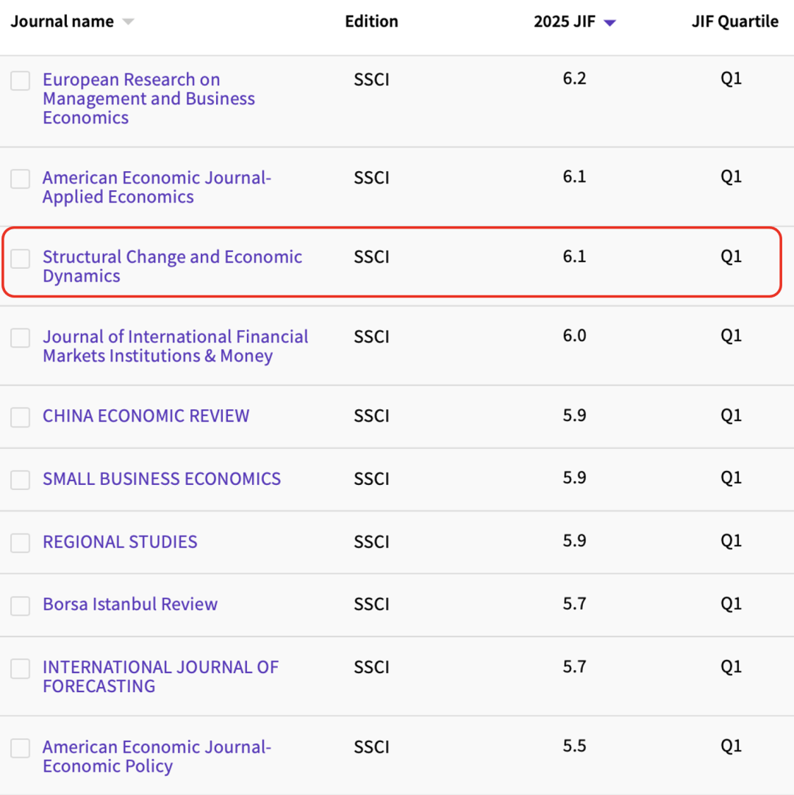
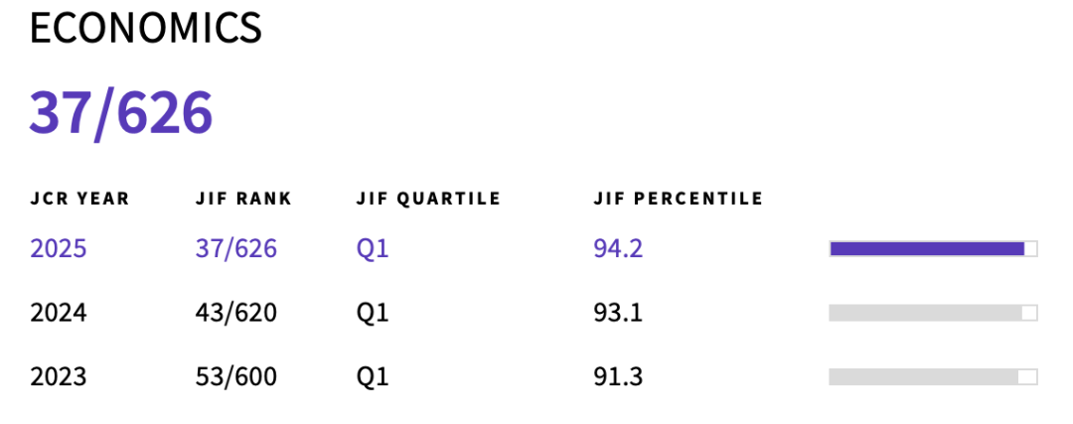
SCED journal metrics
SSCI index
6.1
Impact Factor
9.7
CiteScore
Q1
Quartile
37
Ranking(Economics)

Slide 9
SCED publishing timeline
We are aware that editorial processing speed is very important to authors.
  Submission to first decision: 14 days
  Submission to decision after review: 88 days
  Submission to acceptance: 250 days
  Acceptance to online publication: 3 days
With large submissions, we can only publish a small fraction of manuscripts submitted to the journal. We therefore desk reject most manuscripts as quickly as possible to avoid a time-consuming peer review process.

Slide 10
Research themes of SCED
1
Structural change and transformation
2
Economic dynamics and development
3
Labour markets, inequality, and consumption
4
Innovation, technological change, and artificial intelligence (AI)
5
International trade and global value chains
6
Climate change and sustainable development

Slide 11
Research methods of SCED
Econometric Analysis
Single-regional input-output / SRIO
Multi-regional input-output / MRIO
Environmentally extended input-output analysis / EEIOA
Consumption-based accounting / CBA
Structural decomposition analysis / SDA
Structural scenario analysis
Input-Output Analysis
Simulation and Computational Modelling
Optimization and Efficiency Analysis
Network and Complexity Analysis

Slide 12
IOA papers in SCED
IOA-related papers make up about 12% of SCED's total publications.

Slide 13
Topic trends of IOA papers
Long-term focus:
  Economic development
  Technological change
Emerging topics:
  Digitalization
  Trade policy

Slide 14

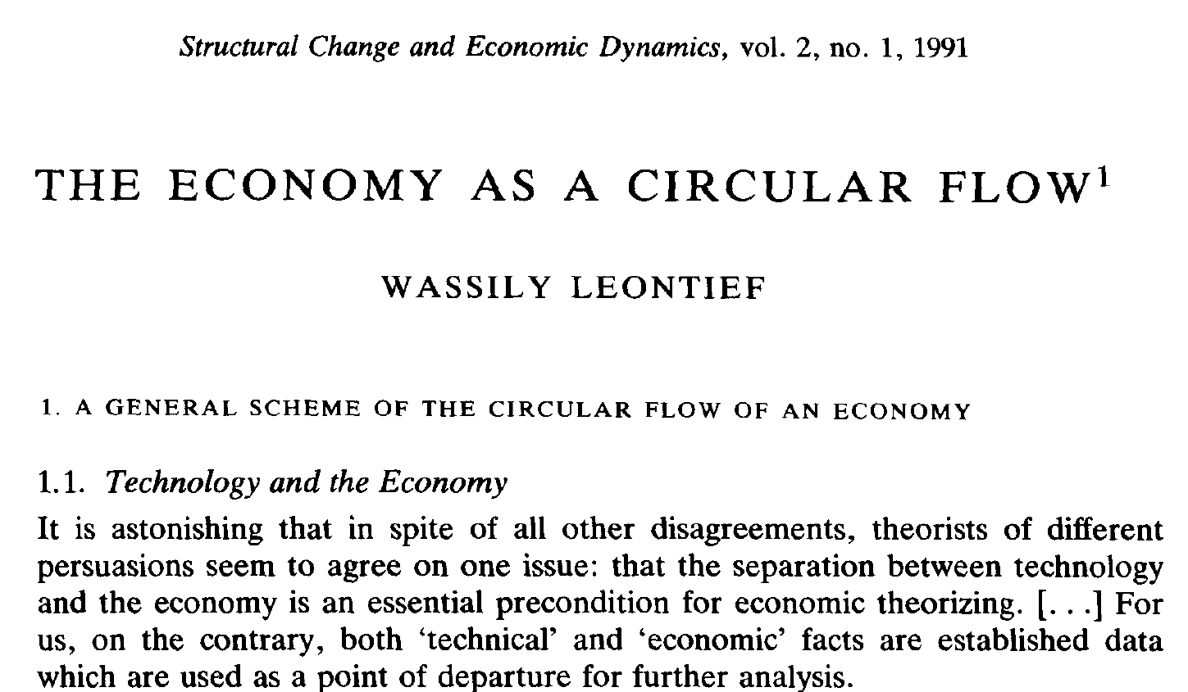
Early-published IOA papers in SCED
Title
The Economy as a Circular Flow
Year
1991
Author
Wassily Leontief, Developer of IOA, Nobel Prize in 1973
Three of his doctoral students received Nobel Prize:
Robert Solow
Vernon L. Smith
Thomas Schelling

Slide 15
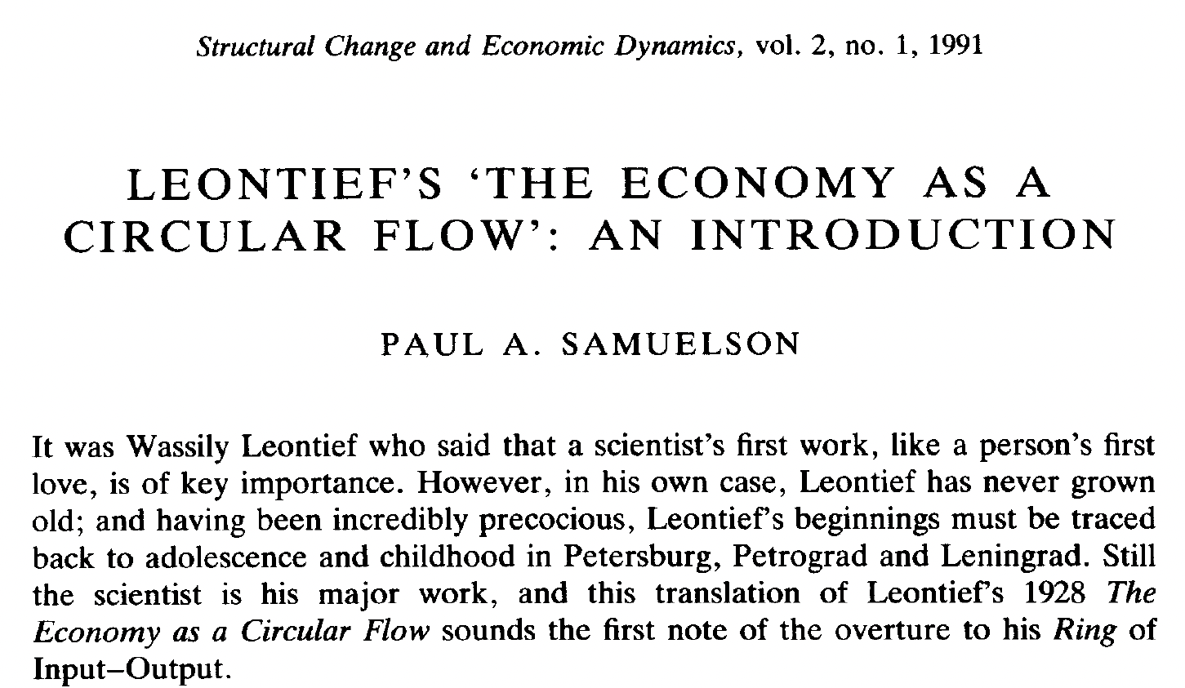
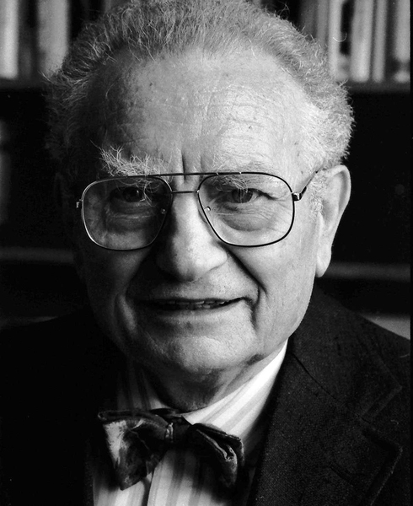
Early-published IOA papers in SCED
Title
Leontief's ‘the economy as a circular flow’: An introduction
Year
1991
Author
Paul A. Samuelson, Nobel Prize in 1970

Slide 16
Wassily Leontief's 90th birthday
To celebrate Wassily Leontief's 90th birthday in 1995, SCED published eight articles dedicated to introducing his contributions and the IOA.
Title | Author | Author information
In honor of Wassily Leontief's 90th birthday | Faye Duchin | Previous President and Fellow of IIOA, one of the founders of SCED
What Input-Output is about | Maria Augusztinovics | Hungarian Academy of Science
Inductive theory in economic development: A tribute to Wassily Leontief on his 90th birthday | Alice H. Amsden | Massachusetts Institute of Technology (MIT)
Input-output economics and computable general equilibrium models | Adam Rose | University Park
In appreciation of Wassily Leontief | Robert Dorfman | Harvard University
Leontief's spatial economic analyses | Karen R. Polenske | Previous President and Fellow of IIOA
When input-output analysis came to Norway | Olav Bjerkholt | Statistics Norway, Research Department
Input-output economics and ecology | Bruce Hannon | University of Illinois

Slide 17
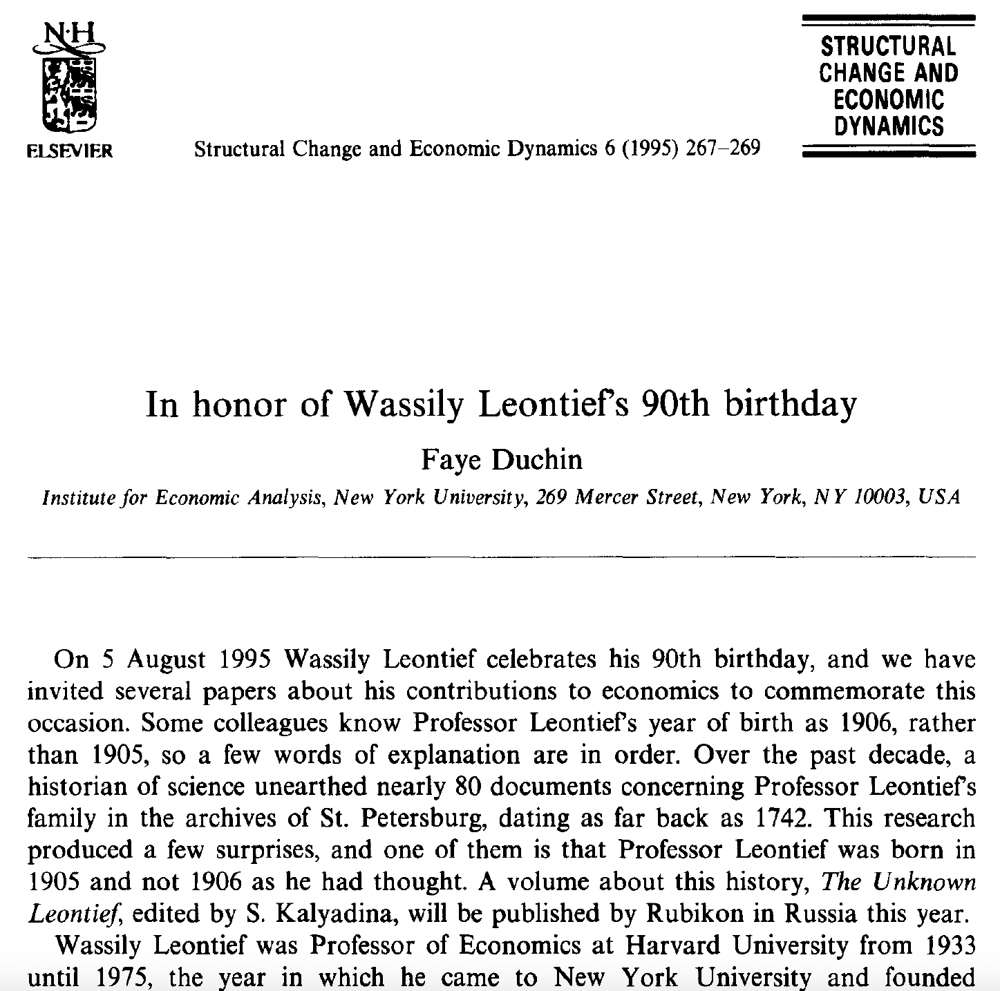

Close connection between SCED and IIOA
Faye Duchin
Previous President of the IIOA
Fellow of the IIOA in 2011
One of the founders and Managing Editor of SCED (1990-2009)
Professor, Rensselaer Polytechnic Institute

Slide 18
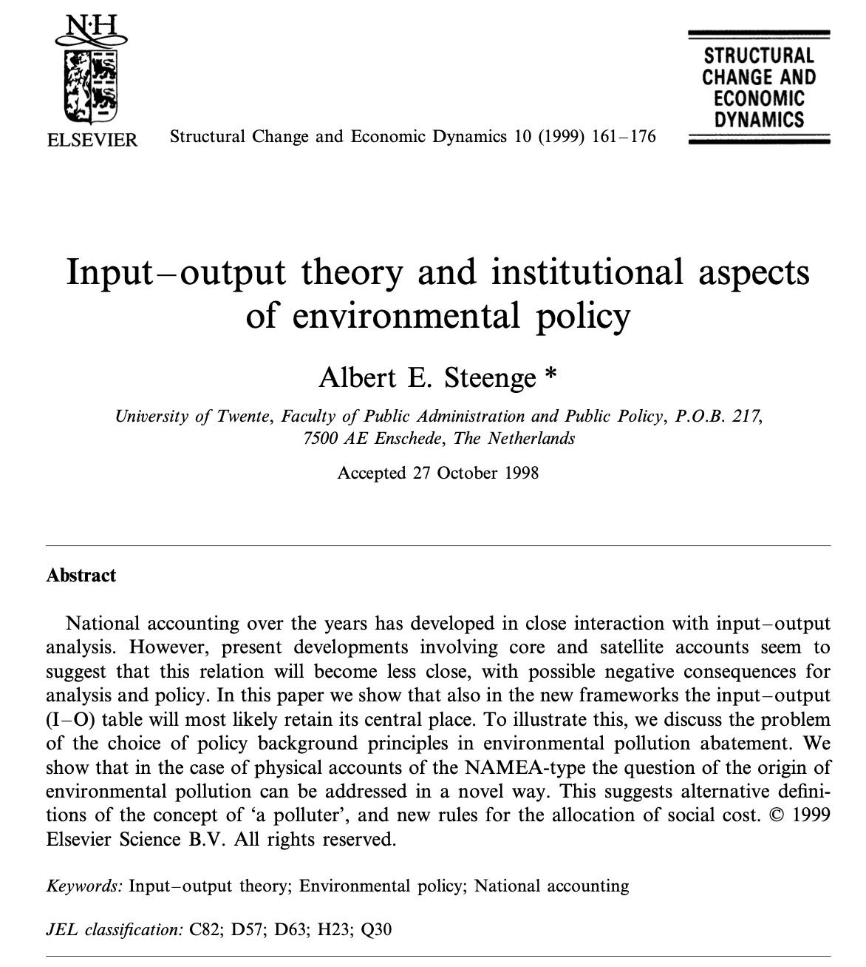

Close connection between SCED and IIOA
Albert E. Steenge
Fellow of the IIOA in 2025
Managing Editor of SCED (1996-2007)
Professor, University of Groningen

Slide 19
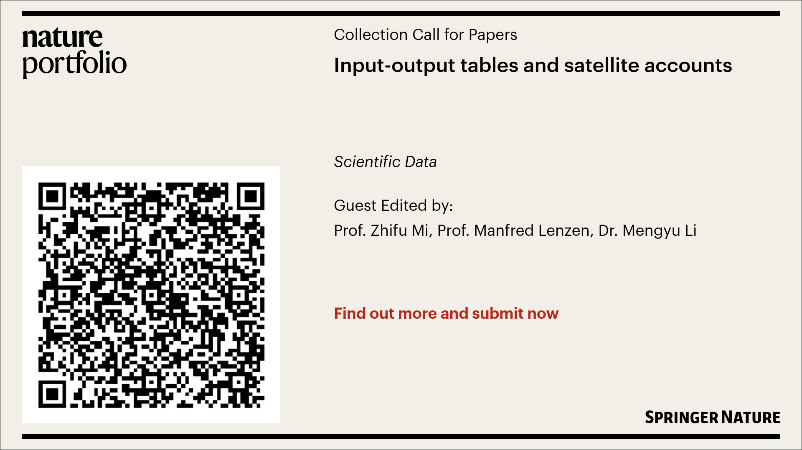
Call for papers
Input-output tables and satellite accounts

Slide 20
Thanks!
Email: z.mi@ucl.ac.uk

