Slide 1
Who Gains and Who Emits? Value Added and Embodied Carbon across Japan's Inbound Source Markets
Evidence from OECD Inter-Country Input-Output Analysis
Mingji Zhu, Taku Ishiro , Yuxuan Sun, Yokohama National University

Slide 2
01
Introduction
02
Literature Review
03
Methodology
Contents
04
Results
05
Conclusion

Slide 3
01
Introduction

Slide 4
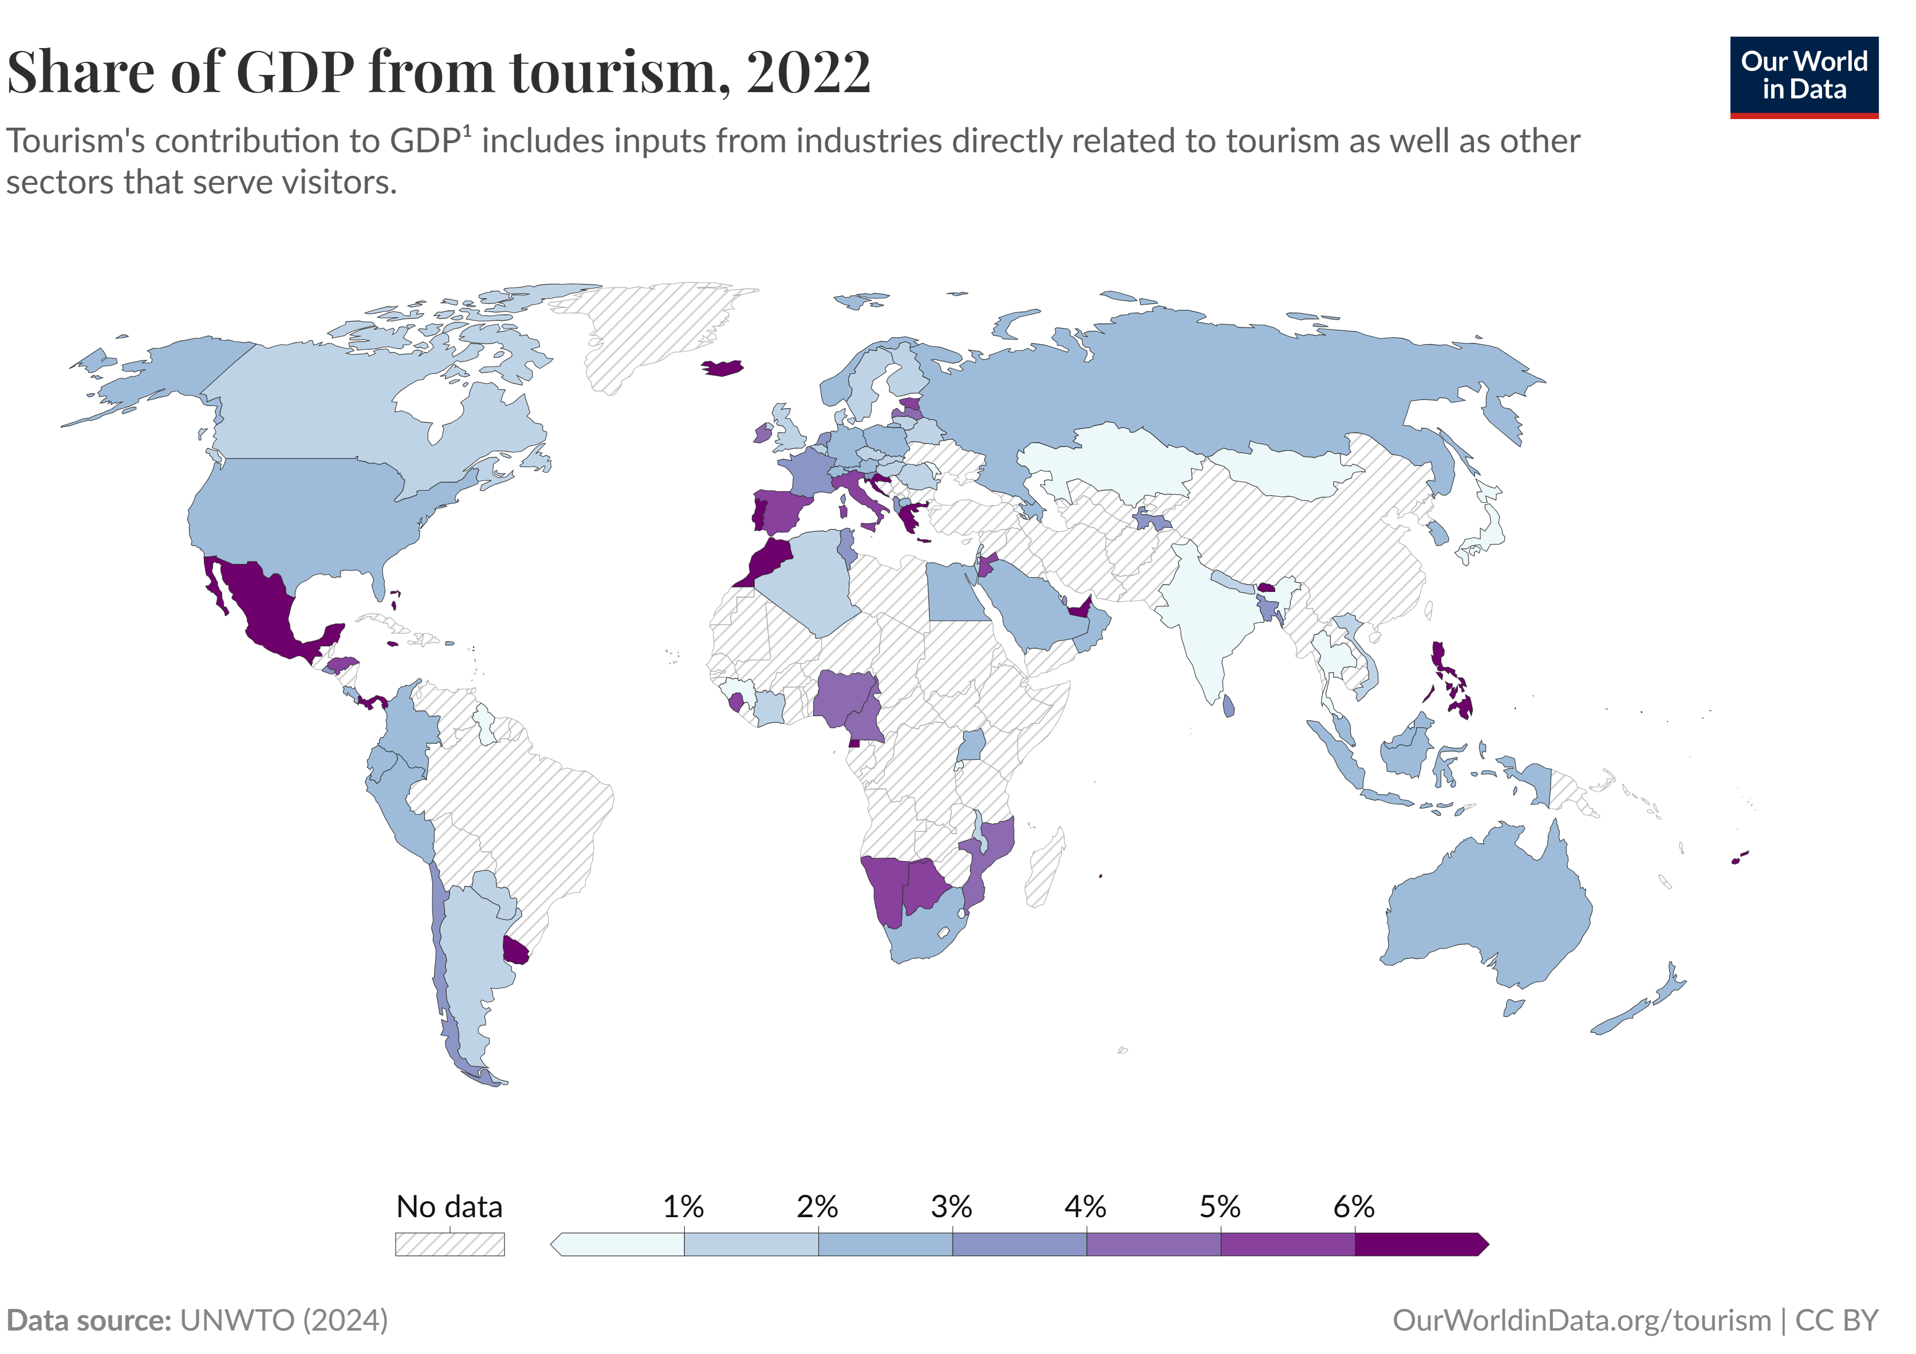
Tourism Recovery Needs More Than Spending
The Problem
Tourism contributes ~8% of global GHG emissions (Lenzen et al. 2018)
Recovery is still judged mainly by:
arrivals + spending
These metrics miss:
Which markets leave the most income
The carbon their spending causes
High receipts ≠ high local value added or low carbon.
Figure 1. Share of GDP from tourism, 2022.Source: Our World in Data / UNWTO (2024)

Slide 5
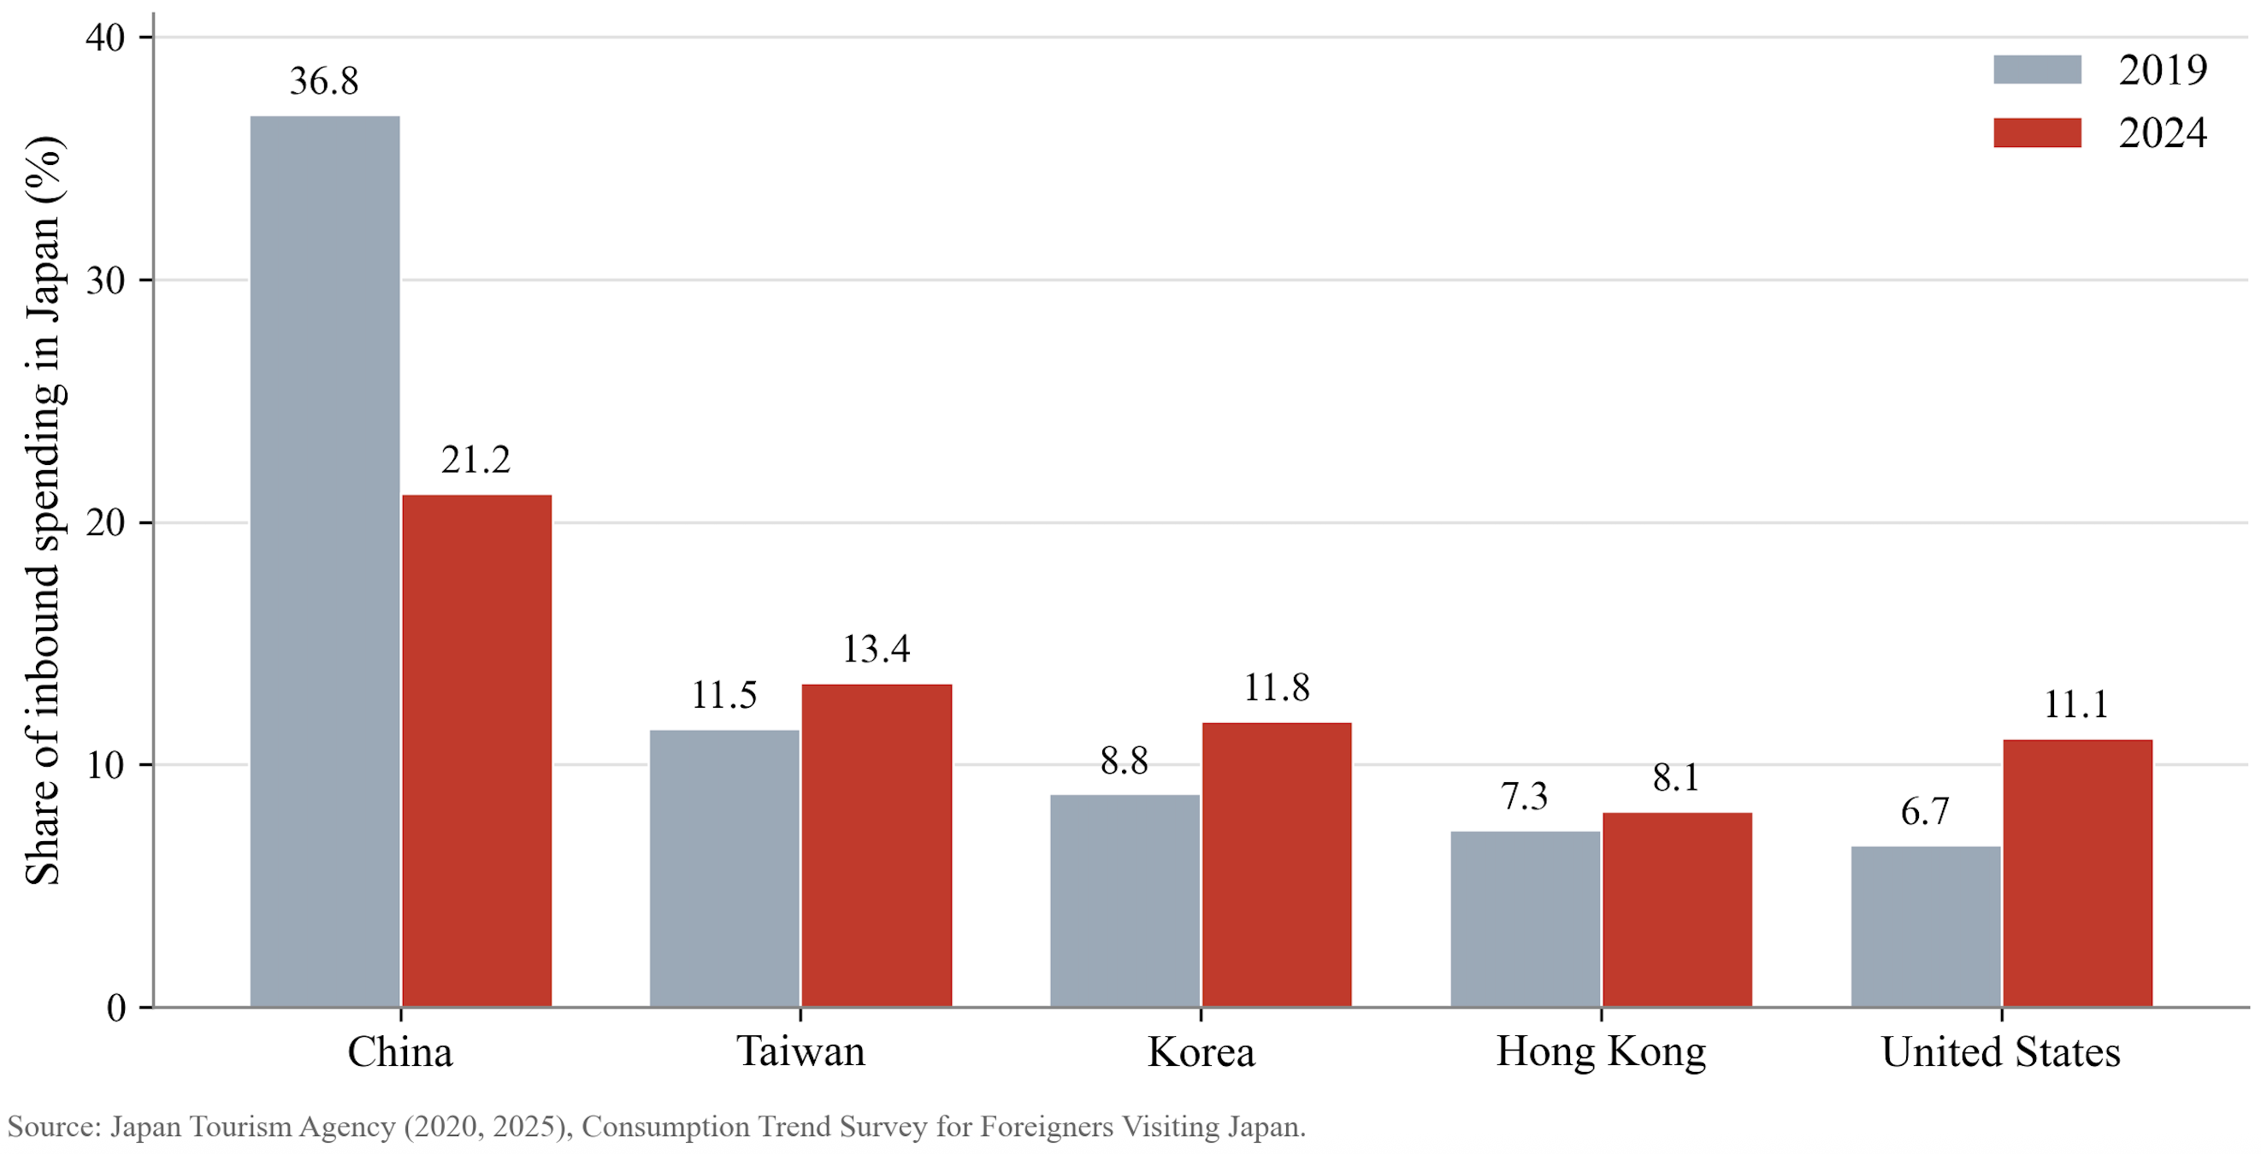
Why Japan? Recovery Mix and Shopping Accounting
Japan's Context
Five largest markets:
China, Taiwan, Korea, Hong Kong, US
Inbound spending share:
2019: 71.1%
2024: 65.7%
The source-market mix has changed.
The Shopping Problem
Shopping is recorded as one category, but can be treated as:
Retail service → shop margin only
Goods demand → manufacturing, materials, energy
Figure 2. Share of inbound spending in Japan, 2019 and 2024. Source: JTA (2020, 2025)
The Question
Do high-spending markets remain attractive once income and carbon are weighed together?

Slide 6

Research Questions
Value Added → Carbon Intensity → Spatial Distribution
1
2
3
How do source markets differ in value added and embodied emissions?
How sensitive are carbon rankings to the treatment of shopping?
Where do value added and emissions end up - Japan, source economy, or third countries?
Method: JTA expenditure × OECD ICIO and GHG accounts; destination spending only.

Slide 7
02
Literature Review

Slide 8
What We Know — and What Is Missing
Embodied Carbon and Accounting Choices
Consumption-based accounting assigns emissions to demand
(Peters, 2008)
EEIO / MRIO trace supply-chain emissions
(Wiedmann, 2009; Lenzen et al., 2018)
Carbon footprints depend on boundary, imports, and allocation
(Sun et al., 2020)
Takeaway: carbon depends on accounting choices.
Economic Value of Source Markets
Spending ≠ retained income
(Dwyer & Forsyth, 2008)
I–O / TSA convert spending into value added
(Frechtling, 1999; Fletcher, 1989)
Retention depends on structure, imports, and leakage
(Pratt, 2015; Yang et al., 2018)
Takeaway: spending alone is not enough.
Gap
The economic-value and carbon-footprint literatures have developed largely in parallel.
Relatively little work compares inbound source markets by both retained value added and embodied carbon within the same accounting boundary.
This study makes two choices explicit: shopping treatment and spatial allocation.

Slide 9
03
Methodology

Slide 10
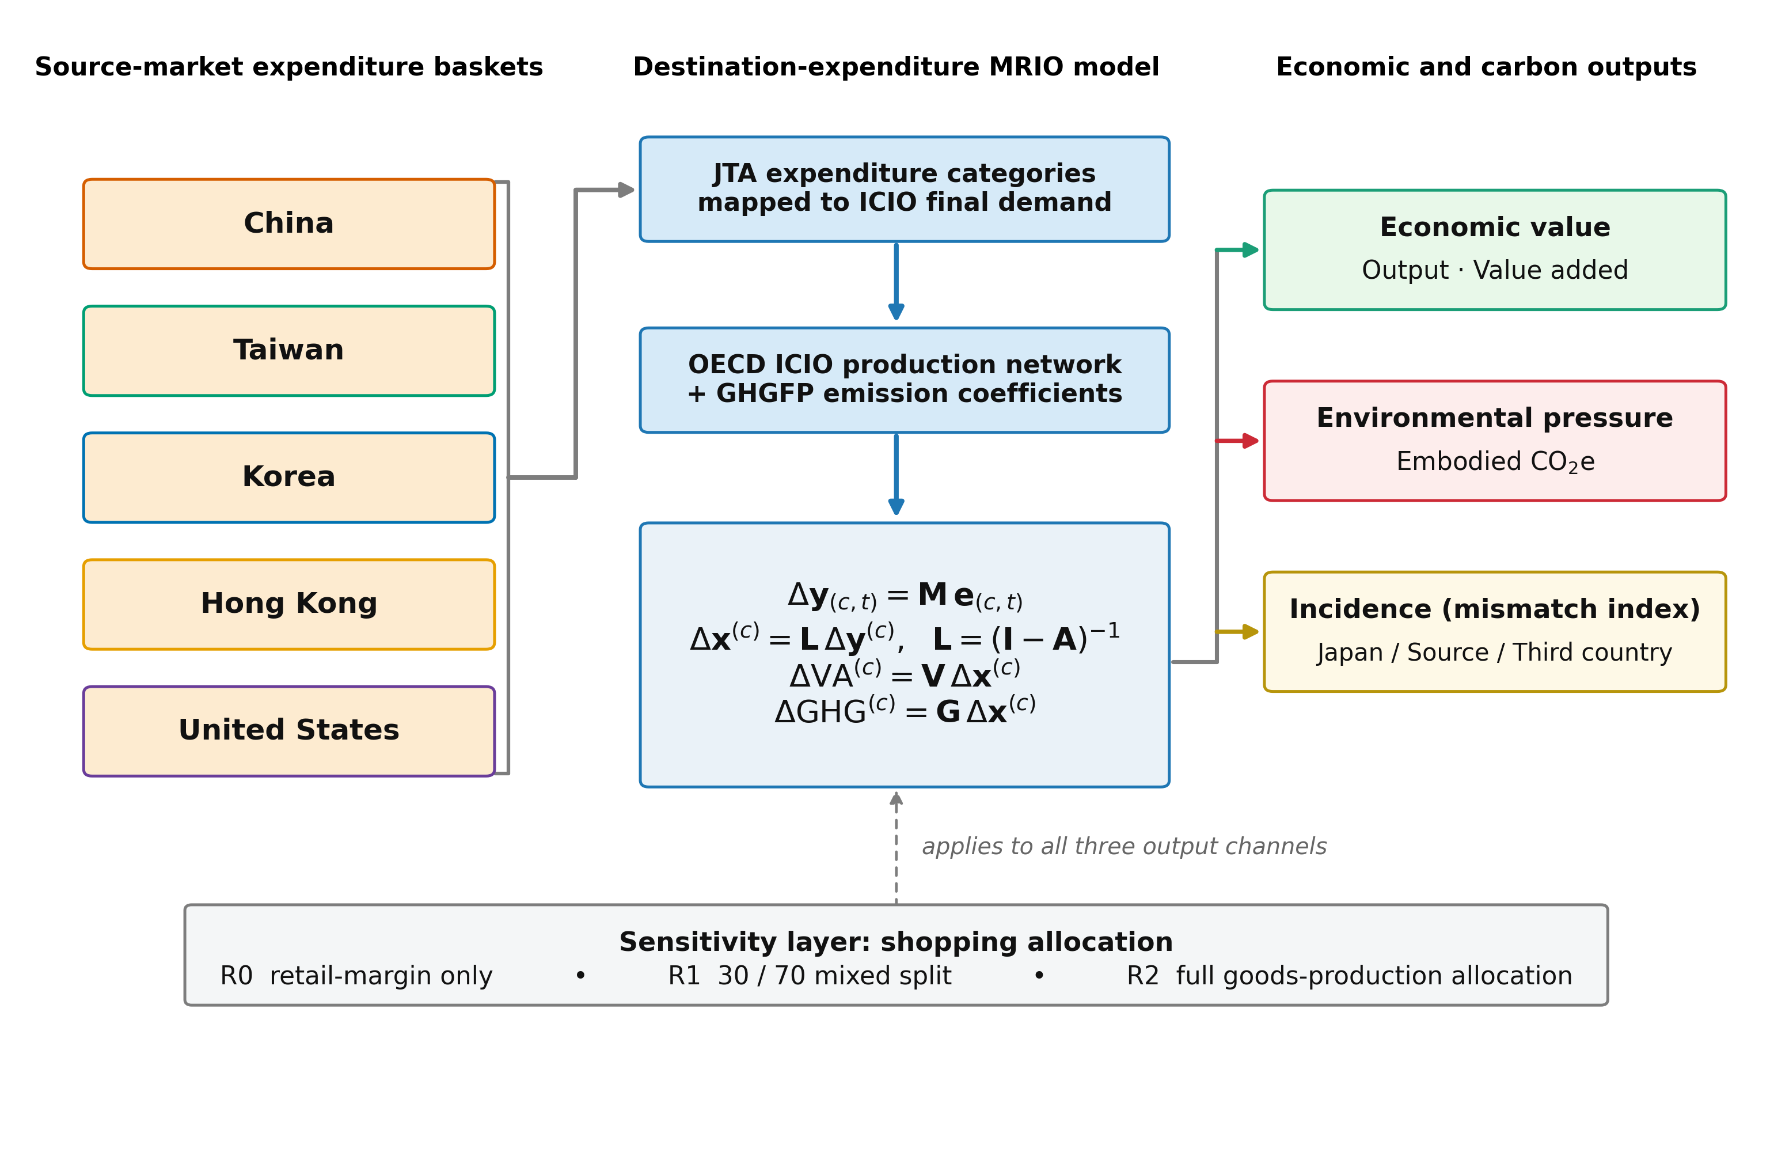
Research Framework: From Spending to Income and Carbon
Three-Step Approach
1. Spending Data
JTA Consumption Trend Survey for five markets
2. ICIO Model
OECD ICIO + GHG accounts trace production, value added, and emissions through supply chains
3. Regional Split
Split VA and emissions: Japan, source economy, Other ICIO economies
Boundary
Spending inside Japan only. Airfares excluded.
Figure 3. Linking source-market spending to induced VA and embodied carbon

Slide 11


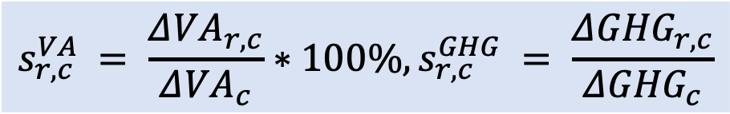


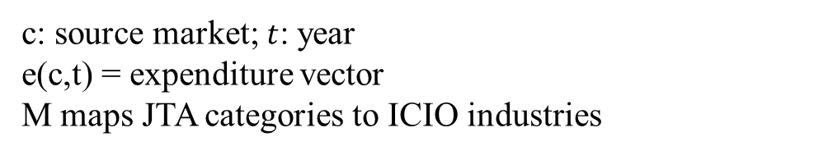
Core Model: From Spending to Value Added and Emissions
Spending to final demand
Induced output to accounts
V = value-added coefficients
G = production-based GHG coefficients
c: source market; $t$: year
e(c,t) = expenditure vector
M maps JTA categories to ICIO industries
03
$$Δ{VA}^{(c)} = V Δx^{(c)}$$
$$∆y_{\left(c,t\right)}=Me_{\left(c,t\right)}$$
$$Δ{GHG}^{(c)} = G Δx^{(c)}$$
Regional shares and mismatch
Final demand to induced output
r = Japan, source economy, or third countries
$$s_{r,c}^{VA} = \frac{Δ{VA}_{r,c}}{Δ{VA}_{c}}∗100\%, s_{r,c}^{GHG} = \frac{Δ{GHG}_{r,c}}{Δ{GHG}_{c}}$$
$$Δx^{(c)} = L Δy^{(c)}, L = {(I − A)}^{−1 }$$
$$m_{r,c} = s_{r,c}^{GHG} − s_{r,c}^{VA}$$

Slide 12
Shopping Treatment & Scenario Design
Three Shopping Treatments
R0 (Retail)
All shopping → wholesale & retail trade
Lower bound for carbon
R1 (Central)
30% retail + 70% goods-producing industries
Realistic midpoint (~30% margin)
R2 (Goods)
All shopping → goods-producing industries
Upper bound for carbon
R0 and R2 define the bounds; R1 is the central case.
Two Scenarios
S1 (2019 Baseline)
2019 spending × 2019 production & emissions structure
S2 (2024 Mix)
2024 spending × 2019 production & emissions structure
Key idea
S1 gives the 2019 baseline.
S2 changes only the spending mix,
holding production and emissions structure fixed.

Slide 13
04
Results

Slide 14
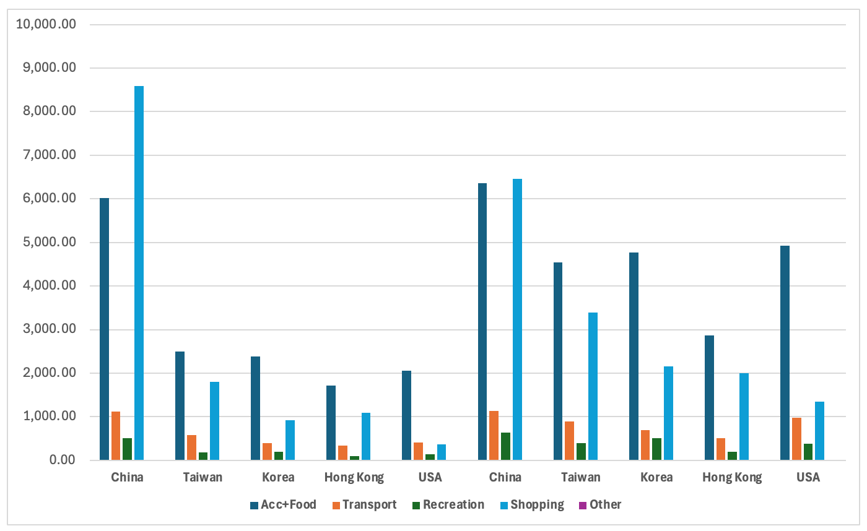
Result 1: Recovery Changed Both Scale and Composition
Key Changes
Total real expenditure rose ~40%
USD 31.4B → USD 45.1B
China contracted
shopping share: 53% → 44%
Taiwan, Korea, Hong Kong, and the United States expanded
US remains the most service-oriented basket
Acc+Food ≈ two-thirds of 2024 spending
2019
2024
Figure 4. Expenditure composition by source market and scenario

Slide 15
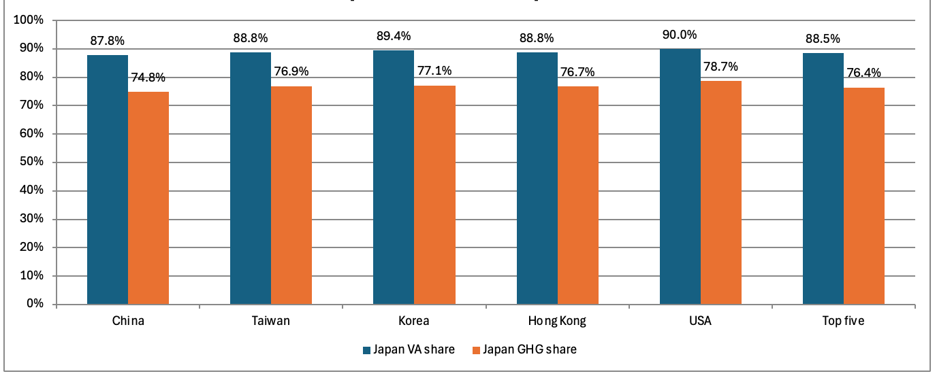
Result 2: Economic Returns Are Stable
Figure 5. Headline magnitudes under R1 midpoint, 2019 baseline
Economic Multipliers
Output multiplier: 1.88
VA intensity: ~USD 0.96 / dollar spent
Value added is tightly clustered across markets.
Implication
Income-side differences are small;
carbon intensity explains more of the market ranking.

Slide 16
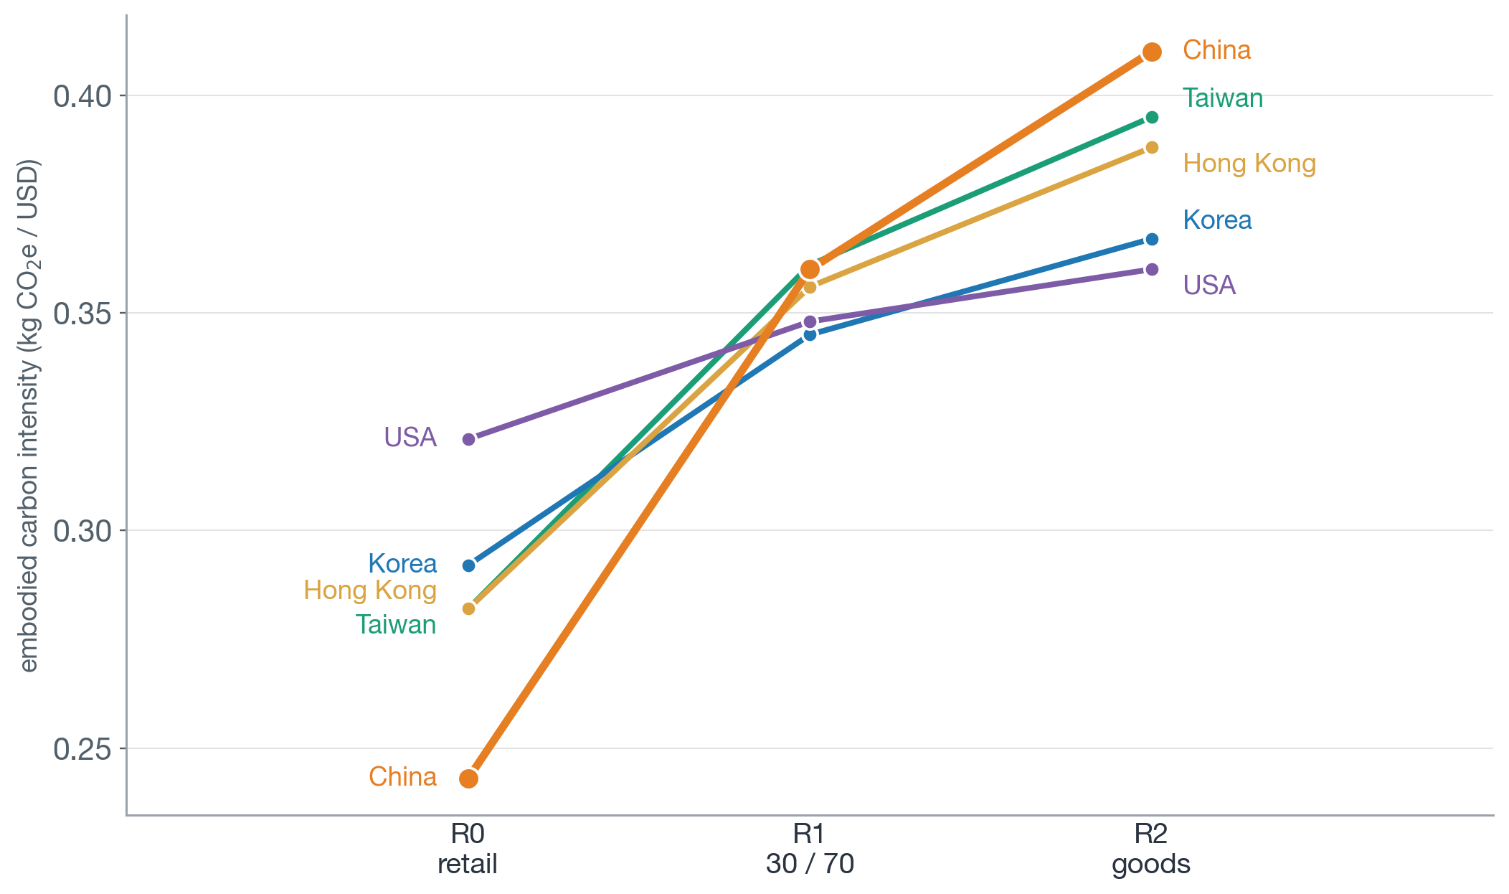
Result 3: Carbon Intensity Depends on Shopping Treatment
Carbon Varies More Than VA
R0 (retail)
China lowest: 0.243
USA highest: 0.321
R2 (goods)
China highest: 0.410
USA lowest: 0.360
Ranking Reversal
Top-five intensity rises:
0.267 → 0.395 kg CO₂e/USD
Main implication
Shopping treatment changes not only the level, but also which markets look carbon-intensive.
Figure 6. Per-dollar embodied CO₂e intensity by shopping treatment.

Slide 17
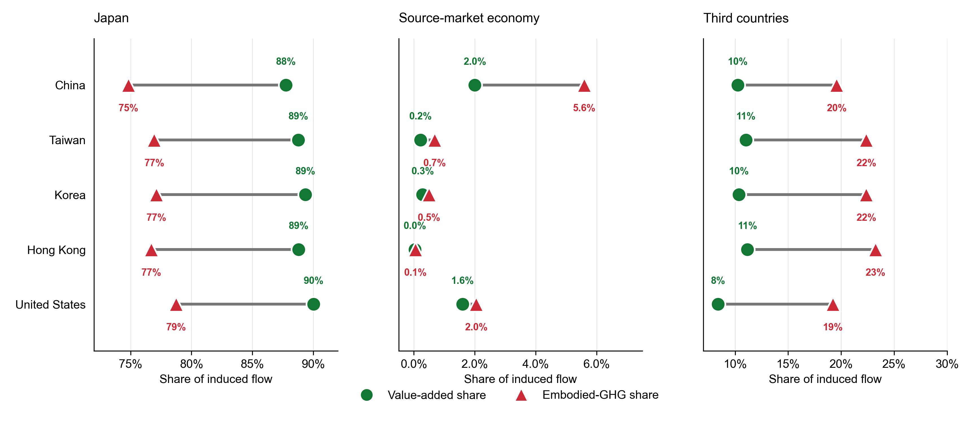
Result 4: Spatial Mismatch — Where Income Stays vs. Where Carbon Goes
Japan
VA share: ~88–90%
GHG share: ~75–79%
Other ICIO economies
Carry more emissions than value added through upstream supply chains.
Source economy
Very little of either flow
Key finding
Japan's mismatch is negative (~−12 pp)
for all five markets.
Direction is robust under R0 and R1.
Other ICIO economies
Figure 7. Gap between VA share and embodied-GHG share by region (S1, R1)

Slide 18
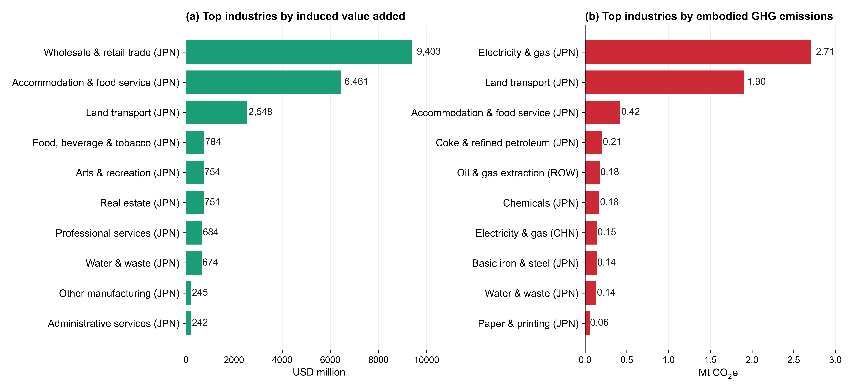
Result 5: Sectoral Mechanisms Behind the Gap
Value Added Concentrated In:
• Wholesale & retail trade
• Accommodation & food services
• Land transport
Emissions Concentrated In:
• Electricity & gas
• Land transport
• Fuels, chemicals, and basic metals
• Agriculture and material inputs
Mechanism:
• Income is created mainly in Japanese services;
• carbon is pushed into upstream energy and material supply chains.
Figure 8. Top industries contributing to induced value added and embodied GHG emissions (S1, R0)

Slide 19
05
Discussion &
Conclusion

Slide 20
Conclusion: Key Findings and Policy Implications
Policy Implications
1
Economic Side: Markets Look Alike
~USD 0.96 VA per dollar across all five markets
Track paired indicators:
Spending + VA + embodied carbon + spatial split
State shopping treatment:
A market’s carbon ranking is conditional on accounting choice
Use two policy levers:
Marketing changes which markets arrive
Procurement standards reduce supply-chain carbon
2
Carbon Side: Markets Differ Sharply
Shopping treatment can reverse carbon rankings
3
Spatial Mismatch: Income ≠ Carbon
Japan keeps ~90% of VA but only ~76% of emissions

Slide 21
Limitations and Future Work
Limitations and next steps
• Destination spending only; international airfares excluded
• Shopping allocation remains uncertain
• Future work: visitor-level data and product-level shopping detail
Take-home message
Source markets should not be evaluated by spending alone.
They should be assessed by:
spending + value added + embodied carbon + spatial incidence

Slide 22
Thanks for your attention!

