Slide 1



Global AREA-of-Protection Footprints
& Spend-Based Impact Factors
First comprehensive damage-level integration of
UNEP-GLAM with EXIOBASE
Konstantin Stadler, Candy Deck, Martin Dorber, Silvan Goldenberg, Francesca Verones, Kajwan Rasul, Kjersti Eikeland, Elisha Willson, Richard Wood
Industrial Ecology Programme, NTNU, Norway
XIO Sustainability Analytics, Oslo, Norway
32nd IIOA Conference, Seville – 23rd June 2026

Slide 2




AoP FOOTPRINTS OF NATIONS · EXIOBASE × UNEP-GLAM
Area-of-protection (AoP) footprints:
Ecosystem Quality - Human Health - Socio-Economic Assets
How big are these footprints?
Q1
Do they decouple from GDP?
Q2
Total and per-capita impact embodied in a country's consumption.
Footprint tracked against economic growth over time
What drives the footprints?
Q3
Where does it show up in products?
Q4
Impact drivers: land use, water use, carbon and ecotoxicity, ...
Economic drivers:: agriculture, manufacturing, ...
Zooming from nations to a product hotspot: textiles & apparel.

Slide 3
But first, the details: Coupling 2 databases

Slide 4
EXIOBASE · CURRENT STATE
EXIOBASE today: versions & roadmap
Versions
Update process
3.10.2 current public release,the basis for this work.
Releases now managed via www.xio-sa.com, available on Zenodo
3.11.2 beta running internally now and testing with collaborators, public release planned late 2026.
Cadence yearly updates for each major version.
Continuity older major versions remain available
In between smaller updates issued as needed.
ON THE ROADMAP
Fully revamped water accounts · Extended Impact Categories (GLAM, LC-IMPACT, PEF) -
Increased country resolution (2027) · Finer sector resolution

Slide 5
Consensus based characterization factors: UNEP-GLAM
UNEP-GLAM
A global, consensus life-cycle impact method linking environmental pressures to damage.
Origin & purpose
Structure
Cause-effect modelling: from pressures to impacts on ecosystems and human well-being.
Endpoint characterization factors: damage per unit of elementary flow.
Developed under the UNEP / SETAC Life Cycle Initiative; we use v1.0.2024.10 (with major modifications)
Country-specific where necessary, capturing geographic sensitivity.
Beta release under development
Flows → 20 impact categories → 3 Areas of Protection.
~500,000
~14,000
20
3
damage-level CFs
elementary flows
impact categories
Areas of Protection

Slide 6
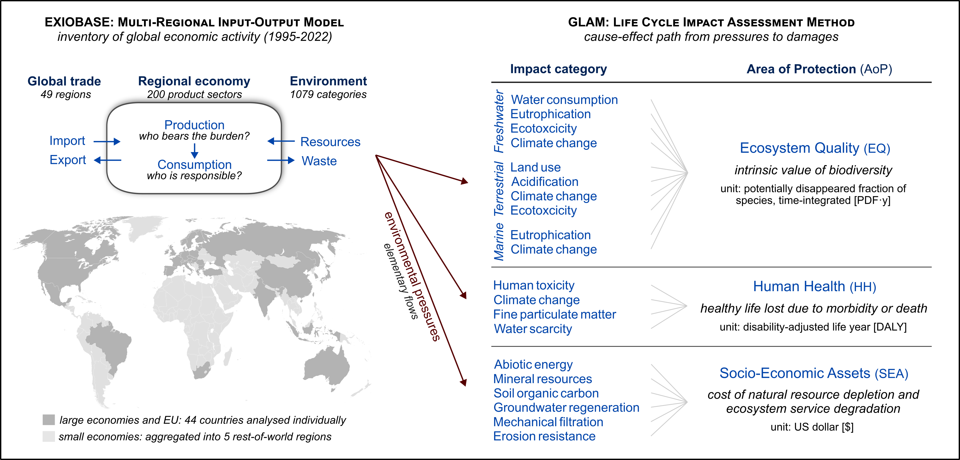

Slide 7
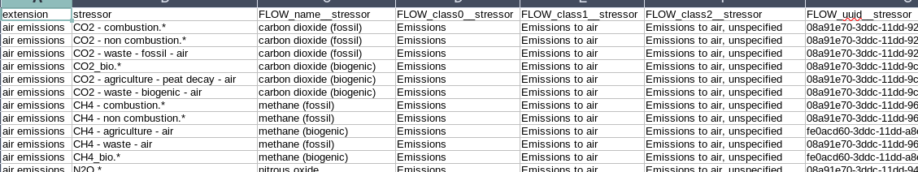
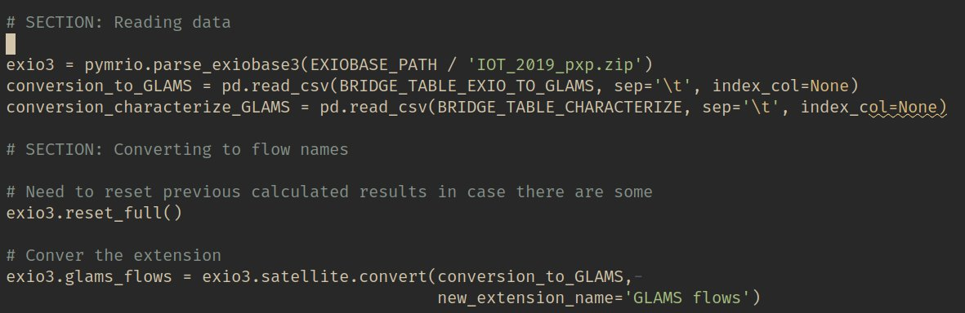
EXIO
Original stressors
EXIO impacts based on
GLAM
LC-IMPACT
PEF
Pymrio conversion
EXIO with ILCD+ flows
Pymrio linking
Bridge:
EXIO stressors to ILCD+ flows
UNEP-GLAM
LC-IMPACT v2
PEF

Slide 8
Linking details
Unit conversions & metal-ore mapping
Details behind the EXIOBASE → GLAM bridge.
Units & ILCD(+) ambiguity
Metal ore → refined metal
Additional ILCD flow names for GLAM do not have UUIDs (yet) and units can vary by impact method.
Ore quantities translated to refined-metal outputs (ILCD) using industry processing-efficiency data.
Example non-renewable energy from the ground: MJ in PEF, kg in GLAM and LC-IMPACT.
Included ore grade and unit conversion.
Excluded concentrator efficiency and smelting recovery - total metal content in ore is counted.
Solution both options provided; conversion via net calorific values.
Data mainly Nassar et al. (2022); aligns with GLAM mineral valuation (Huppertz et al. 2019).

Slide 9
Linking issues
Modifications for a robust coupling
Targeted, documented adjustments to the GLAM and EXIOBASE inputs.
GLAM
EXIOBASE
Base official release GLAM 1.0.2024.10.
Base EXIOBASE 3.10.2.
Back-ported selected beta improvements:
EQ Water Consumption
SEA Land-Use Erosion Resistance
to fix major issues.
Forest types new land-use satellite account splitting non-primary regenerating vs planted forest; primary excluded.
Heavy metals iron & steel emissions rescaled (Zhang et al. 2023).
Why not full beta: still major issues
Upstream both reported to developers → fixed in EXIOBASE 3.11. (beta)

Slide 10
The Results

Slide 11
How big are these footprints?
Q1
Do they decouple from GDP?
Q2
Total and per-capita impact embodied in a country's consumption.
Footprint tracked against economic growth over time
What drives the footprints?
Q3
Where does it show up in products?
Q4
Impact drivers: land use, water use, carbon and ecotoxicity, ...
Economic drivers:: agriculture, manufacturing, ...
Zooming from nations to a product hotspot: textiles & apparel.

Slide 12
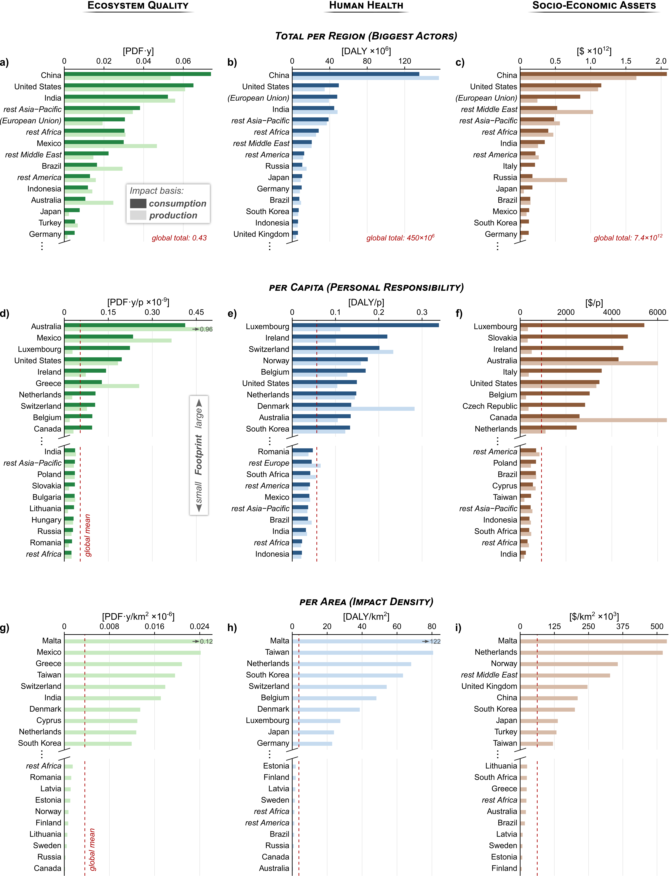
RESULTS · Q1
How big are the total footprints?
Goldenberg et al (subm)

Slide 13
RESULTS · Q1
AoP Footprints: per capita perspective
Goldenberg et al (subm)

Slide 14
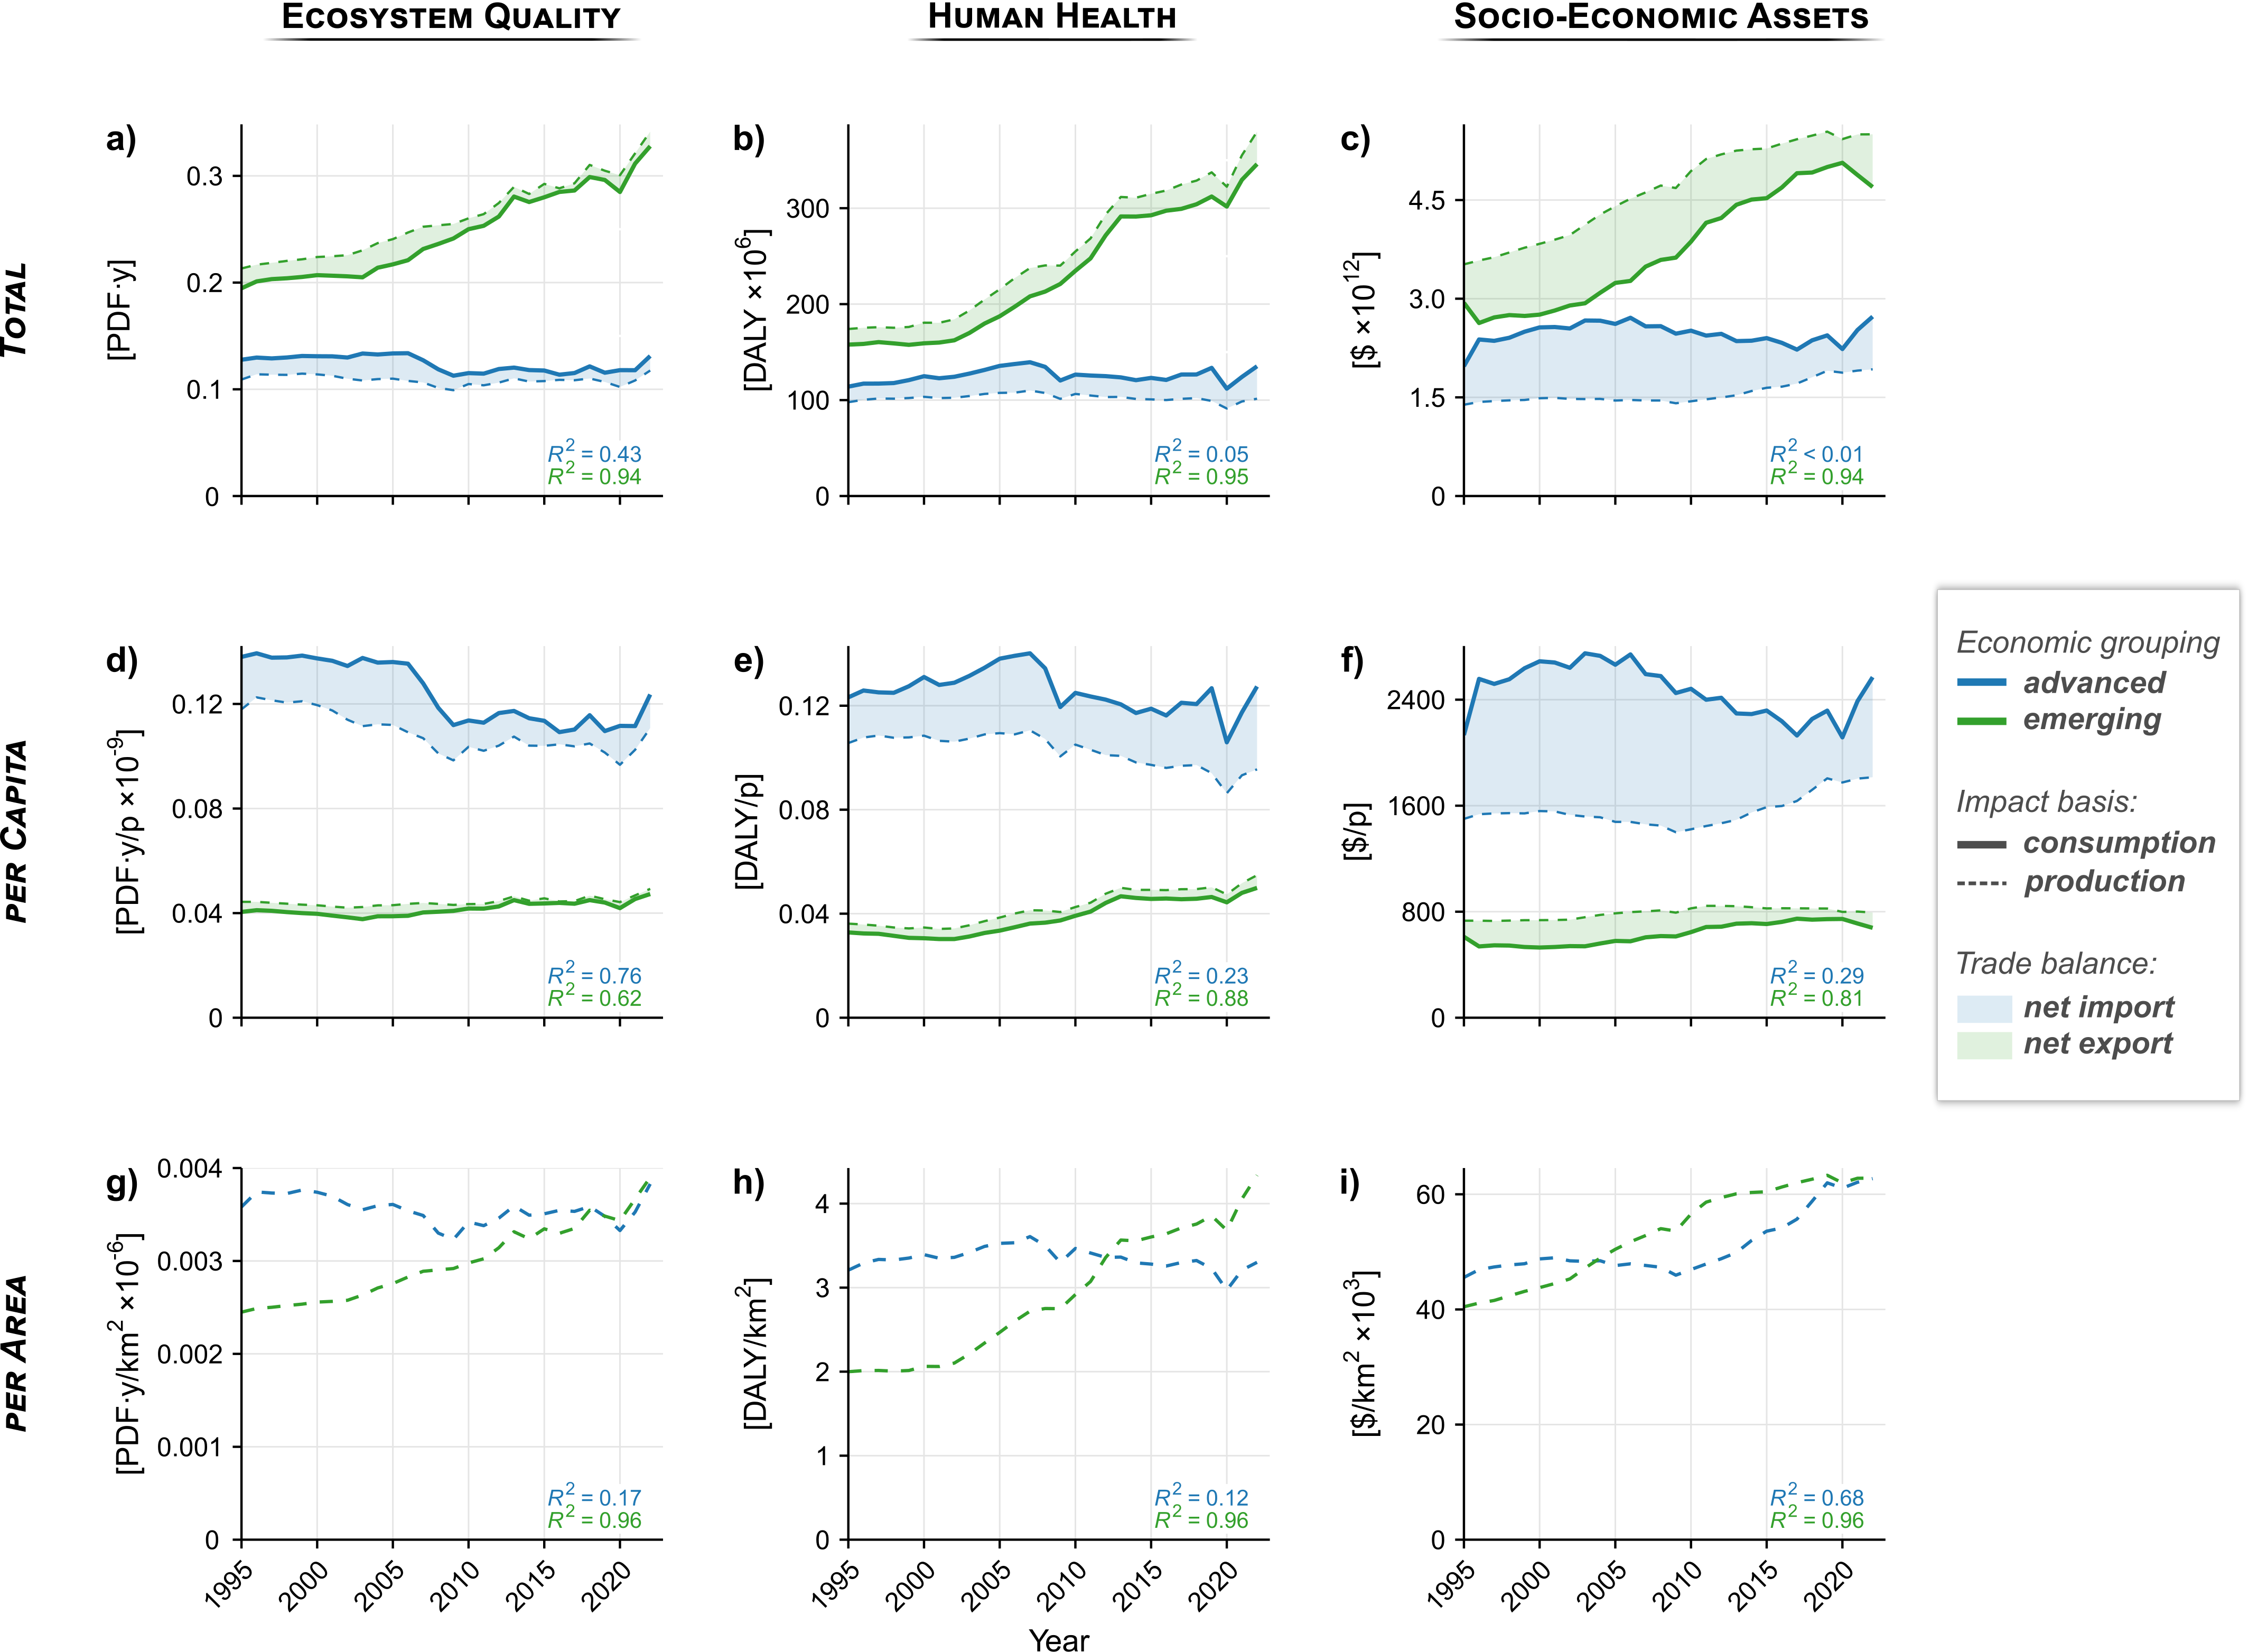
RESULTS · Q1
AoP Footprints over time (1995-2022)
Goldenberg et al (subm)

Slide 15
How big are these footprints?
Q1
Do they decouple from GDP?
Q2
Total and per-capita impact embodied in a country's consumption.
Footprint tracked against economic growth over time
What drives the footprints?
Q3
Where does it show up in products?
Q4
Impact drivers: land use, water use, carbon and ecotoxicity, ...
Economic drivers:: agriculture, manufacturing, ...
Zooming from nations to a product hotspot: textiles & apparel.

Slide 16
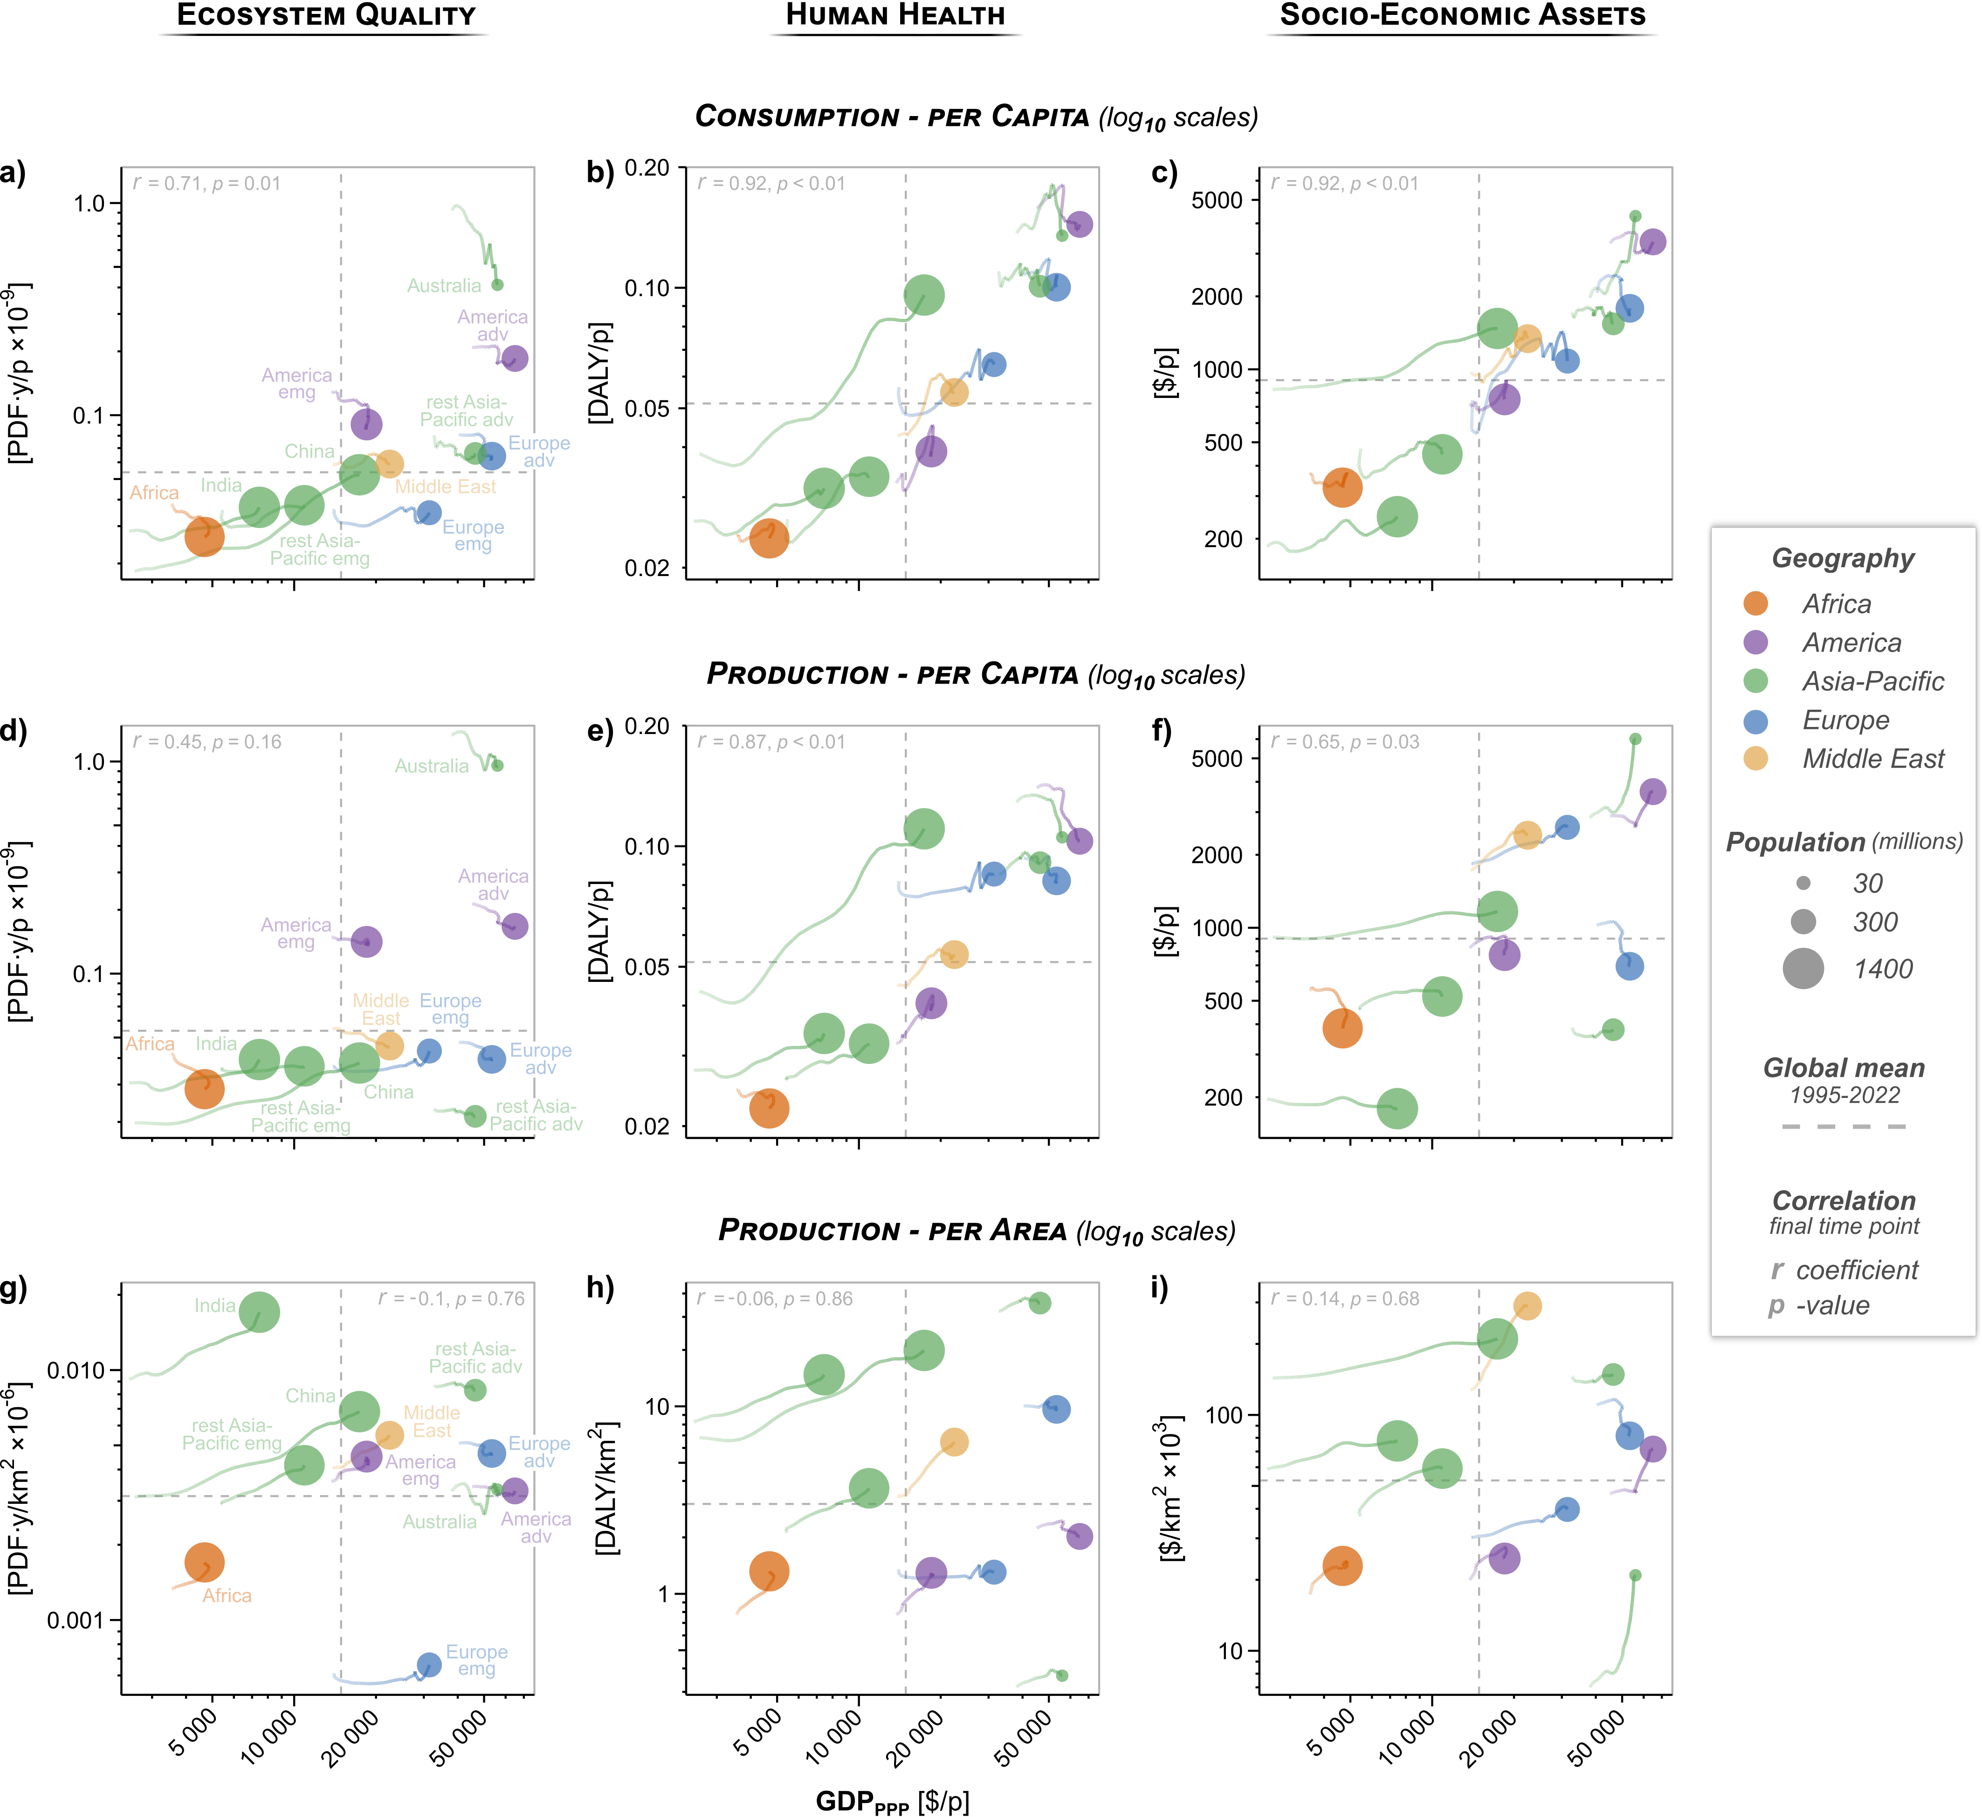
RESULTS · Q2
Do AoP footprints decouple from GDP?
Goldenberg et al (subm)

Slide 17
How big are these footprints?
Q1
Do they decouple from GDP?
Q2
Total and per-capita impact embodied in a country's consumption.
Footprint tracked against economic growth over time
What drives the footprints?
Q3
Where does it show up in products?
Q4
Impact drivers: land use, water use, carbon and ecotoxicity, ...
Economic drivers:: agriculture, manufacturing, ...
Zooming from nations to a product hotspot: textiles & apparel.

Slide 18
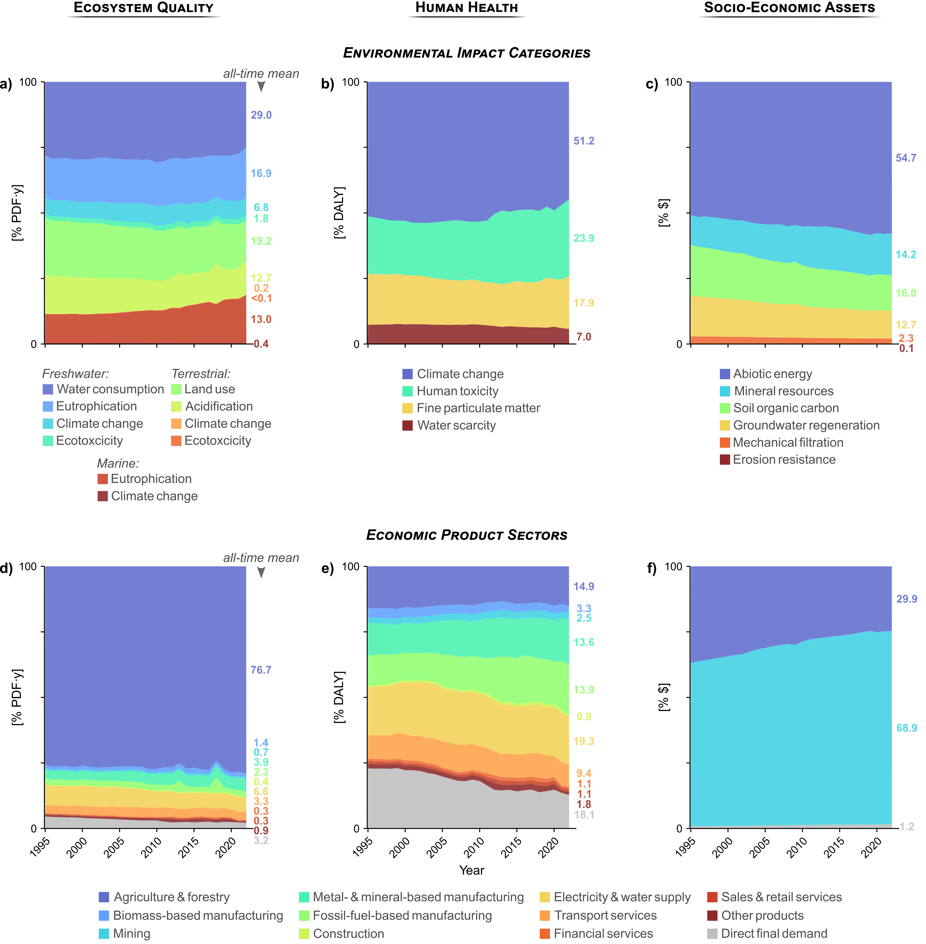
RESULTS · Q3
Impact Drivers
Goldenberg et al (subm)

Slide 19
RESULTS · Q3
Economic Drivers
Goldenberg et al (subm)

Slide 20
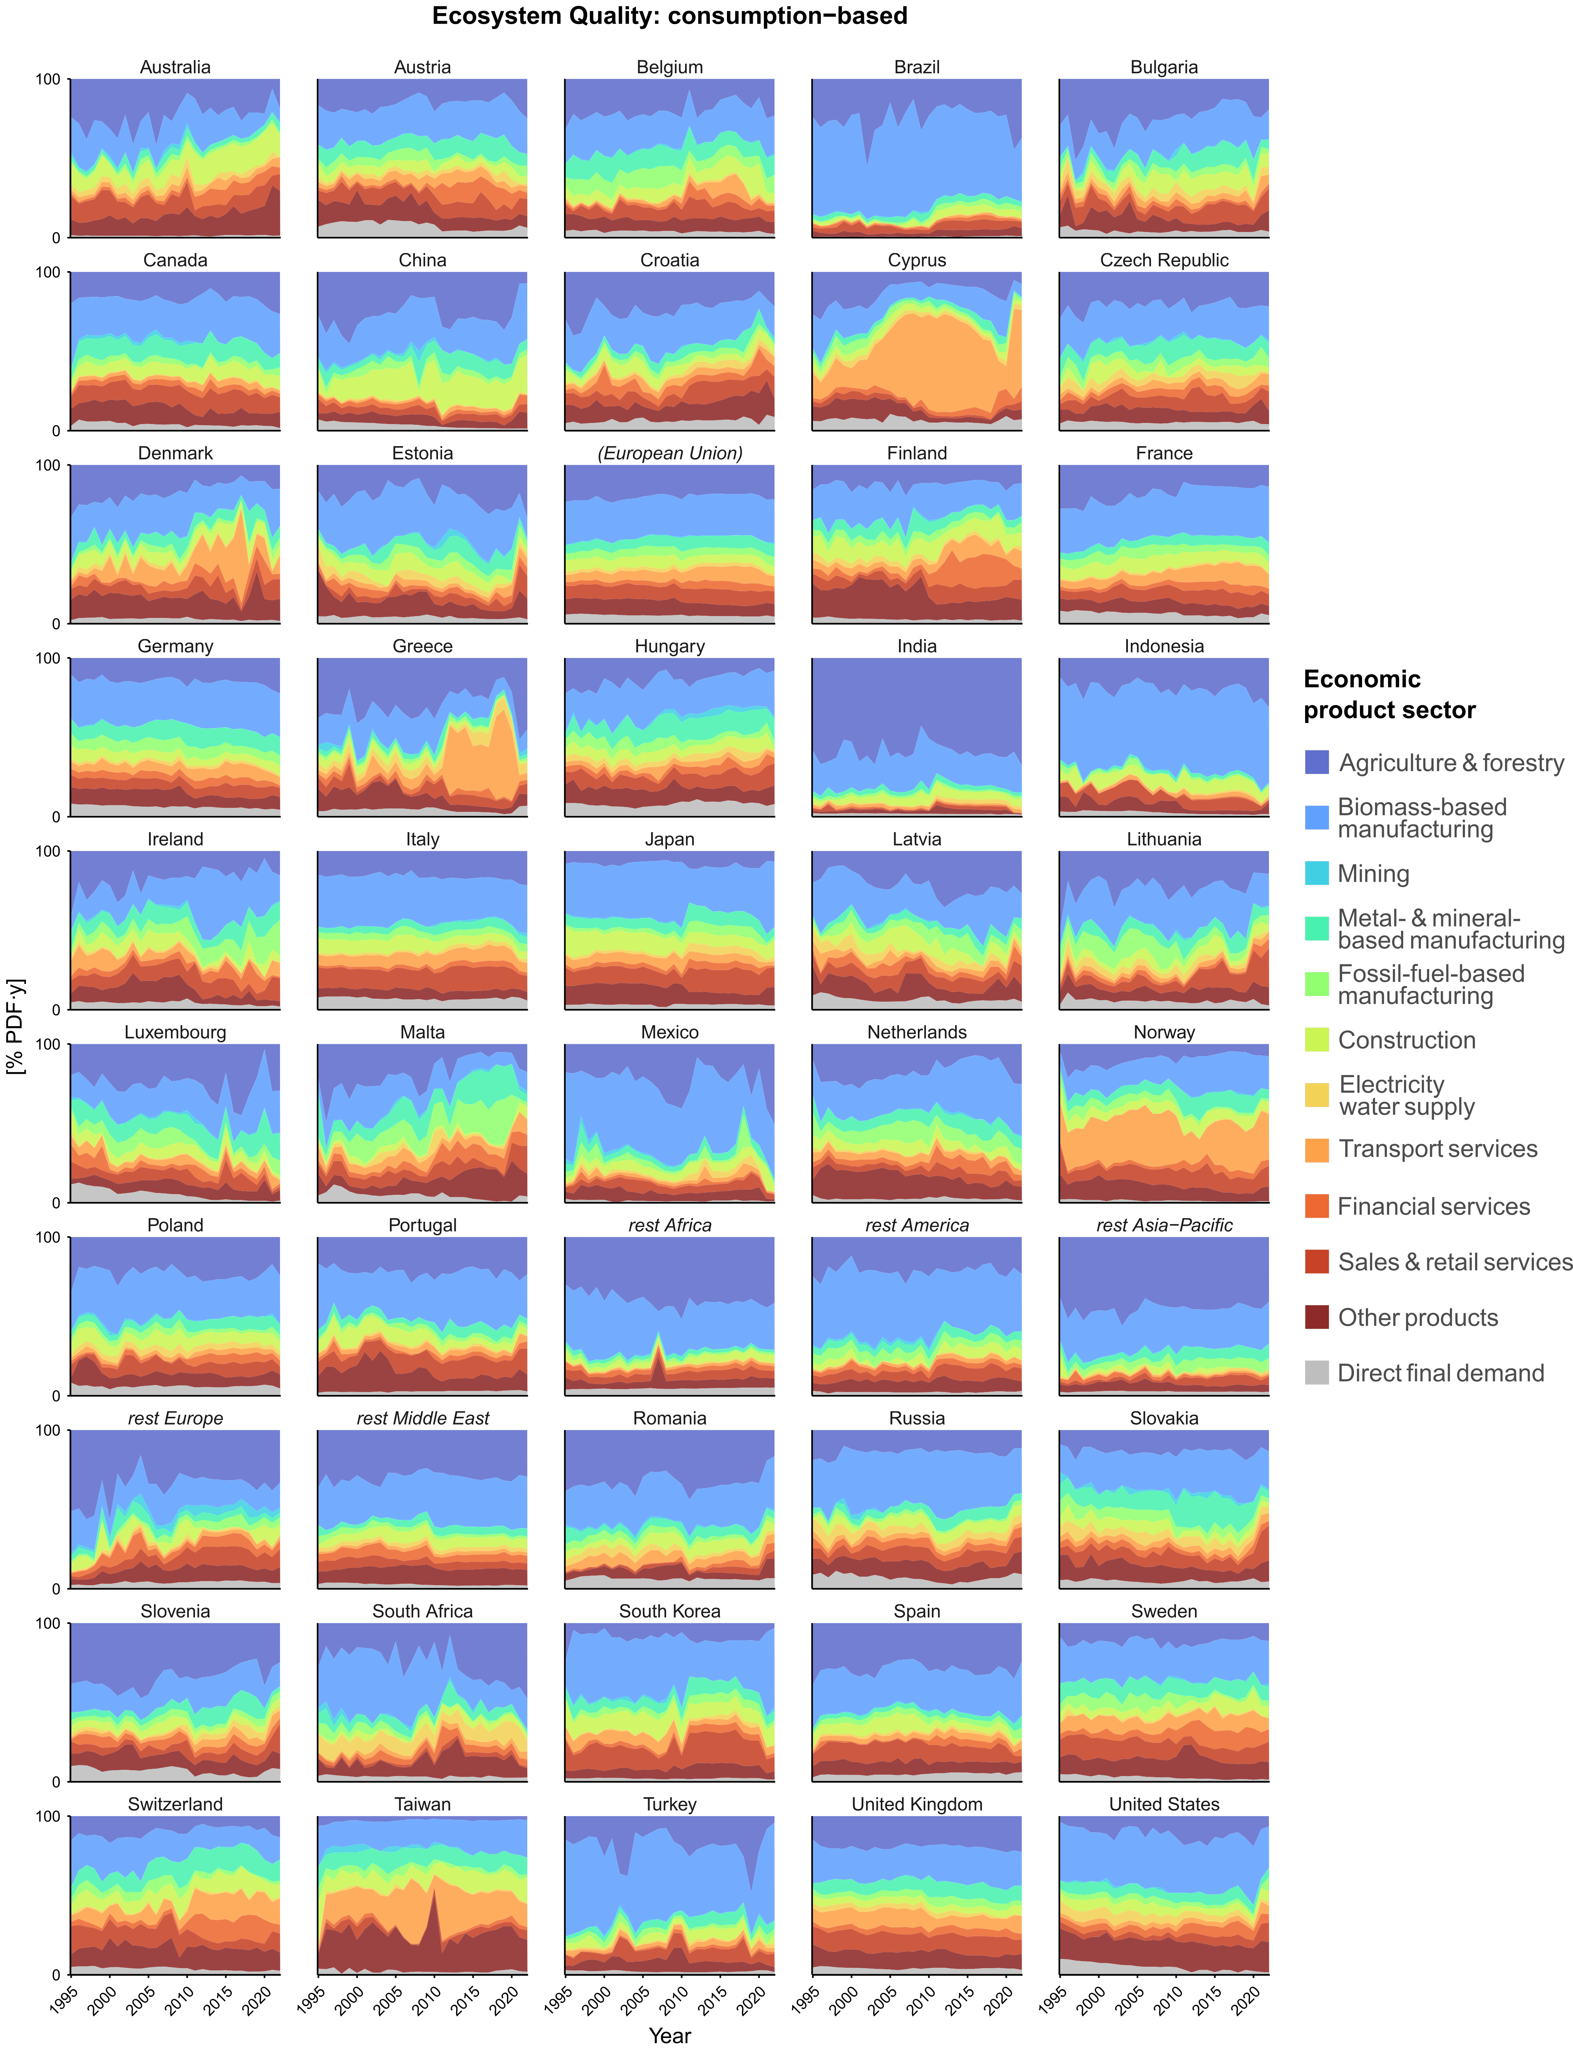
RESULTS · Q3
Economic drivers on a per country level (EQ example)
% PDF.y
Goldenberg et al (subm)

Slide 21
AoP FOOTPRINTS OF NATIONS · EXIOBASE × UNEP-GLAM
Area-of-protection footprints:
Ecosytem Quality / Human Health & Socio-Economic Assets
How big are these footprints?
Q1
Do they decouple from GDP?
Q2
Total and per-capita impact embodied in a country's consumption.
Footprint tracked against economic growth over time
What drives the footprints
Q3
Where does it show up in products?
Q4
Impact drivers: land use, water use, carbon and ecotoxicity, ...
Economic drivers:: agriculture, manufacturing, ...
Zooming from nations to a product hotspot: textiles & apparel.

Slide 22
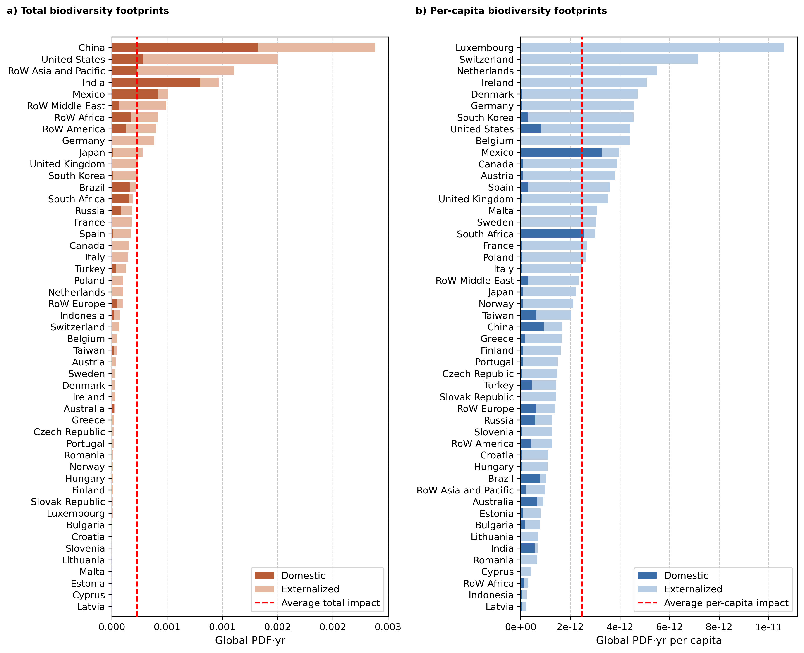
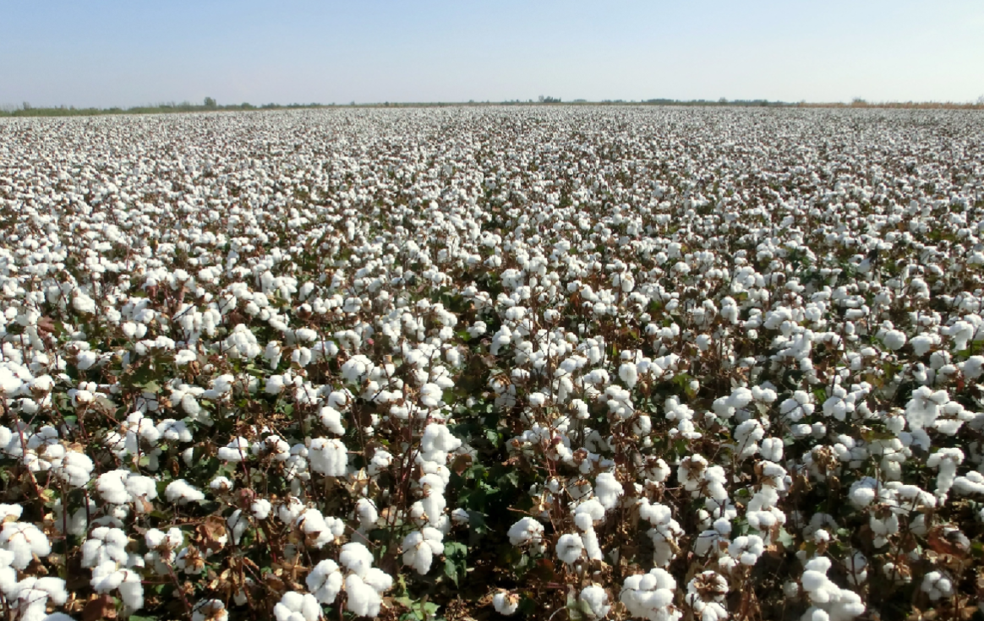
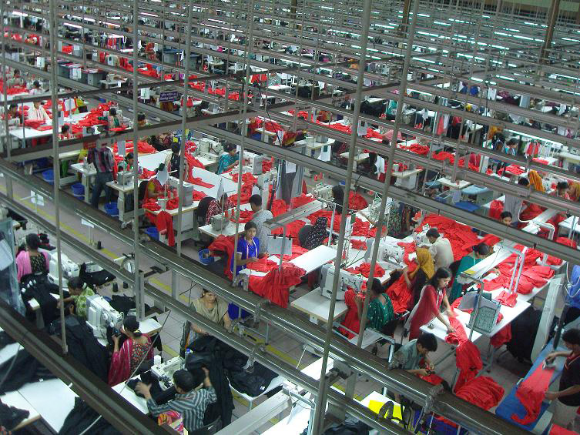
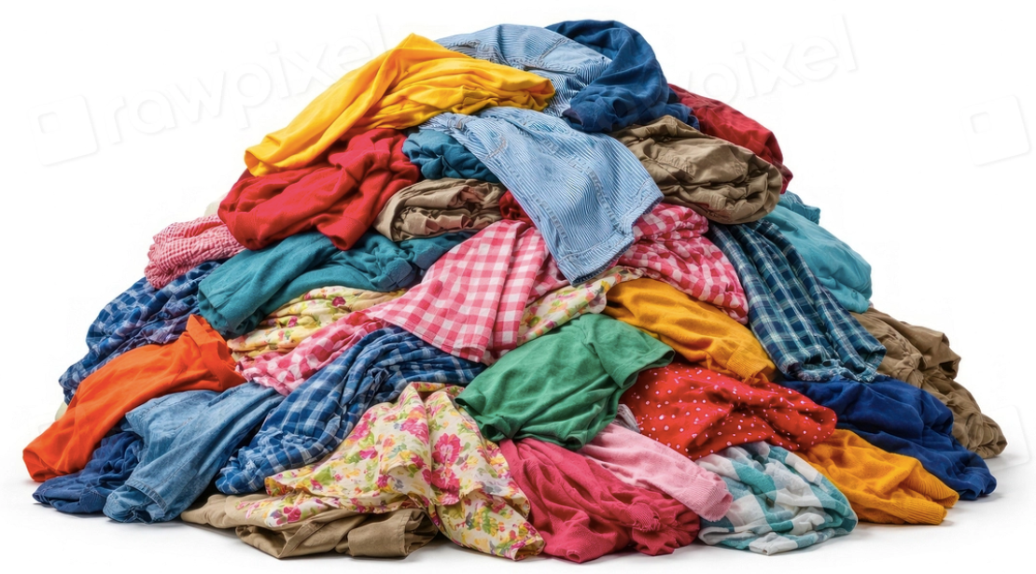
RESULTS · Q4
Where does it show up in products?
Ecosystem Quality Footprints of Apparel/Textiles/Wool/Leather
Eikeland et al (in prep)

Slide 23
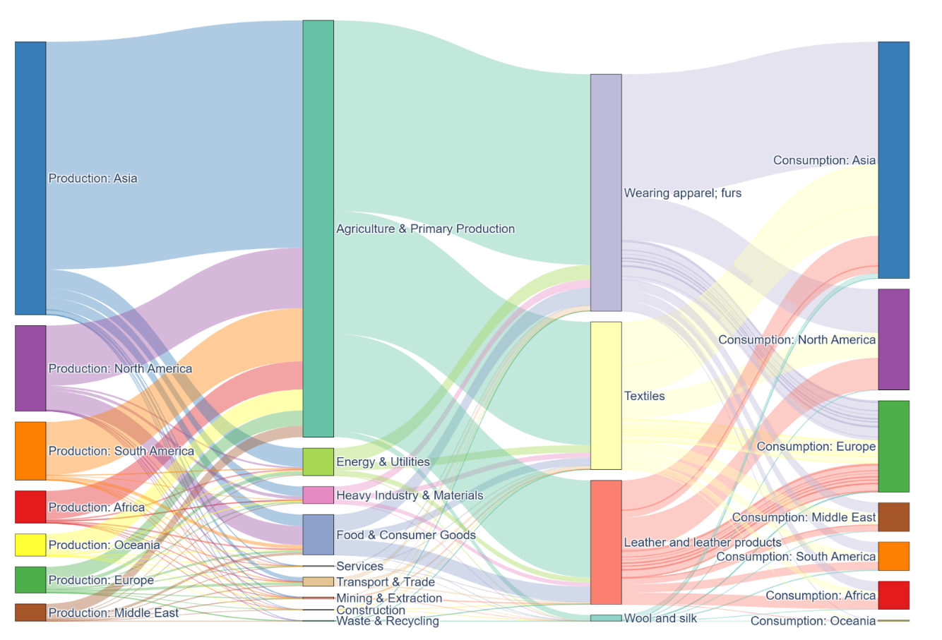
RESULTS · Q4
Where does it show up in products?
Tracking the Footprints of Apparel/Textiles/Wool/Leather
Figure 3: The redistribution of consumption-based biodiversity footprints across the global textile and apparel supply chain in 2022. The flow charts trace biodiversity pressures from producing regions, through upstream supplying sectors and textile-related industries, to final consumption regions. The total flow at each stage represents the total biodiversity footprint of global textile and apparel consumption, averaged across ecosystem realms
Eikeland et al (in prep)

Slide 24
Further applications

Slide 25






Spend-based AoP footprints for sustainability reporting
Coupling EXIOBASE with UNEP-GLAM provides ecosystem/human health/SEA-quality multipliers
→
→
Procurement spend
(€ per EXIOBASE/NACE etc sector)
AoP spend based impact factors
(EXIOBASE × UNEP-GLAM)
+ GHG · water · materials
= full footprint
CSRD · ESRS E4
Country footprints & trends
Framework interoperability
Value-chain AoP impacts under double materiality
One coherent set with GHG, water & material factors → comprehensive screening
Runs on procurement spend firms already hold; flags hotspots to refine
Consumption-based AoP footprints by country, over time
Consumption level vs impact: decoupling analysis
Macro context for sectoral and policy priorities
ILCD-conform EXIOBASE satellite account
Bridges LC-IMPACT & EU-PEF
Cross-method application
www.xio-sa.com
Notes:
Core message: linking EXIOBASE (EE-MRIO) with UNEP-GLAM yields spend-based ecosystem-quality impact factors — IO multipliers (PDF·yr per euro) for every EXIOBASE sector, capturing total supply-chain biodiversity impacts.
Why it matters: biodiversity is the hardest gap in value-chain reporting — most impact sits upstream and abroad, supplier-level data barely exists, and EU-PEF does not cover biodiversity by default. A spend-based factor set closes that gap using the procurement spend companies already report.
Flow (left to right): spend by EXIOBASE sector → EXIOBASE×GLAM linkage → ecosystem-quality multipliers → combined with existing GHG/water/material factors into one comprehensive footprint.
Applications: (1) CSRD/ESRS E4 — value-chain biodiversity under double materiality; consistent with the other stressor multipliers, so a single coherent screening of impacts; useful for hotspot identification before activity-based refinement. (2) Country-level footprints and trends, and the consumption-vs-biodiversity relationship (decoupling). (3) The ILCD-conform satellite account makes results interoperable with LC-IMPACT and EU-PEF, enabling cross-method comparison rather than a silo.
Caveat to pre-empt: EEIO is screening-grade (±40-60% typical), best for hotspotting and macro analysis; activity/site data still needed for material, location-based ESRS E4 disclosures.

Slide 26




OUTLOOK
What's next: papers, data & tooling
Goldenberg et al.
Impacts on biodiversity, human health & natural resources across the global economy
Under review
Eikeland et al.
Biodiversity pressures of the fashion industry
In prep
Impact-characterization satellite account
Upcoming EXIOBASE 3.11
Beta
Spend-based impact factors
In the XIO Sustainability Analytics scope 1 / 2 / 3 factor package · xio-sa.com
Beta
ILCD-based linking to LC-IMPACT 2.0 & EU-PEF
Extending interoperability of the EXIOBASE satellite account
In development

Slide 27
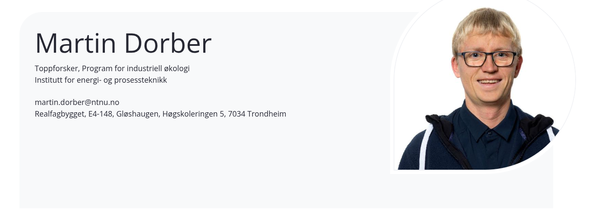





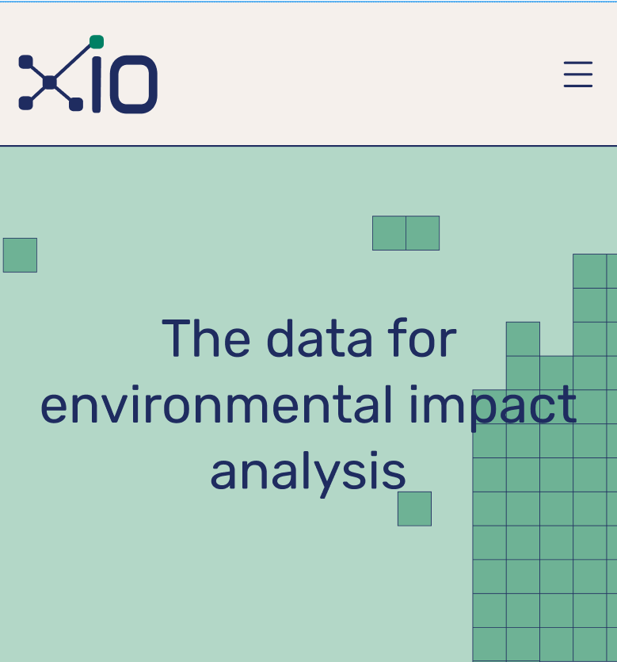



Thanks
The Team
Industrial Ecology Programme
https://www.ntnu.edu/indecol/industrial-ecology-programme
https://xio-sa.com

