Slide 1
Global Production Relocation with Gravity: A Triangle Perspective
Xiang GAO¹ Yi HUANG² Yu ZHAO¹³ Geoffrey Hewings⁴ Cuihong YANG¹
  ¹State Key Laboratory of Mathematical Sciences, Academy of Mathematics and Systems Science, Chinese Academy of Sciences
  ²School of Economics and Management, Xiamen University Malaysia
  ³City University of Hong Kong
  ⁴Institute of Government and Public Affairs, Regional Economics Applications Laboratory (REAL), University of Illinois at Urbana-Champaign

Slide 2
1. Introduction

Slide 3
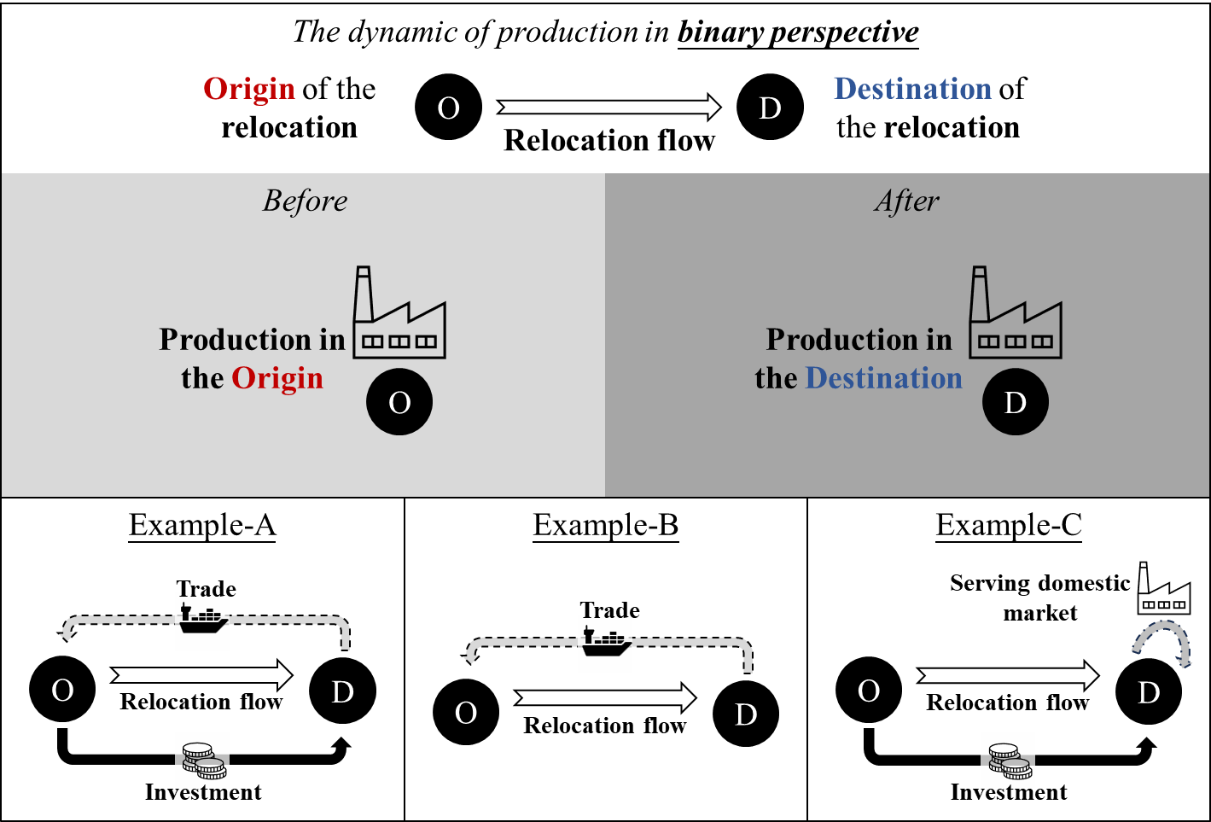
A Binary Perspective of Relocation:
2 nodes: Origin economy (O); Destination economy (D)
The movement of production from an origin economy to a destination economy
Offshore insourcing
Offshore outsourcing
Multinational operation
…
Insufficient for explaining recent episodes of global value chain restructuring

Slide 4
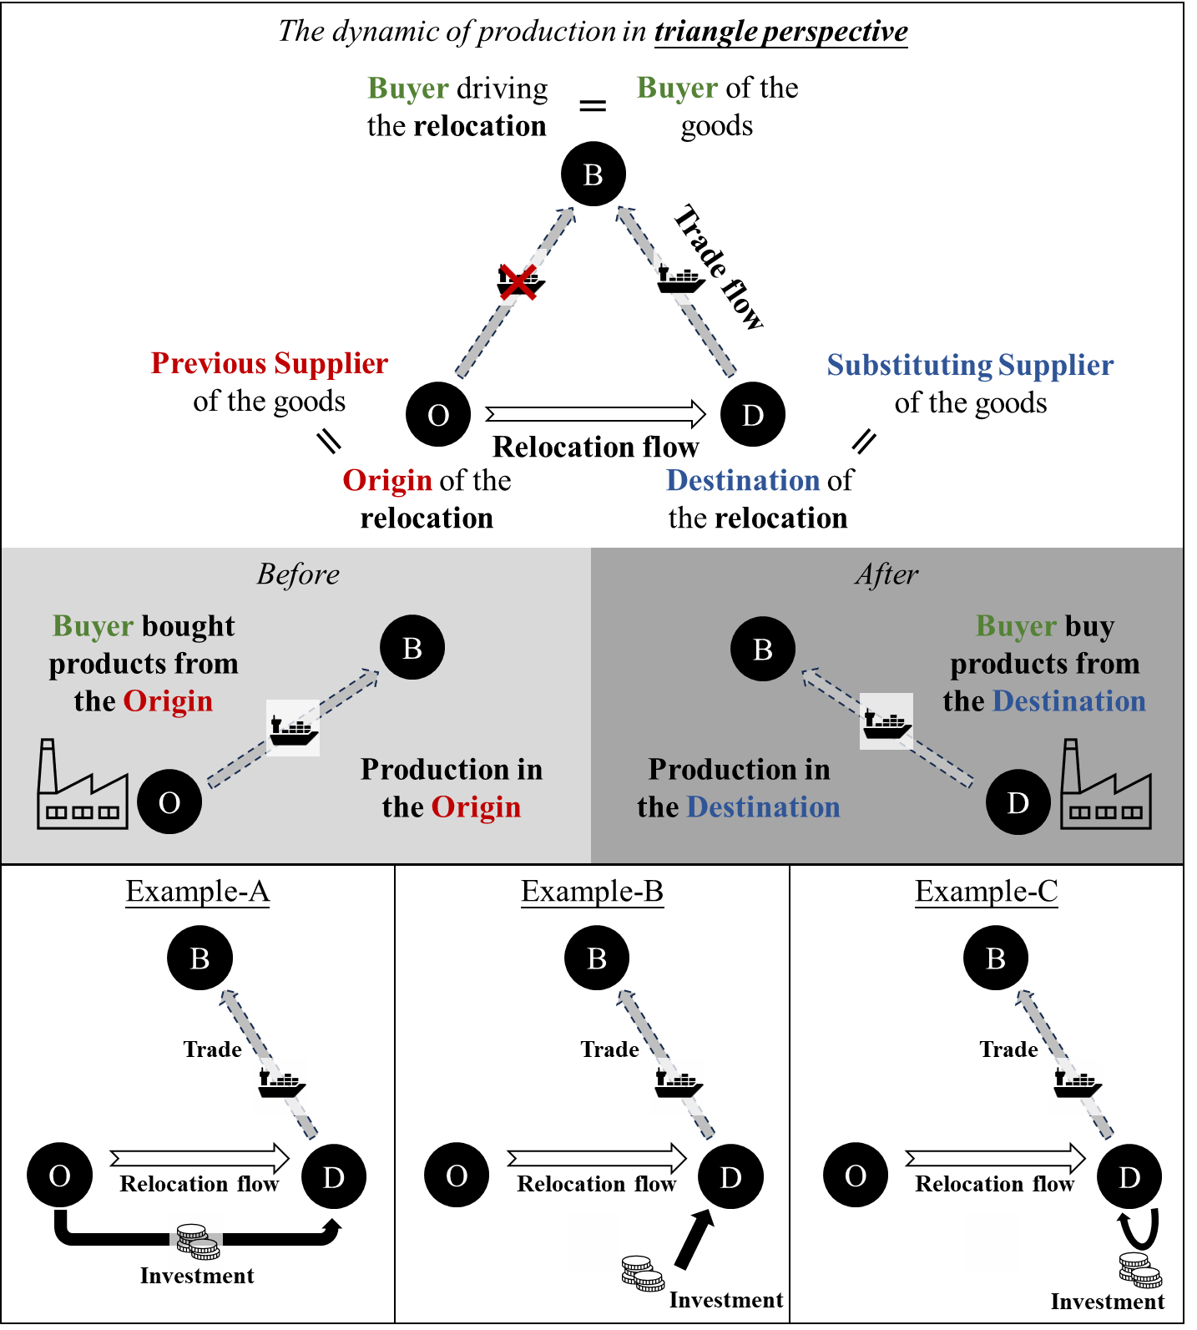
A Triangle Perspective of Relocation:
3 nodes:
  Origin economy (O): Production initially located
  Destination economy (D):
  New production site
  Buyer economy (B):
  Triggering the adjustment
A salient example: The partial decoupling between the U.S. and China, which has prompted substantial relocation of production from China to alternative locations such as Mexico and Vietnam

Slide 5
A Triangle Perspective of Relocation:
Shaped by 2 gravitational forces:
  Trade linkages between B-O and between B-D
    A relative easing of access to the buyer from the destination (a pull factor) versus the origin (a push factor) can motivate a buyer to shift its sourcing network
    Geo, institutional, cultural distance; tariffs
  Relocation barriers between O-D
    fixed investment, supply chain shifting costs

Slide 6
2. Literature

Slide 7
Gravity and Production Relocation:
Gravity in FDI
  Multinational firms transfer productive capacity across borders by establishing or acquiring foreign affiliates (Falk, 2016; Kox and Rojas-Romagosa, 2020; Di Ubaldo and Gasiorek, 2022; Jiang et al., 2024; Larch and Yotov, 2025)
  Vertical FDI: Production stages are fragmented across countries
  Horizontal FDI: Firms replicate production across market
Gravity in Trade
  Modern GVCs often coordinate production through non-equity relationships (Grossman and Helpman, 2002; Antras, 2015; Antras and De Gortari, 2020)
    Outsourcing and contract manufacturing; e.g. Apple’s assembling in China
    Relocation manifests in trade flows rather than investment
  Reduced-form specifications & structural frameworks (Anderson and Van Wincoop, 2003; Caliendo and Parro, 2015; Mayer et al., 2025)
Both traditions analyze bilateral relationships in isolation.

Slide 8
Recent work recognizing the networked dimension:
Structural models incorporating multinational production
  Firms produce across multiple locations to serve global markets (Cai and Xiang, 2025; Cai et al., 2025)
Search-and-matching frameworks embedded in gravity
  The costs of switching suppliers (Grossman et al., 2024; Arkolakis et al., 2023).
GVC measurement literature tracing the structural change of production networks (Gao et al., 2022, 2025; Wang et al., 2025)
Causal inference to study trade diversion following policy shocks (Flaaen and Pierce, 2019; Zhang et al.,2023; Freund et al., 2024; Tan, 2024; Handley et al., 2025)
REMAINING GAPS: Structural models rely on complex simulations; GVC measures are primarily descriptive; Causal studies present the incomplete view due to the data limitation

Slide 9
What the paper did:
Developed a measure of global production relocation that explicitly identifies origins, destinations, and buyer economies.
  Trace changes overtime in the structure of the buyer-driven global relocation
Estimate a triangular gravity model that uncovers a two-stage relocation mechanism in buyer-driven production networks
  Origins are pushed into adjustment by their cost-based exposure to buyer-specific demand shock
  Displaced production capacity is pulled toward destinations that offer more favorable access to the same buyer’s market
  A pronounced asymmetry in effects of tariffs and geopolitical tensions

Slide 10
3. Measurement

Slide 11
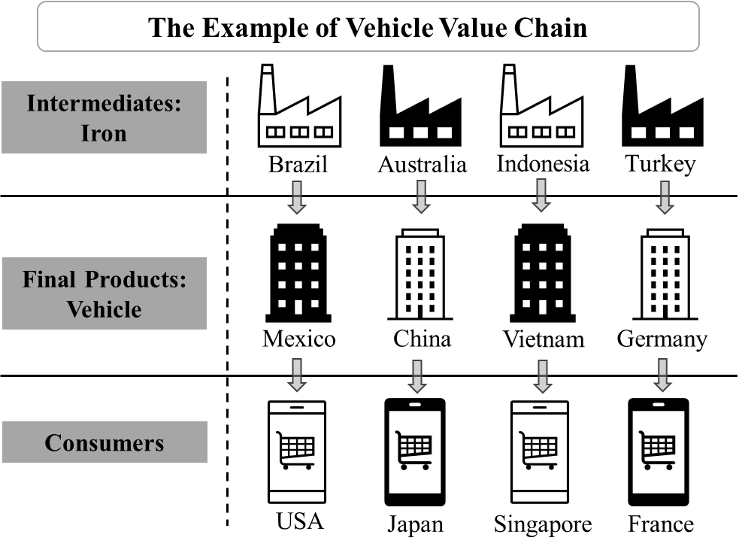
How to measure the global production relocation?
New measurement
  Gao X*, Hewings GJD, Yang CH (2025) Measuring the Industry Relocation at the Macro-level. Economic Systems Research. 37(3), 475–499.
Production Relocation：
The production of a good or service that meets a specific demand is relocated from one location to another.

Slide 12
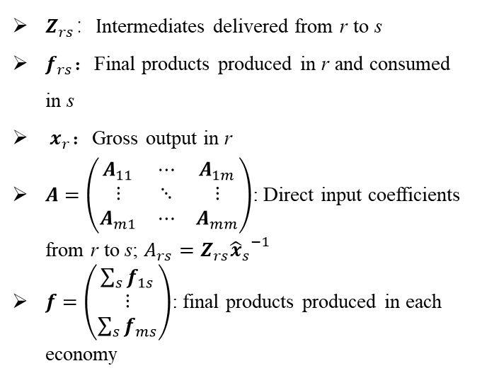
How to measure the global production relocation?
New measurement
  Gao X*, Hewings GJD, Yang CH (2025) Measuring the Industry Relocation at the Macro-level. Economic Systems Research. 37(3), 475–499.
    two components: (i) production relocation driven by intermediate inputs, (ii) by final products
$Z_{rs}：I$ntermediates delivered from r to s
$f_{rs}$：Final products produced in r and consumed in s
${ x}_{r}$：Gross output in r
$A=\left(\begin{matrix}A_{11} & ⋯ & A_{1m} \\ ⋮ & ⋱ & ⋮ \\ A_{m1} & ⋯ & A_{mm}\end{matrix}\right)$: Direct input coefficients from r to s; $A_{rs}=Z_{rs}{{\hat{x}}_{s}}^{−1}$
$f=\left(\begin{matrix}\sum_{s}{f_{1s}} \\ ⋮ \\ \sum_{s}{f_{ms}}\end{matrix}\right)$: final products produced in each economy
World Input-Output Table

Slide 13
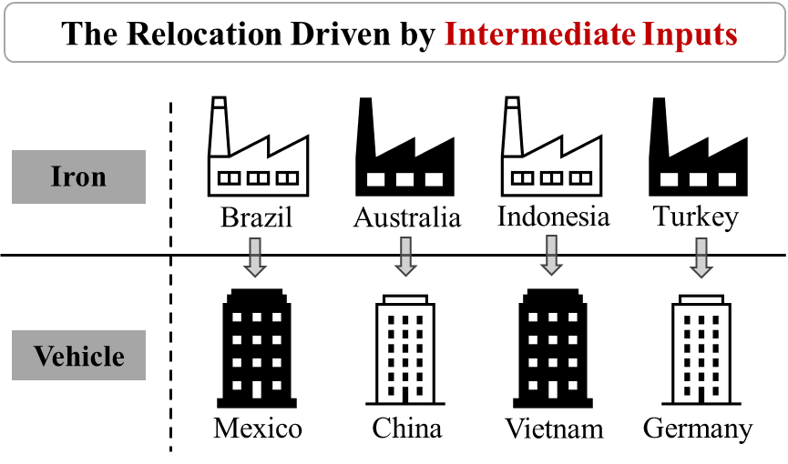
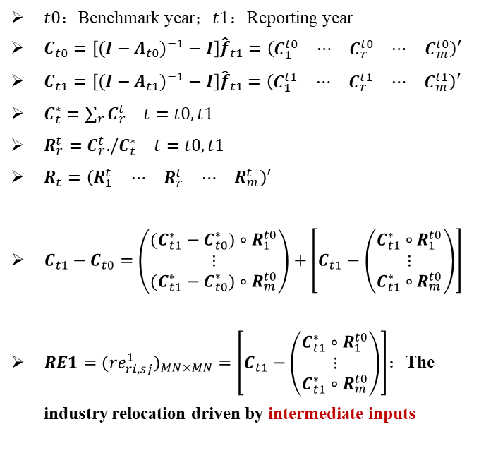
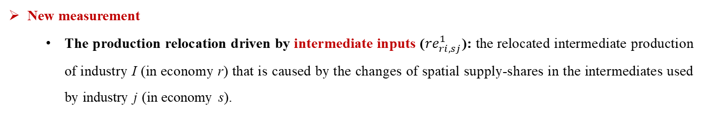

How to measure the global production relocation?
New measurement
  The production relocation driven by intermediate inputs (${re}_{ri,sj}^{1}$): the relocated intermediate production of industry I (in economy r) that is caused by the changes of spatial supply-shares in the intermediates used by industry j (in economy s).
$t0$：Benchmark year；$t1：$Reporting year
$C_{t0}=\left[(I−A_{t0})^{−1}−I\right]{\hat{f}}_{t1}={\left(\begin{matrix}C_{1}^{t0} & \begin{matrix}⋯ & C_{r}^{t0} & ⋯\end{matrix} & C_{m}^{t0}\end{matrix}\right)}^{′}$
$C_{t1}=\left[(I−A_{t1})^{−1}−I\right]{\hat{f}}_{t1}$ $={\left(\begin{matrix}C_{1}^{t1} & \begin{matrix}⋯ & C_{r}^{t1} & ⋯\end{matrix} & C_{m}^{t1}\end{matrix}\right)}^{′}$
$C_{t}^{∗}=\sum_{r}{C_{r}^{t}}$ $t=t0,t1$
$R_{r}^{t}=C_{r}^{t}./C_{t}^{∗} t=t0,t1$
$R_{t}={\left(\begin{matrix}R_{1}^{t} & \begin{matrix}⋯ & R_{r}^{t} & ⋯\end{matrix} & R_{m}^{t}\end{matrix}\right)}^{′}$
$C_{t1}−C_{t0}=\left(\begin{matrix}\begin{matrix}(C_{t1}^{∗}−C_{t0}^{∗})∘R_{1}^{t0} \\ ⋮\end{matrix} \\ (C_{t1}^{∗}−C_{t0}^{∗})∘R_{m}^{t0}\end{matrix}\right)+\left[C_{t1}−\left(\begin{matrix}\begin{matrix}C_{t1}^{∗}∘R_{1}^{t0} \\ ⋮\end{matrix} \\ C_{t1}^{∗}∘R_{m}^{t0}\end{matrix}\right)\right]$
$RE1=({re}_{ri,sj}^{1})_{MN×MN}=\left[C_{t1}−\left(\begin{matrix}\begin{matrix}C_{t1}^{∗}∘R_{1}^{t0} \\ ⋮\end{matrix} \\ C_{t1}^{∗}∘R_{m}^{t0}\end{matrix}\right)\right]$：The industry relocation driven by intermediate inputs
  $$×$$

Slide 14
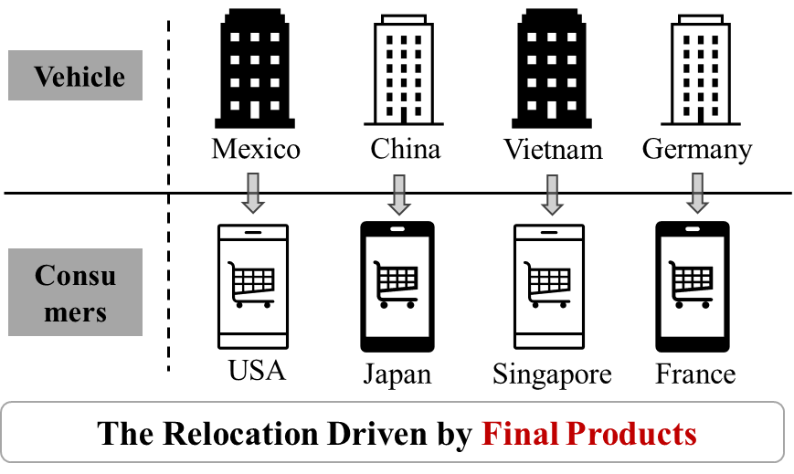
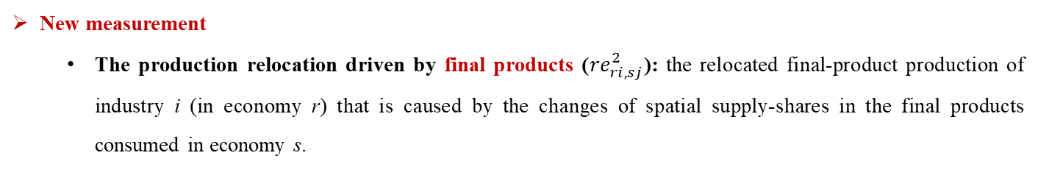

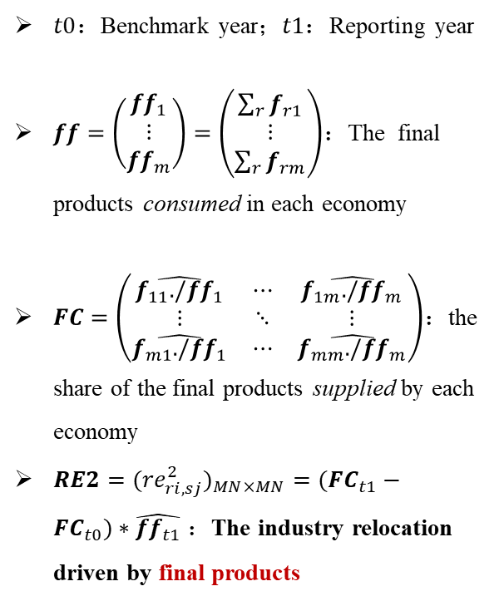
How to measure the global production relocation?
New measurement
  The production relocation driven by final products (${re}_{ri,sj}^{2}$): the relocated final-product production of industry i (in economy r) that is caused by the changes of spatial supply-shares in the final products consumed in economy s.
$t0$：Benchmark year；$t1：$Reporting year
$ff=\left(\begin{matrix}{ff}_{1} \\ ⋮ \\ {ff}_{m}\end{matrix}\right)=\left(\begin{matrix}\sum_{r}{f_{r1}} \\ ⋮ \\ \sum_{r}{f_{rm}}\end{matrix}\right)$：The final products consumed in each economy
$FC=\left(\begin{matrix}\hat{f_{11}./{ff}_{1}} & ⋯ & \hat{f_{1m}./{ff}_{m}} \\ ⋮ & ⋱ & ⋮ \\ \hat{f_{m1}./{ff}_{1}} & ⋯ & \hat{f_{mm}./{ff}_{m}}\end{matrix}\right)$：the share of the final products supplied by each economy
$RE2=({re}_{ri,sj}^{2})_{MN×MN}=({FC}_{t1}−{FC}_{t0})∗\hat{{ff}_{t1}}$ ：The industry relocation driven by final products
  $$×$$

Slide 15
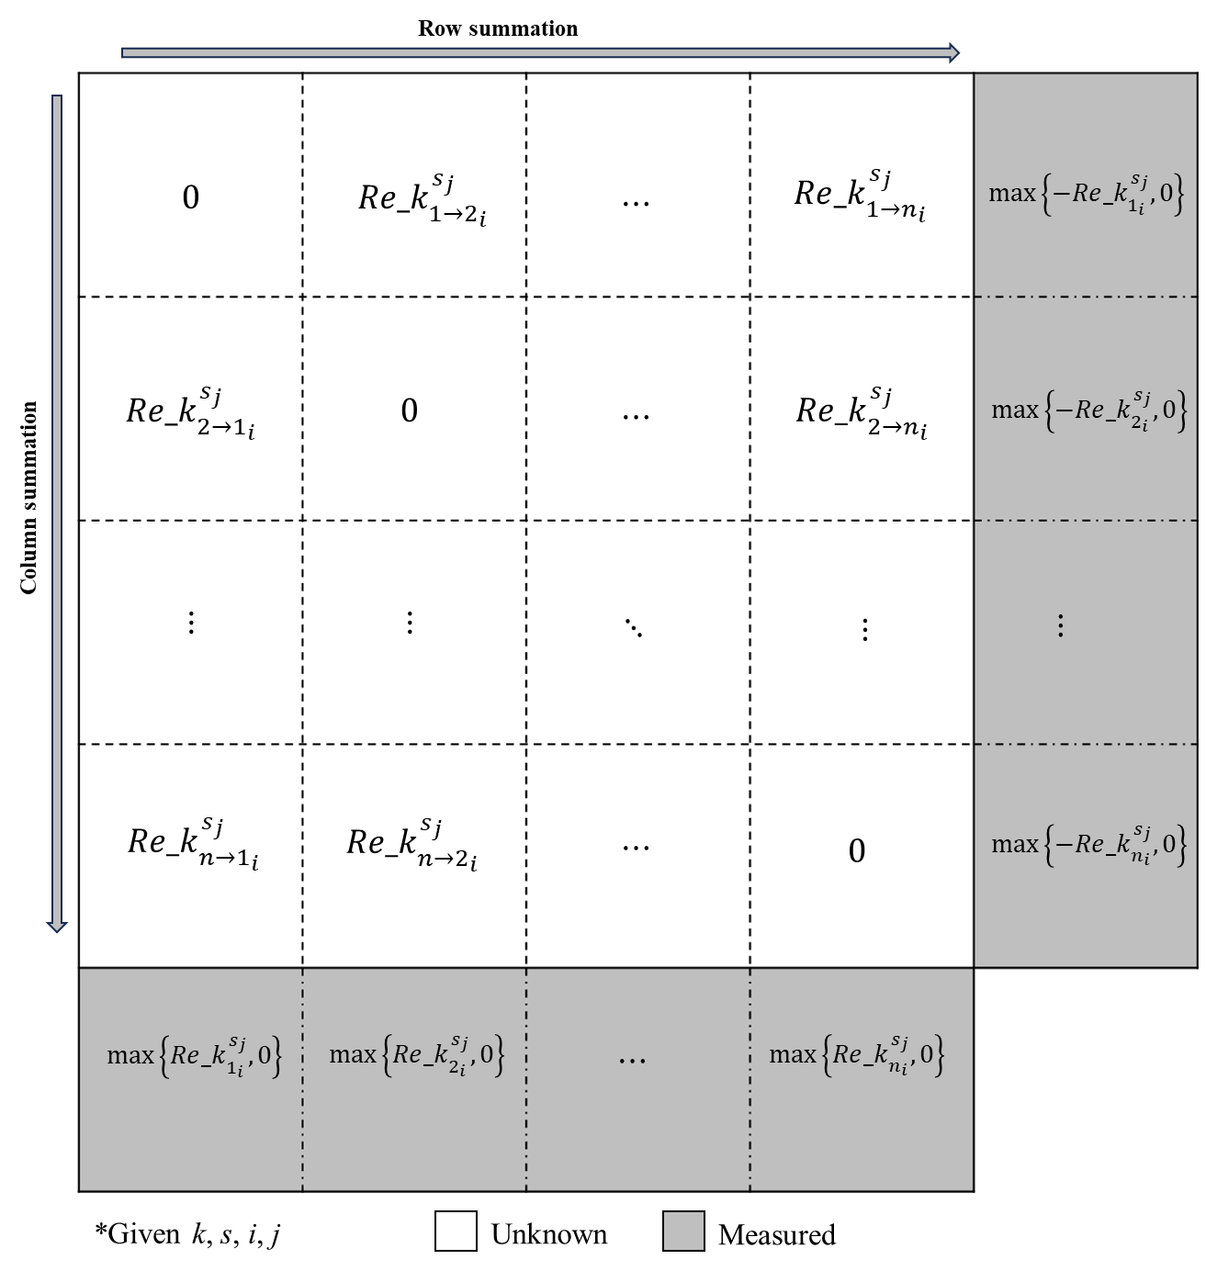
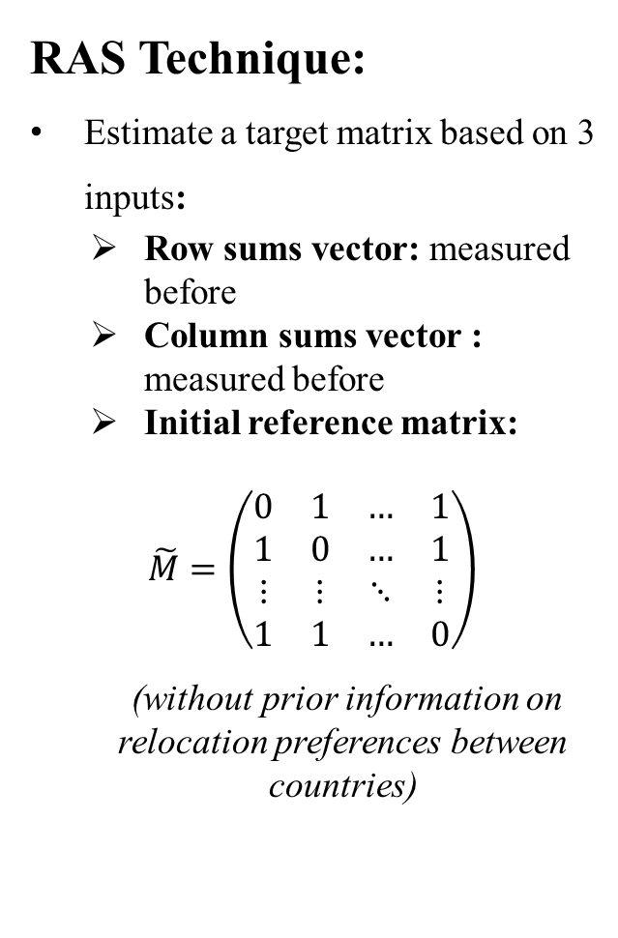
The gap between previous indicator and the triangular measure
RAS Technique:
Estimate a target matrix based on 3 inputs:
  Row sums vector: measured before
  Column sums vector : measured before
  Initial reference matrix:
  $\tilde{M}=\left(\begin{matrix}0 & 1 & … & 1 \\ 1 & 0 & … & 1 \\ ⋮ & ⋮ & ⋱ & ⋮ \\ 1 & 1 & … & 0\end{matrix}\right)$
  (without prior information on relocation preferences between countries)

Slide 16
4. Stylized Facts

Slide 17
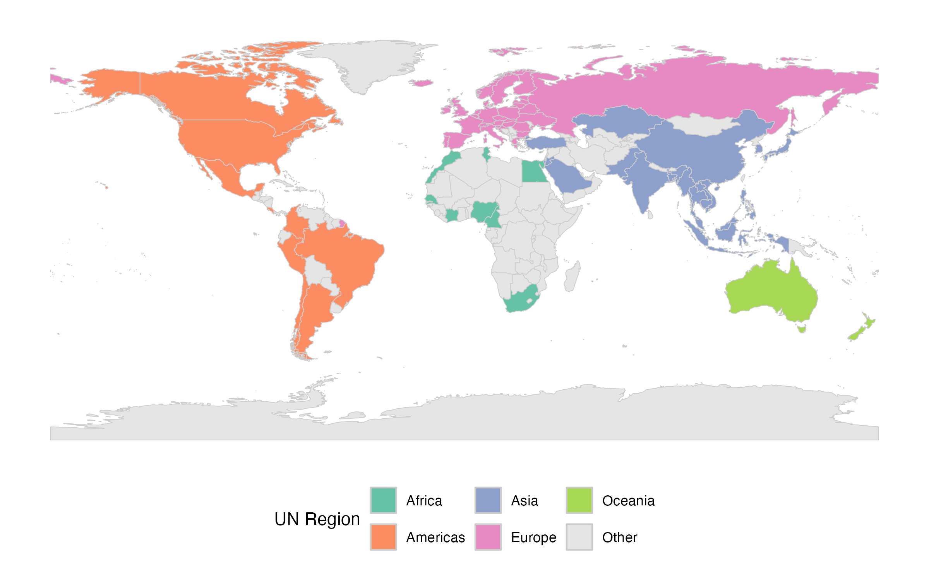
Calculation based on the 2022 edition of OECD-ICIO
74 economies: 33 European, 22 Asian,9 American, 8 African, and 2 Oceanian
3 multi-year windows: 2002-2007 (pre-financial crisis), 2008-2016 (post-crisis recovery), and 2017-2019 (recent trade realignment)

Slide 18
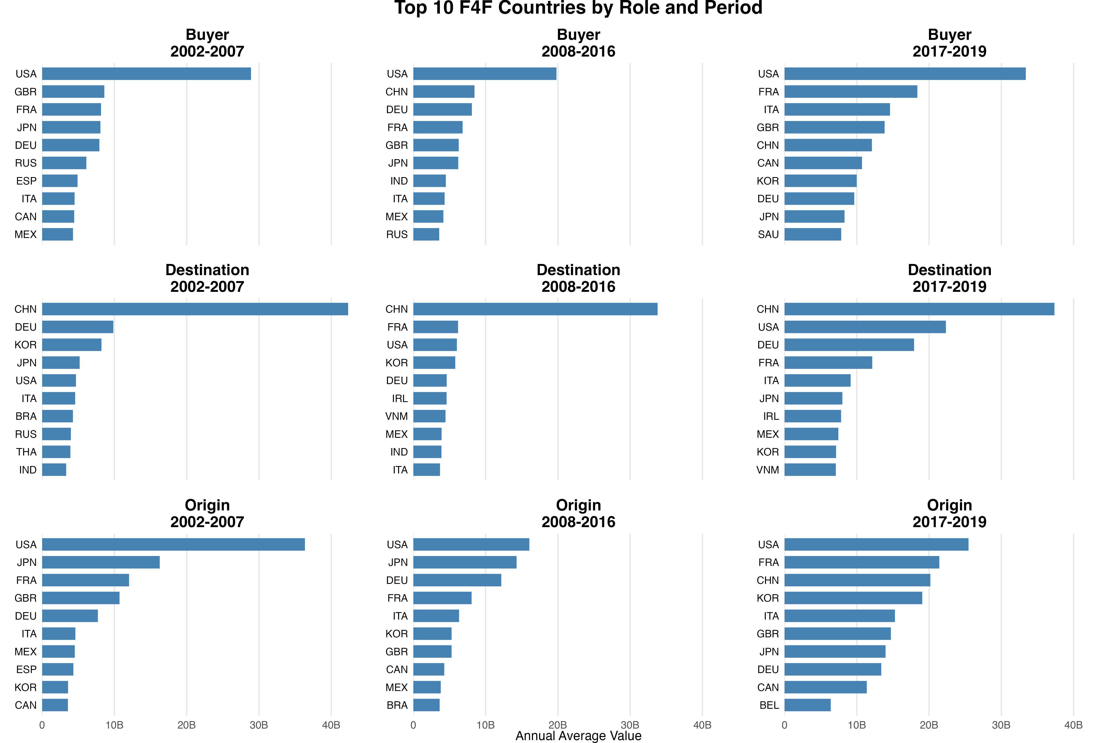
The production relocation driven by final products
Sharp differences after 2016

Slide 19
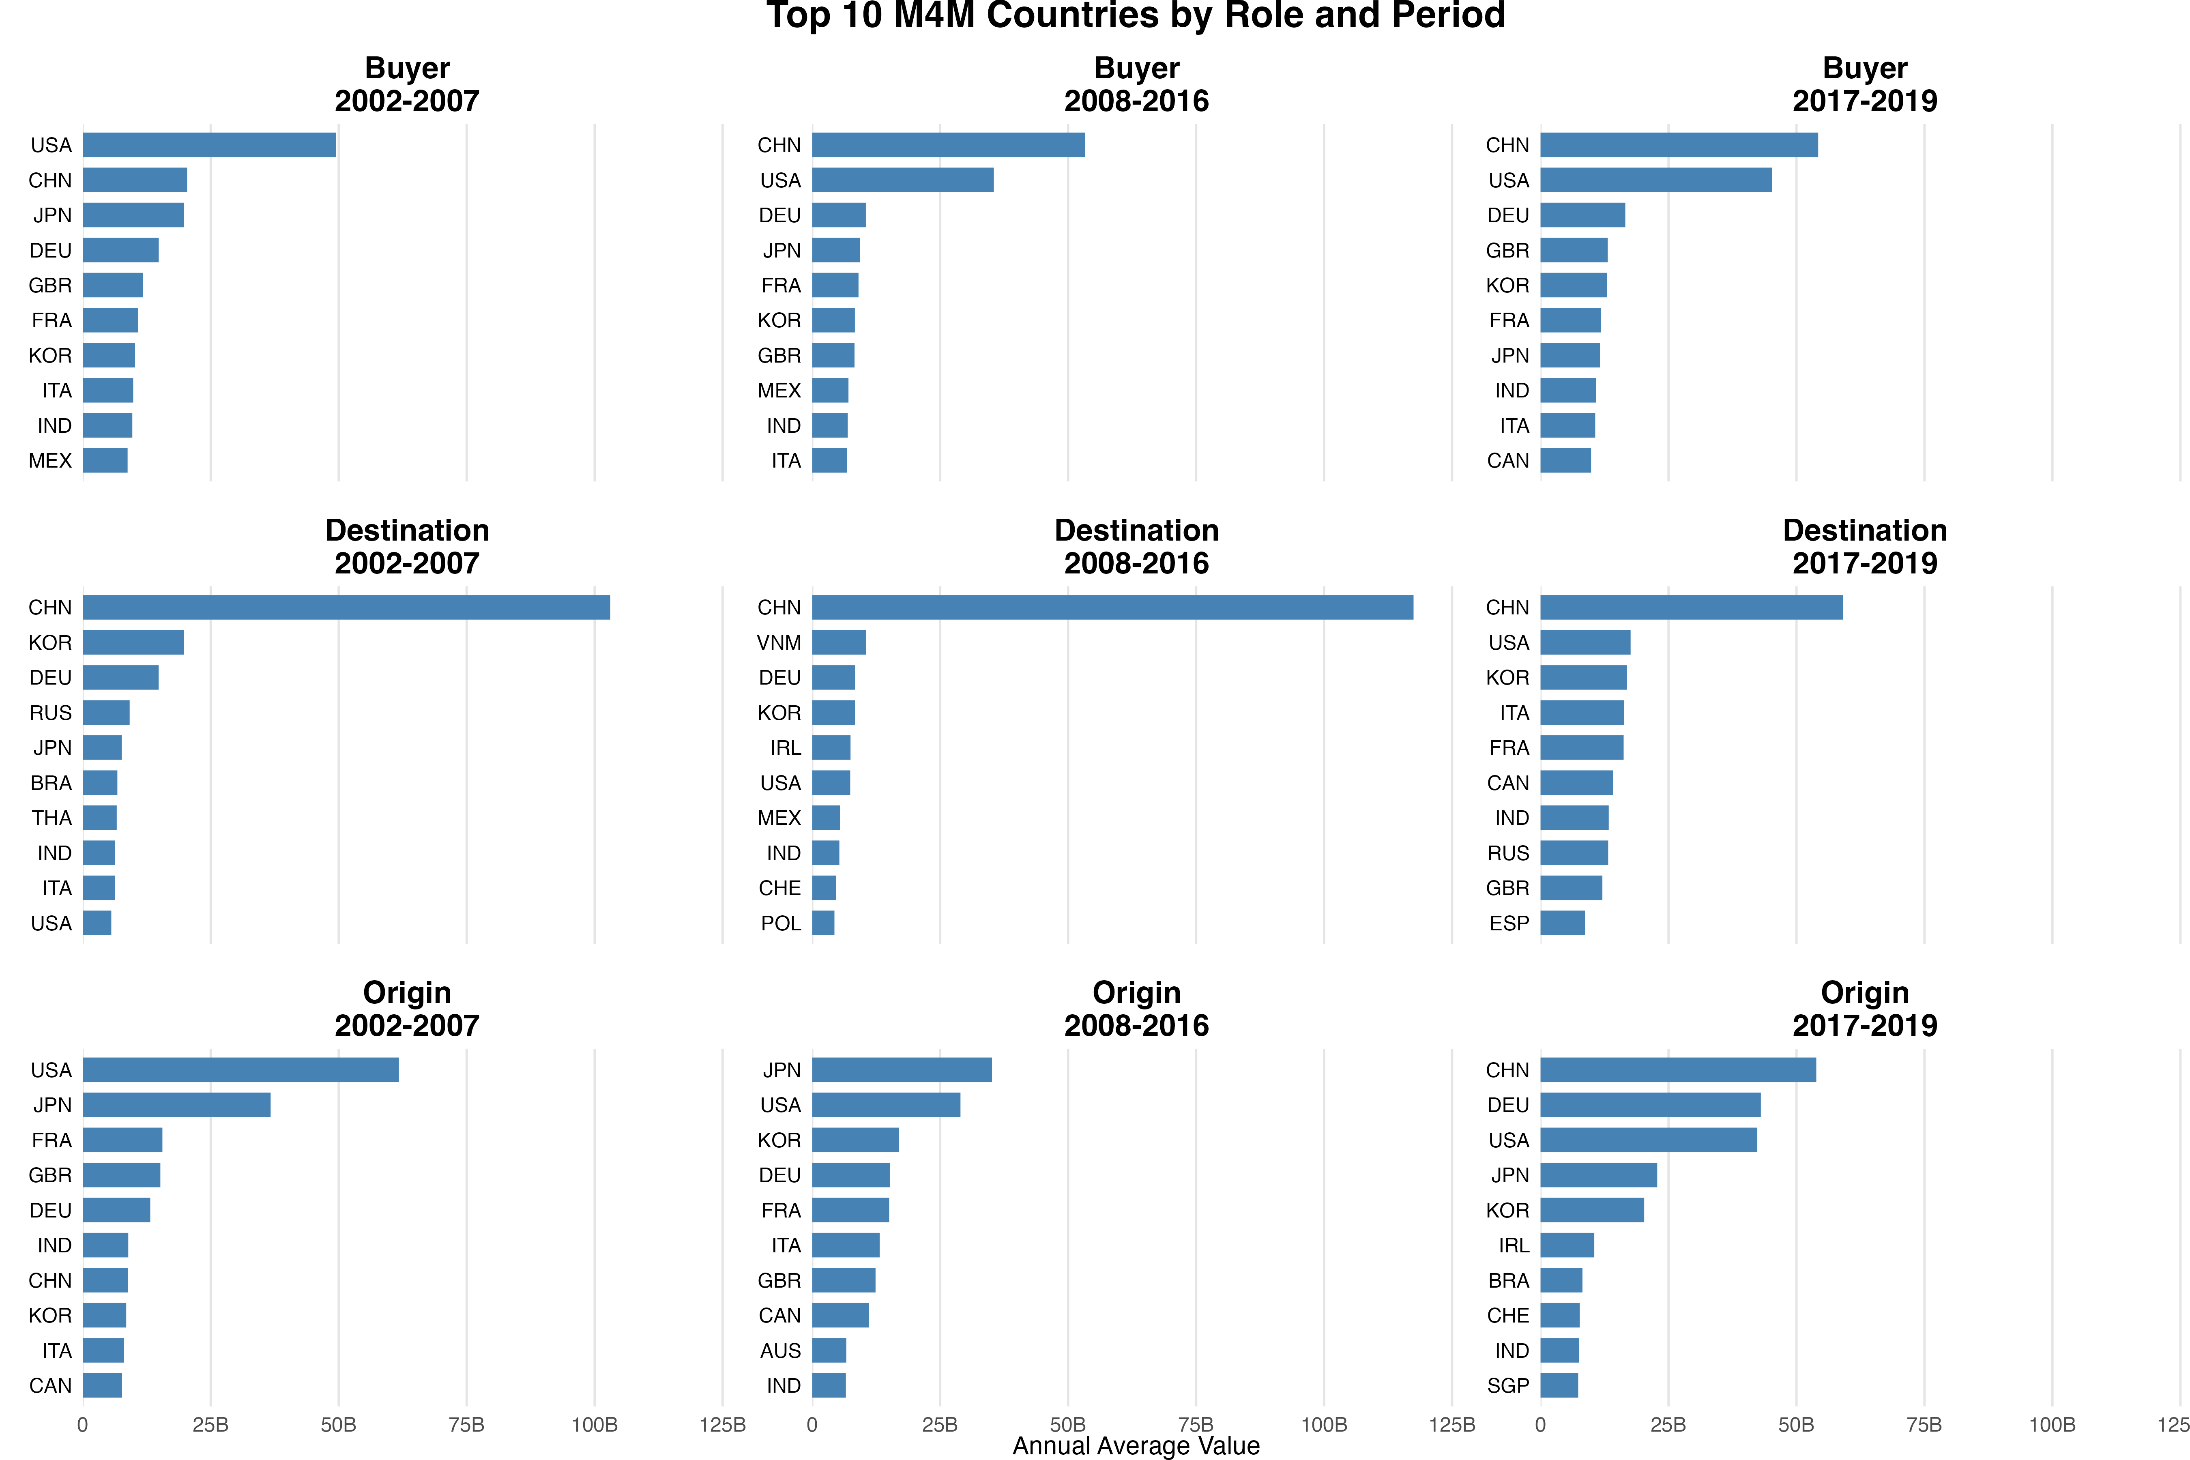
The production relocation driven by intermediate inputs
Sharp differences after 2016

Slide 20
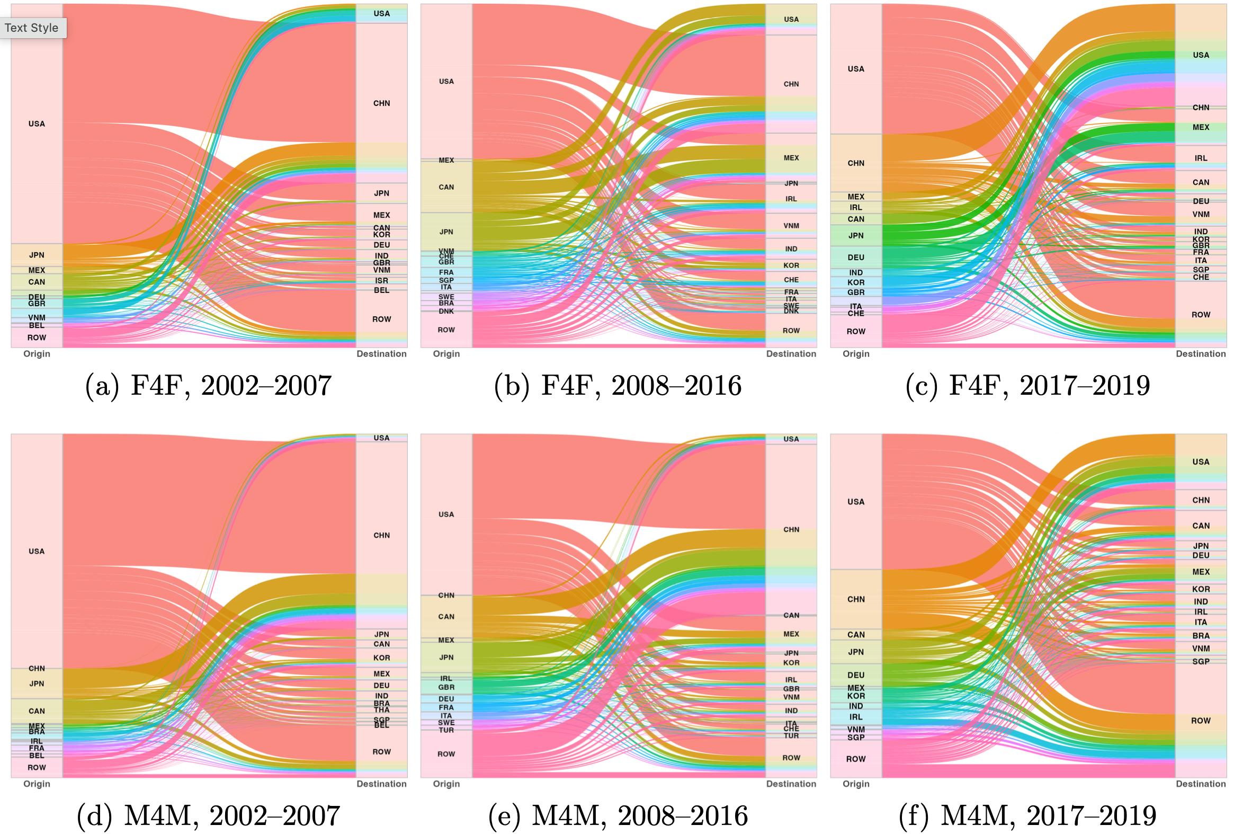
The U.S. as the Buyer economy
From tight coupling to visible decoupling with China

Slide 21
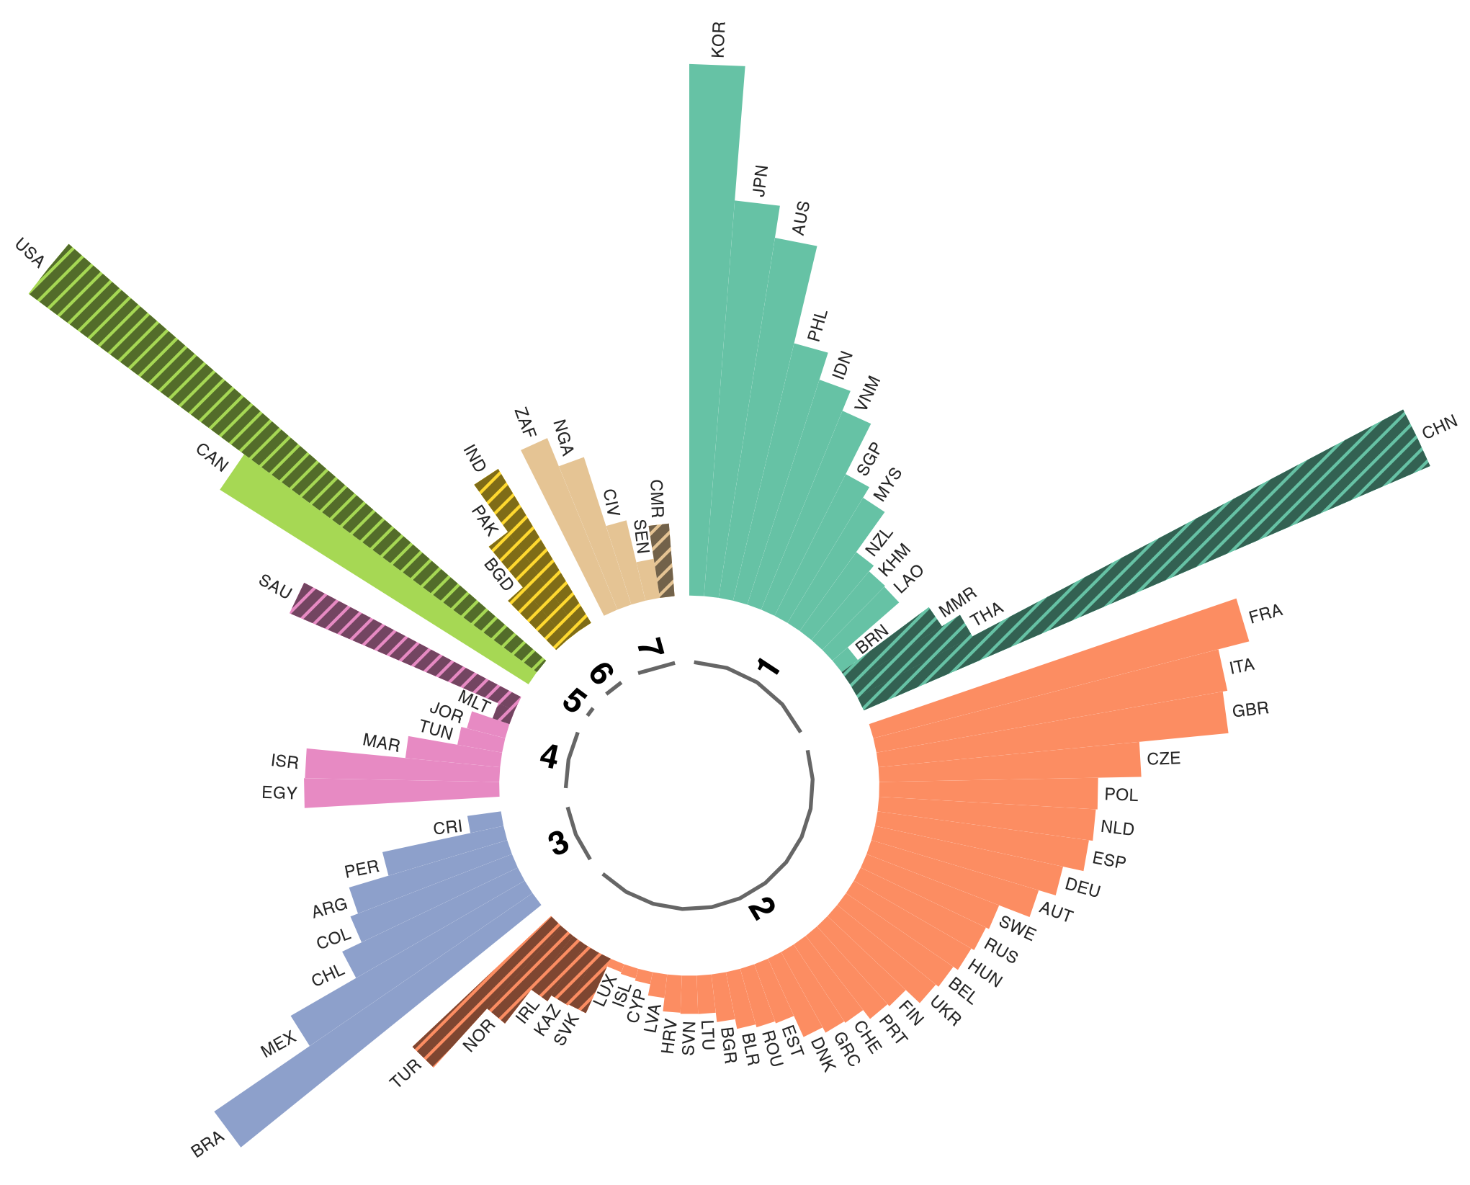
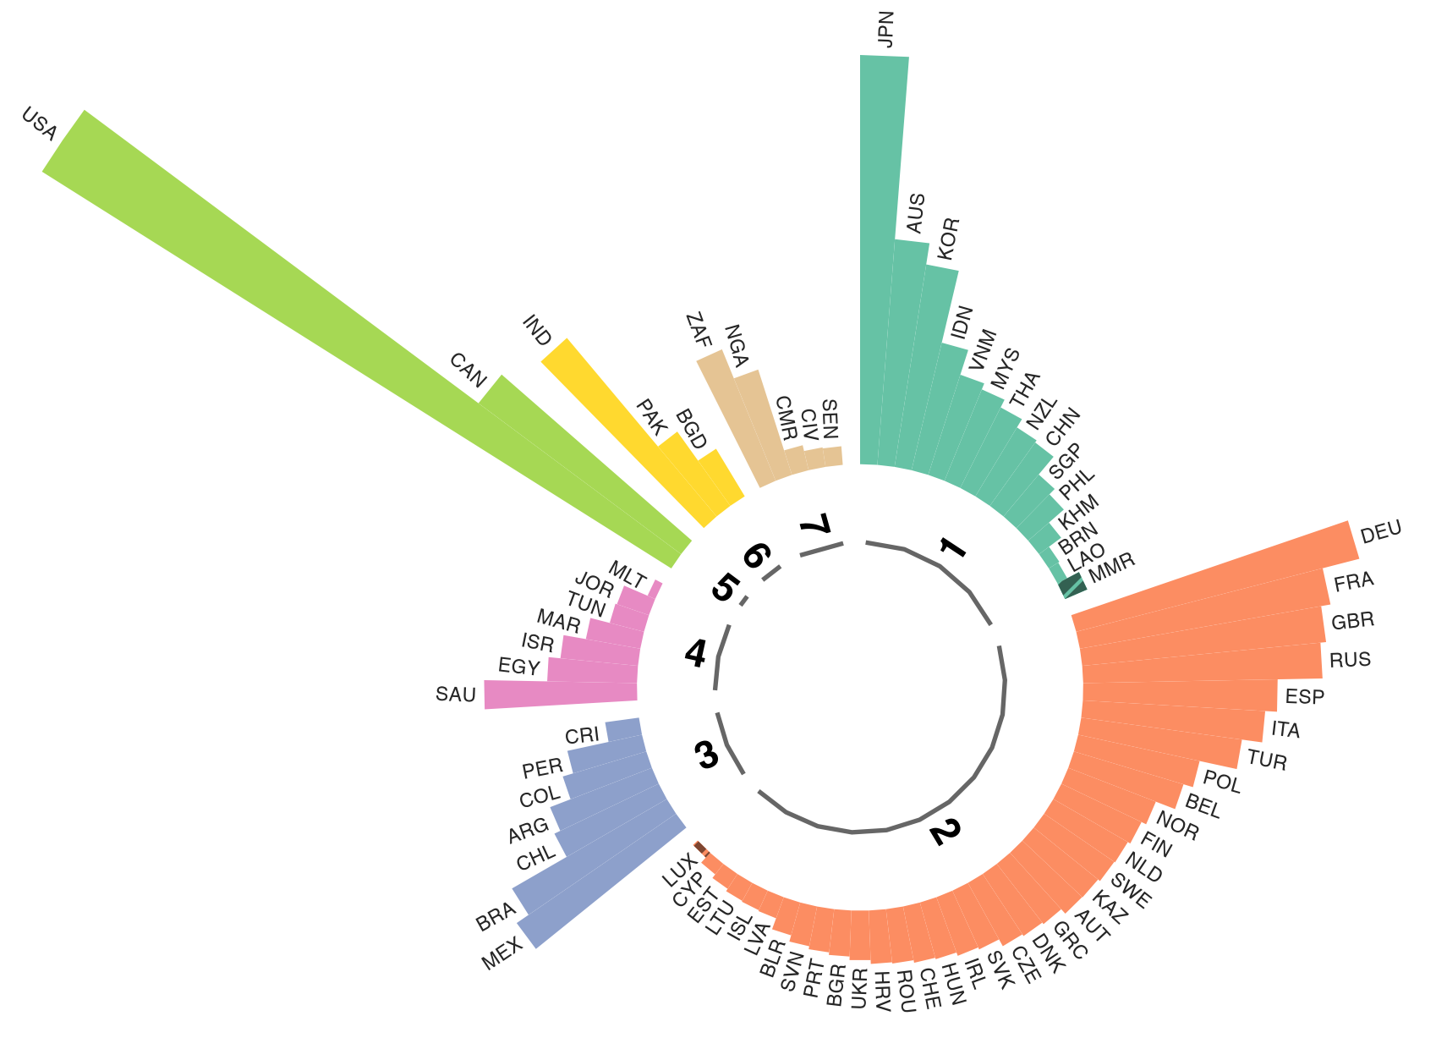
Institutional Shocks of China
China’s WTO accession (a) v.s. China-US trade conflicts (b)
Final products
(a)
China
2002-2007
(b)
China
2016-2019

Slide 22
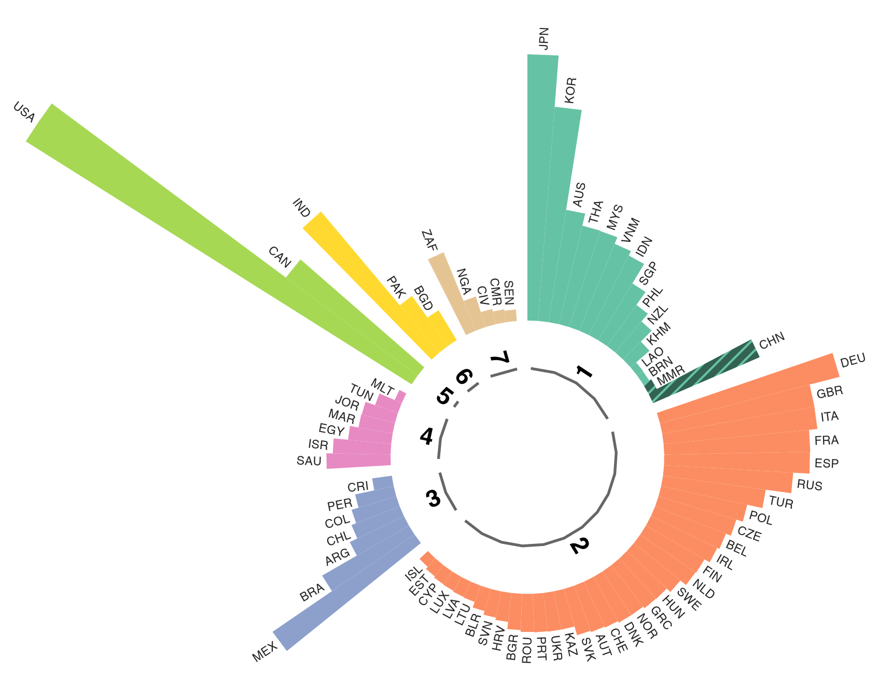
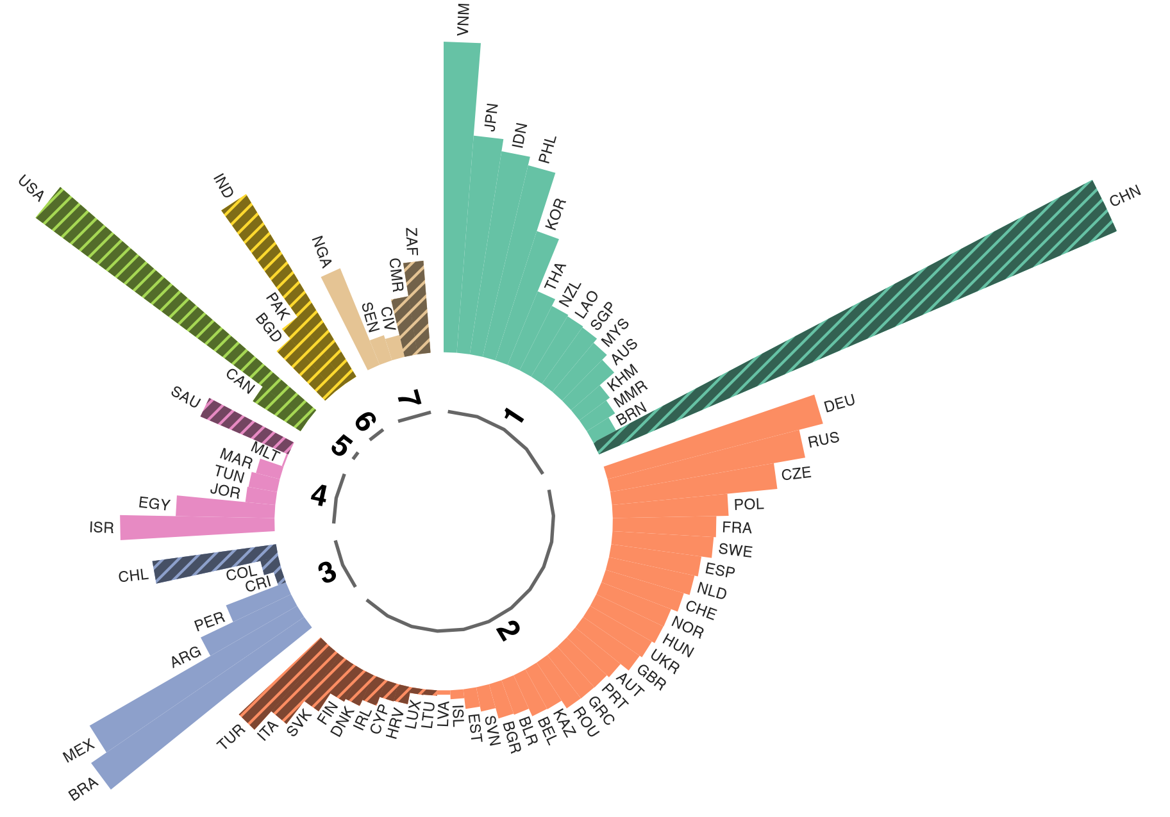
Institutional Shocks of China
China’s WTO accession (a) v.s. China-US trade conflicts (b)
Intermediate inputs
(a)
China
2002-2007
(b)
China
2016-2019

Slide 23
5. Gravity Regression

Slide 24
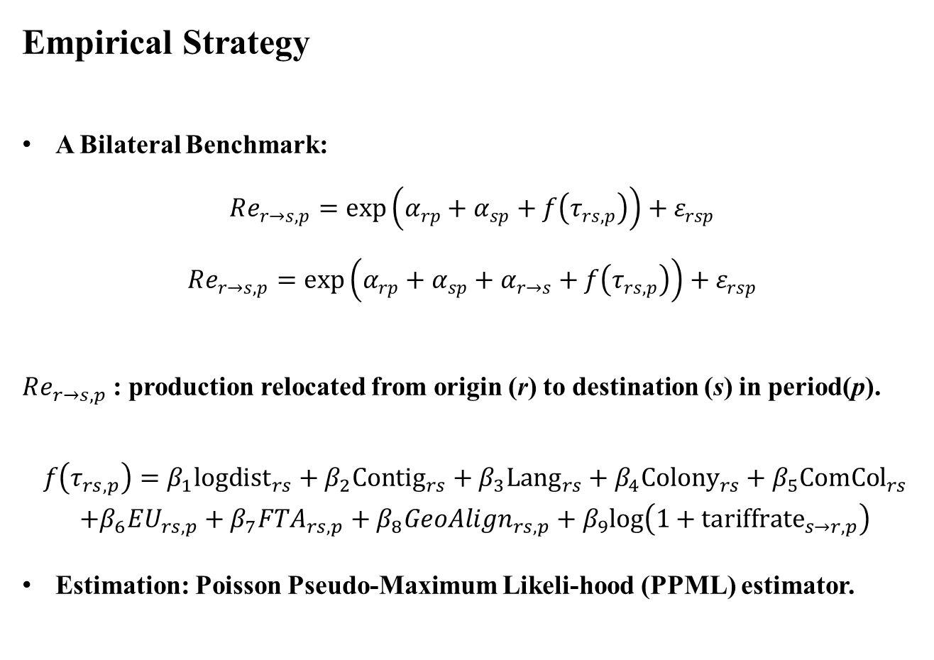
Empirical Strategy
A Bilateral Benchmark:
$$Re_{r→s,p}=exp\left(α_{rp}+α_{sp}+f\left(τ_{rs,p}\right)\right)+ε_{rsp}$$
$$Re_{r→s,p}=exp\left(α_{rp}+α_{sp}+α_{r→s}+f\left(τ_{rs,p}\right)\right)+ε_{rsp}$$
$Re_{r→s,p}$: production relocated from origin (r) to destination (s) in period(p).
$\begin{matrix}f\left(τ_{rs,p}\right)=β_{1}log{dist}_{rs}+β_{2}{Contig}_{rs}+β_{3}{Lang}_{rs}+β_{4}{Colony}_{rs}+β_{5}{ComCol}_{rs} \\ +β_{6}EU_{rs,p}+β_{7}FTA_{rs,p}+β_{8}GeoAlign_{rs,p}+β_{9}log\left(1+tariff{rate}_{s→r,p}\right) \\ \end{matrix}$
Estimation: Poisson Pseudo-Maximum Likeli-hood (PPML) estimator.

Slide 25
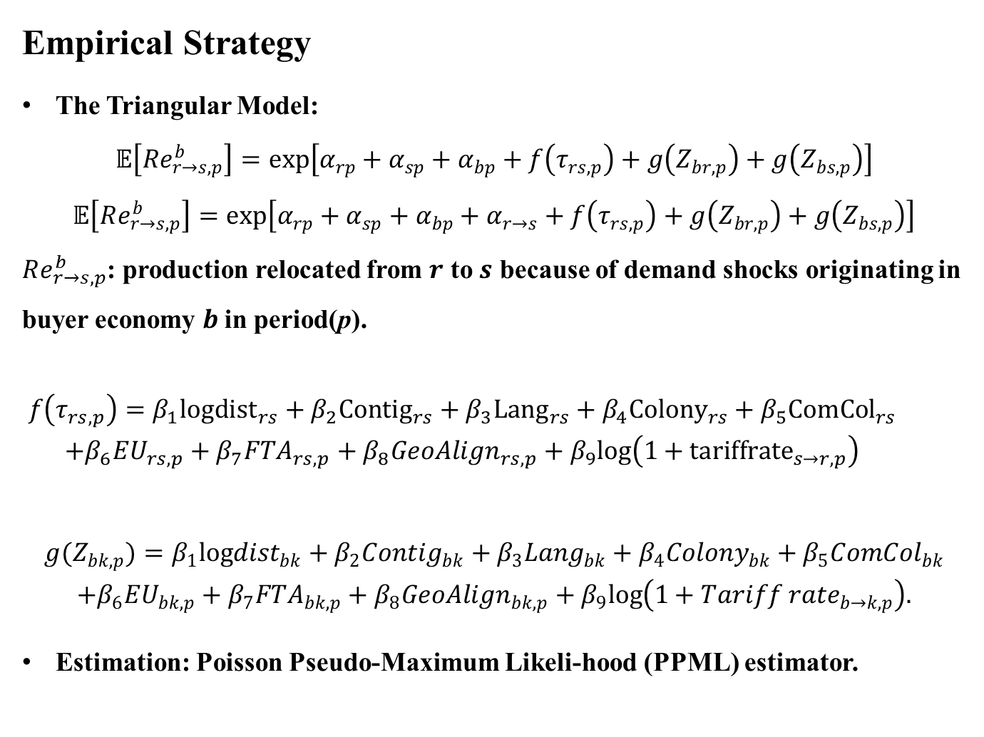
Empirical Strategy
The Triangular Model:
$$𝔼\left[Re_{r→s,p}^{b}\right]=exp\left[α_{rp}+α_{sp}+α_{bp}+f\left(τ_{rs,p}\right)+g\left(Z_{br,p}\right)+g\left(Z_{bs,p}\right)\right]$$
$$𝔼\left[Re_{r→s,p}^{b}\right]=exp\left[α_{rp}+α_{sp}+α_{bp}+α_{r→s}+f\left(τ_{rs,p}\right)+g\left(Z_{br,p}\right)+g\left(Z_{bs,p}\right)\right]$$
$Re_{r→s,p}^{b}$: production relocated from $r$ to $s$ because of demand shocks originating in buyer economy $b$in period(p).
$\begin{matrix}f\left(τ_{rs,p}\right)=β_{1}log{dist}_{rs}+β_{2}{Contig}_{rs}+β_{3}{Lang}_{rs}+β_{4}{Colony}_{rs}+β_{5}{ComCol}_{rs} \\ +β_{6}EU_{rs,p}+β_{7}FTA_{rs,p}+β_{8}GeoAlign_{rs,p}+β_{9}log\left(1+tariff{rate}_{s→r,p}\right) \\ \end{matrix}$
$$\begin{matrix}g(Z_{bk,p})=β_{1}logdist_{bk}+β_{2}Contig_{bk}+β_{3}Lang_{bk}+β_{4}Colony_{bk}+β_{5}ComCol_{bk} \\ +β_{6}EU_{bk,p}+β_{7}FTA_{bk,p}+β_{8}GeoAlign_{bk,p}+β_{9}log\left(1+{Tariff rate}_{b→k,p}\right). \\ \end{matrix}$$
Estimation: Poisson Pseudo-Maximum Likeli-hood (PPML) estimator.

Slide 26
Data
Geographic and historical bilateral characteristics: the CEPII Gravity database
  Distance between most populated cities
  Contiguity
  Common official
Directional trade costs: World Integrated Trade Solutions (WITS) database.
  Simple average ad valorem applied AHS rate+1
Bilateral geopolitical alignmen: Fan et al. (2025)
  A novel measure based on the annual average of Goldstein Scale-coded cooperative and conflictual events between each country pair, rescaled to the interval [−1, 1]
  Common colonial heritage
  Former colonial dependence
  Regional trade agreement
  European Union membership

Slide 27
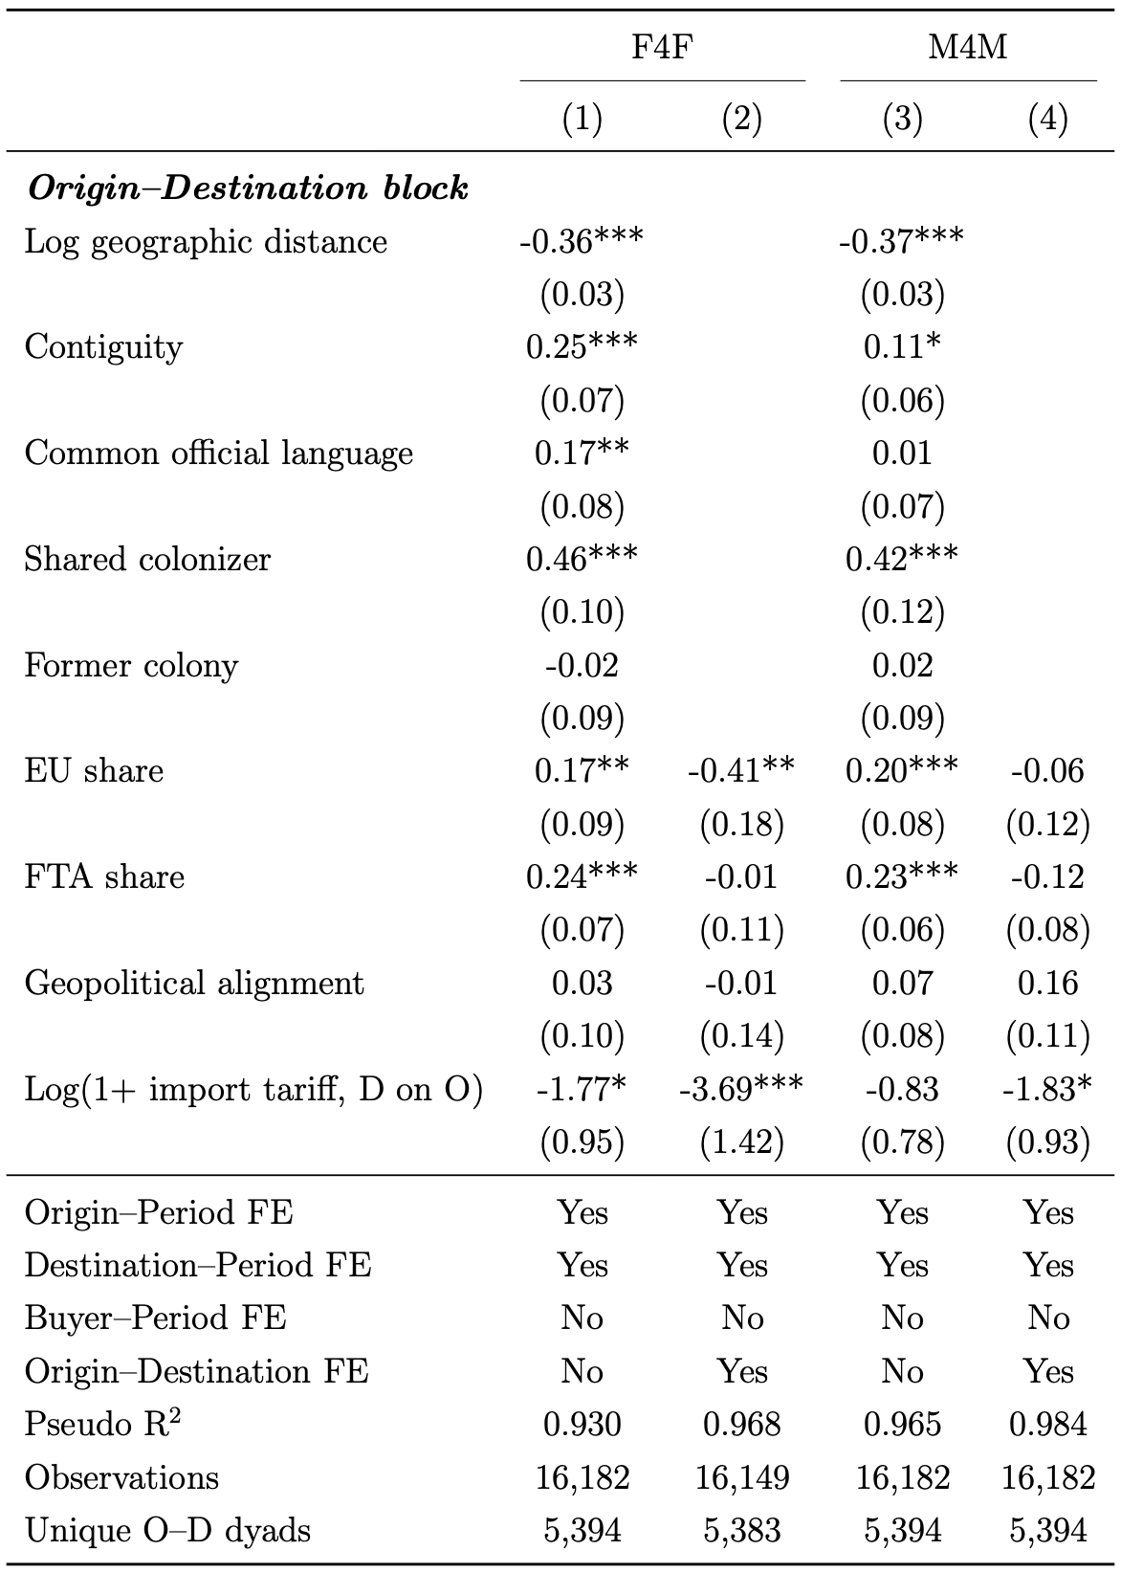
Bilateral Results
A traditional gravity story

Slide 28
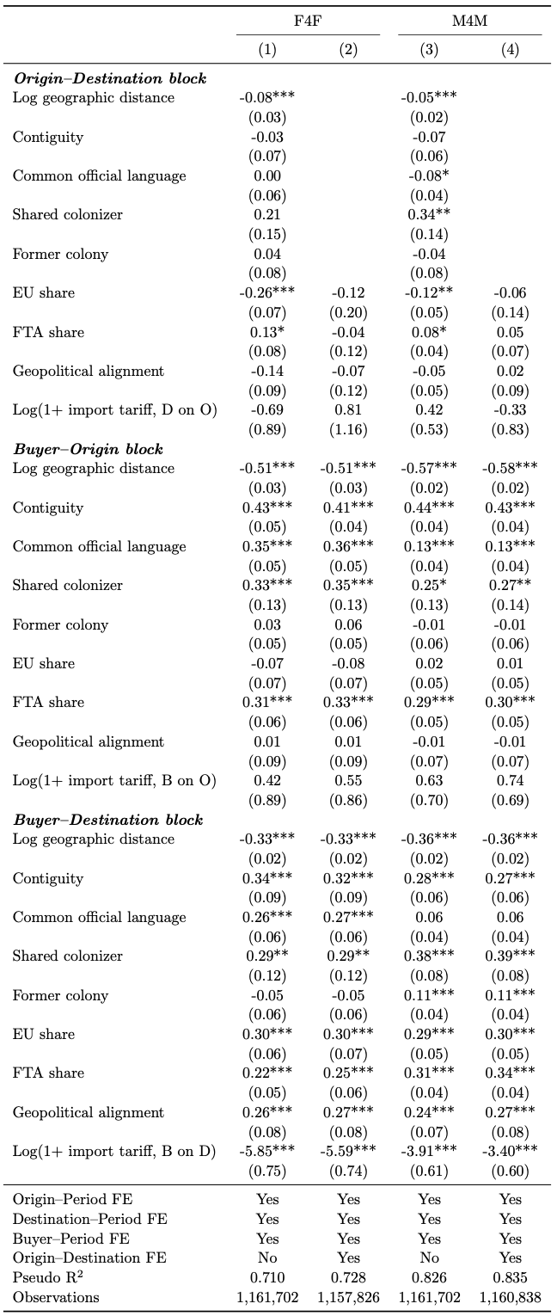
Triangle Results:
Third-party Buyer

Slide 29
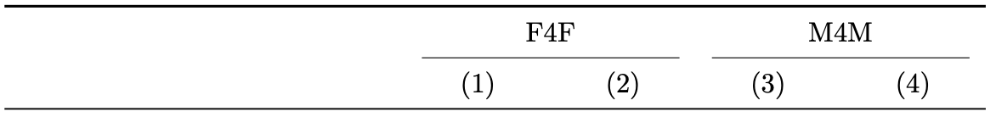
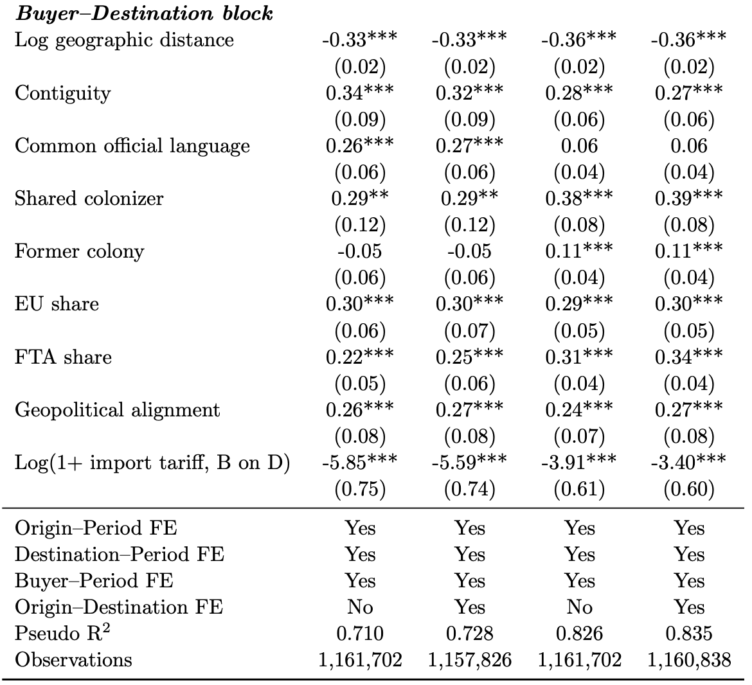
Triangle Results:
B-D Linkage
A traditional gravity story in trade
Destination with better access to the buyer’s market are more attractive relocation sites.

Slide 30
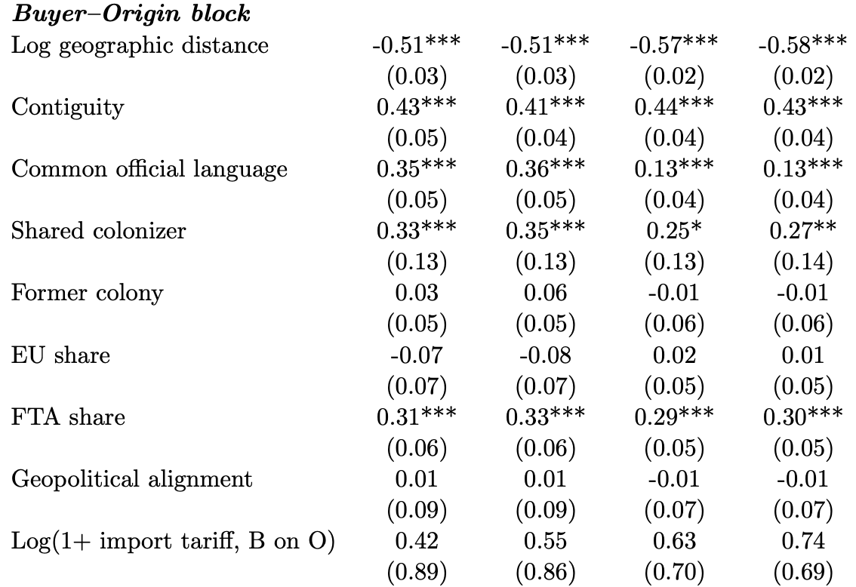
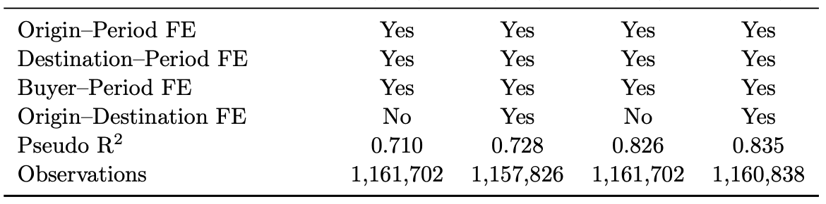
Triangle Results:
B-O Linkage
Ties deepening bilateral integration also heighten vulnerability to buyer-side fluctuations.
The absence (asymmetry) of expected major push forces.

Slide 31
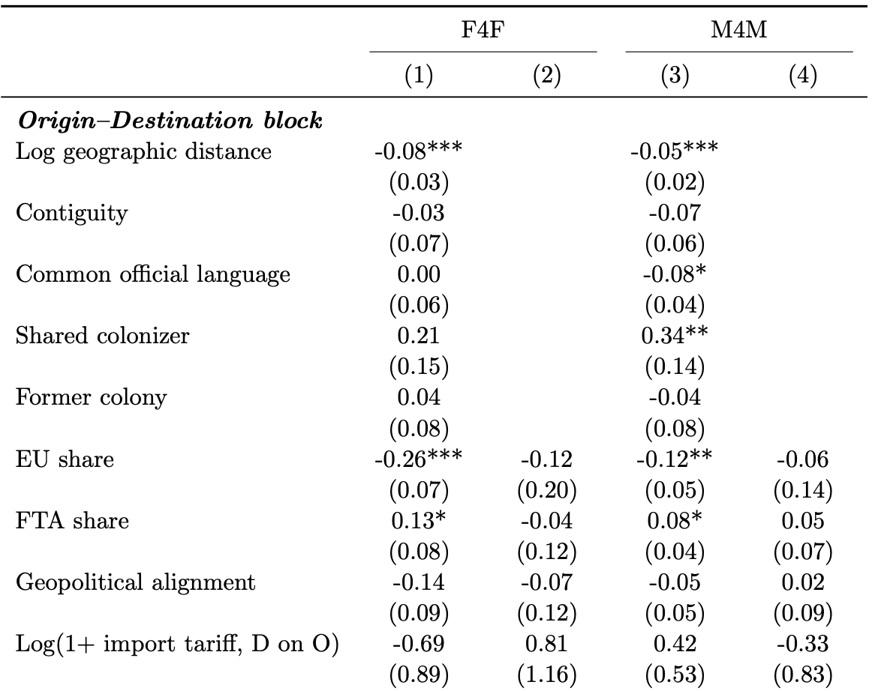
Triangle Results:
O-D Linkage
Diminished Roles

Slide 32
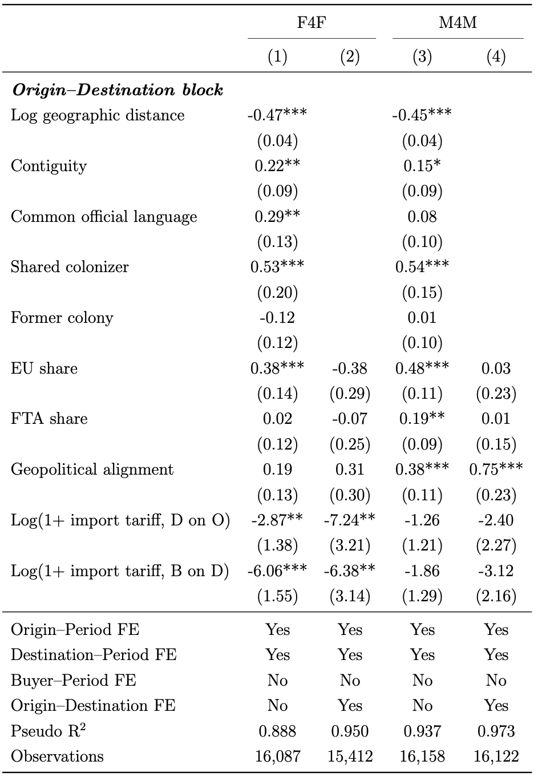
Triangle Results:
Buyer = Origin
Offshoring cases

Slide 33
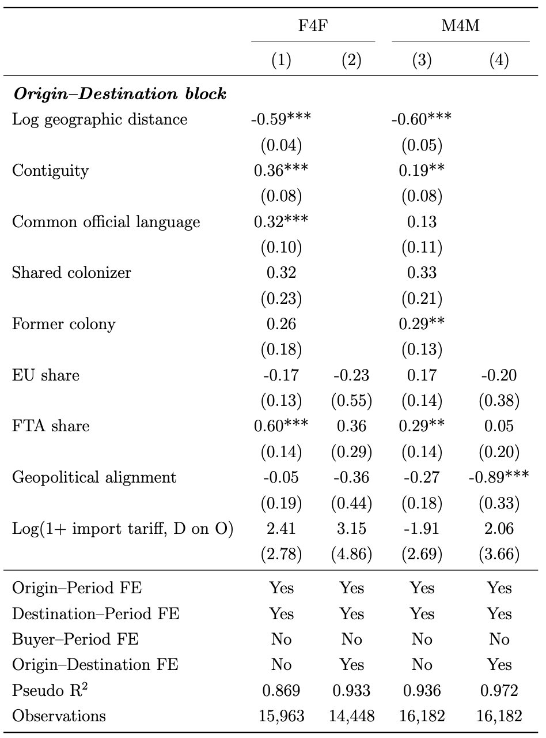
Triangle Results:
Buyer = Destination
Multinational operation
Re-shoring

Slide 34
6. Conclusions

Slide 35
The paper proposing and validating a triangular gravity framework that explicitly incorporates the buyer economy as the driver of relocation.
A clear increase in decoupling, diversification and structural complexity in global production relocation, particularly after 2016.
A clear two-stage mechanism governing global production relocation
  “push” stage: origins are exposed to buyer-specific demand shocks through pre-existing, cost-based linkages, which deepen bilateral integration but also increase exposure.
  “pull” stage: displaced production is rerouted to destinations that offer more favorable access to the same buyer’s market, shaped by tariffs, geopolitical alignment, and institutional ties.
  The asymmetry in the effects of tariffs and geopolitics

Slide 36
Thanks！
Please let me know when you have any suggestions
Xiang GAO gaoxiang@amss.ac.cn

Slide 37
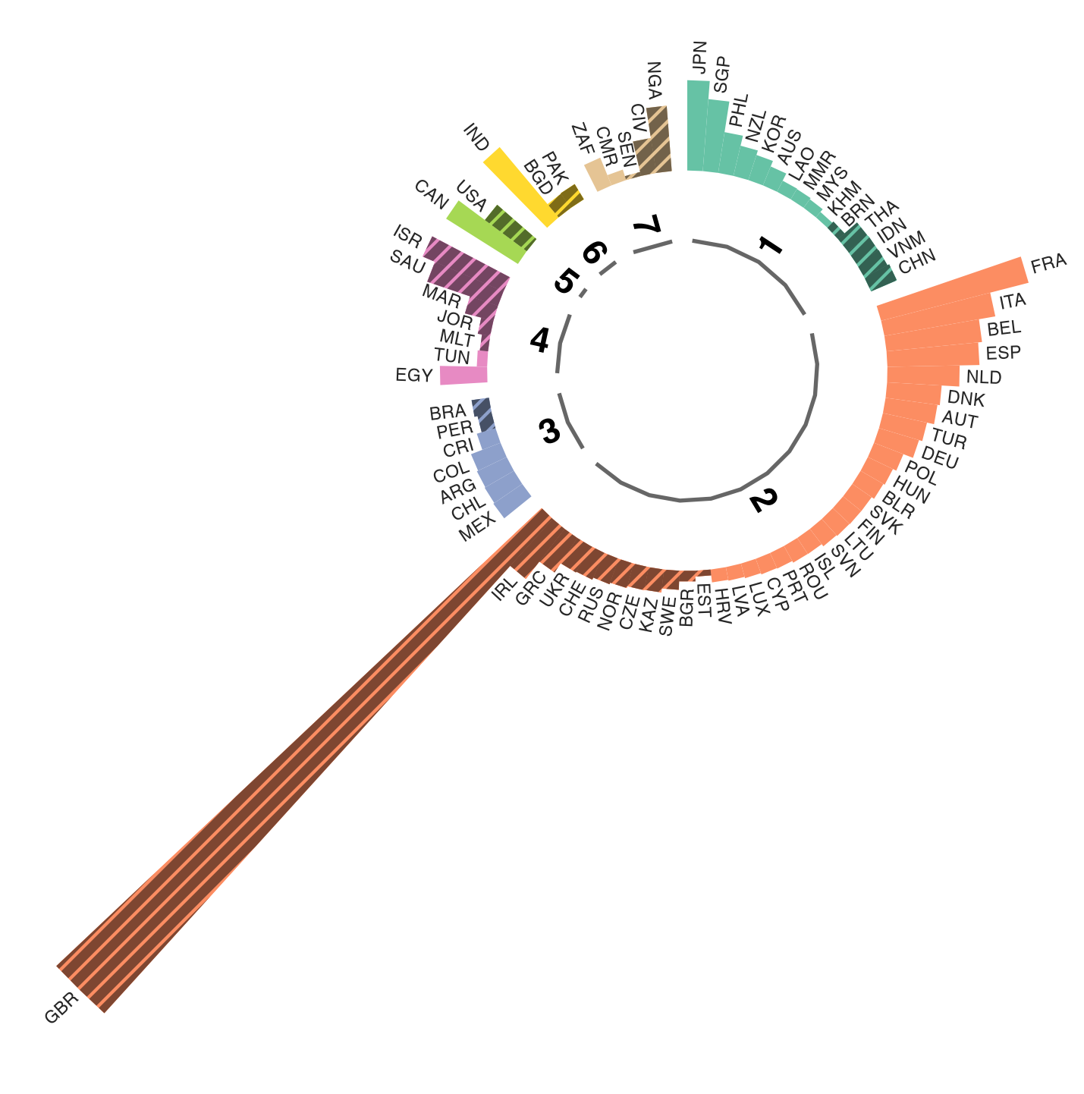
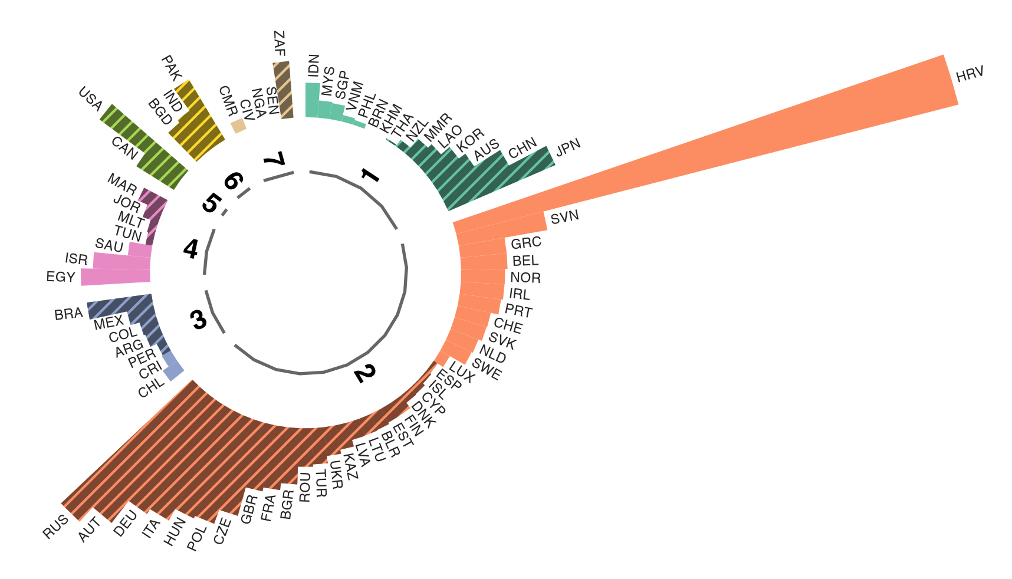
Institutional Shocks of EU
Croatia’s EU accession (a) v.s. Brexit (b)
Final products
(a)
Croatia
2008-2016
(b)
UK
2016-2019

Slide 38
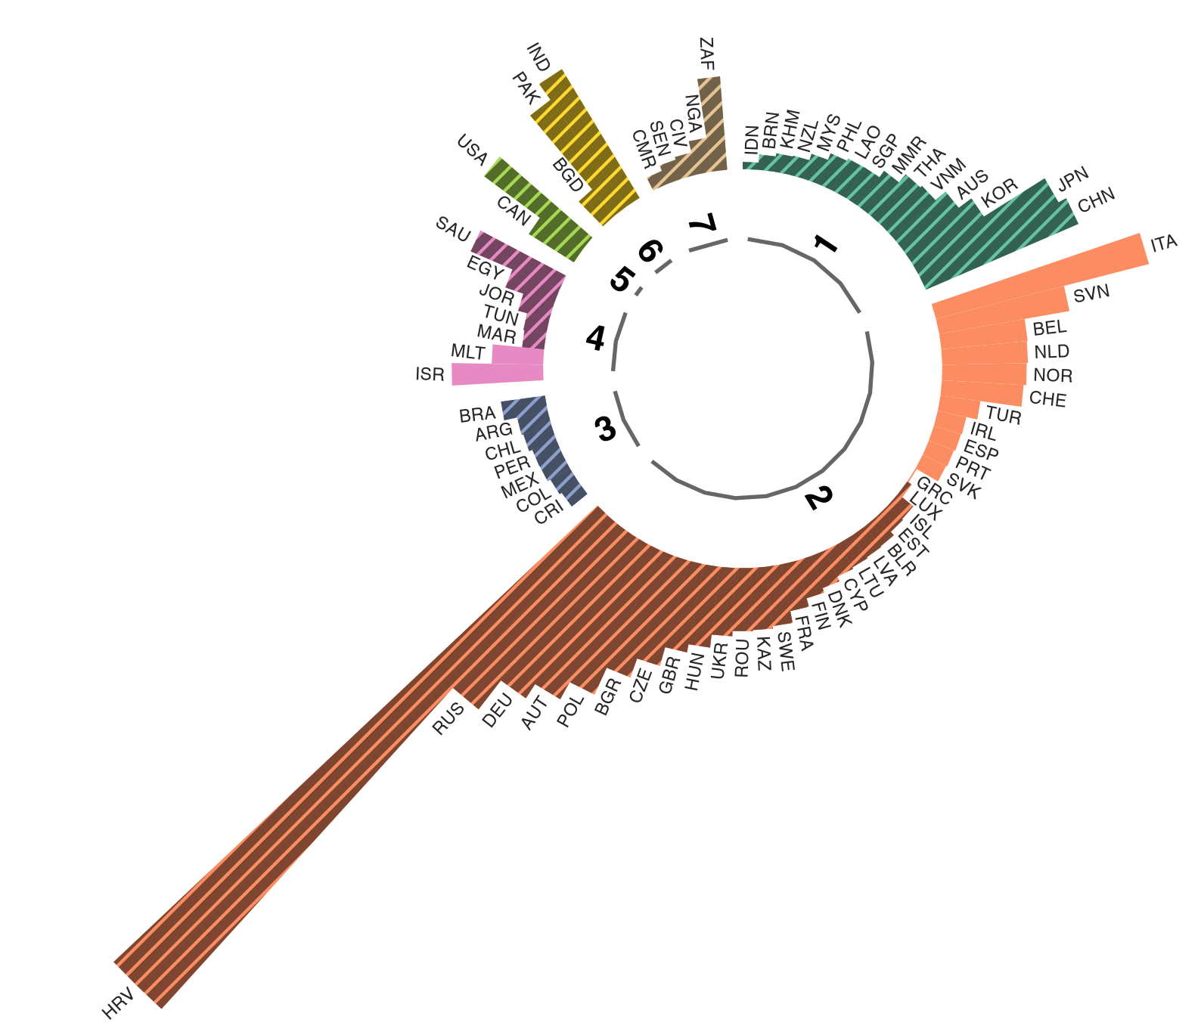
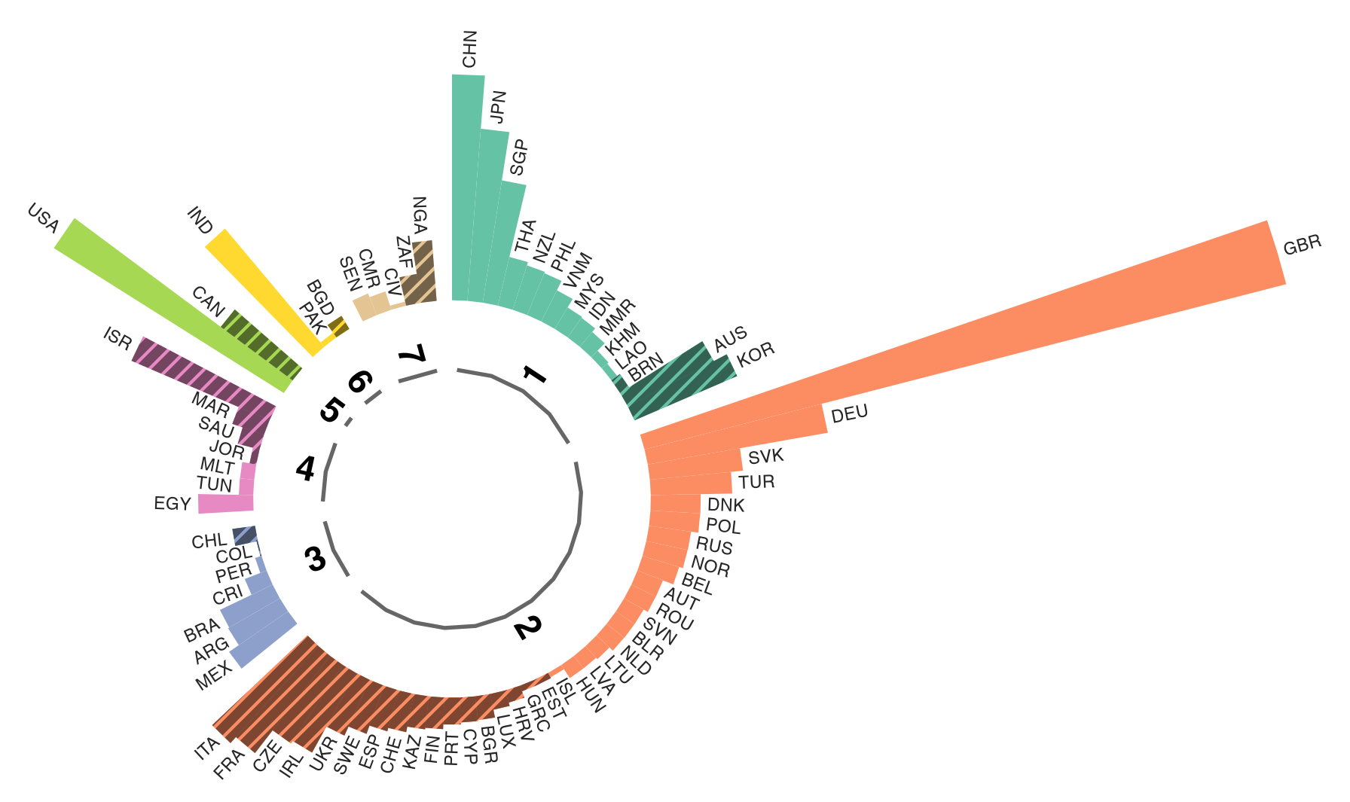
Institutional Shocks of EU
Croatia’s EU accession (a) v.s. Brexit (b)
Intermediate inputs
(a)
Croatia
2008-2016
(b)
UK
2016-2019

Slide 39







25% extra payment for Starbucks.
25% off for Luckin.

