Slide 1
How AI Innovation Reshapes China's
Production Network and Trade Structure
Evidence from an AI Innovation Flow Table
Presenter: YANG HANQI(杨翰奇) | June 2026
Notes:
Welcome and introduction. One-sentence framing: this paper asks how AI innovation — expressed as an inter-industry flow table structurally aligned with input-output tables — reshapes China's production network and trade structure. Preview ~25-30 min, 7 parts.

Slide 2
Presentation Roadmap
01
Motivation & Research Questions
02
Literature Gaps & Contributions
03
Theory: 4-Layer Network & 3 Hypotheses
04
Data: AI Innovation Flow Table
05
Global Ghosh-SDA: Hypothesis 1
06
Regression: Hypotheses 2 & 3
07
Extensions, Conclusions & Policy
2
Notes:
Walk through the seven parts: motivation → theory → data → Ghosh decomposition for H1 → regression for H2 & H3 → heterogeneity & moderation → conclusions.

Slide 3



Motivation & Research Questions
AI as a general-purpose technology — but its network-level impact is unmeasured
Policy Context
Three Research Questions
China's 2024 Central Economic Work Conference launched the 'AI+' initiative; the 2025 Government Work Report called for sustained AI-driven industrial upgrading. AI is now at the core of China's industrial transformation agenda.
When AI innovation flows across industries —
① Does it expand downstream output?
② Does it grow domestic trade & crowd out imports?
③ Does it reshape per-unit input sourcing structure?
Economic Reality
China's AI innovation has grown exponentially; smart manufacturing is spreading across industry; meanwhile the sourcing structure of intermediate inputs is shifting systematically.
Key Tension
Which industries produce AI? Which use it? How does AI rewrite the technology composition and domestic-vs-import sourcing of intermediate inputs? Existing research cannot answer these questions.
3
Notes:
Emphasize three things: policy mandate is unprecedented; AI innovation scale is growing exponentially; but the network question — who produces AI, who uses it, how does it rewrite input sourcing — has never been quantified. These three questions map directly to the three hypotheses.

Slide 4
Three Literature Gaps → Three Contributions
Gap 1
Contribution 1 (Data)
Innovation-spillover literature maps 'how knowledge flows' but stops at citations; production-network literature maps 'how shocks propagate' but treats TFP as exogenous. Neither aligns innovation with I-O-table-compatible inter-industry flows.
Build a 'producing-industry × using-industry' AI innovation flow table structurally isomorphic to the input-output network.
→
Gap 2
Contribution 2 (Theory)
Three strands of AI measurement (micro-text, exposure indices, technology-industry concordance) each capture only the production or the use side — never both simultaneously.
Augment the intermediate-good-augmenting technology model with a domestic–import sourcing layer and AI home-bias, yielding a 4-layer nested model and three testable effects.
→
Gap 3
Contribution 3 (Method)
Mainstream models treat technology as a homogeneous industry-level shock; they neither distinguish AI from non-AI inputs nor domestic from imported sourcing.
Match estimators to data properties (PPML for flows, fractional logit for coefficients); embed the AI flow table in a global Ghosh framework covering 63 economies for a 5-effect exact decomposition.
→
4
Notes:
Walk through each pair: Gap 1 is the methodological disconnect between two literatures — we bridge them with the flow table. Gap 2 is one-sided AI measurement — we go double-sided. Gap 3 is homogeneous TFP shocks — we introduce AI home-bias as the model's main axis.

Slide 5

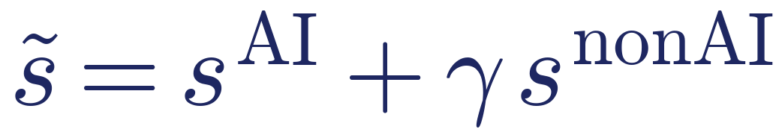
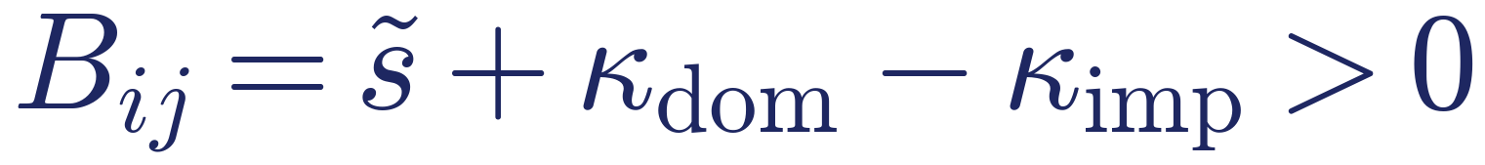
Theory: 4-Layer Nested Production Network
Built on Wu & Guo (2025, EJ China) intermediate-good-augmenting technology model
Top Layer: C-D Aggregation
Two Structural Features of AI as a GPT
Output = Value Added × Composite Intermediates (φᵢ)
Feature 1 Innovation-Complementarity
AI is an 'invention of a general method of invention':
Layer 2: Cross-Industry CES
35 supplying industries (εᵢᴹ)
AI accelerates R&D and induces non-AI innovation → effective AI cost elasticity:
Layer 3: Domestic–Import CES
Feature 2 Home Bias
Domestic vs. Imported (ρ) + AI home-bias ωs
AI co-evolves with domestic supply chains and local data → improves effective cost/quality of domestic intermediates more than imports → home-bias price wedge:
Layer 4: AI–non-AI CES [nested inside domestic]
AI vs. non-AI sub-intermediates (σ, γ)
5
Notes:
Key extension: add the domestic-import sourcing layer as the model's main axis; nest the AI-technology layer inside domestic intermediates because AI is itself a domestic technology. The two structural features define AI as a region in parameter space {γ>0, κdom>κimp}; standard technology is the boundary case.

Slide 6
Three Forces → Three Hypotheses
Elasticity expressions with determinate signs: Intensification + Sourcing Substitution + Output Expansion
Intensification
Sourcing Substitution
Output Expansion
εᵢᴹ > 1: AI lowers relative price of supplier j → demand share rises
ρ > 1 × home-bias Bij: share shifts domestic → imports fall
ηᵢ > 1: lower cost → output grows → all upstream purchases amplified
H1 Output Expansion
H2 Domestic Scale & Import Substitution
H3 Sourcing Substitution Effect
AI lowers downstream unit cost → output rises. Follows from zero-profit + demand closure unconditionally; is the shared foundation for H2 & H3.
Domestic & total intermediate flows rise; when substitutability is strong (ρ > 1), import flows are crowded out; domestic response exceeds import response.
Domestic & total direct requirement coefficients rise; when sourcing substitution dominates intensification, import coefficient falls → input structure 'domesticized'.
Test: Global Ghosh-SDA
Test: PPML flow regressions
6
Test: Fractional logit coefficient regressions
Notes:
Walk through three forces: intensification (ε>1), sourcing substitution (ρ>1 × home-bias), output expansion (η>1). H1 holds unconditionally from market closure. For H2 & H3, the domestic direction has all terms positive; the import direction is ambiguous and requires numerical evaluation.

Slide 7


Numerical Validation of Theoretical Predictions (2007–2021)
Empirical parameters: εᵢᴹ ∈ {1.406, 1.356, 0.893}, baseline ρ = 1.5, η = 1.1; weighted by annual flows
77.9%
99.87%
Domestic flow sign correct
(annual range 70.9%–82.9%)
Import flow sign correct
(each year ≥ 99.8%)
77.7%/77.2%
Dom. coeff / Total coeff positive
(pooled)
Robustness: varying η (0.9–1.3) barely moves results; import substitution requires ρ notably above 1 — at ρ = 1.3 the negative sign rate drops to ~60%, jumping to 99.6%+ for ρ ≥ 1.4 (Appendix Tables B.1–B.9).
7
Notes:
Stress two points: import sign is remarkably stable (>99.8% each year); domestic sign is 80%+ in early years, falls to ~70% later — so the text says 'covers the majority' not just the pooled number. Be upfront about the ρ threshold sensitivity: import substitution is a conditional result requiring ρ clearly above 1.

Slide 8

Data: Constructing the AI Innovation Flow Table
Mapping 5 million+ Chinese patents into an inter-industry AI flow matrix aligned with I-O tables
① Patent Production Prob. Table Pᴾ
Validity Checks
Max Planck Institute: 608 IPC4 classes × 86 NACE industries — 'who produces which technology'
External consistency: distribution matches industry R&D and smart-manufacturing stylized facts
② Patent Use Prob. Table Pᵁ
Lybbert & Zolas (ALP): 636 IPC4 × 83 ISIC industries — 'who uses which technology'
Structural distinctiveness: after dropping top-5 IPC classes, J-S distance between AI table and all-patent table = 0.147, vs. 0.072 for random pseudo-AI tables
③ Joint Probability Matrix Pₕ
Placebo test: AI flow structure cannot be replicated by general technology flows
diag(pₕᴾ) × [pₕᵁ…]: element p_{hij} = prob. tech. h produced by j AND used by i
④ AI Innovation Flow Table
Companion data: ADB-MRIO 2007–2023 (63 economies × 35 sectors) for domestic / import / export intermediate flows, gross output, and value added.
× Chinese patent counts (Key Digital Tech. Classification 2023, 42 IPC4 classes) → 35×35×15 years
8
Notes:
Explain the four-step construction. The JS-distance placebo evidence is key: even after removing the five most-contributing IPC classes, the AI table is still significantly more distinct from the all-patent table than a random pseudo-AI table — it is not merely a scaled-down version of general patenting.

Slide 9
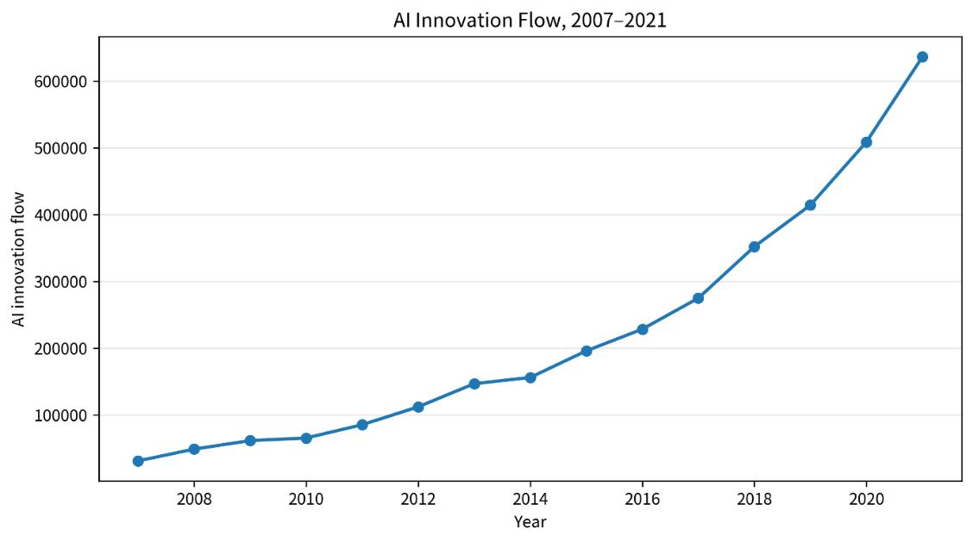
Stylized Facts from the AI Flow Table
Exponential scale growth, concentrated pathways, significant cross-industry spillovers
20.2×
Absolute scale of AI flows 2007→2021; CAGR 24.0%; steep inflection after 2014
15.5%
Share of all innovation flows; stable at 14%–18% — not a measurement artifact
Figure: Annual AI Innovation Flow (China, 2007–2021)
72.4%
Cross-industry flows; top 20 pathways account for 71.3%; electrical & optical equipment internal loop leads at 21.4%
9
Notes:
Three facts: exponential scale with a 2014 inflection coinciding with the policy push; stable share (not measurement drift); 72% cross-industry spillover along a few concentrated pathways — equipment manufacturing + producer services dual-core. This pre-empts the industry heterogeneity finding.

Slide 10

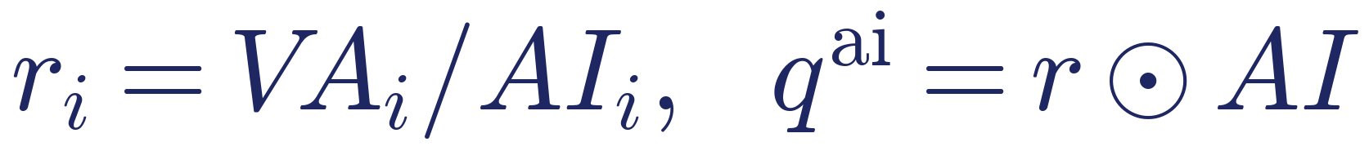
Global Ghosh-SDA Framework: Testing H1
Embedding China's AI innovation in a global supply network of 63 economies × 35 sectors = 2,205 units
Supply-Side Equilibrium
Why the Supply-Side Ghosh Framework?
Only value added as primary input; all cross-border flows endogenous
① H1 is a supply-side proposition: AI lowers cost → supply expands, propagating along the 'allocation' direction;
② Global table makes cross-border transmission fully endogenous — spillover geography is identified;
③ Output elasticity in Eq.(15) is structurally isomorphic to the Ghosh allocation chain — theory ↔ empirics are strictly matched;
④ AI flows measured only for China → identifies single-source global diffusion.
AI-Attributed Injection
Inject only the value added attributable to China's AI use
5-Effect Exact Closure
3 AI scale effects + Ghosh network effect + VA/AI intensity effect; polar decomposition; residual < 10⁻⁹
Three Sub-periods
2007–2012 / 2012–2017 / 2017–2021
10
Notes:
Two technical points: the attribution injection (r = VA/AI) ensures only AI-attributable value added is injected, so the decomposition closes. The polar decomposition guarantees five terms sum exactly to the total output change, closure error < 10^{-9}.

Slide 11
Result 1: 'Scale–Intensity' Scissor Effect; Network Effect Turns Negative
Scissors Open
Contribution rates (%, relative to ΔX in each sub-period)
AI scale effects dominate (US$28.4→52.6 trillion); intensity effect deepens in negative: China's global output pull shifts from 'factor accumulation' to 'AI-densification' → H1 holds globally
Tech-method AI leads
57%–61% of scale effects: the more fundamental and general-purpose the AI, the more it amplifies through the global network
Network effect reverses 2012–2017 then plunges
Concentrated in transport equipment, electrical & optical, basic metals, mining — quantitative supply-side evidence of 'slowbalization' and supply-chain restructuring
11
Notes:
The chart shows contribution rates per sub-period. Green = AI scale (three categories total), red = VA/AI intensity, gold = network effect. The scissors: AI flow growth outpaces value-added growth — China's global output pull is increasingly driven by AI-intensity not factor accumulation. Network effect −2.46 trillion in 2017–2021 precisely aligns with trade friction timing.

Slide 12
Result 2: Spillover Pattern — 'Internalization–Re-Spillover' with Two Structural Shifts
93%–97% absorbed domestically; offshore share: 6.54% → 2.72% → 4.99% (U-shape)
2007–2012
2012–2017
2017–2021
Resource-Pull Type
Advanced-Economy Service Type
Regional Network Type
60.7% to developing economies; rest-of-world takes 43.5% of offshore spillover; commodity super-cycle drives outflow through energy–raw-material channels
1st restructuring: total spillover contracts 70%; 92.1% flows to advanced economies; US rises to #1 (US$97.4bn); developing-economy channel collapses
2nd restructuring: Vietnam (US$58.4bn) & Chinese Taipei (US$50.0bn) top the list; US drops to US$38.5bn; East Asian electronics chain + South Asian textile chain become new conduits
→
→
Key takeaway: Supply chain restructuring did not cut China's global AI spillovers — it rewrote the routing. Regional production networks are replacing the transpacific direct channel.
12
Notes:
First point: 93-97% stays domestic — China's large domestic market and integrated supply chain absorb most of the supply-side expansion; mutually corroborates the regression's 'domestic-dominant' finding. Second: the two structural shifts show that geopolitical disruption redirected rather than eliminated AI spillovers.

Slide 13


Industry-Pair Regressions: Empirical Strategy
Estimator choice strictly matched to distributional properties of each dependent variable
Flow Equation: PPML (H2)
Coefficient Equation: Fractional Logit (H3)
Flows are non-negative, zero-inflated, and right-skewed. Log OLS loses zeros and is inconsistent under heteroskedasticity. PPML preserves zeros, gives semi-elasticity interpretation, robust to arbitrary heteroskedasticity (Santos Silva & Tenreyro, 2006).
Direct requirement coefficients lie in [0, 1). Linear models produce out-of-range fitted values; log-odds cannot handle zeros. Fractional logit guarantees unit-interval predictions (Papke & Wooldridge, 1996); coefficients are log-odds scale.
Identification
Core regressor: ln(1 + AIᵢⱼₜ), the AI innovation flow produced by industry j and used by industry i;
3-way high-dimensional FEs: industry-pair + producing-industry × year + using-industry × year — absorbs all industry-level time-varying shocks; variation comes from within-pair dynamics;
Standard errors clustered by industry pair; sample 2007–2021, 35×35 industry pairs.
13
Notes:
Emphasize 'matching estimator to data': flows → PPML, unit-interval coefficients → fractional logit. The 3-way FE design absorbs any time-varying industry-level confounders; identification is sharper than industry-level studies because it exploits within-pair variation.

Slide 14
Baseline Results: 'Domestic-Strong, Import-Weak' Asymmetric Pattern
H2 (PPML flows) and H3 (fractional logit coefficients) both supported
Intermediate Flows (H2, PPML)
Direct Req. Coefficients (H3, Frac. Logit)
Domestic flow
+0.0252***
Domestic coeff
+0.0290***
Total flow
+0.0170**
Total coeff
+0.0191*
Import flow
−0.0747***
Import coeff
−0.0769***
14
Notes:
Core numbers: domestic flow +0.0252***, import flow −0.0747***; domestic coefficient +0.0290***, import coefficient −0.0769***. AI is not uniformly growing all intermediate transactions — it shows a stark domestic-strong, import-weak asymmetry. The two-table design is not redundant: flows answer the quantity question, coefficients answer the structure question. Fractional logit coefficients are log-odds; we interpret sign and significance, not magnitude.

Slide 15
Robustness and Endogeneity Checks
Core results hold across multiple specifications and identification strategies
Robustness
Endogeneity
Log-log (OLS) specification
Strategy 1: One-period lagged regressor
Severs contemporaneous reverse causality; sign and significance of core coefficients unchanged.
Extend window to 2007–2023
Strategy 2: US & Japan AI stock IVs + control function
Exogenous global frontier drives China's AI flows; first-stage coefficients 0.186 & 0.581 (both significant); domestic-direction results maintained.
Leontief (total) requirement coefficients
Narrow-scope AI measure (Strategic Emerging Industries 2021 classification)
Limitations (transparent disclosure)
IV exclusion restriction requires US/Japan technology to affect China's input structure only through AI flows — this is debatable. Import-equation IV is imprecisely estimated; causal interpretation of import-side results is cautious. Fractional logit coefficients are not interpreted as marginal effects.
15
Notes:
Four robustness checks: one sentence each. For endogeneity, the lag strategy and the IV strategy are mutually reinforcing. Proactively disclosing the IV exclusion restriction concern and the imprecise import-equation IV is better than waiting for a referee to raise it.

Slide 16
Extensions: Where and When Is the Effect Stronger?
Industry Heterogeneity
AI Category Heterogeneity
Moderation by Non-AI Tech Base
Production side: primary industries and utilities show the most complete 'domestic up, import down' pattern. Use side: labor-intensive manufacturing is significant across all four dimensions — traditional sector upgrading is the main arena for import substitution; tech-intensive manufacturing using more AI actually promotes imports (complementarity).
Three AI types: tech-methods, functional applications, domain applications. No significant flow-level differences across types, but structural effect on direct requirement coefficients differs significantly: functional AI (recognition, prediction, decision, control) has the strongest reshaping effect on per-unit sourcing.
Interaction: domestic flow +0.0106***, domestic coeff +0.0116***, import flow −0.0174*** — a richer existing non-AI technology base amplifies AI's import-substitution effect. AI complements, not substitutes for, accumulated capabilities.
Structural corroboration: minimum-distance estimation of AI–non-AI substitution elasticity σ yields σ ≤ 1 (complementarity), consistent with the moderation finding.
16
Notes:
Three extensions. First: AI works through foundational and traditional manufacturing sectors, not just high-tech internal loops — tech-intensive sectors' import promotion reflects high-end complementarity. Second: functional AI has the strongest structural reshaping effect. Third: σ ≤ 1 from structural estimation corroborates the 'AI is complementary to existing tech' interpretation.

Slide 17
Conclusions and Policy Implications
Three Conclusions
① AI scale effects dominate output expansion; pull shifts from factor accumulation to AI-densification (H1). ② AI innovation creates a 'domestic-strong, import-weak' pattern: expands domestic flows/coefficients, crowds out import flows/coefficients (H2, H3). ③ Effects concentrate in foundational & traditional manufacturing; functional AI strongest; non-AI tech base amplifies.
View AI as a 'Network Reshaper'
Build the Non-AI Tech Foundation
Digitalization and industrial software are amplifiers of AI dividends — 'AI+' requires solid '+digitalization'
Policy evaluation should include supply-chain coordination and input-structure metrics — not just AI sector output
Technology-Driven Domesticization
Functional AI × Industrial Scenes
Follow the import-substitution trend while stabilizing access to key high-tech inputs — structural upgrading, not decoupling
Prioritize recognition/prediction/decision/control capabilities; smart manufacturing as the main implementation arena
Overarching direction: shift from 'develop the AI industry' to 'reshape the production network through AI'.
17
Notes:
Conclusions map back to three hypotheses. Four policy implications are direct corollaries of the findings: heterogeneity → prioritize traditional manufacturing; moderation → build non-AI base; H2/H3 → technology-driven domesticization not decoupling; AI category → functional AI in industrial settings. Final sentence elevates the framing.

Slide 18
Thank You — Comments Welcome!
Q&A
Notes:
Q&A backup responses:
[κ identification] We acknowledge κdom and κimp enter only as a difference (the price wedge Bij); they are not separately identified. Recovering them from relative domestic-vs-import share elasticities is a natural extension.
[ρ sensitivity] Import substitution is a conditional result requiring ρ clearly above 1. We provide full sensitivity tables B.7 & B.9.
[IV exclusion] The exclusion restriction assumes US/Japan AI affects China's input structure only through AI flows; US/Japan tech could also work through imported goods quality — we acknowledge this and treat the import-side IV result cautiously.
[Ghosh attribution] r = VA/AI imposes proportional attribution; the level estimates of spillovers should be interpreted as cross-period structural comparisons, not absolute values.
[vs. robot literature] Robot measures capture only the 'use side'; our flow table captures both production and use sides and is structurally aligned with I-O tables, enabling network-level analysis.

