Slide 1
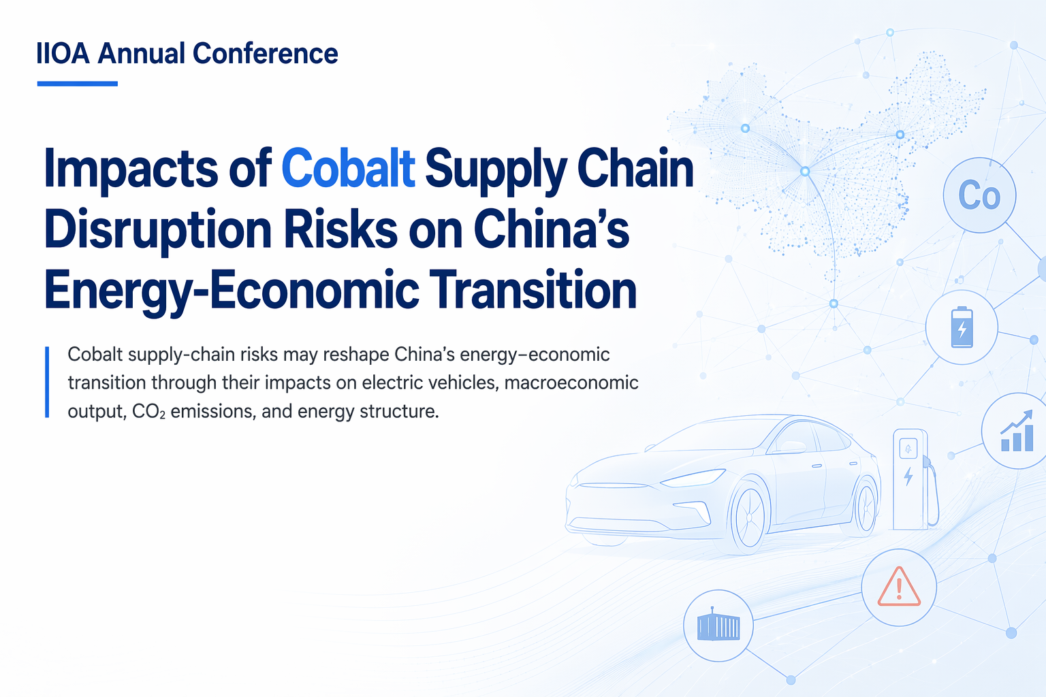


Yuanchen Sun¹，Sanmang Wu¹，Shantong Li²，Jianwu He²
1. China University of Geosciences (Beijing)
      2.Development Research Center of the State Council, People’s Republic of China
23/Jun/2026
Notes:
Good morning, everyone. My name is Yuanchen Sun from China University of Geosciences Beijing. Today, I am honored to present our work with Professor Sanmang Wu, Shantong Li, and Jianwu He. The title of my presentation is: 【Impacts of Cobalt Supply Chain Disruption Risks on China's Energy-Economic Transition.】

Slide 2

Motivation
Research Question
Methodology-DRCCGE
Split IO Table
Result
Conclusion
CONTENTS
Notes:
My presentation has five parts: 【Motivation, Research Question, Methodology, Result, and Conclusion.】

Slide 3



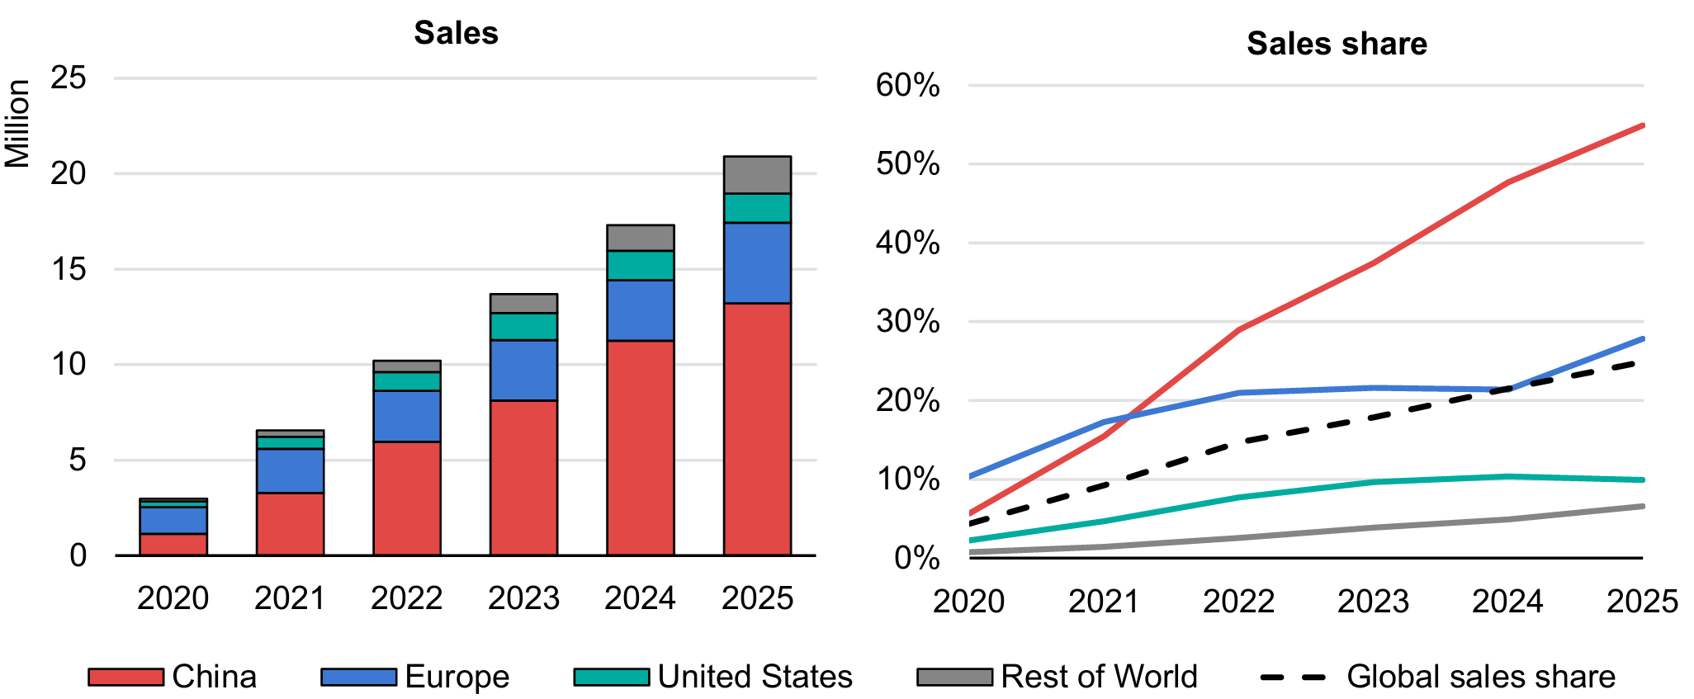

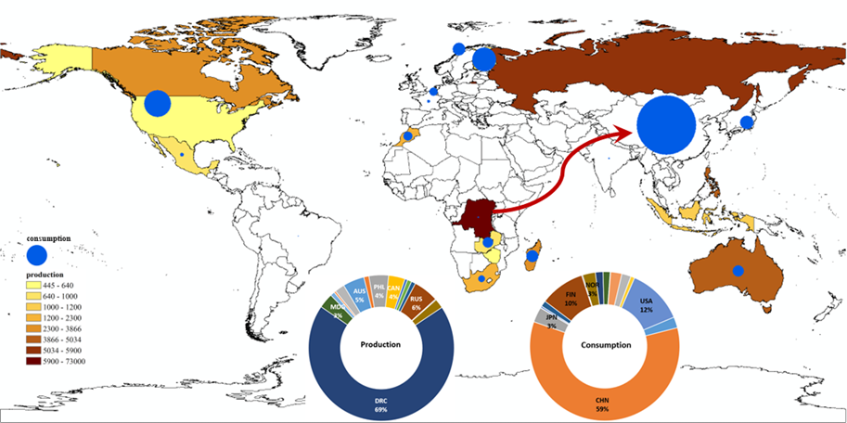
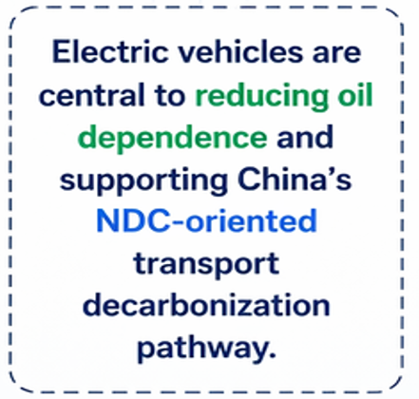




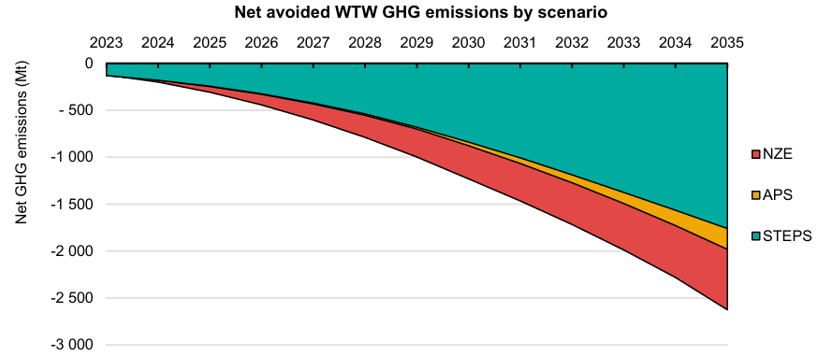

Motivation
China is the world's largest EV-manufacturing hub— yet imports 98% of the cobalt that powers them.
China is the world's largest EV-manufacturing hub
(IEA Global EV Outlook 2025)
98% Cobalt Import Dependence
Highly Concentrated & Disruption-Prone
Fig. Electric Vehicle sales globally and sales share
World's largest
EV market
Global leader in
battery & EV
manufacturing
Supports NDC-
oriented transport
decarbonization
Reduces oil
dependence &
emissions
Figure 3: Global distribution of cobalt mine production and consumption
Data sources: USGS, UN Comtrade
Yet the batteries that enable this transition depend on cobalt, a mineral with highly concentrated and disruption-prone supply chains.
Fig. Net avoided well-to-wheel greenhouse gas emissions from EV deployment
Source:IEA, Global EV Outlook 2026
Notes:
Let's start with the motivation. As we know,【Electric vehicles are central to reducing oil dependence and supporting China’s NDC-oriented transport decarbonization pathway. China is the world's largest EV-manufacturing hub. 】 However, we face a paradox:【China imports 98% of the cobalt that powers them.】And as we can see from recent events, this cobalt supply chain is【highly concentrated and disruption-prone.】

Slide 4


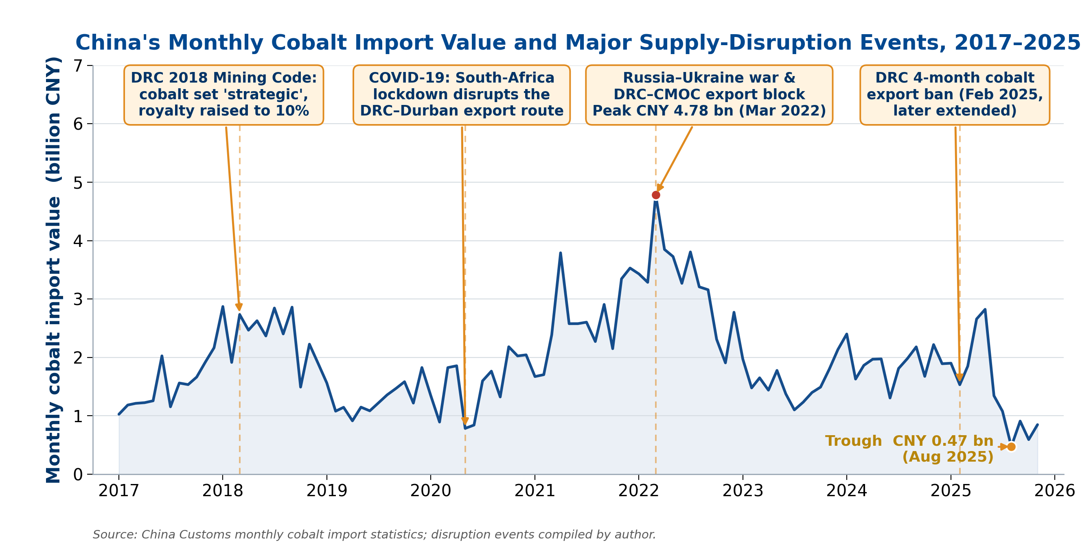












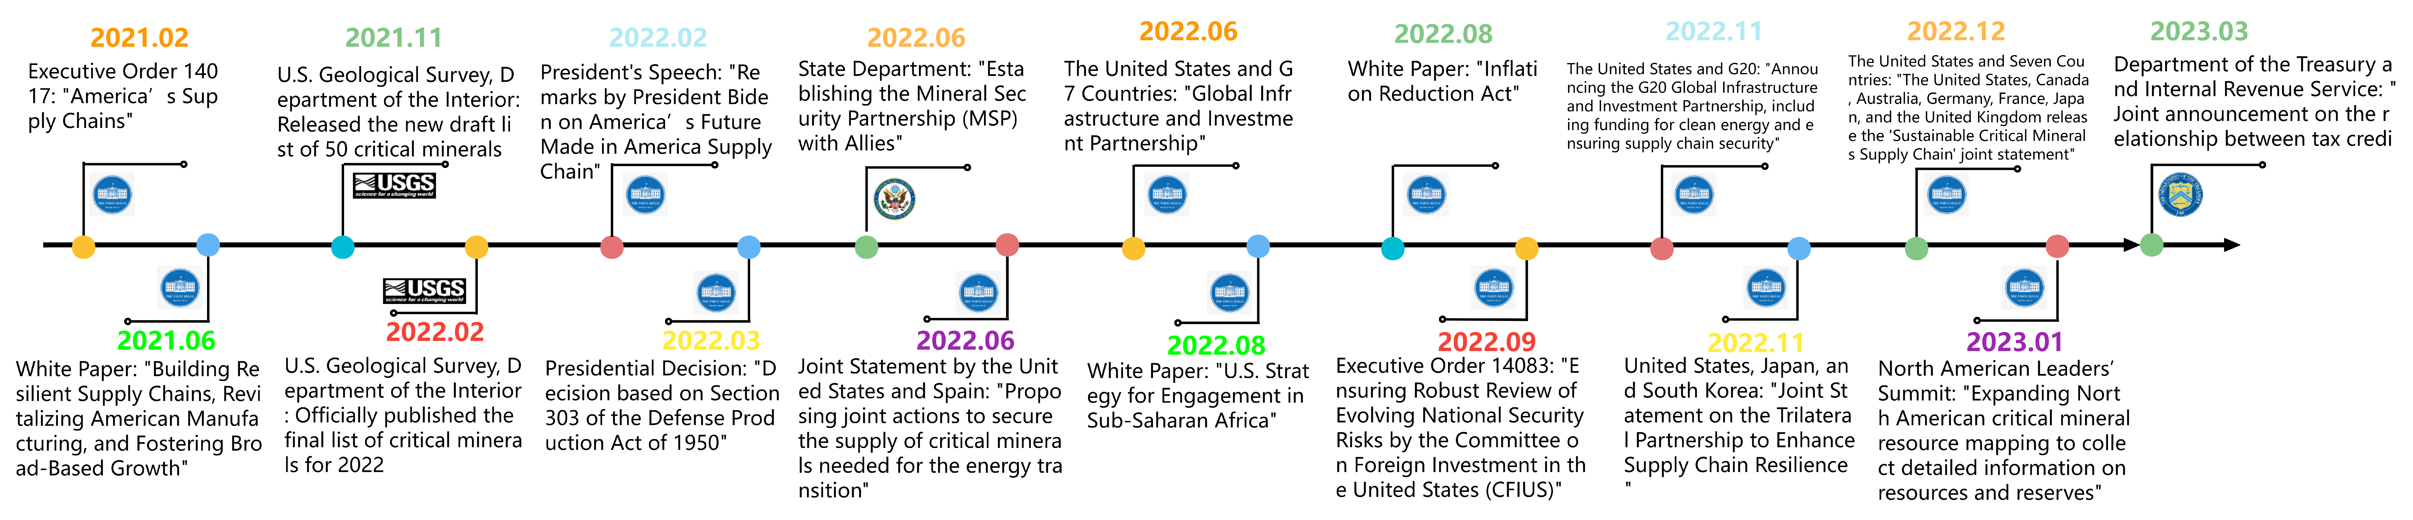
Motivation
A cascade of recent disruptions has turned cobalt into a systemic risk to the transition.
1.Geopolitical Competition
Geopolitical tension
& export restrictions
Strategic rivalry and resource
nationalism heighten supply risk.
Higher probability of
supply disruption
2. resource-rich countries Instability
Production
interruptions
Governance challenges, conflict,
and security risks disrupt
production and logistics.
Lower supply
reliability
3.Market Concentration
Price volatility &
refining bottlenecks
Mining and especially refining
capacity are highly concentrated,
creating chokepoints.
Tightened material
availability
4.Maritime Route Vulnerability
Shipping delays
& route disruption
Chokepoints, congestion, and
security threats can interrupt
maritime transport.
Extended lead times
& higher costs
5.Policy Uncertainty
Compliance costs
& investment delays
Evolving trade, industrial, and
environmental policies increase
compliance and cost risks.
Fig. Recent supply-disruption events along China's cobalt import chain (2017–2025）
Slower capacity
expansion
Unstable policies in resource-rich countries, blocked maritime corridors, and frequent geopolitical shocks have left China's cobalt supply chain acutely exposed to disruption.
Notes:
As we can see from the timeline here, 【a cascade of recent disruptions has turned cobalt into a systemic risk to the transition.】

Slide 5
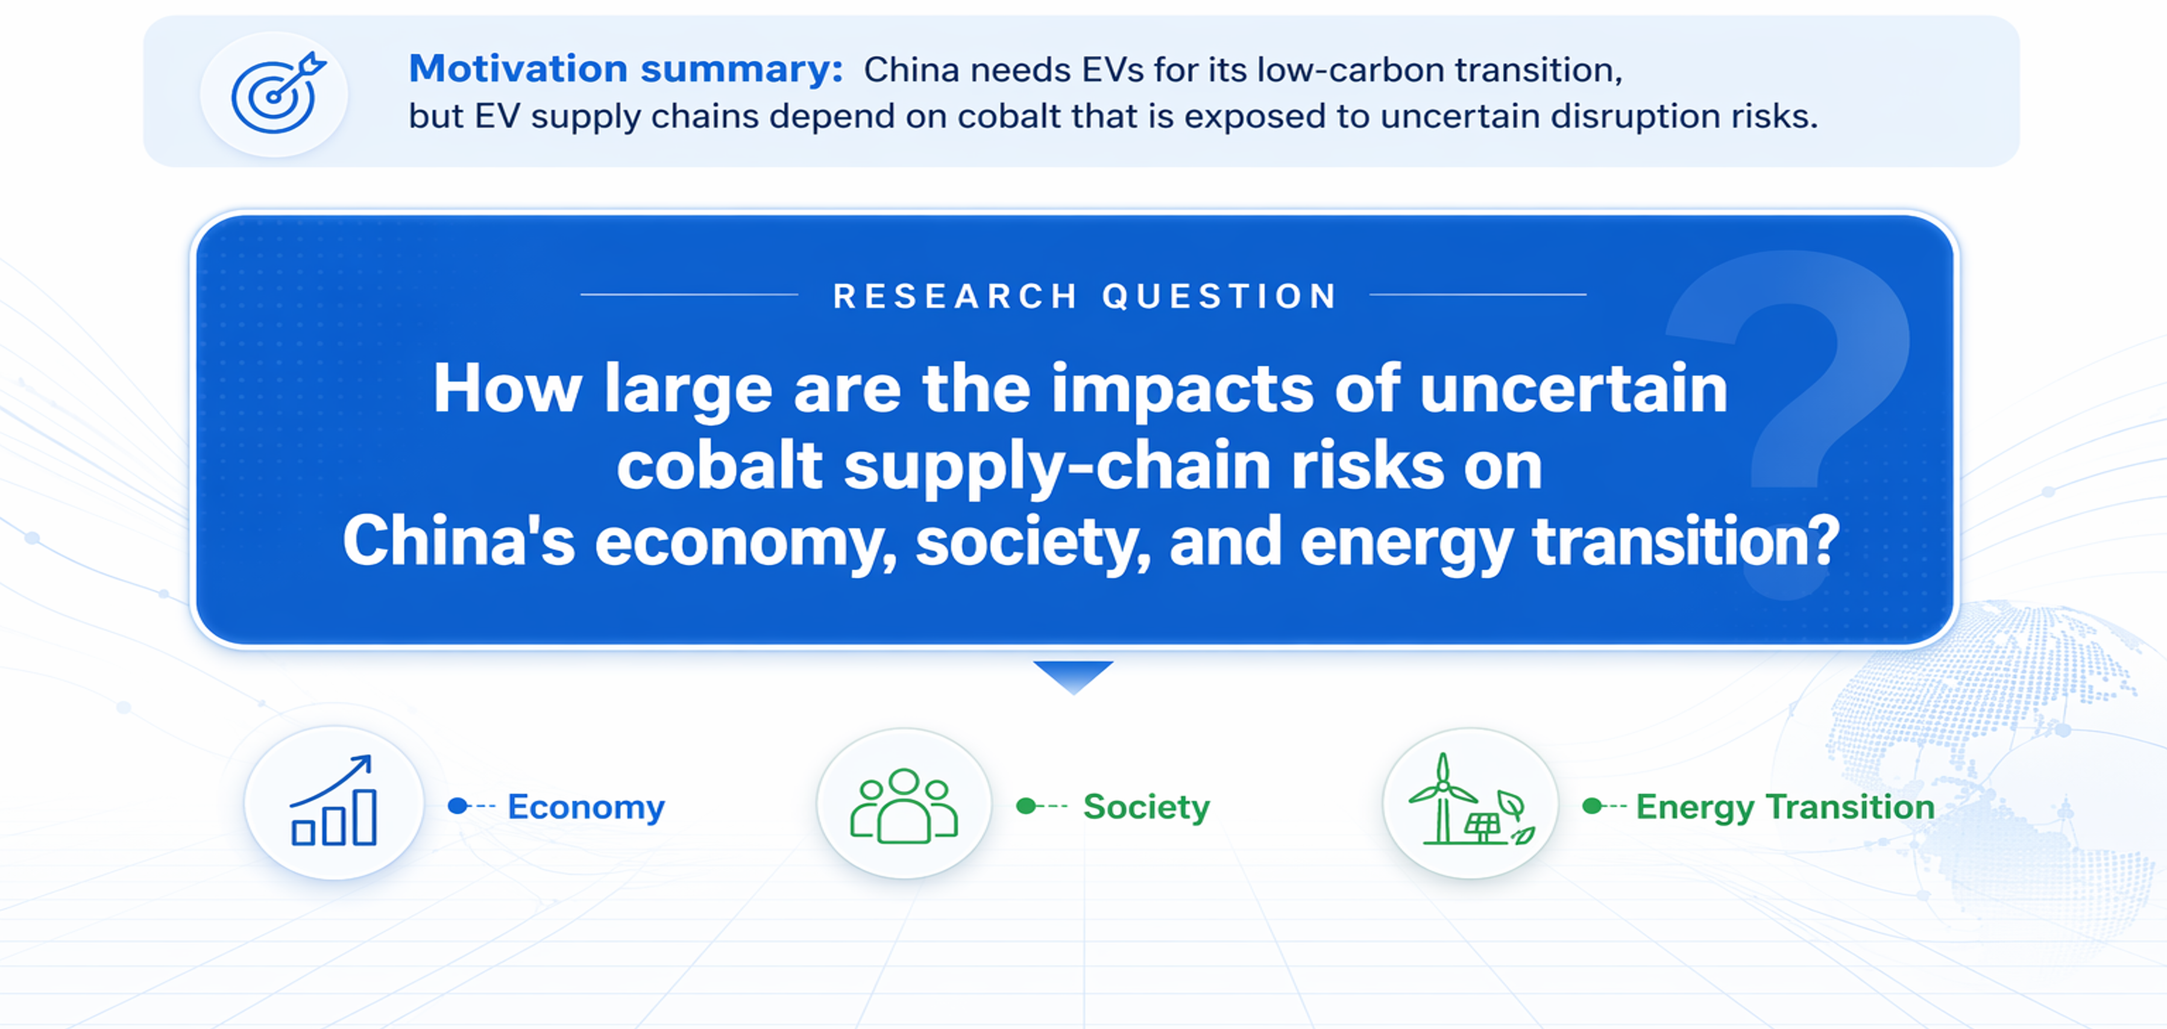
Research Question
Notes:
This brings us to our research question:【How large are the impacts of uncertain cobalt supply-chain risks on China's economy, society, and energy transition?】

Slide 6
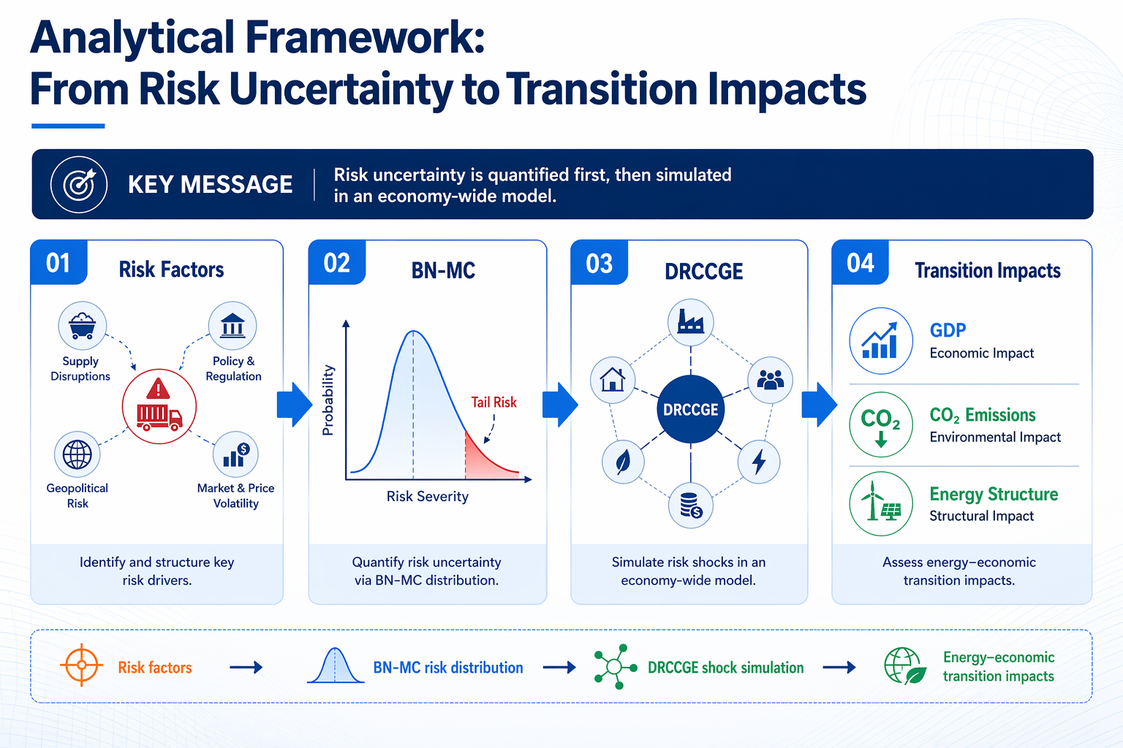
Analytical Framework
From Risk Uncertainty to Transition Impacts
Risk uncertainty is quantified first, then simulated in CGE model.
Notes:
To answer this, we built an analytical framework that combines Bayes-Monte Carlo simulation models with DRCCGE models.

Slide 7

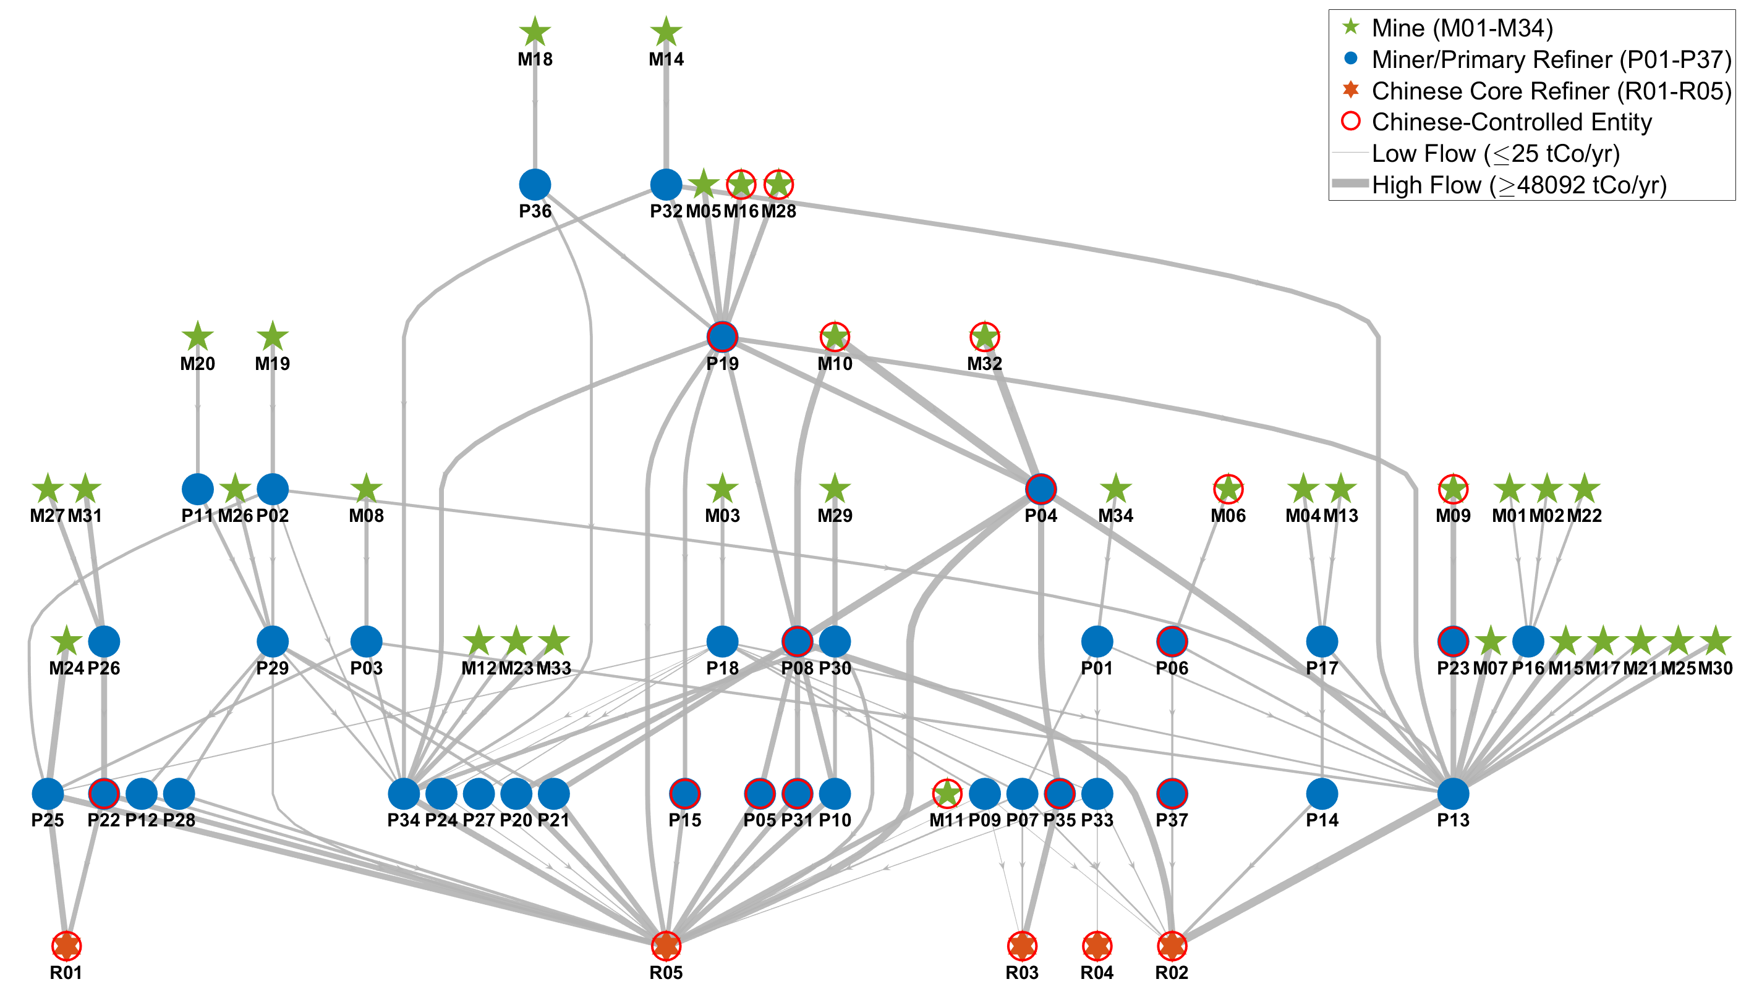
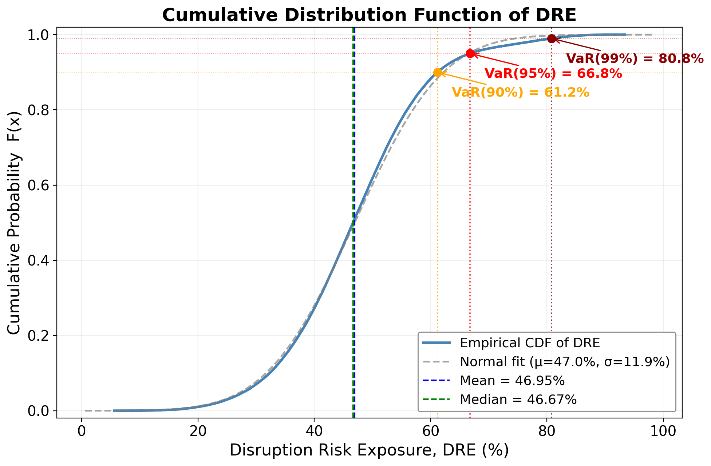
Methodology：BN-MC Risk Assessment
1
A firm-level Bayesian network
2
Monte-Carlo simulation
By integrating the S&P Global mine database, the FactSet global supply-chain database, and firm-level trade records from China Customs, we constructed a Bayesian-network model of China's cobalt supply chain — spanning 34 upstream mines, 37 midstream firms, and 5 Chinese refiners (77 nodes, 124 edges) — with edge weights calibrated to trade-flow shares.
Monte Carlo simulation (100,000 runs, three risk scenarios) yields a distribution of disruption risk exposure rather than a single deterministic shock.
3
China's cobalt disruption-risk exposure(DRE)
DRE ≈ 47%
China's refined-cobalt disruption-risk exposure
Fig. China's cobalt supply-chain topology
Fig. China's cobalt supply-chain disruption-risk exposure
Notes:
First, to quantify the risk, we constructed a 【firm-level Bayesian-network model of China's cobalt supply chain.】 Through Monte Carlo simulations, we found that China's expected 【Disruption Risk Exposure is about 47%.】

Slide 8
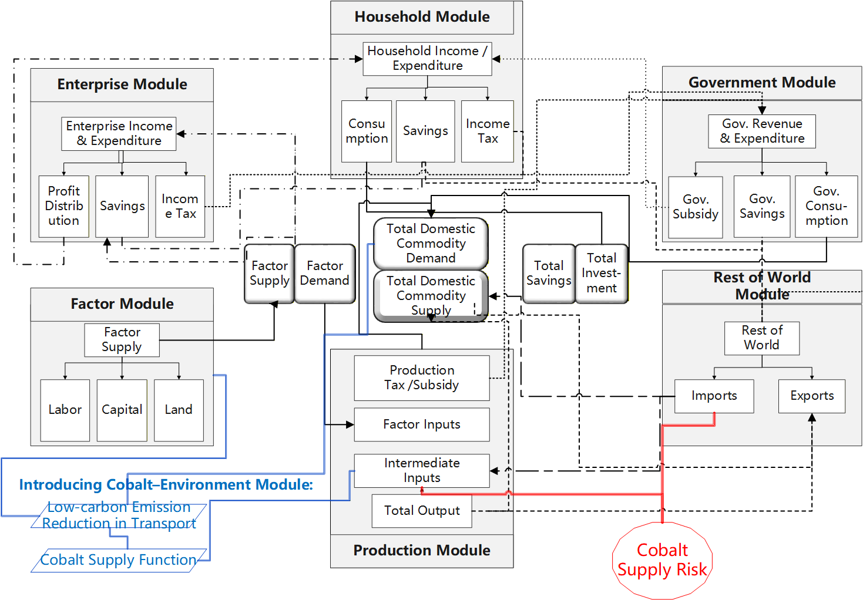
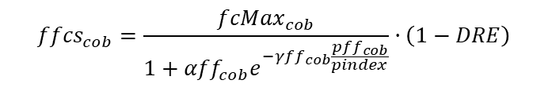
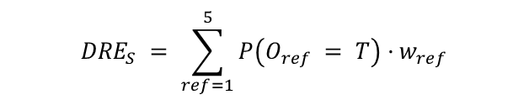
Methodology：DRCCGE
BN-MC
The probability distribution of DRE is obtained through 100,000 Monte Carlo draws under three states.
$${DRE}_{S} = \sum_{ref=1}^{5}{P\left(O_{ref} = T\right)·w_{ref}}$$
This study uses a Logistic function to represent the price response of resource supply:
$${ffcs}_{cob}=\frac{{fcMax}_{cob}}{1+{αff}_{cob}e^{−{γff}_{cob}\frac{{pff}_{cob}}{pindex}}}·\left(1−DRE\right)$$
Notes:
Next, we input this risk into our DRCCGE model. To connect the supply chain risk to the macroeconomy, we introduced a Cobalt-Environment Module. Specifically, we use a 【Logistic function to represent the price response of resource supply.】And most importantly, we directly introduce the measured Disruption Risk Exposure into this cobalt supply function to simulate the shock.

Slide 9
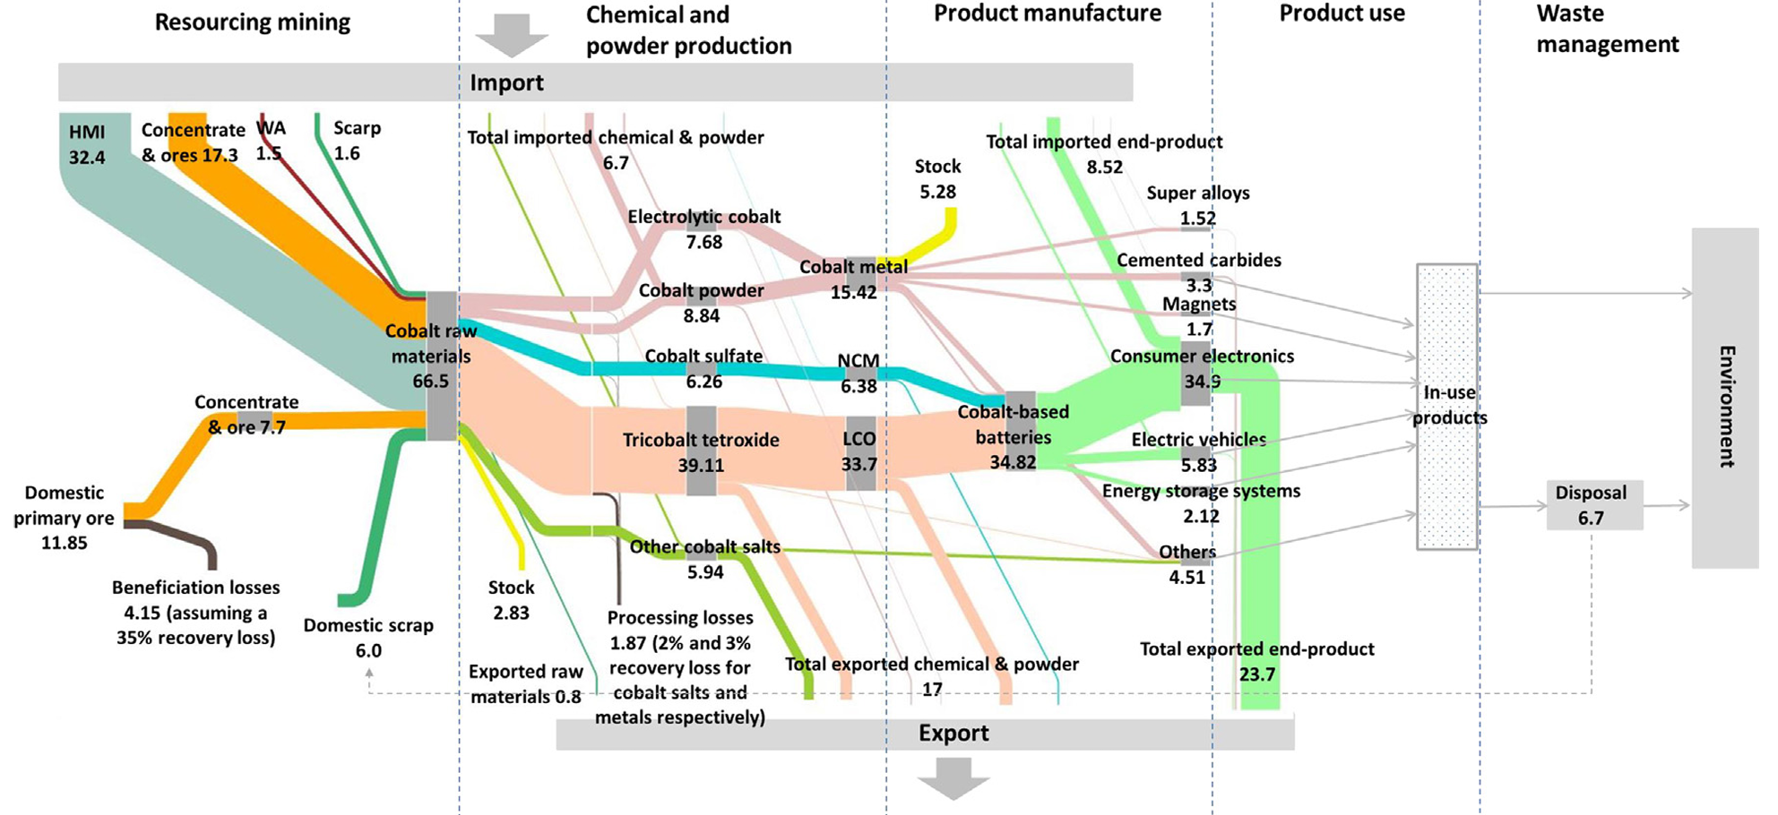
Data: Split Input-Output Table
Built on the NBS 2023 China Input–Output Table (211 sectors → 37 commodities/43 activities), splitting out a refined-cobalt sector and six electricity-generation technologies, supplemented by 2024 national statistical yearbooks.
Tabal. Steps for spliting the Input-Output Table
 | Item | Data Source
1 | Total Output | Refined Cobalt Quantity: USGS Price: USGS
2 | Export | Trademap、UN Comtrade (Divide the country)
3 | Final Demand | Estimated based on the proportion of mining and nonferrous metals sectors
4 | Intermediate Use | Total Output - Export - Final Demand as the control number Allocated based on the proportion of material flow analysis(MFA)
5 | Total Input | Total Input
6 | Value Added | Estimated based on the proportion of mining and nonferrous metals sectors
7 | Intermediate Input | Import as the control number (Trademap), Total Input - Value Added - Import as domestic intermediate input control number Refined Cobalt: Collect approximate investment ratios from the financial reports of major refined cobalt companies in China
Tabal. Structure of the splited Input-Output Table by sector
 |  | Sector1 | Sector2 | … | … | Refined cobalt | Other metals | EV | Battery | Final demand | Export | Total output
Domestic products | Sector1
 | Sector2
 | …
 | …
 | Refined cobalt
 | Other metals
 | EV
 | Battery
Value added
Total input
Fig. Cobalt material flow in China – Chen et al. (2020)
Notes:
To simulate the macroeconomic impacts accurately, we modified the standard data. We 【built on the NBS 2023 China Input-Output Table, splitting out a refined-cobalt sector and six electricity-generation technologies.】To do this, we integrated multi-source data from 【USGS, UN Comtrade, Material Flow Analysis and the financial reports of major refined cobalt companies in China】

Slide 10
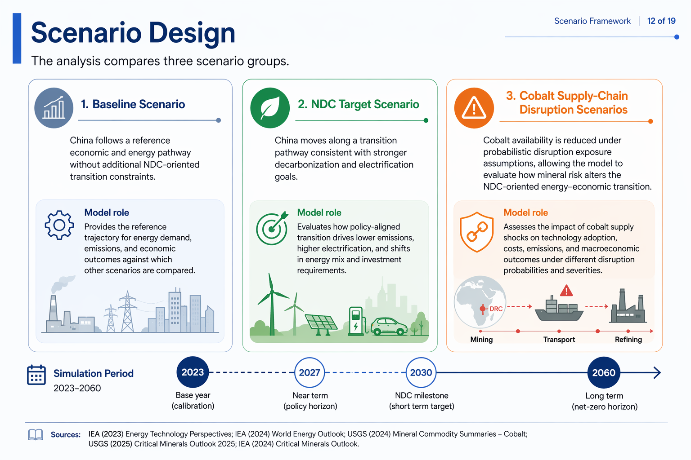
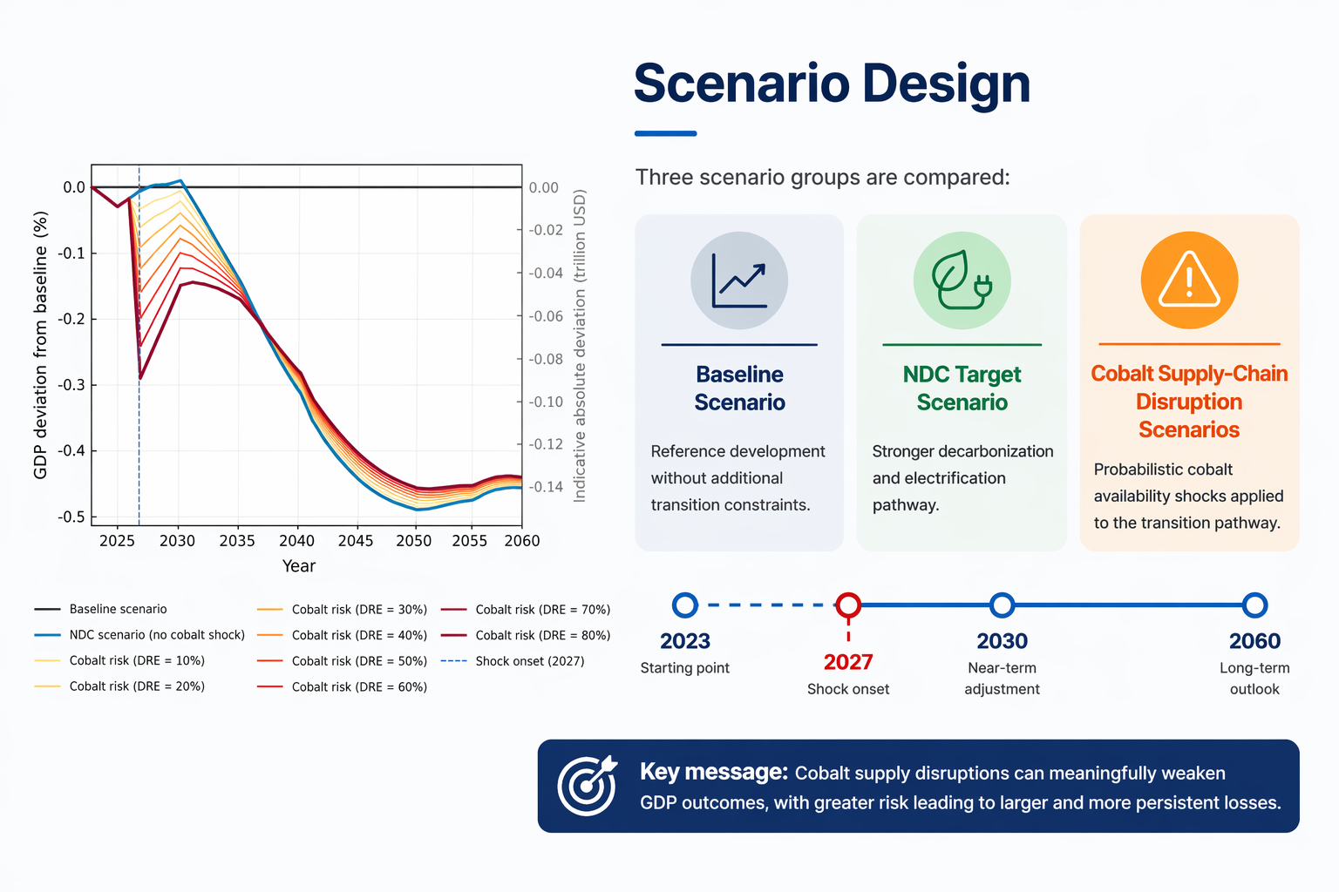
Scenario
Notes:
For our scenario design, we compare three groups: 【Baseline Scenario, NDC Target Scenario, and Cobalt Supply-Chain Disruption Scenarios.】

Slide 11
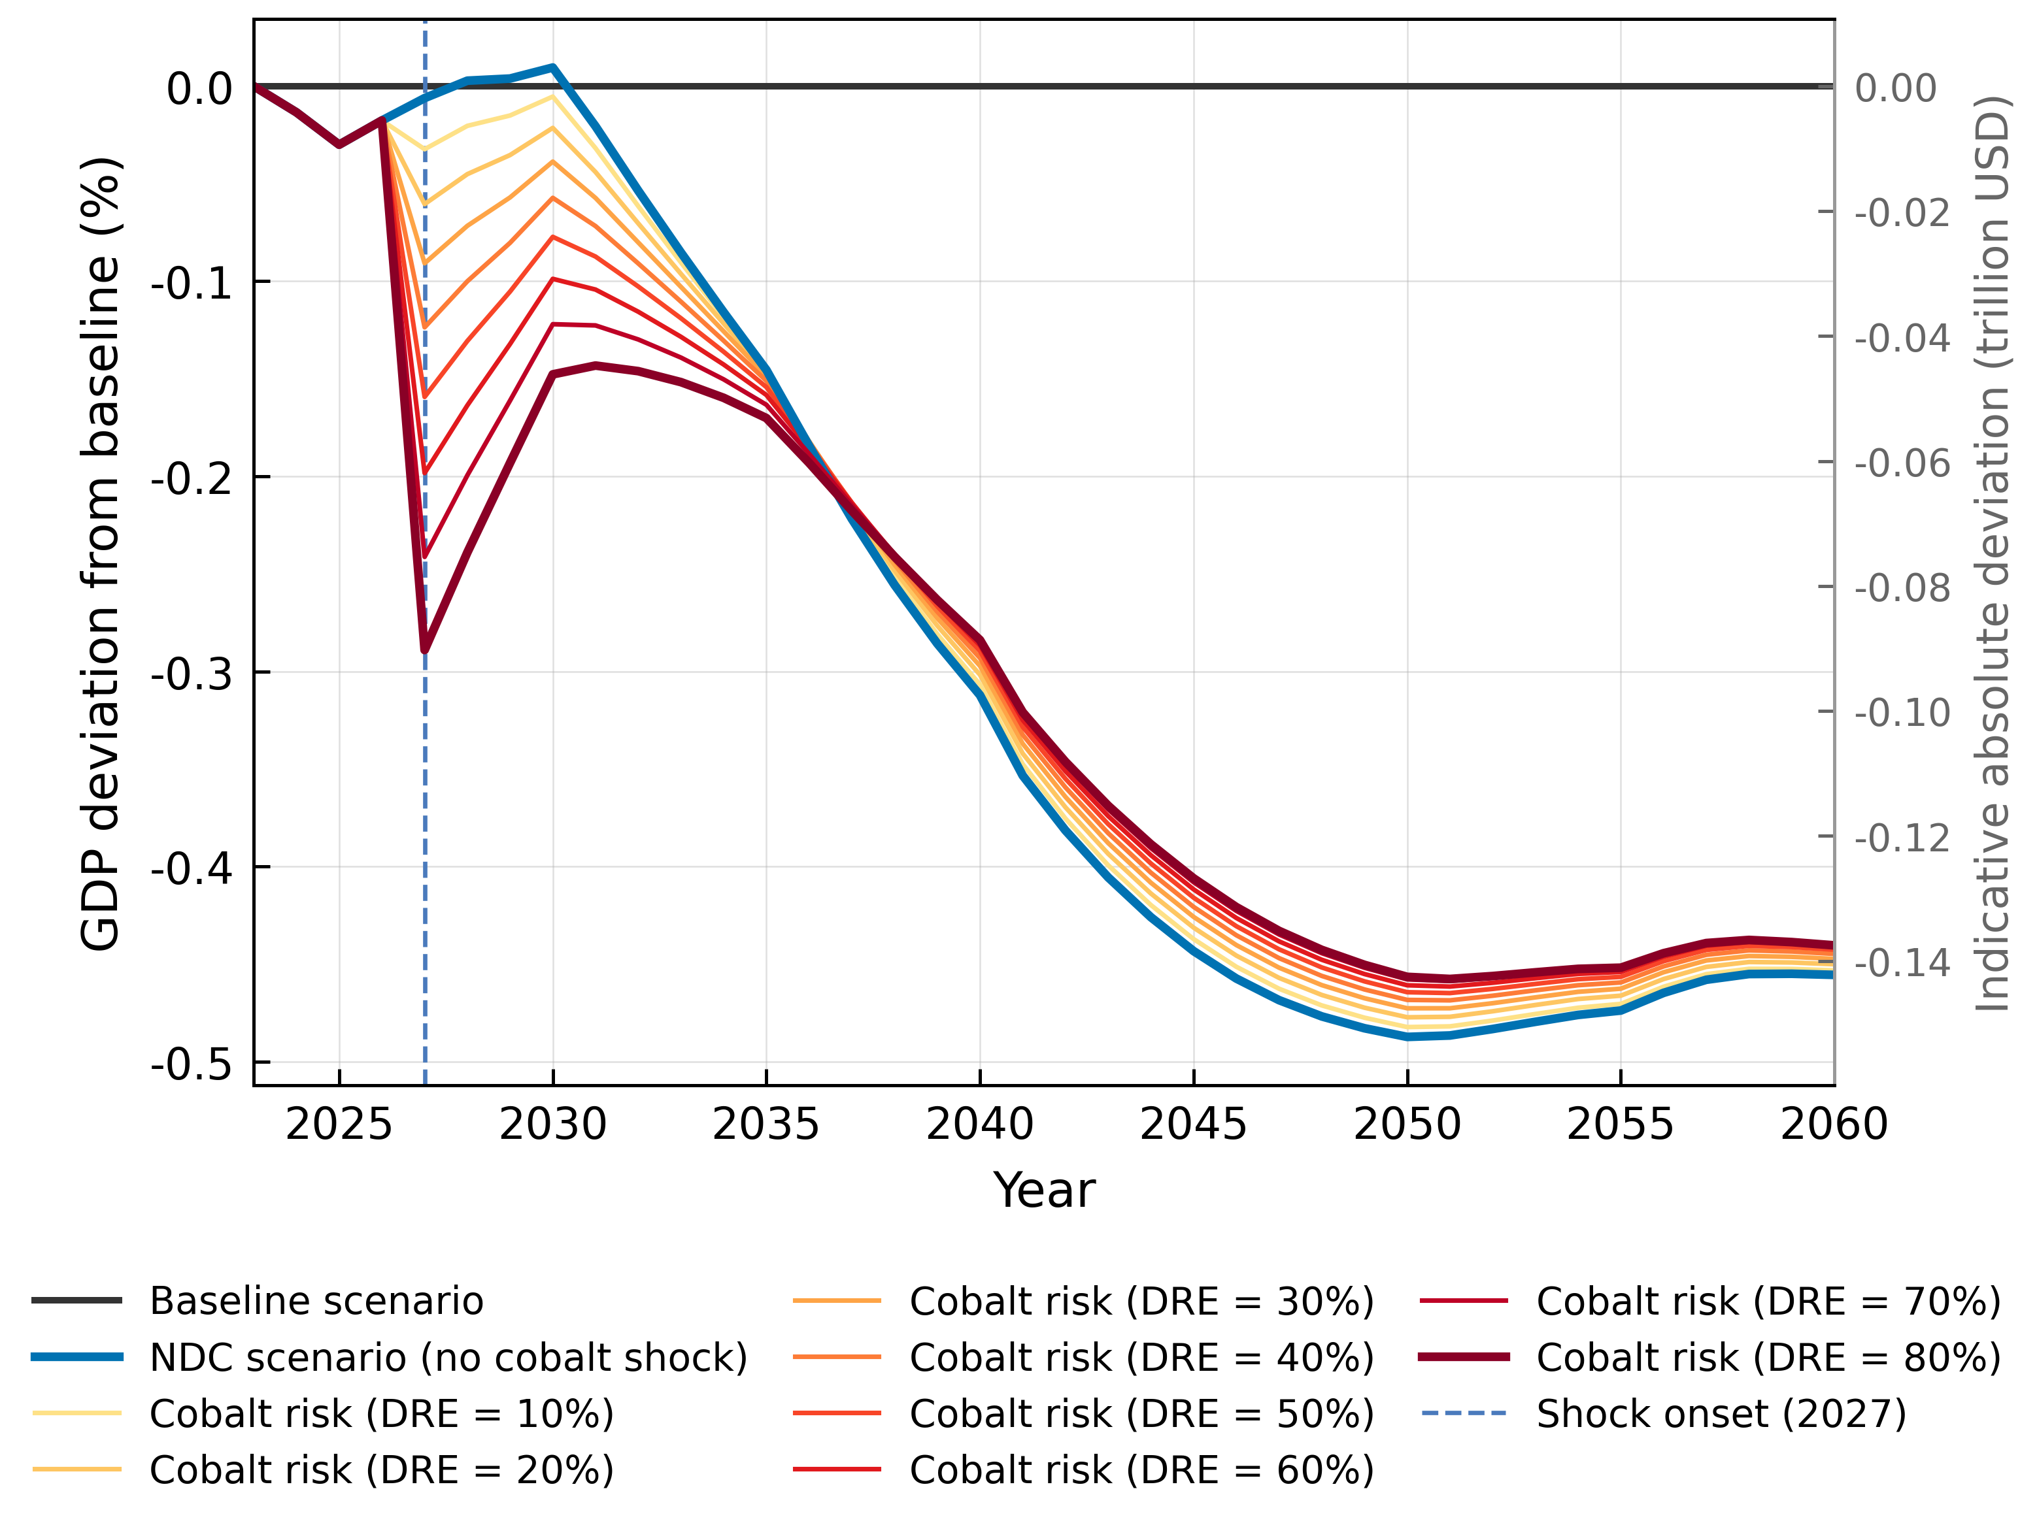
Result — GDP: Small Sector, Large Macro Leverage
Two loss components, very different in mechanism
−0.15%
−0.29%
GDP in 2027 at expected DRE≈47%
GDP in 2027 under extreme DRE=80%
$31.3 billion
≈98%
marginal cobalt-shock loss (DRE=47%,2027)
of total 2027 loss is the cobalt shock
Short run. Cobalt scarcity hits the refined-cobalt→battery→NEV chain; cross-sector capital and labour reallocation amplifies a <0.02%-of-GDP sector into tens of US$ bn of loss.
GDP will decline by 0.15% from the baseline, with the marginal contribution of the impact from cobalt supply chain disruptions to about 96% (approximately $31.3 billion), and losses amplify nonlinearly as risk exposure expands.
Rising marginal damage. Incremental GDP loss climbs from 0.028 pp (DRE 10→20%) to 0.048 pp (DRE 70→80%): +70%. Reserves earn higher avoided-loss returns in the high-DRE range.
Fig. Impacts of cobalt supply-chain disruption on China's GDP
Long-run trajectory. NDC loss widens to −0.31% (2040) and −0.49% (2050), then eases to −0.46% by 2060 as clean-capital accumulates; vs NDC, the cobalt-shock deviation turns positive around 2040.
Long-run reversal. Under the binding NDC cap, capital from shrinking EV/battery sectors is redeployed to wind/solar/nuclear/CCS — GDP deviation turns positive around 2040.
Notes:
Now let's look at the results, starting with GDP. In the short run, we see a 【small sector, but large macro leverage.】 Under the 2027 DRE = 47% scenario, GDP will decline by 0.15% from the baseline, with the marginal contribution of the impact from cobalt supply chain disruptions approximately $31.3 billion, and losses amplify nonlinearly as risk exposure expands. In the long term, that is, after 2050, losses will be reduced

Slide 12
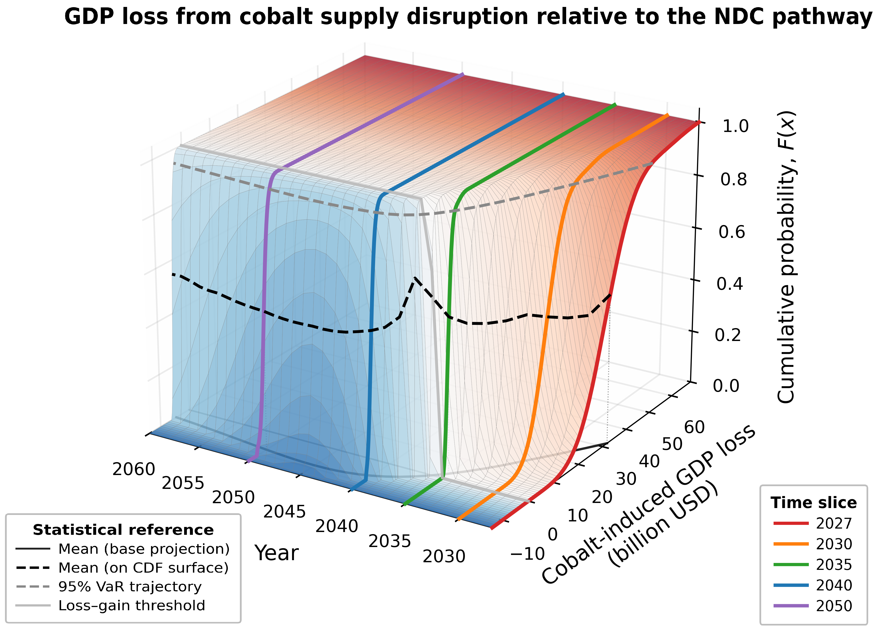
Result — GDP Loss →Gain Dominated Distribution
US$31.3 bn
US$62.2 bn
expected 2027 GDP loss (BN-MC mean)
99th-pct tail value at risk, 2027
2035–2040
30.7→20.6%
loss → gain reversal window
CoV by 2050: uncertainty converges
Reading the CDF. For any year t, the vertical cross-section gives the probability that the GDP impact stays below x — the full risk structure from 100 000 BN-MC draws.
Tail risk collapses. 2027 extreme loss (VaR₉₉) US$62.2 bn → by 2035 the 99th-pct loss is only ≈US$7.06 bn; from 2040 even the tail turns to a small gain. US$62.2 bn · CoV falls 30.7%→20.6% by 2050.
Fig. Impacts of cobalt supply-chain disruption on CO₂ emissions
Robust reversal. The loss-to-gain shift concentrates in 2035–2040 and the coefficient of variation falls 30.7%→20.6% by 2050 — expected and increasingly certain.
KEY FINDING The whole impact distribution — not just the mean — shifts from loss to gain over time
Notes:
This 3D chart shows our finding:【The whole impact distribution — not just the mean — shifts from loss to gain over time.】

Slide 13
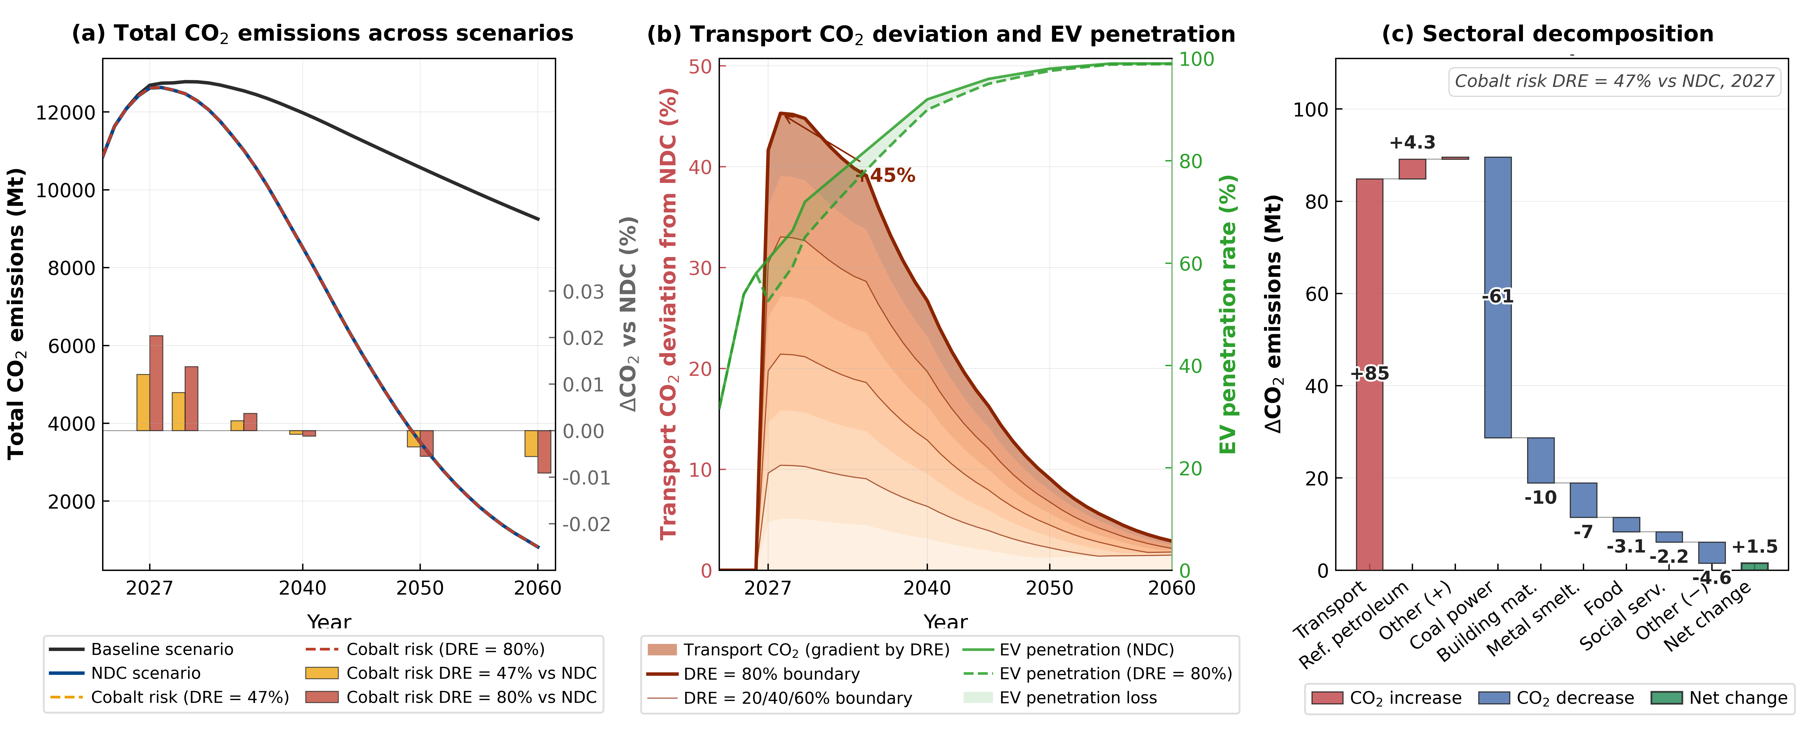
Result — CO₂: Stable Aggregate, Structural Setback
The aggregate barely moves — but the composition deteriorates sharply.
Net economy-wide CO₂: +2.55 Mt (+0.020%)
Under DRE = 80%, 2027 — a hidden offset
Not real abatement. The flat total is passive — economic contraction offsets the transport spike, not technology or efficiency gains.
+141.09 Mt
−98.45 Mt
Coal offsets >70% of the transport-emission rise: cobalt scarcity suppresses electricity-intensive manufacturing, cutting power demand and coal generation.
transport CO₂
(EV penetration −8.18%)
coal-power CO₂
(passive abatement)
Policy implication. Aggregate CO₂ indicators conceal structural risk — critical-mineral assessment must track sectoral pathways, especially transport electrification.
KEY FINDING The aggregate total barely moves. But the structure changes sharply. Because of the disruption, we see a transport CO2 spike, but a drop in coal-power CO2 because the economy slows down. This is a structural setback, not real abatement.
Fig. Impacts of cobalt supply-chain disruption on CO₂ emissions
Notes:
For CO2 emissions, the aggregate total barely moves. But the structure changes sharply. Because of the disruption, we see a 【transport CO2 spike,】 but a drop in 【coal-power CO2】 because the economy slows down. This is a 【structural setback】, not real abatement.

Slide 14
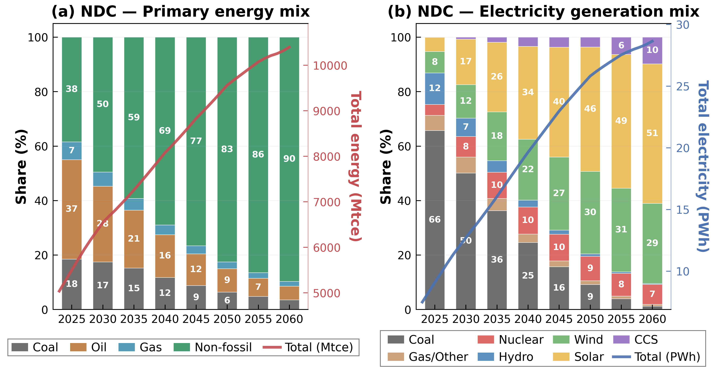
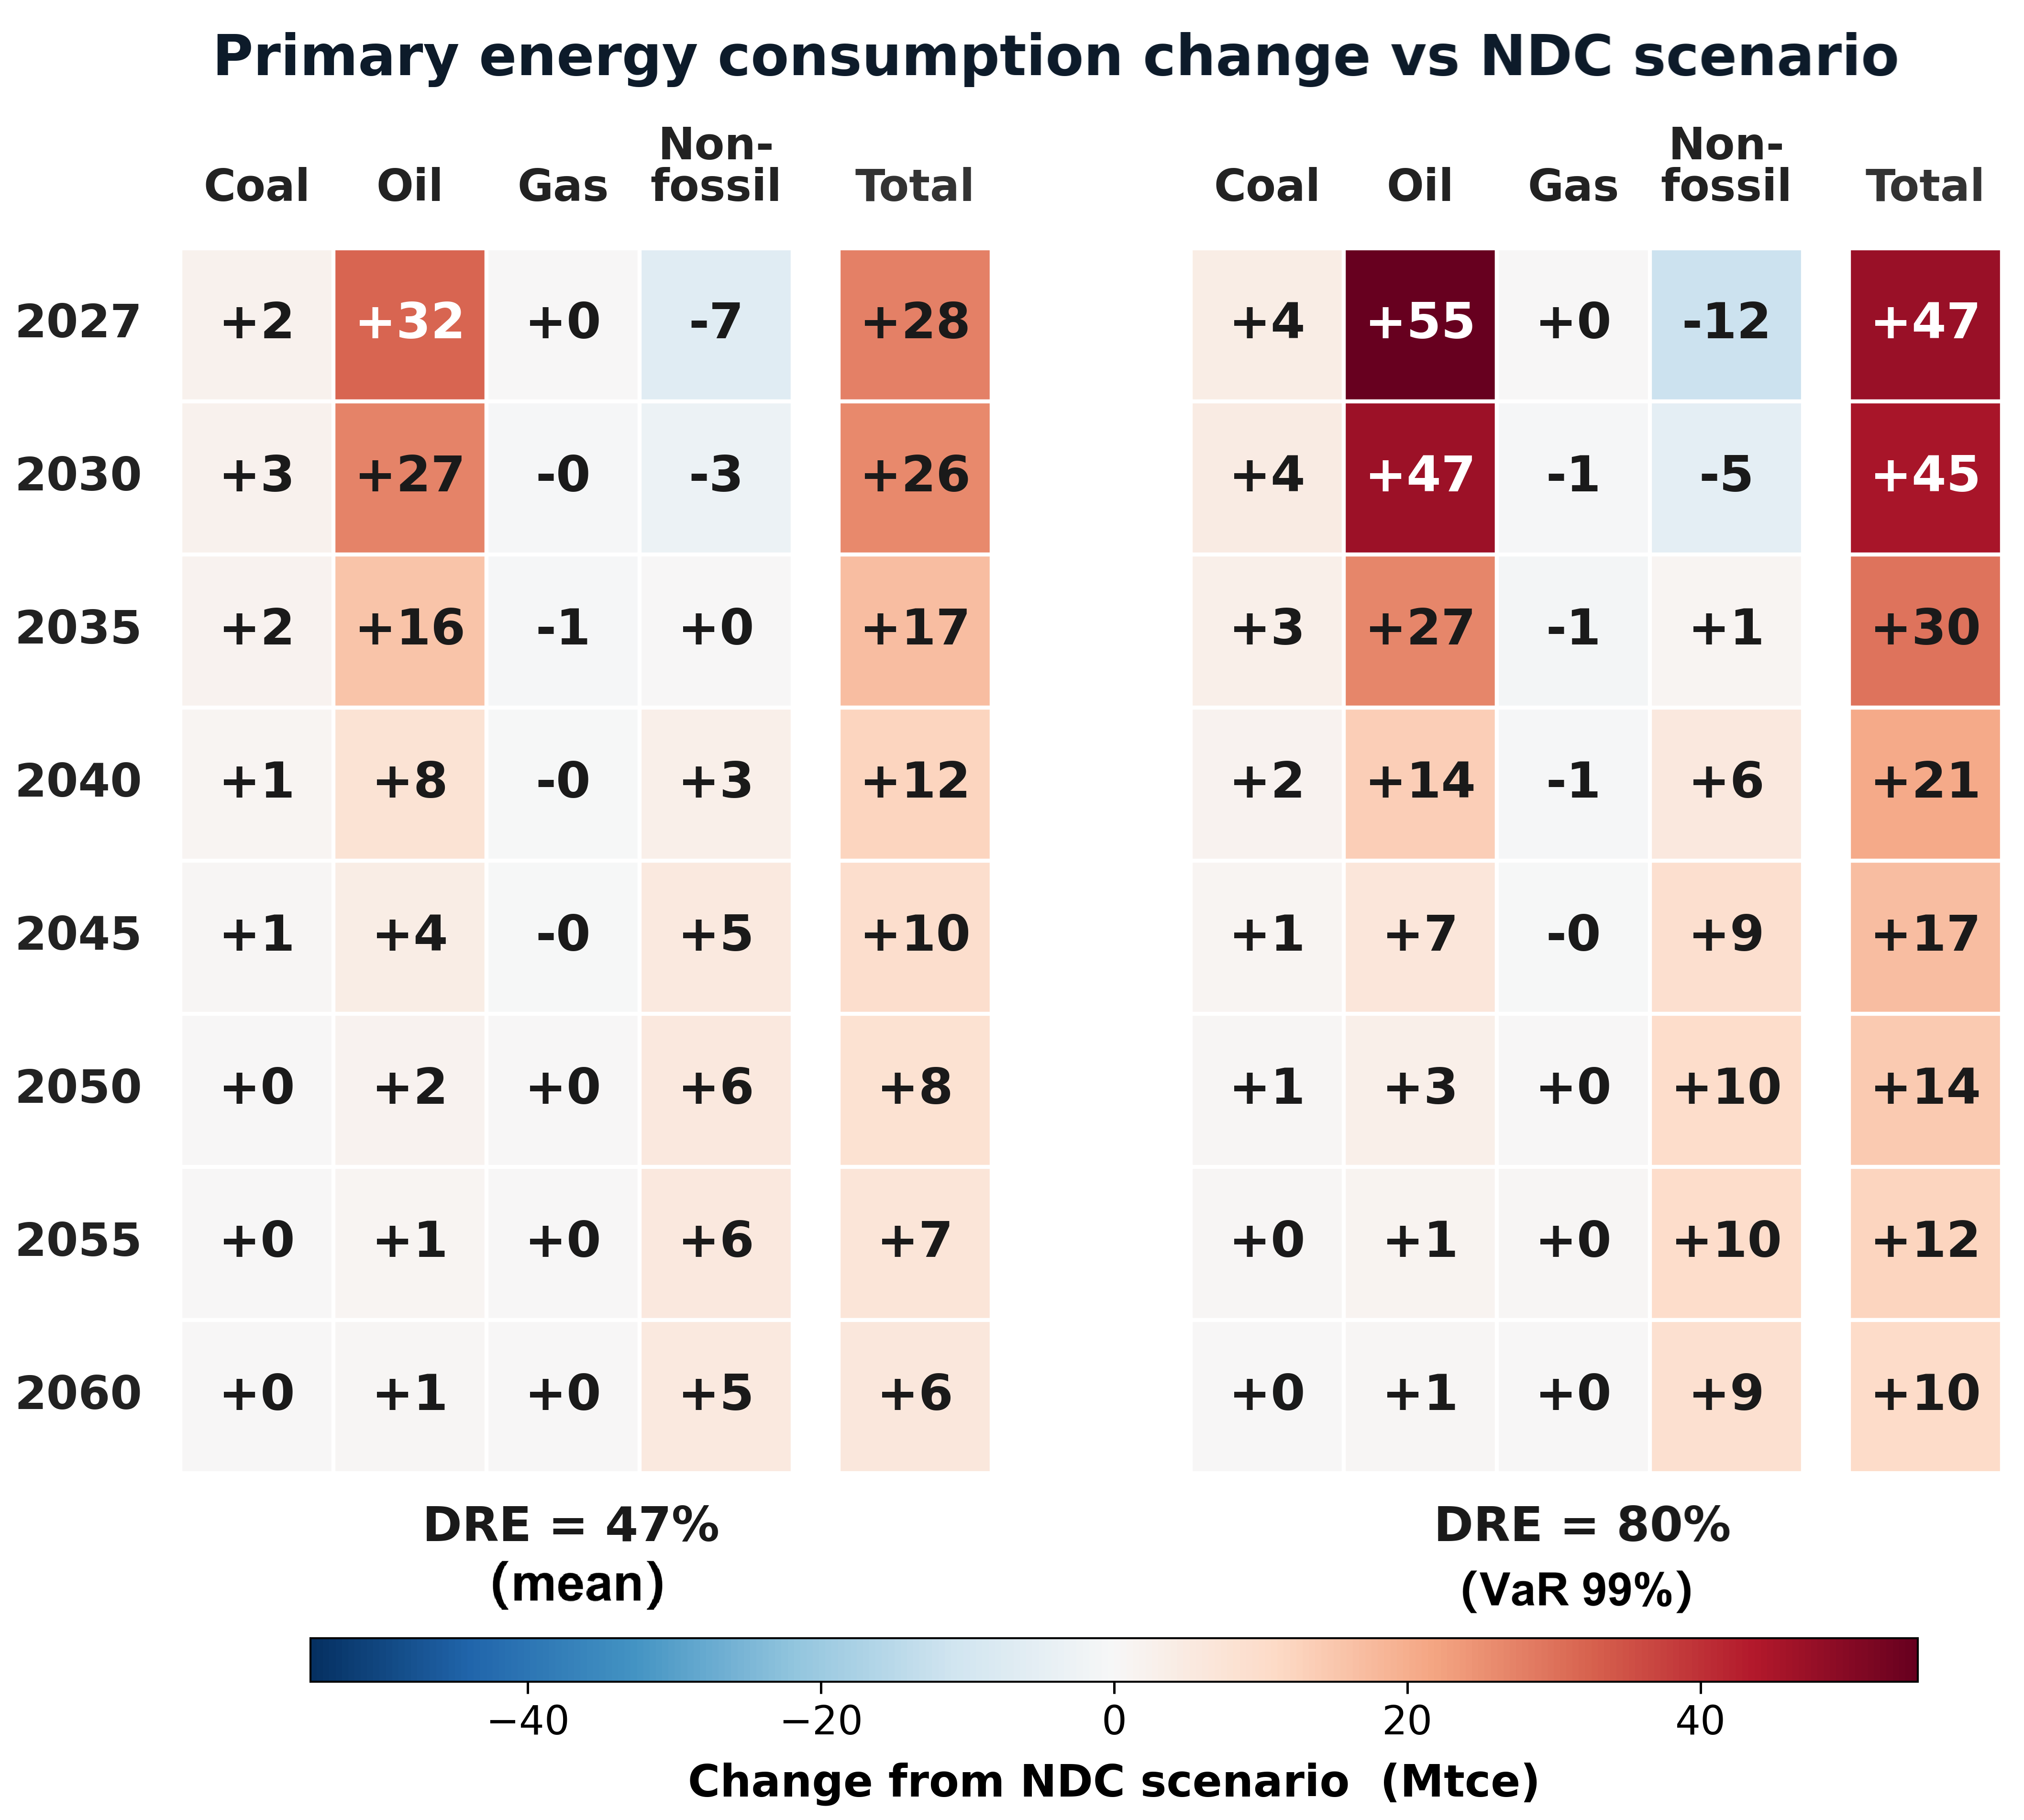
Result — Energy Mix: Disruption Accelerates the Transition
Fig. Evolution of China's energy structure under the NDC scenario
Short-run fossil rebound, then a long-run non-fossil net gain.
Fig. Evolution of China's energy structure under the NDC scenario
Non-fossil energy Δ vs NDC, DRE = 80% (Mtce)
Initial setback. Cobalt scarcity slows EV/electrification; oil and coal shares rise as road transport falls back on liquid fuels.
2027
2035
2040
2050
−12
+1
+6
+10
Capital redirection. Under the binding NDC cap, capital stranded from NEV/battery sectors cannot return — equilibrium reallocates it to wind, solar, nuclear and CCS.
2027 shock: +47 Mtce total (oil +55, coal +4, non-fossil −12). Reversal of the non-fossil sign by ~2035.
Net long-run gain. By 2050 non-fossil consumption is +10 Mtce vs NDC (BN-MC mean +6 Mtce in 2050, +5 Mtce in 2060); fossil share contracts.
Notes:
Regarding the energy and power mix, the disruption causes an initial setback, with more oil and coal used in the short term. But, as capital is redirected, it accelerates the transition in the long term. By 2050, we see a 【net long-run gain in non-fossil energy】 and a 【clean-power net gain.】

Slide 15
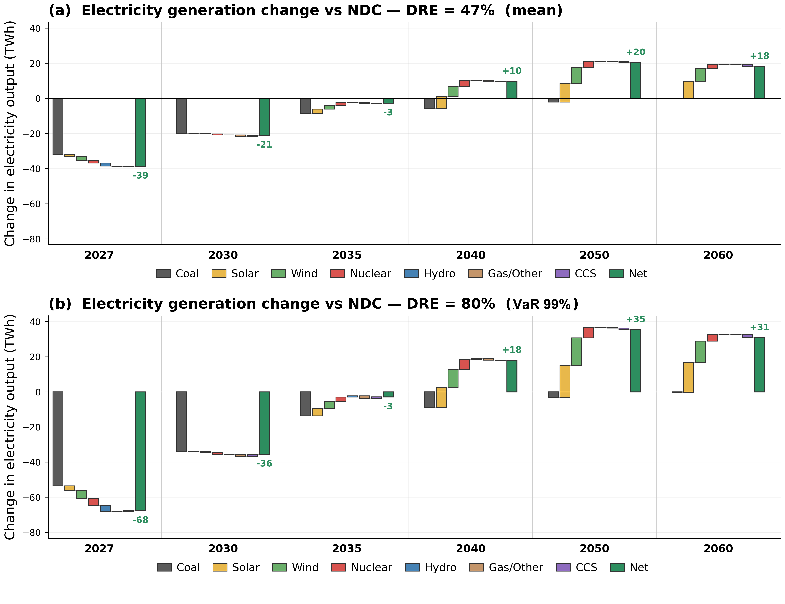
Result — Power Mix: From Demand Drop to Clean Net Gain
Generation first falls across the board, then turns into a clean-power net gain.
Net generation Δ vs NDC, DRE = 80% (TWh)
2027
2035
2040
2050
2060
−68
−3
+18
+35
+31
2027 demand shock. Net generation −68 TWh; coal power −54 TWh = 79% of the drop, as electricity-intensive manufacturing contracts.
2040 crossover. Net generation turns positive (+18 TWh): solar +11.7, wind +10.1 TWh while the coal-power cut shrinks to −9 TWh.
2050 clean gain. +35 TWh net; solar+wind +33.9 TWh, coal cut narrows to −3 TWh. BN-MC mean +20 TWh ≈ 58% of the extreme case.
Mechanism. The binding carbon cap converts a short-run mineral bottleneck into faster renewable deployment — a structural, not transient, shift.
Fig. Impacts of cobalt supply-chain disruption on the electricity generation structure
Notes:
Regarding the energy and power mix, the disruption causes an initial setback, with more oil and coal used in the short term. But, as capital is redirected, it accelerates the transition in the long term. By 2050, we see a 【net long-run gain in non-fossil energy】 and a 【clean-power net gain.】

Slide 16
Conclusion
Coupling BN-MC supply-chain risk with the DRCCGE model reveals how cobalt disruption reshapes China's decarbonization pathway — small in scale, large in leverage, and asymmetric over time.
01
Tiny sector, macro leverage
02
Asymmetric emissions effect
03
Long-run transition reordering
Cobalt mining-refining < 0.01% of GDP, yet DRE=80% cuts 2027 GDP by 0.29% (US$61.4 bn; VaR₉₉ US$62.2 bn).
Aggregate CO₂ barely moves (+2.55 Mt, +0.020%) but transport +141 Mt vs coal −98 Mt.
The binding NDC cap redirects stranded EV/battery capital to wind, solar, nuclear, CCS.
Around 2040 GDP, energy and power effects all reverse from loss to gain.
Marginal damage rises with DRE → prevent entry into the severe-disruption range first.
Passive abatement from contraction masks a real electrification setback.
A mineral worth <0.02% of GDP can swing the macroeconomy by tens of US$ bn in the short run — yet under a binding carbon cap, the same disruption accelerates the clean-energy transition in the long run!
Four policy levers
Strategic reserve
Trade diversification
Substitution & recycling
Geopolitical watch
size to the short-run disruption-probability distribution; central-led, dynamic rotation.
upstream equity & offtake in Indonesia, Philippines, Australia; avoid new single-source concentration.
stable expectations for LFP, Mn-rich, Na-ion chemistries plus end-of-life battery recycling.
dynamic tracking of DRC mining policy & conflict risk; hub-node marginal impact up to 25× edge nodes.
Notes:
To conclude, our study reveals three main points:【Tiny sector, macro leverage.】 【Asymmetric emissions effect.】 and【Long-run transition reordering.】

Slide 17
Thank you
Impacts of Cobalt Supply-Chain Disruption on China's Decarbonization Pathway
Yuanchen Sun · Sanmang Wu · Shantong Li · Jianwu He
28th IIOA Conference · 23 June 2026
Notes:
Thank you for your time and attention.

