Slide 1

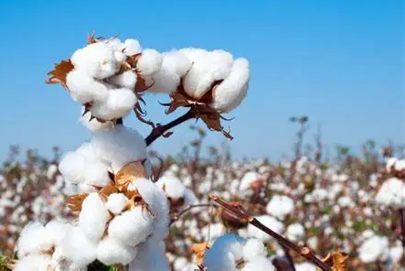
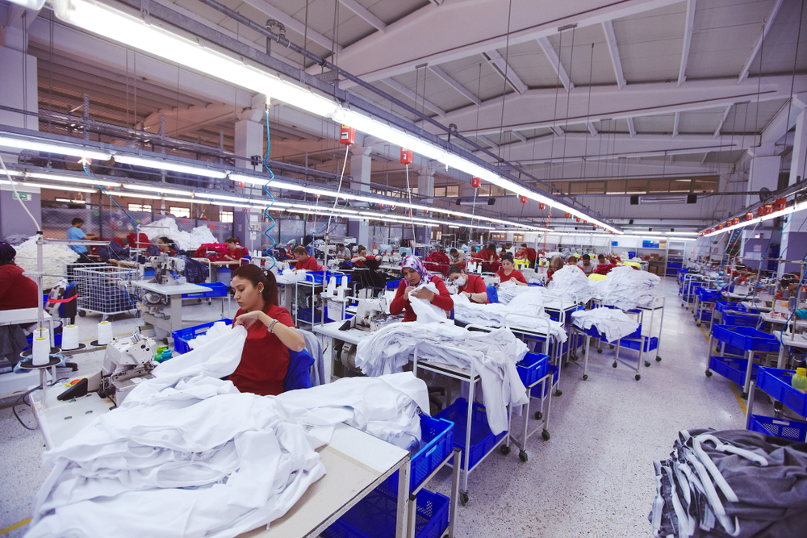
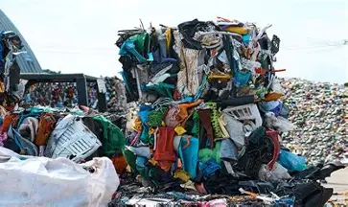
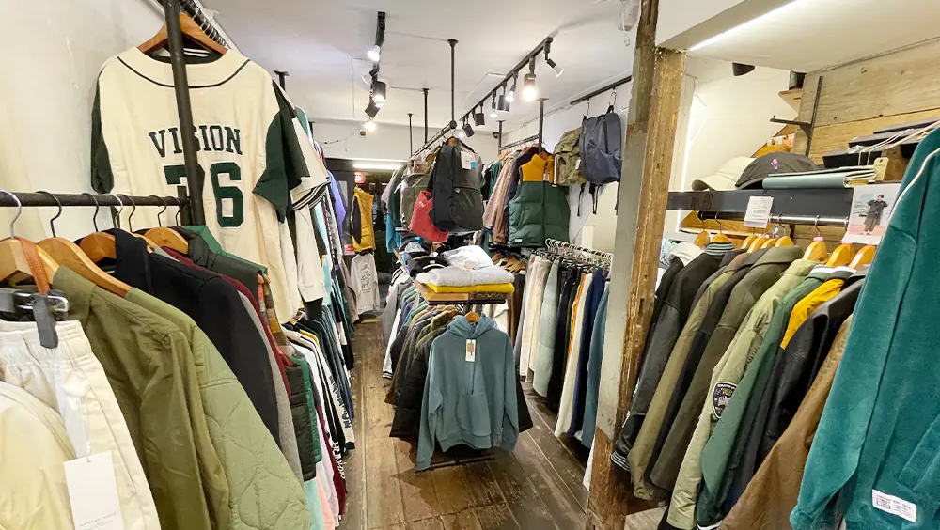
Tracing Carbon-Intensive Upstream Paths in the Global Textile Supply Chain
ーA Unit Structure Analysis of
Japanese Final Demandー
Motohiro Sano¹⁾, Kairi Inoue¹⁾ and Shigemi Kagawa²⁾
1) Undergraduate School of Economics, Kyushu University
2) Faculty of Economics, Kyushu University
Notes:
Good afternoon, everyone. My name is Motohiro Sano, from Kyushu University.
Today, I'd like to share our research on carbon emissions / in the global textile supply chain — with a focus on Japan's final demand.

Slide 2
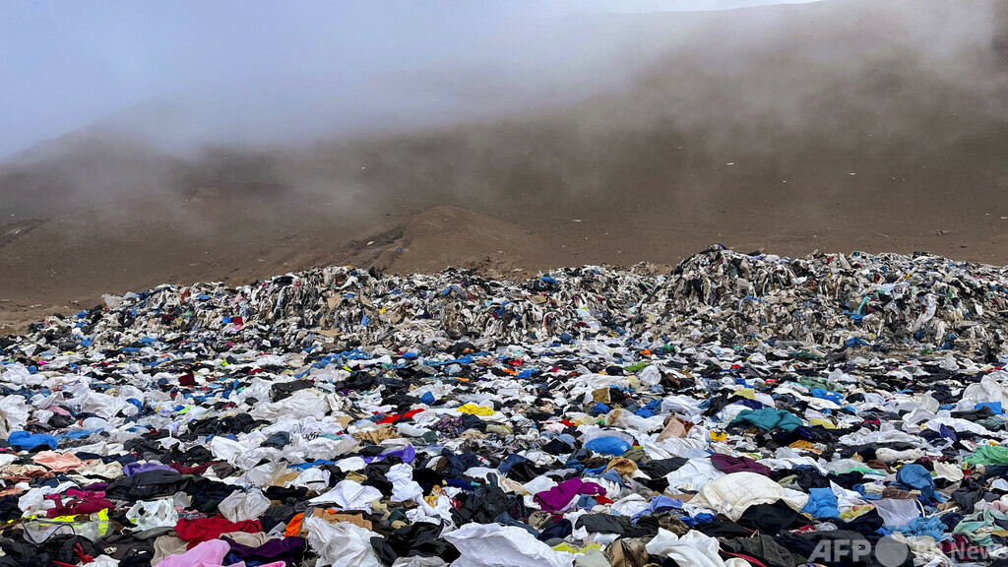
The clothing desert
in the Atacama Desert in Chile
Notes:
Before I begin, I wanna you to look at this image.
This is the Atacama Desert in Chile — one of the driest places on-Earth. And yet, it’s now covered in used clothes.
These are garments that were thrown away — mostly from wealthy countries — and got dumped here / cuz they had nowhere else to go.
The pile is so large that it is actually visible from space.
This is not just a waste problem. It is the result of how our global clothing system works. And today's research is about that system.

Slide 3
Agenda
1
Introduction
Methods
Results
Conclusions
✔
d
d
Notes:
Here is the agenda for today.
I'll start with the background and motivation, / then explain our methods, present the results, / and close with our conclusions and policy suggestions.

Slide 4
Introduction
1
Introduction
Methods
Results
Conclusions
✔
d
d
Notes:
Let me begin with the introduction.

Slide 5
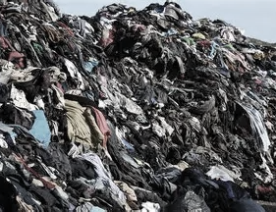


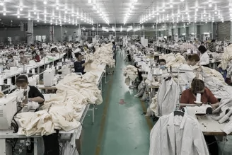
Introduction ―Textile industry issue―
2
The textile industry accounts for 6–10% of
global GHG emissions, generating 1.2 billion
tons of CO₂ equivalent annually.
3%
6-10%
Exceeding the combined CO₂ emissions
from international aviation and shipping.
Notes:
The textile industry is a / huge source of gas emissions.
It creates 6 to 10 percent of global emissions /which is about 1.2 billion tons of CO-two every year.
To give you an idea, this is more than the combined emissions / from all international flights and ships.
This is a big problem — and its getting bigger.

Slide 6
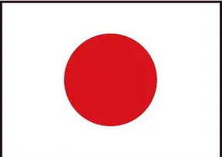

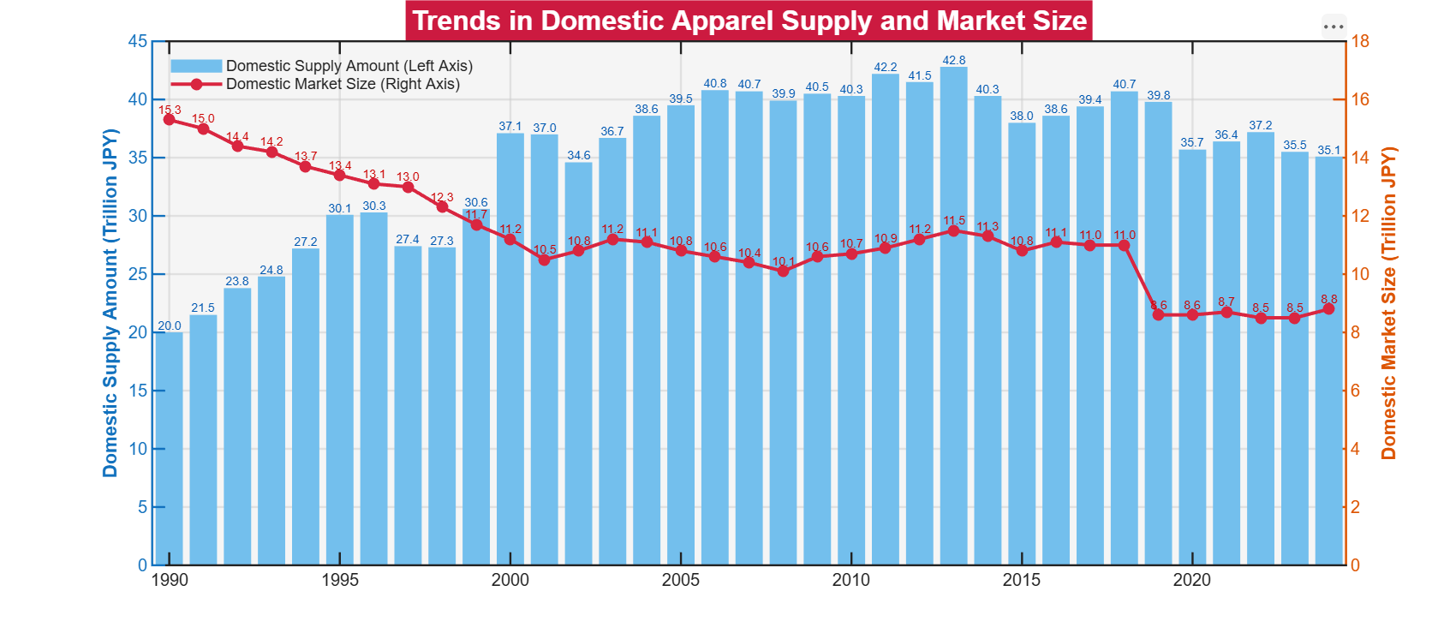
Introduction ―Apparel waste―
3
1990
2024
2.5 billion items
THE OVERSUPPLY MECHANISUM
3.5 billion items
Apparel firms prioritize extreme cost reduction
by placing massive orders
A structure based on the assumption
of unsold inventory
1.4x supply volume
Supply of clothing in Japan
MASS DISPOSAL CRISIS
The surplus directly fuels a waste epidemic.
In the Japanese market, it is estimated that
1 billion brand-new items are discarded annually
Size of the Japan’s market
Equivalent to one in every four items
Notes:
Part-of the problem is overproduction.(pを意識）
Clothing companies try to lower costs /by ordering huge amounts of products. This creates a system where /unsold items are expected from the start.
In Japan, it is estimated that /1 billion new unworn items are thrown away every year. That’s /one-in-every-four items produced.
(次のスライド）
Lookin at-the bar chart on the right. The blue bars show the total supply of clothing in Japan — this grew from 2.5 billion-items in 1990 / to 3.5 billion-in 2024. even though, the size of the domestic market has been shrinking /as we can see from the red line.
These shows that / textile industry is moving toward mass production. And-Japa-is getting to rely heavily on importing them from overseas.
apparel supply overproduction

Slide 7
Introduction ―Apparel waste―
3
1990
2024
2.5 billion items
THE OVERSUPPLY MECHANISUM
3.5 billion items
Apparel firms prioritize extreme cost reduction
by placing massive orders
Reducing the environmental
burden of the textile industry
requires action from Japan
A structure based on the assumption
of unsold inventory
1.4x supply volume
Supply of clothing in Japan
MASS DISPOSAL CRISIS
But
The surplus directly fuels a waste epidemic.
In the Japanese market, it is estimated that
1 billion brand-new items are discarded annually
Research on Japan's textile
industry is still limited.
Size of the Japan’s market
Equivalent to one in every four items
Notes:
Reducing the environmental burden of the textile industry requires action from Japan.
But, Research on Japan's textile industry is still limited.

Slide 8

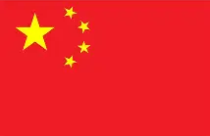
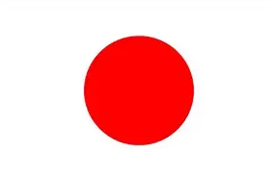
Introduction ―Japanese textile demand―
4
Production value share
CO₂ emission share
2021, China accounted for 67% of
Production value induced by Japan’s
textile demand, while Japan accounted
for only 12%.
China's share jumps to 77% of
emissions, while Japan’s drops
to 5%. This reflects China’s carbon-
intensive coal-fired infrastructure.
Figure 1: Share of production value and CO₂ emissions induced by Japan’s final textile demand In 2021
Notes:
Let me show you one key fact about Japan's textile supply chain.
In 2021, China produced / 67% of-the goods /that came from Japan’s textile demand. Japan itself only produced 12%.
When we look at CO₂ emissions, China's share rises even further — to 77%. Japan's share drops/ to just 5%.
Why? Cuz China relies on coal-fired power/ making production there / is much higher in CO2 emissions.
This tells us that where clothes are made matters a great deal.

Slide 9



Introduction ―Research questions―
5
Company
Government
What are the most effective way
Japanese apparel companies and
the government can take to reduce
the environmental burden
of the textile industry?
Examines effective measures through several scenarios
Notes:
So my central question is this:
What is the most effective way for Japanese companies and the government / to reduce the carbon footprint of Japan's textile industry?
I try-it answer this / by testing several scenarios.

Slide 10
Methods
6
Introduction
Methods
Results
Conclusions
✔
d
d
Notes:
Now let me explain our methods.

Slide 11

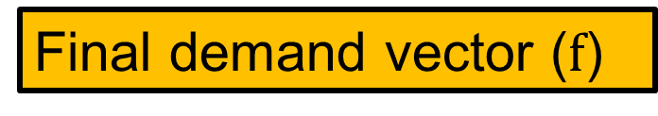
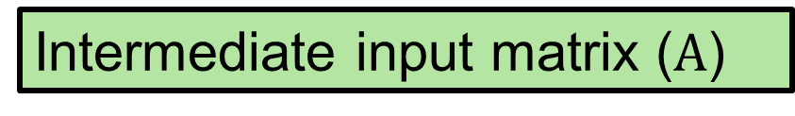
Methods ―Over view―
7
Distinguishes between changes in the country of origin of final goods imports and changes in intermediate input sourcing.
Final demand
Sold horizontally
Intermediate input matrix ($A$)
Represents transactions of raw materials
between industries and countries, and
shifting it changes the sourcing of intermediate inputs along the supply chain.
Transactions
of raw
materials
Gross output
Final demand vector ($f$)
Produced vertically
Represents where Japan imports its final textile goods from, and shifting it changes the country of origin of those imports.
Gross value
added
Gross output
Notes:
To solve that questions, I use a multi-regional input-output model.
To put it simply: every product we buy requires raw materials / and parts from many countries. This table tracks those flows — basically / who buys from whom-and how much.
In this study, I focus on two key elements.
The First is the final demand vector, which represents where Japan imports its finished clothing from.
The Second is the intermediate input matrix, which tracks / how raw materials — like cotton-or-fabric — move between industries and countries along the supply chain.
By changing these two elements, we can simulate / what happens when Japan shifts its sourcing.
メソドロジーのover viewにする
Ｚの太字
赤→の 向き

Slide 12
Methods ―Previous studies―
8
Maeno, Tokito & Kagawa (2022)
Nagashima et al. (2025)
Developed the Scenario-Based Extraction Method (SEM) and
applied it to Japan's automotive
Industry
Identified the driving forces of
embodied CO₂ emissions from
intermediate goods export
Found that CO₂ emissions spread through intermediate goods trade and must be managed across supply chains.
Found that supply chain restructuring can reduce its global carbon footprint by 6.5%.
Application of SEM to the Japan-China textile industry
Separate analysis of the effects of changes in final demand (f)
and intermediate input matrix (A)
Notes:
My approach / mainly builds-on two existing studies.
Maeno developed the Scenario-Based Extraction Method /and applied it to Japan's car industry. They found-that (supply chain changes) could cut emissions by 6.5%.
As well as ながしま / who identified the driving forces of embodied CO2 emissions /from intermediate goods export, /finding that CO2 emissions spread through (intermediate goods trade) and must be managed (across supply chains).
.
My contribution is to apply SEM method to the Japanese textile industry /and then, to address the unique structure of Japanese textile industry.
so this study separately analyze the effects of changing / where finished goods come from versus where intermediate inputs come from.
Z

Slide 13
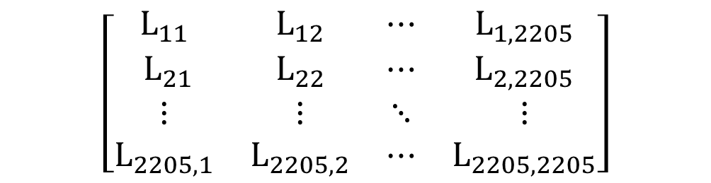
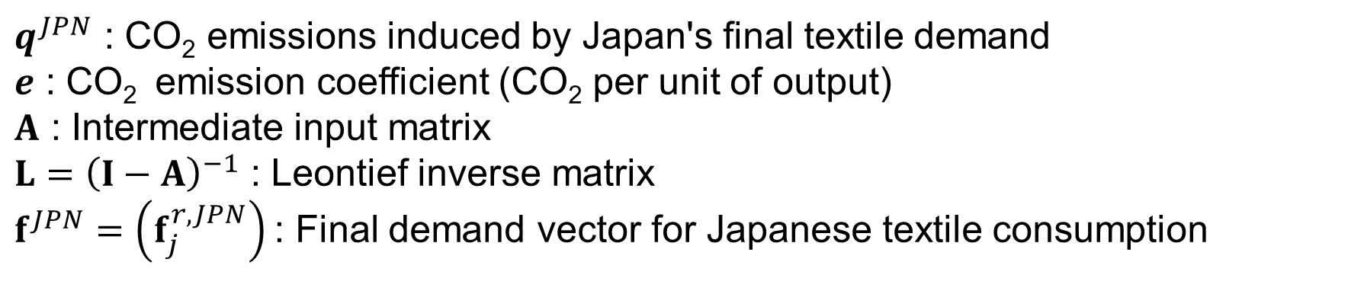



Methods ―Emissions Calculation―
9
Emissions factor multiplied by Leontief inverse and final demand
$$\begin{aligned}q^{JPN}=e{\left(I−A\right)}^{−1}f=eLf^{JPN}\#\end{aligned}$$
(1)
$q^{JPN}$ : CO₂ emissions induced by Japan's final textile demand
$e$ : CO₂ emission coefficient (CO₂ per unit of output)
$A$ : Intermediate input matrix
${L=\left(I−A\right)}^{−1}$ : Leontief inverse matrix
$f^{JPN}=\left(f_{j}^{r, JPN}\right)$: Final demand vector for Japanese textile consumption
※
$$\left[\begin{matrix}L_{11} & L_{12} & ⋯ & L_{1,2205} \\ { L}_{21} & L_{22} & ⋯ & L_{2,2205} \\ ⋮ & ⋮ & ⋱ & ⋮ \\ L_{2205,1} & L_{2205,2} & ⋯ & L_{2205,2205}\end{matrix}\right]$$
$$\left[\begin{matrix}f_{1} \\ \begin{aligned}f_{2} \\ ⋮\end{aligned} \\ f_{t}\end{matrix}\right]$$
$q^{JPN}=$ $e$
Notes:
This is the core equation.
Total emissions equal the emission factor multiplied by the Leontief inverse — which captures all the supply chain links
,and multiplied by final demand.
In simple terms: We multiplied (how much CO₂ each unit of output generates,) by (how much production is triggered by Japan‘s purchases), (by how much Japan actually buys.)

Slide 14
Methods ―Data―
10
ADB-MRIO
IEA-Greenhouse gas emissions from energy
Asian-development bank multi-regional input-output table
International energy agency
Coverage
Variable
63 regions (62 countries + other)
CO₂ emission intensity by country
Sectors
Unit
35 industrial sectors
kt- CO₂ per unit of output
Period
Method
2007-2021
Direct CO₂ emission coefficient matrix
Base year
2010 (price- adjusted)
Emission data were aligned with the
ADB-MRIO classification using the
direct CO₂ emission coefficient matrix
developed by Maeno et al. (2022)
Dimension
2205×2205
Notes:
For data, I use two main sources.
First, the ADB Multi-Regional Input-Output Table, which covers 63 regions and 35 sectors from 2007 to 2021.
Second, (CO₂ emission intensity data )from (the International Energy Agency), standardized to the same classification system /used in the MRIO table by Maeno et al.(2022)
dataは別で作る

Slide 15
Methods ―Over view―
11
Distinguishes between changes in the country of origin of final goods imports and changes in intermediate input sourcing.
Final demand
Sold horizontally
Intermediate input matrix (A)
Represents transactions of raw materials
between industries and countries, and
shifting it changes the sourcing of intermediate inputs along the supply chain.
Transactions
of raw
materials
Gross output
Final demand vector (f)
Produced vertically
Represents where Japan imports its final textile goods from, and shifting it changes the country of origin of those imports.
Gross value
added
Gross output
Notes:
To do this, I use a multi-regional input-output model.
To put it simply: every product we buy requires raw materials / and parts from many countries. This table tracks those flows — basically / who buys from whom-and how much.
In this study, I focus on two key elements.
The First is the final demand vector, which represents where Japan imports its finished clothing from.
The Second is the intermediate input matrix, which tracks / how raw materials — like cotton-or-fabric — move between industries and countries along the supply chain.
By changing these two elements, we can simulate / what happens when Japan shifts its sourcing.
メソドロジーのover viewにする
Ｚの太字
赤→の 向き

Slide 16
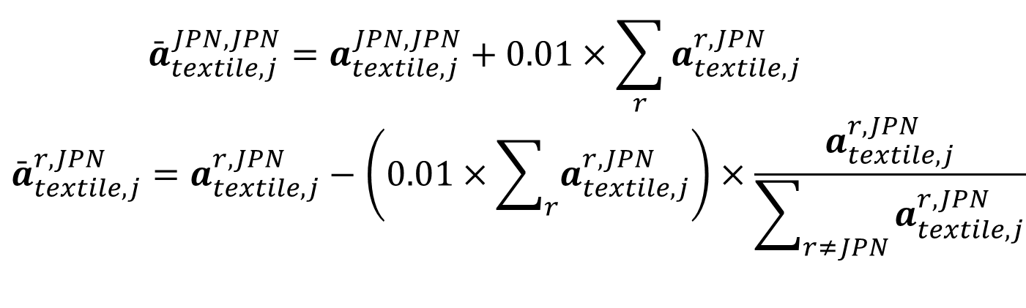
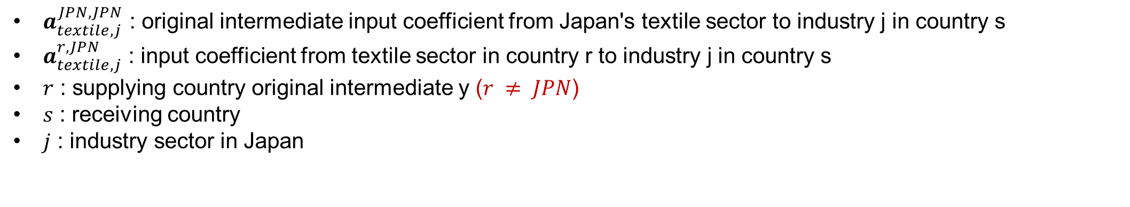
Methods ―Scenario setting―
12
Manipulating the intermediate input matrix (A), shifting the sourcing of intermediate inputs
〇
＋1%
⑴ ScenarioーDomestic sourcing of intermediate goods
$$\begin{aligned}{\overset{ˉ}{a}}_{textile,j}^{JPN,JPN}=a_{textile,j}^{JPN,JPN}+0.01×\sum_{r}{a_{textile,j}^{r,JPN}}\end{aligned}$$
$$\begin{aligned}{\overset{ˉ}{a}}_{textile,j}^{r,JPN}=a_{textile,j}^{r,JPN}−\left(0.01 × \sum_{r}{a_{textile,j}^{r,JPN}}\right)×\frac{a_{textile,j}^{r,JPN}}{\sum_{r≠JPN}{a_{textile,j}^{r,JPN}}}\end{aligned}$$
(2)
(3)
$a_{textile,j}^{JPN,JPN}$ : original intermediate input coefficient from Japan's textile sector to industry j in country s
$a_{textile,j}^{r,JPN}$ : input coefficient from textile sector in country r to industry j in country s
$r$ : supplying country original intermediate y ($r ≠ JPN$)
$s$ : receiving country
$j$ : industry sector in Japan
Notes:
This is Scenario 1.
Scenario 1 asks what happens if Japan increases domestic sourcing of（ textile-intermediate inputs) / by 1%.
In the equation, ”A” means the intermediate input coefficient.
This shows how much input / an industry buys from a specific sector and-country.
The symbol ”a_bar” means the new coefficient after-applying this scenario.
Let me explain the notation briefly.
textile means the textile sector.
“j” is the receiving industry in Japan.
“r” is the supplying country.
And JPN means Japan.
So, this term here (1つ目の項を指す), , means the updated input coefficient from Japan’s textile sector / to industry ”j” in Japan.
And this term here (2つ目の項を指す), , means the input coefficient from the textile sector in country ”r” / to industry ”j” in Japan.
The first equation increases / the domestic input- coefficient.
The increase is set-at 1% of (the total textile intermediate inputs) that Japan originally imports from foreign countries.
The second equation decreases (the foreign* input coefficients) by the same total amount.
In other words, the reduction is distributed across foreign countries / in proportion to their original shares.
As a result, the total amount of inputs remains unchanged, / while the source shifts / from foreign countries to domestic suppliers in Japan.

Slide 17
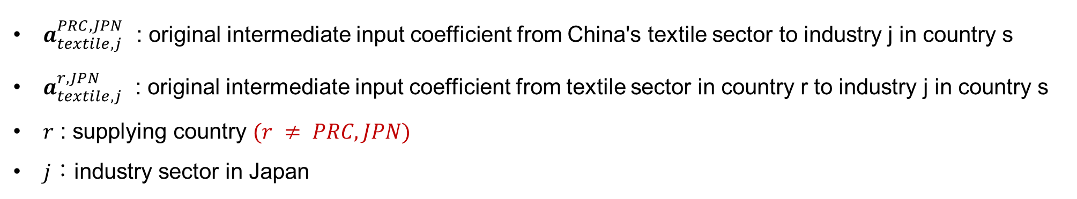
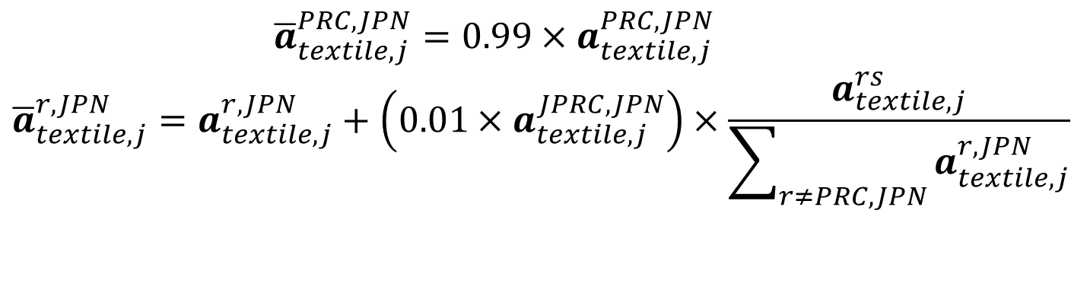
Methods ―Scenario setting―
13
Manipulating the intermediate input matrix (A), shifting the sourcing of intermediate inputs
✖
-1%
⑵ ScenarioーSwitching sources of intermediate goods
$$\begin{aligned}{\overline{a}}_{textile,j}^{PRC,JPN}=0.99×a_{textile,j}^{PRC,JPN}\end{aligned}$$
$$\begin{aligned}{\overline{a}}_{textile,j}^{r,JPN}=a_{textile,j}^{r,JPN}+\left(0.01×a_{textile,j}^{JPRC,JPN}\right)×\frac{a_{textile,j}^{rs}}{\sum_{r≠PRC,JPN}{a_{textile,j}^{r,JPN}}}\end{aligned}$$
(4)
(5)
$a_{textile,j}^{PRC,JPN}$ : original intermediate input coefficient from China's textile sector to industry j in country s
$a_{textile,j}^{r,JPN}$ : original intermediate input coefficient from textile sector in country r to industry j in country s
$r$ : supplying country $(r ≠ PRC, JPN)$
$j$：industry sector in Japan
Notes:
This is Scenario 2.
In Scenario 1, Japan increased domestic sourcing by 1%.
In Scenario 2, Japan reduces textile inputs from China by 1% / and-replaces them with inputs from other countries.
The definitions of the coefficients and notations are the same as the previous slide.
So, looking at the first equation, it reduces the input coefficient from China.
(1つ目の式を指す）
More specifically, it multiplies / the original coefficient by 0.99. This means that Japan decreases textile intermediate inputs from China by 1%.
（2つ目の式を指す）
The second equation reallocates that 1% reduction to other foreign suppliers. The reduced amount is added to other countries in proportion to their original shares.
As a result, the total amount of textile intermediate inputs remains unchanged, but the sourcing structure changes.
Japan becomes less dependent on-China / and shifts part-of-its-sourcing to other countries.
Aは太字、シナリオのタイトルをもっとわかりやすく

Slide 18
Methods ―Over view―
14
Distinguishes between changes in the country of origin of final goods imports and changes in intermediate input sourcing.
Final demand
Sold horizontally
Intermediate input matrix (A)
Represents transactions of raw materials
between industries and countries, and
shifting it changes the sourcing of intermediate inputs along the supply chain.
Transactions
of raw
materials
Produced vertically
Gross output
Final demand vector (f)
Represents where Japan imports its final textile goods from, and shifting it changes the country of origin of those imports.
Gross value
added
Gross output
Notes:
To do this, I use a multi-regional input-output model.
To put it simply: every product we buy requires raw materials / and parts from many countries. This table tracks those flows — basically / who buys from whom-and how much.
In this study, I focus on two key elements.
The First is the final demand vector, which represents where Japan imports its finished clothing from.
The Second is the intermediate input matrix, which tracks / how raw materials — like cotton-or-fabric — move between industries and countries along the supply chain.
By changing these two elements, we can simulate / what happens when Japan shifts its sourcing.
メソドロジーのover viewにする
Ｚの太字
赤→の 向き

Slide 19
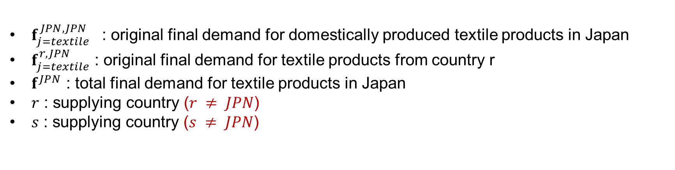
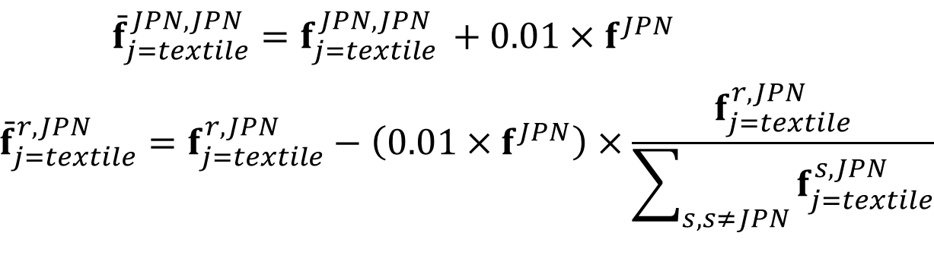
Methods ―Scenario setting―
15
Manipulating the final demand vector (f),
shifting the origin of final goods imports
〇
＋1%
⑶ ScenarioーReshoring of final demand of textile products in Japan
$$\begin{aligned}{\overset{ˉ}{f}}_{j=textile}^{JPN,JPN}=f_{j=textile }^{JPN,JPN}+0.01×f^{JPN}\#\end{aligned}$$
$$\begin{aligned}{\overset{ˉ}{f}}_{j=textile}^{r,JPN}=f_{j=textile}^{r,JPN}−\left(0.01×f^{JPN}\right)×\frac{f_{j=textile}^{r,JPN}}{\sum_{s, s≠JPN}{f_{j=textile}^{s,JPN}}}\#\end{aligned}$$
(6)
(7)
$f_{j=textile }^{JPN,JPN}$ : original final demand for domestically produced textile products in Japan
$f_{j=textile}^{r,JPN}$ : original final demand for textile products from country r
$f^{JPN}$ : total final demand for textile products in Japan
$r$ : supplying country ($r ≠ JPN$)
$s$ : supplying country ($s ≠ JPN$)
Notes:
This is Scenario 3.
Scenario 3 asks what-happens / if Japan increases domestic sourcing of textile final demand by 1%.
In this equation, "f" means the final demand.
The symbol "f_bar" means the new ratio after applying this scenario.
The basic notation is the same as before.
So, this term here (1つ目の項を指す), means the updated domestic final demand ratio in Japan.
And this term here (2つ目の項を指す), means the original final demand ratio / from foreign country "r" to Japan.
The first equation increases the domestic final demand ratio.
The increase-is-set-at 1% of the total textile final demand / that Japan originally imports from foreign countries.
The second equation decreases (the foreign final demand ratios) by the same total amount.
As a result, the total amount of final demand remains unchanged, while the sourcing shifts / from foreign countries to domestic suppliers in Japan.
式番号

Slide 20
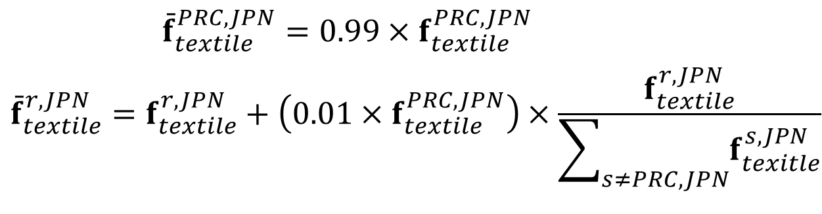

Methods ―Scenario setting―
16
Manipulating the final demand vector (f),
shifting the origin of final goods imports
✖
-1%
⑷ ScenarioーFinal demand decoupling from China
$\begin{aligned}{\overset{ˉ}{f}}_{textile}^{PRC,JPN}=0.99×f_{textile}^{PRC,JPN}\#\end{aligned}$
$$\begin{aligned}{\overset{ˉ}{f}}_{textile}^{r,JPN}=f_{textile}^{r,JPN}+\left(0.01×f_{textile}^{PRC,JPN}\right)×\frac{f_{textile}^{r,JPN}}{\sum_{s≠PRC,JPN}{f_{texitle}^{s,JPN}}}\#\end{aligned}$$
(8)
(9)
$f_{textile}^{PRC,JPN}$ : Japan's final demand for textile products from China
$f_{textile}^{r,JPN}$ : Japan's final demand for textile products from country r
$r$ : supplying country ($r ≠ PRC, JPN$)
$s$ : supplying country ($s ≠ PRC, JPN$)
Notes:
This is Scenario 4.
In the previous scenario, Japan increased (domestic sourcing of final demand) by 1%.
In contrast, this scenario examines what happens when Japan reduces textile final demand from China by 1% / and switches that share to other suppliers.
The basic notation and definitions are the same as the previous slide.
So, looking at the first equation, it reduces the final demand ratio from China.
This means that Japan decreases textile final demand from China by 1%.
The second equation / reallocates that 1% reduction to other foreign suppliers, except China and Japan.
The reduced amount is distributed to other countries in proportion to their original shares.
As a result, the total-amount of final demand remains unchanged, but the sourcing structure changes.
Japan becomes less dependent-on China / and shifts / part-of-its-final-demand to other foreign countries.

Slide 21
Results
17
Introduction
Methods
Results
Conclusions
✔
d
d
Notes:
Now lets move on to the results.

Slide 22
Results ―Scenario (1) and (2) ―
18
⑴ Domestic procurement of intermediate inputs
⑵ Switching Sources of Intermediate Goods
Mt-CO₂
Mt-CO₂
Kt-CO₂
Kt-CO₂
Figure 3: CO₂ emission reduction impacts of shifting 1%
of Japan’s intermediate textile product
procurement from China to other countries
Figure 2: CO₂ emission reduction impacts of replacing
1% of imported
Global CO₂ emissions decrease
by approx.−38.5 kt/yr on average.
Global CO₂ emissions decrease
by approx. −0.56 kt/yr on average.
0.008% reduction from pre-restructuring
0.0001% reduction from pre-restructuring
Notes:
Here-are the results for the first-two scenarios / both about raw materials.
Left is Scenario 1: what happens when Japan sources more raw materials at home?
These two graphs on this slide have the same structure. The left axis shows / total CO₂ in megatons. The blue bars are emissions before the change, and the orange bars are emissions after. The right axis shows the difference in kilotons — that is the green line.
On average, CO₂ drops by aroud / 38.5 kilotons per year. That is a 0.008% reduction from emissions before the change.
Right is Scenario 2: what happens (when Japan shifts raw material purchases) away from China?
The reduction is even smaller — only 0.56 kilotons per year.
Intermidiate inputs とGoodsを合わせる
フォント

Slide 23
Results ―Scenario (3) and (4) ―
19
⑶ Domestic reshoring of final demand
⑷ China decoupling of final demand
Figure 6: CO₂ emission reduction impacts of geographical shift of final demand away from China in 2010, 2015, and 2020 under Scenario 5
Mt-CO₂
Kt-CO₂
Mt-CO₂
Kt-CO₂
Figure 4: CO₂ emission reduction impacts of a 1%
increase in the consumption of domestically
produced textile product
Figure 5: CO₂ emission reduction impacts of
geographical 1% shift of final demand
away from China
Global CO₂ emissions decrease
by approx. −15.6 kt/yr on average.
Global CO₂ emissions decrease
by approx. −832.9 kt/yr on average.
0.003% reduction from pre-restructuring
0.17% reduction from pre-restructuring
Notes:
These two graph shows scenario 3 and 4.
The graphs here have the same structure — blue for before, orange for after, green line for the difference.
Scenario 3 is about what happens when Japan buys more domestically made final clothing?
The green line drops a little. CO₂ goes down by 15.6 kilotons on average.
Scenario 4 is about what happens when Japan shifts finished-clothing imports / away from China?
Look at the graph on-a-right. CO2 emissions drop by-an-average-of-833 kilotons, which is a huge decrease / compared to the other scenarios. This accounts for about / （point-seventeen-percent) of the total / before the restructuring

Slide 24
Results ―Comparison of scenarios (2) and (4)
20
CO₂ reduction
Transaction scale
⑵ Final Goods (Switching Sources of Intermediate Goods )
$12,930 million
✖
−832.9 kt-CO₂
(€11,336 million)
-1%
7 times
1,500 times
⑷ China decoupling of final demand
$1760 million
✖
−0.56 kt-CO₂
( €1,543 million)
-1%
Notes:
Look at this comparison.
A 1% shift in final goods away from China involves a transaction of (about Thirteen thousand billion US dollars) — and reduces emissions by 833 kilotons.
On the other hand, a 1% shift in intermediate inputs away from China involves around one thousand and 7 hundred million dollars — and reduces emissions by only 0.56 kilotons.
(アニメーションのため、スライド進める）
The final goods shift involves 7 times more money — but-it delivers 1,500 times more CO₂ reduction.
That tells us the location of final production matters more / than the sourcing of raw materials.
日本のアパレル輸入は年間約1.5〜2兆円規模で、その約7〜8割が中国からと言われています。1.4兆円 ÷ 110円 ≈ $12,900M はその範囲内でしっかり一致しています。
Dechainaとは言わない
Co2 reduction potential under the

Slide 25
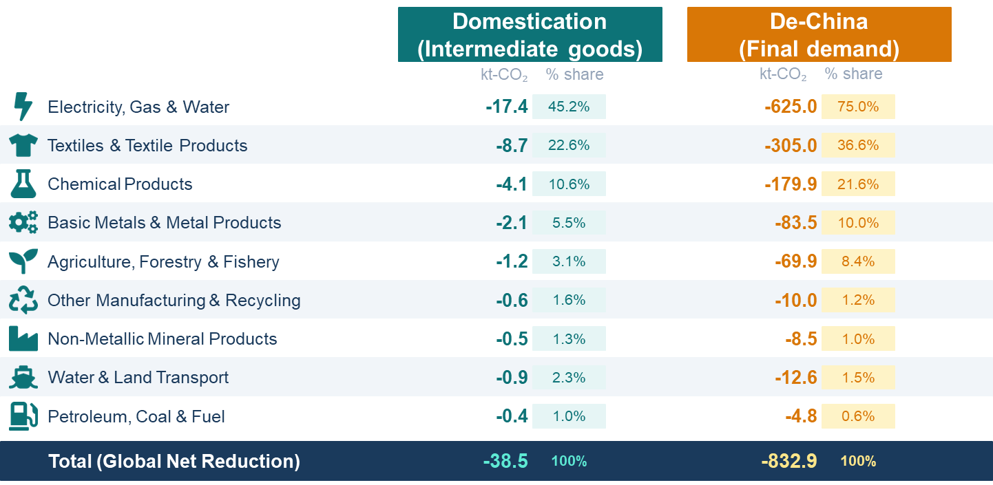
ResultsーCO₂ Emission reductions by sector
21
Figure 6:
Sectoral CO₂ Emission
Reductions under
Domestication and
De-China Scenarios
In 2020
Three sectors — electricity, textiles, and chemicals — consistently explain 78% of total CO₂ reductions across both scenarios.
The sectoral composition of reductions remains nearly identical regardless of whether final demand or intermediate sourcing is restructured.
Notes:
There is one more thing I wanna highlight.
This chart shows the global impact of this scenario, aggregated by sector.
It is clear that electricity accounts for the largest part of the total worldwide economic impact.
Across all scenarios, three sectors — electricity, textiles, and chemicals — consistently(cansinary) account for 78% of total CO₂ reductions.
And this is true whether I / restructure final demand or intermediate inputs.
This means that targeted policy / in just these three sectors / can capture most of the emission reduction potential.
Tableにする、in2020にする

Slide 26
Conclusions
22
Introduction
Methods
Results
Conclusions
✔
d
d
Notes:
Let me move to the conclusions.

Slide 27
Conclusions
23
What are the most effective way
Japanese apparel companies and
the government can take to reduce
the environmental burden
of the textile industry?
Notes:
Now, let's return to the initial question /we posed during the introduction.
What is the most effective way for Japanese companies and the government /to reduce the environmental burden of Japan's textile industry?
Based on my results, I can provide two suggestions.

Slide 28
Conclusions ―Manufacturing locations―
24
In the Japanese textile industry, true decarbonization requires changing where products are made, not just where materials are sourced.
Final production locations determine the energy mix of key manufacturing processes; therefore, companies must assess supply chain-wide emissions to optimize their production and procurement strategies.
Governments can support these efforts by mandating full
supply chain disclosures, including Scope 3.
Notes:
The first conclusion is about where products are made.
True decarbonization requires changing the location of final production — not just where materials are sourced.
Because the energy mix at the factory matters a lot.
For companies, this means they need to measure supply (chain-wide emissions) — including Scope 3 — when making production decisions.
For governments, this means mandating (full supply chain disclosures,) so that (carbon-intensive-choices) cannot be hidden.
結論にする
タイトル

Slide 29
Conclusions ― Upstream Processes ―
25
In the Japanese textile industry, effective decarbonization relies on retaining upstream processes within Japan.
To effectively reduce global CO₂ emissions induced by Japanese textile demand, it is essential to retain energy-intensive upstream processes—such as dyeing, spinning, and material production—within Japan.
Policy support for domestic textile SMEs to sustain operations and prevent closures or overseas relocation.
Notes:
The second conclusion is about protecting Japan's domestic capacity.
Our results show that / reshoring upstream processes does produce a meaningful effect. On-average, a 1% shift delivers around 38.5 kilotons of CO₂ reduction per year.
The key reason is that upstream processes like dyeing, spinning, and fiber production are energy-intensive.
So, Keeping-them-in-Japan, where the energy mix is relatively cleaner than other countries, directly cuts emissions.
So the government should support domestic textile small and medium enterprises — to keep these processes inside Japan. If these firms close or move overseas, that reduction potential disappears.
具体的な事例を入れる
ZARAの事例を挙げる

Slide 30
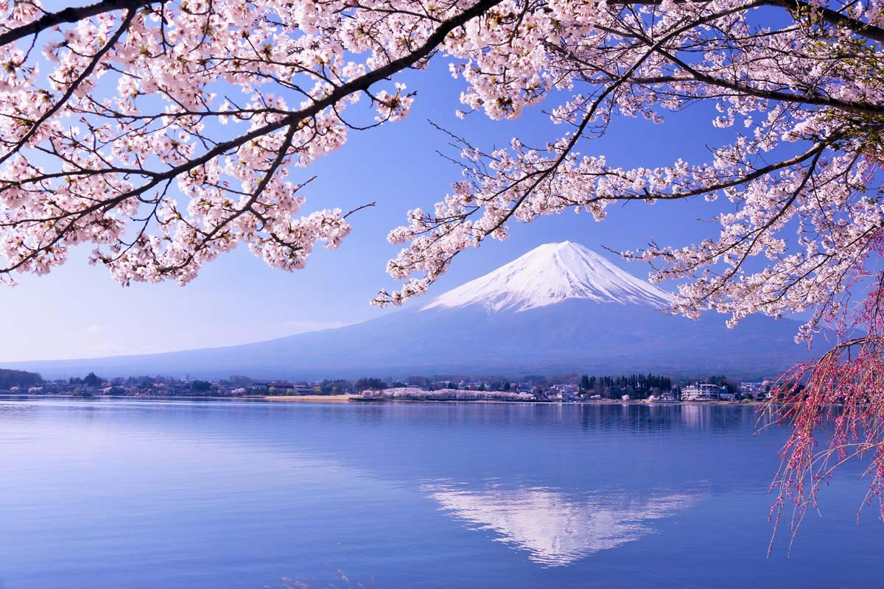
Thank You
Q & A
Motohiro Sano, Kairi Inoue, Shigemi Kagawa
Kyushu University
Notes:
Thank you so much for your attention.
And, happy to take any questions.
質疑応答
以下、質問は日本語のまま、回答だけ簡潔な英語にしました。
Q: なぜ2010・2015・2020年を選んだのか?
A: "We chose these three years to see the trend over time, every five years. 2010 is also our base year for prices. We did not use 2021 because of COVID-19.
Q: なぜ1%という変化幅を使ったのか。より大きな変化は検証したか?
A: "We followed the method from Maeno et al., 2022. A small change, like 1%, works well in a linear model. This is a Leontief model, so it is linear. We did not test non-linear effects. This is a limitation."
Q: 最終需要と中間財を同時に変化させた場合はどうなるか?
A: “In this study, we changed them separately. This helps us see each effect clearly. Testing them together is a good idea for future research. Im planning to use Structural Path Analysis.
Q: 価格変化や代替効果は考慮しているか?
A: "No, we did not. This is a quantity-based input-output model. Prices are fixed. This is a limitation of our model. A CGE model could help with this in the future."
Q: なぜシナリオ2(最終需要)の方がシナリオ4(中間財)より1,500倍も削減効果が大きいのか?
A: "It's not about the trade value. It's about which country's production structure is used. When we change the final production country, we also change all the upstream processes, like dyeing and spinning. These processes use a lot of coal power in China. But in Scenario 4, the final product is still made in China. So most high-emission processes stay the same."
Q: なぜ染色・紡績などの上流工程に排出がこれほど集中するのか?
A: "In our results, the electricity sector explains about 45% of the reduction. Textile and chemical sectors add more. Together, three sectors explain 78% of the total. This matches previous research. Dyeing needs a lot of heat and electricity."
Q: なぜシナリオ1(最終財の国内シフト)はシナリオ2(中間財の国内シフト)より効果が小さいのか?
A: "Scenario 1 only changes where the final product is bought. It does not change how the materials, like fabric and yarn, are made. Scenario 2 directly changes these upstream processes. That is why Scenario 2 has a bigger effect, about 2.5 times larger."
Q: なぜシナリオ3(国内生産ゼロ化)で世界全体の排出が増加するのか?
A: "Japan's emissions go down. But emissions in China, India, and Turkey go up more. These countries use more coal power than Japan. So moving production overseas increases total global emissions.“
Q: ADB-MRIOの35セクター分類は粗いのではないか。より詳細な分類は使わなかったのか?
A: "Yes, 35 sectors is not very detailed. We could not separate dyeing and spinning directly. This is a data limitation. A more detailed table could show clearer results in the future."
Q: 本研究の新規性は何か。Peters et al. (2011)のカーボンリーケージ研究と何が違うのか?
A: "Peters et al. showed that carbon leakage happens through trade in general. Our study focuses only on the textile industry. We also separate two channels: final demand and intermediate input. This separation is new."
Q: なぜ繊維産業に着目したのか?
A: "Textile industry produces 6 to 10% of global emissions. Most of this comes from upstream processes. Also, research on Japan's textile industry is still limited. So we chose this industry."
Q: シナリオ5・6で「中国以外の国」への代替先はどう決まるのか?
A: "The model does not choose one country. It removes demand from China proportionally. Other countries' production increases based on the existing trade structure in the model."
Q: Scope3開示義務化の提言は、具体的にどの制度を想定しているか?
A: "We are thinking of policies like the EU's CSRD, Corporate Sustainability Reporting Directive. Japan could introduce a similar rule for supply chain disclosure."
Q: 1%のシフトは、現実的にどれくらいの規模を意味するのか?
A: "In Scenario 5, 1% of final demand from China equals about 12,930 million dollars. It's a small percentage, but a large amount in actual trade value."
Q: 価格効果や技術代替を考慮していないことは、結果にどう影響するか?
A: "Our model assumes fixed technology and fixed prices. In reality, companies may find new suppliers or new technology. So our results show potential, not exact predictions."
Q: なぜCO2のみを対象とし、メタンなど他の温室効果ガスは含めないのか?
A: "CO2 is the main greenhouse gas from energy use in manufacturing. Our emission data, from IEA, focuses on CO2. Other gases, like methane, need different data sources."
Q: 国内回帰を促す提言は、保護主義的ではないか?
A: "Our goal is not protectionism. It's about reducing carbon emissions in the supply chain. Companies can choose any country, but they should also think about each country's energy mix, not only cost."
Q: モデルは静的(static)だが、将来的な動的(dynamic)変化は考慮しているか?
A: "No, this is a static model. It does not include long-term changes, like new technology or new energy policy. This is a limitation. Future research could use a dynamic model."
Q: 今後の研究方向性は?
A: "We plan to use Structural Path Analysis, or SPA, to find the most important supply chain routes. We also want to study economic feasibility, like cost and value-added effects, not only emissions."

