Slide 1


Uneven Transitions: Environmental and Spatial Consequences of the Economic Security in the Aluminium Industry
Roberto Dellisanti and Marina Sánchez-Serrano
32nd International Input-Output Association Conference
11th Jornadas de Análisis Input Output

Slide 2



Introduction
Rethinking global trade of critical materials
Open Strategic Autonomy and European Economic Security Strategy
“AS OPEN AS POSSIBLE, AS AUTONOMOUS AS NECESSARY”
As Europe currently relies on imports of critical inputs
Critical Raw Material Act
The objective is the reactivation of European primary industries, considering mining, processing and recycling

Slide 3









Benefits and cost of mining reactivation
Direct and indirect employment generation
Investments in promote mainly the mining sector
Reduces global environmental impacts
Environmental negative effects at local level
These impacts (either positive or negative) will not be geographically neutral across the EU
The case of aluminium
To simulate the environmental, social, and spatial effects of a substantial reactivation of the mining of aluminium sector, and the activities of its value-chain

Slide 4



Methods
To calculate the different impacts: Multiregional Input-Output Model
$$F=\hat{f}·{\left(I−A\right)}^{−1}·\hat{Y}$$
Final demand matrix
Environmental, economic, or social factor requirements
Technical coefficients matrix
$$A=Z·{\hat{x}}^{−1}$$
Leontief inverse matrix
Environmental impacts: CO₂ emissions
Employment impacts: direct and indirect employment generation
Economic impacts: direct and indirect value-added generation
Using the original data from EXIOBASE, we calculate the initial situation to compare with the increase in demand scenarios

Slide 5










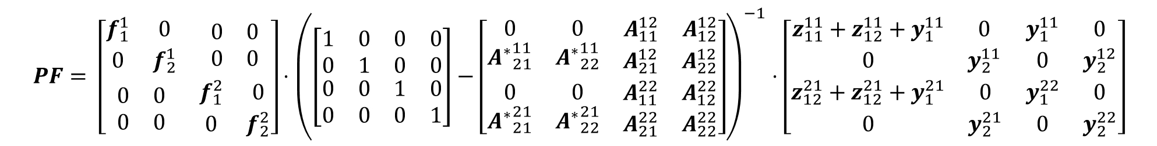
Production footprint
Region 1: Europe / Region 2: rest of the world
Sector 1: aluminium-related industries / Sector 2: non-aluminium-related industries
(Wilting & in 't Veld, 2025)
$$PF= \left[\begin{matrix}\begin{matrix}f_{1}^{1} & 0 \\ 0 & f_{2}^{1}\end{matrix} & \begin{matrix}0 & 0 \\ 0 & 0\end{matrix} \\ \begin{matrix}0 & 0 \\ 0 & 0\end{matrix} & \begin{matrix}f_{1}^{2} & 0 \\ 0 & f_{2}^{2}\end{matrix}\end{matrix}\right]⋅{\left(\left[\begin{matrix}\begin{matrix}1 & 0 \\ 0 & 1\end{matrix} & \begin{matrix}0 & 0 \\ 0 & 0\end{matrix} \\ \begin{matrix}0 & 0 \\ 0 & 0\end{matrix} & \begin{matrix}1 & 0 \\ 0 & 1\end{matrix}\end{matrix}\right]−\left[\begin{matrix}\begin{matrix}0 & 0 \\ {A^{∗}}_{21}^{11} & {A^{∗}}_{22}^{11}\end{matrix} & \begin{matrix}A_{11}^{12} & A_{12}^{12} \\ A_{21}^{12} & A_{22}^{12}\end{matrix} \\ \begin{matrix}0 & 0 \\ {A^{∗}}_{21}^{21} & {A^{∗}}_{22}^{21}\end{matrix} & \begin{matrix}A_{11}^{22} & A_{12}^{22} \\ A_{21}^{22} & A_{22}^{22}\end{matrix}\end{matrix}\right]\right)}^{−1}⋅\left[\begin{matrix}\begin{matrix}z_{11}^{11}+z_{12}^{11}+y_{1}^{11} & 0 \\ 0 & y_{2}^{11}\end{matrix} & \begin{matrix}y_{1}^{11} & 0 \\ 0 & y_{2}^{12}\end{matrix} \\ \begin{matrix}z_{12}^{21}+z_{12}^{21}+y_{1}^{21} & 0 \\ 0 & y_{2}^{21}\end{matrix} & \begin{matrix}y_{1}^{22} & 0 \\ 0 & y_{2}^{22}\end{matrix}\end{matrix}\right]$$
Scenario setting:
In the case of the mining sector, the production is assigned to those countries with bauxite deposits:
Scenario 1
An increase of 4% annually in demand applied to 2 years
Countries with an import and export structure
Countries with an estimated import and export structure
The imports’ structure is maintained
Substitution coefficients
Scenario 2
Unitary import price
Unitary intra-europe price
Same increase in physical terms, but modifying the imports’ structure
Only European countries increase their production
Import from a third country in monetary terms
Import from a third country in physical terms
Intra-Europe imports in monetary terms

Slide 6
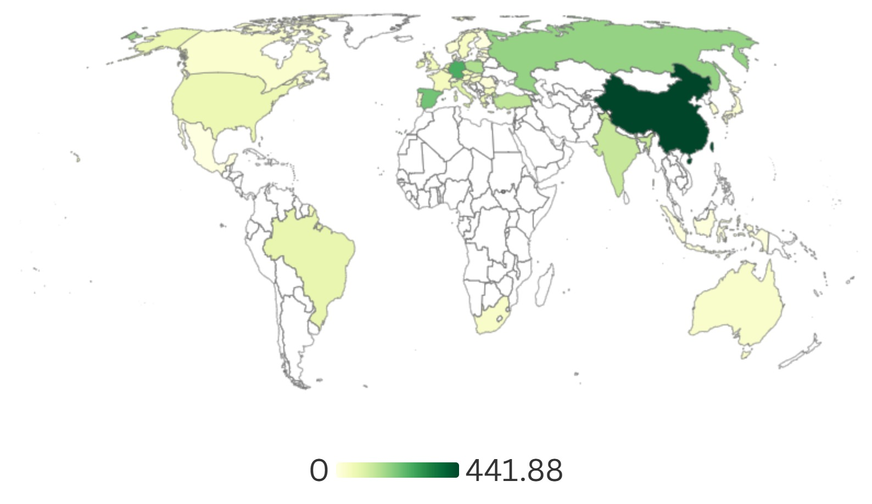
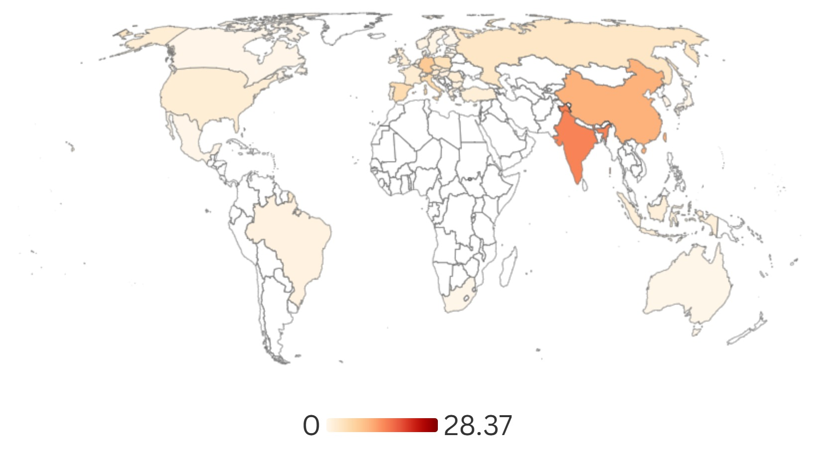
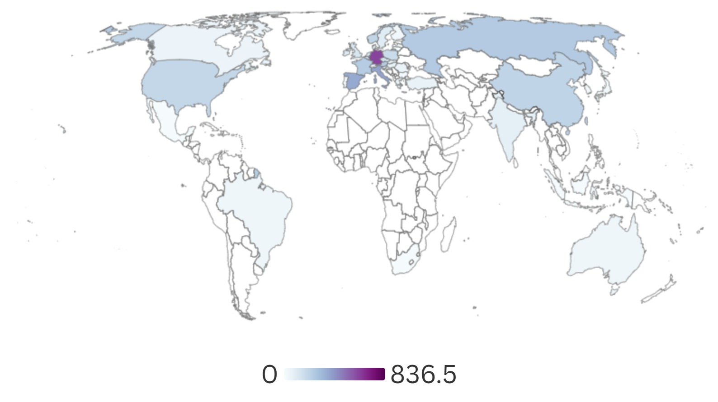
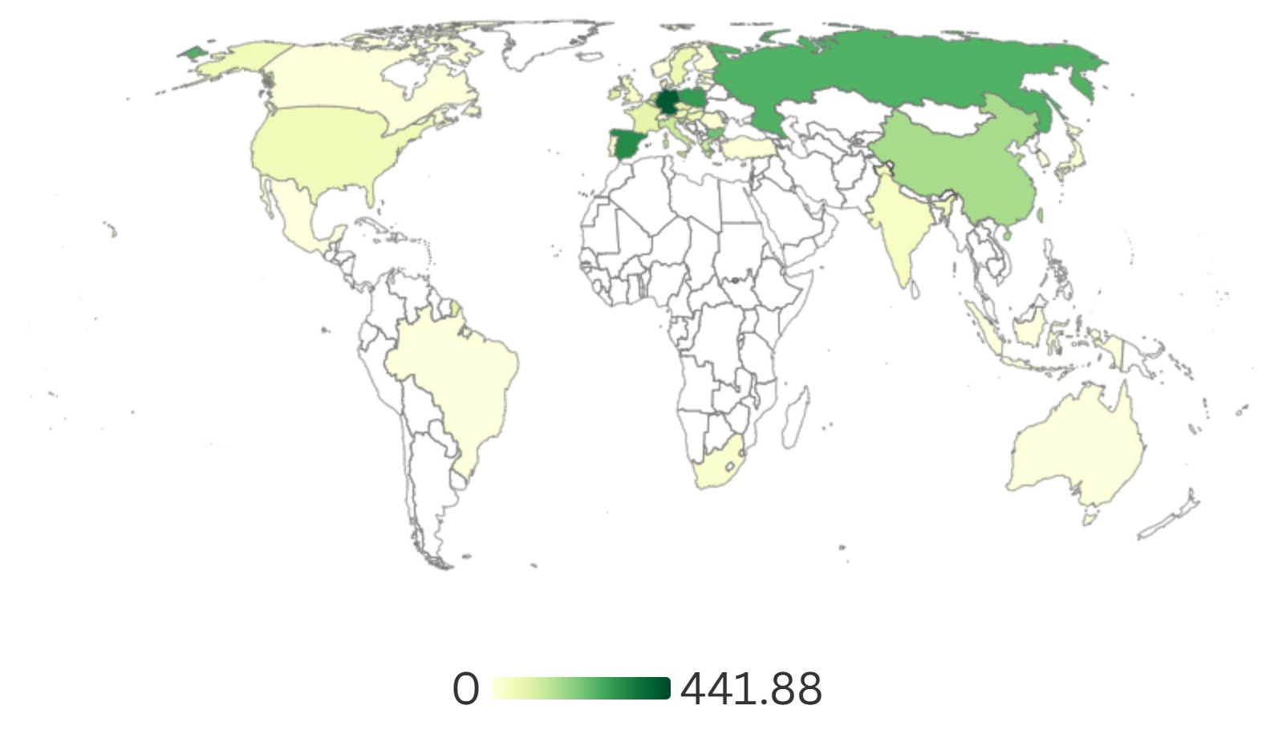
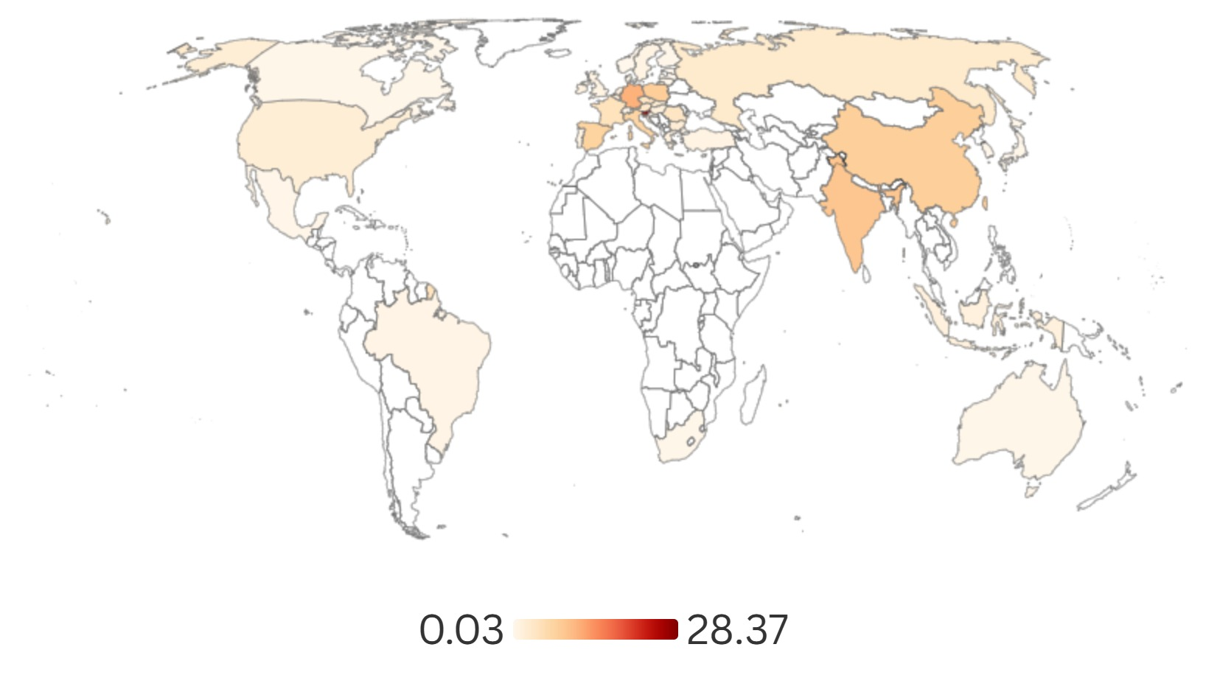
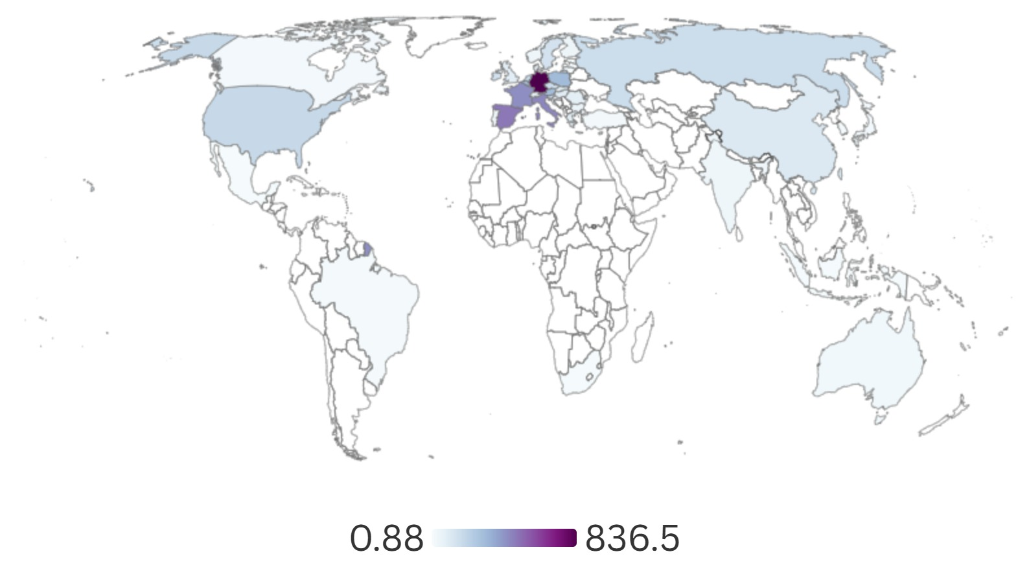
Results
FIGURE 1: MAPS FROM THE PRODUCER-BASED PERSPECTIVE
EMISSIONS: - 241.9 Kt CO₂
EMPLOYMENT: - 20.7 thousand of employments
VALUE-ADDED: 574.9 million of €
Scenario 1
Scenario 2

Slide 7

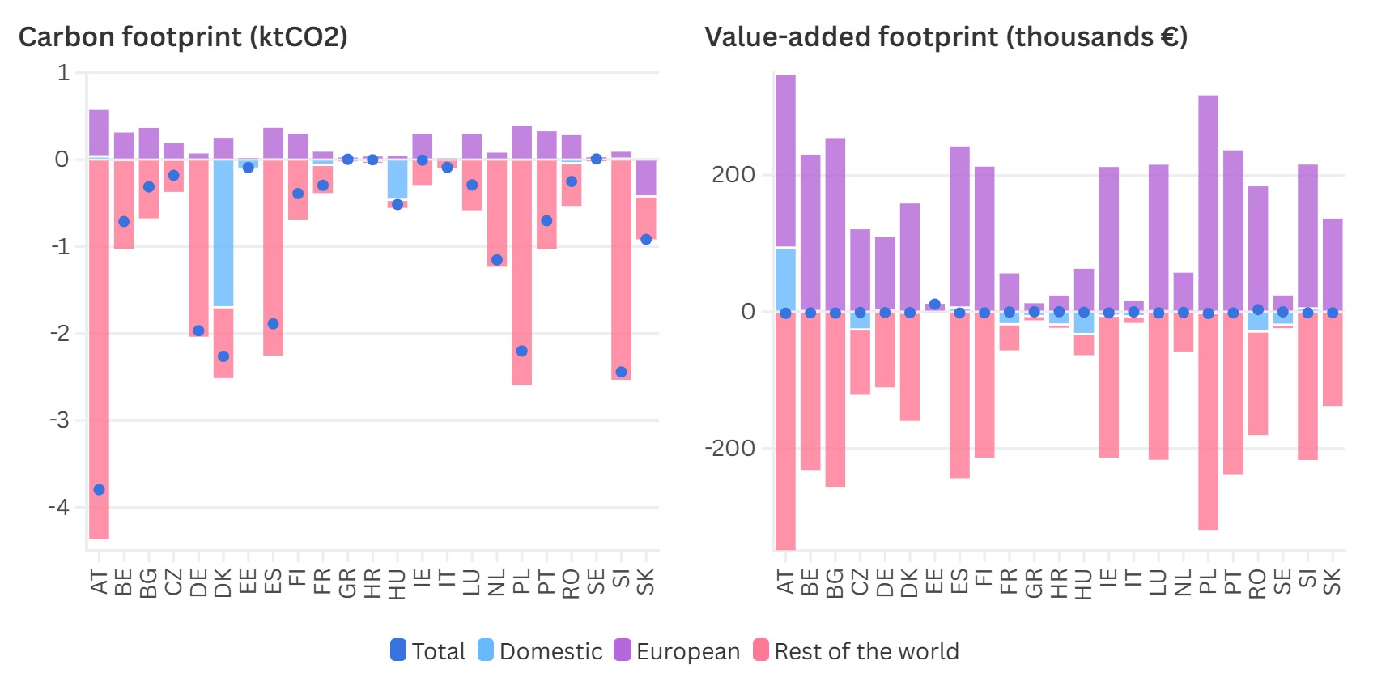
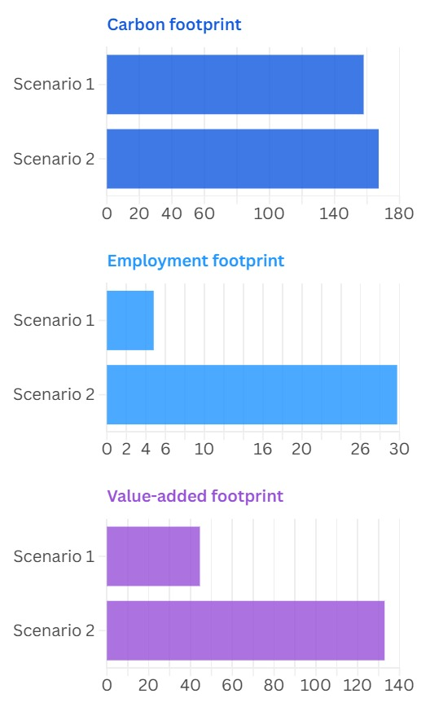
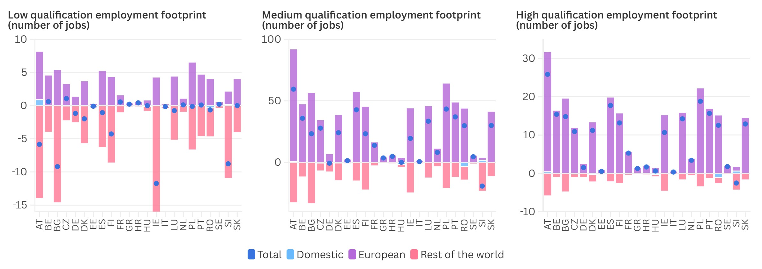
Figure 2. Changes in the footprints of the aluminium ore mining sector by million € of demand.
Figure 3. Total impacts

Slide 8

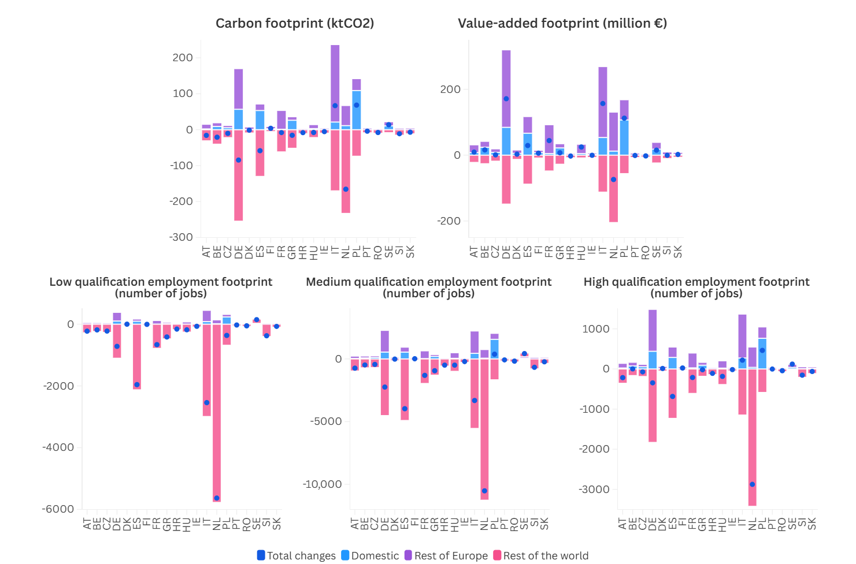
Figure 4. Changes in the footprints of the production of aluminium sector

Slide 9
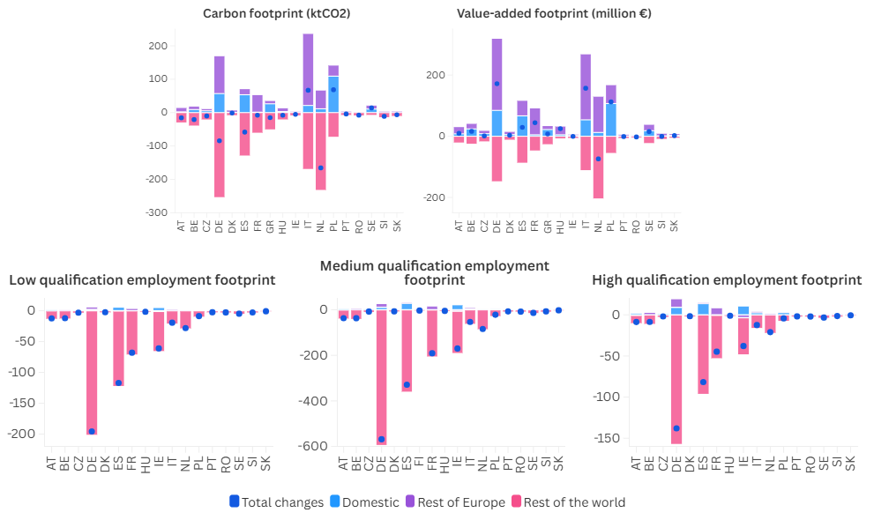
Figure 5. Changes in the footprints of the reprocessing of aluminium products sector

Slide 10
Conclusions and policy implications
Consolidating the aluminium supply chain in European regions could significantly reduce emissions from the aluminium production chain.
Relocation the extraction process will benefit Europe by creating skilled jobs in a sector primarily located in rural areas, aligning with regional development policies.
Reshoring aluminium production and recycling sectors helps in reducing global emissions, without compromising international agreements.
When increasing European production to cover the expected increase in demand, although the total employment generation in all qualification levels is smaller, it is concentrated in Europe.

Slide 11
THANK YOU
Uneven Transitions: Environmental and Spatial Consequences of the Economic Security in the Aluminium Industry
Roberto Dellisanti and Marina Sánchez-Serrano
32nd International Input-Output Association Conference
11th Jornadas de Análisis Input Output

