Slide 1

Decomposition of Total Factor Productivity and Industry Spillover Effects
——Based on input-output linkage
Yiran Huang，Zichuan Guo，Qi Su and Prof. Jian Xu
School of Economics and Management, University of Chinese Academy of Sciences, Beijing, China
June, 2026

Slide 2

1
Motivation
2
The Model
CONTENTS
3
Empirical Analysis
4
Limitations & Future Work

Slide 3
Motivation

Slide 4
Motivation
Why TFP Measurement Matters
Global shift: From factor-driven to innovation-driven growth paradigm.
Declining TFP growth → key macro slowdown driver. (Shen & Chen, 2024)
Existing studies identify multiple influencing factors (technology, infrastructure, trade, digitalization, etc.) (Evenson 1997; Sakurai, Papaconstantinou, and Ioannidis 1997; Vuori 1997; Hanel 2000; Gu and Rennison 2005; Jorgenson and Nomura 2007;Jorgenson et al., 2007; Yang, 2015; Zhao et al., 2021; Liu & Gong, 2022; Liu & Zhang, 2023;Yang et al., 2023; Huang & Gao, 2023; Li et al., 2024; Li & Xu, 2024; Xie & Zhang, 2024; Zhou et al., 2025; Nie et al., 2025)
Lack of theoretical framework.
TFP spillovers ≠ technology diffusion → broader mechanisms exist
→ Need systematic TFP decomposition to isolate channels
⇒ Focus: Inter‑industry spillovers (next page)

Slide 5
Motivation
Why Inter‑industry Spillovers Matter: Evidence & Mechanisms
TFP spillovers across industries: technological breakthrough, efficiency gain, or scale change in one industry can generate positive or negative spillovers to upstream/downstream partners.
Positive examples: logistics standardization (He et al., 2025); intelligent computing centers (Xu et al., 2025)
Negative shocks: rapid ICT advances without cross‑industry diffusion → TFP stagnation (Acemoglu, Autor & Patterson, 2023)
Mechanism: upstream TFP improvement →downstream adaptation
(R&D/management/business model)
  Fast & effective adaptation → synergistic TFP growth.
  Slow or mismatched adaptation → “adjustment pains”, negative marginal effects.
  Upstream scale efficiency also reduces downstream search costs & intermediate input prices → improves downstream resource allocation (Bernard, Moxnes & Saito, 2019; Boehm & Oberfield, 2020).

Slide 6
Motivation
Inter‑industry Spillovers on TFP – Research Gap & Questions
Existing TFP decompositions → focus on tech progress, efficiency, returns to scale (Solow, 1957; Kumbhakar et al., 2000) → limited on inter‑industry spillovers
Production network literature → confirms upstream→downstream effects (Dietzenbacher & Los, 1998; Acemoglu et al., 2012; Baqaee & Farhi, 2018) but treats network as aggregate shock tool → cannot pinpoint industry‑specific bottlenecks
Forward spillovers (upstream→downstream) :
  Upstream technological progress, management improvement, etc. → better intermediates , lower search costs & input prices → pushes downstream TFP, improves downstream resource allocation (Bernard et al., 2019; Boehm & Oberfield, 2020)
Critical gap:
Most studies treat upstream → downstream as a single entity, ignoring spillovers from the one sector to another
→ Identify the specific bottlenecks of TFP spillover networks → industrial policies
Research question: How can we decompose and quantify the effects of TFP shocks in upstream on TFP growth in downstream?

Slide 7
Motivation
Approach & Results
Embed upstream TFP & factor growth into downstream TFP formula using input‑output linkages (Jones, 2011)
Identification: downstream intermediates = upstream outputs → map directly
Final decomposition: Downstream TFP growth broken into five components:
  (a) Own output growth
  (b) Own factor contribution
  (c) Direct upstream TFP spillovers (technology channel)
  (d) Direct upstream VA factor effects (scale channel)
  (e) Indirect network effects
Results
TFP spillovers:
total intensity: ranging from 0.012% to 6.541%, a median of 0.217% , average of 0.605%.
net intensity: ranges from - 6.541% to 0.593%, a median of 0.012%, average of - 0.123%
Sectors with strong outward spillovers: primarily foundational and producer service industries (e.g., Agriculture, Chemicals, Metal Smelting, Power & Heat, Wholesale & Retail, Transport) ，as the backbone of the economy.
Strong spillover recipients are mostly downstream manufacturing and construction sectors (e.g., Non-metallic Mineral Products, Transport Equipment, Construction).

Slide 8
The Model

Slide 9
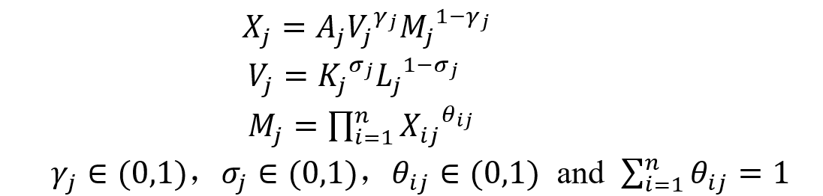
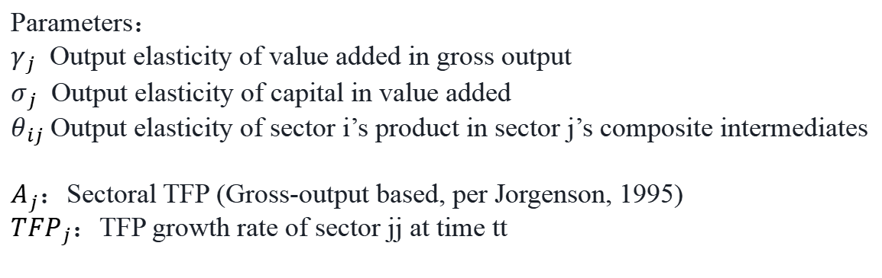
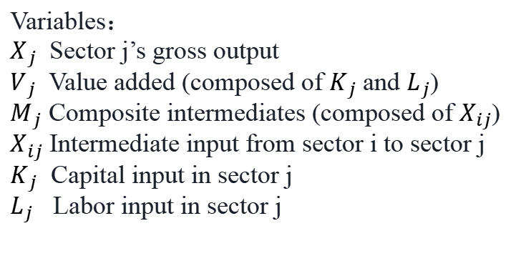
The Model
Production Setup & TFP Growth Accounting
Multi-Sector Framework:
Integrates Aggregate Production Function with Input-Output model
(n sectors, i,j∈{1,...,n})
Three-Tier Nested Cobb-Douglas Technology:
(1)
Variables：
$X_{j}$ Sector j’s gross output
$V_{j}$ Value added (composed of $K_{j}$ and $L_{j}$)
$M_{j}$ Composite intermediates (composed of $X_{ij}$)
$X_{ij}$ Intermediate input from sector i to sector j
$K_{j}$ Capital input in sector j
$L_{j}$ Labor input in sector j
Parameters：
$γ_{j}$ Output elasticity of value added in gross output
$σ_{j}$ Output elasticity of capital in value added
$θ_{ij}$ Output elasticity of sector i’s product in sector j’s composite intermediates
$A_{j}$：Sectoral TFP (Gross-output based, per Jorgenson, 1995)
${TFP}_{j}$：TFP growth rate of sector jj at time tt

Slide 10
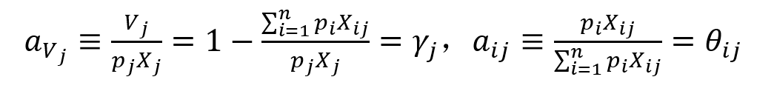
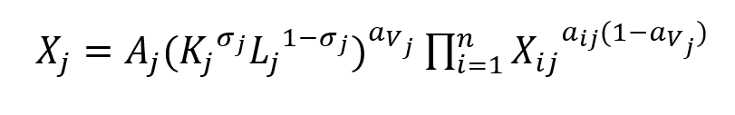
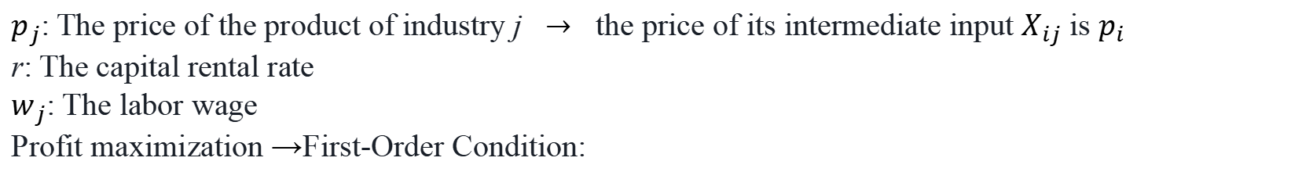
The Model
Production Setup & TFP Growth Accounting
$p_{j}$: The price of the product of industry j $→$ the price of its intermediate input $X_{ij}$ is $p_{i}$
r: The capital rental rate
$w_{j}$: The labor wage
Profit maximization →First-Order Condition:
(2)
Let Value-added ratio $a_{V_{j}}$ and Direct coefficient $a_{ij}$:
(3)
Expanded Production Function
(4)
Output elasticities in the CD function perfectly map to standard I-O accounting ratios ($a_{V_{j}}$ ,$a_{ij}$​), bridging production theory with I-O tables.

Slide 11
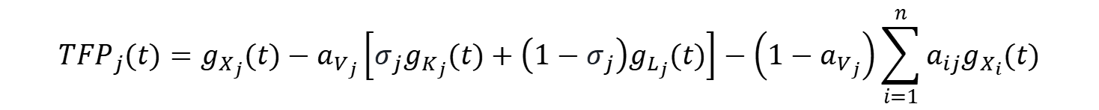
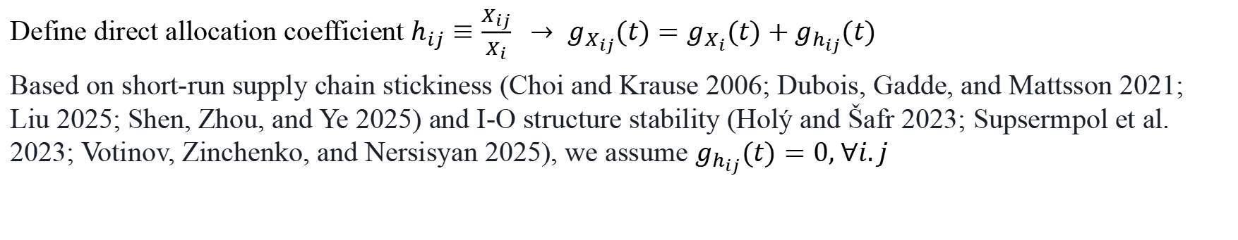
The Model
Production Setup & TFP Growth Accounting
Log-differentiating Eq. (4) and defining growth rate as $g_{Z}(t)≡\frac{d\ln{Z}}{dt}$ ,
we obtain the sectoral TFP growth:
$${TFP}_{j}(t)=g_{X_{j}}(t)−a_{V_{j}}\left[σ_{j}g_{K_{j}}(t)+\left(1−σ_{j}\right)g_{L_{j}}(t)\right]−\left(1−a_{V_{j}}\right)\sum_{i=1}^{n}{a_{ij}g_{X_{ij}}(t)}$$
(5)
Define direct allocation coefficient $h_{ij}≡\frac{X_{ij}}{X_{i}} → g_{X_{ij}}(t)=g_{X_{i}}(t)+g_{h_{ij}}(t)$
Based on short-run supply chain stickiness (Choi and Krause 2006; Dubois, Gadde, and Mattsson 2021; Liu 2025; Shen, Zhou, and Ye 2025) and I-O structure stability (Holý and Šafr 2023; Supsermpol et al. 2023; Votinov, Zinchenko, and Nersisyan 2025), we assume $g_{h_{ij}}(t)=0, ∀i.j$
(6)
$$g_{X_{ij}}(t)=g_{X_{i}}(t)$$
$${TFP}_{j}(t)=g_{X_{j}}(t)−a_{V_{j}}\left[σ_{j}g_{K_{j}}(t)+\left(1−σ_{j}\right)g_{L_{j}}(t)\right]−\left(1−a_{V_{j}}\right)\sum_{i=1}^{n}{a_{ij}g_{X_{i}}(t)}$$
(7)

Slide 12
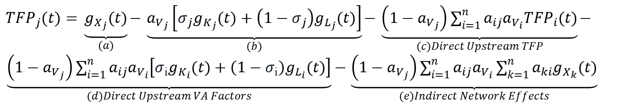
The Model
Output-Network-Based Progressive TFP Decomposition
Upstream Output Growth (for any sector i)
$$g_{X_{i}}(t)={TFP}_{i}(t)+a_{V_{i}}\left[σ_{i}g_{K_{i}}(t)+\left(1−σ_{i}\right)g_{L_{i}}(t)\right]+\left(1−a_{V_{i}}\right)\sum_{k=1}^{n}{a_{ki}g_{X_{k}}(t)}$$
(8)
Substituting Eq. (8) into Eq. (7) ⇒ 1st-Order TFP Decomposition:
${TFP}_{j}(t)=\underset{(a)}{\underbrace{g_{X_{j}}(t)}}−\underset{(b)}{\underbrace{a_{V_{j}}\left[σ_{j}g_{K_{j}}(t)+\left(1−σ_{j}\right)g_{L_{j}}(t)\right]}}−\underset{(c)Direct Upstream TFP}{\underbrace{\left(1−a_{V_{j}}\right)\sum_{i=1}^{n}{a_{ij}a_{V_{i}}{TFP}_{i}(t)}}}−\underset{(d)Direct Upstream VA Factors}{\underbrace{\left(1−a_{V_{j}}\right)\sum_{i=1}^{n}{a_{ij}a_{V_{i}}\left[σ_{i}g_{K_{i}}(t)+\left(1−σ_{i}\right)g_{L_{i}}(t)\right]}}}−\underset{(e)Indirect Network Effects}{\underbrace{\left(1−a_{V_{j}}\right)\sum_{i=1}^{n}{a_{ij}a_{V_{i}}\sum_{k=1}^{n}{a_{ki}g_{X_{k}}(t)}}}}$
(9)

Slide 13
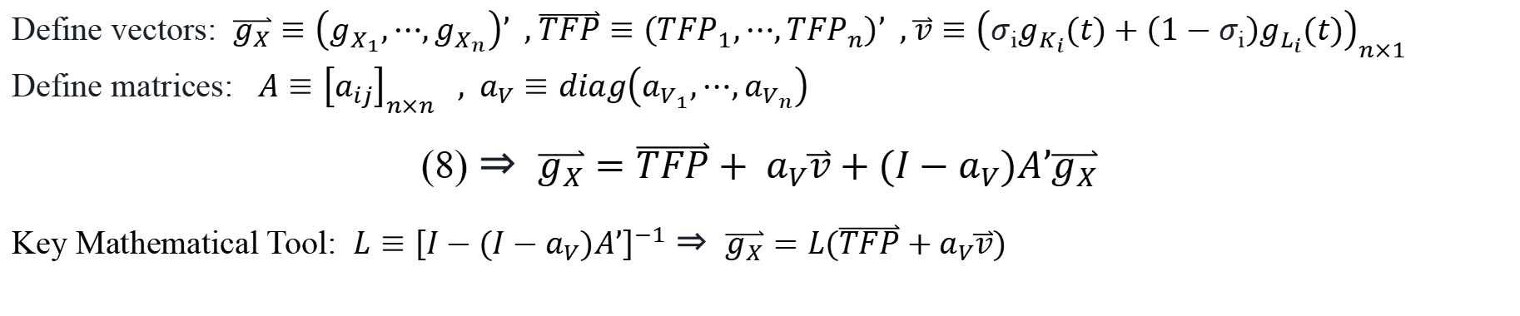
The Model
Output-Network-Based Progressive TFP Decomposition
Define vectors: $\overset{⃑}{g_{X}}≡\left(g_{X_{1}},⋯,g_{X_{n}}\right)’$ , $\overset{⃑}{TFP}≡\left({TFP}_{1},⋯,{TFP}_{n}\right)’$ , $\overset{⃑}{v}≡{\left(σ_{i}g_{K_{i}}(t)+\left(1−σ_{i}\right)g_{L_{i}}(t)\right)}_{n×1}$
Define matrices: $A≡{\left[a_{ij}\right]}_{n×n}$ , $a_{V}≡diag\left(a_{V_{1}},⋯,a_{V_{n}}\right)$
(8) ⇒ $\overset{⃑}{g_{X}}=\overset{⃑}{TFP}+ a_{V}\overset{⃑}{v}+(I−a_{V})A’\overset{⃑}{g_{X}}$
Key Mathematical Tool: $L≡{\left[I−(I−a_{V})A’\right]}^{−1}$ ⇒ $\overset{⃑}{g_{X}}=L(\overset{⃑}{TFP}+a_{V}\overset{⃑}{v})$
$\overset{⃑}{TFP}=\overset{⃑}{g_{X}}−a_{V}\overset{⃑}{v}−(I−a_{V})A’L(\overset{⃑}{TFP}+a_{V}\overset{⃑}{v})$
(10)
$${TFP}_{j}(t)=g_{X_{j}}(t)−a_{V_{j}}\left[σ_{j}g_{K_{j}}(t)+\left(1−σ_{j}\right)g_{L_{j}}(t)\right]−\left(1−a_{V_{j}}\right){\left[A’L(\overset{⃑}{TFP}+a_{V}\overset{⃑}{v})\right]}_{j}$$
$${TFP}_{j}(t)=g_{X_{j}}(t)−a_{V_{j}}\left[σ_{j}g_{K_{j}}(t)+\left(1−σ_{j}\right)g_{L_{j}}(t)\right]−\left(1−a_{V_{j}}\right){\left[A’L\overset{⃑}{TFP}\right]}_{j}−\left(1−a_{V_{j}}\right){\left[A’La_{V}\overset{⃑}{v}\right]}_{j}$$

Slide 14
Empirical Analysis

Slide 15



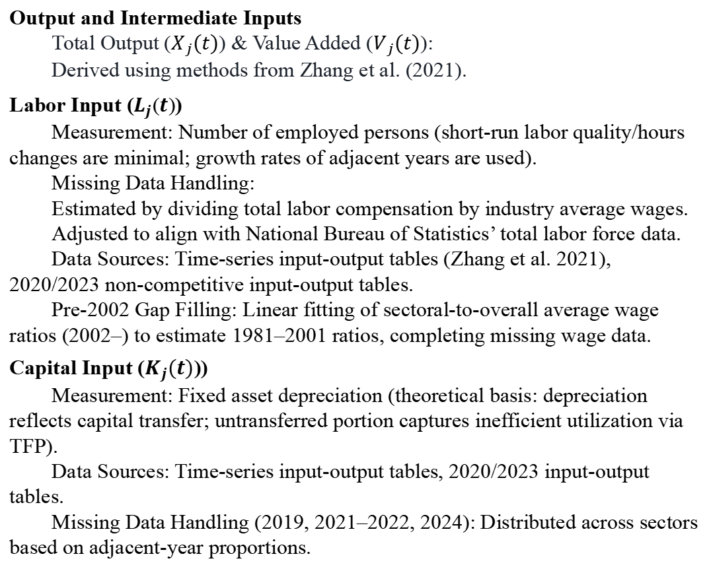
Variable and Data
Sample Coverage
Output and Intermediate Inputs
Total Output ($X_{j}(t)$) & Value Added ($V_{j}(t)$):
Derived using methods from Zhang et al. (2021).
Labor Input ($L_{j}(t)$)
Measurement: Number of employed persons (short-run labor quality/hours changes are minimal; growth rates of adjacent years are used).
Missing Data Handling:
Estimated by dividing total labor compensation by industry average wages.
Adjusted to align with National Bureau of Statistics’ total labor force data.
Data Sources: Time-series input-output tables (Zhang et al. 2021), 2020/2023 non-competitive input-output tables.
Pre-2002 Gap Filling: Linear fitting of sectoral-to-overall average wage ratios (2002–) to estimate 1981–2001 ratios, completing missing wage data.
Capital Input ($K_{j}(t)$))
Measurement: Fixed asset depreciation (theoretical basis: depreciation reflects capital transfer; untransferred portion captures inefficient utilization via TFP).
Data Sources: Time-series input-output tables, 2020/2023 input-output tables.
Missing Data Handling (2019, 2021–2022, 2024): Distributed across sectors based on adjacent-year proportions.
37
44
1981-2024
Sectors
Years
Period
Data Sources
CSMAR Database
National Bureau of Statistics
China Statistical Yearbook
2023 Non-competitive Input-Output Table
37-sector classification
References:Zhang et al. (2021), He (2023), OECD (2009) for methodology and data processing.

Slide 16
Empirical Analysis
Data Transformation:
Log-transformed data on gross output, capital stock, labor, and intermediate inputs.
First-differencing
GMM
Estimation Methods
OLS
Time Trend Control
Economic Priors:
Retain estimates where factor elasticities (capital, labor, intermediate inputs) are non-negative (α, β, γ ≥ 0) to align with production theory.
Optimization Criteria:
Maximize adjusted R-square
Minimize AIC (Akaike Information Criterion)
Sector-Specific Selection:
Optimal method chosen per sector based on data characteristics.

Slide 17
Empirical Analysis
Sectoral TFP Levels and Growth Rates
Frontier Sectors
Drive output expansion via high TFP improvements.
Resource-Based Sectors
Rely on resource endowments; TFP growth lags frontier sectors.
Manufacturing Paradox
“High-tech” sectors: Explosive output growth, but stagnant TFP → Scale-efficiency disconnect.
Service Sector Issues
Rely on factor inputs; weak TFP growth.
Public Utilities
Production and Supply of Water
Production and Supply of Gas
Show severe scale-efficiency disconnect between expansion and efficiency improvement.
Figure 1 TFP Levels and Gross Output Growth Multiples of 37 Sectors in 2024 (Base Year: 1981)

Slide 18
Empirical Analysis
Sectoral TFP Levels and Growth Rates
TFP Growth Concentration: Modern service sectors benefiting from the IT revolution and deepening of knowledge capital.
Efficiency Lagging Sectors: Manufacturing (especially high-tech manufacturing) and some service sectors are trapped in a “large but not strong” development paradigm.
Transformation Challenge: Shifting from factor-driven scale expansion to TFP-driven high-quality growth remains a formidable challenge.
Figure 1 TFP Levels and Gross Output Growth Multiples of 37 Sectors in 2024 (Base Year: 1981)

Slide 19
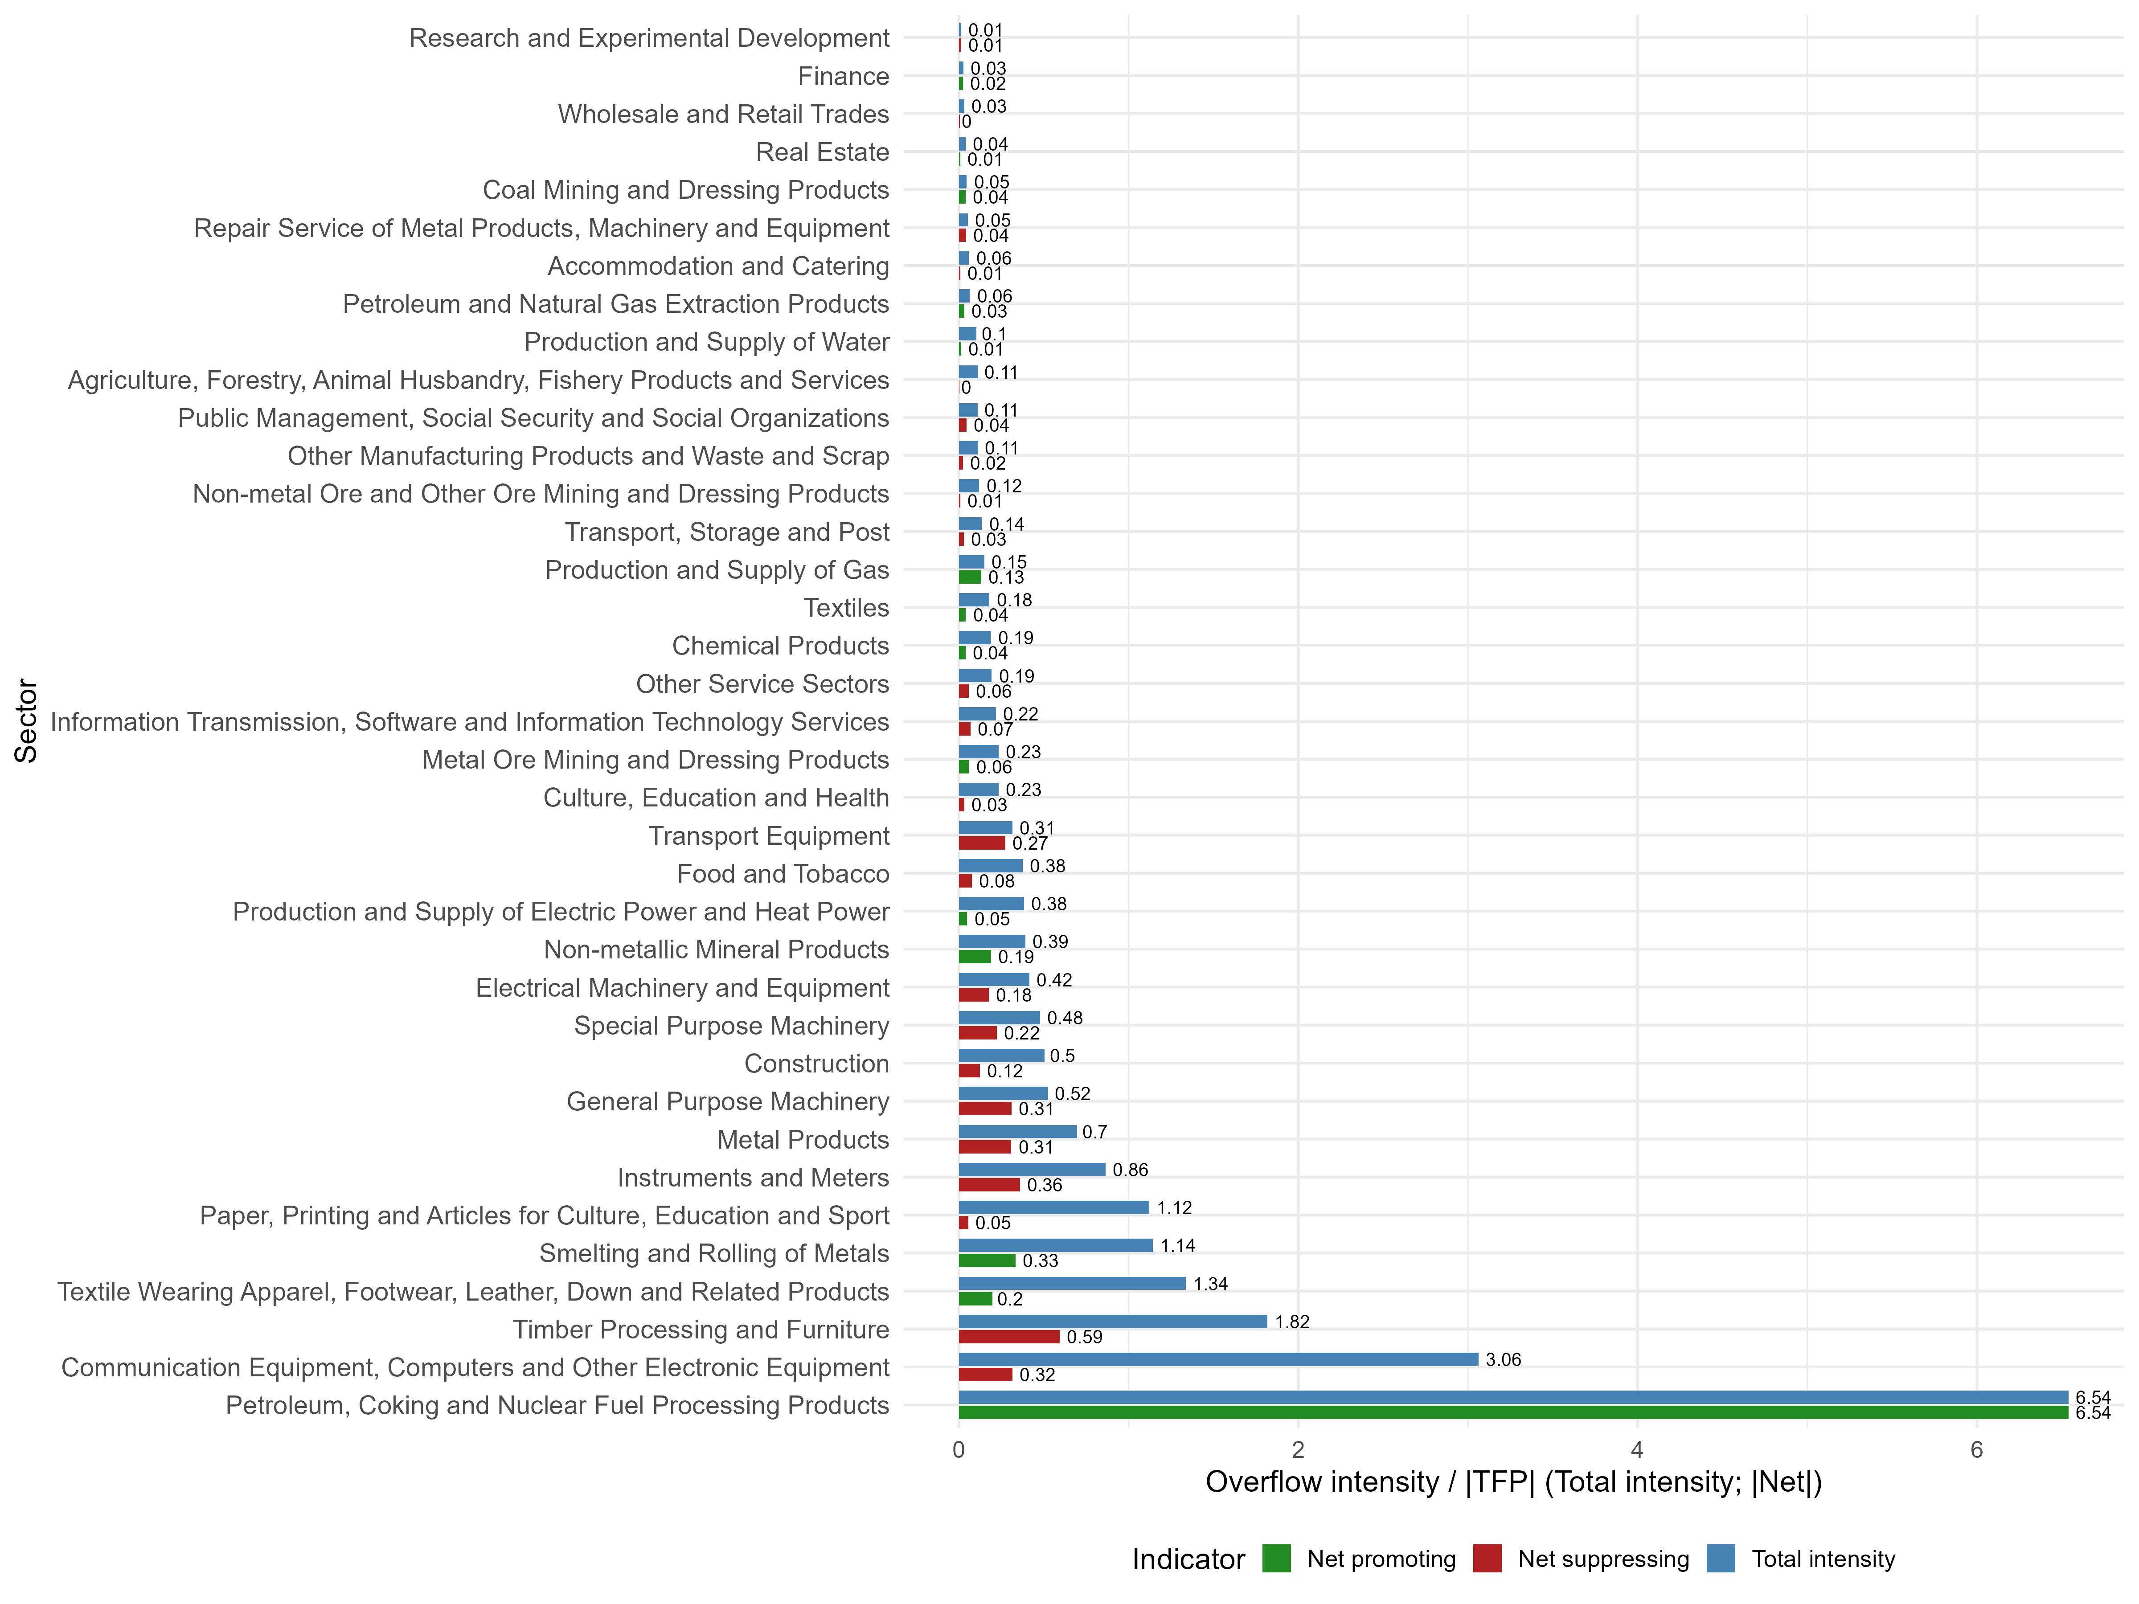
Empirical Analysis
Inter-sectoral Decomposition of TFP in 2023
——1st-Order TFP Decomposition
Figure 4 Total vs. Net Overflow Intensity by Sector (Absolute Net Values, Color-coded by Direction)
Total intensity (steelblue)
= total absolute spillover / |TFP|
→ measures a sector’s overall exposure to external shocks, regardless of direction.
|Net| (green/red) = |net spillover / |TFP|| → captures the magnitude of net effect,
(%) | Total intensity | Net intensity
average | 0.605 | -0.123
min | 0.012 | -6.541
mid | 0.217 | 0.012
max | 6.541 | 0.593
Notes:
Indicator definition and sorting:
The Total intensity (steelblue bars) is defined as overflow_share = total_overflow_abs / |TFP|, measuring the absolute exposure of a sector to all upstream spillovers regardless of direction. The net absolute intensity (green/red bars) is defined as net_abs = |net_overflow_share| where net_overflow_share = (c+d+e) / |TFP|, capturing the magnitude of the net spillover effect, with green indicating a net promoting effect (positive) and red a net suppressing effect (negative). Sectors are sorted in descending order of Total intensity (overflow_share) so that the most exposed sectors appear at the top, facilitating easy comparison of both total exposure and net directional impact within each sector.

Slide 20
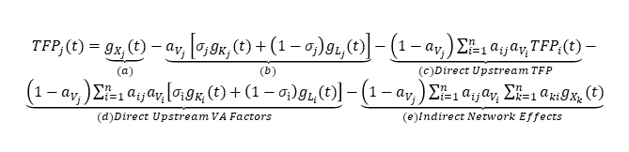
Figure 4 Total vs. Net Overflow Intensity by Sector (Absolute Net Values, Color-coded by Direction)
Total intensity (steelblue)
= total absolute spillover / |TFP|
→ measures a sector’s overall exposure to external shocks, regardless of direction.
|Net| (green/red) = |net spillover / |TFP|| → captures the magnitude of net effect,
High Spillover Intensity ≠ Net Positive Gains
Sectors with the highest total spillover intensity (e.g., Communication Equipment, Timber Processing, Smelting) exhibit large positive net spillovers (red), meaning they are strongly suppressed by upstream networks.
Few sectors show net promoting effects (green), with Transport Equipment as a notable example benefiting from upstream spillovers.
${TFP}_{j}(t)=\underset{(a)}{\underbrace{g_{X_{j}}(t)}}−\underset{(b)}{\underbrace{a_{V_{j}}\left[σ_{j}g_{K_{j}}(t)+\left(1−σ_{j}\right)g_{L_{j}}(t)\right]}}−\underset{(c)Direct Upstream TFP}{\underbrace{\left(1−a_{V_{j}}\right)\sum_{i=1}^{n}{a_{ij}a_{V_{i}}{TFP}_{i}(t)}}}−\underset{(d)Direct Upstream VA Factors}{\underbrace{\left(1−a_{V_{j}}\right)\sum_{i=1}^{n}{a_{ij}a_{V_{i}}\left[σ_{i}g_{K_{i}}(t)+\left(1−σ_{i}\right)g_{L_{i}}(t)\right]}}}−\underset{(e)Indirect Network Effects}{\underbrace{\left(1−a_{V_{j}}\right)\sum_{i=1}^{n}{a_{ij}a_{V_{i}}\sum_{k=1}^{n}{a_{ki}g_{X_{k}}(t)}}}}$
Notes:
Indicator definition and sorting:
The Total intensity (steelblue bars) is defined as overflow_share = total_overflow_abs / |TFP|, measuring the absolute exposure of a sector to all upstream spillovers regardless of direction. The net absolute intensity (green/red bars) is defined as net_abs = |net_overflow_share| where net_overflow_share = (c+d+e) / |TFP|, capturing the magnitude of the net spillover effect, with green indicating a net promoting effect (positive) and red a net suppressing effect (negative). Sectors are sorted in descending order of Total intensity (overflow_share) so that the most exposed sectors appear at the top, facilitating easy comparison of both total exposure and net directional impact within each sector.

Slide 21
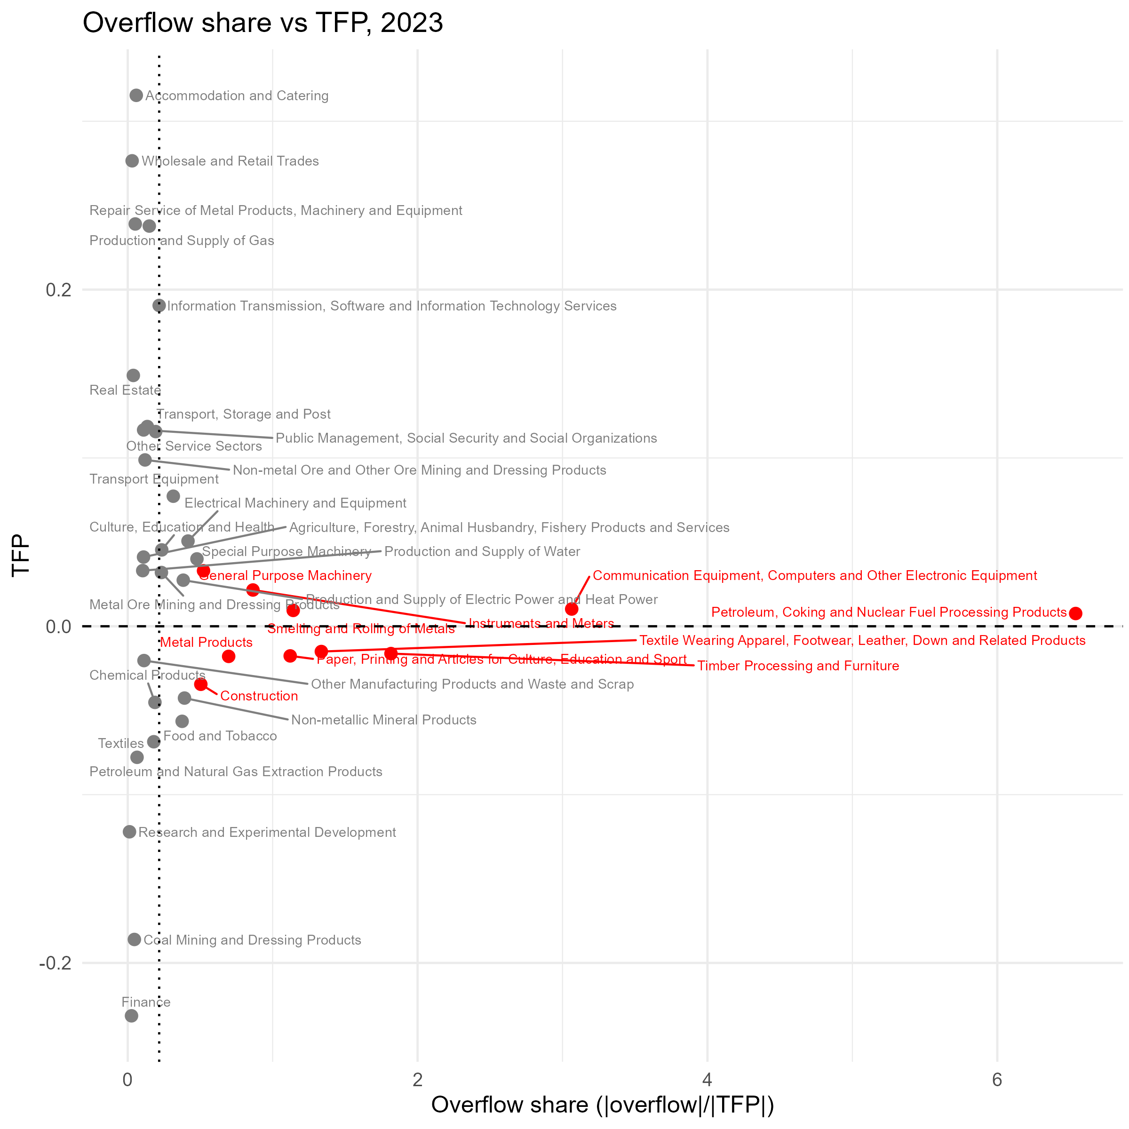

Empirical Analysis
Inter-sectoral Decomposition of TFP in 2023
——1st-Order TFP Decomposition
${TFP}_{j}(t)=\underset{(a)}{\underbrace{g_{X_{j}}(t)}}−\underset{(b)}{\underbrace{a_{V_{j}}\left[σ_{j}g_{K_{j}}(t)+\left(1−σ_{j}\right)g_{L_{j}}(t)\right]}}−\underset{(c)Direct Upstream TFP}{\underbrace{\left(1−a_{V_{j}}\right)\sum_{i=1}^{n}{a_{ij}a_{V_{i}}{TFP}_{i}(t)}}}−\underset{(d)Direct Upstream VA Factors}{\underbrace{\left(1−a_{V_{j}}\right)\sum_{i=1}^{n}{a_{ij}a_{V_{i}}\left[σ_{i}g_{K_{i}}(t)+\left(1−σ_{i}\right)g_{L_{i}}(t)\right]}}}−\underset{(e)Indirect Network Effects}{\underbrace{\left(1−a_{V_{j}}\right)\sum_{i=1}^{n}{a_{ij}a_{V_{i}}\sum_{k=1}^{n}{a_{ki}g_{X_{k}}(t)}}}}$
Threshold Criteria for Overflow Pattern Classification
Criteria | Pattern
prop_c >= 0.6 | Upstream TFP dominated
prop_d >= 0.6 | Upstream VA Factors dominated
prop_e >= 0.6 | Indirect Network dominated
prop_c >= 0.4 & prop_d >= 0.4 | TFP & VA Factors interaction dominated
prop_c >= 0.4 & prop_e >= 0.4 | TFP & Network mixed interaction dominated
prop_d >= 0.4 & prop_e >= 0.4 | VA & Network mixed interaction dominated
Otherwise | Others
prop_c, prop_d, prop_e are the absolute shares of each overflow channel in total absolute overflow (c+d+e).
Notes:
*Note: Classification is based on the absolute contribution of each channel to total absolute spillovers, regardless of the net effect (promoting vs. suppressing).*

Slide 22
Empirical Analysis
Inter-sectoral Decomposition of TFP in 2023
——1st-Order TFP Decomposition
Upstream TFP dominated sectors | TFP | （a） | （b） | （c） | （d） | （e）
Coal Mining and Dressing Products | -0.1861 | -0.1592 | 0.0376 | -0.0077 | 0.0006 | -0.0002
Petroleum, Coking and Nuclear Fuel Processing Products | 0.0076 | -0.0148 | 0.0365 | -0.0311 | -0.0175 | -0.0010
Transport Equipment | 0.0773 | 0.1643 | 0.0252 | 0.0155 | -0.0016 | 0.0072
Repair Service of Metal Products, Machinery and Equipment | 0.2390 | 0.3485 | 0.0802 | 0.0079 | -0.0012 | 0.0034
Research and Experimental Development | -0.1221 | 0.1217 | 0.2406 | 0.0010 | 0.0001 | 0.0004
Upstream VA Factors dominated sectors | TFP | （a） | （b） | （c） | （d） | （e）
Petroleum and Natural Gas Extraction Products | -0.0778 | -0.1221 | -0.0439 | 0.0010 | -0.0037 | 0.0003
Metal Ore Mining and Dressing Products | 0.0319 | -0.0069 | -0.0407 | 0.0021 | -0.0047 | 0.0007
Textiles | -0.0686 | -0.0815 | -0.0008 | 0.0043 | -0.0076 | 0.0005
Chemical Products | -0.0452 | -0.0410 | 0.0094 | 0.0029 | -0.0051 | 0.0005
Non-metallic Mineral Products | -0.0427 | -0.0609 | -0.0154 | 0.0030 | -0.0124 | 0.0013
Smelting and Rolling of Metals | 0.0094 | 0.0186 | 0.0023 | 0.0026 | -0.0070 | 0.0012
Production and Supply of Gas | 0.2377 | 0.2572 | -0.0234 | -0.0104 | -0.0229 | 0.0021
Real Estate | 0.1490 | 0.0703 | -0.0808 | 0.0015 | -0.0035 | 0.0008
Notes:
${TFP}_{j}(t)=\underset{(a)}{\underbrace{g_{X_{j}}(t)}}−\underset{(b)}{\underbrace{a_{V_{j}}\left[σ_{j}g_{K_{j}}(t)+\left(1−σ_{j}\right)g_{L_{j}}(t)\right]}}−\underset{(c)Direct Upstream TFP}{\underbrace{\left(1−a_{V_{j}}\right)\sum_{i=1}^{n}{a_{ij}a_{V_{i}}{TFP}_{i}(t)}}}−\underset{(d)Direct Upstream VA Factors}{\underbrace{\left(1−a_{V_{j}}\right)\sum_{i=1}^{n}{a_{ij}a_{V_{i}}\left[σ_{i}g_{K_{i}}(t)+\left(1−σ_{i}\right)g_{L_{i}}(t)\right]}}}−\underset{(e)Indirect Network Effects}{\underbrace{\left(1−a_{V_{j}}\right)\sum_{i=1}^{n}{a_{ij}a_{V_{i}}\sum_{k=1}^{n}{a_{ki}g_{X_{k}}(t)}}}}$

Slide 23
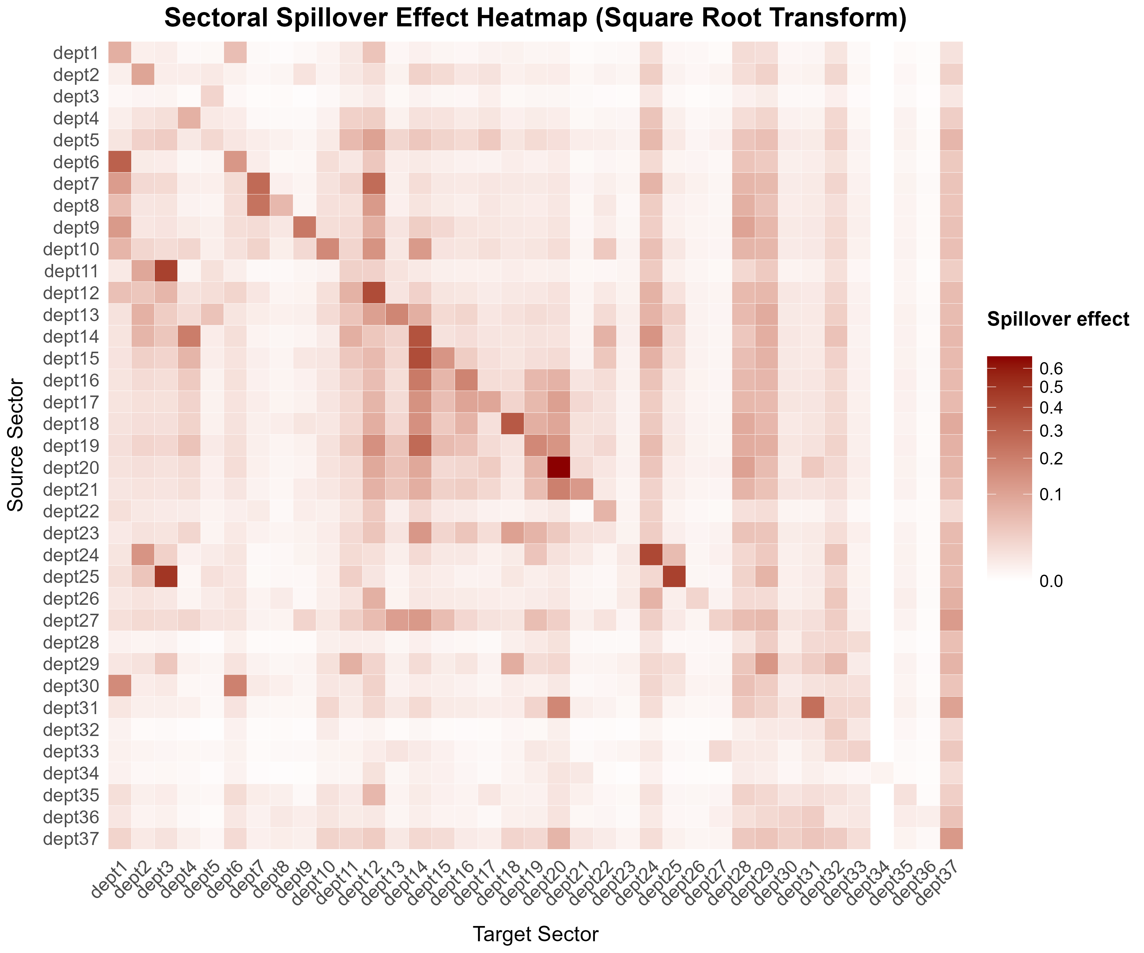

dept
Figure 6 Sectoral Spillover Intensity Heatmap (Square Root Transform)
Empirical Analysis
Inter-sectoral Decomposition of TFP in 2023
Sectors with strong outward spillover intensity
1 Agriculture, Forestry, Animal Husbandry, Fishery Products and Services, 12 Chemical Products, 14 Smelting and Rolling of Metals, 24 Production and Supply of Electric Powerand Heat Power, 28 Wholesale and Retail Trades, 29 Transport, Storage and Post, 37 Other Service Sectors
——primarily foundational and producer service industries
Strong spillover recipients
5 Non-metal Ore and Other Ore Mining and Dressing Products, 13 Non-metallic Mineral Products, 17 Special Purpose Machinery, 18 Transport Equipment, 23 Equipment, 27 Construction
——downstream manufacturing and construction sectors
Spillover effects
$(I−a_{V})A’L$
Notes:
Strong spillover recipients are mostly downstream manufacturing and construction sectors (e.g., Non-metallic Mineral Products, Transport Equipment, Construction).

Slide 24
1 | Agriculture, Forestry, Animal Husbandry, Fishery Products and Services | 14 | Smelting and Rolling of Metals | 26 | Production and Supply of Water
2 | Coal Mining and Dressing Products | 15 | Metal Products | 27 | Construction
3 | Petroleum and Natural Gas Extraction Products | 16 | General Purpose Machinery | 28 | Wholesale and Retail Trades
4 | Metal Ore Mining and Dressing Products | 17 | Special Purpose Machinery | 29 | Transport, Storage and Post
5 | Non-metal Ore and Other Ore Mining and Dressing Products | 18 | Transport Equipment | 30 | Accommodation and Catering
6 | Food and Tobacco | 19 | Electrical Machinery and Equipment | 31 | Information Transmission, Software and Information Technology Services
7 | Textiles | 20 | Communication Equipment, Computers and Other Electronic Equipment | 32 | Finance
8 | Textile Wearing Apparel, Footwear, Leather, Down and Related Products | 21 | Instruments and Meters | 33 | Real Estate
9 | Timber Processing and Furniture | 22 | Other Manufacturing Products and Waste and Scrap | 34 | Research and Experimental Development
10 | Paper, Printing and Articles for Culture, Education and Sport | 23 | Repair Service of Metal Products, Machinery and Equipment | 35 | Culture, Education and Health
11 | Petroleum, Coking and Nuclear Fuel Processing Products | 24 | Production and Supply of Electric Power and Heat Power | 36 | Public Management, Social Security and Social Organizations
12 | Chemical Products | 25 | Production and Supply of Gas | 37 | Other Service Sectors
13 | Non-metallic Mineral Products

Slide 25
dept
Figure 6 Sectoral Spillover Intensity Heatmap (Square Root Transform)
Empirical Analysis
Inter-sectoral Decomposition of TFP in 2023
34 Research & Experimental Dev. lower spillover intensity and the highest TFP level
01 Agric., Forestry & Fishery has higher spillover intensity and lowest own TFP level
Policy makers should consider both aspects.
Spillover effects
$(I−a_{V})A’L$
Notes:
上游行业TFP对下游行业的溢出（完全溢出）热力图
负向影响，技术进步or行业规模发展对下游造成的生存环境的挤压
典型的，有链主企业的产业链造成的对下游有压制情况
$−(I−a_{V})A’L(\overset{⃑}{TFP}+a_{V}\overset{⃑}{v})$

Slide 26
Limitations & Future Work

Slide 27
Limitations & Future Work
Current Limitation
Future Direction
Data & Micro-Mechanism
Relies on macro data and empirical facts; (micro-firm-level transmission mechanisms are not constructed due to data constraints.)
Utilize micro-level firm data to uncover inter-industry TFP spillover formation mechanisms and test robustness.
Model Specification & Dynamics
Extend to long-term policy simulations using Dynamic Regional IO or CGE models;
endogenize trade coefficientsvia CES functions / Gravity models (capturing responses to prices, tech, trade costs).
Short-term fixed-coefficient assumption:
no trade substitution;
fixed market share/regional self-sufficiency ratios.
Macro Decomposition & Origins
Current TFP decomposition depth is insufficient to fully trace macro-level origins.
Incorporate inter-regional IO and input-occupancy-output frameworks for deeper TFP decomposition.
Structural Feedback Effects
Downstream intermediate purchasing feedback on upstream industries is not fully accounted for.
Explicitly model and integrate these downstream-to-upstream feedback loops.

Slide 28
THANKS

